Slide 1
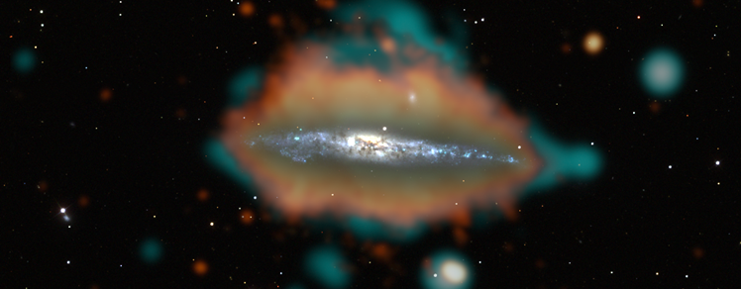


The LOFAR2.0 perspective of nearby star-forming galaxies, laboratories of magnetic fields and cosmic ray transport
Image Credit:
NRAO, NASA, ESA, Hubble; Processing: Jayanne English (U. Manitoba)
Michael Stein | LOFAR Annual Meeting | 12.06.2026 | Dublin

Slide 2
The LOFAR2.0 perspective of nearby star-forming galaxies….. (IN PREPARATION)
Image Credit:
NRAO, NASA, ESA, Hubble; Processing: Jayanne English (U. Manitoba)
Michael Stein | LOFAR Annual Meeting | 12.06.2026 | Dublin

Slide 3
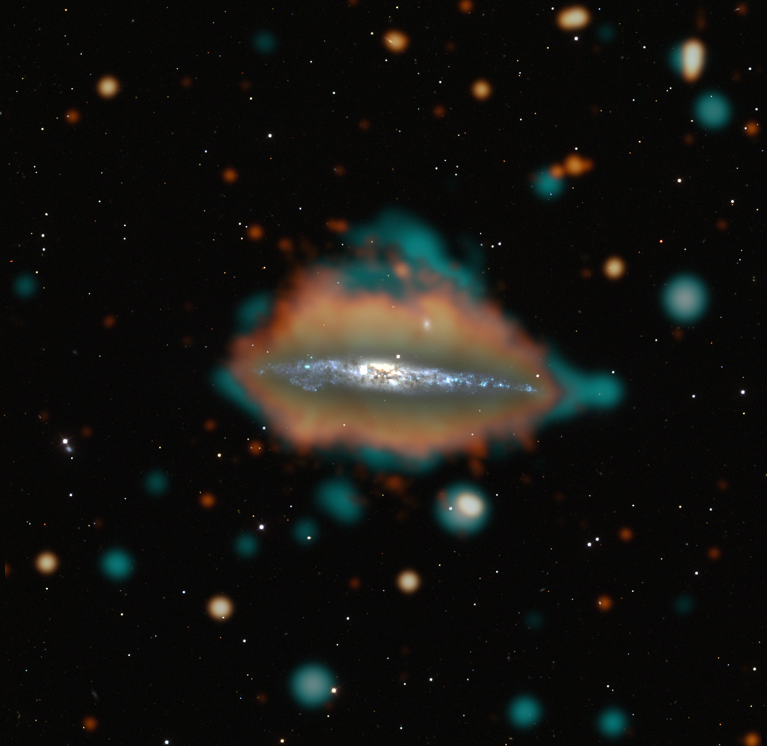
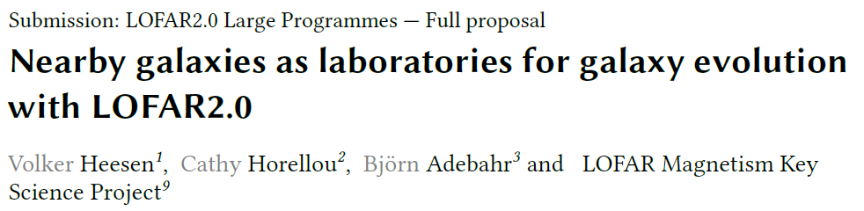

In collaboration with:
Reinout van Weeren, Tim Shimwell, Henrik Edler, MKSP/SKSP nearby galaxies working groups

Slide 4
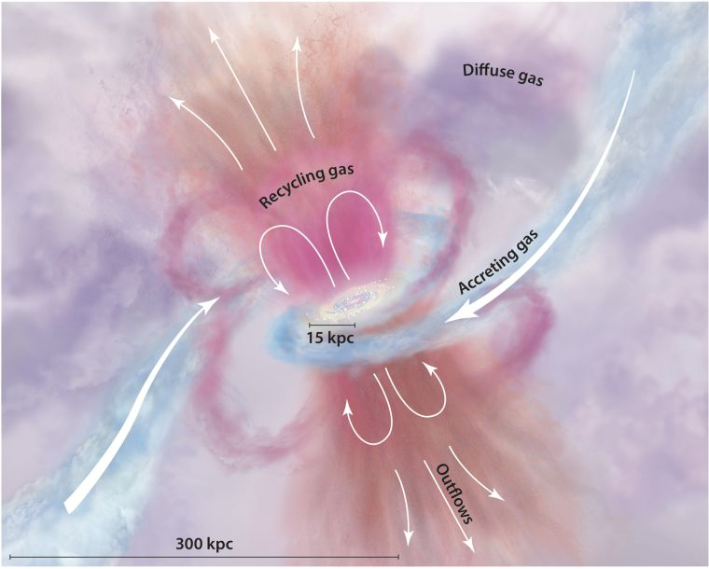
Galactic Halos
Image Credit: Tumlinson+2017

Slide 5
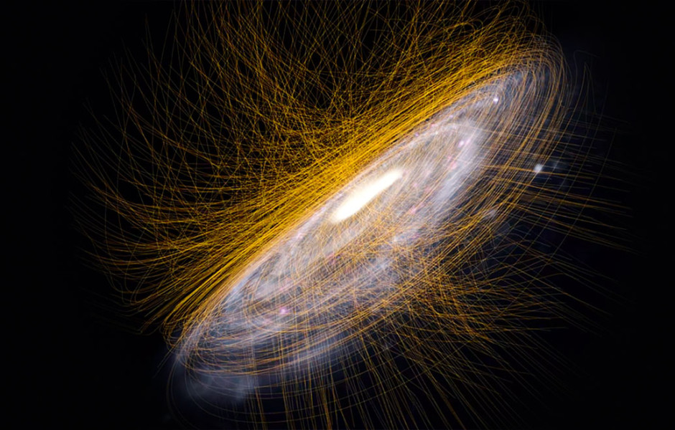
Image Credit: J. Dörner, SFB 1491

Slide 6
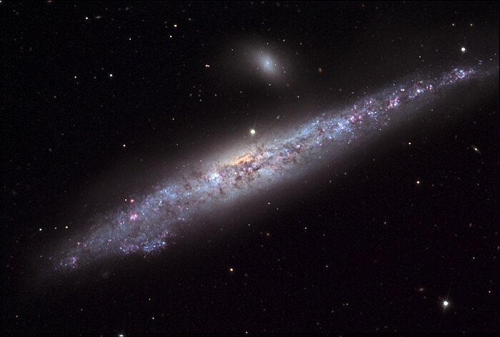
Image Credit: Noirlab

Slide 7
Image Credit: Tumlinson+2017

Slide 8
The sample
Galaxy | D [Mpc] | RA | Dec | Comment
IC 342 | 3.5 | 03 46 48.5 | 68 05 47 | Spiral galaxy
NGC 1569 | 2.9 | 04 30 49.1 | 64 50 53 | Dwarf galaxy with wind
NGC 2820 | 28.2 | 09 21 45.6 | 64 15 29 | Galaxy group and radio halo
M 81/M 82-group | 3.7 | 09 55 33.2 | 69 03 55 | Group interaction, starburst wind in M82
Arp 214 | 14.7 | 11 32 34.8 | 53 04 04 | Barred, warpeddisk, tidaltails, compact group
M 108 | 10.0 | 11 11 31.0 | 55 40 27 | Galaxy with filaments and wind
NGC 4217 | 18.3 | 12 15 50.9 | 47 05 03 | Superbubble structure
NGC 4214 | 3.0 | 12 15 39.2 | 36 19 37 | Starburst dwarf galaxy
NGC 4631 | 5.1 | 12 42 08.0 | 32 32 29 | Large radio halo
NGC 4449 | 3.9 | 12 28 11.1 | 44 05 37 | Starburst dwarf galaxy
M 51 | 7.3 | 13 29 52.7 | 47 15 58 | Grand-design spiral galaxy
M 101 | 6.6 | 14 03 12.5 | 54 20 56 | Grand-design spiral galaxy
Stephan’s Quintet | 90.3 | 22 35 57.5 | 33 57 36 | Galaxy group, intra group emission
NGC 7331 | 13.4 | 22 37 04.0 | 34 24 56 | Late-type galaxy

Slide 9
Science Goals
Face-on galaxies:
CR transport in galactic discs (convolution experiments)
Spectral curvature analysis
Edge-on galaxies:
CR transport (disc halo transition)
Detecting the galactic wind termination shock?
Galaxy groups:
Magnetic fields in the intra group medium
CR re-acceleration in shocks
High resolution studies of star-forming regions in galaxies
Diffuse polarised emission at HBA frequencies?

Slide 10
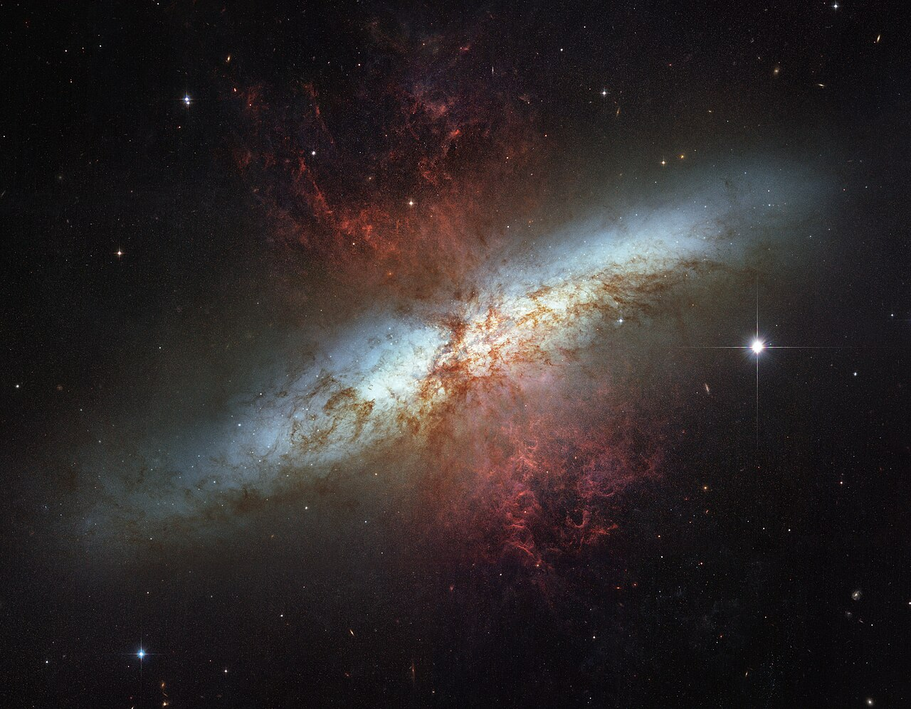
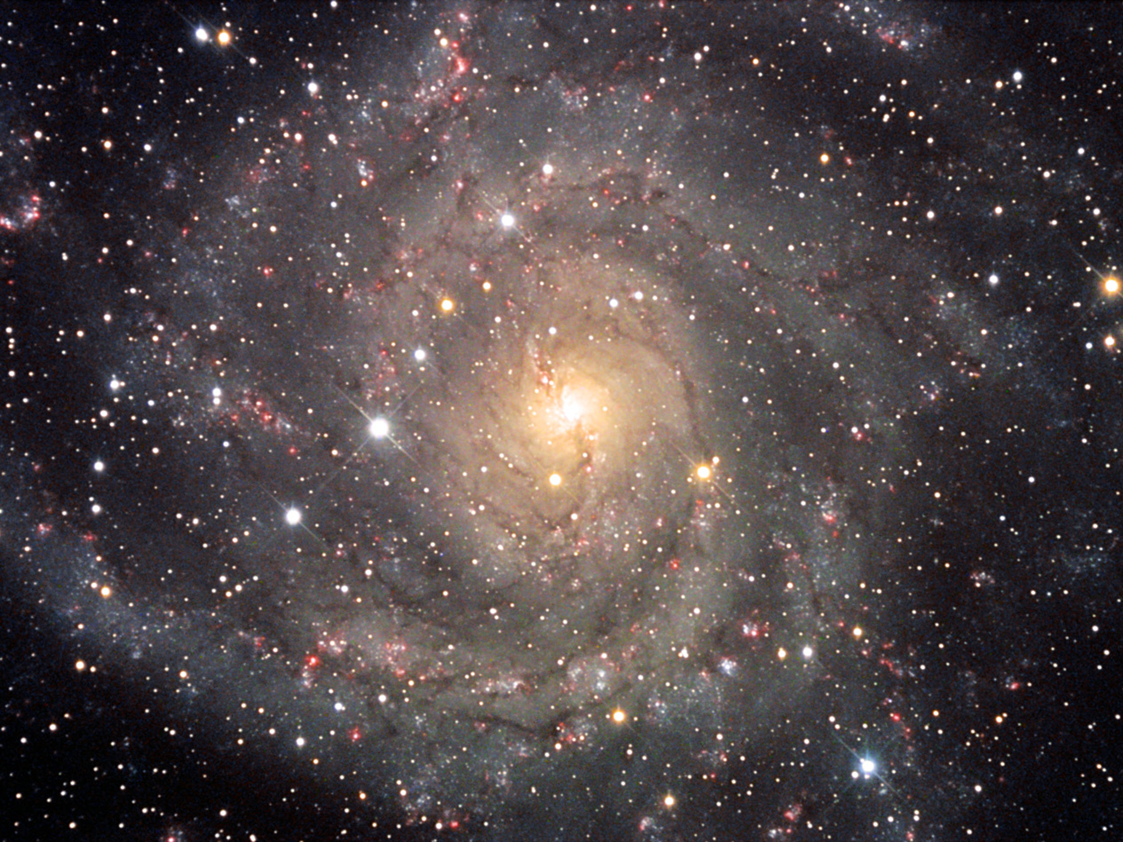
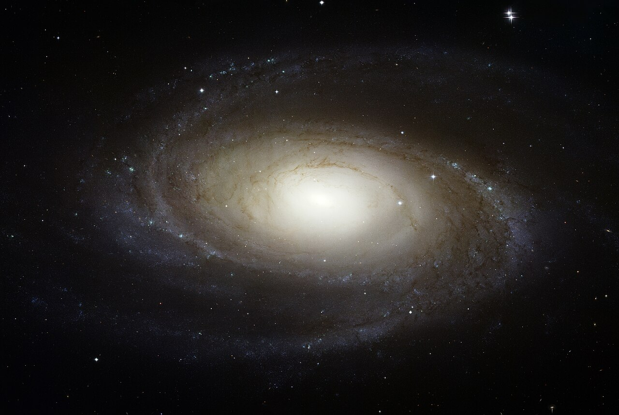
Proposed observations
1000 hrs LBA and HBA observations
Distributed on 14 fields
First observations targeting IC 324 and/or M 81-M 82 field
Image Credit: Noirlab;
NASA, ESA, Hubble heritage team

Slide 11
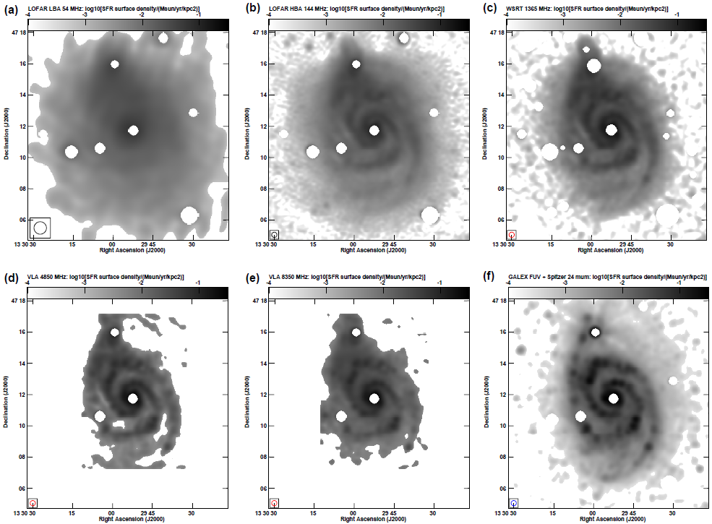
LOFAR 1 results:
M 51
Radio maps look like smoothed versions of the SFR distributions
Can be compared to CR transport modes
-> See talk by Volker
Image credit: Heesen+2023

Slide 12
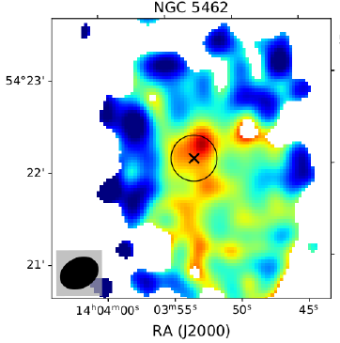
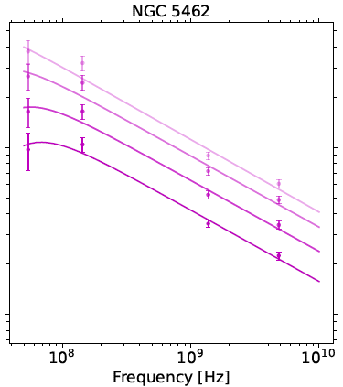
LOFAR 1 results:
M 101
Spectral curvature informs about the physical conditions of the plasma in the ISM
-> See talk by Volker
Image credit: Gajovic+2025
-> LOFAR international baselines needed for high resolution

Slide 13
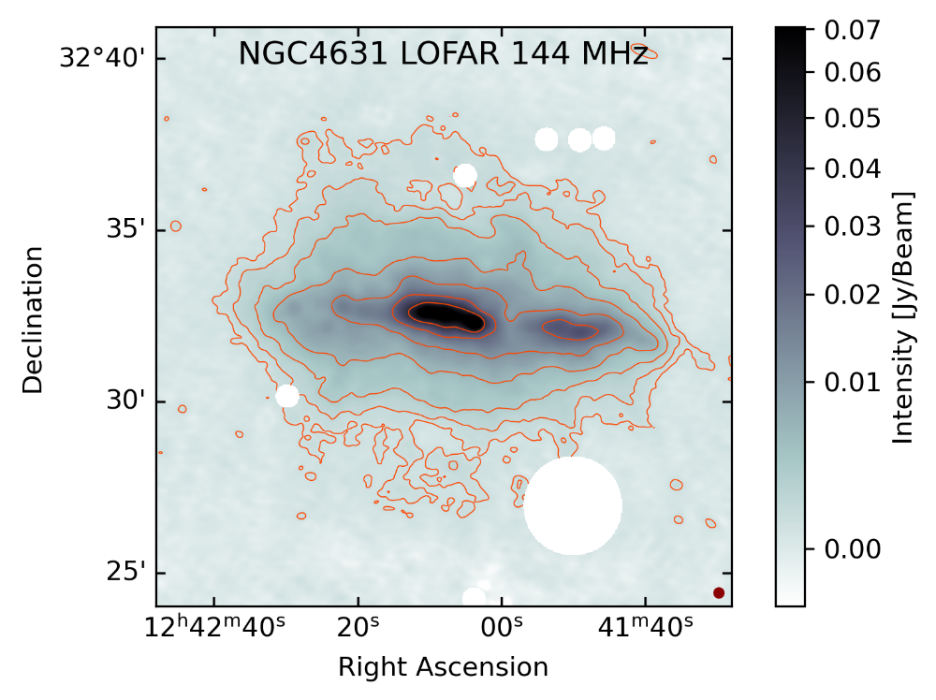
LOFAR 1 results: NGC 4631
Image credit: Stein+2023

Slide 14
…preparing for LOFAR 2 observations

Slide 15
Preparing for LOFAR 2 observations
Creating Imaging products from existing LOFAR data sets (e.g. LoTSS)
    Source extraction
    Self-calibration (DI and/or DD)
    Manual cleaning (matching resolution/uv-coverage of other data sets)
  Collecting multi-frequency radio continuum data e.g.:
    CHANG-ES data (1.5, 3, 6 GHz VLA data) for edge-on galaxies
    Adebahr+2013 multi-frequency study of M 82 (1.3 – 8 GHz)
  Applying for new data
    Successful proposal 12h each on M 82 and M 81 with GMRT Band 3
    (observation scheduled for July 2026)
-> Having good initial solutions when LOFAR 2 data arrives

Slide 16
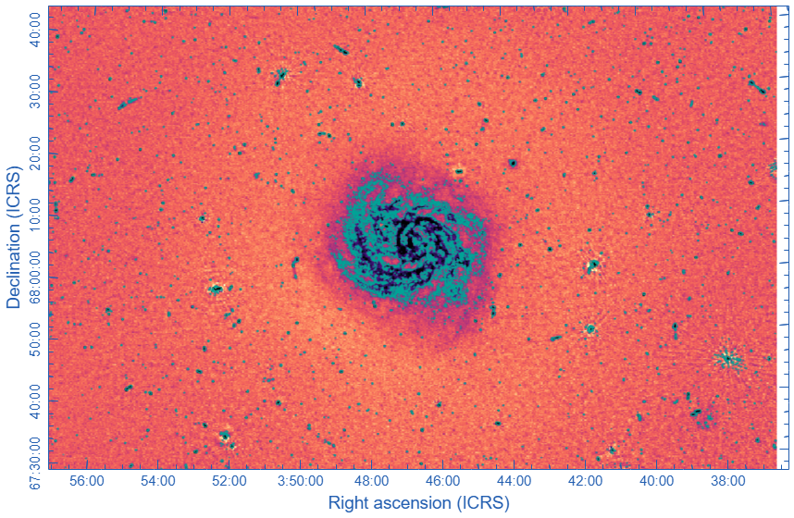
IC 342 LoTSS cutout
Extracting LoTSS data:
Extraction region:
0.9 deg x 0.9 deg
Combining data from two pointings:
    P054+69
    P061+69
  Run facetselfcal (DI)
    uvmin=10
    multiscale

Slide 17
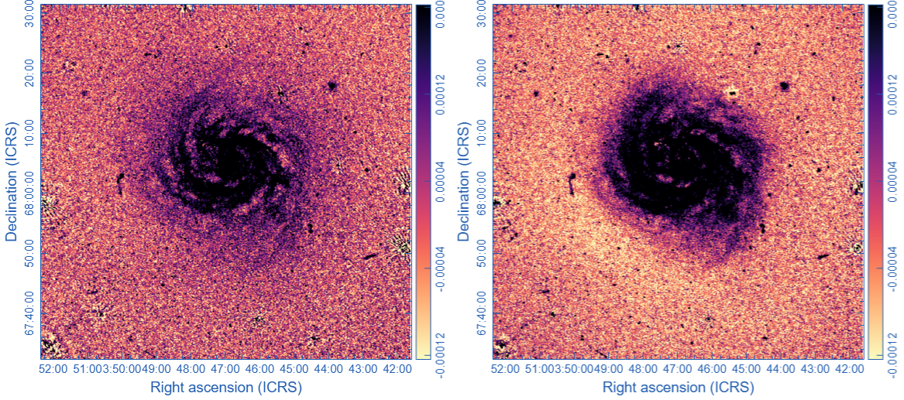
IC 342 comparison
LoTSS Recalibrated
LoTSS Cutout

Slide 18
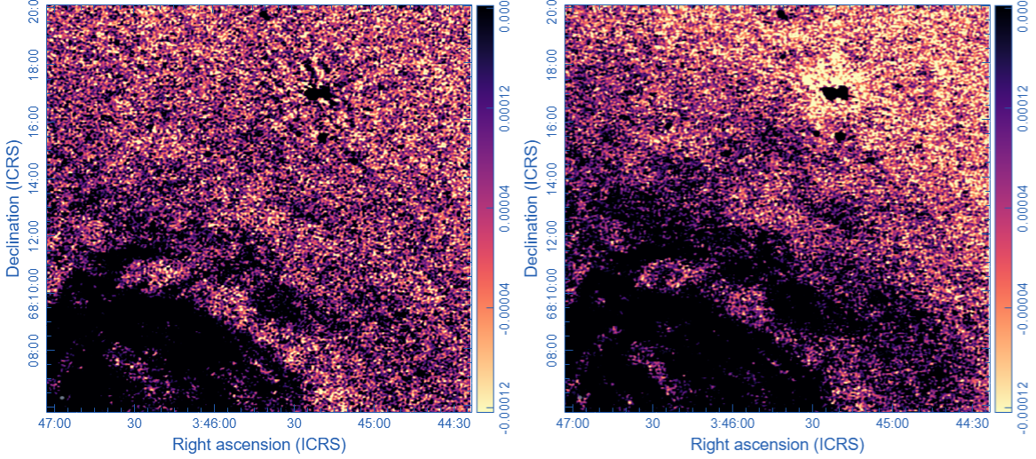
IC 342 comparison
LoTSS Recalibrated
LoTSS Cutout

Slide 19
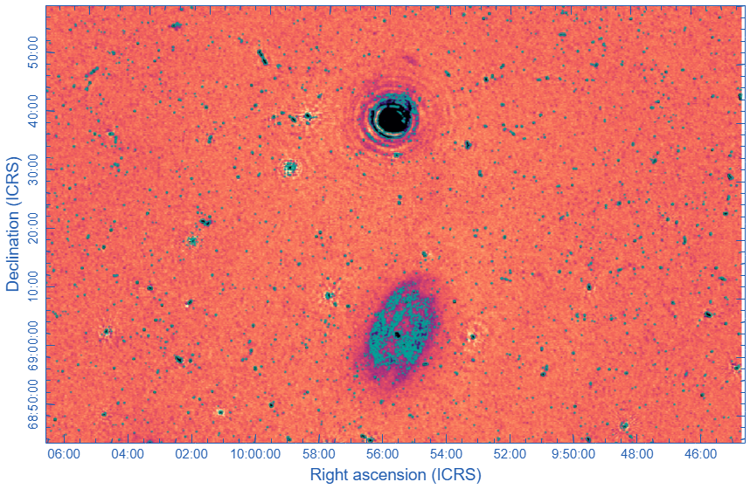
M 81 / M 82 LoTSS cutout
Extracting LoTSS data:
Individual extraction for M 82 and M 81 (combined extractions needed for studying group interactions)
Extraction region (M82):
0.4 deg x 0.4 deg
One pointing (P149+70)
  Run facetselfcal (DI)
  …challenging target

Slide 20
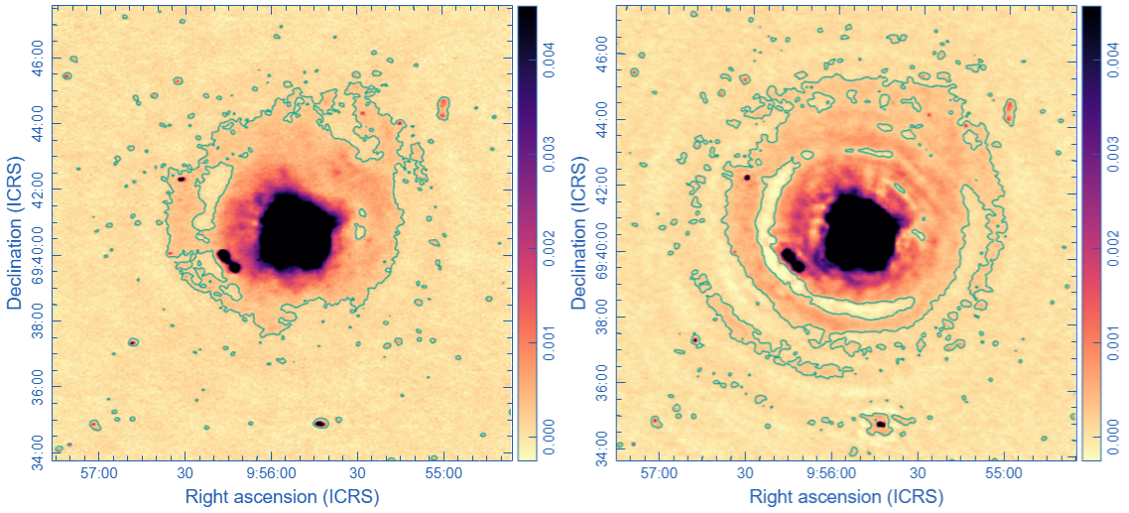
M 82 comparison
LoTSS Recalibrated
LoTSS Cutout

Slide 21
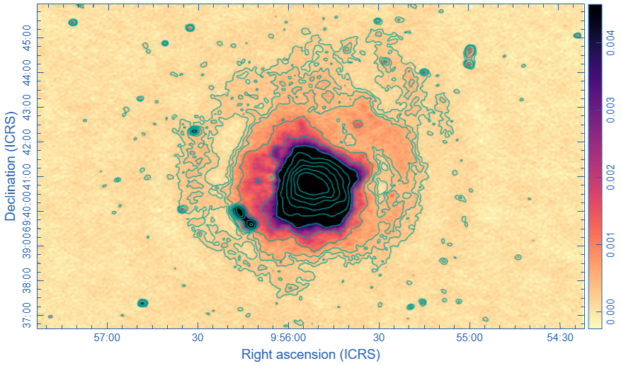
M 82
1792-σ level

Slide 22
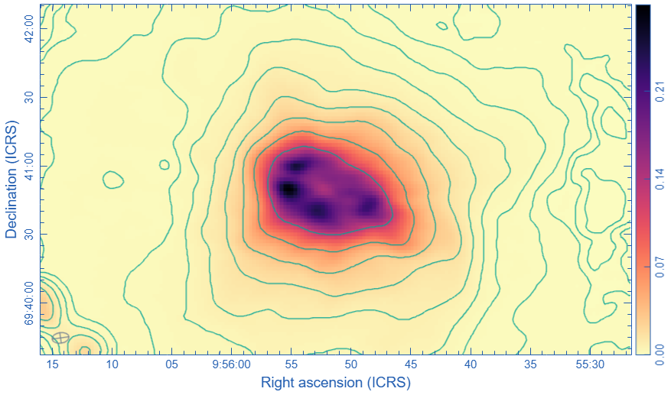
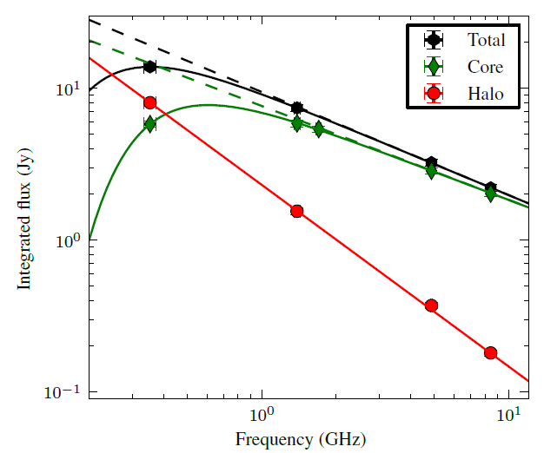
M 82 absorption processes
Image Credit: Adebahr+2013

Slide 23

Thank you for you attention and
save travels!

