Slide 1

LOFAR Observations of Lightning Propagation
the surprising fine structure of lightning
Marten Lourens
for LOFAR Lightning Collaboration
Notes:
Abstract:
----------
Lightning discharges emit millions of short (< 1 μs) radio pulses. By measuring the relative
arrival times of these pulses at multiple antennas, researchers can probe lightning processes occurring
deep within optically opaque thunderclouds. LOFAR is currently the most sensitive and precise VHF
lightning imaging instrument in the world, capable of locating sources well below the noise level of
individual antennas with sub-meter accuracy [1].
In this talk, we will begin with a brief introduction to the imaging techniques used to study lightning.
We will then present recent LOFAR observations of a lightning discharge, focusing on the dynamics of
a High Altitude Negative Leader (HANL) propagating upward from 9 km altitude. Although lightning
develops through a bi-directional leader structure, most VHF emission originates from the advancing tip
of the negative leader. Negative leaders grow in jumps, commonly referred to as “steps”. The plasma
processes underlying these steps are not fully understood, largely because no other instrument has the
spatial and temporal resolution required to study them in detail.
Here, we present the most detailed observations resolving the internal structure of these steps, revealing
previously unseen plasma behavior. In VHF images, each step appears as fan-like structure that advances
the discharge. We discover that these fans are composed of several branched networks of filaments
initiating at different times from various locations. We refer to these networks as filament trees. Each
filament tree forms starting with a burst of VHF radiation that is significantly more energetic than pulses
emitted immediately before or after it from the same region. The filaments themselves form channels
with a diameter on the order of our instrumental resolution of 1 m and show no sign of broadening as
they fill a volume on the order of 100 m.
The behavior of these filaments is striking. Lightning is typically described as consisting of two compo-
nents: a hot, conductive leader channel capable of transporting charge over several kilometers, and cold
streamers that form at the leader tip. The filaments we observe inside a leader step are inconsistent with
both leaders and streamers. We will discuss a possible hypothesis for the nature of these structures and
their implication for our understanding of leader stepping and plasma physics.

Slide 2
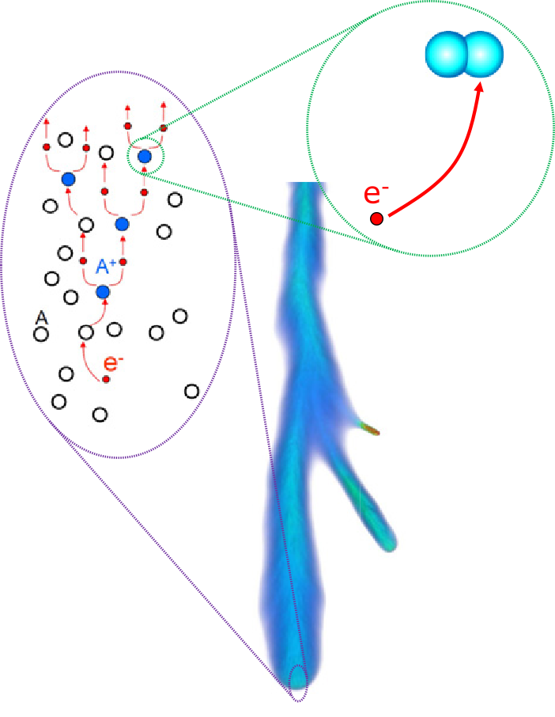
Building Blocks of Discharge Process
Probing the microphysics of the discharge.
Simulations show “streamers”:
  self-propagating due to strong E-field at tip
  cold plasma
Building blocks of lightning discharge?
Streamer
Nijdam et al. (2020)

Slide 3
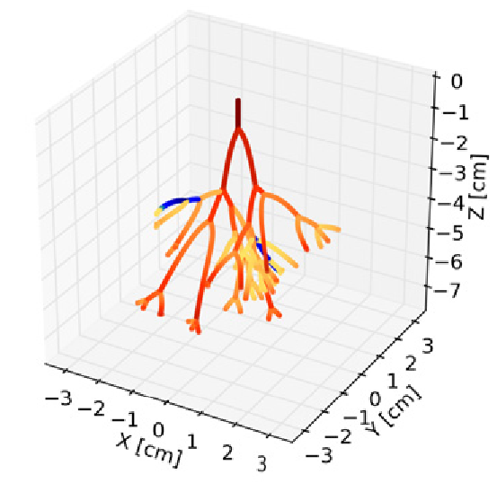
Streamer Tree
When radius of streamer head becomes sufficiently large it can branch. → “streamer tree”
To what extent do simulations agree with LOFAR data?
~8 cm
~10 cm
Luque & Ebert (2014)

Slide 4
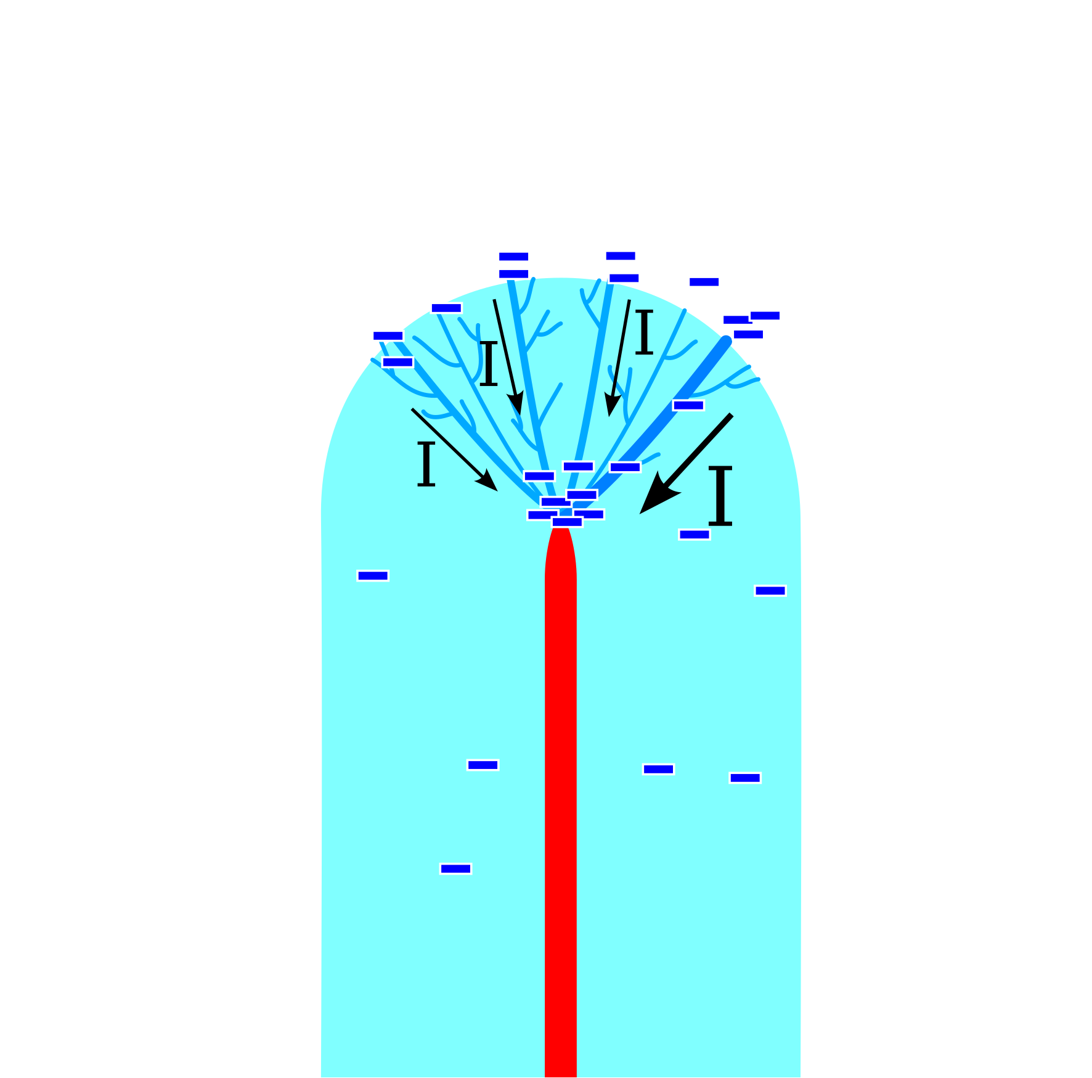
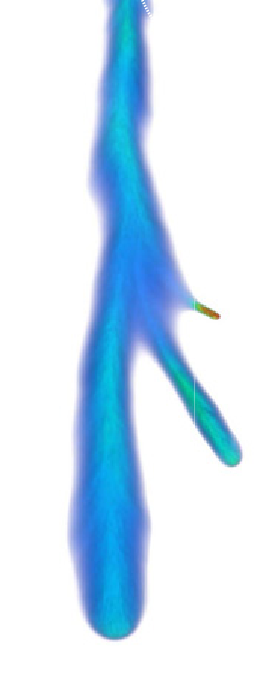
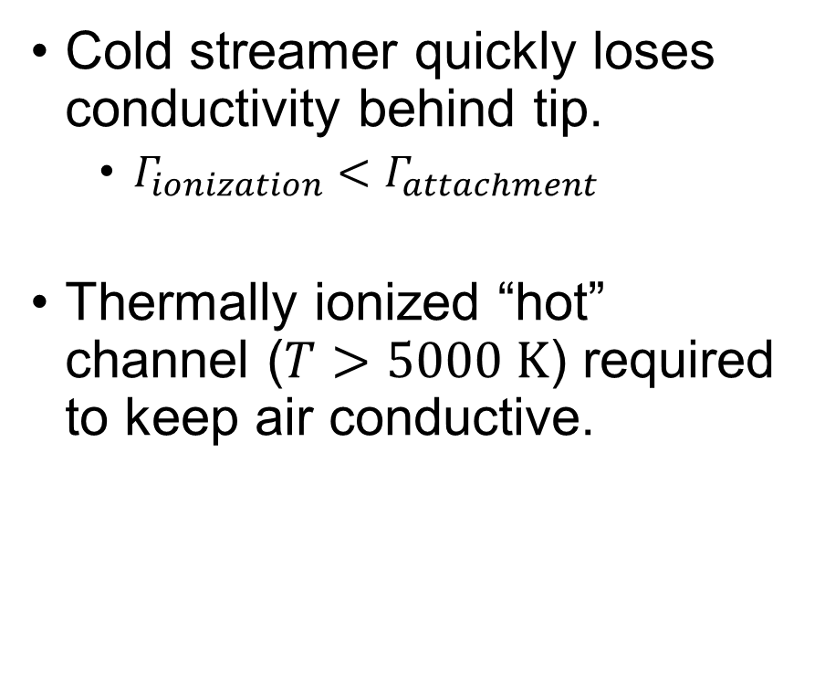
Leader
Cold streamer quickly loses conductivity behind tip.
  $Γ_{ionization}<Γ_{attachment}$
Thermally ionized “hot” channel ($T>5000 K$) required to keep air conductive.
Streamers?
Leader

Slide 5
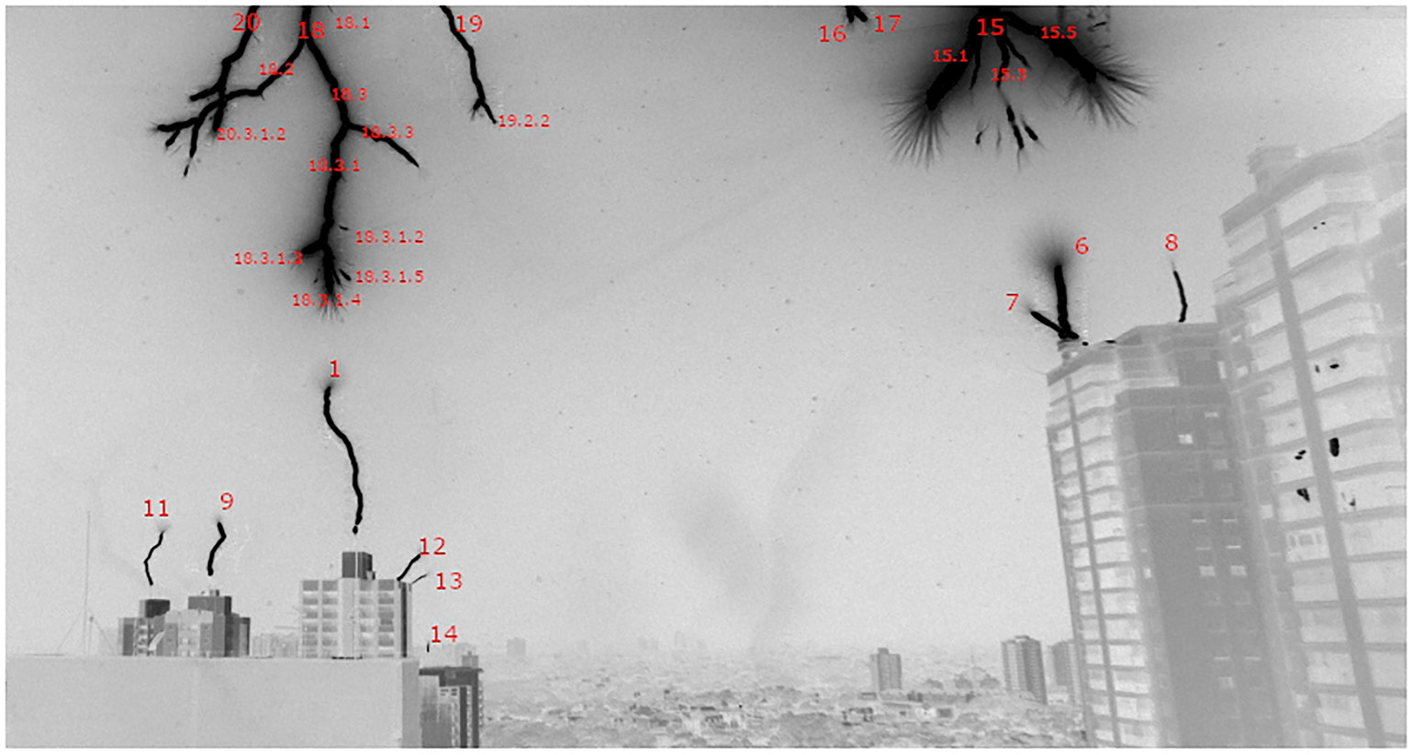
Previous Observations
Best most recent camera observation near ground.
Time resolution of high-speed cameras insufficient to resolve filament development
~20 m
25 us integration
Majority of discharge inside optically opaque thundercloud!!
Saba et al. (2022)
Notes:
Snarky comment: these optical observations combined with the conceptual model on the previous slide has always be considered “strong” evidence that the filaments seen in these images are streamers

Slide 6
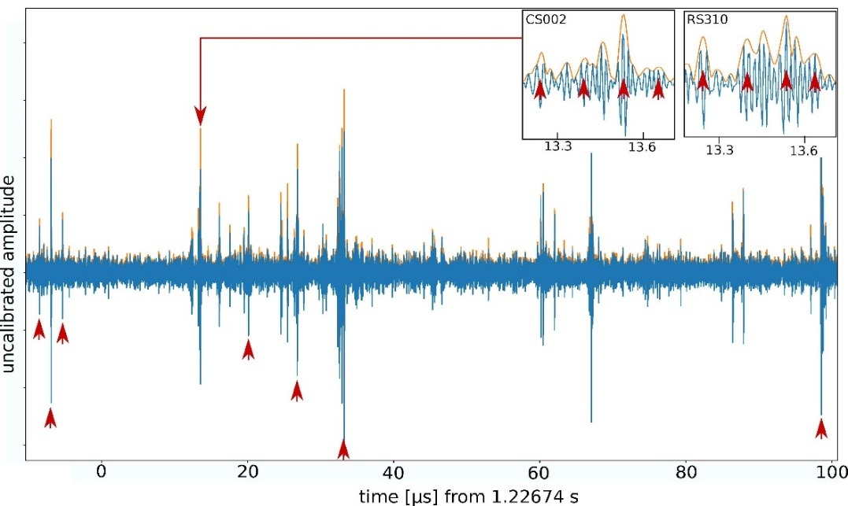
Why is LOFAR so good?
Large area (3000 km²) and high timing accuracy (~1 ns):
  sees over large distances (and through clouds)
  sub-meter spatial resolution
We use transient buffers recording raw voltages measured by LBA (5 ns time resolution)
Image credit: Brian Hare

Slide 7
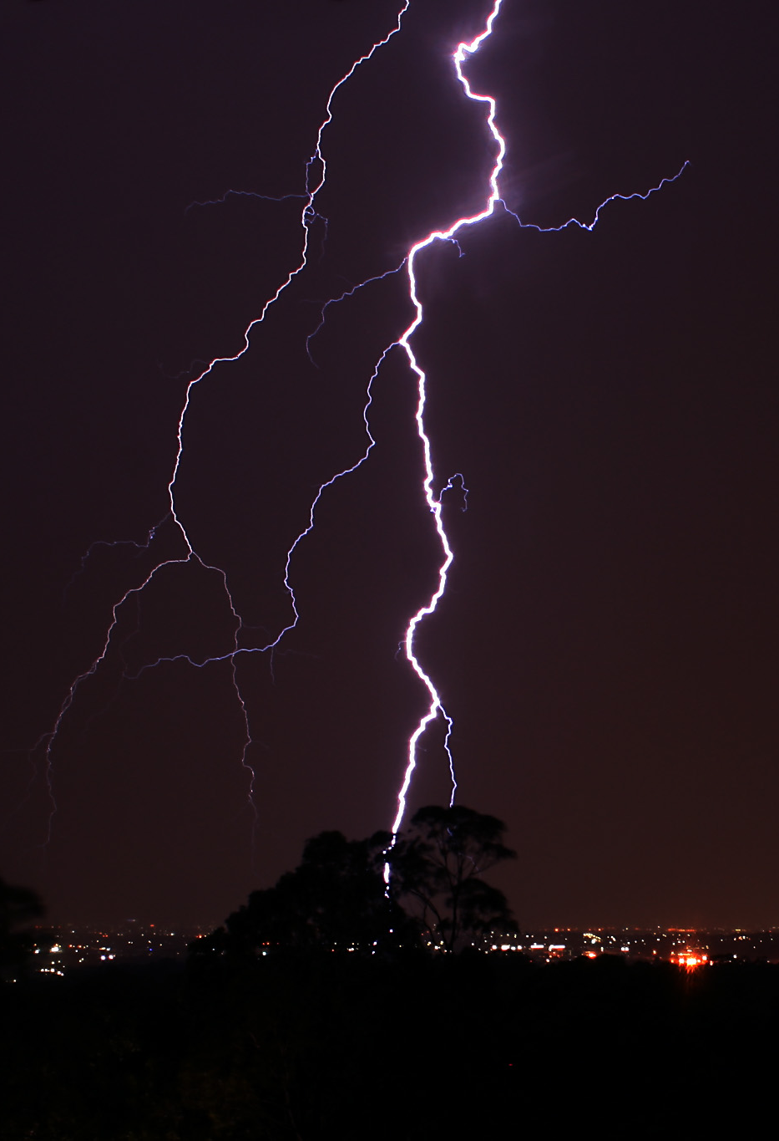
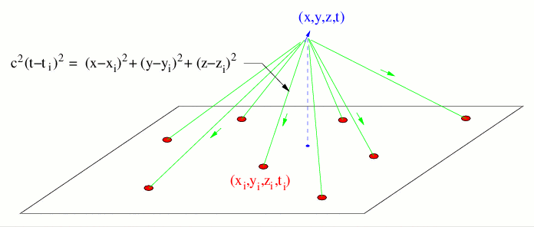
Imaging Lightning in VHF
Emitted VHF Pulse
Image credit: Brian Hare
Measure arrival time differences with LOFAR antennas
Mike Lehmann, Mike Switzerland 13:44, 4 March 2007 (UTC), CC BY-SA 3.0
source: http://ibis.nmt.edu/nmt_lms/descrip.html

Slide 8
Imaging Challenges
Large number of antennas (~400 single dipoles)
Lightning discharges emit millions of short VHF pulses → pulse confusion
Polarization direction and magnitude of received E-field is antenna position dependent → solved by near-field beamformer: “ATRI-D”

Slide 9
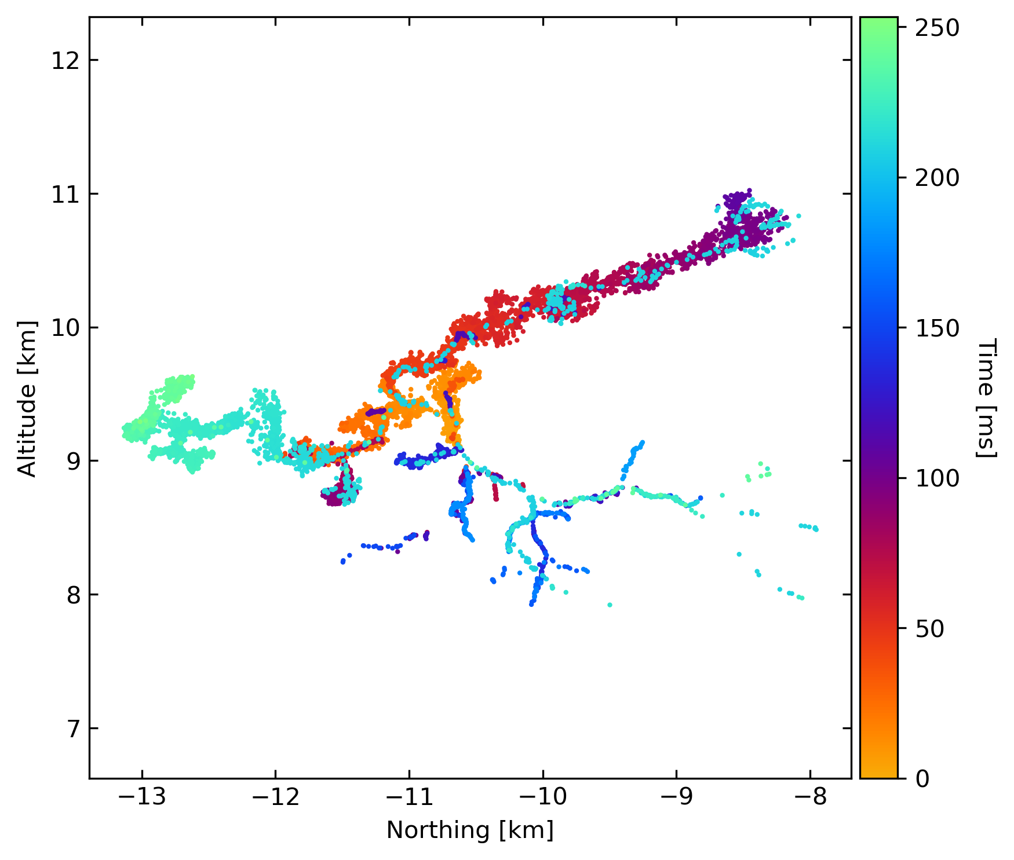
Full flash
August 14, 2020, 14:15 UTC
Entire flash
  By computationally efficient imager.
  Time-of-arrival difference (TOAD)
~5 km
Initiation point

Slide 10
Full flash
August 14, 2020, 14:15 UTC
Entire flash
  By computationally efficient imager.
  Time-of-arrival difference (TOAD)
Leader = conductive channel
Negative Leader
Positive Leader

Slide 11
Full flash
August 14, 2020, 14:15 UTC
Entire flash
  By computationally efficient imager.
  Time-of-arrival difference (TOAD)
Leader = conductive channel
Negative leaders
  Above 7 km are rare in Dutch storms
  Only in severe storms!
Negative Leader
Positive Leader

Slide 12
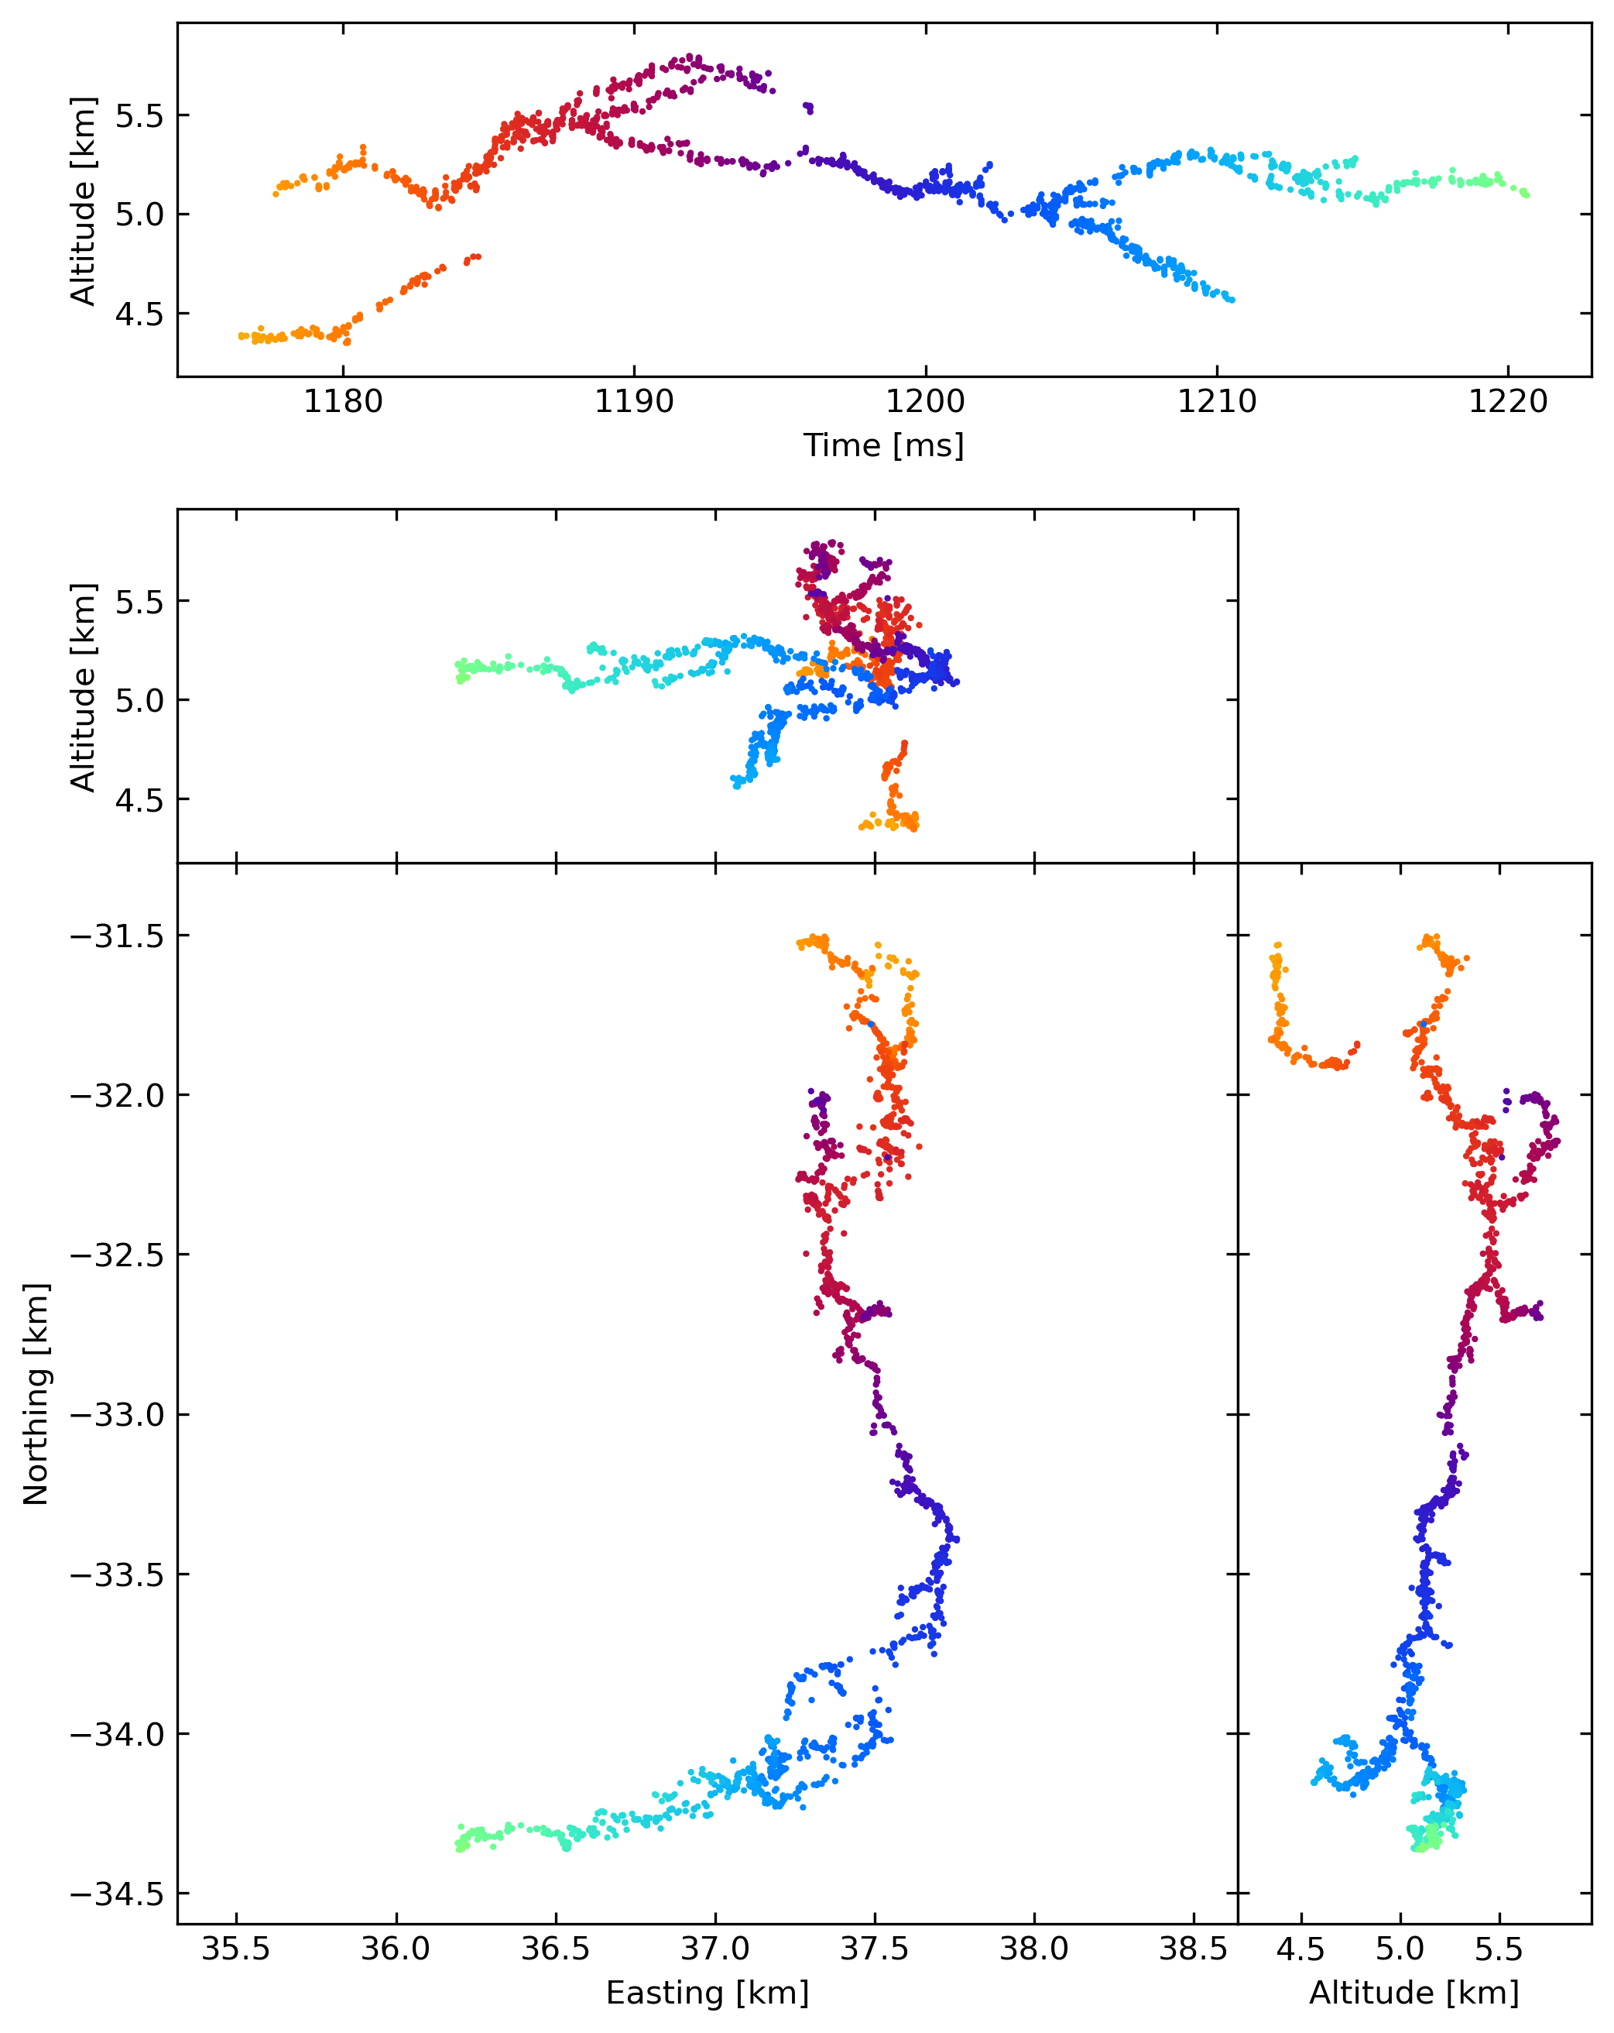
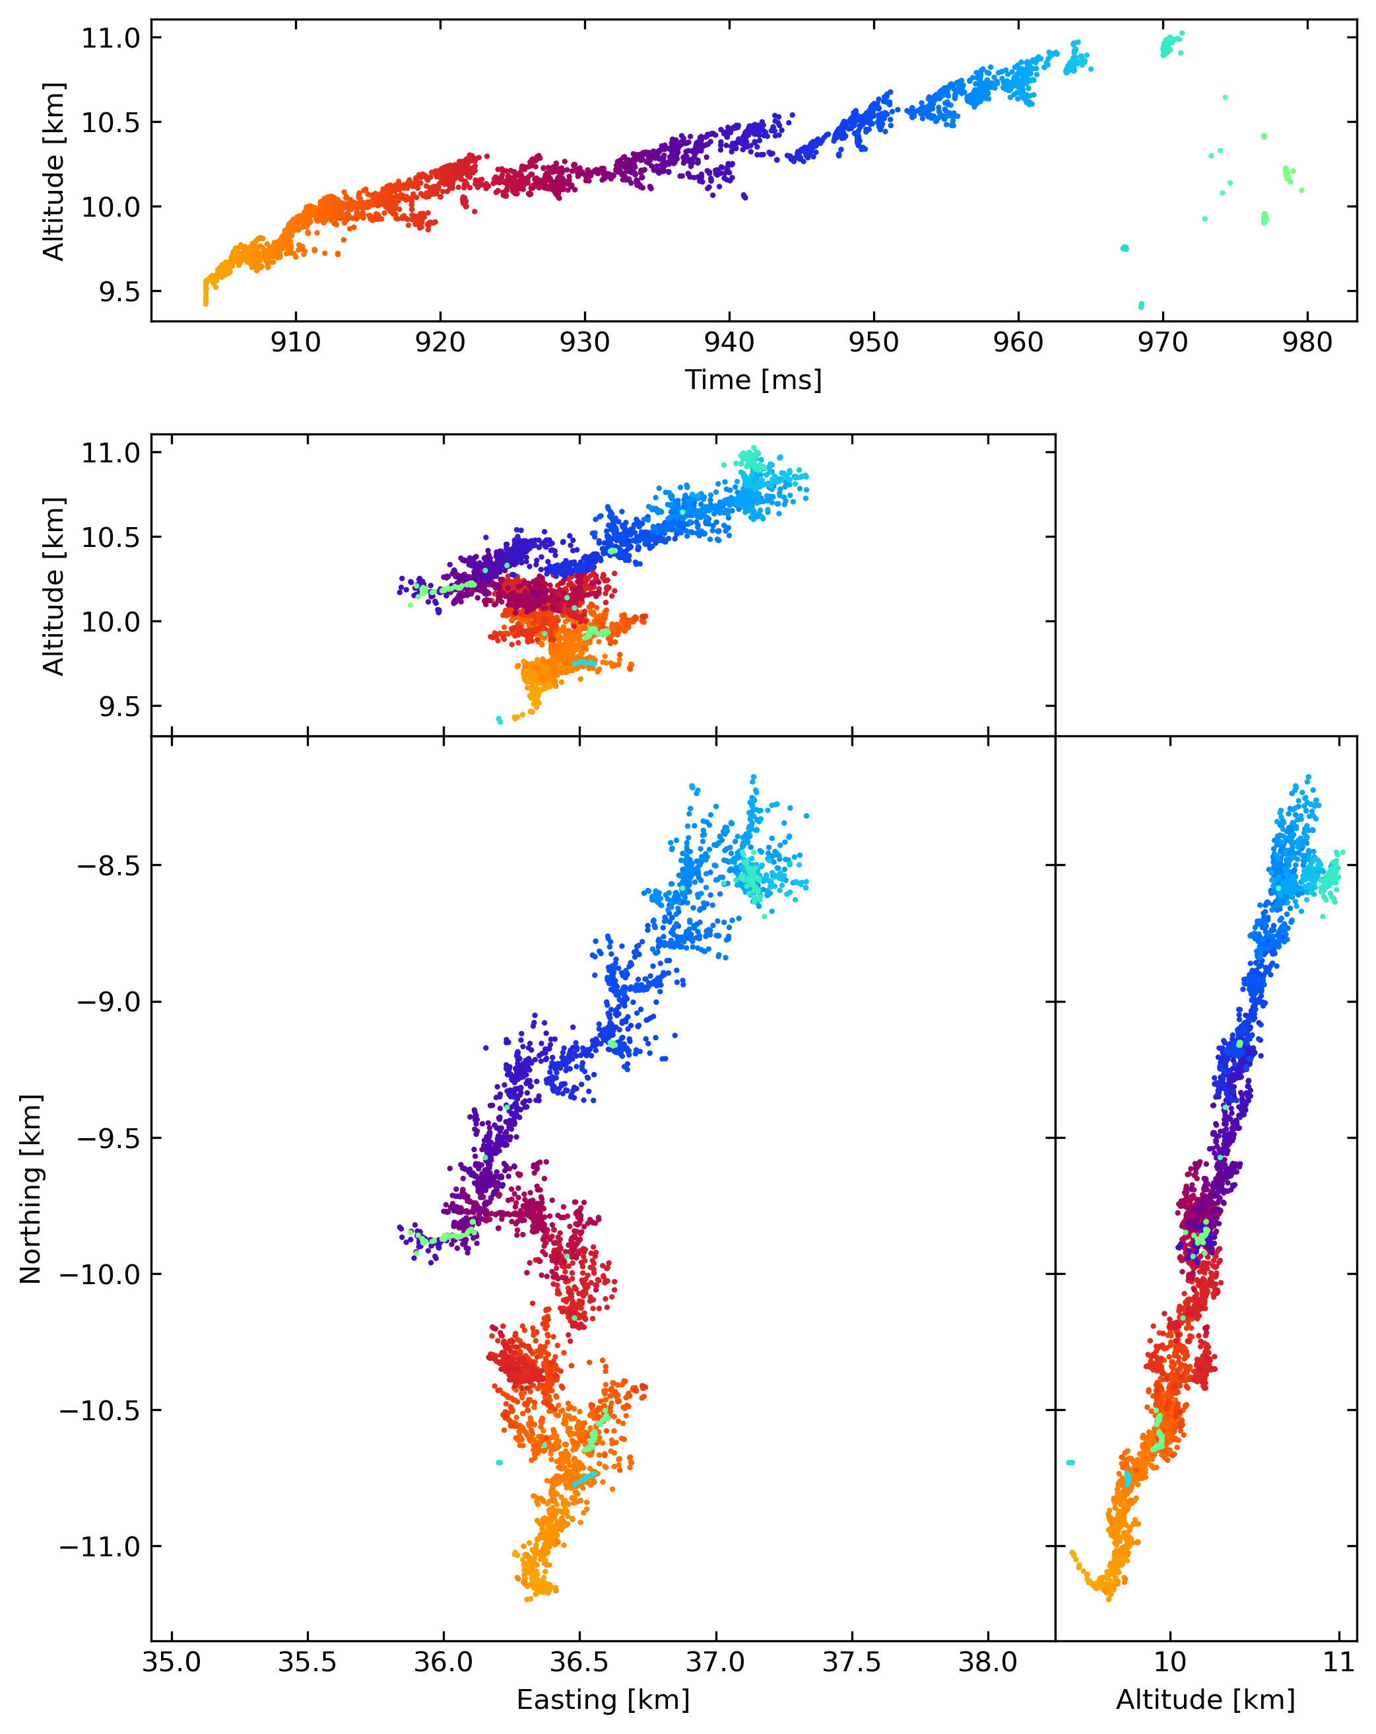
500 m
Low altitude negative leader
50 m
difference in width
High Altitude Negative Leader (HANL)

Slide 13
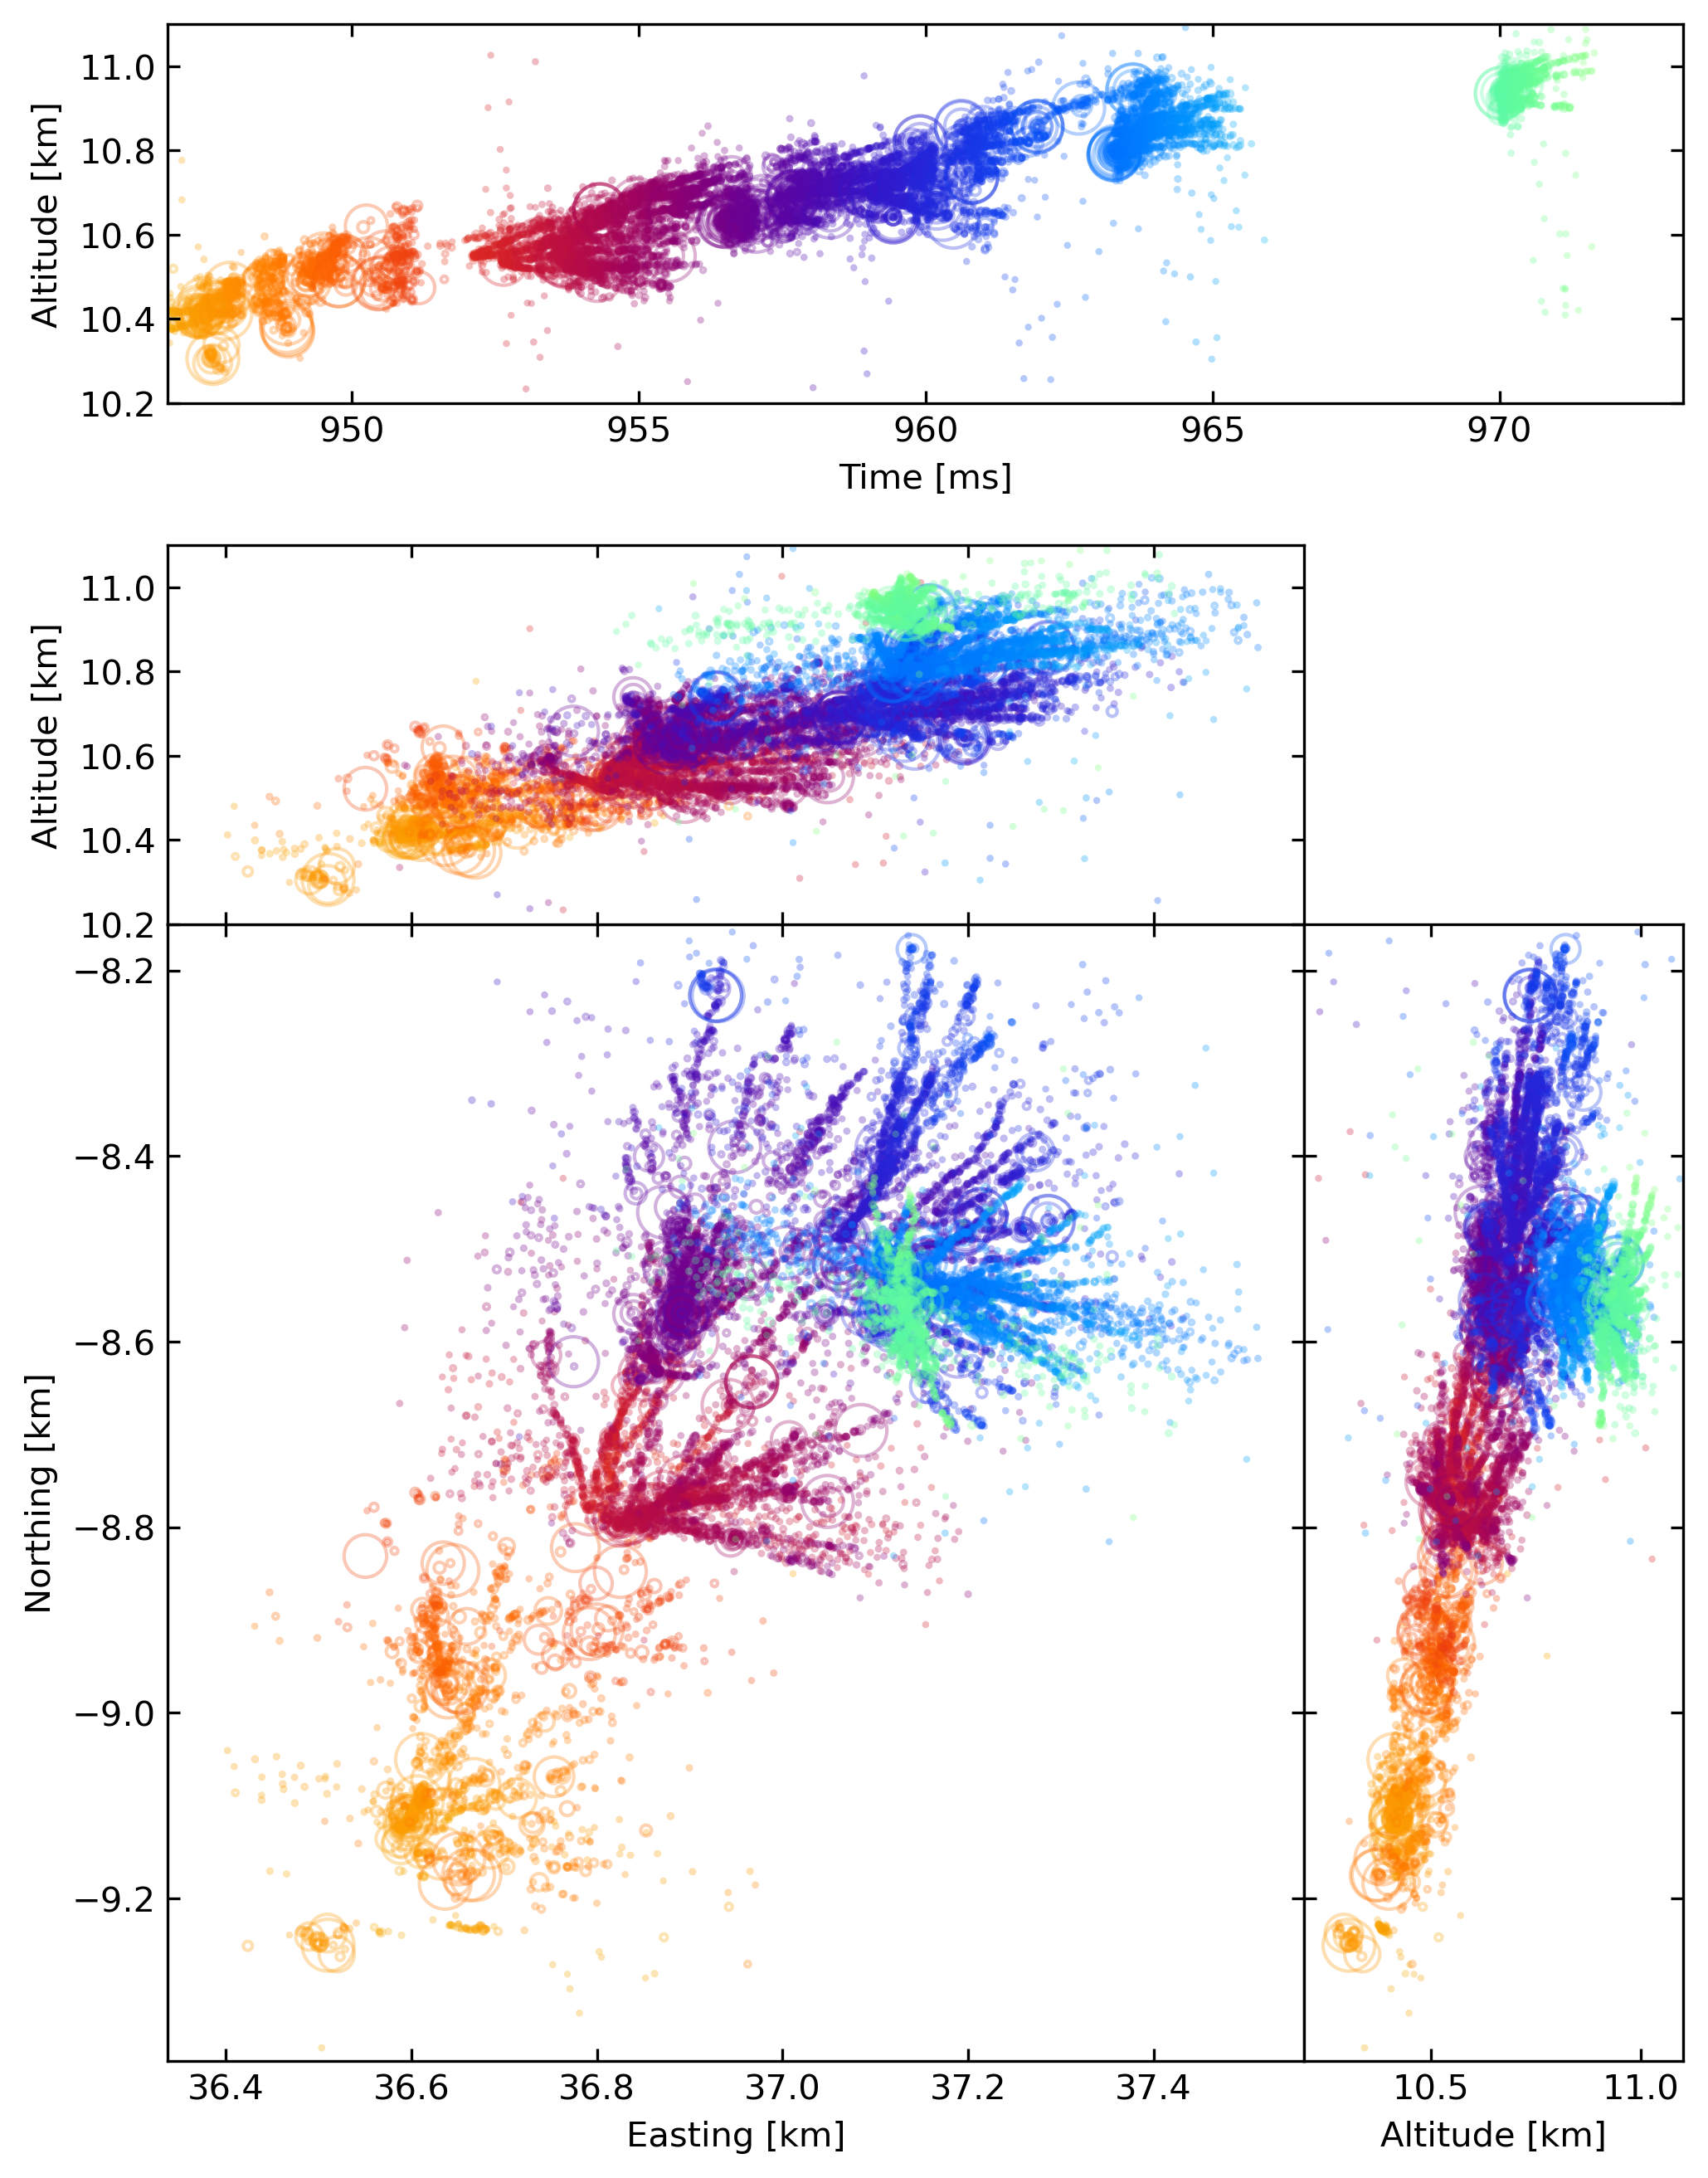
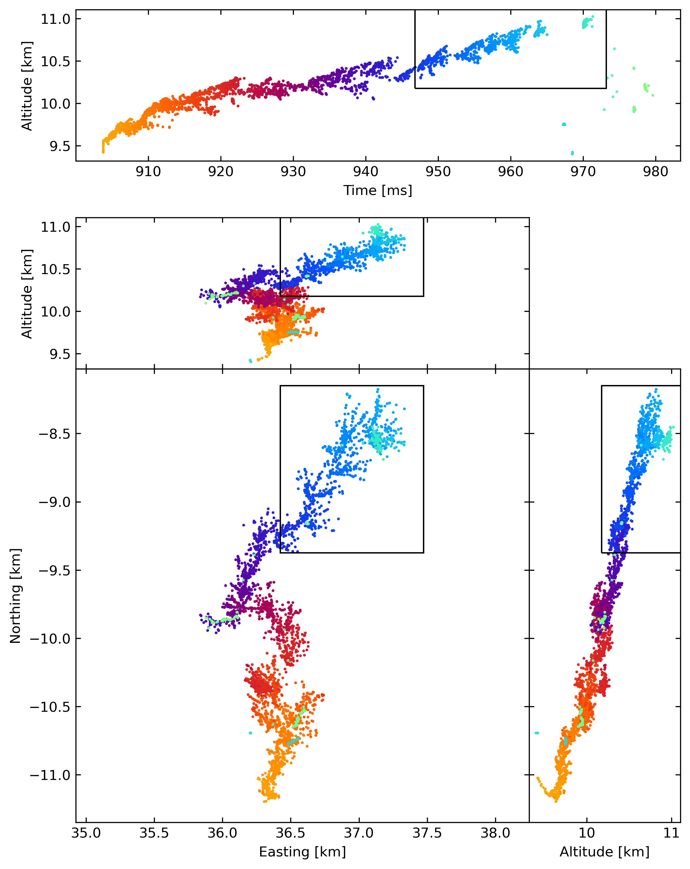
ATRI-D
TOAD

Slide 14
4 ms
HANL moves in steps
Sequence of fans-like structures:
  ~ 300 m in size
  forms in ~ 4 ms
300 m

Slide 15

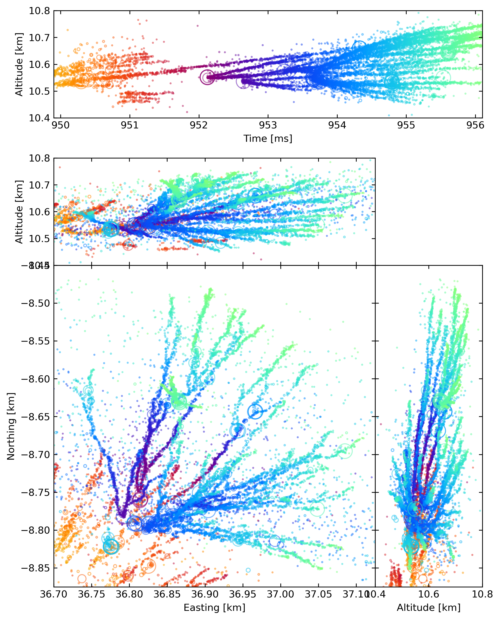

Slide 16
Fans have substructure
A
B
C
Surprising! → previous data suggested single fan
Fans build out of independent filamentary structures
A
B
C

Slide 17
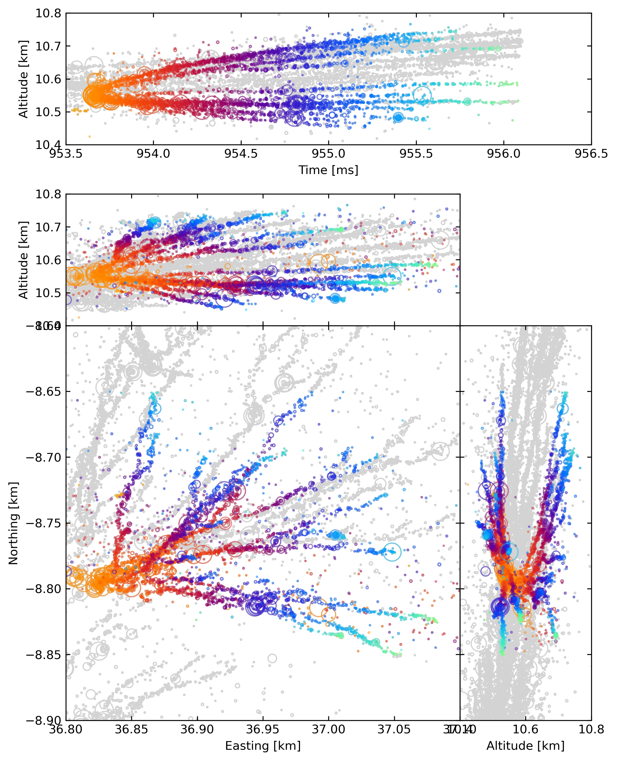
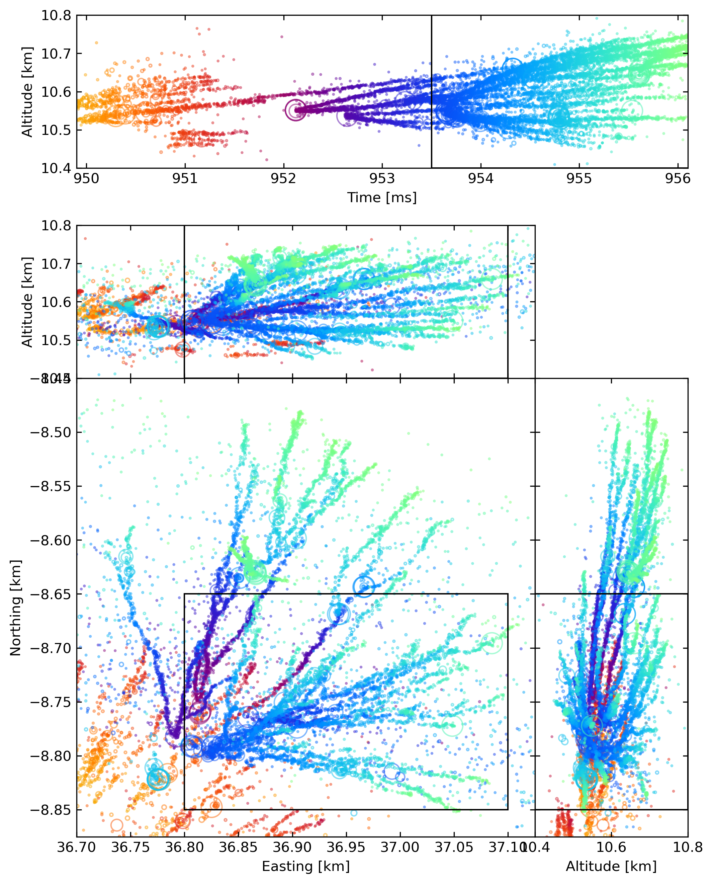
Filaments propagate away and bend around other filaments

Slide 18
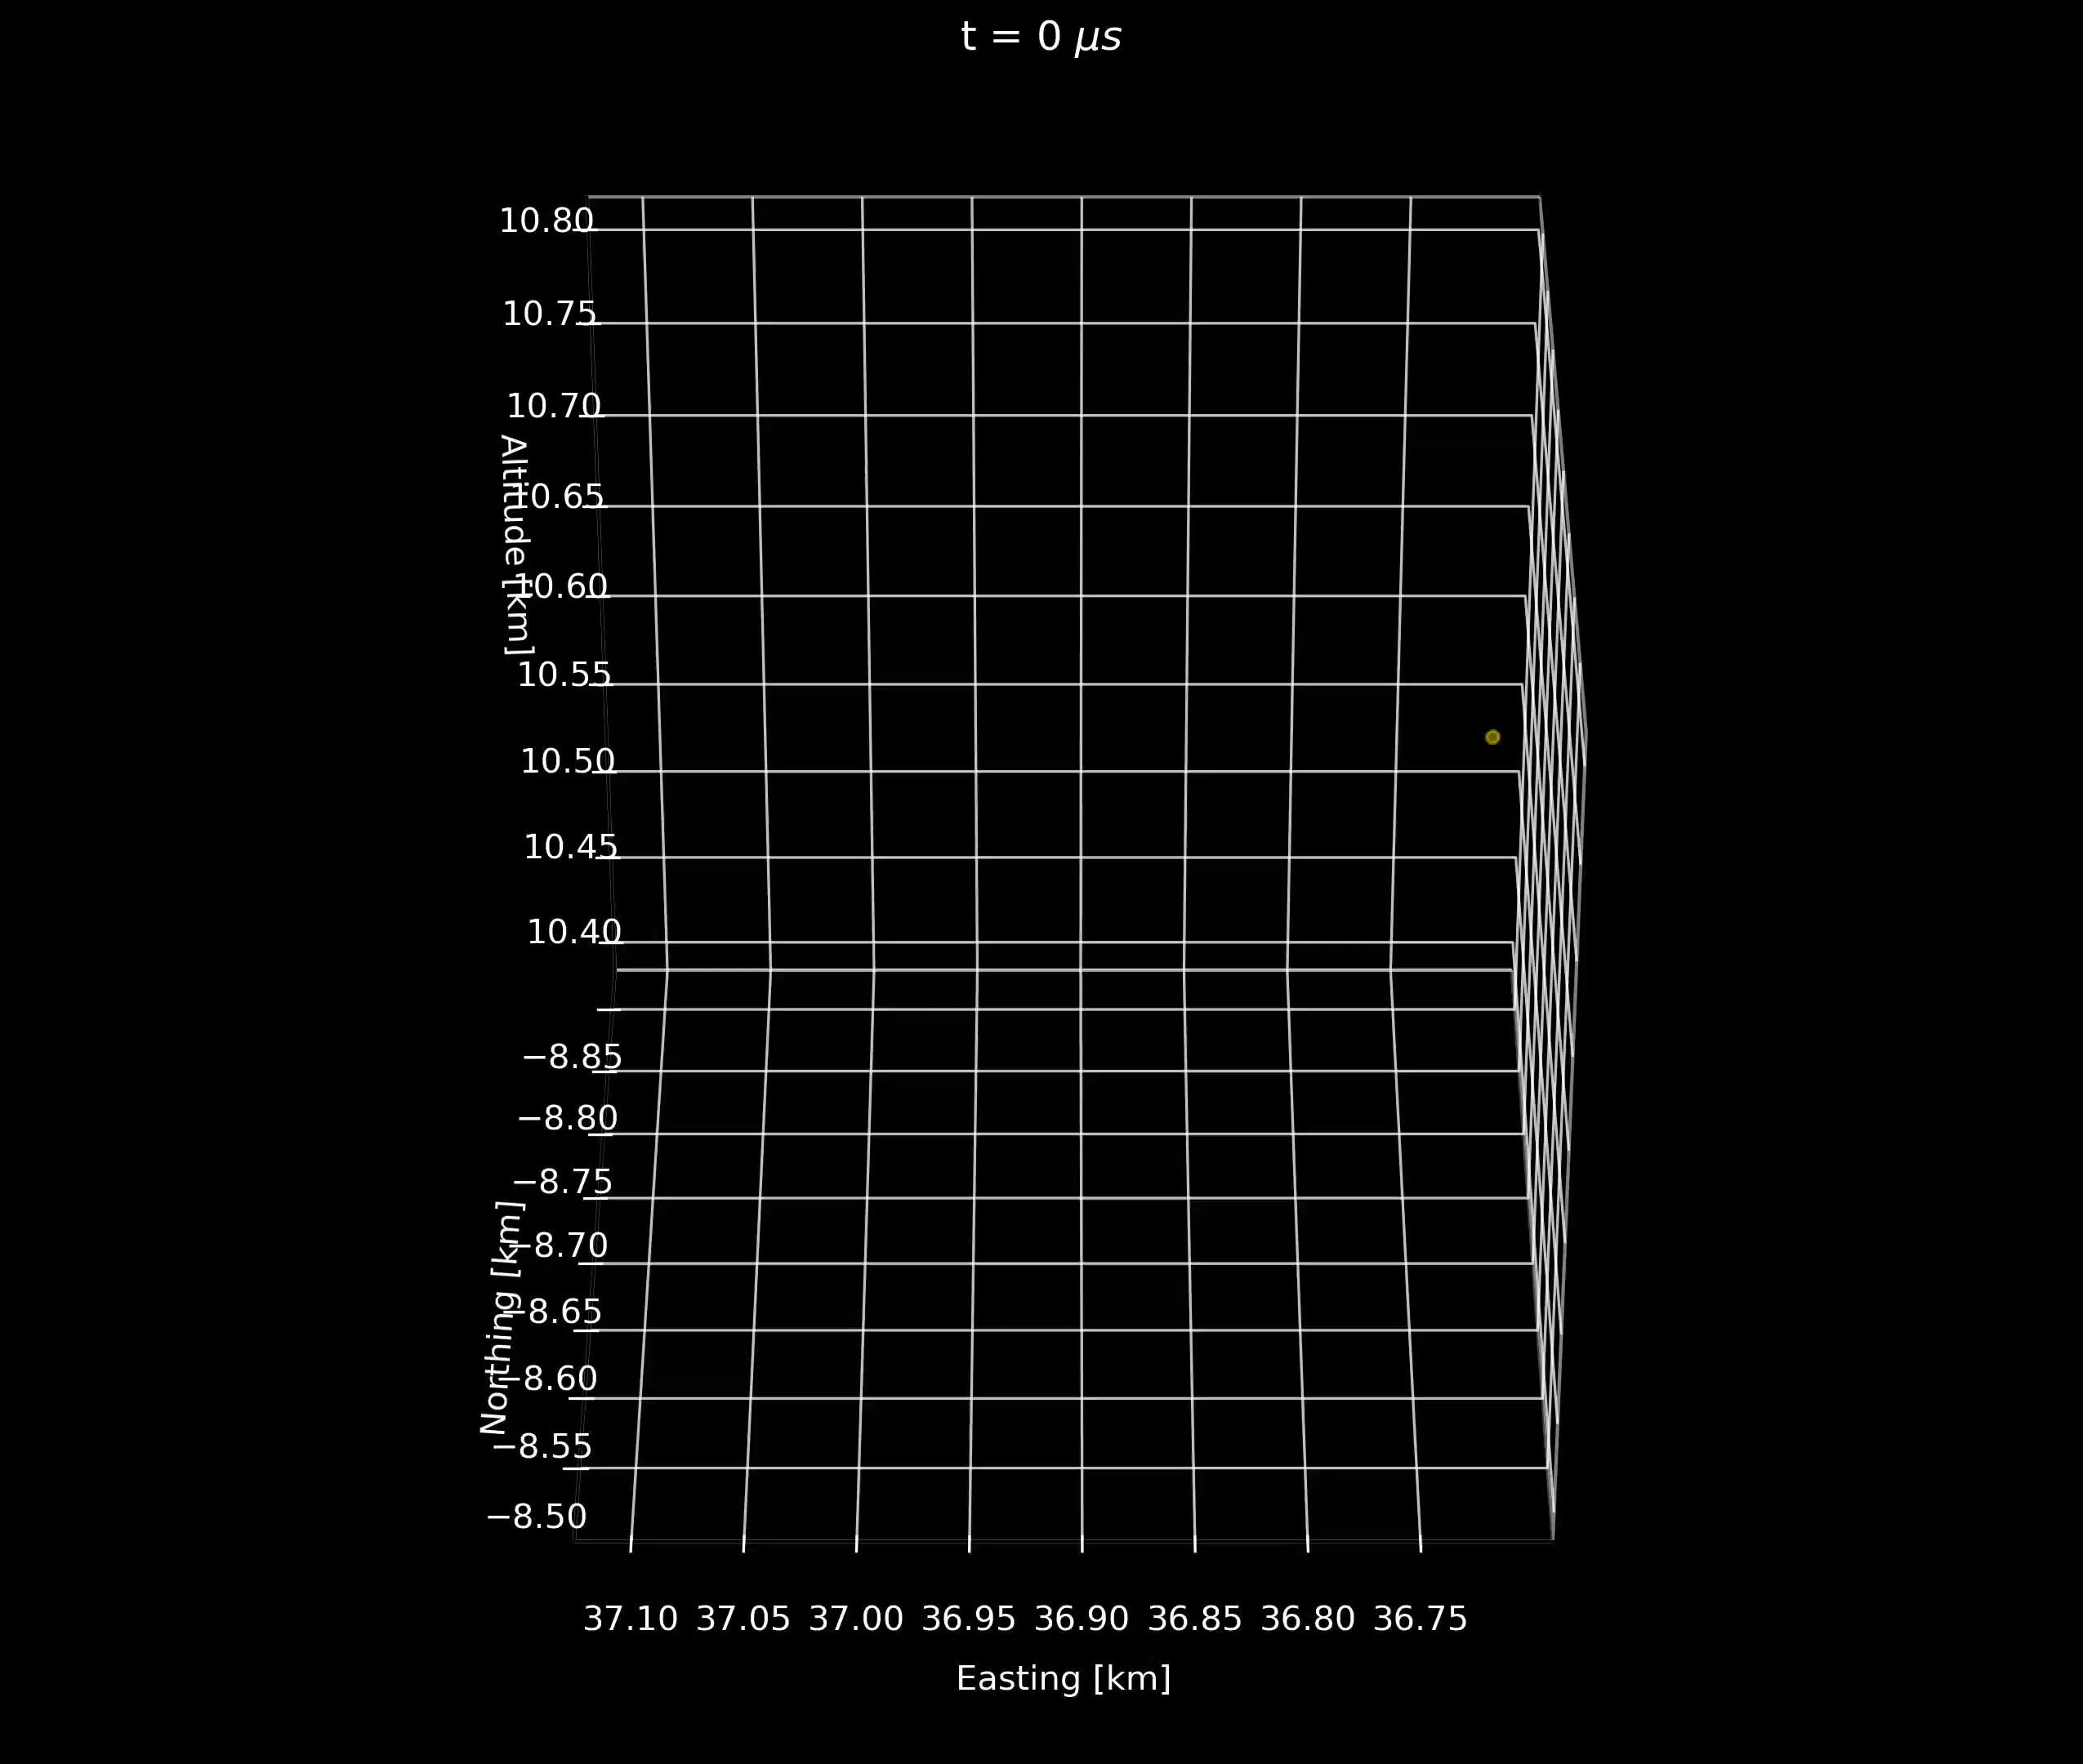

Slide 19
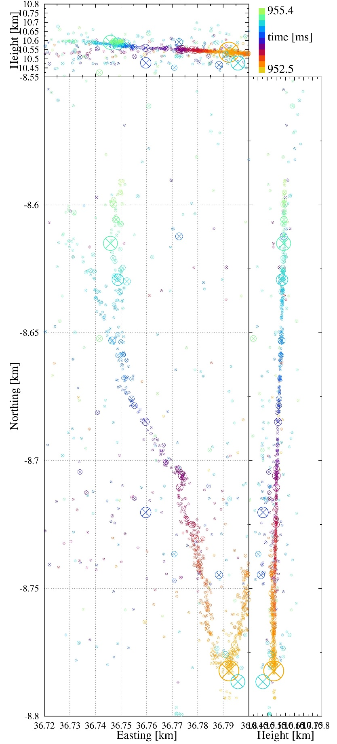



What is a filament?
$v\sim {10}^{5}$ m/s
$σ\sim 1.5$ m

Slide 20
What is a filament?
$v\sim {10}^{5}$ m/s
Hypothesis 1: Filaments are individual streamers.
  Unlikely
  Streamers are unstable
  Slight changes in E-field can cause streamer to quickly accelerate/decelerate
  Observed constant speed requires nearly constant E-field
$σ\sim 1.5$ m
Nijdam et al. (2020)
Notes:
structure as list of hypotheses with figures of indiv streamer and network of streamer

Slide 21
What is a filament?
$v\sim {10}^{5}$ m/s
Hypothesis 1: Filaments are individual streamers.
Hypothesis 2: Filaments are networks of streamers.
  Unlikely
  Streamers repel due to charge carried at tip.
  We observe no broadening.
~8 cm
$σ\sim 1.5$ m
simulations predict wide opening angle
~10 cm
Luque & Ebert (2014)
Notes:
structure as list of hypotheses with figures of indiv streamer and network of streamer

Slide 22
Summary
With LOFAR we can study lightning with the highest resolution in space and time:
  Time resolution ~100 ns
  Spatial resolution ~1 m
Finally able to compare observations and theory → they do not match
  What we learned:
    Fans have substructure → distinct networks of filaments
    Filaments avoid each other
    Filaments are narrow and likely not (networks of) streamers

Slide 24
Extra Slides

Slide 25
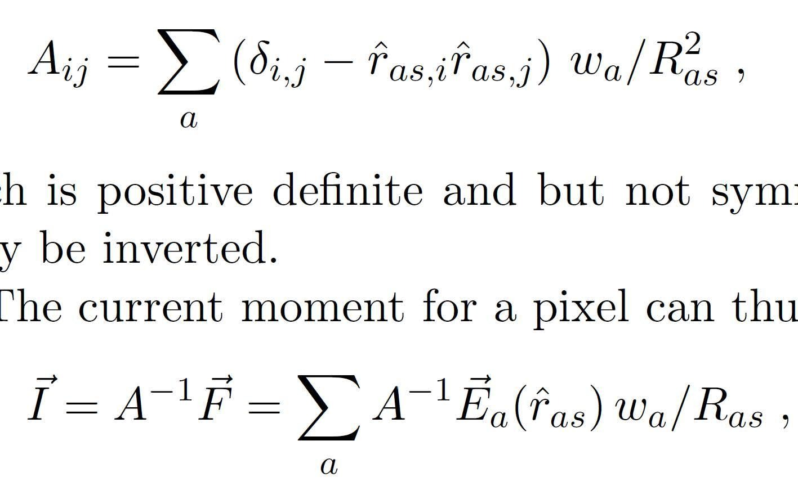
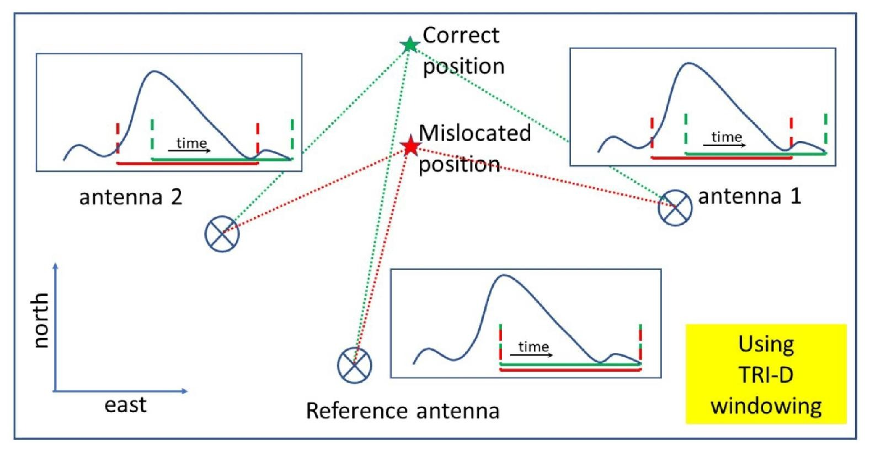
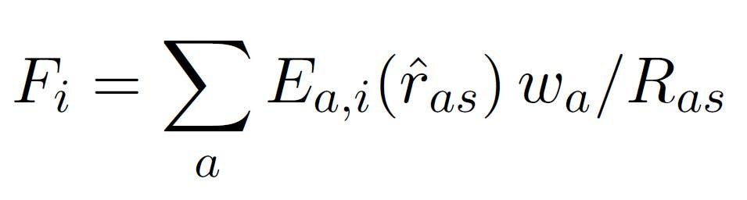




Beamforming
in Near-field
for Short Pulses
Antenna 1
$${\vec{E}}_{1}$$
Polarization rotation tensor
Coherent sum of E-fields
$$\vec{I}$$
Polarization Issue
Windowing Issue
Scholten et al. (2025)
$${\vec{E}}_{3}$$
Integration window needs to be well centered around pulse in beamformed trace.
$${\vec{E}}_{2}=0$$
Antenna 2
Antenna 3

Slide 26
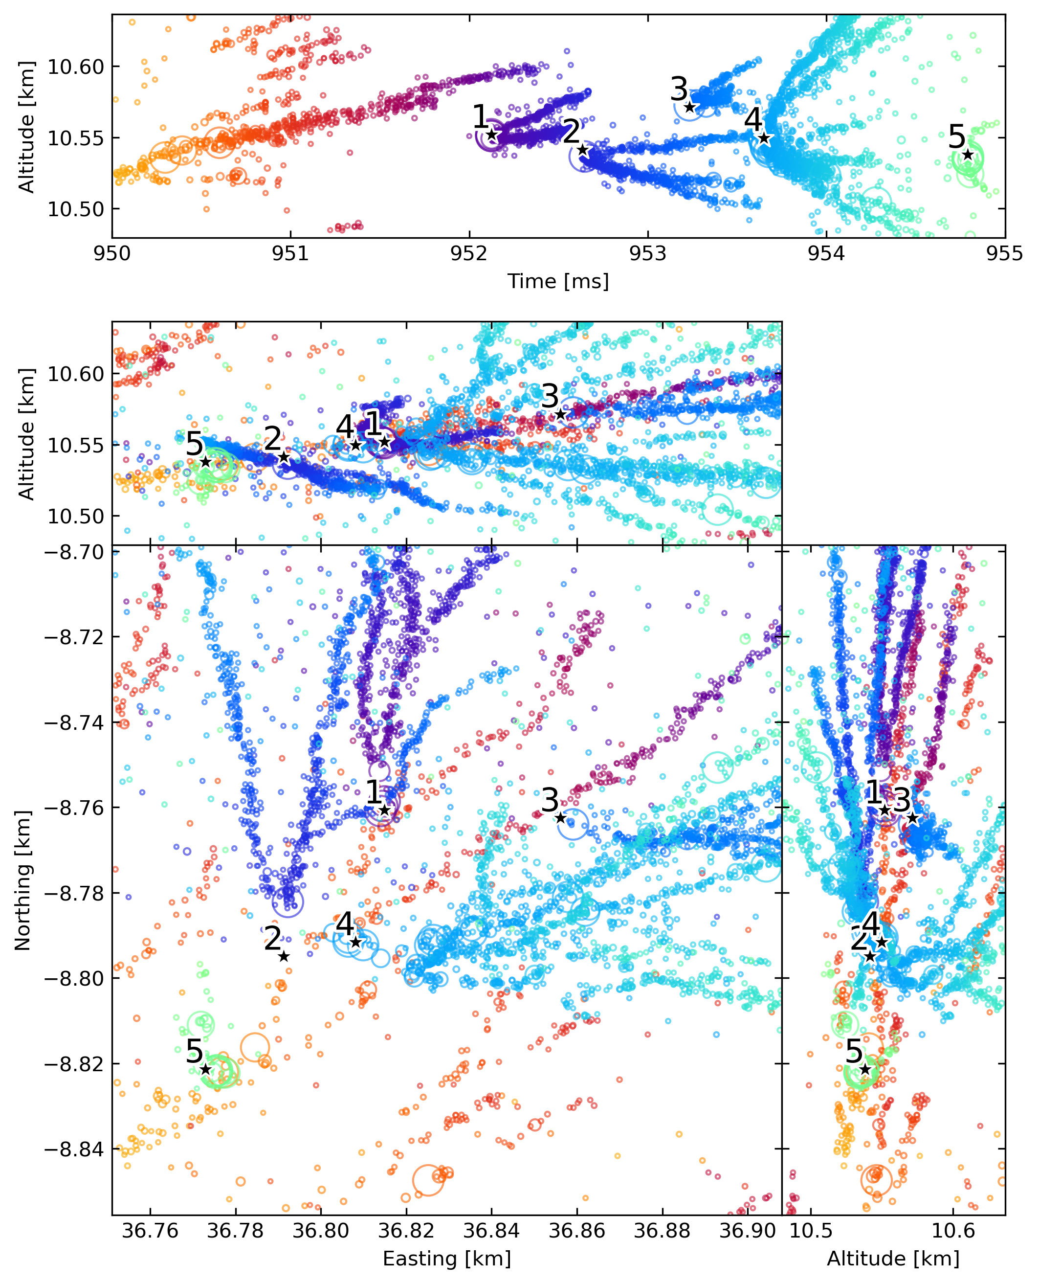
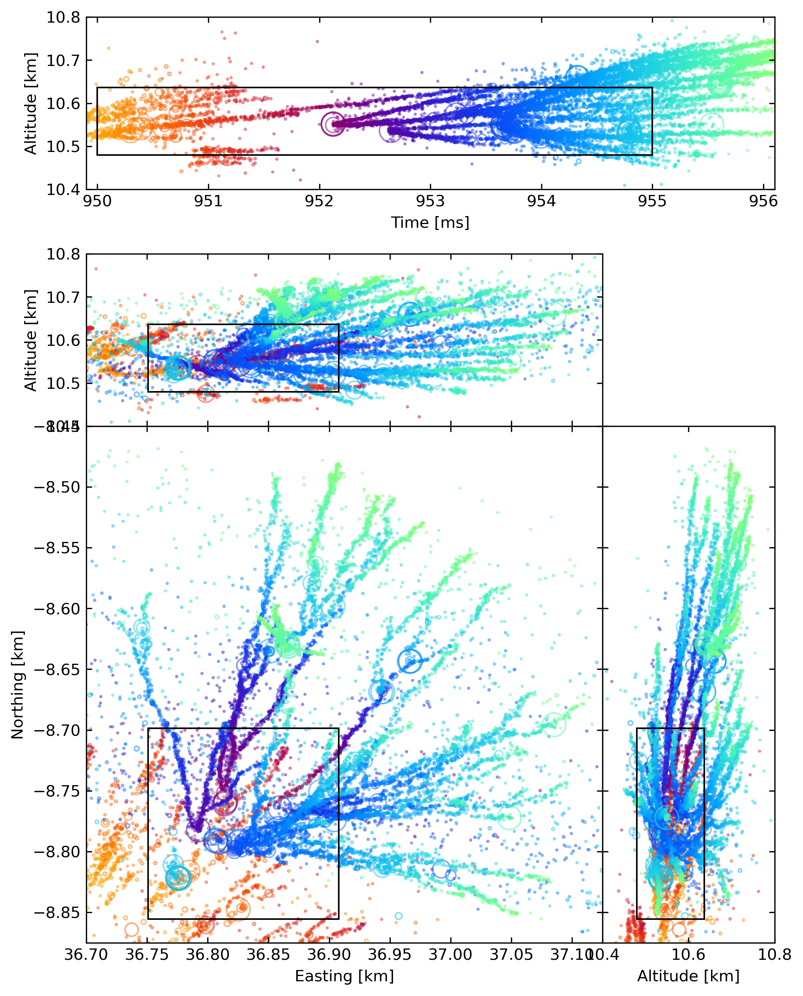
Zooming in on filament starts
radio bursts

Slide 27
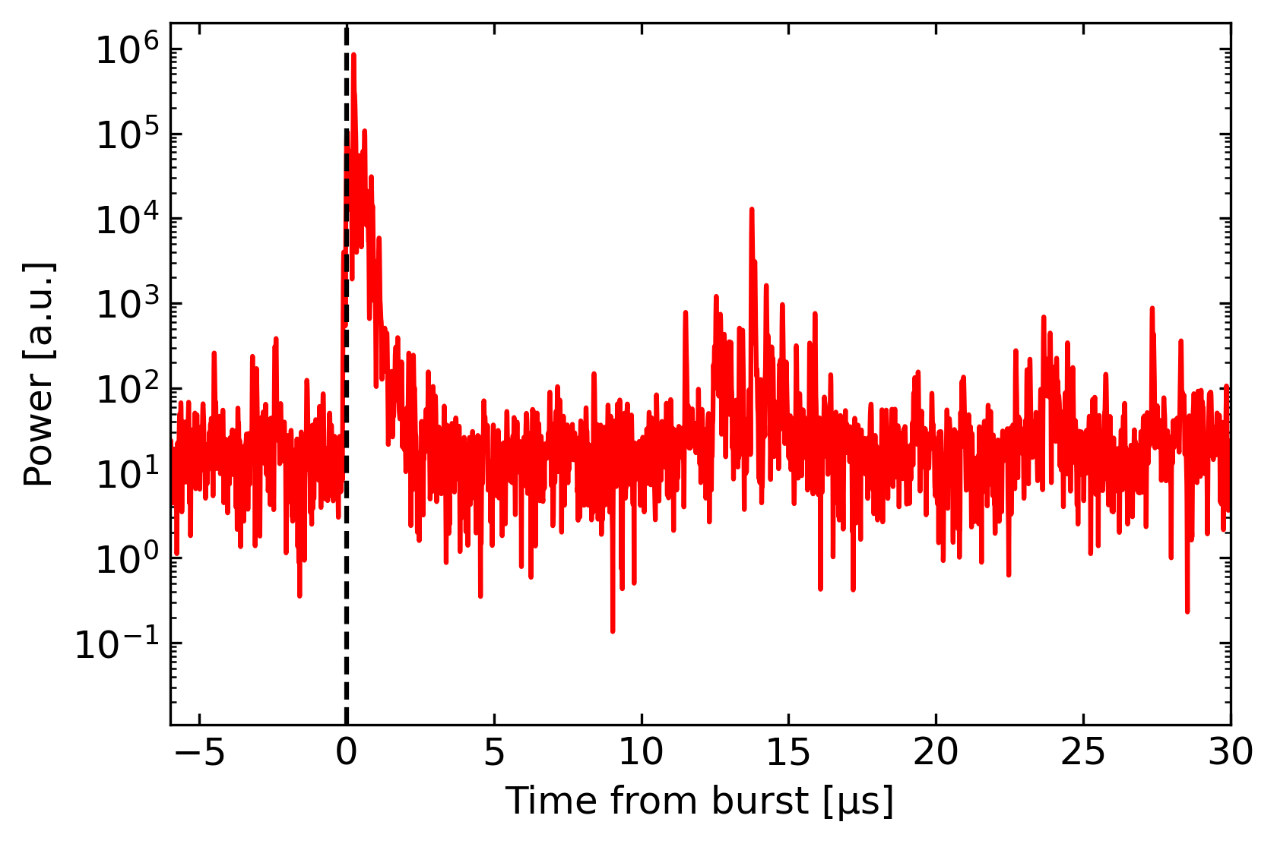
Filament Initiation
Start of new network of filaments:
  Near previous filament
  With “burst” of VHF emission
radio bursts

Slide 28
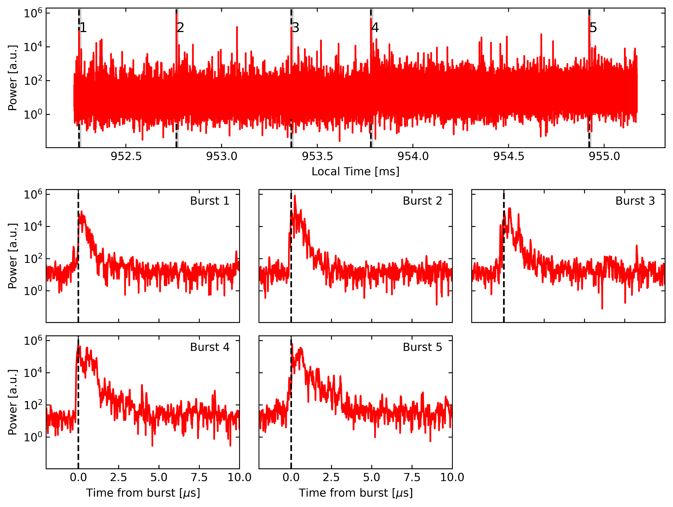
Each burst has similar structure
Nanosecond risetime
Burst duration: ~2.5 us
radio bursts

Slide 29
Interpretation
Charge builds up at various locations along the filaments.
Conclusion: Filaments are not streamers
radio bursts

