Slide 1
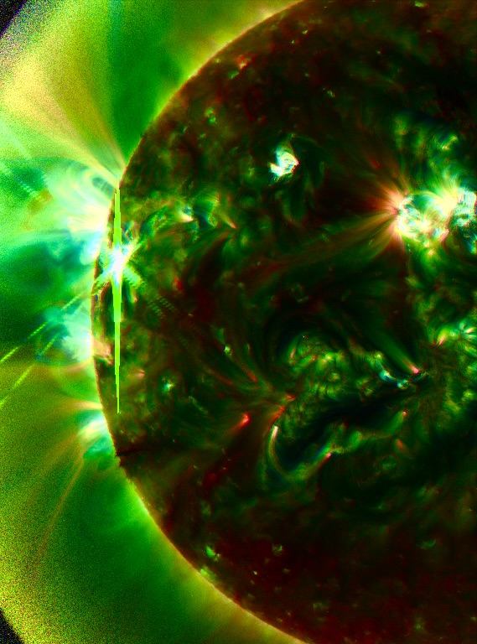




Resolving spatial and temporal shock structures using high-resolution radio observations of the Sun
Diana Morosan
diana.morosan@utu.fi
Immanuel Jebaraj, Peijin Zhang, Pietro Zucca, Bartosz Dabrowski, Peter Gallagher Andrzej Krankowski, Christian Vocks and Rami Vainio
Funded by the European Union. Views and opinions expressed are however those of the author(s) only and do not necessarily reflect those of the European Union or HaDEA. Neither the European Union nor the granting authority can be held responsible for them.

Slide 2
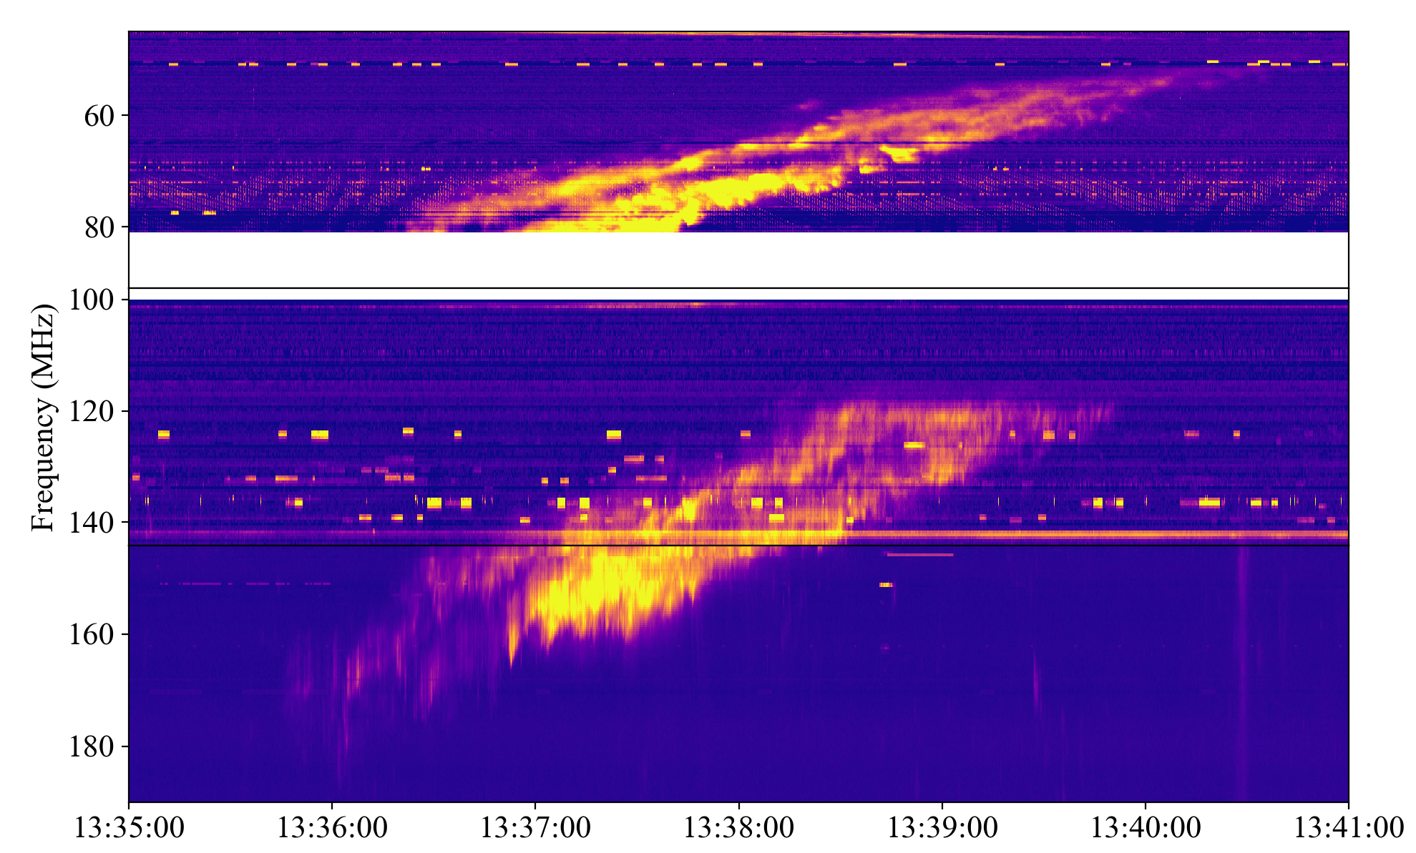
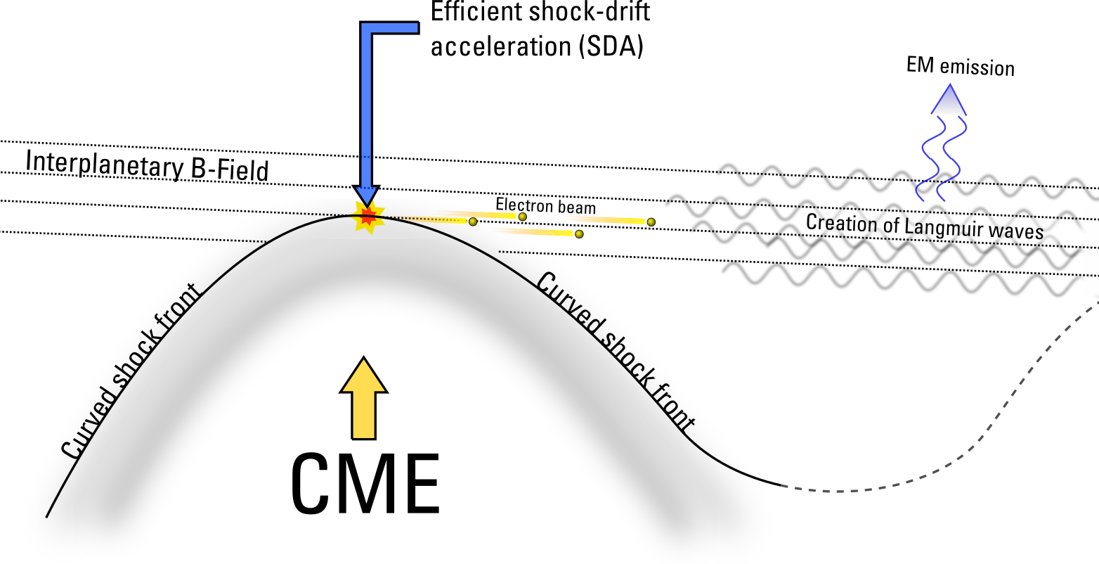



Type II Radio Bursts
Fundamental; $f_{p}$
Harmonic; $2f_{p}$
Ganse et al. 2012
$$f_{p}≈8980\sqrt{n_{e}}$$
Type II radio bursts are the radio signature of shock-accelerated electrons in the corona.

Slide 3
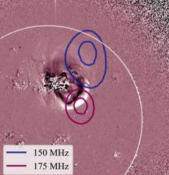
Type II Radio Bursts
Ganse et al. 2012
Morosan et al. 2024
Type II radio bursts are the radio signature of shock-accelerated electrons in the corona.

Slide 4
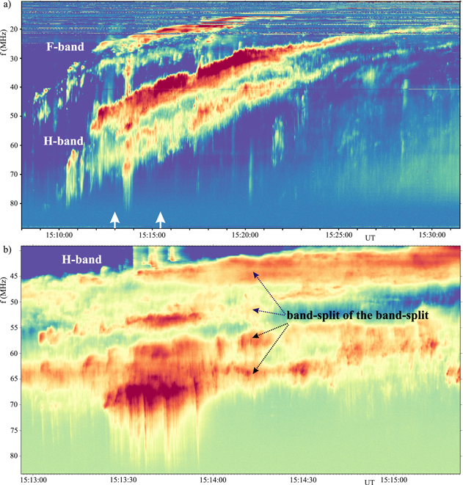


Type II Radio Bursts – Fine Structures
Fundamental; $f_{p}$
Fundamental or harmonic bands can also be split into multiple lanes:
Bandsplitting
Multi-lanes
Harmonic; $2f_{p}$
Ganse et al. 2012
Morosan et al. 2024
Complex nature of electron acceleration at the shock
Magdalenic et al. 2024

Slide 5
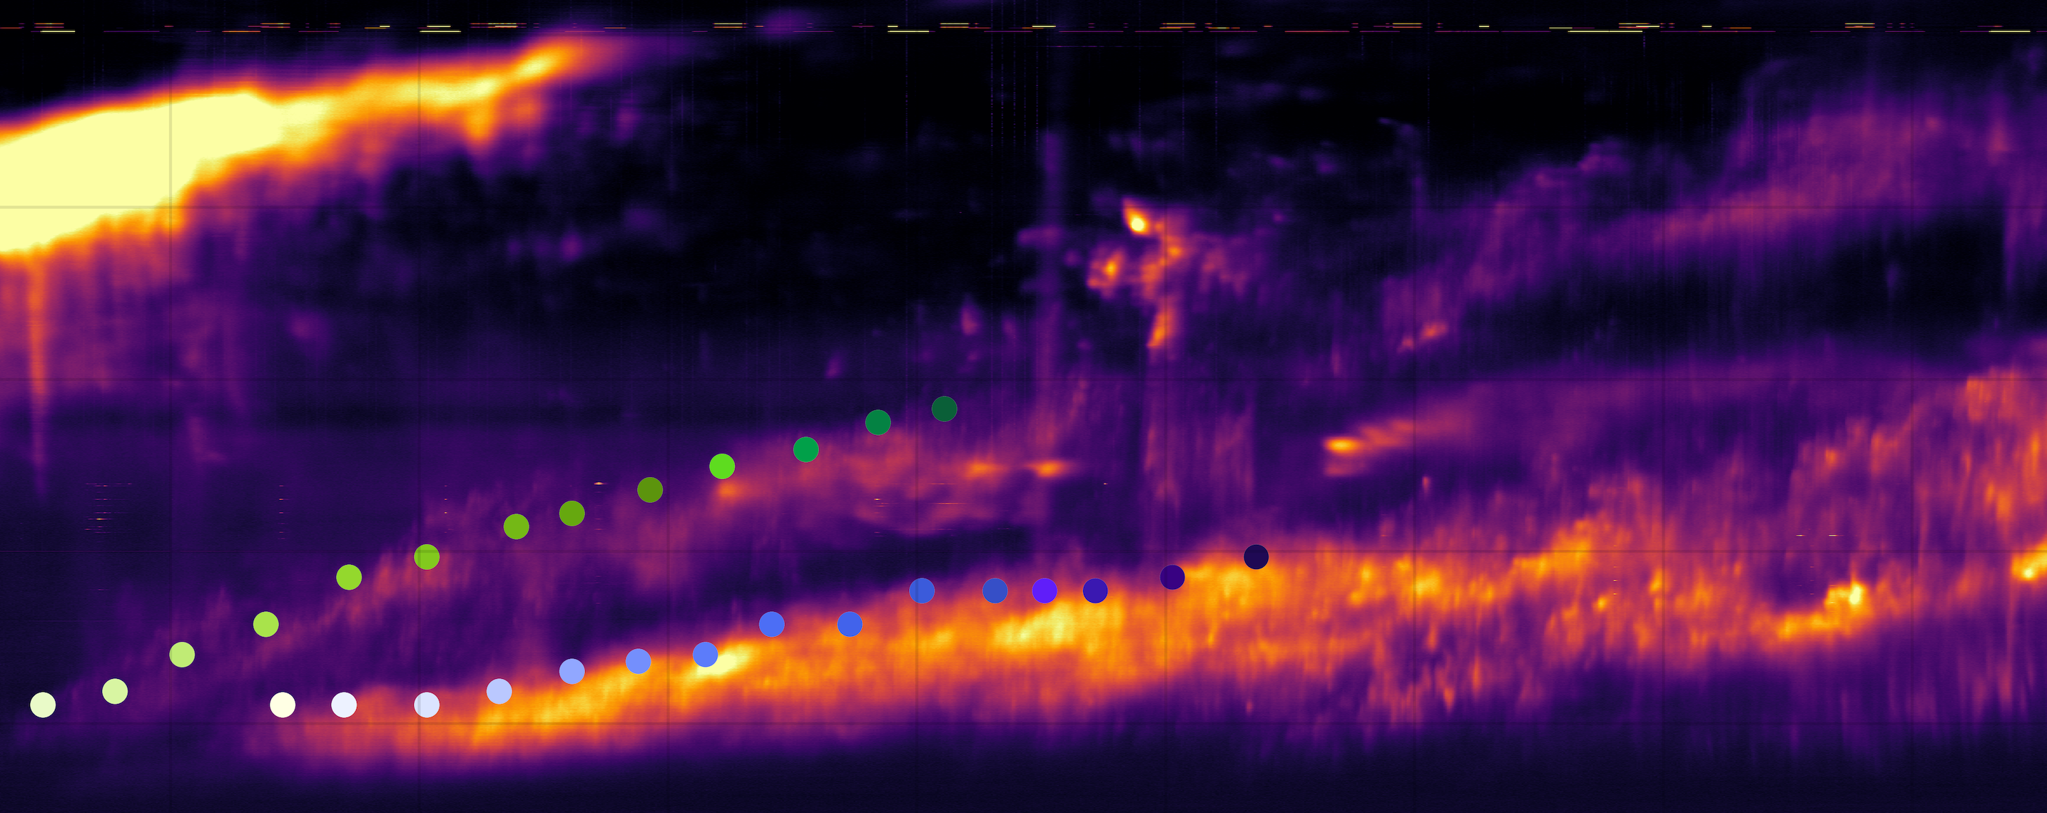
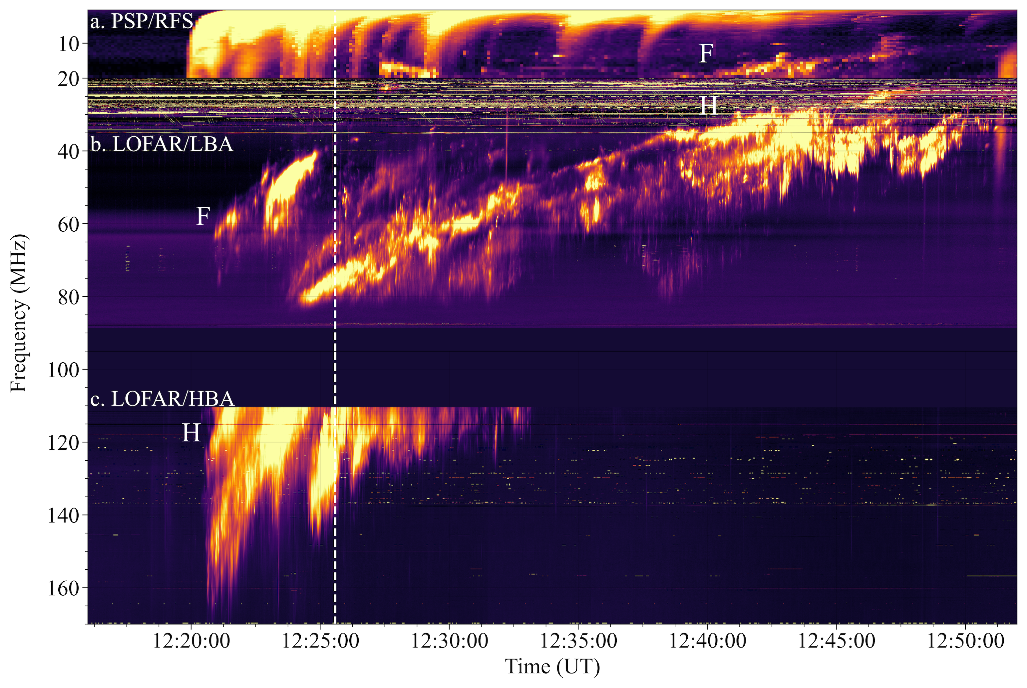
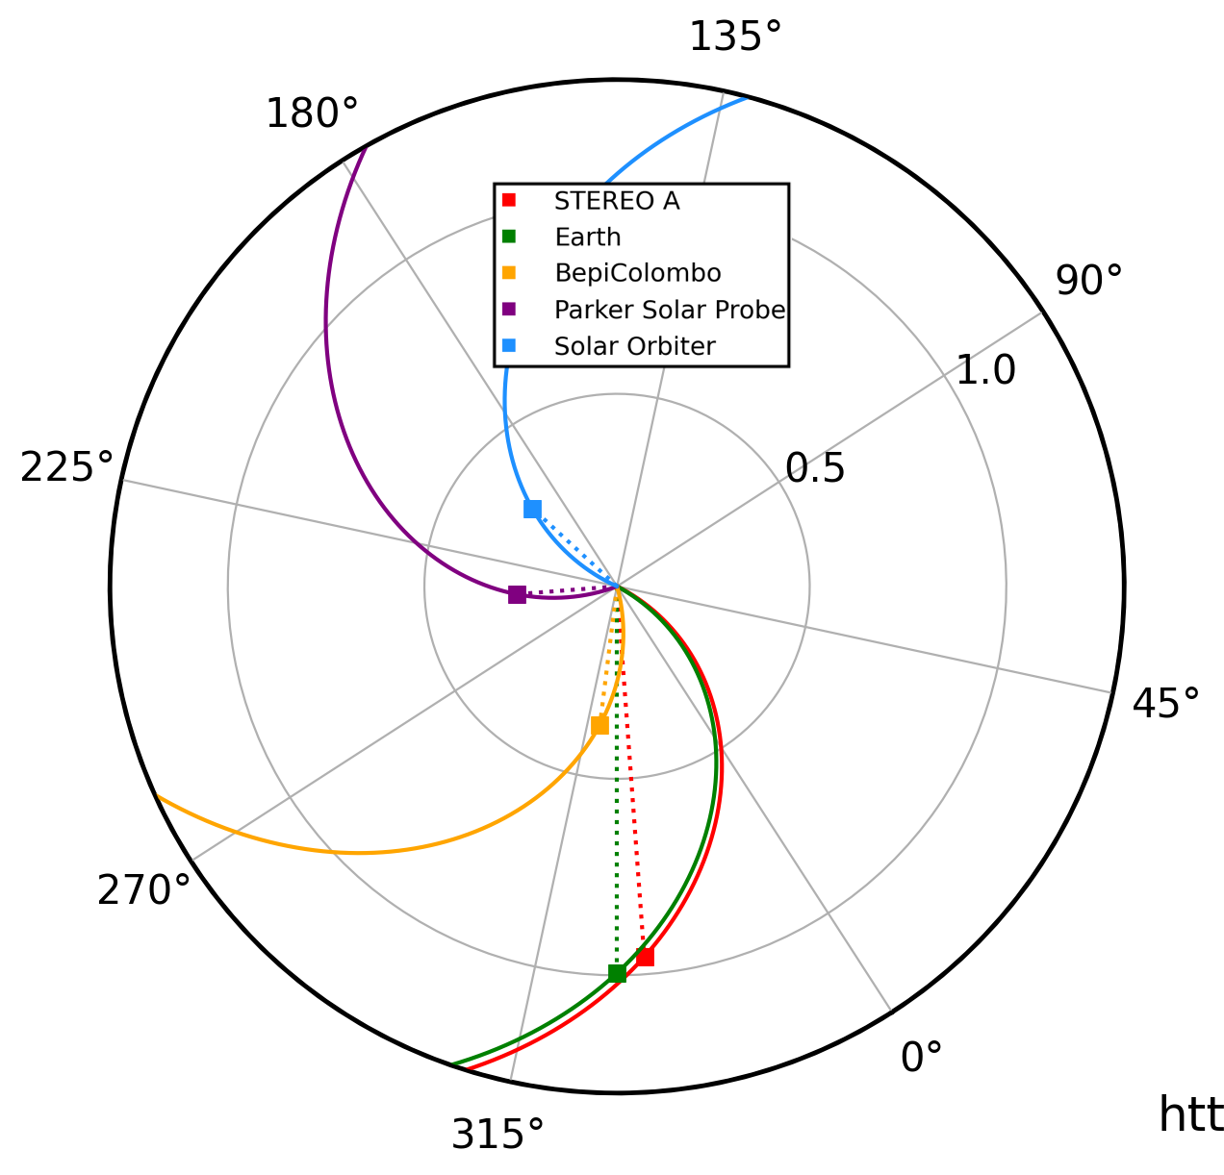
3 October 2023 Type II Burst
Notes:
Recent event with good imaging observations at lower frequencies

Slide 6
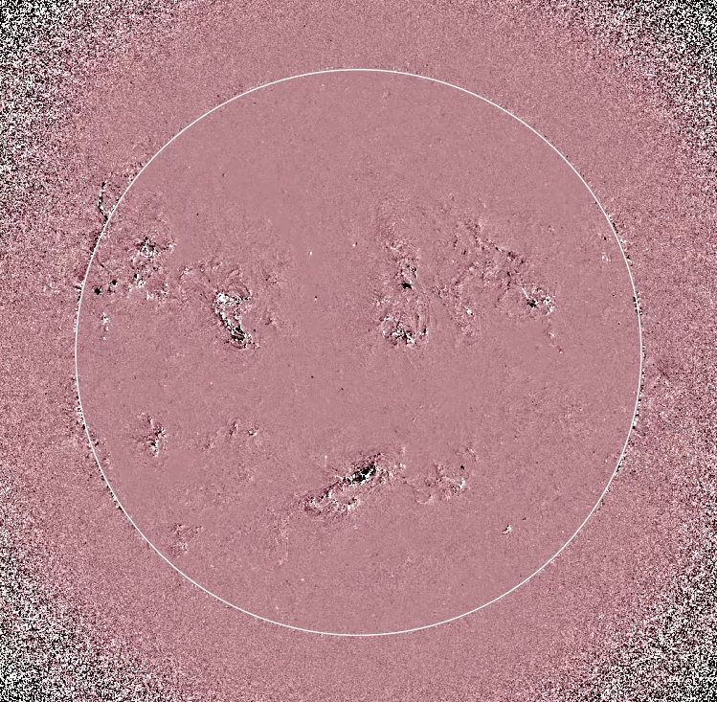
3 October 2023 Type II Burst
Notes:
Recent event with good imaging observations at lower frequencies

Slide 7
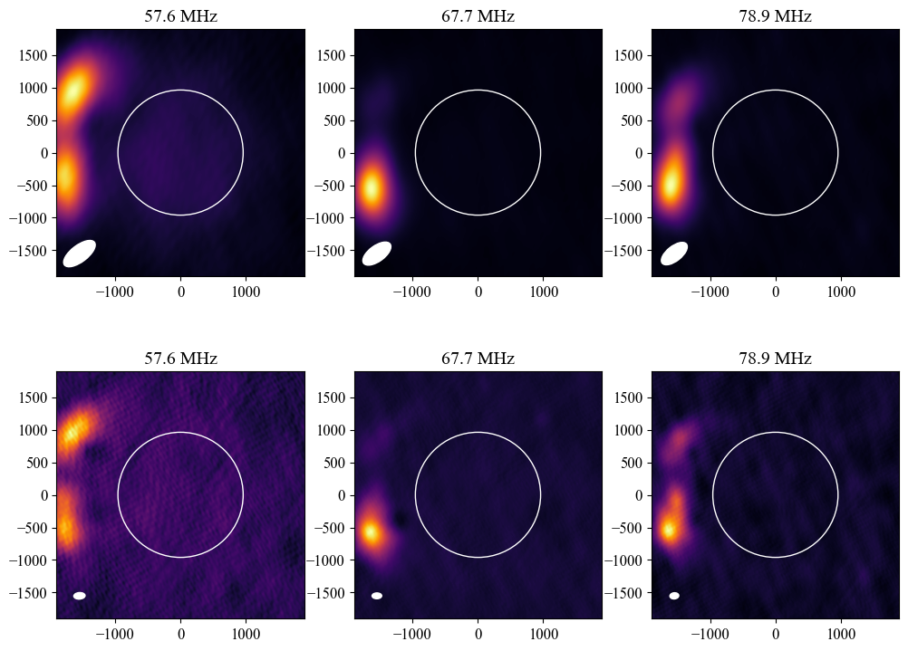
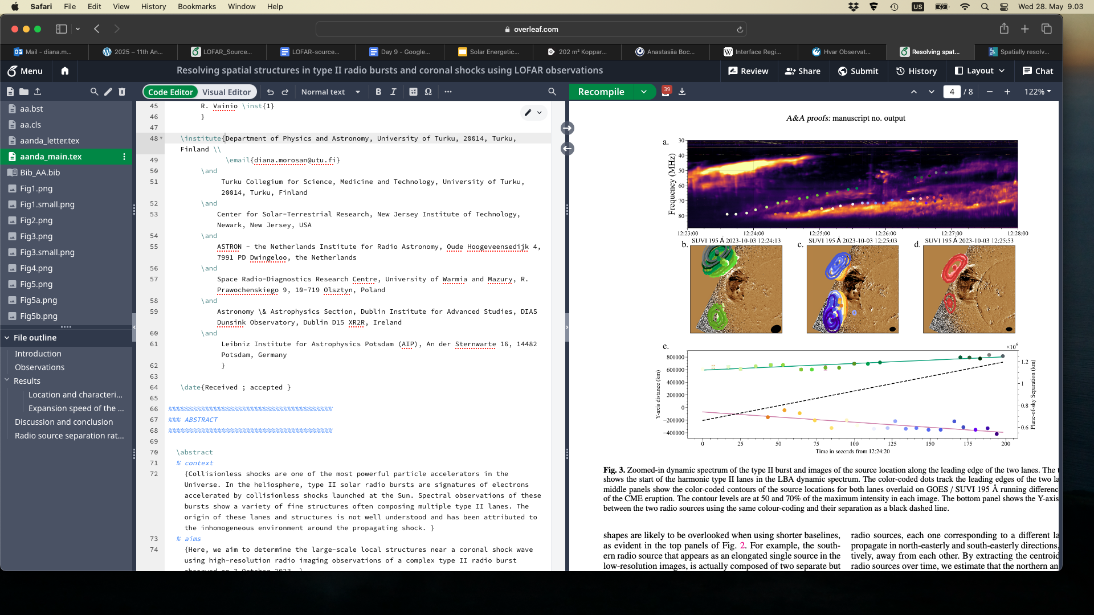
Type II Bursts – Low-resolution Snapshot Imaging – 0.33 s
E-W: 15 km
N-S: 10 km
E-W: 20 km
N-S: 32 km

Slide 8
Type II Bursts – High-resolution Snapshot Imaging – 0.33 s
E-W: 15 km
N-S: 10 km
E-W: 20 km
N-S: 32 km
Morosan et al., A&A, 2025

Slide 9
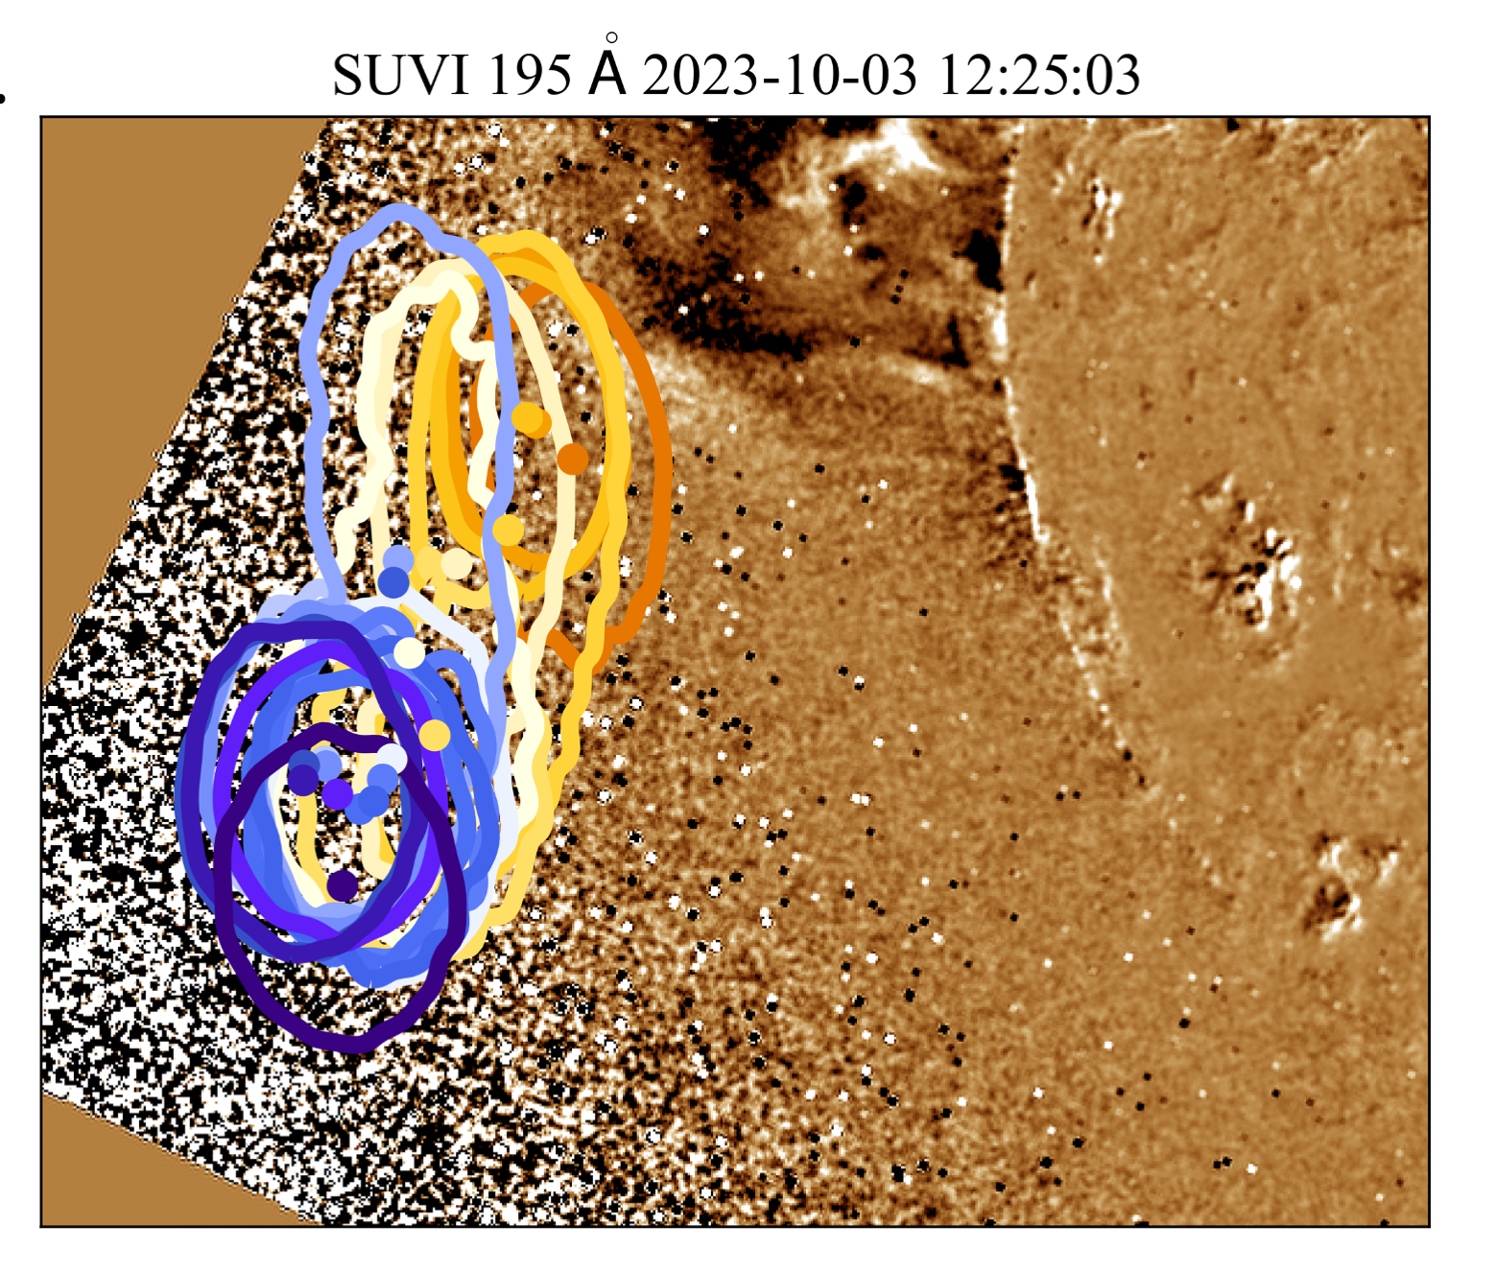
Type II Bursts – High-resolution Snapshot Imaging – 0.33 s
Morosan et al., A&A, 2025

Slide 10
Type II Bursts – High-resolution Imaging
Morosan et al., A&A, 2025

Slide 11
Type II Bursts – Shock Properties

Slide 12
Type II Bursts – Shock Properties

Slide 13
Type II Bursts – Shock Properties

Slide 14
Type II Bursts – Shock Properties

Slide 15
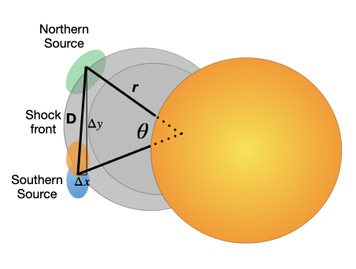

Type II Bursts – Shock Properties
North and South sources separate at a rate of $≈$2400 km/s

Slide 16
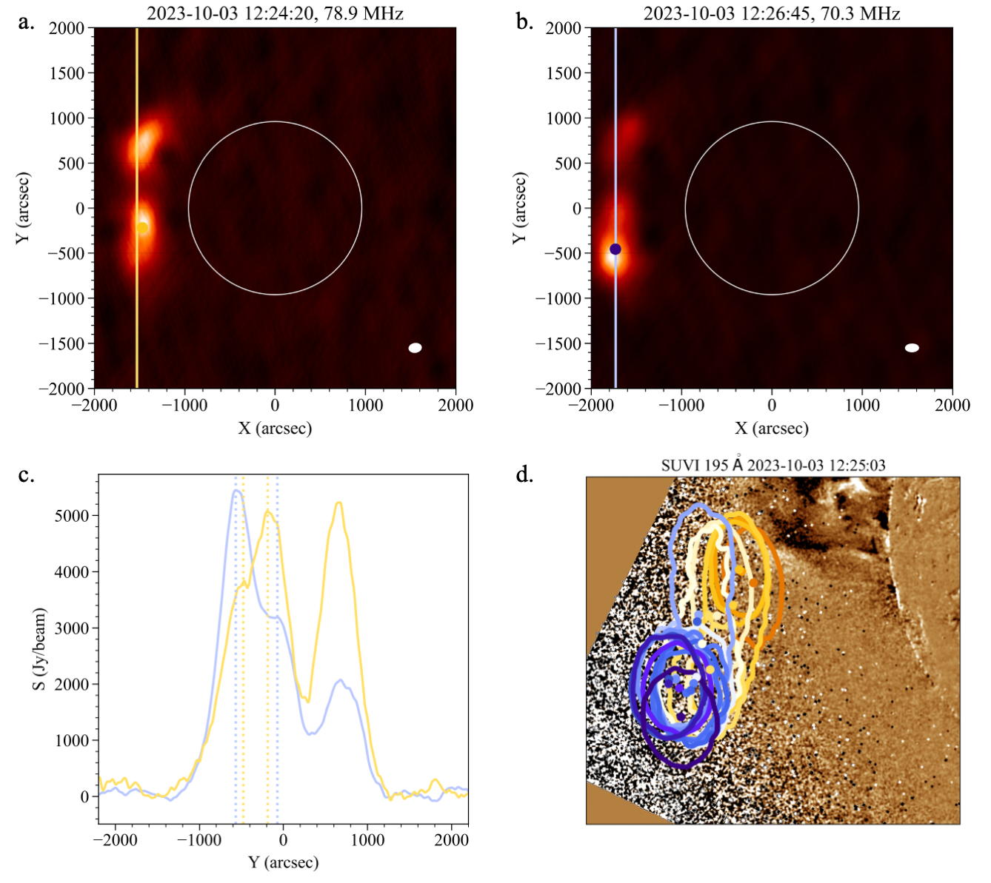

Type II Bursts – Shock Properties
N
N
S
N
S
S
Double source separates at a rate of $≈$3000 km/s
Separation increases from 0.3 to 0.5 solar radii in $≈$1 minute
Morosan et al., A&A, 2025

Slide 17
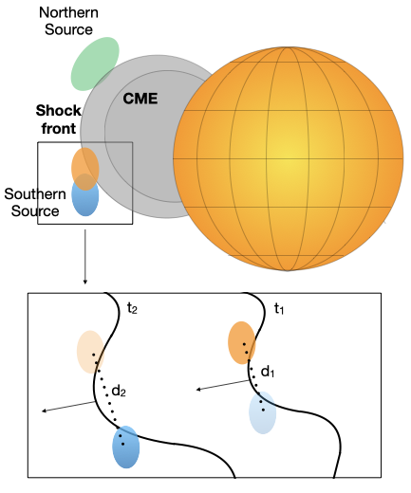

Type II Bursts – Shock Properties
N
N
N
S
N
S
S
S
S
Shock corrugation or ambient medium inhomogeneity $≈$10⁵ km
→ Hotspots for acceleration

Slide 18
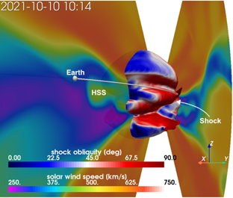
Type II Bursts – Shock Properties
N
N
S
N
S
S
Wijsen et al. 2023
Shock corrugation or ambient medium inhomogeneity $≈$10⁵ km
→ Hotspots for acceleration

Slide 19
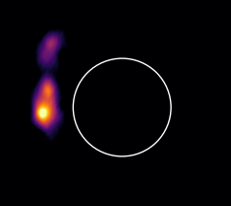

Summary
LOFAR is a powerful instrument to image the fine structure of low frequency solar radio bursts
Currently, the only radio telescope capable of solar imaging with large baselines (tens of km)
Increased spatial resolution is essential determining the small-scale spatial properties of radio bursts; in this case they related to coronal shocks or the structuring of the ambient medium

