Slide 1
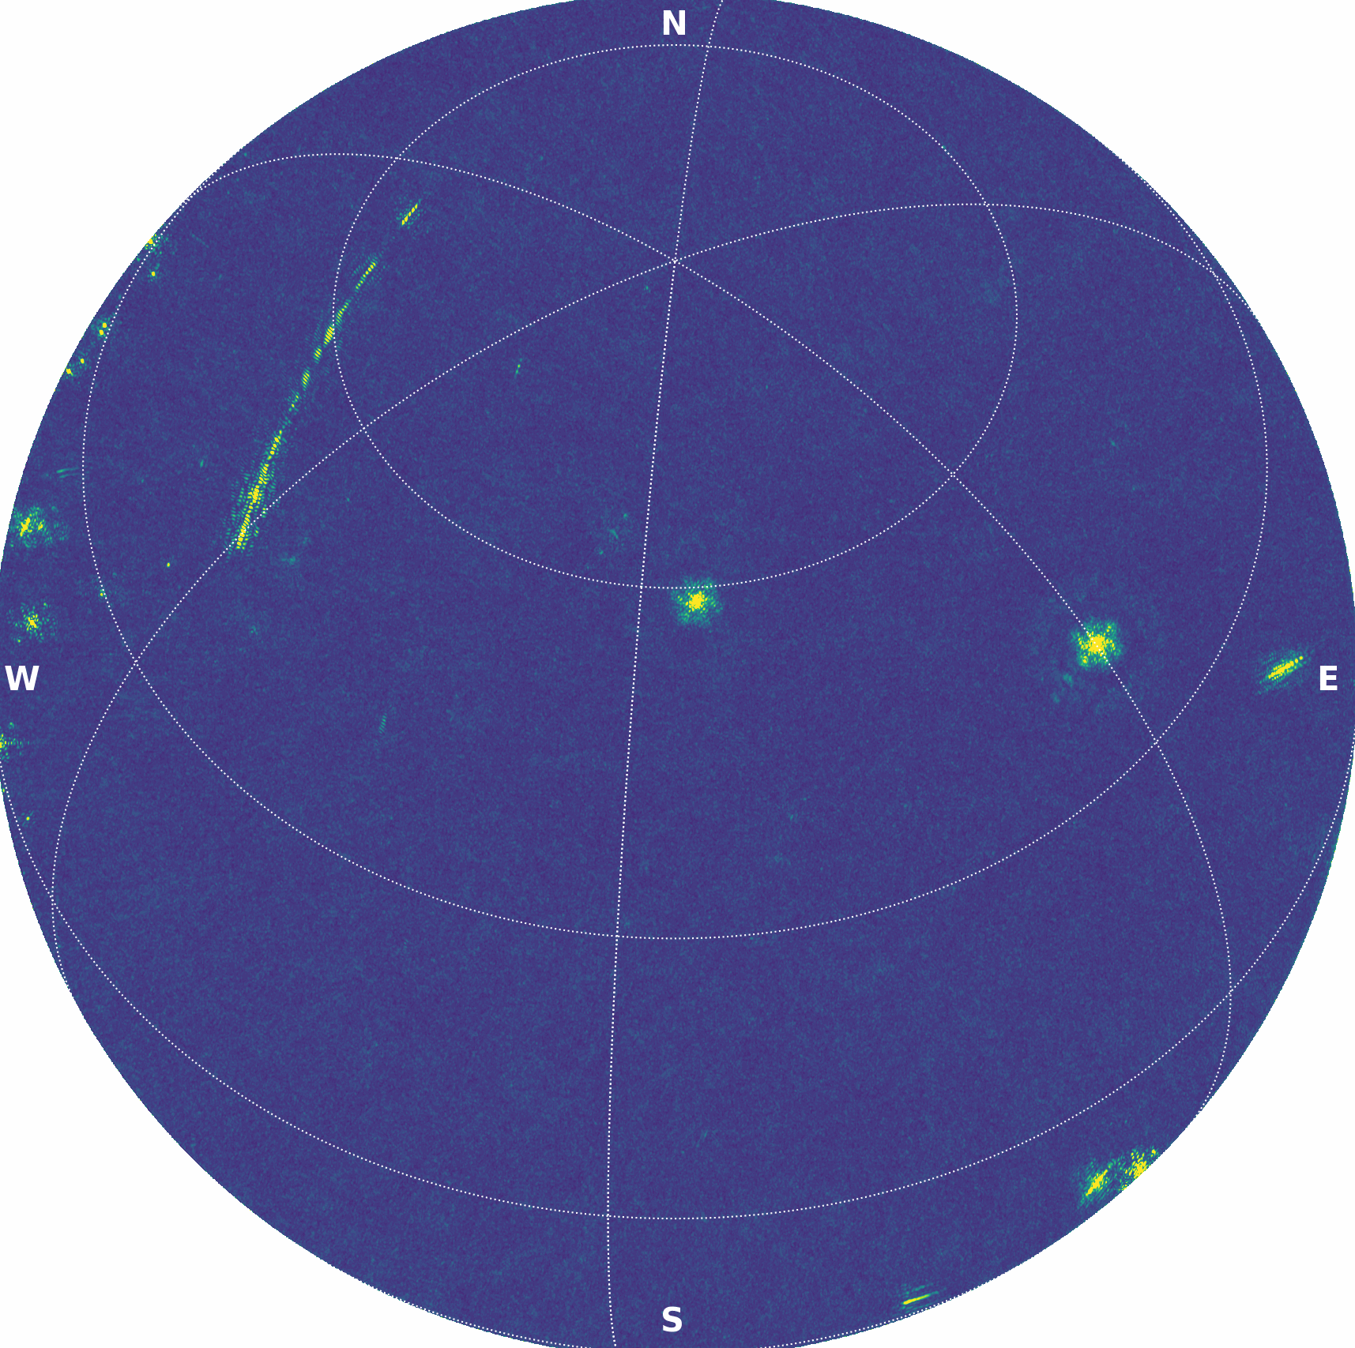





AARTFAAC 2.0
Searching for the Rarest Radio Transients
Kate Kelley
We acknowledge funding from the European Research Council (ERC) under the European Union’s Horizon research and innovation program (‘QuickBlitz’; grant agreement number 101170284)"
Image credit: Bharat Kumar Gehlot

Slide 2
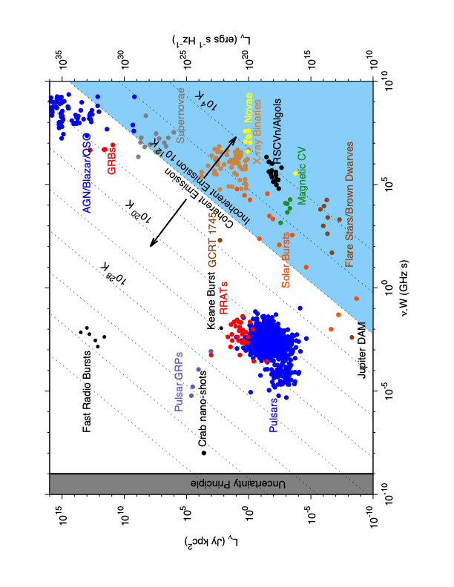
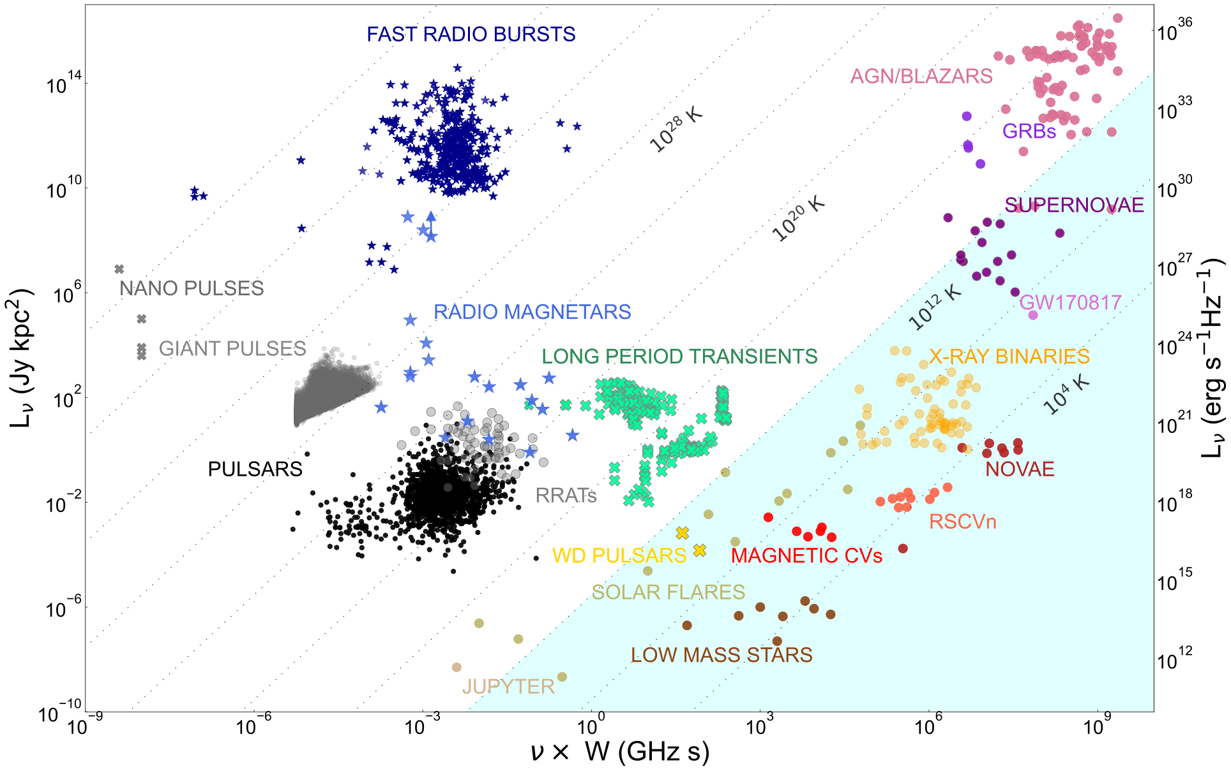
Why low frequency radio?
Pietka et al. 2014
Rea et al. 2026
Notes:
Transients characterized by periodic radio pulses lasting seconds to minutes
Possible optical and x-ray counterpart emission

Slide 3
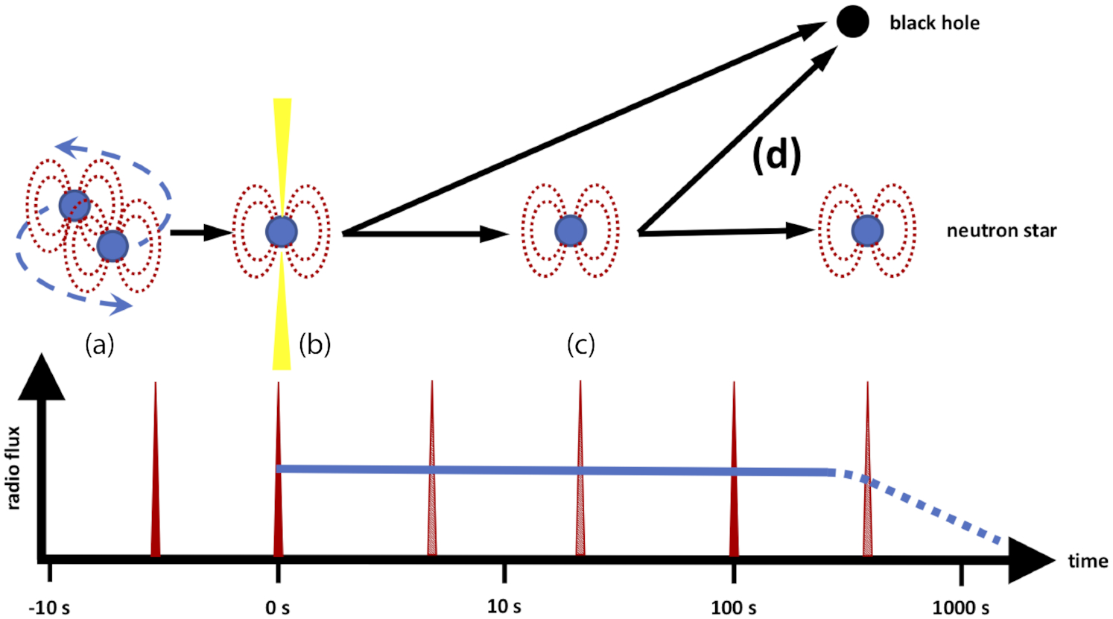
Why low frequency radio?
Rowlinson et al. 2019
Notes:
. An illustration of the outcomes of a binary neutron star merger and the various coherent emission models as a function of the rest-frame time-scale from the merger time. In the rough light curve, the red spikes are millisecond duration radio flares, consistent with FRBs, while the blue line represents persistent radio emission

Slide 4
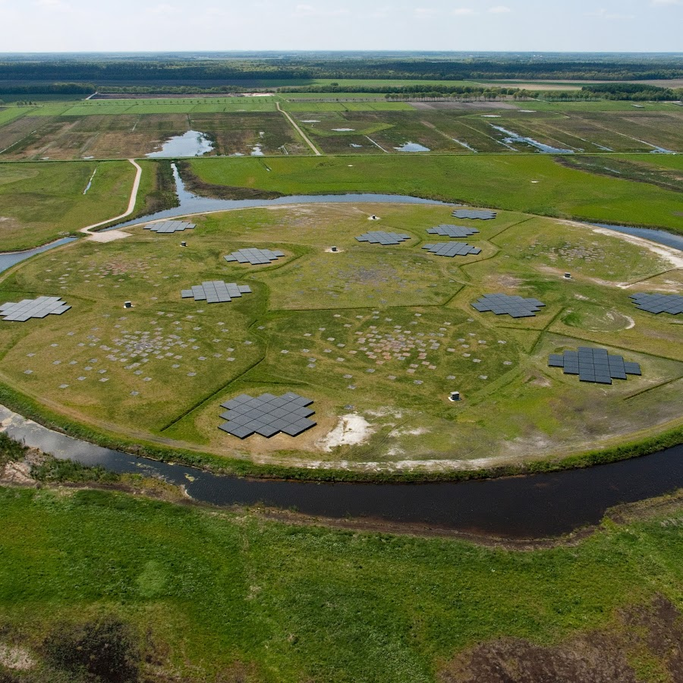
What is AARTFAAC?
Amsterdam - ASTRON Radio Transients Facility and Analysis Centre
24/7 all sky observation
3 MHz bandwidth centered at 60 MHz
Mission: searching for the rarest extreme transients
Key publications:
Rude et al. 2022 arXiv:2103.15418
Kuiack et al. 2020 arXiv:2003.00720
Kuiack et al. 2021 arXiv:2003.13289
Notes:
3MHz bandwidth centered at 60 MHz
16 channels with 1s cadence

Slide 5
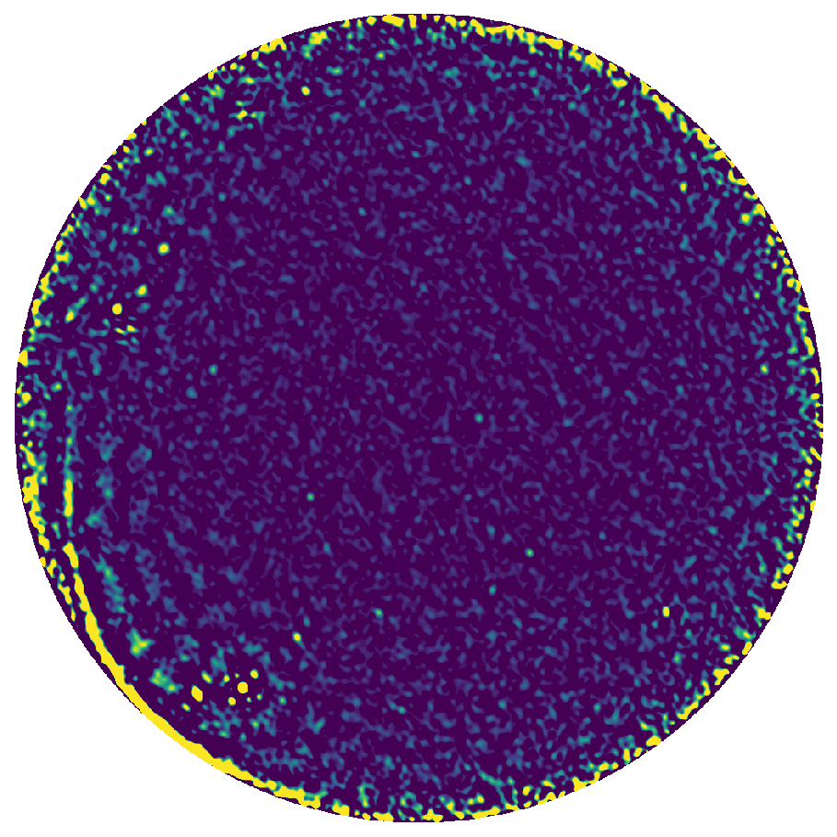
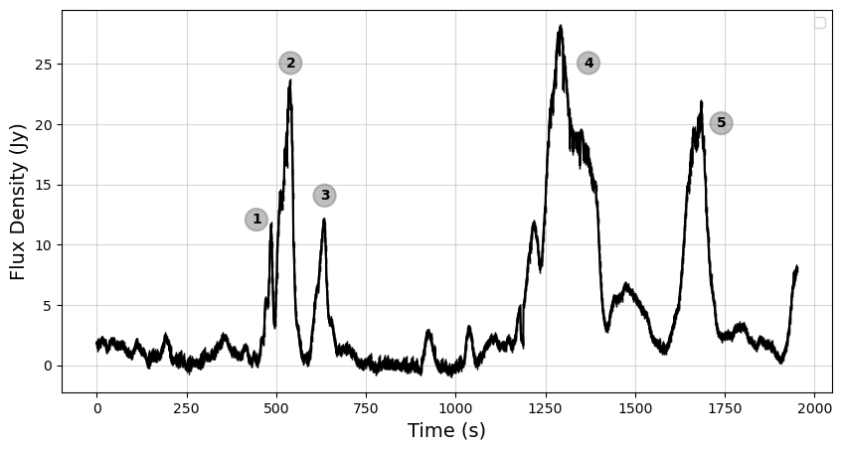
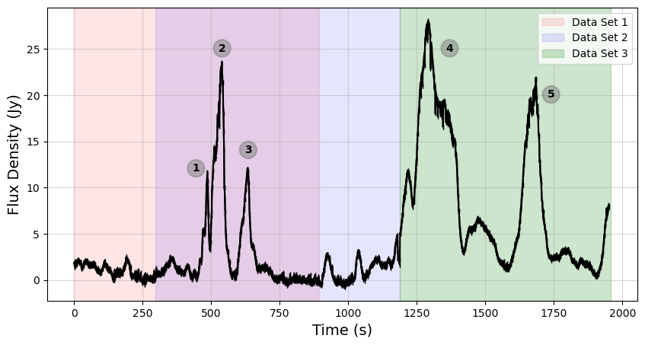
New transient candidate

Slide 6
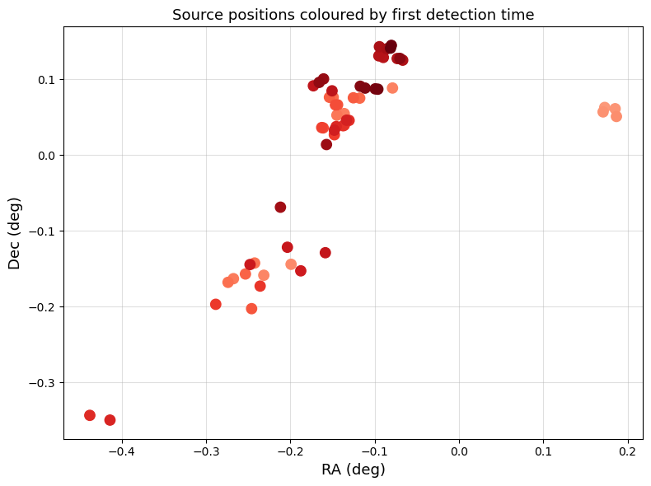
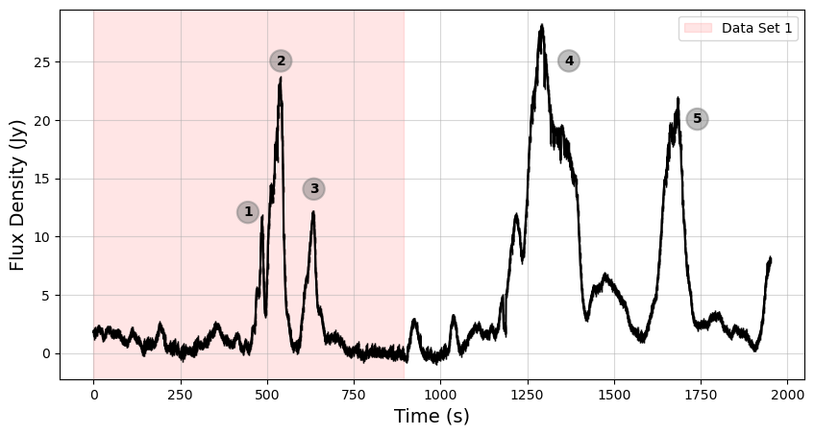
Constraining the Position

Slide 7
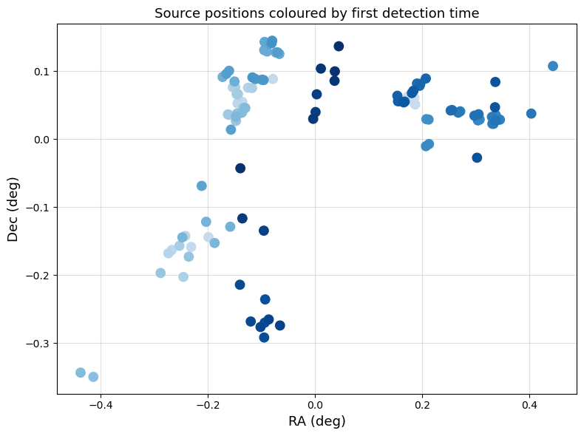
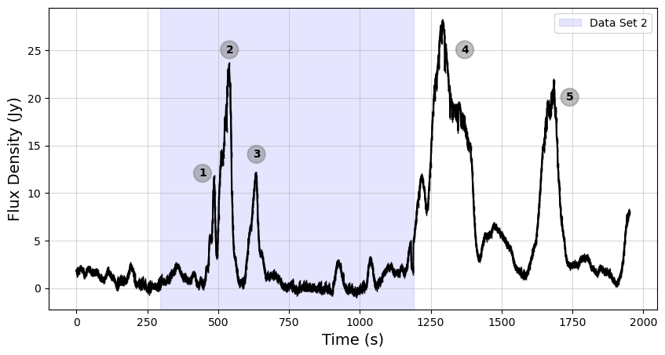
Constraining the Position

Slide 8
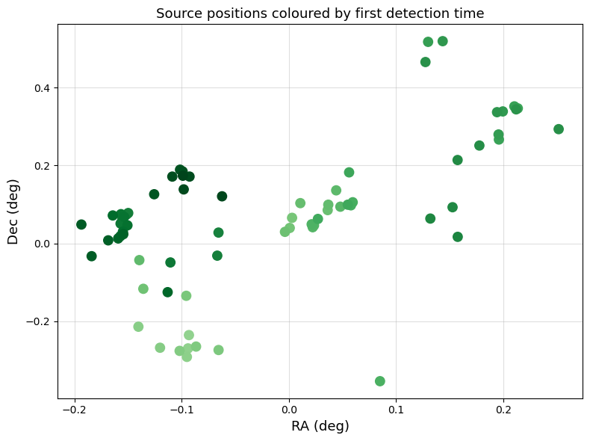
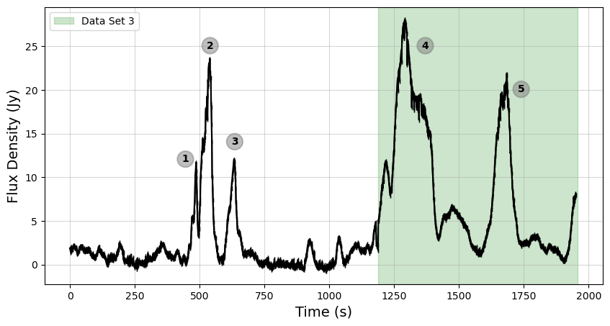
Constraining the Position

Slide 9
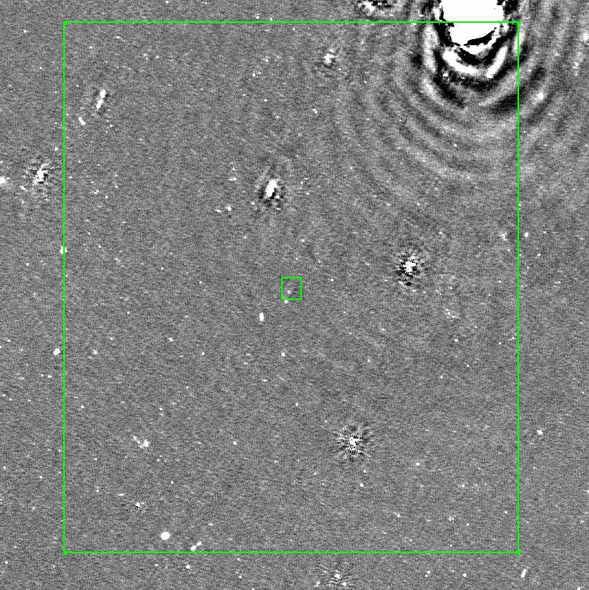
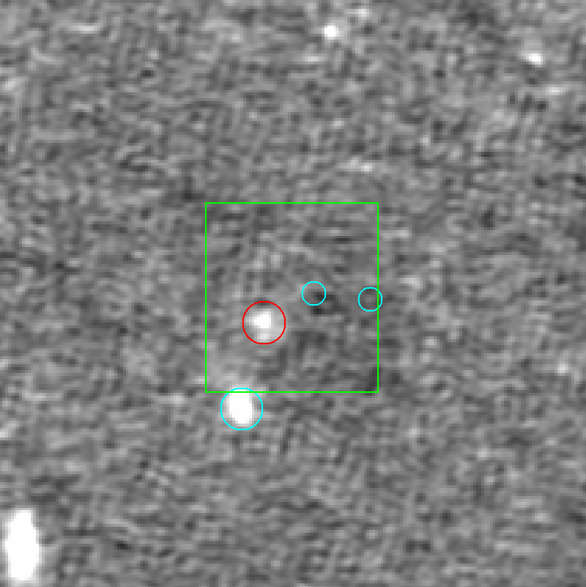
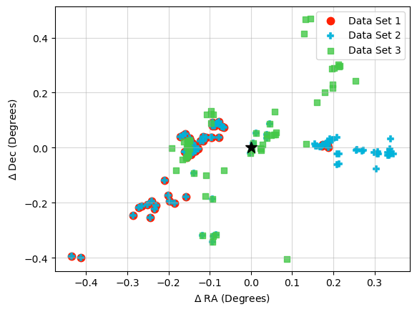
Source Association
Image: LOTSS DR3

Slide 10
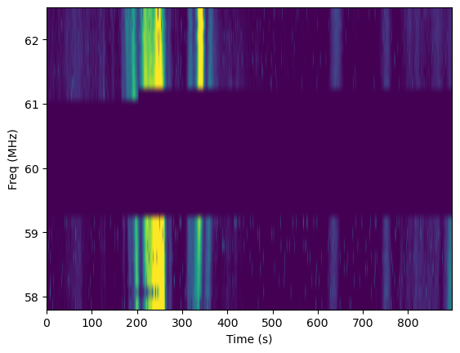
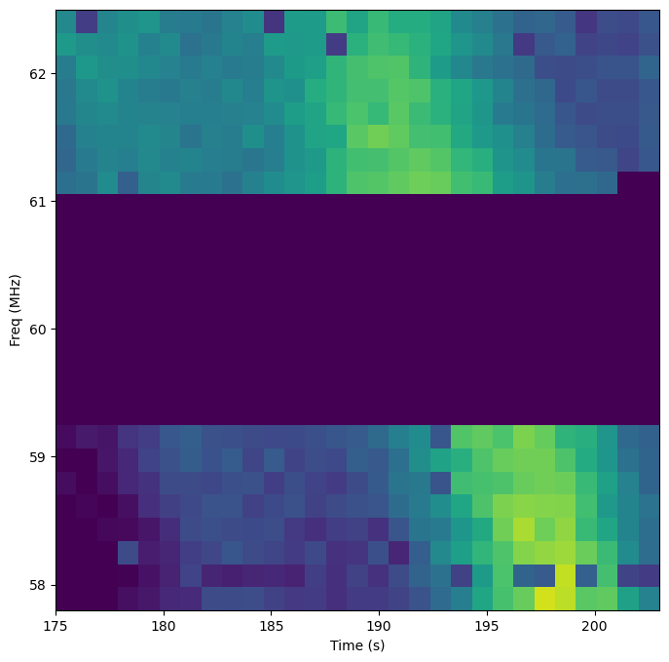
Dynamic spectra – constraining distance

Slide 11
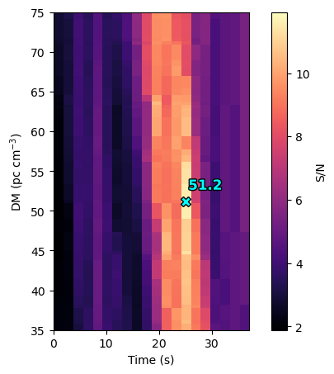
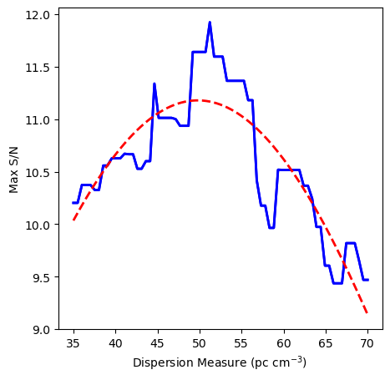

Dynamic spectra – constraining distance
$DM ≅49±4\frac{pc}{cm^{3}}→D≅14 kpc$

Slide 12
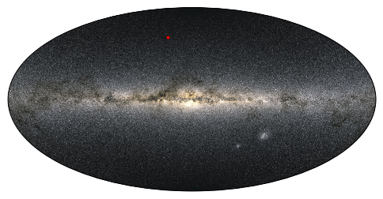

Dynamic spectra – constraining distance
$DM ≅49±4\frac{pc}{cm^{3}}→D≅14 kpc$

Slide 13
Rea et al. 2026

Slide 14
Introducing AARTFAAC 2.O
15 x 1 min images
RFI map
All sky
Coming mid 2027
12 LBA Stations
10 x more bandwidth
5-10 x more sensitive
10 x more data
12 hour data buffer
Image credit: Bharat Kumar Gehlot
Notes:
12 LBA stations
Increased capabilities
10x bandwidth
Sensetivity
Data processing and storage
10x more data, retaining real time
12 hour data hold
confusion limited at 0.9 Jy/PSF

Slide 15
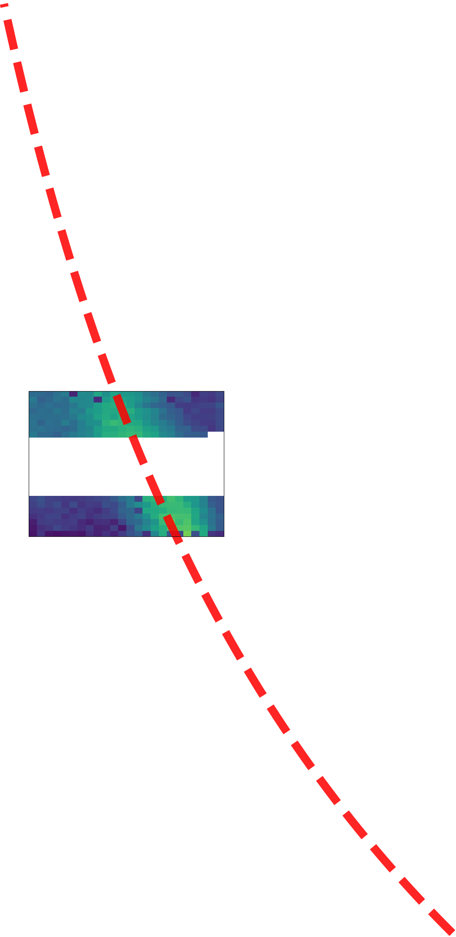
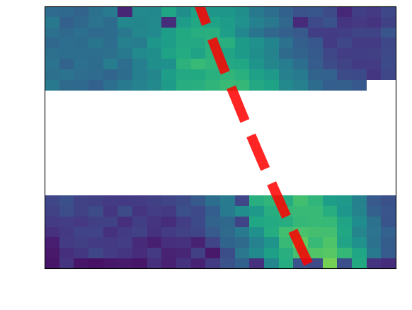
Introducing AARTFAAC 2.O
15 x 1 min images
RFI map
All sky
Image credit: Bharat Kumar Gehlot
Notes:
Show how the dynamic spectra will change

Slide 16
Introducing AARTFAAC 2.O
15 x 1 min images
RFI map
All sky
Additional Usses
Mapping Low Freq. RFI
Satellite Tracking
Meteor Showers
Cosmic Dawn
Space Weather
Image credit: Bharat Kumar Gehlot
Notes:
12 LBA stations
Increased capabilities
10x bandwidth
Sensetivity
Data processing and storage
10x more data, retaining real time
12 hour data hold

Slide 17
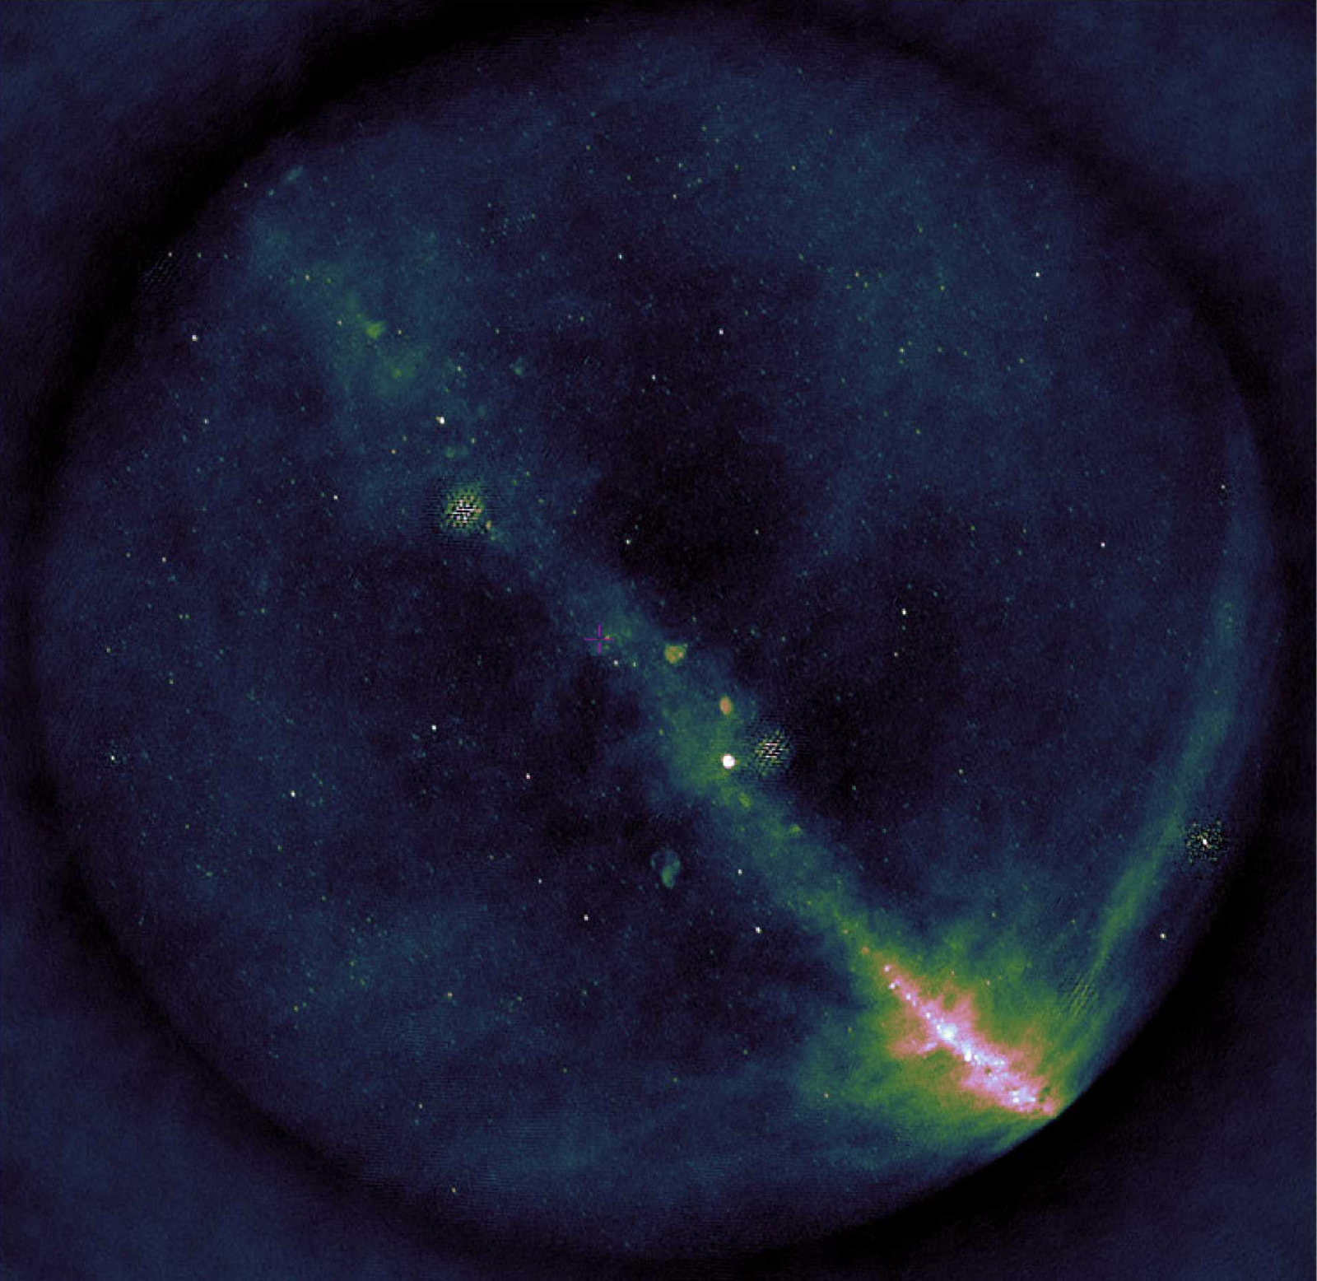
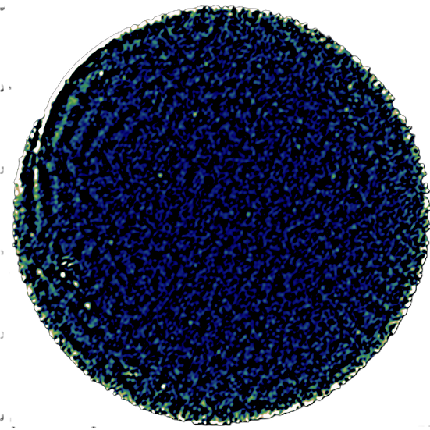
15min deep image
60 MHz
All sky
1 sec image
58 MHz
All sky
Final Thoughts
Continuing our hunt for rare transients
Searching for coherent emissions from compact binary mergers
Mapping low-frequency RFI
Image credit: Aleksandar Shulevski
Notes:
All sky all the time
12 hour data hold
Finding the rarest radio transients

Slide 18
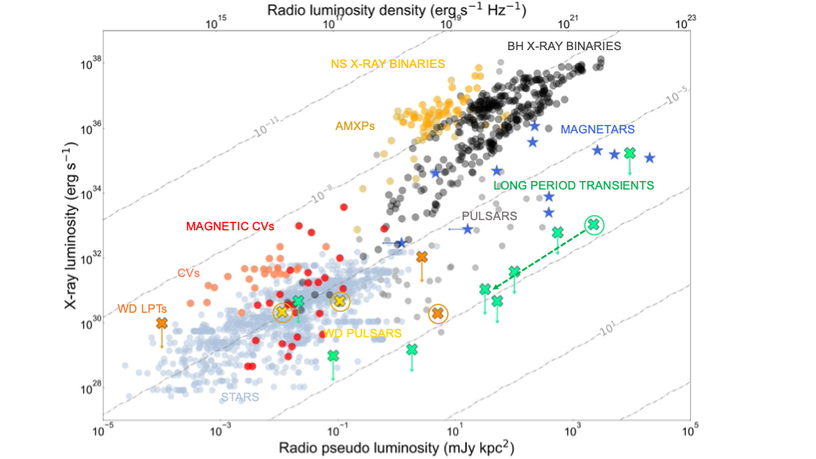
Next steps- multi-messenger
Rea et al. 2026

Slide 19
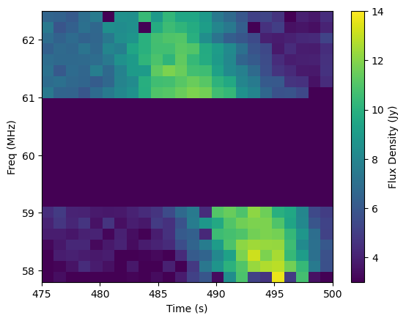
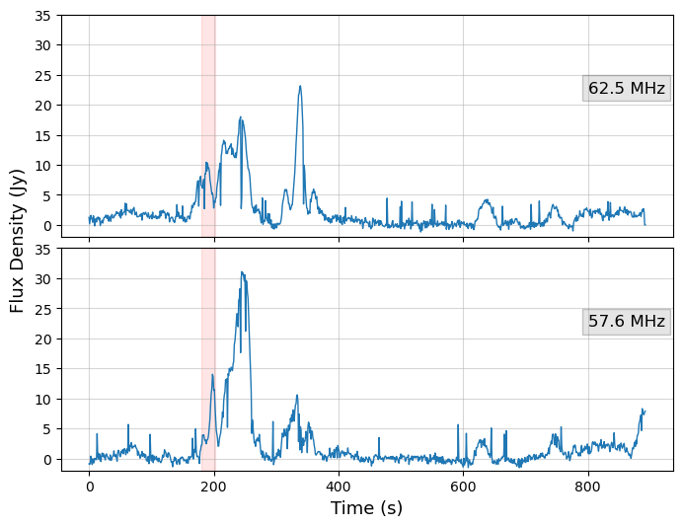

Slide 20
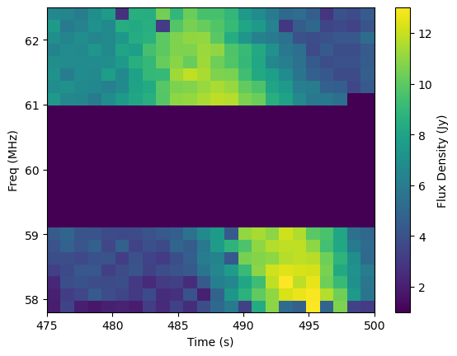
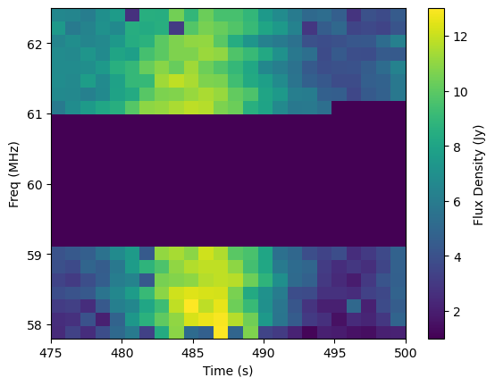

Slide 21
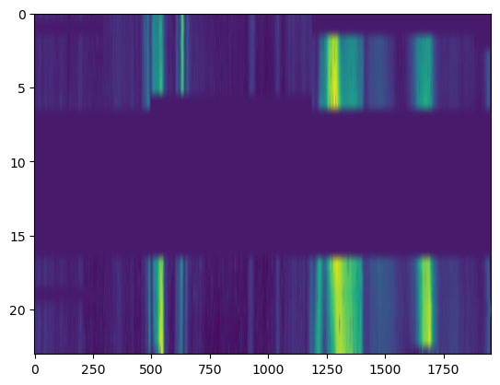

Slide 22
