Slide 1
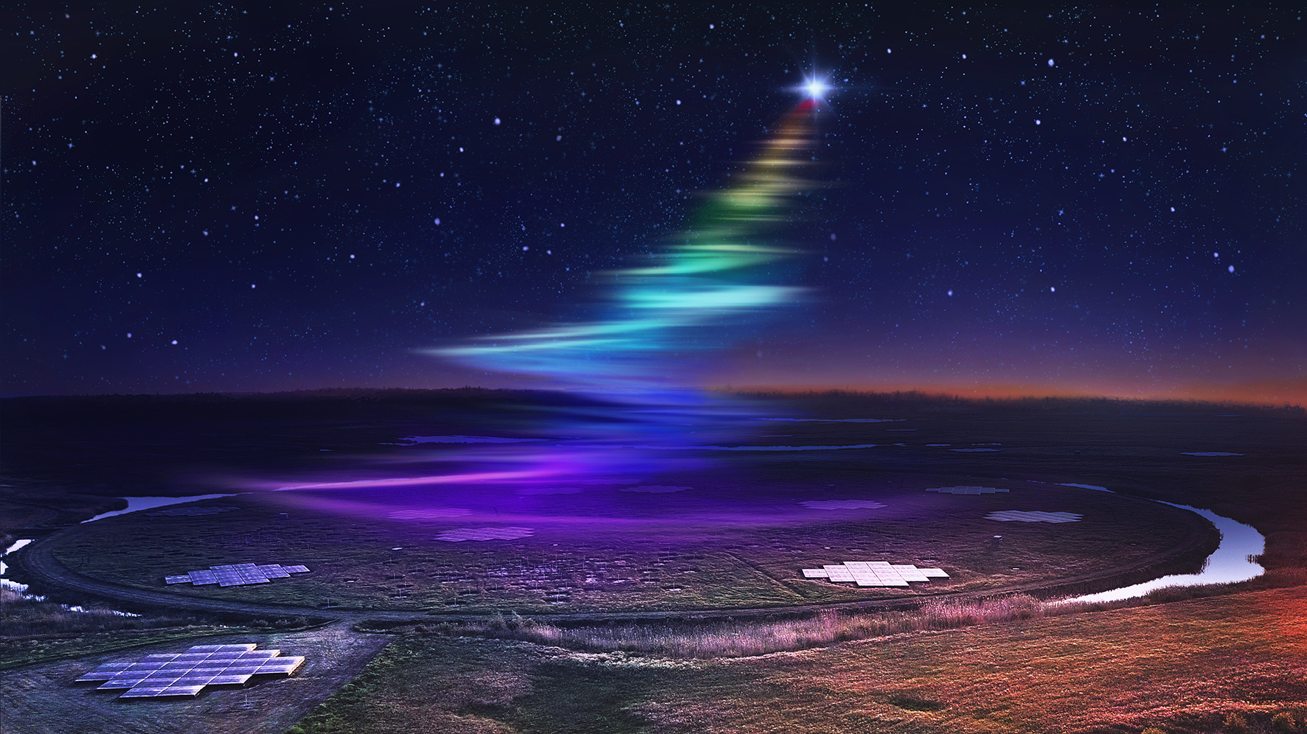

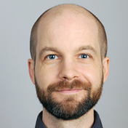
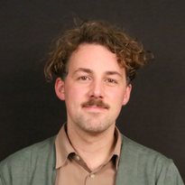
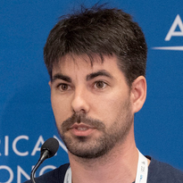


DETECTING
RADIO TRANSIENTS WITH LoTSS
Image credit: Daniëlle Futselaar
ASTR
FL
SH
Sylvain RANGUIN
in collaboration with Tim Shimwell, Reshma Anna-Thomas, Inés Pastor-Marazuela, Kaustubh Rajwade and Iris de Ruiter
Advised by: Jason Hessels, Ziggy Pleunis, Benito Marcote, Antonia Rowlinson

Slide 2
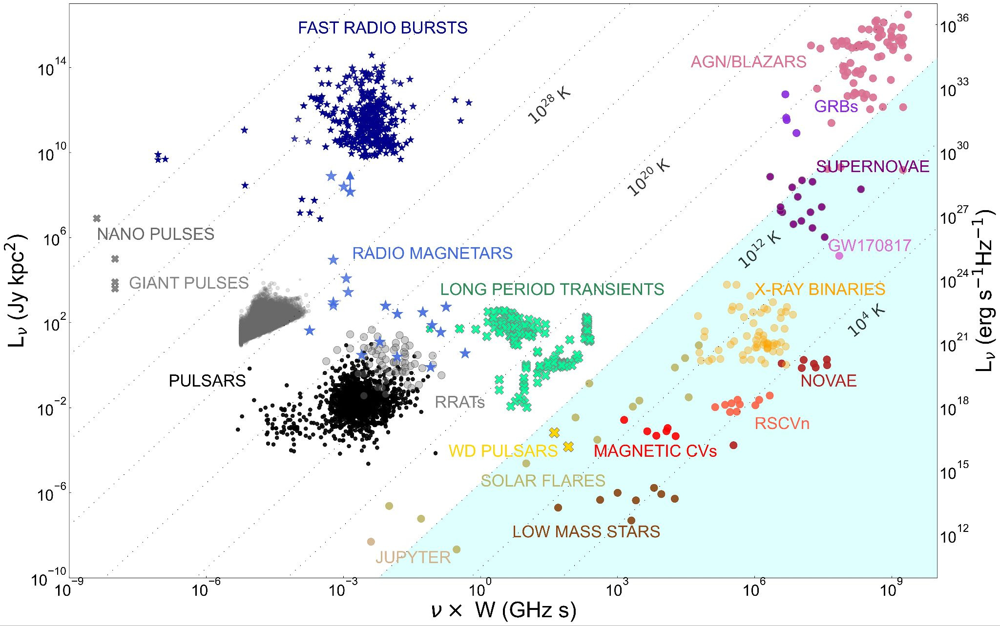
Credit: Rea+26

Slide 3
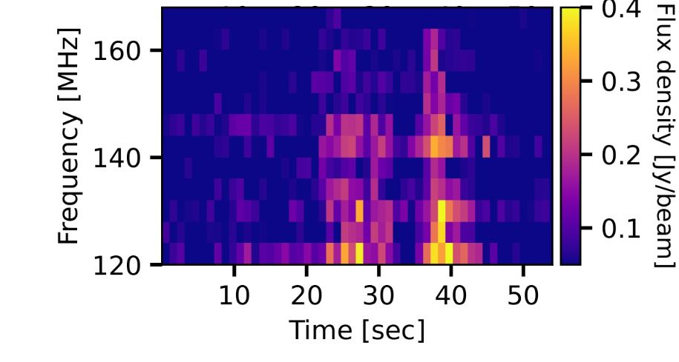
LPTs: de Ruiter+ 2024
Credit: Rea+26

Slide 4
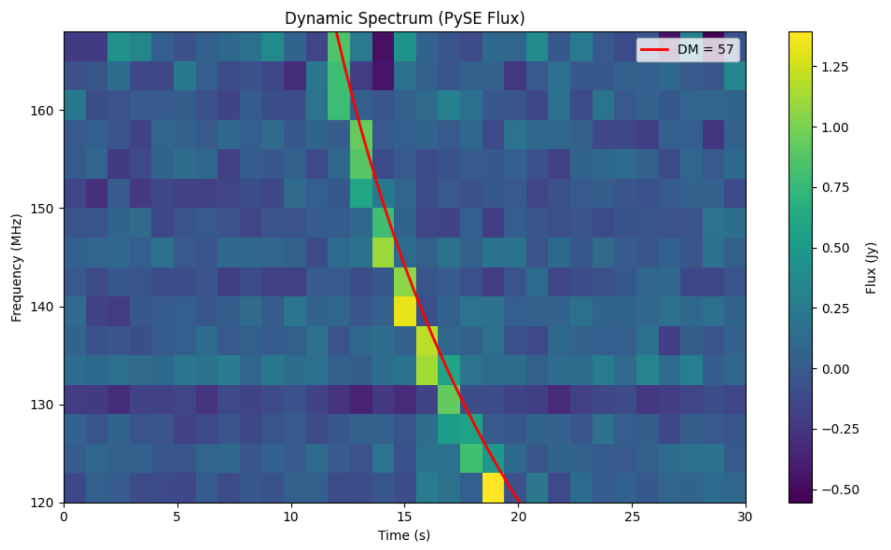
LPTs: de Ruiter+ 2024
RRATs?: Ranguin, in prepp.
Credit: Rea+26

Slide 5
LPTs: de Ruiter+ 2024
Slow FRBs?
RRATs?: Ranguin, in prepp.
Credit: Rea+26

Slide 6
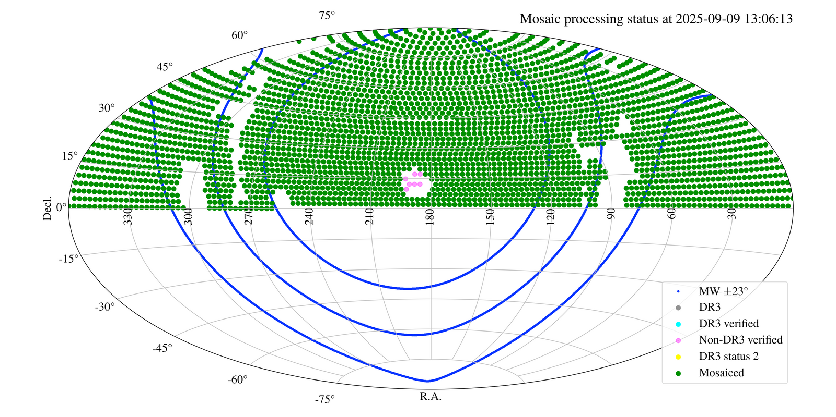
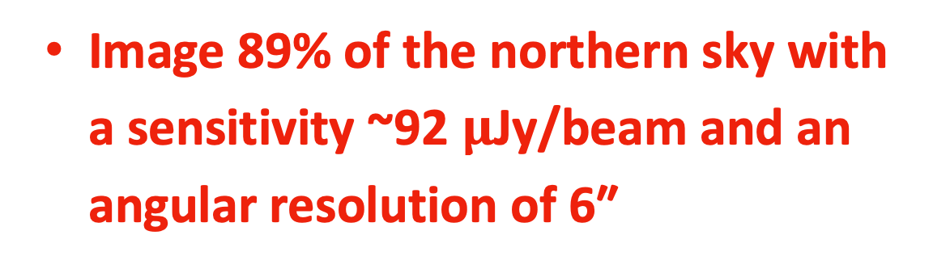
The LOFAR Two meter Sky Survey (LoTSS)
The LOFAR HBA of 120-168MHz wide-area survey.
  2000+ pointings to search for !
  Image 89% of the northern sky with a sensitivity ~92 $μ$Jy/beam and an angular resolution of 6″
Credit DR3 internal data release,
Shimwell+26

Slide 7
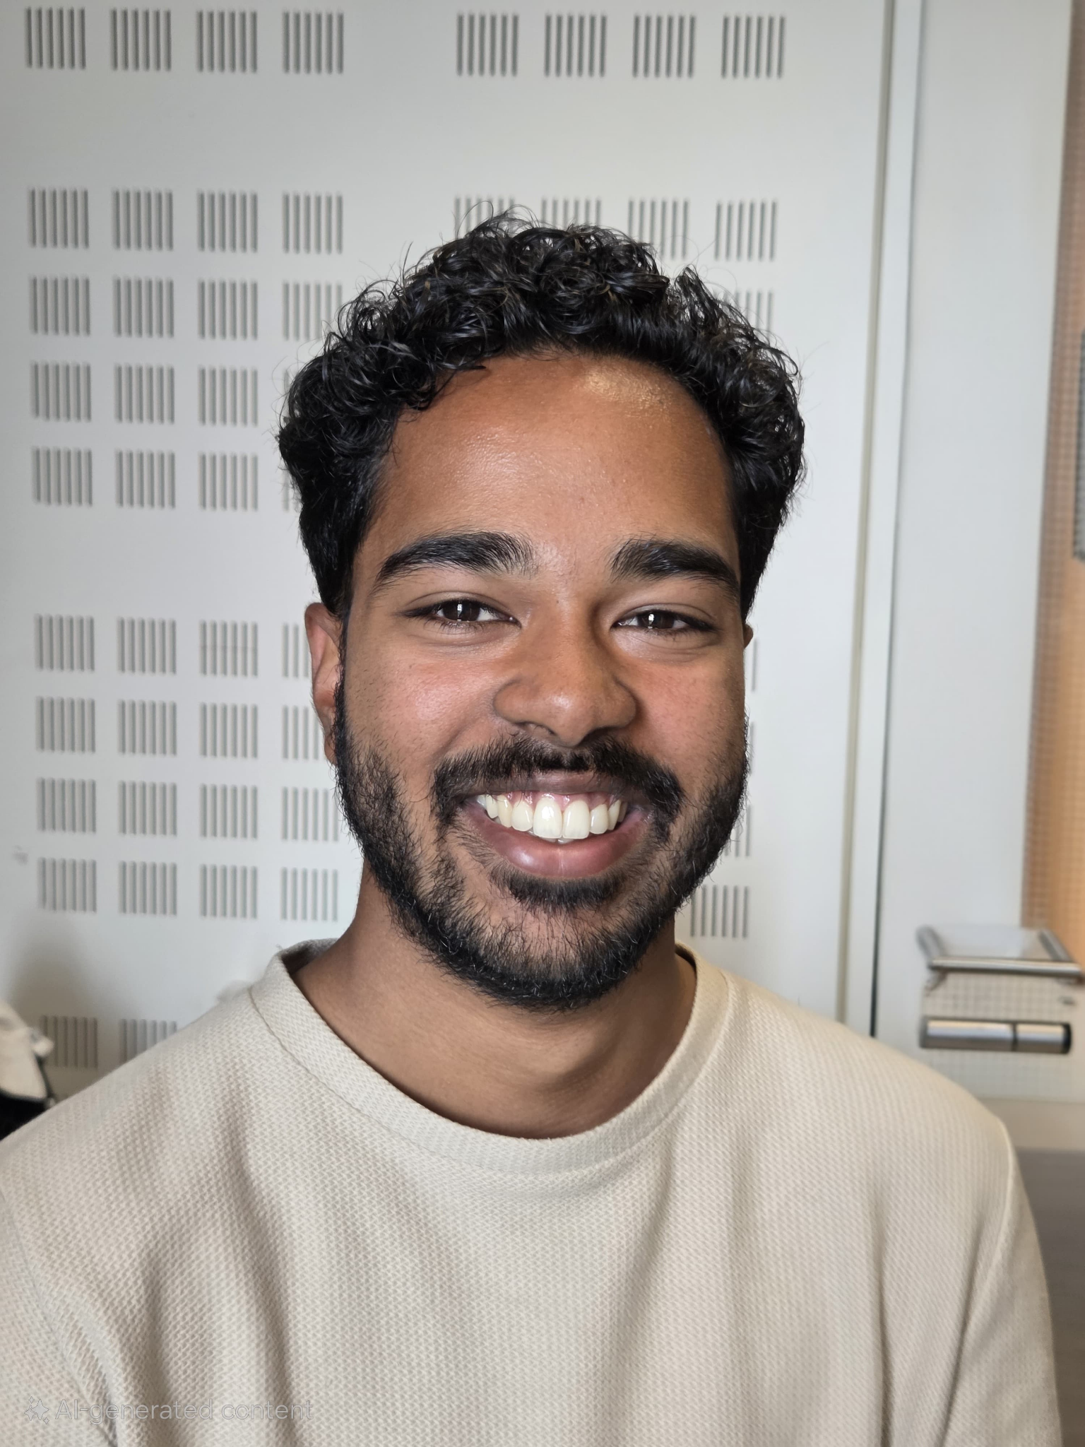
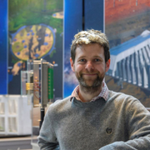
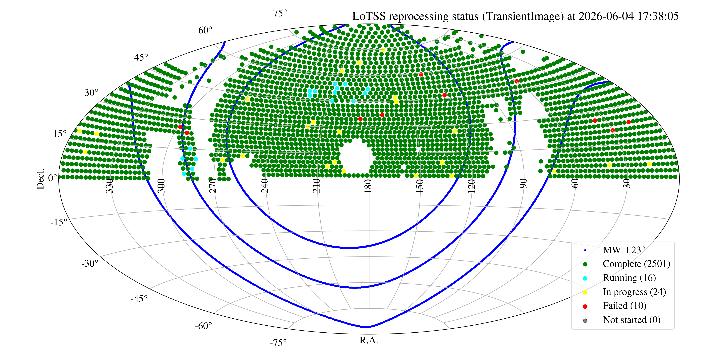
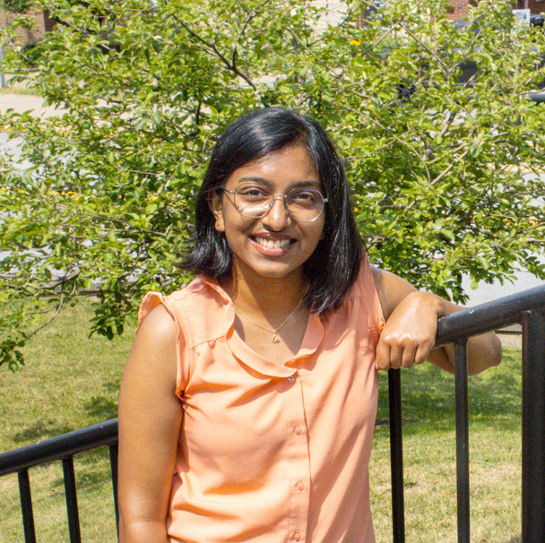

The LOFAR Two meter Sky Survey (LoTSS)
Current status
Tim Shimwell
Reshma Anna-Thomas
Inés Pastor-Marazuela
Credit: LOFAR surveys’ website, Tim Shimwell

Slide 8
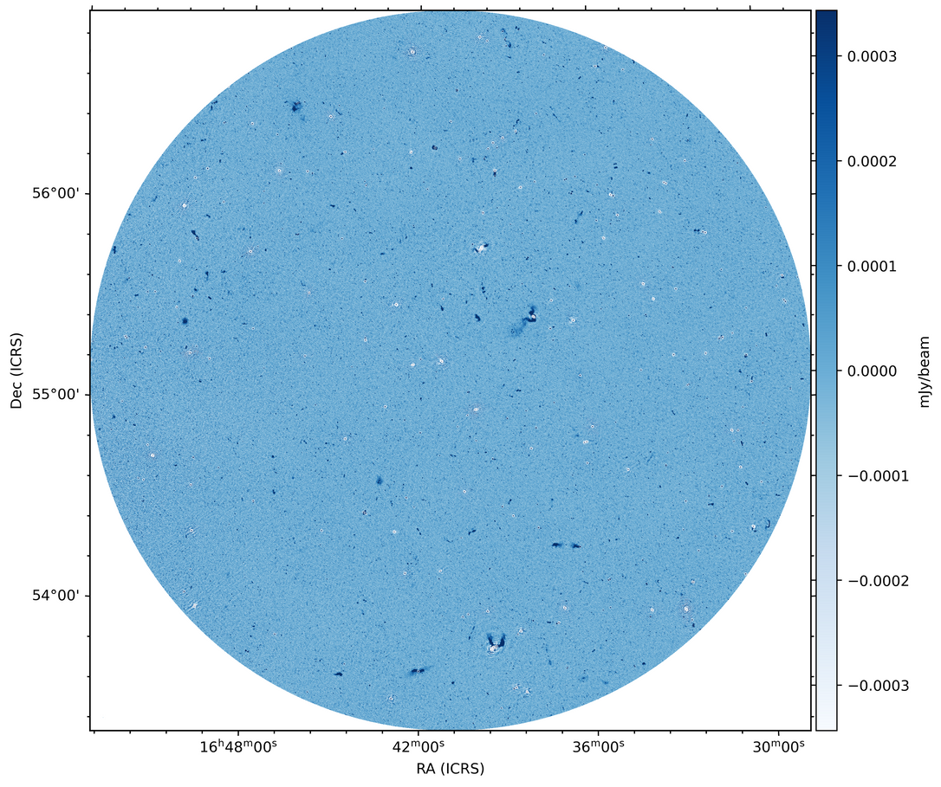
The LOFAR Two meter Sky Survey (LoTSS)
Current status
Credit: LOFAR surveys’ website, Tim Shimwell

Slide 9
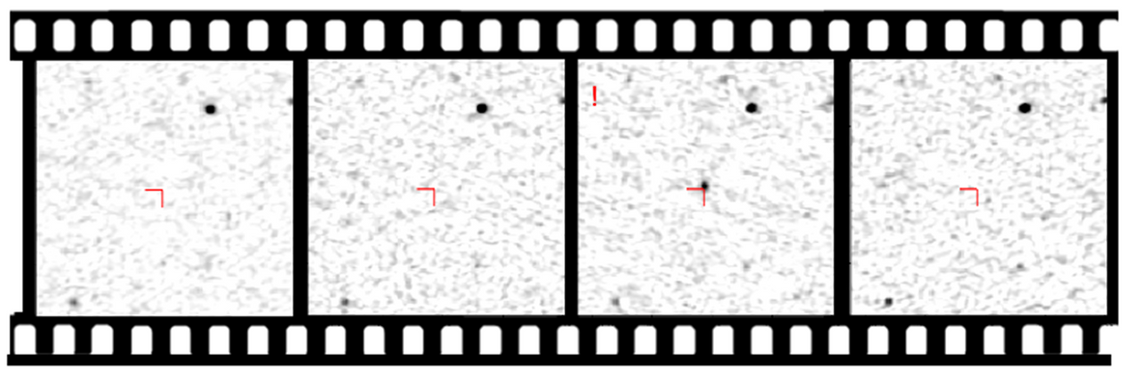
LoTSS pointing vs Subtraction image
Our inputs
  8 seconds snapshots
Film example of a LoTSS 8-hour observation
  Subtraction imaging
Snapshot images
  ~3600 images to process
  About 100 000 detections per field !
Credit: Iris de Ruiter

Slide 10
LoTSS pointing vs Subtraction image
Our inputs
  8 seconds snapshots
Film example of a LoTSS 8-hour observation
?
  Subtraction imaging
Snapshot images
  ~3600 images to process
  About 100 000 detections per field !
Credit: Iris de Ruiter

Slide 11
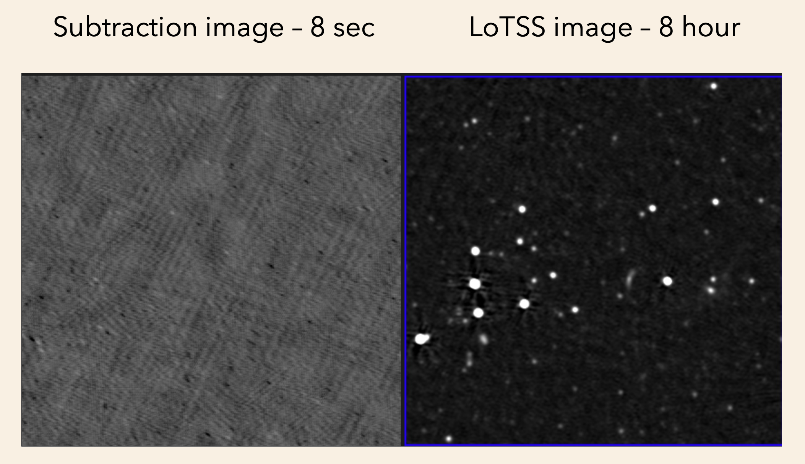
Credit: Iris de Ruiter

Slide 12

LATTES’ overview
Reshma
Anna-Thomas
Inés
Pastor-Marazuela

Slide 13
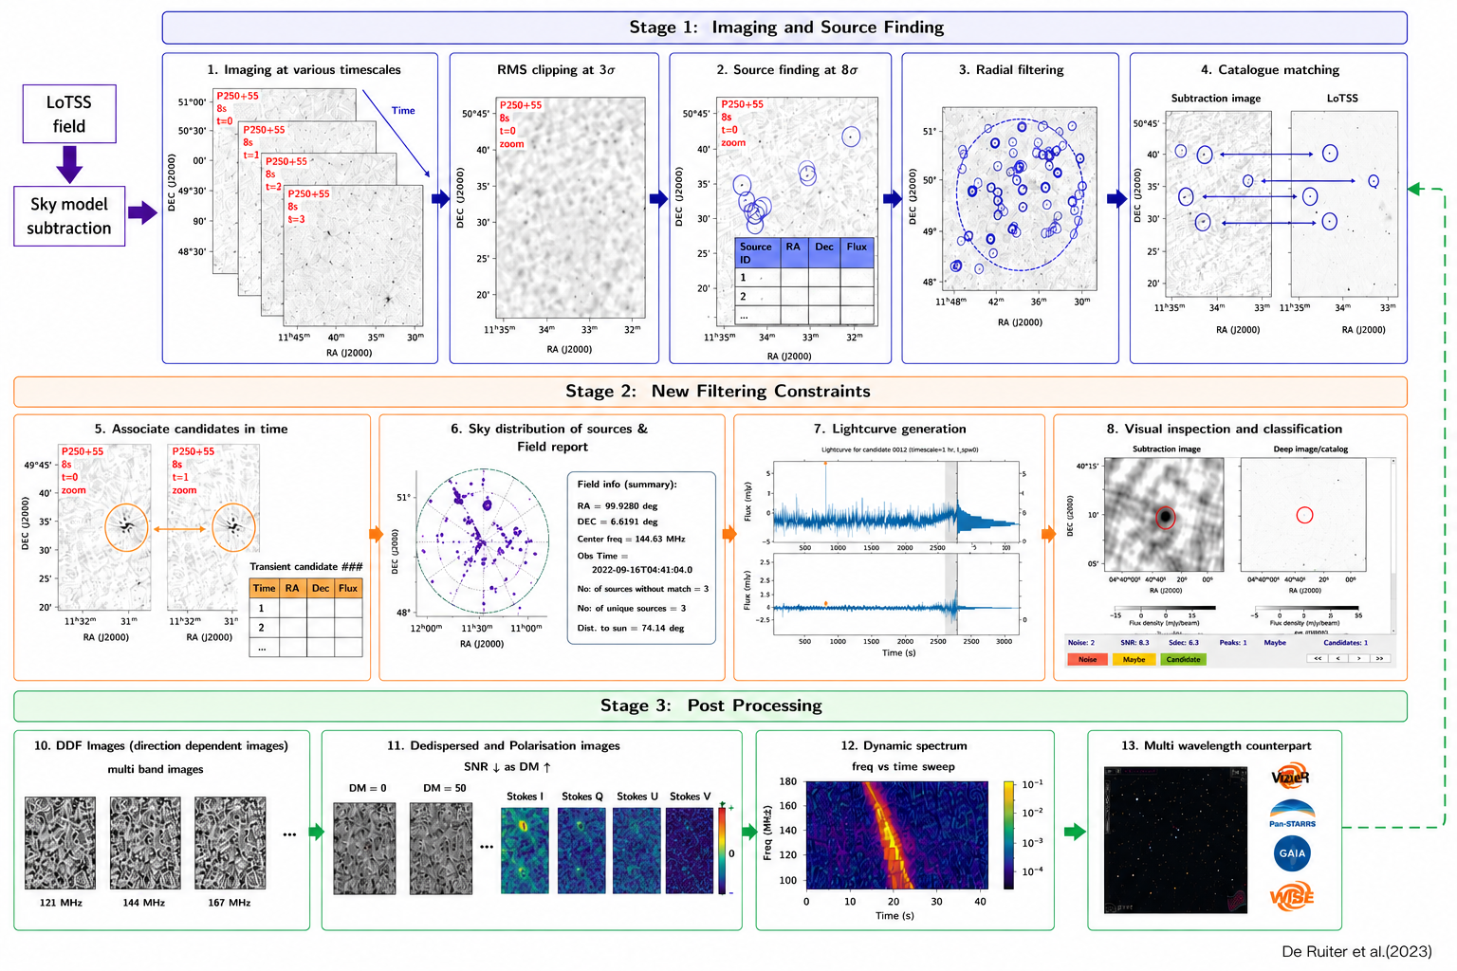
LATTES’ overview
Based on de Ruiter+2024

Slide 14
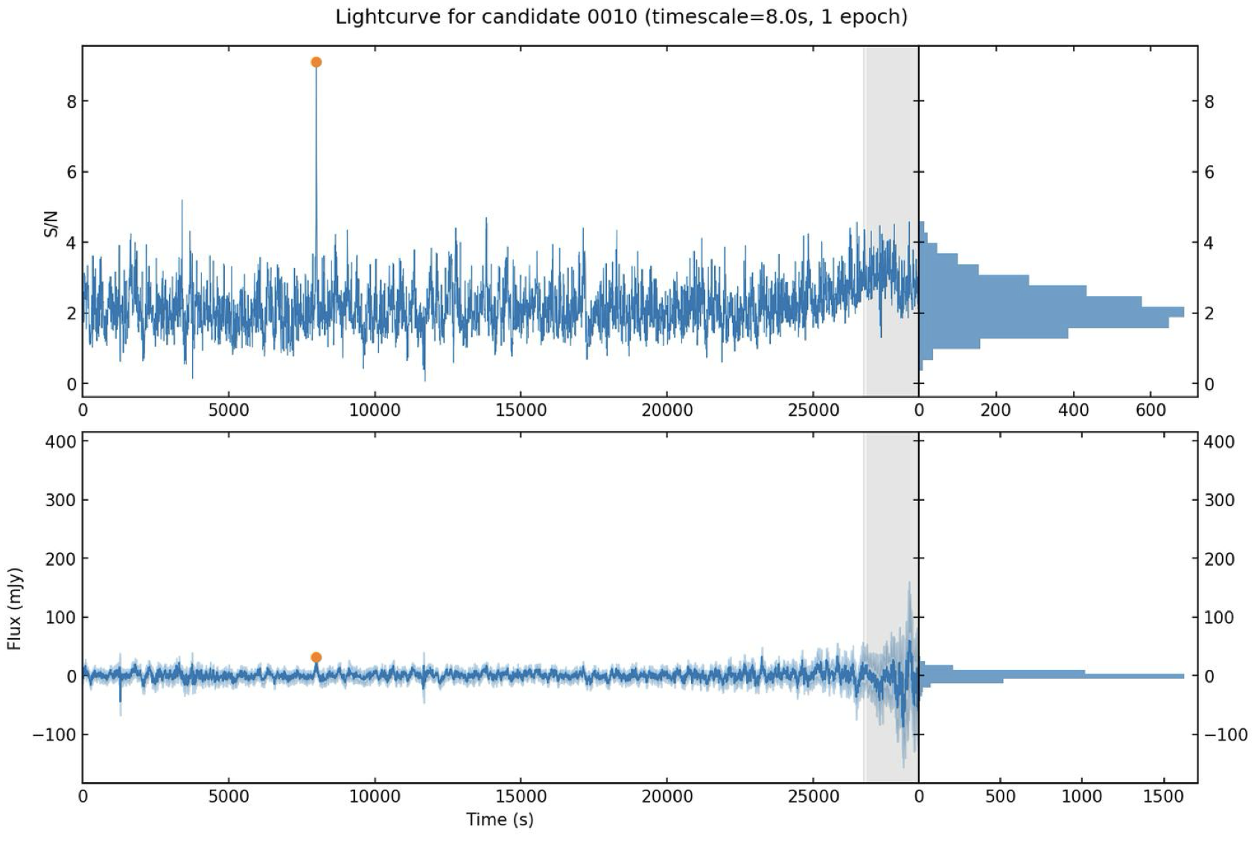
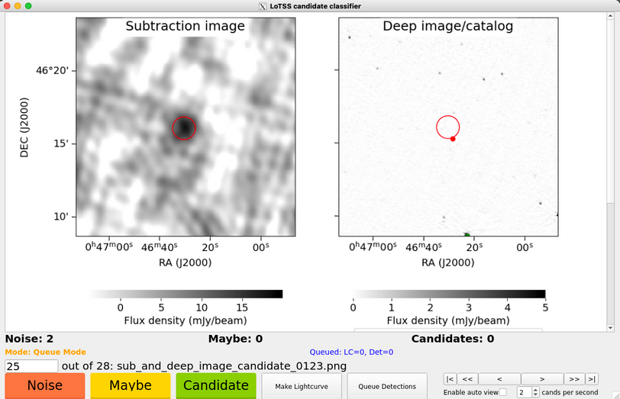
LATTES’ overview
Based on de Ruiter+2024
  Up to this stage, everything is automated !!

Slide 15
LATTES’ overview
Based on de Ruiter+2024

Slide 16

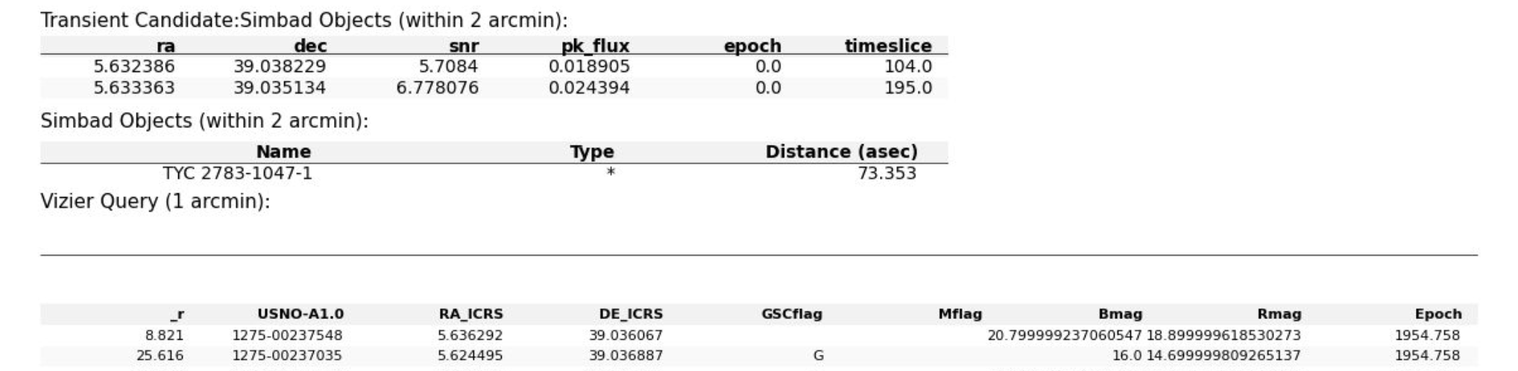
LoTSS classifier
Credit: Inés Pastor-Marazuela
Based on jester (MeerTRAP)
Classification of candidates as Noise, Maybe, or Candidate.

Slide 17
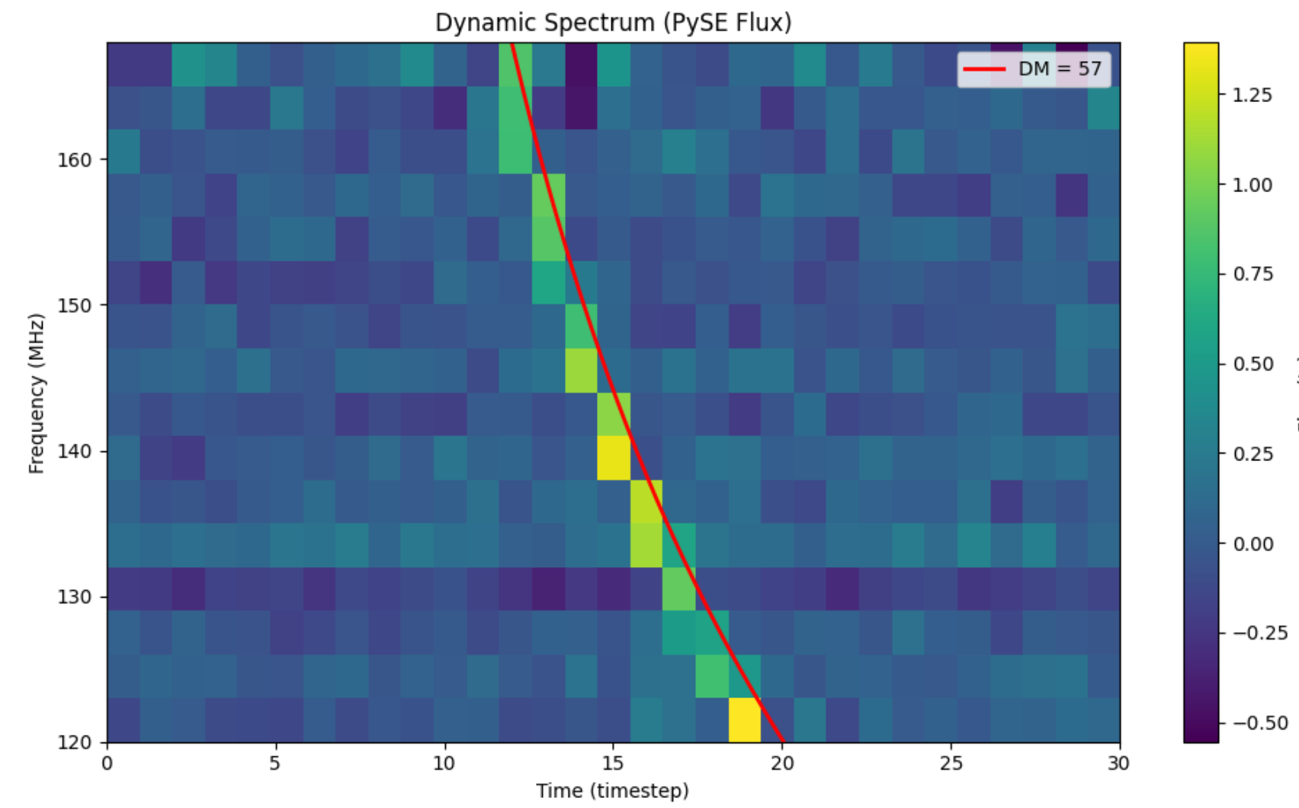

LATTES’ overview
Based on de Ruiter+2024

Slide 18
LATTES’ overview
Based on de Ruiter+2024

Slide 19
LATTES’ overview
  Final last stage is the manual post processing to confirm the candidates !

Slide 20
LATTES’ overview
de Ruiter et al +2023

Slide 21
LATTES’ overview
Full processing for an 8-hr observation
, with 8-s snapshot images,
done in ~7 minutes using 3000 cores at once !
(without classification and post processing)
Reshma
Anna-Thomas
Inés
Pastor-Marazuela
Thanks to SURF !

Slide 22
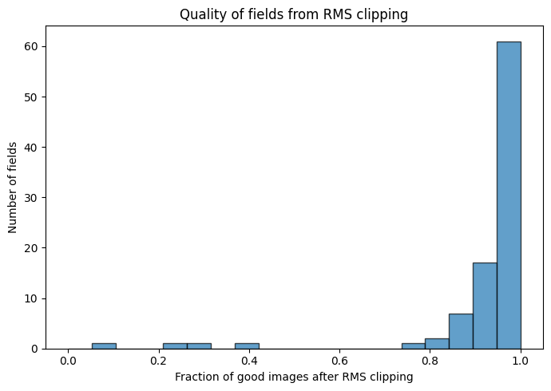
Initial results for 10% of the survey
100 fields processed
Total candidates above a S/N of 7 = 3201
Candidates tagged as “maybe” and “candidate” = 30 (above S/N of 8)

Slide 23
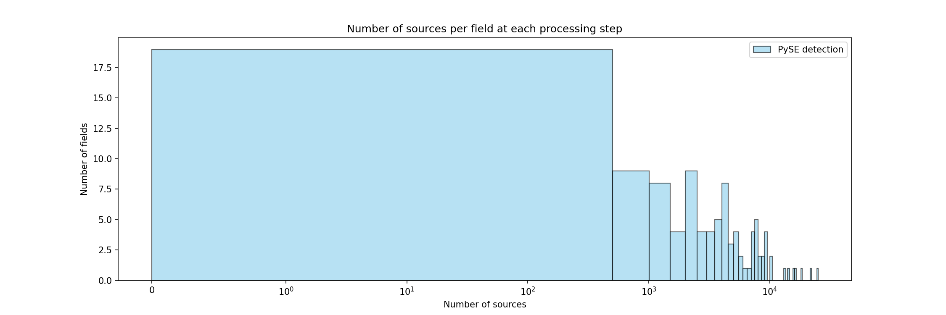
Initial results for 10% of the survey
 | Total detections | Remaining (%)
 | 468,858 | 100.000%
 | 4,644 | 0.990%
 | 1,943 | 0.414%
 | 1,513 | 0.323%
 | 30 | 0.006%
 | 15 | 0.003%
 | 413 | 0.088%

Slide 24
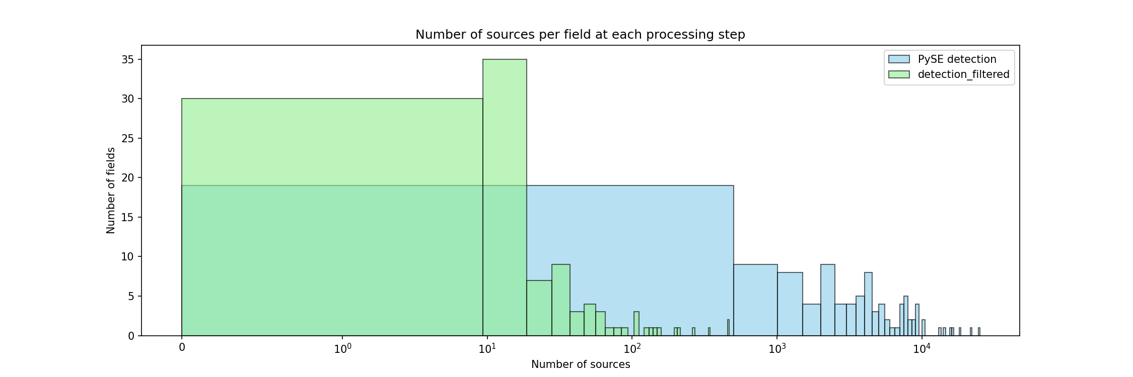
Initial results for 10% of the survey
 | Total detections | Remaining (%)
 | 468,858 | 100.000%
 | 4,644 | 0.990%
 | 1,943 | 0.414%
 | 1,513 | 0.323%
 | 30 | 0.006%
 | 15 | 0.003%
 | 413 | 0.088%

Slide 25
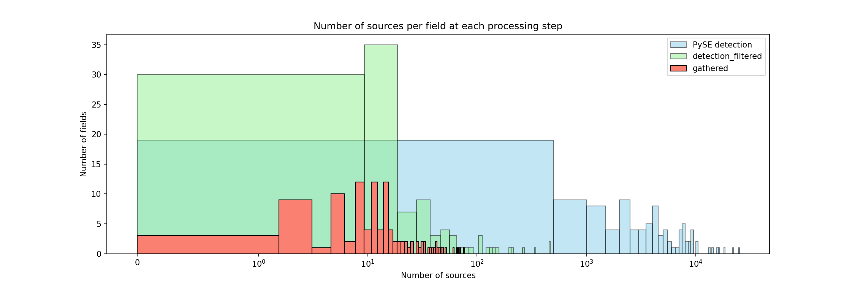
Initial results for 10% of the survey
 | Total detections | Remaining (%)
 | 468,858 | 100.000%
 | 4,644 | 0.990%
 | 1,943 | 0.414%
 | 1,513 | 0.323%
 | 30 | 0.006%
 | 15 | 0.003%
 | 413 | 0.088%

Slide 26
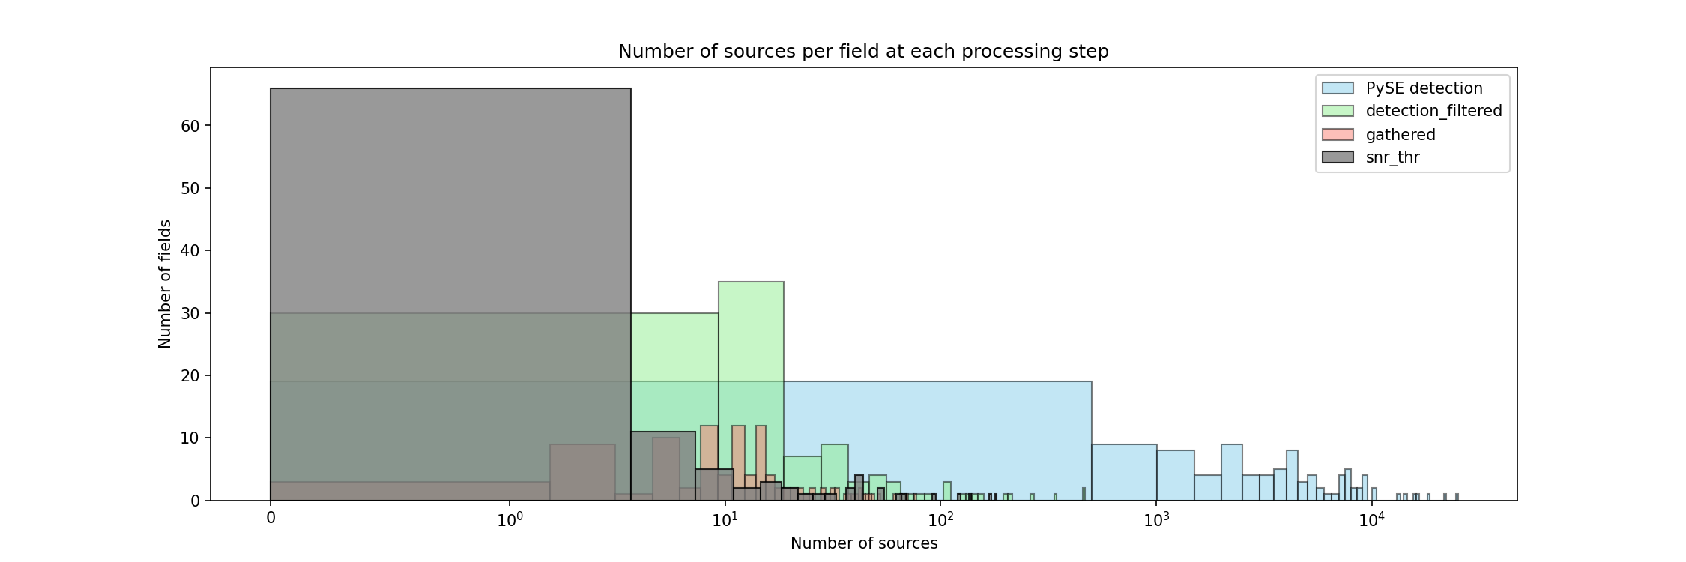
Initial results for 10% of the survey
 | Total detections | Remaining (%)
 | 468,858 | 100.000%
 | 4,644 | 0.990%
 | 1,943 | 0.414%
 | 1,513 | 0.323%
 | 30 | 0.006%
 | 15 | 0.003%
 | 413 | 0.088%
0.32 % of PySE detections remains after snr threshold !

Slide 27
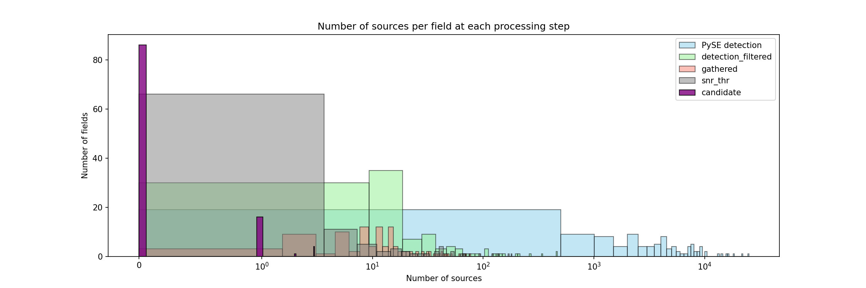
Initial results for 10% of the survey
 | Total detections | Remaining (%)
 | 468,858 | 100.000%
 | 4,644 | 0.990%
 | 1,943 | 0.414%
 | 1,513 | 0.323%
 | 30 | 0.006%
 | 15 | 0.003%
 | 413 | 0.088%
Last step is the manual classification

Slide 28
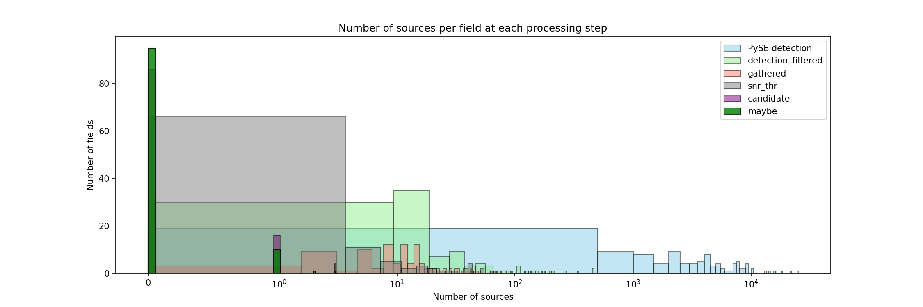
Initial results for 10% of the survey
 | Total detections | Remaining (%)
 | 468,858 | 100.000%
 | 4,644 | 0.990%
 | 1,943 | 0.414%
 | 1,513 | 0.323%
 | 30 | 0.006%
 | 15 | 0.003%
 | 413 | 0.088%
Last step is the manual classification
0.006 % of detections are classified as “Candidates after the visual inspection !

Slide 29
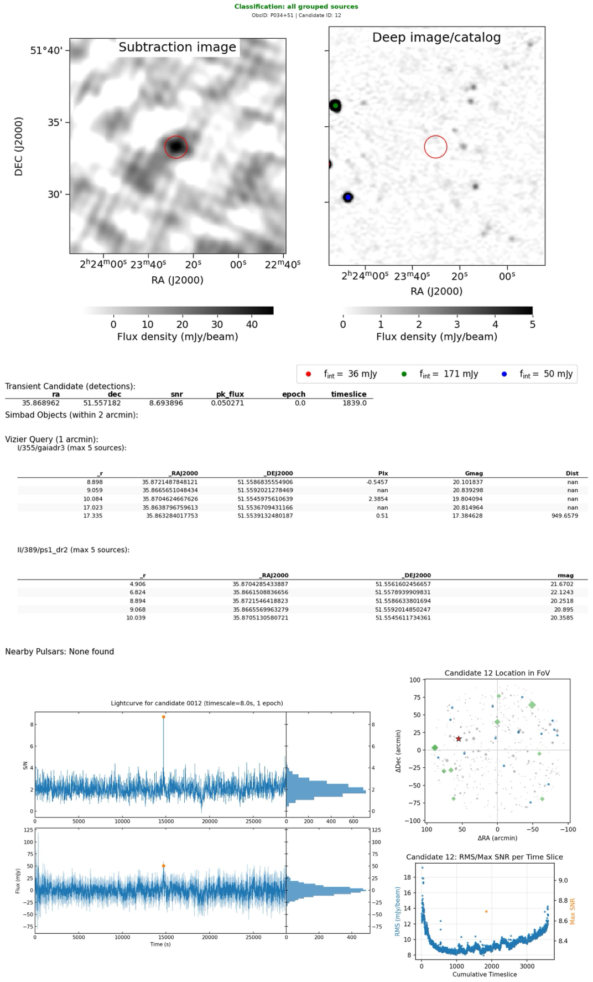
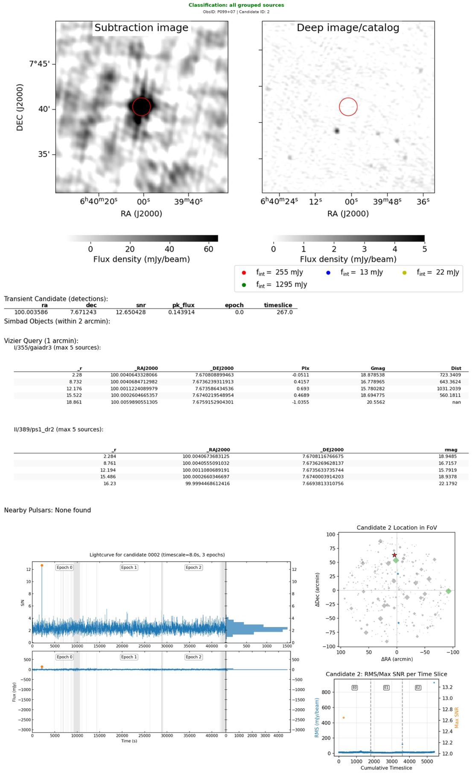
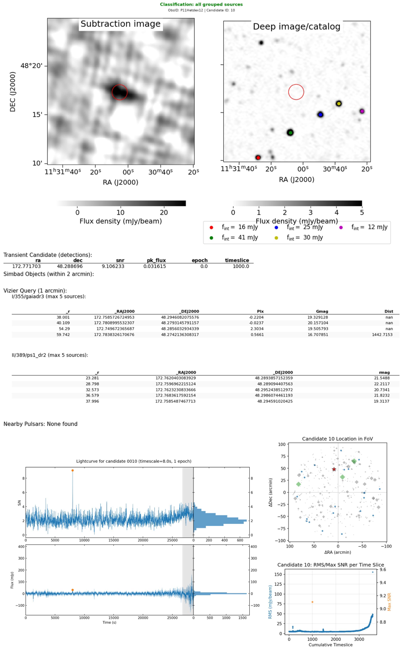
Some candidates
CAND_0001
CAND_0002
CAND_0003

Slide 30
Some candidates
CAND_0001
CAND_0002
CAND_0003

Slide 31
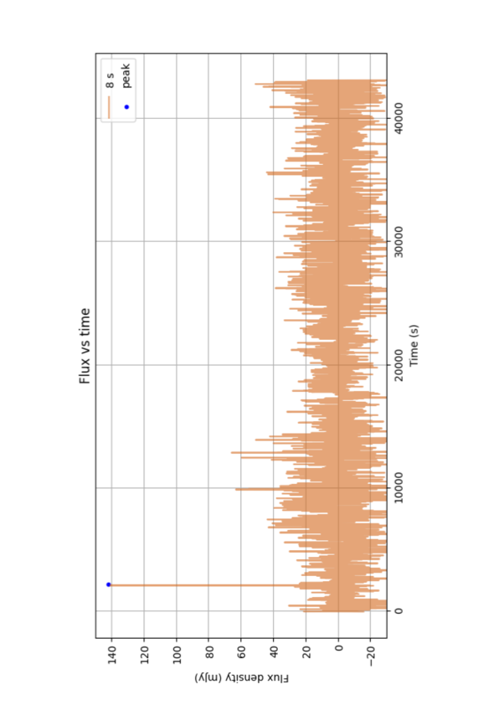
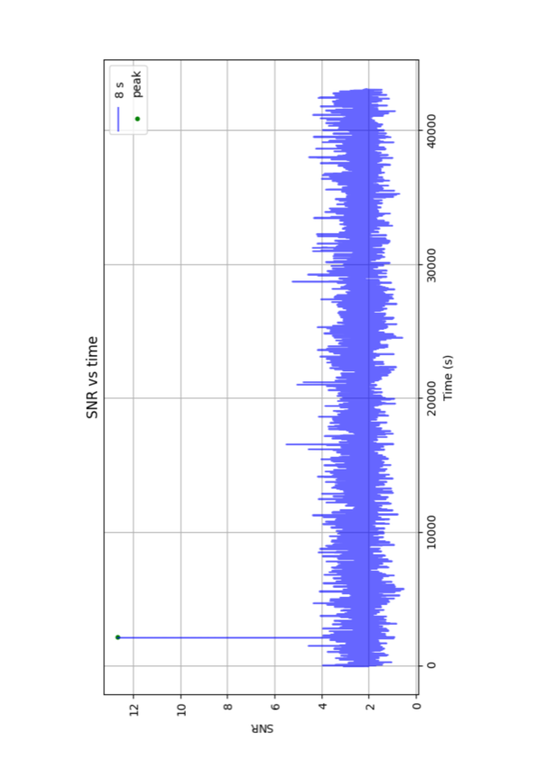
CAND_0002
  Monitoring of SNR and Flux of each candidate

Slide 32
CAND_0002

Slide 33
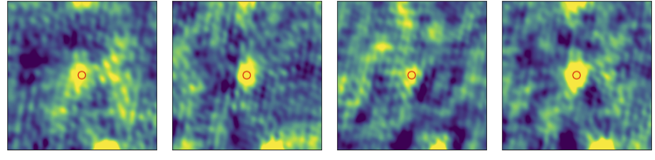
CAND_0002
  Re-imaging at 1 and 8-second resolution across different channels around transient location !
121 MHz
144 MHz
167 MHz
MFS

Slide 34
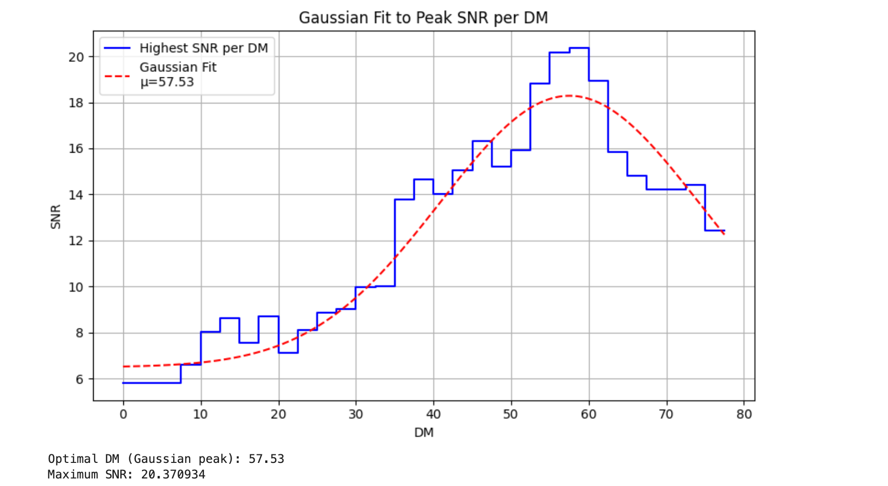
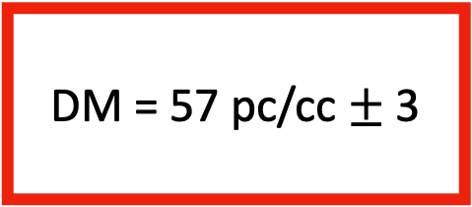
CAND_0002
  DISPERSION MEASURE (DM) using LORDS software, Rajwade in prep
DM = 57 pc/cc $±$ 3
GitLab: https://gitlab.com/kmrajwade/lordss

Slide 35
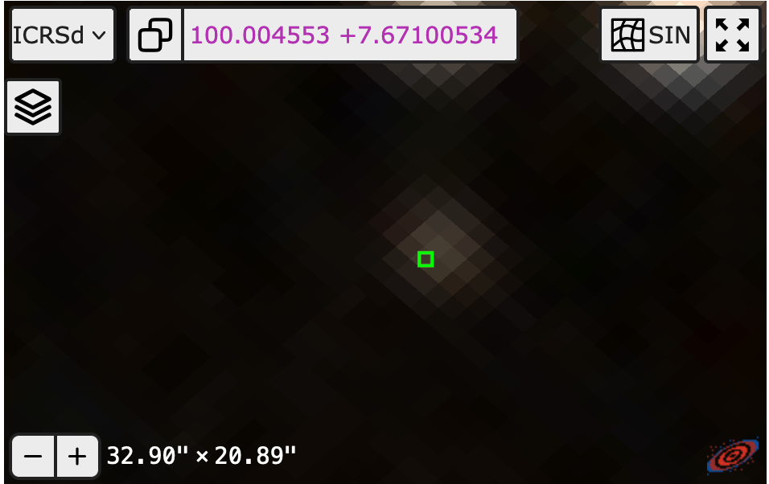
CAND_0002
  Possible optical counterpart found ?!
  STAY TUNED !!

Slide 36

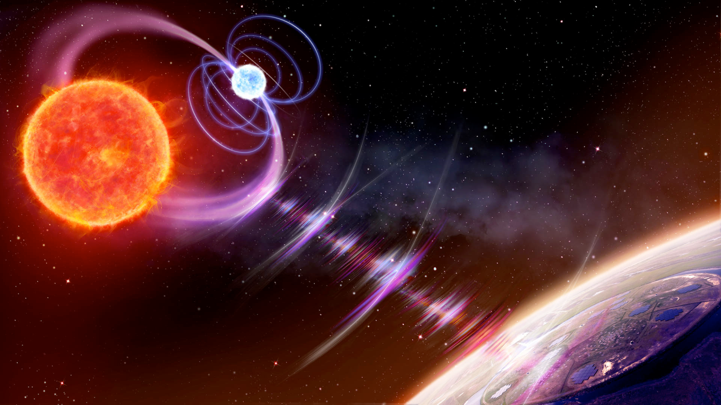
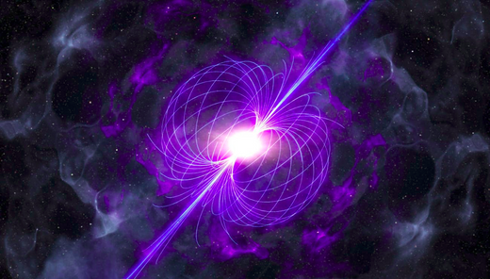
CONCLUSION AND OUTLOOK
  Post processing on candidates found in first 10% of the data!
  LoTSS DR3
Image the whole Northern sky, including the Galactic Plane with more than 2000 pointings
?
?
LoTSS observations, Credit: T. W. Shimwell (2025)

Slide 37
BACKUP SLIDES

Slide 38
  DISPERSION MEASURE (DM)
  Using LORDS software (Rajwade in prep) to extract a DM

Slide 39
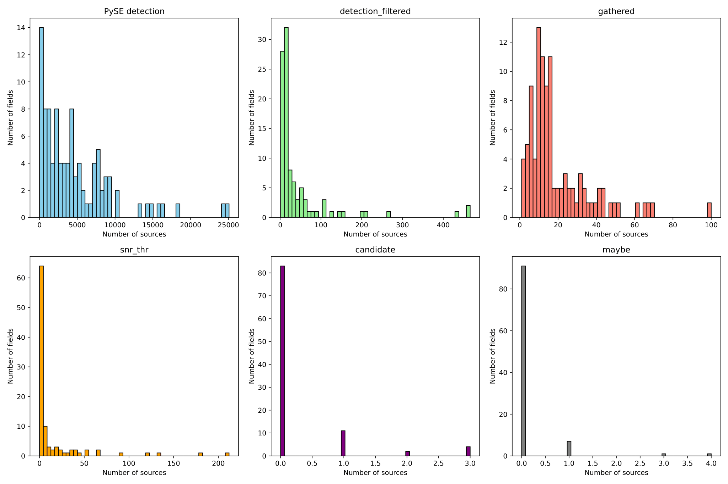
Initial results for 10% of the survey
Number of sources left after each step in the analysis

Slide 40
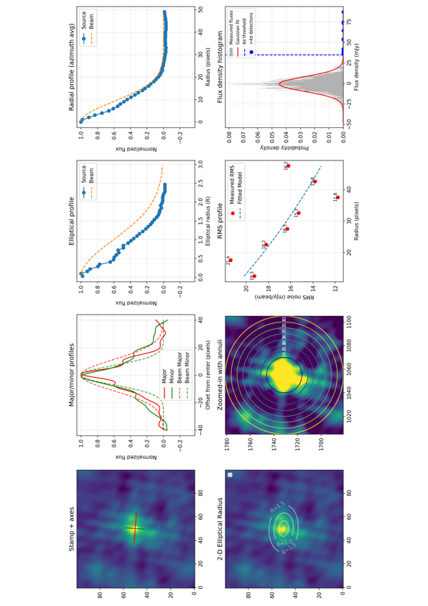
CAND_0002
  Beam fitting

Slide 41
LATTES’ overview
RMS clipping
Full processing for an 8-hr observation, with 8-s snapshot images, done in ~7 minutes using 3000 cores at once ! (without classification and post processing)
Pipeline stages
Field report summary
Thanks to SURF !

Slide 42
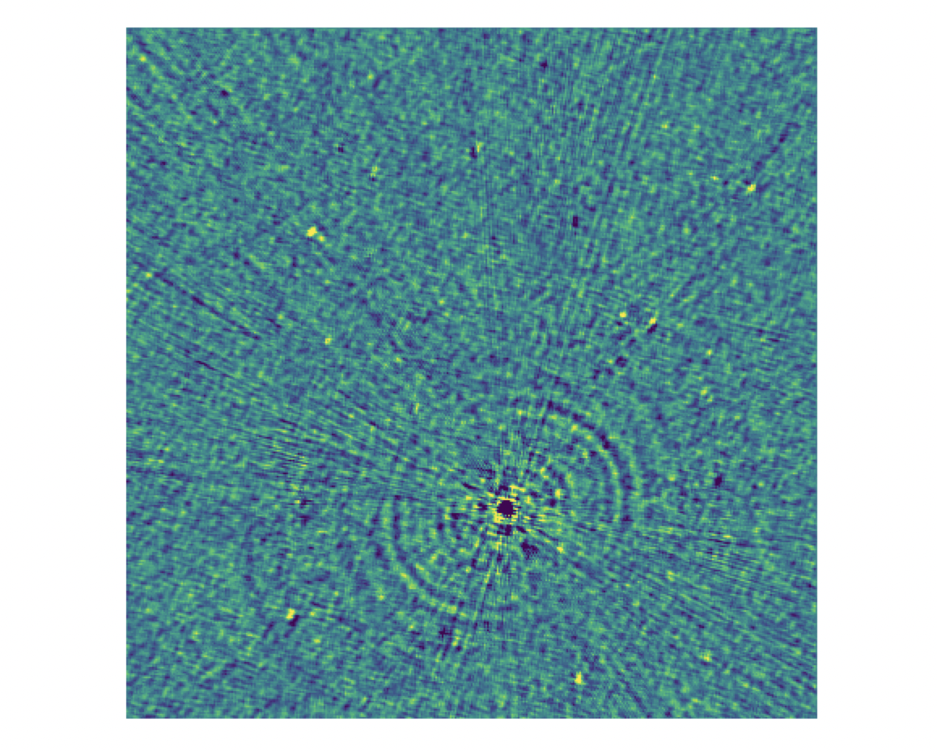
RMS clipping for noisy images
  Example of a bad image with an artifact from a known source
  We remove this bad images from further analysis by using an RMS threshold computed beforehand

Slide 43
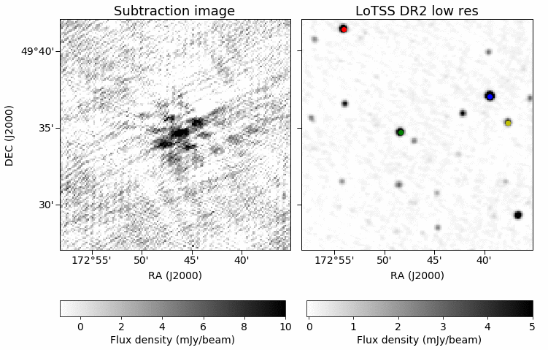
Example of a false positive in our images
Aliased source
Source location is moving quite a bit over the observation.

Slide 44
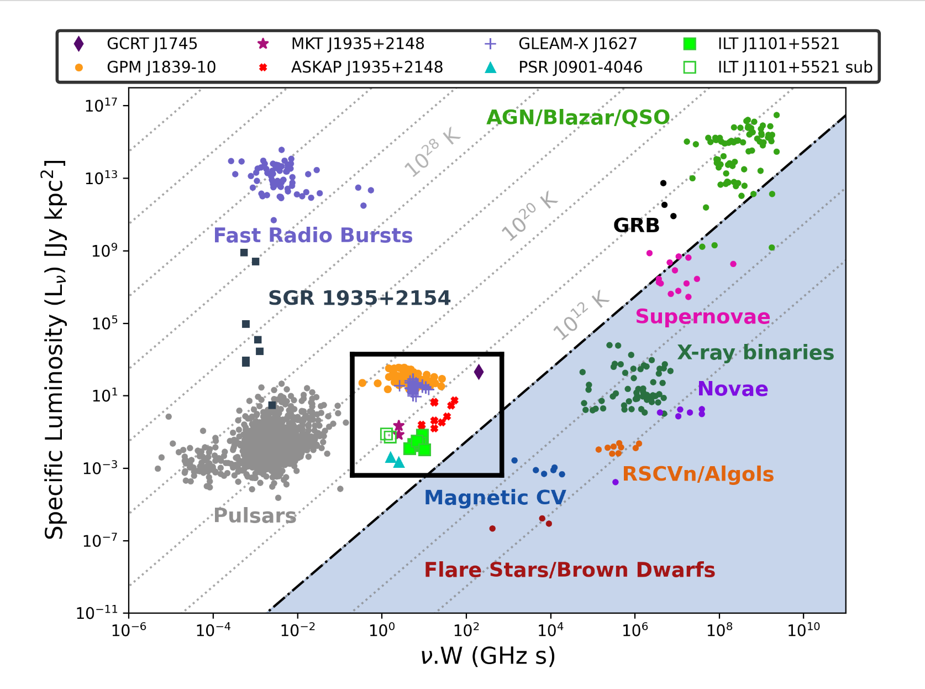
Coherent emission
Incoherent emission
Credit: De Ruiter et al. 2024
3
Notes:
I wanted to start this talk by the very common transient phase-space diagram, where we have here a big picture of the emission and objects detected in the radio sky. As we know in the plot, we have 2 type of emission, (coherent and in-coherent) differentiate by the brightness temp of this objects. Exceeding this temperature by 10^12K we will mainly detect coherent emission. That’s where I will mainly focus during this talk.
As we know most of the coherent emission processes have been detected using beamformed data (high time resolution). BUT We recently open a new window in the transient phase space diagram. Where we detected for the first time radio coherent emission from a new population of objects called LPTs. This emissions where detected in very short timescales from sec to minutes, mainly in the image plane. Each of this LPTs detected have actually different origins from WD-MD binaries, pulsars (RRAT) or magnetars. This is actually a very exited topic at the moment where a lot of radio observatories are now looking for this emission using fast imaging that was poorly explored historically.

Slide 45
Time’s window that we probe with LOFAR
Coherent emission
Incoherent emission
Credit: De Ruiter et al. 2024
4
Notes:
I wanted to start this talk by the very common transient phase-space diagram, where we have here a big picture of the emission and objects detected in the radio sky. As we know in the plot, we have 2 type of emission, (coherent and in-coherent) differentiate by the brightness temp of this objects. Exceeding this temperature by 10^12K we will mainly detect coherent emission. That’s where I will mainly focus during this talk.
As we know most of the coherent emission processes have been detected using beamformed data (high time resolution). BUT We recently open a new window in the transient phase space diagram. Where we detected for the first time radio coherent emission from a new population of objects called LPTs. This emissions where detected in very short timescales from sec to minutes, mainly in the image plane. Each of this LPTs detected have actually different origins from WD-MD binaries, pulsars (RRAT) or magnetars. This is actually a very exited topic at the moment where a lot of radio observatories are now looking for this emission using fast imaging that was poorly explored historically.

Slide 46

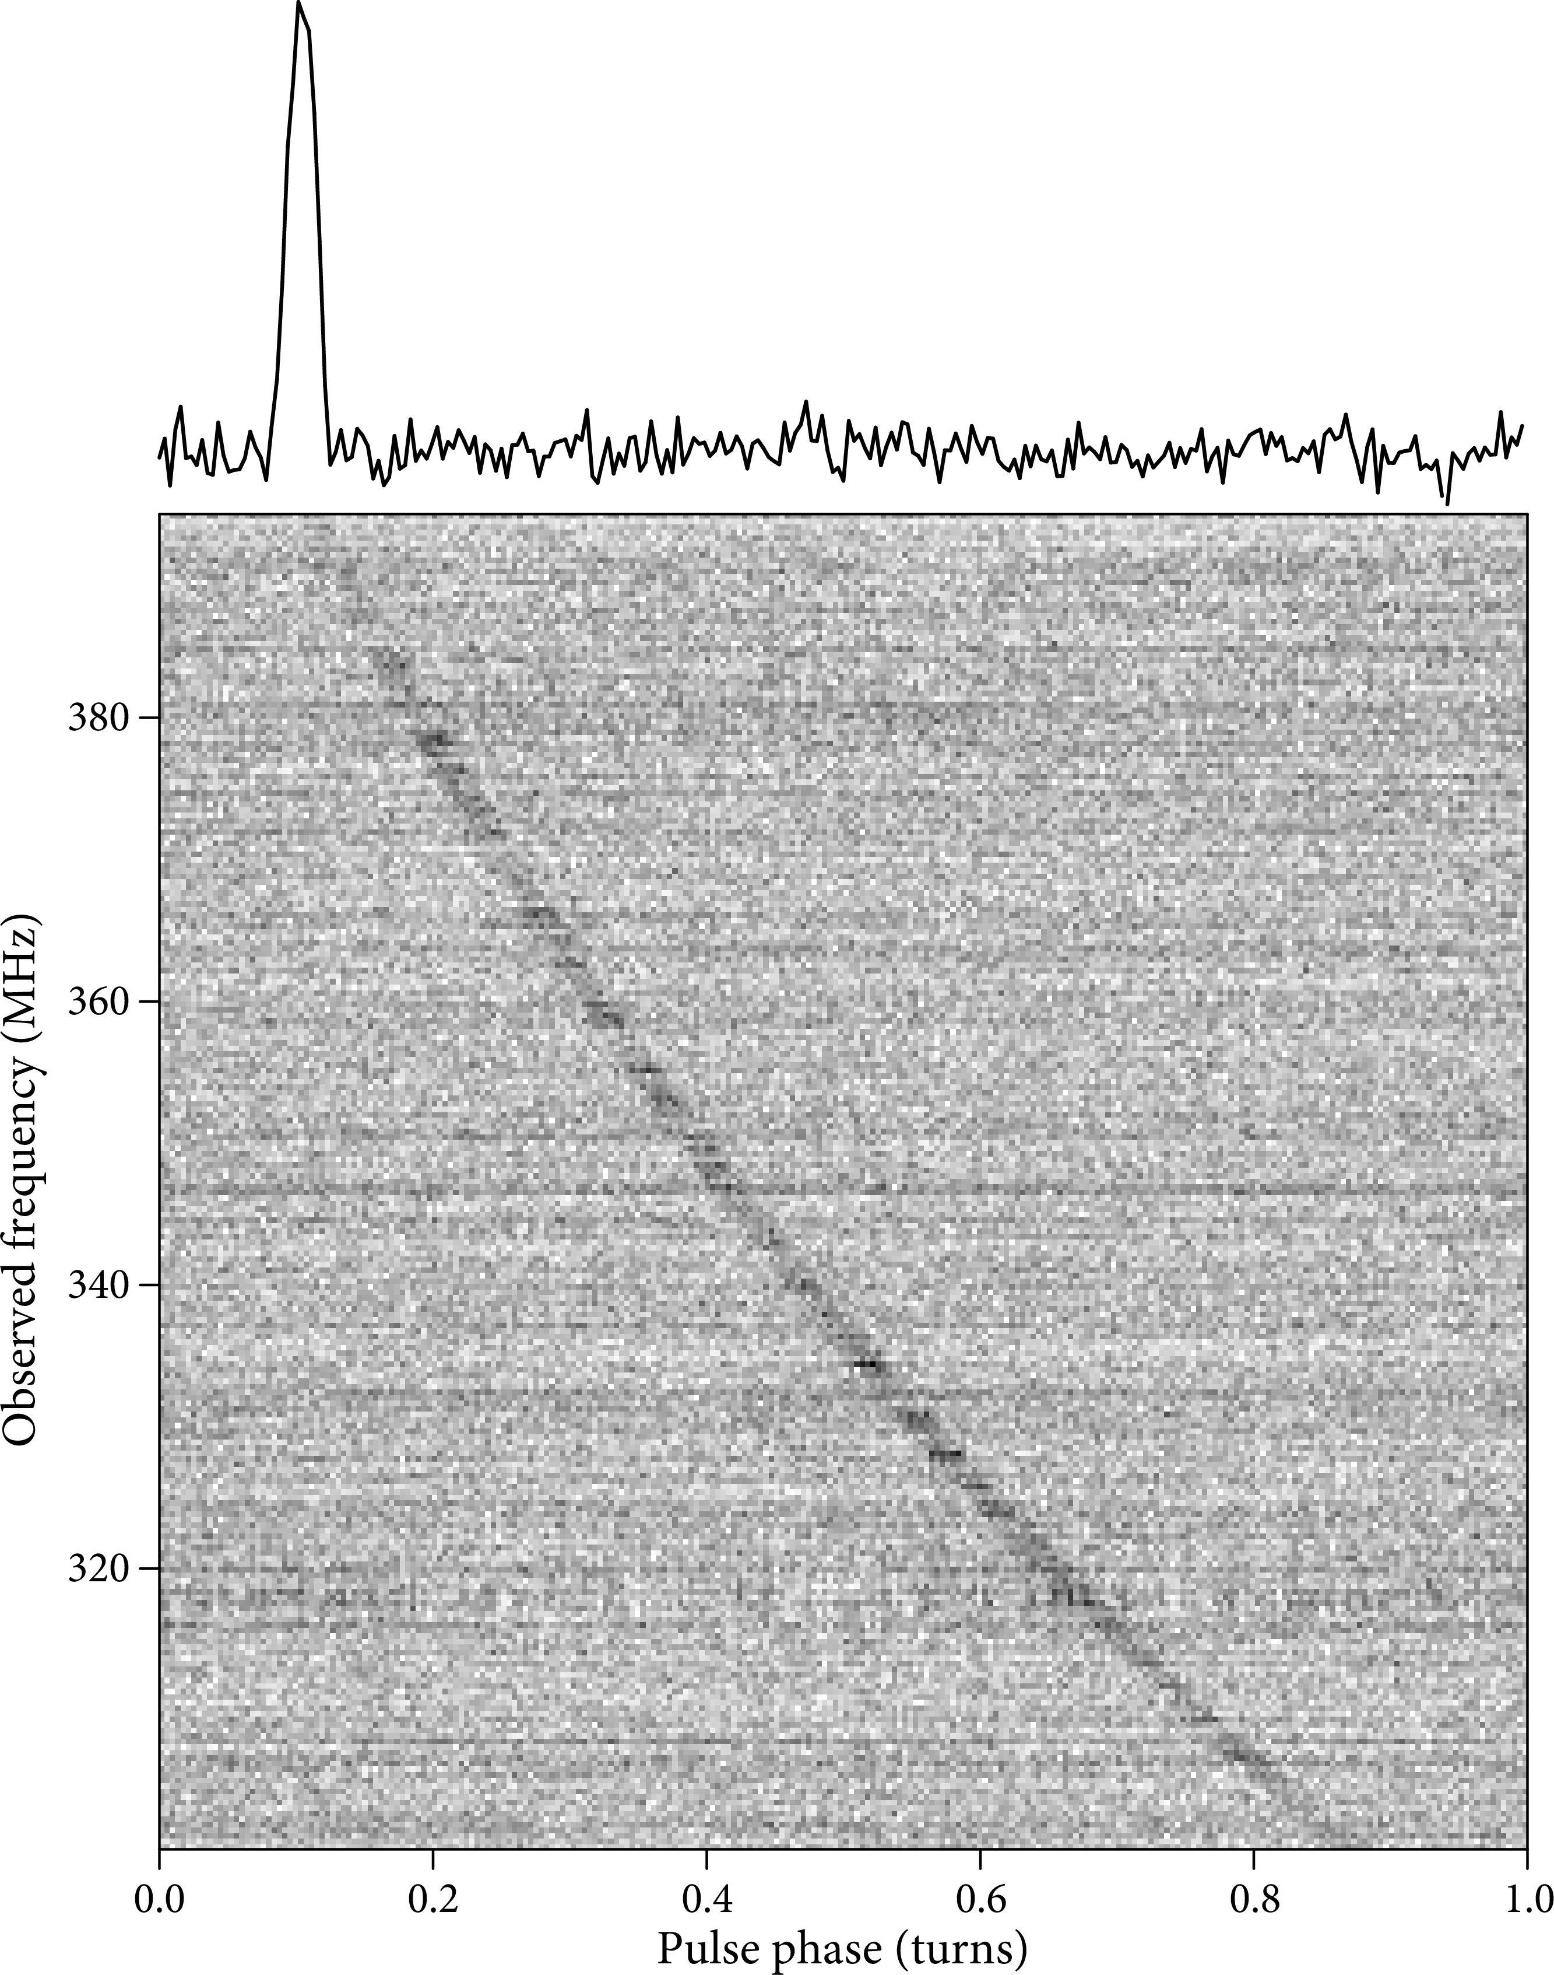
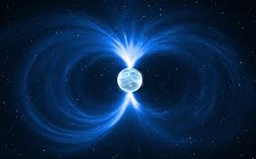
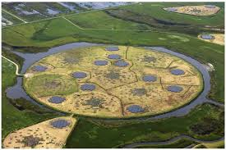
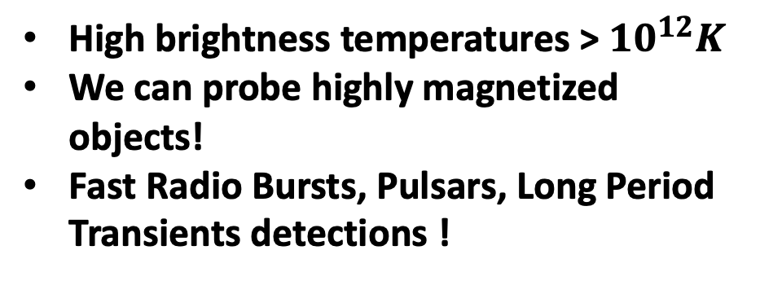
Probing coherent radio emission with LOFAR
Low frequency band very sensitive to coherent emission
Characterize the emission
Large collecting area
Image Credit: Jurik Peter
Image: ASTRON
High brightness temperatures > ${10}^{12}K$
We can probe highly magnetized objects!
Fast Radio Bursts, Pulsars, Long Period Transients detections !
Wide field of view
Fast imaging correlation
Handle Ionospheric variability
James J. Condon et al.(2018)
Bright and bursty signals
Timescales (sec →mins)

Slide 47
Pipeline’s overview
LoTSS classifier
RMS clipping
pipeline processing
Field report summary
Credit: Inés Pastor-Marazuela
Based on jester (MeerTRAP)
Classification of candidates as Noise, Maybe, or Candidate.

Slide 48

IMAGING BOTTLENECK
Cleaning
  Iterative process
  Per snapshot
Imaging
Solution:
  Sky model subtraction
See Wang et al. (2023), Fijma et al. (2023), Hurley-Walker et al. (2022)

Slide 49
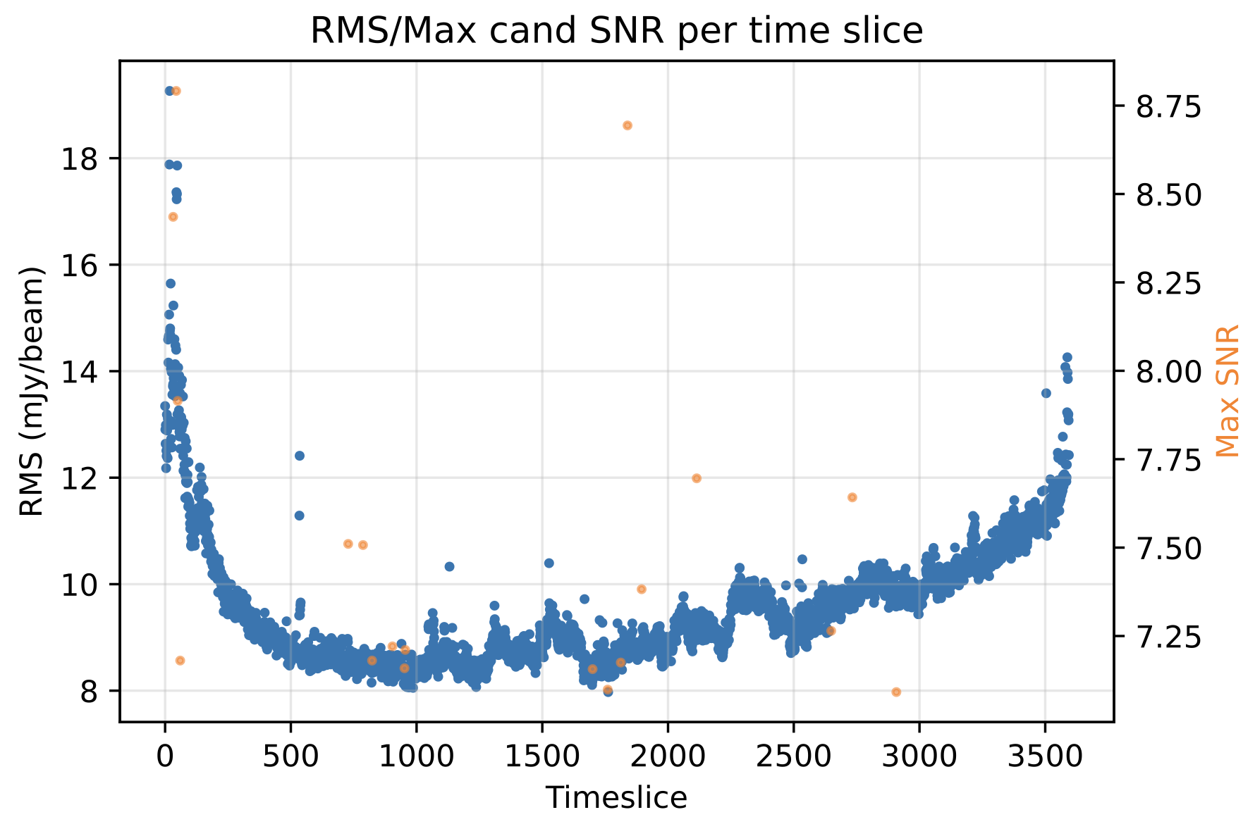
RMS clipping for noisy images
  We remove bad images from further analysis by using an RMS threshold computed beforehand
  Example of a bad image with an artifact from a known source

Slide 50
Image processing
  Subtraction imaging
-
We take the calibrated data
We take a source sky model
Subtracted datasets calibrated
WSClean imager
Subtracted images

Slide 51
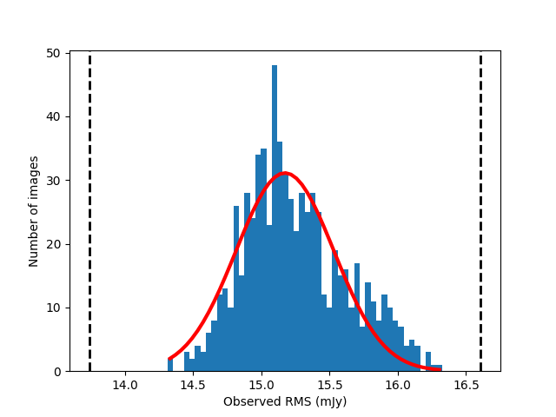
RMS clipping for noisy images
  RMS computation done in parallel for efficiency
  Allow us to remove bad images from further analysis

Slide 52



White Dwarf binary : ILT J1101 + 5521
The first LPT found with LOFAR with a counterpart!
Parameter | LOFAR
Imaging resolution | 8 sec
Polarisation | Highly linear
RM | 4.72 rad m-2
DM | 16 $±$ 6 pc/cm3
Peak flux density | 41 ± 6 to 256 ± 10 mJy/beam
Period | 125.52 min
Credit: de Ruiter et al.(2025)

Slide 53


Snapshot image and deep image of the first detection
GIF of the 8-sec snapshot images
Credit: Iris de Ruiter
Credit: de Ruiter et al.(2024)

Slide 54



Long Period transients
Progenitor
2 confirm WD+MD and a new one possible ? 2 possible WD pulsars also detected !
1 Galactic transient found by (Hyman et al. (2005)
2 confirm NS and 3 possible magnetars origins ??
Unknown or unidentified | ??
Image credit: Daniëlle Futselaar
Image credit: NRAO
Image Credit: Jurik Peter
You can visit this very nice website created by Sam McSweeney for LPTs: https://lpt.mwa-image-plane.cloud.edu.au/published/galactic_view

Slide 55
Long Period transients
Progenitor
2 confirm WD+MD and a new one possible ? 2 possible WD pulsars also detected !
1 Galactic transient found by (Hyman et al. (2005)
2 confirm NS and 3 possible magnetars origins ??
Unknown or unidentified | ??
First LPT’s progenitor found with LOFAR !
Image credit: Daniëlle Futselaar
Image credit: NRAO
Image Credit: Jurik Peter
You can visit this very nice website created by Sam McSweeney for LPTs: https://lpt.mwa-image-plane.cloud.edu.au/published/galactic_view

Slide 56

GALACTIC PLANE SEARCH

Slide 57

First batch of 100 fields

Slide 58
Long Period transients
Galactic transient
White Dwarf- M Dwarf Binaries
Neutron stars or Magnetars ??
Unknown or unidentified
Image credit: Daniëlle Futselaar
Image Credit: Jurik Peter
ASKAP J175534.9-252749.1, Dobie et al.(2024)
ASKAP J144834-685644, Anumarlapudi et al. (2025)
…
ILT J1101 +5521, de Ruiter et al. (2025)
GLEAM-X J0704-37, Hurley-Walker et al. (2024)
…
GLEAM-X J162759.5−523504.3, Hurley-Walker et al. (2022)
ASKAP J193505.1+214841.0, Caleb et al.(2024)
…
Image credit: NRAO
GCRT J1745-3009 (Hyman et al. (2005)
…
You can visit this very nice website created by Sam McSweeney for LPTs: https://lpt.mwa-image-plane.cloud.edu.au/published/galactic_view

Slide 59

Image processing
  Subtraction imaging
-
We take the calibrated data
We take a source sky model
$$\sim 15 TB$$
A few days to process and calibrate
Subtracted datasets calibrated
WSClean imager
From 15 TB to ~ 50 GB
A few hours to process and image
Subtracted images
> ${10}^{6}$ order , from petabytes to gigabytes → Data reduction factor is enormous !!

Slide 60

Image processing
PySE - LOFAR Transients Pipeline
Up to 8 sigma now!
  Source extraction for radio-synthesis images
  Fitting of identified sources with elliptical Gaussians
  Force fit axis lengths to beam size
Created by Spreeuw (2010)

Slide 61

White Dwarf binary : ILT J1101 + 5521
The first LPT found with LOFAR with a counterpart !
Parameter | LOFAR
Imaging resolution | 8 sec
Polarisation | 51$±6\%$
RM | 4.72 rad m-2
DM | 16 $±$ 6 pc/cm3
Peak flux density | 41 ± 6 to 256 ± 10 mJy/beam
Period | 125.52 min
Credit: de Ruiter et al.(2024 & 2025)
9

Slide 62

RA
DEC
Elevation
Center freq
Obs Time
Field information
= 34.3895 deg
= 51.2995 deg
= 58.7188 deg
= 143.65 MHz
= 2023-07-24T02:17:04.0
Sky distribution of sources
52.5
52.0 51.5
transients
No:of unique sources
Distance to sun
Distance to CasA, CygA,
Vir A, Tau A
No: of sources without match = 21
= 19
= 73.5731 deg
= [25.5238, 61.842] deg
= [112.2208, 47.8584] deg
Dec (deg)
51.0 50.5 50.0
32
33
34
RA (deg)
35
36
37
SNR distribution
No:of candidates per time slice
16 14 12 10
1.04
1.02
8 6 4 2 0
1.00
Counts
No:of candidates
0.98
0.96
7.25
7.50
7.75
8.00
8.25
8.50
8.75
0
500
1000
1500
2000
2500
3000
SNR
Timeslice
RMS distribution
RMS/Max cand SNR per time slice
8.75 8.50 8.25 8.00
500
400
18
16 14
Counts
300 200 100 0
RMS (mJy/beam)
Max SNR
12 10 8
7.75 7.50 7.25
8
10
12
14
16
18
0
500
1000
1500
2000
2500
3000
3500
RMS (mJy/beam)
Timeslice

Slide 63


Slide 64


Previous background and studies
Bachelor degree in Physics at the Universite des Antilles
Internship abroad on Radio Transients at API in Amsterdam
PhD on
Fast Radio Burst in Amsterdam
2019-2022
2022-2024
01/2024-03/2024
03/2024-08/2024
10/2024-Now
Master in Astrophysics at the Cote d’Azur University
Master thesis on Be stars at the Observatoire de Paris
2

Slide 65


Transients candidates
20

Slide 66


Gaussian distribution of all the flux density measurements
12 outliers (above 3 sigma detections) !
20

Slide 67

  Radio window
LOFAR range observations
Credit: NASA/IPAC
3

Slide 68

Particular settings
No clean iterations
  Find an emission not substracted out
  Only shows sources with significantly different flux density
  Uniform noise background
2

Slide 69

Particular settings : No iterations
=
Iteration proces
Deconvolution of the dirty images
No clean iterations
Thousands iterations
Credit : Iris de Ruiter
  Computation time reduce by 81 % !
  Only shows sources with significantly different flux density
  Uniform background noise
2

Slide 70
CAND_0001
CAND_0002
CAND_0003

Slide 71
CAND_0002
  Beam fitting
  SNR and Flux lightcurve

Slide 72
100 fields processed
Total candidates above a S/N 7 = 3201
Candidates tagged as “maybe & candidate” = 30 (above S/N 8)
Number of sources left after each step in the analysis

Slide 73
8-sec snapshot images of the first detection
Credit: Iris de Ruiter

Slide 75
CAND_0002
  Beam fitting
  SNR and Flux lightcurve

Slide 76





13. Multi wavelength counterpart

Slide 78


