Slide 1
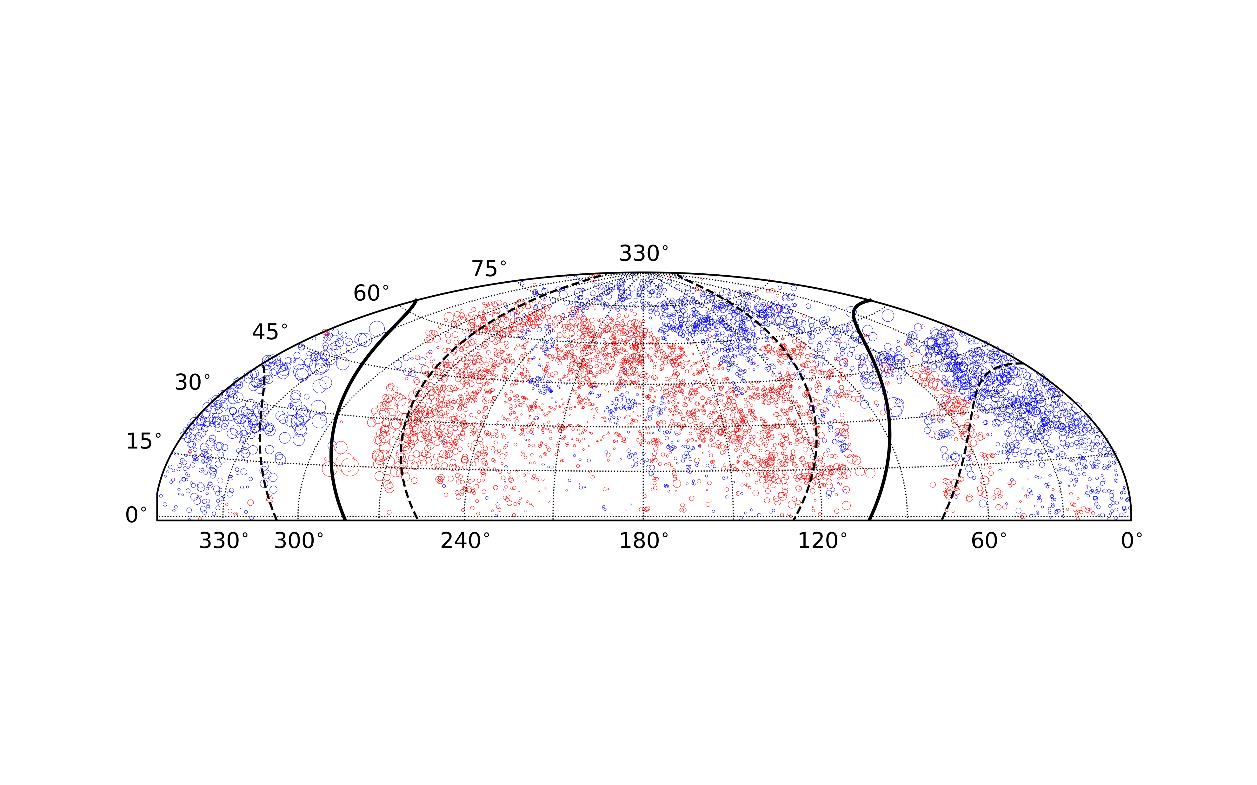


The LOFAR RM Grid: a precision view of cosmic magnetism at metre wavelengths
Shane O’Sullivan
Universidad Complutense de Madrid s.p.osullivan@ucm.es
LOFAR Surveys & Magnetism Key Science Projects
https://lofar-surveys.org/, https://lofar-mksp.org/
O’Sullivan et al. in prep.
9 June 2026
LOFAR Annual Meeting
Notes:
25 mins + 5 mins

Slide 2
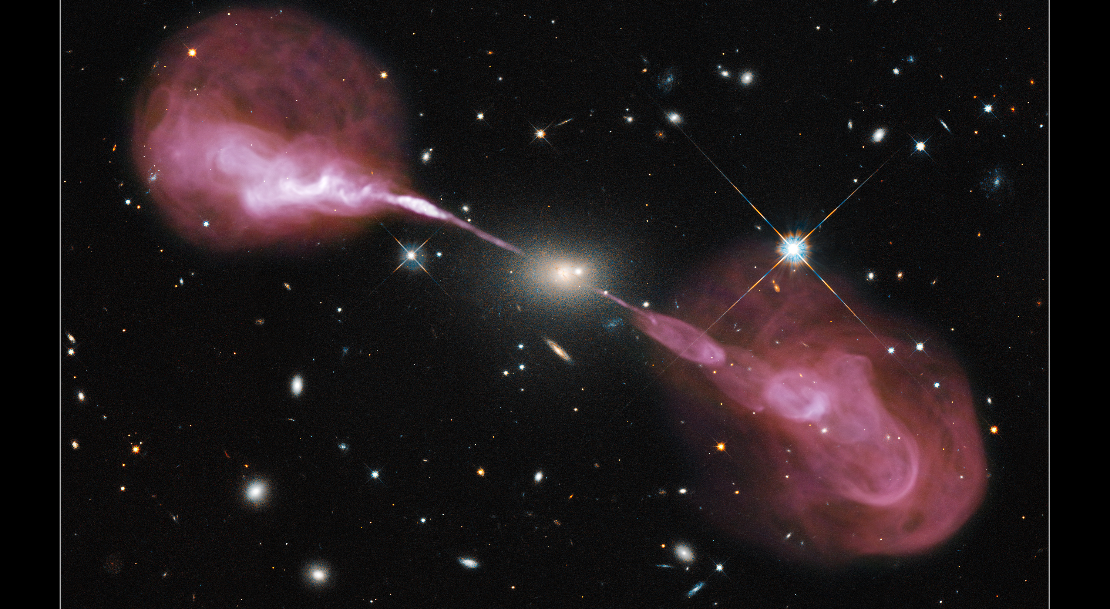
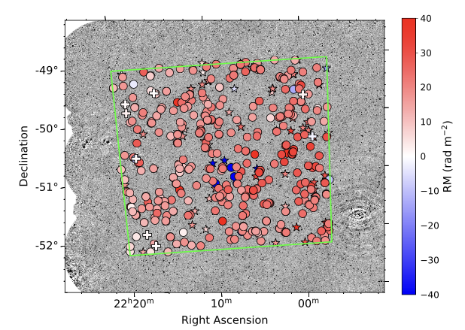
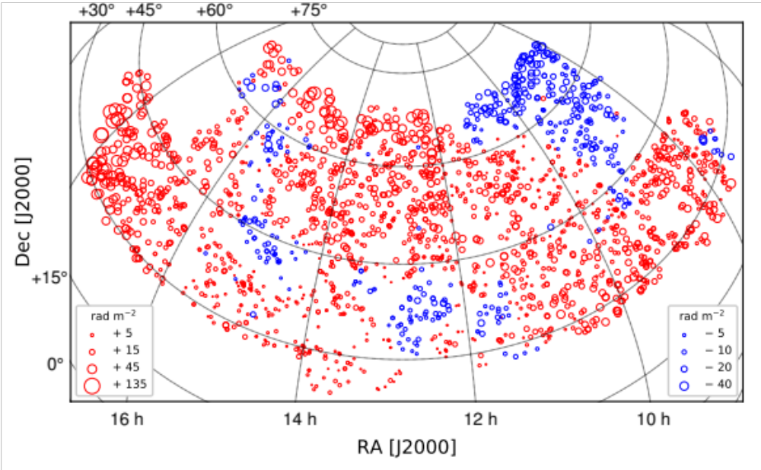

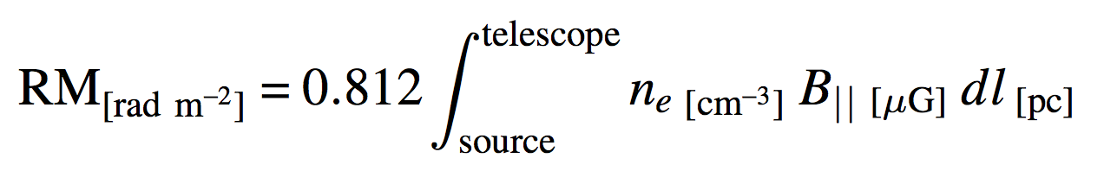
Magnetism with radio telescopes
Constructing wide-area “RM Grids” are a key science goal for the study of cosmic magnetism and its origin
  Polarized synchrotron emission from radio galaxies → Faraday rotation due to cosmic magnetic fields
RM studies at cm-wavelengths
  Dense RM Grids: 30 – 80 RMs/deg² Vanderwoude+24, Loi+25
  Moderate uncertainty: δRM ~ 1.5 rad/m²
  Probe magnetic fields across many environments
RM studies at m-wavelengths
  Low RM density: ~0.4 – 2 RMs/deg² O’Sullivan+23, Piras+24
  Excellent precision: δRM ~ 0.05 rad/m²
  Probe weakly magnetised, low density environments
Vanderwoude+24
O’Sullivan+23
Notes:
One of the best parts of my job: getting to analyse these stunningly beautiful jets, that come in all shapes and sizes

Slide 3
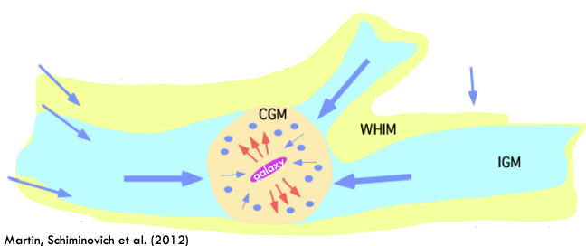
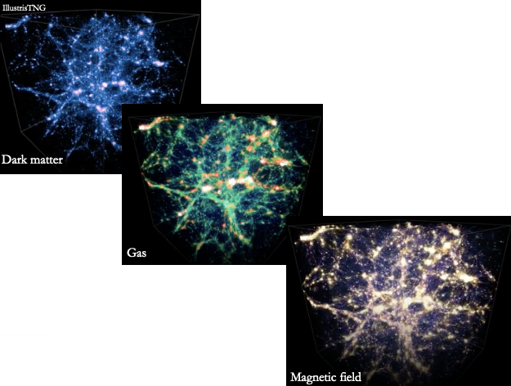
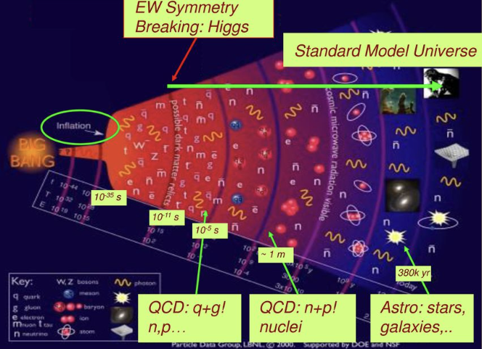
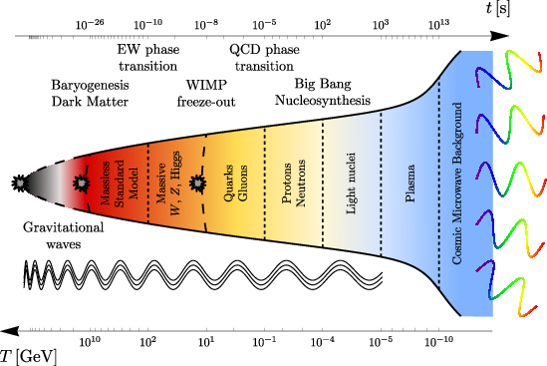
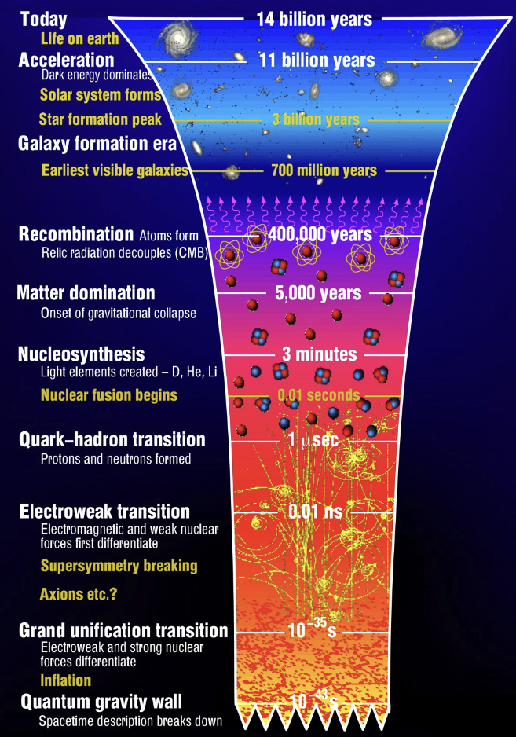
RM Grid motivation
Faraday rotation: tracer of the inventory of matter out to cosmic noon
  Cluster outskirts & IGrM – IGM interface (Anderson+21,24)
  Testing MHD models of the CGM (Heesen+23, Ramesh+24)
  Constraining extent of AGN feedback (Blunier & Neronov 2024)
Radio cosmic web: the origin of cosmic magnetism & properties of primordial magnetic fields
  Probe of early Universe physics (Vachaspati+21)
    Inflation, Electroweak, QCD eras
  Stochastic Gravitational Wave Background (Neronov+21)
  Alleviate “Hubble Tension” (Jedamzik & Pogosian 2020)
  Influence on structure formation and reionisation (Ralegankar+24, Sanati+24)
Image credit: M.J. Ramsey-Musolf
Primordial magnetic fields?
Image credit: Schmitz (2022)
Notes:
Schmitz (2022) https://cds.cern.ch/record/2804870/plots

Slide 4
LoTSS DR2 RM Grid: Science Highlights
Notes:
Radio telescopes are magnetic field measuring machines
Most of the phenomena that produce bright continuum radio emission are related to magnetic fields

Slide 5
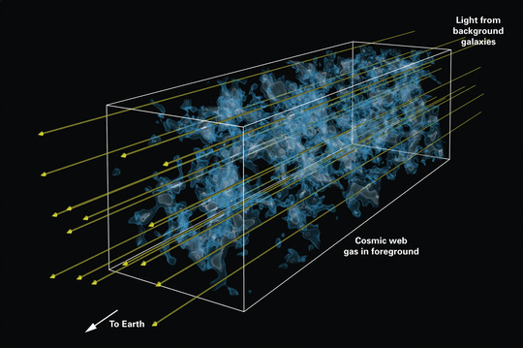
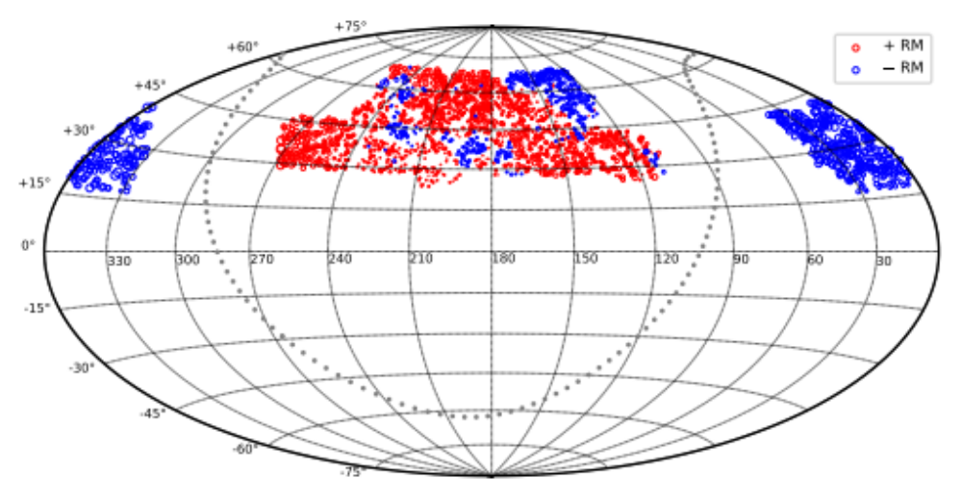
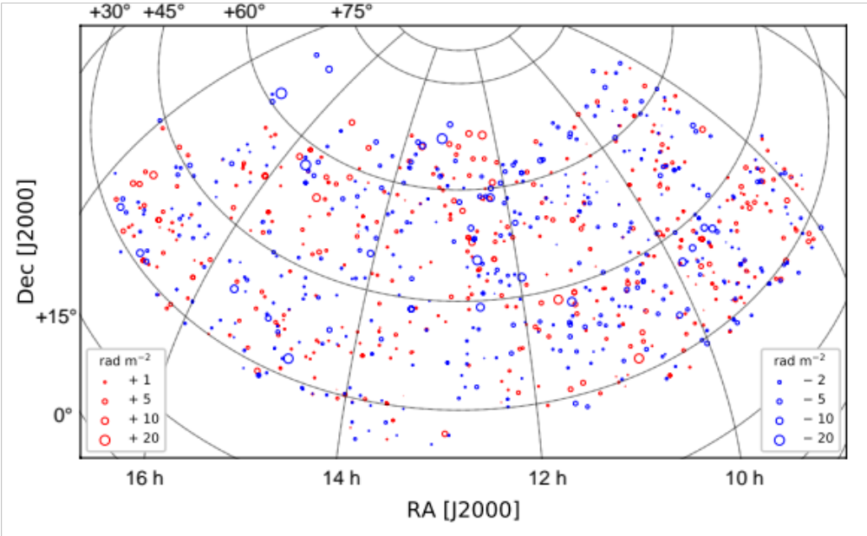
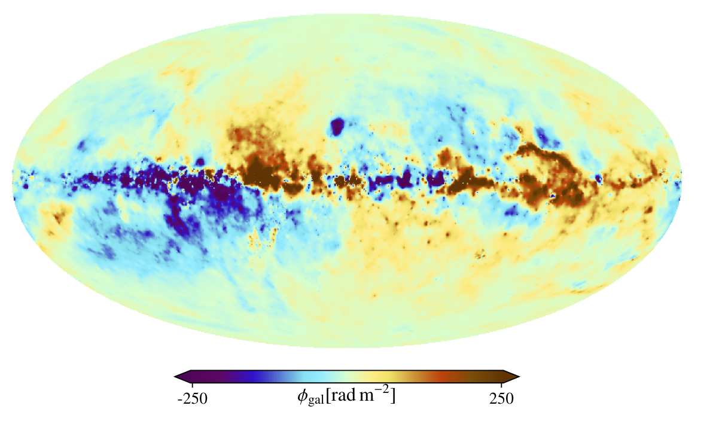
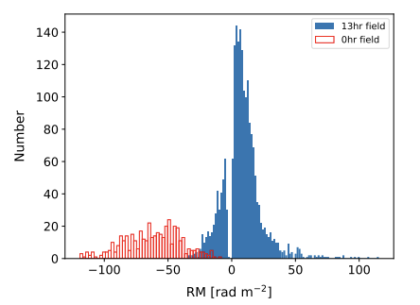
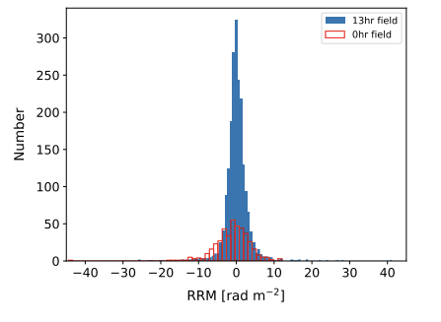
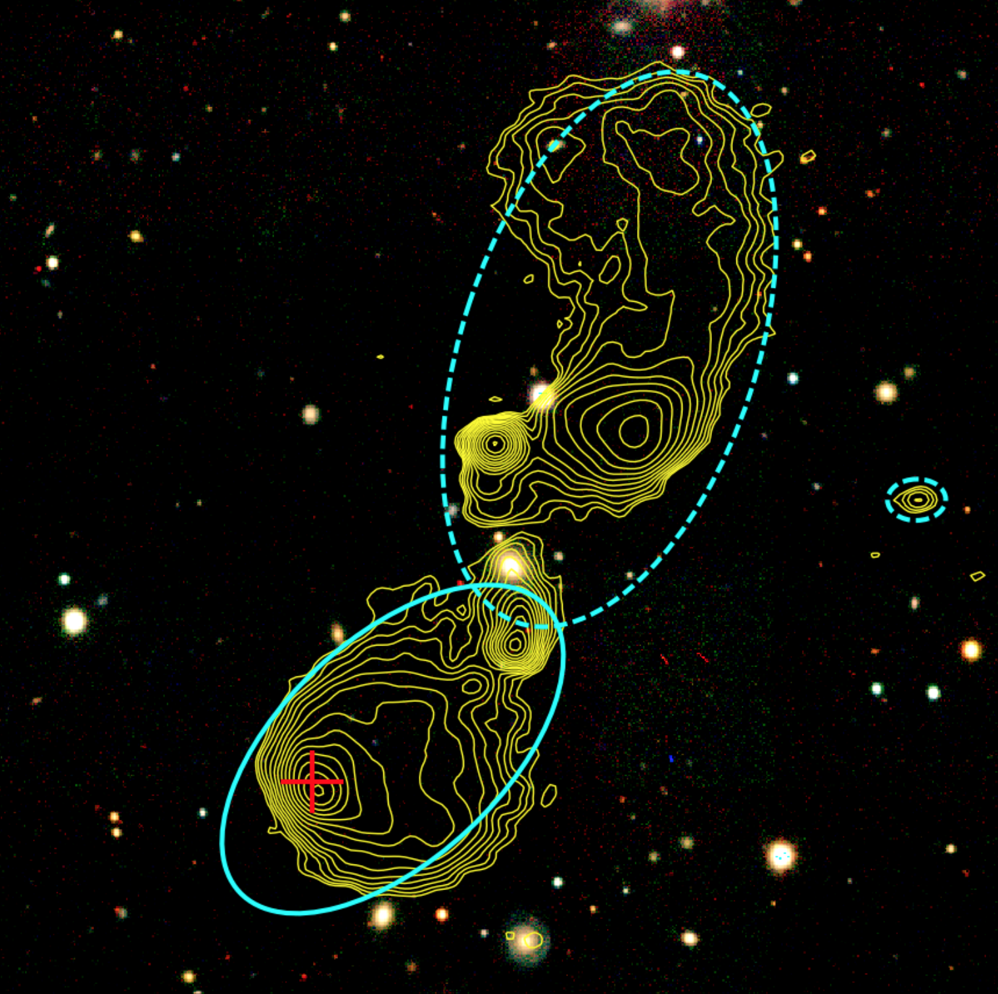

LOFAR Two-Metre Sky Survey (LoTSS) RM Grid
GRM model
RRM = RM - GRM
GRM = Galactic RM
RRM = Residual RM
<RM> ≠ 0
_{(dominated by GRM)}
<RRM>=0
O’Sullivan et al. (2023)
Notes:
How are we going to do this (ie. measure fields in filaments and voids)?
Use a Faraday rotation measure ‘grid’. The is a plot of the LOFAR RM Grid in equatorial coordinates (ie. RA, Dec).
Producing this from the LOFAR data is what has consumed the last 3 years of my life.
Every circle here denotes the RM value of one of these spectacular relativistic jets.
Size of circle: magnitude of RM
Colour: sign of RM

Slide 6
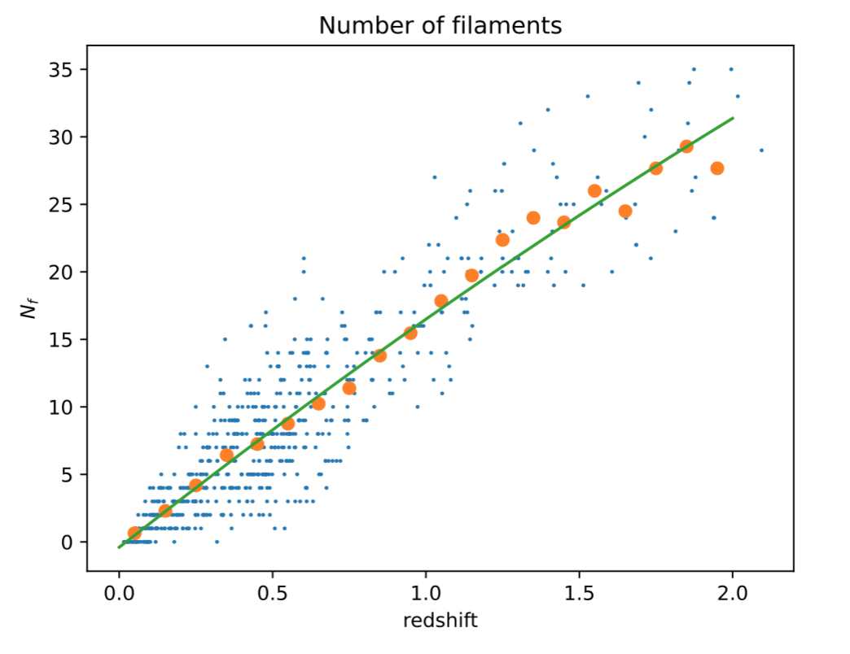


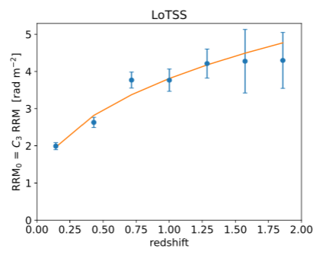
LoTSS DR2: B in cosmic web filaments
Carretti, Vacca, O’Sullivan, et al. (2022), MNRAS, 512, 945. arXiv:2202.04607 (Paper I)
  σ_{(R)RM} vs z analysis for 1003 RMs, z < 2
  Compare with number of filaments along each line of sight
    Chen+15, Carrón-Duque+21
Number of filaments
redshift
  Assuming typical n_{e,f} ~ 10⁻⁵ cm⁻³ and mean path length through a filament L_{f} ~ 3 Mpc => average B_{f} ~ 30 nG
RM dispersion [rad/m²]
More detailed modelling: B_{f} ~10 to 40 nG at z = 0
(Carretti+23, 25)
Redshift
Notes:
We consider the most reasonable interpretation (based on various tests on the data) that the RM signal is really from filaments and not dominated by clusters. But not yet definitive.
10 nG or greater in filaments, depending on how we model n_e

Slide 7
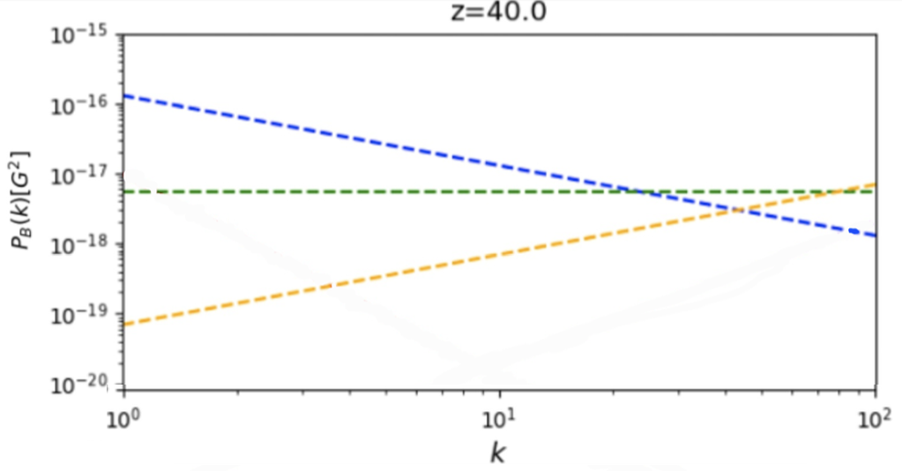
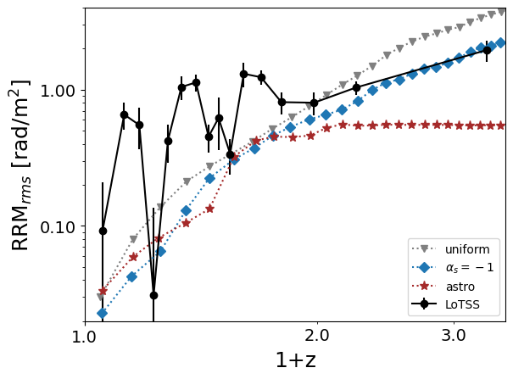
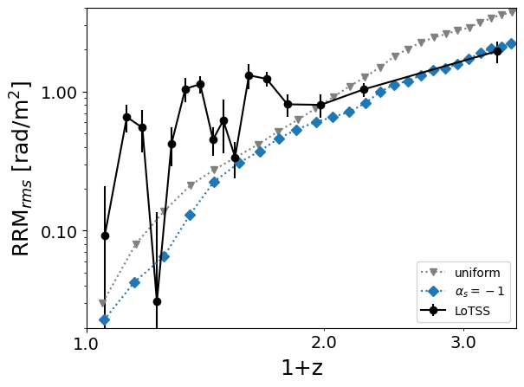
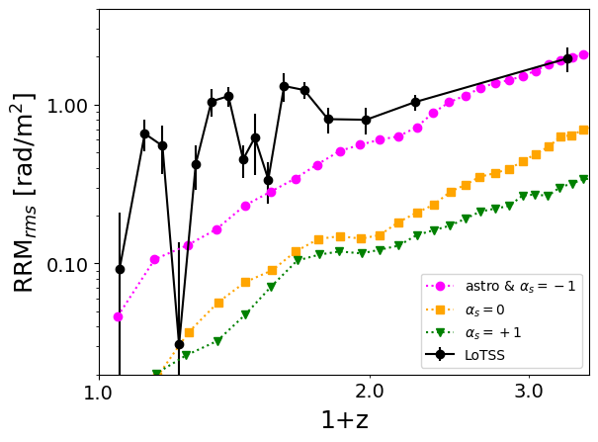
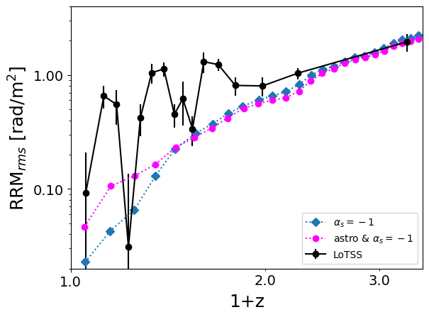
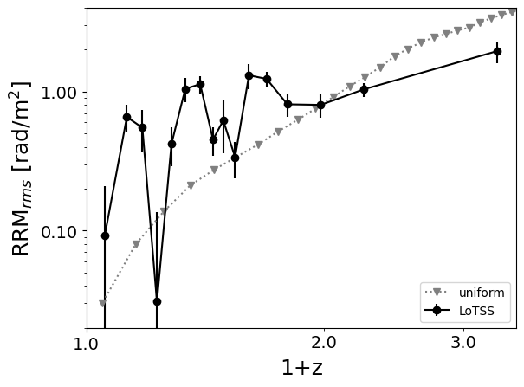
Testing magnetogenesis scenarios
Primordial (causal or inflationary) vs. Astrophysical (galaxy/AGN outflows)
Comparison between LOFAR data and RMs derived from cosmological MHD simulations (Vazza+21, 24)
    Power spectra constrained by CMB limits
    Focus on filament-only contributions
  Primordial uniform B₀ ~ 0.1 nG ruled out (grey)
  Primordial stochastic B consistent (blue) B_{0,rms,Mpc} ~ 0.4 nG
    Dominant astrophysical scenarios disfavored
    Causal scenarios also disfavoured
simulation input
α_{s} = -1 “inflationary”
magnetic field power spectrum
α_{s} = +1 “causal” mechanism
Vazza+21
large scales
small scales
Carretti, Vazza, O’Sullivan, et al. (2024)
RM dispersion [rad/m²]
Notes:
Uniform limit is 10x better than CMB, and comparable to expectations for next-gen CMB missions
Improved high-redshift data quite important for discarding models
Wiggles: 40 sources per bin
Inflation: uniform, or scale-invariant EB ~ k^-1 at generation but turbulent decay produces k^-1.6 at end of recombination
Phase-transitional: k^+2,+4 → causal PMFs + turbulent decay
Tilt of -3 would likely need a B0 lower than 0.4 nG (eg. Vazza+21)
Franco’s models: power spectrum at CMB (not at generation); can a “causal” mechanism decay/evolve to look like “inflationary” spectrum at CMB?
B1 Mpc = 0.04 nG for αs = +1.0, B1 Mpc = 0.35 nG for αs =0.0

Slide 8
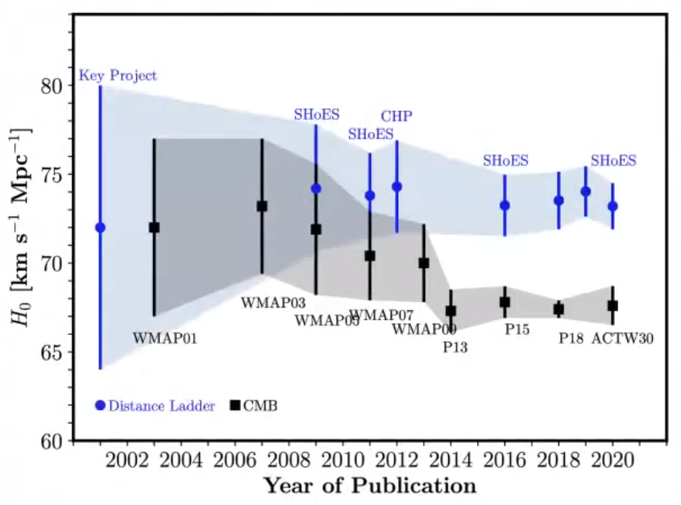
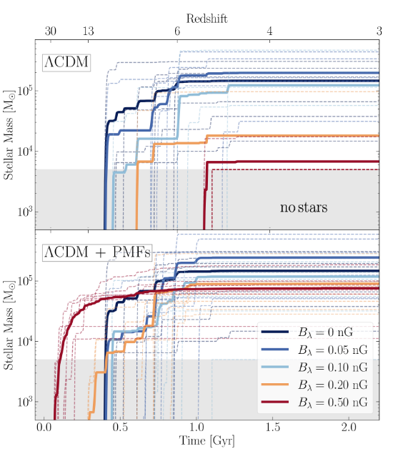
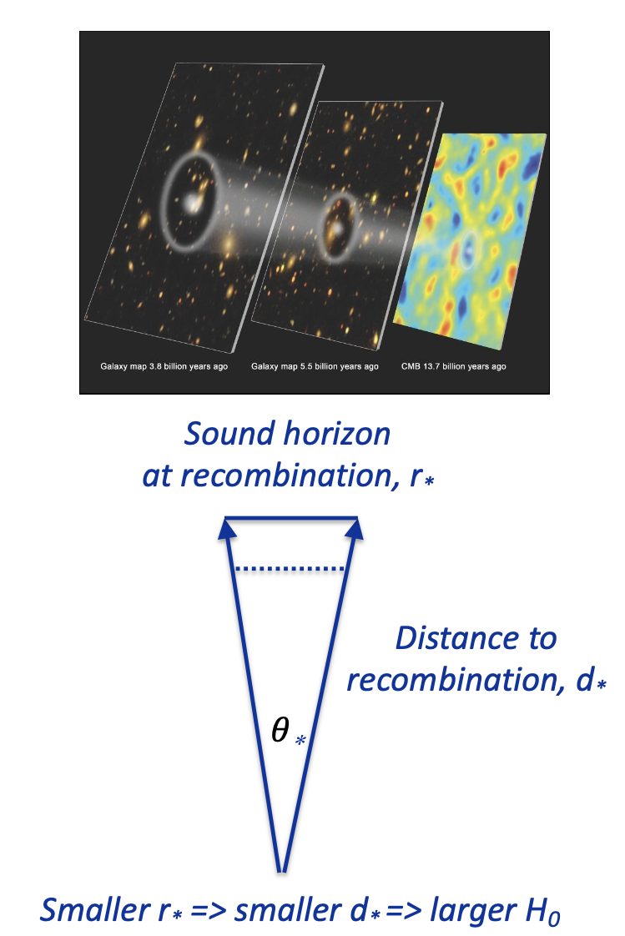
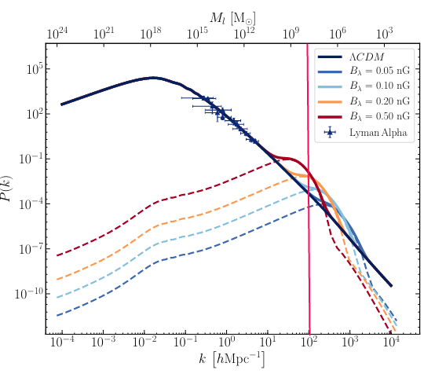
Implications of B_{PMF} ~ 0.4 nG
PMF can “alleviate” Hubble Tension
  B_{PMF}~0.1 nG leads to earlier recombination and H₀ of 70-71 km/s/Mpc Jedamzik & Pogosian (2020)
Effect on matter power spectrum
  Early (dwarf) galaxy formation (Sanati+24)
  Reionisation impact is small (<10%)
MHD turbulence induced SGWB during QCD epoch (in nHz range) or EWPT (μHz – mHz)
  Needs B ~ μG (< pc scales) but can evolve to B < nG on kpc scales by time of CMB
    eg. Caprini & Durrer (2006)

Slide 9
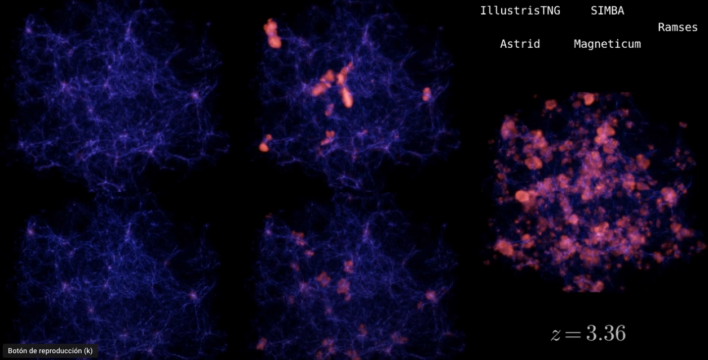
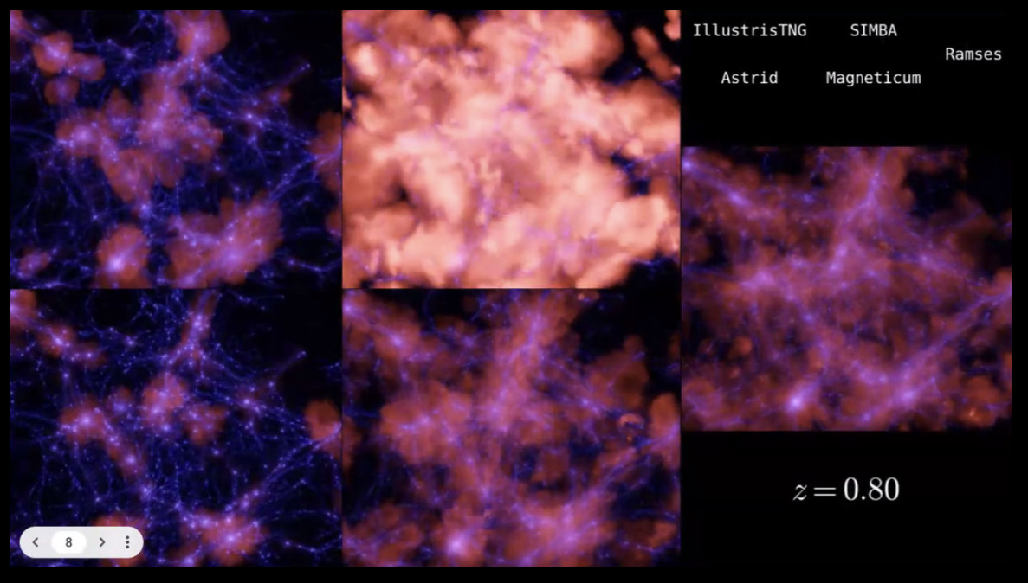
(Magnetised) outflows in simulations
Francisco Villaescusa-Navarro
gas density (blue) and gas temperature (red), 25 Mpc³ box
Notes:
https://www.youtube.com/watch?v=-Za5Eer0DXw

Slide 10
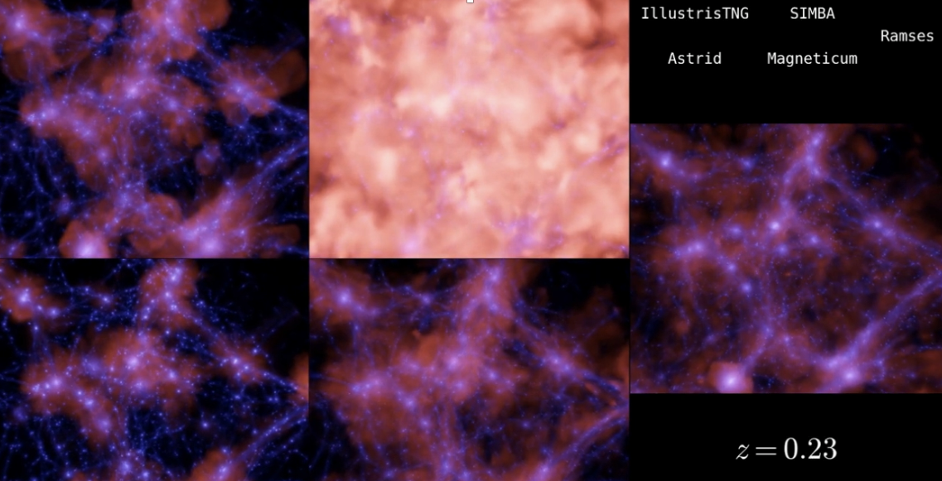
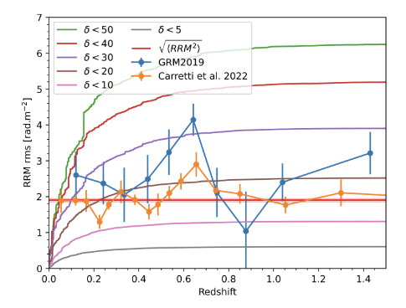
(Magnetised) outflows in simulations
Comparing with IllustrisTNG, magnetised outflows overpredict the observed RRM
  Blunier & Neronov (2023)
RMs provide a key constraint for simulations beyond virialized halos, where there is a lack of other tracers on these scales

Slide 11
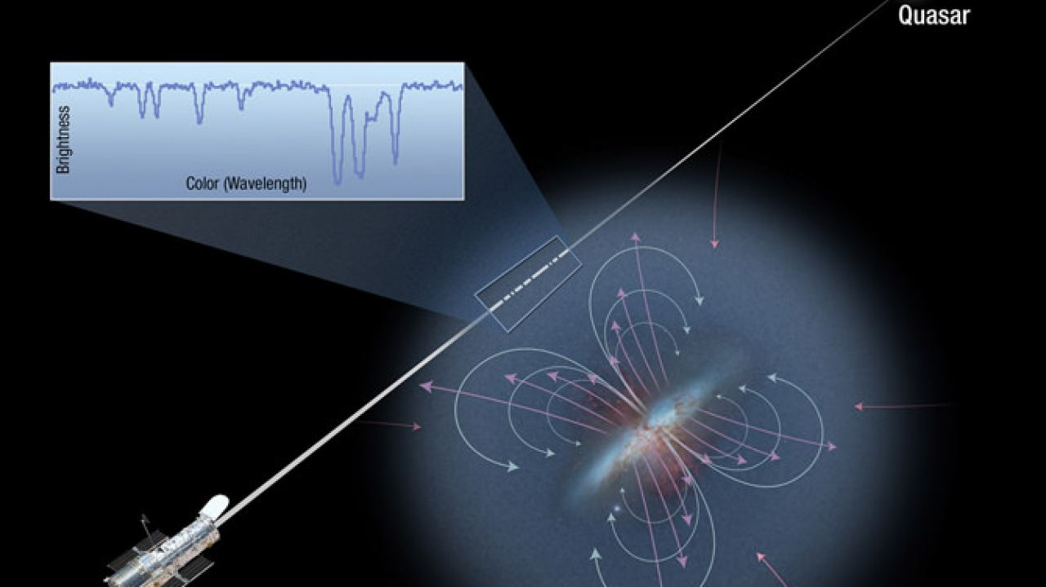
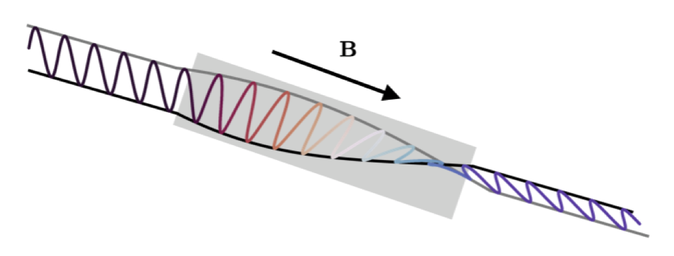
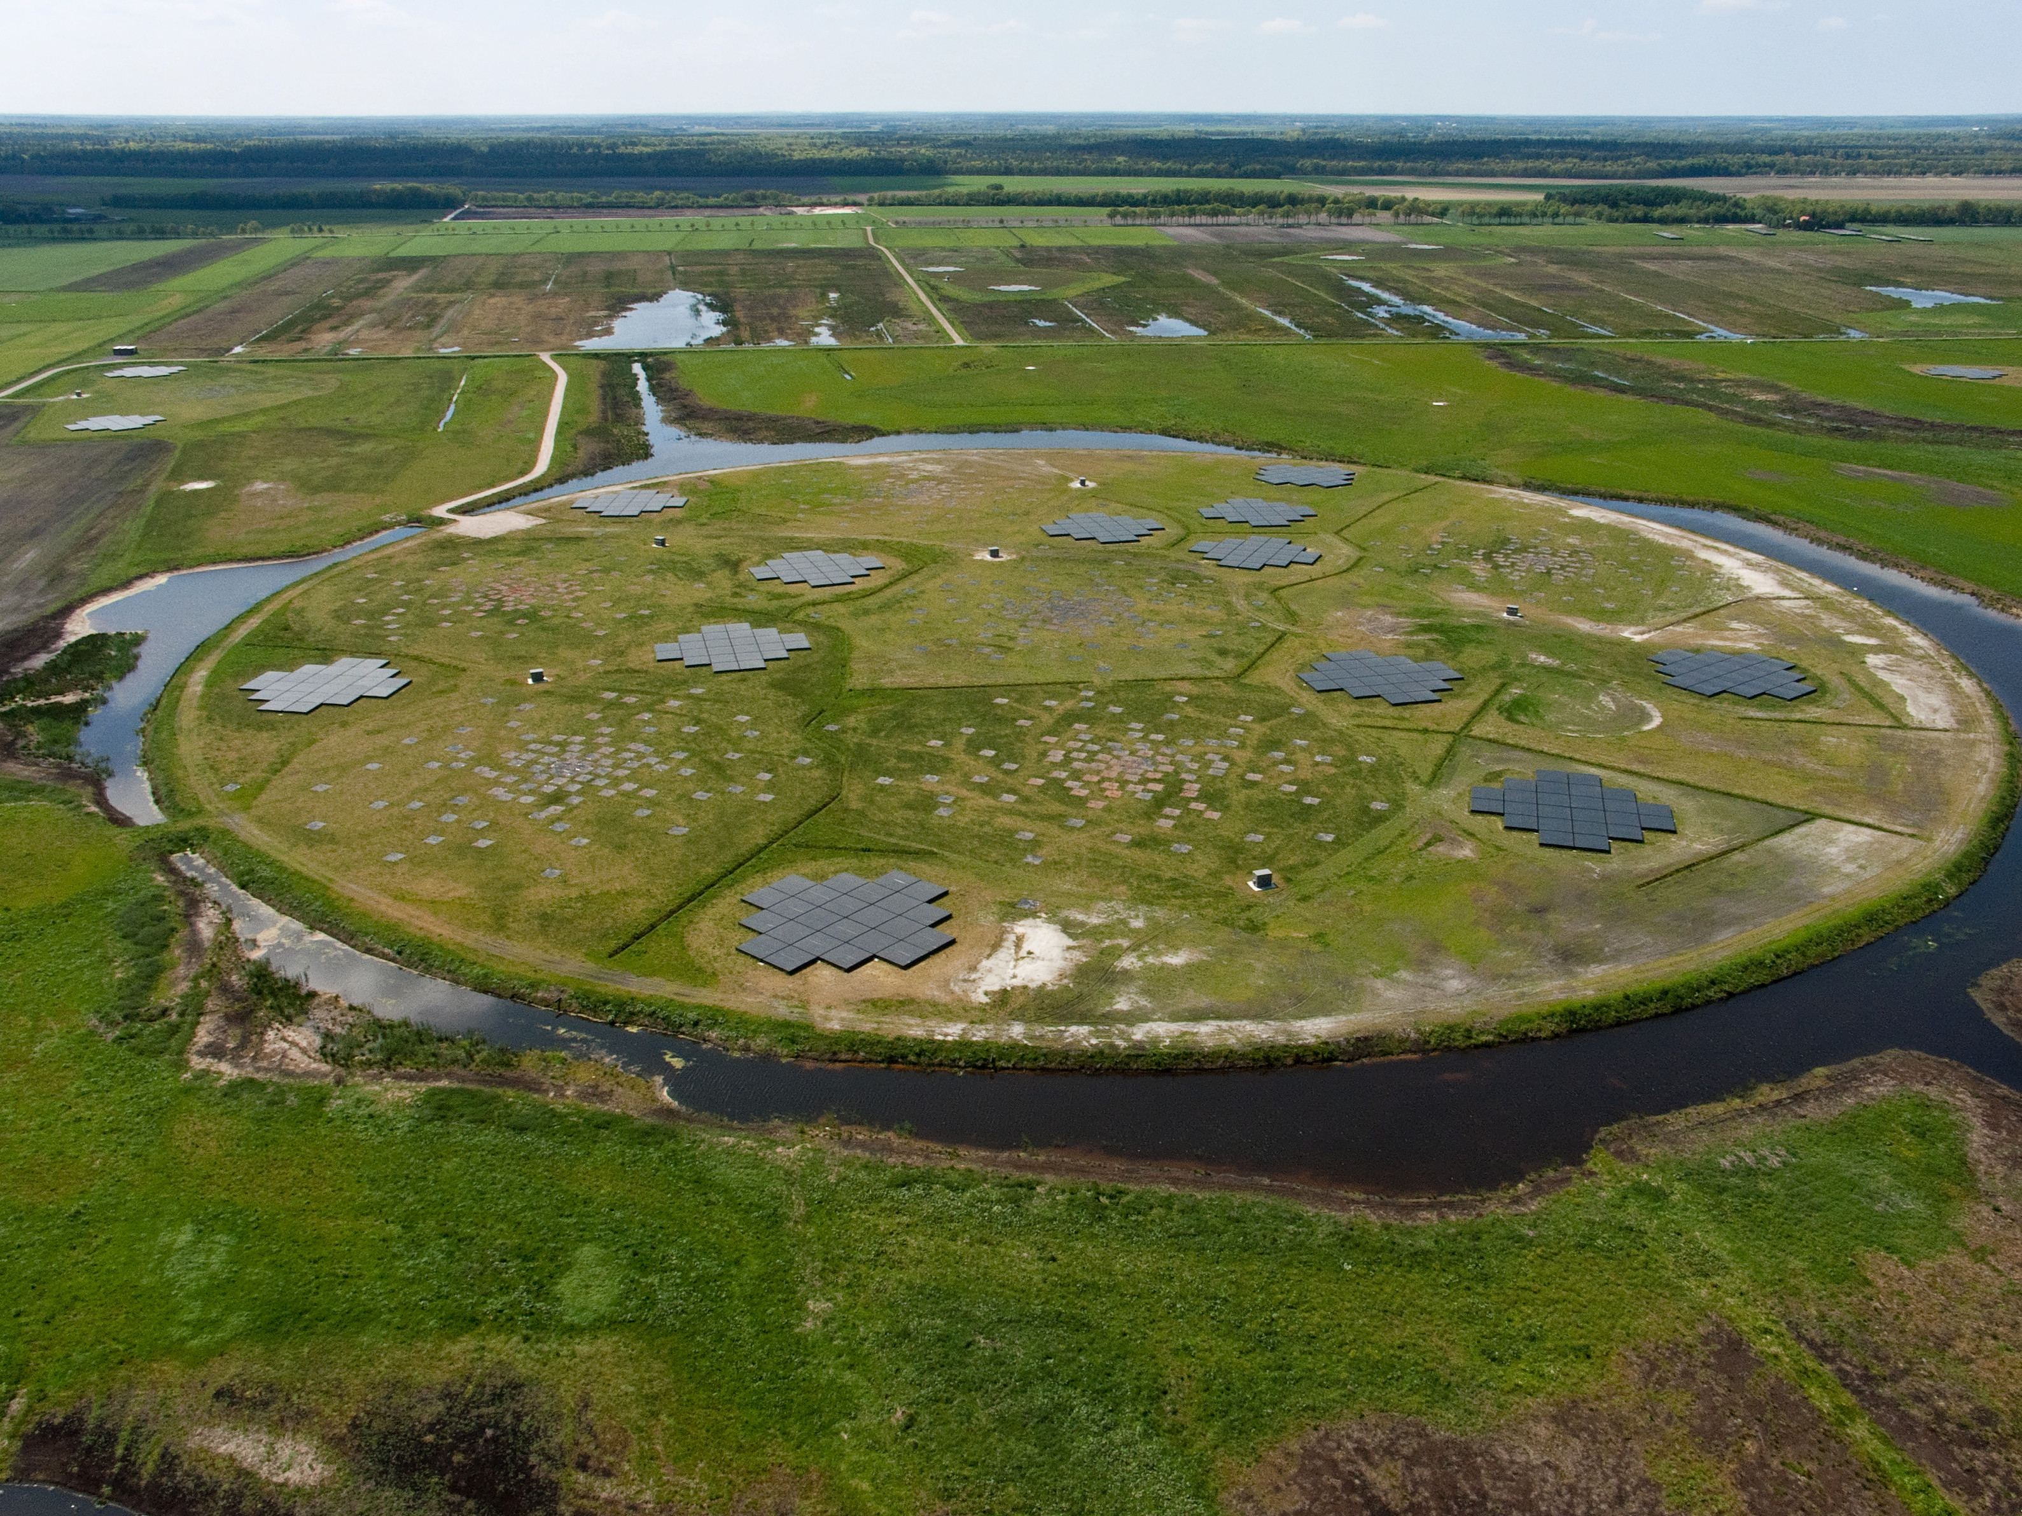
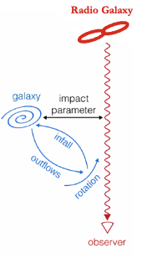
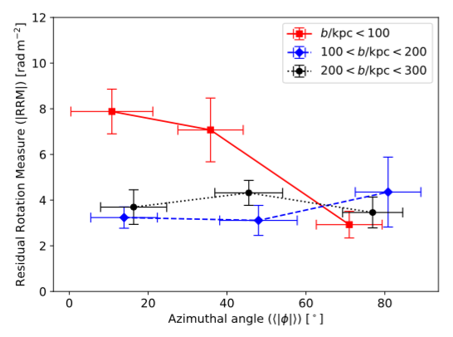
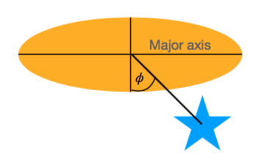
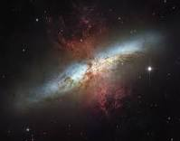
LoTSS DR2: Magnetised CGM of nearby galaxies
Heesen, O’Sullivan, Brüggen, et al. (2023), A&A, 670, 23. arXiv:2302.06617
Radio galaxy
Tracing the magnetised CGM
RM vs impact parameter for 183 nearby galaxies
  Palomar: D < 100 Mpc, D_{median} ~ 18 Mpc
  Excess RM signal at < 100 kpc: galaxies with high inclination angle, and sightlines close to minor axis
  RM excess of ~3.7 ± 0.9 rad/m² (~4σ)
  Implies ~0.5 μG for n_{e} ~ 10⁻⁴ cm⁻³ at ~50 kpc, β ~ 1 (for hot CGM)
  Consistent with expectations from simulations, if CGM magnetised by winds and outflows eg. Pakmor+20
RM dispersion [rad/m²]
Azimuthal angle [deg]
M82
Notes:
Dependence on the azimuthal angle also seen in MgII absorption eg. Bouché+12
Median M* ~ 10⁹ M_{sol}
~10% ellipticals, of order 100 data points on plot
(Palomar m_{B} < 12.5)
For the ordered field, significantly higher scale heights are found (Krause et al. 2020). Assuming r0 ≈ 20 kpc and B0 ≈ 5 μG, the ordered field strength would be the correct strength at r = 50 kpc. B = B0 exp(−r/r0)
The energy density of this field component is UB ≈ 10−14 erg cm−3, in good agreement with the thermal energy density of the hot CGM (T ≈ 106 K), meaning that we find a plasma beta of β ≈ 1

Slide 12
LoTSS DR3 RM Grid
Notes:
Radio telescopes are magnetic field measuring machines
Most of the phenomena that produce bright continuum radio emission are related to magnetic fields

Slide 13
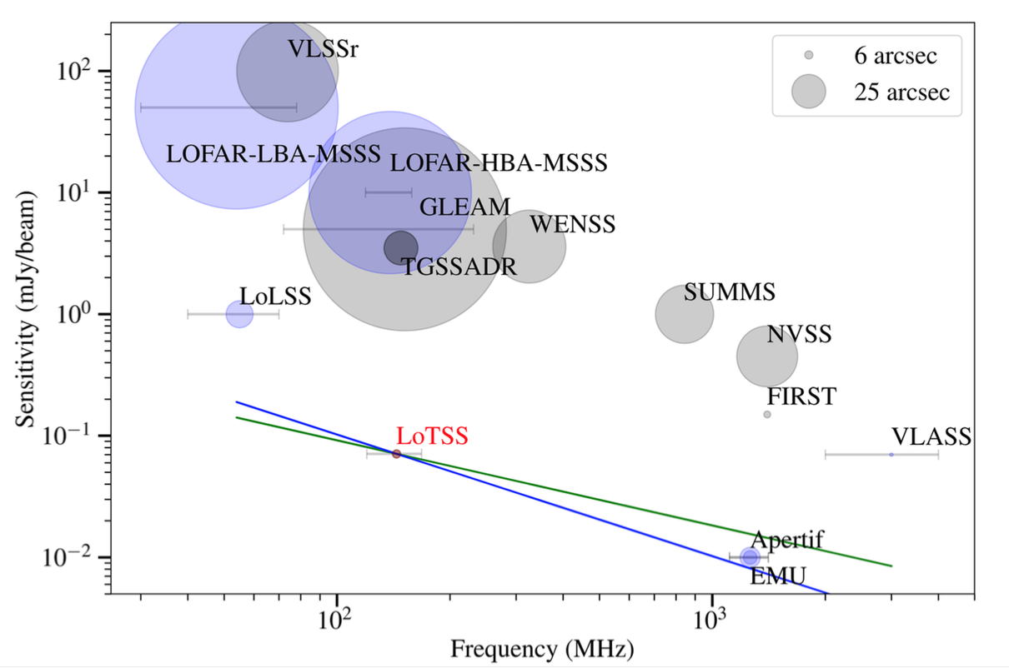
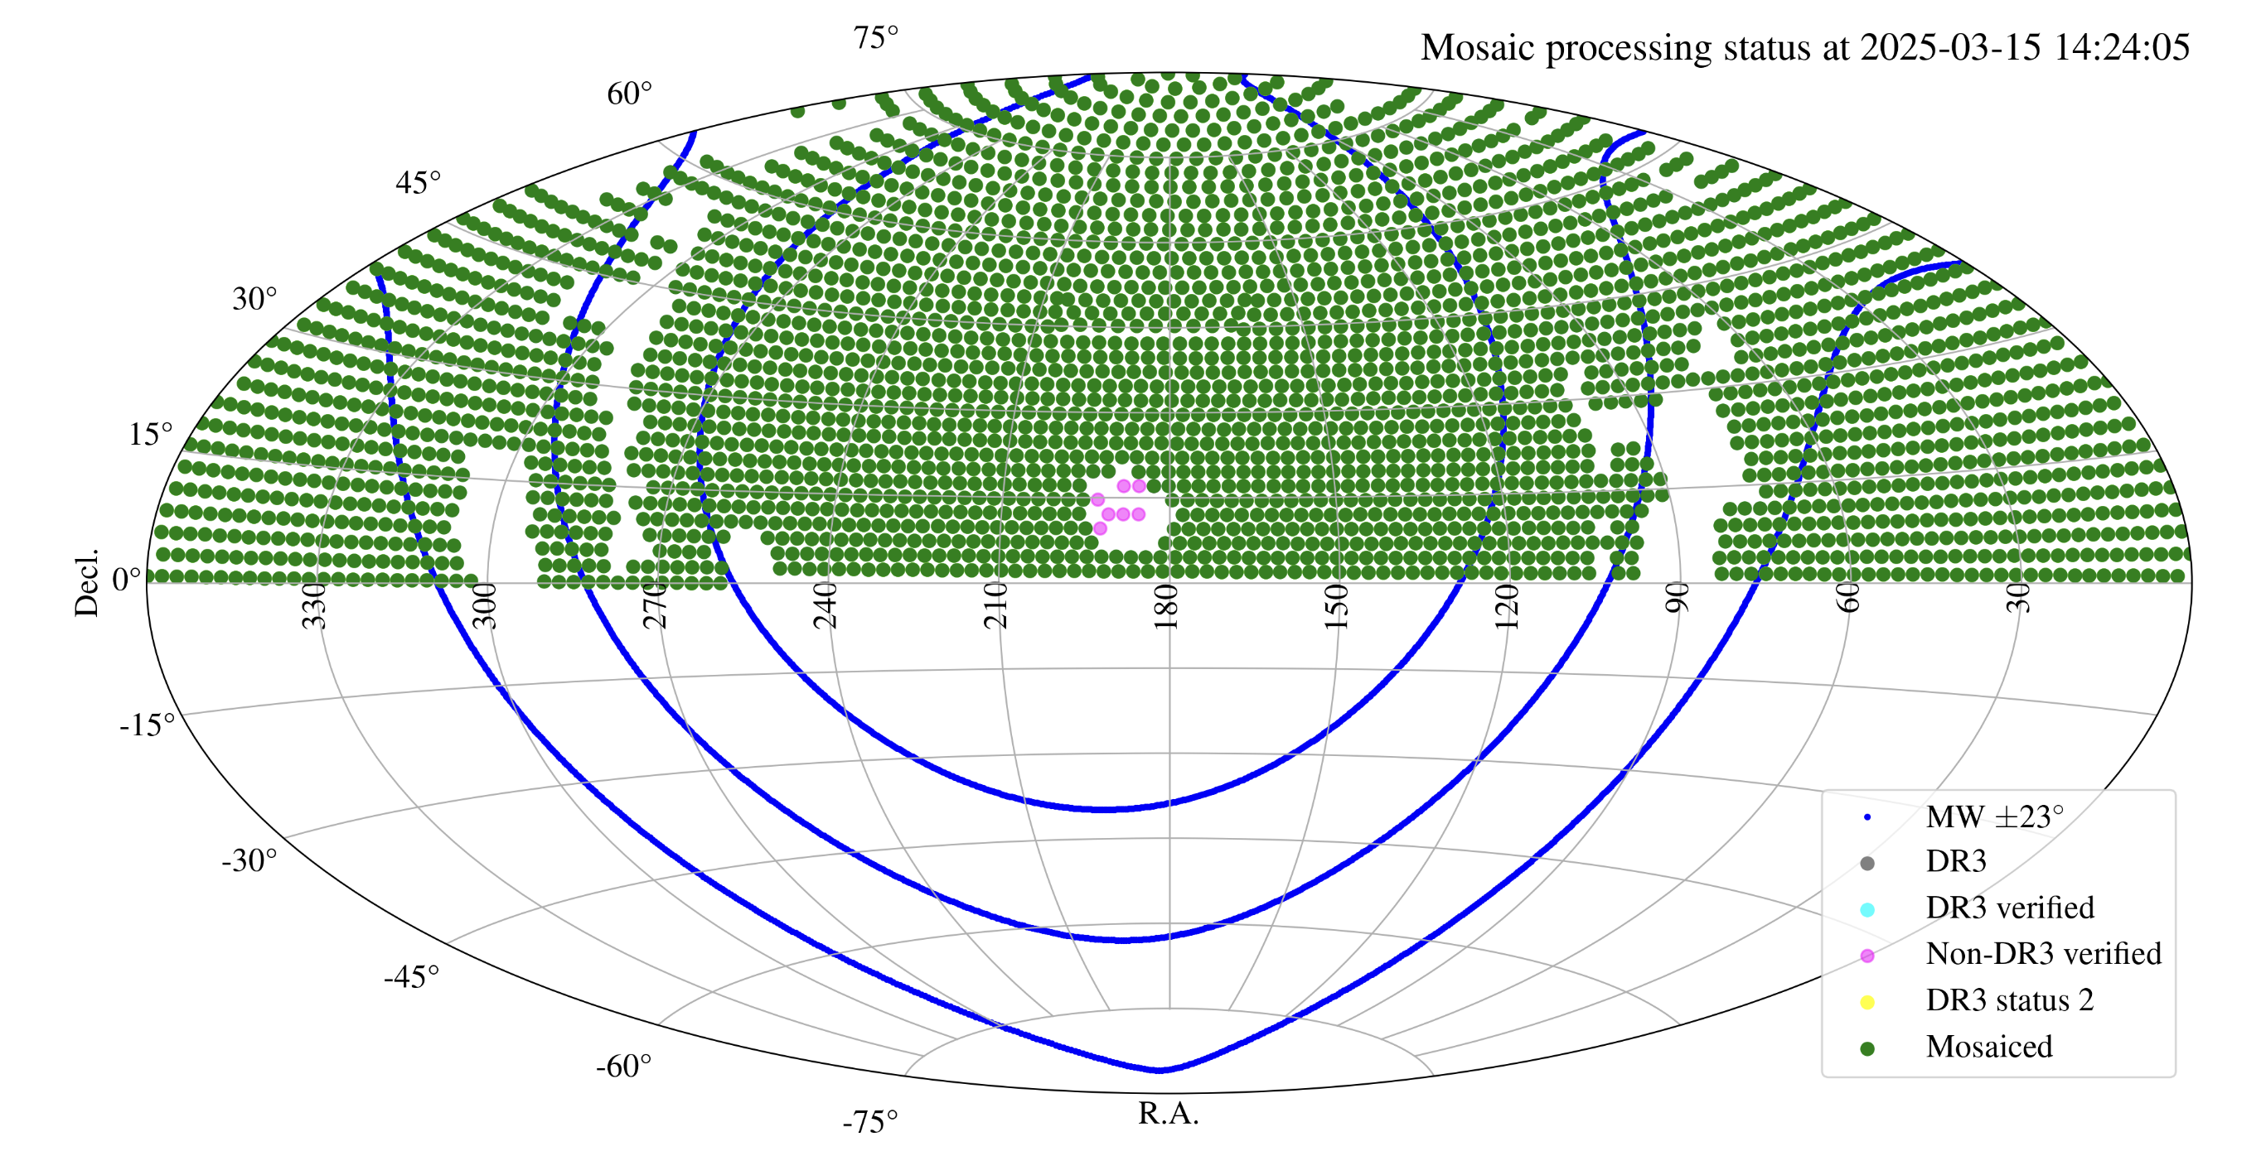
LOFAR Two-metre Sky Survey (LoTSS)
Data Release 3: ~19,000 deg²
  ~14 million Stokes I sources
  120 – 168 MHz (1.8 – 2.5 m, 480 channels)
  20” Stokes QU cubes
  5,104 polarized (> 7σ_{QU})
    ~0.1% of bright detectable sources
  Low RM errors: ≤ 0.1 rad/m²
https://lofar-surveys.org/
Shimwell+26
Notes:
841 → ~0.75 years
Partial coverage within |b| ~ 23º

Slide 14
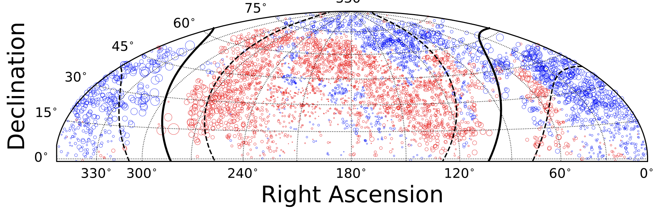

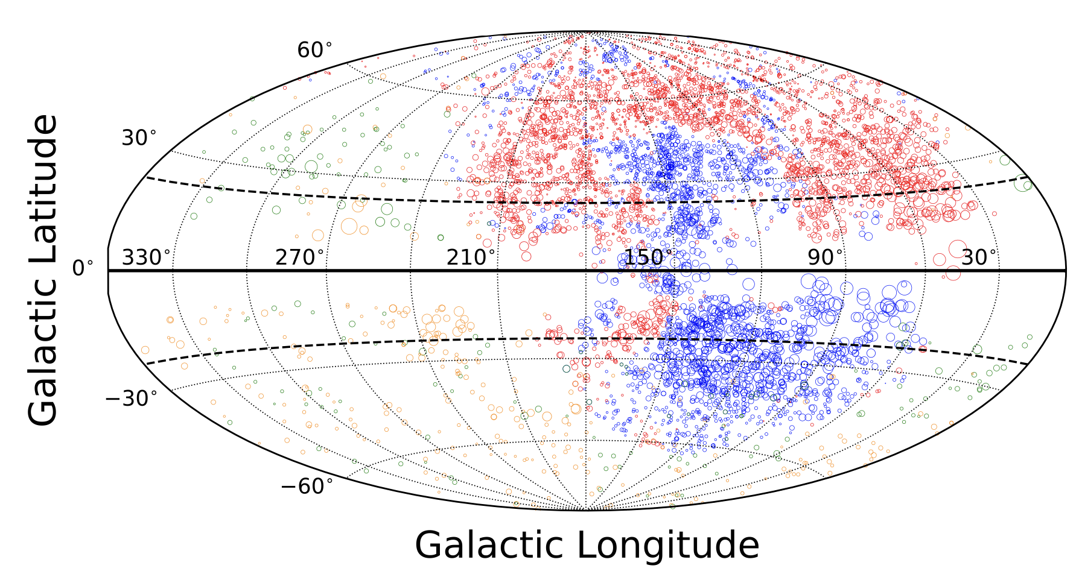
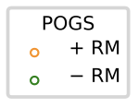
DR3
LoTSS DR3 RM Grid
O’Sullivan+26, in prep
Riseley+20
Notes:
Declination trends due to increased noise:
Dec > 20 deg: median of 2 RMs/field, 24% of fields with no pol sources
Dec < 20 deg: median of 1 RM/field, 34% of fields with no pol sources

Slide 15
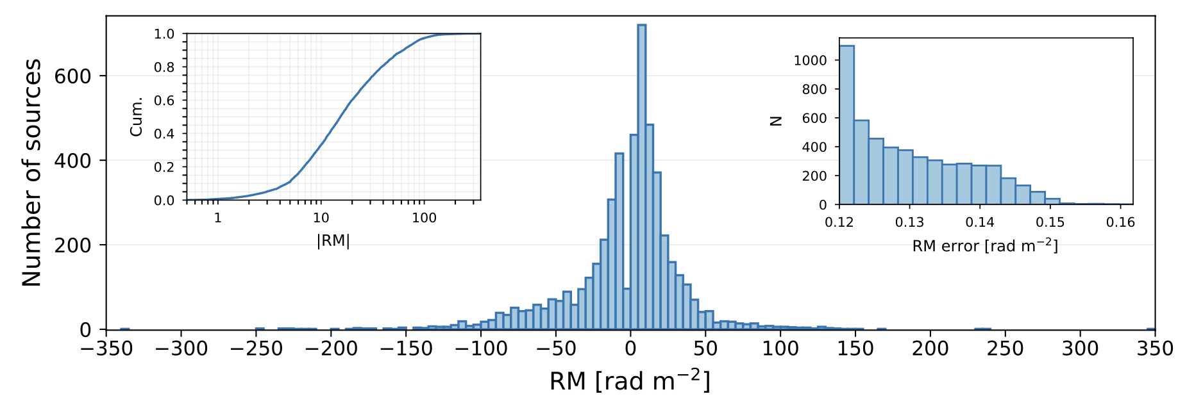
RM distribution
Median RM error ~0.13 rad/m²: dominated by ionosphere (2.5x RM error from S/N)
97.6 kHz channels: bandwidth depolarization significant for |RM| > 100 rad/m2
  ~10% of GRM values > 100 rad/m2 in DR3 area, but only ~4% of RMs > 100 rad/m2
Decrement of RMs near 0 rad/m2: difficult to identify sources in presence of leakage
Notes:
0.04*5104 = 204, so could be missing almost 300 sources due to b/w depol

Slide 16
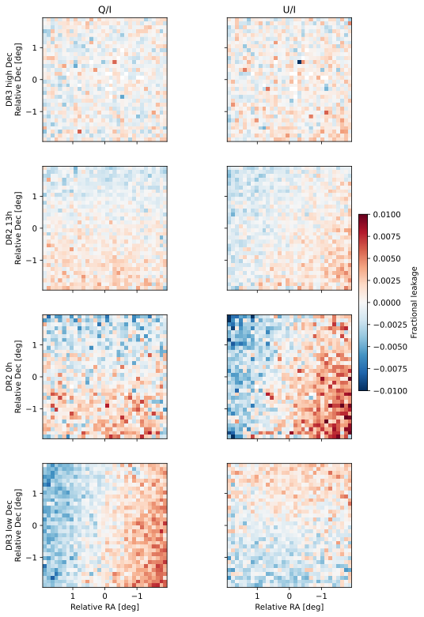
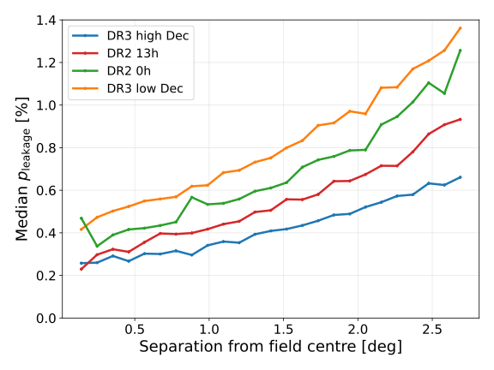
Residual instrumental polarization
Leakage varies from ~0.3% to 1.4%, depending on distance from field centre and Dec.
Residual patterns in Q/I and U/I, which change with Dec.

Slide 17
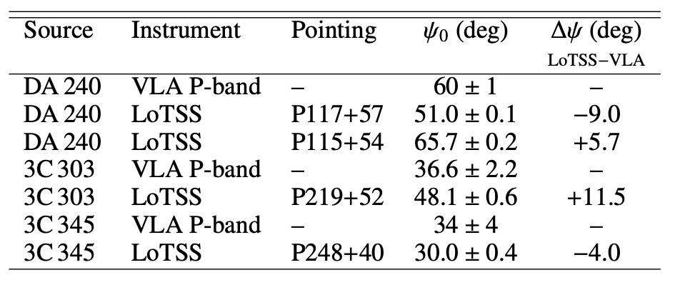
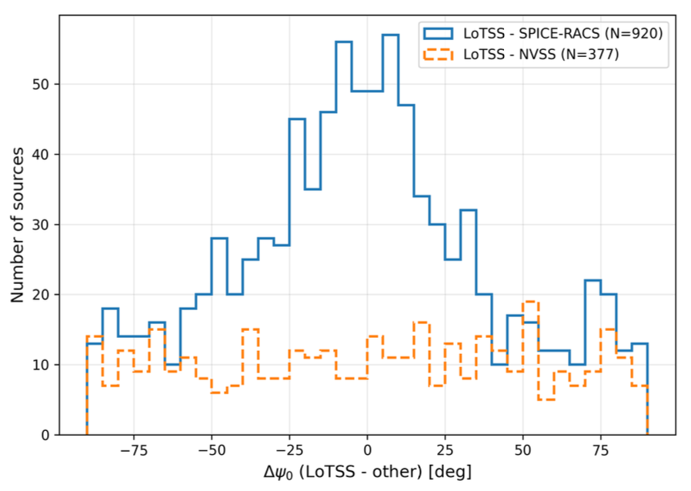
Polarization angle accuracy
Comparison of intrinsic polarization angle for DA 240, 3C 303, 3C 345 between LoTSS and VLA P-band data (EVLA Memo 236)
  Indicates accurate to within ~10 deg
Supported by correlation with angles from SPICE-RACS (ASKAP)
  Thomson+26

Slide 18


Host IDs
DESI Legacy
5,104 RMs
  98% have a host ID (21% “uncertain”)
  88% have a redshift
  1,920 have spec-z, 2324 have phot-z
  0.006 < z < 3.9, with a median z = 0.6

Slide 19



Next frontier: LOFAR2.0
LOFAR2.0: a series of upgrades to enhance LOFAR capabilities (2027+)
  ILoTSS: Proposing to cover 7,600 sq deg at 0.3” down to 30 uJy/beam at 150 MHz
    & finish LoTSS in Galactic plane
  ~80% of LoTSS polarized sources resolved
  Much greater fraction of polarized sources at 0.3 to 1.2”? Overcoming Faraday and beam depolarization
20” to 6” to 0.3”
Cross: linear polarization detection

Slide 20

RM number density at metre-λ
O’Sullivan et al. DR3 RM Grid, in prep.
Missing dense m-λ
RM Grid in southern sky

Slide 21



SKA-Low RM Grid prospects
SKA-Low Commissioning Team
RM detection in imaging mode

Slide 22


SKA-Low: polarized source counts
O’Sullivan et al. Advancing Astrophysics with the SKA II, (2026)
Prediction:
Cumulative polarized source counts
eg. wide-area SKA-Low RM Grid
  80 uJy threshold
  ~5.9 RMs/deg²
  ~15x better than LoTSS
  Could start with AA* and continue with AA4
  Up to 100,000 m-λ RMs possible!

Slide 23
Summary
m-λ RM Grids: powerful probe of the origin of cosmic magnetism
  LoTSS DR2 RM Grid (& γ-ray) analysis favour primodial scenarios (B_{0,1Mpc} ~ 0.4 nG) for the origin of cosmic magnetism Carretti+25
    alleviate Hubble tension, early (dwarf) galaxy formation, impact reionisation history
  But have a broad range of applications (eg. magnetised CGM: Heesen+24, extent of AGN feedback: Blunier & Neronov 2024, new pulsars: Sobey+22, MW B-field: Unger & Farrar 2024)
LOFAR DR3 RM Grid (O’Sullivan et al. in prep.): ~19,000 deg² of northern sky
  5,104 RMs with ~88% having redshift estimates (0.006 < z < 3.9)
LOFAR2.0, 2027+: ILoTSS (0.3” sky survey overlapping with Euclid)
SKA-Low RM Grid: >15x advance on state-of-the-art (up to 100,000 m-λ RMs)
This research is supported by funding from the Comunidad de Madrid Atracción de Talento program via grant 2022-T1/TIC-23797, and grant PID2023-146372OB-I00 funded by MICIU/AEI 10.13039/501100011033 and by ERDF, EU.
Notes:
Faraday rotation: tracer of the inventory of matter, determine origin of cosmic magnetism, probe of early-universe physics (before CMB)
Naively favours inflationary vs causal or astro
However “inverse-cascade” pushes B power to large scales, so TBD (need self consistent sims from generation to structure formation)

Slide 24

depol

Slide 25

Depolarization colour-colour plot

Slide 26



LOFAR2.0: ILoTSS
Contours:
polarized intensity
ILoTSS (2025+): cover Euclid extragalactic sky at matched resolution (0.3”), 30 uJy/beam at 150 MHz
  Deepest wide-area and highest resolution radio survey
  Spec-z of 10⁶ host galaxies to z ~ 1 (WEAVE-LOFAR)
  >5000 new radio-loud gravitational lens systems expected
  Independent constraints on the cosmological parameters
  Advanced RM Grid: unique science cases at 0.3” that are not presently possible with SKA-Low
van Weeren et al., (2026)
lofar-surveys.org/ilotss
Mahatma+23
Credit: T.W. Shimwell

Slide 27

Host IDs
DESI Legacy
RM = -13.374 ± 0.003 rad/m²
P ~ 42 mJy/beam (2.4%)

Slide 28

SKA-Low 10,000 deg² RM Grid
O’Sullivan et al. SKA Science chapter, in prep.
Survey area of ~10,000 deg² of extragalactic sky
  eg. match DES and Euclid for Dec < 0º (and Roman)
  and full overlap with ASKAP-POSSUM (best cm-RM Grid)
Yellow: Euclid
Red: DES
Pink/purple/black: Roman
Euclid preparation. I. The Euclid Wide Survey (2022)

Slide 29

SKA-Low 10,000 deg² RM Grid
O’Sullivan et al. SKA Science chapter, in prep.
Higher FoM = better
N_{total}: combines survey area and RM sky density
SKA-Low wide-area: leading RM Grid for low-density, weakly magnetised Universe (eg. cosmic web filaments)
  assumes high precision Milky Way RM model (expected from POSSUM data & SKA-Mid) and current best ionosphere RM models
Notes:
At what dRM=0.8 rad/m2 it matches POSSUM, LoTSS DR3: ~1.4
A bit unfair because median error is still 0.5 for SKA-Low but ~1.5 for POSSUM/SKA-Mid ➔ 0.6

