Slide 1
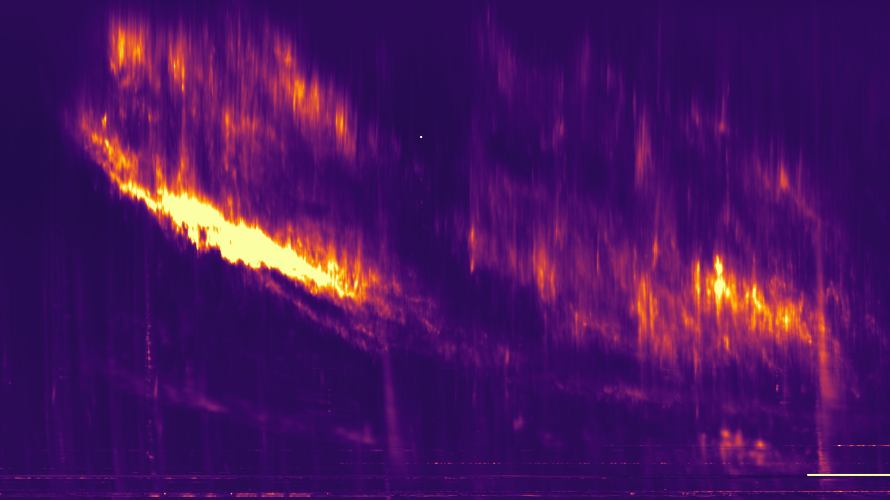



SOLAR RESEARCH WITH LOFAR TELESCOPE
BARTOSZ DĄBROWSKI and core team of Solar and Space Weather KSP
Space Radio-Diagnostics Research Centre
University of Warmia and Mazury in Olsztyn
@LOFAR IDOLS
2023/07/10
LOFAR
Solar and Space Weather
KSP
Incremental Development of LOFAR Space-Weather

Slide 2
LIST OF SOLAR AND SPACE WEATHER KSP CORE MEMBERS (IN ALPHABETICAL ORDER)
Mario Bisi
Bartosz Dabrowski
Peter Gallagher
Andrzej Krankowski
Jasmina Magdalenic
Gottfried Mann
Christophe Marqué
Barbara Matyjasiak
Diana Morosan
Hanna Rothkaehl
Christian Vocks
Pietro Zucca
LOFAR
Solar and Space Weather
KSP

Slide 3
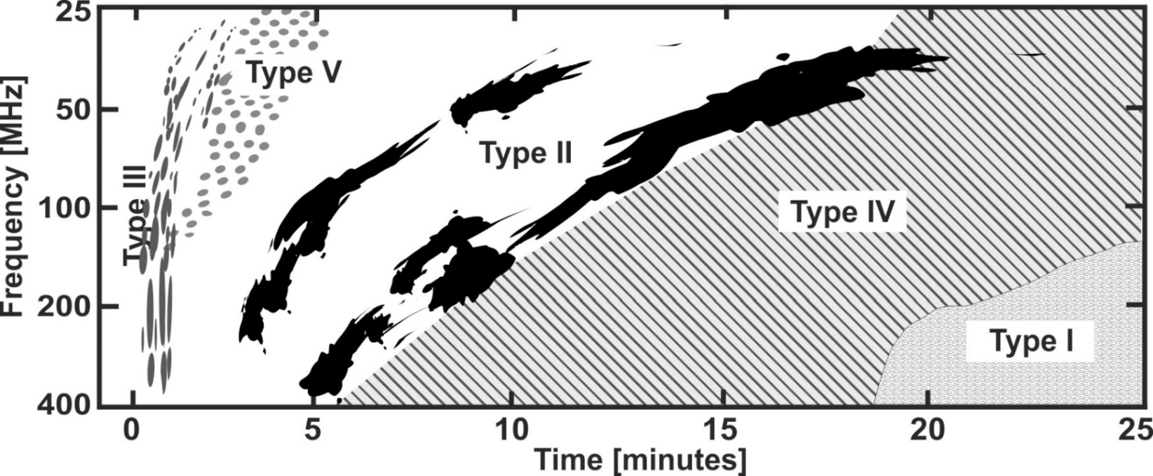
SOLAR RADIO BURSTS
Solar radio observations are made at a large range of wavelengths: microwaves (f > 3 GHz), decimeter/meter (f < 3 GHz), dekameter (f < 30 MHz), hectometer/kilometer (f < 3 MHz).
All this is also a result of solar radiation properties in different wavelength ranges.
Meter-λ bursts were classified into into five basic types: type I, type II , type III, type IV, and type V.
Based on: Wild et al. 1963

Slide 4
SOLAR RADIO BURSTS
Radio burst types in the framework of the standard flare scenario.
The acceleration region is located in the reconnection area. Accelerating electron beams move upward (type III, U) and downward (type RS, DCIM bursts).
Aschwanden 2005

Slide 5
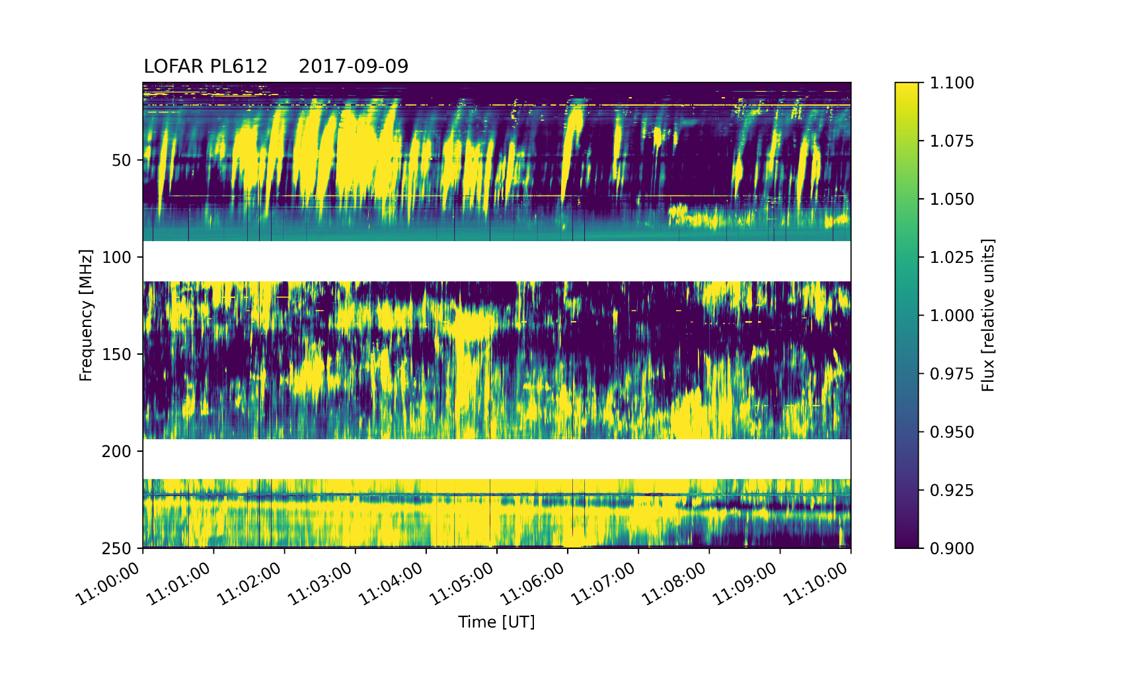
TYPE I RADIO BURSTS
Type I bursts on dynamic spectra are observed as narrow-band and short-lived structures. They most often appear as chains. When type I bursts are superimposed on an amplified, slowly varying continuum of emissions, it is called a type I noise storm, lasting from tens of minutes to several days.
Type III
Type I
Type I
Solar research with LOFAR telescope

Slide 6
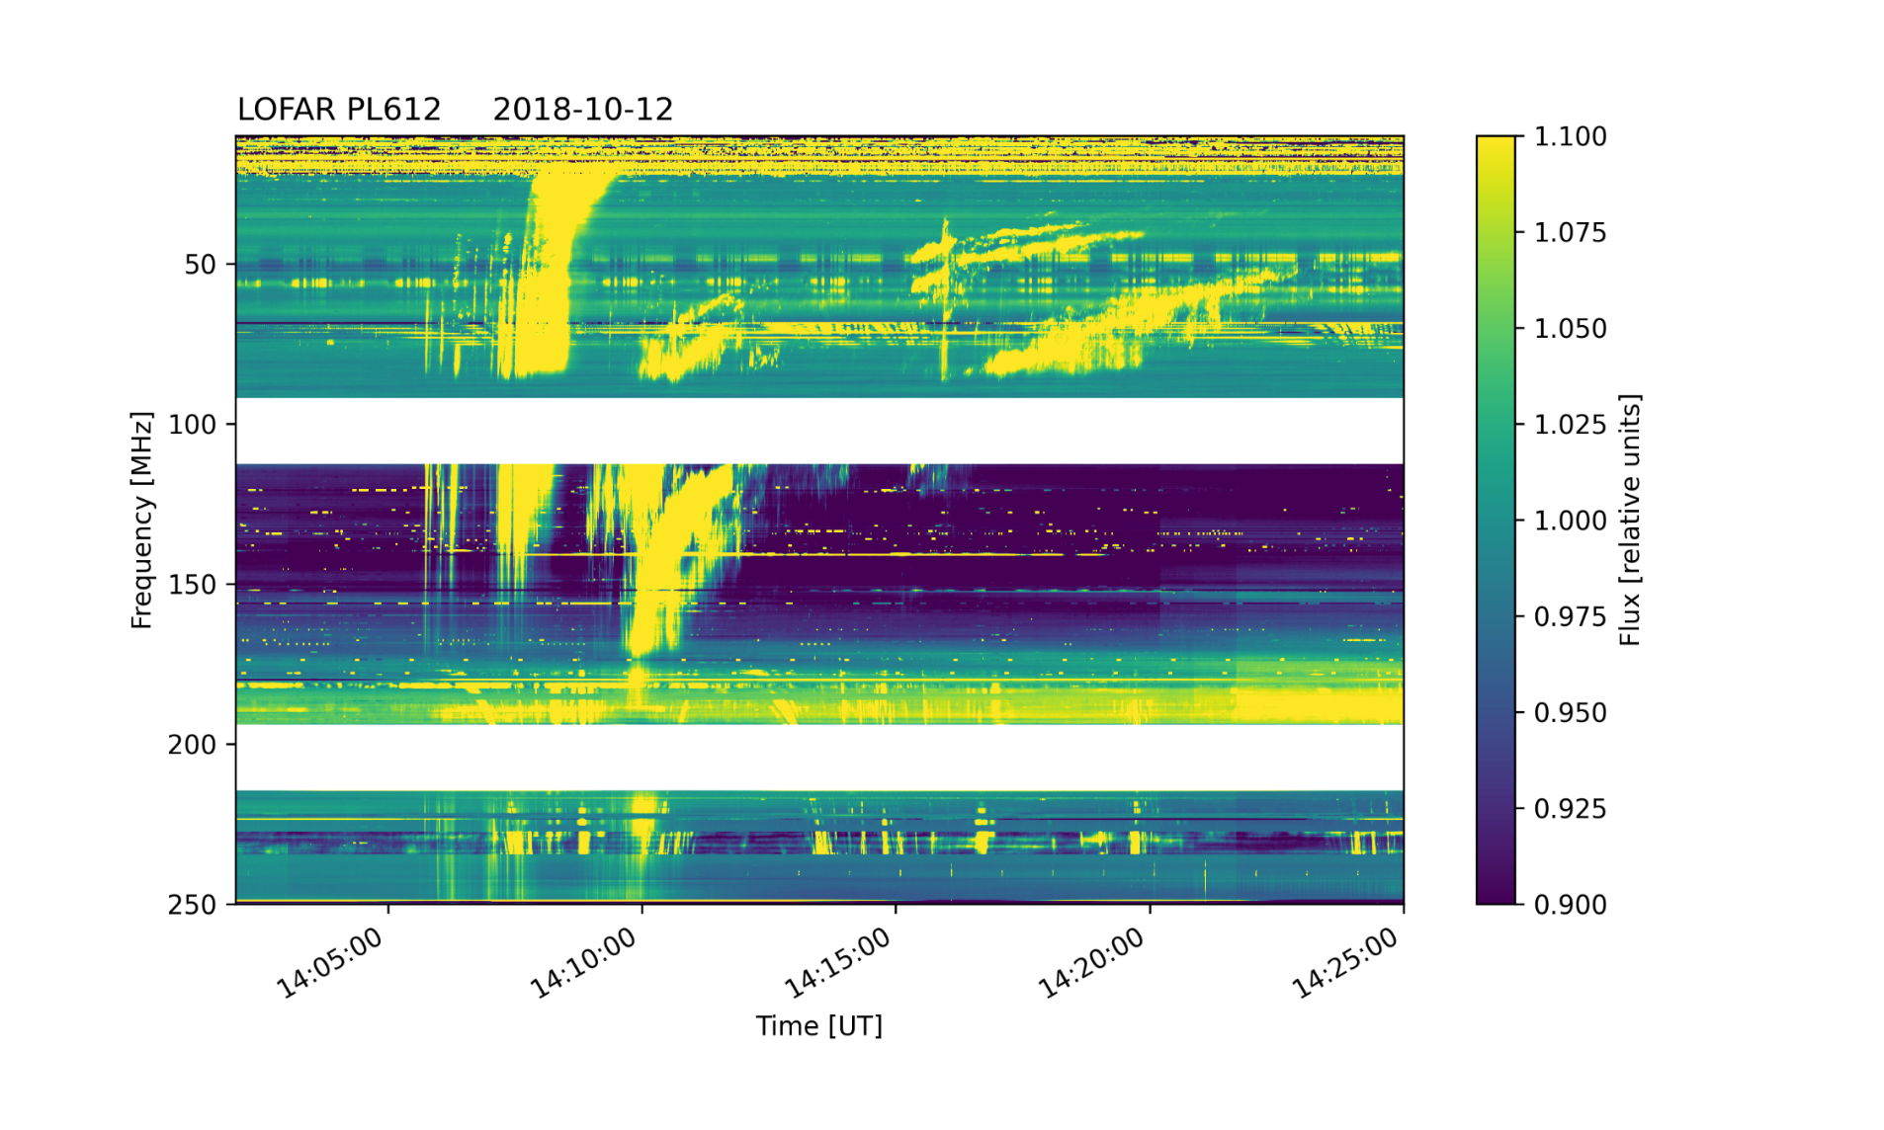
TYPE II RADIO BURSTS
Type II bursts are narrowband (a few MHz) emission lanes which slowly drift towards lower frequencies (around 0.1−1 MHz/s). Both fundamental (F) and harmonic (H) band can be present, and sometimes each band is split into a higher and a lower frequency lane. Type II bursts are asocieted with flares and/or CMEs.
F
F
band-splitting
Type III
H
Type II
band-splitting
Solar research with LOFAR telescope

Slide 7
TYPE III RADIO BURSTS
Type III events are the most common flare associated bursts and can occur over a wide frequency range 1 GHz–10 kHz (from the low corona to beyond 1 AU). In the dynamic spectrum they occur usually in groups of several almost vertical structures of enhanced radio emission.
Duration:
single burst: 1–3 s,
group: 1–5 min,
storm: minutes–hours.
Type III
Type I
Type I
Solar research with LOFAR telescope

Slide 8
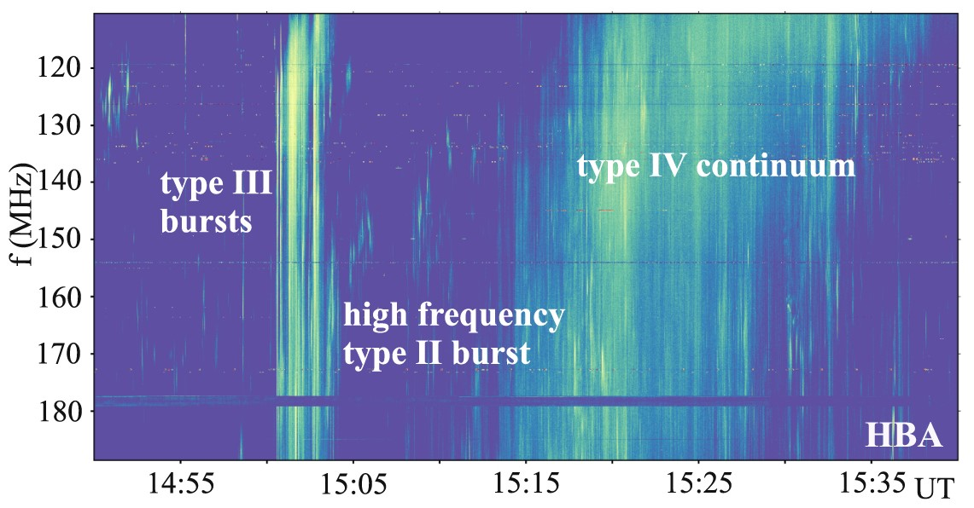
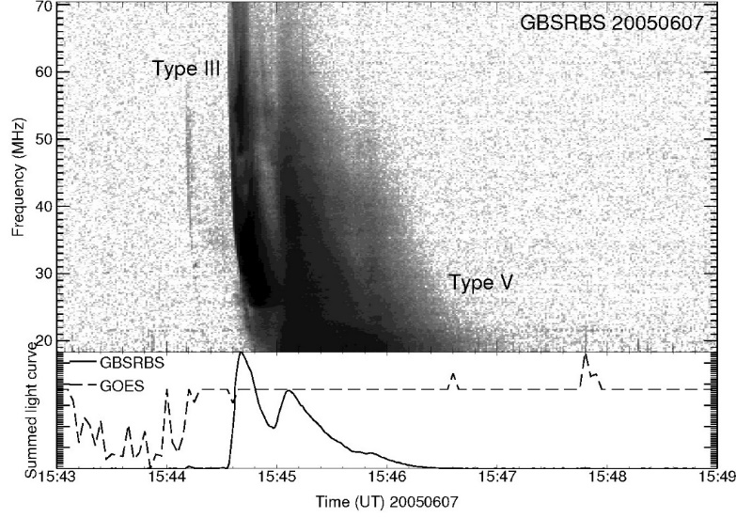
TYPE IV & V RADIO BURSTS
Type IV bursts are flare-related broad-band continua. They are divided into two distinct categories:
stationary, show no frequency drift and are characterized as broad-band, long-lasting continuum features which show a wide variety of fine structures – pulsations, zebra patterns and fiber bursts,
moving, display a slow drift towards lower frequencies, while they are otherwise morphologically similar to stationary type IVs.
Magdalenić et al. 2020
Type V bursts are continuum bursts which start during or immediately after a group of type III bursts. They are relatively rare and often difficult to identify, particularly if there are other bursts present at the same time.
White 2007
Solar research with LOFAR telescope

Slide 9
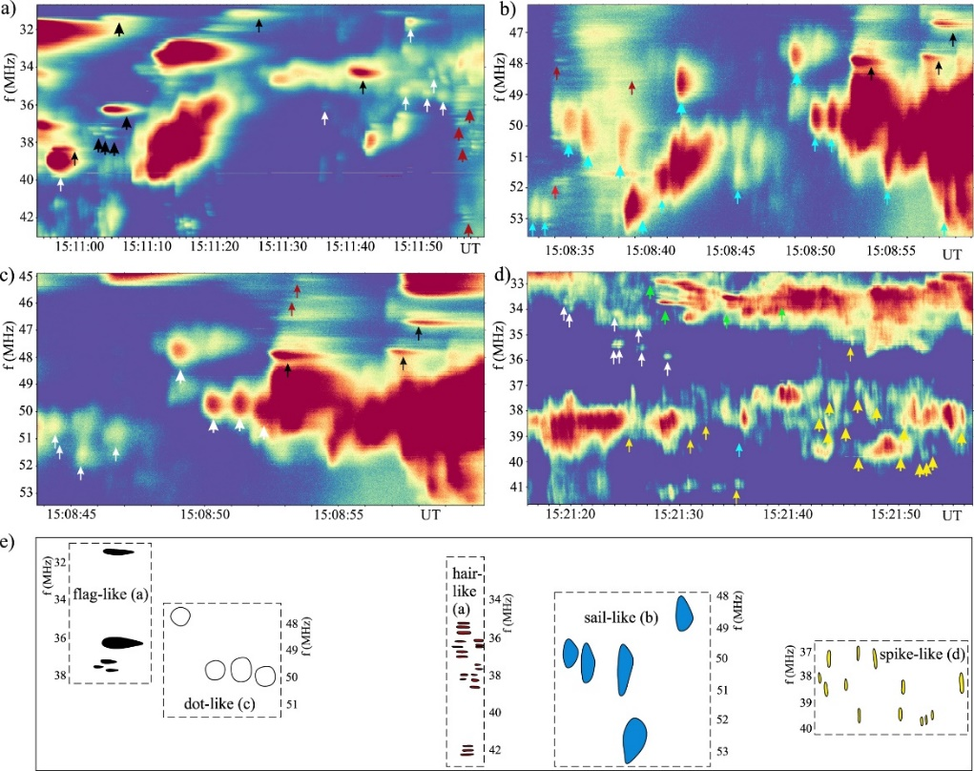
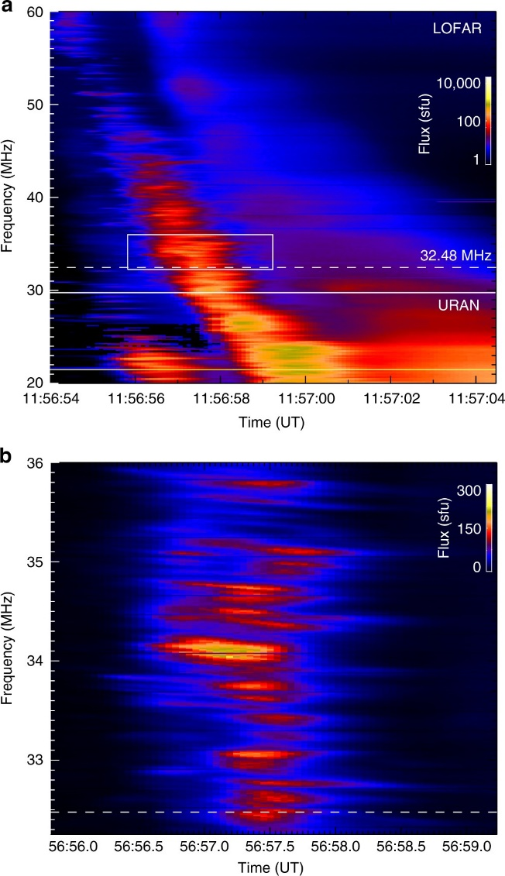
FINE STRUCTURES
a) The type III-IIIb solar radio burst observed on 16 April 2015 with both LOFAR and URAN-2. b) The expanded view of a 3 s interval shows finely-structured type IIIb striae (Kontar et al. 2017)
LOFAR dynamic spectra of different narrowband FSs (flag-like, dot-like, sail-like, and spike-like bursts) in the type II burst (Magdalenić et al. 2020)

Slide 10
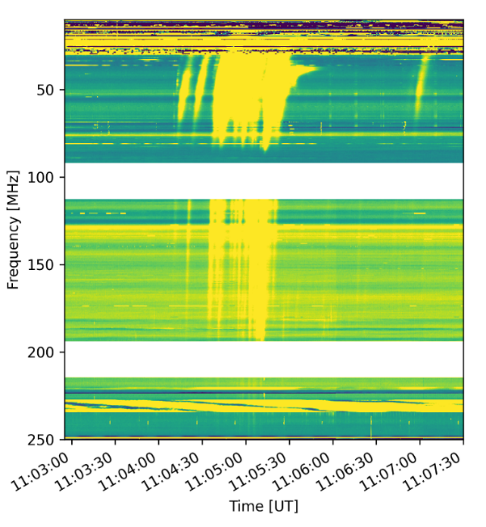
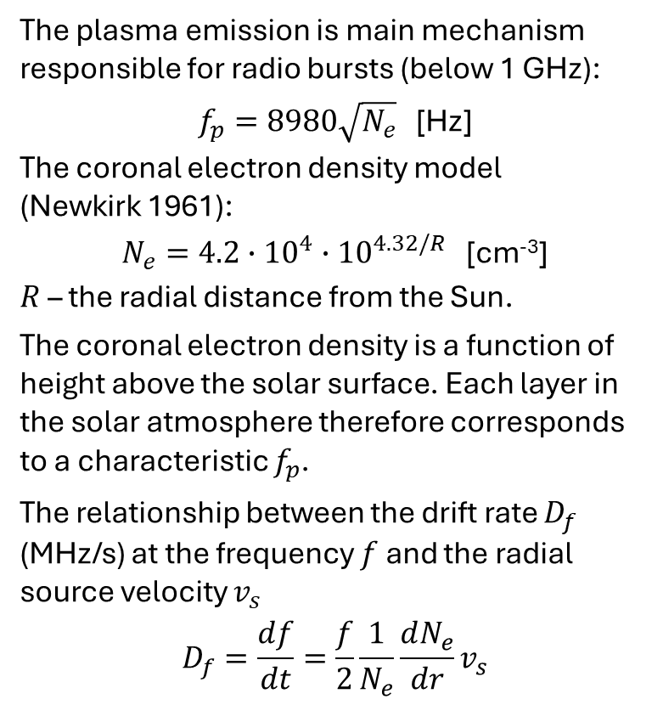
SOURCE HEIGHT AND VELOCITY
Height from center of the Sun
The plasma emission is main mechanism responsible for radio bursts (below 1 GHz):
$f_{p}=8980\sqrt{N_{e}}$ [Hz]
The coronal electron density model
(Newkirk 1961):
$N_{e}=4.2∙{10}^{4}{∙10}^{4.32/R}$ [cm⁻³]
$R$ – the radial distance from the Sun.
The coronal electron density is a function of height above the solar surface. Each layer in the solar atmosphere therefore corresponds to a characteristic $f_{p}$.
The relationship between the drift rate $D_{f}$ (MHz/s) at the frequency $f$ and the radial source velocity $v_{s}$
$$D_{f}=\frac{df}{dt}=\frac{f}{2}\frac{1}{N_{e}}\frac{dN_{e}}{dr}v_{s}$$
2.00·10⁶ km
15 MHz
1.75·10⁶ km
19 MHz
3R☉
1.50·10⁶ km
27 MHz
Frequency [MHz]
1.25·10⁶ km
43 MHz
1.00·10⁶ km
86 MHz
2R☉
0.75·10⁶ km
270 MHz
SUN
Time [UT]
1R☉
Based on: Warmuth & Mann 2005
Relationship between frequency and height

Slide 11
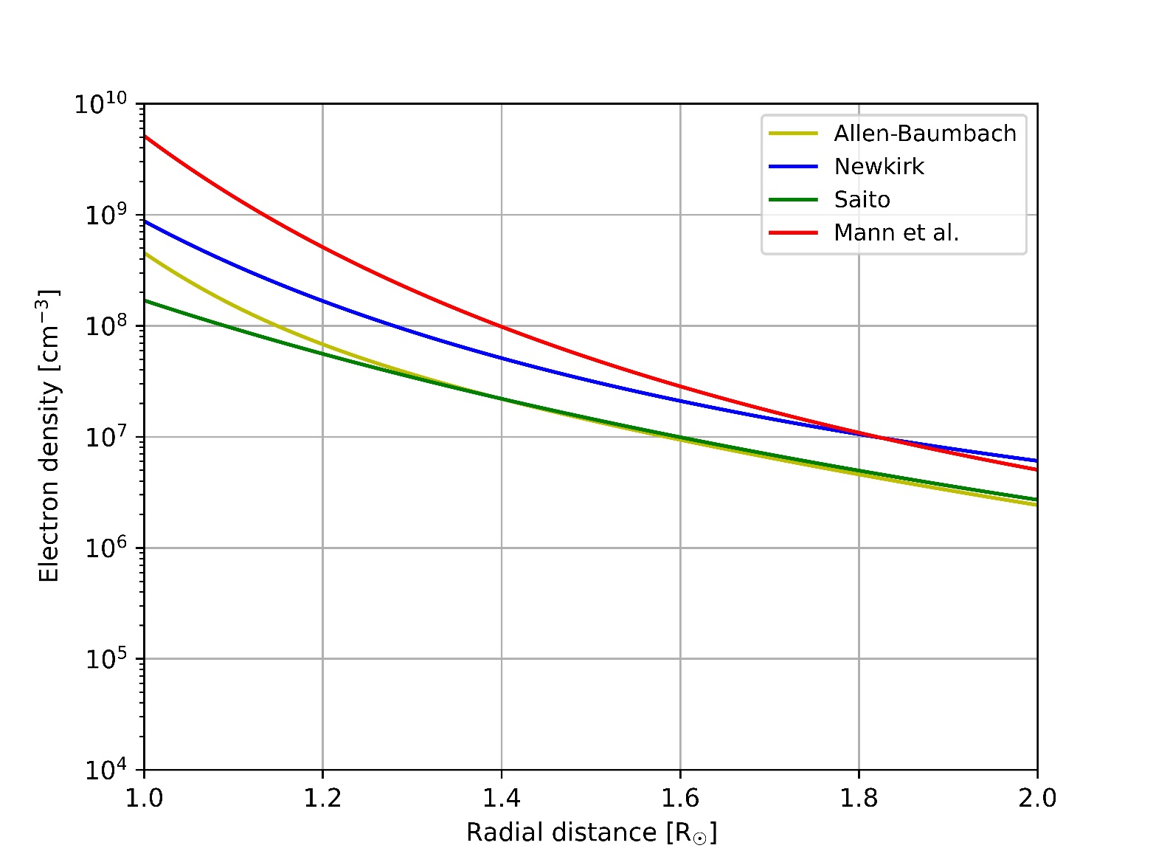
MODELS OF ELECTRON DENSITY IN THE SOLAR CORONA
(1)
Allen-Baumbach (Allen 1947; Baumbach 1937)
isothermal corona R ∈ (1.0144 R☉, 3 R☉)
(2)
Newkirk (Newkirk 1961)
quiet corona
(3)
Saito (Saito et al. 1970; Saito et al. 1977)
non-spherical, axisymmetric model
(4)
Mann et al. (Mann et al. 1999)
barometric density model with a temperature of 10⁶ K
Relationship between electron density vs height (Dabrowski et al. 2021)

Slide 12
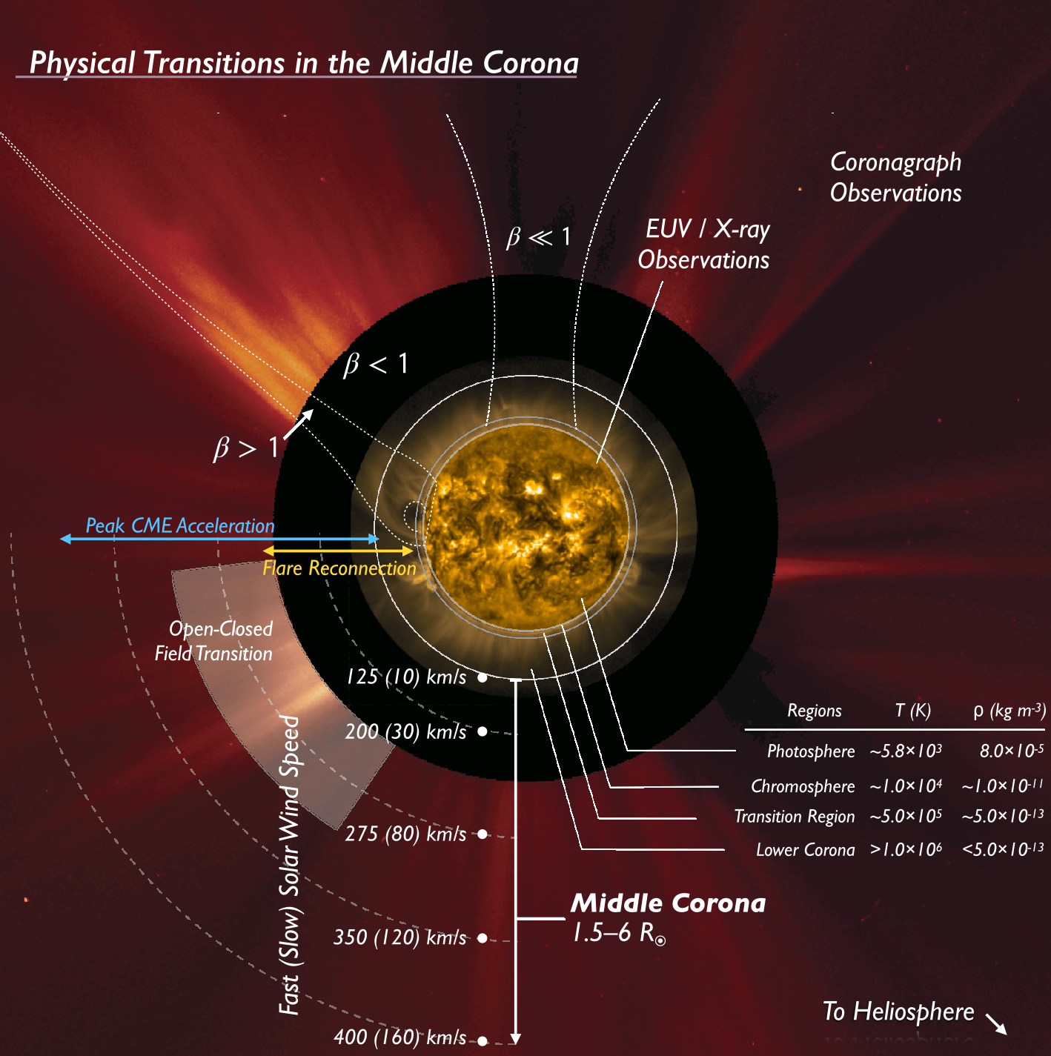
SOLAR CORONA
LOFAR: 1.1–2.9 R☉ (270–15 MHz)
Middle corona: 1.5–6 R☉
2.9 R☉ (15 MHz)
1.1 R☉ (270 MHz)
West et al. 2023

Slide 13
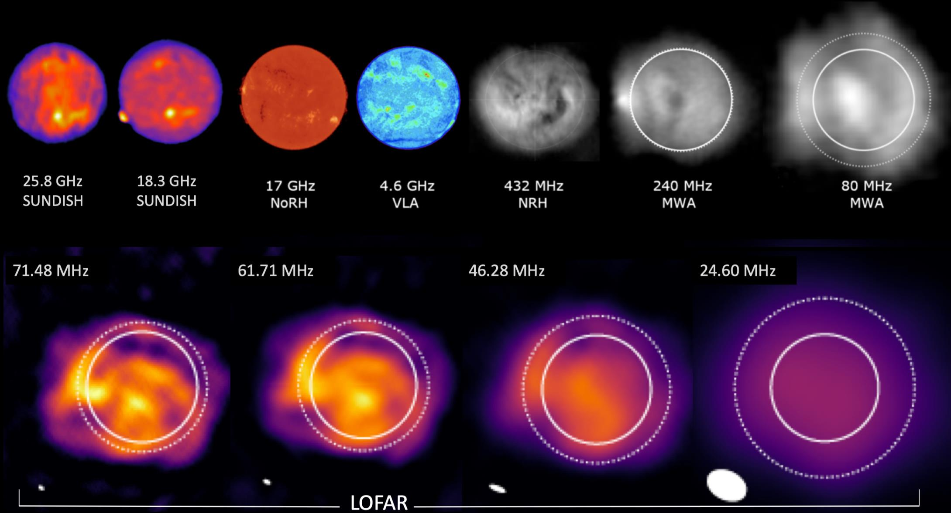
THE QUIET SUN IN DIFFERENT RADIO FREQUENCIES
Due to the scattering of radio waves within the solar corona, the spatial resolution of the images is limited to a few 10 arcsec.
Saito model (1977)
The solid circles in the images correspond to the size of the Sun seen in visible light
optical solar disk
Zhang et al. 2022

Slide 14
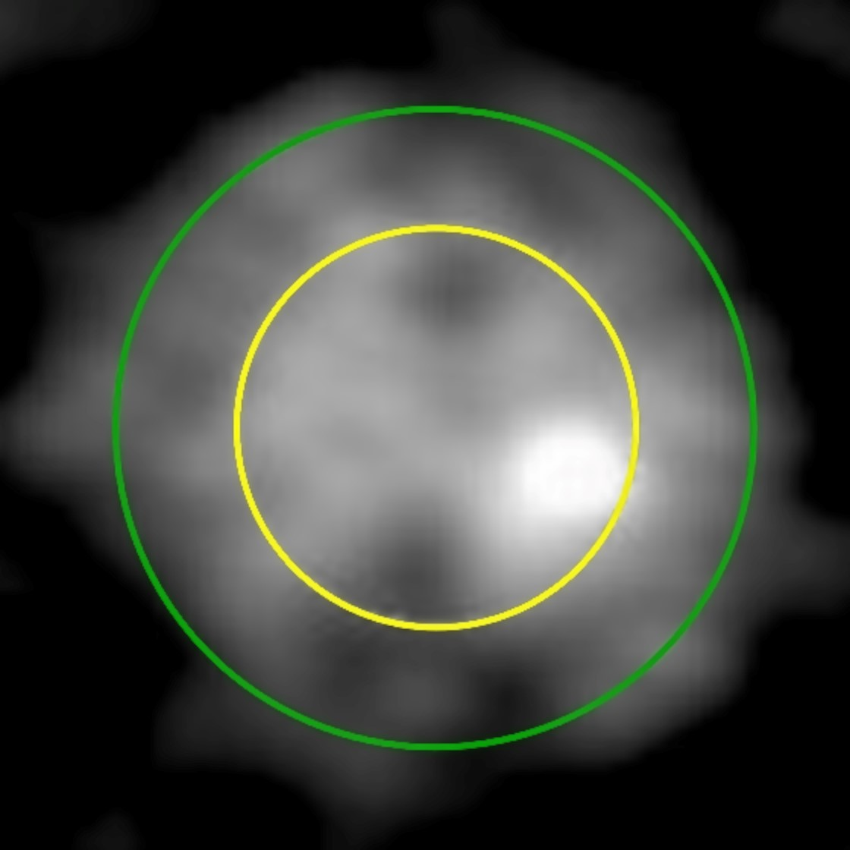
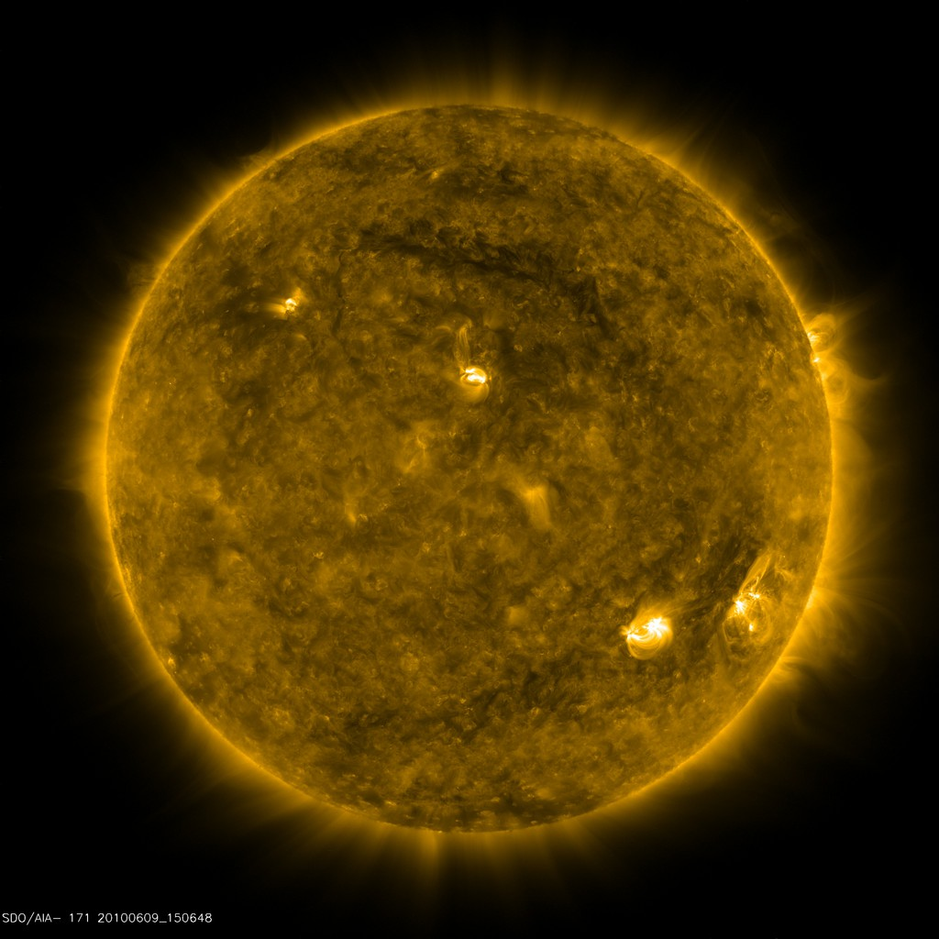
FIRST LOFAR IMAGE OF THE SUN
LOFAR (135 MHz)
9 June 2010
SDO EUV 171 Å
9 June 2010
Sun at 135 MHz
optical solar disk
Leibniz Institute for Astrophysics Potsdam (AIP)

Slide 15
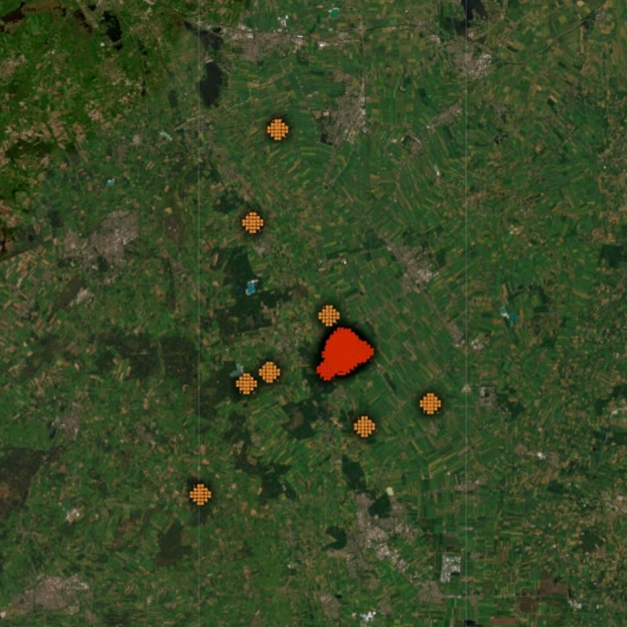
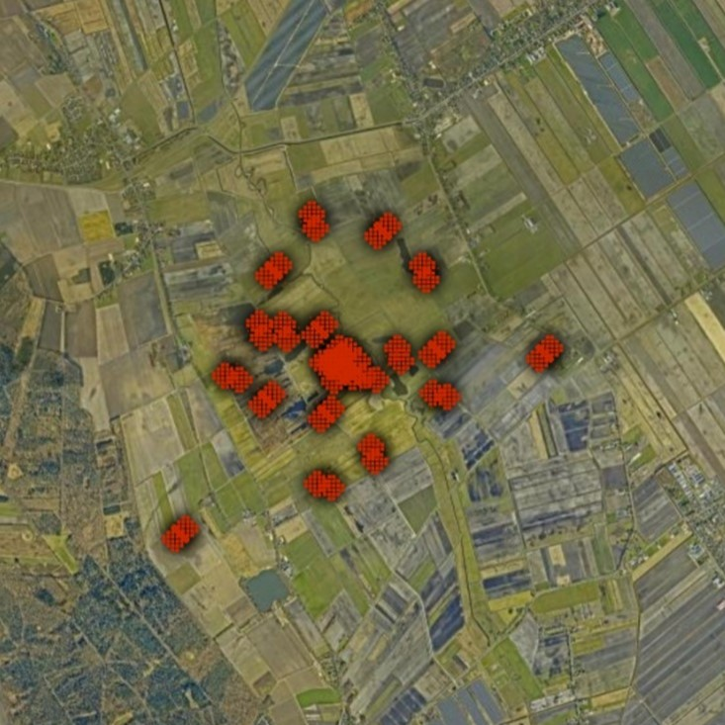

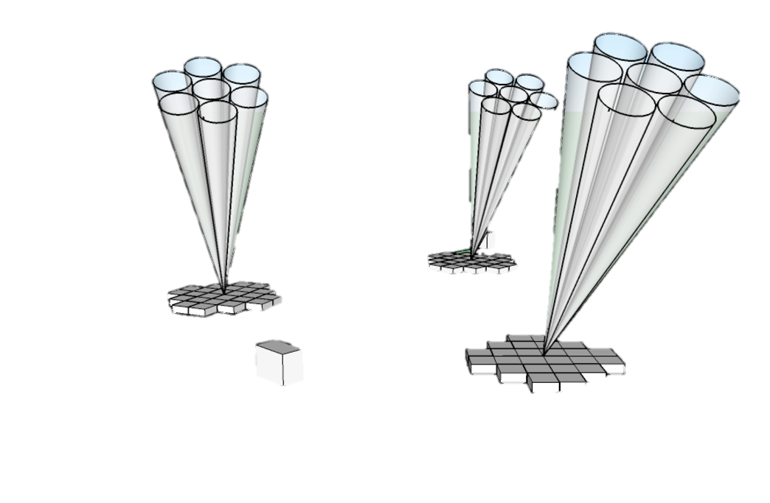
LOFAR allows images to be taken using standard interferometric techniques as well as tied-array beam forming method.
LOFAR OBSERVING MODE
core & remote stations
Interferometric
core stations
Tied Array Beam
Based on: P. Zucca presentation

Slide 16
LOFAR TIED-ARRAY BEAM OBSERVATIONS OF TYPE III RADIO BURSTS AND SOLAR S BURSTS
Dynamic spectrum corresponding to Beam 14 containing type III bursts
Dynamic spectrum corresponding to Beam 35 containing type III and S bursts
Map of 170 tied-array beams covering a field-of-view of ∼1.3° about the Sun. The full-width half-maximum of the beams at zenith at a frequency of 60 MHz is represented by the red circle
Morosan et al. 2015

Slide 17
IDOLS
https://spaceweather.astron.nl/SolarKSP/data/website/#/
Incremental Development of LOFAR Space-Weather
Incremental Development of LOFAR Space-Weather (IDOLS) project demonstrates the capabilities of LOFAR for space weather studies in an incremental way, starting with a single LOFAR station.
A team of scientists from ASTRON and the Solar and Space Weather KSP develop a set of dedicated solar and space weather observation routines, based on the existing LOFAR instrument.
Status:
first light – 13 April 2022
live monitoring tests – summer 2022
live monitoring operational – end 2022
archive processing – updated daily
preparing teams – from summer 2023
Based on: P. Zucca presentation

Slide 18
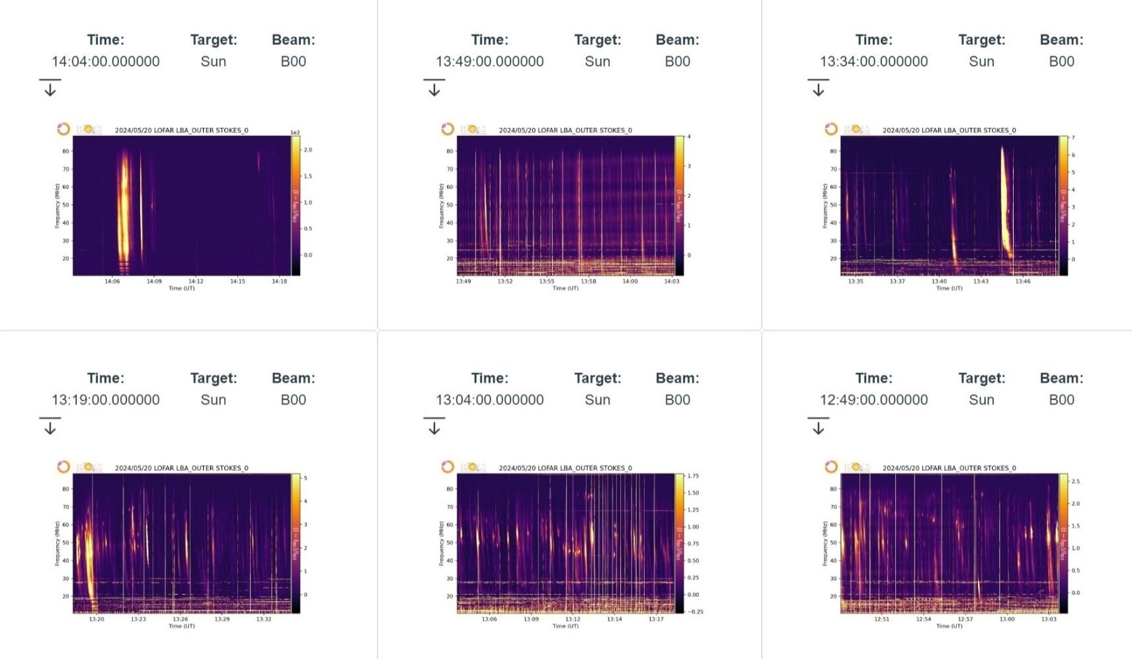
IDOLS – DYNAMIC SPECTRA
https://spaceweather.astron.nl/SolarKSP/data/website/#/
Incremental Development of LOFAR Space-Weather

Slide 19
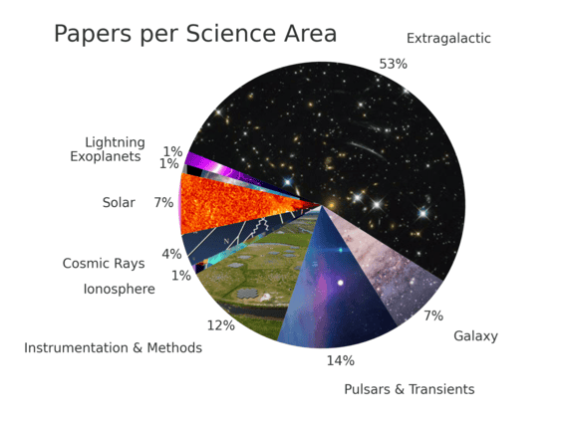
AN OVERVIEW OF LOFAR PUBLICATIONS (2011–2023)
About 60 papers about the Sun with LOFAR (about 7% output of all LOFAR papers) were published.
https://science.astron.nl/telescopes/lofar/science-with-lofar/lofar-papers/

Slide 20
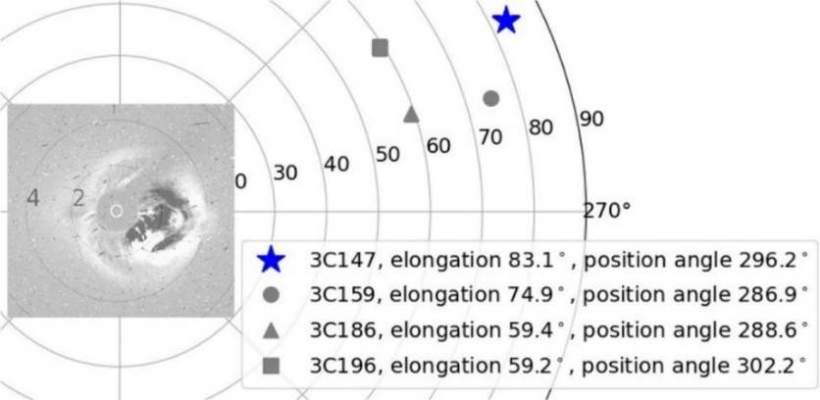
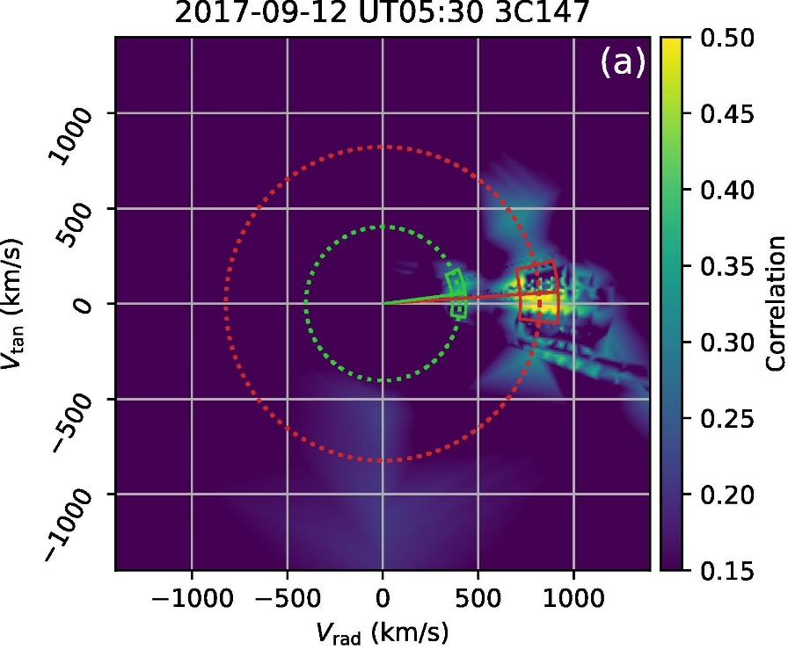
Fallows et al. 2023, APPLICATION OF NOVEL INTERPLANETARY SCINTILLATION VISUALISATIONS USING LOFAR: A CASE STUDY OF MERGED CMES FROM SEPTEMBER 2017, AdSpR, 72, 5311
Observations of interplanetary scintillation allow the velocity of the solar wind to be determined, and its bulk density to be estimated, throughout the inner heliosphere.
LOFAR observed the passage of an ultra-fast CME which launched from the Sun following the X-class flare of 10 September 2017.
Segment of a polar plot giving the elongations and position angles in the sky plane of the radio sources observed by LOFAR. A LASCO image (10.9.2017) is superposed for reference (not displayed to scale)
Velocity distribution for the observation of 3C147 at 05:30 UT on 12 September 2017

Slide 21
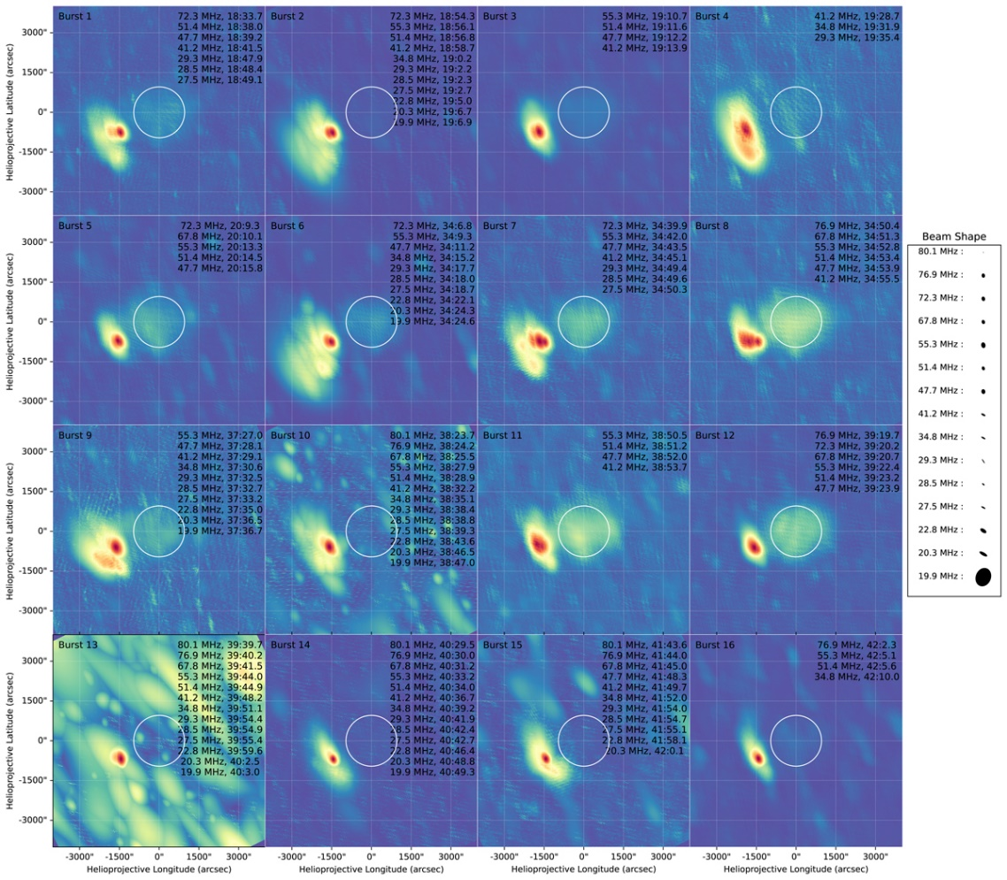
Nedal et al. 2023, CORONAL DIAGNOSTICS OF SOLAR TYPE III RADIO BURSTS USING LOFAR AND PSP OBSERVATIONS, A&A, 680, A106
9 type III radio bursts in the LOFAR-PSP combined dynamic spectrum and 16 type III bursts in the LOFAR dynamic spectrum were identified and characterized.
The primary goal is to identify the spatial and temporal characteristics of the radio sources, as well as the plasma conditions along their trajectories.
Imaging for the 16 type III bursts detected in the LOFAR dynamic spectrum

Slide 22
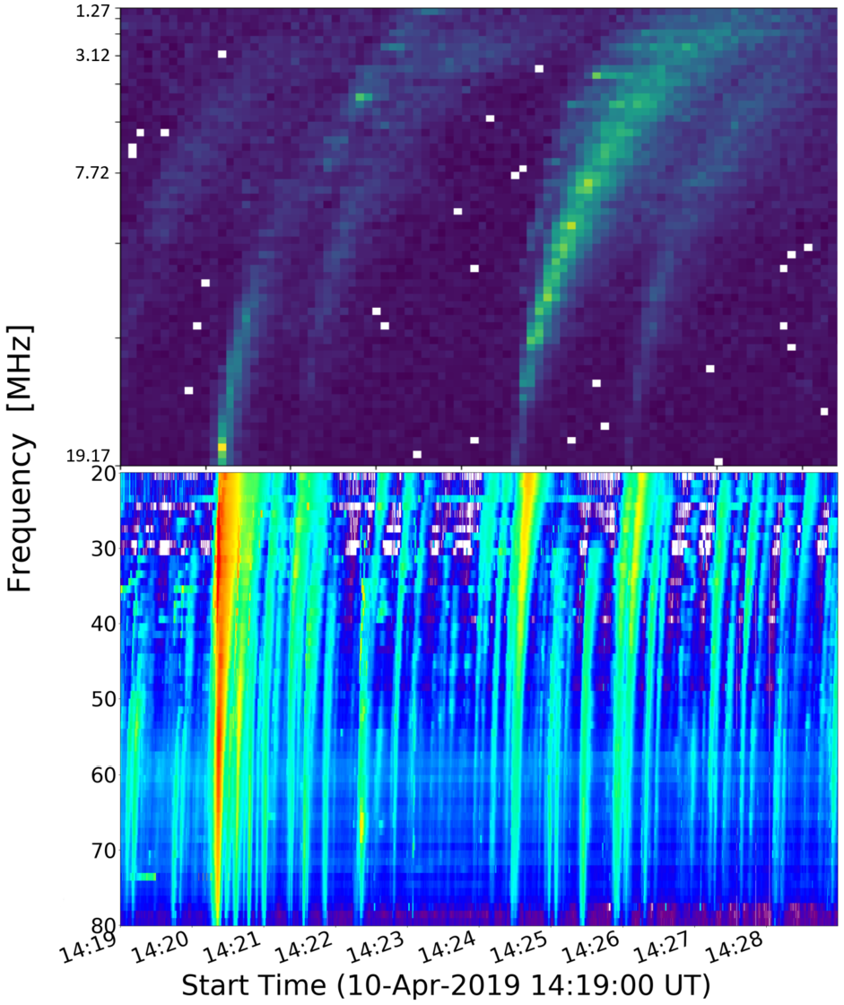
Zhang et al. 2023, DERIVING LARGE CORONAL MAGNETIC LOOP PARAMETERS USING LOFAR J BURST OBSERVATIONS, SoPh, 298, 7
LOFAR and PSP solar radio dynamic spectra were used to identify 27 type III bursts and 27 J bursts during a solar radio noise storm observed on 10 April 2019.
The basic physical parameters of the studied bursts were determined:
altidudes of J bursts loop apexes: ∼1.3 R☉,
temperaturę: ∼1 MK,
pressure: 0.7 mdyn cm⁻²,
magnetic field strength: 0.13 G.
LOFAR and PSP dynamic spectrum with type III and J bursts during the noise storm on 10 April 2019

Slide 23
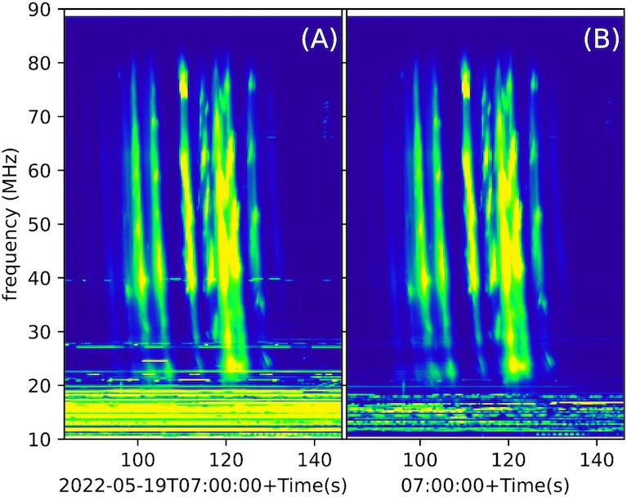
Zhang et al. 2023, RFI FLAGGING IN SOLAR AND SPACE WEATHER LOW FREQUENCY RADIO OBSERVATIONS, MNRAS, 521, 630
Radio-frequency interference (RFI) from human activities affects the quality of observation.
Thus, RFI detection is necessary to obtain high quality data.
The flagging of RFI is particularly challenging for the solar and space weather observations at low frequency, because the solar radio bursts can be brighter than the RFI and may show similar temporal behavior.
The averaged dynamic spectrum. Panel (A) without flagging; panel (B) with flagging

Slide 24
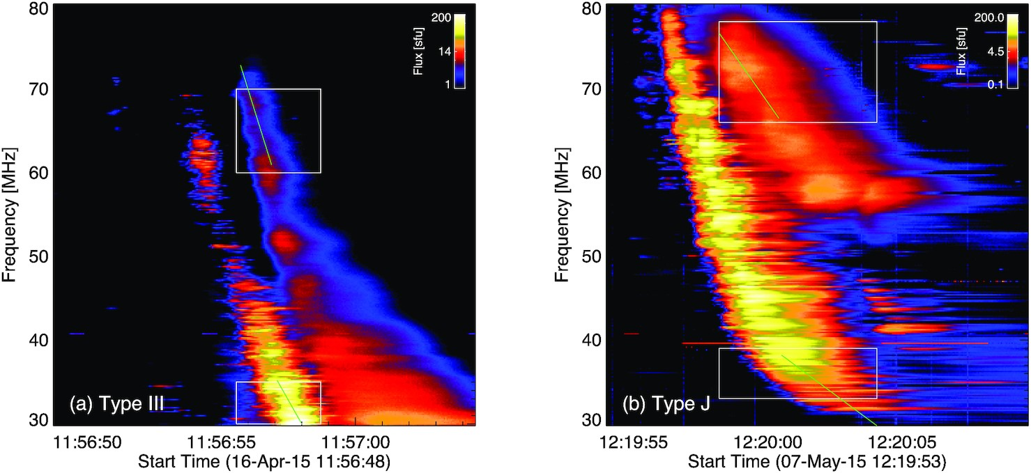
Chen et al. 2023, THE FREQUENCY RATIO AND TIME DELAY OF SOLAR RADIO EMISSIONS WITH FUNDAMENTAL AND HARMONIC COMPONENTS, MNRAS, 520, 3117
In this paper the fundamental/harmonic emission frequency ratios and delay times between the F and H emissions from type III and type J bursts with striae observed with LOFAR (30–80 MHz) are studied.
The paper provides quantitative estimates of the delay time of the fundamental emissions caused by radio-wave propagation effects at multiple frequencies, which can be used in future studies.
The dynamic spectra of type III (a) and J (b) bursts with both F and H components observed by LOFAR

Slide 25
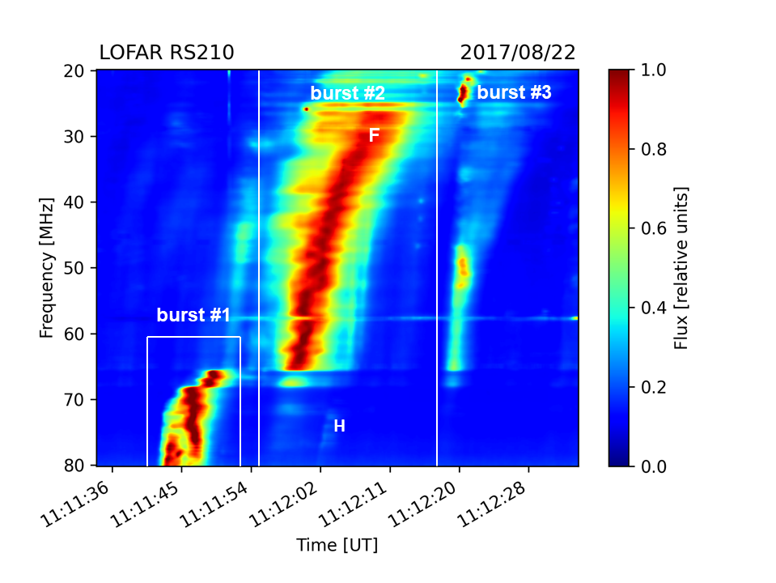
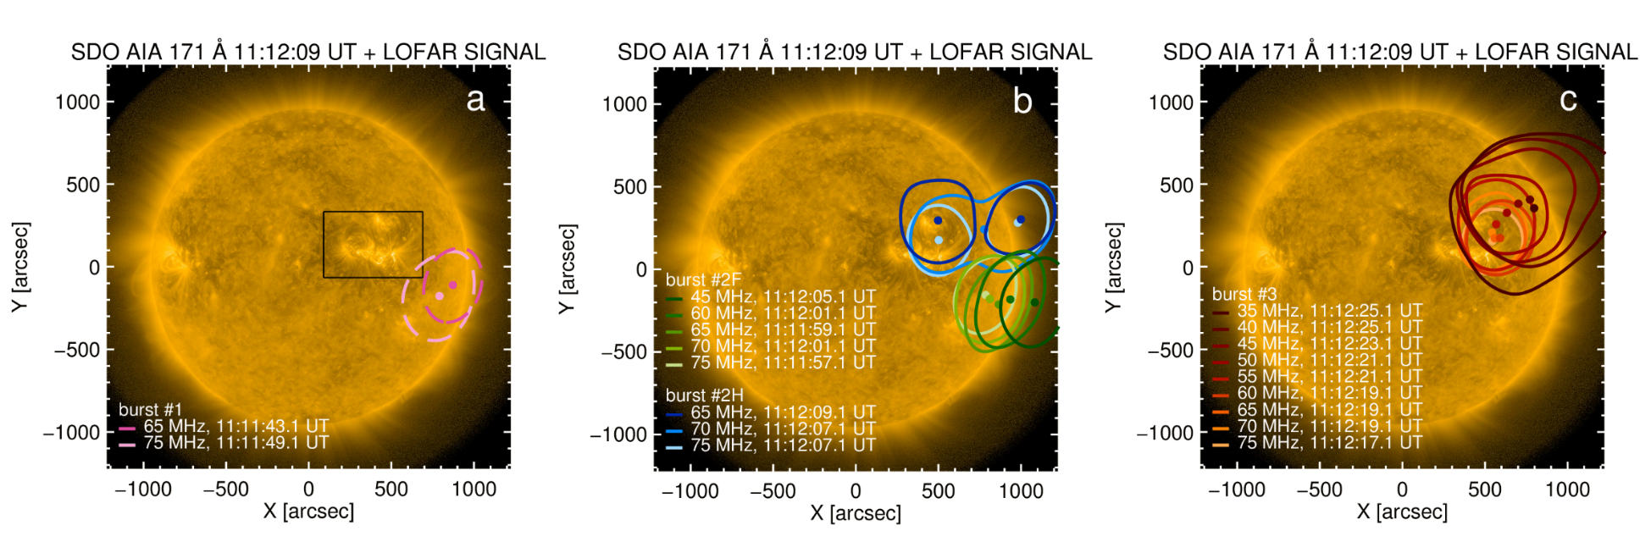
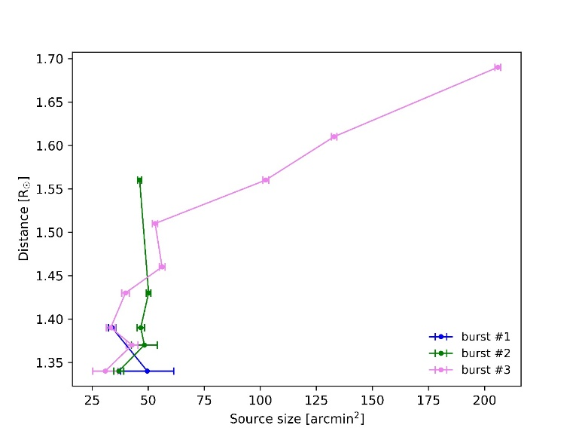
Dabrowski et al. 2023, INTERFEROMETRIC IMAGING OF THE TYPE IIIB AND U RADIO BURSTS OBSERVED WITH LOFAR ON 22 AUGUST 2017, A&A, 669, A52
In this study the source of type IIIb and U solar bursts in a relatively wide frequency band from 20 to 80 MHz was determined.
TYPE U BURST
burst #1
TYPE IIIb BURST
burst #2
TYPE IIIb BURST
burst #3
Image of the Sun received in the AIA 171 Å channel by SDO with superimposed color contours showing bursts #1, #2, and #3 (c), at a range of frequencies
Change in the size of the emission area with the height for the investigated bursts

Slide 26
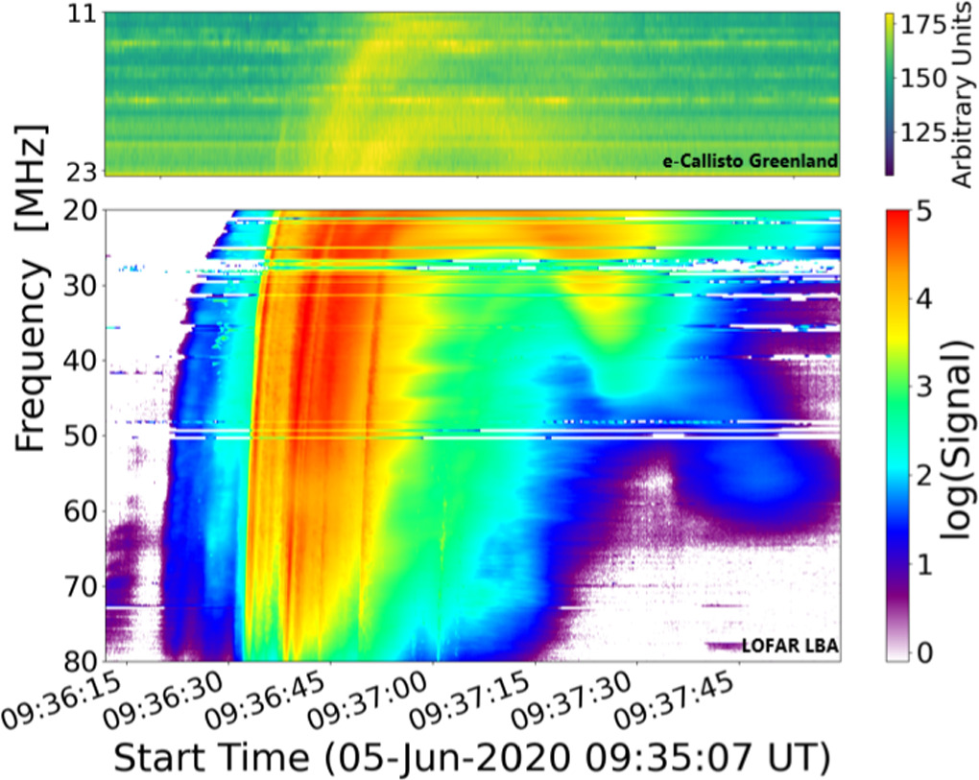
Zhang et al. 2024, IMAGING A LARGE CORONAL LOOP USING TYPE U SOLAR RADIO BURST INTERFEROMETRY, ApJ, 965, 107
In this study LOFAR interferometric solar imaging data from an U burst that has a significant descending leg component, observed between 10 and 90 MHz on 5 June 2020 were used.
The positive frequency drift component (descending leg) of U bursts has received less attention in previous studies, as the descending radio flux is weak.
A large coronal magnetic loop that reached just about 1.3 R☉ in altitude had:
temperature: ∼1.1 MK,
plasma pressure: ∼0.20 mdyn cm⁻²,
magnetic field strength: ∼0.07 G.
Dynamic spectrum of the U burst event on 5 June 2020

Slide 27
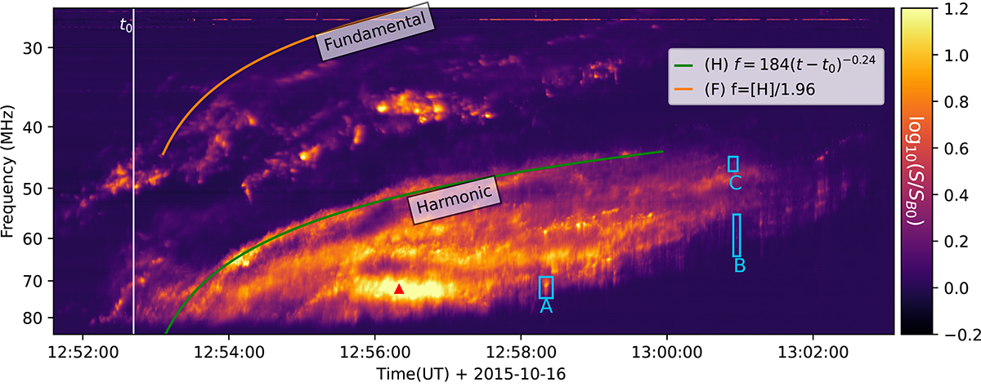
Zhang et al. 2024, SPATIALLY RESOLVED RADIO SIGNATURES OF ELECTRON BEAMS IN A CORONAL SHOCK, A&A, 683, A123
A low-frequency interferometric imaging observations from LOFAR were used to provide a spatially resolved analysis for three herringbone groups in a type II radio burst that occurred on 16 October 2015.
The characteristics derived from imaging spectroscopy suggest that the studied herringbones originate from different processes.
Dynamic spectrum of the type II radio burst. Three herringbone groups are shown with blue boxes and labeled A, B, and C

Slide 28
Zhang et al. 2024, IMAGING SPECTROSCOPY OF A SPECTRAL BUMP IN A TYPE II RADIO BURST, A&A, 684, L22
A type II burst that experiences a sudden spectral bump in its frequency-time profile was found.
The estimated speed of the electron beams responsible for type II formation was 295 km/s.
During the observed bump, the shock wave travelled a distance of 29 Mm.
The bump visible on the dynamic spectrum indicates that the shock wave encounters a compact region of reduced density, most likely a coronal hole.
Dynamic spectrum and imaging of three time-points in the type II radio burst

Slide 29
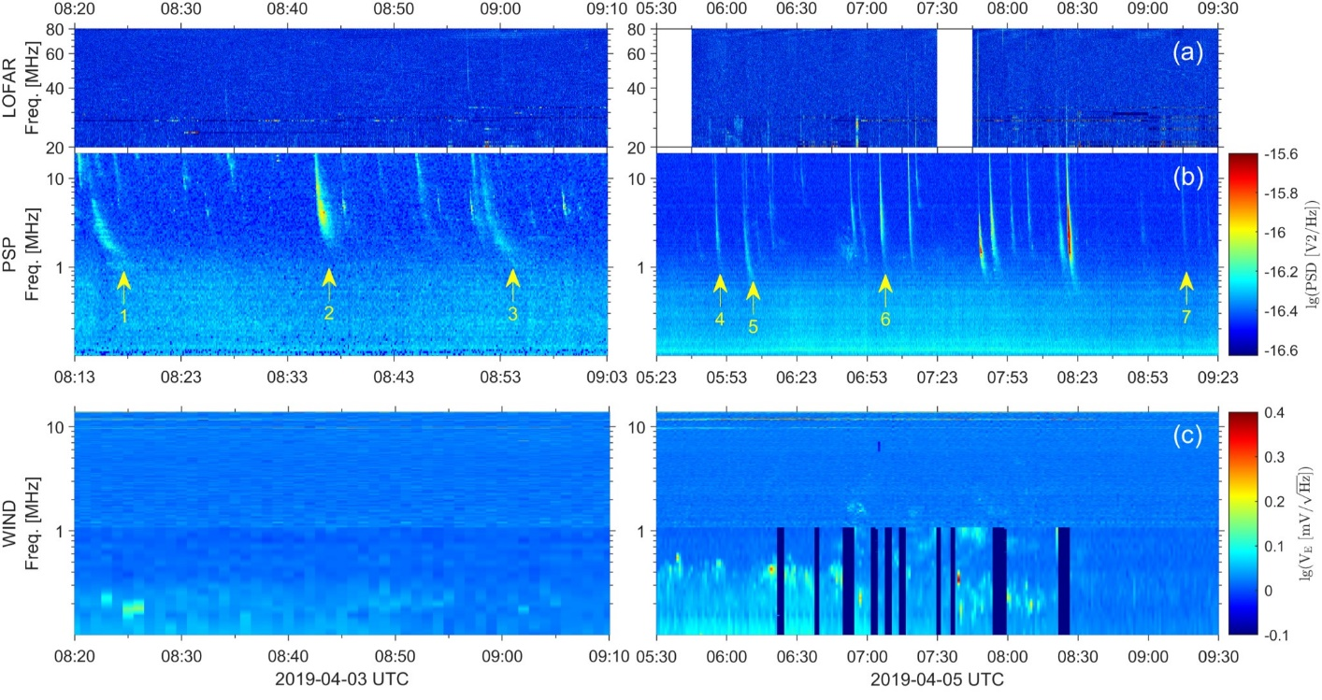
Chen et al. 2024, WEAK SOLAR RADIO BURSTS FROM THE SOLAR WIND ACCELERATION REGION OBSERVED BY THE PARKER SOLAR PROBE AND ITS PROBABLE EMISSION MECHANISM, ApJ, 961, 136
The weak solar radio burst observed by PSP during its sources’ crossing of the low-density magnetic channel from the heliocentric distance ∼1.1–6.1 R☉.
These weak radio bursts have a low starting frequency of ∼20 MHz and a narrow frequency range from a few tens of MHz to a few hundred kHz.

