Slide 1
ApPolLo - Apertif counterparts of polarised LOFAR sources
Anna Berger

Slide 2
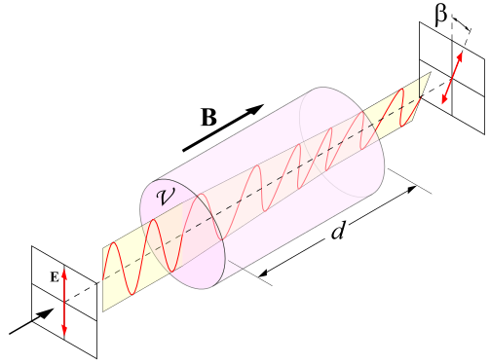
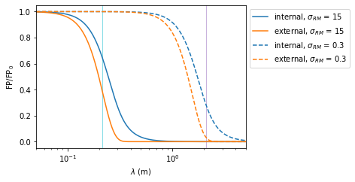
Motivation
Magnetic field evolution
Faraday Rotation
Wavelength dependent rotation of polarisation axis: $Δψ=RM λ^{2}$ with $RM=0.81\int_{0_{}}^{r_{0}}{\left(\frac{n_{e}}{{cm}^{−3}}\right)\left(\frac{B_{||}}{{μG}^{}}\right)\left(\frac{{dr}_{}}{{pc}^{}}\right)rad m^{−2}}$
Rotation can occur everywhere along the line of sight, no information on distance
Depolarisation $DP= \frac{{FP}_{λ2}}{{FP}_{λ1}}$
Internal Faraday Dispersion $FP={FP}_{0}\frac{1 −exp⁡(2σ_{RM}^{2}λ^{4})}{2σ_{RM}^{2}λ^{4}}$ with $σ_{RM}^{} \sim \left\langle n_{e}\right\rangle \left\langle B\right\rangle$ the RM dispersion
External Faraday Dispersion $FP={{FP}_{0} e}^{−2 σ_{RM}^{2}λ^{4}}$
Comparison of different wavelength allowed investigation of the effects and location

Slide 3
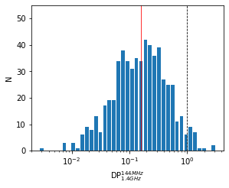
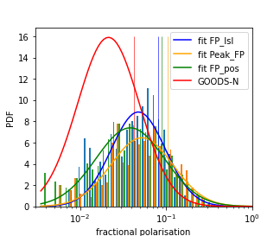
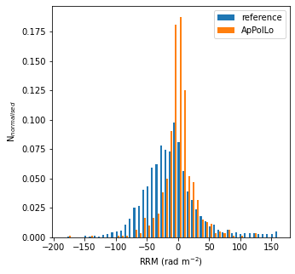
Overview and Comparison
LoTSS DR2 RM grid catalog (O‘Sullivan et al. 2023)
→ 598 ApPolLo sources
Compare to GOODS-N and SVC Apertif data → higher fractional polarisation → lower median RRM → low density environment

Slide 4
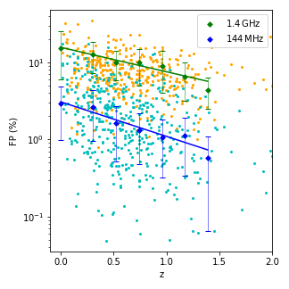
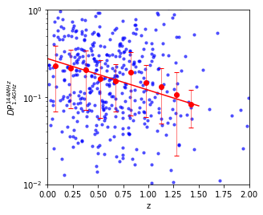
Depolarisation - redshift
Berger et. al. in prep.
Berger et. al. in prep.

Slide 5
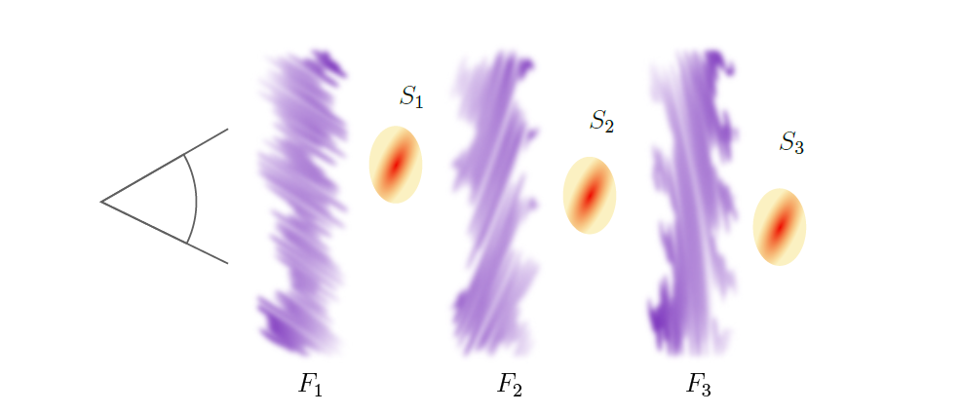
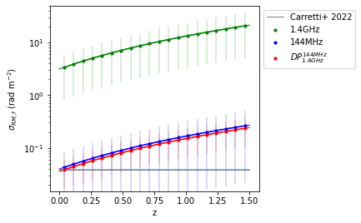
Cosmic Web Filaments
Depolarisation: $$FP={{FP}_{0}^{}\prod_{i=1}^{N_{f}}{(}e}^{−2 σ_{RM,i}^{2}λ_{i}^{4}})$$
For the individual filaments: $\frac{\begin{aligned} \\ {FP}_{i}\end{aligned}}{{FP}_{i−1}}=e^{−2σ_{RM,i}^{2}λ_{i}^{4}}$
→ get $σ_{RM}^{2}$ of the filament
Reality, position of filaments unknown → use redshift bins: $$FP={{FP}_{0}^{}\prod_{i=z_{1}}^{z_{s}}{(}e}^{−2 σ_{RM,i}^{2}{ΔN}_{f,i}λ_{i}^{4}})$$
Berger et. al. in prep.

Slide 6
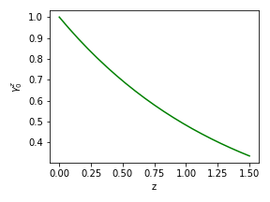
Cosmic Web Filaments
$$σ_{RM}^{}=0.81 \frac{{(\left\langle n_{e}\right\rangle \left\langle B_{f,turb}\right\rangle )}^{2}Ld}{f}$$
Fit $σ_{RM,f}^{}=b{(z+1)}^{a}+c$
Berger et. al. in prep.
→ $a=2.19$ → no evolution of $B_{f,turb}$
Offset between 1.4GHz and 144MHz & ${DP}_{1.4GHZ}^{144MHz}$ from ignoring local component $ξ(z)$ → with local component $ξ_{z}$:
Correct 1.4GHz data for $σ_{RM,f}^{}$ from 144MHz:
$$FP={{FP}_{0}^{}ξ_{z_{s}}\prod_{i=z_{1}}^{z_{s}}{(}e}^{−2 σ_{RM,i}^{2}{ΔN}_{f,i}λ_{i}^{4}})$$
${DP}_{1.4GHz}^{144MHz}$:
$$β_{i}= \frac{ξ_{i,144MHz}}{ξ_{i,1.4GHz}}≈const.$$
→ $ξ_{144MHz}≪ξ_{1.4GHz}$
1.4GHz and 144MHz: $$γ_{0}^{z}=\frac{ξ_{z}}{ξ_{0}}≈const.$$
Assumptions:
Berger et. al. in prep.
Notes:
19:00

Slide 7
Summary
598 sources
2 without Apertif ${5σ}_{QU}^{}$ PI detection (also no detection in TP)
21 sources with ${DP}_{1.4GHZ}^{144MHz}>1$
ApPolLo sources differ from Apertif sources:
higher TP, PI and FP
lower RRM
FP drops with z for Apertif and LOFAR
local component shows evolution at 1.4GHz
first z-dependent estimate of $σ_{RM,f}^{}∝{\left(z+1\right)}^{2.19}$
no evolution of $B_{f,turb}$ with redshift
less dense environment

Slide 8
Cosmic Web Filaments
Fit $σ_{RM,f}^{}=b{(z+1)}^{a}+c$ → $a=2.19$ → no evolution of $B_{f}$
Offset between 1.4GHz and 144MHz & ${DP}_{1.4GHZ}^{144MHz}$ from ignoring local component $ξ(z)$ $$FP={{FP}_{0}^{}ξ_{z_{s}}\prod_{i=z_{1}}^{z_{s}}{(}e}^{−2 σ_{RM,i}^{2}{ΔN}_{f,i}λ_{i}^{4}})$$
For 1.4GHz and 144MHz data individual: $$γ_{0}^{z}=\frac{ξ_{z}}{ξ_{0}}=const.$$
Berger et. al. in prep.
Correct 1.4GHz data for $σ_{RM,f}^{}$ from 144MHz:
For ${DP}_{1.4GHZ}^{144MHz}$:
$β_{i}^{}=\frac{ξ_{i,144MHz}}{ξ_{i,1.4GHz}}=const.$ → $ξ_{144MHz} ≪ξ_{1.4GHz}$
Berger et. al. in prep.

Slide 9
ApPolLo data
Use LoTSS DR2 RM grid catalogue (O‘Sullivan et al. 2023)
Apertif observations from AWES
Crossmatch with AWES data reduced by Sep. 2022 consider data with PB > 5% at LOFAR position
761 polarised sources with Apertif data
Automatic imaging and polarisation analysis: amosaic and aperpol
Preparation for full AWES polarisation catalogue
598 IDs in final catalogue
30 IDs PB < 10% PB
124 IDs „bad quality“
8 IDs no Q&U Cubes
LoTSS RM grid catalogue has only peak fluxes
use peak finder for Apertif data
get Apertif flux at LoTSS RM grid catalogue position

