Slide 1
A statistical study of the most extreme star factories and gorging black holes
LOFAR Family Meeting 2024
Ismail Eissa Dr. Lingyu Wang

Slide 2
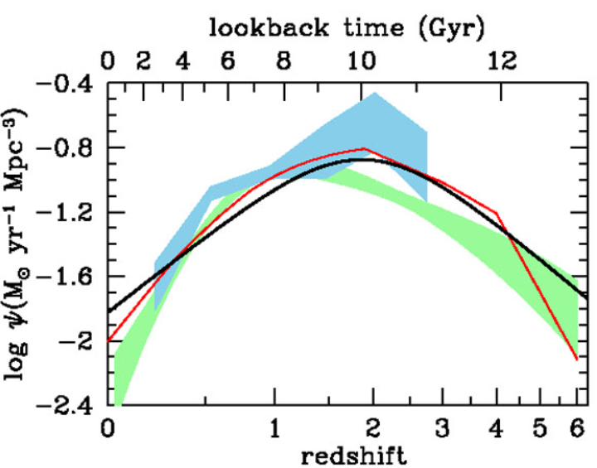
Quasars (Current understanding)
Credit: Gemini Observatory
Madau & Dickinson, 2014
Quasars
Ellipticals
LIRG/ULIRG

Slide 3
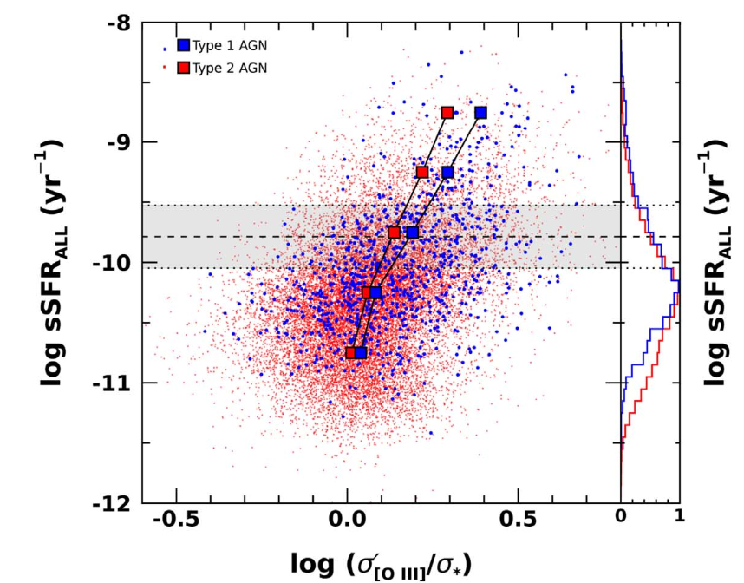
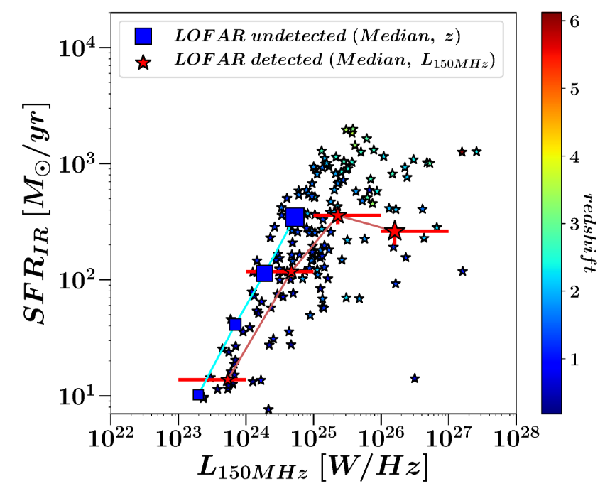
Positive Feedback
AGN- SFR evolution
Negative Feedback
Woo et al., 2020
Retana-Montenegro, 2022
Notes:
The positive correlation of outflow strength with SFR indicates no clear sign of instantaneous or fast feedback of suppressing SF.
When AGN energetics are strong, SFR is also high as the gas in the host galaxy feeds black hole and SF at the same time. After certain timescale, however, which is required for outflows to start impacting on gas in a large scale, both AGN accretion, hence the strength of outflows, and SFR becomes weaker.
Or is it just because the gas fraction for different galaxies changes? So high gas, high SFR and high outflows.
Strong radio jets preventing gas from cooling or expelling gas out of the gas

Slide 4
Coevolution study
Aim: Use the same galaxy population to study BH and SFR
Data
SED fitting/analysis
Results
Summary

Slide 5
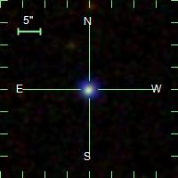
The approach
AGN through UV/optical
SDSS catalog
Notes:
Whats so different about our study then? Instead of X-ray stacking analysis to get the agn component, we use the optical to track the AGN component since it outshines the host galaxy, and we will use the far infrared data using Herschel to track the star formation, but the sensitivity and the resolution of FIR photometry is not great, yes that’s why the data connecting the dots in this case will be the radio

Slide 6
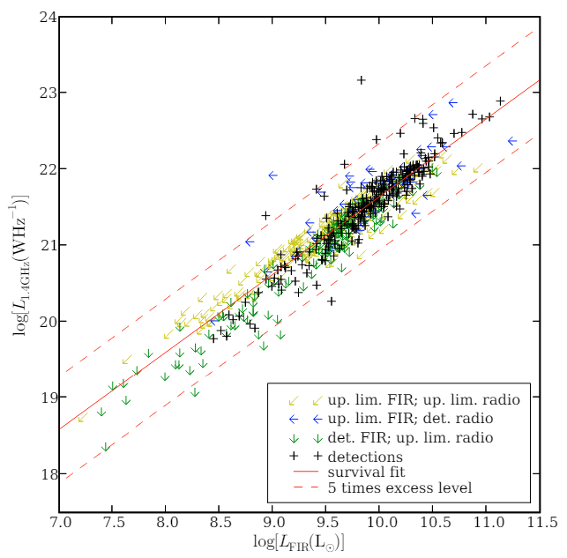
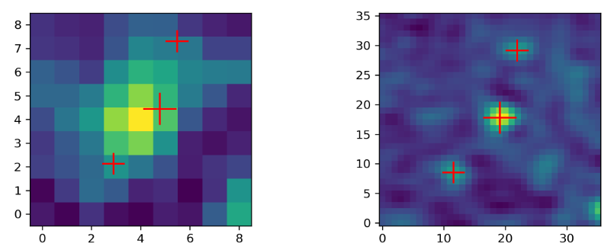
Herschel-detected optical ‘cold’ quasars
Herschel SPIRE FIR bands for SFR
Make use of the FIRC
Wang et al., 2021
Sabater et al., 2008

Slide 7
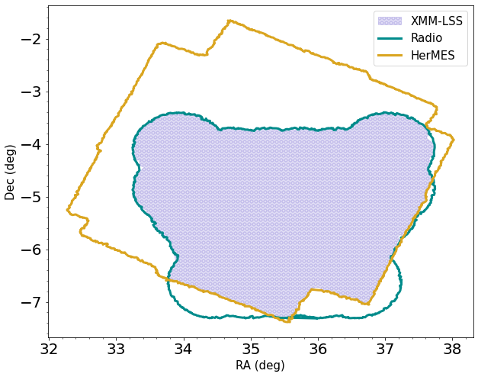
Catalog assembly
Cross-match Herschel-radio data
Overlapping region crossmatched with
SDSS
Ancillary data (WISE, GALEX,
XMM, eROSITA and WSRT)

Slide 8
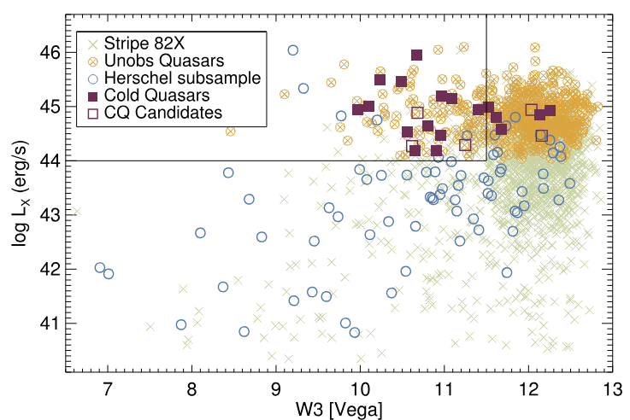
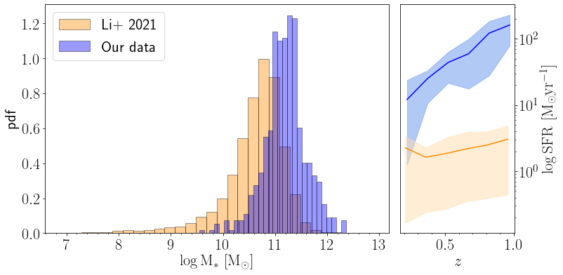
Subsample of quasars?
Optical quasars detected by SPIRE
Bluer in NIR than general SDSS quasars
Mostly lie in the Starburst regime
‘Cold quasars’
Kirkpatrick et al., 2020

Slide 9
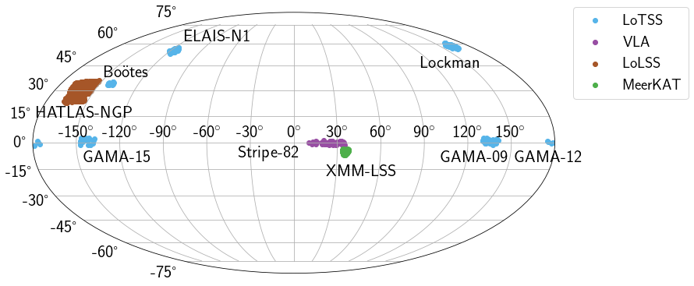
Where are we looking?
Nine fields
731 objects
1% of the SDSS
population

Slide 10
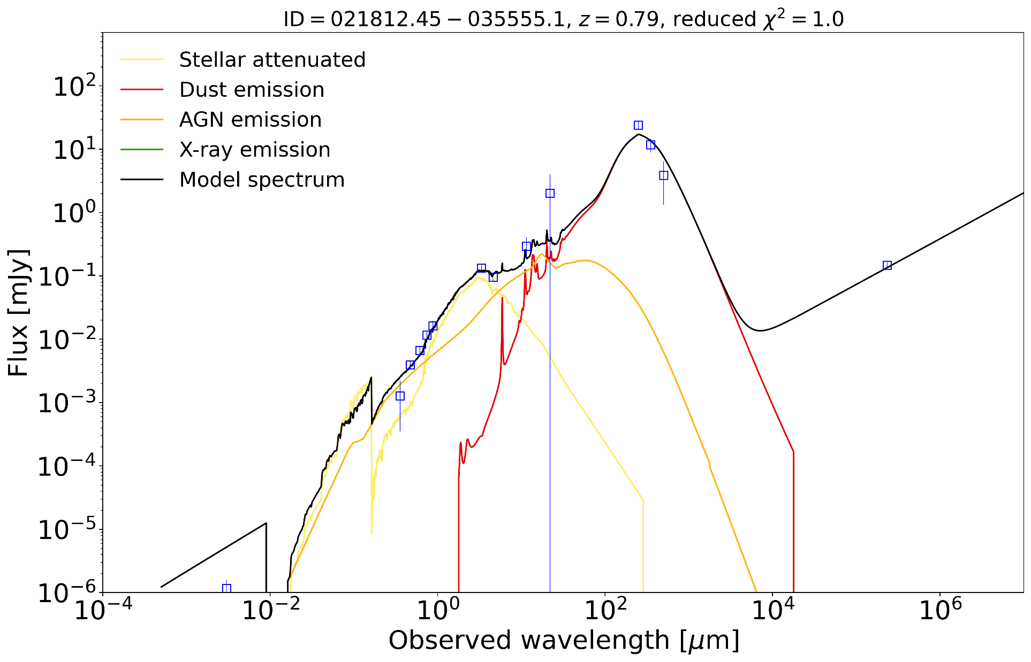
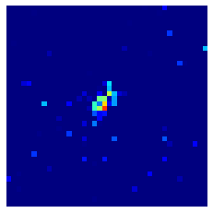
SED example
Blue Bump
Infrared bump
146 bad fits (20%)
Boquien et al., 2018; Yang et al., 2022

Slide 11
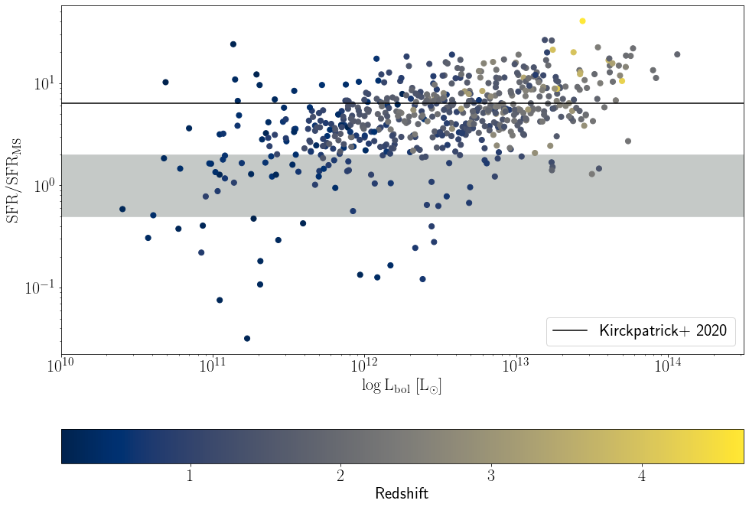
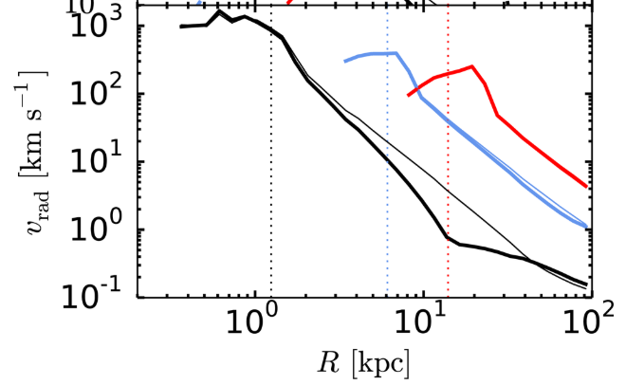
SFR analysis
Mean ${SFR/SFR}_{MS}$ is 5.9
Starburst fraction goes up with z
‘Peaceful’ Coevolution?
Costa et al., 2018
Notes:
Bow shocks created from the radio jets, compressing the molecular clouds into clumps hence enhancing the SFR

Slide 12
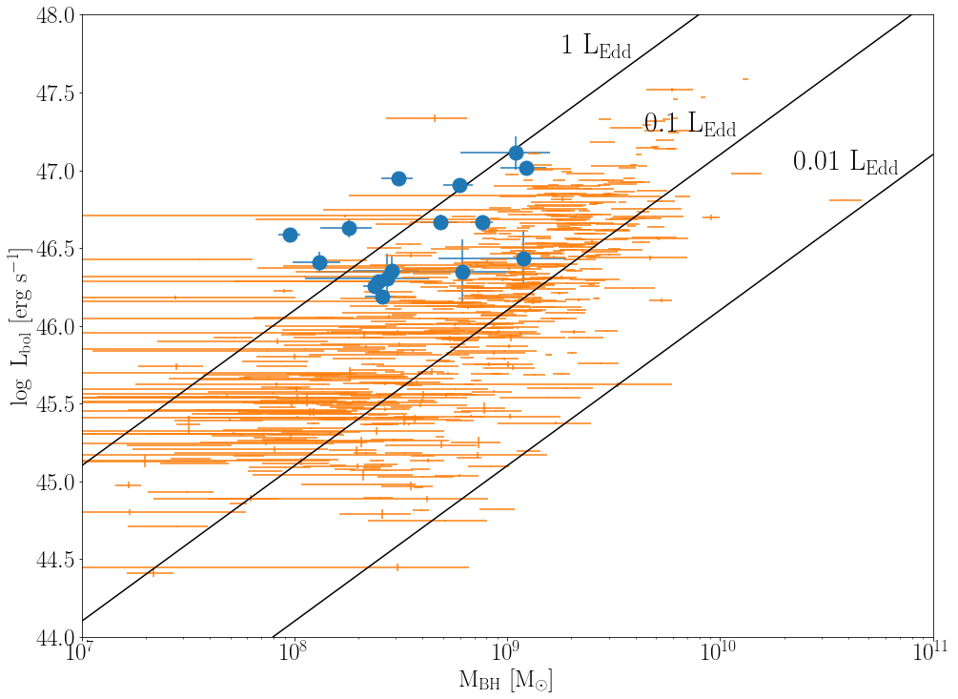
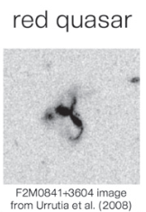
Just red quasars?
BH managed to poke a hole
through the dust?
Our quasars have typical Eddington
ratio type 1 quasars
Morphology studies?
Kim et al. 2015b
Notes:
So are they intrinsically different? Is there more dust and gas around them that allows for this?
We compare the black hole mass and bolometric to confirmed red quasars as red quasars are on going merger
We know the dust spatial distribution is that it lies within 1-3kpc of the center, Red quasars that the AGN managed to punch a hole through?

Slide 13
Downsizing
Notes:
Accretion history through out the redshift, carraro sh

Slide 14
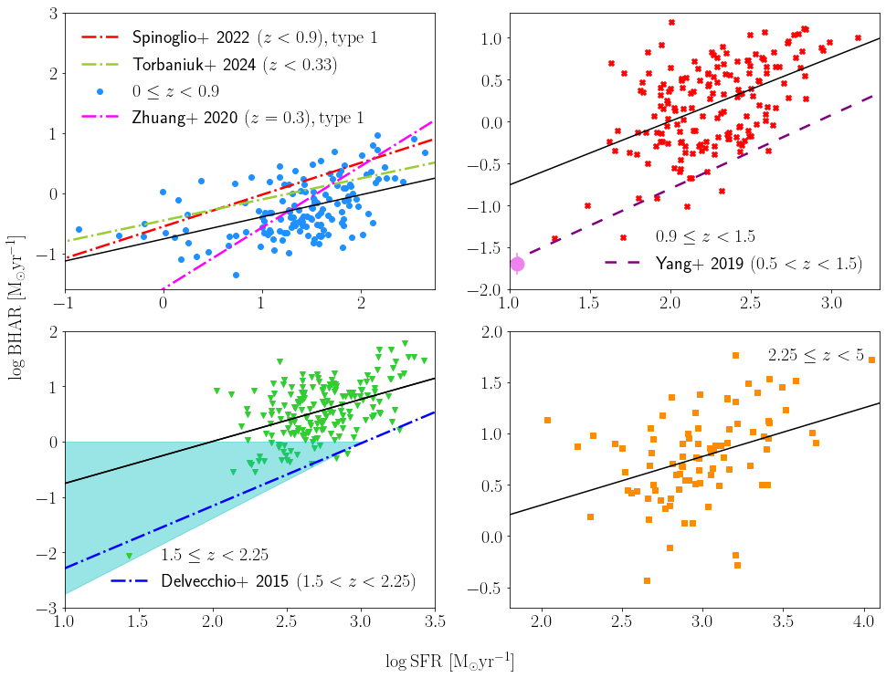
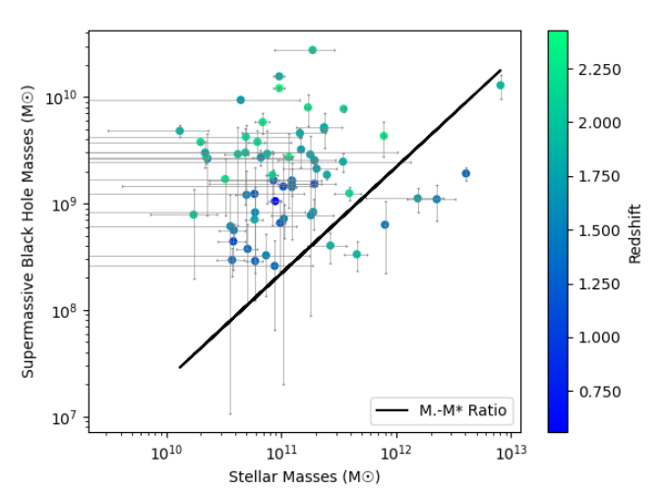
SFR vs. BHAR
Positive correlation
Selection bias
BHAR evolution flattens as
z increases
Mintz et al., 2024
Notes:
Is it because central regions are affected but outer regions SFR still has it going on,
Just high availability of gas

Slide 15
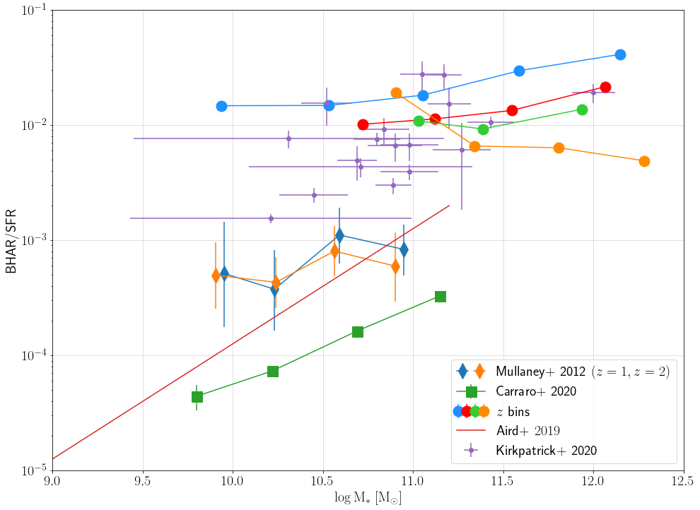
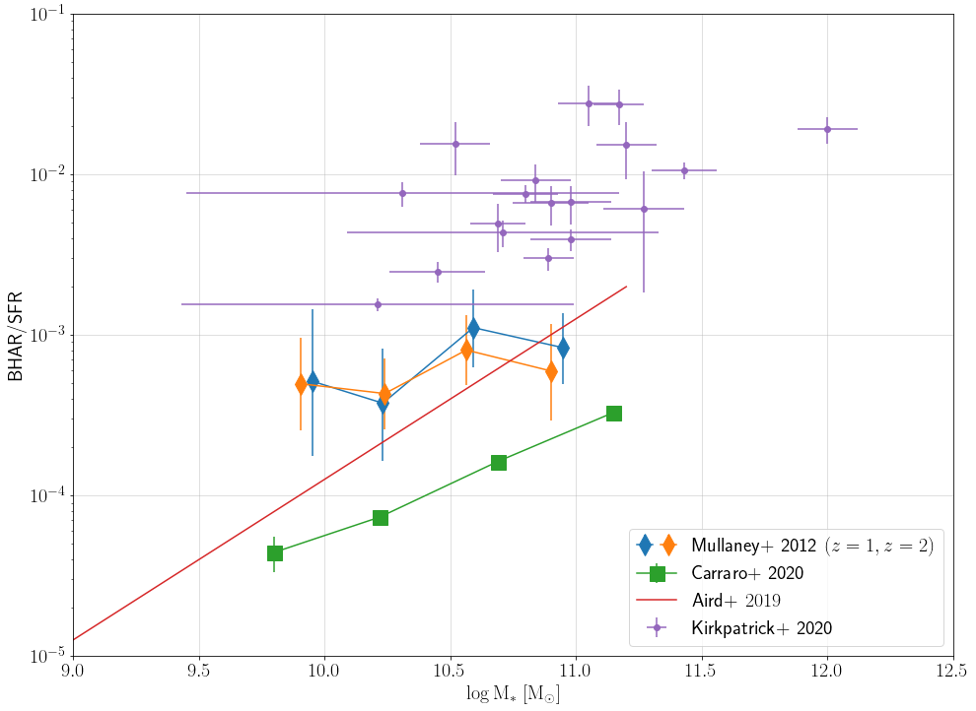
BHAR/SFR
Flat trend
Order of magnitude difference
BH halting only its central region?
At low redshift BH is catching up

Slide 16
Summary
Rare subsample of quasars that are detectable in FIR (1%)
Intense SFR, SB fraction increases with z
Downsizing phenomena (seen for sSFR)
BHAR/SFR flat trend, SFR evolution while BH is halted
i.eissa.1@student.rug.nl

Slide 17
How accurate is our SED fitting?
Compare bolometric luminosities with Wu and Shen (2022)
Compare stellar masses
with Li et al. (2021)

Slide 18
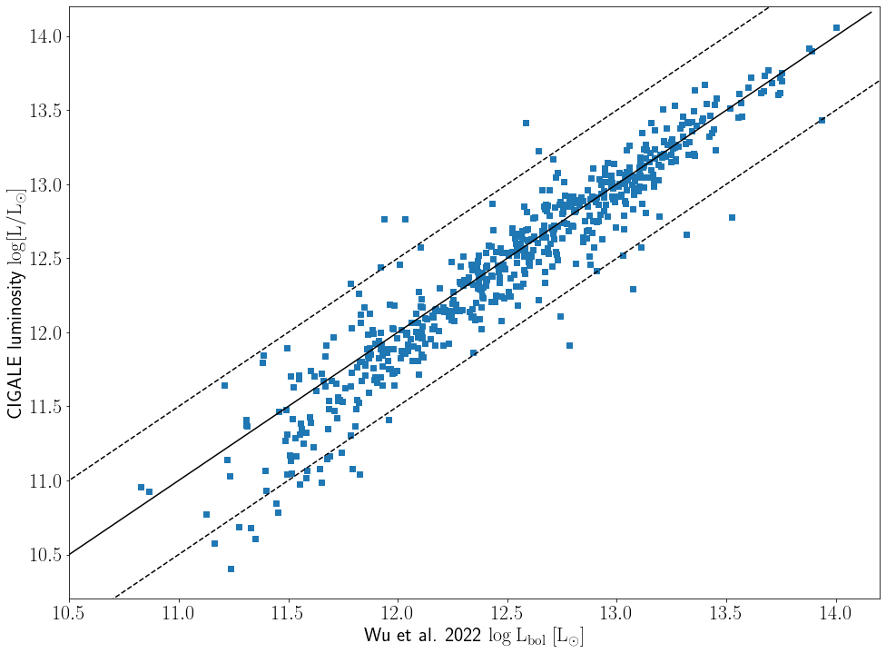
How accurate is our SED fitting?
Agrees well
Only 5% fall out of the 0.5 dex
CIGALE overestimates the
mass by 0.2 dex

Slide 19
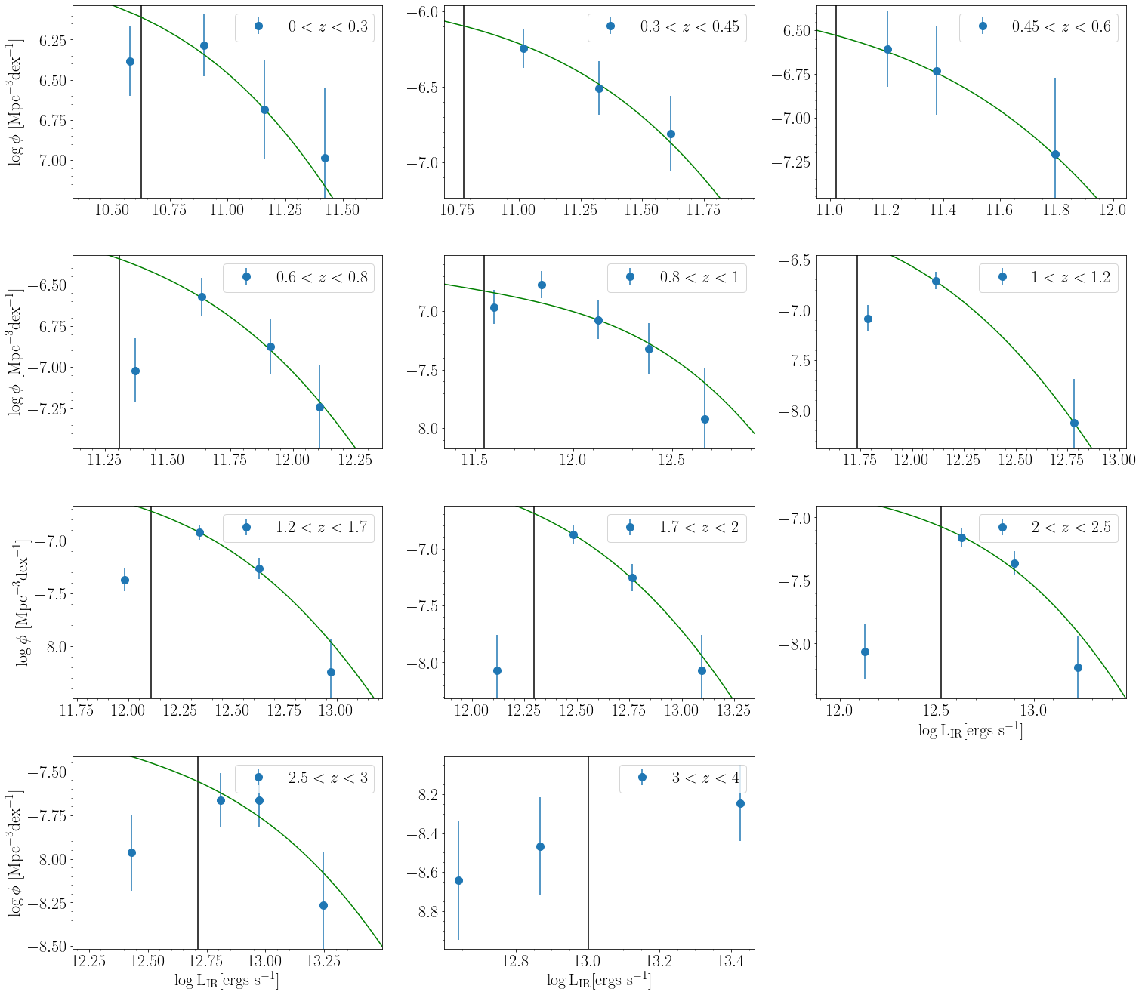
IR LF

