Slide 1
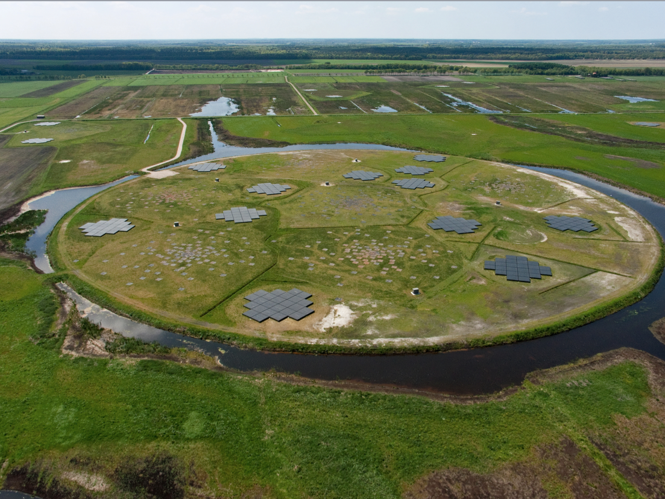
SDC Operations: Achievements, Past & Future Challenges
R. F. Pizzo
Head Science Data Centre Operations
Leiden, June 3rd 2024
Notes:
Bridge to the next talks
Eye on LOFAR2

Slide 2
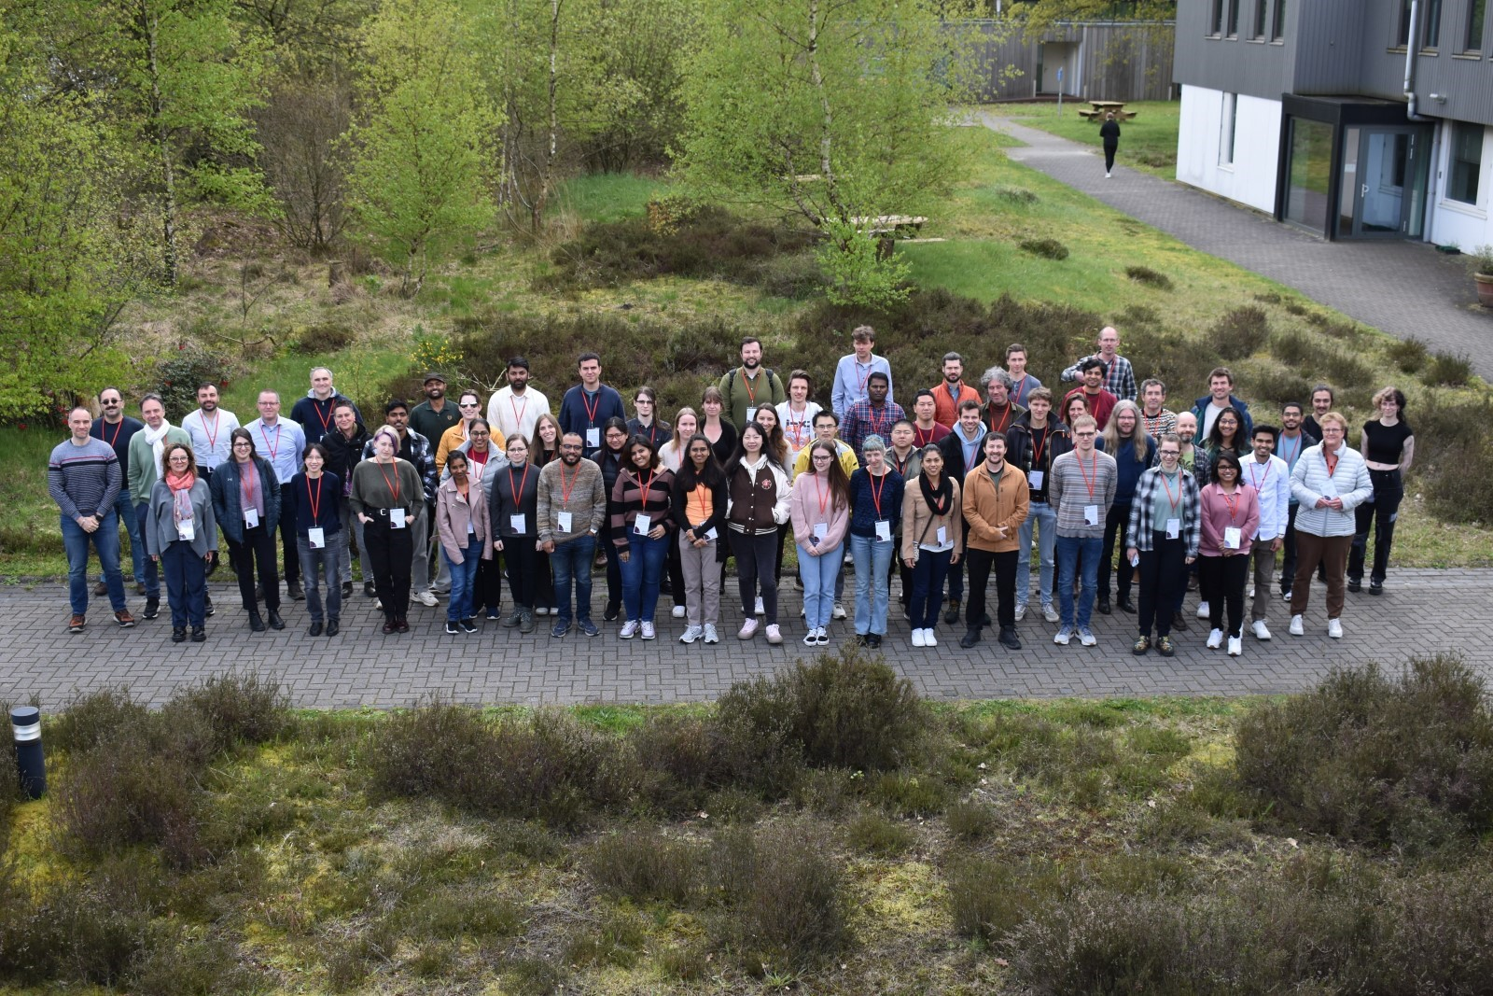
Achievements
Completed 21 operational Cycles
~65000 hours successfully observed – >70% operational efficiency
Operating a massive array growing in size and capabilities
60 PB (!) in the LTA- Largest astronomical data collection to date.
Supported an ever-growing community
Brought the instrument closer to our users:
LOFAR Schools (400+ participants)
60 Busy Weeks
Traineeships
LOFAR School 2024
2

Slide 3
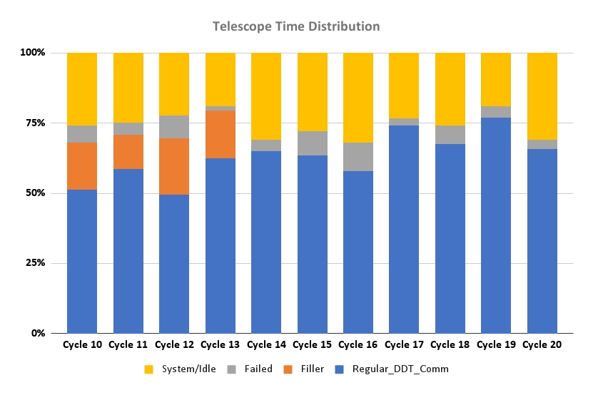
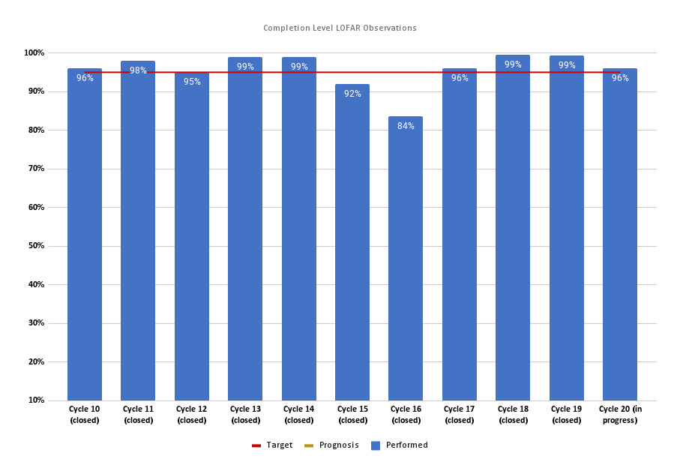
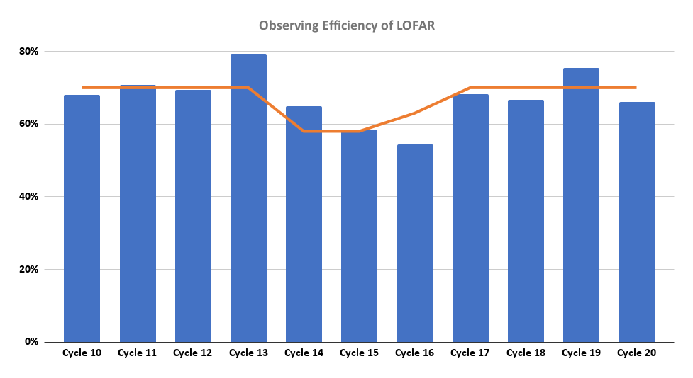
Observatory Performance
Telescope Time Distribution
Cycle Completion
Observing Efficiency
Target efficiency: 70%
Target completion: 95%
Cycle 20: 96% completed - 66% efficiency
3
Notes:
The current telescope efficiency is 66%, which is below our target efficiency of 75%. This is mainly due to the cobalt breakdown, unfavourable environmental conditions and LST pressure constraints on the observing schedule.
The COBALT correlator broke down during weeks 31 and 32, resulting in the observing system’s unavailability for most part of the period. This accounted for the very low observing efficiencies during the period. The lower efficiency values during the last few months are due to bad environmental conditions (higher solar activities and ionospheric scintillations) and LST pressure constraints in scheduling the remaining observations

Slide 4
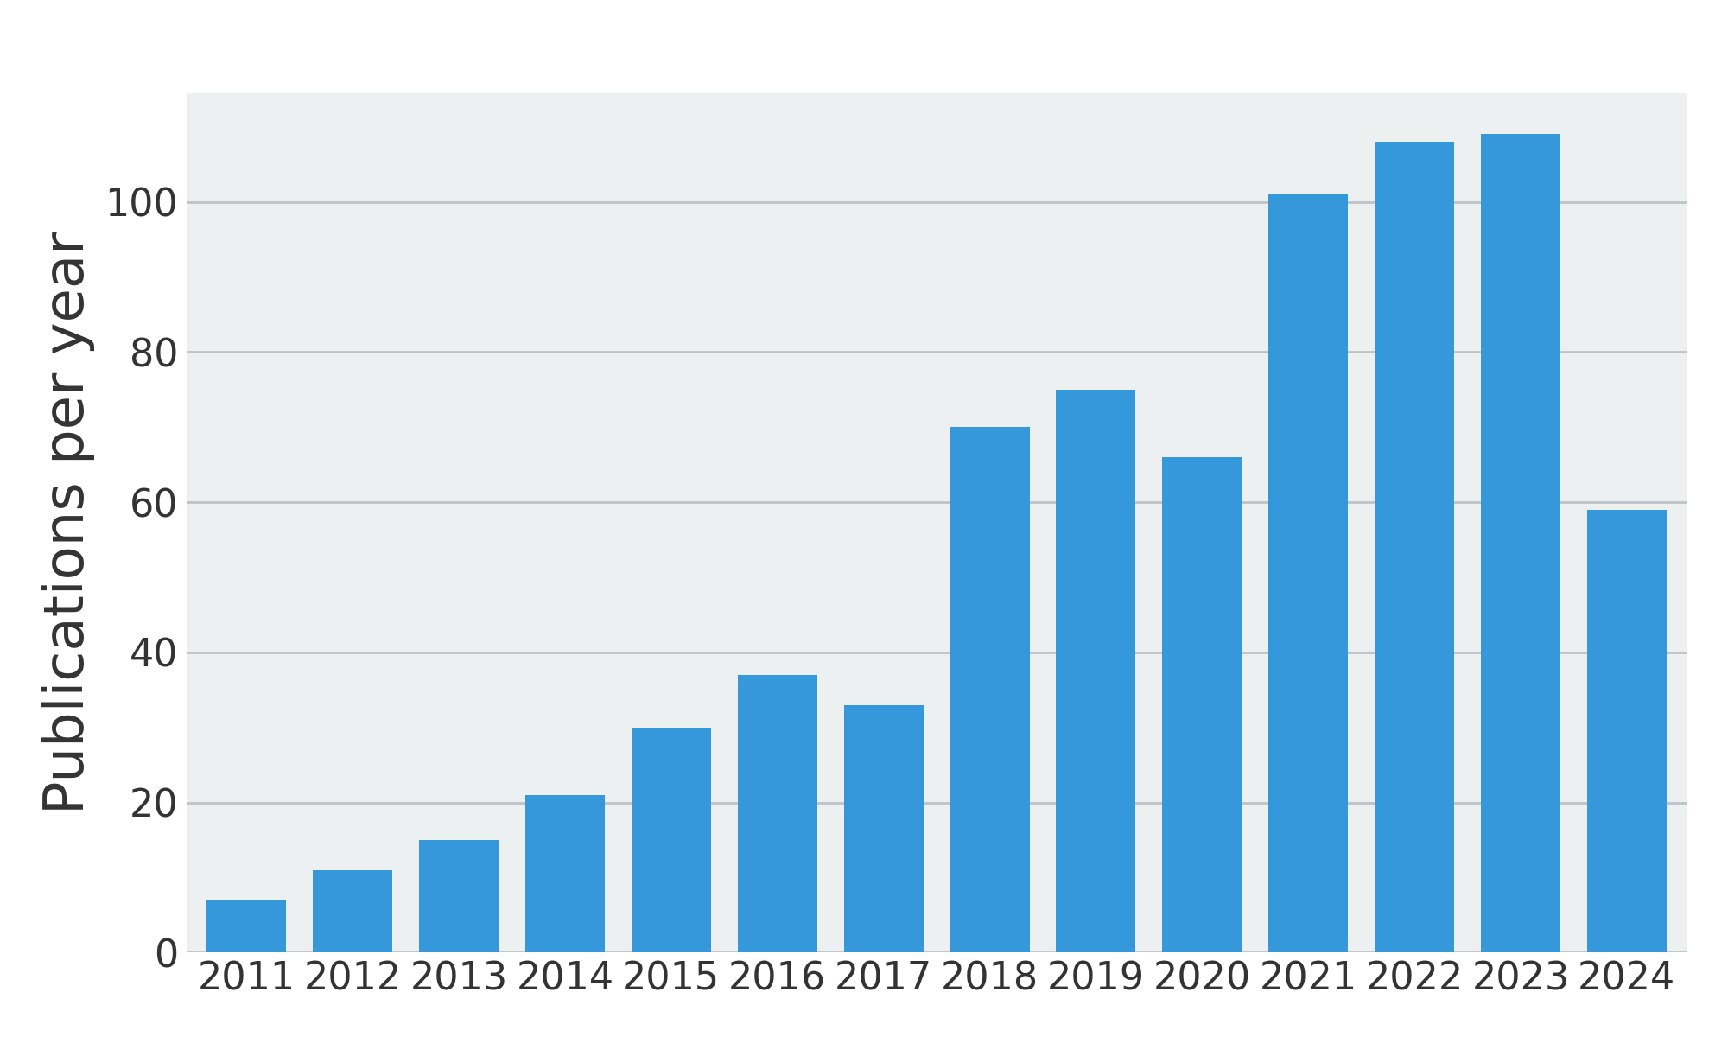
Lofar Science Output
Refereed LOFAR papers till May 2024
742 refereed publications
Publication rate: 2 papers per week – top 10% of all astronomical facilities
4
Notes:
The current rate of LOFAR publications is close to two refereed papers per week. Not only is this rate in the top 10% of all astronomical facilities in the world – each paper has more than twice the impact of the average astronomical publication. This makes LOFAR one of the highest impact Observatories in the world, at any wavelength, as can be seen from Figures 4 and 5, which compare the publication impact of the world’s highest performing astronomical facilities (credit: D. Crabtree). Notably, LOFAR performs extra-ordinarily well on the altmetric measure of impact – altmetrics capture non-citation impact of a publication, for example the number of downloads uptake in personal Mendeley libraries, mentions on social media, by news outlets, and in policy documents. This indicates high societal or educational relevance of publications or scientists. This is supported by the measure of media impact of LOFAR publications which is on average twice that of publications across all scientific fields.

Slide 5
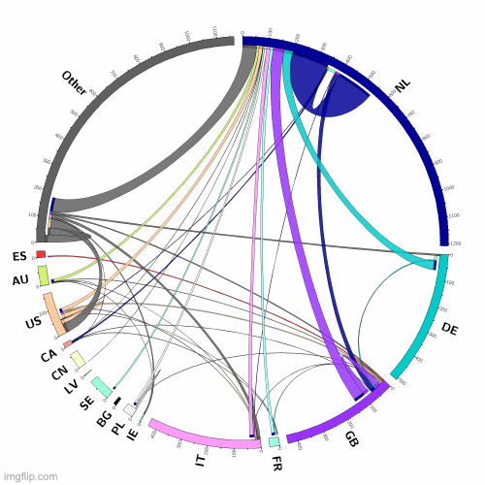
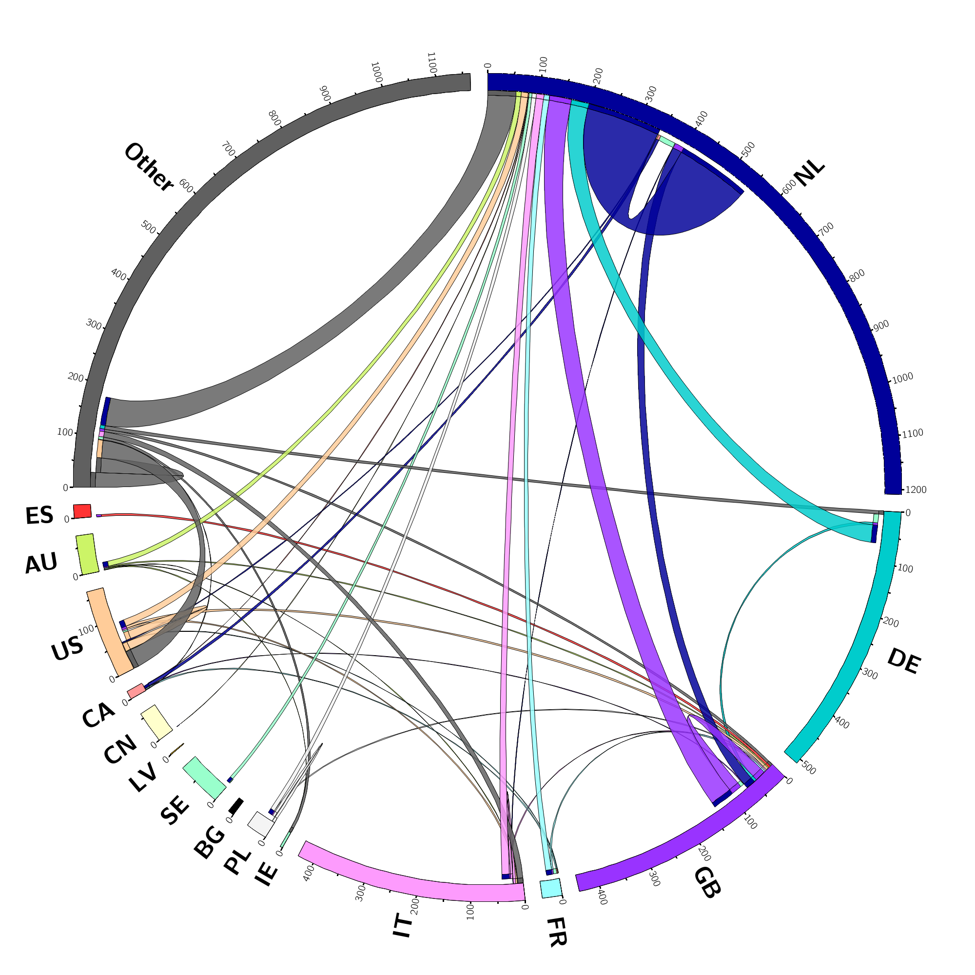
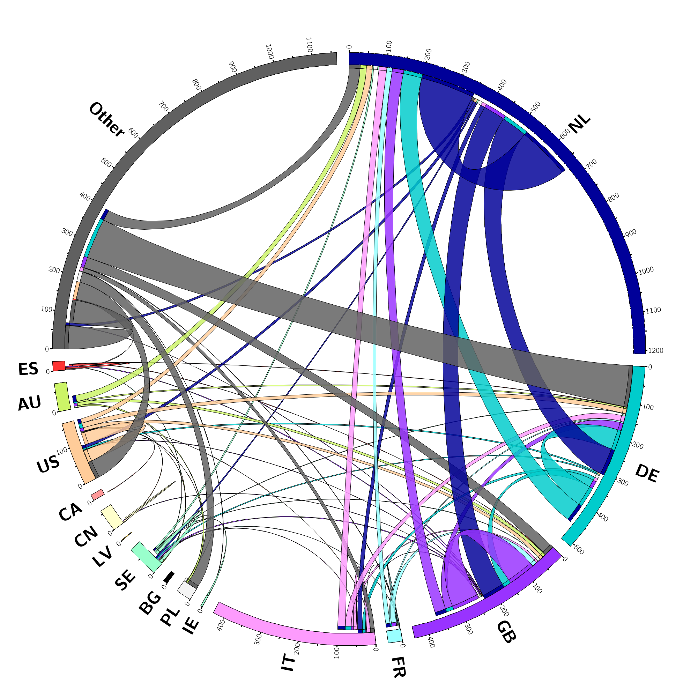
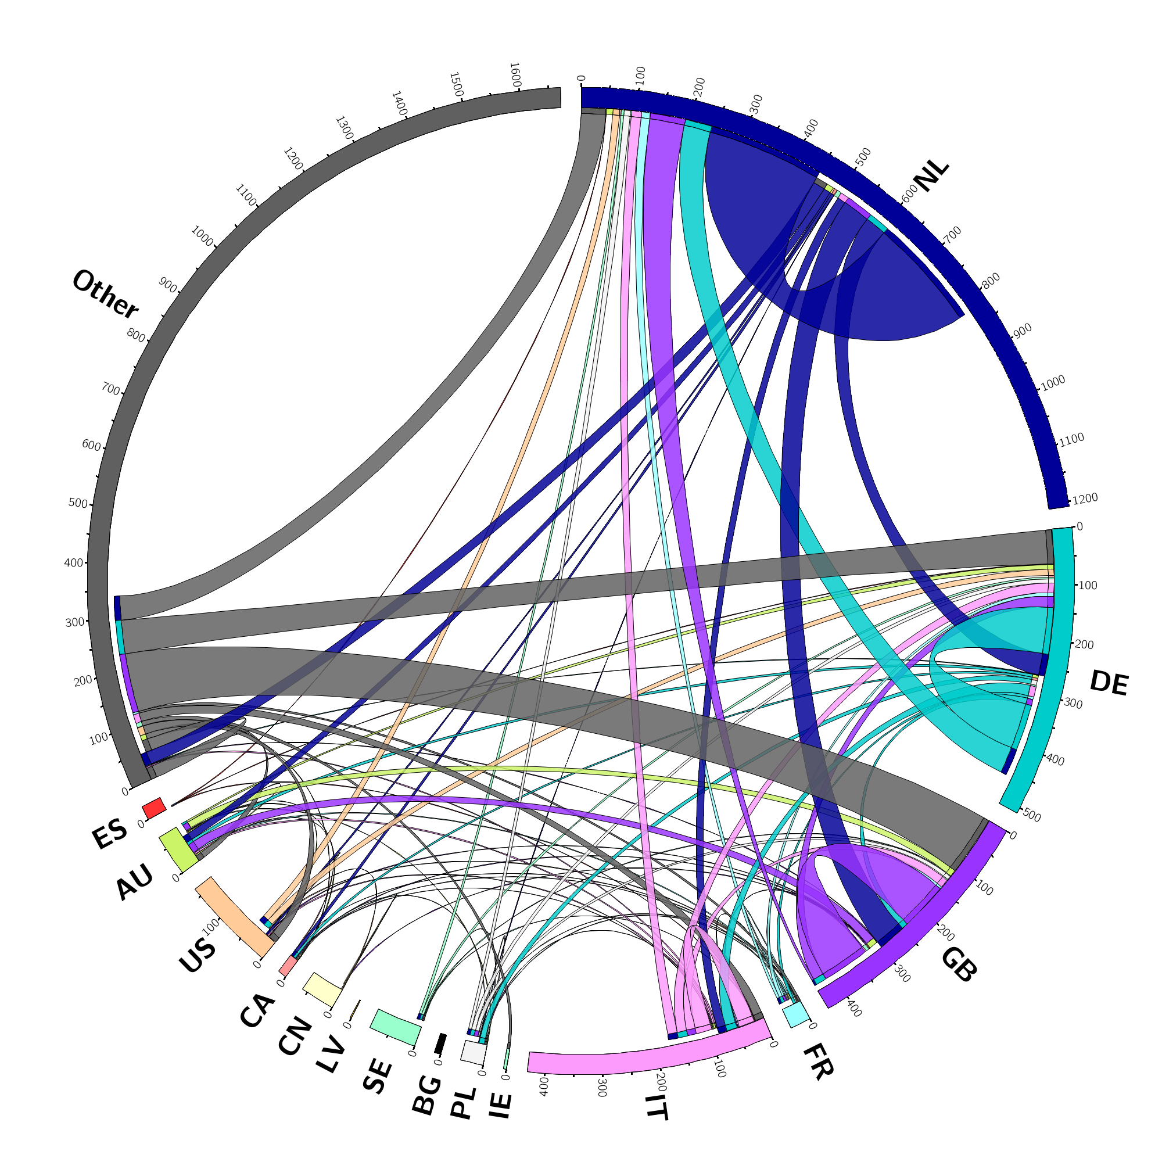
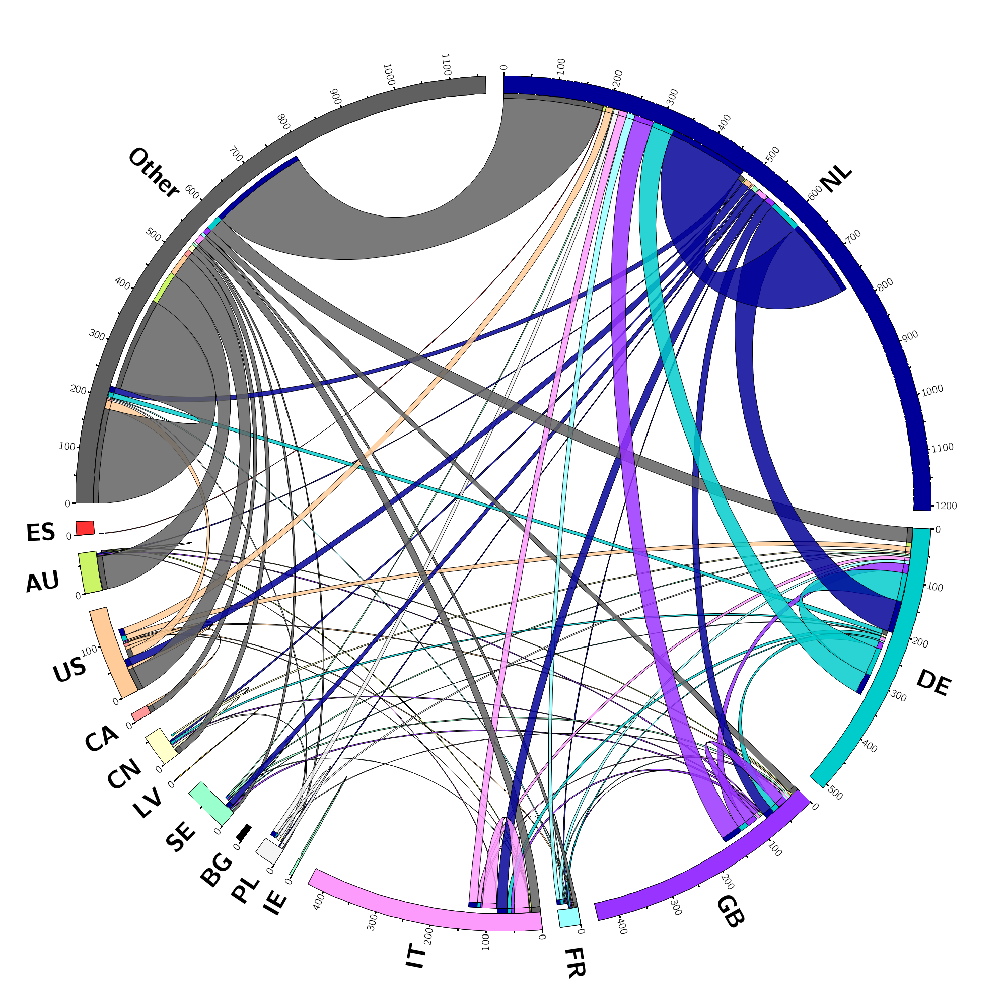
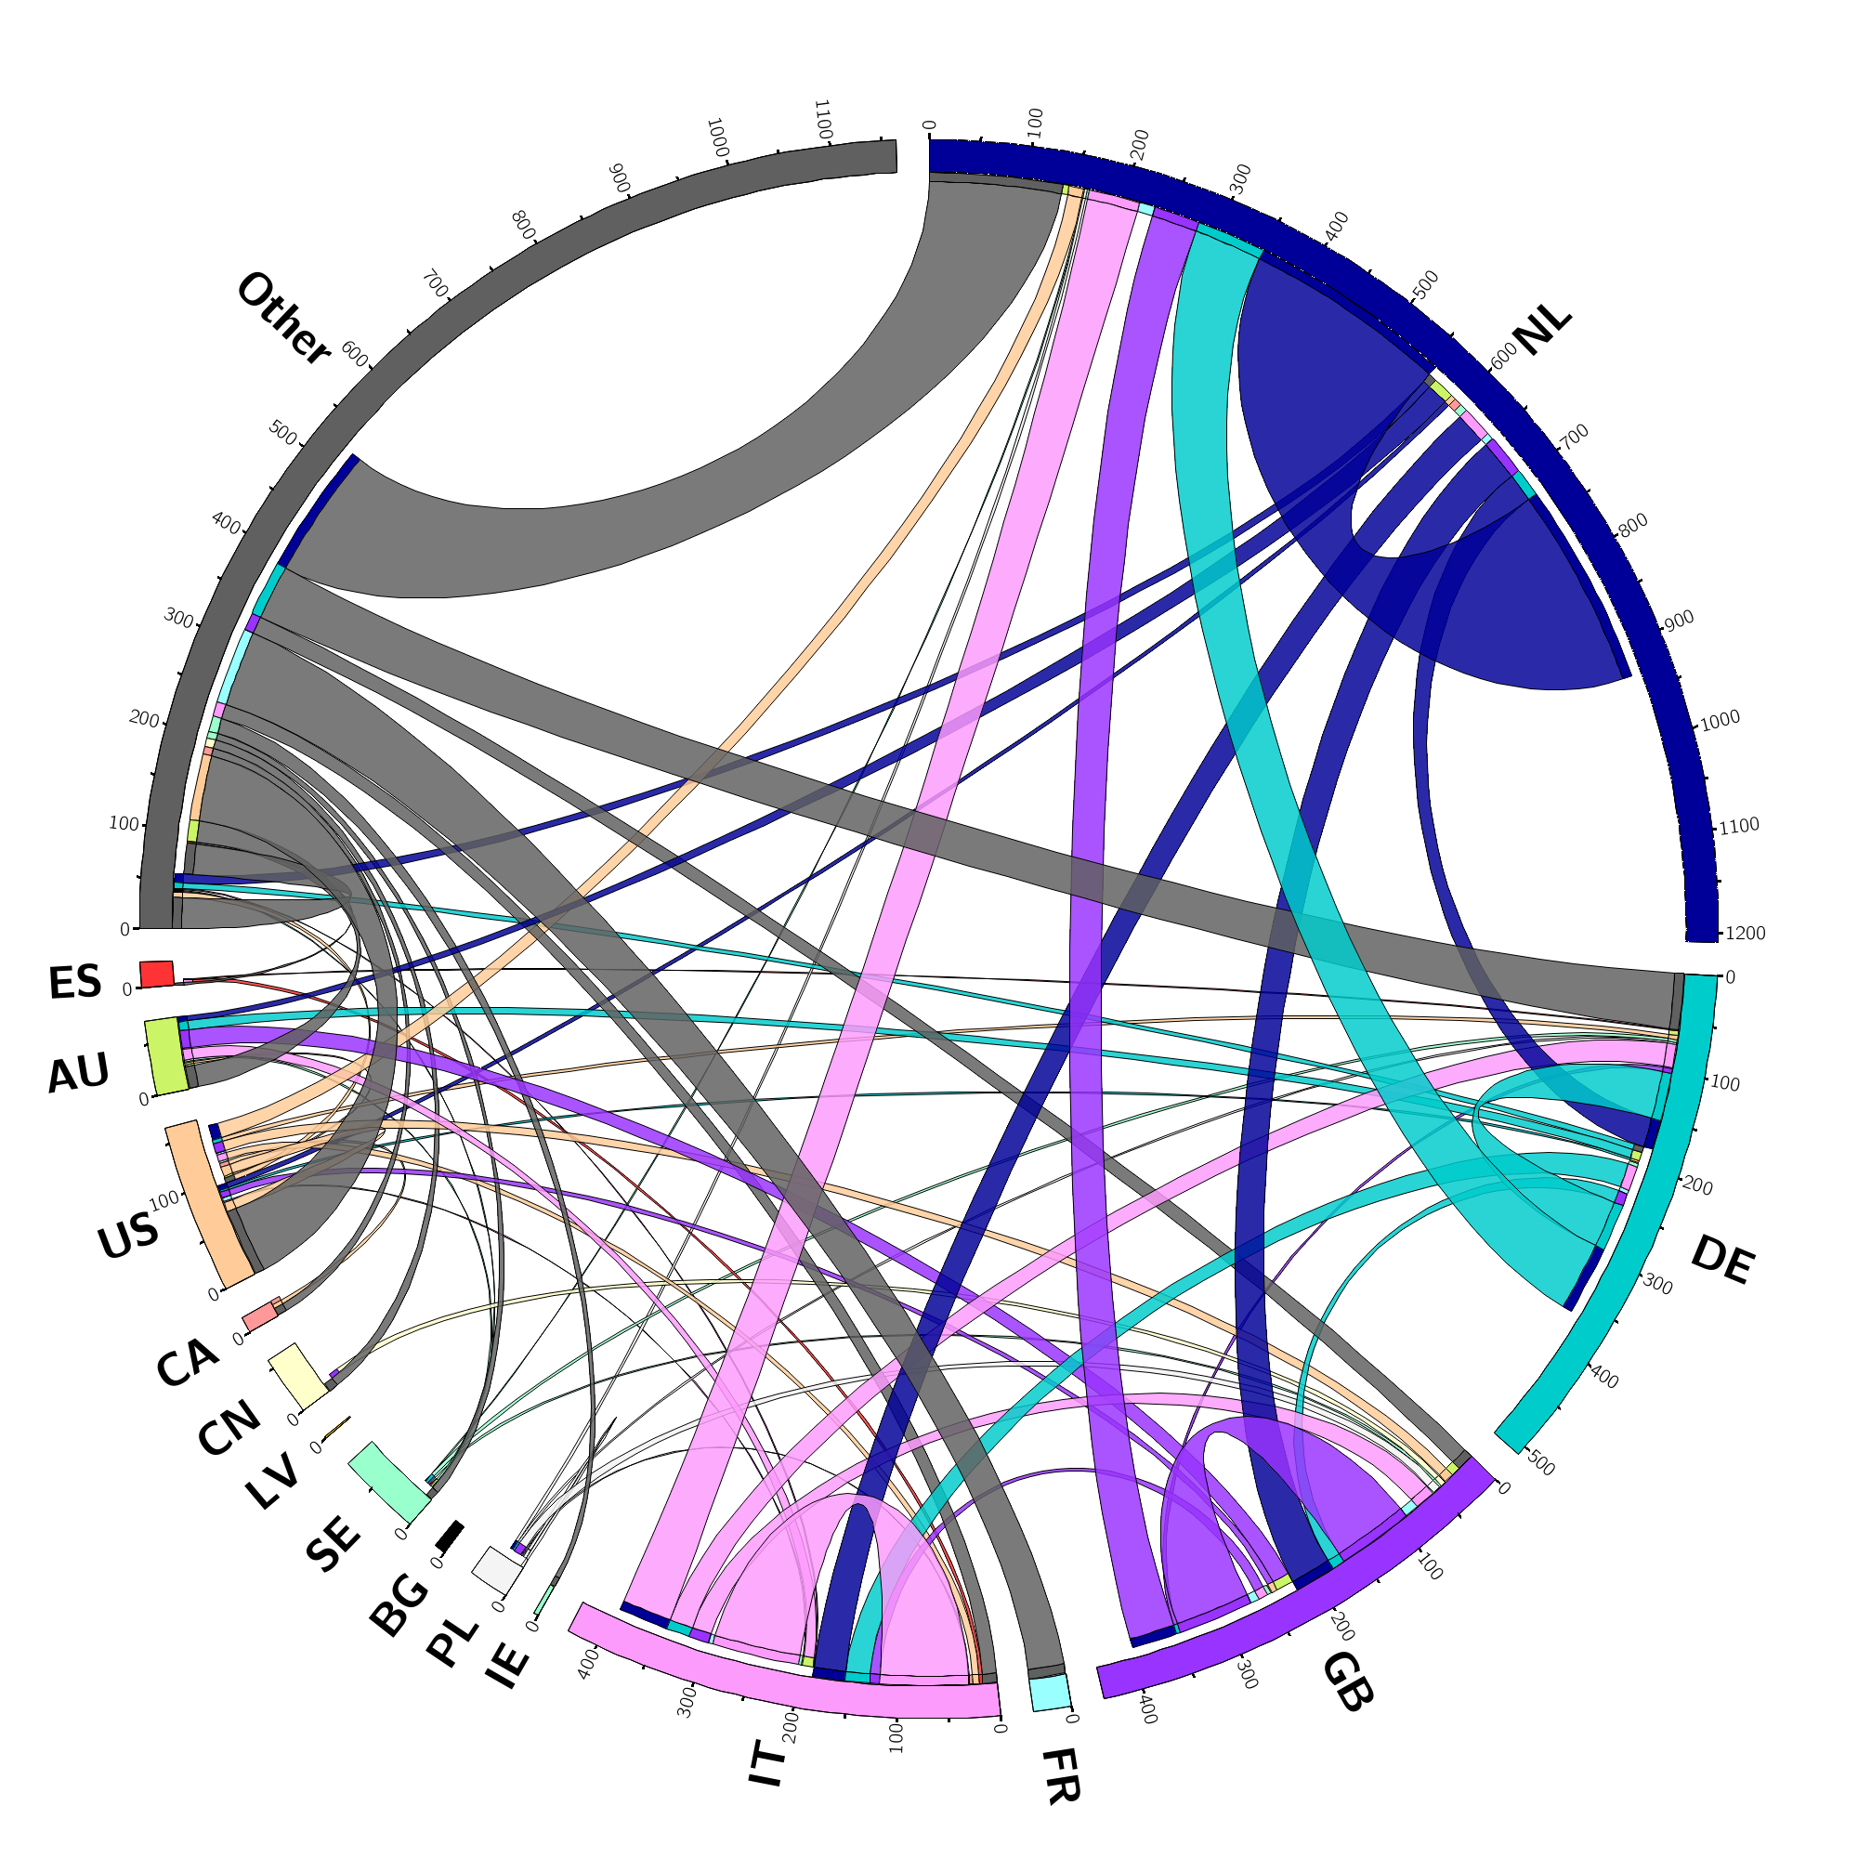
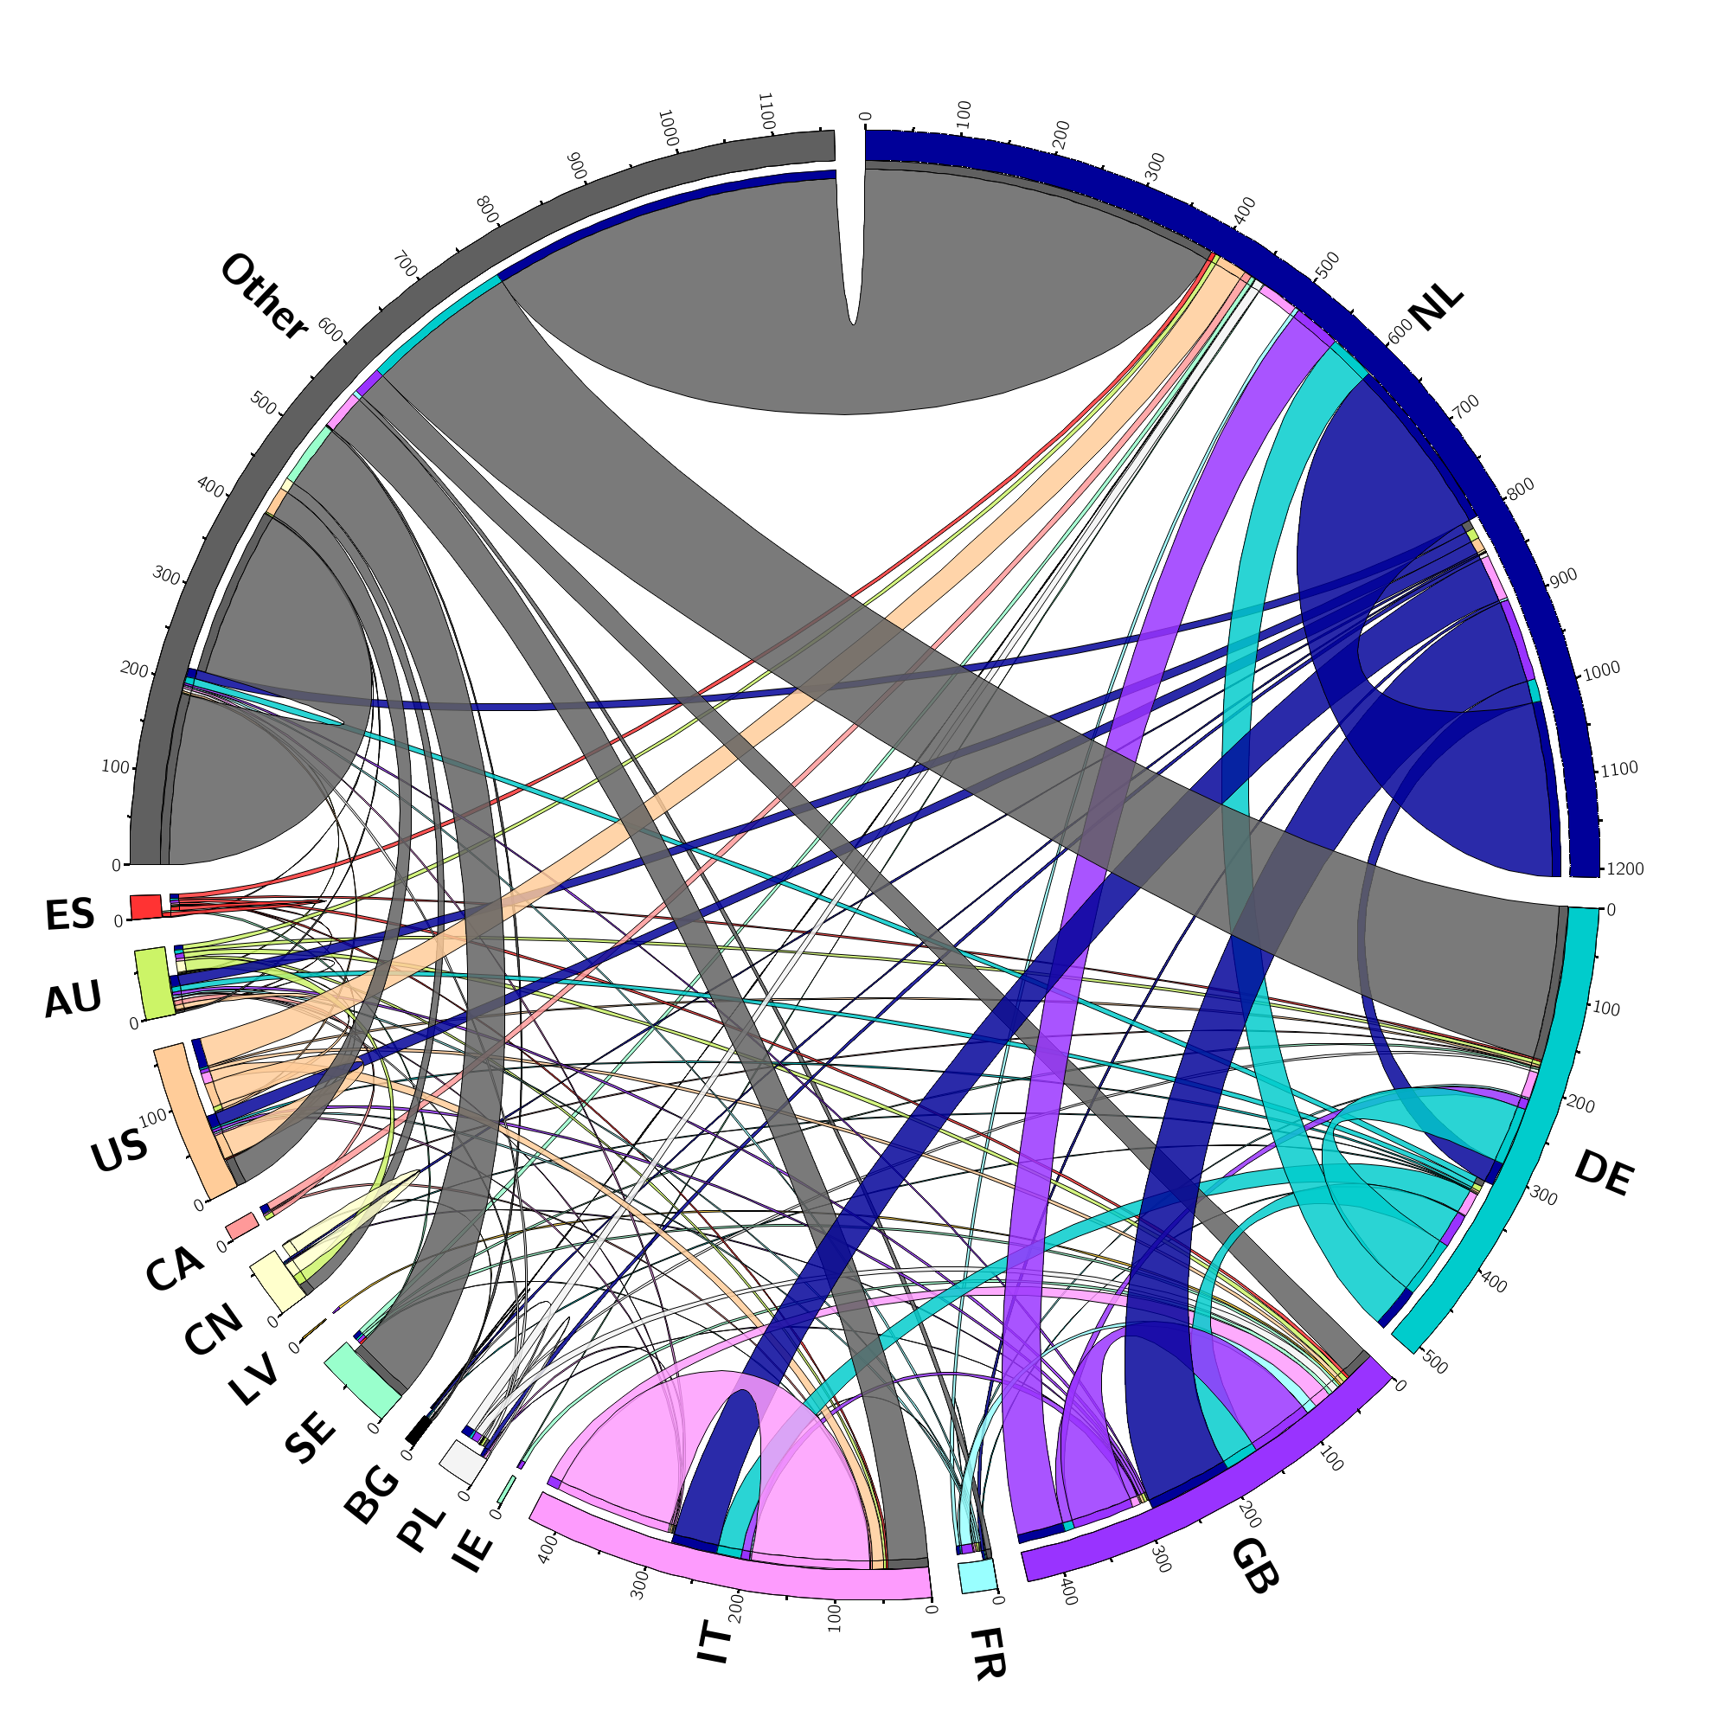
Community Evolution
Measuring the success of LOFAR: shape of the LOFAR community and evolution of international collaborations.
LOFAR’s community spans the entire World and expanded by over a factor of 3 in the period 2017-2022.
Evolution of collaborations: chord plots obtained by analysing the LOFAR publications over the period 2017-2022.
Between 2017 and 2022 there was a factor of 7 increase in collaborations.
2017
2018
2019
2020
2021
2022
Plots courtesy of J. Dempsey
5
Notes:
Another metric of an Observatory’s success can be found in analysis of the depth and breadth of collaborations in the scientific user community. LOFAR’s community spans the entire world, and expanded by over a factor of 3 in the reporting period from 610 users in 2017 to 2000 in 2022. A measure of the successful Observatory can be found in tracking whether the facility stimulates international collaborations and develops new astronomical communities. Details are provided in Appendix 8, and the evolution of the LOFAR collaborations is shown in the animation in Figure 13. Between 2017 and 2022 there was a factor of 7 increase in collaborations.

Slide 6
LOFAR2.0: New Challenges
LOFAR2 will:
Double the number of active LBA antennas
Realize simultaneous HBA and LBA observations
use the Megamode – interferometric and TAB data products at the same time
Delivery of science-ready data products
Telescope components
SDC components
System specification and task management
See also next talks for complementary info on station & array calibration
6
Notes:
There is an increased complexity compared to LOFAR1 operations and improvements in software and procedures are necessary in various areas of operations

Slide 7
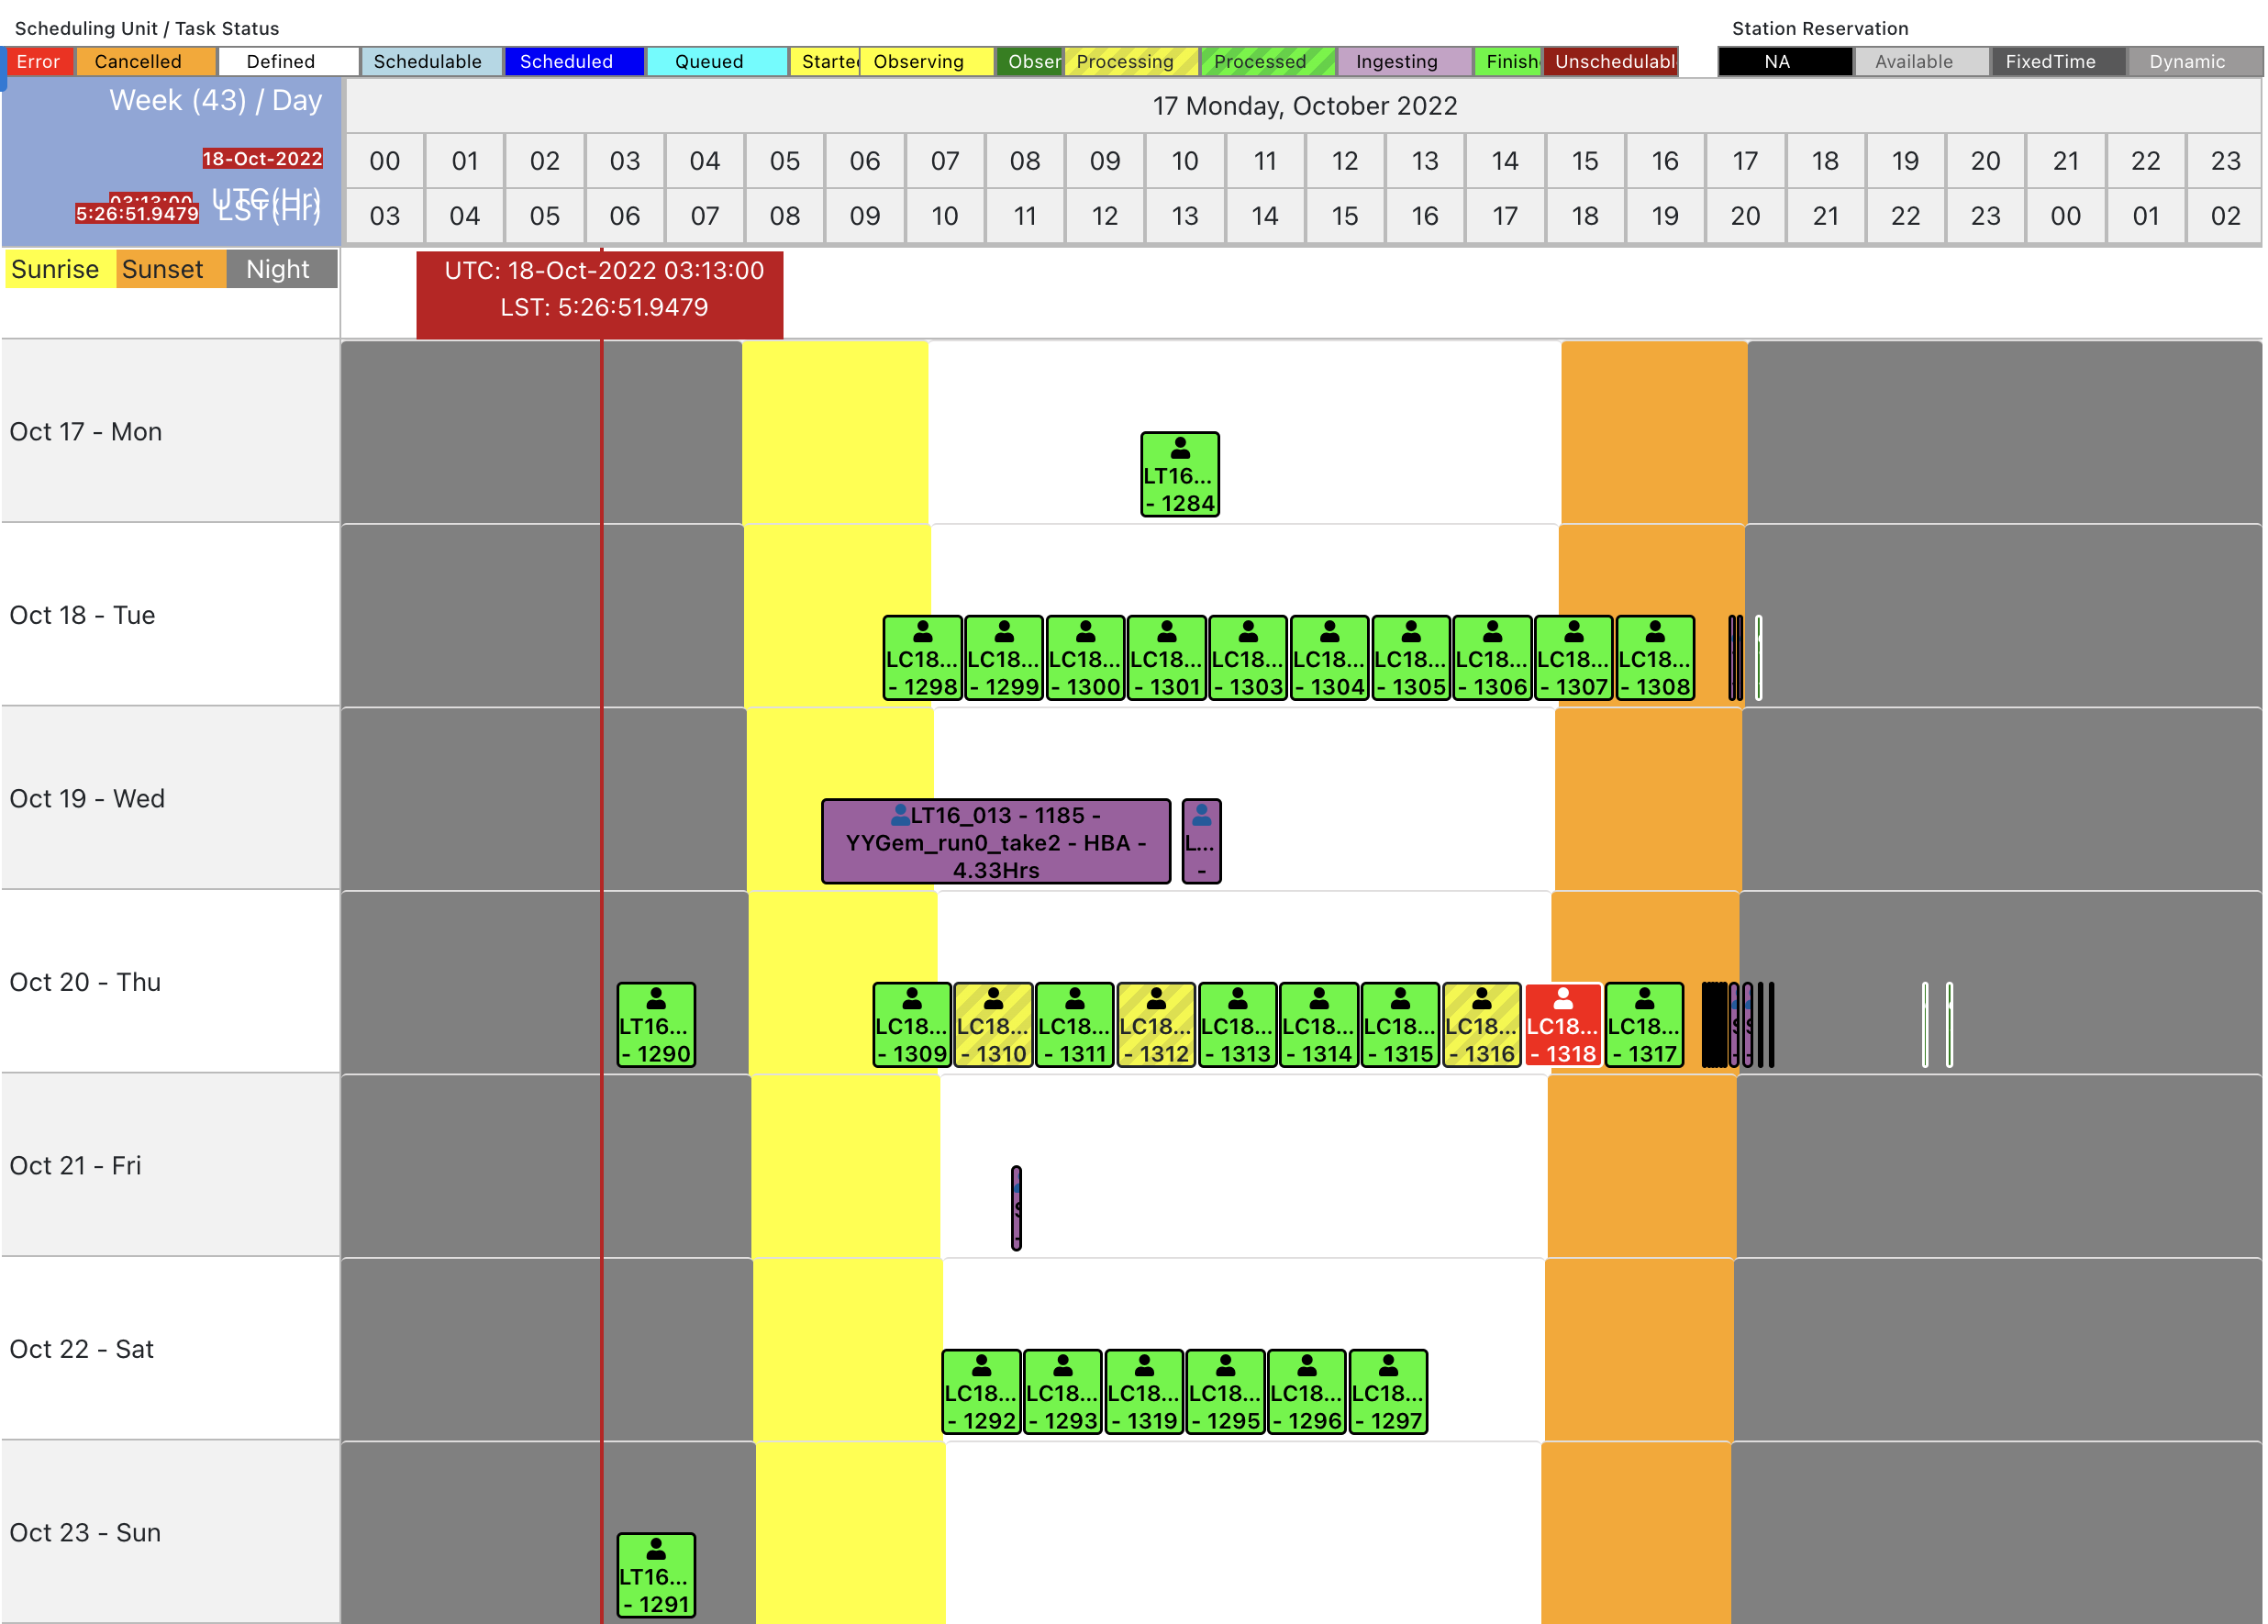
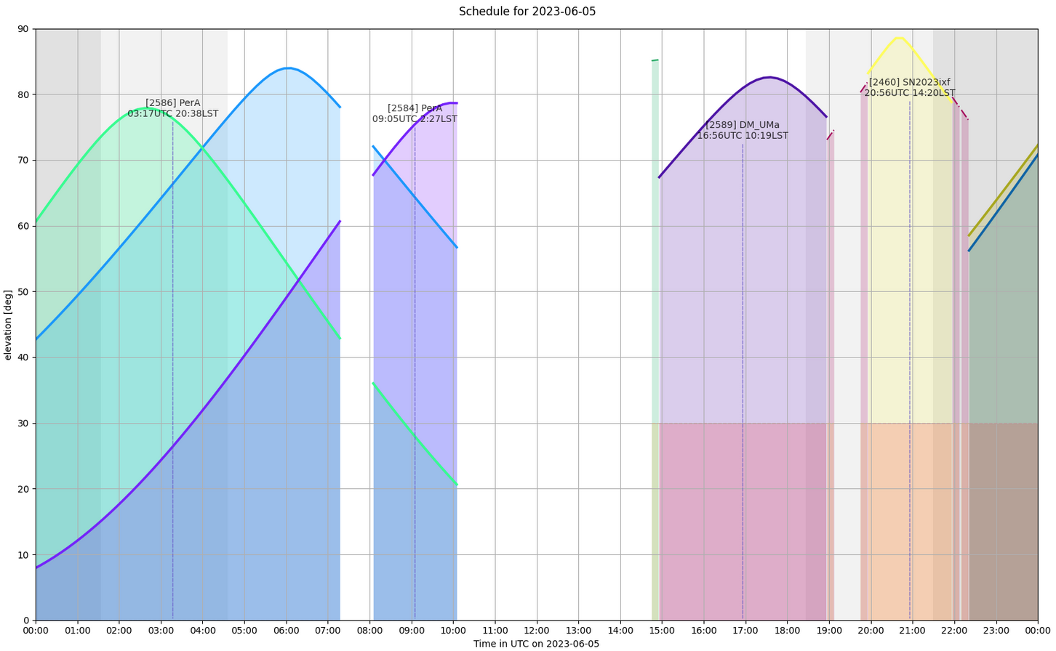
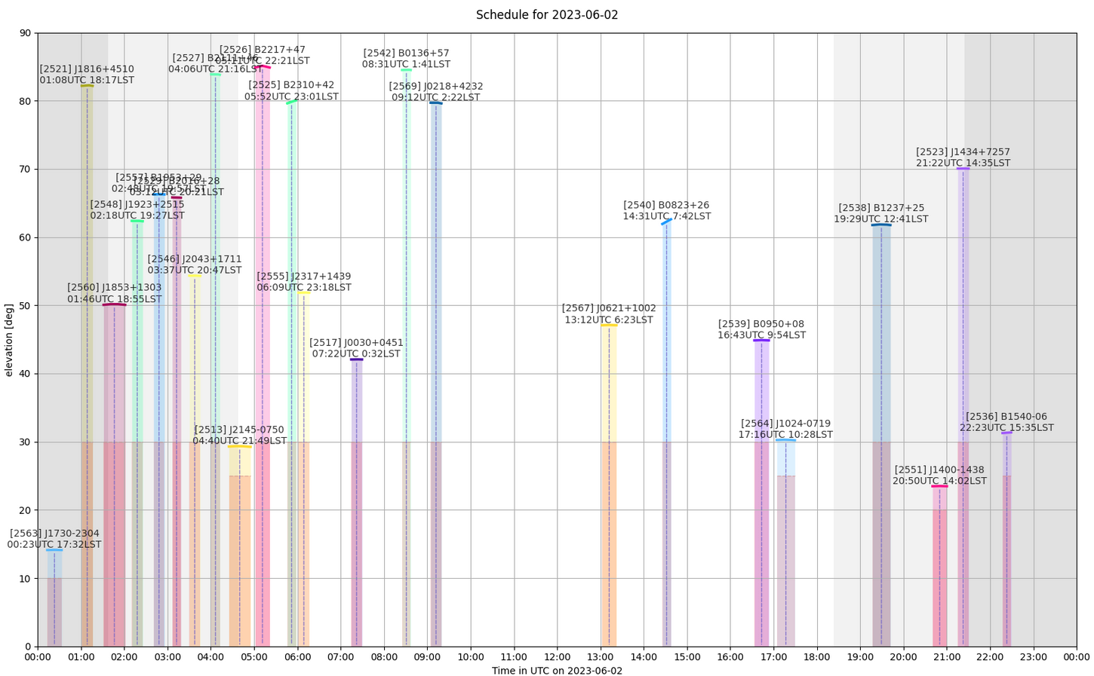
Scheduling & observing: TMSS Now Runs The Show
More efficient LOFAR operations
Dynamic scheduling
Improved adaptability and maintainability of software
TMSS running the full Cycle 20 observing program – public schedule here
Dynamic scheduler: schedule observations automatically based on constraints
Further enhancements:
system reacting to external events (solar activity, ionospheric conditions, etc.)
More automation in data acceptance & data quality assessment
Specification -> interaction with proposal submission tool
Images courtesy of the TMSS team
7
Notes:
The intention is to develop a system that reacts to external events such as solar activity, ionospheric conditions, and lightening in order to
use the telescope time in such a way that the conditions are suitable for each science case
LENSS: ‘A suite of quality control metrics will also be registered at this stage, and the system will request re-observation if the data is found to be inadequate. While automated quality assurance (QA) of this type is not currently employed in the LOFAR system, we will exploit recent work by ASTRON and partners to enable machine-learning-based anomaly detection ‘

Slide 8
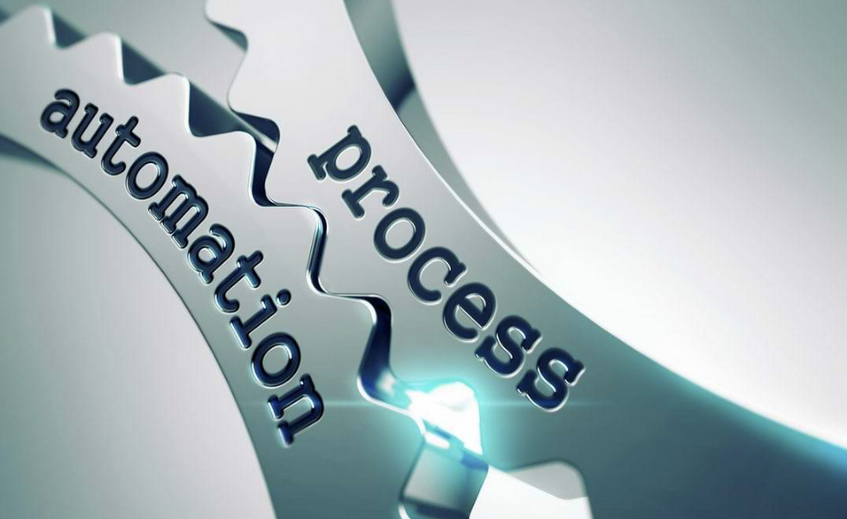
Proposing: New Proposal Management Tool
NorthStar successor needed for LOFAR2
Analyzed tools adopted at other major astronomical facilities
New tool under development (inspired by Hedwig, adopted at EAO)
It will:
Support proposal creation and experiment specification
Support review process
Transfer technical specs of allocated projects automatically to facility management systems (LOFAR & SDC)
Integrate with FAAI
8
Notes:
SDC is moving towards integration with a Federated Authentication and Authorization Infrastructure (FAAI) that the proposal tool is required to interface with as well.

Slide 9
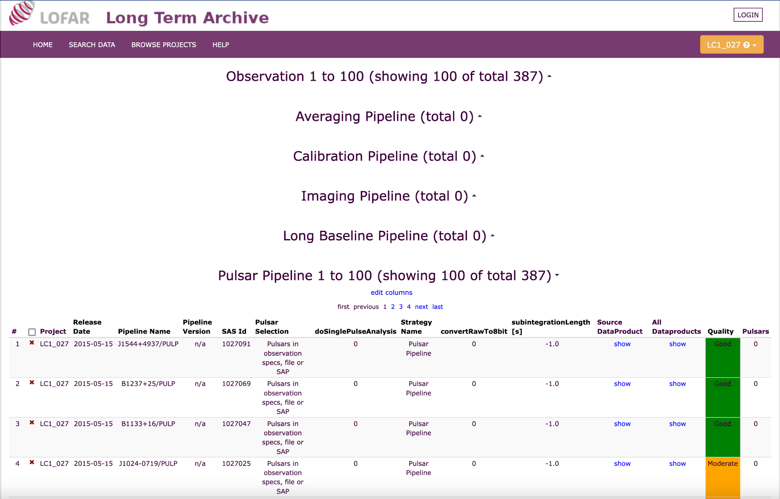
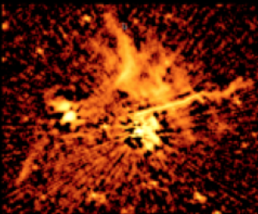
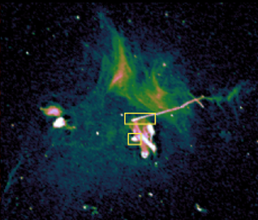
Generating Science-Ready Data Products: LTA Ops
New operational area compared to LOFAR1
Will run workflows currently under development
LDV:
Reduce data volume at the LTA to reduce operational costs
Streamline data processing operations at the LTA
Prepare ASTRON for LOFAR2 Large Programs
LDV Operations started early 2023
Current focus: BF data processing (re-quantization) – IF data compression following this year. Savings so far: ~4PB PB + introduction of data quality flag
Further valorisation of portions of the archive through data previews (marriage with LOFAR2.0 commissioning)
LOFAR Data Valorization
data quality flag
LTA NOW
Courtesy SKSP
LTA FUTURE
LTA FUTURE
LDV timeline
Courtesy SKSP
Courtesy SKSP
9
Notes:
LDV will significantly increase the scientific output of LOFAR (since more users will be able to more easily access the advanced data products and use them for cross-domain science) and will streamline data processing operations at the LTA through a gradual adoption in production of the LTA processing interface under development within the SDF-PPE project. By doing so, LDV will prepare SDCO (SDC Operations) for routine LTA operations towards the DUPLLO surveys.

Slide 10
Preparing the Infrastructure for LOFAR2.0: Data Life Cycle & Early LOFAR Cycle data Retirement
Product type | Example | Retention period
Raw | unprocessed vis. | Not retained
Instrumental | Flagged, compressed vis. | 18 months
Intermediate | Direction-independent vis | 18 months
Advanced | Images, cubes | Indefinite
Special cases | Unique observations | For discussion
LOFAR2 will generate considerably more data than LOFAR1: ~70 PB intermediate + ~30 PB advanced
Data challenge outstrips current affordable solutions
Early LOFAR Cycle data (Cycle 0-6) retirement:
In progress
ILT-board approved a data life cycle:
Advanced data products (images, cubes, catalogues) kept indefinitely
Intermediate data products will be retired after a period (~18 months), based on available resources
Exceptions to be considered in exceptional cases
Shift of paradigm: trust observatory pipelines
10
Notes:
LOFAR is preparing the upgrade to the LOFAR2.0 system, which will offer simultaneous low- and high-band observing, increased field-of-view, and various other improvements to the sensitivity and operation of the telescope. The new system will generate considerably more data than the current one. The need for processing and storage of this data represents a significant challenge, as it outstrips current affordable solutions. To realize the goals of the new Observatory, the ILT board has approved a data life cycle that optimises science data processing capacity and efficiency with respect to affordable data storage. This includes data retirement. The ILT anticipates that (final) science data products, generated through standard pipelines (such as image cubes) can be kept available indefinitely (under open access policies), but that raw/intermediate products may only be retained for further processing within a restricted dwell time.
To prepare the ILT infrastructure for the LOFAR2.0 data challenges, a first step needs to be taken now that involves the retirement of early Cycle data from the LOFAR Long-Term Archive (LTA). After careful analysis, it has been concluded that data from Cycle 0 up to and including Cycle 6 is either low in metadata quality or already valorized and published (https://science.astron.nl/telescopes/lofar/science-with-lofar/lofar-papers/) or, based on the download statistics, of little demonstrable interest to the current community. The ILT has therefore approved that mid-2024 this data will be deleted from all LTA sites.
Through this notification, we give the opportunity to any users (i.e. not only the projects’ PI’s) who may need to retrieve data from these early LOFAR Cycles, to signal this to the Observatory to coordinate the data download. The requests will be evaluated by the Observatory for technical feasibility and reviewed by the ILT-board for approval. We emphasize that all data concerned is public data.

Slide 11
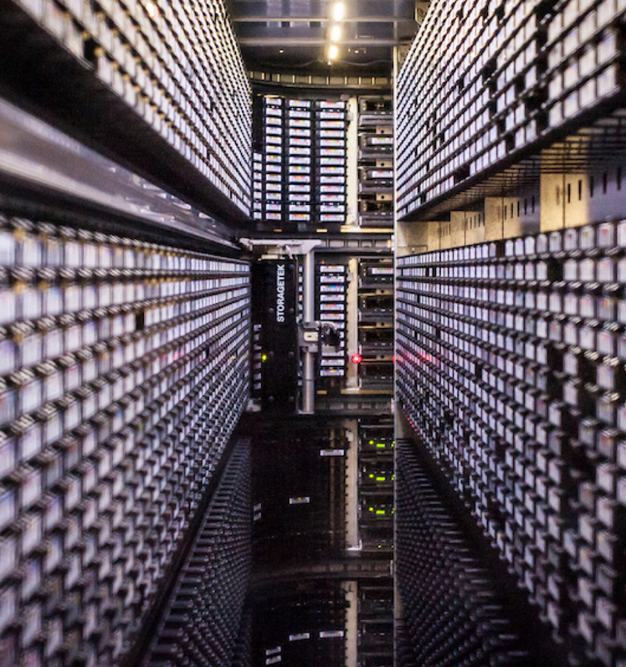
Data Access: Improving the LTA performance
Towards more stability of data staging and downloading:
Dutch (SURF) and German (Jülich) LTA data centres are ready to support more performant and reliable data access, offering a.o. WEBDAV and token-based authorization.
Poznan just upgraded their environment to support this as well.
Verification and final configuration changes underway
After completion, we will start offering new access methods through an upgraded stager service (StageIt)
Enhanced functionality for automated and interactive user staging requests
Instructions will be shared with the community
11
Notes:
We have already been offering WebDAV + Macaroon access at SURF and Jülich in the recent past to selected users (early cycle data plus a few special cases).

Slide 12
Thanks – questions?

