Slide 1
A periodic radio transient found with lofar
Iris de Ruiter
i.deruiter@uva.nl
Kaustubh Rajwade, Antonia Rowlinson, Ralph Wijers, Charlie Kilpatrick, Cees Bassa, Jason Hessels, Joe Callingham, Gudmundur Stefansson, Rudy Wijnands

Slide 2
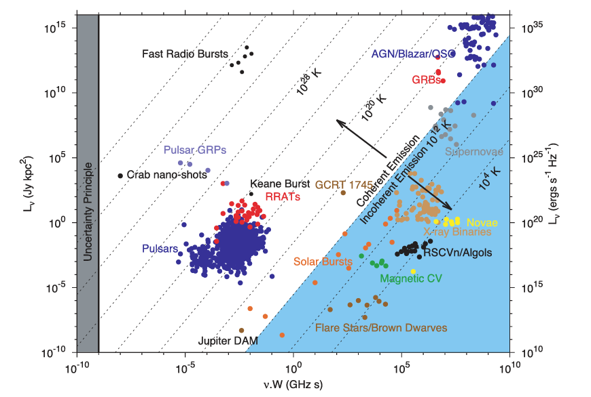
Radio transient phase space
Pulsars
FRBs
Stars
Hot Jupiters
Solar bursts
AGN
Pietka et al. (2015)

Slide 3
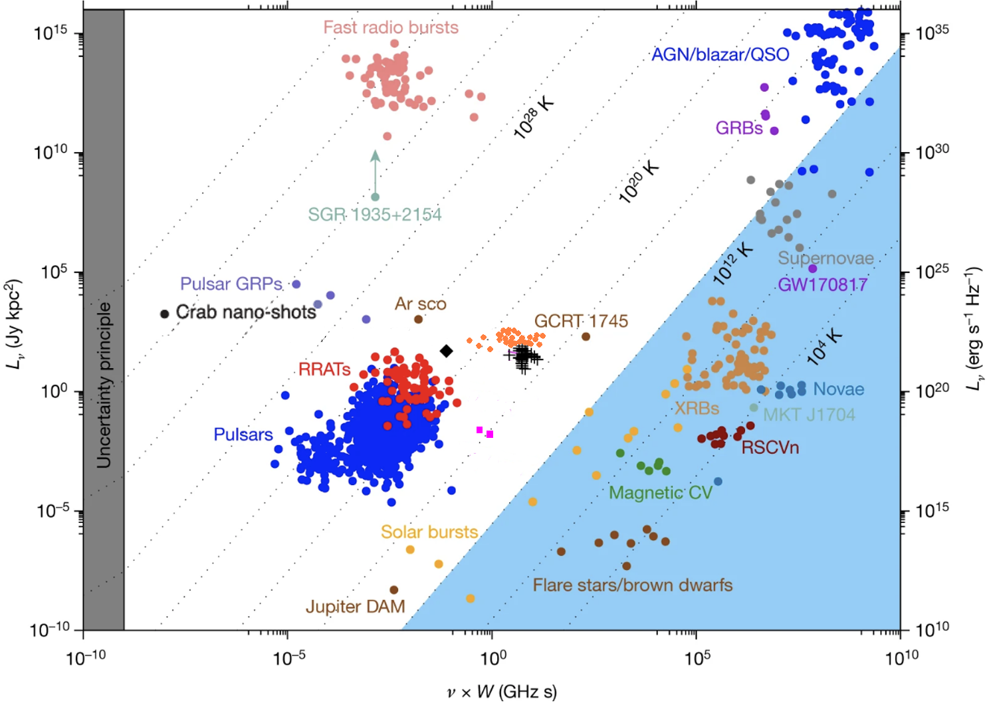
Radio transient phase space
Updated
Adapted from
Hurley-Walker et al. (2022)

Slide 4
Radio transient phase space
Updated
Adapted from
Hurley-Walker et al. (2022)

Slide 5
Radio transient phase space
Updated
Adapted from
Hurley-Walker et al. (2022)

Slide 6
Radio transient phase space
Ultra-long period sources
76 sec pulsar
20 minute period magnetars
White dwarf pulsar
Adapted from
Hurley-Walker et al. (2022)

Slide 7
Radio transient phase space
Ultra-long period sources
Observation bias
Beamformed vs imaging observations
Adapted from
Hurley-Walker et al. (2022)

Slide 8
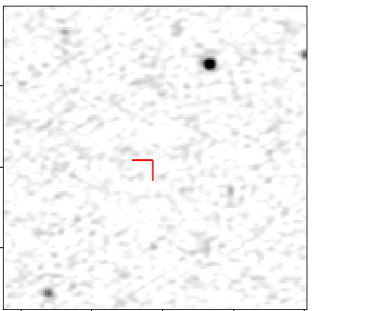
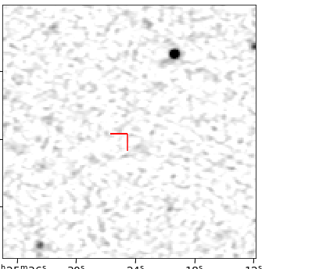
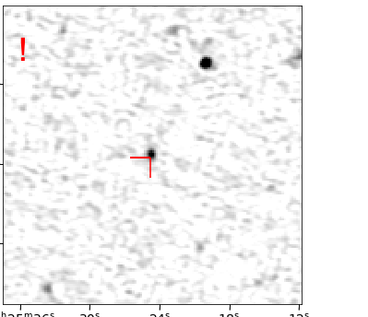
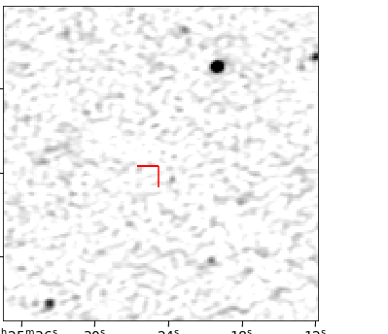
Image domain

Slide 9
Imaging bottleneck
Cleaning
Iterative process
Per snapshot
Solution:
Sky model subtraction
See eg. Wang et al (2023), Fijma et al. (2023), Hurley-Walker et al. (2022)
Imaging
Snapshot images

Slide 10
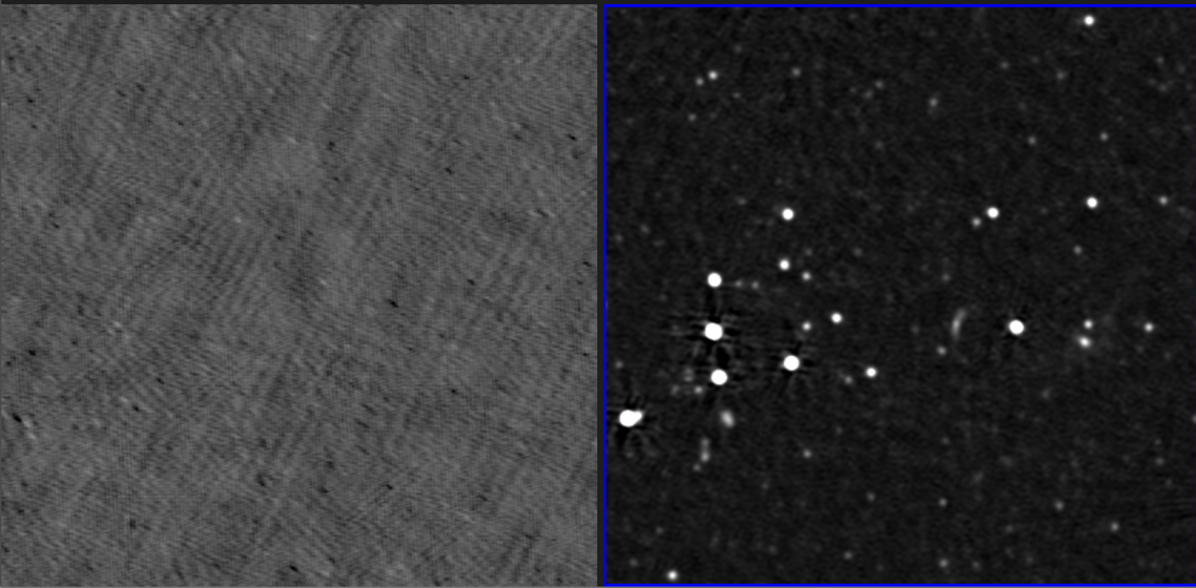
Subtraction image example
Subtraction image – 8 sec LoTSS image – 8 hour

Slide 11
Simulated transients
Stand out against an empty background
- No cleaning
Multiple simulations to test the sensitivity of this method
Filtering steps that keep us from identifying subtraction artefacts as transient sources

Slide 12
Conclusions
Method in place to perform commensal transient searches on LOFAR survey data de Ruiter et al. (submitted) arXiv:2311.07394
Student Thijn Swinkels working on DR2
In only 2% of LoTSS we find a transient source!

Slide 13
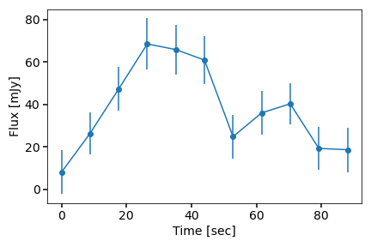
Transient source
Δt = 8 sec

Slide 14
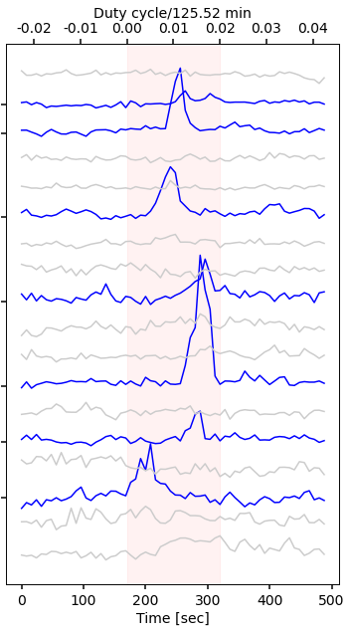
Periodicity
2020
P = 125.519601 ±0.000005 min
No new flares in 2023
2020
2015

Slide 15
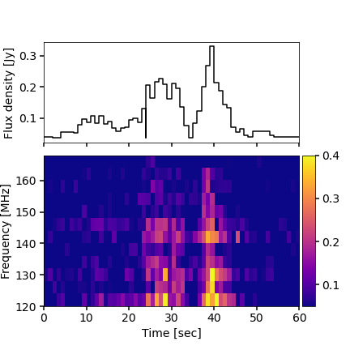
Radio properties
1) Steep spectrum
$α=−4.2 ±1.0$
2) No circular polarization (<1.6%)
3) High linear polarization (>70%)
4) DM = $15.9 ±6 pc {cm}^{−3}$
$$S_{ν}∝ν^{α}$$

Slide 16
Comparing to ultra-long period sources
✅ Long period
✅ Steep spectrum
✅ Polarization
✅ Intermittent
❌ Towards galactic plane
optical counterparts
See Hurley-Walker et al. (2022) and Hurley-Walker et al. (2023)

Slide 17
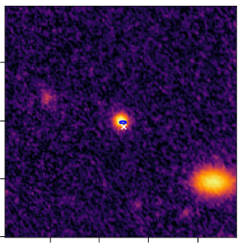
Optical counterpart
M5 star
P_{chance}< 0.00014 (0.0022)
Radio emission from the M star?
Luminosity
Polarization properties
Other long period sources - compact object

Slide 18
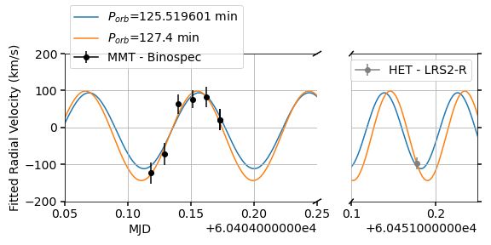
Radial velocity
Spectra confirm the spectral type as a M4.5V
Radial velocity measurement

Slide 19
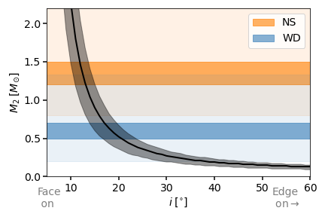
Binary mass function
$$\frac{{\left(M_{2}sin⁡(i)\right)}^{3}}{{\left(M_{1}+ M_{2}\right)}^{2}}=\frac{P{\left(V_{1}sin⁡(i)\right)}^{3}}{2πG}$$
For K=103 ± 15 km/s
M₁ between 0.184 and 0.23 Msun
P the radio period
System must be close to face on

Slide 20
Companion (1)
Stellar
No evidence in the spectrum
Sub M4.5V star
Photometry
Orbital phase 1 Orbital phase 2
Radio?
Notes:
WD in AR sco ~ 10.000K

Slide 21
Companion (2)
Neutron star
Spin period / orbital period?
Galactic magnetar 1E 161348-5055 P=6.67 hrs (De Luca et al. 2006, Rea et al. 2016, D’Aì et al. 2016)
Quiescent X-ray lum > 10³¹ erg/s
Lx < 3 x10³⁰ erg/s
Notes:
Far off the galatic plane – fits with an older magnetar with weaker X-ray emission
White dwarf more likely from a binary evolution standpoint

Slide 22
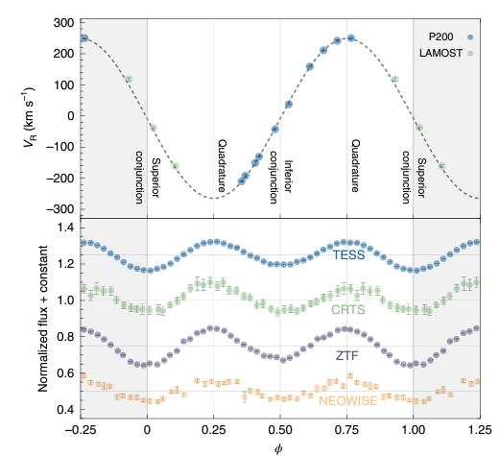
Companion (2)
Neutron star
Galactic magnetar 1E 161348-5055 P=6.67 hrs (De Luca et al. 2006, Rea et al. 2016, D’Aì et al. 2016)
Quiescent X-ray lum > 10³¹ erg/s
Lx < 3 x10³⁰ erg/s
A dynamically discovered and characterized non-accreting neutron star–M dwarf binary candidate – Yi et al. (2022)
Notes:
Far off the galatic plane – fits with an older magnetar with weaker X-ray emission
White dwarf more likely from a binary evolution standpoint
Yi et al. 6 hr period

Slide 23
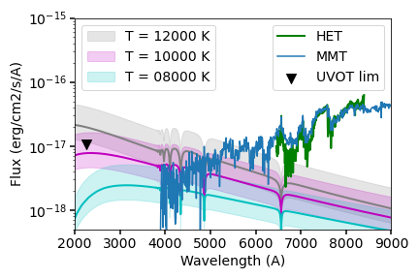
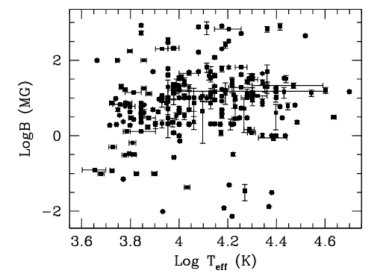
Companion (3)
White dwarf
Polars: highly magnetized ~ 10 -100 MG
Rotation is synchronized with the orbital period
Most have periods <2 hrs
Magnetic moment prevents accretion disk
-> UV observations to constrain WD temperature
T=11000 K
Ferrario, deMartino, Gänsicke et al. (2015)
Notes:
Ar Sco (T~11500 K) (Garnavich et al. 2021)
Ar Sco twin (T~11400 K) (Pelosi et al. 2024)

Slide 24
Conclusions 2
We found a long-period source with LOFAR
Binary companion
To do:
Finish thesis 🙃
UV and photometry to further constrain the system/binary companion
Find more!

Slide 25
THANks
Any questions?
i.deruiter@uva.nl

Slide 26
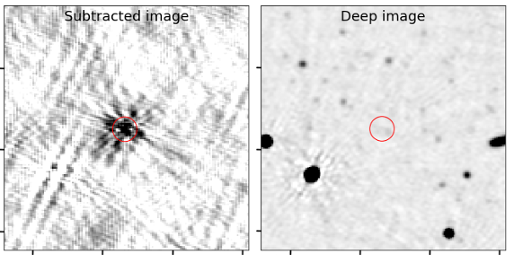
Detection image

Slide 27
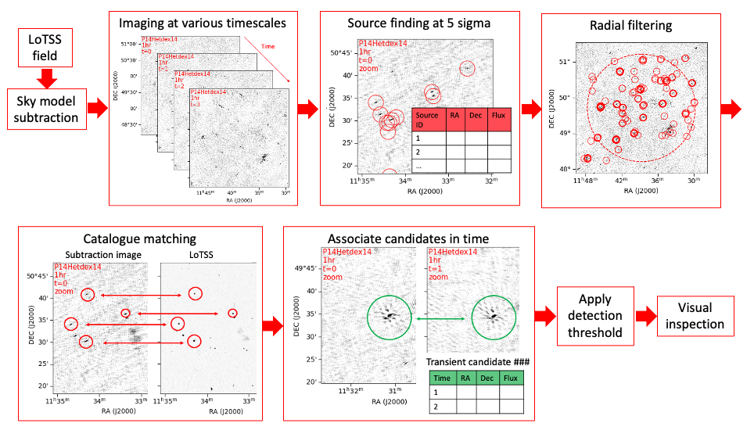
Pipeline

Slide 28
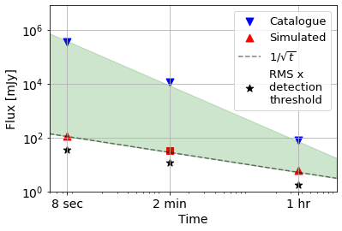
Sensitivity

Slide 29
Imaging bottleneck
Imaging settings | Time to image one pointing | Full LoTSS* 3100 pointings
Full image – including all sources and full cleaning | 180 hr | 3.2 yrs
Subtraction imaging | 7.5 hr | 48 days
*Assuming we can run 20 pointings in parallel

