Slide 1
Evolution of fundamental and harmonic sources in LOFAR type III radio burst images
C. Vocks, M. Bisi, E. Carley, B. Dabrowski, R. Fallows, P. Gallagher, A. Krankowski, J. Magdalenic, G. Mann, C. Marque, B. Matyjasiak, D. Morosan, H. Rothkaehl, P. Zucca
LOFAR Family Meeting 2024, Leiden, 6 June 2024

Slide 2
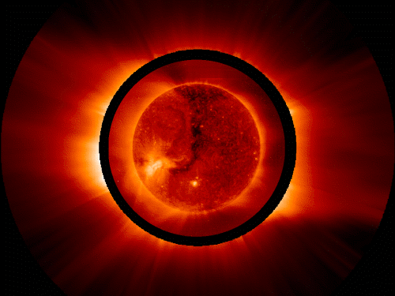
Solar observations with LOFAR
The Sun is a strong radio source:
Thermal: 10⁶ K corona
Non-thermal: Flares, CMEs
Intensities:
Thermal: some 10⁴ Jy
Non-thermal: up to 10⁸ Jy
Non-thermal radio wave emission:
Plasma emission
Energetic electrons in the Plasma
Electrostatic instability, Langmuir waves
Wave-wave interaction creates radio waves
Wave emission at local plasma frequency:
The frequency f depends only on the density N
and its harmonics

Slide 3
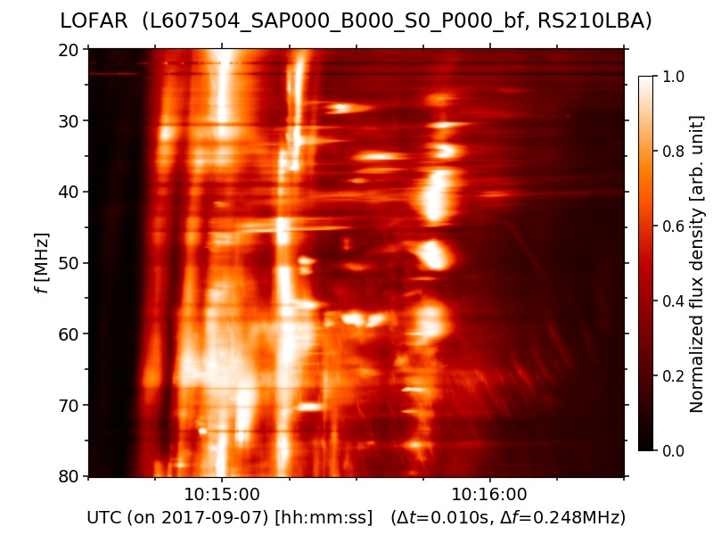
LOFAR observation of an M class flare
Solar M class flare on 7 September 2017:
LOFAR images of the type III bursts:
Starting at 10:14:40 UT
Intermittent dual-source structure
Accompanied by several type III bursts

Slide 4
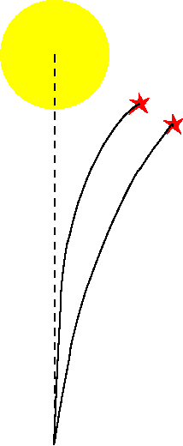
Interpretation: Fundamental and harmonic plasma emission
Given observation frequency: f_{obs}
Plasma frequency:
f
f_{p} = (N e² / (m_{e} ε₀))^{1/2} / (2 π)
h
Refractive index:
Fundamental and harmonic sources:
n = (1 – f_{p} / f)^{1/2}
h source: local plasma frequency is f_{obs} / 2
Fundamental emission:
located higher in the corona
f_{p} = f_{obs} , n → 0
less refraction towards the solar disk center
Harmonic emission:
in the large-scale coronal density decrease
f_{p} = f_{obs} / 2, n = 0.886
with height than for the f source
Separation of f and h sources

Slide 5
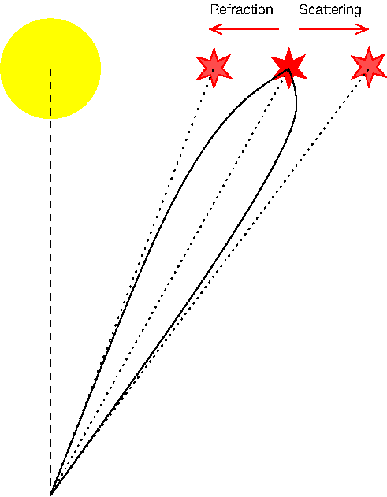
Radio wave propagation in the corona
Competing effects: Refraction and scattering
Refraction:
Large-scale density decrease with height
Refractive index increases
Snell‘s law
Ray path curved away from the Sun
Scattering:
Turbulent density fluctuations
Variation of refractive index
Distortion of wave fronts
Not isotropic
Net result is an apparent source position away from the Sun
These effects are stronger for f than for h emission.

Slide 6
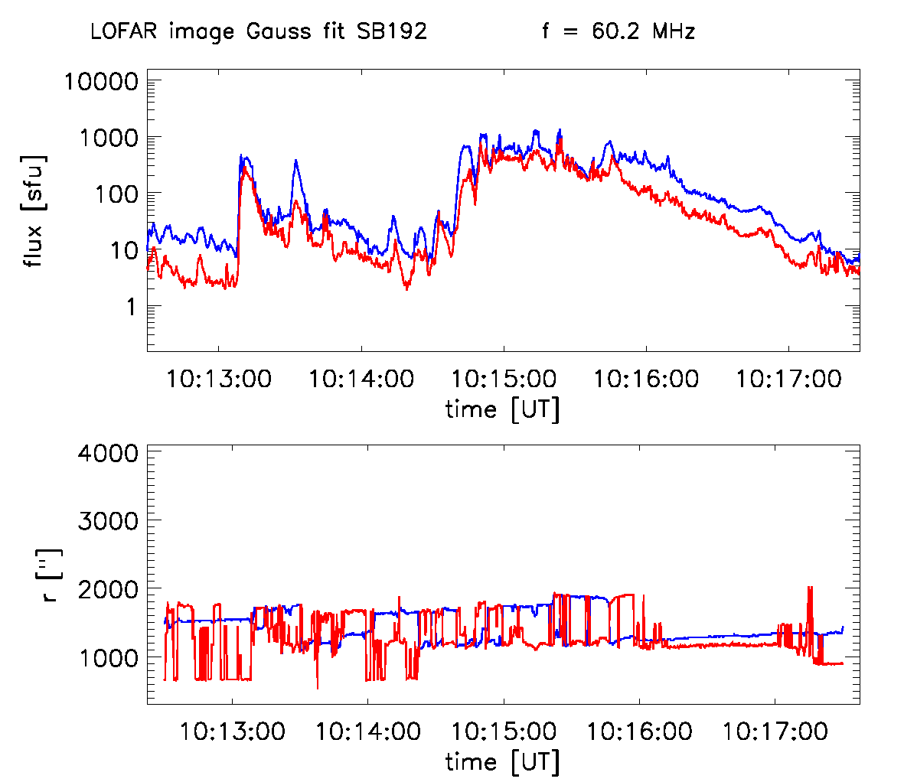
Evolution of f and h sources
Gaussian fits:
Strongest source (blue)
Subtract this source
Second strongest source (red)
Source positions:
(x, y) positions from Gaussian fits
Compensate for drift over time
Fundamental and harmonic fluxes:
Areas around (x, y)
Integrate flux over these areas
Result:
Separate lightcurves for fundamental and
harmonic sources

Slide 7
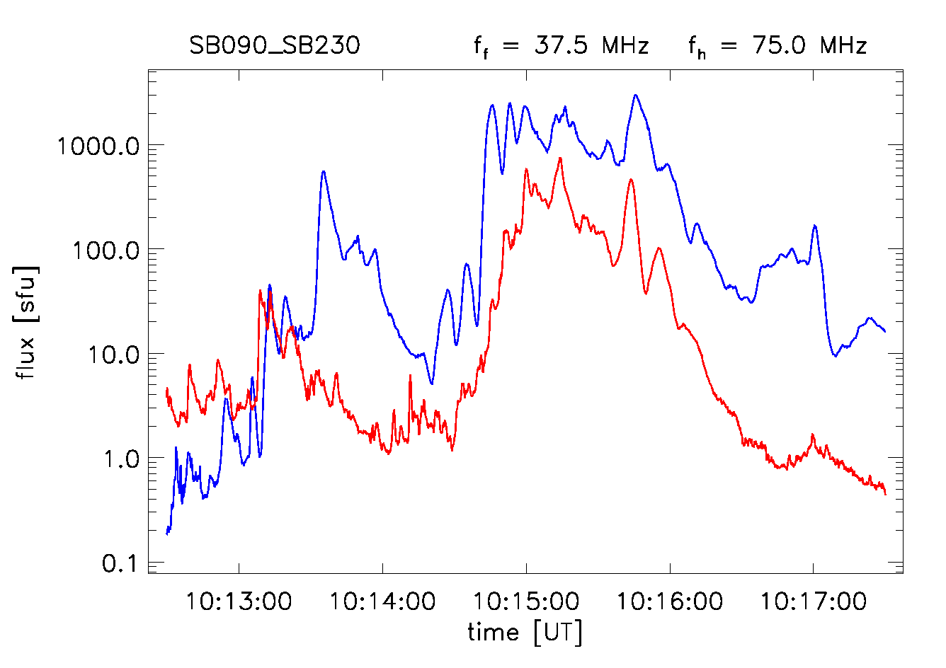
Fundamental – harmonic pairs
Example: 37.5 / 75 MHz and lower:
Fundamental emission at 37.5 MHz
Harmonic emission at 75 MHz
Originate from the same source region
Differences between lightcurves:
Earlier onset for harmonic at 10:13:05 UT
Not visible at 10:14:30 UT
Source finding method can impact results
Influence of coronal scattering, especially
on fundamental emission
Such plots can provide information
on coronal radio wave propagation
blue
red
: fundamental
: harmonic

Slide 8
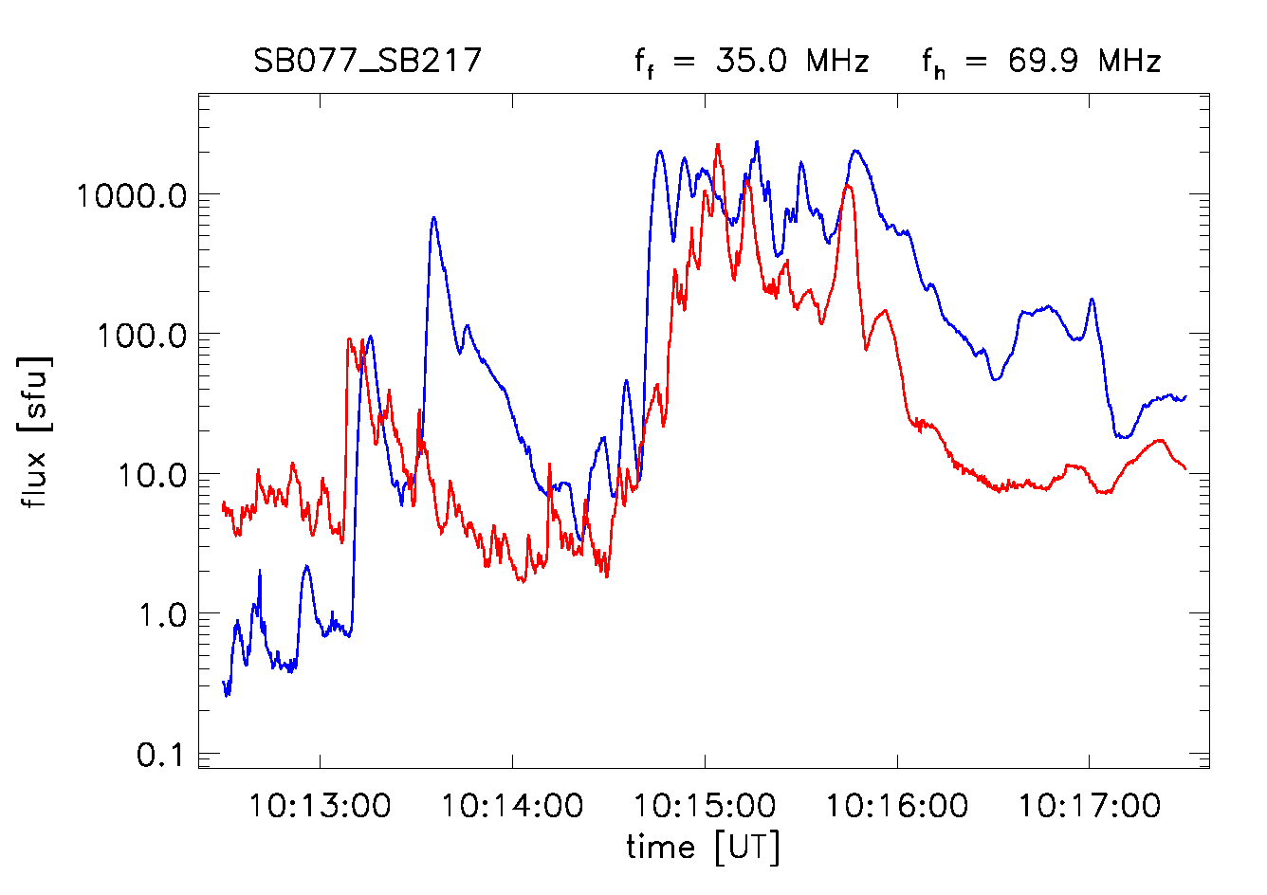
Fundamental – harmonic pairs
Example: 37.5 / 75 MHz and lower:
Fundamental emission at 37.5 MHz
Harmonic emission at 75 MHz
Originate from the same source region
Differences between lightcurves:
Earlier onset for harmonic at 10:13:05 UT
Not visible at 10:14:30 UT
Source finding method can impact results
Influence of coronal scattering, especially
on fundamental emission
Such plots can provide information
on coronal radio wave propagation
blue
red
: fundamental
: harmonic

Slide 9
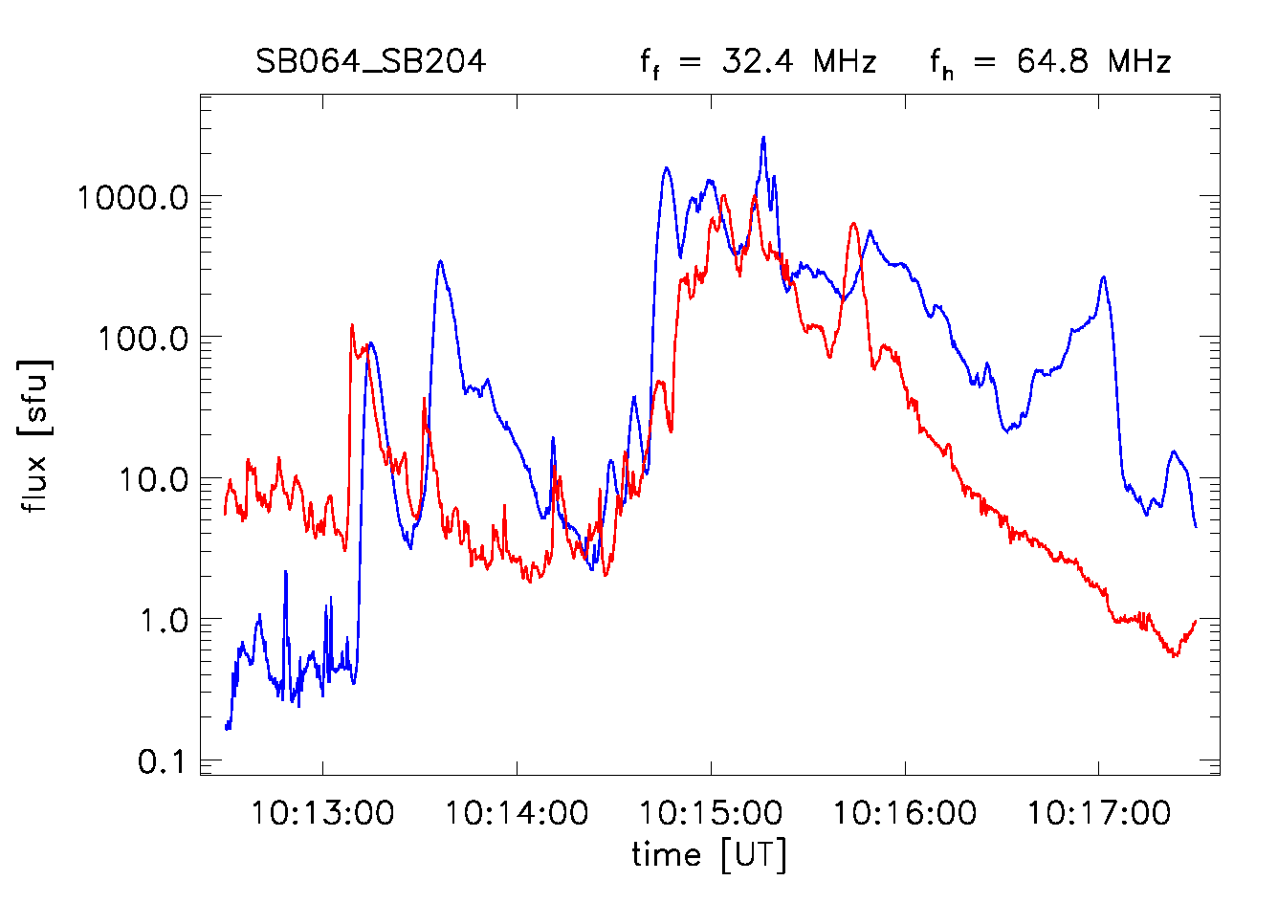
Fundamental – harmonic pairs
Example: 37.5 / 75 MHz and lower:
Fundamental emission at 37.5 MHz
Harmonic emission at 75 MHz
Originate from the same source region
Differences between lightcurves:
Earlier onset for harmonic at 10:13:05 UT
Not visible at 10:14:30 UT
Source finding method can impact results
Influence of coronal scattering, especially
on fundamental emission
Such plots can provide information
on coronal radio wave propagation
blue
red
: fundamental
: harmonic

Slide 10
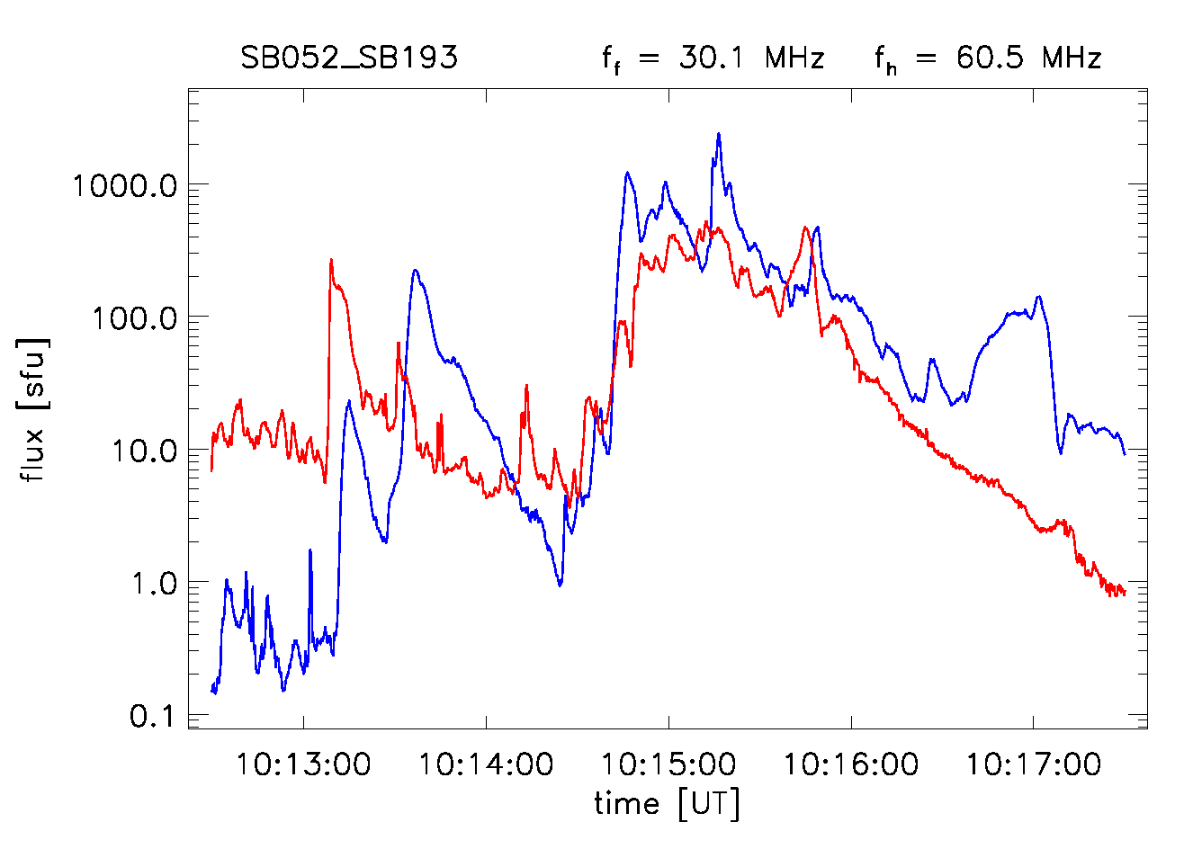
Fundamental – harmonic pairs
Example: 37.5 / 75 MHz and lower:
Fundamental emission at 37.5 MHz
4
Harmonic emission at 75 MHz
1
Originate from the same source region
2
3
Differences between lightcurves:
Earlier onset for harmonic at 10:13:05 UT
Not visible at 10:14:30 UT
Source finding method can impact results
Influence of coronal scattering, especially
on fundamental emission
Such plots can provide information
on coronal radio wave propagation
Christian Vocks LOFAR Family Meeting 2024, Leiden 6 June 2024
blue
red
: fundamental
: harmonic

Slide 11
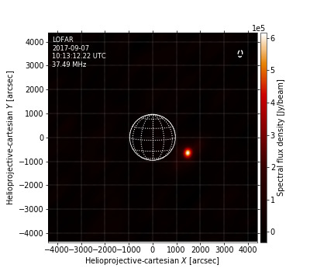
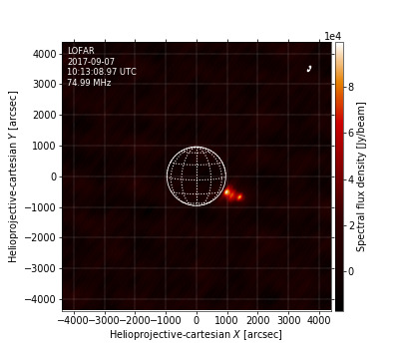
Relative positions of fundamental and harmonic sources
Event 1:
Position differences:
∆(x, y) = pos(h) – pos(f)
37.5 MHz:
∆x = -65’’
∆y = -33’’
blue
red
: fundamental
: harmonic

Slide 12
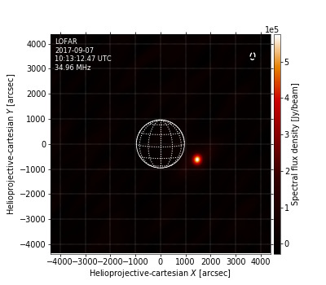
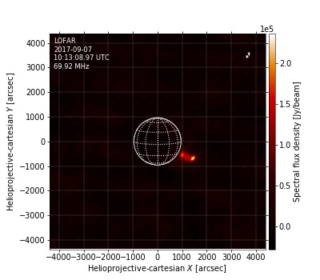
Relative positions of fundamental and harmonic sources
Event 1:
Position differences:
∆(x, y) = pos(h) – pos(f)
37.5 MHz:
∆x = -65’’
∆y = -33’’
35.0 MHz:
∆x = -32’’
∆y = -65’’
blue
red
: fundamental
: harmonic

Slide 13
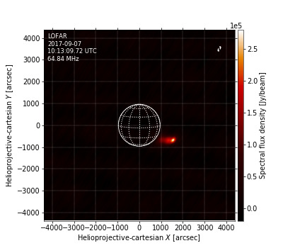
Relative positions of fundamental and harmonic sources
Event 1:
Position differences:
∆(x, y) = pos(h) – pos(f)
37.5 MHz:
∆x = -65’’
∆y = -33’’
35.0 MHz:
∆x = -32’’
∆y = -65’’
32.5 MHz:
∆x = 98’’
∆y = -98’’
blue
red
: fundamental
: harmonic

Slide 14
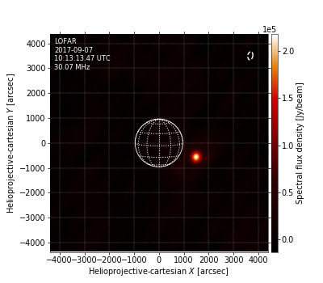
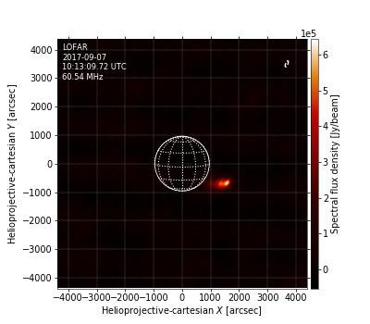
Relative positions of fundamental and harmonic sources
Event 1:
Position differences:
∆(x, y) = pos(h) – pos(f)
Conclusion:
37.5 MHz:
∆x = -65’’
∆y = -33’’
f source moves sunwards relative to h source
35.0 MHz:
∆x = -32’’
∆y = -65’’
→ f refraction becomes stronger than scattering
32.5 MHz:
∆x = 98’’
∆y = -98’’
with decreasing frequency
30.0 MHz:
∆x = 97’’
∆y = -130’’
blue
red
: fundamental
: harmonic

Slide 15
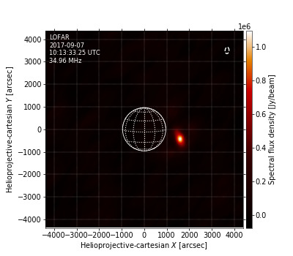
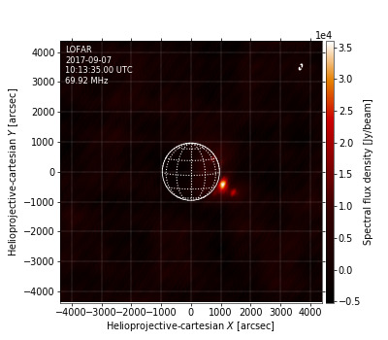
Relative positions of fundamental and harmonic sources
Event 2:
Position differences:
∆(x, y) = pos(h) – pos(f)
35.0 MHz:
∆x = -162’’
∆y = -292’’
blue
red
: fundamental
: harmonic

Slide 16
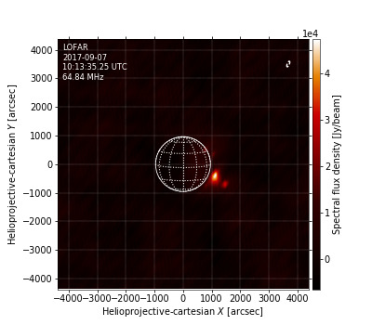
Relative positions of fundamental and harmonic sources
Event 2:
Position differences:
∆(x, y) = pos(h) – pos(f)
35.0 MHz:
∆x = -162’’
∆y = -292’’
32.5 MHz:
∆x = -196’’
∆y = -292’’
blue
red
: fundamental
: harmonic

Slide 17
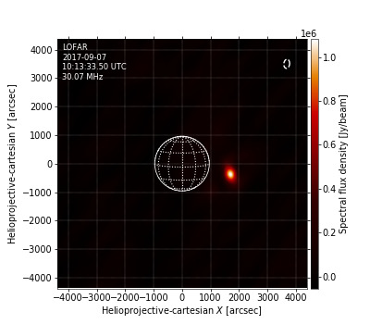
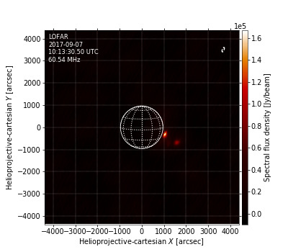
Relative positions of fundamental and harmonic sources
Event 2:
Position differences:
∆(x, y) = pos(h) – pos(f)
Conclusion:
35.0 MHz:
∆x = -162’’
∆y = -292’’
Less clear relation between F and H increases here,
32.5 MHz:
∆x = -196’’
∆y = -292’’
but the same tendency
30.0 MHz:
∆x = -98’’
∆y = -325’’
At 65 MHz the f increase outshined the h increase,
h source position was hard to measure
blue
red
: fundamental
: harmonic

Slide 18
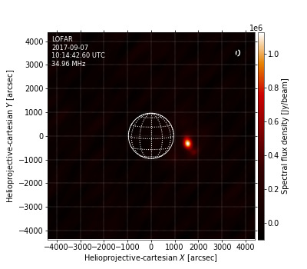
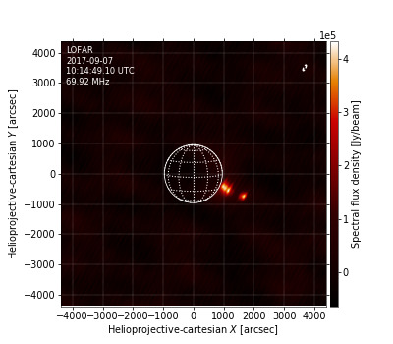
Relative positions of fundamental and harmonic sources
Event 3:
Position differences:
∆(x, y) = pos(h) – pos(f)
35.0 MHz:
∆x = 98’’
∆y = -423’’
blue
red
: fundamental
: harmonic

Slide 19
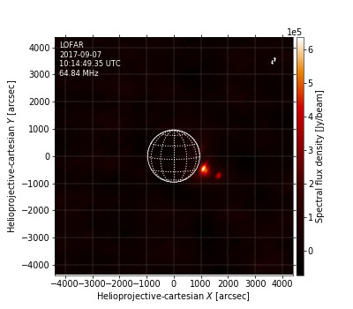
Relative positions of fundamental and harmonic sources
Event 3:
Position differences:
∆(x, y) = pos(h) – pos(f)
35.0 MHz:
∆x = 98’’
∆y = -423’’
32.5 MHz:
∆x = 0’’
∆y = -357’’
blue
red
: fundamental
: harmonic

Slide 20
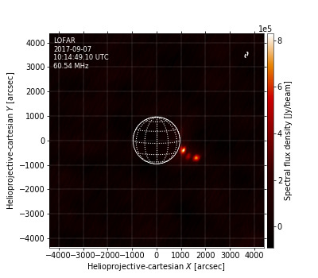
Relative positions of fundamental and harmonic sources
Event 3:
Position differences:
∆(x, y) = pos(h) – pos(f)
Conclusion:
35.0 MHz:
∆x = 98’’
∆y = -423’’
Opposite trend: f moves anti-sunward
32.5 MHz:
∆x = 0’’
∆y = -357’’
→ f scattering becomes stronger than refraction
30.0 MHz:
∆x = -195’’
∆y = -227’’
with decreasing frequency?
But: h is lagging f emission, not the same source?
blue
red
: fundamental
: harmonic

Slide 21
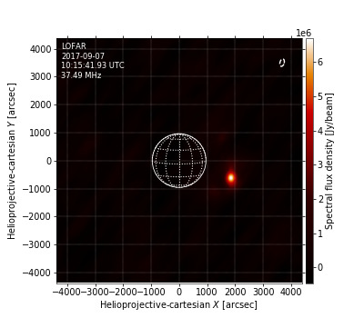
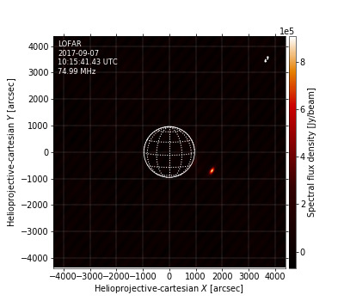
Relative positions of fundamental and harmonic sources
Event 4:
Position differences:
∆(x, y) = pos(h) – pos(f)
37.5 MHz:
∆x = -228’’
∆y = -97’’
blue
red
: fundamental
: harmonic

Slide 22
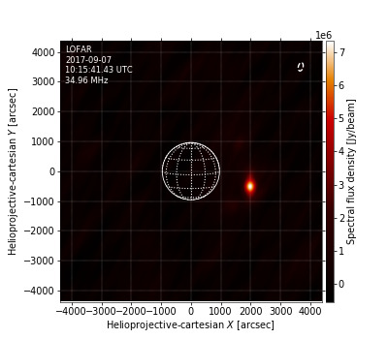
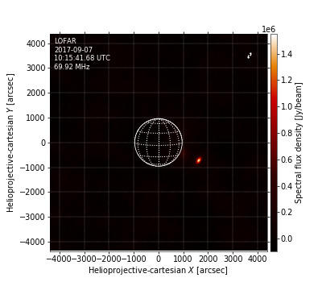
Relative positions of fundamental and harmonic sources
Event 4:
Position differences:
∆(x, y) = pos(h) – pos(f)
37.5 MHz:
∆x = -228’’
∆y = -97’’
35.0 MHz:
∆x = -358’’
∆y = -195’’
blue
red
: fundamental
: harmonic

Slide 23
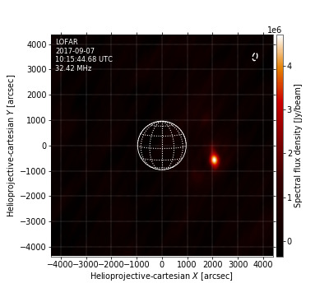
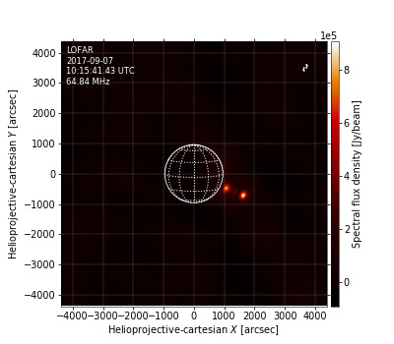
Relative positions of fundamental and harmonic sources
Event 4:
Position differences:
∆(x, y) = pos(h) – pos(f)
37.5 MHz:
∆x = -228’’
∆y = -97’’
35.0 MHz:
∆x = -358’’
∆y = -195’’
32.5 MHz:
∆x = -455’’
∆y = -130’’
blue
red
: fundamental
: harmonic

Slide 24
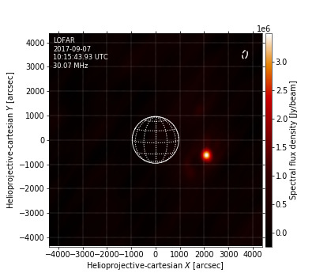
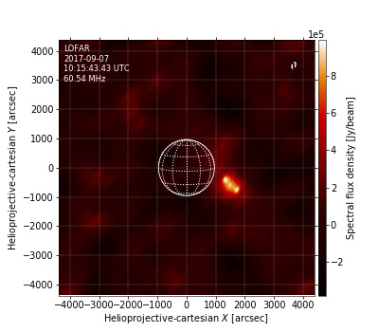
Relative positions of fundamental and harmonic sources
Event 4:
Position differences:
∆(x, y) = pos(h) – pos(f)
Conclusion:
37.5 MHz:
∆x = -228’’
∆y = -97’’
f source clearly moves anti-sunwards relative to h source
35.0 MHz:
∆x = -358’’
∆y = -195’’
→ f scattering becomes stronger than refraction
32.5 MHz:
∆x = -455’’
∆y = -130’’
with decreasing frequency
30.0 MHz:
∆x = -390’’
∆y = -130’’
→ Increased turbulence due to previous M flare and type III?
blue
red
: fundamental
: harmonic

Slide 25
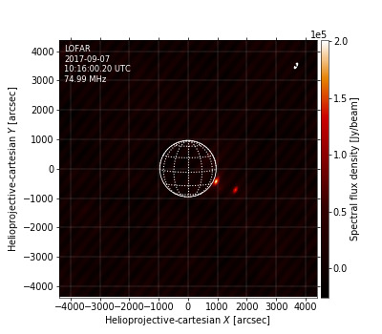
Summary and conclusion
LOFAR M class flare observations:
Dominated by strong type III emission
Images show intermittent dual source structure
Interpretation: fundamental and harmonic emission
At given frequency: Outer source is harmonic, inner is fundamental
Separate lightcurves for both sources
Fundamental-harmonic pairs: Same source region
Relative source positions determined by competing effects of refraction and scattering
No unique trend with frequency found
This is to be expected if coronal conditions change
→ Useful tool for investigating radio wave propagation in the solar corona

