Slide 1
IFU study of radio AGN host galaxies
Gaoxiang Jin (MPA)
with Guinevere Kauffmann and Philip Best
LOFAR Family Meeting
Leiden, 7th June 2024
gxjin@mpa-garching.mpg.de

Slide 2
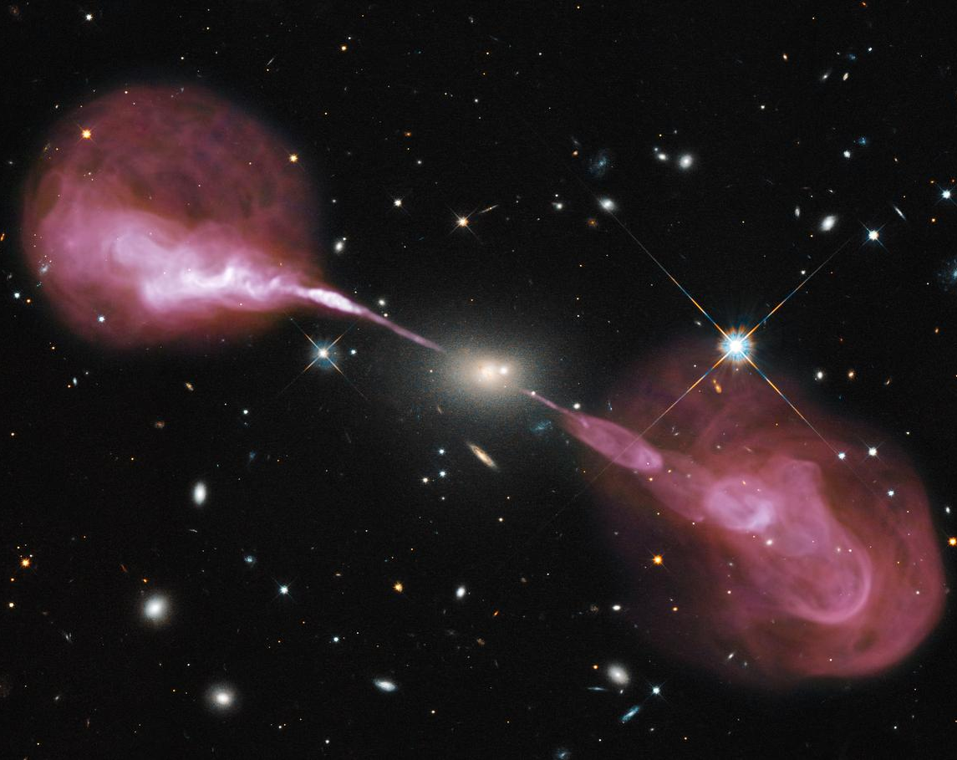
What can radio AGN tell us?
Key questions:
The accretion mode of supermassive blackholes
Radio AGN feedback
Jet-ISM interaction

Slide 3
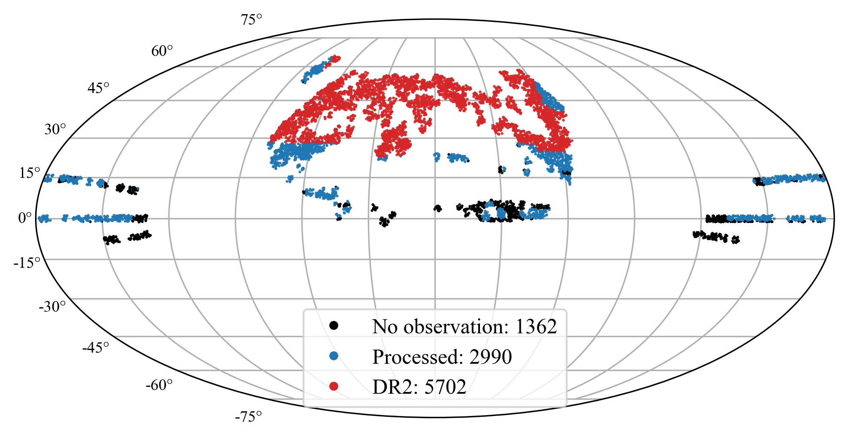
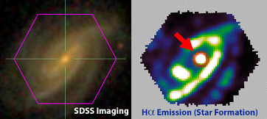
Data: MaNGA and LoTSS
MaNGA: Mapping Nearby Galaxies at APO
spatially resolved spectroscopic information
MaNGA-LoTSS
~6000 galaxies covered by LoTSS DR2
~9000 covered by the final LoTSS
Without IFU
Credit: sdss.org/surveys/manga

Slide 4
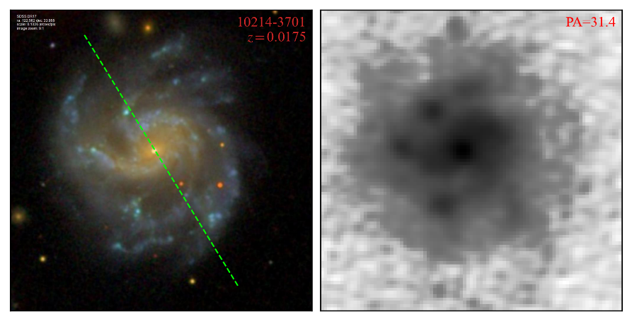
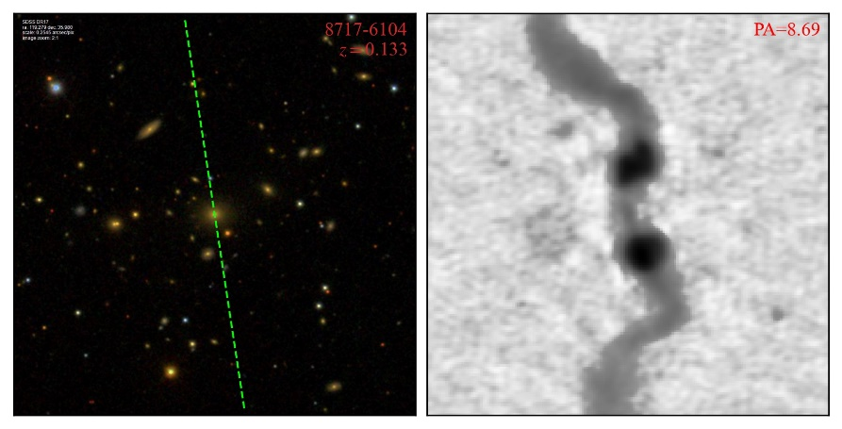
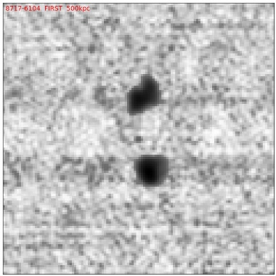
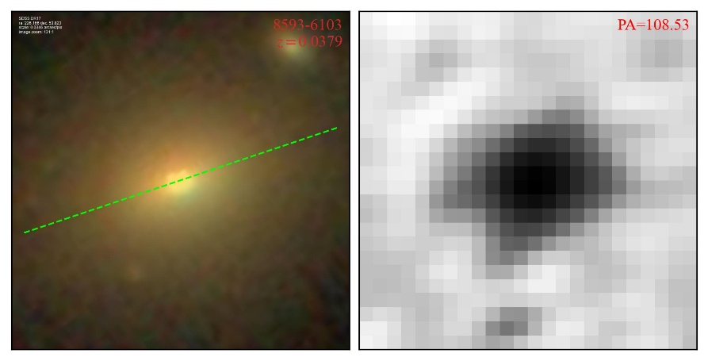
The improvement from LoTSS
SDSS LoTSS FIRST
MaNGA-LoTSS(DR2):
~6000 galaxies, ~50% radio detection rate
Reveal diffuse SF
Low-z sample
~15×deeper
Reveal diffuse jet
Reveal faint jet

Slide 5
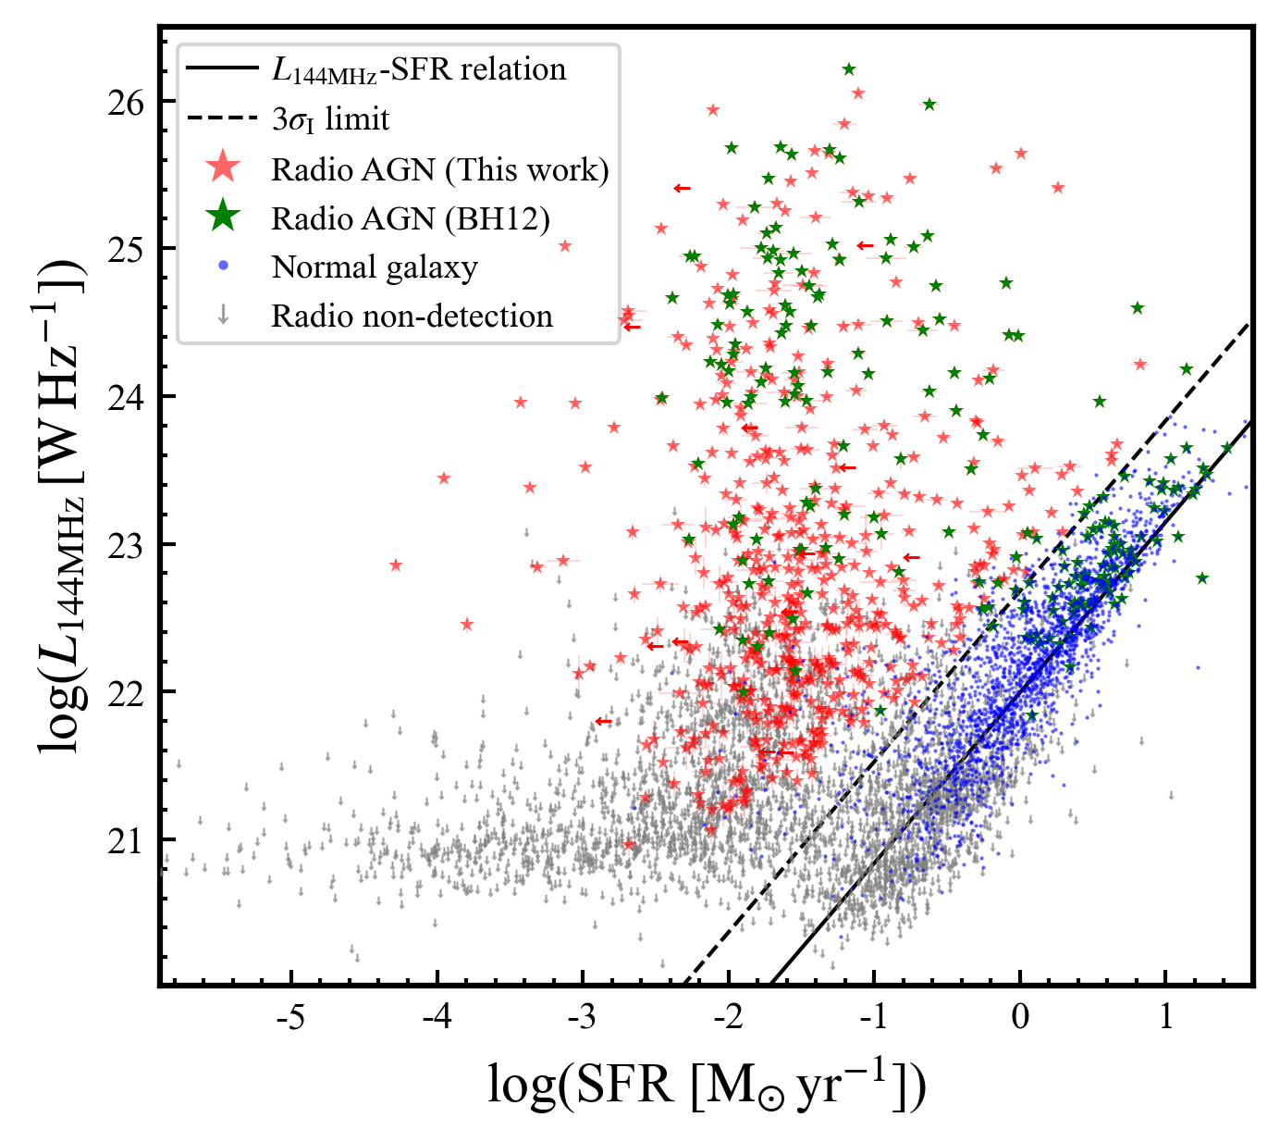
Decompose AGN from star formation
Method: SF radio ∝ SFR
AGN jets bring excess
If there are no AGN

Slide 6
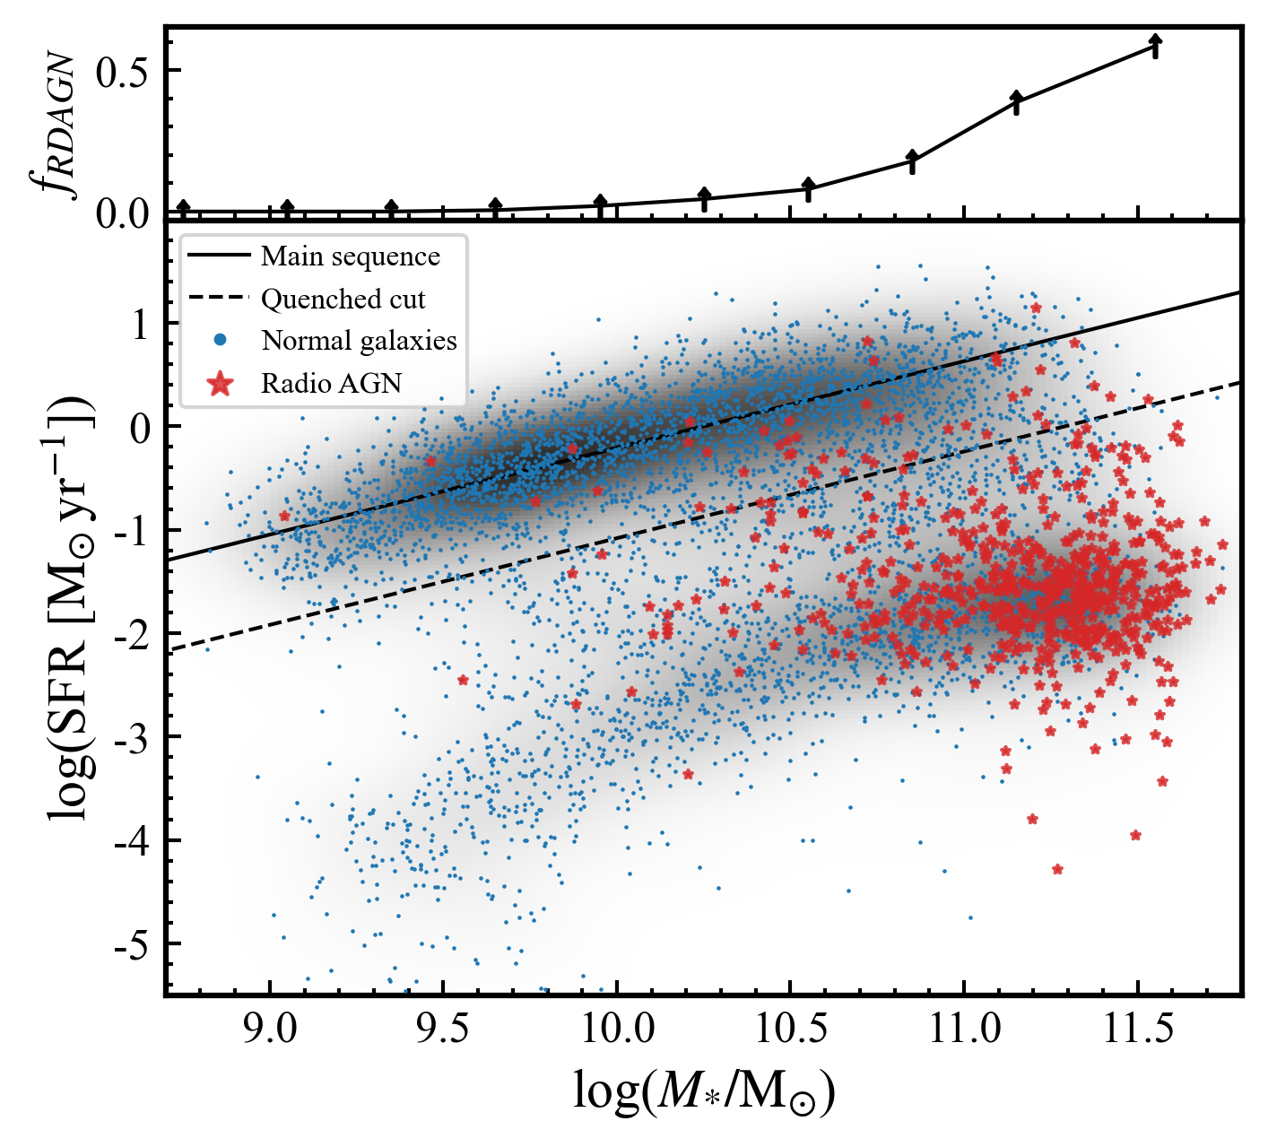
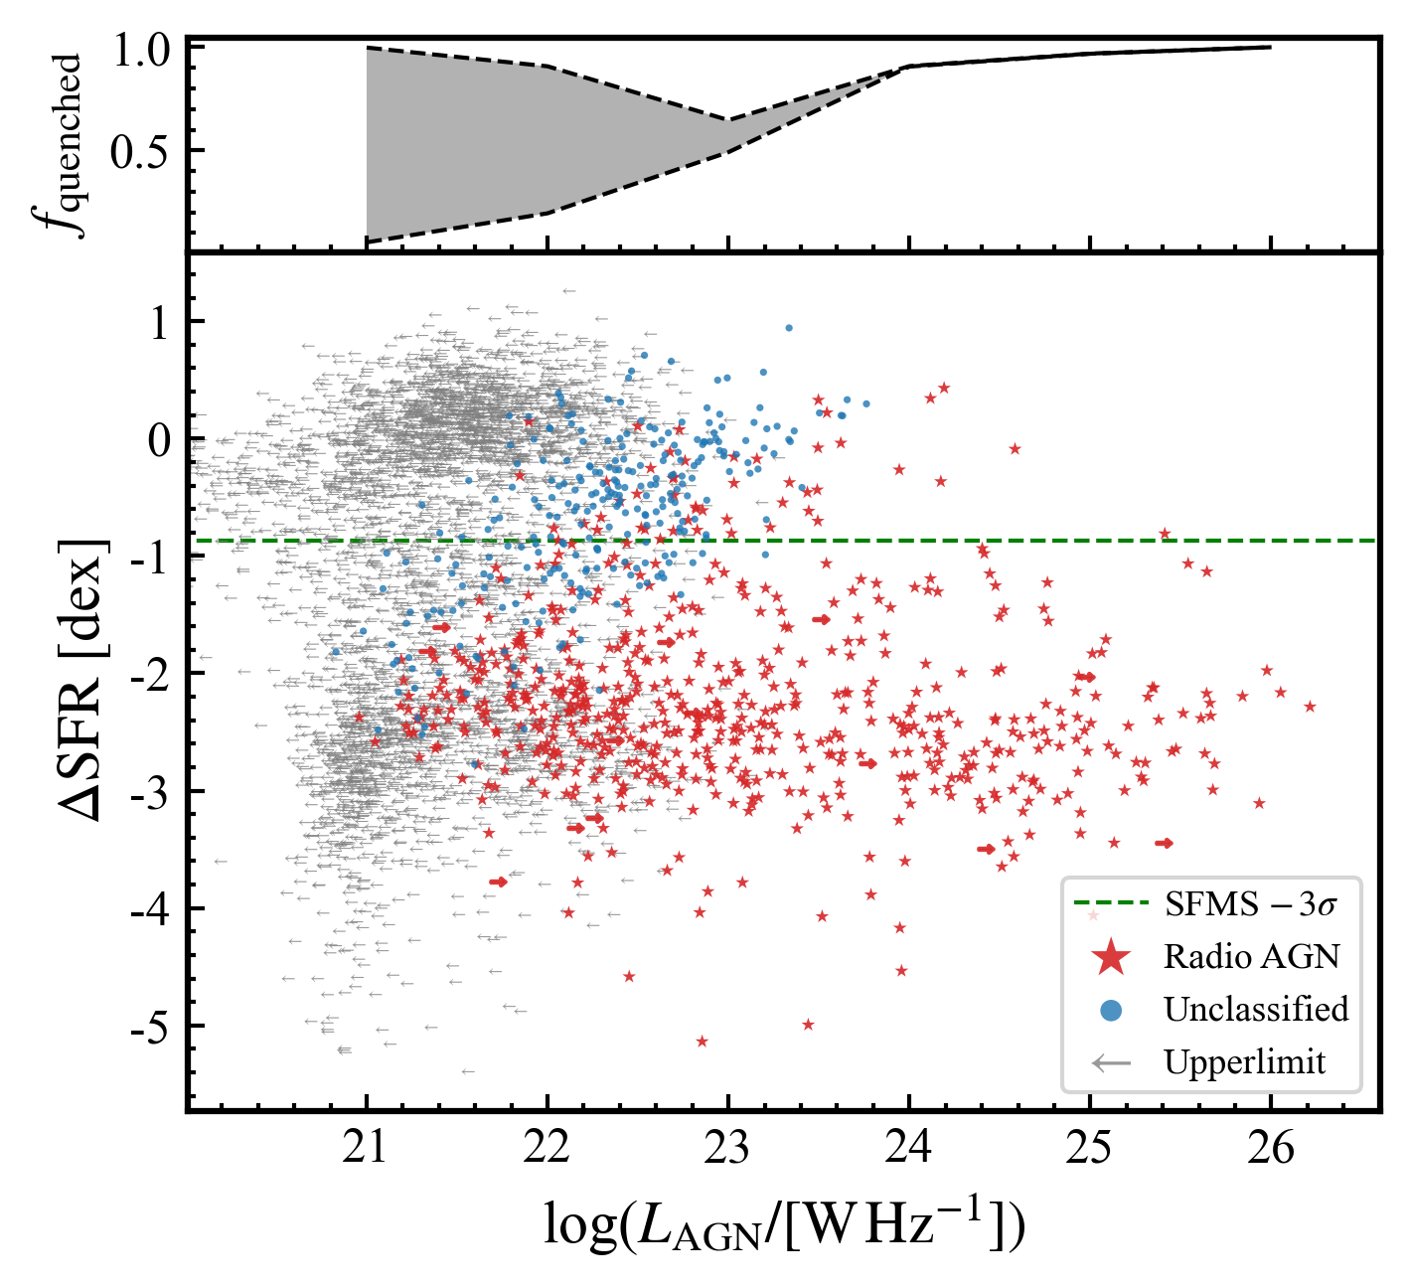
Global SF: Radio AGN hosts are quenched
High jet incidence in massive quiescent galaxies
Powerful jet hosts are all quenched

Slide 7
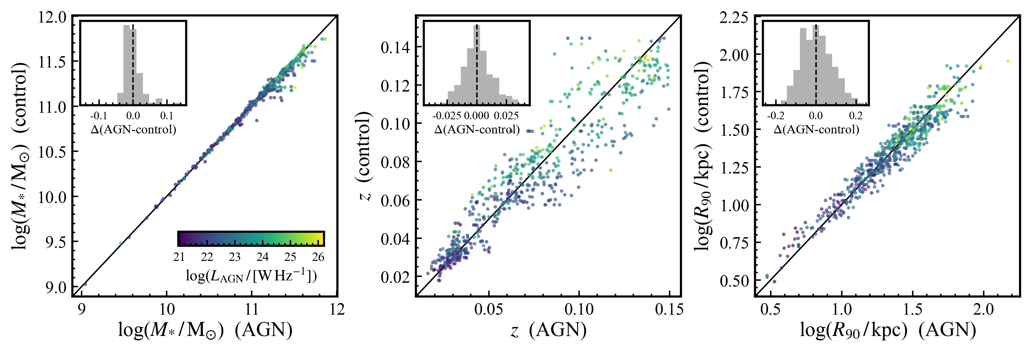
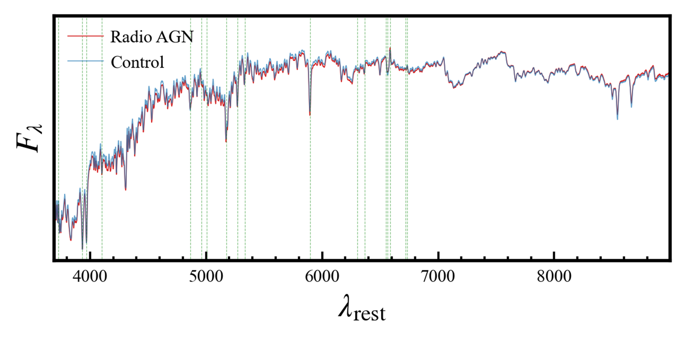
Jet-ISM interplay: Method
Selecting control sample:
Controlled well
Typical quiescent spectra
Need stacking

Slide 8
Jet-ISM interplay: Nuclear emission excess
Ionized gas enhancement in the nuclear region.
Jets may affect the ionization of central ISM
SF residual in non-RDAGN outskirts.
Jets may be important in maintaining quiescent.

Slide 9
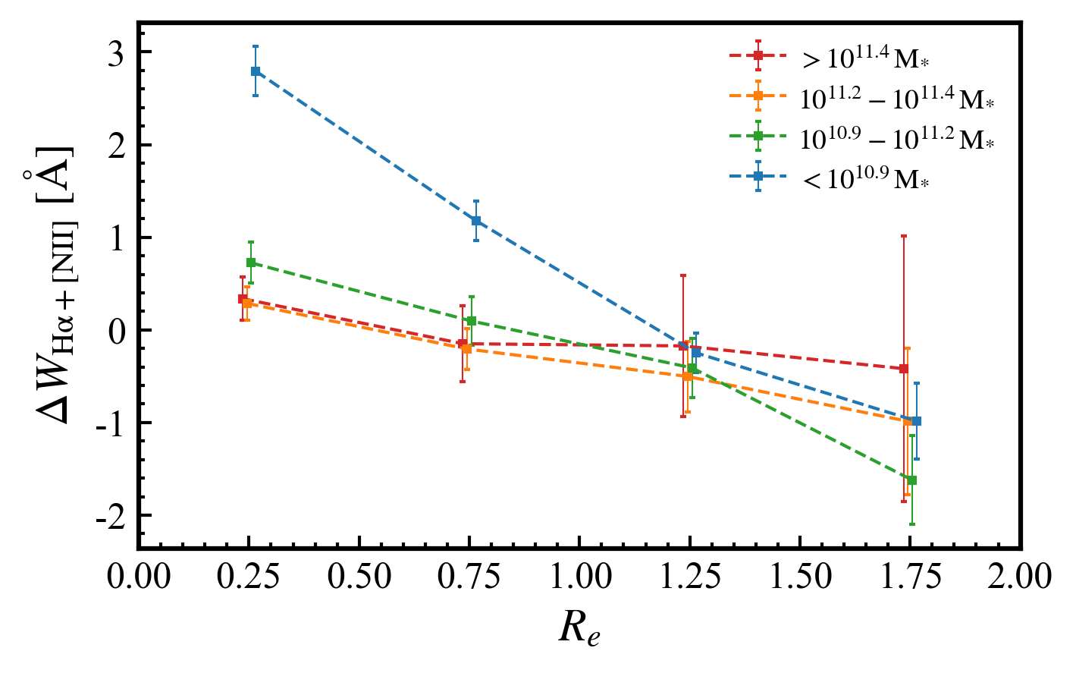
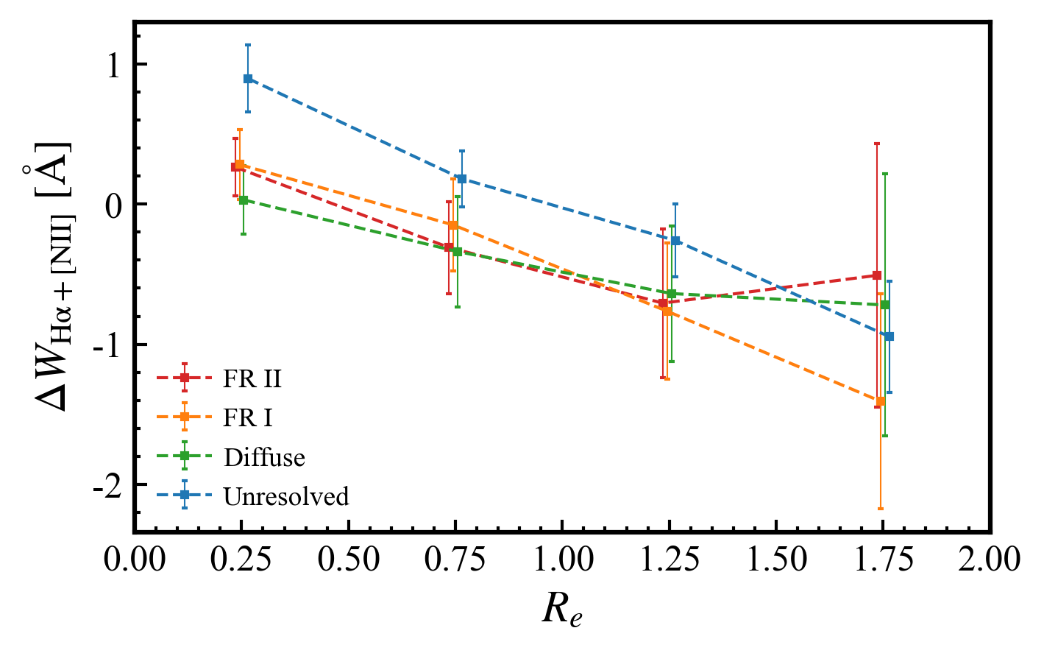
Jet-ISM interplay: More significant in lower M*
More nuclear gas in lower mass galaxies?
Need high resolution gas observations
LOFAR2.0 can resolve these jets in ~100pc scale

Slide 10
Star formation history: Radio AGN hosts grow faster
Radio AGN hosts formed earlier and become quenched earlier.
Massive galaxies quench from inside to outside.
The observation-derived SFH agree well with the simulations with jet feedback.

Slide 11
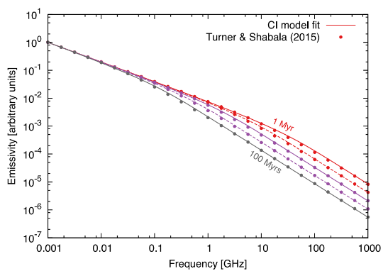
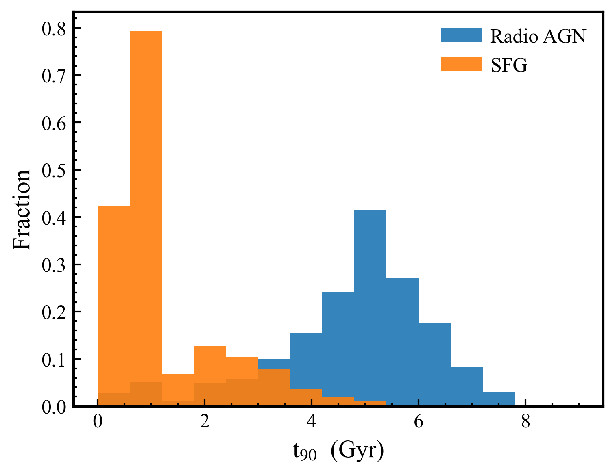
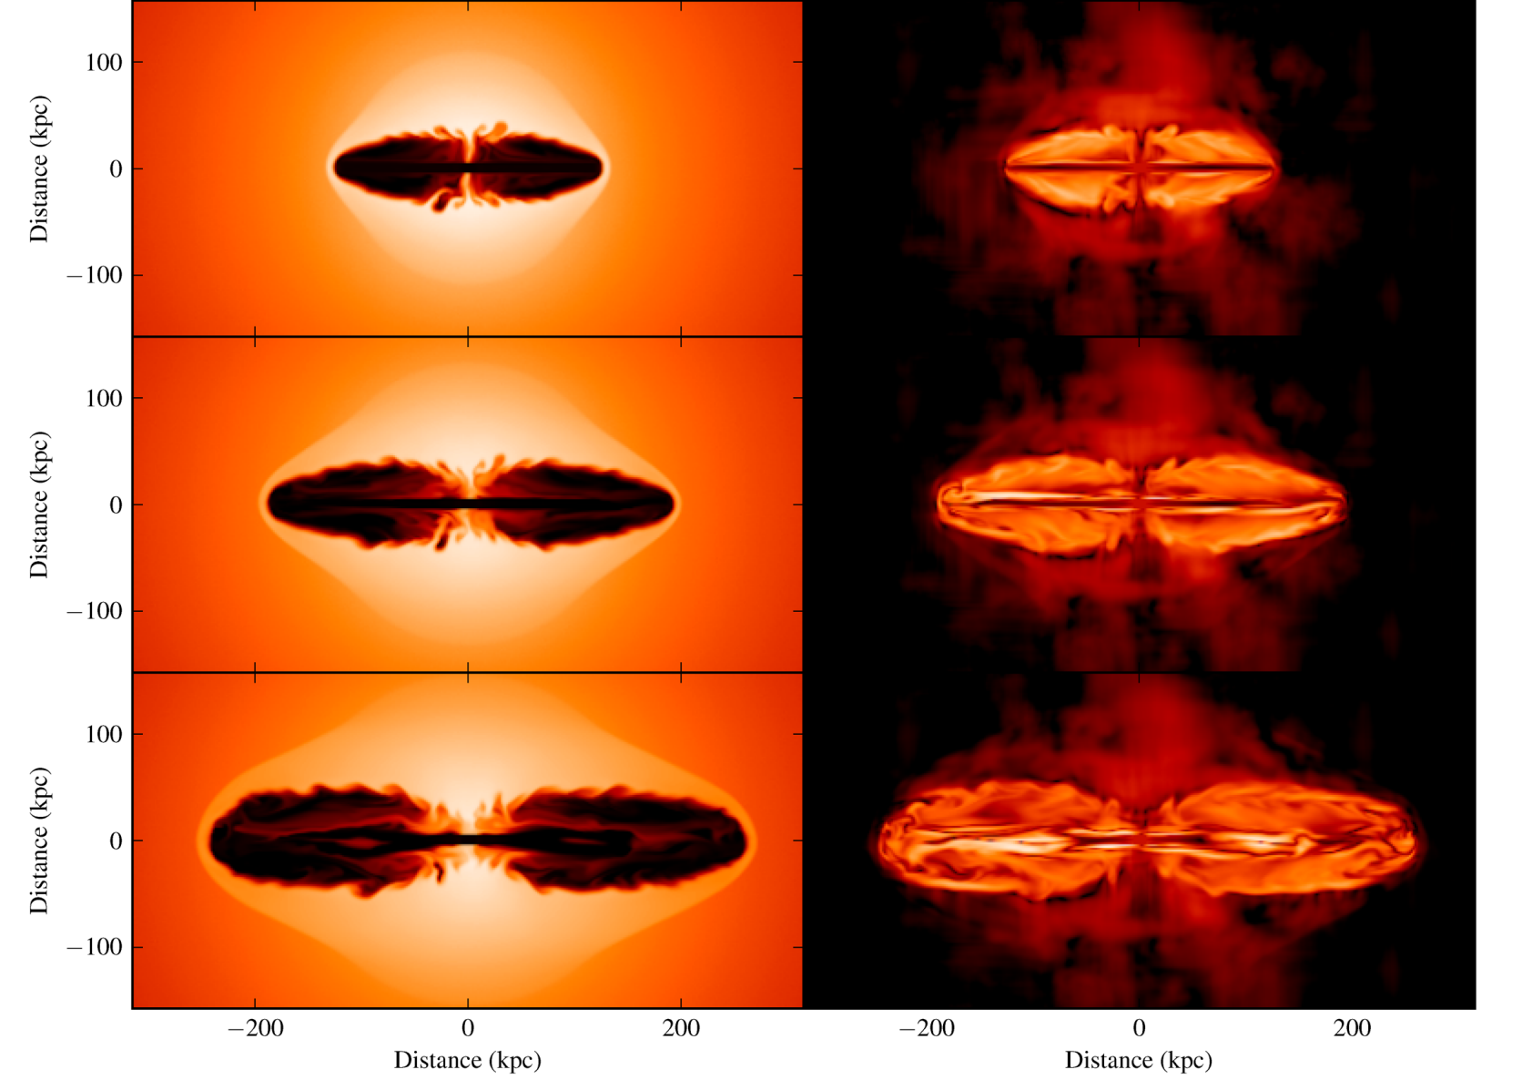
Star formation history: t_{AGN} (Myr) « t_{quench} (Gyr)
Spectral age: <300Myr
The hosts stopped growing much earlier before AGN occurred
Turner+2018
Dynamical age: ~100Myr
Are the current jets responsible for the past quenching?
Hardcastle+2014

Slide 12
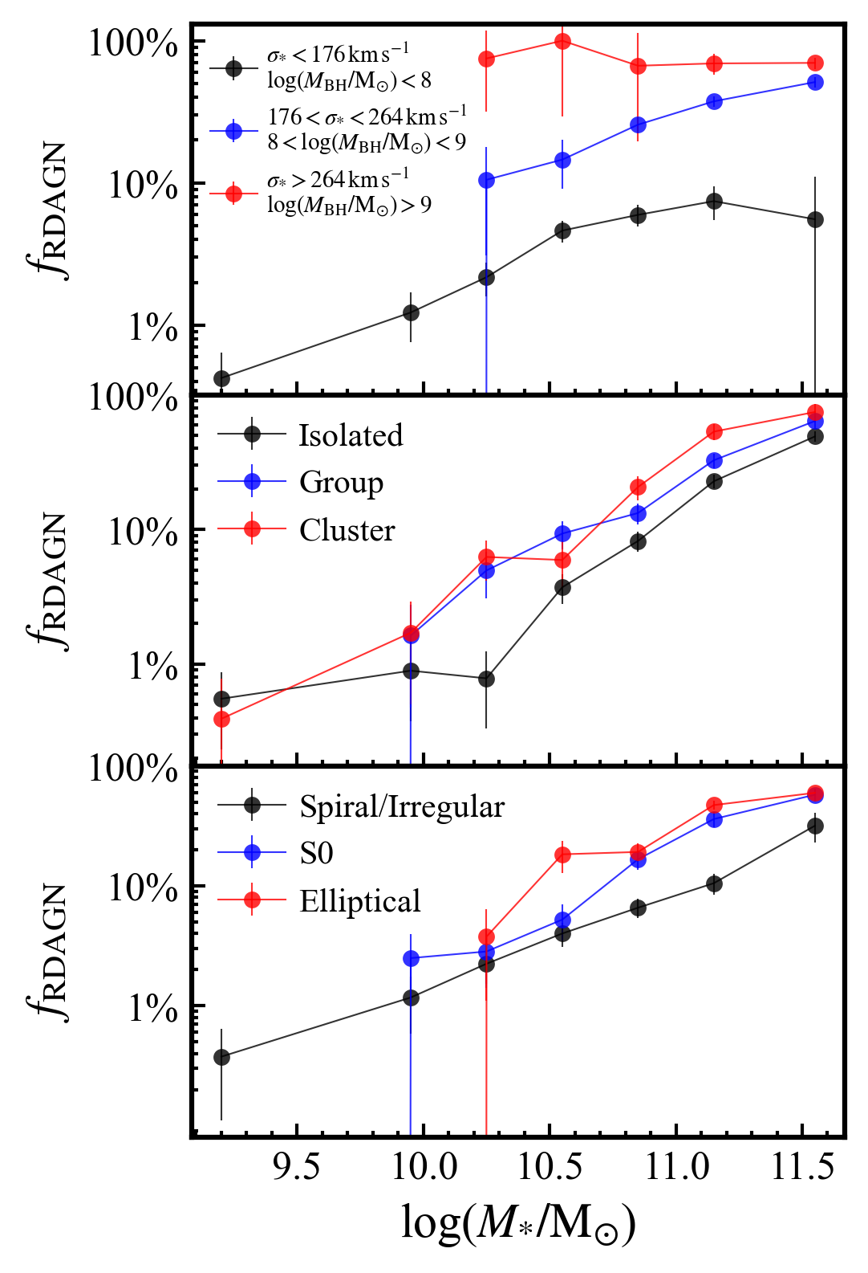
What triggered the current radio AGN?
The M_{BH} itself may be the most important trigger
LoTSS can detect the emission from all the most massive blackholes (10⁹ M⊙) in nearby universe.
Blackhole mass
Cosmic environment
Galaxy morphology
Hints for AGN feedback scenario:
Current jets may not be responsible the observed quenching.
Higher stellar dispersion indicate that their SMBH accreted faster in the past. (e.g. stronger AGN, more mergers etc.)
Jets are helping galaxies to maintain quiescent

Slide 13
The IFU-LOFAR results now and future
LoTSS+MaNGA:
Future LOFAR+IFU:
?
Case studies.
Forming more stars.
SMBH grew faster.
Direct population study at cosmic noon.
Emitting jets.
Quench at all radii.
Ionizing nuclear gas
Lower angular momentum (Zheng+22).
Resolving most jets.
Connect the NLR with small-scale jets.
Decompose the emission from SF and AGN.

Slide 14
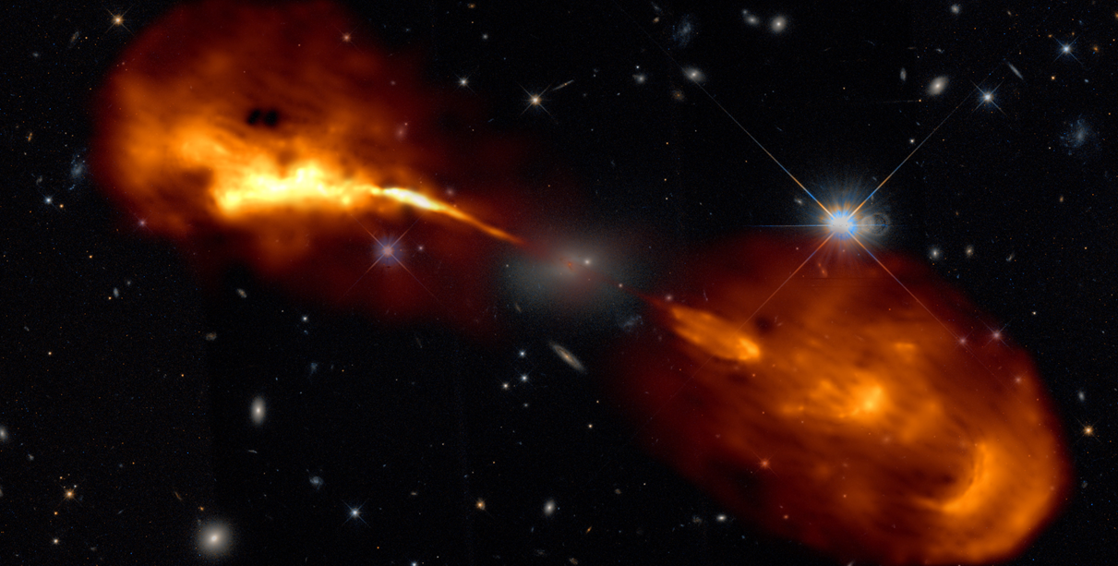
Summary
Observational results :
Most massive galaxies (or blackholes) always host jets, and luminous radio AGN hosts are all quenched.
Evidence of nuclear jet-ionized gas: radio AGN hosts have emission line excess.
Radio AGN hosts are older and more quiescent in outskirts.
Radio AGN hosts and their SMBHs grew faster and earlier.
gxjin@mpa-garching.mpg.de

