Slide 1
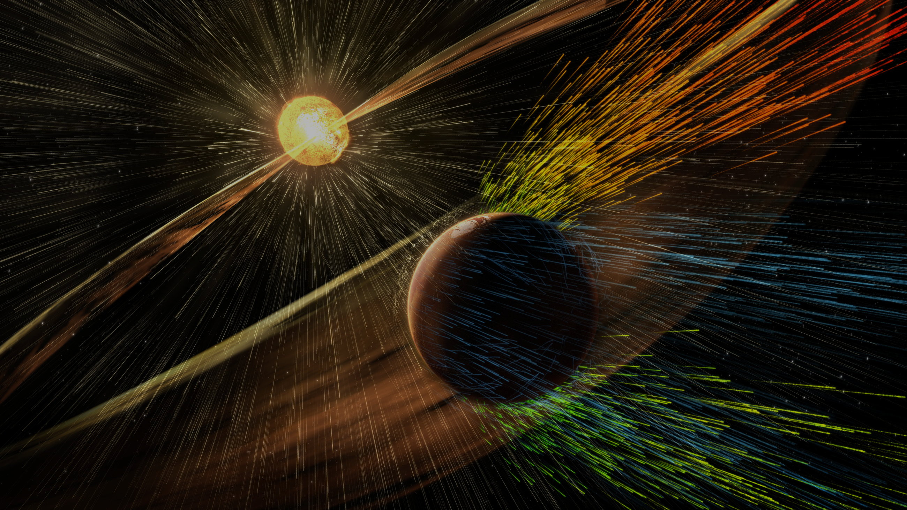

Catching the wisps
Constraining mass-loss rates of cool stars at low frequencies
Sanne Bloot
LOFAR Family 2024
05-06-2024
VIDI Grant
PI: Vedantham
Image credit: NASA/GSFC

Slide 2
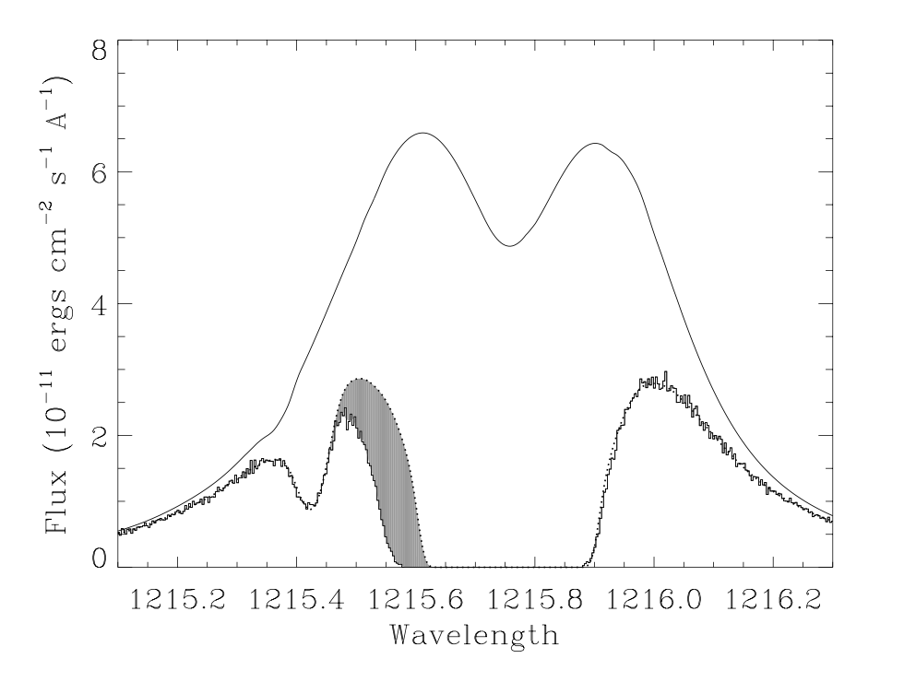
Stellar winds of low-mass stars
Stellar evolution
Star-planet interactions
Extremely tenuous
Astrospheric absorption
  E.g. Wood et al. 2002, 2004, 2005, 2010, 2021
  Limited to 7 pc
Wood et al. 2002
Sanne Bloot – ASTRON/RUG – bloot@astron.nl

Slide 3

Free-free absorption
Lim & White 1996
Sanne Bloot – ASTRON/RUG – bloot@astron.nl

Slide 4
Free-free absorption
Sanne Bloot – ASTRON/RUG – bloot@astron.nl

Slide 5
Free-free absorption
Sanne Bloot – ASTRON/RUG – bloot@astron.nl

Slide 6
LOFAR-detected M dwarfs
Sanne Bloot – ASTRON/RUG – bloot@astron.nl

Slide 7
LOFAR-detected M dwarfs
Sanne Bloot – ASTRON/RUG – bloot@astron.nl

Slide 8
GJ 625 b
Sanne Bloot – ASTRON/RUG – bloot@astron.nl

Slide 9
Summary
With coherent radio emission of a star, we can constrain its mass-loss rate
GJ 625 b is probably not being stripped of its atmosphere by the stellar wind
Sanne Bloot – ASTRON/RUG – bloot@astron.nl

Slide 10
