Slide 1
Recent Lightning Results with LOFAR
Brian Hare,
Olaf Scholten, Paulina Turekova,
the LOFAR lightning group,
and many collaborators
Notes:
Total Talk Time is 13 mins

Slide 2
The Flash
Lightning Flash observed by LOFAR in 2021
Imaged by Impulsive Imager
Fancy Time-of-Arrival
Very computationally efficient
We also have near-field beamforming
See Poster by P. Turekova

Slide 3
The Flash
Lightning Flash observed by LOFAR in 2021
Imaged by Impulsive Imager
Fancy Time-of-Arrival
Very computationally efficient
We also have near-field beamforming
See Poster by P. Turekova
Zoom-In

Slide 4
Some Phenomenology

Slide 5
Some Phenomenology
1) Initial Leader
negatively charged plasma channel

Slide 6
Some Phenomenology
1) Initial Leader
negatively charged plasma channel
2) Negative Leader Branches re-start propagating

Slide 7
Some Phenomenology
3) Needles
Discharges along positive channel
which is otherwise VHF-invisible
1) Initial Leader
negatively charged plasma channel
2) Negative Leader Branches re-start propagating

Slide 8
Some Phenomenology
Dart Leader
propagates along previous channel
very fast (≈10⁷ m/s )
Thus appears as vertical bar
Can re-energize tips of leaders
3) Needles
Discharges along positive channel
which is otherwise VHF-invisible
1) Initial Leader
negatively charged plasma channel
2) Negative Leader Branches re-start propagating

Slide 9
Recent Work
Initiation!
Sterpka et al,
The Spontaneous Nature of Lightning Initiation Revealed (PhD student in New Hampshire, now graduated)

Slide 10
First Image of “normal” Lightning Initiation

Slide 11
Initiation
First Image of first process in lightning
Process goes UP
Confirmation that initial breakdown is positively charged

Slide 12
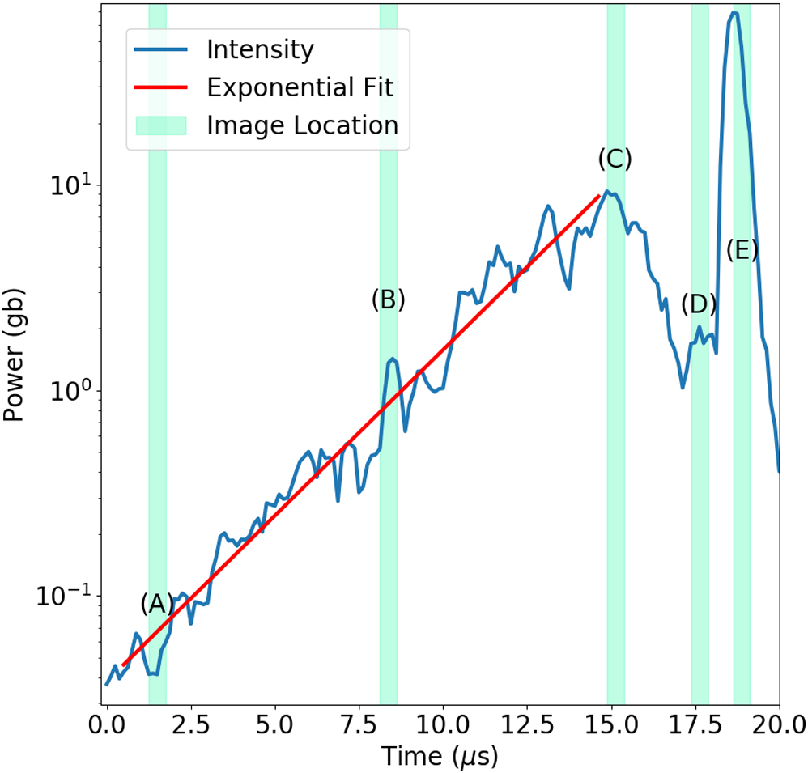
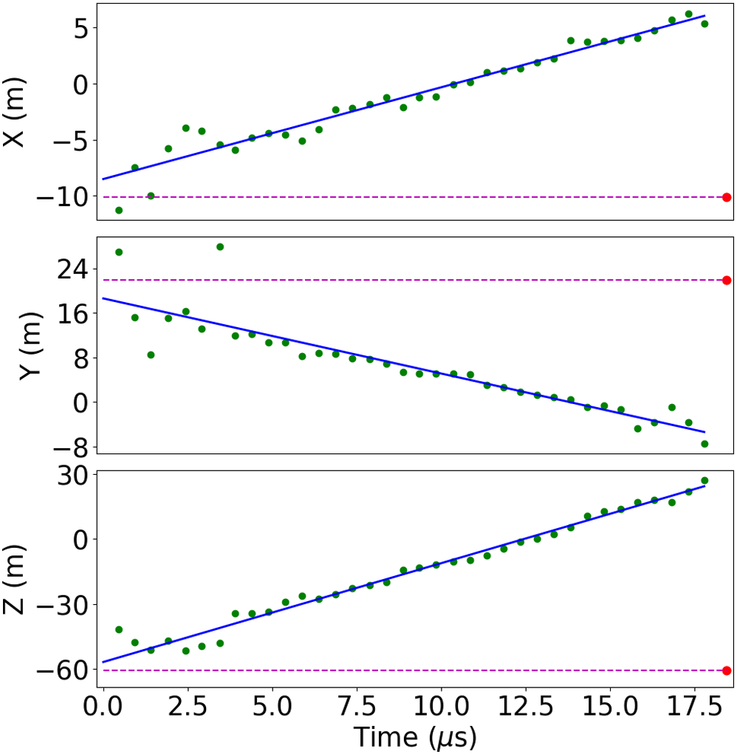
Initiation
Power Vs Time
With log-y scale
Location Vs Time
Power increases exponentially
Speed is constant
Explaining both is hard

Slide 13
Recent Work
I. Kolmašová et al,
A Strong Pulsing Nature of Negative Intracloud Dart Leaders Accompanied by Regular Trains of Microsecond-Scale Pulses
Czech Academy of Sciences
Dart Leaders

Slide 14
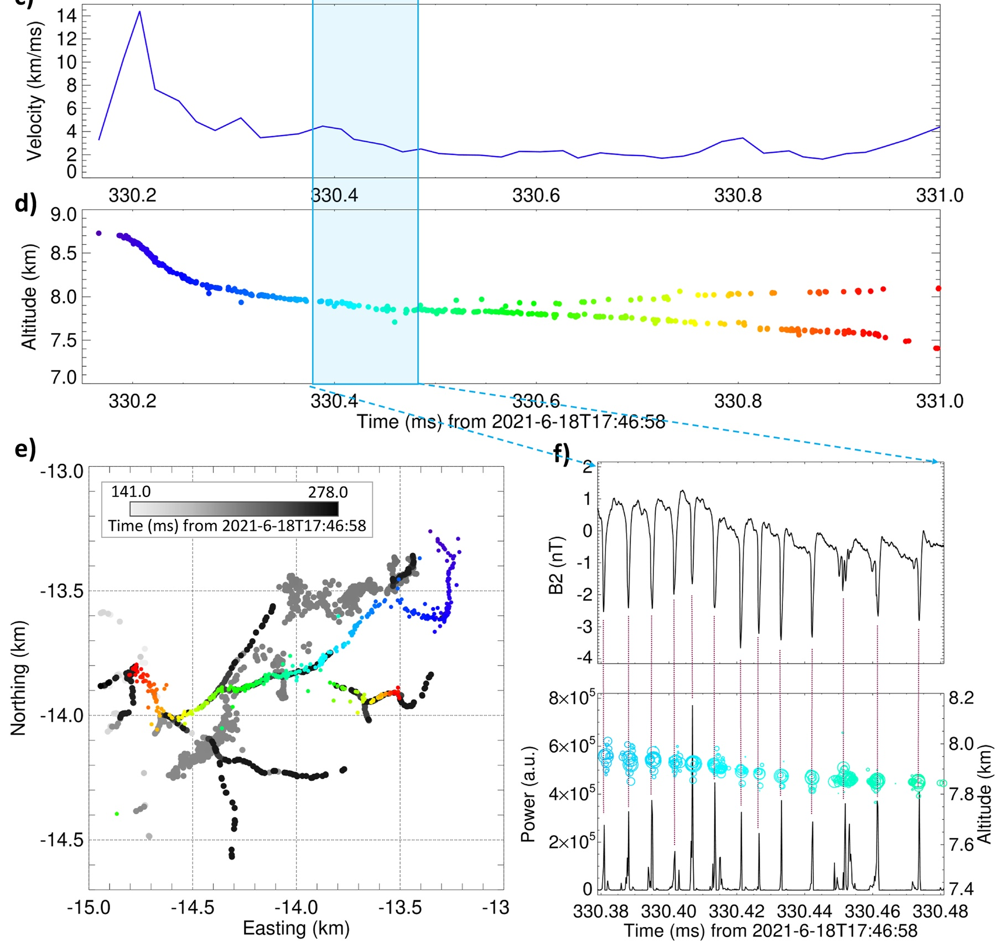
Dart Leaders
High Speed!
Colored dots show dart leader imaged by LOFAR
Regular Pulse Train
Loop antenna
f < 10 MHz

Slide 15
The Flash

Slide 16
The Flash
O. Scholten et al
Small-scale discharges observed near the top of a thunderstorm
University of Groningen / ASTRON
Sparkles
Independent small discharges
At top of thundercloud
Often observed from space
Only LOFAR can resolve shape

Slide 17
Sparkle Storm
Figure shows a complex of many lightning flashes
Single dots shows sparkles
Sparkles cover large distance (whole storm)
and long time (as far as we can tell)

Slide 18
Sparkles
Sparkles come in many shapes and sizes
2 km long
Nearly point-like
Thus, sparkles are many different phenomena
Previous studies assumed they were all the same

Slide 19
Conclusion
Discussed:
Image of initiation
Dart Leaders
Sparkles
Far more science published and in to be published
LOFAR is a leader in the lightning field
LOFAR data used by a significant international collaboration

