Slide 1


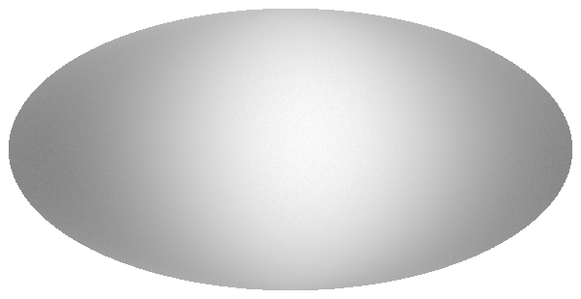
Cosmic Radio Dipole
LOFAR Family Meeting 2024
Lukas Böhme
Notes:
Lukas Böhme, PhD student from Bielefeld University
Topic cosmic radio dipole + observing it with LOFAR

Slide 2
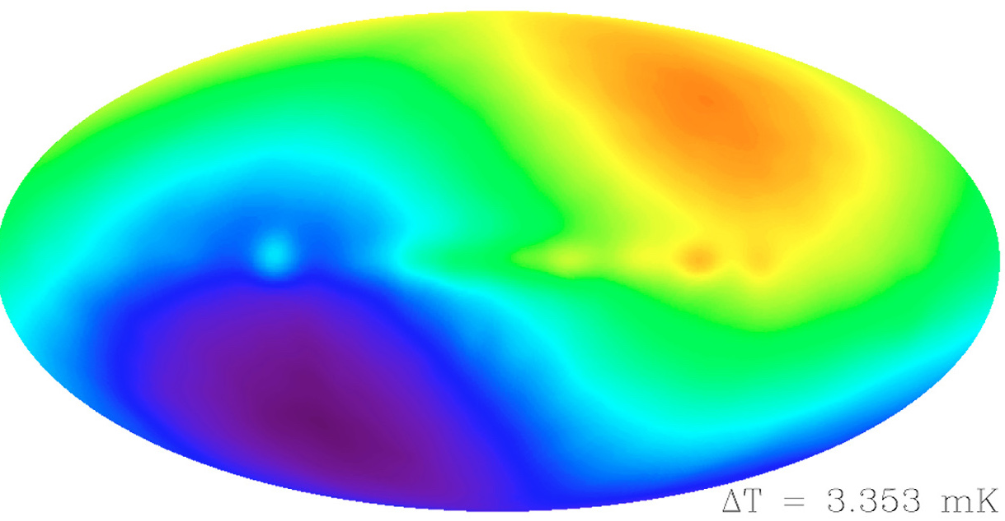

Cosmic Microwave Background
First noted in 1967/69 [1]
Clear result: 1994 COBE [2]
Assumption: Due to motion of the Solar System in relation to CMB rest-frame
On the order of ${10}^{−3}$
$v_{CMB}=369.82±0.11{ km s}^{−1}$ [3]
[1] Partridge and Wilkinson, 1967
[2] Fixsen et al. 1994
[3] Planck Collaboration 2020
Notes:
Let's start with a quick overview of the cosmic microwave background dipole anisotropy.
First noted 1967 in measurements
Clear with COBE 1994, shown on the right
Possible explanation for dipole anisotropy: Motion of Solar System towards CMB rest-frame
Anisotropies of order: 10^-3
Measured velocity: 369 km/s

Slide 3
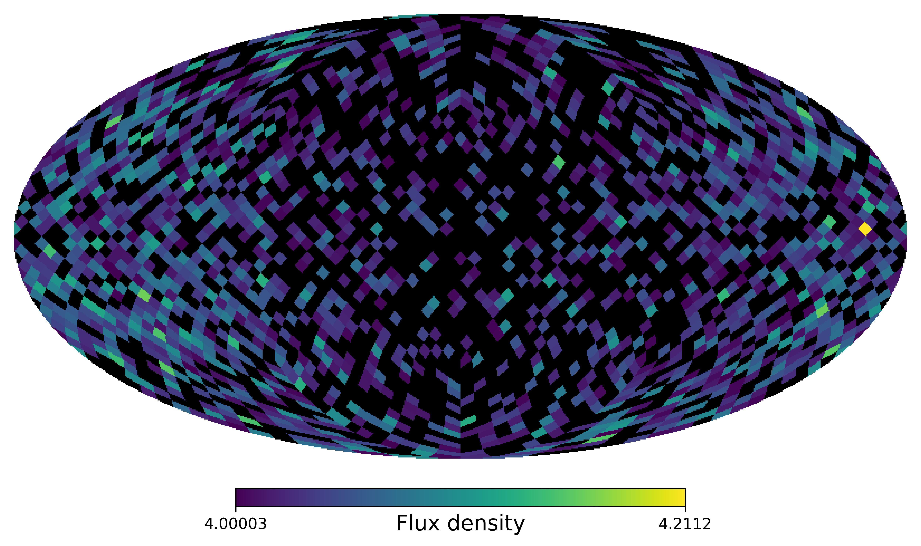
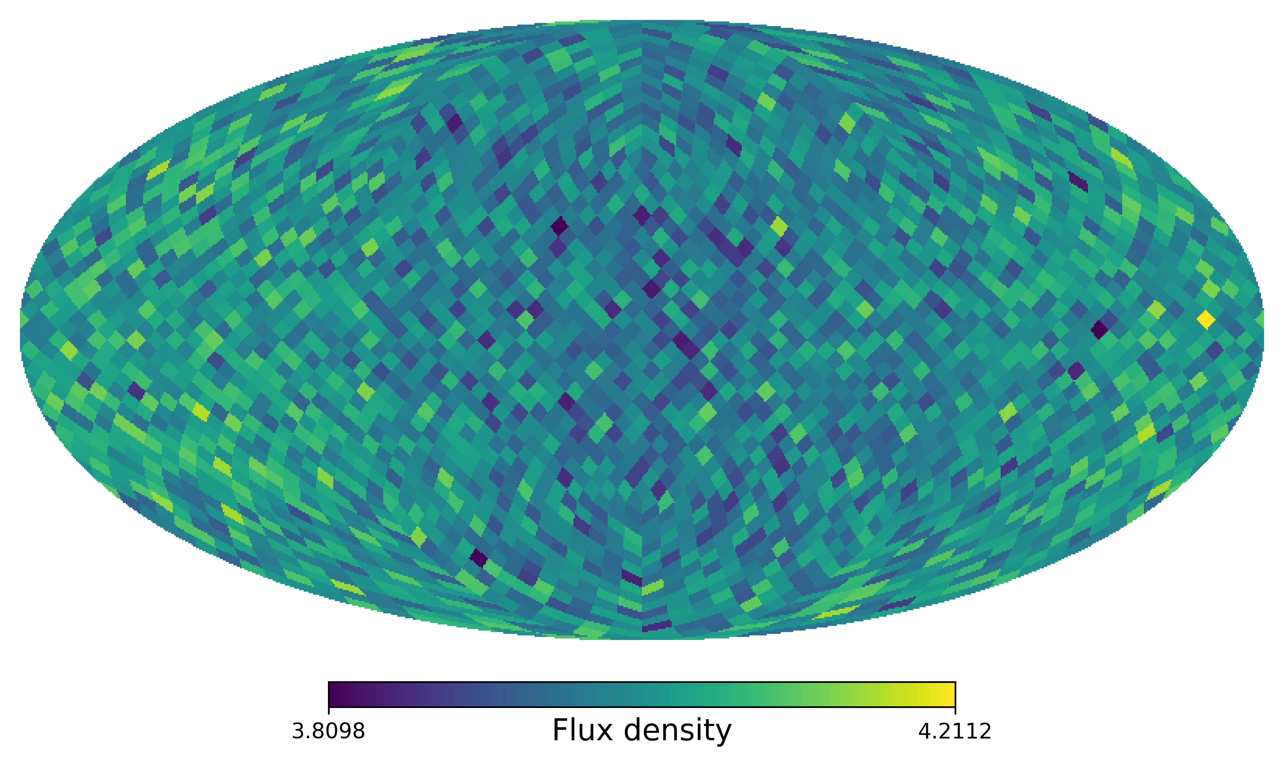
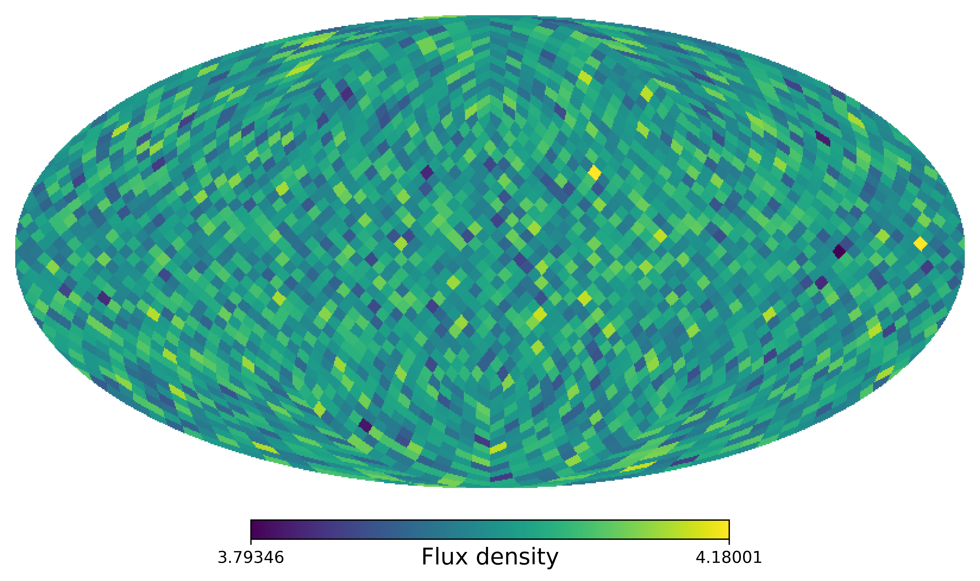
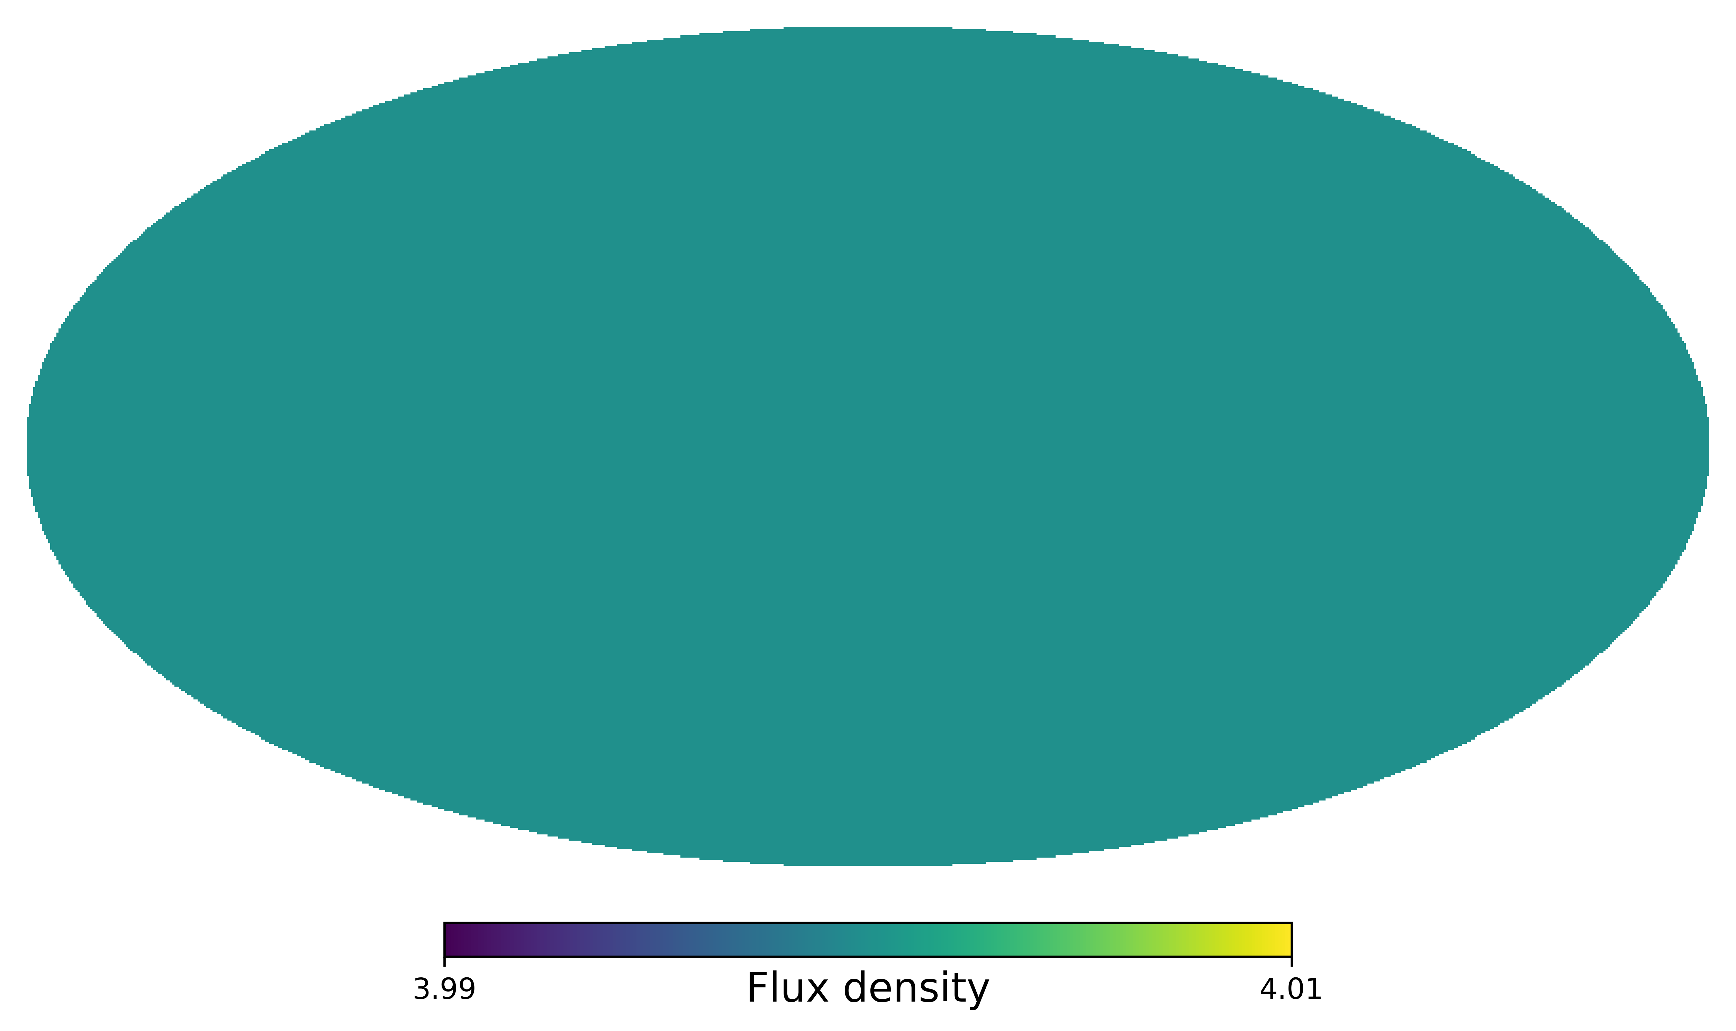


Cosmic Radio Dipole
$\overline{z}≈$1
$d_{radio}=d_{kin}+d_{matter}$
$d_{matter}$ expected to be small
$d_{kin}$ due to Doppler shift & Aberration
Doppler shift
Change in frequency
  Change in flux density ($S∝ν^{−α}$)
Aberration
Change of observed angle towards direction of motion („Clustering“)
Each pixel $≜$ 1 source at 4mJy
+ Noise
+ Dipole boost
+ 4mJy flux cut
Notes:
Switch to radio, expect same aniso. in distr. Of radio
Hope that we only see Extragalactic
Radio dipole also assumed mainly kinematic
Due to doppler shift and aberration
Example: Pixel == Source at 4mJy + Noise
Doppler motion -> change flux, S prop to Frequency
Overall, more sources in d.o.m
Aberration observed angle towards dir. Of motion
Also leads to more and less sources,
These two are additive effects

Slide 4
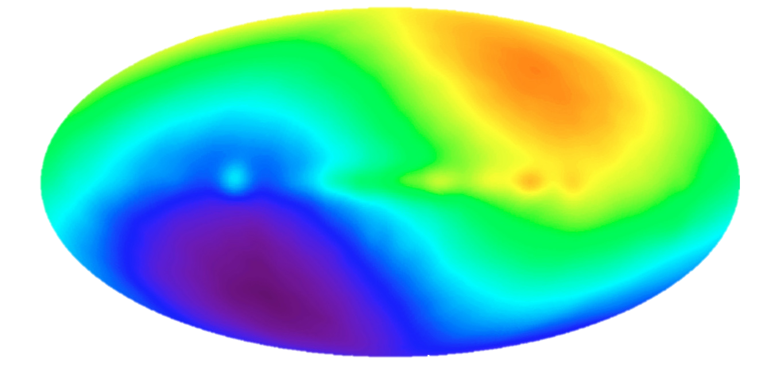
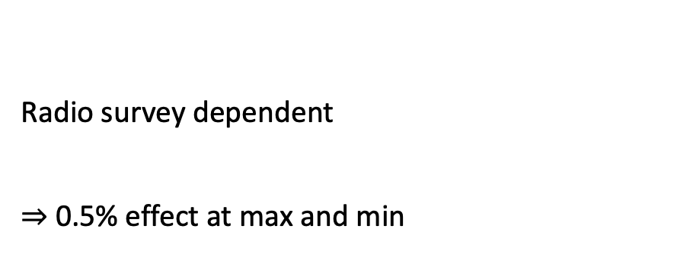
Source Count Dipole
Counts-in-Cell
(Pixel, direction of motion)
Slope in source counts
Spectral index
(Ellis and Baldwin, 1984)
Radio survey dependent
$⇒$ 0.5% effect at max and min
COBE, NASA
Fixsen+ 1994
Notes:
Dipole in Count-in-Cells restframe times 1+d cos theta
D expected amplitude, CMB + alpha, x
Expected amplitude is only 0.5 * 10^-2
This is the description of the dipole in the Counts-in-Cells. So the observed Counts-in-Cell are the restframe times 1+dcos theta.
What is d? Formula for expected dipole amplitude, insert CMB velocity and two survey dependent variables, x and alpha. alpha is the mean spectral index and x the slope of the power law in the source counts at the flux cut. Alpha is roughly .75 and x roughly 1.
Expected amplitude is only 0.5 * 10^-2
Max. change only 0.5%

Slide 5
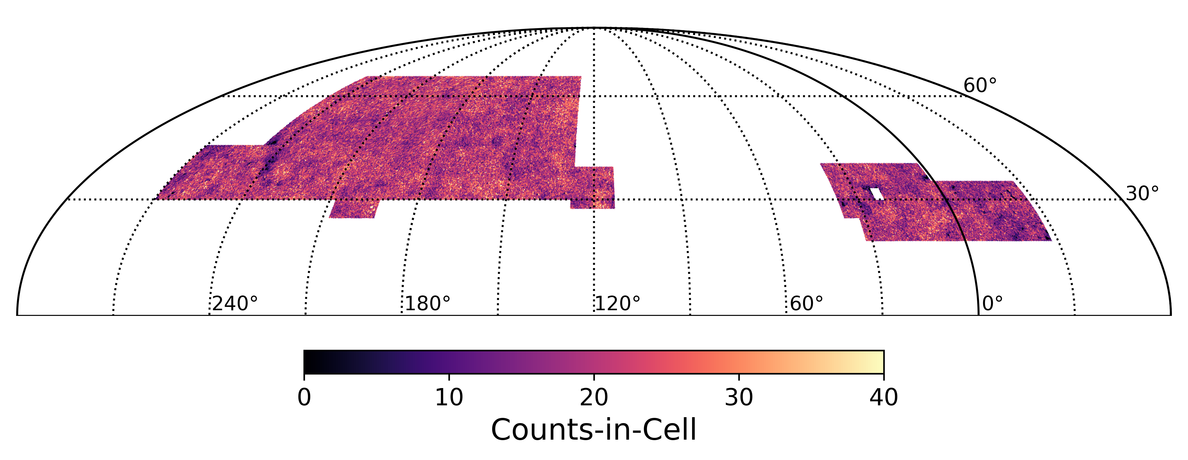
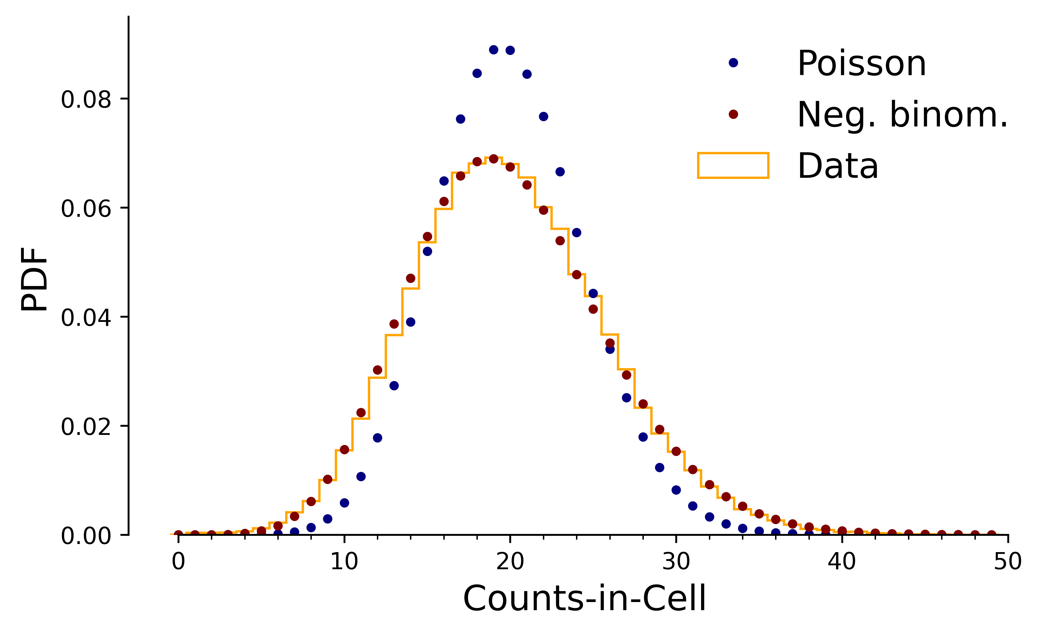
Counts-in-Cell
Counts-in-Cell histogram
Poster on this:
Pashapour-Ahmadabadi, Böhme+, in prep.
Notes:
Small excursion from dipole to Counts-in-Cell
Take data and bin it using Healpy
Map to histogram
Let's take a small excursion from the dipole to the Counts-in-Cell. When we take our data and bin it using Healpy, we get the Counts-in-Cell.
Then we turn this map-view of the Counts-in-Cell into a histogram.

Slide 6
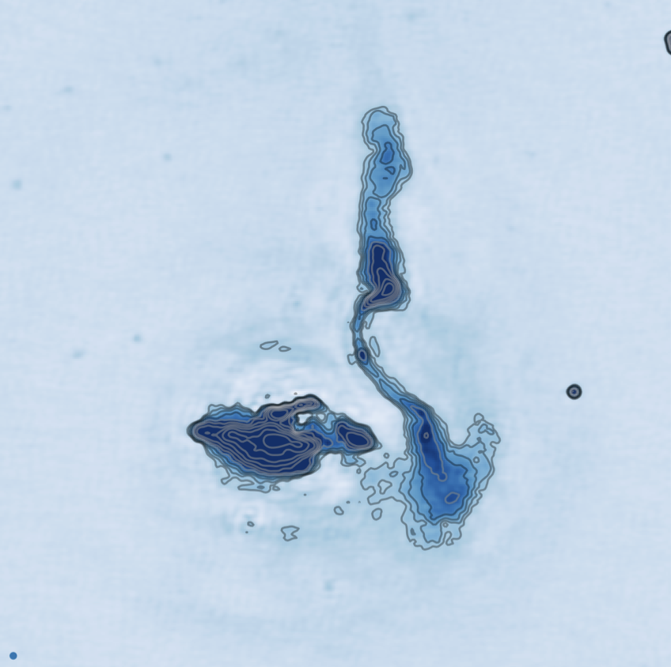
Counts-in-Cell
Counts-in-Cell histogram
Poisson distr. Point sources
Negative binomial distribution
Poisson:
Neg. binom.:
Poster on this:
Pashapour-Ahmadabadi, Böhme+, in prep.
Notes:
Compare histogram with Poisson -> Not good
Assumes independent point sources
Better model is negative binomial, also describes multi-comp.
When we compare the Histogram with the standard Poisson distribution, we find that this is not able to describe our observed Counts-in-Cells. The reason for this is that the Poisson distribution assumes independent point sources, but at 144 MHz and 6 arcseconds we see a lot of components as for example the jets and core from AGNs.
A better model here is the negative binomial distribution, which is also able to describe the distribution of multi-component sources and gives a much better fit to the data.

Slide 7
Negative binomial distribution
Work in progress
Model:
Count of radio sources in cell
Poisson:
Neg. binom.:
Poster on this:
Pashapour-Ahmadabadi, Böhme+, in prep.
Notes:
So in this model we describe the total count of radio sources in any given cell, N, by a sum.

Slide 8
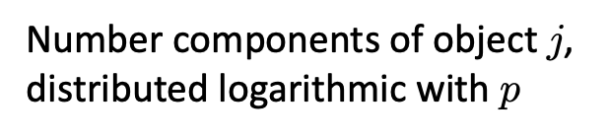
Negative binomial distribution
Work in progress
Poisson distributed physical objects
Model:
Number components of object $j$, distributed logarithmic with $p$
Count of radio sources in cell
Poisson:
Neg. binom.:
Pashapour-Ahmadabadi, Böhme+, in prep.
Notes:
Sum over number of physical objects, Poissonian, as before.
For every one, draw component from logarithmic
C_j = 1, 2, 3,.
Compount Poisson -> negative binomial distr.
This sum runs over the total number of physical objects, which is Poisson distributed. So just as before. But now for every one of these objects, we draw a number of components and these are distributed logarithmic with parameter p. This distribution only gives us integers greater or equal 1. So for every objects we may have 1,2,3,… components. This method is called compound Poisson and results in the negative binomial distribution.

Slide 9
Negative binomial distribution
Work in progress
Poisson distributed physical objects
Model:
Number components of object $j$, distributed logarithmic with $p$
Count of radio sources in cell
Poissonian limit, : Clustering
Pashapour-Ahmadabadi, Böhme+, in prep.
Notes:
Easy to measure parameters, r and p, linked to mean and standard.
Limit p->1, r->infty gives Poisson
It‘s able to describe High-resolution with components and low-res with no.
Biggest improvement-> more realistic errorbars
The nice thing of this distribution as seen here is, that we can directly measure it‘s parameters from the data. Both parameters, r and p, are directly linked to the mean and standard deviation of the data. What is also nice is that in the limit of p goes to 1 and r goes to infinity this results in the Poisson distribution again. So the negative binomial distribution is able to describe high-resolution radio surveys with a lot of visible components but also low-resolution ones with almost no components. The biggest improvement from this that we see in the end are more realistic error bars, as the distribution describes the spread of the data better.

Slide 10
Estimator for radio source counts
Likelihood for the negative binomial distr. with dipole given by:
Minimise the negative log-likelihood with Bilby [1,2]
Multi-survey estimation:
  Simply add log-likelihoods to obtain a combined estimate
  +Assume: Same underlying dipole in all surveys
Dipole affects mean count as a function of direction
[1] Ashton et al. 2019
[2] Romero-Shaw et al. 2020
Notes:
Use Morteza‘s result, build Bayesian estimator of it.
Likelihood and add dipole as r(d). Implement in bilby.
Easy to combine multiple surveys with this
Start with assumption of direction fixed towards CMB Dipoe.
So I take this result from Morteza and build a Bayesian estimator for the dipole out of it.
First, we have to add the effect of the radio dipole on the source counts to the distribution. This is a straightforward modification of the mean, and represented here by the parameter r, as seen before.
We then implement the negative binomial distribution as a negative log-likelihood in bilby.
For our measurement we make one assumption.
For the multi-survey estimation, we can simply add the log-likelihoods for the individual surveys to obtain a combined estimator. An additional assumption we take here is that the underlying dipole in all surveys is the same. So we exclude the possibility of a frequency dependent dipole, in the combined estimator.

Slide 11
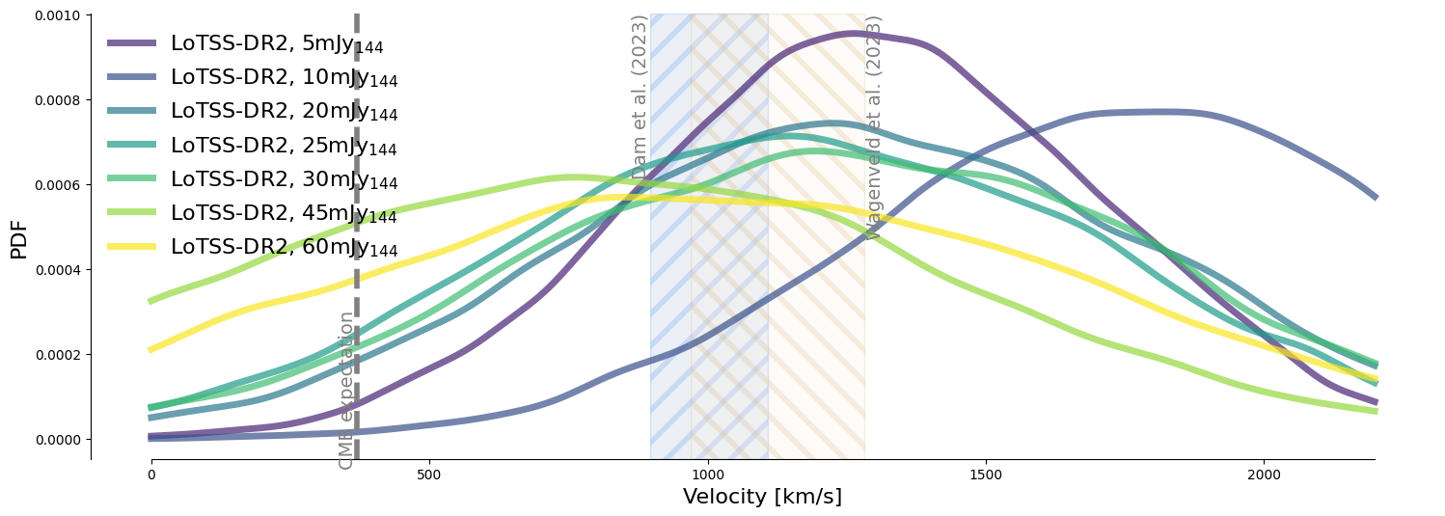
Radio Dipole
Work in progress
Fixed direction towards CMB dipole
Measure at different flux density cuts
Notes:
Result for LoTSS-DR2, fixed direction @ diff. flux cuts.
Velocity quite stable, in line with previous measurements in the back.
Continue and ask, what is the preferred direction of the data? Is it really this?
This is the result I get for LoTSS-DR2 for the fixed direction towards the CMB dipole shown for different minimum flux density cuts. Overall we see that the velocity is quite stable and in line with previous measurements shown here in the back, just not with the CMB velocity.
But, then we can continue and ask, is this also the preferred direction of the data? And the answer to that is NO.

Slide 12
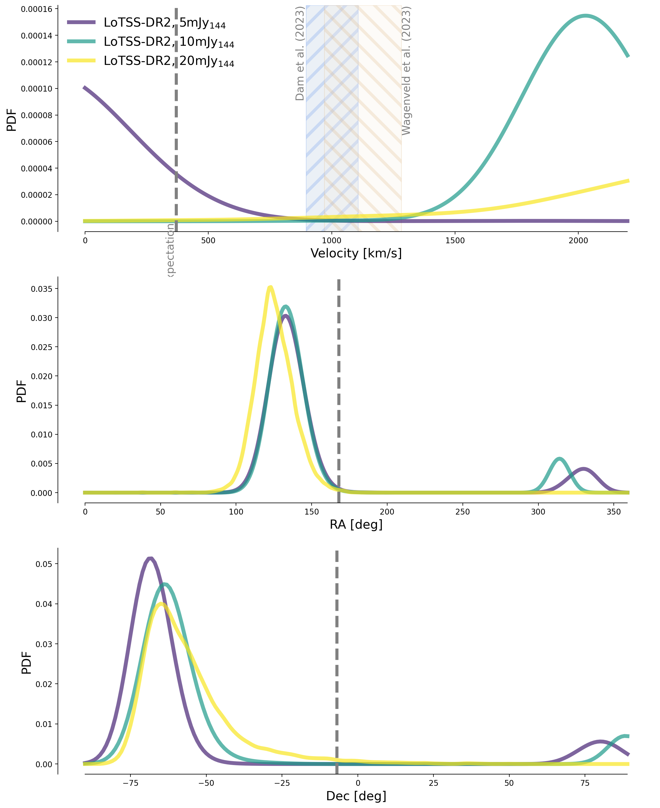
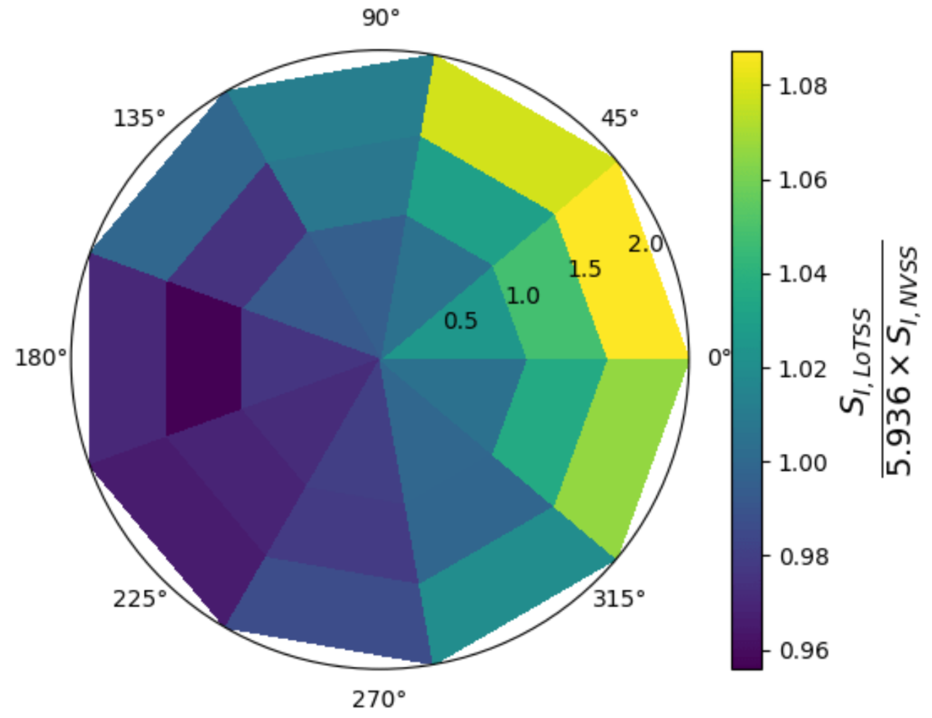
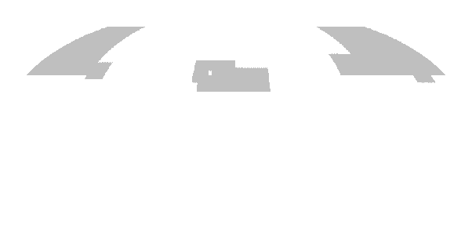
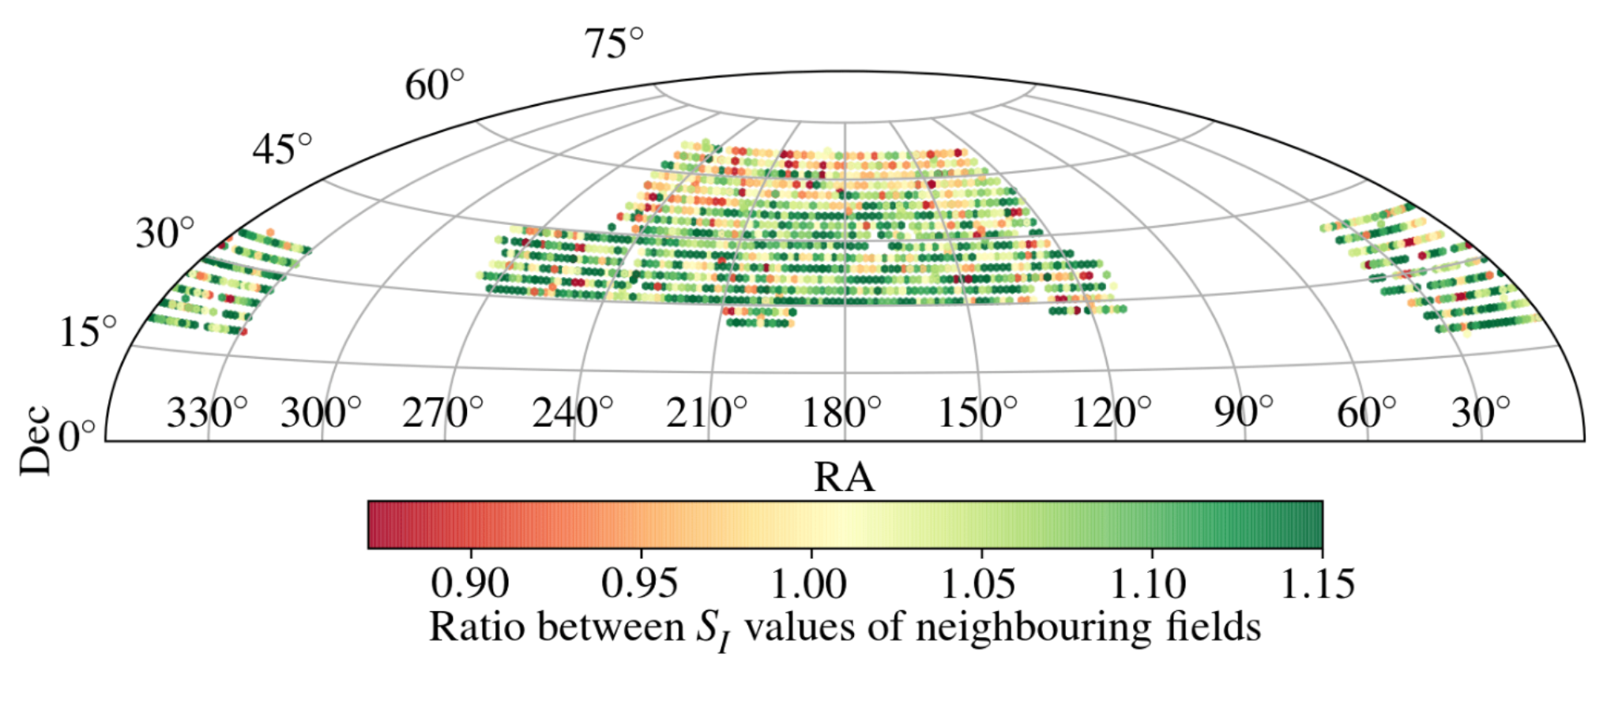
Radio Dipole
Work in progress
LoTSS-DR2 result unusable for my analysis
Reasons:
  Flux density calibration across large-scales
    Fitting a N-S variance
  ???
  ??
  ?
Notes:
So what I find is that the data prefers a direction towards -70° in declination, which means we are mainly fitting some declination dependent effect.
Reasons for this are probably the flux density calibration across large-scales,
See here in the illustration
and more
and more

Slide 13
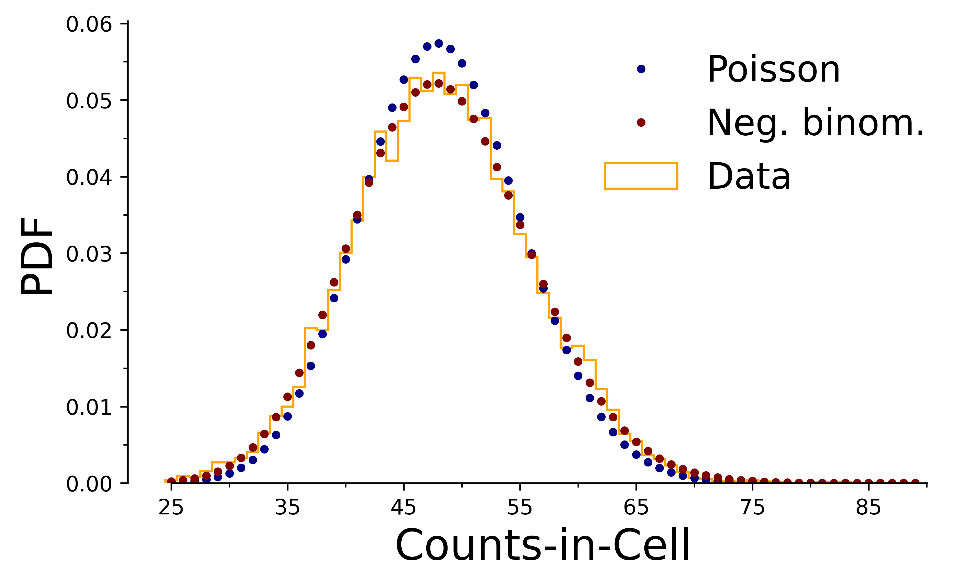
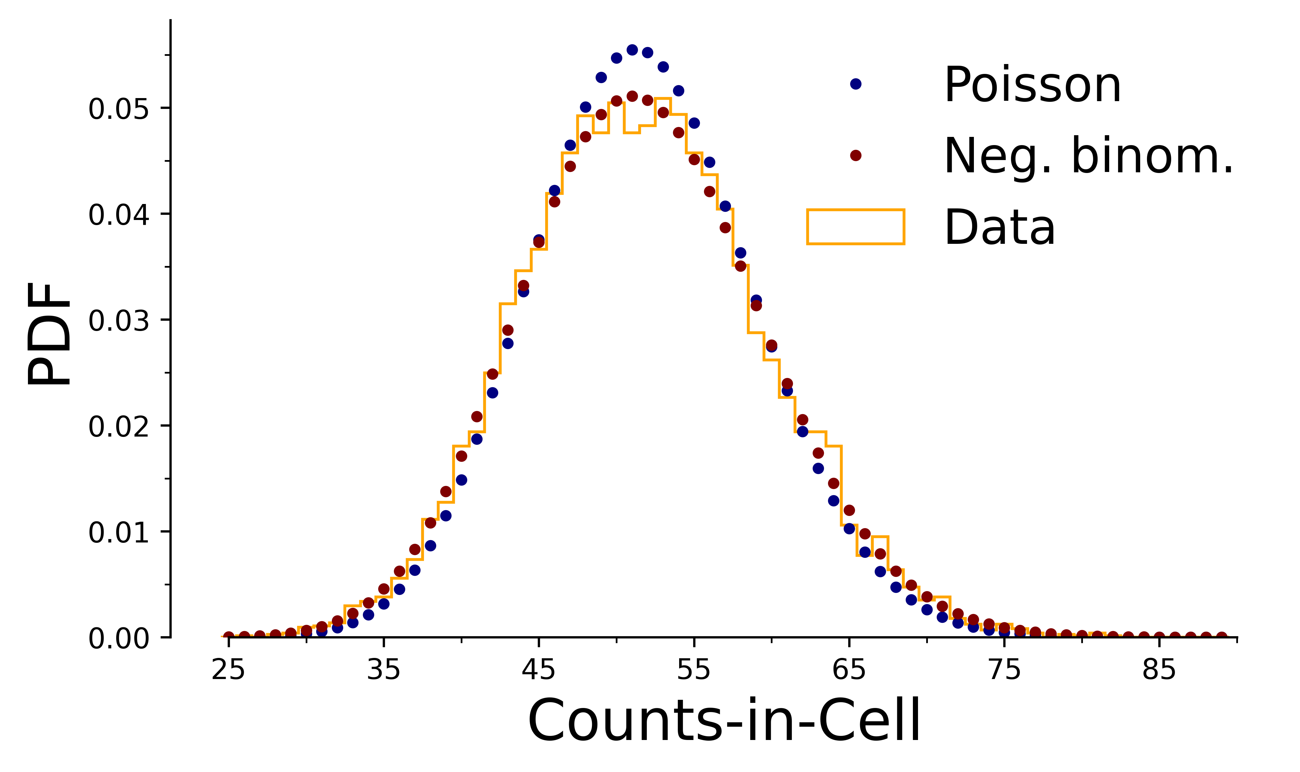
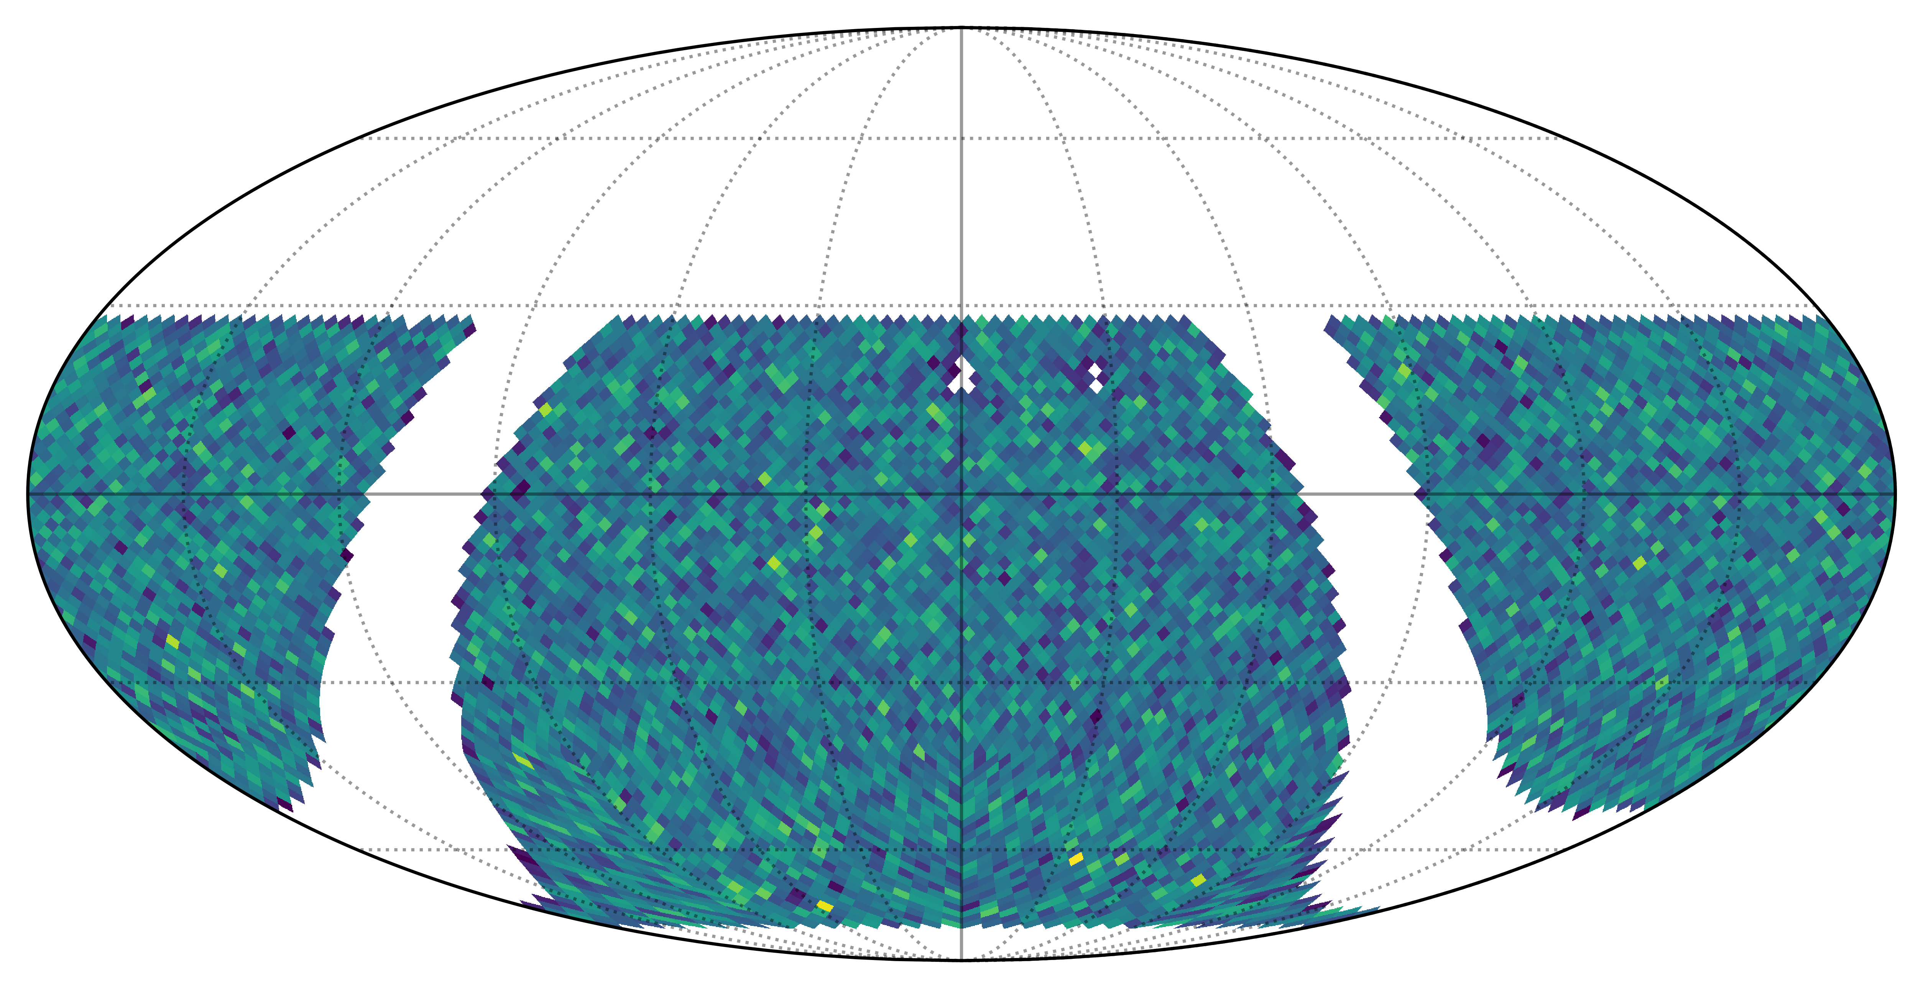
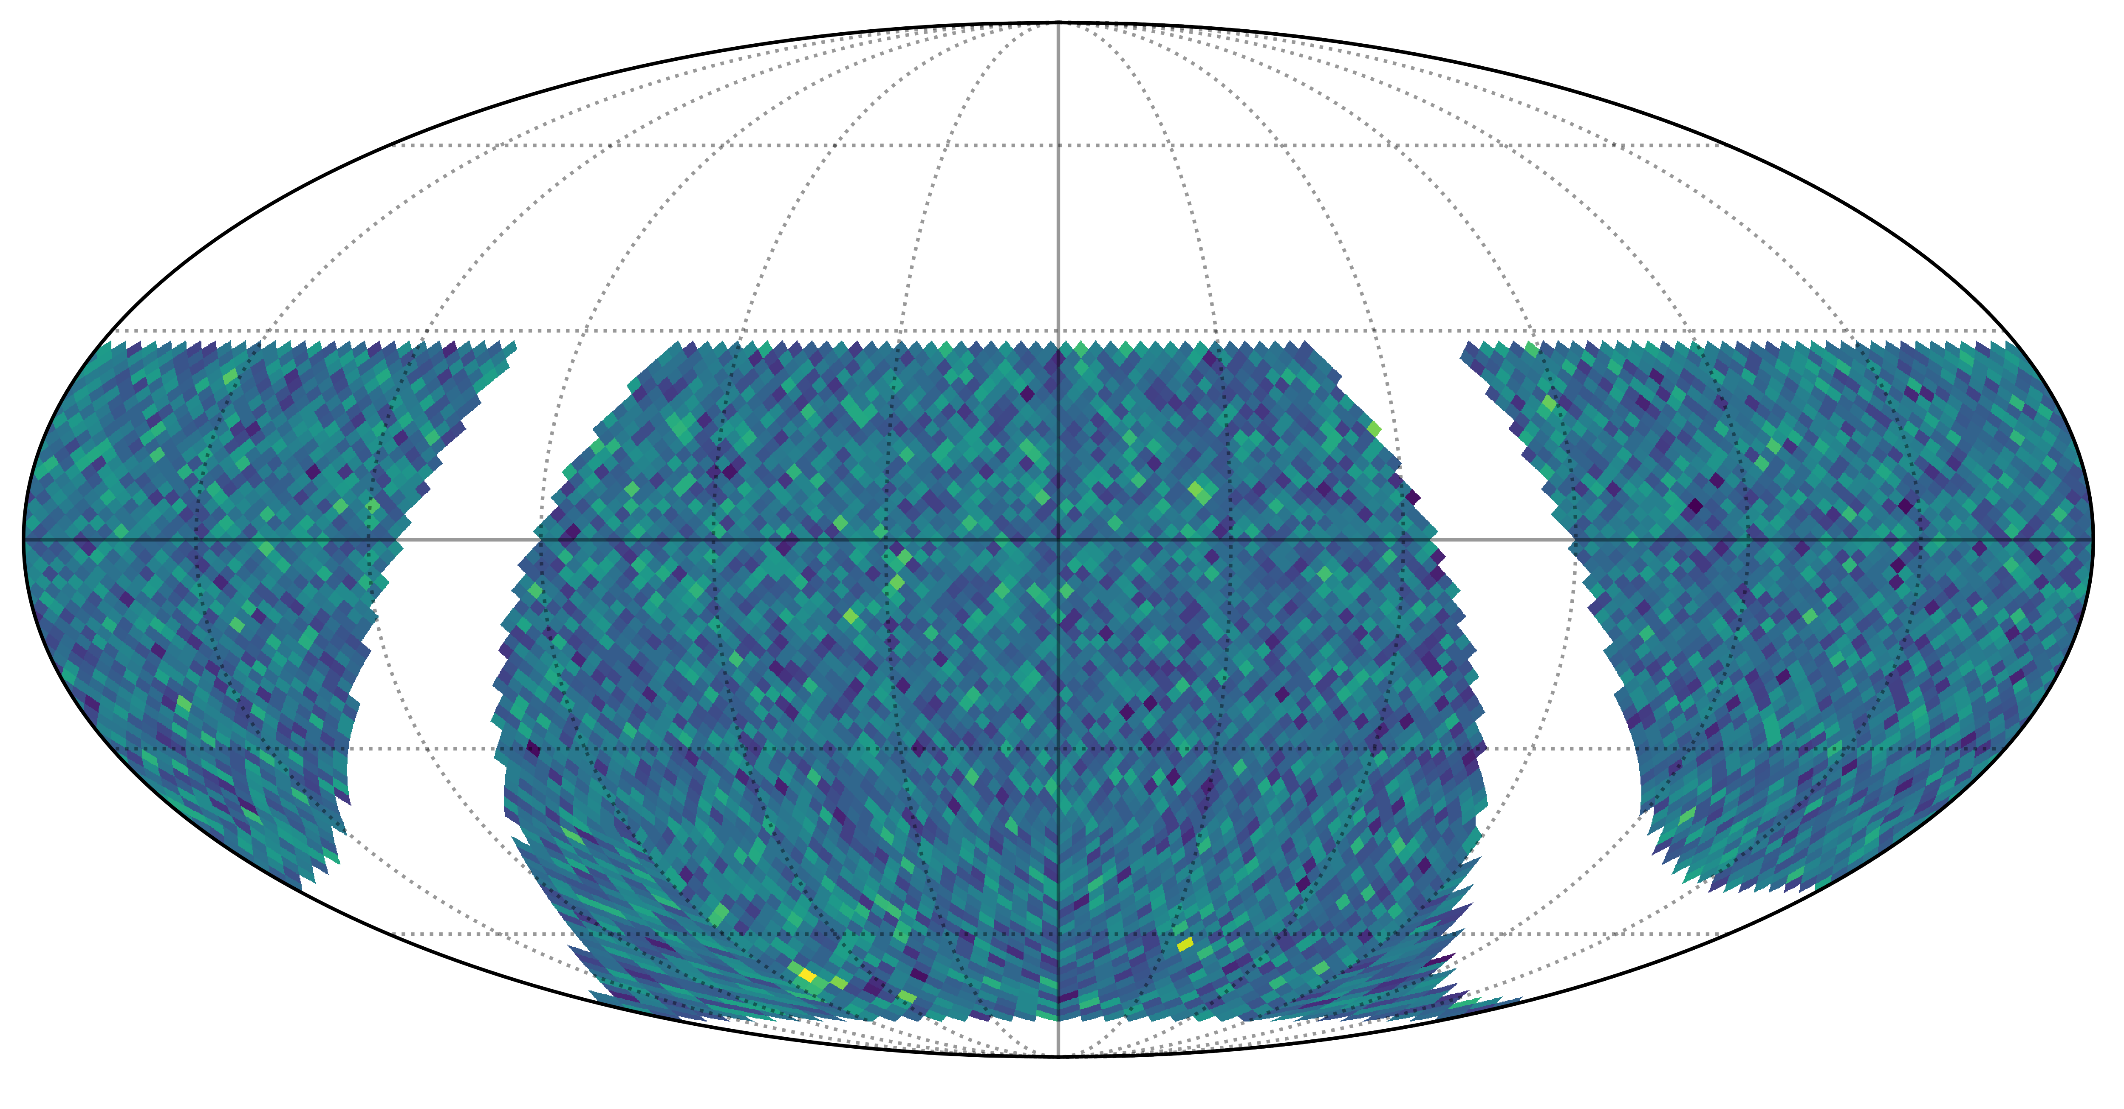
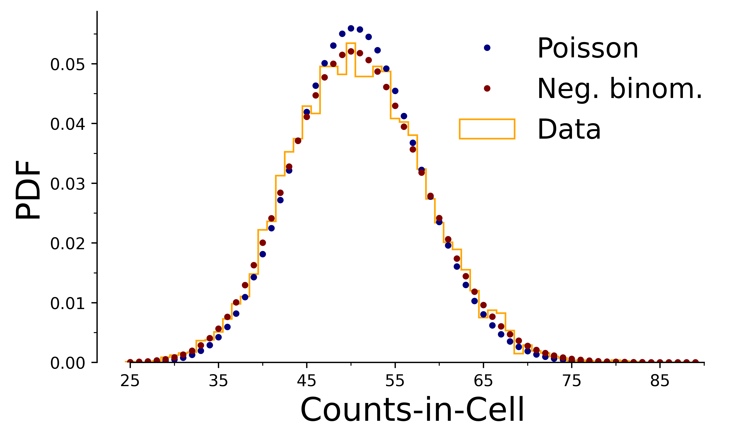
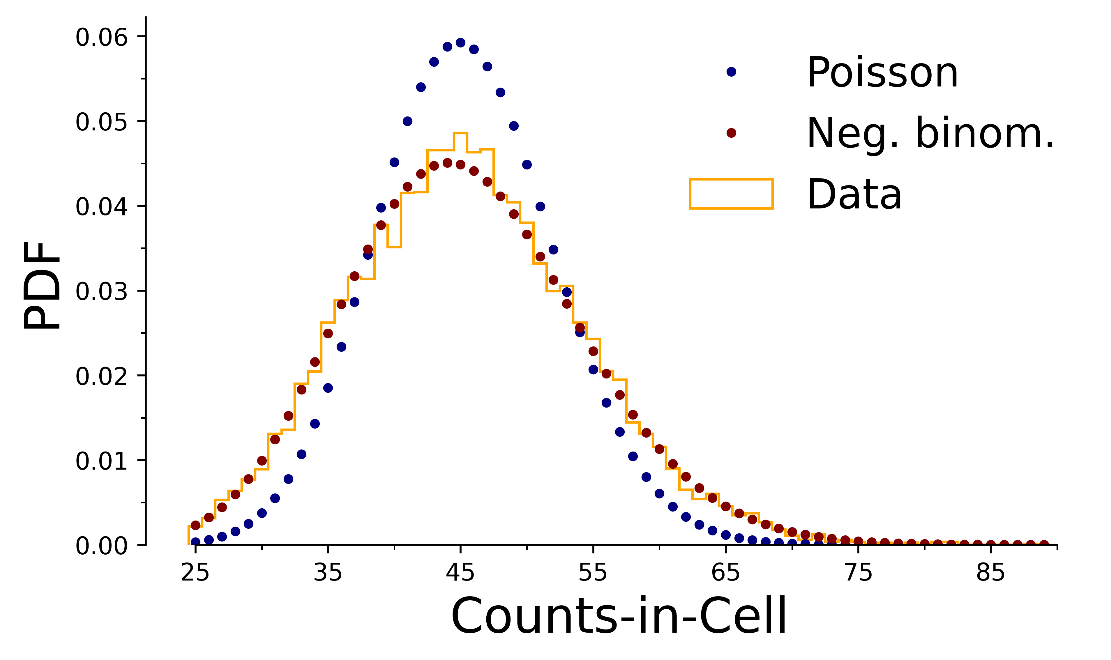
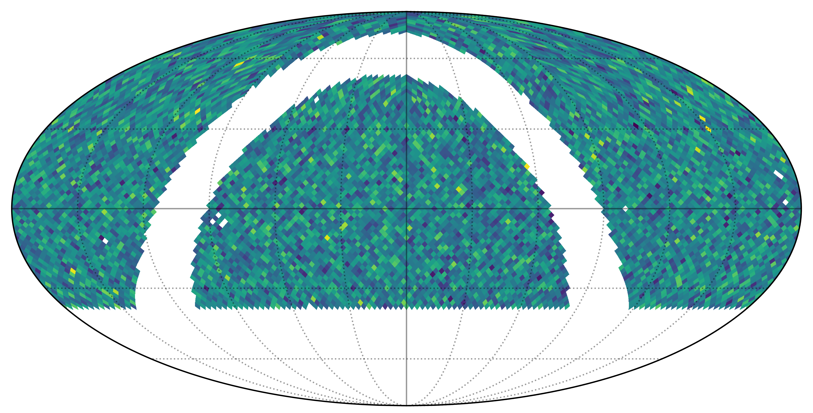
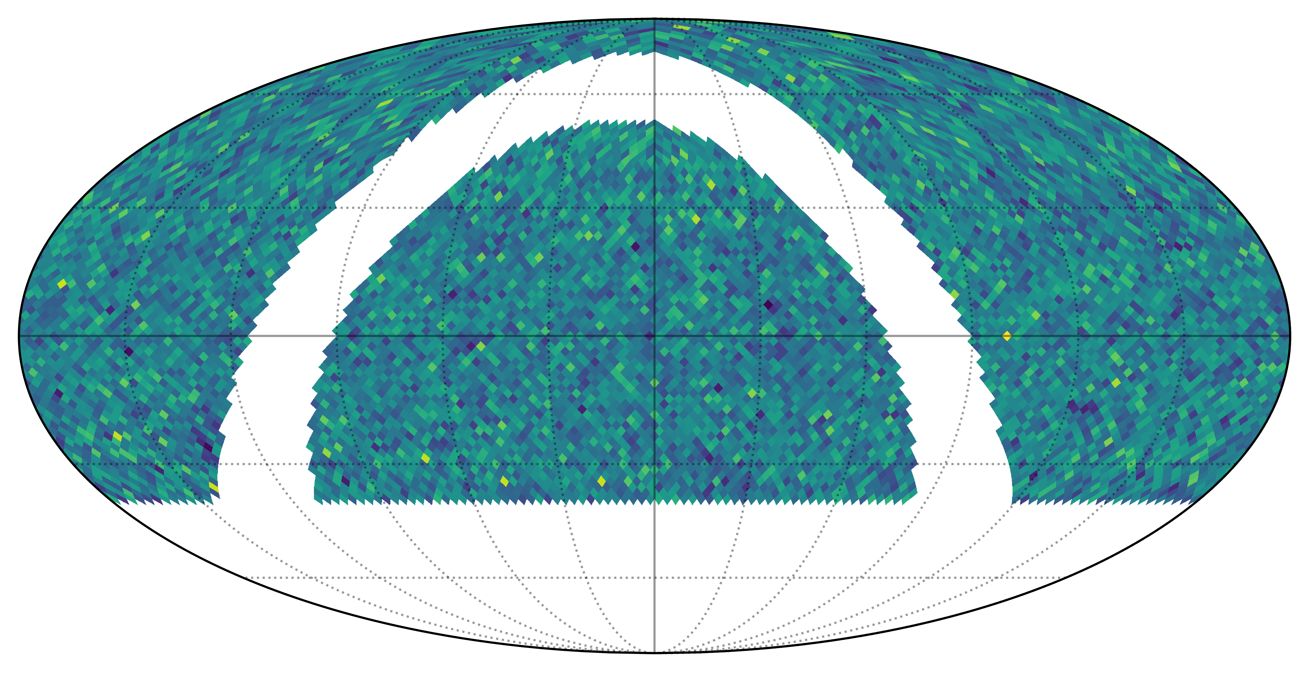
Data distribution
Work in progress
RACS-low
RACS-mid
NVSS
VLASS
Notes:
Luckily for my PhD, I found some other data to study.
Here I'll give you a quick overview of the different datasets I use. In addition to LoTSS-DR2, I'm also using RACS-low at 888MHz,
for the first time the newly released RACS-mid,
the classic NVSS at 1.4 GHz
and on the upper end of the frequency range VLASS at 3GHz.
For all surveys, I mask the galactic plane up to 10 degrees.
As you can see, the negative binomial distribution gives a better description of the source counts for all four radio surveys, though the difference is smaller than for LoTSS-DR2. This is due to the fact that we see less multi-component sources in these surveys either due to resolution or sensitivity.

Slide 14
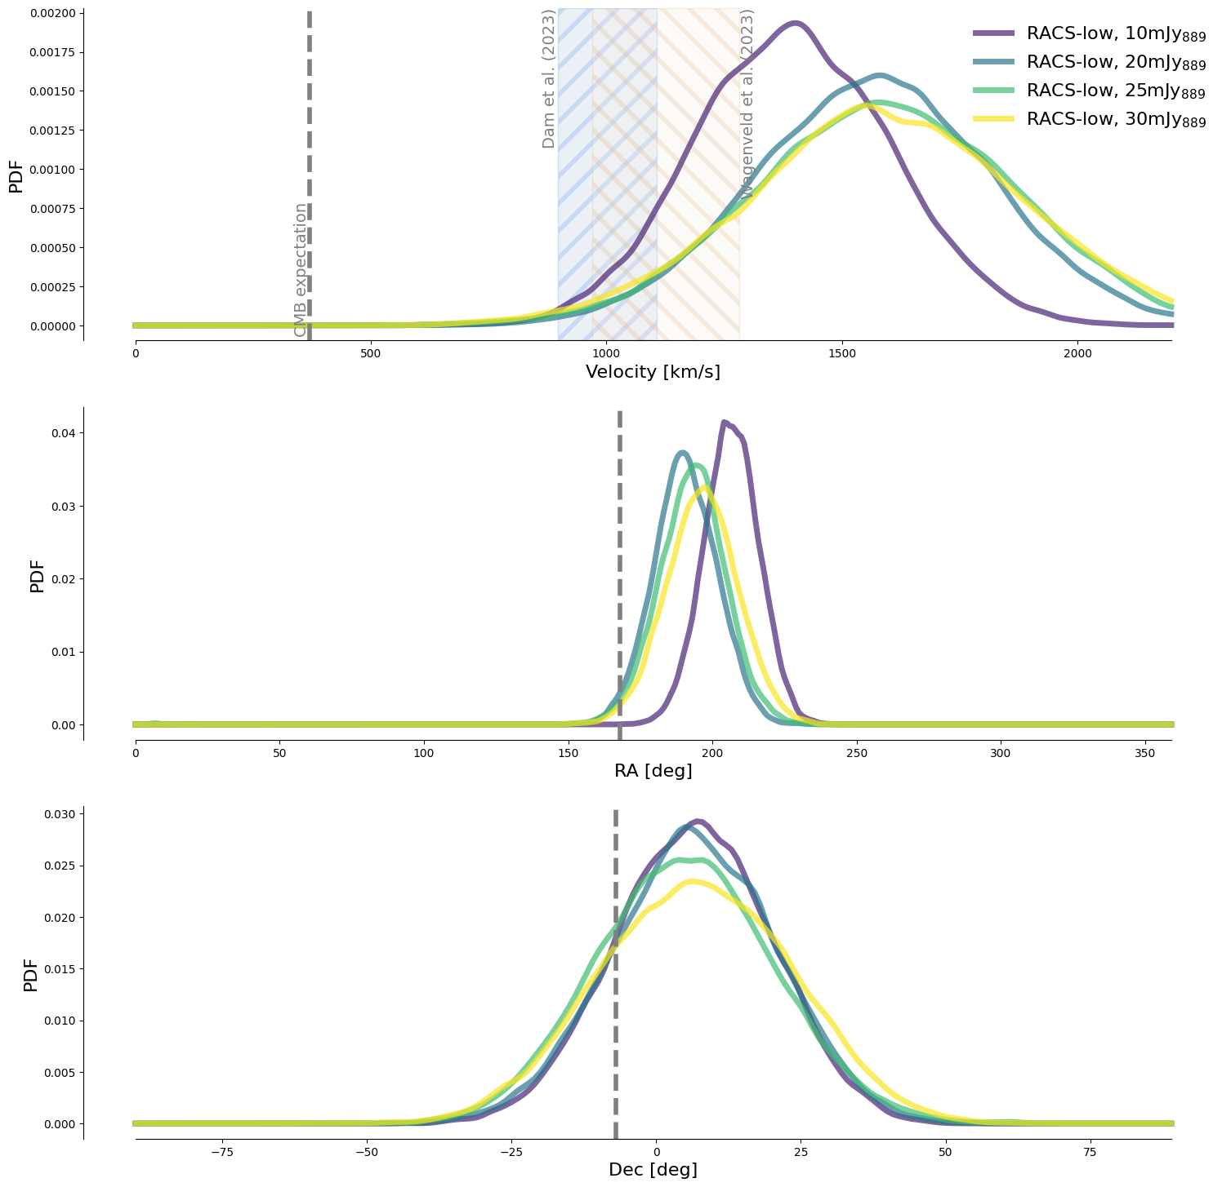
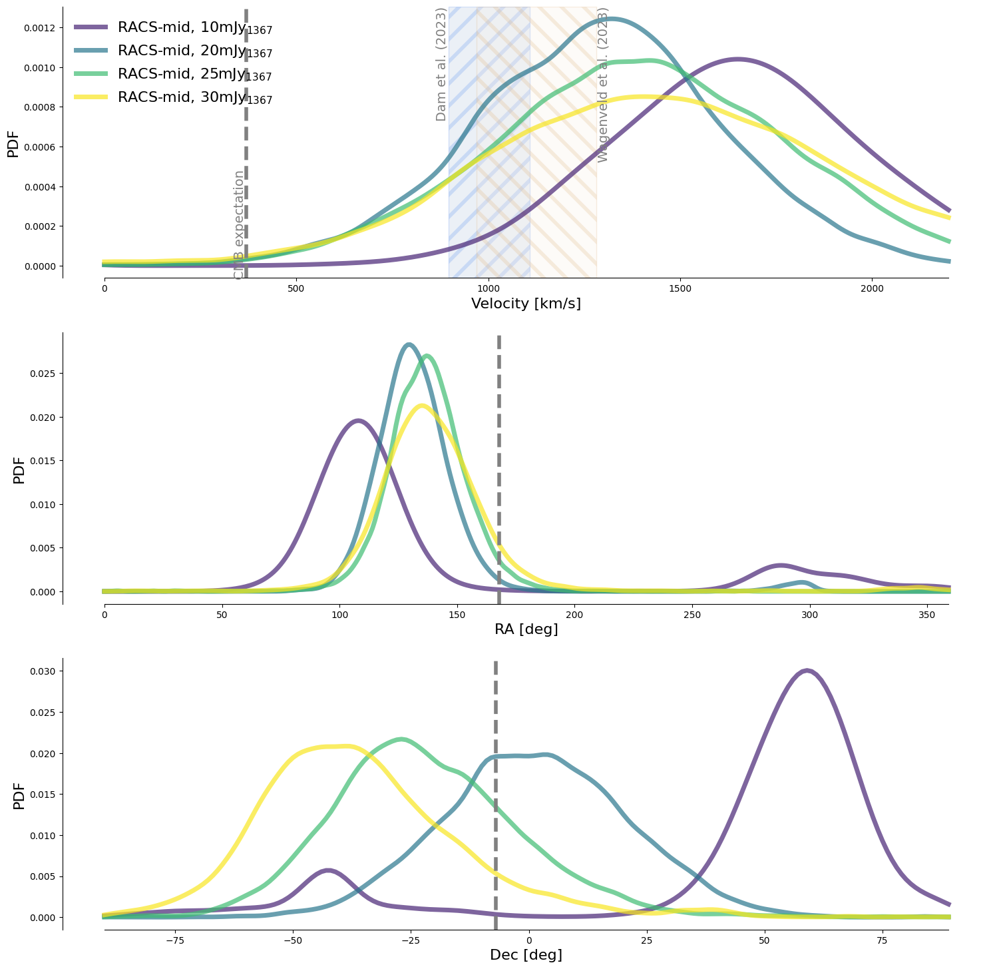
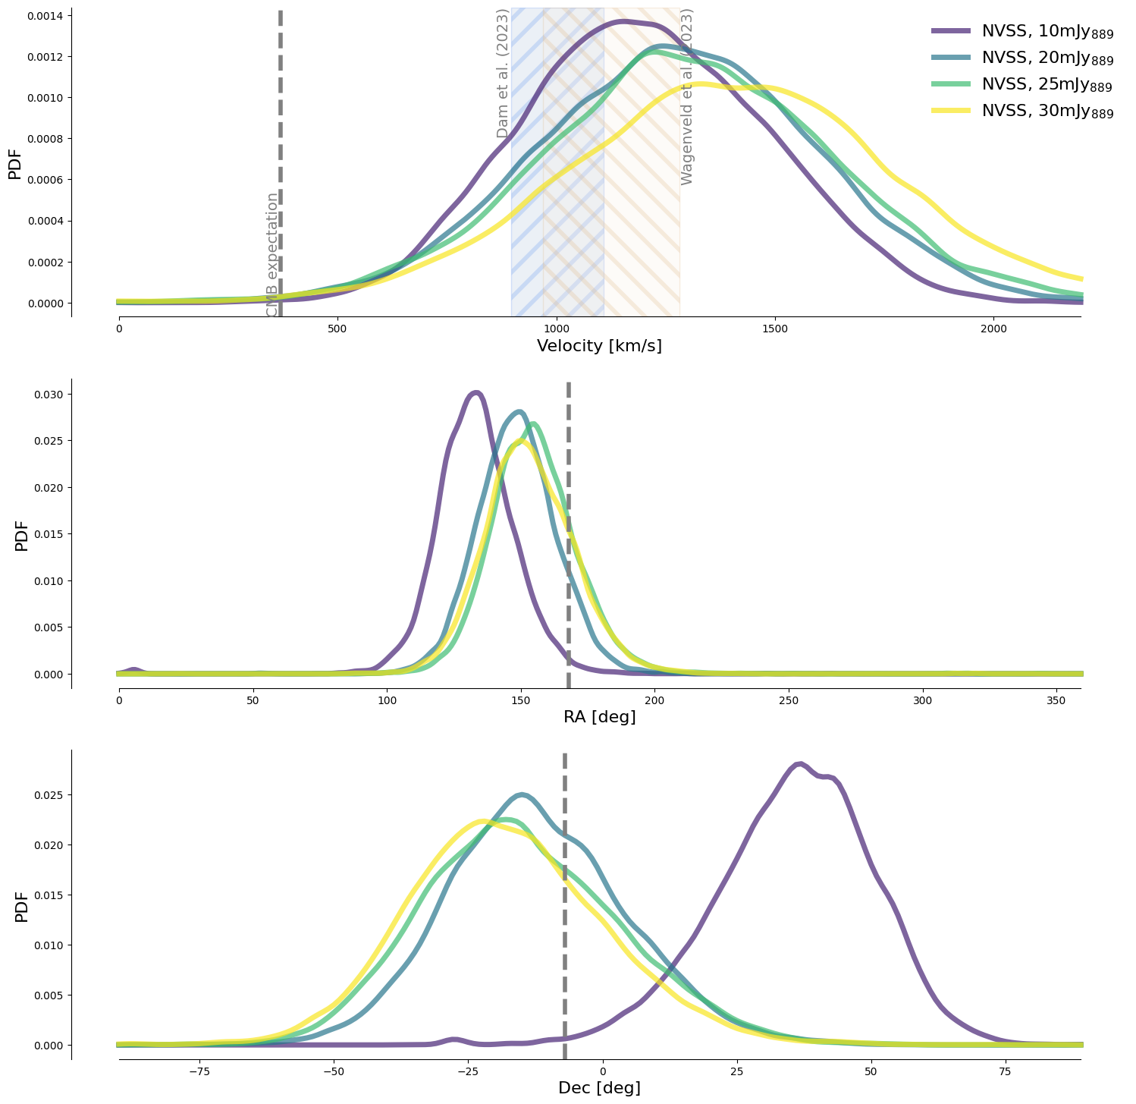
Radio Dipole
Work in progress
Only three of these four catalogues examined show a realistic dipole signal
RACS-low
RACS-mid
NVSS
Fine above 10 mJy
Fine above 10 mJy
All good
Notes:
When we make the same plots for the remaining surveys, we find that VLASS shows the same problems as LoTSS.
And here for RACS-low all flux cuts are fine, RACS-mid is fine above 10mJy and NVSS also above 10.

Slide 15
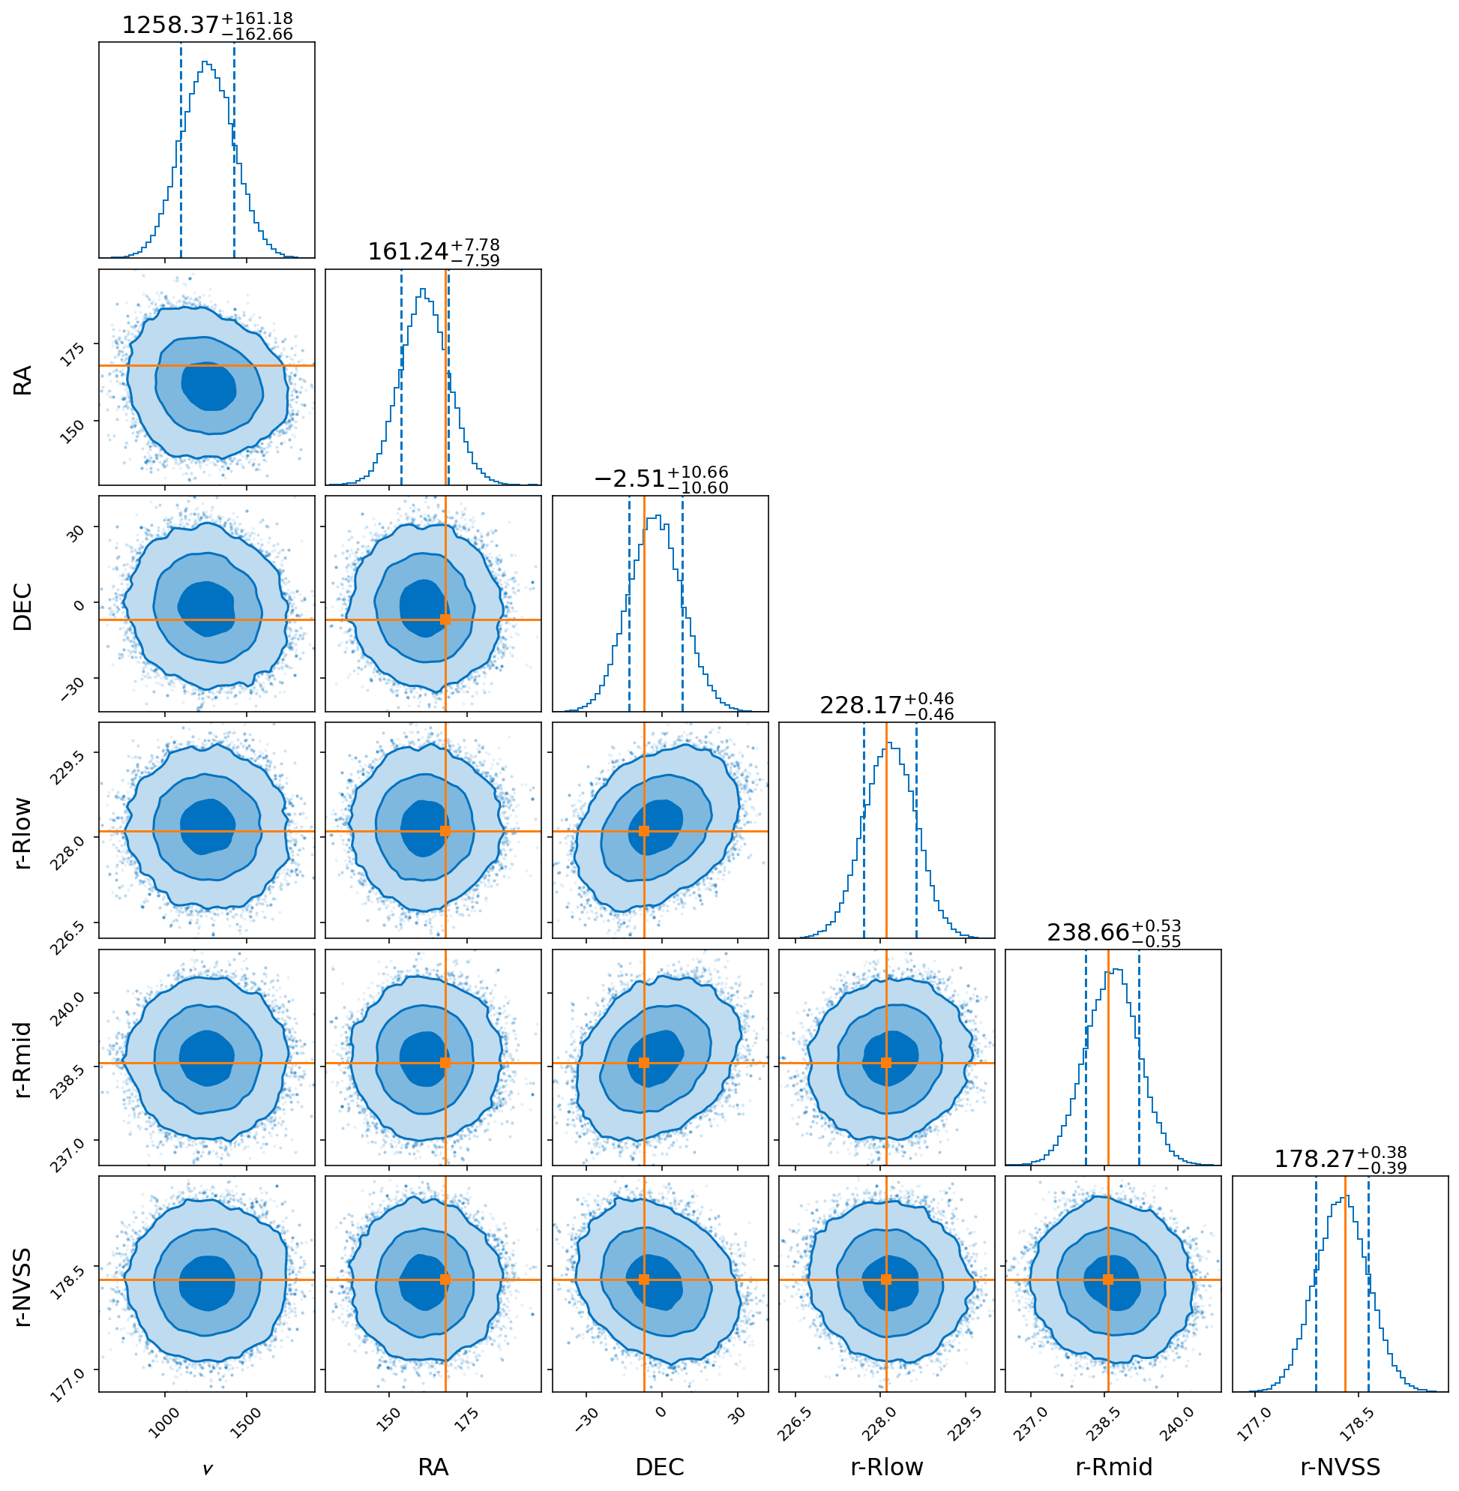
Joint estimate
Work in progress
Do a joint-estimate of
  RACS-low
  RACS-mid
  NVSS
Each at 20 mJy
Velocity ~4 times higher than CMB,
direction well aligned
Notes:
Joint estimate
Use RACS-low, RACS-mid and NVSS, all at 20mJy
Direction within 1 sigma to CMB
Velocity 1250km/s, 4 times higher
Small errorbars, would mean significant tension
Then I do the joint estimate I have talked about before. For this we use the RACS-low, RACS-mid and NVSS, all at 20mJy.
The direction we find is within 1sigma to the CMB direction as shown here, but the velocity we find is 1250 km/s, which is about 4 times higher than the CMB. As you can see from the error bars here, this is also in significant tension to the CMB. Though I should add that these are of course not completely independent samples.

Slide 16
Conclusion, future prospects
        Joint estimate raises significant tension with CMB,
        consistent with previous measurements
  Future large area sky surveys will help
  Current impression: More area -> less problems with systematics
  Wide-field spectroscopic follow ups: WEAVE-LOFAR -> Removing low-z/local sources
More thorough analysis of systematics
Notes:
Okay, let me come to my conclusion. For the joint estimate we find a significant tension with the CMB dipole but are in agreement with previous measurement that use different estimators and datasets, also in the infrared with CatWISE quasars.
In the future I think new large area sky surveys will help us identify reasons for this excess, especially in the near future with LoTSS-DR3, LoLSS-DR2, RACS-high and the improved RACS-low-DR2 and then finally in some time the SKA.
Also, wide-field spectroscopic follow ups will be very important for observing the Dipole in different redshift slices and maybe localising anisotropies. What will also be important is the more thorough analysis of systematic effects, since we are expecting a .5% effect over the whole sky.
Thank you!

