Slide 1
Beyond Just Beam Errors Direction-Dependent Calibration Challenges Far from the Phase Center
Stefanie Brackenhoff
Kapteyn Astronomical Institute
Advisors:
Prof. dr. Léon Koopmans (Kapteyn)
Prof. dr. ir. Alle-Jan van der Veen (TU Delft)
Dr. André Offringa (ASTRON/Kapteyn)
Dr. Maaijke Mevius (ASTRON)

Slide 2
Motivation
Beam errors are a challenge for high contrast projects
Issue for 21-cm cosmology
Limiting NenuFAR results (Munshi et al., 2024)
Need for uv-excision in LOFAR data (~19 % data loss)

Slide 3
Motivation
Beam errors are a challenge for high contrast projects
Limits results for 21-cm cosmology
Signal can stay buried under sidelobes of bright sources
Issue pressing for
High contrast study
Bright sources
A-team sources
High beam variability
(nulls & sidelobes)
Signal not detectable

Slide 4
Motivation
Beam errors are a challenge for high contrast projects
Limits results for 21-cm cosmology
Signal can stay buried under sidelobes of bright sources
Issue pressing for
High contrast study
Bright sources
A-team sources
High beam variability
(nulls & sidelobes)
Signal not detectable
I will be talking about the HBA

Slide 5
The structure of the beam

Slide 6
Beams in 4D
2x spatial
Temporal
Spectral

Slide 7
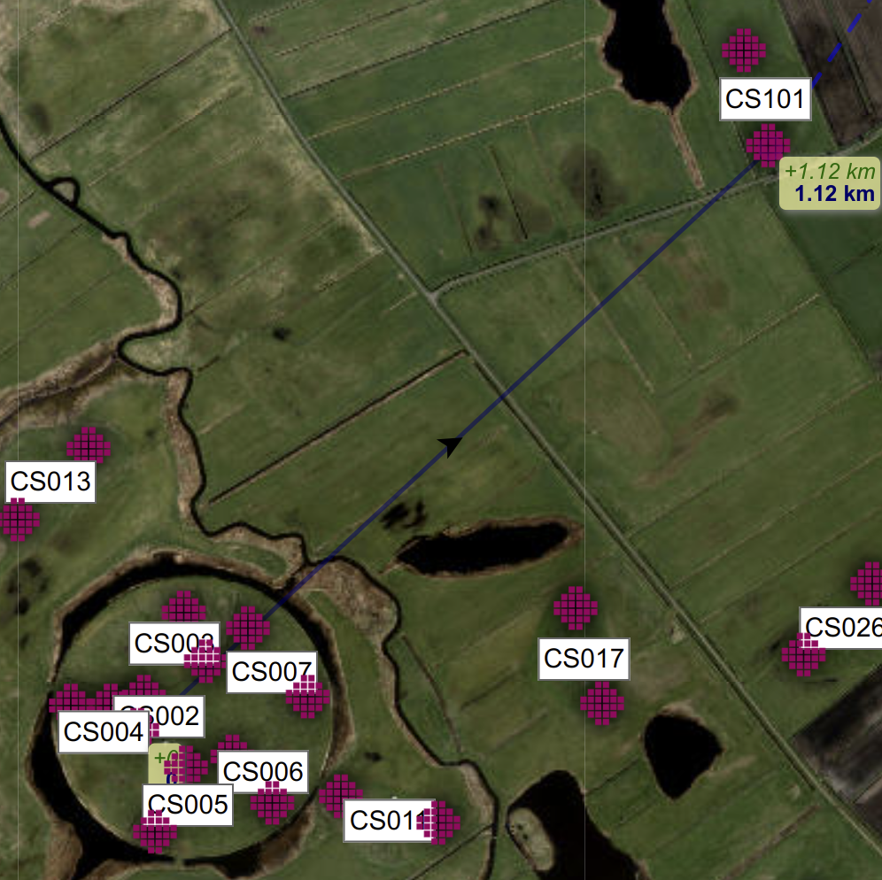
Beams in 4D
2x spatial
Temporal
Spectral
CS002HBA0 – CS101HBA0 1.1km

Slide 8
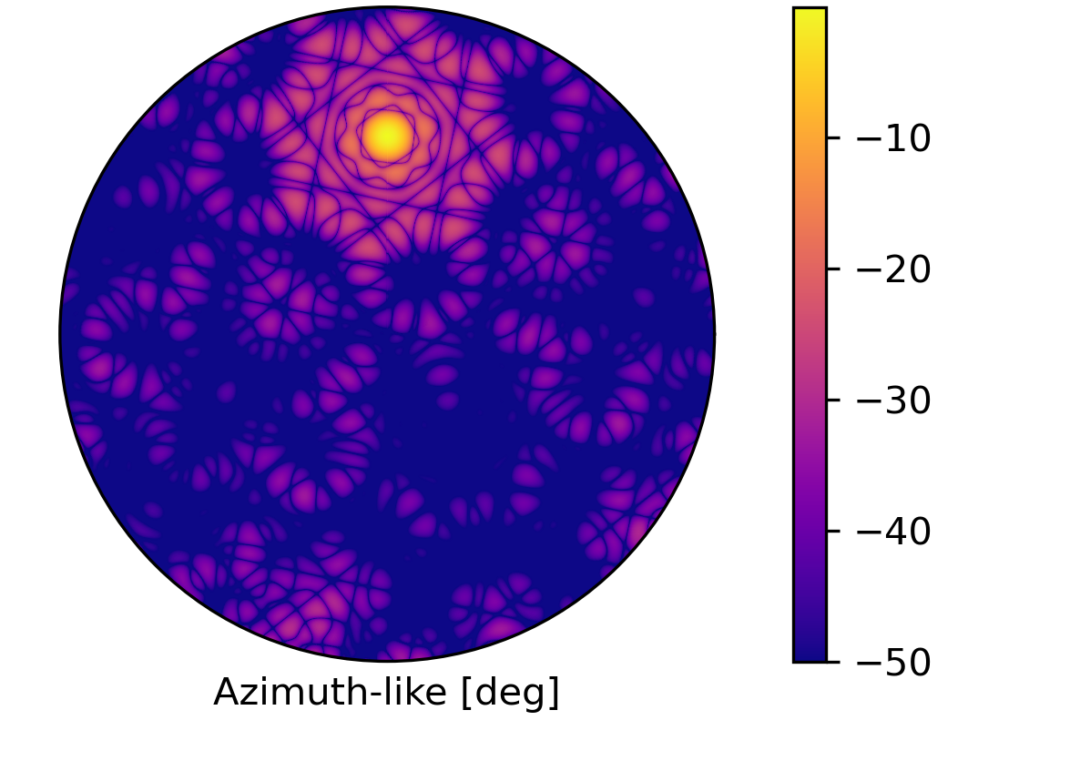
Beams in 4D
Phase center
2x spatial
Temporal
Spectral
Voltage-beam (dB)
CS002HBA0 – CS101HBA0 1.1km
*array factor only: assumes omnidirectional elements at the lowest level

Slide 9
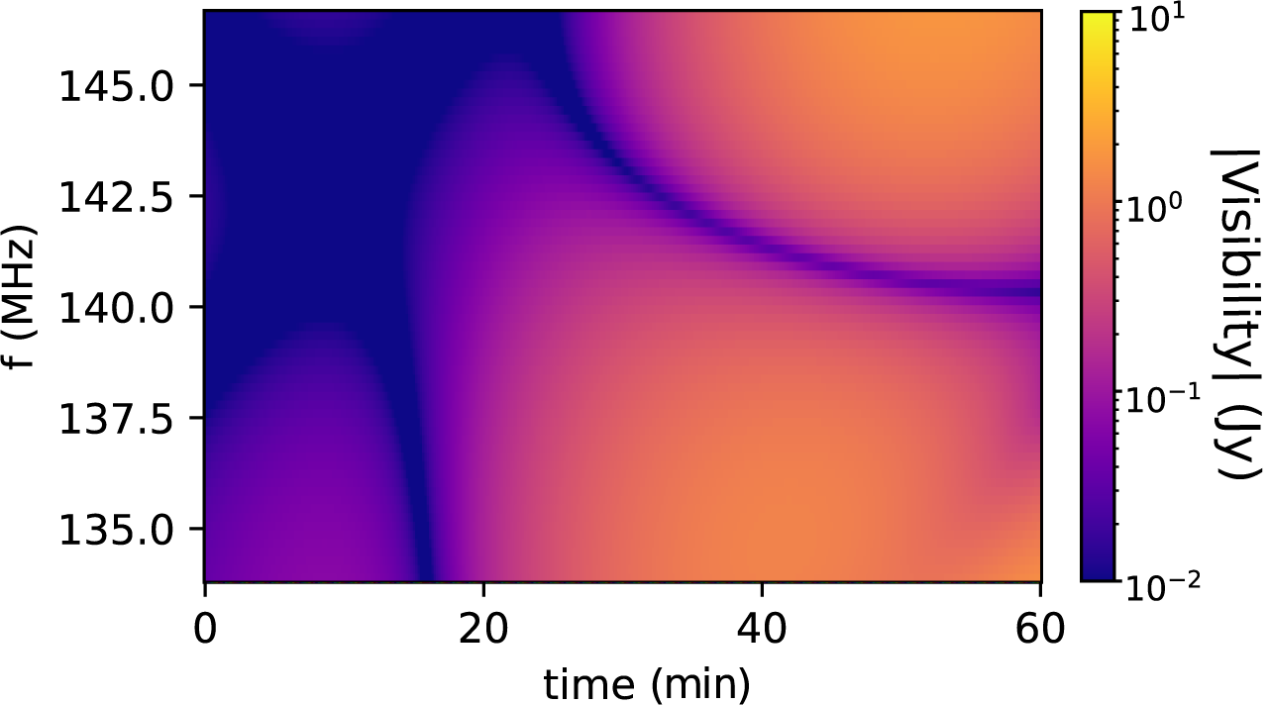
Beams in 4D
2x spatial
Temporal
Spectral
CS002HBA0 – CS101HBA0 1.1km
π
0
-π
0
Time (min)
60

Slide 10
Current EoR calibration

Slide 11
Calibration
Sky and beam models
Predict in a direction
Sky model with beam on baseline i,j
$$G_{i}={minimize}_{G_{i}} \sum_{i,j}{{\left|V_{i,j}−\sum_{k}{G_{i,k}M_{i,j,k}G_{j,k}}\right|}_{F}^{2}}$$

Slide 12
Calibration
Sky and beam models
Predict in a direction
Find gains that minimize the difference between model and data
Sky model with beam on baseline i,j
$$G_{i}={minimize}_{G_{i}} \sum_{i,j}{{\left|V_{i,j}−\sum_{k}{G_{i,k}M_{i,j,k}G_{j,k}^{H}}\right|}_{F}^{2}}$$

Slide 13
Calibration
Sky and beam models
Predict in a direction
Find gains that minimize the difference between model and data
Sky model with beam on baseline i,j
$$G_{i}={minimize}_{G_{i}} \sum_{i,j}{{\left|V_{i,j}−\sum_{k}{G_{i,k}M_{i,j,k}G_{j,k}^{H}}\right|}_{F}^{2}}$$
Direction-dependent
gains

Slide 14
Calibration
Sky and beam models
Predict in a direction
Find gains that minimize the difference between model and data
Sky model with beam on baseline i,j
$$G_{i}={minimize}_{G_{i}} \sum_{i,j}{{\left|V_{i,j}−\sum_{k}{G_{i,k}M_{i,j,k}G_{j,k}^{H}}\right|}_{F}^{2}}$$
Direction-dependent
gains
directions

Slide 15
Calibration
Sky and beam models
Predict in a direction
Find gains that minimize the difference between model and data
Sky model with beam on baseline i,j
$$G_{i}={minimize}_{G_{i}} \sum_{i,j}{{\left|V_{i,j}−\sum_{k}{G_{i,k}M_{i,j,k}G_{j,k}^{H}}\right|}_{F}^{2}}$$
Measured visibility
Direction-dependent
gains
directions

Slide 16
Calibration
Sky and beam models
Predict in a direction
Find gains that minimize the difference between model and data
Sky model with beam on baseline i,j
$$G_{i}={minimize}_{G_{i}} \sum_{i,j}{{\left|V_{i,j}−\sum_{k}{G_{i,k}M_{i,j,k}G_{j,k}^{H}}\right|}_{F}^{2}}$$
$$subject to spectral smoothness$$
DDECal: smoothing kernel
SAGECal: polynomial basis
Measured visibility
Direction-dependent
gains
directions

Slide 17
Beam unmodelled
We predict without the beam (computationally cheaper)
➡ Large errors near the nulls
= not calibrating in this direction anymore

Slide 18
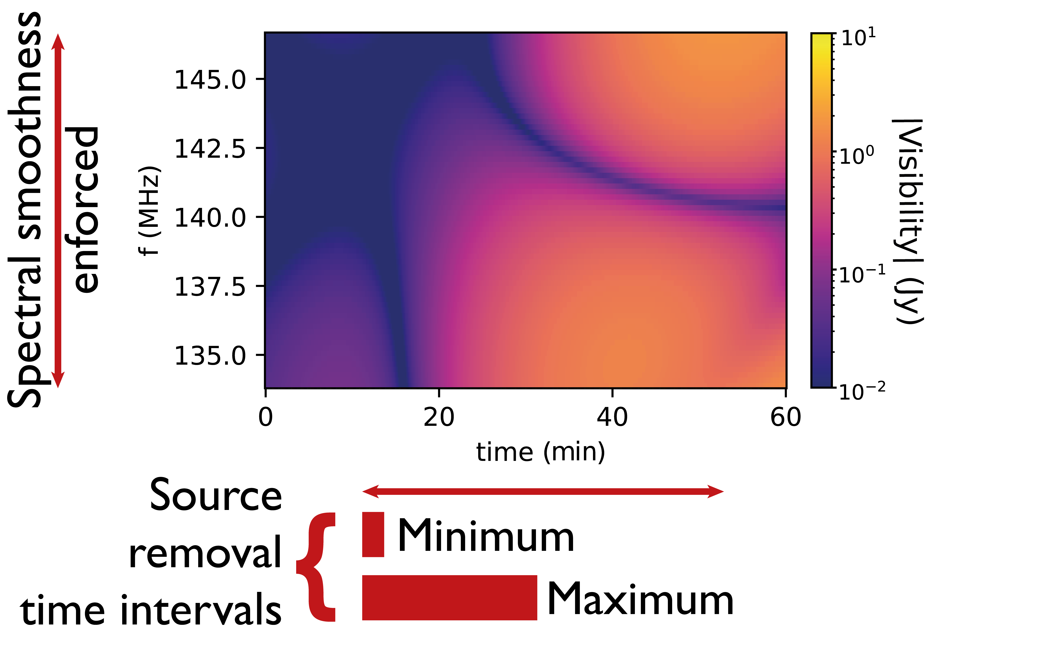
Beam unmodelled
This is not effective in the far field!

Slide 19
Far-field spectral smoothing with a perfect beam model

Slide 20
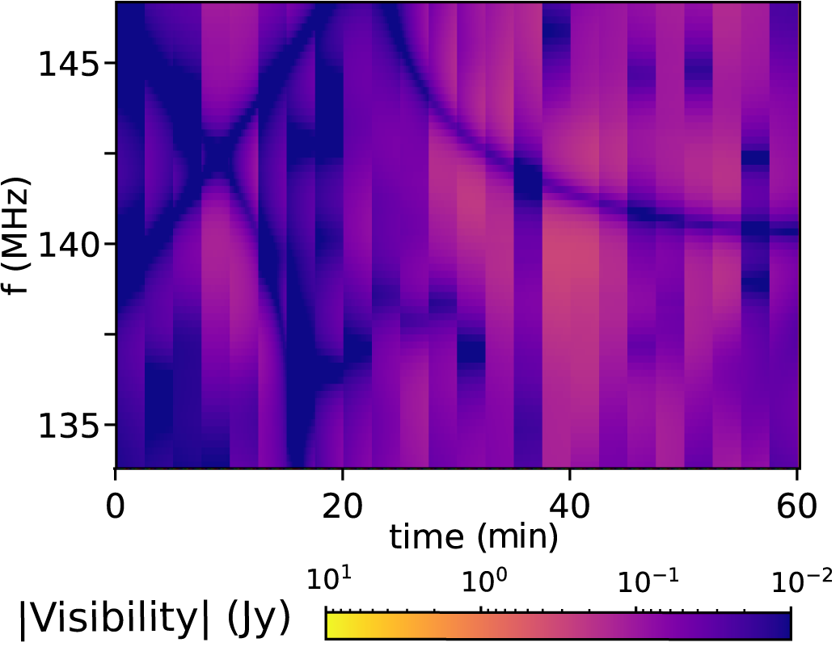
Perfect beam model
Even if we can fully model the beam, we need to be careful about smoothing the solutions
Prediction of Cas A
Residual
Predict Cas A + NCP
Add thermal noise
Calibrate DD ➡ gains
Take noiseless prediction of Cas A (left) and subtract with gains

Slide 21
Perfect beam model
Even if we can fully model the beam, we need to be careful about smoothing the solutions
Prediction of Cas A
Residual

Slide 22
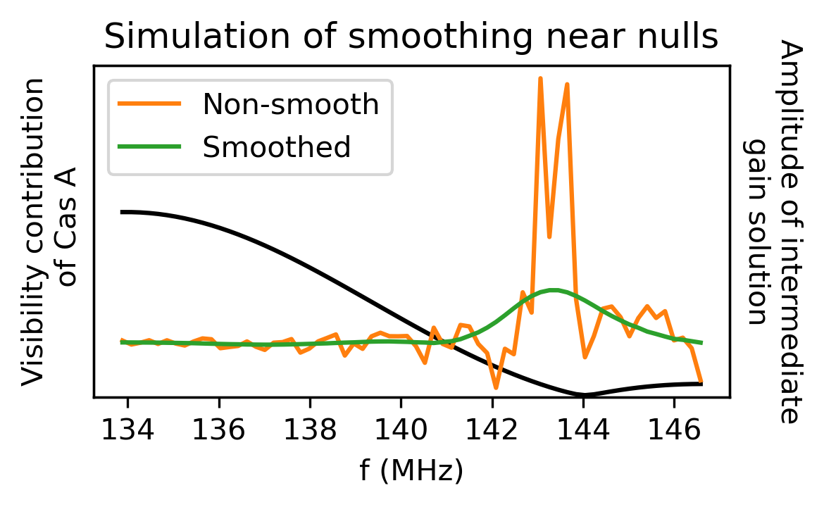
Perfect beam model
cartoon
Forward prediction very weak at null

Slide 23
Perfect beam model
cartoon
Weight with forward prediction
Forward prediction very weak at null

Slide 24
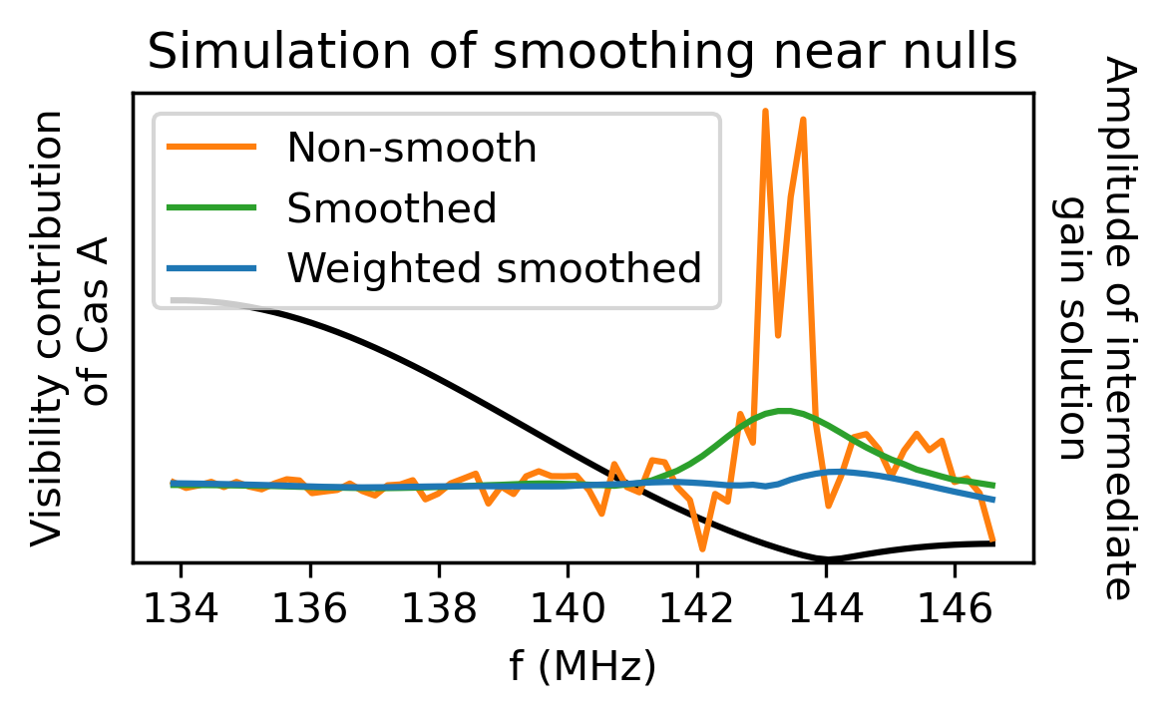
Perfect beam model
Weight with forward prediction

Slide 25
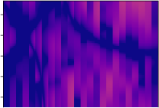
Perfect beam model
Even if we can fully model the beam, we need to be careful about smoothing the solutions
Residual
Reweighted smoothing

Slide 26
Perfect beam model
Future work: test this with beam errors
Residual
Reweighted smoothing

Slide 27
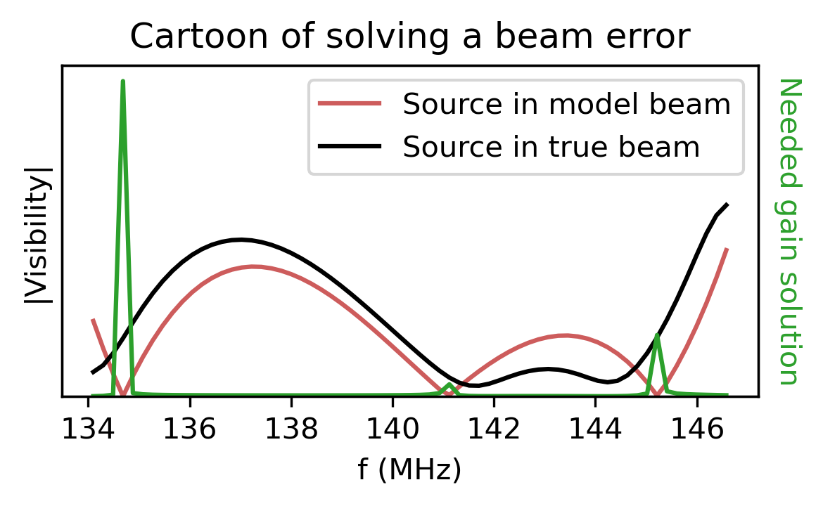
Beam errors
cartoons

Slide 28
Primary beam errors

Slide 29
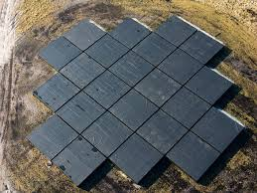
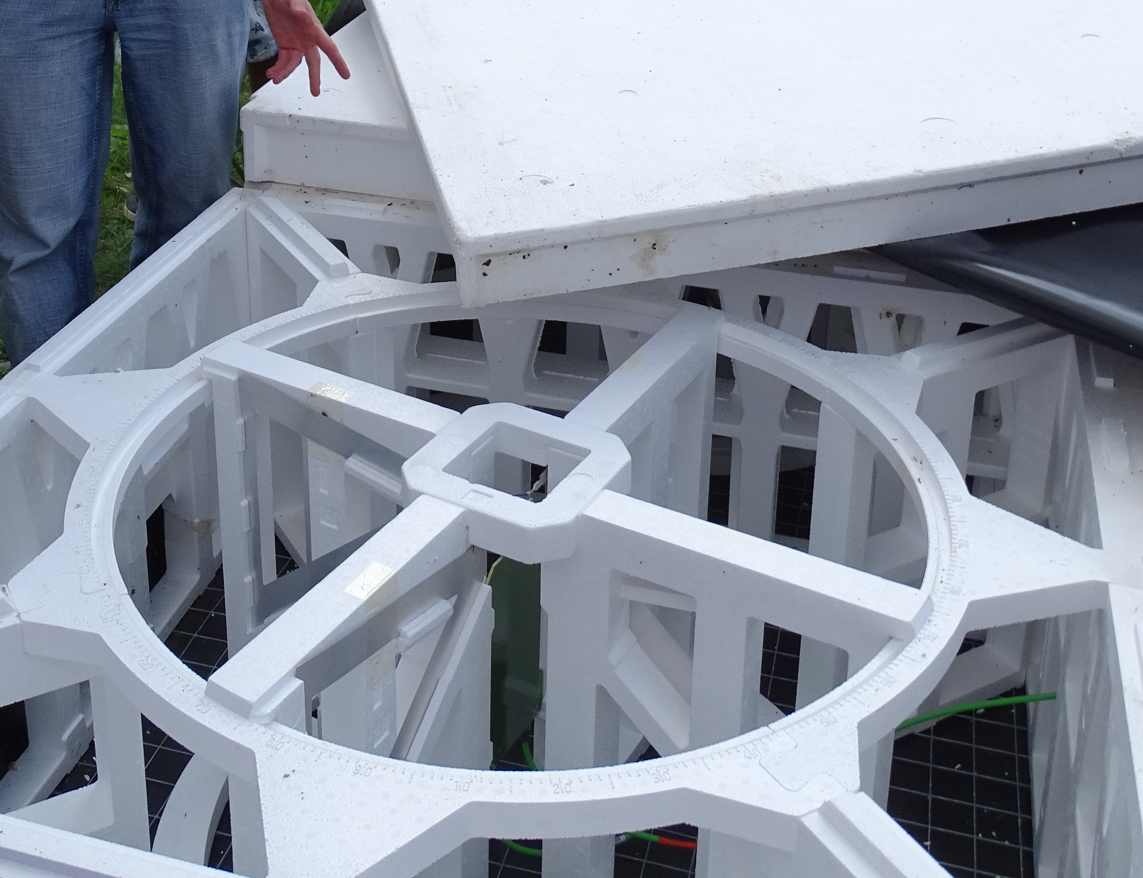
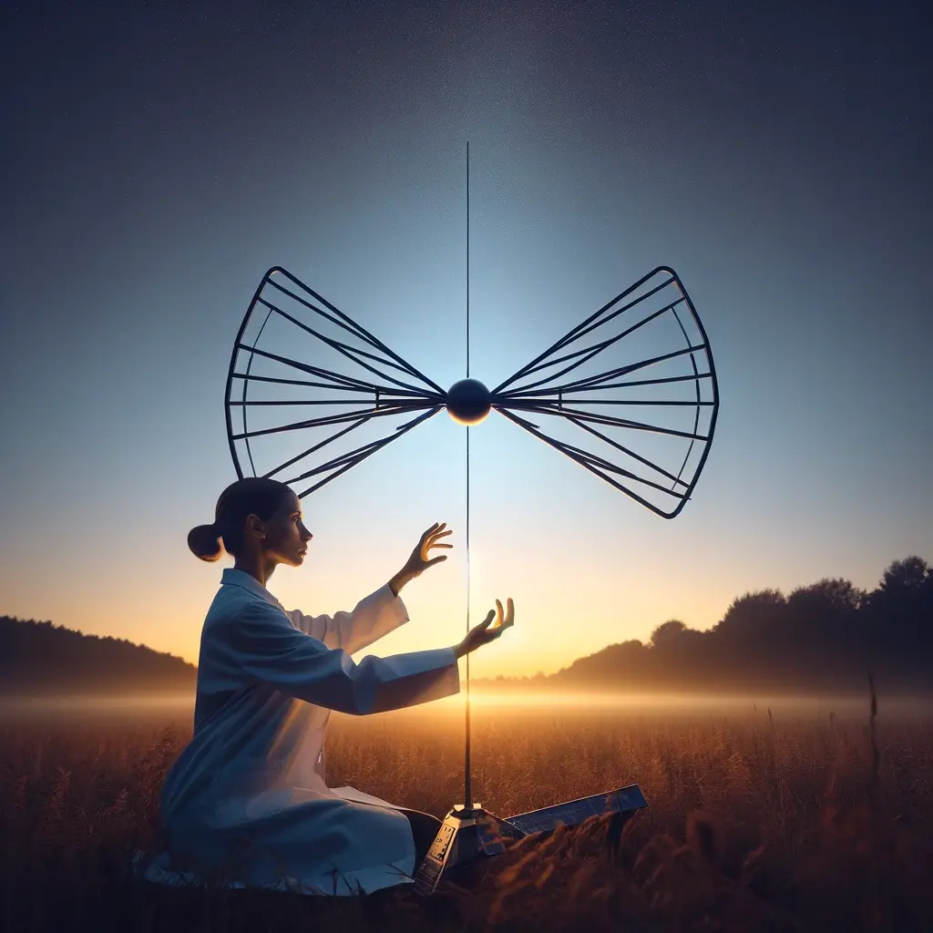
LOFAR beams

Slide 30
LOFAR beams

Slide 31
Missing tiles (implemented)
Spatial Change
Altered beam
Original beam

Slide 32
Missing dipoles (not implemented)
Spatial Change
Altered beam
Original beam

Slide 33
Dipole gain variation (not implemented)
Spatial Change
Altered beam
Original beam

Slide 34
Future Work

Slide 35
Altered spectral smoothness constraint
Far field sources must allow non-smoothness in their regularized solutions
DDECal: reweight the smoothing kernel
SAGECal: different basis near nulls
Easy to implement
Fits naturally in existing pipeline
Expertise exists
Only works for high S/N ratio
More degrees of freedom needed
2x spatial
Temporal
Spectral

Slide 36
Fitting the station beam
Allow for variations of the elements within a station to fit the station beam directly
Slowly varying direction-dependent gains result from this
Based on physics
Theoretically able to describe all directions (also fainter sources)
May remove need for (high number of) solution intervals and calibration directions
Entirely new technique (may not work)
Requires many degrees of freedom to calibrate station
2x spatial
Temporal
Spectral

Slide 37
Summary & Future work

Slide 38
Issues with beams in calibration
We cannot model nulls/rapidly varying lobes far from the phase center well in our current calibration strategy
Changes within a solution interval
Changes on spectral scales << smoothness scale
Changes on spatial scales smaller than a cluster
For bright clusters, we can alter the regularization
For the full problem, we would need to fit the station beam

Slide 39
Supplements

Slide 40
Beams in calibration
Dipole
Can not model all station beams fully
In-situ spatiotemporal variations, mutual coupling, manufacturing variations etc.
Both Sagecal and DDECal contain:
Dipole beam (EM simulated model)
Array factor of all dipoles
Tile flagging
Option to calibrate on a station level
Neither have:
Full array EM simulation (not feasible)
Discrete analogue beamformer
Intra-tile flagging
Option to calibrate on a lower level
Tile array factor
Station array factor

Slide 41
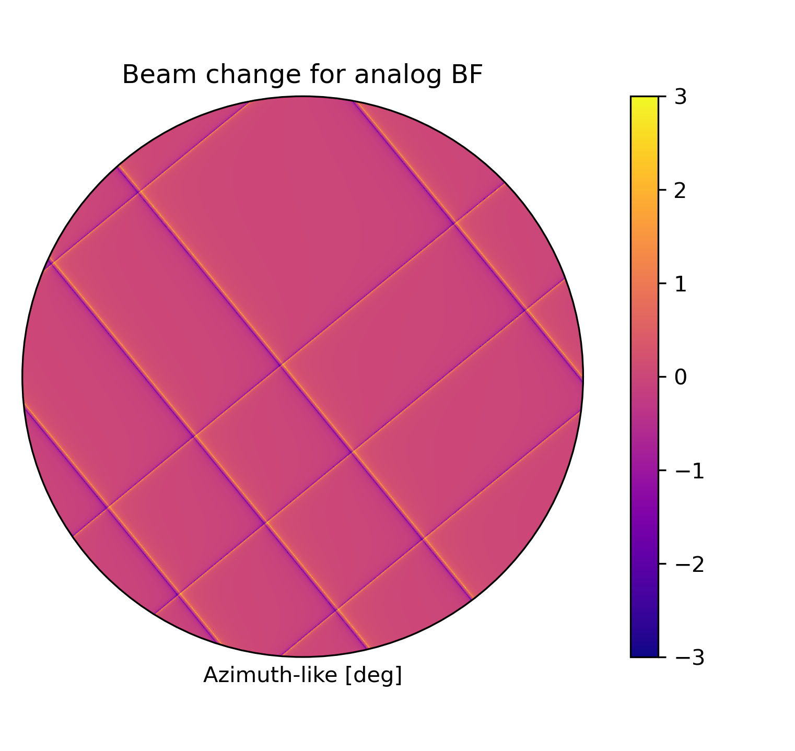
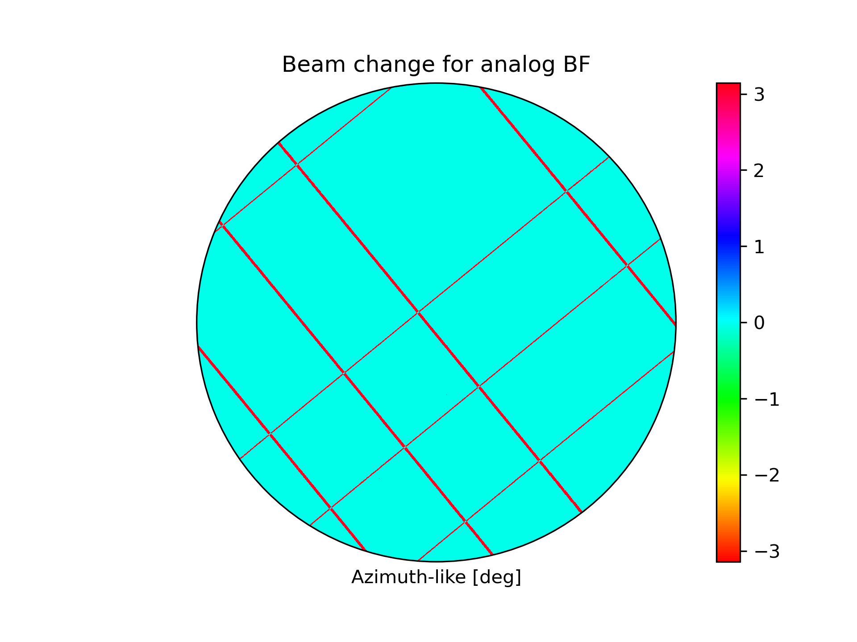
The issue with modelling the beam
A small error can move a null / grating lobe significantly
Analogue tile beamformer
Voltage-beam amplitude ratio (dB)
Voltage-beam phase difference (rad)

Slide 42
Smoothing tests DDEcal
Ook met beam error

Slide 43
Better model!
Temperature drift [ref]
Elements breaking
Discrete steering
Higher order effects (mutual coupling, manufactoring variation etc)

Slide 44
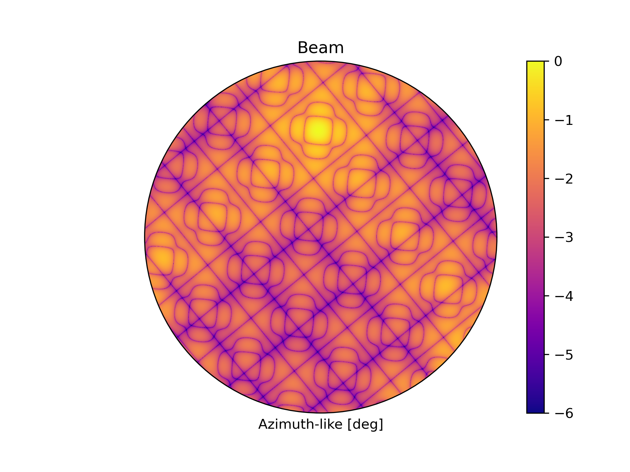
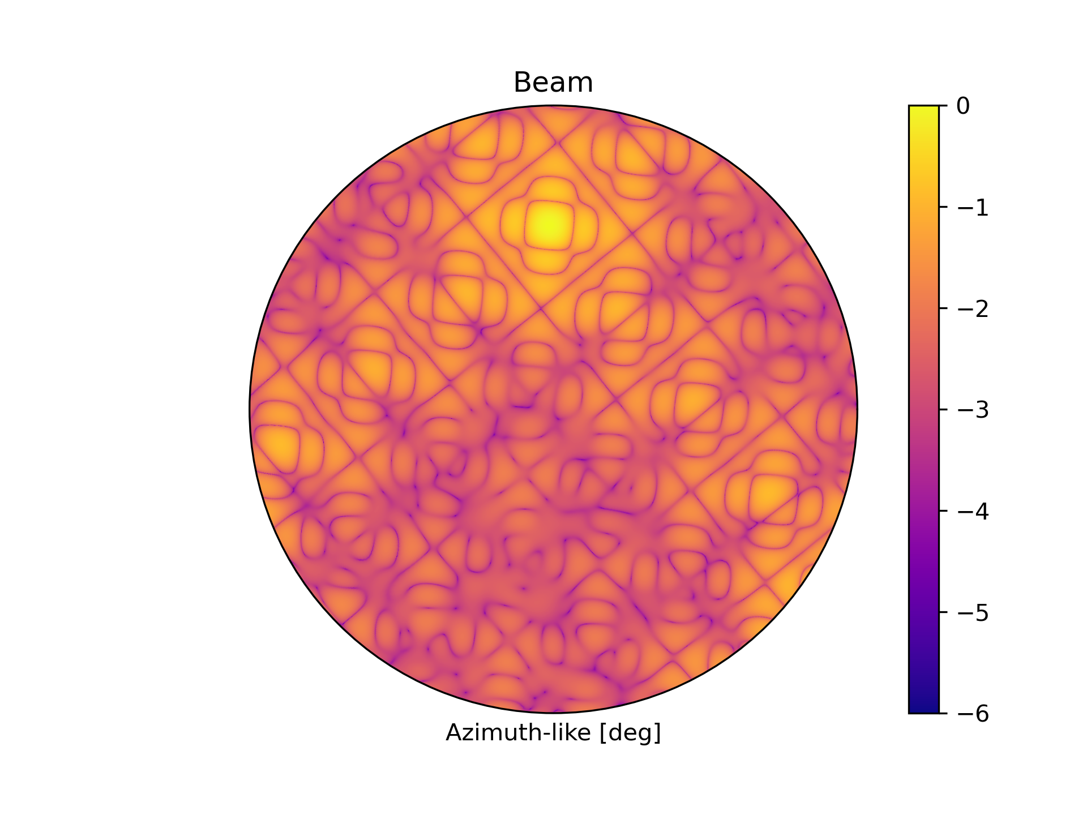
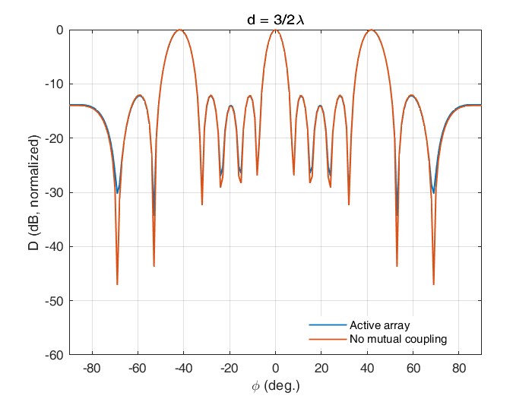
Displacing nulls
Exact model placement
σ=1 cm placement errors
A small error can move a null significantly
A null moving has 2 effects
A null in data but not in model
A null in model but not in data
A real beam will always be more smooth than a model beam
Real array less regular → helps with data nulls
Worry on model side
Linear dipole array

Slide 45
Reweighted smoothing
Beam error

Slide 46
Reweighted smoothing
Perfect beam match

Slide 47
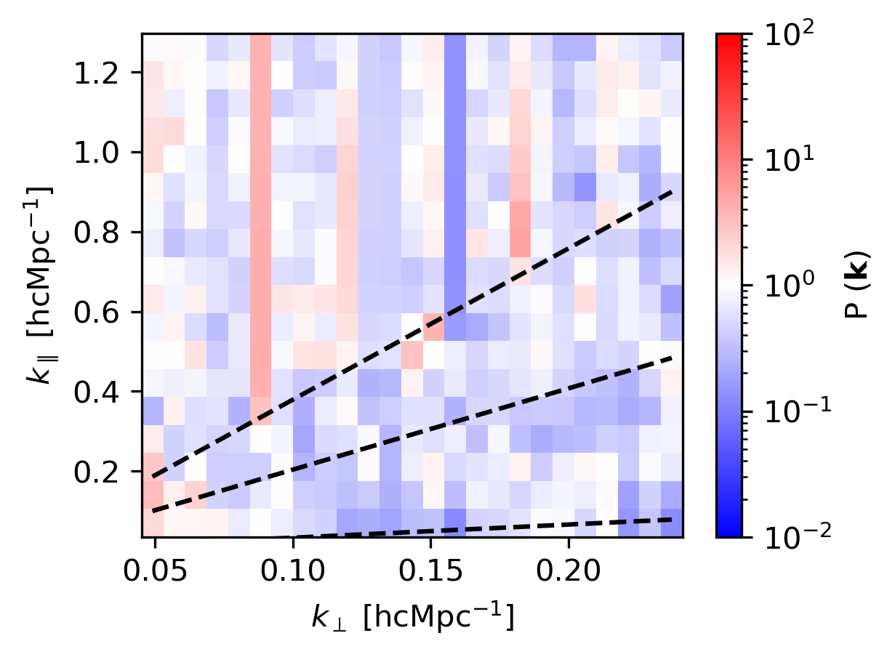
Reweighted smoothing
Perfect beam match

