Slide 1
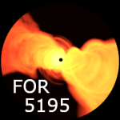
High-resolution low-frequency probes of X-ray emitting knots in blazar jets
Clues on High-Energy Emission from Low-Frequency Radio Observations
Hrishikesh Shetgaonkar
Etienne Bonnassieux , Matthias Kadler, Marcus Brüggen
LOFAR Family Leiden 07th June 2024
Notes:
Good Morning. Hello everyone
I'm hrishi, PhD student from Wü in the Kadler working group. I going provide a status update talk about the work we are doing here…
Studying high energy astrophysics at low frequencies…
So last two years have been about answering two main questions… What, Why and how. And that’s along with some new exiting results, going to be the simple outline of my talk
Supervised…

Slide 2
Blazars
AGNs where jet is directed towards us
Emit across the electromagnetic spectrum
Relativistic beaming
Very bright and compact core
European Southern Observatory (ESO)
3
Notes:
Jet pointed towards us
Relativistic beaming (Doppler boosting, or the headlight effect)
Have compact and bright core
How it looks in different frequency

Slide 3
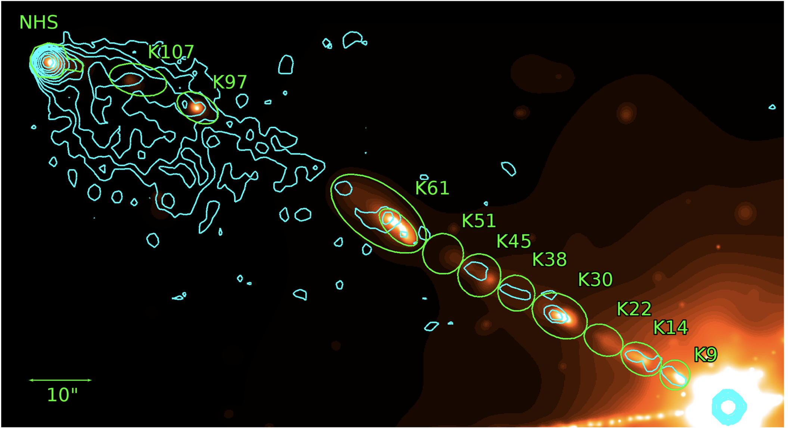
Knots in Jets
Jet is towards us
Compact bright regions in the jet
Detection in X-rays -> emission processes?
Re-acceleration mechanisms?
Inverse scattering -> Photon field?
High angular resolution necessary to separate the knots from core
Imaging at low radio frequencies is a challenge
Low resolution
Ionospheric effects
3C 111 in Chandra X-ray (heat scale), 8 GHz VLA (cyan contours) Clautice et al., (2016)
4
Notes:
In this Chandra image of 3c111, we see bright compact regions… Also seen in VLA
Remain relativistic far from the core. Alternative acceleration mechanisms of the knots
Studying these is necessary to understand the physical properties of relativistic electrons
Challenging-> Low resolution. And ionospheric effects makes calibration difficult. Especially at very long baselines.

Slide 4
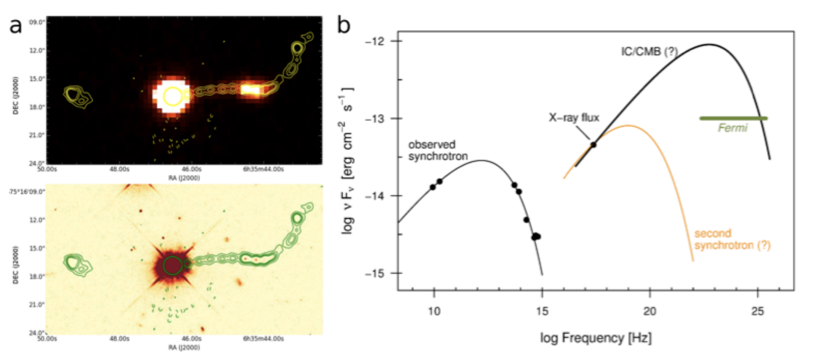
PKS 0637-752 (X-ray)
3’’
PKS 0637-752 (Optical)
3’’
Left: PKS 0637-752 in X-ray (top), optical (bottom) with 17 GHz radio contours
Right: Radio to X-ray SED
Perlman et al. (2019)
5
Notes:
A Different source… In the X-ray image on the top and optical image on the bottom, we see the knots
How are these low frequency emissions connected to high energy x-ray and gamma ray emissions?
Multi wavelength SED modelling is needed to test and constrain different models
Models like IC/CMB, SSC… This will enable us to understand the physical properties e` in these knots in the jets better.
This emission, over an order of magnitude brighter than an extrapolation of the radio continuum,
ATCA 17GHz

Slide 5
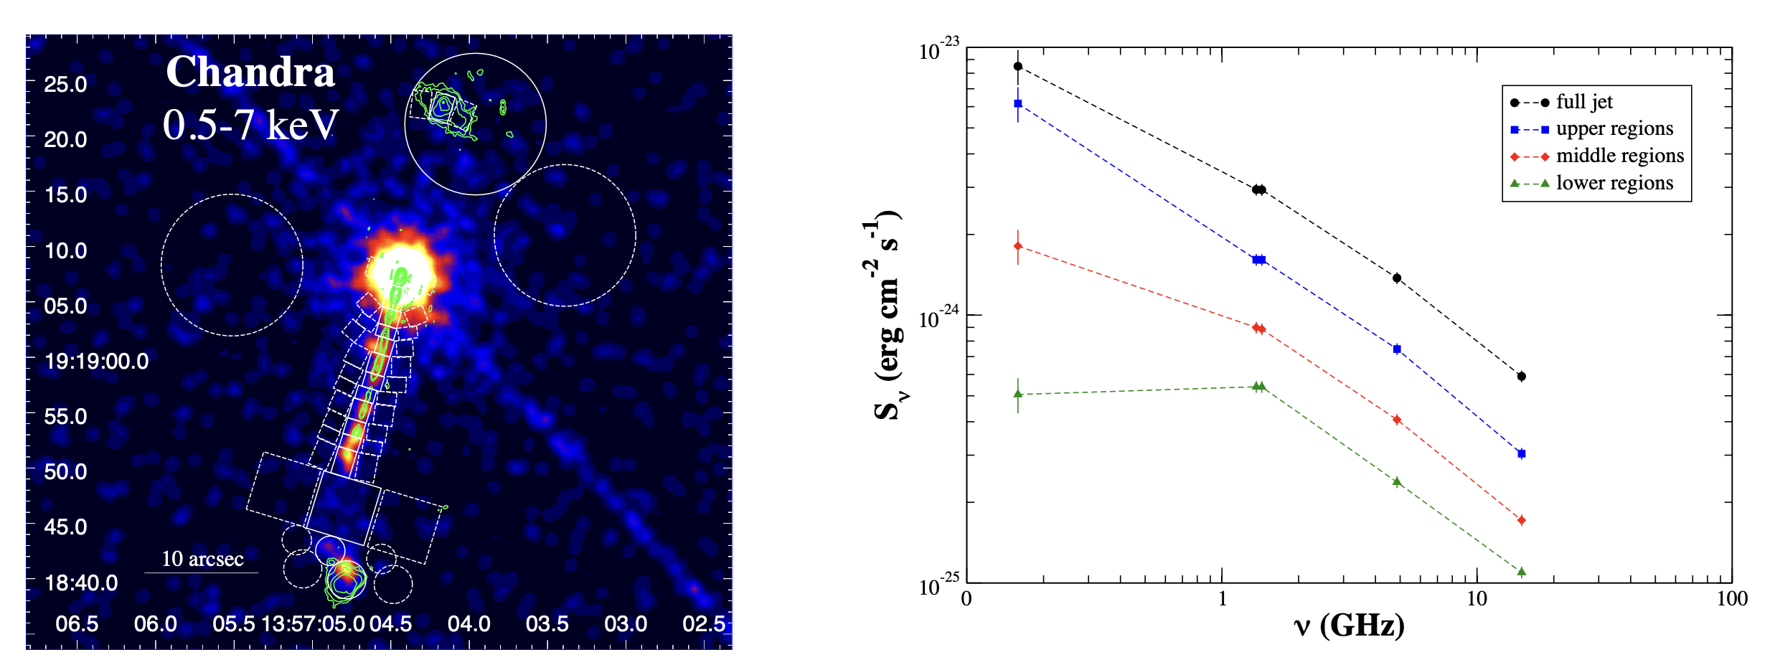
Why LOFAR-VLBI?
Without LOFAR
With LOFAR!
Left : 4C +19.44 in Chandra X-Ray with LOFAR radio contours overlaid
Right: MHz to GHz radio spectra of the jet.
Adapted from Harris et al., (2019)
6
Notes:
Talk about regions.
No LOFAR: Spectral properties for all regions looks same.
With lofar, Whole new parameter space where: low unexplored radio regime and high angular resolution
the radio flux densities measured at hundreds of MHz lie well below the values estimated by extrapolating the GHz spectra. This clearly indicates the presence of spectral curvature.
Note the low-frequency curvature in the spectra of region farther from the core
Valuable information might be hidden in the new previously unexplored regime.
Would not be possible without either: Low Freq(LOFAR) and High angular resolution(int stations)
With this, we hope to see the turnover at these previously unexplored low frequencies !
propose to interpret the spectral curvature as due to the intrinsic, curved, spectral shape of the emitting PED when stochastic acceleration mechanisms
as a curved particle energy distribution, rather than absorption mechanisms (Razin–Tsytovich effect, free–free or synchrotron self absorption to name a few)
> 1.36, 1.44, 4.86, 14.96

Slide 6
Why LOFAR-VLBI?
With LOFAR!
Left : 4C +19.44 in Chandra X-Ray with LOFAR radio contours overlaid
Right: MHz to GHz radio spectra of the jet.
Adapted from Harris et al., (2019)
6
Notes:
Would not be possible without either: Low Freq(LOFAR) and High angular resolution(int stations)
With this, we hope to see the turnover at these previously unexplored low frequencies !
propose to interpret the spectral curvature as due to the intrinsic, curved, spectral shape of the emitting PED when stochastic acceleration mechanisms
as a curved particle energy distribution, rather than absorption mechanisms (Razin–Tsytovich effect, free–free or synchrotron self absorption to name a few)
Breaking the technological barriers
> 1.36, 1.44, 4.86, 14.96

Slide 7
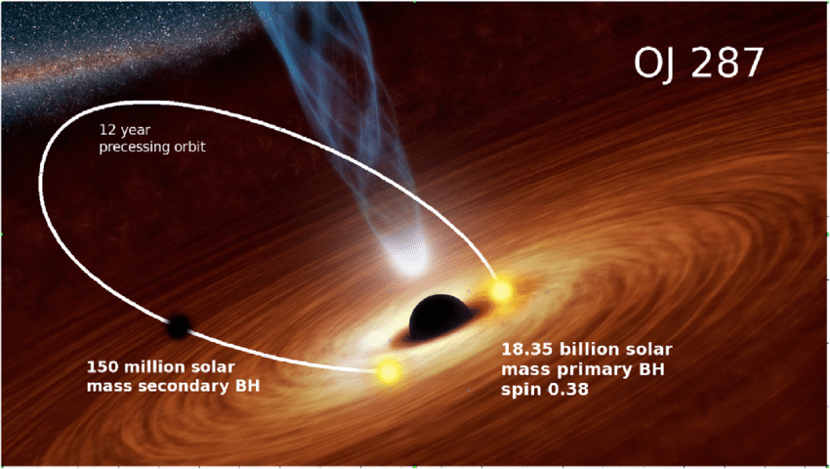
Pilot Dataset
Target: OJ287
4 hour observation
13 June 2019
13 international stations
5 TB of data!
PI: Sean Mooney
Artist impression
https://www.scientificeuropean.co.uk/sciences/space/flares-from-the-supermassive-binary-black-hole-oj-287-put-constraint-on-the-no-hair-theorem/
7
Notes:
BL Lac, Binary blackholes,
Good test bed for gravitational physics
Shows knots in x-ray and radio as well
Also because previously studied by Sean Mooney in his PhD. So the perfect target for us to start and check our processing and pipeline setup. And verify our setup

Slide 8
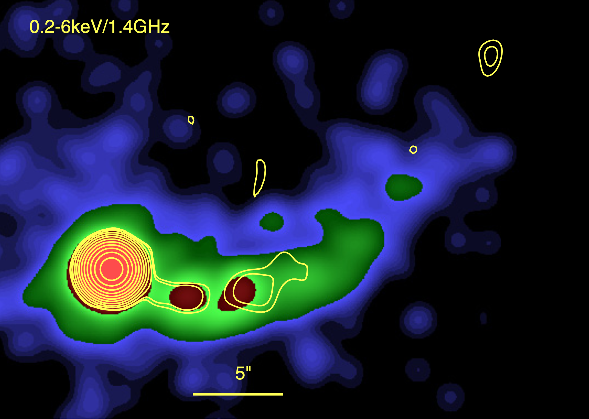
Pilot Dataset
Target: OJ287
4 hour observation
13 June 2019
13 international stations
5 TB of data!
PI: Sean Mooney
OJ287 in Chandra X-ray with VLA contours (Convolved with gaussian having FWHM=1.5’’) Marscher, A.P., Jorstad, S.G. (2011)
7
Notes:
Shows knots in x-ray and radio as well
Also because previously studied by Sean Mooney in his PhD. So the perfect target for us to start and check our processing and pipeline setup
> Spend time and explain morphology.

Slide 9
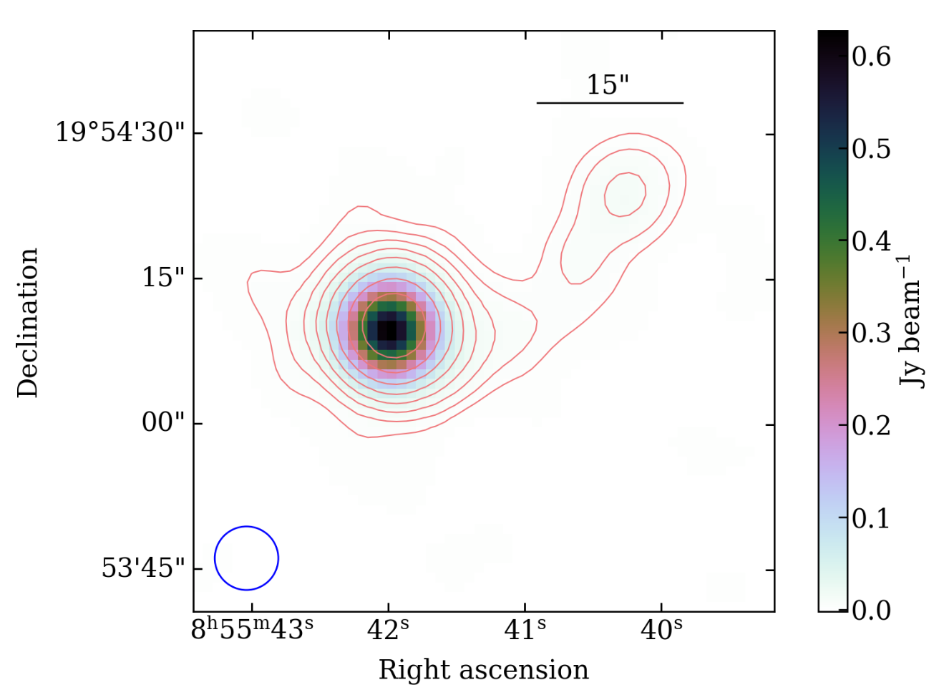
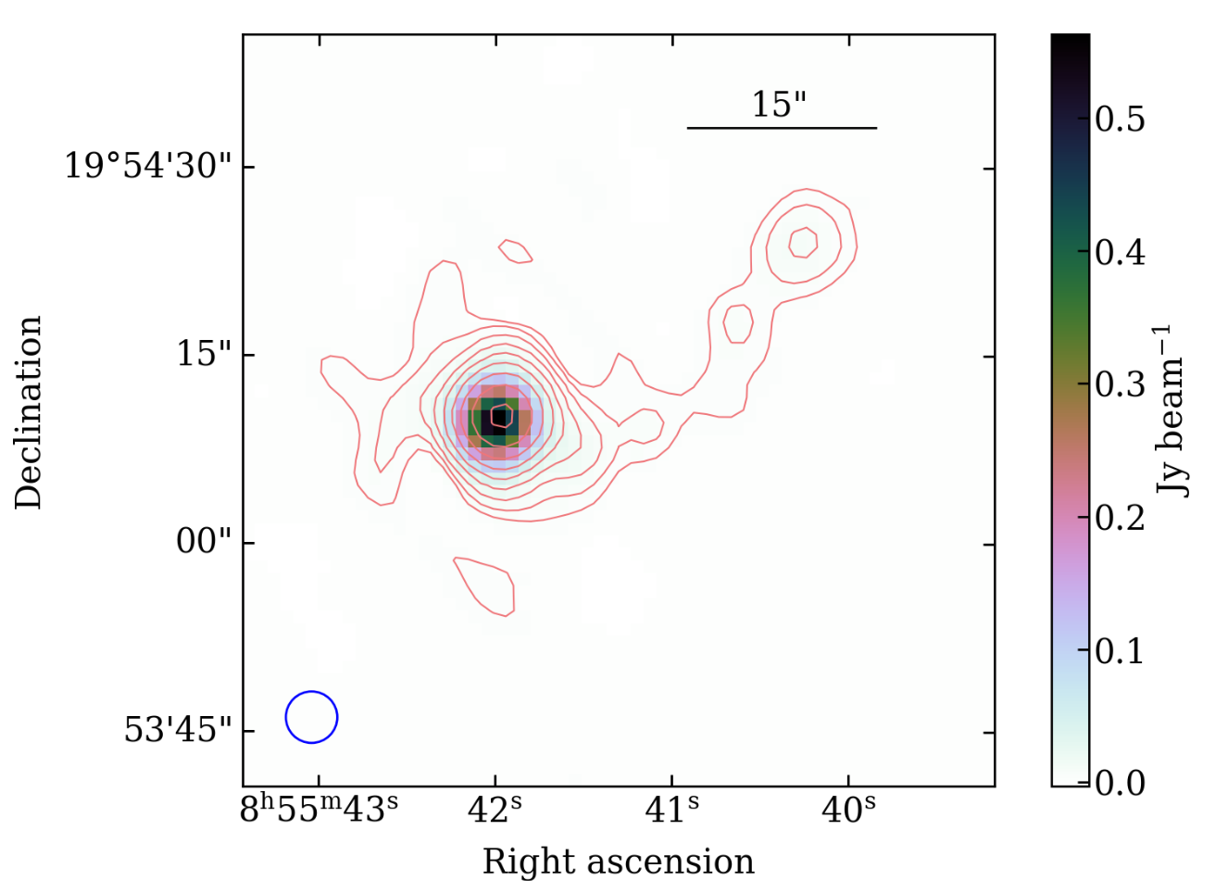
Previous work
OJ287 imaged with LOFAR at 6” (left) and at 4” (right) Mooney S. PhD Thesis (2020)
7
Notes:
In his work, Sean Mooney saw a similar morphology
Both are LOFAR maps.Contour is at a resolution of 6’’.
Higher resolution image with international station shows what appears to be the first knot but no jet structure.
Lets see what the data holds for us when tackle this imaging challenges with newer /better tools

Slide 10
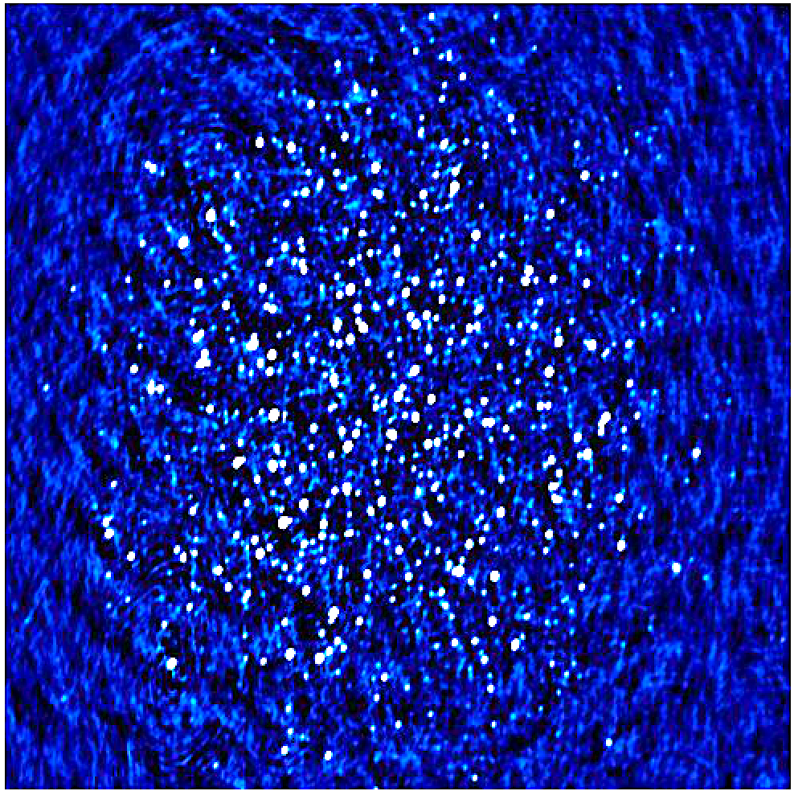
LOFAR Initial Calibration (LINC) Pipeline
Calibrator and Target Pipeline
Self Calibration
Only Core and Remote stations No International stations
Field Subtraction
“Stay on target!”
- Gold Five
VLBI Self Calibration
With International Stations
(9.7° x 9.7°)
8
Notes:
Trying different parameters and Preparing recipe! Using individual components DDF and kMS so that it’s learning for me instead of using the VLBI pipeline
Just on one sub-band
Talk about LINC pipeline
Se artilects… Scope for furthercalibration

Slide 11
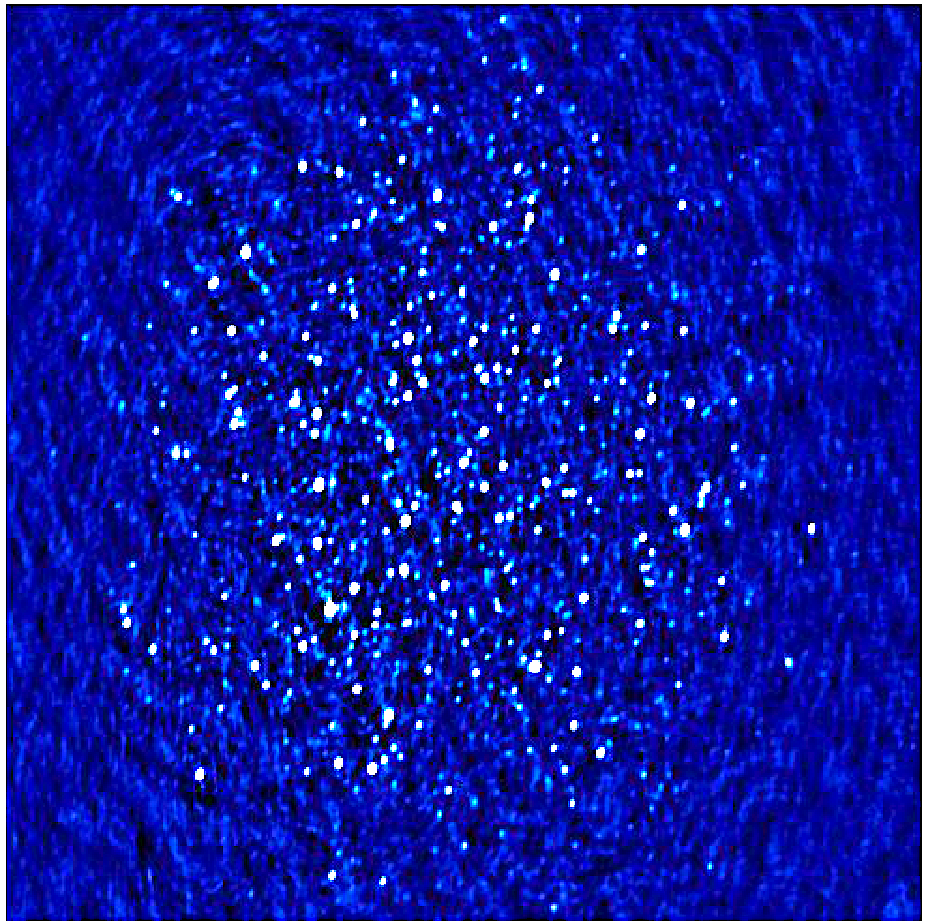
LOFAR Initial Calibration (LINC) Pipeline
Calibrator and Target Pipeline
Self Calibration
Only Core and Remote stations No International stations
Field Subtraction
“Stay on target!”
- Gold Five
VLBI Self Calibration
With International Stations
(9.7° x 9.7°)
9
Notes:
P3 Restored

Slide 12
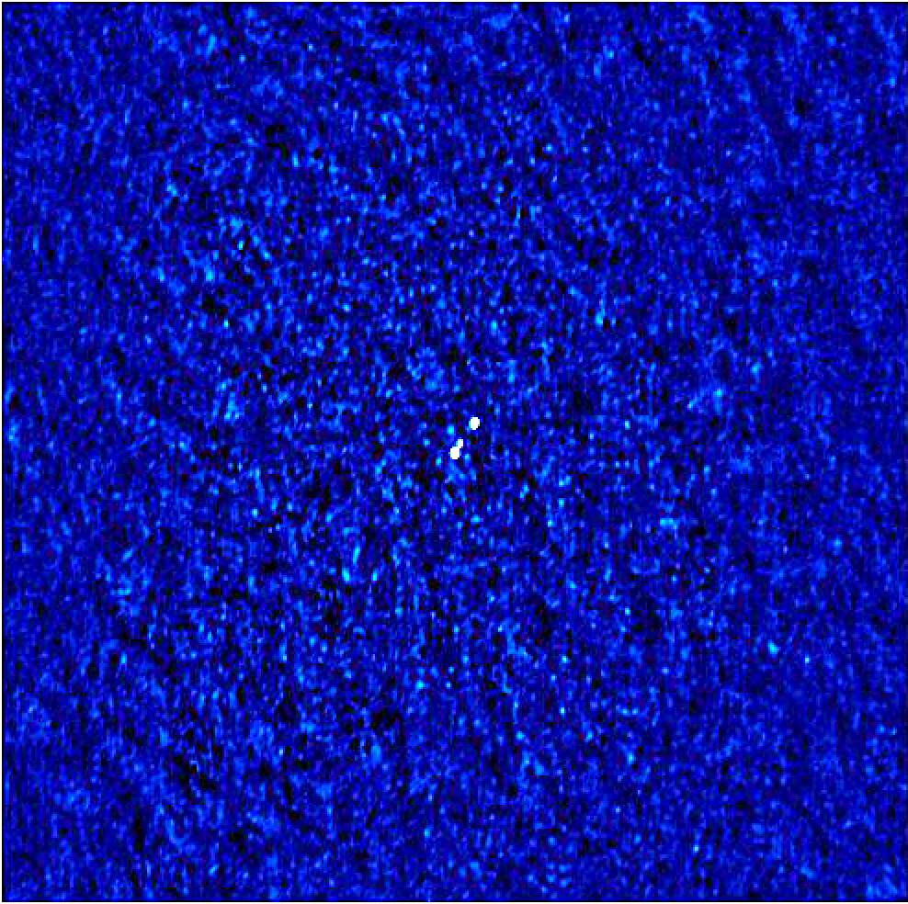
LOFAR Initial Calibration (LINC) Pipeline
Calibrator and Target Pipeline
Self Calibration
Only Core and Remote stations No International stations
Field Subtraction
“Stay on target!”
- Gold Five
VLBI Self Calibration
With International Stations
(9.7° x 9.7°)
10
Notes:
P0 target (40arcmin x 40arcmin) (~0.66deg)

Slide 13
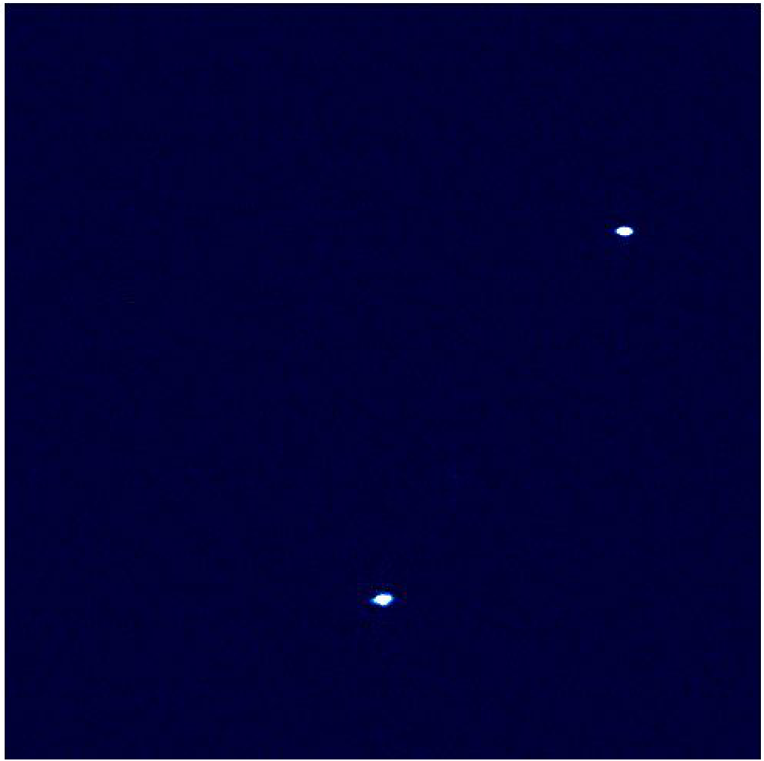
LOFAR Initial Calibration (LINC) Pipeline
Calibrator and Target Pipeline
Self Calibration
Only Core and Remote stations No International stations
Field Subtraction
“Stay on target!”
- Gold Five
VLBI Self Calibration
With International Stations
(0.66° x 0.66°)
11
Notes:
P0 target zoomed

Slide 14
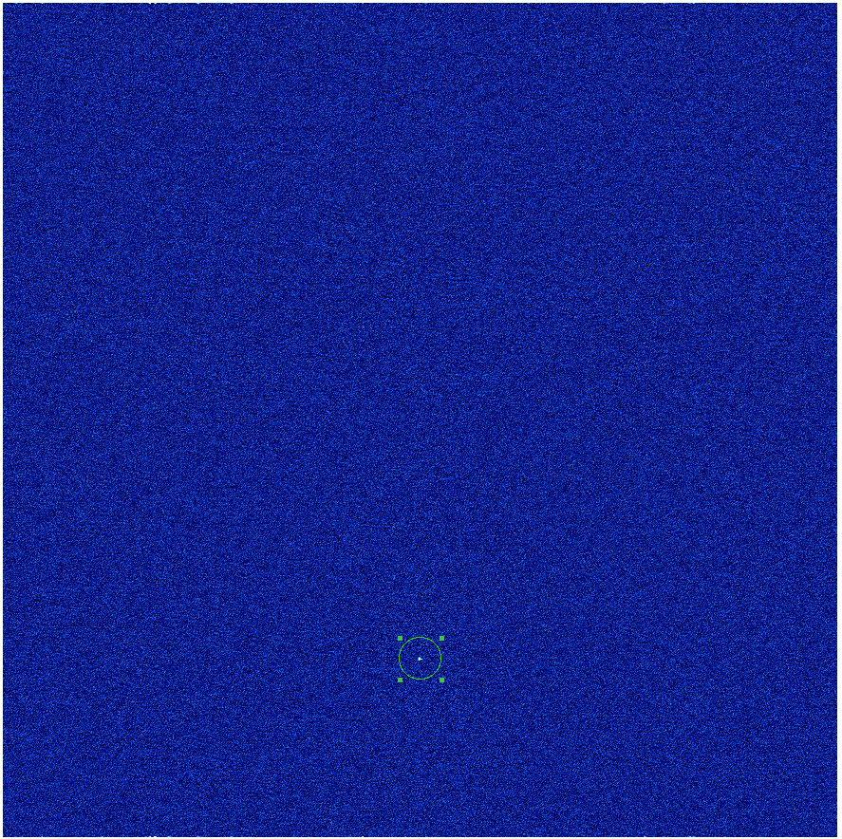
LOFAR Initial Calibration (LINC) Pipeline
Calibrator and Target Pipeline
Self Calibration
Only Core and Remote stations No International stations
Field Subtraction
“Stay on target!”
- Gold Five
VLBI Self Calibration
With International Stations
(0.66° x 0.66°)
12
Notes:
Just after one pass of amp and phase self cal…

Slide 15
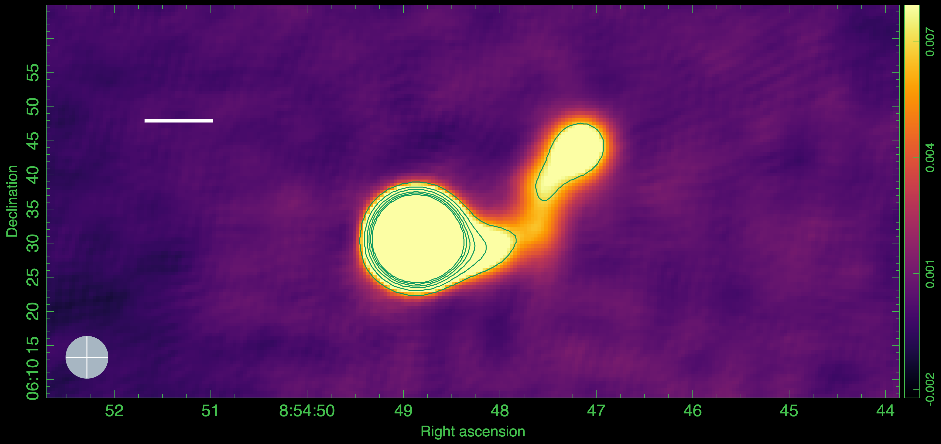
LOFAR (Restoring Beam: 6’’)
10”
13
Notes:
Image at 6 arcsec. Let’s compare it with the Chandra x-ray image from Marcherand Josrtad
6” -> 4.026e-4 Jy/beam
1.5 -> 1.238870902688e-4 Jy/beam
0.8 -> 1.100112445666e-4 Jy/beam
0.4-> 7.380971460550e-5 Jy/beam

Slide 16
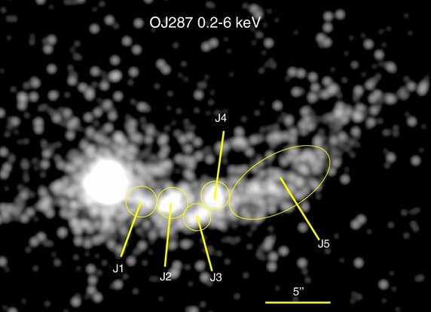
6’’ LOFAR
10”
OJ287 in Chandra X-ray (0.2 – 6keV) (convolved with a Gaussian kernel of FWHM= 0.5’’) Marscher, A.P., Jorstad, S.G. (2011)
13
Notes:
They identified these x-ray knots in jets. But they are not visible in the LOFAR map… Yet. So we zoom in to a resolution of 1.3’’

Slide 17
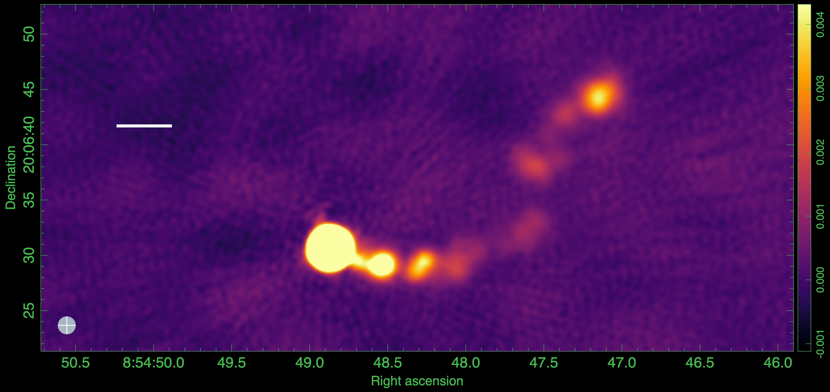
6’’ LOFAR
10”
1.5’’ LOFAR
5”
13

Slide 18
6’’ LOFAR
10”
1.5’’ LOFAR
J8
J7
5”
J6
J3/J4
J5₂
J1
J2
J5₁
13
Notes:
In addition to these 5 knots. We also pick up new emission. We call it J6 and J7. J7 is where VLA GHz is but not detected in x-ray.
J3 and j4 are not resolved. SO let’s zoom in more

Slide 19
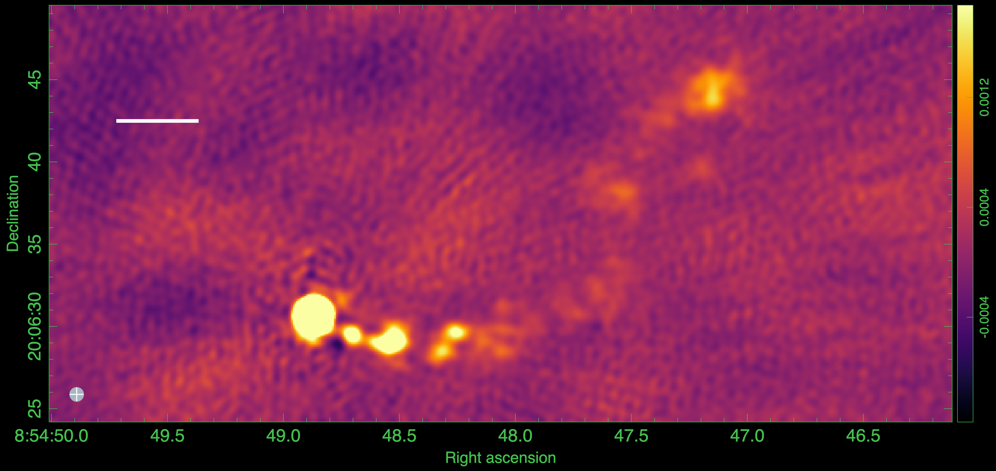
6’’ LOFAR
10”
1.5’’ LOFAR
5”
0.8’’ LOFAR
5”
13

Slide 20
6’’ LOFAR
10”
1.5’’ LOFAR
5”
0.8’’ LOFAR
J8
J7
5”
J6
J4
J5₂
J1
J2
J3
J5₁
13

Slide 21
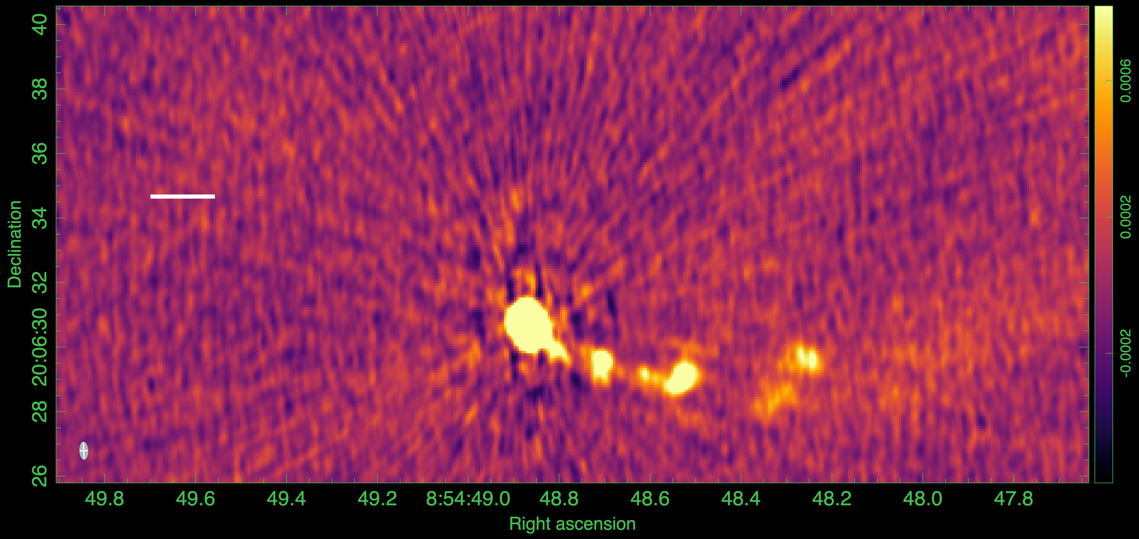
6’’ LOFAR
10”
1.5’’ LOFAR
5”
0.8’’ LOFAR
5”
0.4” LOFAR
2”
13

Slide 22
6’’ LOFAR
10”
1.5’’ LOFAR
5”
0.8’’ LOFAR
5”
0.4” LOFAR
2”
J2₂
J4
J1
J2₁
J3
13

Slide 23
6’’ LOFAR
10”
1.5’’ LOFAR
5”
0.8’’ LOFAR
5”
0.4” LOFAR
2”
13

Slide 24
6’’ LOFAR
10”
1.5’’ LOFAR
5”
0.8’’ LOFAR
5”
0.4” LOFAR
Name | Angular Separation from core | Linear Separation (z=0.3) | De-projected Separation
J1 | 3’’ | 14 kpc | 267 kpc
J2 | 5’’ | 23 kpc | 439 kpc
J3 | 8.3’’ | 38 kpc | 726 kpc
J4 | 9’’ | 42 kpc | 802 kpc
J7 | 30’’ | 140 kpc | 1150 kpc!!!
2”
13

Slide 25
LOFAR(144MHz) – VLA(1.4GHz)
𝛼 = -0.86
𝛼 < -1.41
5”
𝛼 = -0.51
𝛼 = 0.38
𝛼 < -1.19
𝛼 = -0.62
𝛼 = -0.68
$$S_{ν}∝ υ^{α}$$
Notes:
J2 has two structures.
So here, we demonstrate that We can match Chandra x-ray resolution with LOFAR!

Slide 26
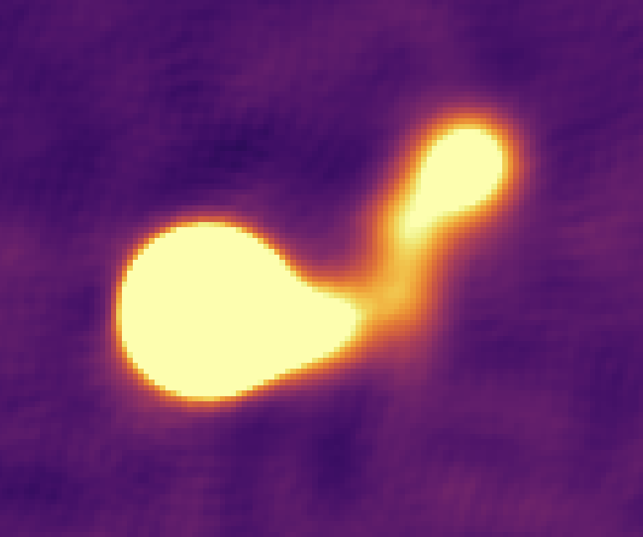
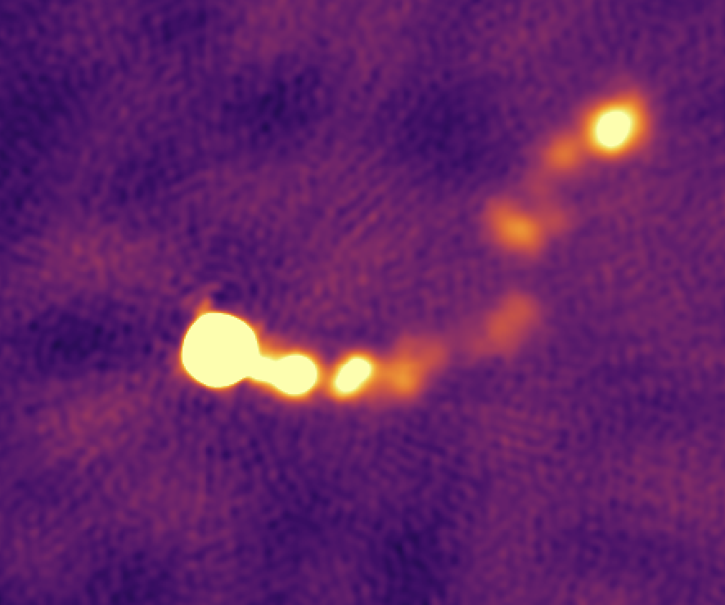
The journey so far…
Set up LINC pipeline
https://git.astron.nl/RD/LINC.git
Set up LOFAR-VLBI pipeline
https://github.com/LOFAR-VLBI/lofar-vlbi-pipeline
Used facet_selfcal script (R. J. van Weeren+ 2016)
https://github.com/rvweeren/lofar_facet_selfcal
‘NeReVar: Net Relative Variances
‘Smart’ re-weighting of gains to reduce artefacts (Bonnassieux+ 2018)
14
Notes:
Downloaded data. Set up the architecture and ETN just set up the VLBI pipeline
Industrial mode
So like spiderman, we are now equipped with these superpower tools!

Slide 27
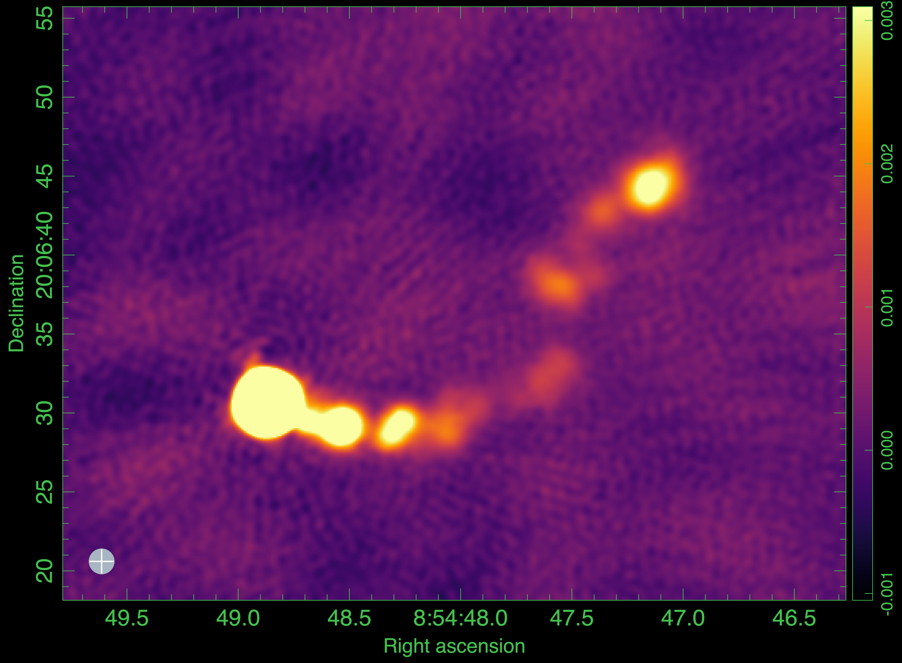
The road ahead…
Image OJ287 archival data at two more epochs
Complement with high-frequency radio, optical and X-ray data
Spectral Energy Distribution (SED) modelling to test models
IC/CMB, SSC, second synchrotron
Repeat the analysis for other X-ray selected blazars!
Fullband LOFAR-VLBI image of OJ287
15
Notes:
Downloaded data. Set up the architecture and setting up the pipeline.
See if there’s a curvature in radio spectrum at low frequencies. Less steep at low? If yes, at what frequency.
How does it connect with the behavior at high energies?
Better understand the physical properties on electrons in the knots in jets of blazars
Get into an industrial production mode
No conclusion slide as my work has just begun… Instead have a future work slide

Slide 28
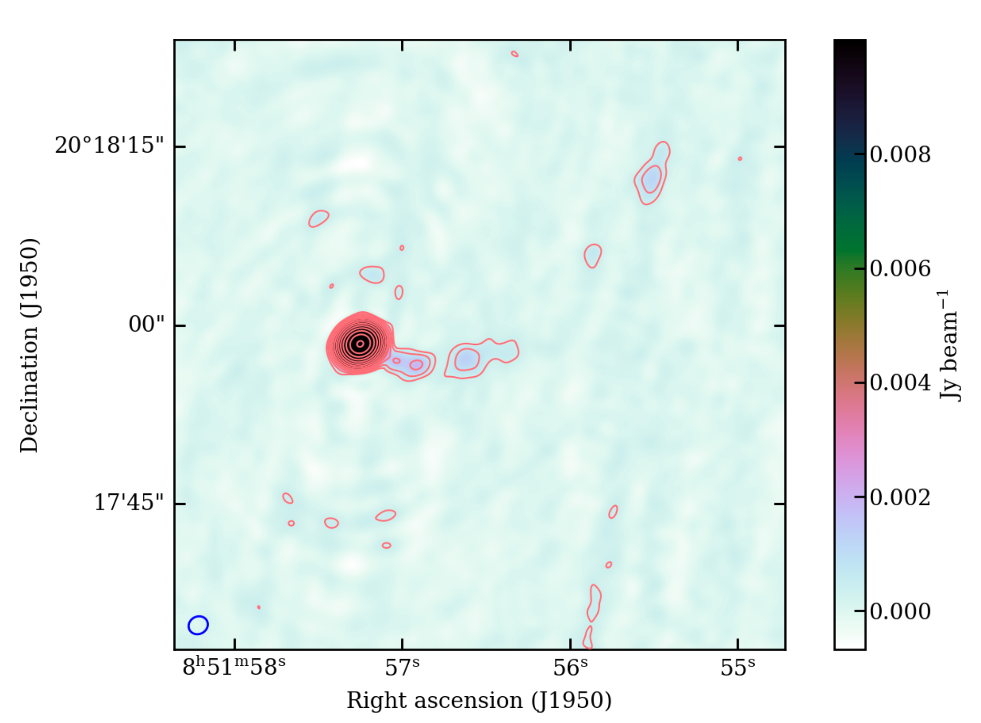
The road ahead…
Image OJ287 archival data at two more epochs
Complement with high-frequency radio, optical and X-ray data
Spectral Energy Distribution (SED) modelling to test models
IC/CMB, SSC, second synchrotron
Repeat the analysis for other X-ray selected blazars!
1.4 GHz VLA image of OJ287 Mooney S. PhD Thesis (2020)
16
Notes:
Downloaded data. Set up the architecture and setting up the pipeline.
See if there’s a curvature in radio spectrum at low frequencies. Less steep at low? If yes, at what frequency.
How does it connect with the behavior at high energies?
Better understand the physical properties on electrons in the knots in jets of blazars
Get into an industrial production mode
No conclusion slide as my work has just begun… Instead have a future work slide

Slide 29
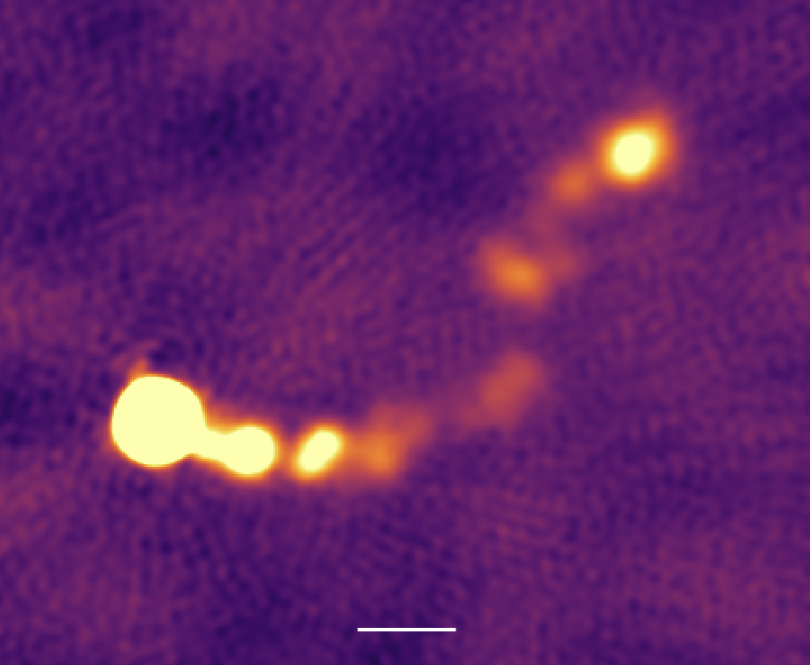
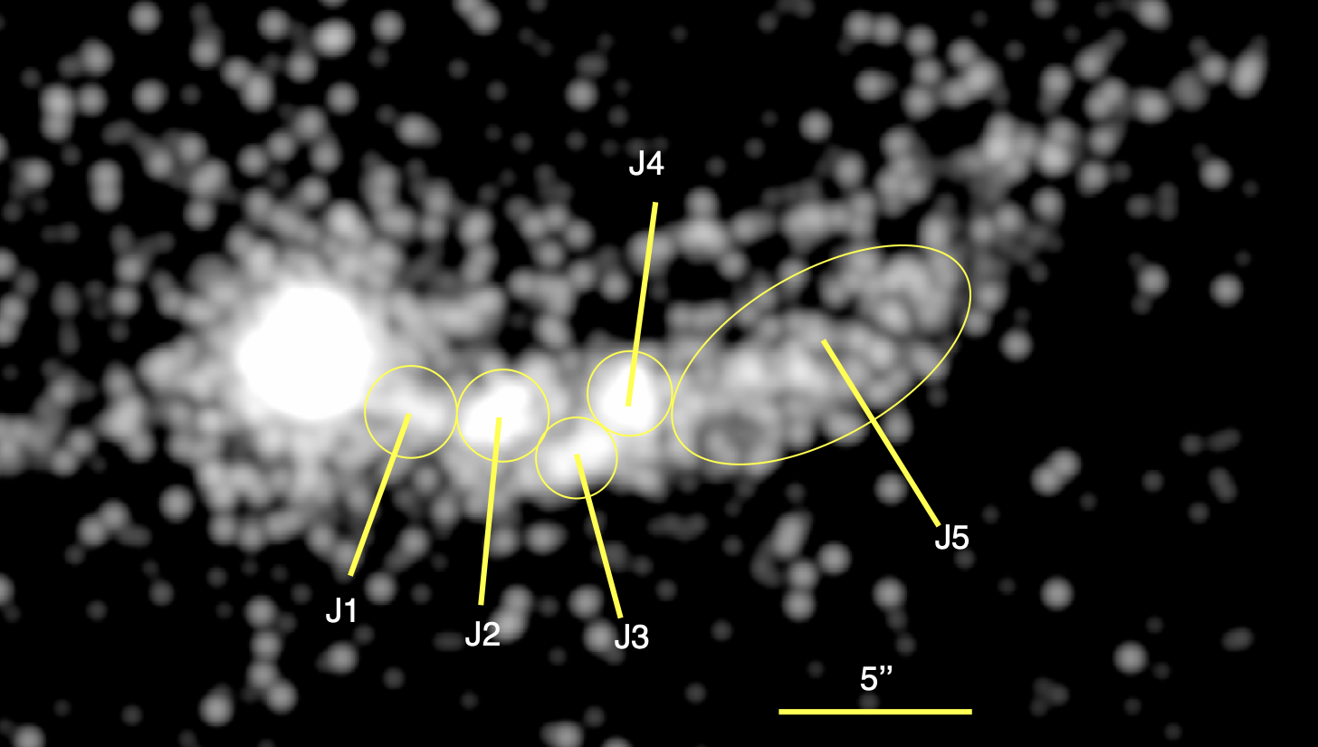
The road ahead…
Image OJ287 archival data at two more epochs
Complement with high-frequency radio, optical and X-ray data
Spectral Energy Distribution (SED) modelling to test models
IC/CMB, SSC, second synchrotron
Repeat the analysis for other X-ray selected blazars!
5”
OJ287 in Chandra X-ray Marscher, A.P., Jorstad, S.G. (2011)
17
Notes:
Downloaded data. Set up the architecture and setting up the pipeline.
See if there’s a curvature in radio spectrum at low frequencies. Less steep at low? If yes, at what frequency.
How does it connect with the behavior at high energies?
Better understand the physical properties on electrons in the knots in jets of blazars
Get into an industrial production mode
No conclusion slide as my work has just begun… Instead have a future work slide

Slide 30
The road ahead…
Image OJ287 archival data at two more epochs
Complement with high-frequency radio, optical and X-ray data
Spectral Energy Distribution (SED) modelling to test models
IC/CMB, SSC, second synchrotron
Repeat the analysis for other X-ray selected blazars!
Radio-X-ray SED
Perlman et al. (2019)
18
Notes:
Downloaded data. Set up the architecture and setting up the pipeline.
See if there’s a curvature in radio spectrum at low frequencies. Less steep at low? If yes, at what frequency.
How does it connect with the behavior at high energies?
Better understand the physical properties on electrons in the knots in jets of blazars
Get into an industrial production mode
No conclusion slide as my work has just begun… Instead have a future work slide

Slide 31
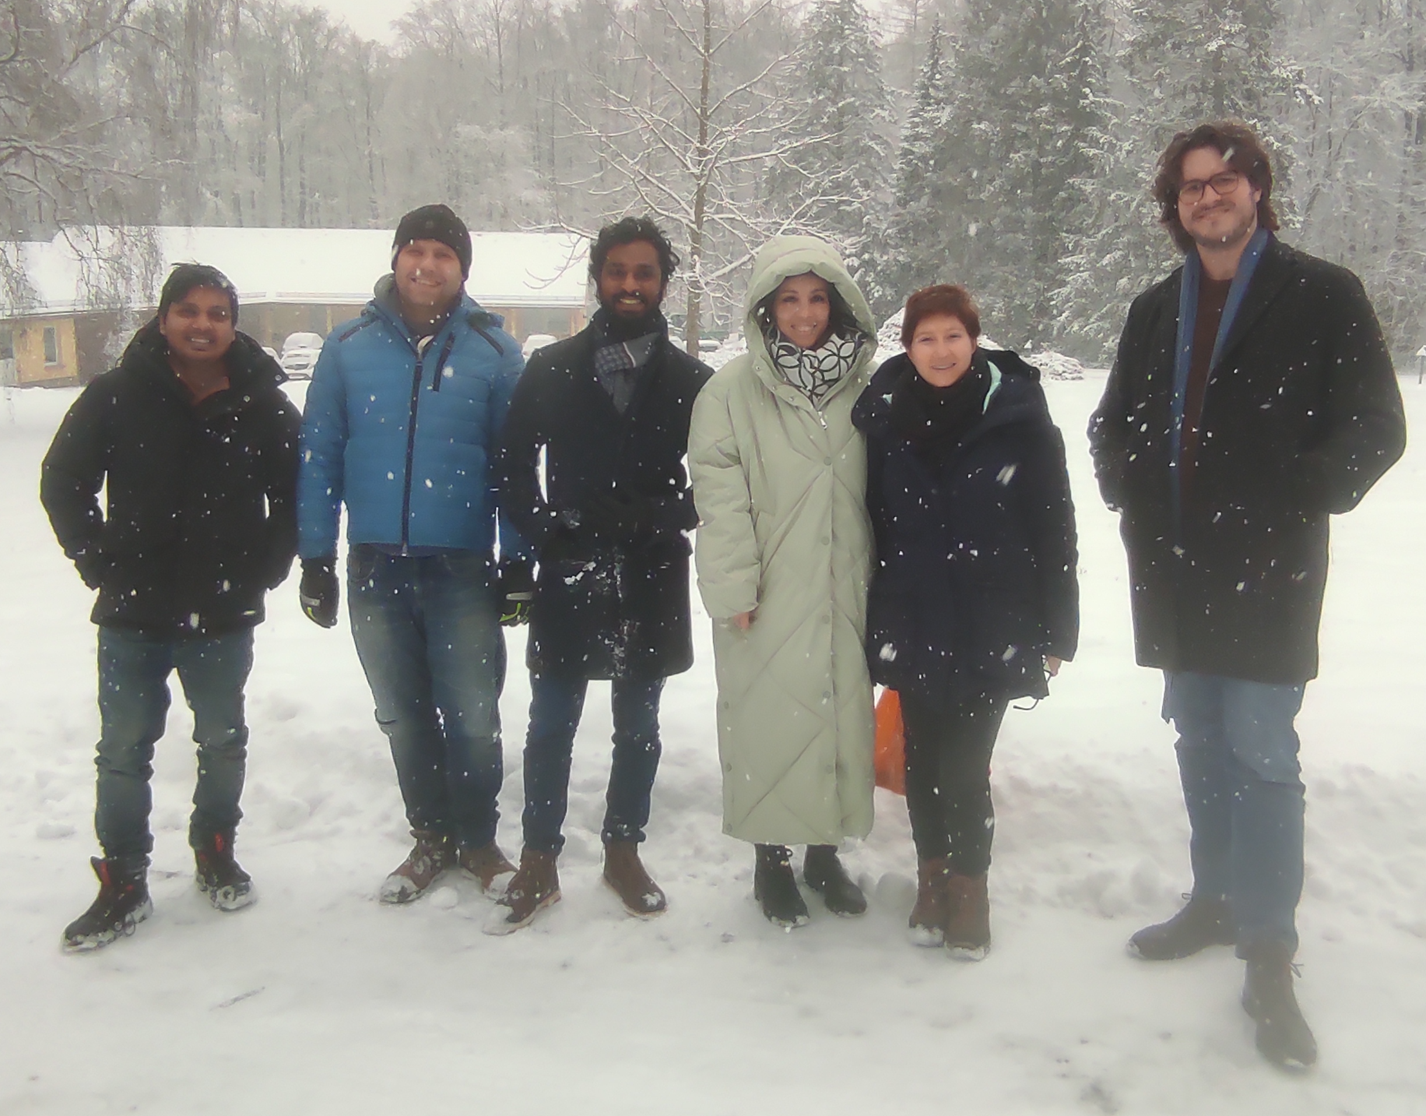
Thank You!
Question?
Comments and suggestions?
*Processing credits: Roland
hrishikesh.shetgaonkar@uni-wuerzburg.de

Slide 32
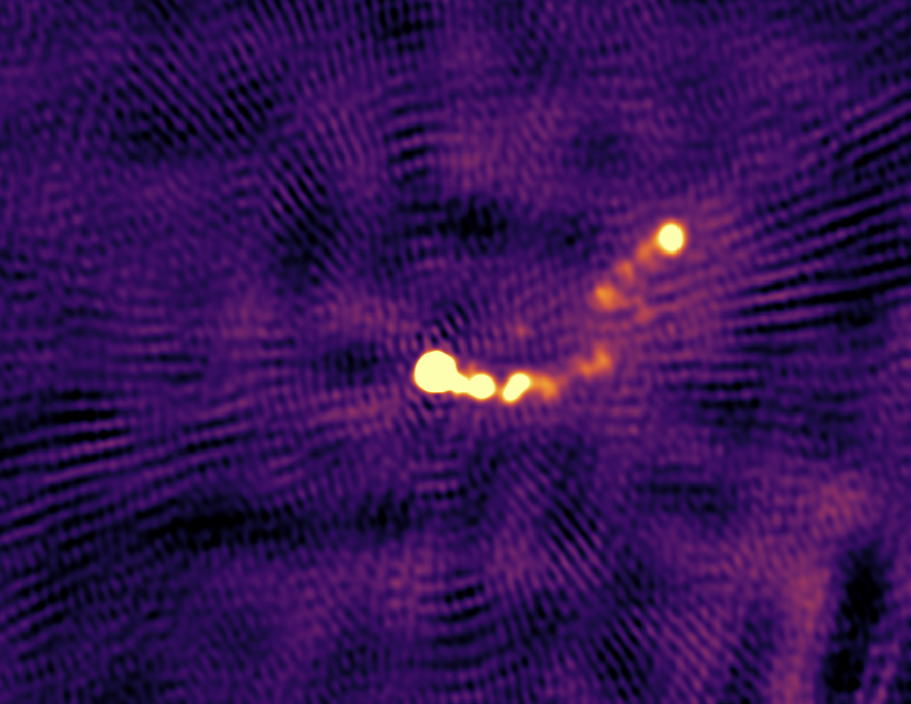
Before NeReVar

Slide 33
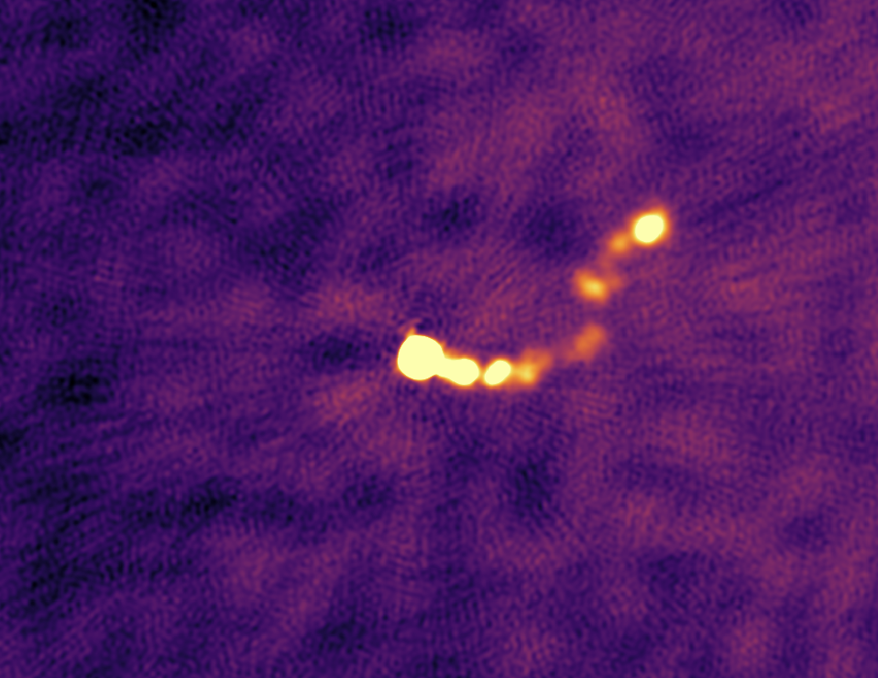
After NeReVar

Slide 34
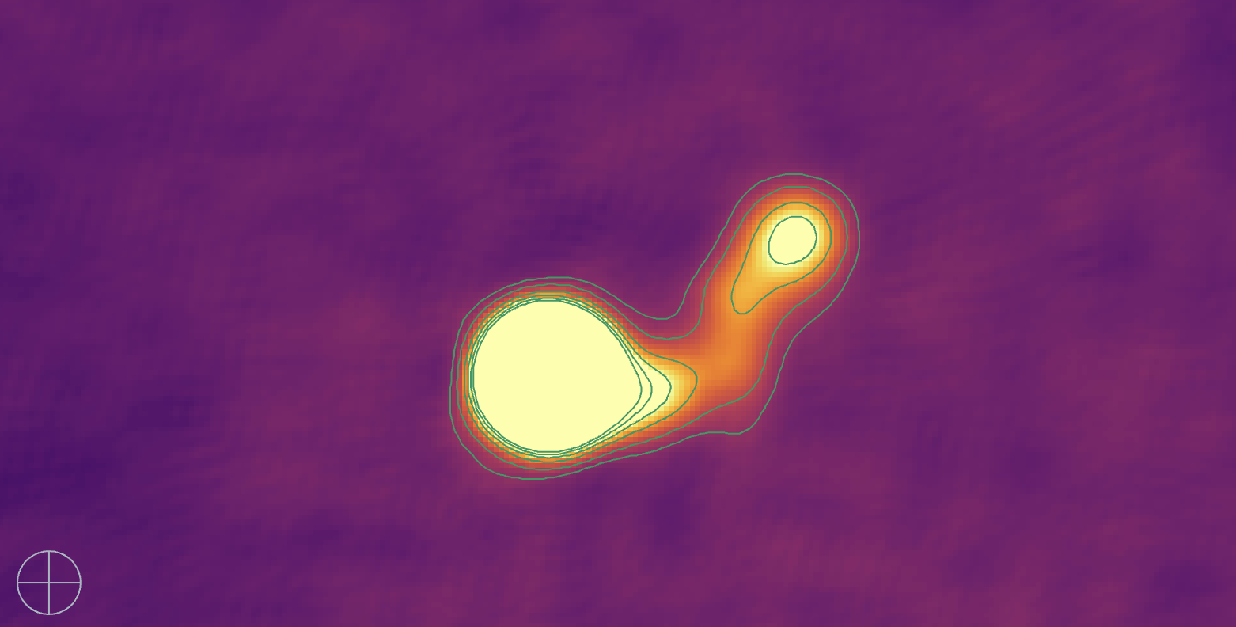
Notes:
Contour starting from 5sig, 10, 20, 30, 40, 50

Slide 35
Notes:
Contour starting from 5sig, 10, 20, 30, 40, 50

Slide 36
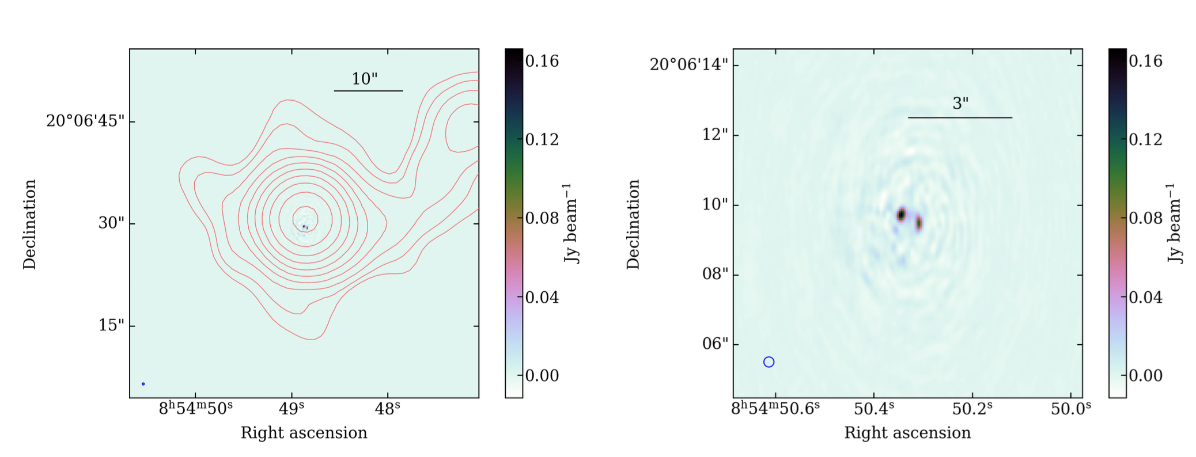
Previous work
OJ287 imaged with LOFAR international stations (colormap) and LOFAR Dutch array (contours) Mooney S. PhD Thesis (2020)
7
Notes:
In his work, Sean Mooney saw a similar morphology
Both are LOFAR maps.Contour is at a resolution of 6’’.
Higher resolution image with international station shows what appears to be the first knot but no jet structure.
Lets see what the data holds for us when tackle this imaging challenges with newer /better tools

Slide 37
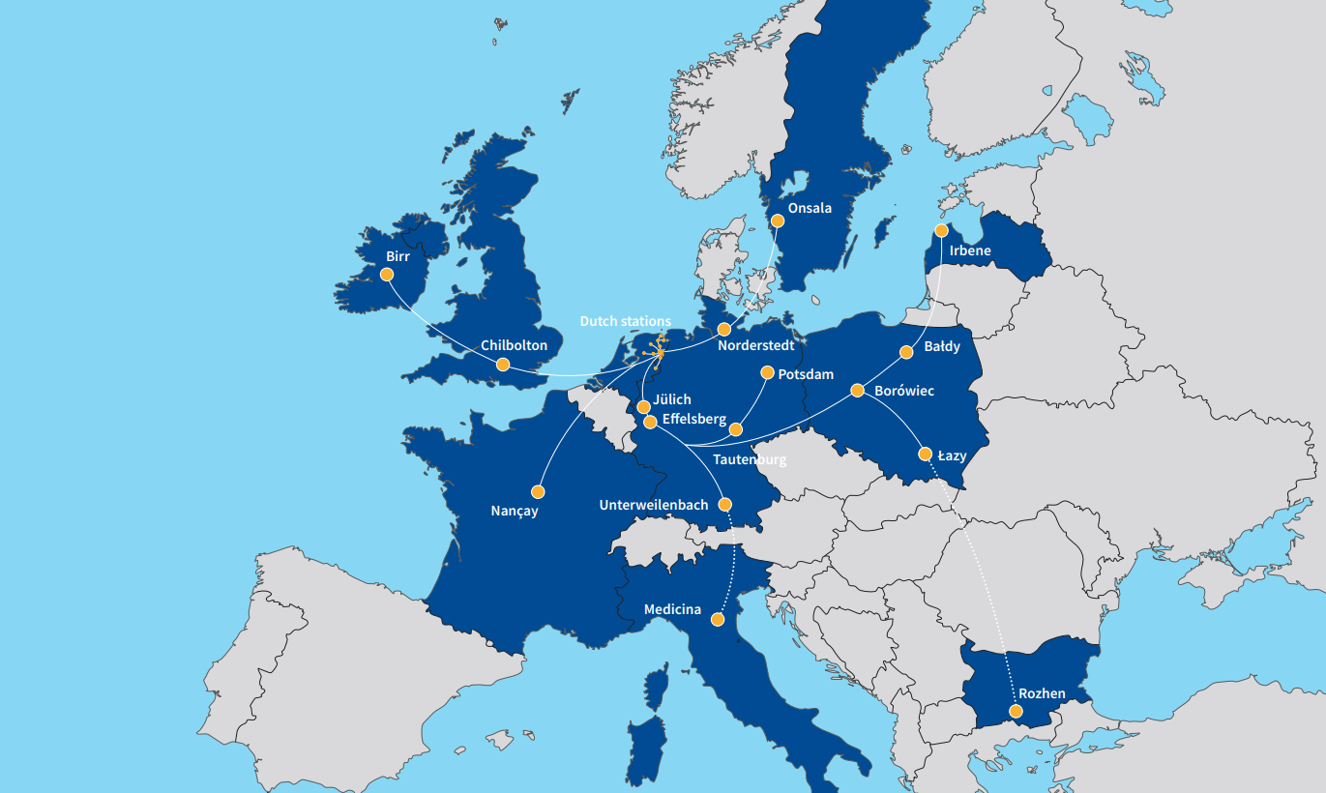
Stations:
24 core
14 remote
14 international
+2 in construction
LOFAR : Low Frequency Array
Stations:
24 core (Dutch)
14 remote (Dutch)
14 international +2 in construction
1
Notes:
Marcus already talked about LOFAR, so I’ll skip this

Slide 38
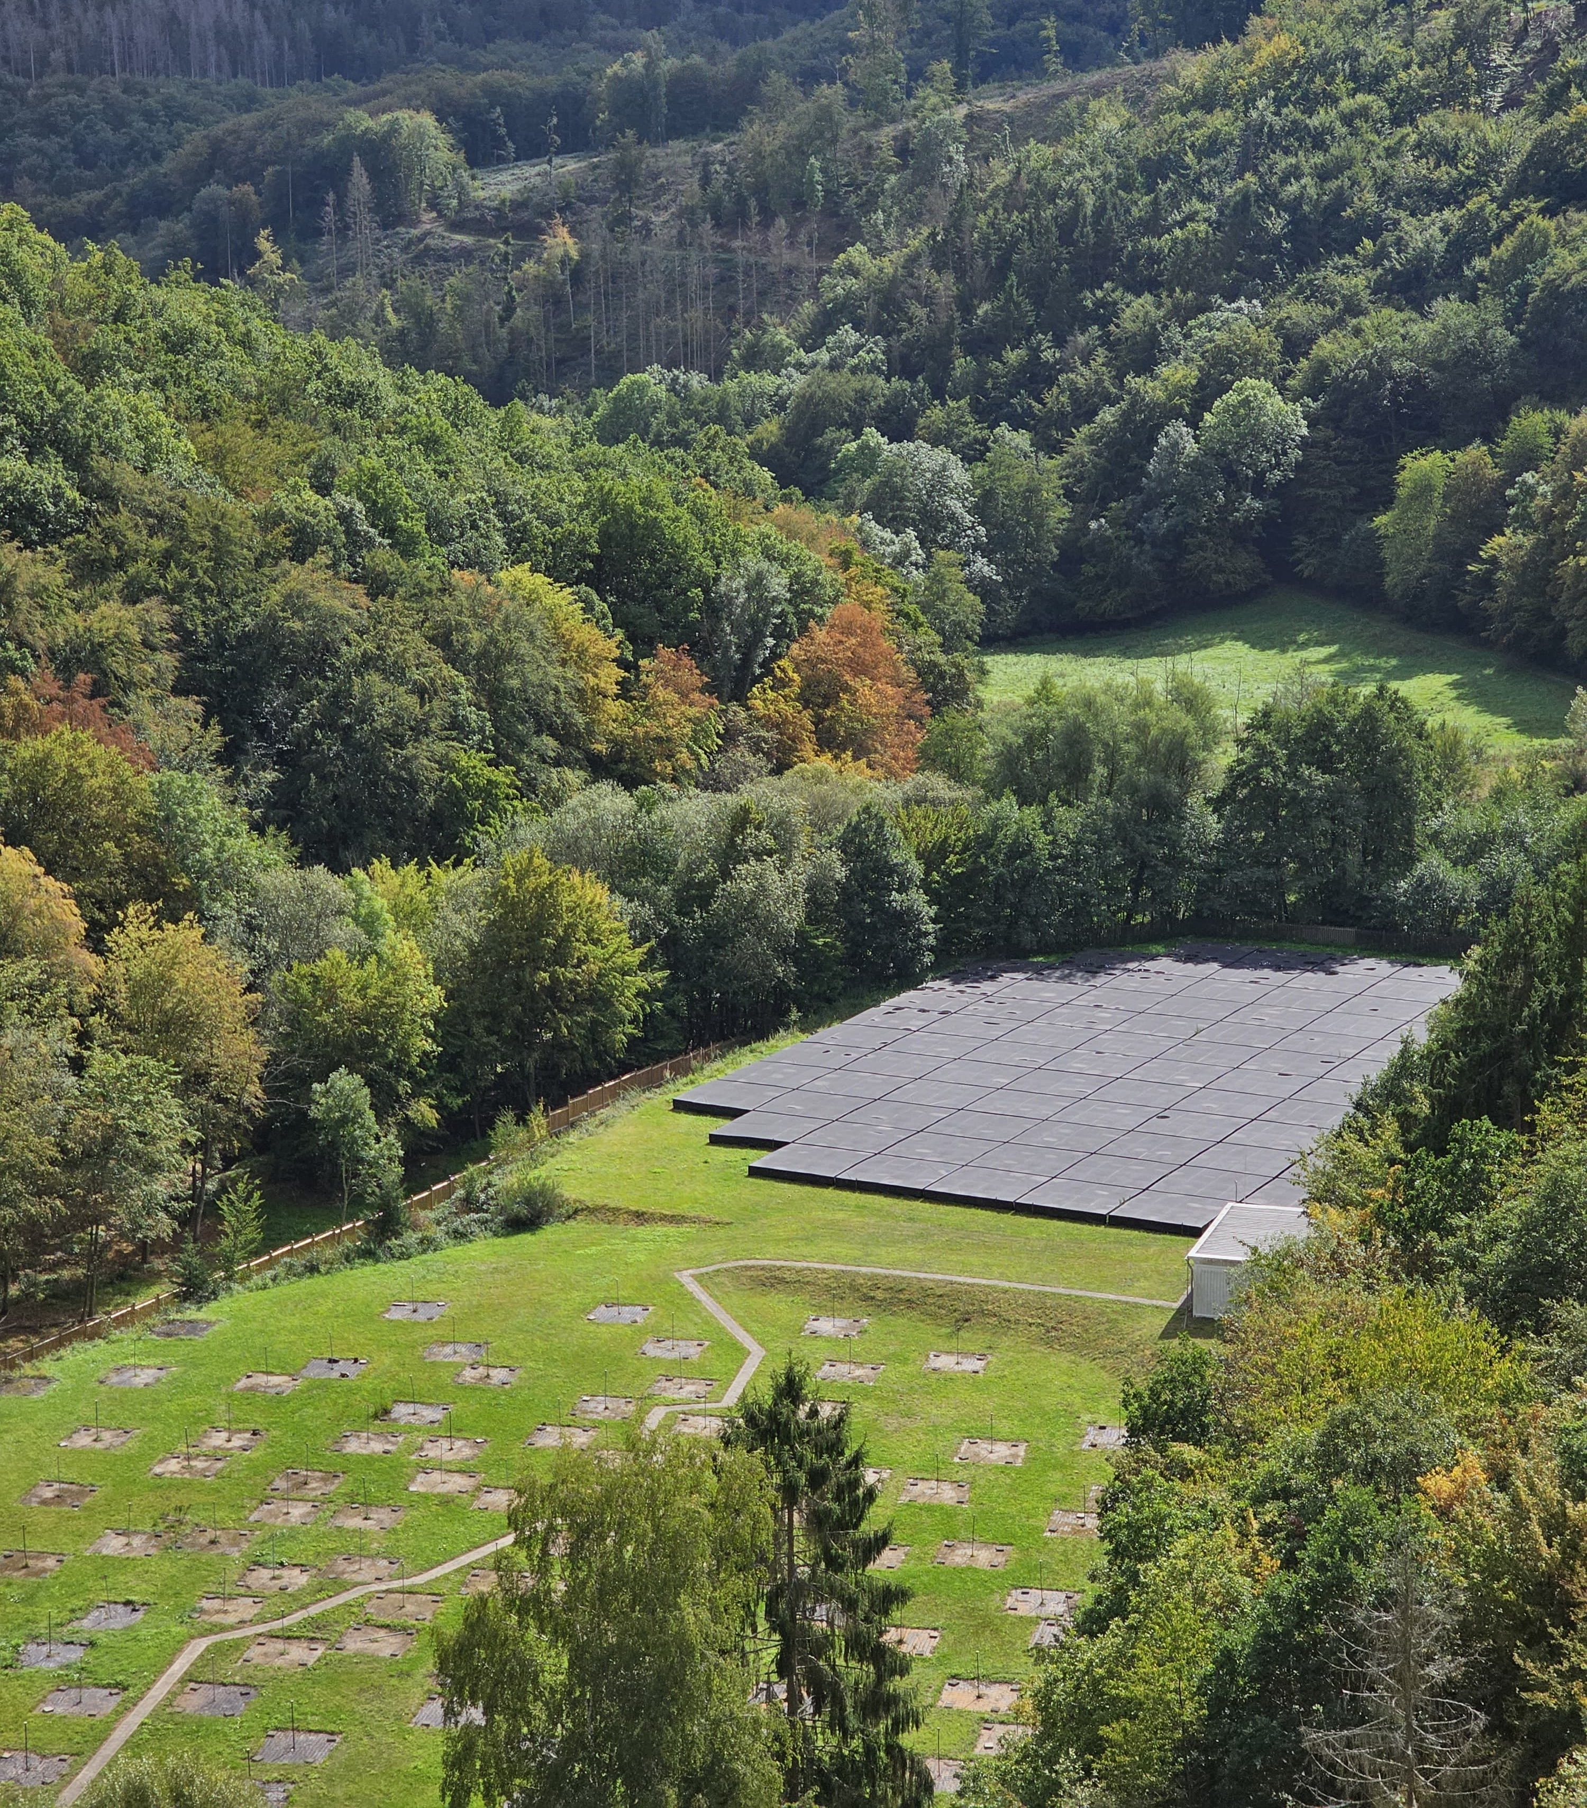
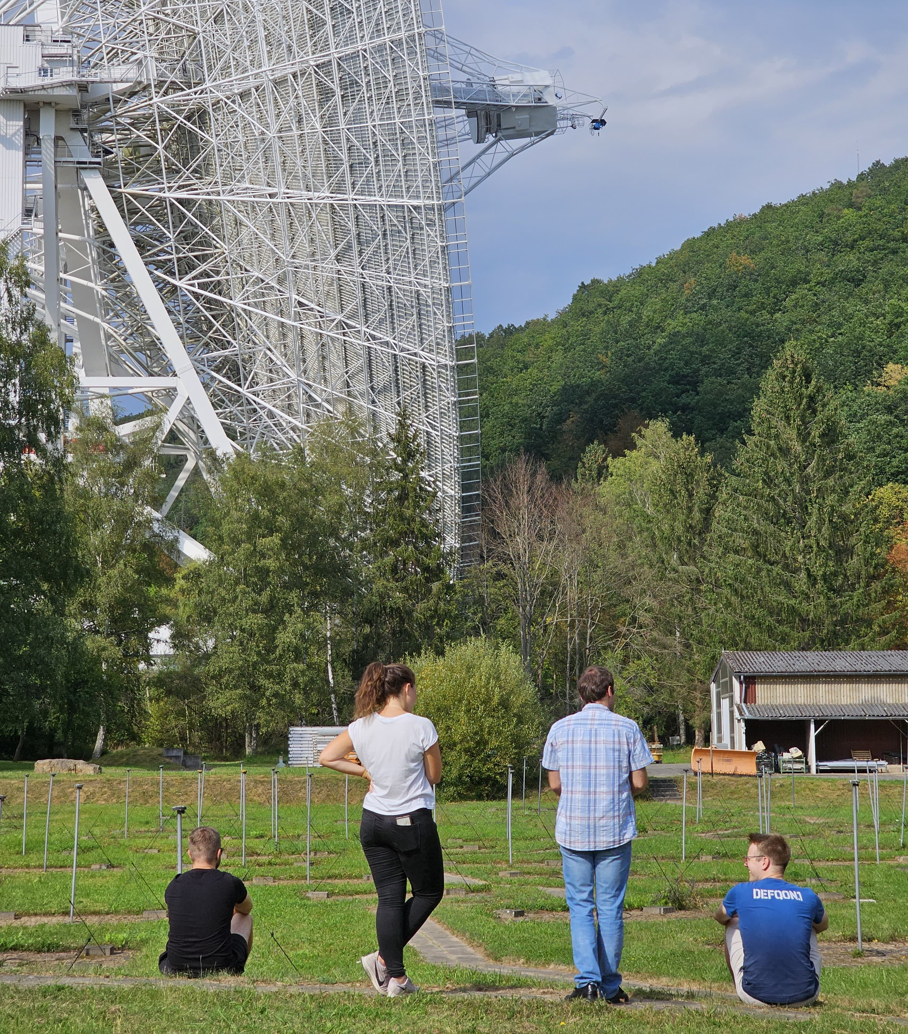
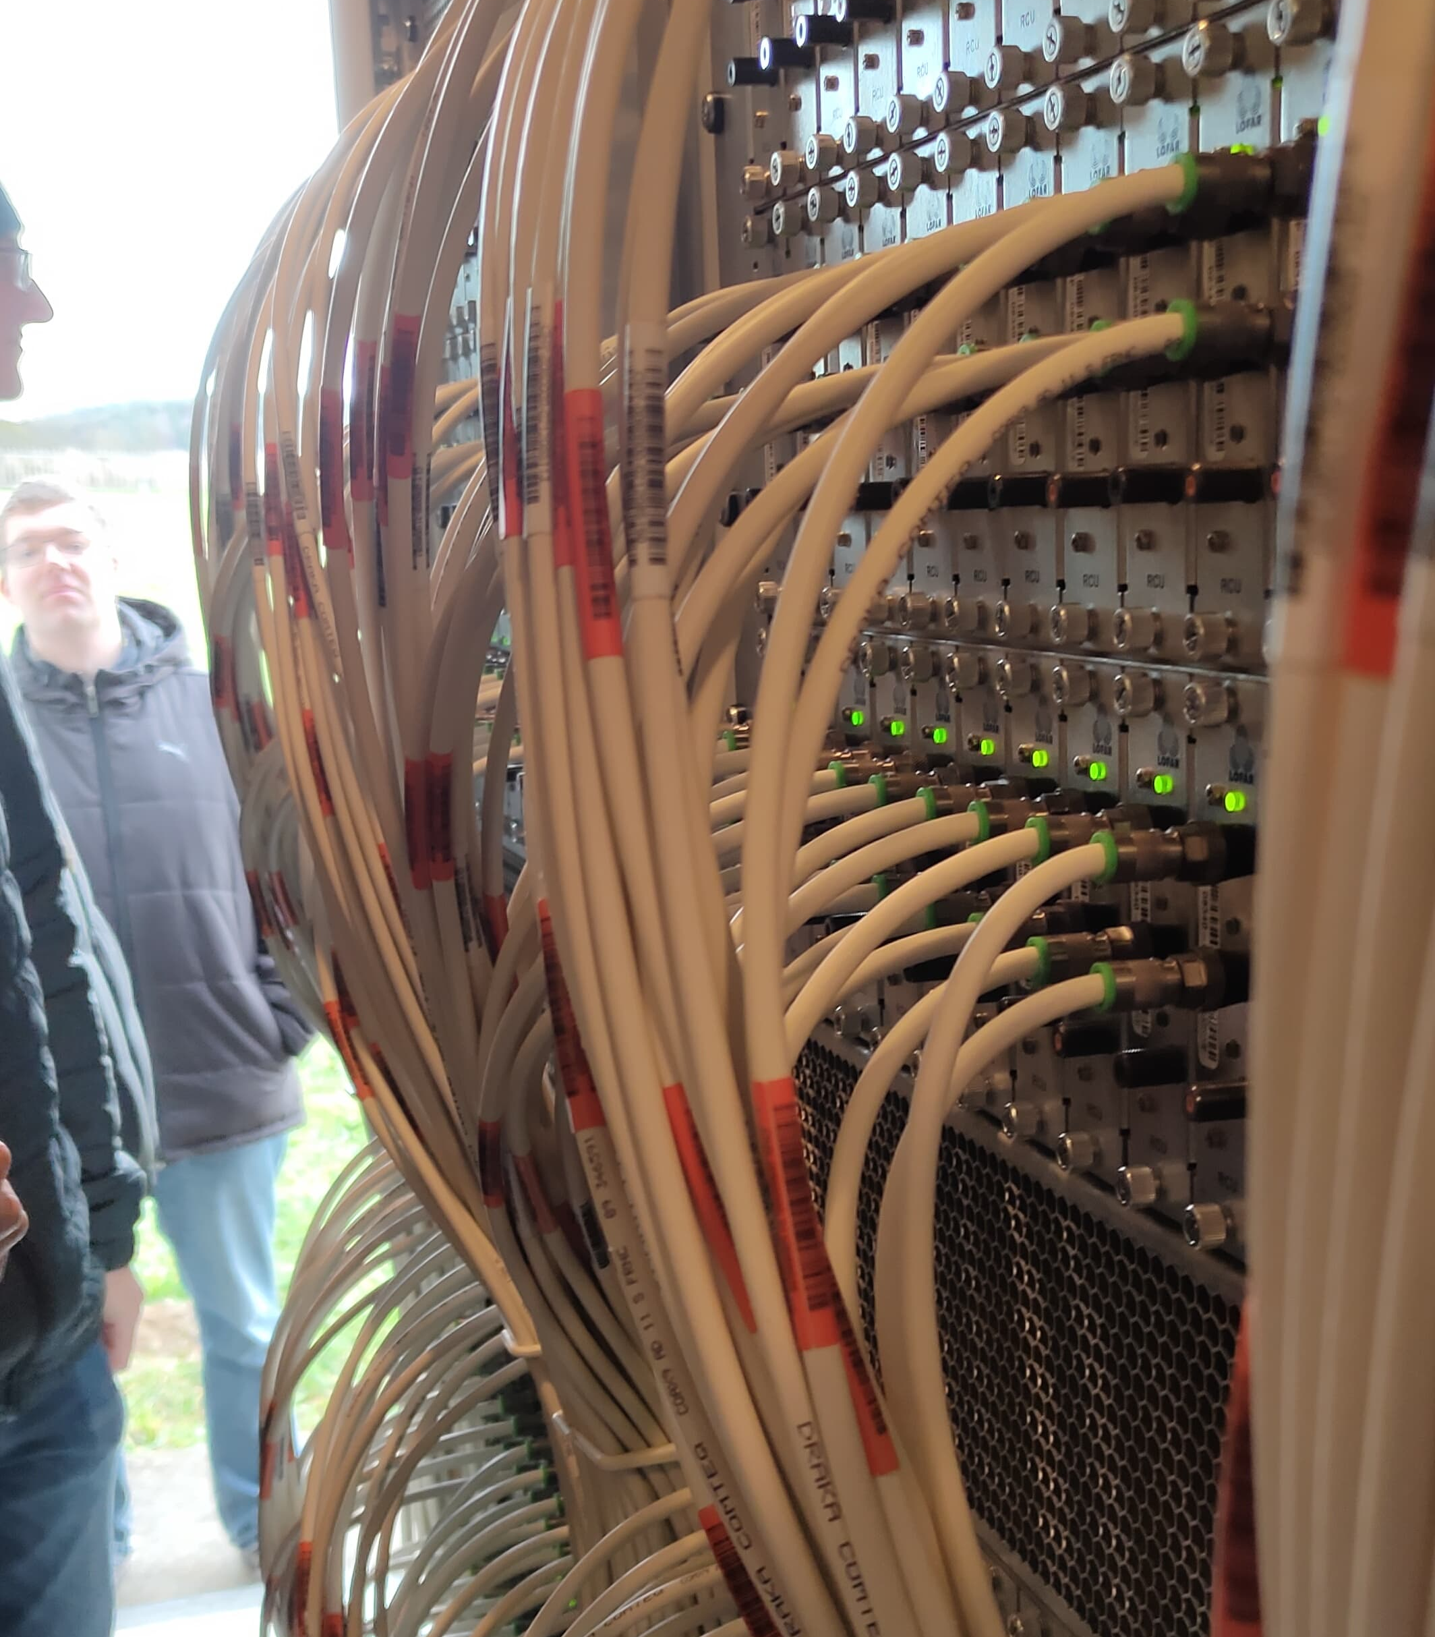
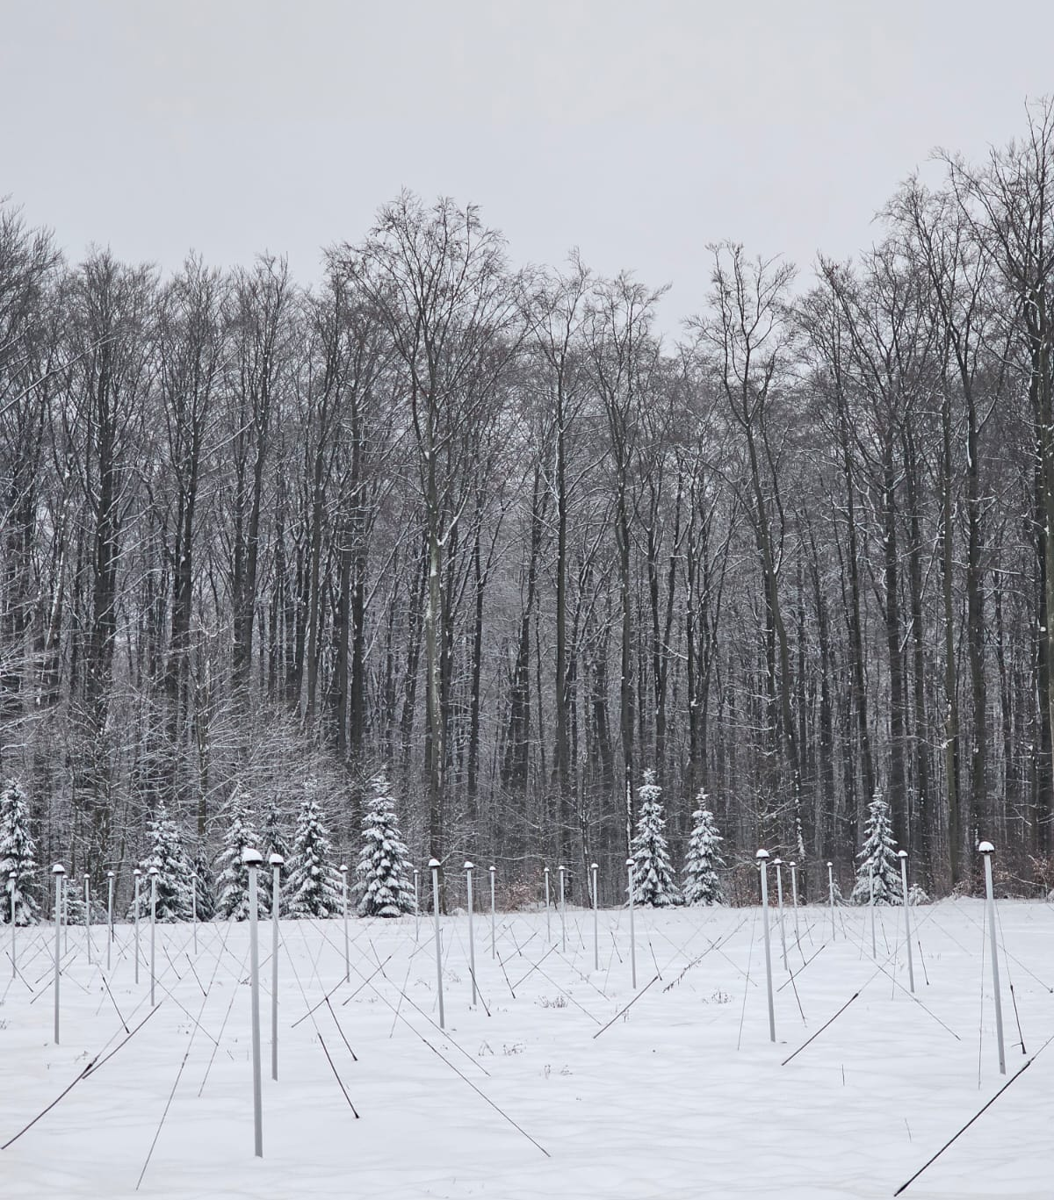
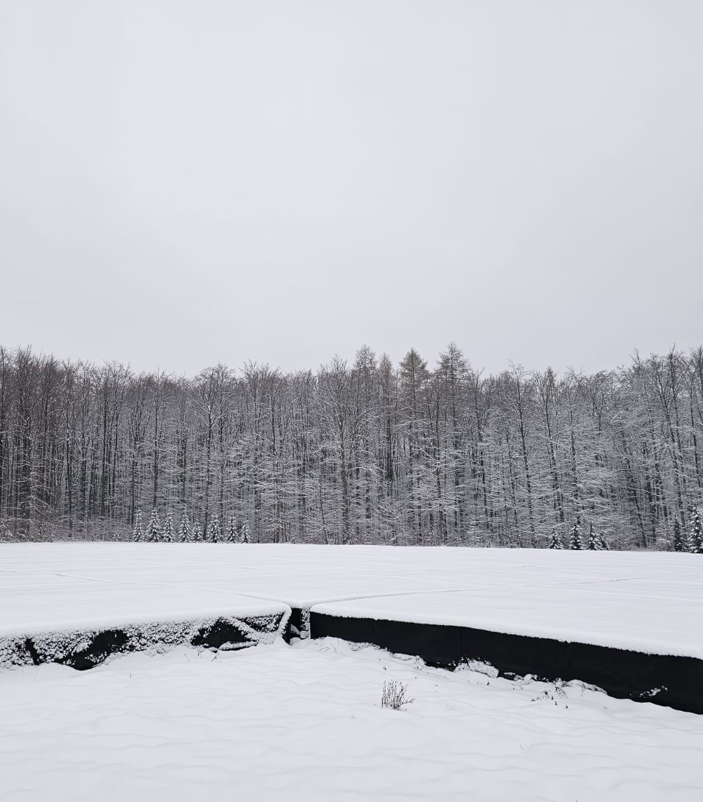
LOFAR in Germany
- DE601: Effelsberg
- DE602: Unterweilenbach
- DE603: Tautenburg
- DE604: Bornim
- DE605: Jülich
- DE609: Norderstedt
2
Notes:
Amazing how a bunch of wires in a field, which can be mistaken for a fence or trampoline are state of the art radio telescopes.
>All weather

Slide 39
 | BZCAT Blazars
 | LoLSS Footprint
 | LoTSS Footprint
 | FIRST Footprint

