Slide 1
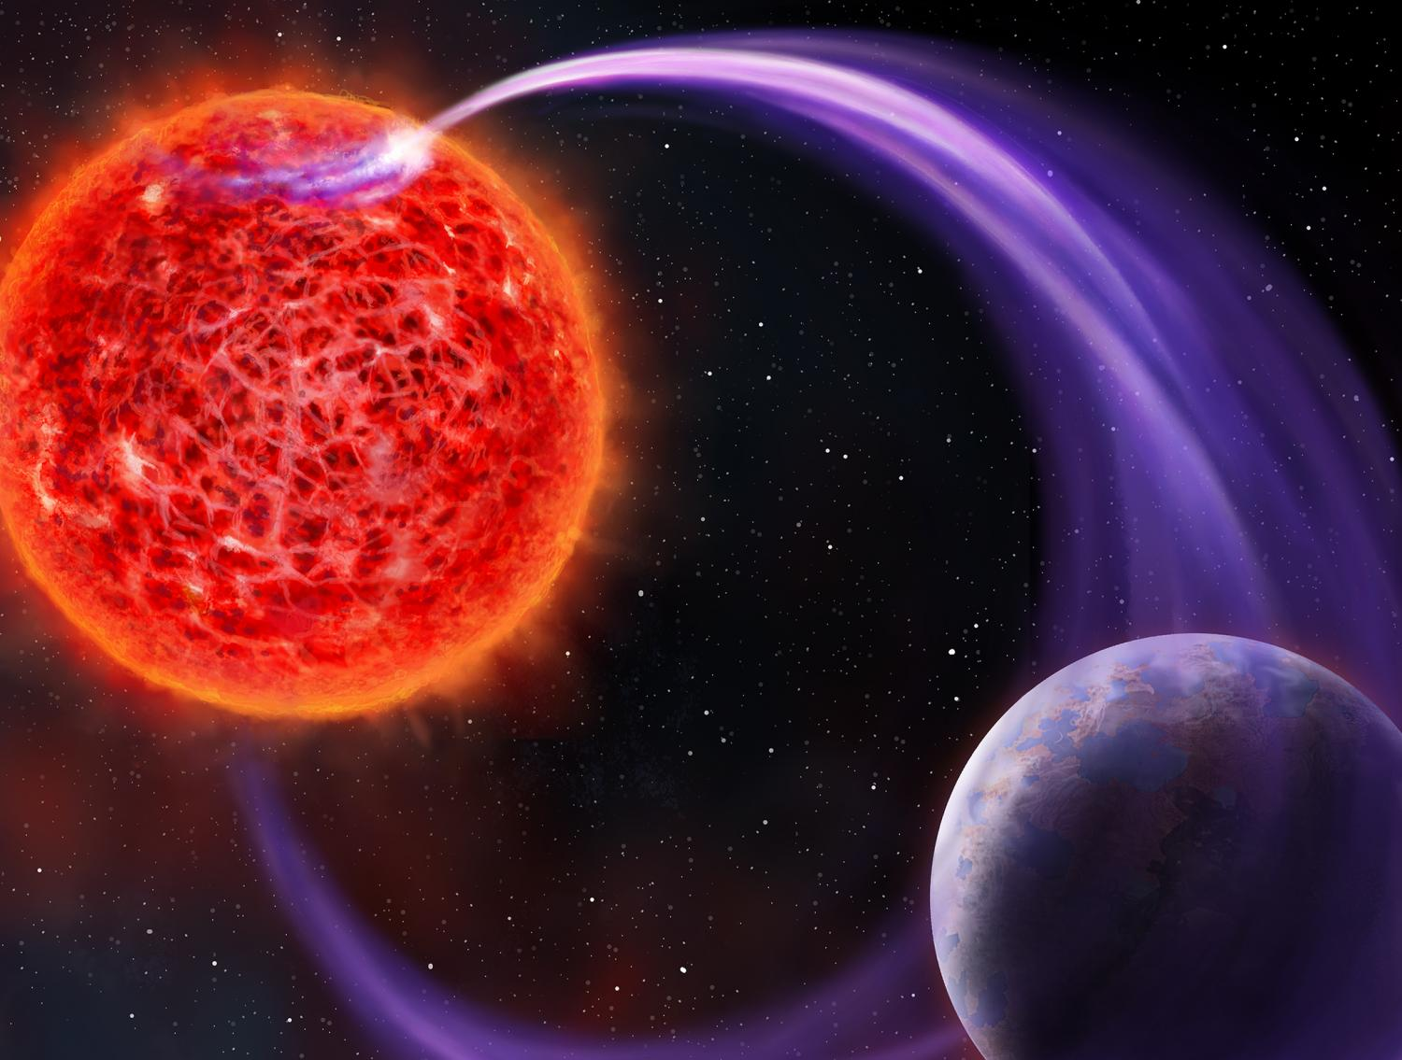

Stars at low (to mid) frequencies
Sanne Bloot
LFM 2025
26-09-2025
VIDI Grant
PI: Vedantham
Image credit: Daniëlle Futselaar

Slide 2
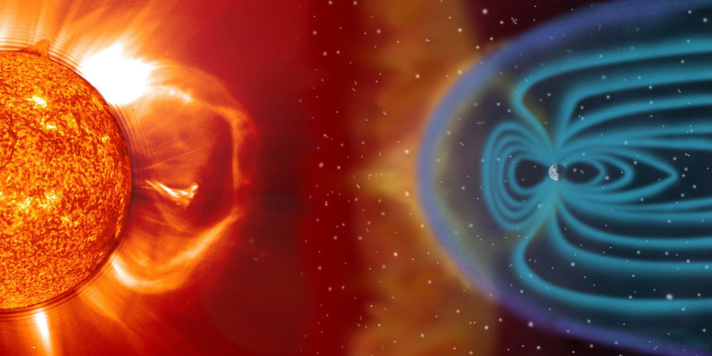
Stars at low frequencies
Space weather
Stellar environment
Exoplanet impact
Exoplanet discovery
Image credit: ESA

Slide 3
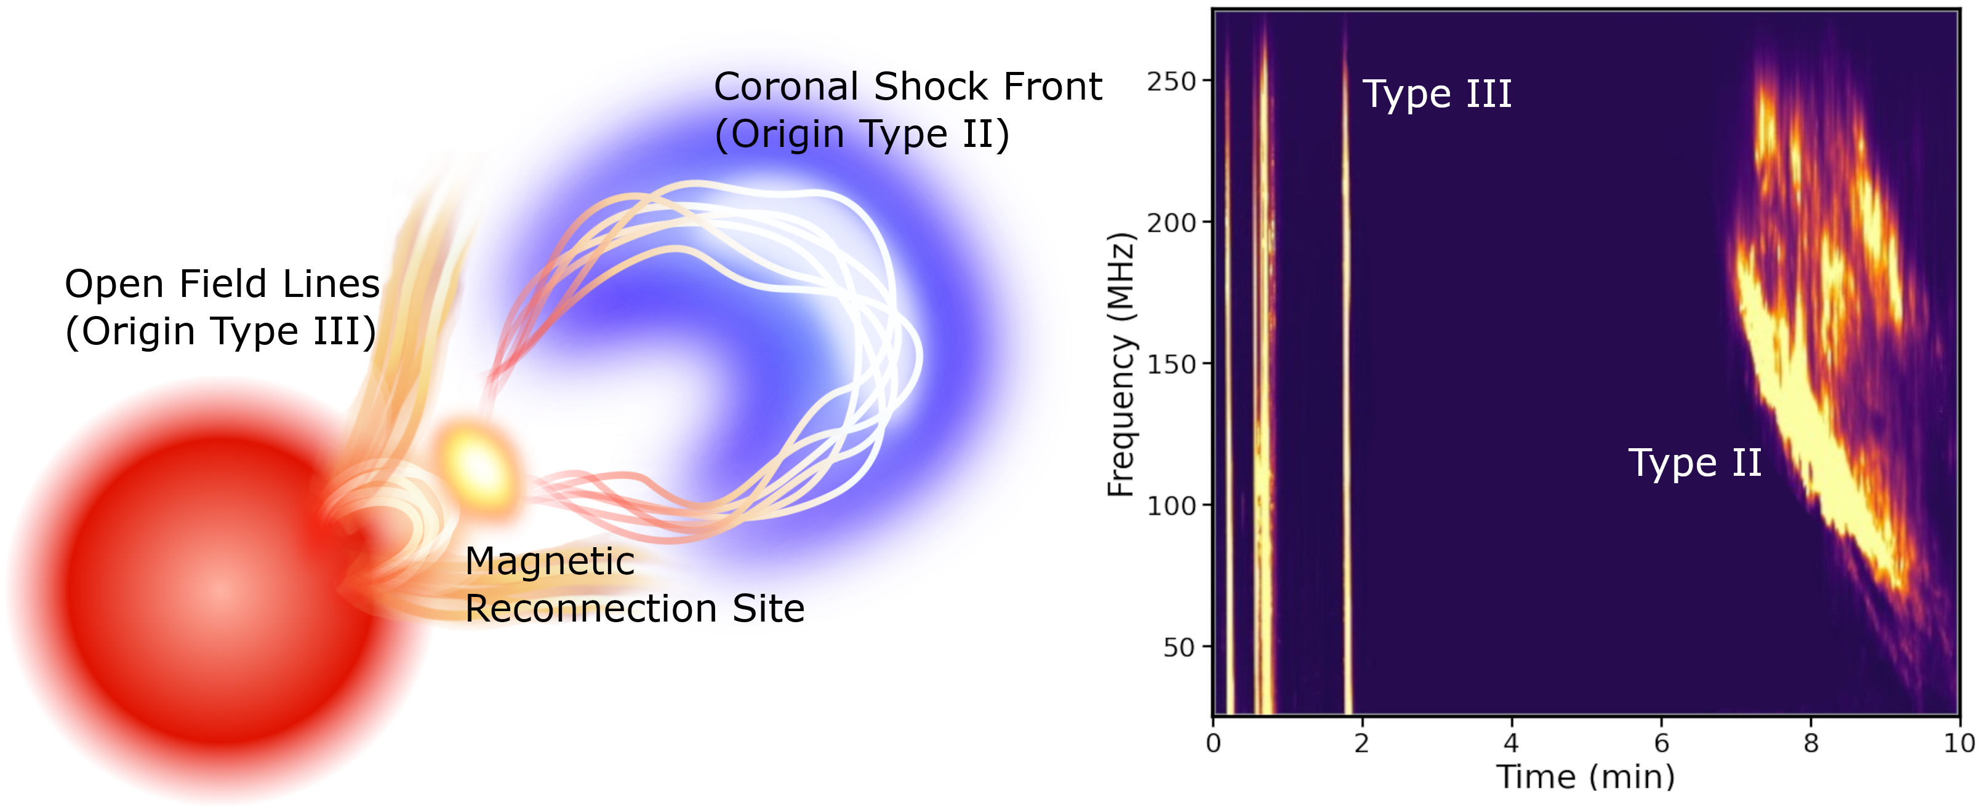
The Sun
Plasma emission
Traces local density
Stochastic
CMEs
Callingham et al. (2024)
Image credit: Rob Kavanagh and Joe Callingham

Slide 4
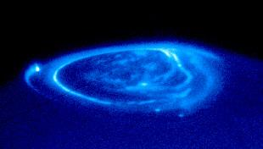
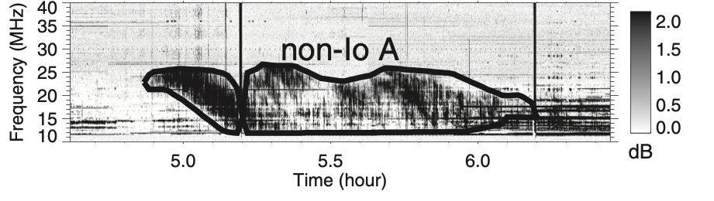
Jupiter
Auroral emission
Electron cyclotron maser instability (ECMI)
Traces magnetic field strength
Periodic
Image credit: ESA
E.g. Burke & Franklin (1955), Zarka & Genovan (1983), Marques et al. (2017), Zarka et al. (2018)
Marques et al. (2017)

Slide 5
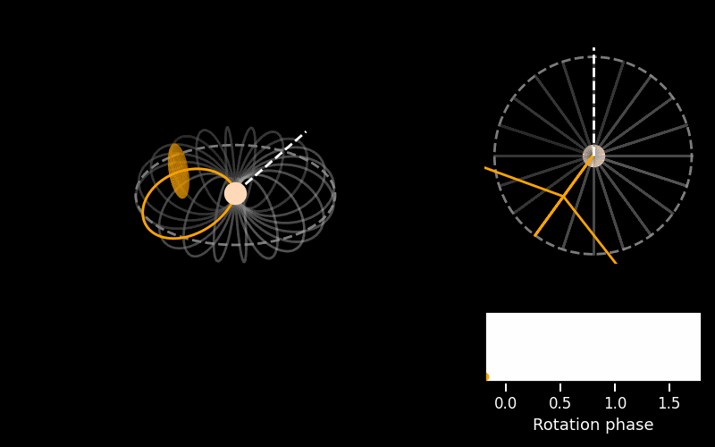

Slide 6
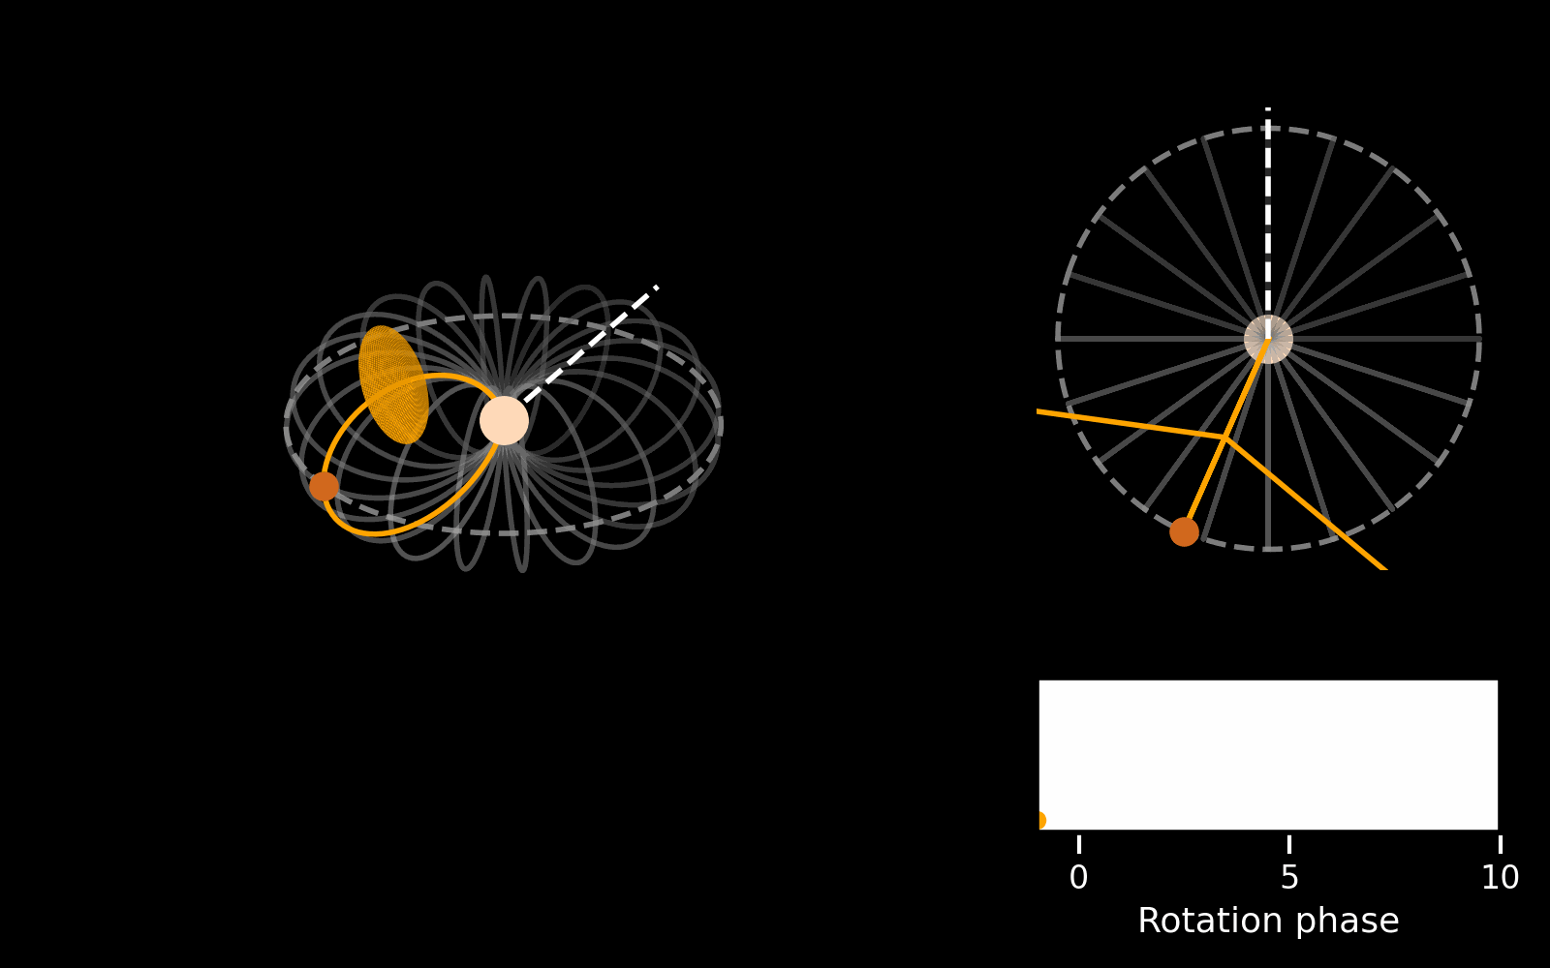
Jupiter-Io interaction
ECMI induced by a companion
Periodic with orbit or beat period
E.g. Goldreich and Lynden-Bell (1969), Zarka et al. (2001), Zarka (2007, 2018), Grießmeier et al. (2007), Grießmeier (2018)

Slide 7
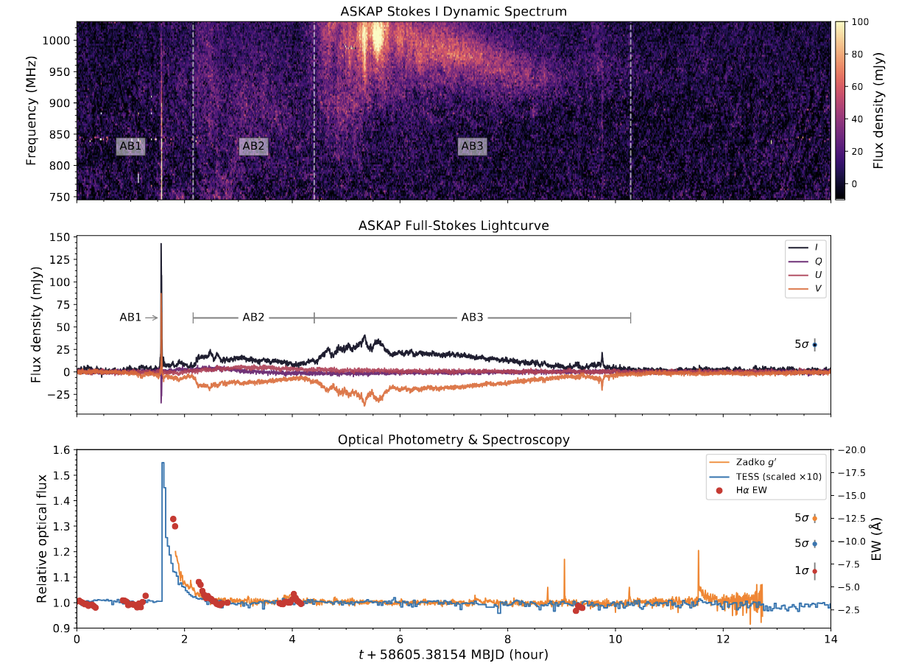
Solar-type bursts – Proxima Centauri
Zic et al. (2020)

Slide 8
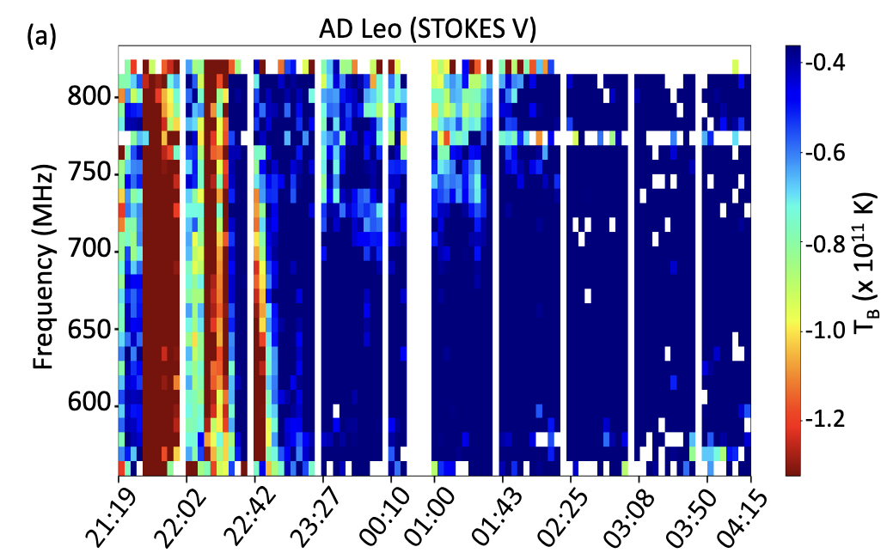
Solar-type bursts – AD Leo
Mohan et al. (2024)

Slide 9
Auroral emission – UV Ceti
Zic et al. (2019)

Slide 10
Auroral emission – AU Mic
Bloot et al. (2023)

Slide 11
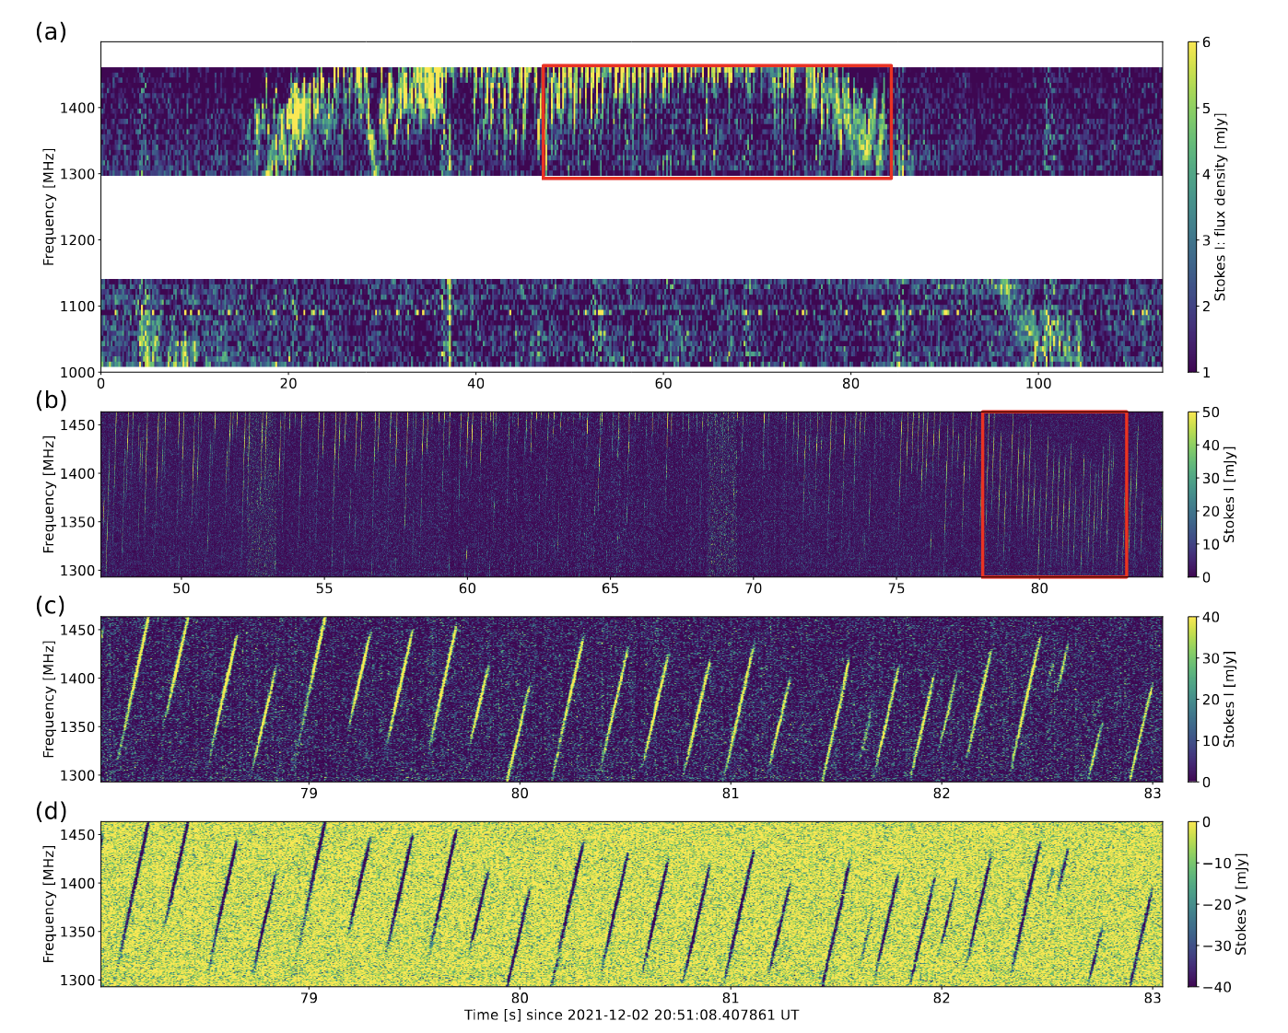
Auroral emission – AD Leo
Zhang et al. (2023), Zarka et al. (2025)

Slide 12
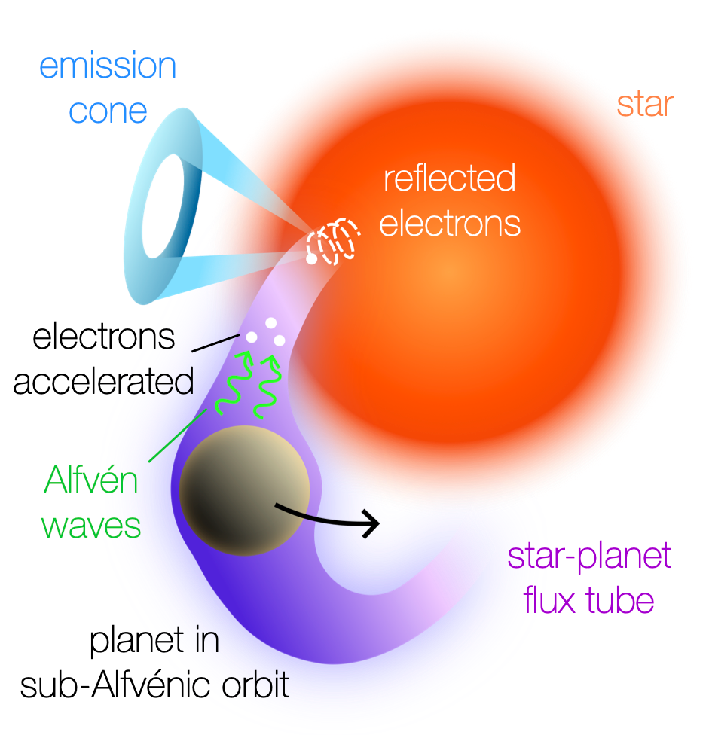
Star-planet interactions
Magnetic interaction between a planet and its host star
  e.g. Zarka et al. (2001), Zarka (2007, 2018), Lanza (2012, 2013)

Slide 13
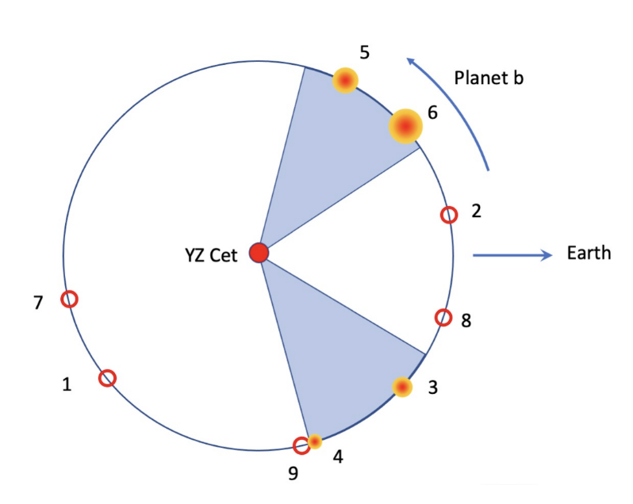
Star-planet interactions
Magnetic interaction between a planet and its host star
  e.g. Zarka et al. (2001), Zarka (2007, 2018), Lanza (2012, 2013)
Suggestions, but difficult to confirm
  e.g. Perez-Torres et al. (2019), Vedantham et al. (2020), Pineda & Villadsen (2023), Trigilio et al. (2023)
Trigilio et al. (2024)

Slide 14
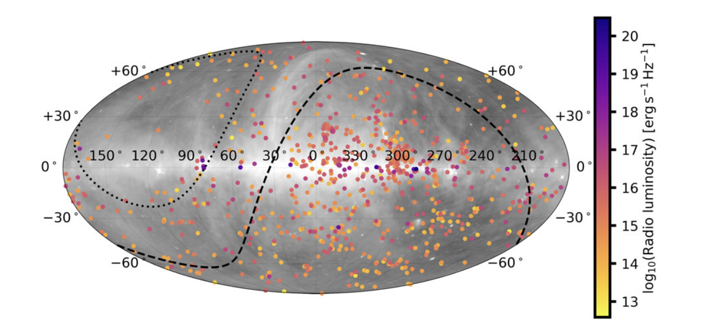
Sydney Radio Star Catalogue
Driessen et al. (2024)

Slide 15
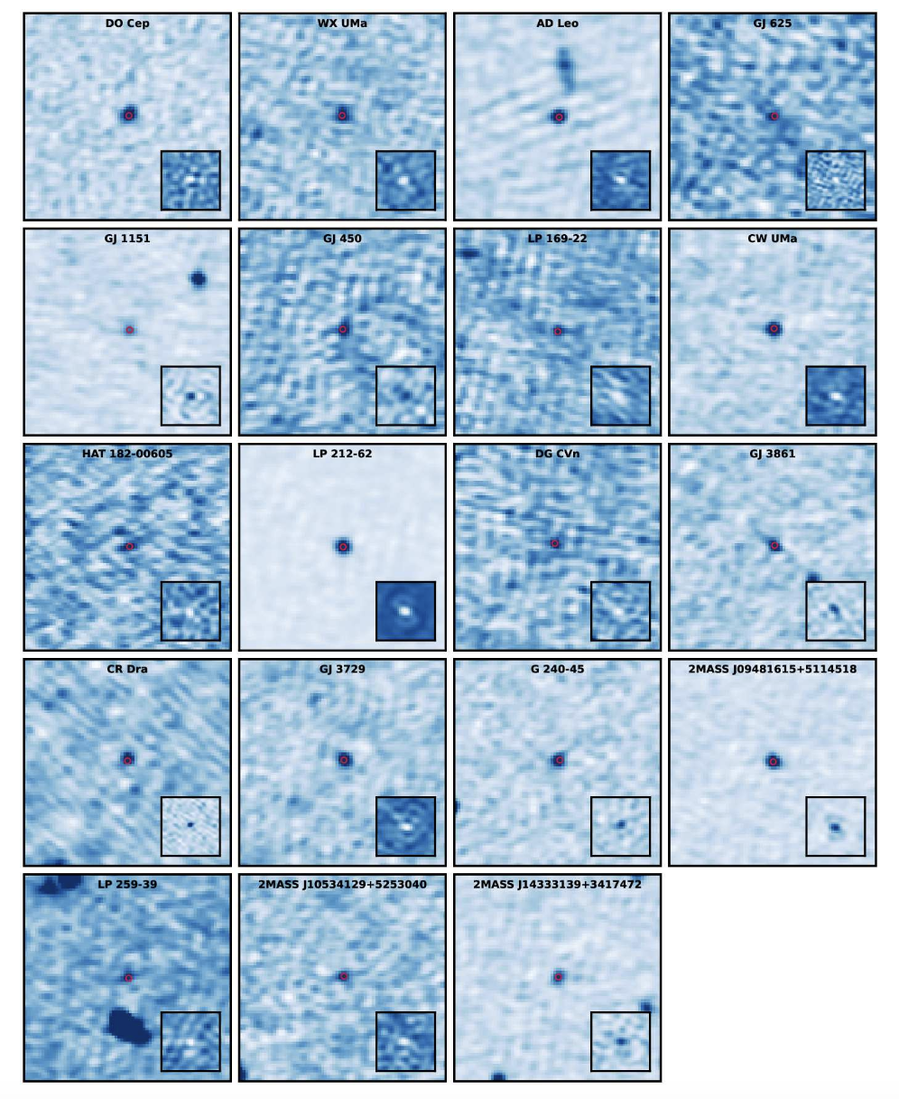
LOFAR image plane searches
Callingham et al. (2020)

Slide 16
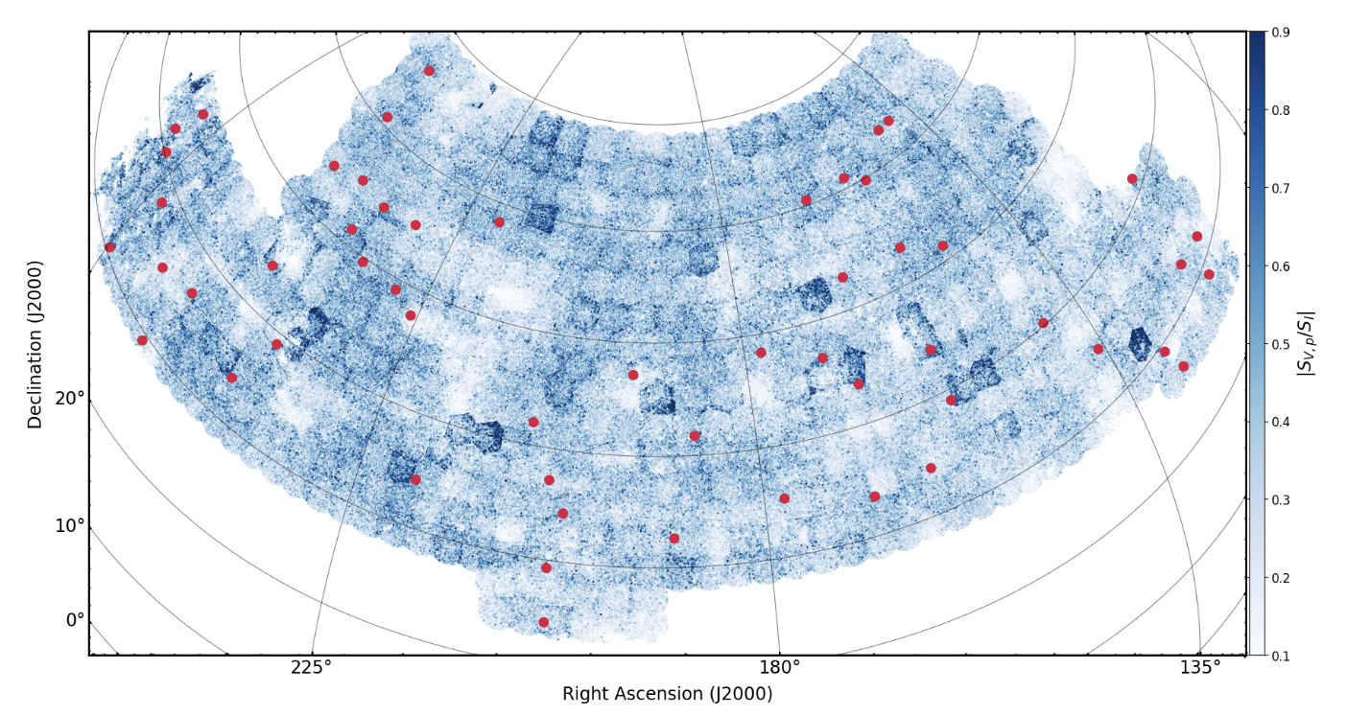
V-LoTSS
Callingham et al. (2023)

Slide 17
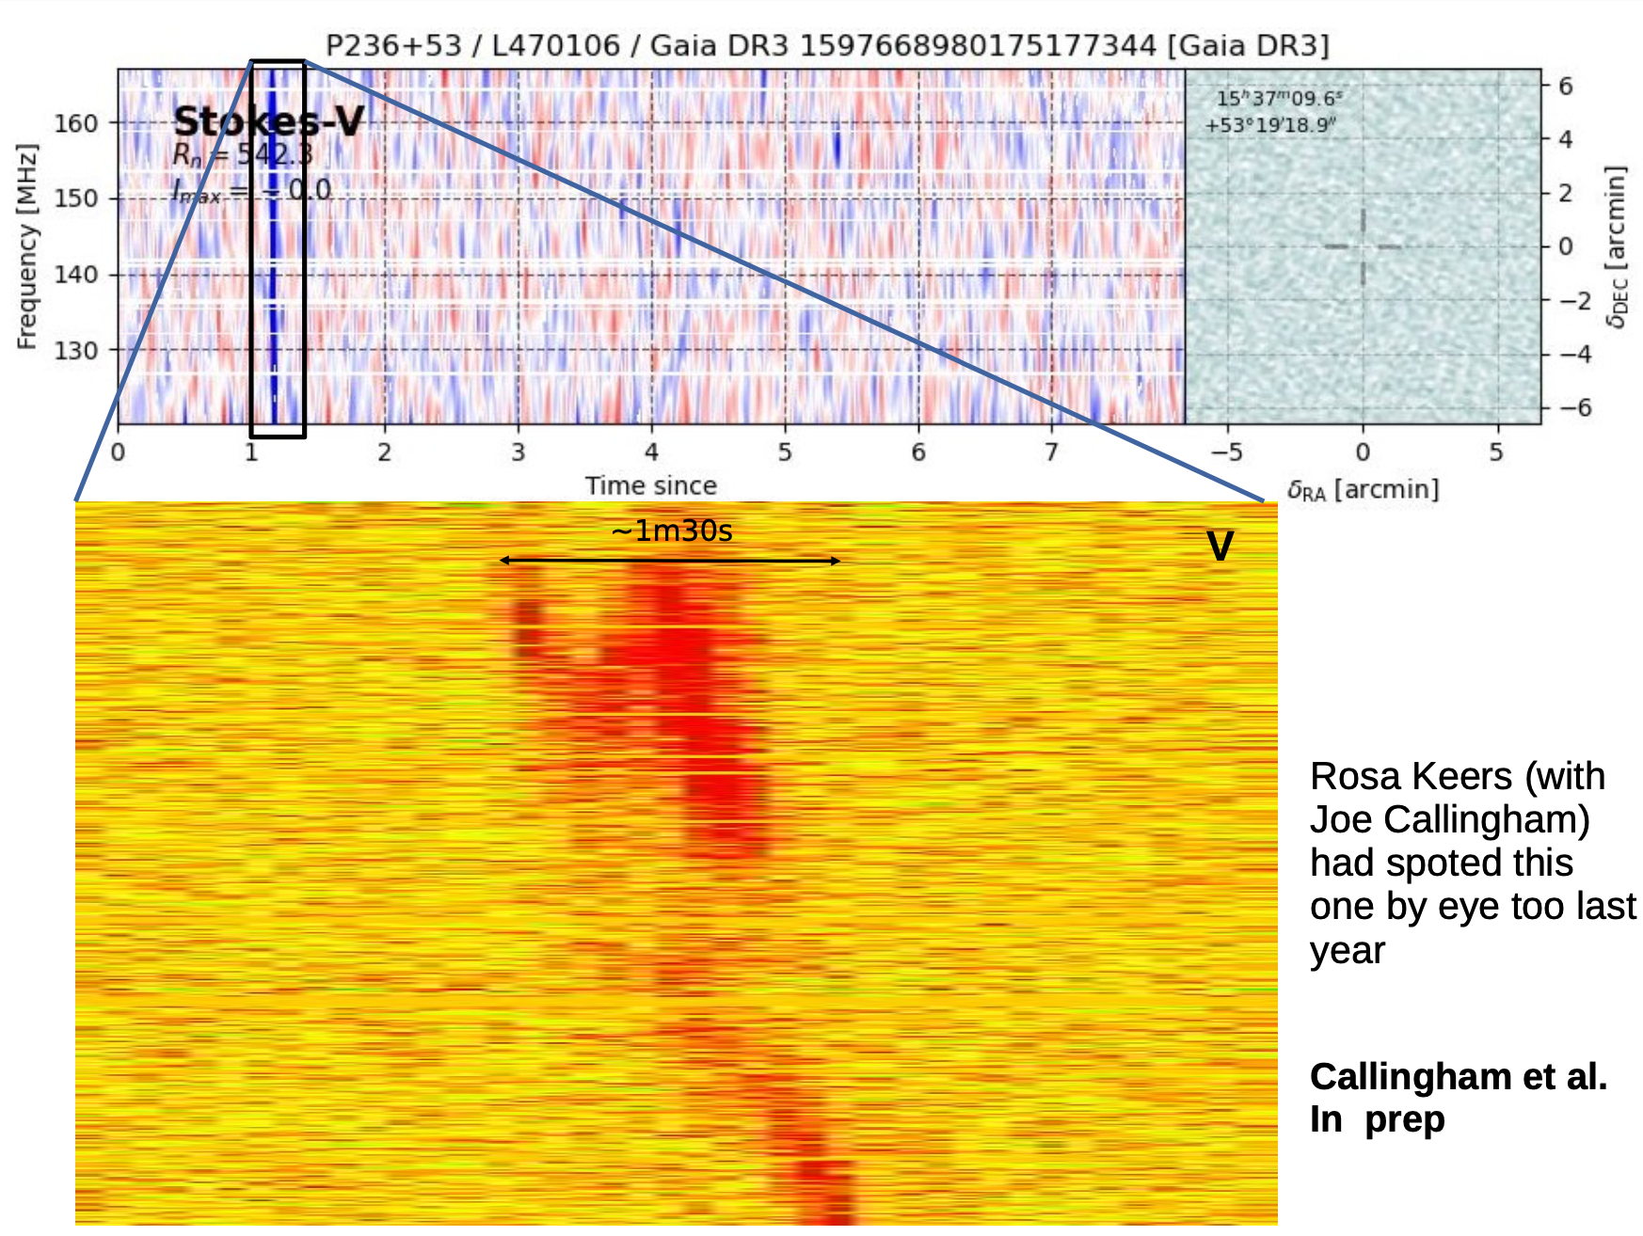
LOFAR dynamic spectra
Tasse et al. (under review)
Found by then Master student Roos Keers
Callingham, Tasse, Keers et al. (accepted)

Slide 18
LOFAR dynamic spectra
Tasse et al. (under review)
Found by then Master student Roos Keers
Callingham, Tasse, Keers et al. (accepted)
See Xiang Zhang’s talk for even lower frequencies

Slide 19
First extrasolar type II burst
Callingham, Tasse et al. (accepted)

Slide 20
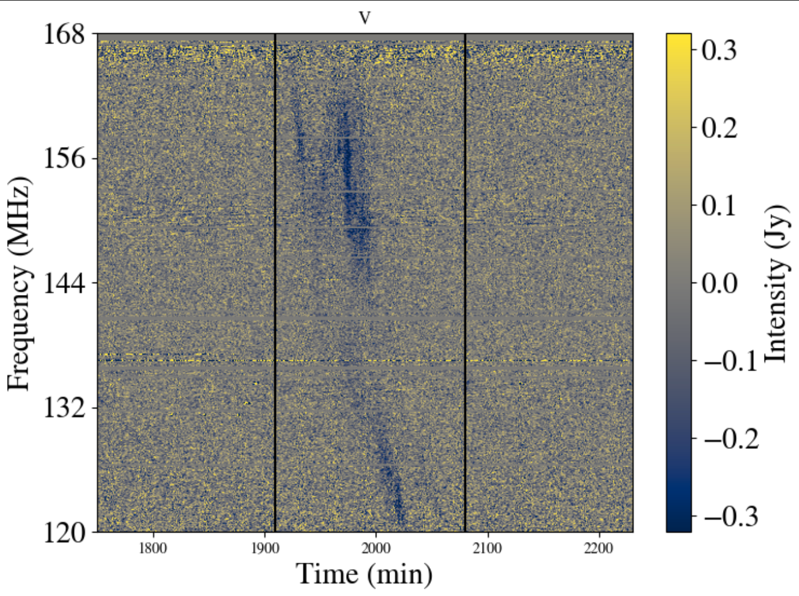
First extrasolar type II burst
Callingham, Tasse et al. (accepted)
Konijn et al. (under review)

Slide 21
Search for other bursts
Konijn et al. (under review)

Slide 22
Search for other bursts
Konijn et al. (under review)

Slide 23
Search for other bursts
Konijn et al. (under review)

Slide 24
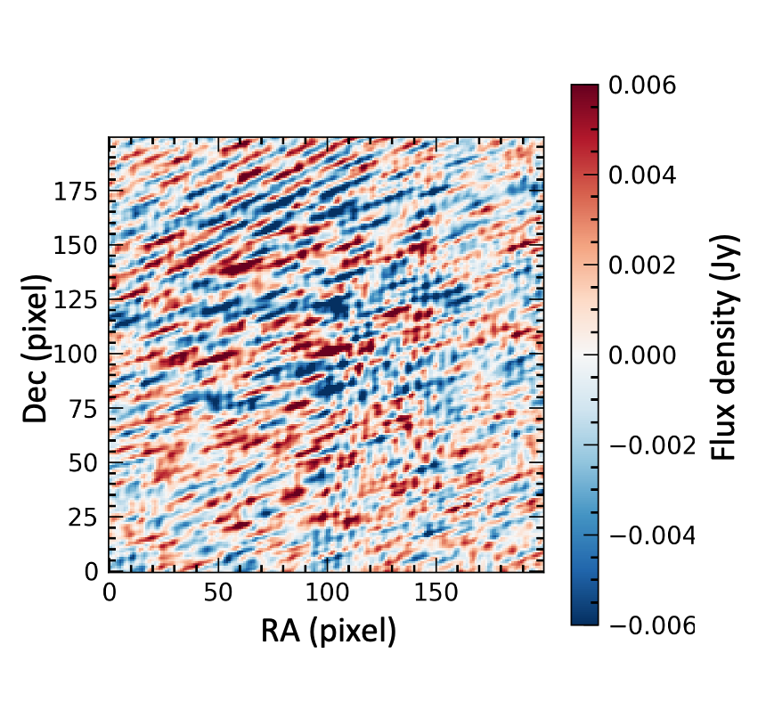
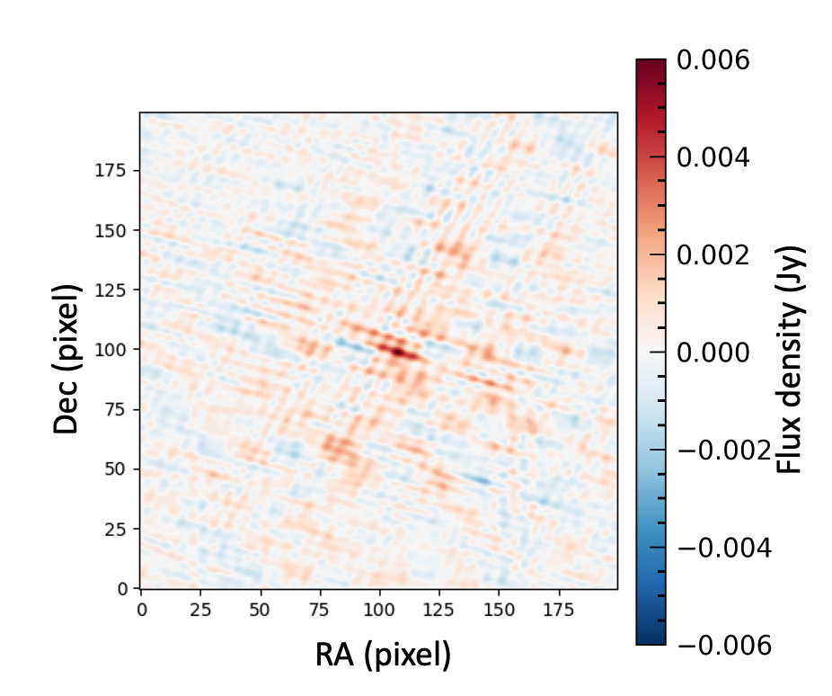
LOFAR snapshot imaging
Bloot et al. (in prep)

Slide 25
Stellar wind constraints
Bloot et al. (2025)

Slide 26
Stellar wind constraints
Bloot et al. (2025)

Slide 27
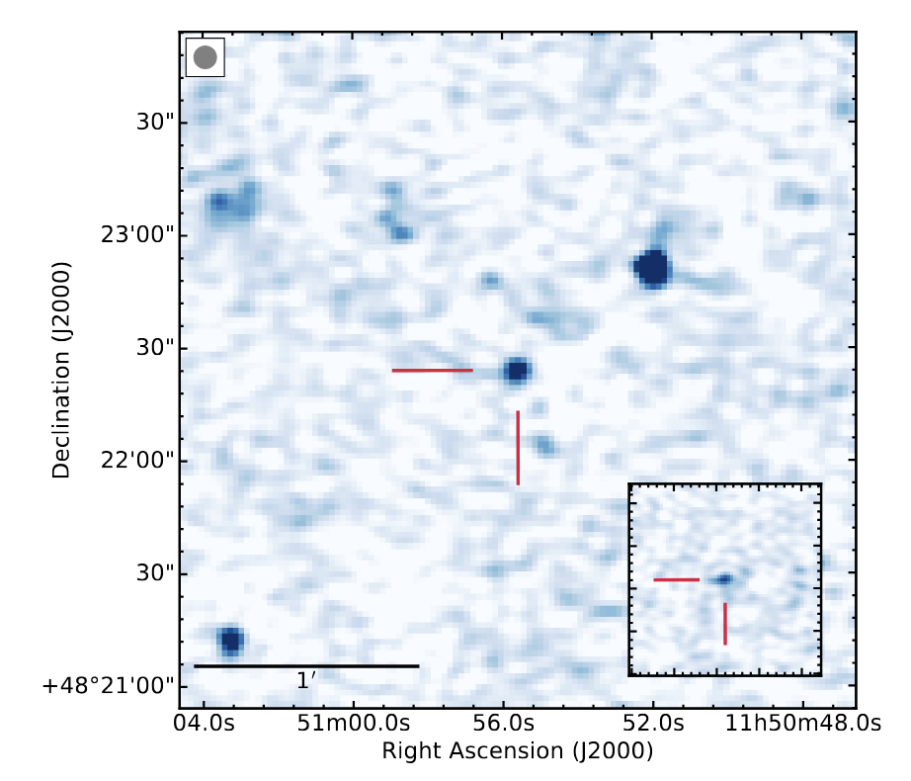
Exoplanet interactions
SPI suggested for GJ 1151 (Vedantham et al. 2020)
No evidence for a short-period planet so far (Pope et al. 2020, Perger et al. 2021, Blanco-Pozo et al. 2023)
Other LOFAR-detected stars studied thoroughly (e.g. Koo et al. 2025)

Slide 28
Stars at low frequencies
Characterise stellar environment
Directly detect coronal mass ejections
Measure magnetic fields
Discover exoplanets?
Image credit: Daniëlle Futselaar

Slide 29
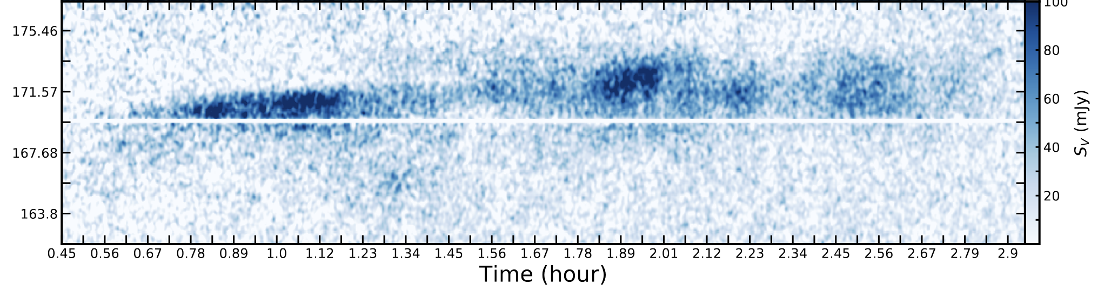
CR Dra
Callingham et al. 2021

Slide 30
Occurence rate

