Slide 1



Hunting Radio Bursts from Exoplanets and Brown Dwarfs with NenuFAR
X. Zhang, P. Zarka, J. Girard, A. Loh,
C. Tasse + the NenuFAR team
LIRA-CNRS, Observatoire de Paris
LOFAR Family Meeting
Paris | 2025-09-26

Slide 2
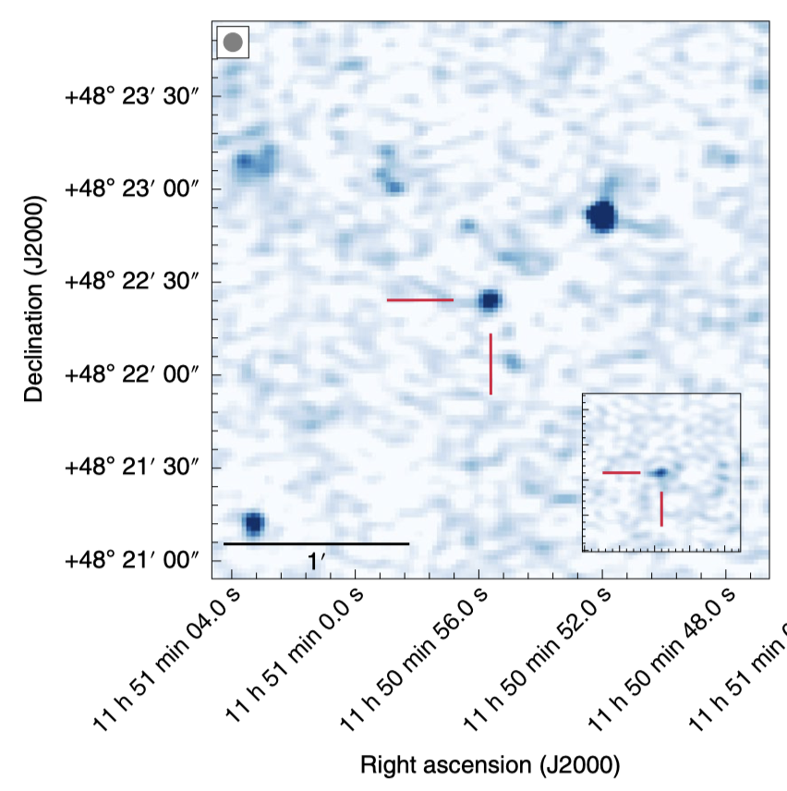
Predictions for Radio-Exoplanets
Magnetospheric → Low frequencies
Star-Planet Interactions → Low & High frequencies
Circular polarization (Cyclotron-Maser Instability)
Possible linear emission
Transients, only detectable at specific orbital phases.
Total intensity image for GJ1151, Vedantham et al. 2020

Slide 3
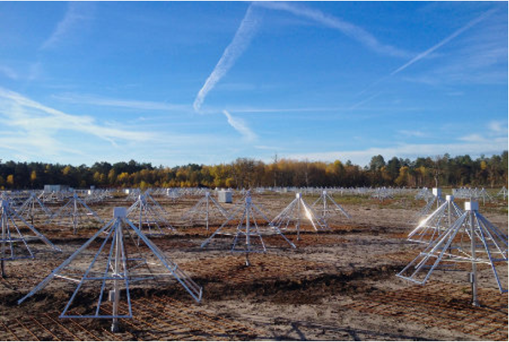
NenuFAR
Dense core (400 m) + remote antennas (~3 km)
Low-frequency (10 - 88 MHz)
High sensitivity @ 20-30 MHz
Low spatial resolution (1 deg @ 20 MHz)

Slide 4
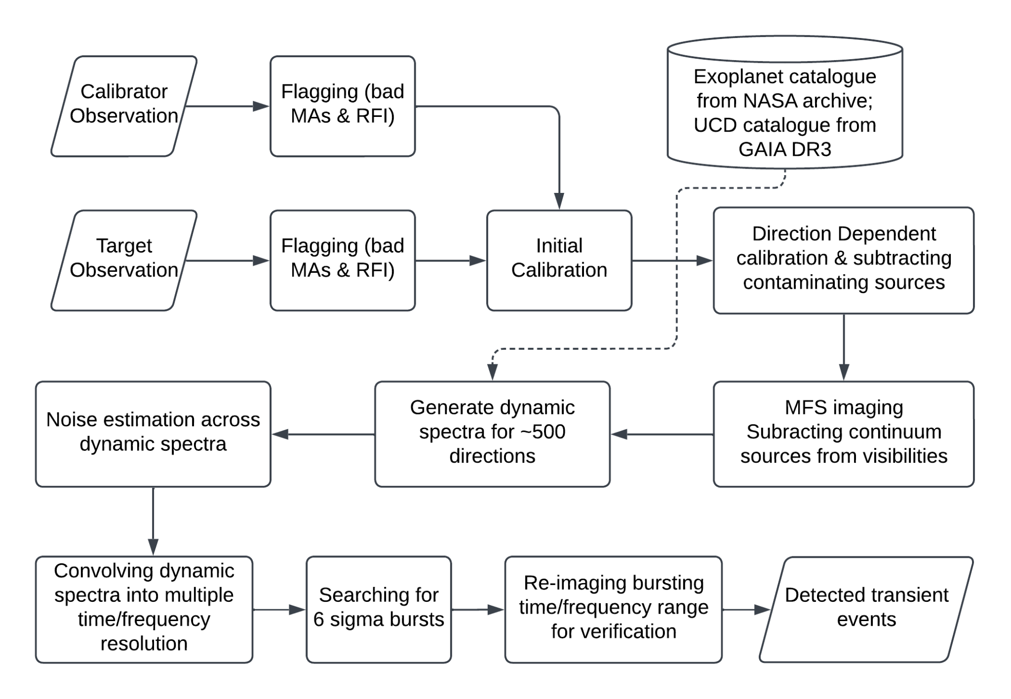
The pipeline
Pipeline optimized for transients:
Direction-dependent calibration
Remove non-variable sources from visibilities
Generate dynamic spectra for multiple directions

Slide 5
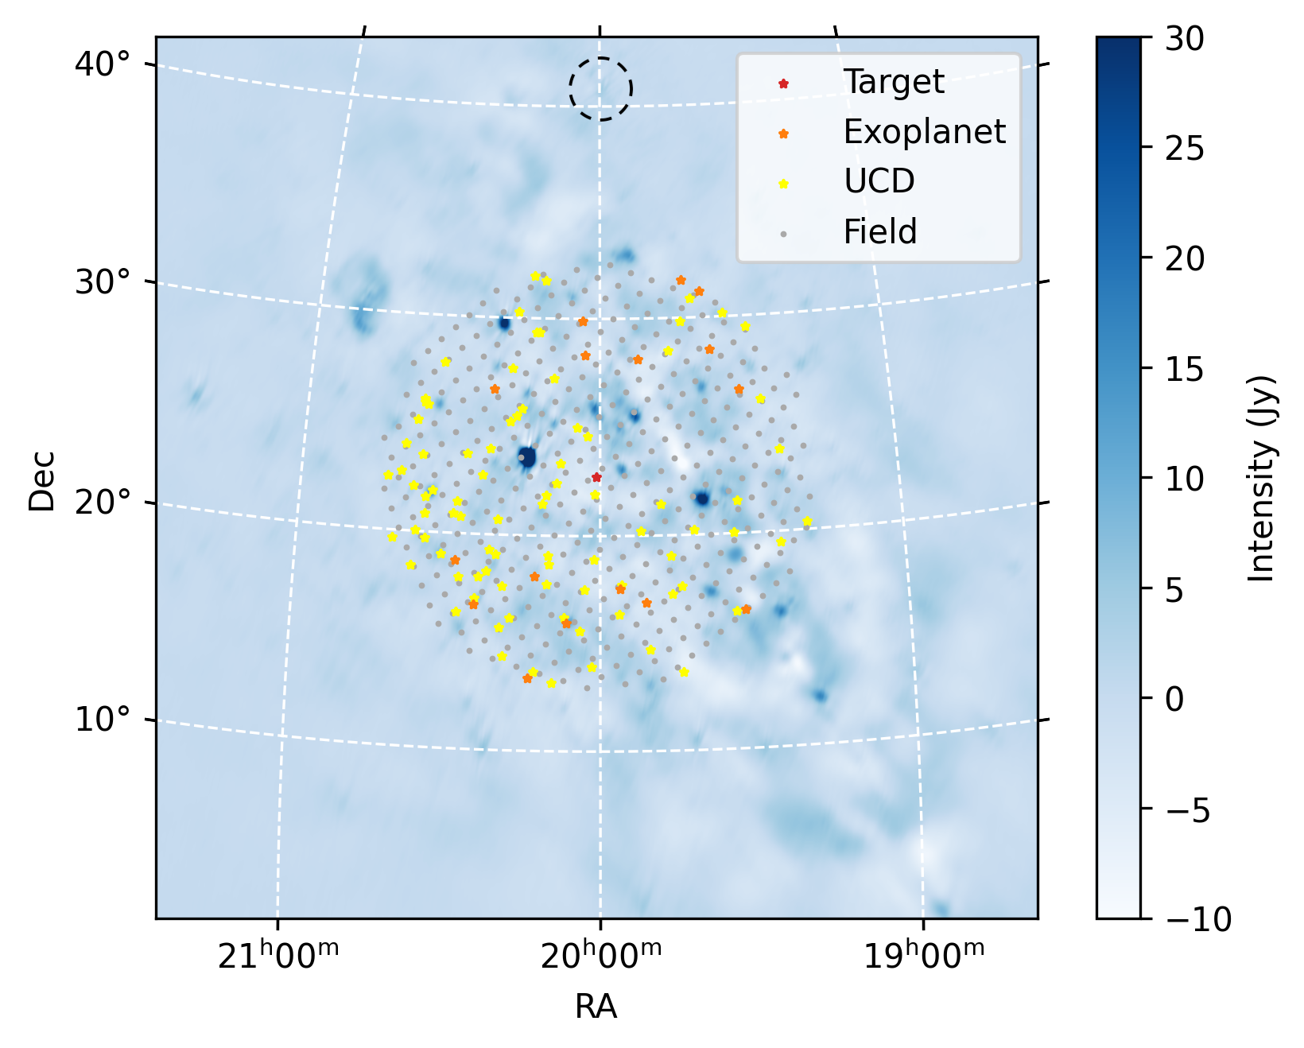
Dynamic spectra, multiple directions
500 “beams” within the FoV!
Primary target
Exoplanets (~20)
Brown Dwarfs (~80)
Field grids (~400, 1 deg separation)

Slide 6
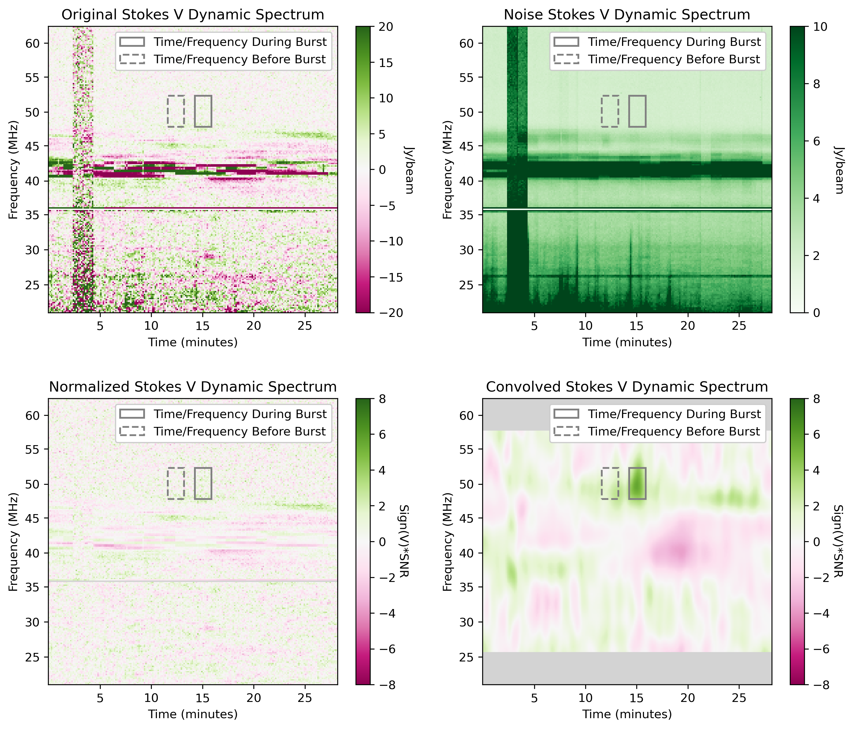
Finding transients in dynamic spectra
Normalisation: flatten the noise
Convolution: multiple time/frequency width to search for transients
Verification: Re-image the bursting time/frequency range.

Slide 7

HD 189733, a case study
The system
K-type primary + M dwarf companion
Hosting a hot Jupiter
19 pc away
40 G magnetic field
Star-planet interaction, yes or no?
ZDI, Ca II K, X ray: yes
Radio: tentative detection (2.7 sigma)
Multiwavelength analysis: stellar activity, not SPI
Stellar wind modeling: planetary emission 21-25 MHz
Low-frequency observation is needed!
Image Credit: ESO/M. Kornmesser

Slide 8
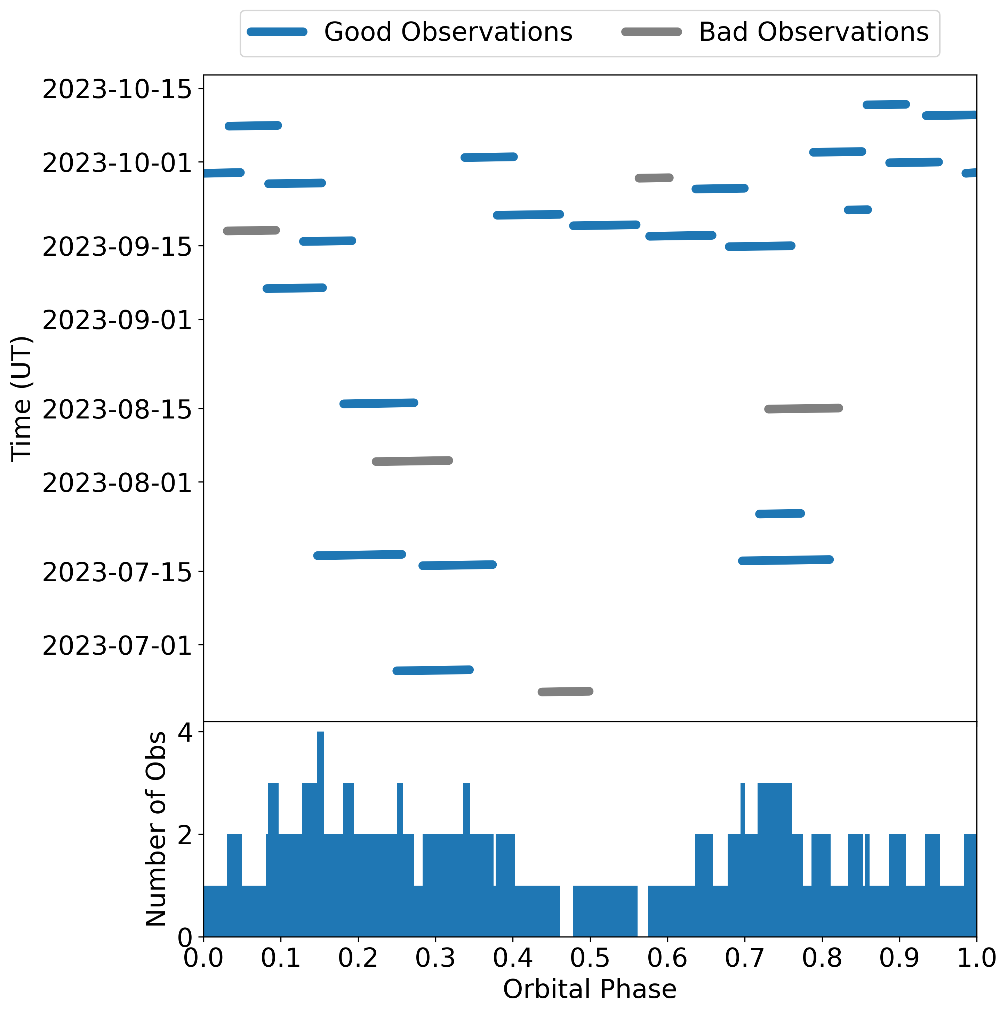
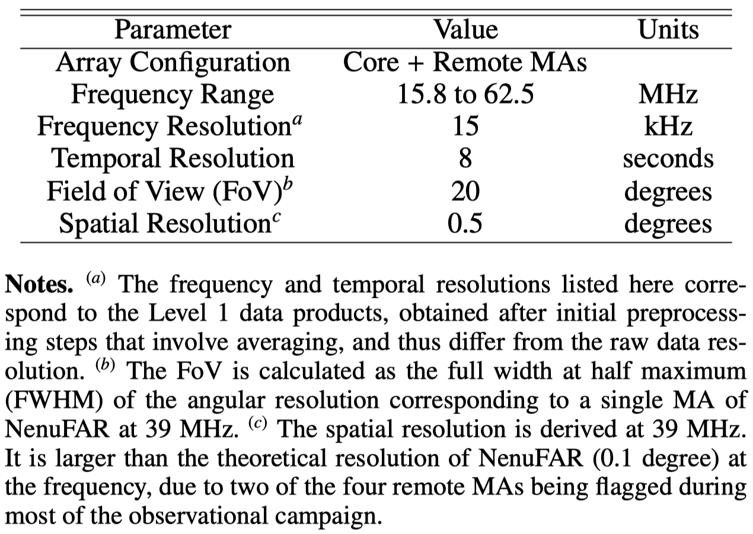
Observations
NenuFAR observed the system for 103 hours (imaging), covering entire orbital phase.

Slide 9
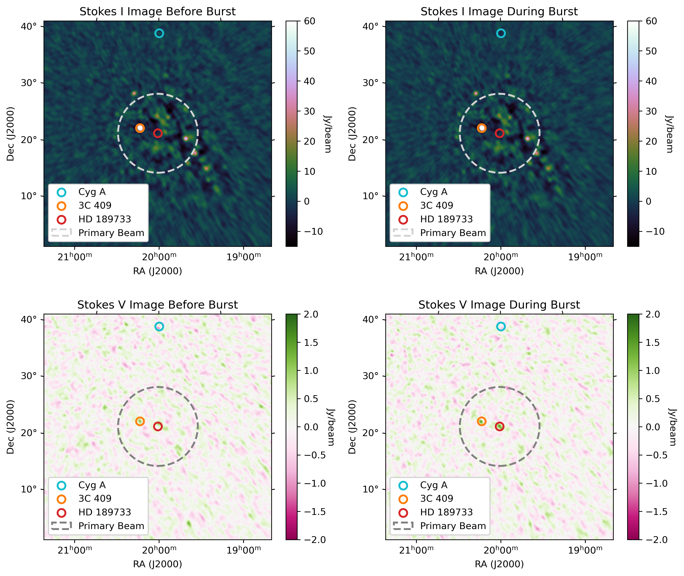
HD 189733
1.5 Jy (6 sigma) burst
1.5 min * 5 MHz
Fractional pol > 38%
Detected at the transit of the planet
No multiwavelength observation available

Slide 10
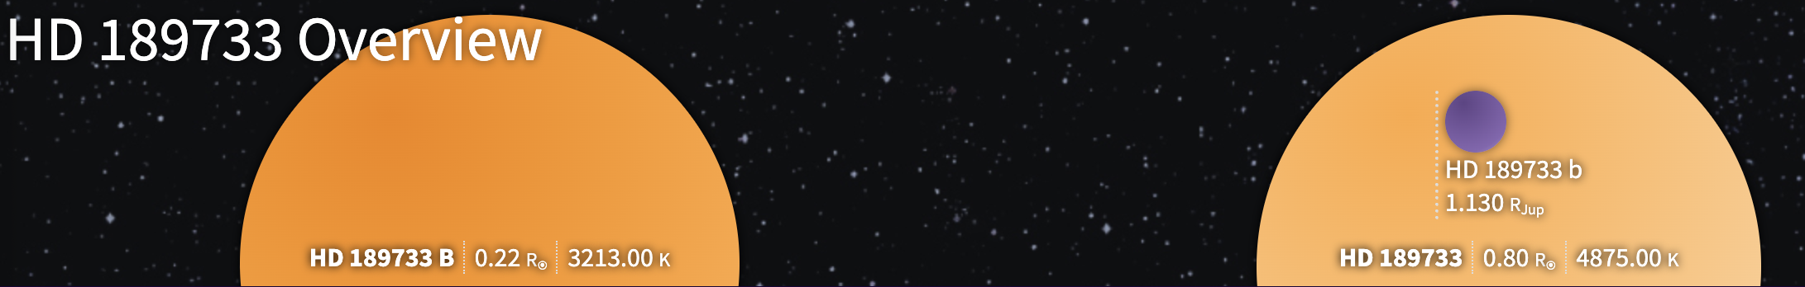
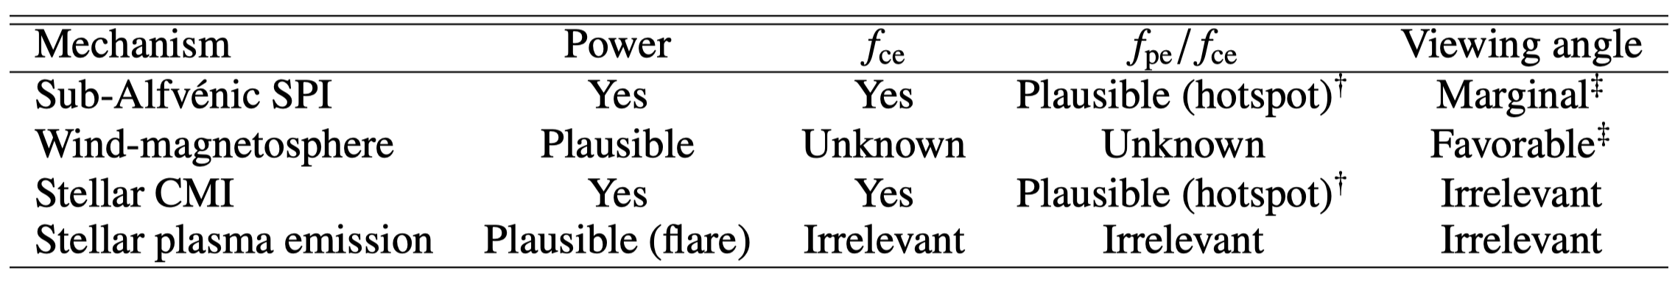
Four hypotheses regarding the burst
1. Star-Planet Interaction
2. Intrinsic Stellar Activity
3. Background M-dwarf (HD 189733 B)
4. Noise Peak
Image Credit: NASA Exoplanet Archive

Slide 11
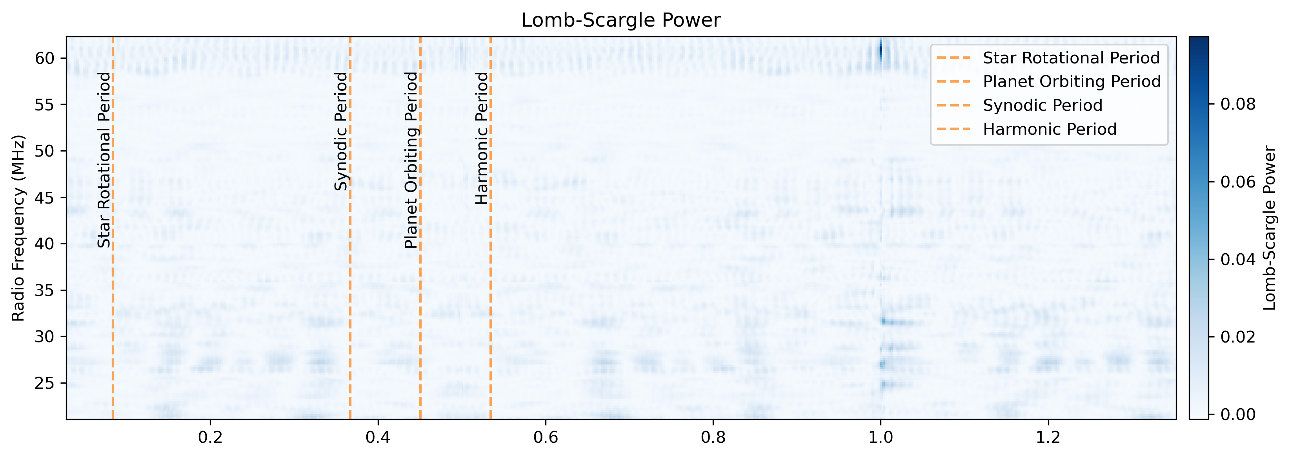
Search for periodicity
Repeating bursts => not noise peak
Lomb-Scargle method
Periods searched:
Star rotation
Planet orbiting
Synodic/harmonic period between the two

Slide 12
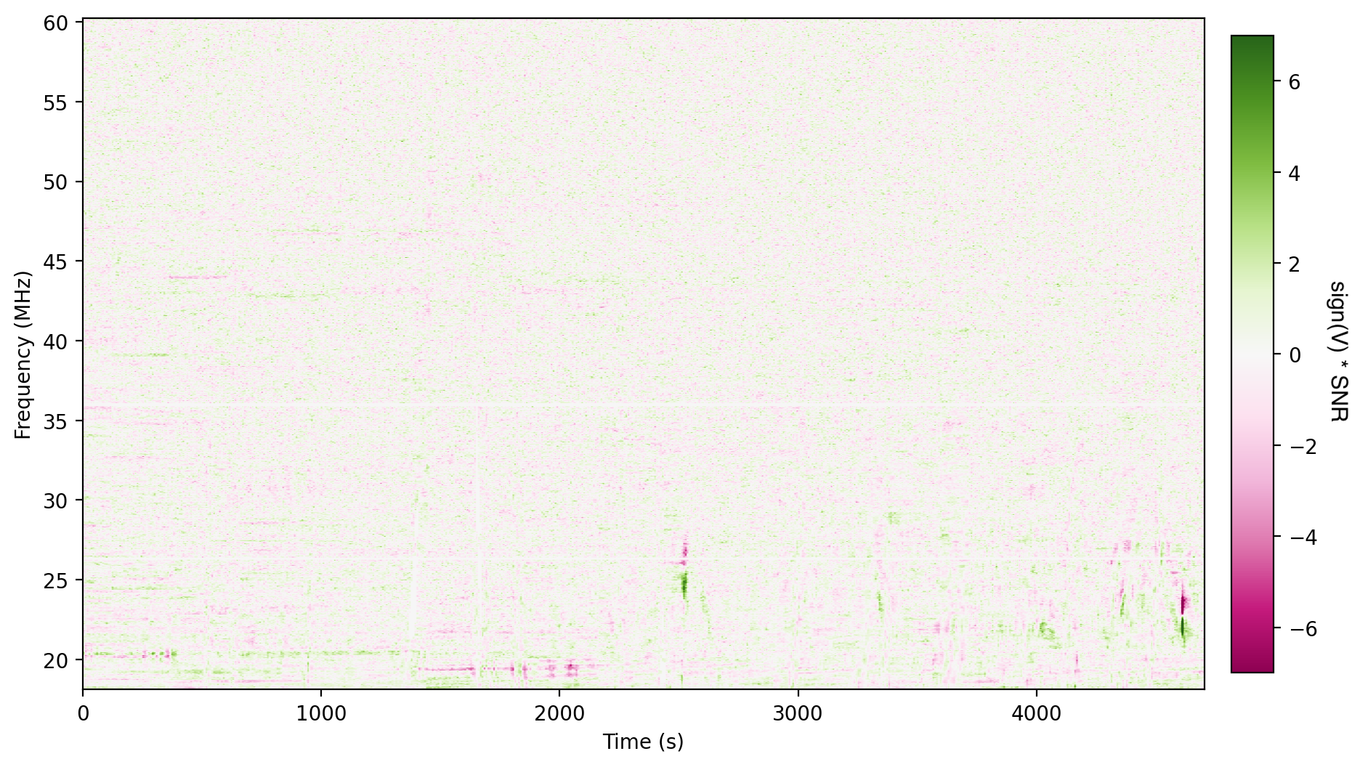
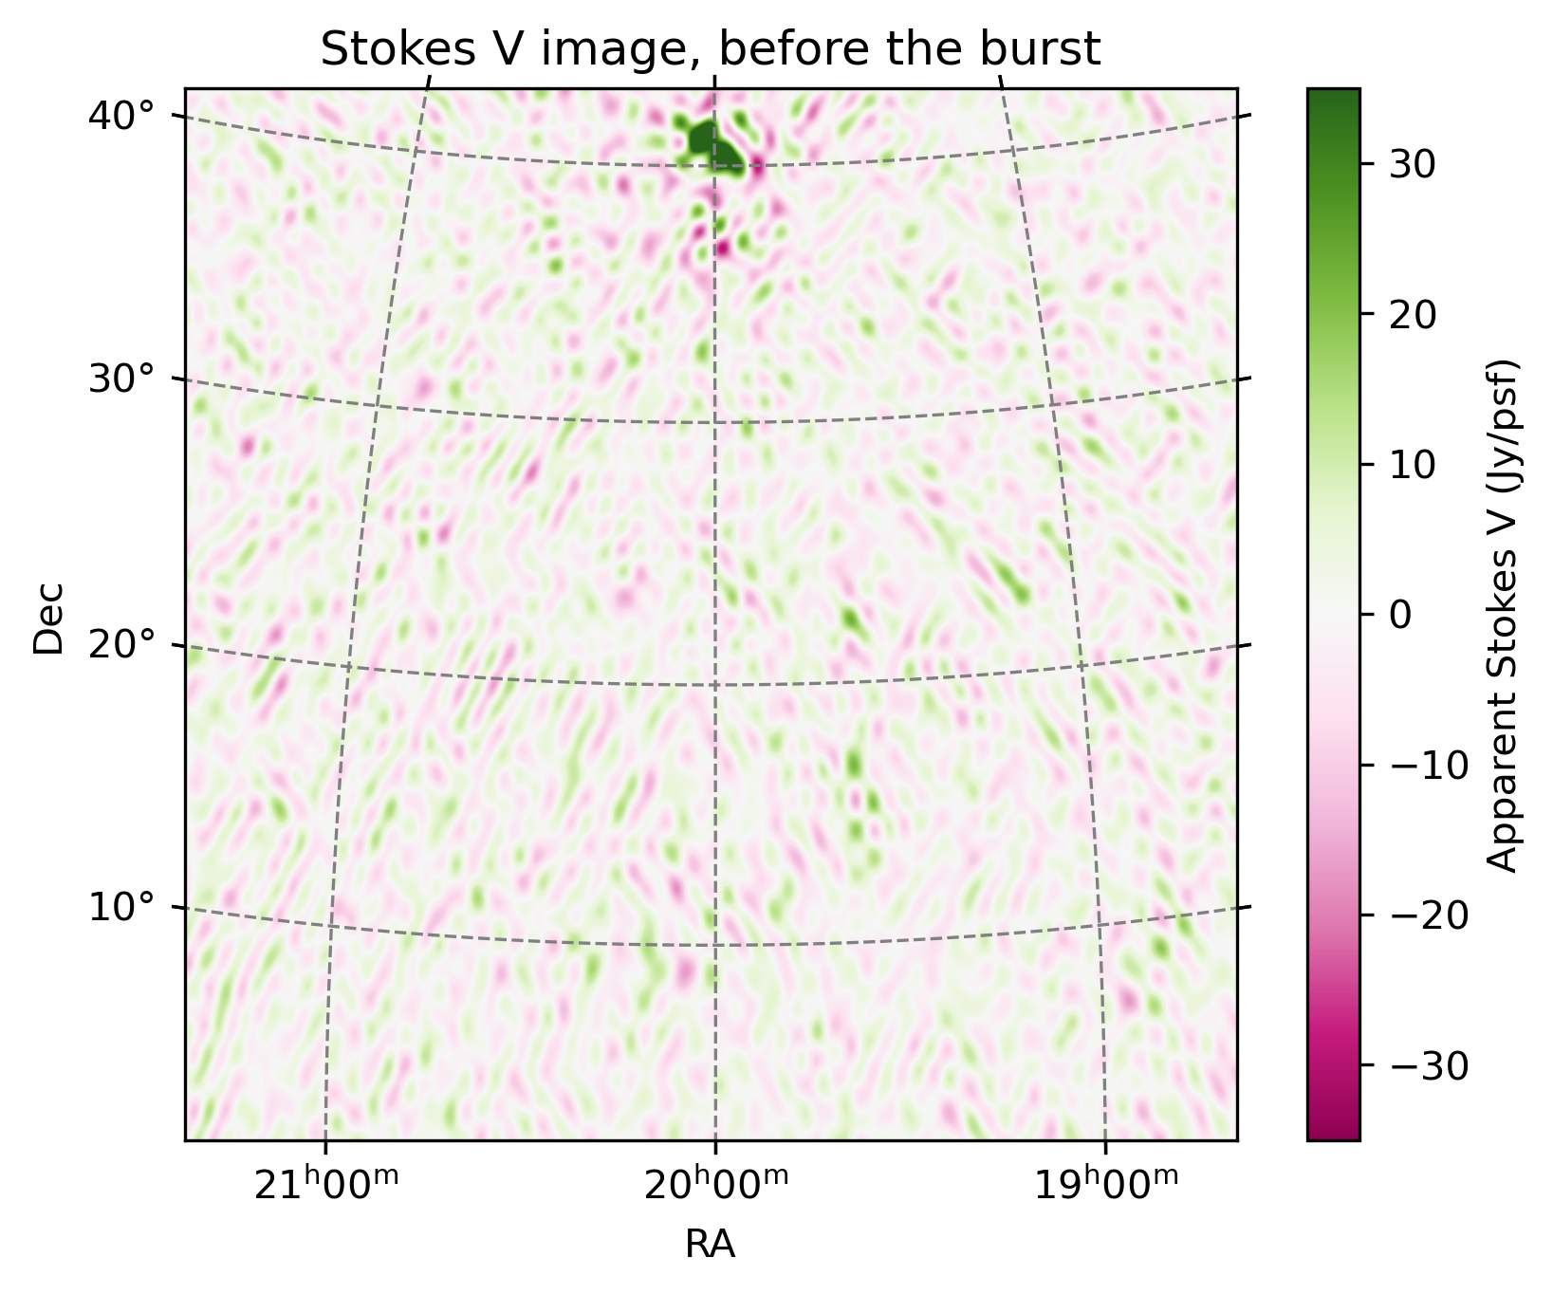
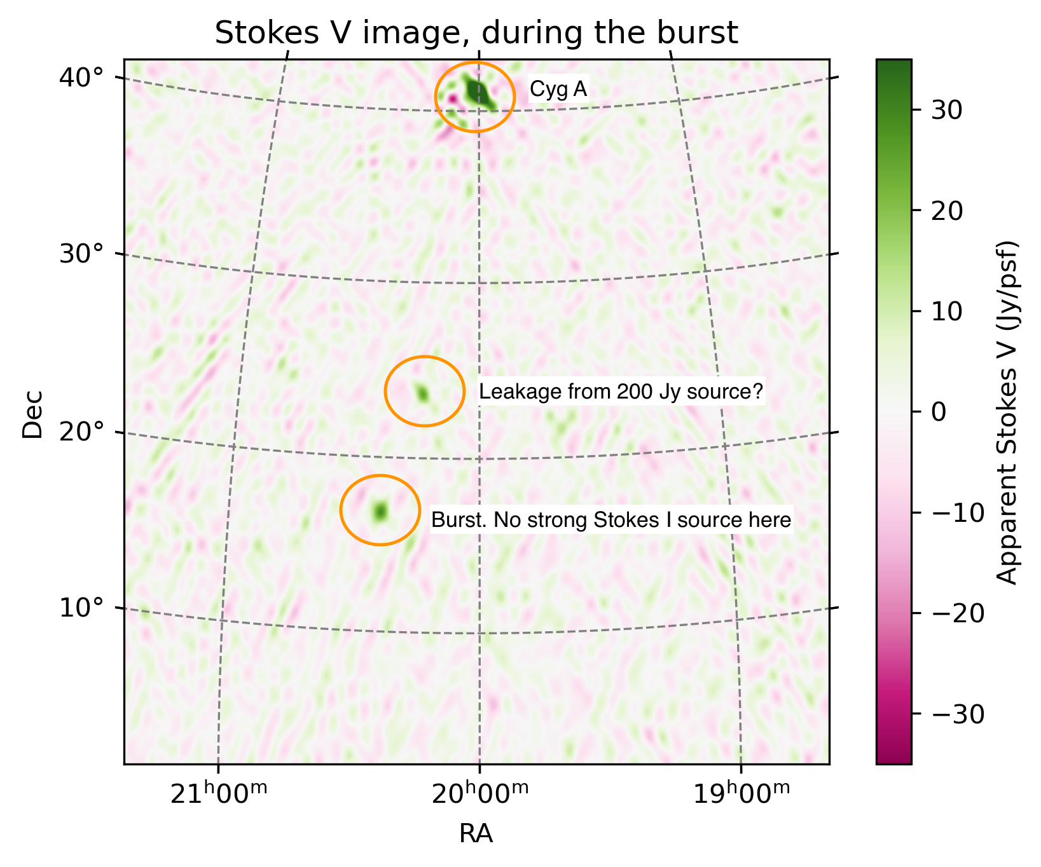
Ongoing work: more candidates from more fields
1000-hour observations; 28 observing fields; 50 transient candidates
Most candidates are normal (blobs), but we’ve seen some weirdos…

Slide 13

Take-away messages
103-hour campaign with NenuFAR on HD 189733
1.5 Jy Stokes V burst detected
No periodicity found
Multiple hypotheses including SPI, stellar emission, background source and noise peak
50 more candidates are being verified
Zhang, X., P. Zarka, J. N. Girard, C. Tasse, A. Loh, E. Mauduit, F. G. Mertens et al. "A circularly polarized low-frequency radio burst from the exoplanetary system HD 189733." Astronomy & Astrophysics 700 (2025): A140.

