Slide 1

Richard A. Fallows (1), Biagio Forte (2), Steve Milan (3), David J. Jackson (4), Bernard V. Jackson (5), Dusan Odstrcil (6,7), Edmund Henley (4), Oyuki Chang (1), David Barnes (1), Matthew Bracamontes (5), Siegfried Gonzi (4), Paul Kinsler (2). (1) RAL Space, United Kingdom Research And Innovation - Science & Technology Facilities Council - Rutherford Appleton Laboratory, Harwell Campus, United Kingdom; (2) Department of Electronic and Electrical Engineering, University of Bath, Bath, United Kingdom; (3) School of Physics and Astronomy, University of Leicester, Leicester, United Kingdom; (4) Met Office, Exeter, United Kingdom; (5) Department of Astronomy & Astrophysics, University of California, San Diego, San Diego, USA; (6) George Mason University, Department of Physics and Astronomy, Fairfax, USA; (7) NASA Goddard Space Flight Center, Heliophysics Division, Greenbelt, USA.
RISER – Using LOFAR to Track Space Weather Through the Heliosphere-Magnetosphere-Ionosphere System

Slide 2
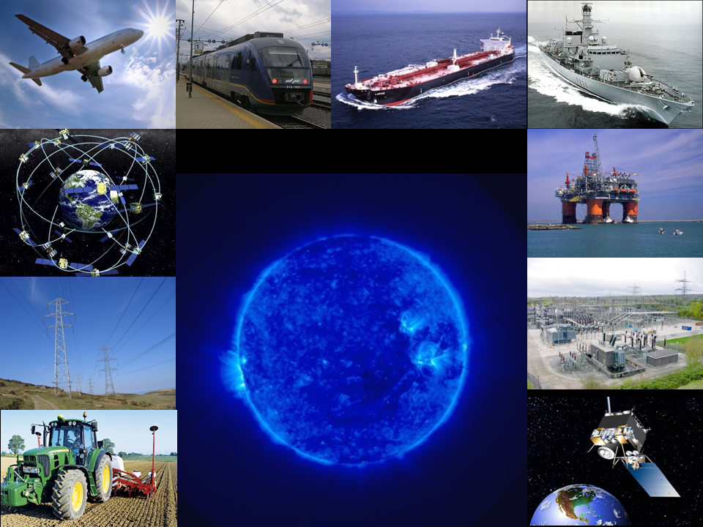
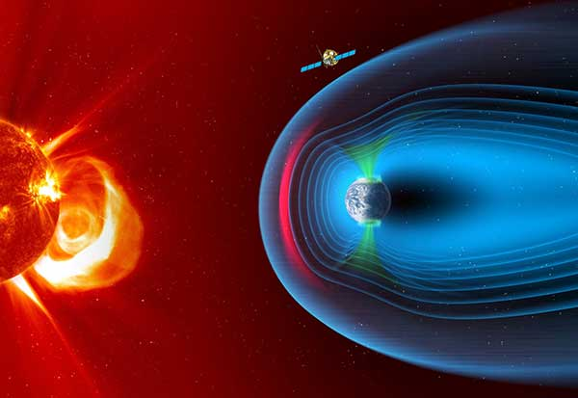
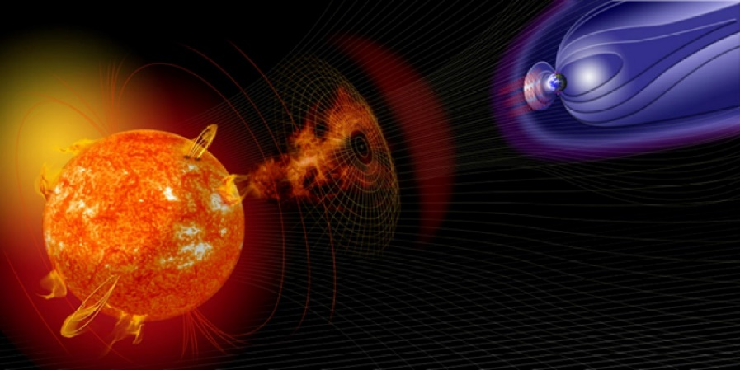
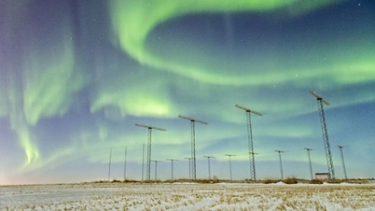
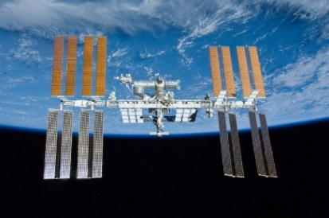
Space Weather Impacts…
…on many human activities!

Slide 3
What is RISER?
RISER is a £3.7M FEC NERC-funded (NE/X019004/1) Large Environment 5-Year Project (commenced 01 September 2023 – Kick-Off Meeting 06-08 September 2023) to addresses the chain of events through which the Sun creates adverse space-weather conditions at Earth and within the Earth’s space environment.
RISER aims to investigate how the LOw Frequency ARray (LOFAR) can be utilised for continuous and accurate tracking of inner-heliospheric and ionospheric plasma structures, combined with magnetospheric modelling, leading to more-precise and advanced forecasts of space-weather conditions and their impacts at Earth.
RISER will provide a comprehensive understanding of the Earth’s space-environment through the use of novel radio observations and modelling techniques to investigate coupling between solar-driven inner-heliospheric structures and the Earth.

Slide 4
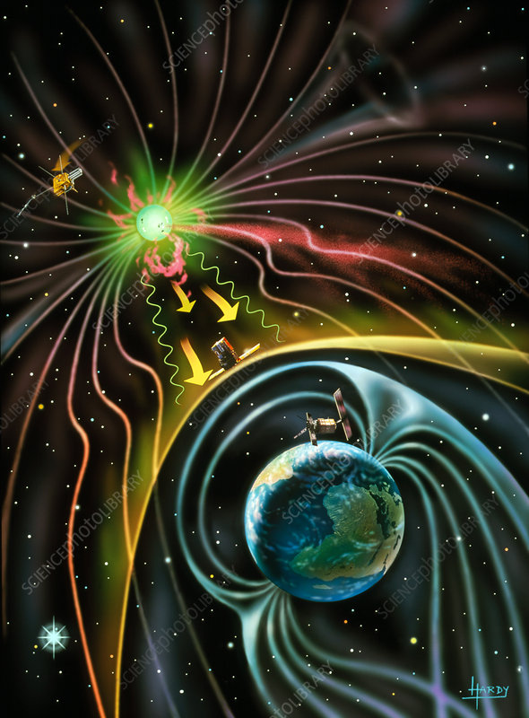
Magnetospheric Connection…
Improve space weather forecasts using Sun-to-Earth radio data.
Move from 1-D (L₁ monitoring) to 3-D space situational awareness.
Provide validation and calibration using global-scale ground- and space-based networks of observatories, and simulations.
Resolve solar wind structures on scales relevant to solar wind-magnetosphere coupling.
Estimate the geoeffectiveness of incoming solar wind hazards.

Slide 5
RISER WPs Gantt Chart…
We are here!

Slide 6
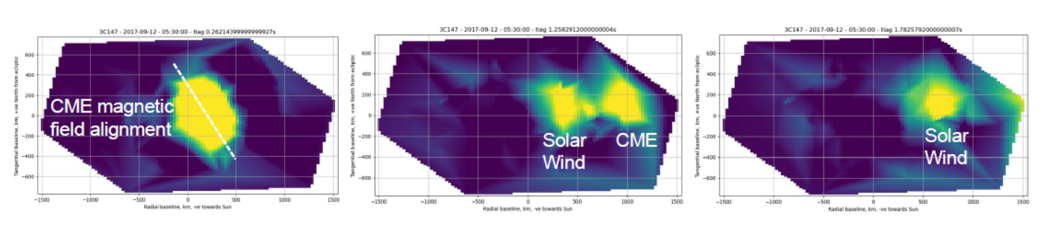

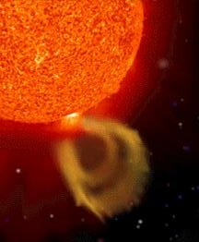

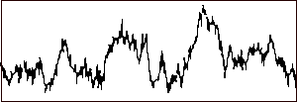

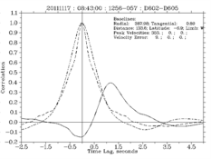
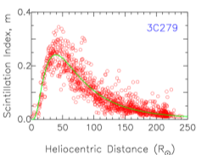
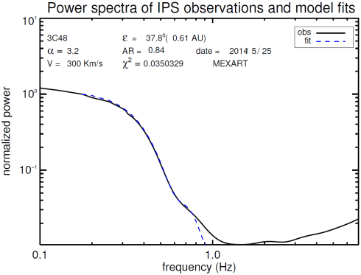
Radio Techniques in RISER…
Imaging turbulent structure
Ionospheric scintillation
Solar wind velocity, density/turbulence, and signatures of field rotation and SIRs
Interplanetary scintillation (IPS)
from compact radio source
Cross-correlation of power spectra → velocity
Variation in amount of scintillation → density proxy
Fit to individual power spectra → velocity etc…

Slide 7
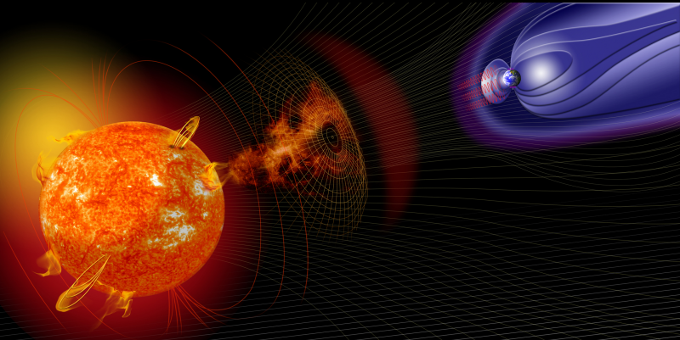
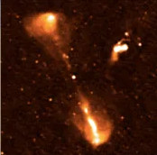
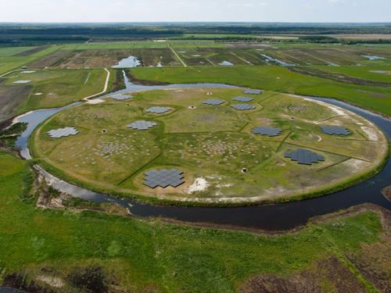
LOFAR4SW Upgrades…
Make one telescope into two:
With NO effect on normal astronomy operations!
Critically, RISER provides the funding for upgrading the UK LOFAR station to space-weather capabilities… (Funded under the Horizon 2020 Programme H2020 INFRADEV-2017-1 under grant agreement 777442; 2017-2022).

Slide 8
Worldwide IPS Stations (WIPSS) (1)
The WIPSS Network is an international collaboration of ground-based radio observatories observing IPS over a significant range of longitudes around the world…
ISEE: Institute for Space-Earth Environment Research (Japan) [observes in near real time]
LOFAR: Low Frequency Array (Europe) [nominally a science instrument, but currently undergoing 24/7 testing]
MWA: The Murchison Widefield Array (Australia) [nominally a science instrument, but regular IPS observations are underway]
MEXART: Mexican Array Radio Telescope (Mexico) [calibration problems being investigated]
Pushchino Radio Astronomy Observatory (Russia) [unknown status]
ORT: Ooty Radio Telescope (India) [currently offline, but work underway to bring back into action]
Chinese Meridian-II IPS system (China) [currently undergoing commissioning]
LWA: Long Wavelength Array (USA) [interest in observing IPS]

Slide 9
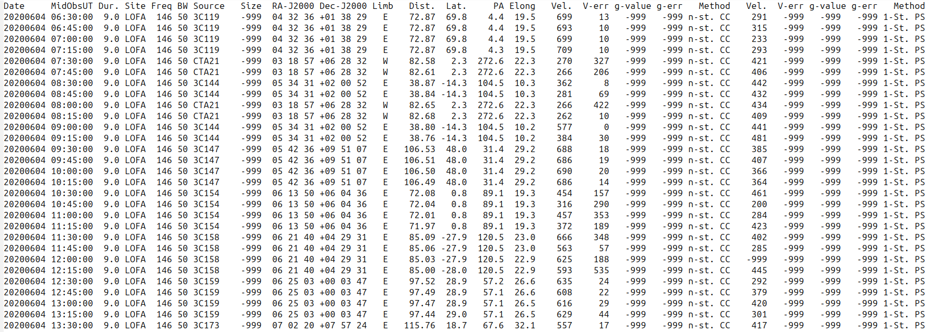
Worldwide IPS Stations (WIPSS) (2)
WIPSS Network IPS Common Data Format (IPSCDFv1.0 and v1.1)…
IPS data can be folded into the University of California, San Diego, 3-D tomography to provide heliospheric reconstructions of the inner heliosphere in both density and velocity with the ability to also include ambient magnetic fields…

Slide 10
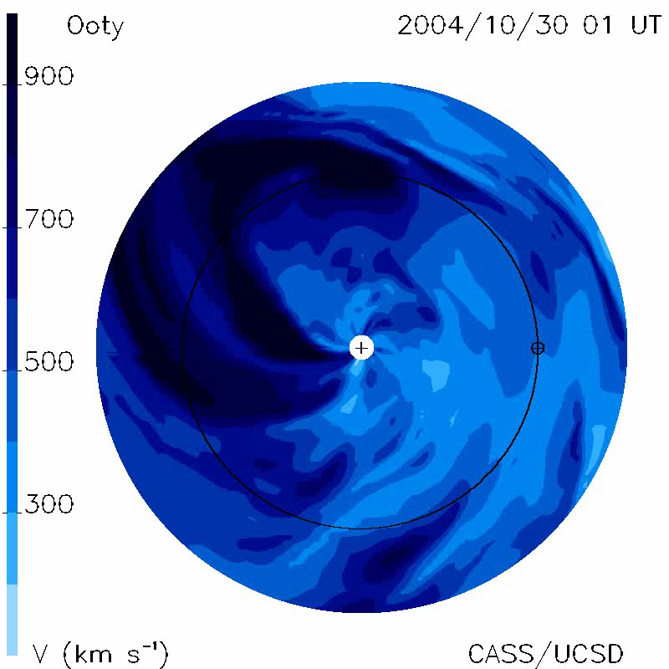
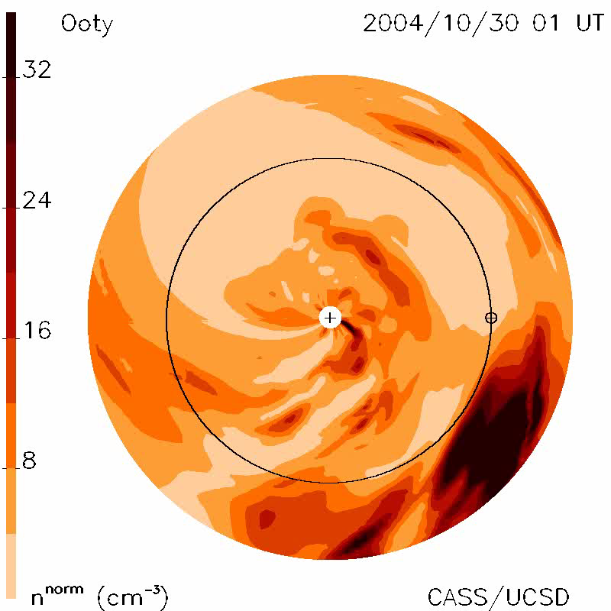
Worldwide IPS Stations (WIPSS) (3)
Using the UCSD 3-D Tomography for space-weather reconstructions of the inner heliosphere in this detail…?
See Bisi et al., Ann. Geophys., 2009 for further details…

Slide 11
RISER Key Steps to Date…
We have a fully established LOFAR IPS data processing pipeline (updated from the initial LOFAR4SW version).
UCSD tomography and IPS Enlil are being tested for research and in real time with multiple IPS data sources.
Taking advantage of the LOFAR2.0 Network shut down:
LOFAR-UK Station (UK608) currently running in real time with IPS and ionospheric observations 24/7;
Coordination across other LOFAR stations are currently underway;
See Richard Fallows’ talk tomorrow for further details…
Multiple case studies at Earth with various space-weather phenomena causing enhancements in the Earth’s space environment have been selected.
Two-year progress meeting just completed last week to fully finalise the linkages into the magnetospheric modelling…

Slide 12
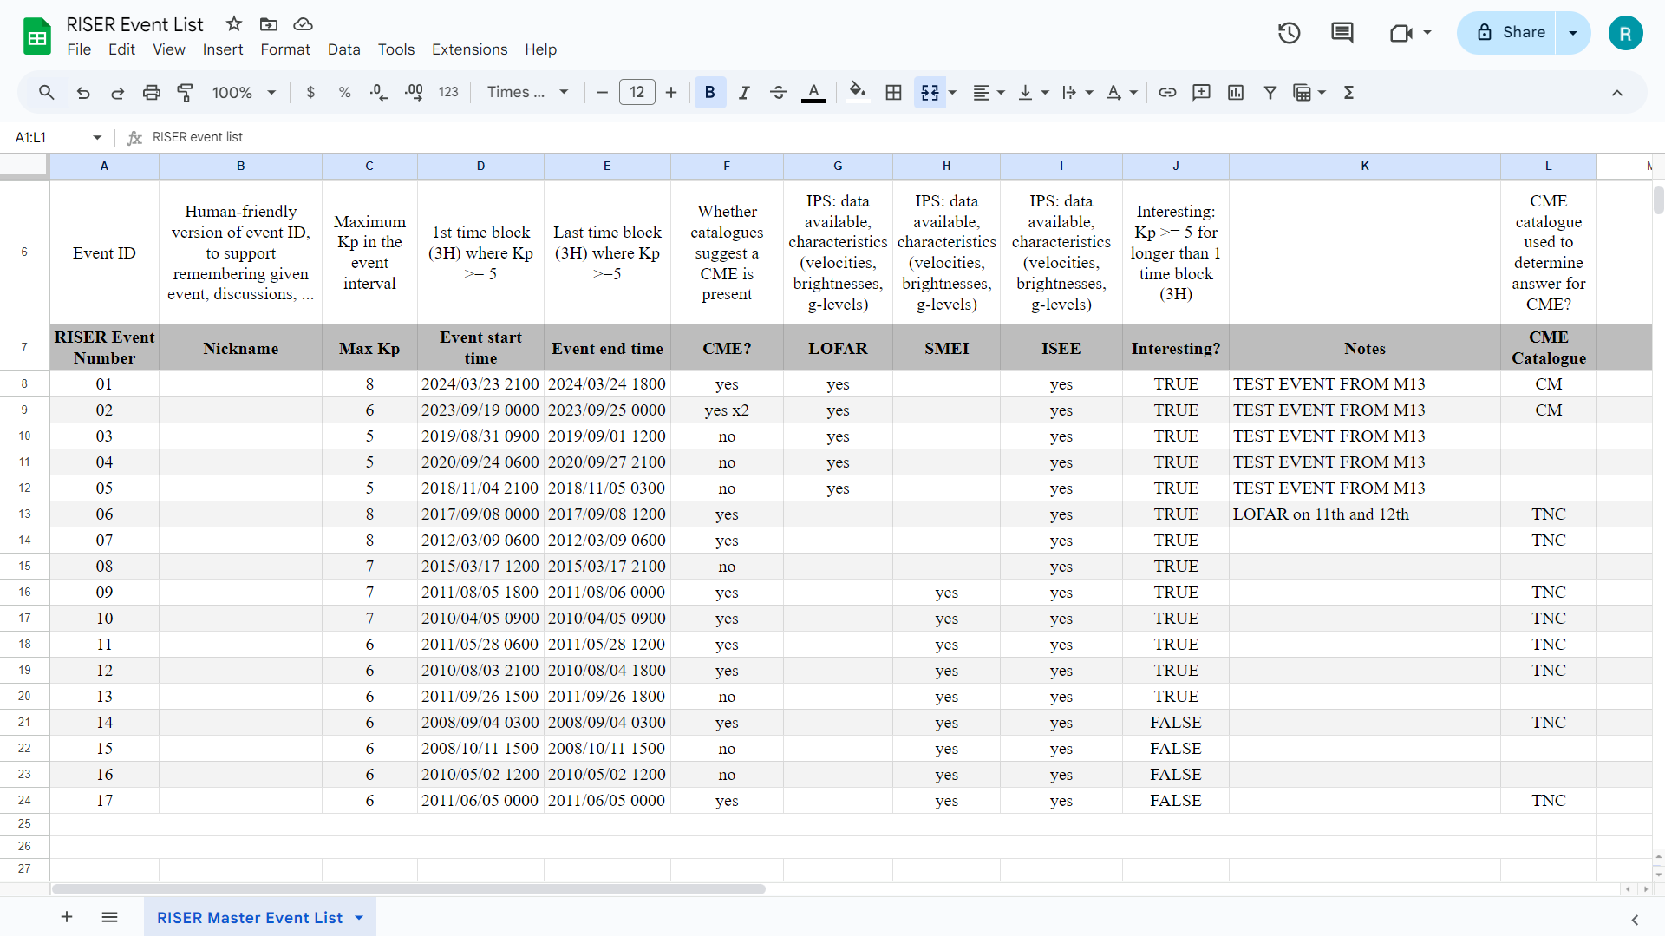
RISER Event List…
This list is now expanded to include more 2024 and 2025 interesting event periods…

Slide 13
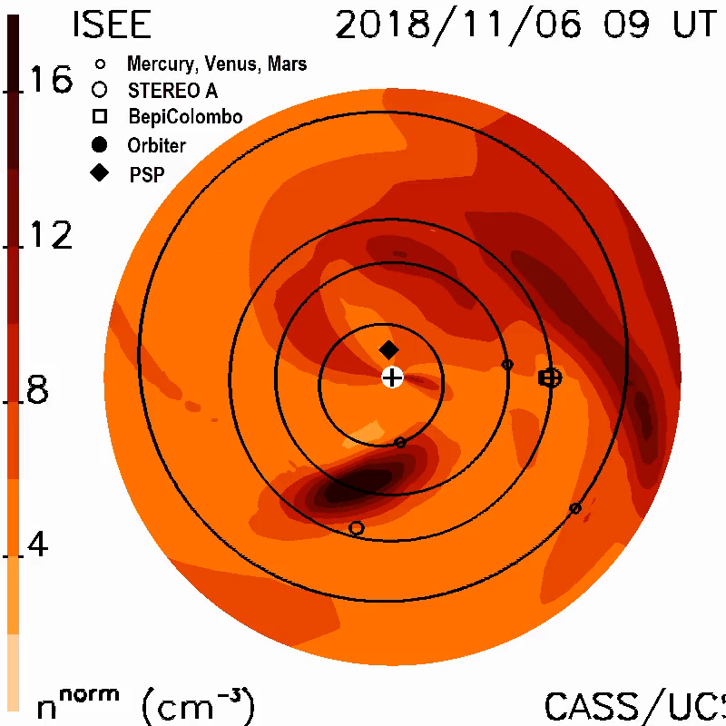
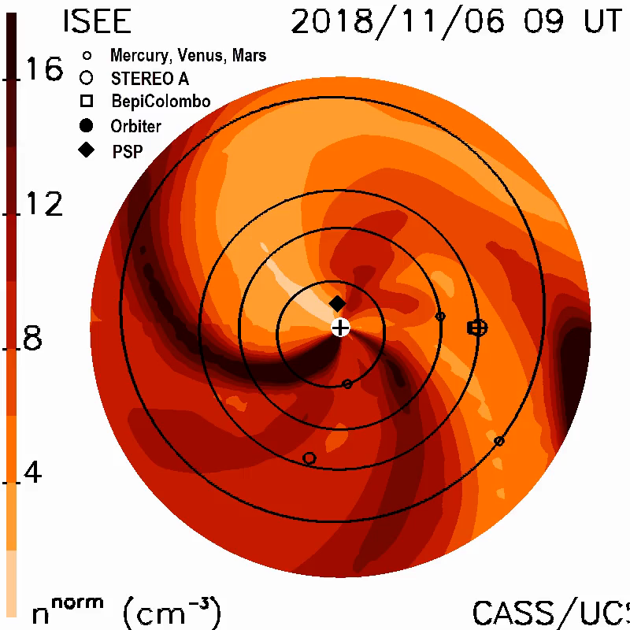
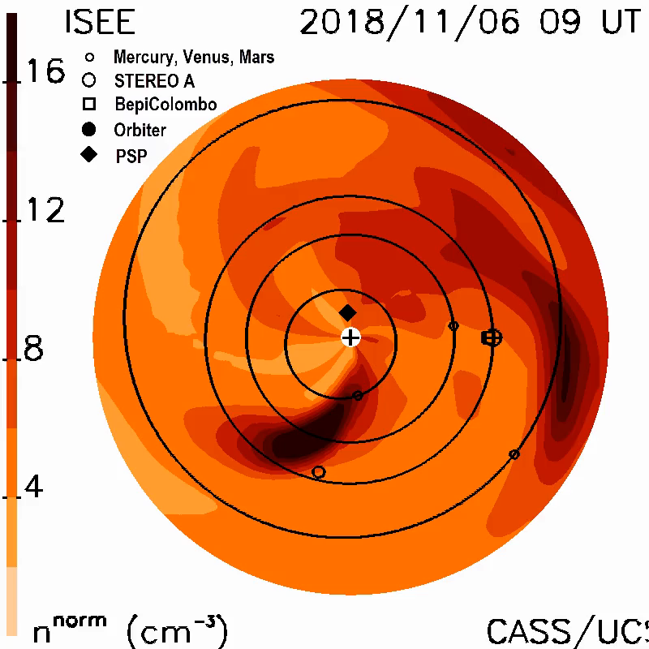
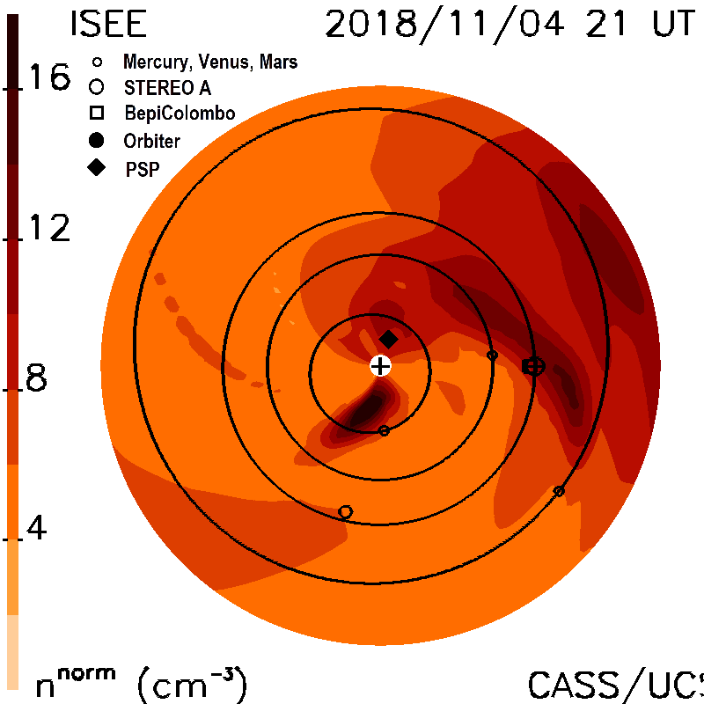
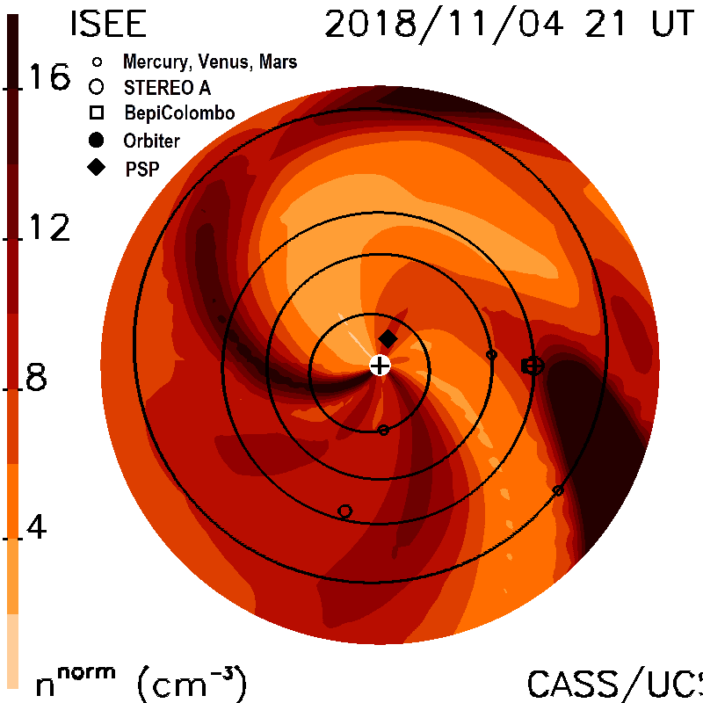
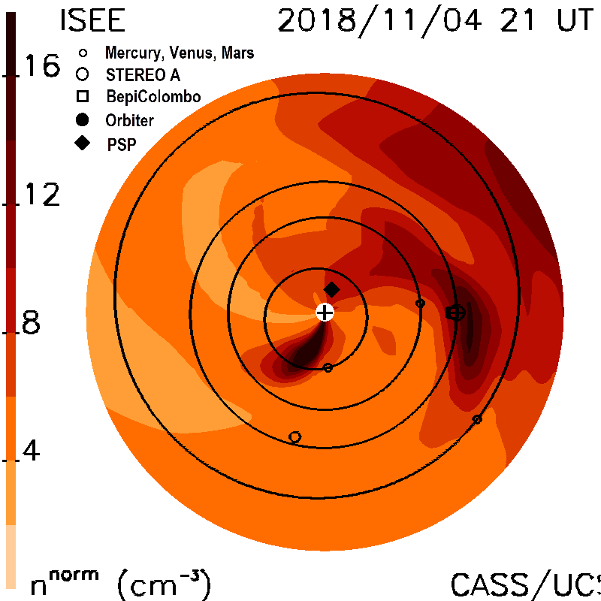
RISER Event #05 (04/11/2018) – Kp5

Slide 14
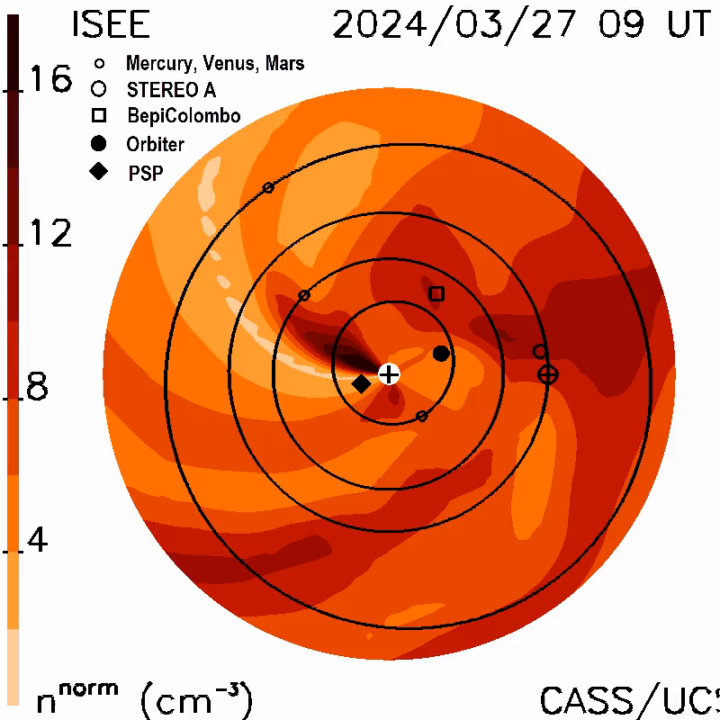
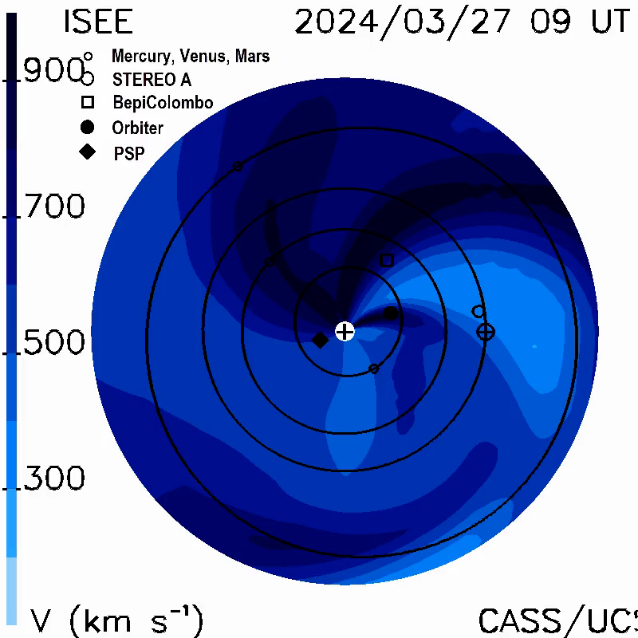
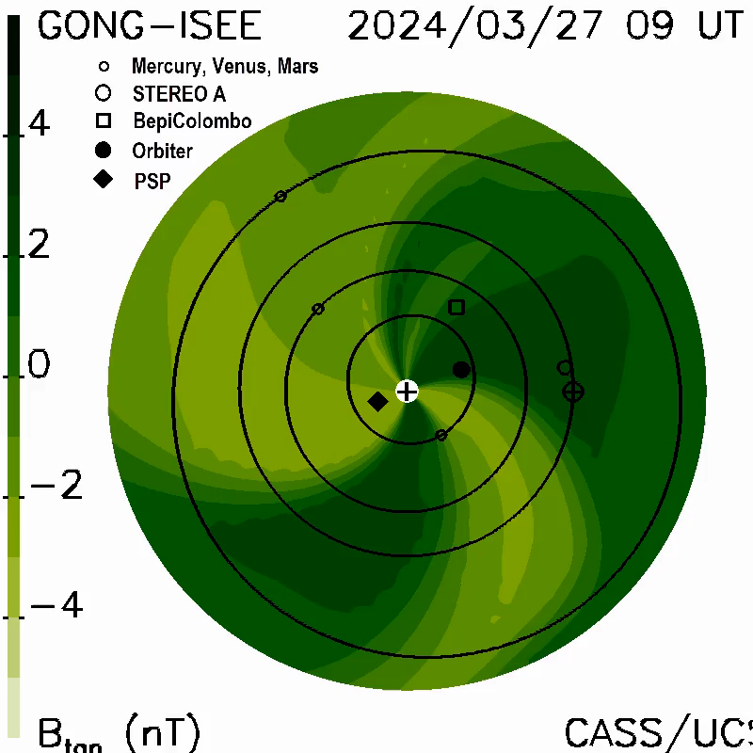
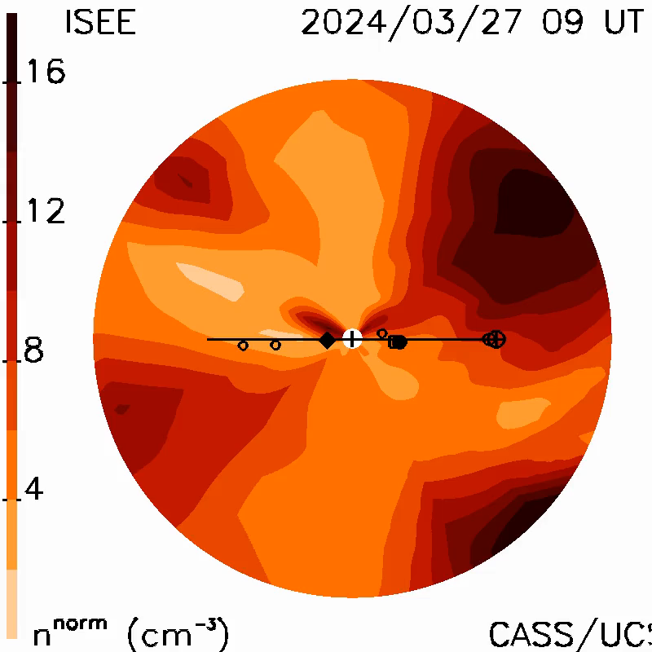
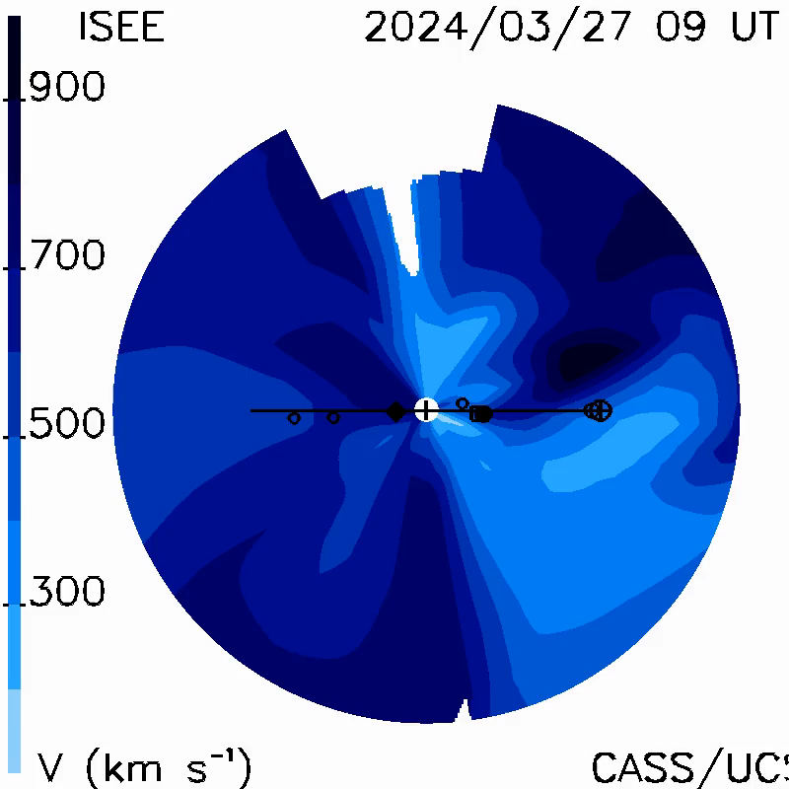
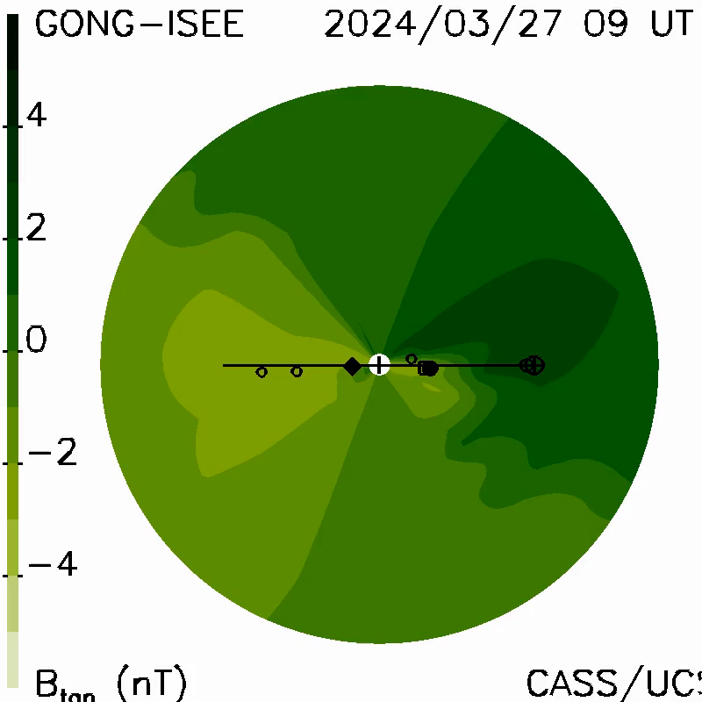
RISER Event #01 (24/03/2024) – Kp8

Slide 15
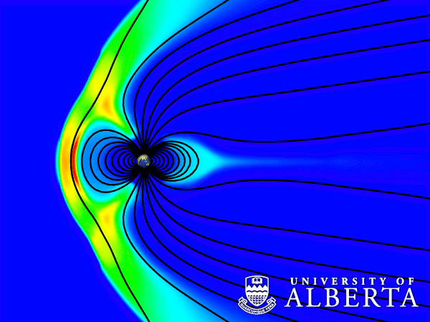
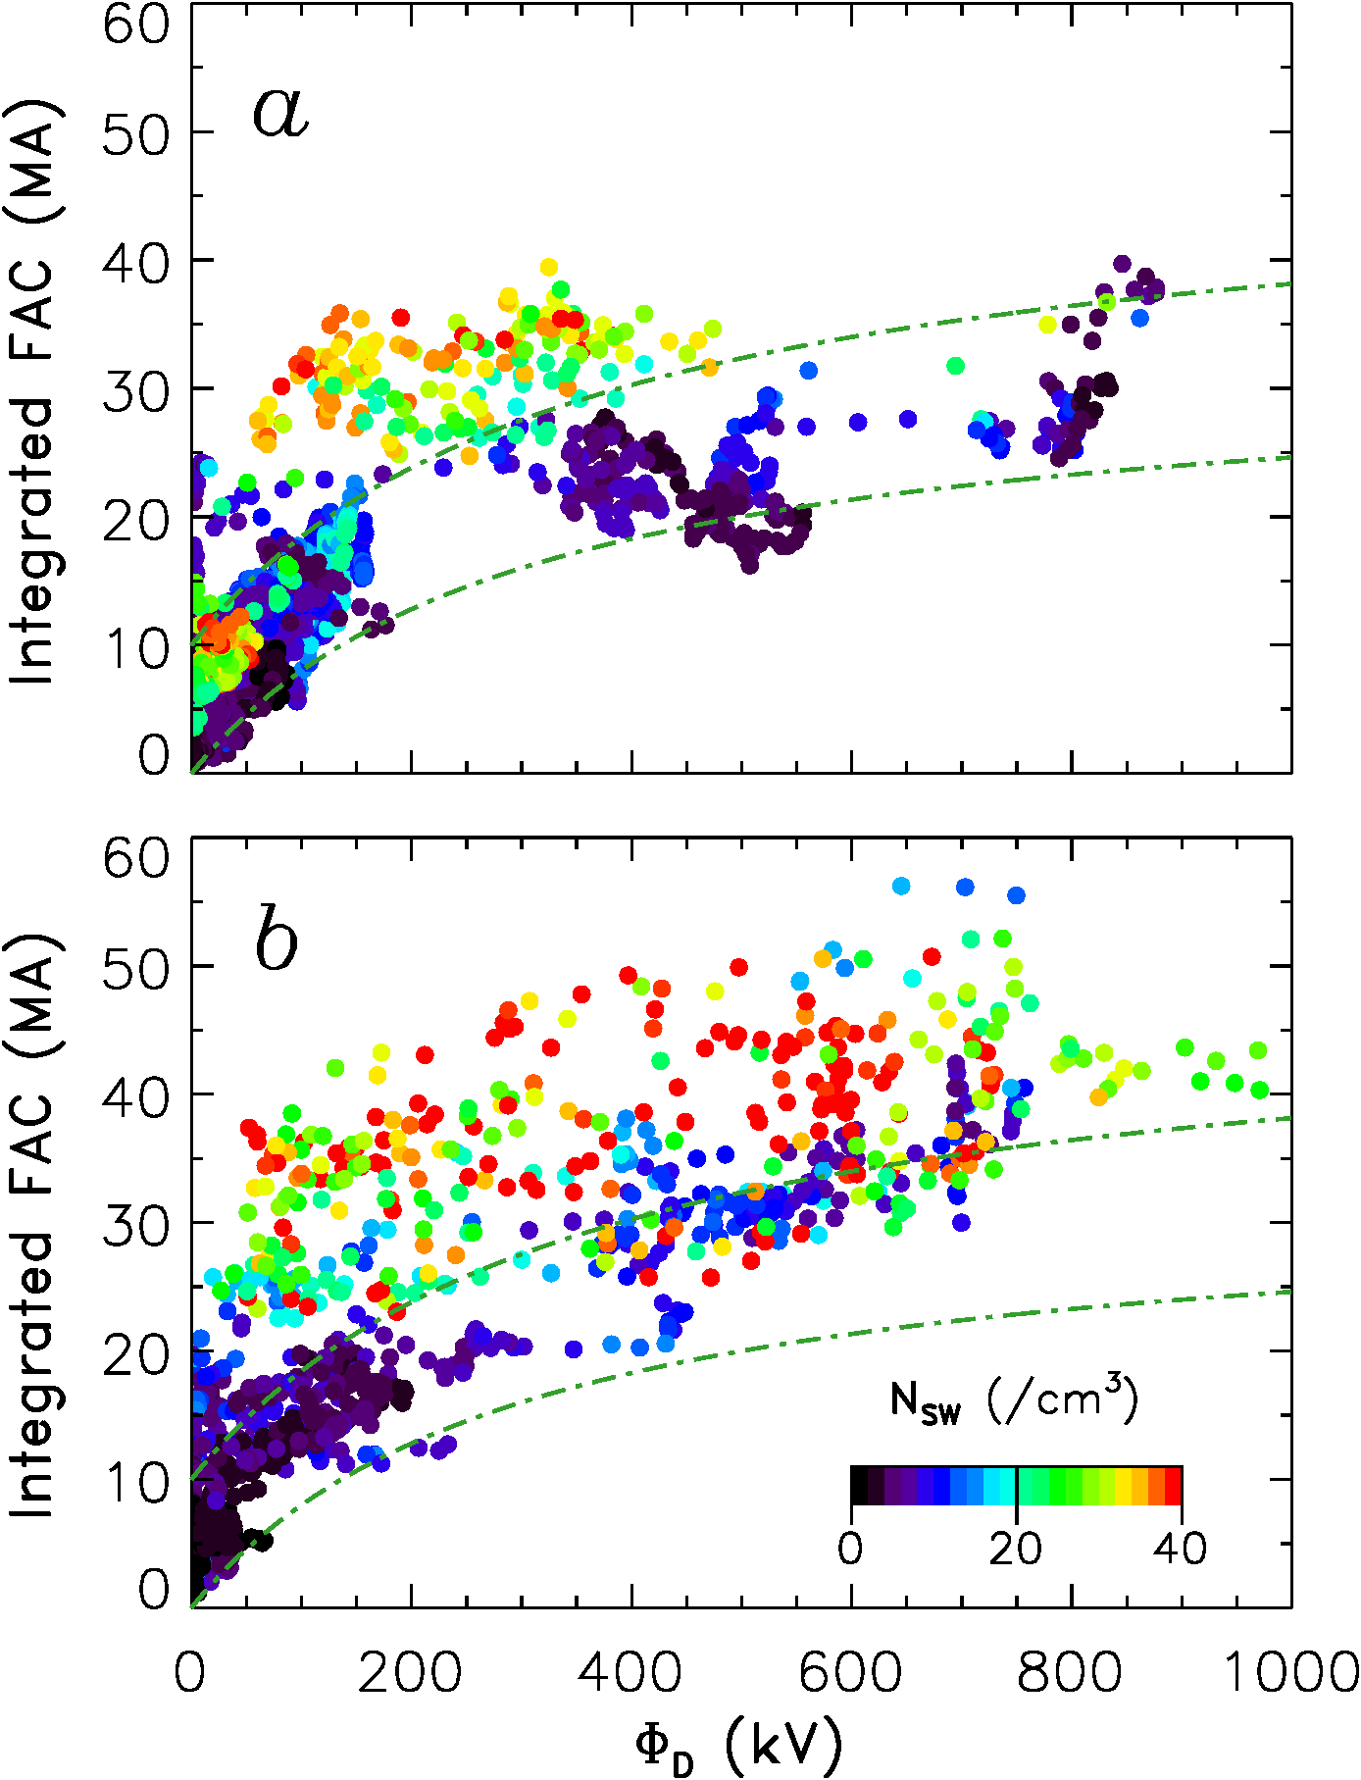

Into the Magnetosphere…
Solar wind-magnetosphere-ionosphere coupling
Steve Milan and Michaela Mooney
University of Leicester
Credit: University of Alberta
Dependence of geomagnetic activity on dayside reconnection and solar wind pressure
Oct 2024
Understanding the magnetospheric response to solar wind perturbations
Geoeffectiveness of solar wind structures – predictive power of IPS observations
Causes of ground magnetic perturbations, dB/dt, and GICs
Effects of transverse solar wind structure
May 2024
plasma
density
RISER Events 25/26 and 20…

Slide 16
Magnetosphere/Ionosphere…
We will use boundary conditions from the UCSD 3-D tomography to drive IPS ENLIL (replacing WSA/Cone).
We will use the L₁ data extraction from the tomography and the IPS ENLIL runs to drive magnetospheric modelling.
Replacing the L₁ data currently used.
We will also use extractions from around a grid around the L₁ point to compare and investigate transverse structures.
All of these will be looked at for event onsets and impacts at the Earth.
LOFAR ionospheric observations can also then be used to monitor and observe the impacts on the ionosphere.

Slide 17
RISER: Fitting everything together…

Slide 18
Take Aways…
RISER will truly demonstrate heliospheric and ionospheric radio capabilities for space-weather research, monitoring, and forecasting potential.
RISER will provide a link in the chain for sub-L₁ modelling inputs for magnetospheric modelling.
RISER ionospheric data can measure impacts at Earth.
RISER IPS data can be used in conjunction with other WIPPS Network IPS data for the UCSD tomography.
RISER IPS data and modelling can be used for direct comparison to other data sets and models.
Further details and updates from the RISER project will be provided on the RISER website in due course…
https://www.ukssdc.ac.uk/RISER/

