Slide 1
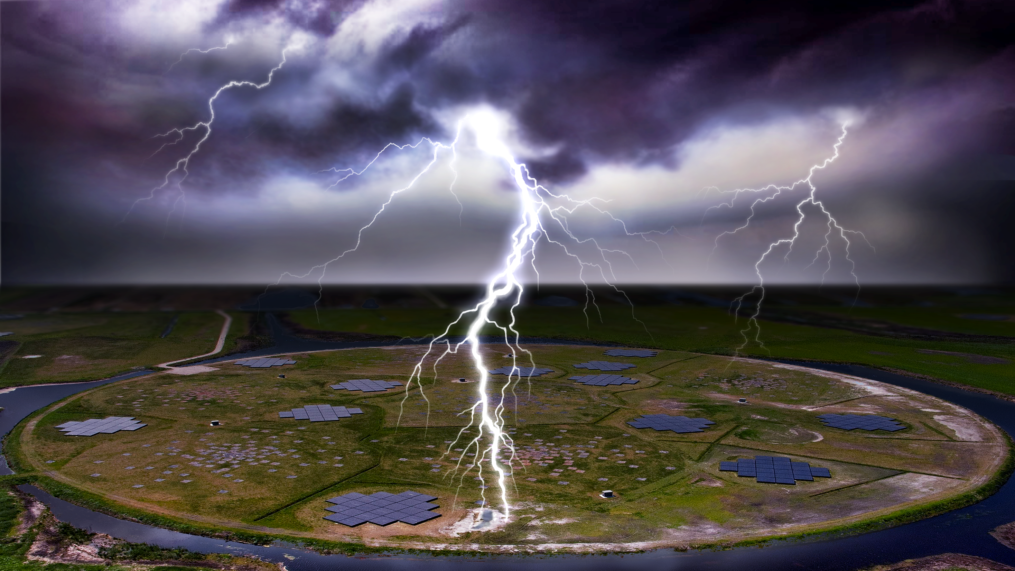
Advancing Understanding of Lightning Initiation through LOFAR Beamforming and ATRI-D
Chris Sterpka and the LOFAR Lightning group

Slide 2
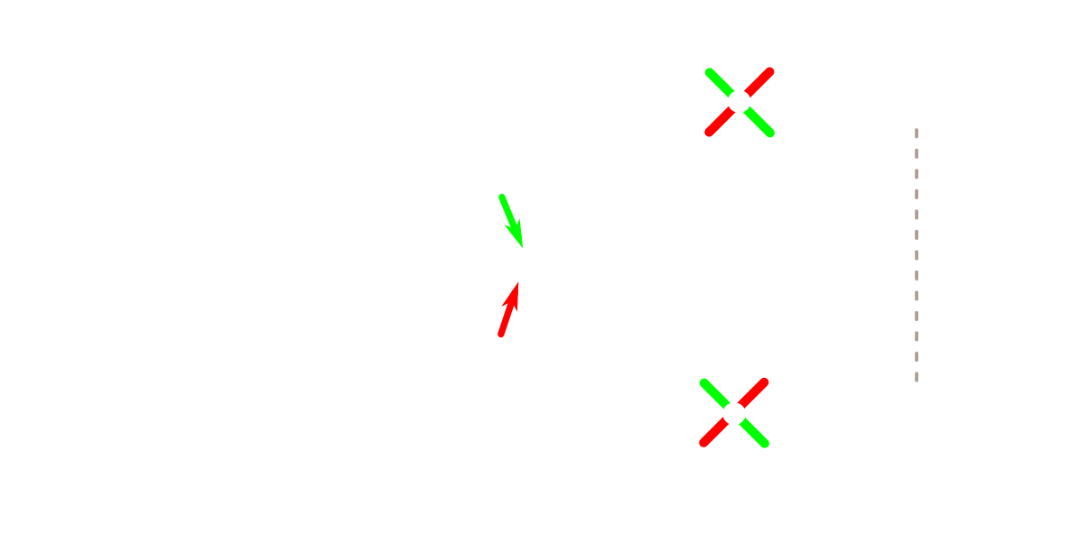

Near-Field Interferometry of Lightning with LOFAR
Two antennas observe different polarizations for the same source
0
1
0
1

Slide 3
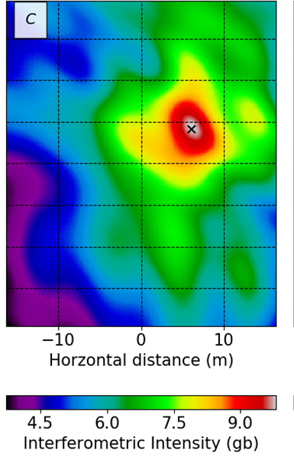


Beamforming Imaging Technique
Beamformed Image
$$\vec{B}\left(\vec{x},t\right)=A^{−1}\sum_{i}^{Ant}{w_{i}{ \vec{Ei}(τ−Δt)}^{}}$$
E_{i}: Measured electric field
B: beam
w_{i}: weights
A: 3 x 3 polarization correction tensor
Both $\vec{B}$ and $\vec{E}$ are 3D vectors
Actually solving for the 3D dipole moment!

Slide 4
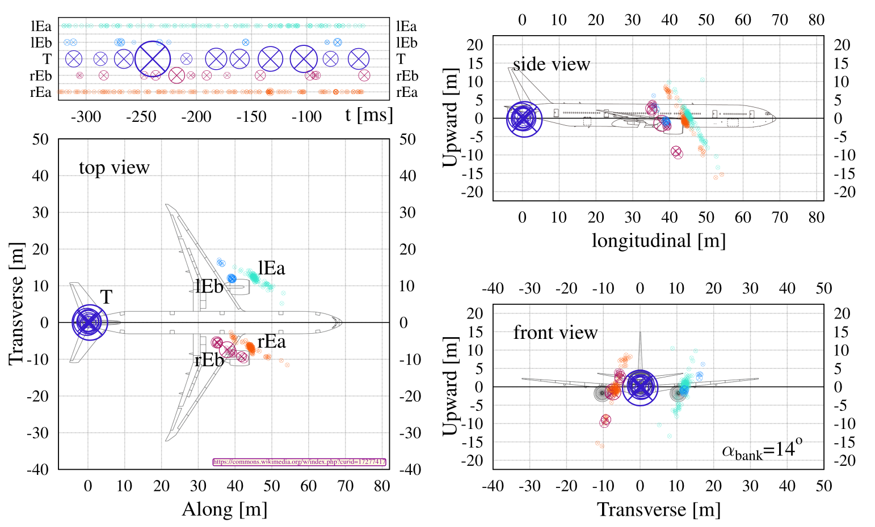
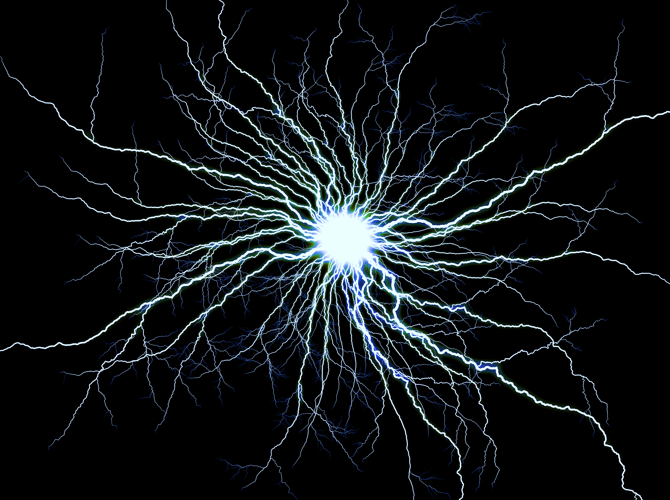
Locating an Airplane via
Lightning?
Able to locate to 10cm precision!
Can clearly see discharges are located on the engines and the tail
This is only possible through near-field beamforming

Slide 5
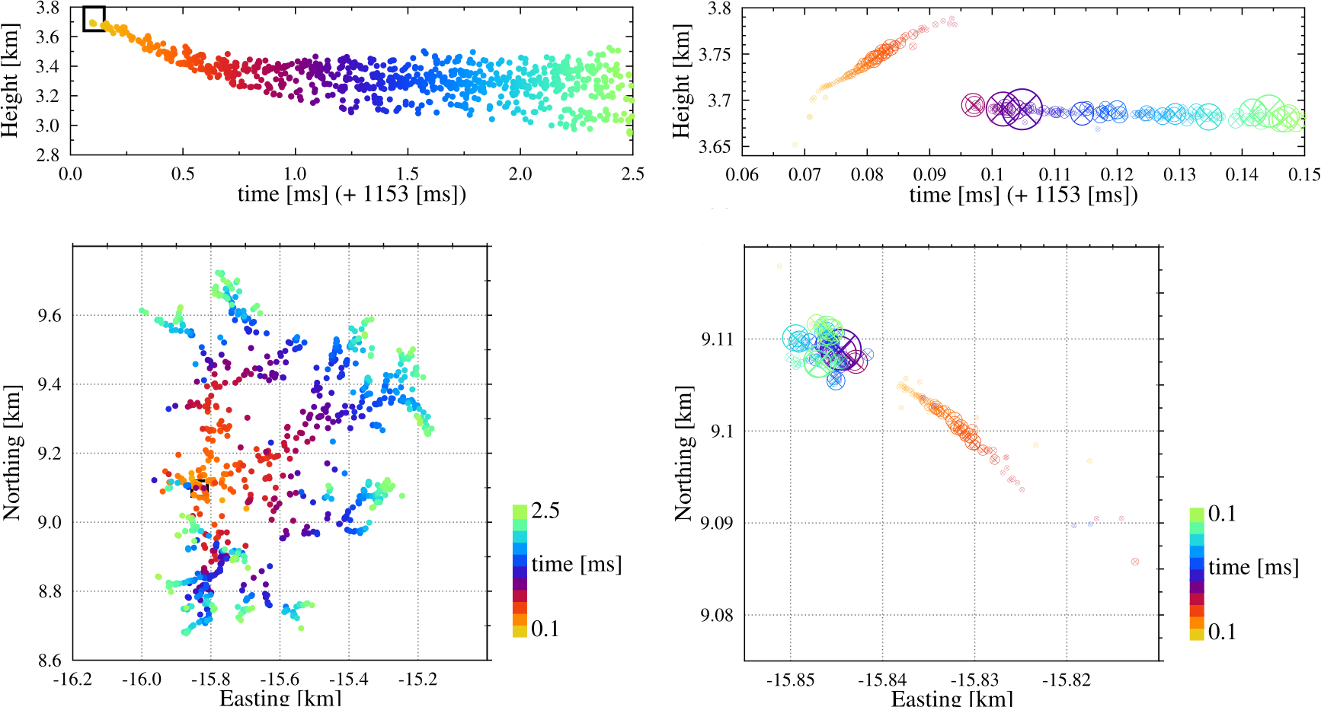
Lightning initiation
Lightning Initial Stage (TOA Image)
Formation of initial leader stage
250 μs
At later stage, additional plasma channels form
200 m
Note: spatial scale is 200 m, time is 250 μs

Slide 6
Lightning initiation
Lightning Initial Stage (ATRI-D Image)
Lightning Initial Stage (TOA Image)
Formation of initial leader stage
10 μs
250 μs
At later stage, additional plasma channels form
10 m
200 m
Note: spatial scale is 200 m, time is 250 μs

Slide 7
Lightning initiation
Lightning Initial Stage (ATRI-D Image)
Upward moving discharge
10 μs
Formation of initial leader stage
Note: spatial scale is 10 m, time is 10 μs!
10 m

Slide 8
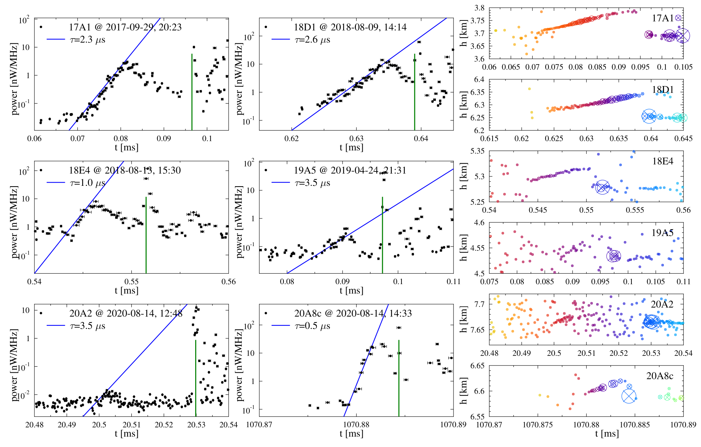
Initiation Events: Detailed Comparison
Initiation Source Power
Several such events have been found
Green lines indicates start of lightning leader
Able to measure width, intensity, and speed of these events
Discharge is less than a meter wide!
Speed is constant, but intensity grows exponentially!
Decays before initiation event

Slide 9
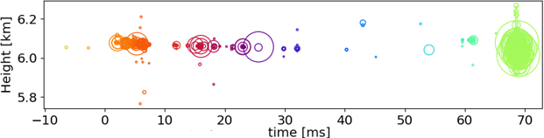
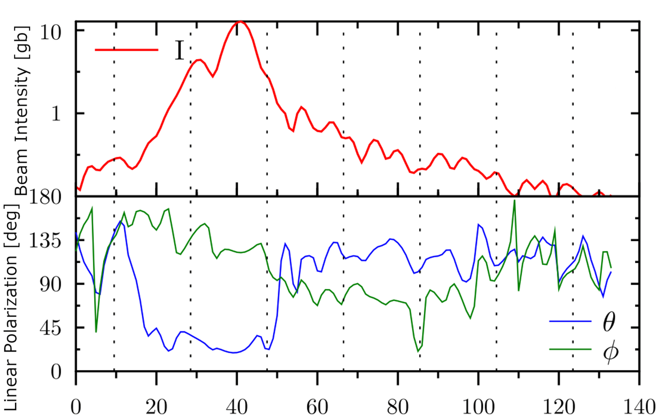
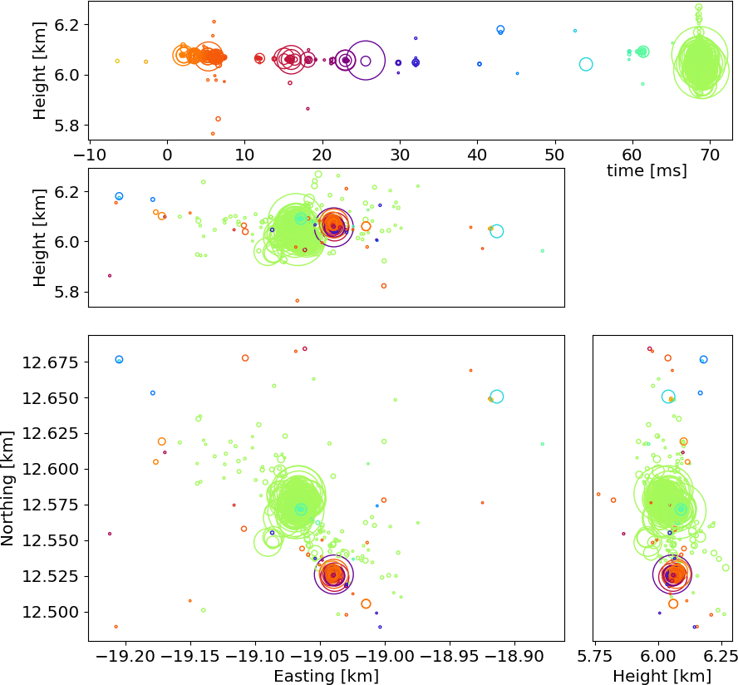
Small-Scale Discharges Before Lightning
3D TRI-D Image of Small-Scale Discharges
Tiny sparks never seen before in thundercloud
Real sources!
Too weak to be seen with any other instrumentation or imaging techniques!
0 100 200 300 400 500 500 700
t [ns]

Slide 10
Conclusions
Near-field beamforming achieves 10 cm resolution
Seeing many initiation events with details that do not fit models
Seeing many small-scale sparks before initiation that have be predicted but never observed

Slide 11
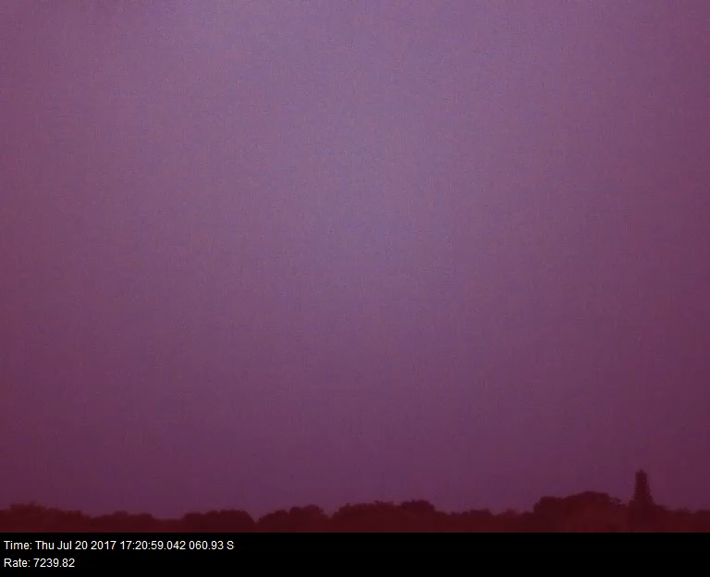
Thank You For Your Attention!

Slide 12
Additional Slides

Slide 13
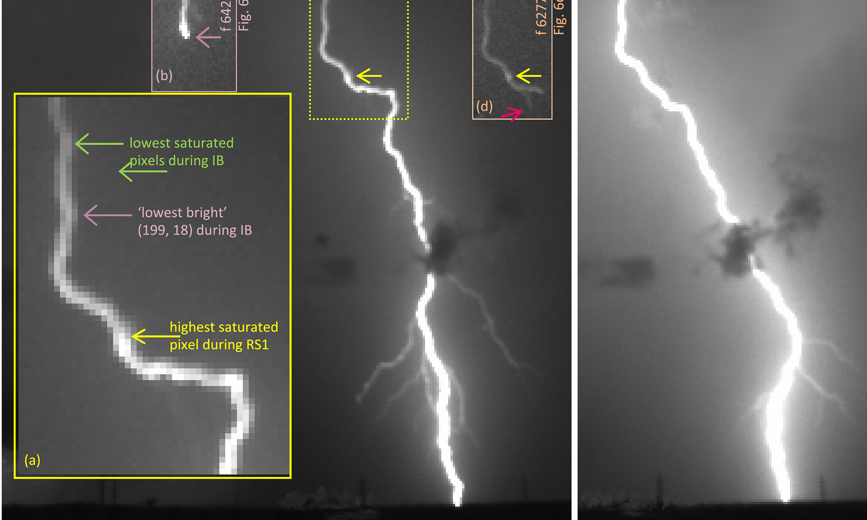
Lightning: Leaders
Hot plasma phenomena (up to 15,000 K) [12]
Requires pre-existing dielectric breakdown to form [3]
≥ 3 MV/m at 0°C and sea level!
Bidirectional propagation [12]
Typically, only one direction of the propagation is visible from ground
Many types of leaders exist
Positive, Negative, stepped, dart, dart chaotic, IRNL... [3][11]
Streamers ionize air to allow leaders to propagate
First image source: Stolzenburg et al 2020
Second image source: Saba et al 2022

Slide 14
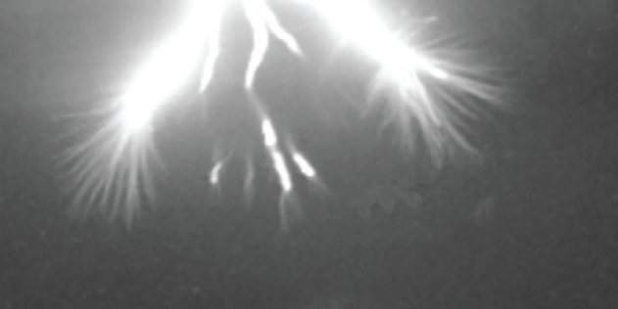
Lightning: Leaders
Hot plasma phenomena (up to 15,000 K) [12]
Requires pre-existing dielectric breakdown to form [3]
≥ 3 MV/m at 0°C and sea level!
Bidirectional propagation [12]
Typically, only one direction of the propagation is visible from ground
Many types of leaders exist
Positive, Negative, stepped, dart, dart chaotic, IRNL... [3][11]
Streamers ionize air to allow leaders to propagate
First image source: Stolzenburg et al 2020
Second image source: Saba et al 2022

Slide 15
References
J. R. Dwyer and M. A. Uman. The physics of lightning. Physics Reports, 534(4):147–241, Jan. 2014.
R. I. Albrecht, S. J. Goodman, D. E. Buechler, R. J. Blakeslee, and H. J. Christian. Where Are the Lightning Hotspots on Earth? Bulletin of the American Meteorological Society, 97(11):2051–2068, Nov. 2016.
Y. Yair. Lightning hazards to human societies in a changing climate. Environmental Research Letters, 13(12):123002, Nov. 2018.
L. D. Santis. The Calculated Risk of Experiencing Lightning Caused Unplanned Detonation. In Proceedings of the Fourteenth Annual Symposium on Explosives and Blasting Research, 1998 Feb :107-119. NIOSH, Feb. 1998.
F. Lyu, S. A. Cummer, P. R. Krehbiel, W. Rison, E. C. Bruning, and S. A. Rutledge. A Distinct Class of High Peak-Current Lightning Pulses Over Mountainous Terrain in Thunderstorms. Geophysical Research Letters, 48(14):e2021GL094153, 2021.
J. S. Levine, T. R. Augustsson, I. C. Andersont, J. M. Hoell, and D. A. Brewer. Tropospheric sources of NOx: Lightning and biology. Atmospheric Environment (1967), 18(9):1797– 1804, Jan. 1984.
W. H. Brune, P. J. McFarland, E. Bruning, S. Waugh, D. MacGorman, D. O. Miller, J. M. Jenkins, X. Ren, J. Mao, and J. Peischl. Extreme oxidant amounts produced by lightning in storm clouds. Science, 372(6543):711–715, May 2021.
O. Scholten, B. M. Hare, J. Dwyer, N. Liu, C. Sterpka, I. Kolmašová, O. Santolík, R. Lán, L. Uhlíř, S. Buitink, A. Corstanje, H. Falcke, T. Huege, J. R. Hörandel, G. K. Krampah, P. Mitra, K. Mulrey, A. Nelles, H. Pandya, J. P. Rachen, T. N. G. Trinh, S. ter Veen, S. Thoudam, and T. Winchen. A distinct negative leader propagation mode. Scientific Reports, 11(1):16256, Aug. 2021.
J. N. Tilles. Broadband radio mapping and imaging of lightning processes.
R. Morrow and J. J. Lowke. Streamer propagation in air. Journal of Physics D: Applied Physics, 30(4):614–627, Feb. 1997.
D. Petersen, M. Bailey, W. H. Beasley, and J. Hallett. A brief review of the problem of lightning initiation and a hypothesis of initial lightning leader formation. Journal of Geophysical Research: Atmospheres, 113(D17), 2008.
Ebert, U., S. Nijdam, C. Li, A. Luque, T. Briels, and E. van Veldhuizen (2010), Review of recent results on streamer discharges and discussion of their relevance for sprites and lightning, J. Geophys. Res., 115, A00E43, doi:10.1029/2009JA014867.
A. Fridman, Plasma Chemistry, Cambridge University Press, Cambride
Mirpour, S., & Nijdam, S. (2022). Experimental investigation on streamer inception from artificial hydrometeors.Plasma Sources Science and Technology, 31(10), Article 105009. https://doi.org/10.1088/1361-6595/ac95be

Slide 16
References
R. F. Griffiths and C. T. Phelps. A model for lightning initiation arising from positive corona streamer development. Journal of Geophysical Research (1896-1977), 81(21):3671–3676, 1976.
A. Attanasio, P. R. Krehbiel, and C. L. da Silva. Griffiths and Phelps Lightning Initiation Model, Revisited. Journal of Geophysical Research: Atmospheres, 124(14):8076–8094, 2019.
Haarlem, M. P. van et al. LOFAR: The LOw-Frequency ARray. A&A 556, A2 (2013).
B. M. Hare, O. Scholten, A. Bonardi, S. Buitink, A. Corstanje, U. Ebert, H. Falcke, J. R. Hörandel, H. Leijnse, P. Mitra, K. Mulrey, A. Nelles, J. P. Rachen, L. Rossetto, C. Rutjes, P. Schellart, S. Thoudam, T. N. G. Trinh, S. ter Veen, and T. Winchen. LOFAR Lightning Imaging: Mapping Lightning With Nanosecond Precision. Journal of Geophysical Research: Atmospheres, 123(5):2861–2876, 2018.
O. Scholten, B. M. Hare, J. Dwyer, C. Sterpka, I. Kolmašová, O. Santolík, R. Lán, L. Uhlíř, S. Buitink, A. Corstanje, H. Falcke, T. Huege, J. R. Hörandel, G. K. Krampah, P. Mitra, K. Mulrey, A. Nelles, H. Pandya, A. Pel, J. P. Rachen, T. N. G. Trinh, S. ter Veen, S. Thoudam, and T. Winchen. The Initial Stage of Cloud Lightning Imaged in High Resolution. Journal of Geophysical Research: Atmospheres, 126(4):e2020JD033126, 2021.
O. Scholten, B. M. Hare, J. Dwyer, N. Liu, C. Sterpka, S. Buitink, T. Huege, A. Nelles, and S. ter Veen. Time resolved 3D interferometric imaging of a section of a negative leader with LOFAR. Physical Review D, 104(6):063022, Sept. 2021.
W. Rison, P. R. Krehbiel, M. G. Stock, H. E. Edens, X.-M. Shao, R. J. Thomas, M. A. Stan- ley, and Y. Zhang. Observations of narrow bipolar events reveal how lightning is initiated in thunderstorms. Nature Communications, 7(1):10721, Feb. 2016.
Krider, E. P. Thunderstorm - Thunderstorm electrification | Britannica. Thunderstorm Electrification https://www.britannica.com/science/thunderstorm/Thunderstorm-electrification.
Krider, E. P. Lecture 11 - Thunderstorm electrification. Lecture 11 Cloud Electrification http://www.atmo.arizona.edu/students/courselinks/spring15/atmo589/ATMO489_online/lecture_11/lect11_cloud_electrification.html (2015).
Saba, Marcelo M. F., Diego Rhamon R. da Silva, John G. Pantuso, and Caitano L. da Silva. “Close View of the Lightning Attachment Process Unveils the Streamer Zone Fine Structure.” Geophysical Research Letters 49, no. 24 (2022): e2022GL101482.
Kochkin, P., D. Sarria, N. Lehtinen, A. Mezentsev, S. Yang, G. Genov, K. Ullaland, et al. “A Rapid Gamma-Ray Glow Flux Reduction Observed From 20 Km Altitude.” Journal of Geophysical Research: Atmospheres 126, no. 9 (2021): e2020JD033467. https://doi.org/10.1029/2020JD033467. https://doi.org/10.1029/2022GL101482.
Uman, Martin A. The Lightning Discharge. Unabridged edition. Mineola, N.Y: Dover Publications, 2001.
Rakov, Vladimir A., and Martin A. Uman. Lightning: Physics and Effects. Cambridge University Press, 2003.

