Slide 1


Periodic changes in the dynamic spectra of pulsars as an effect of signal propagation through the ionosphere?
Leszek Błaszkiewicz ⁽¹⁾, Yuriy Rapoport⁽¹⁾, Andrzej Krankowski⁽¹⁾, Adam Froń⁽¹⁾, Biagio Forte⁽⁴⁾,
Wojciech Lewandowski⁽²⁾ Bartosz Śmierciak ⁽³⁾, Krzysztof Chyży ⁽³⁾, Jarosław Kijak ⁽²⁾ , Bartosz Dąbrowski ⁽¹⁾ ,
Michal Kownacki⁽¹⁾, Bartosz Radzanowski⁽¹⁾ Tianchu Lu⁽⁴⁾ and Aleksandra Wołowska⁽¹⁾
(1) Space Radio-Diagnostic Research Centre, University of Warmia and Mazury in Olsztyn, Poland
(2) Janusz Gil Institute of Astronomy, University of Zielona Gora, Poland
(3) Astronomical Observatory, Jagiellonian University, Cracow, Poland
(4) Department of Electronic and Electrical Engineering, University of Bath, United Kingdom
Grant No. 2023/49/B/ST10/03465

Slide 2
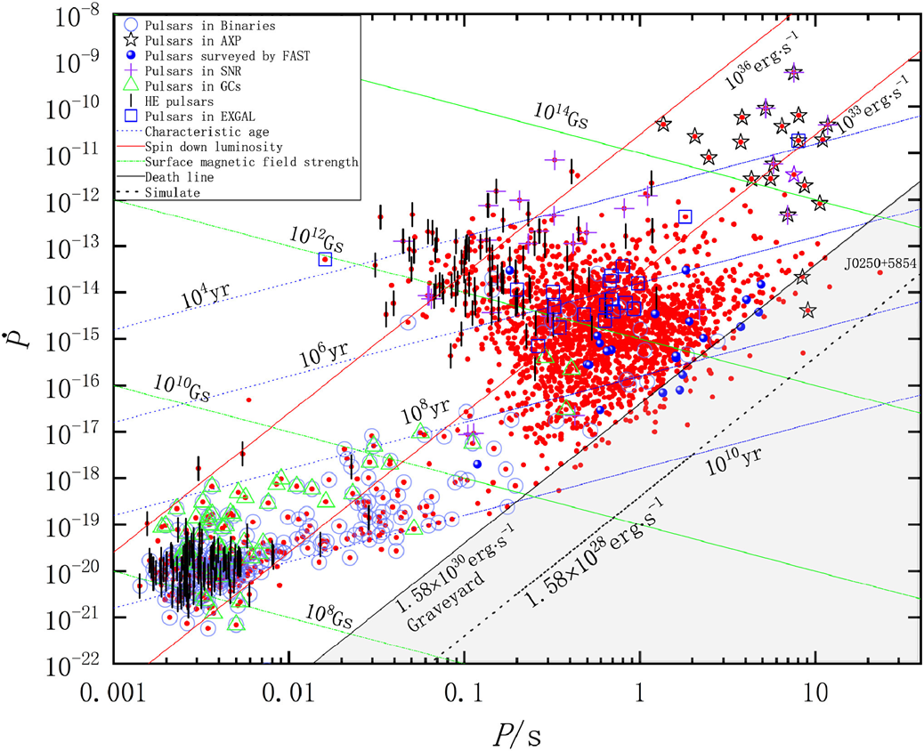
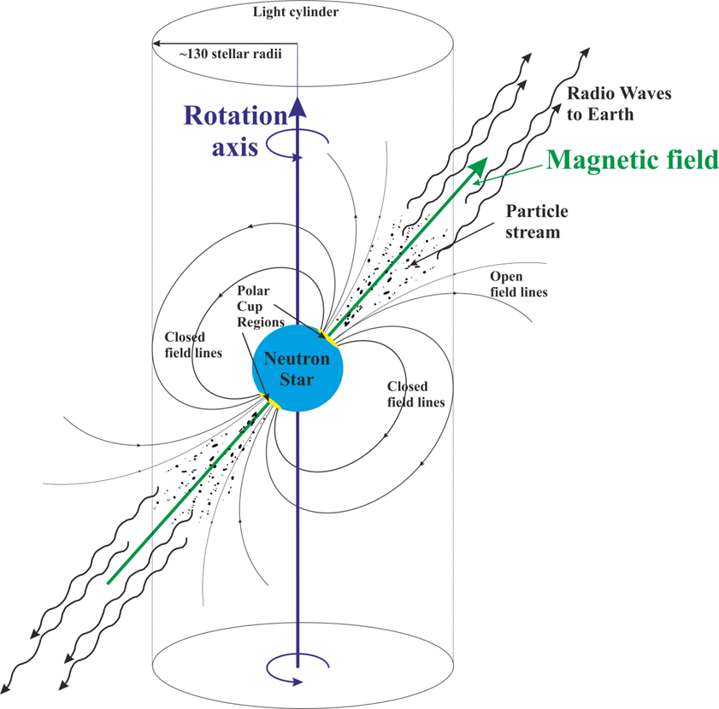
Properties of pulsars
Yin De-jiang, Zhang Li-yun,2023

Slide 3
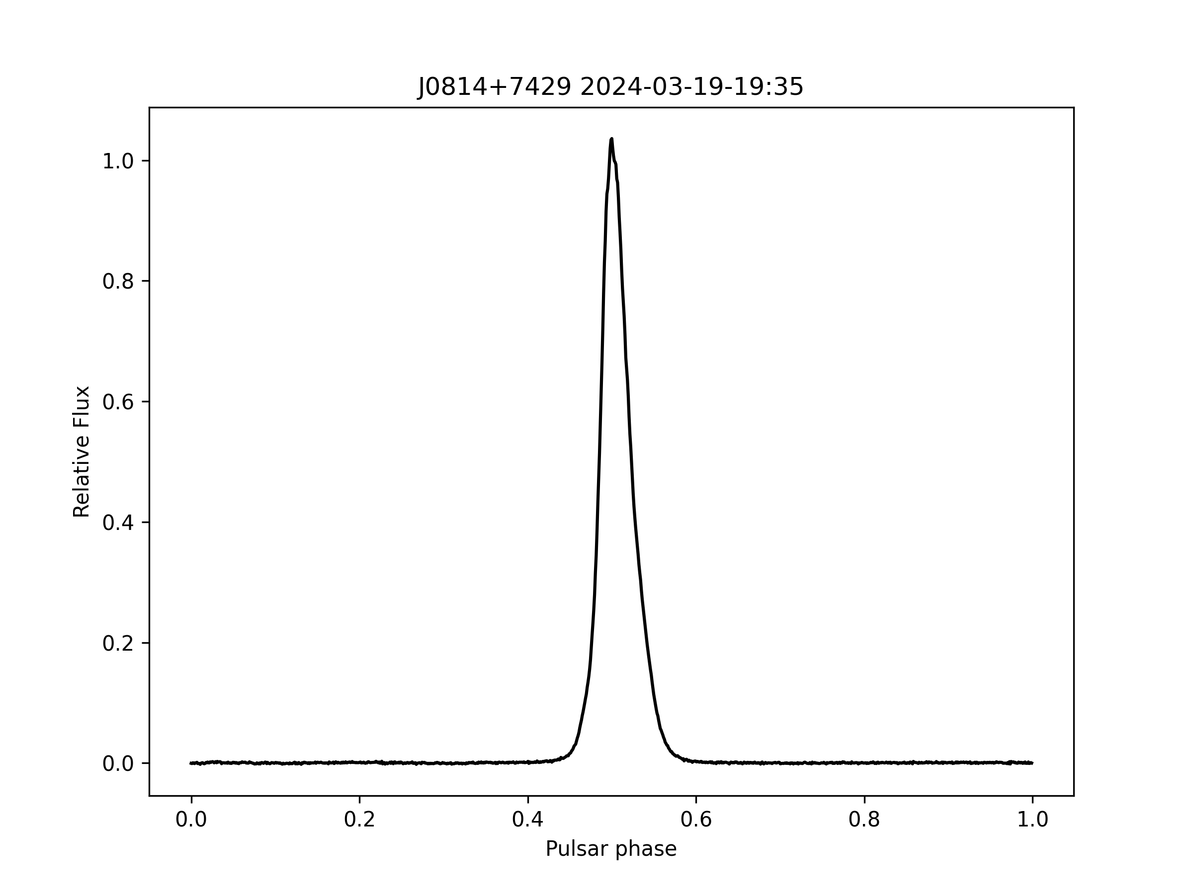
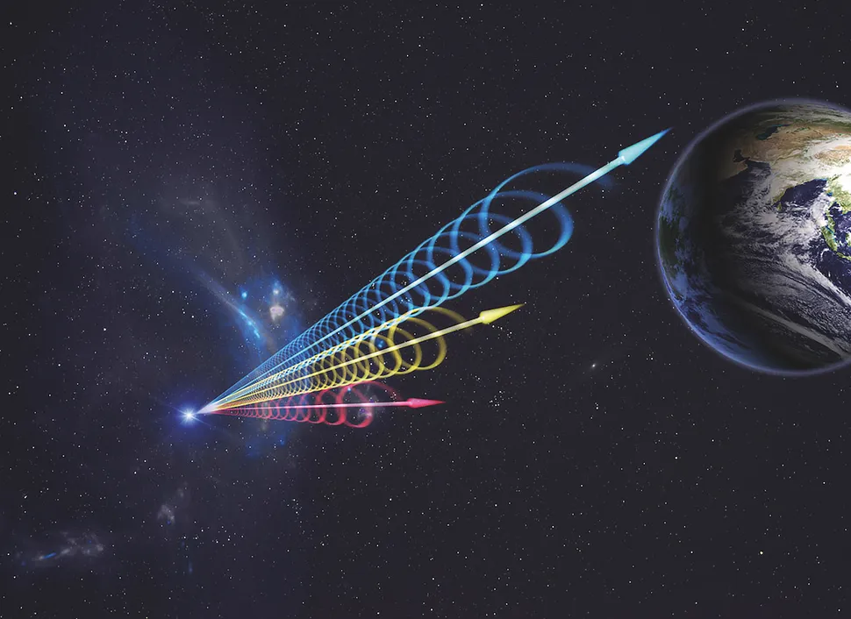
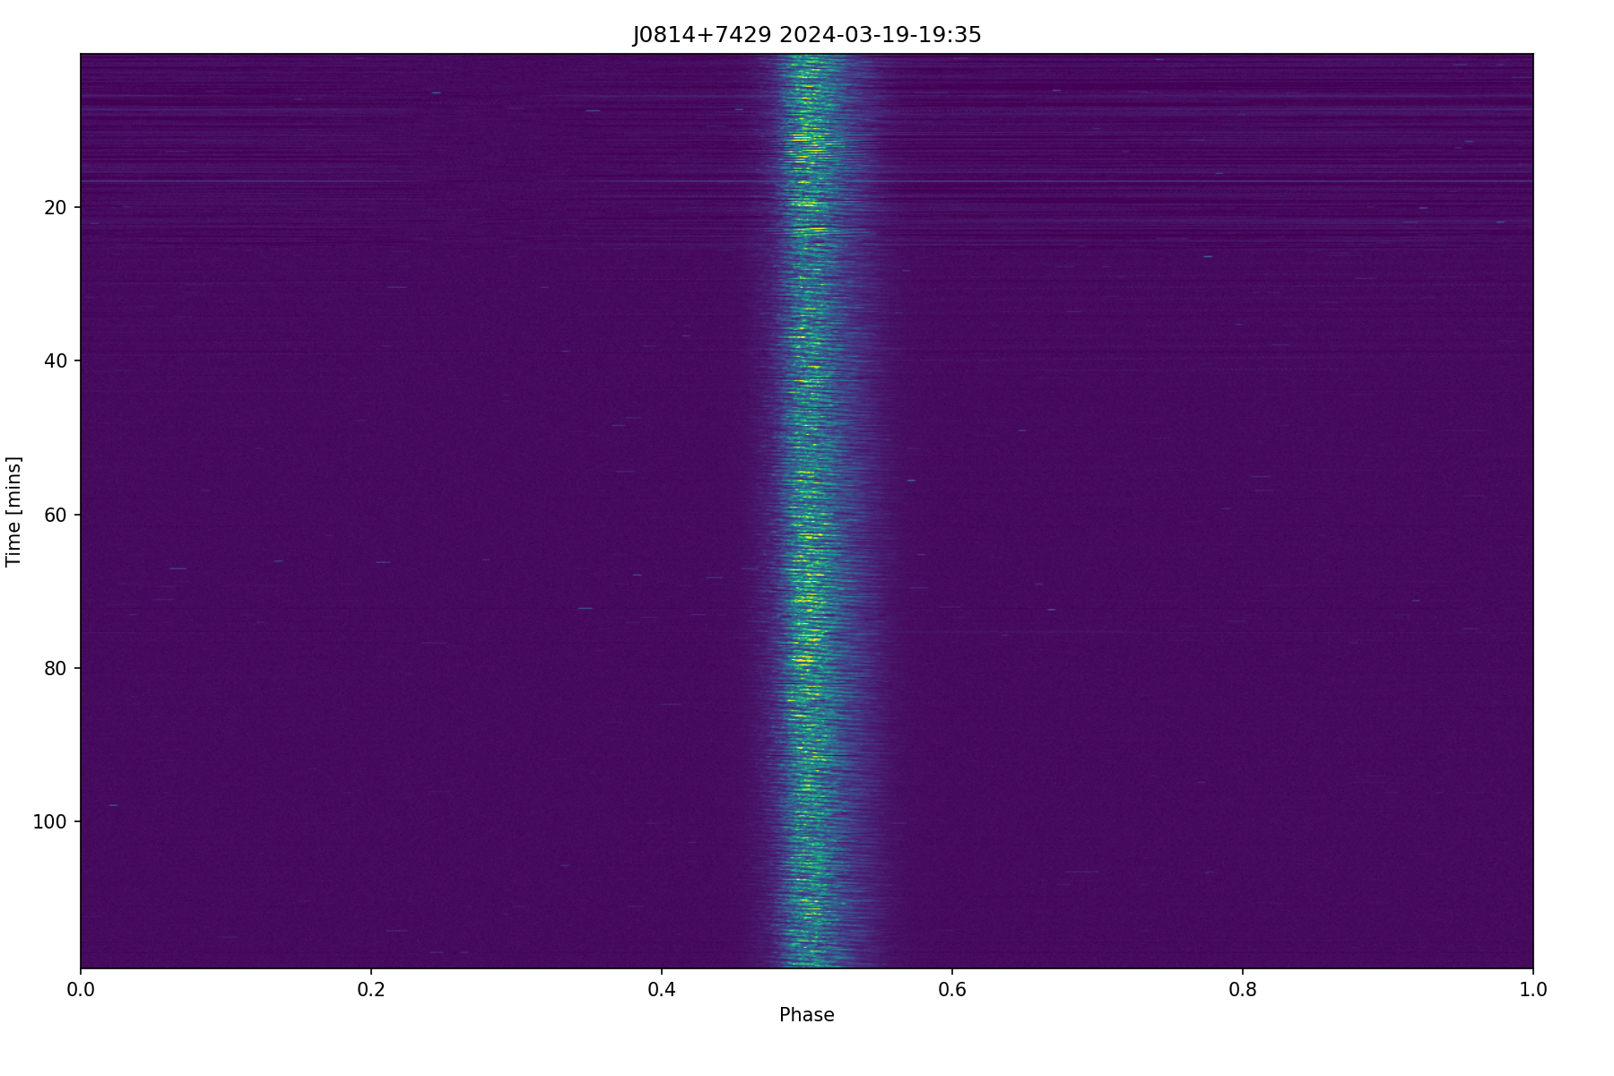
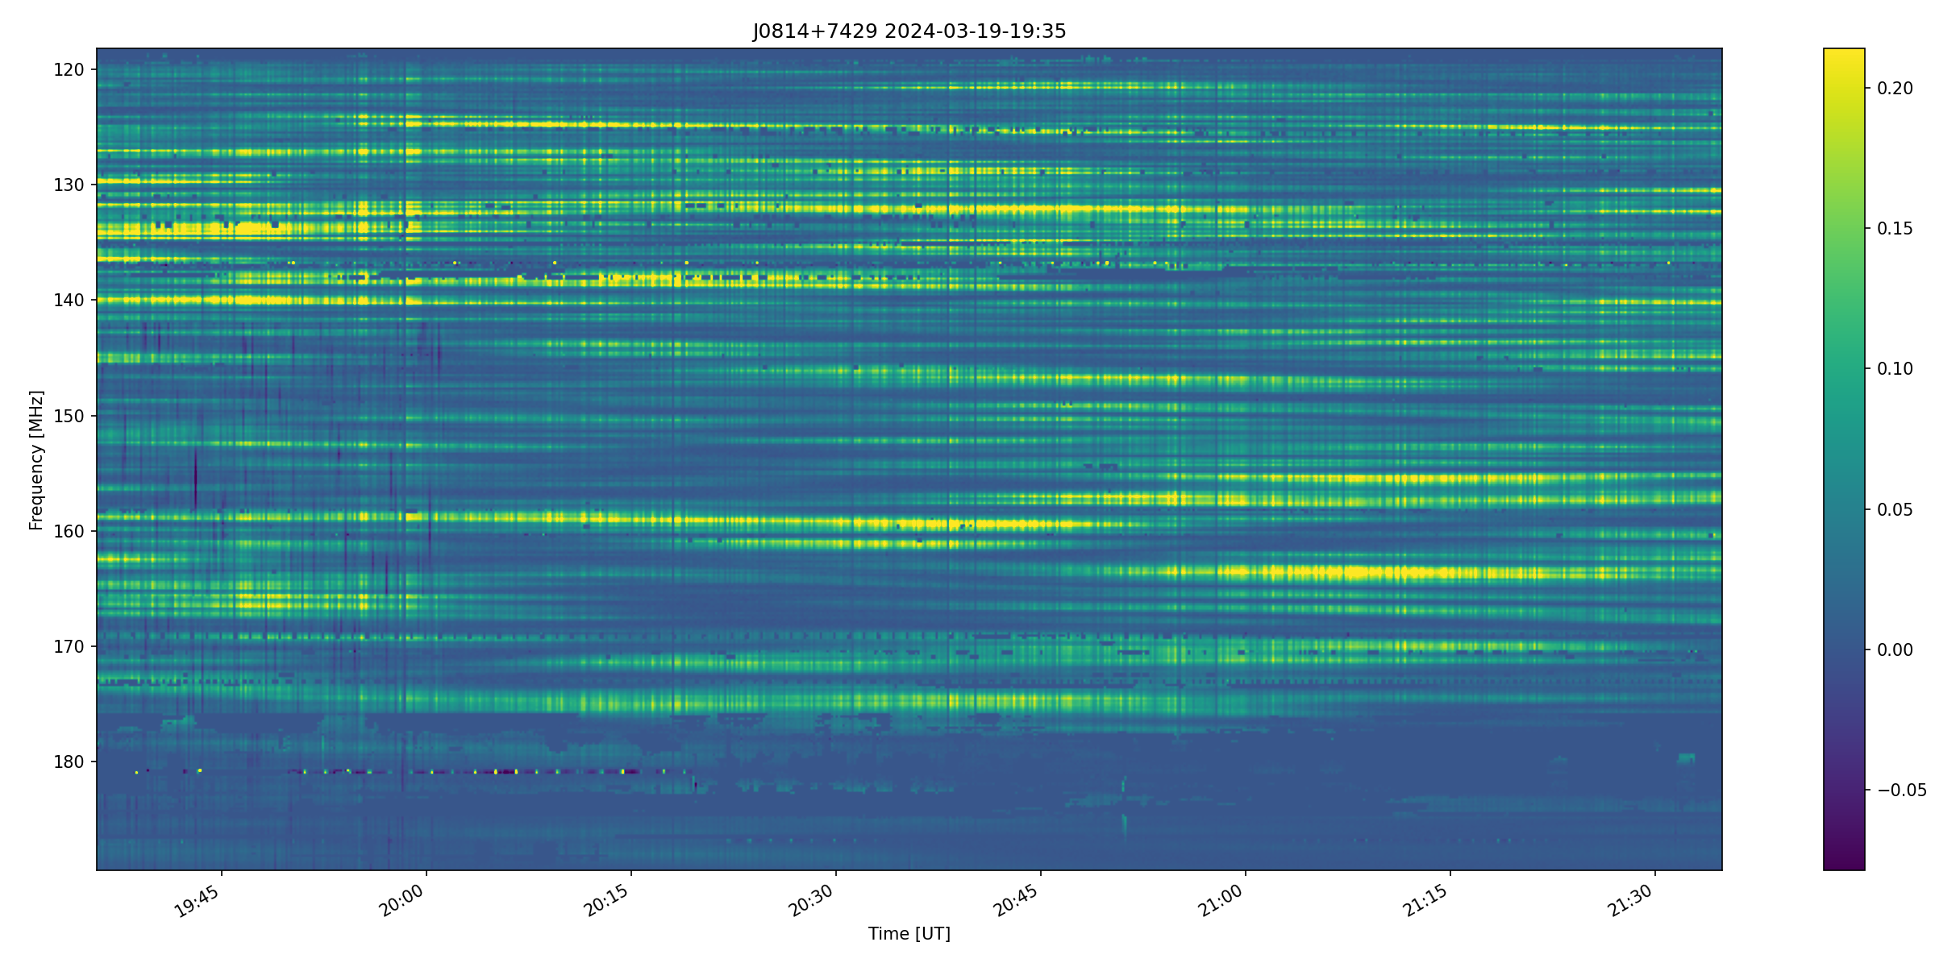
Pulsar signals
Image credit: © Jingchuan Yu, Beijing Planetarium

Slide 4
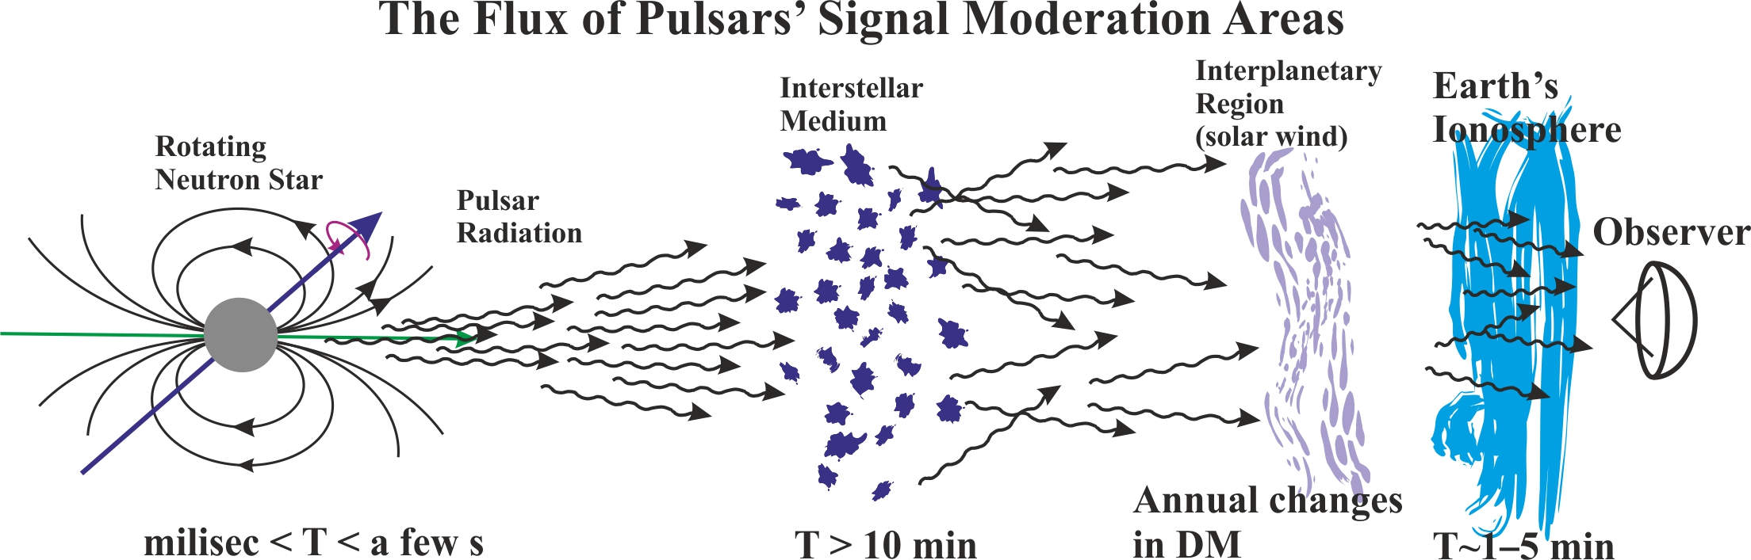
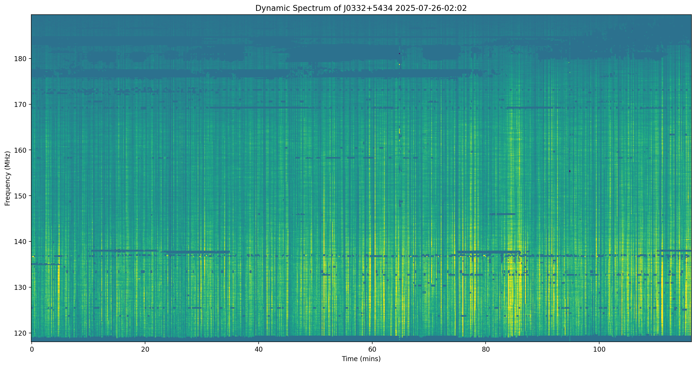
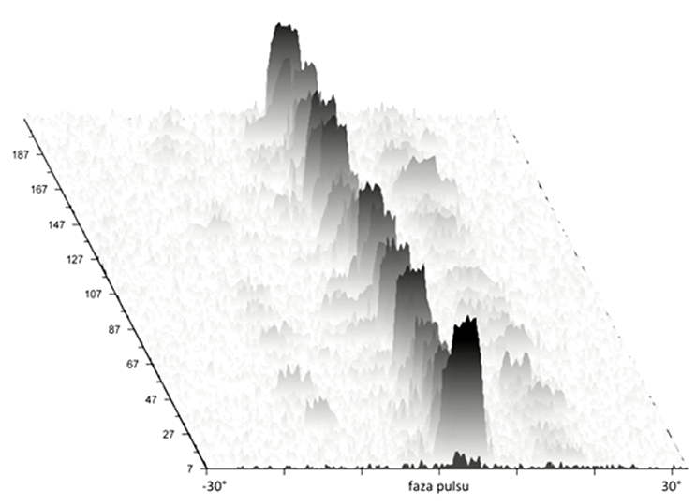
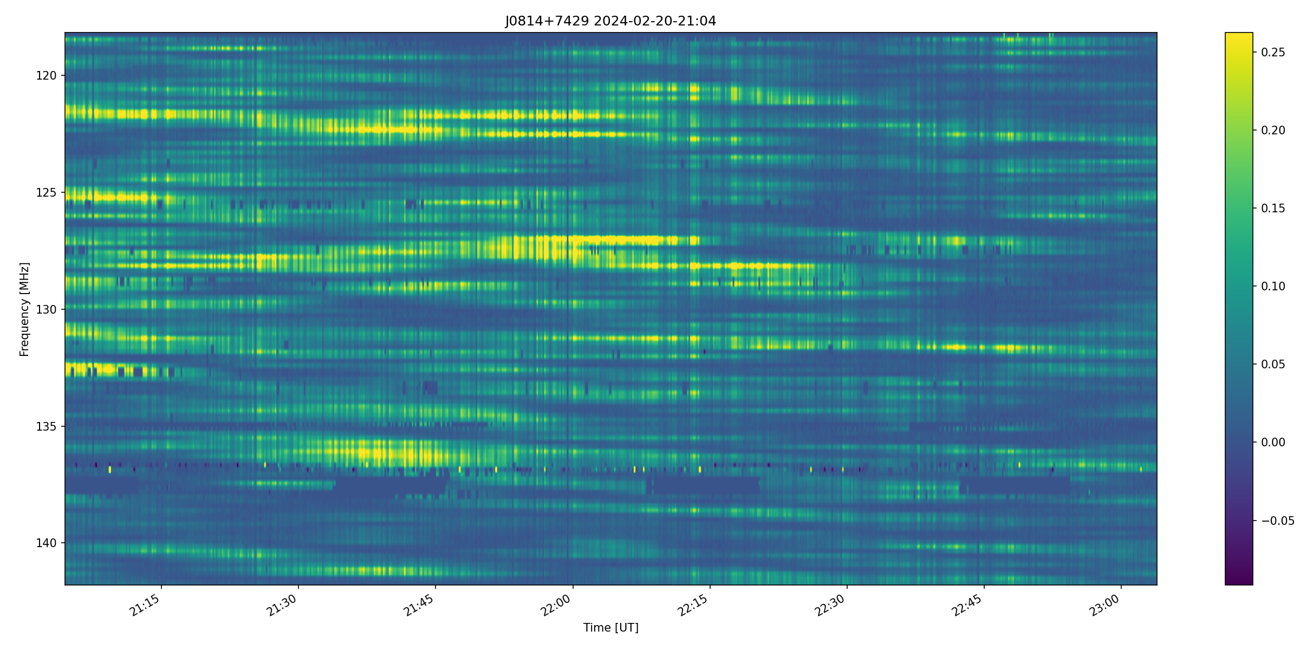

Slide 5
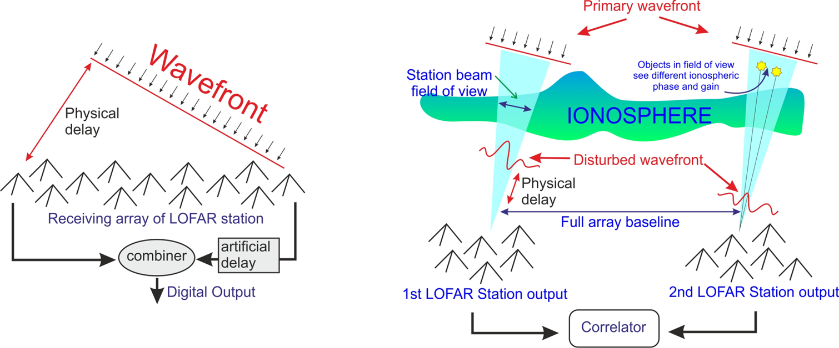
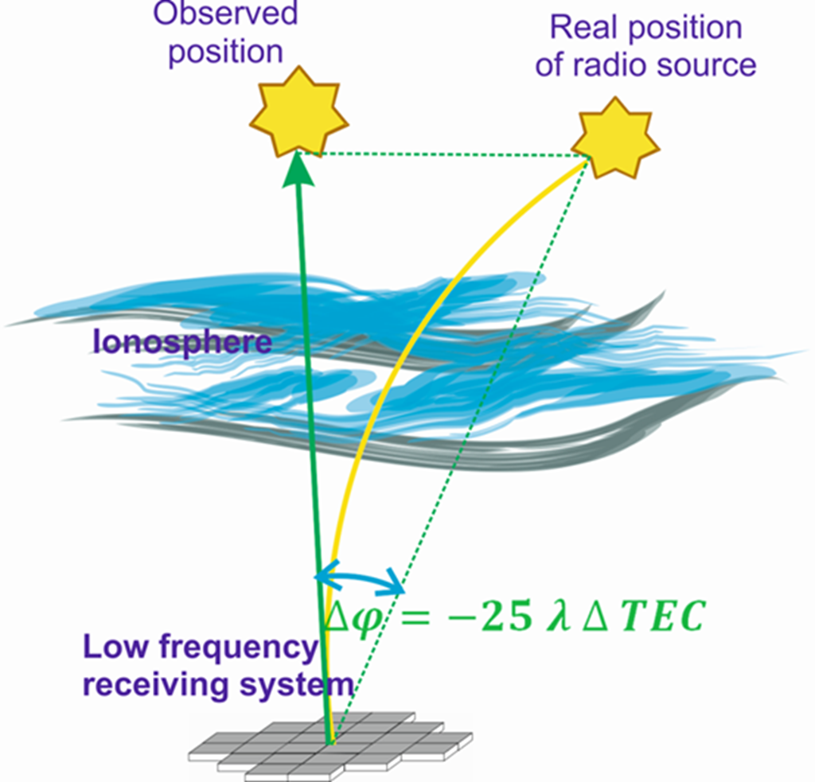
LOFAR and Ionosphere
Inspired by Van der Tol and Van der Veen, 2007

Slide 6
LOFAR and Ionosphere

Slide 7
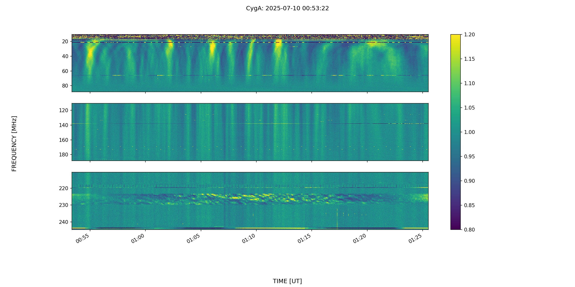
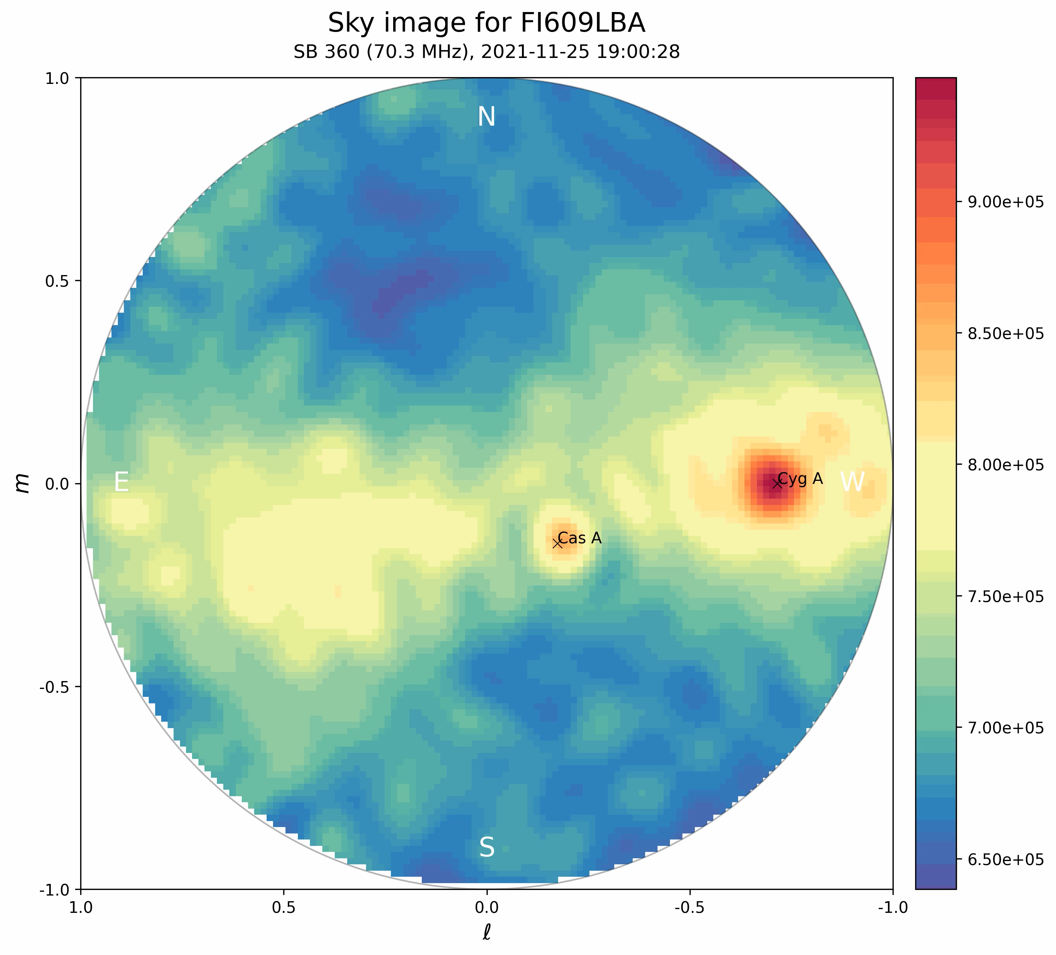
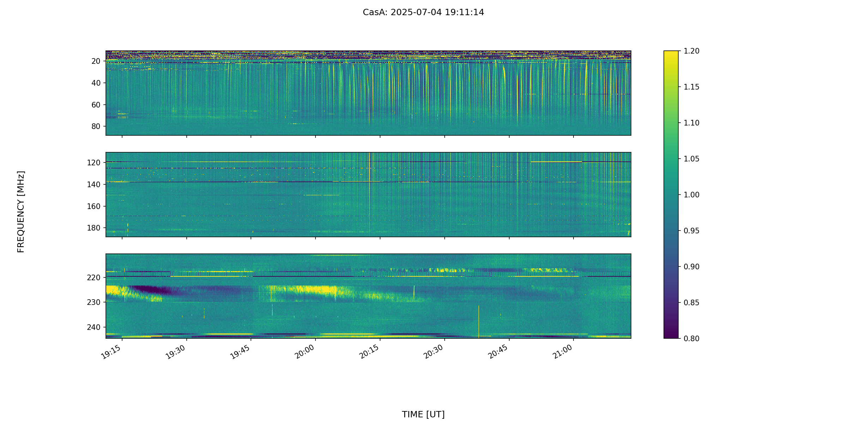
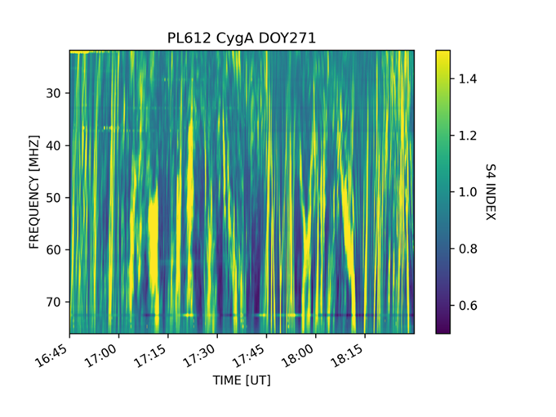
Ionospheric Scintillations

Slide 8
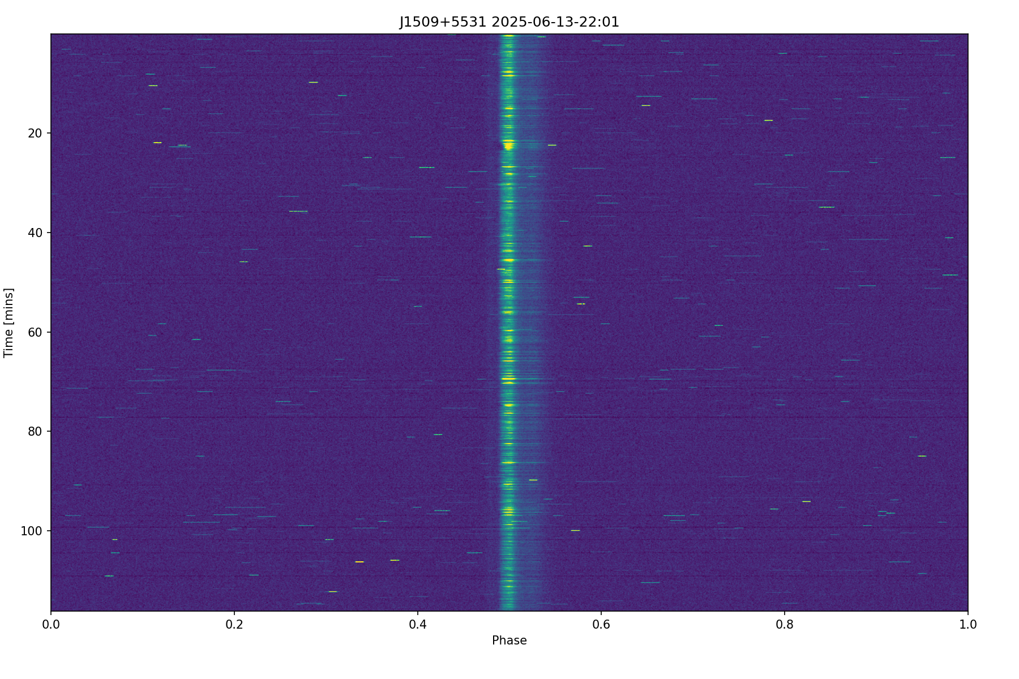
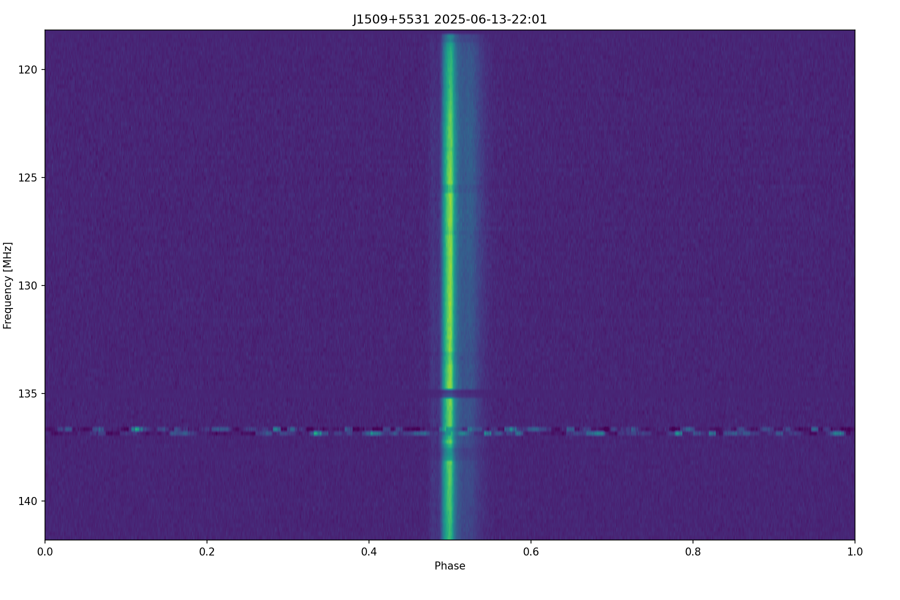
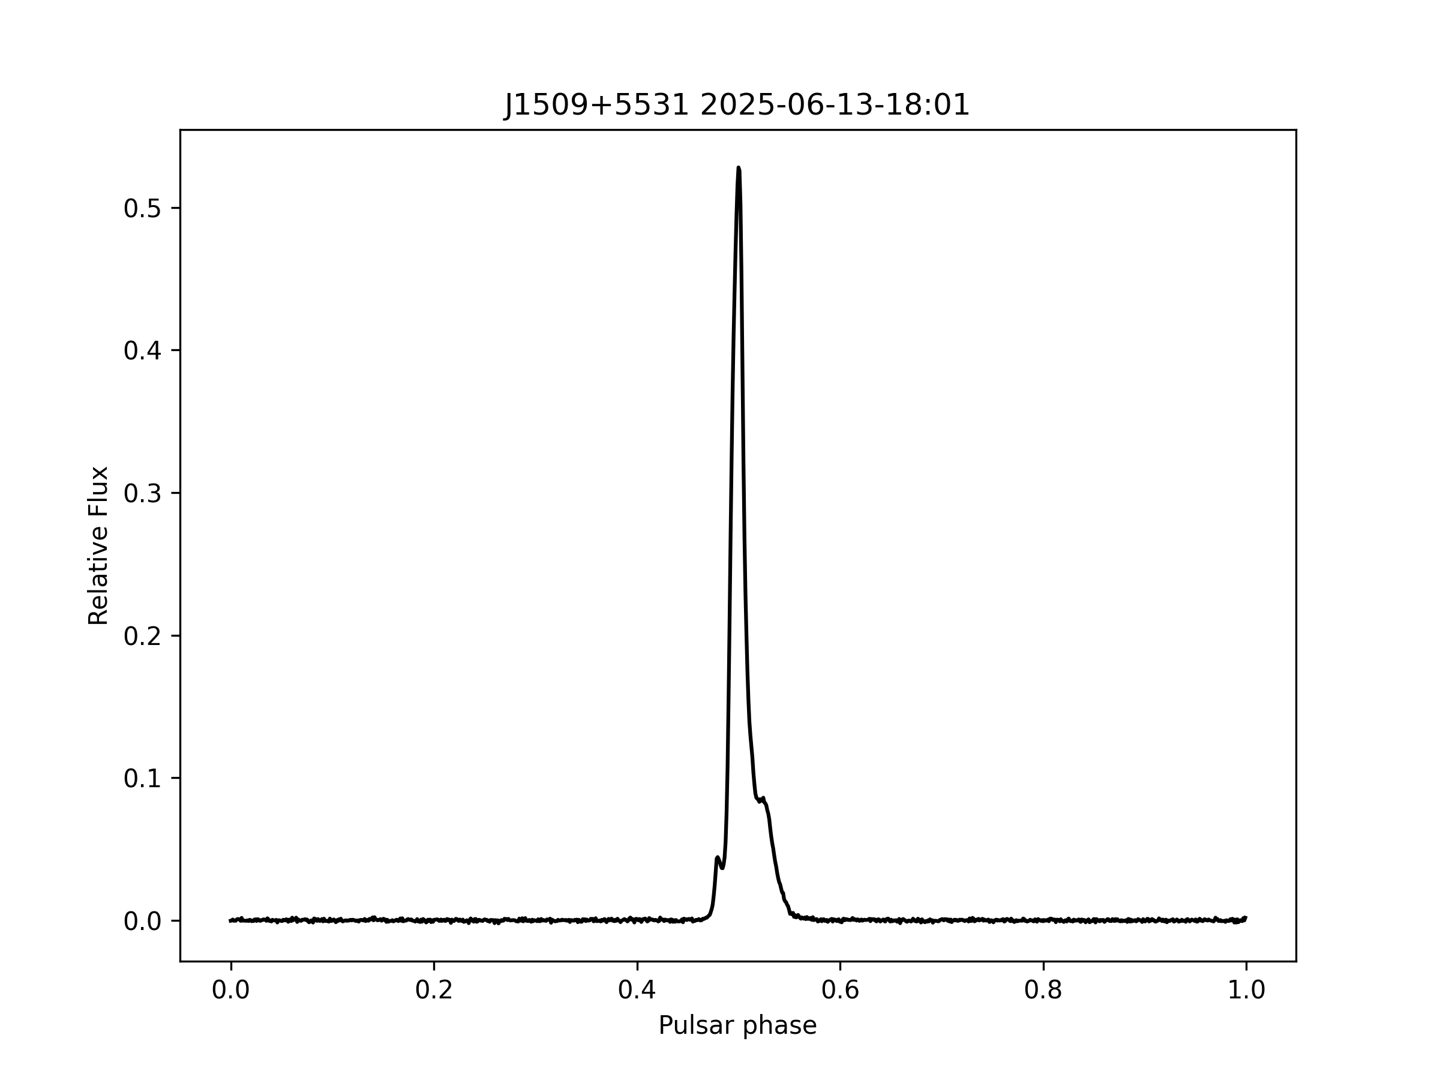
Pulsar Observations
The LuMP software by GLOW
(recording)
The PSRCHIVE package (analysis)

Slide 9
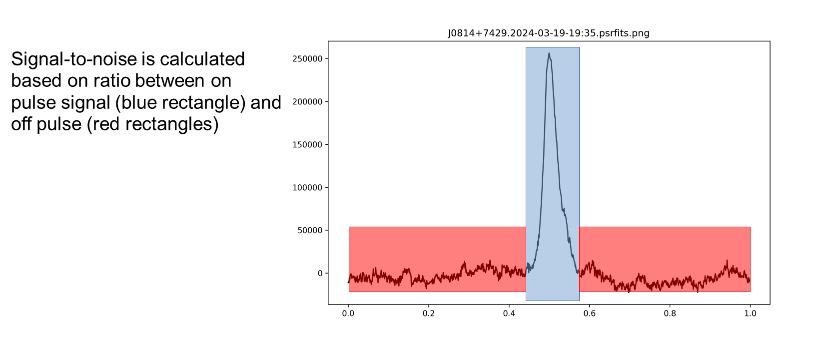
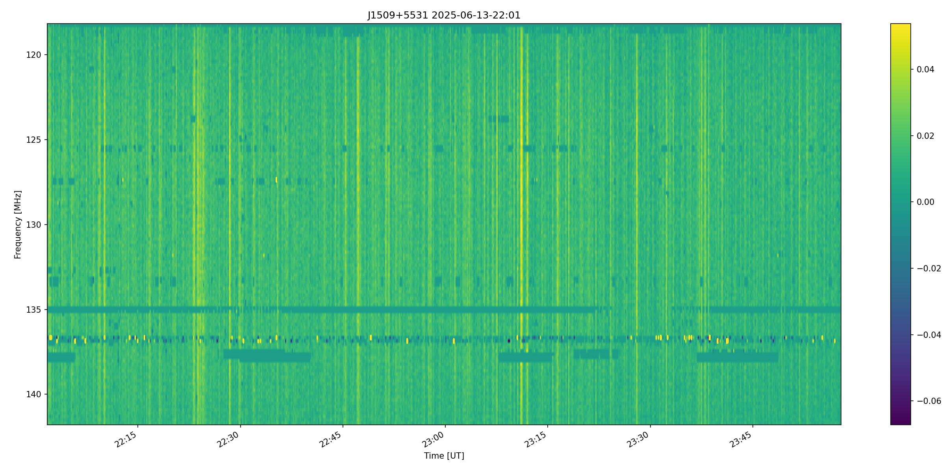
Dynamic spectra based on S/N ratio
Measurements are performed for each channel, for pulses integrated over 10, 20 or 30 seconds.

Slide 10
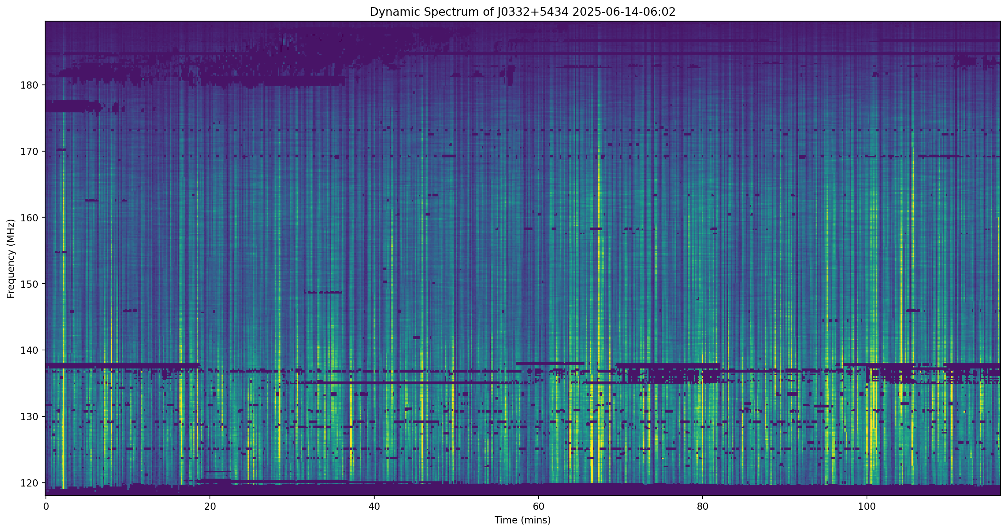
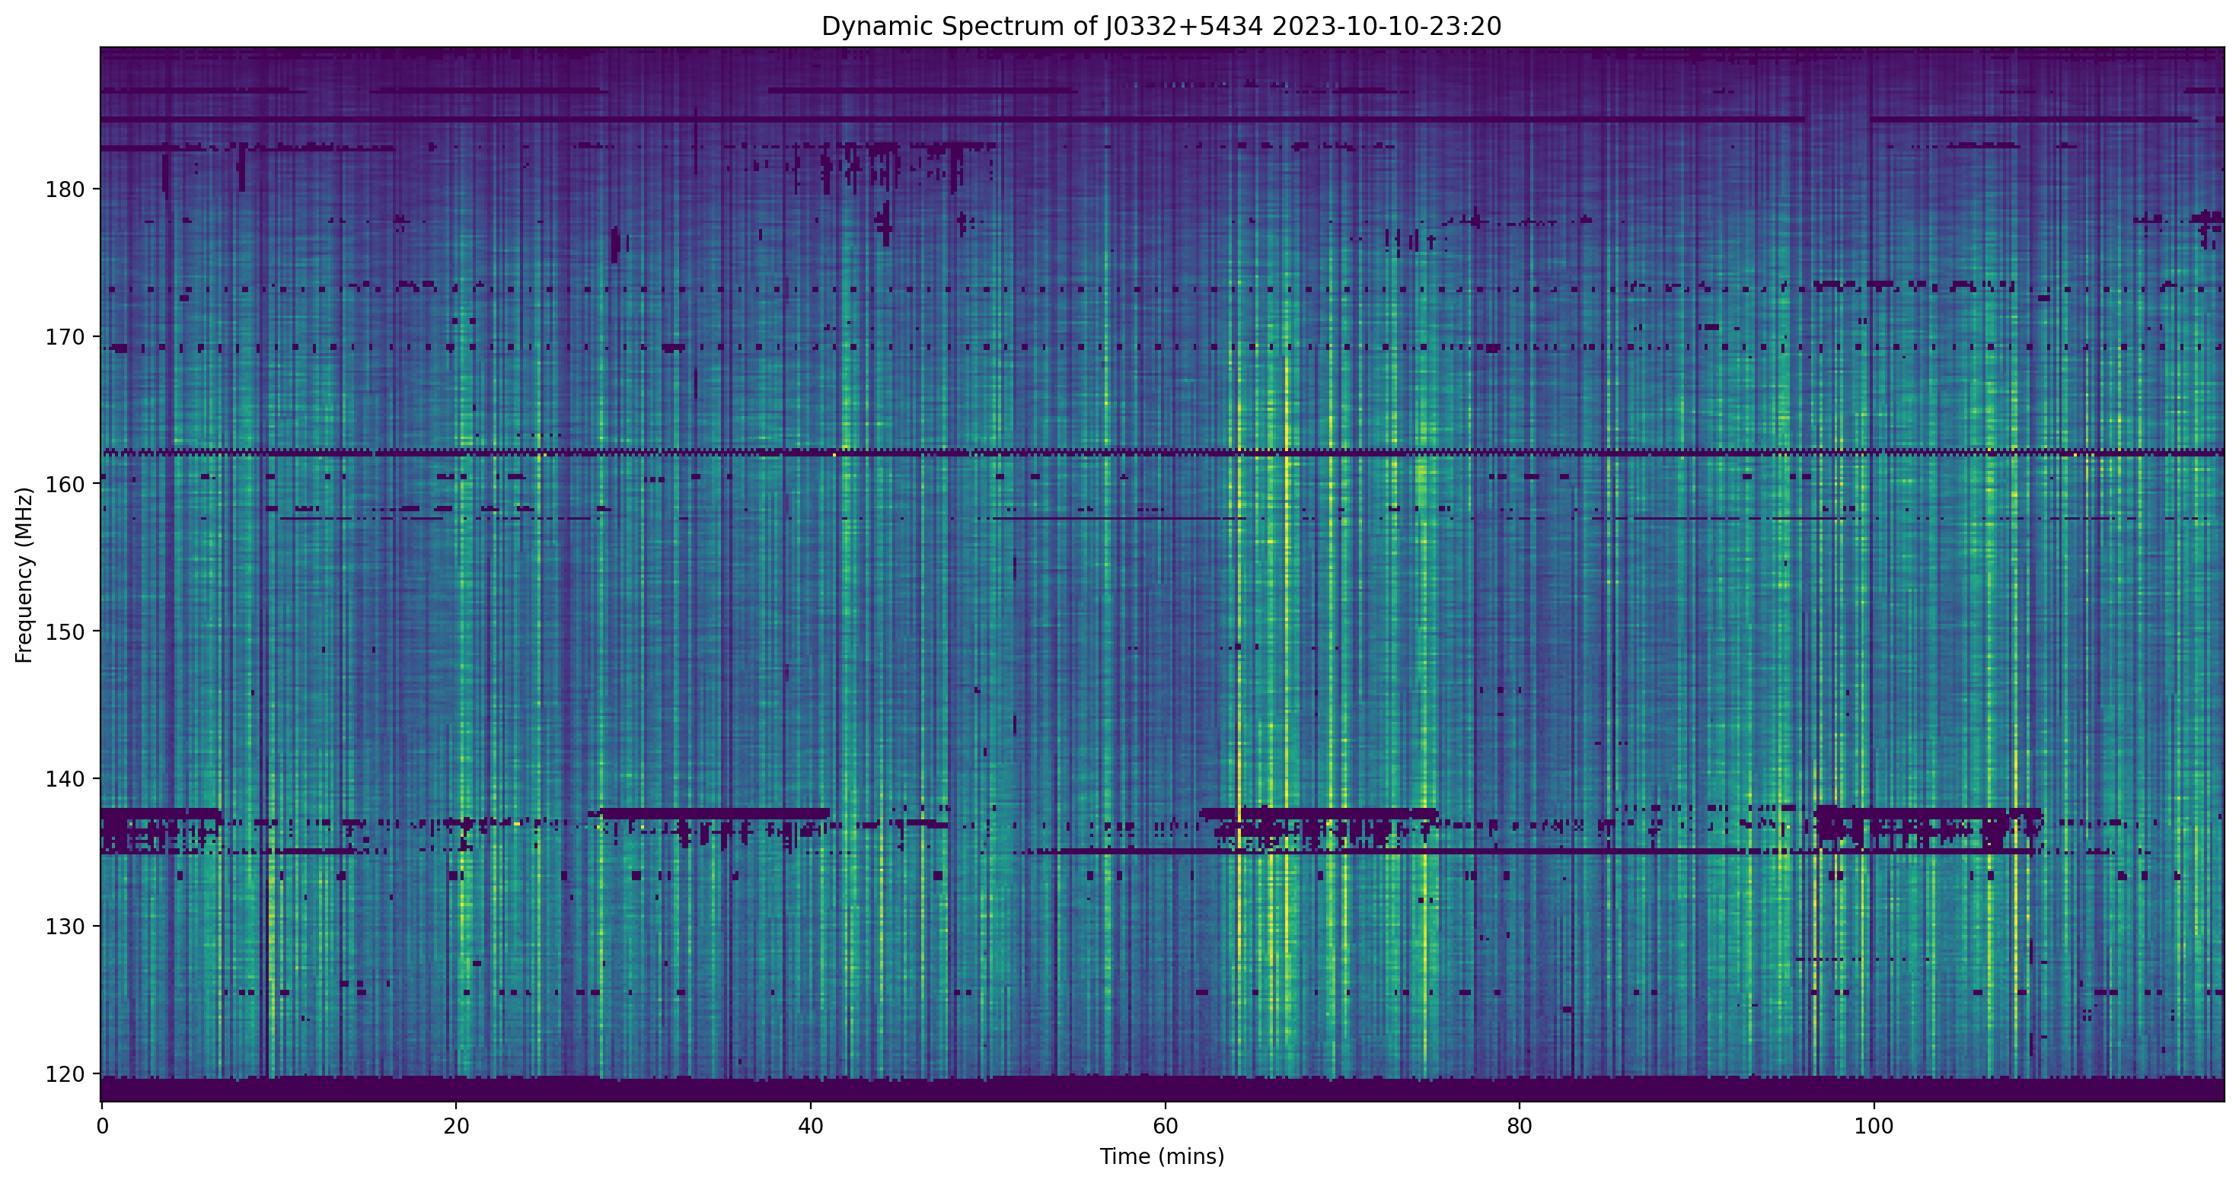
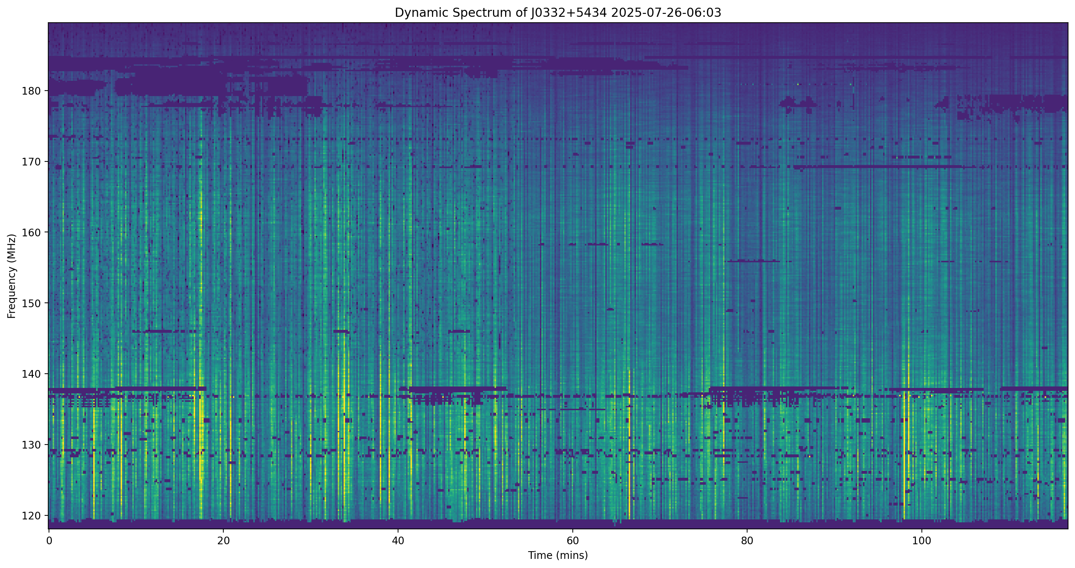
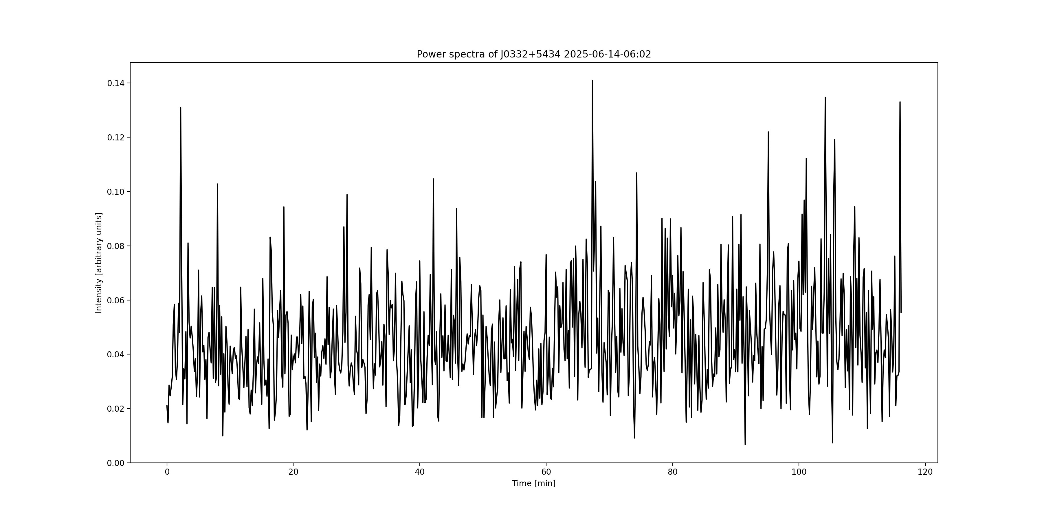
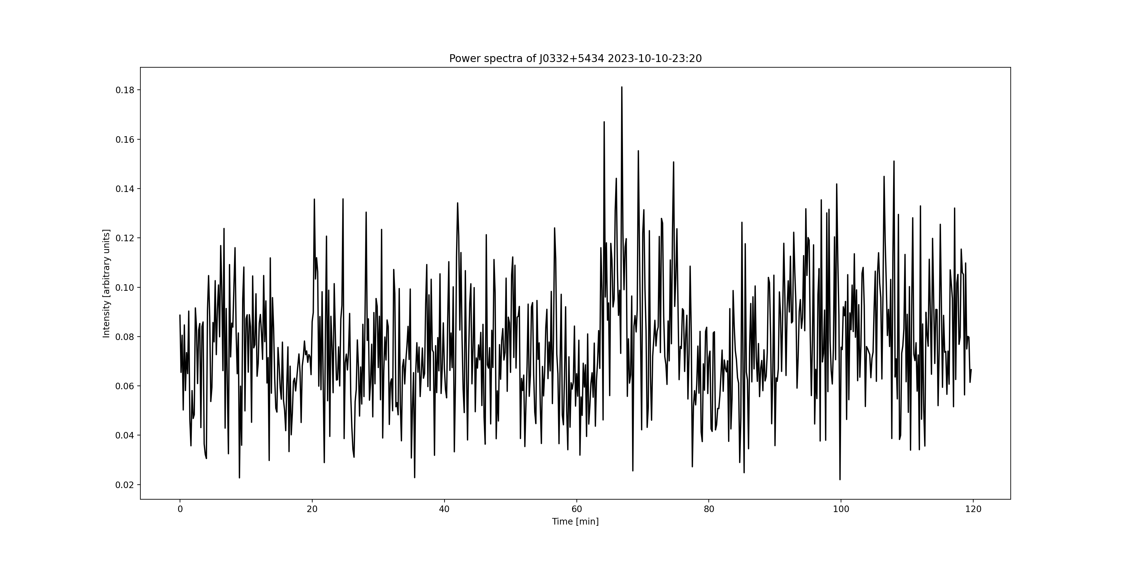
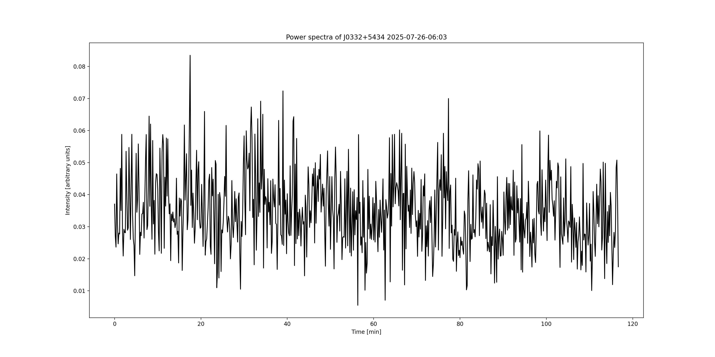
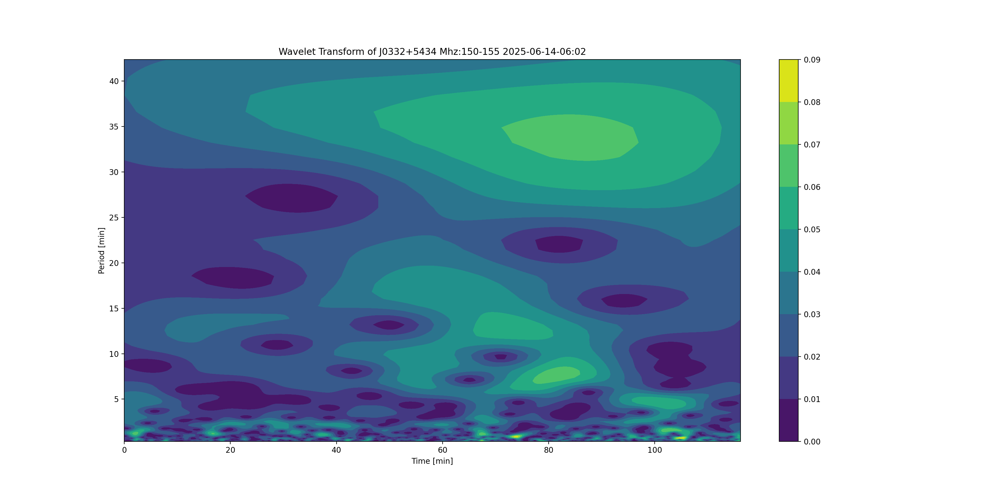
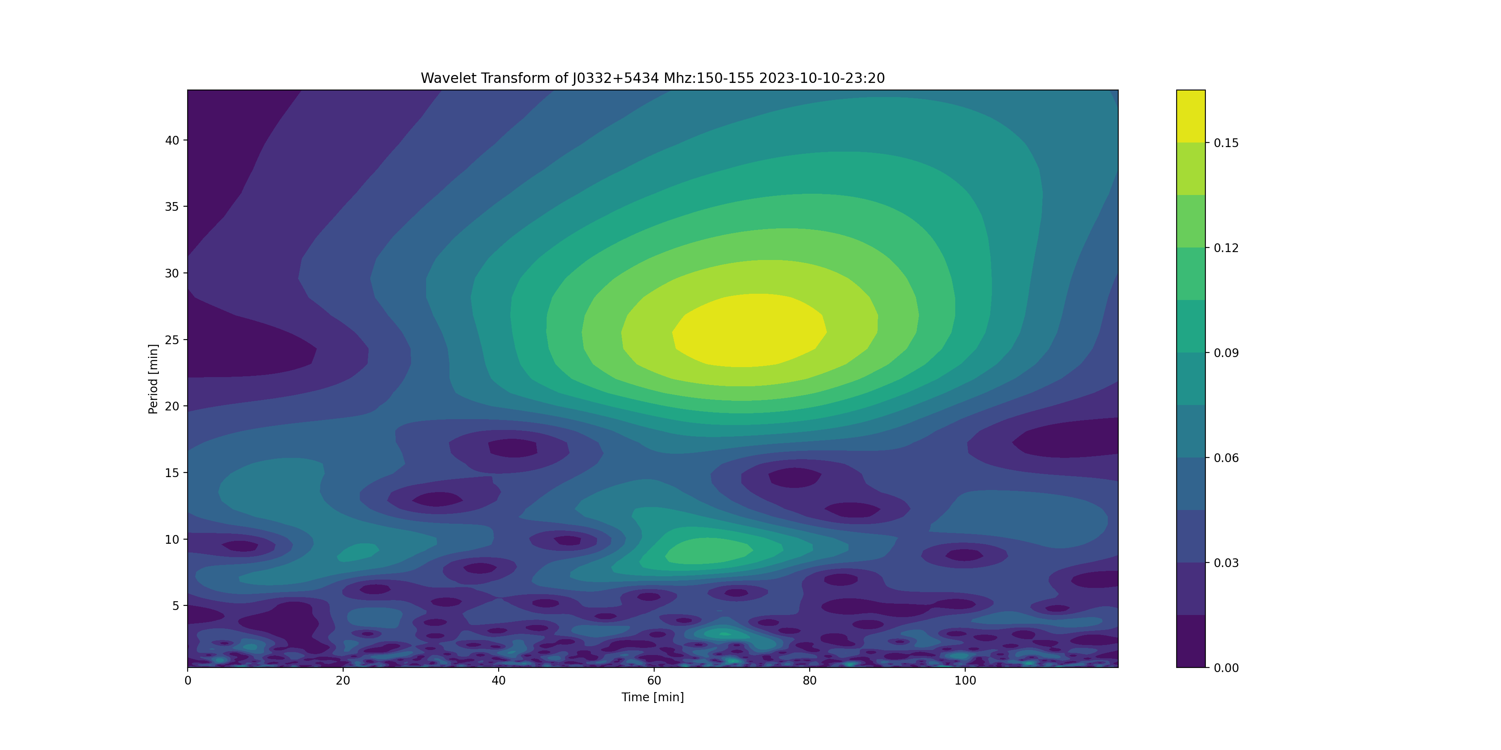
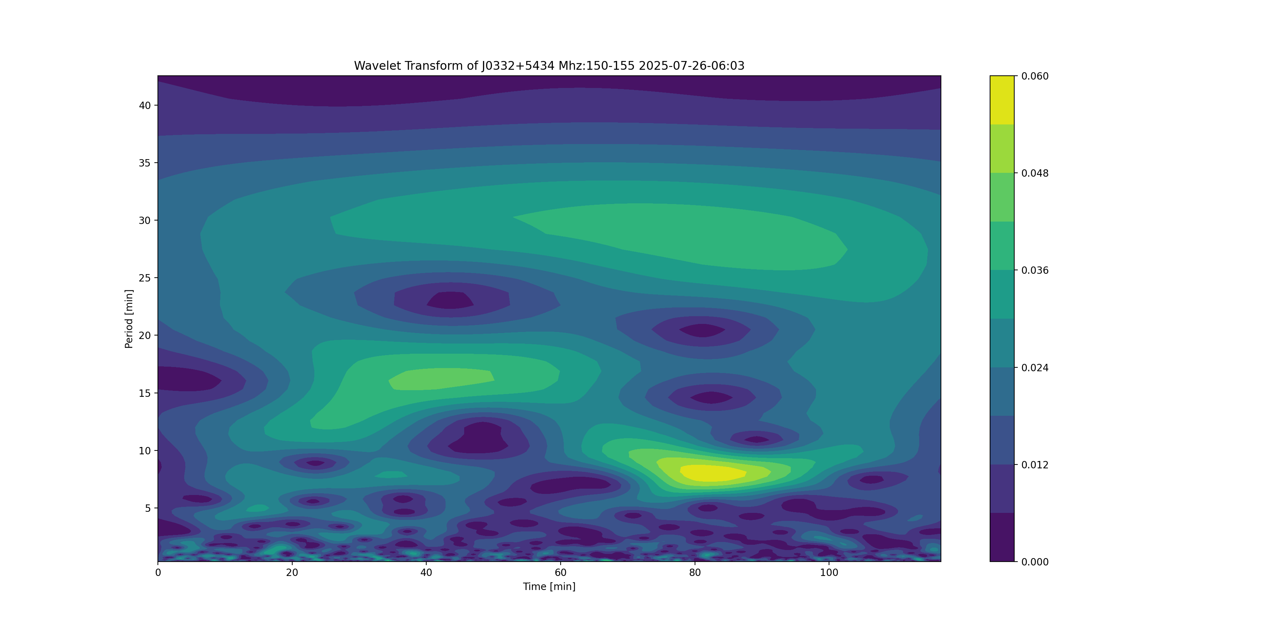
J0332+5434 P - 0.7145 s

Slide 11
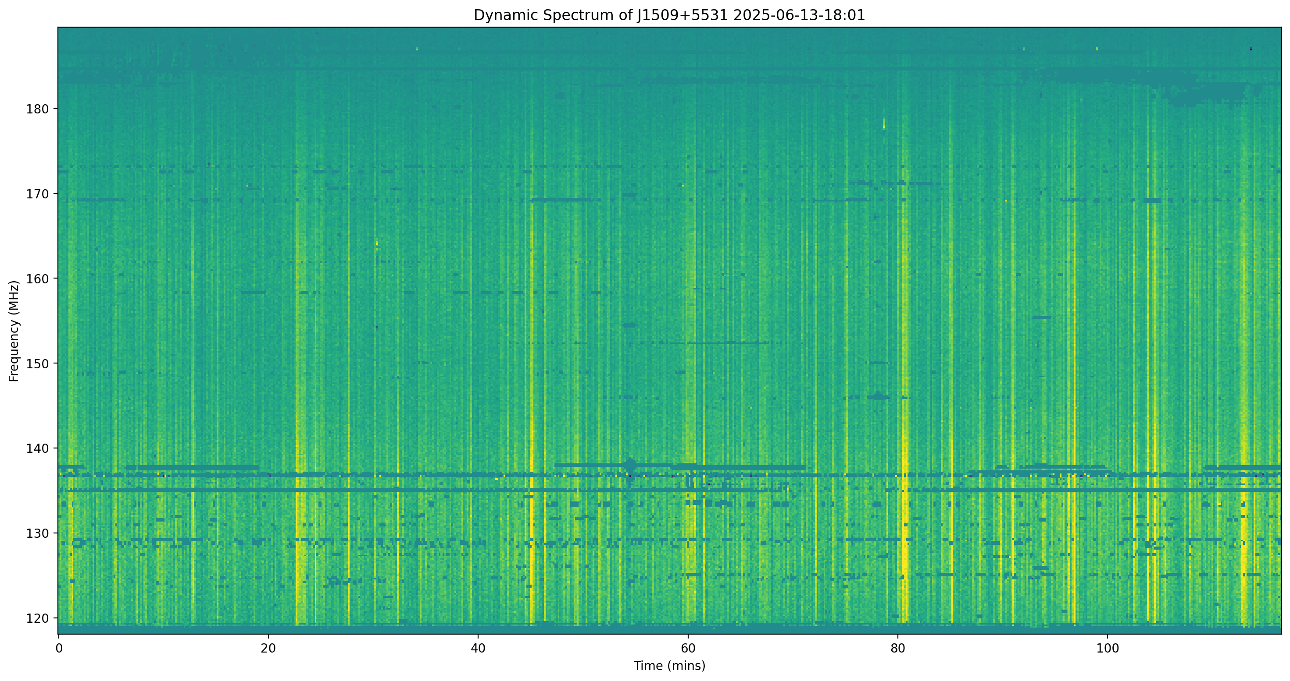
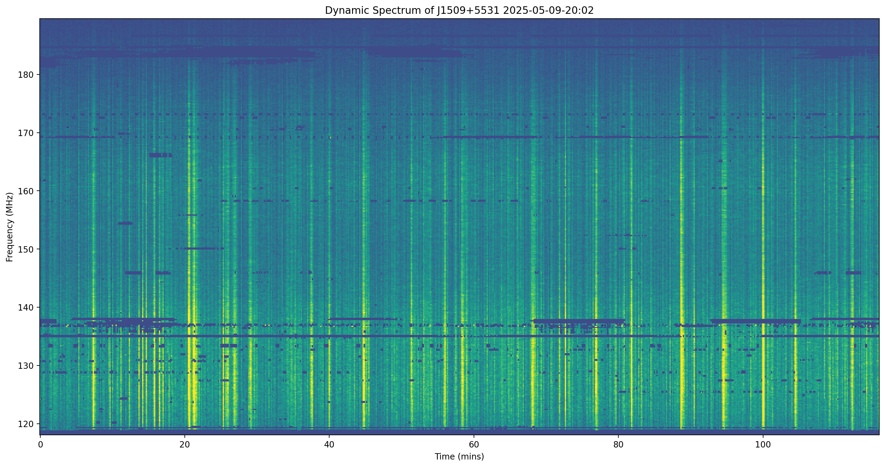
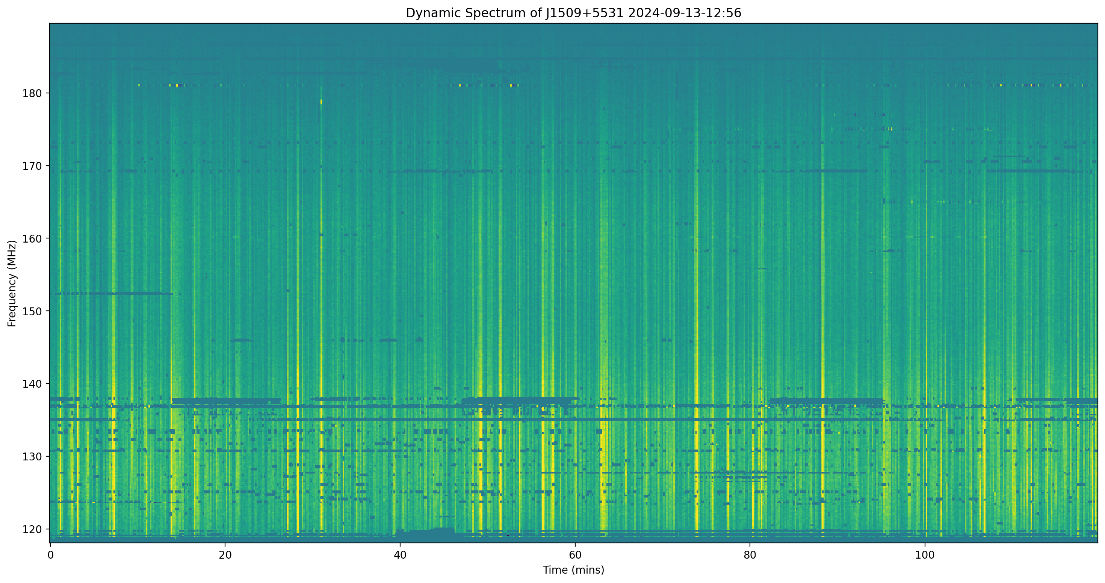
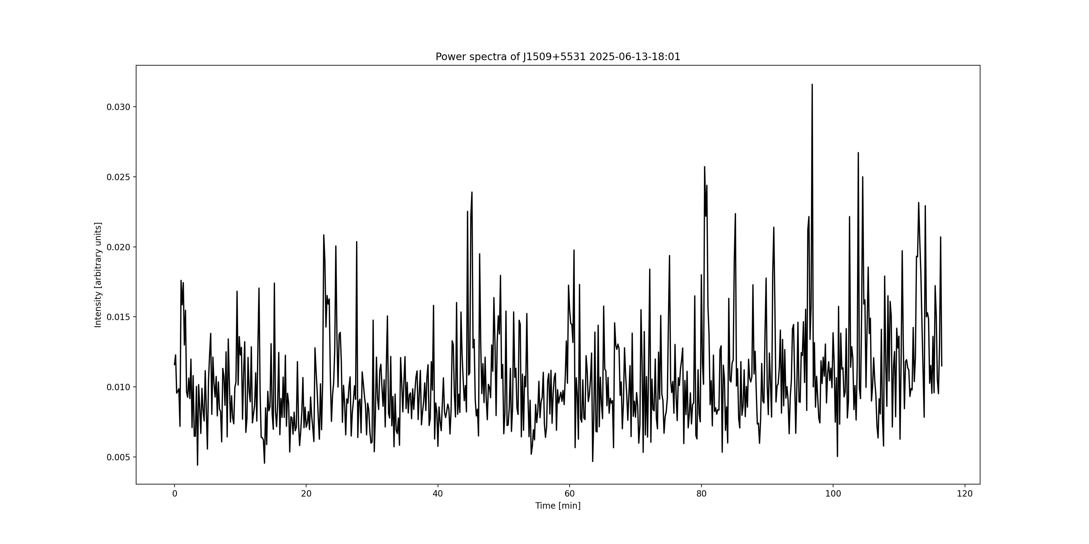
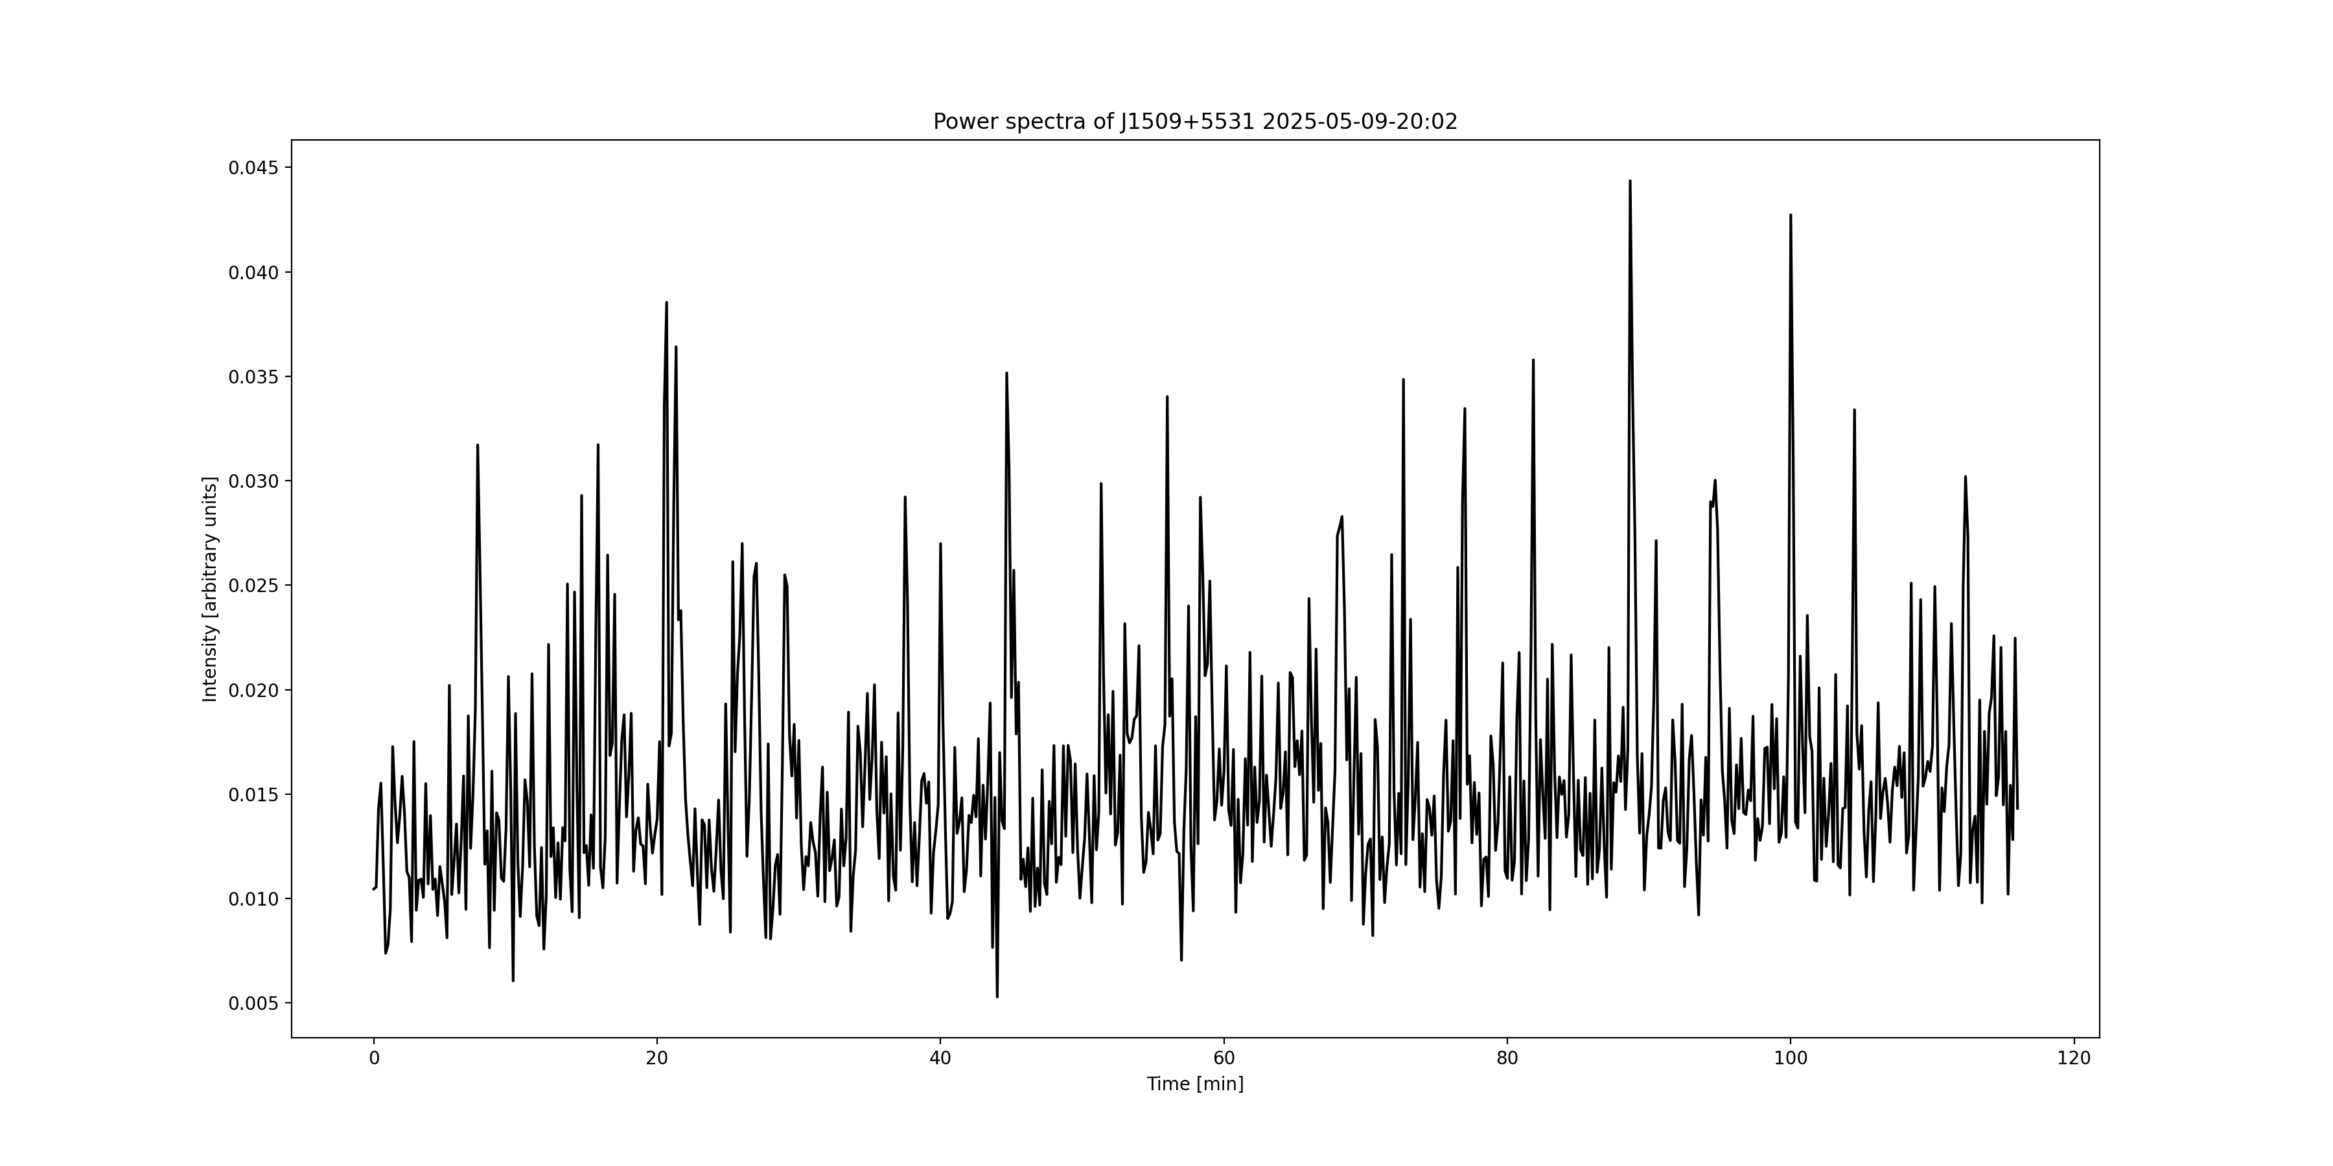
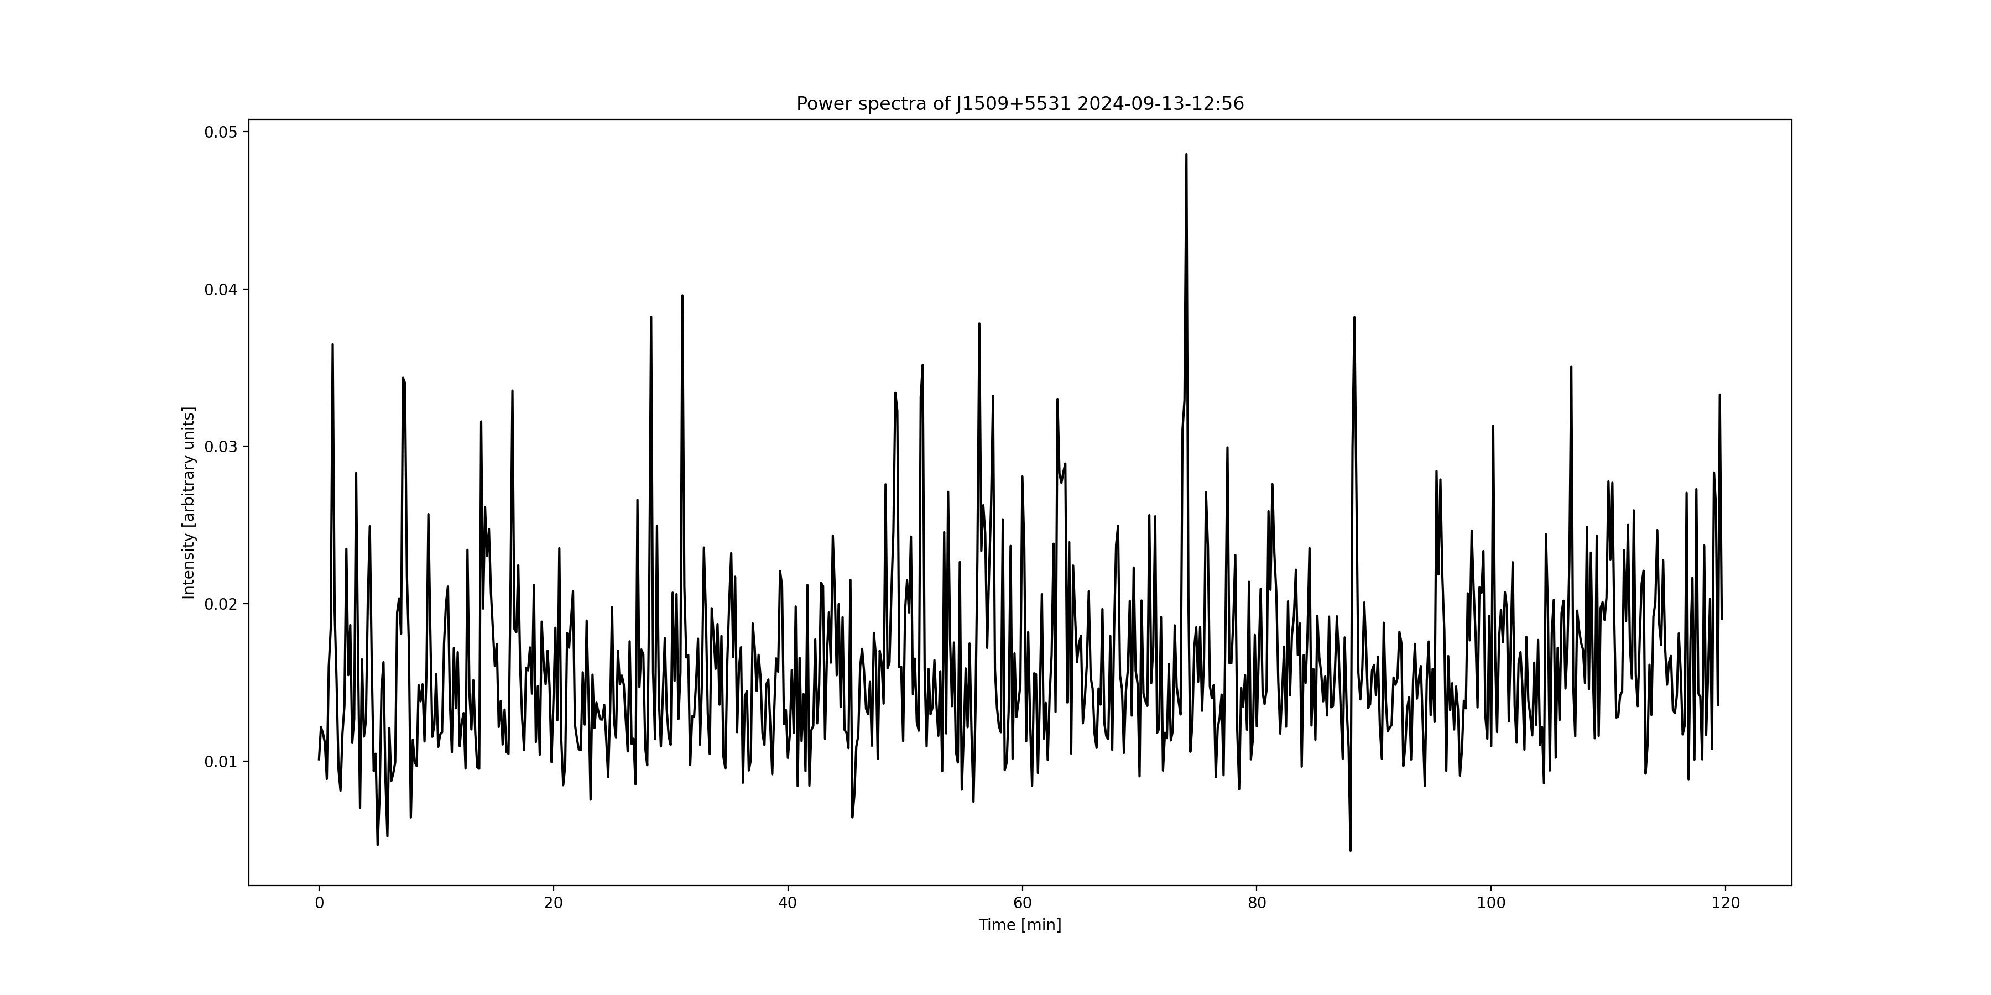
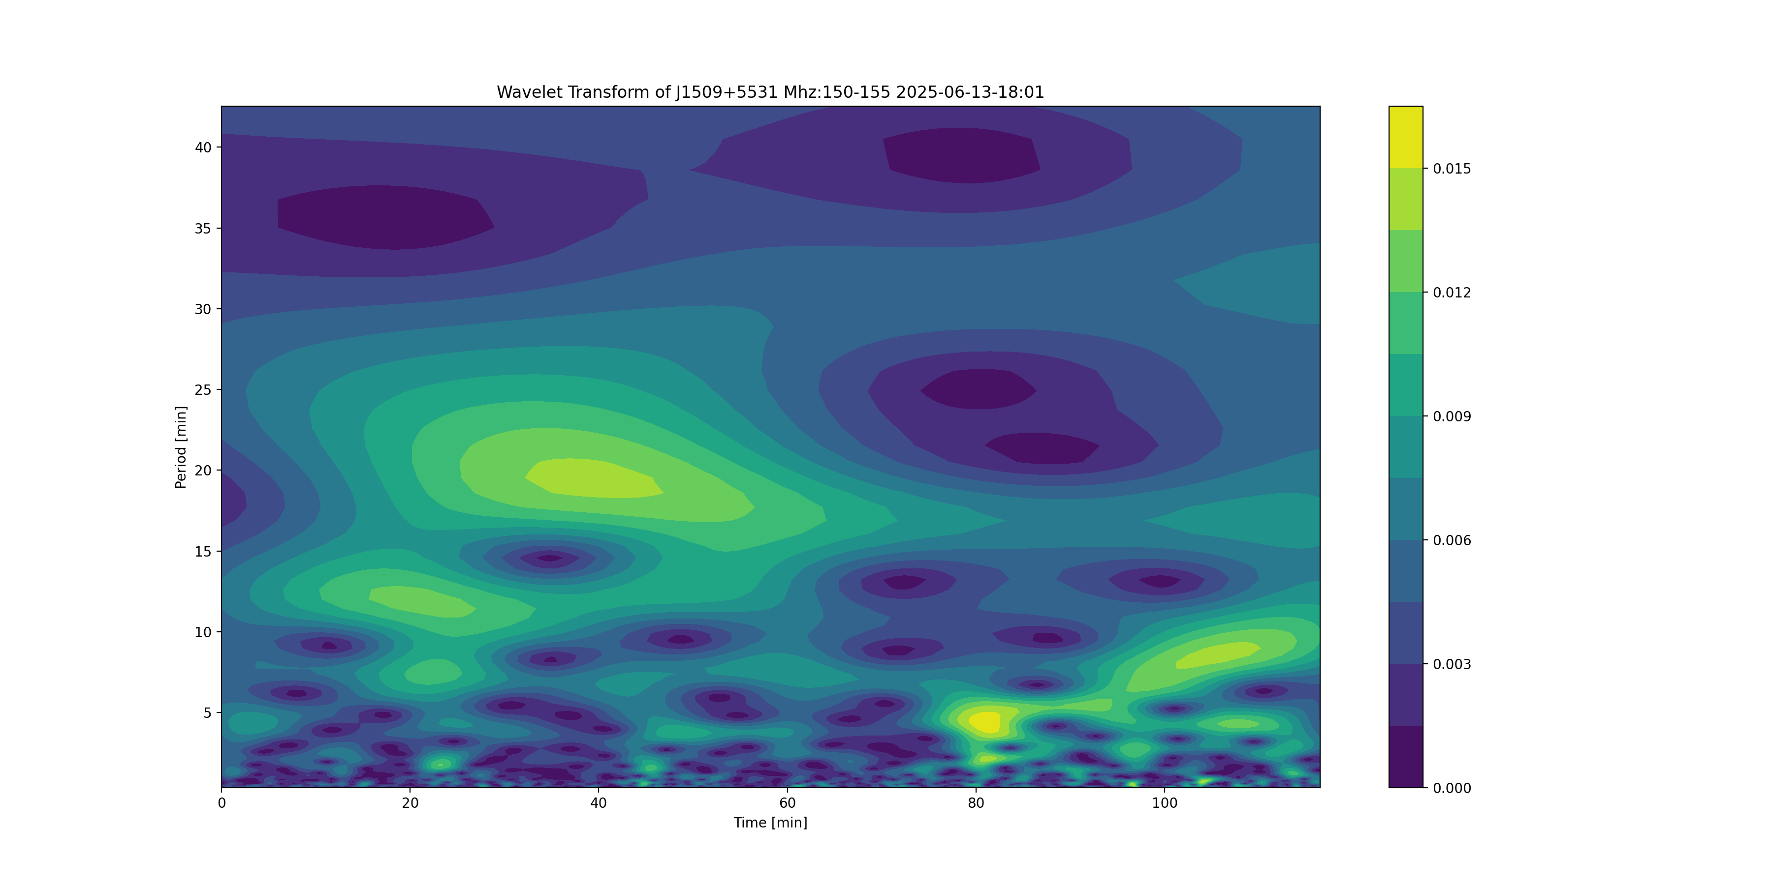
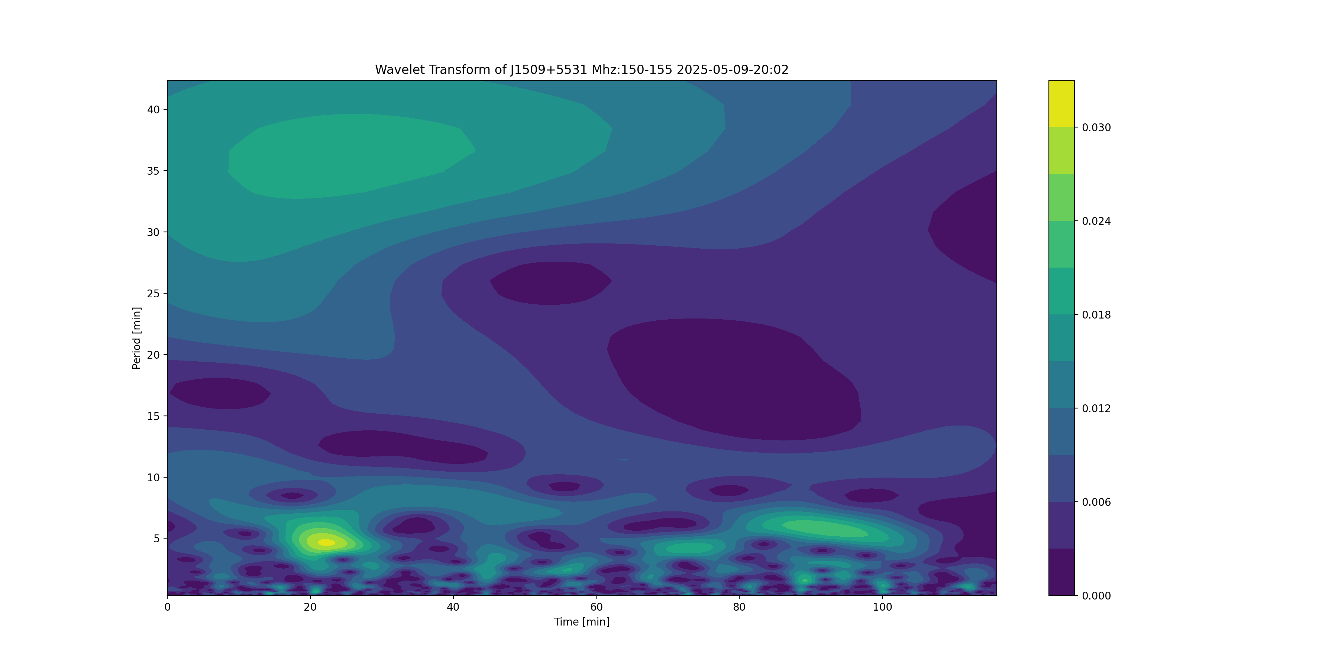
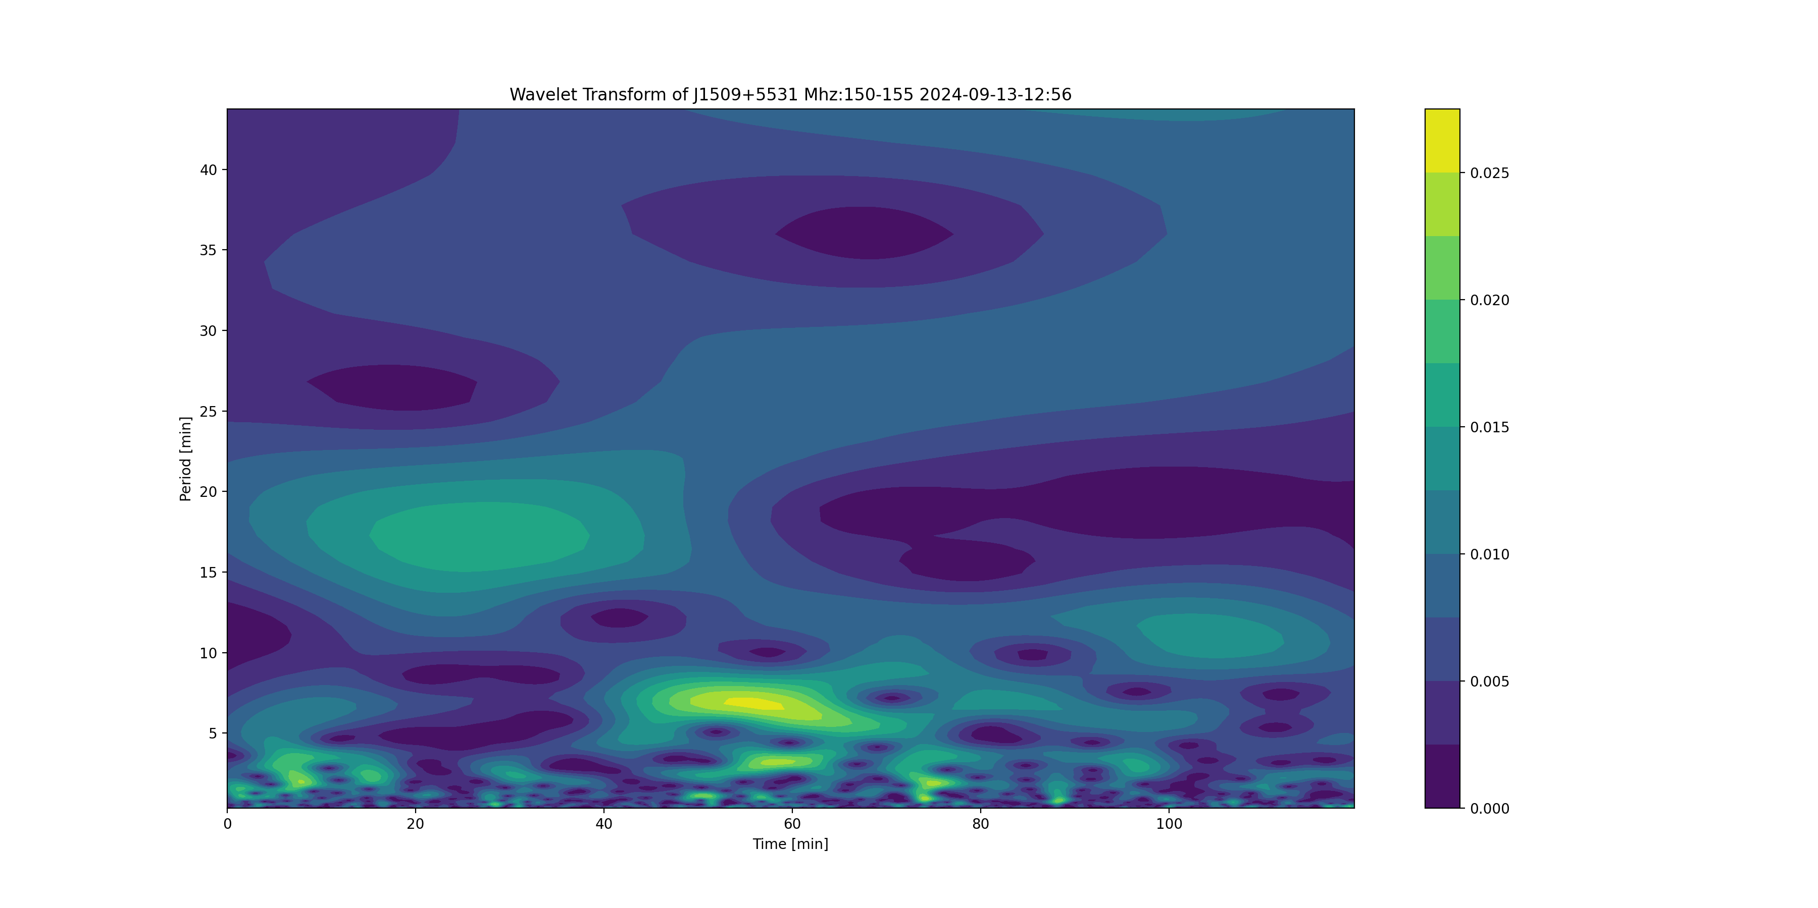
J1509+5531 P - 0.7397 s

Slide 12
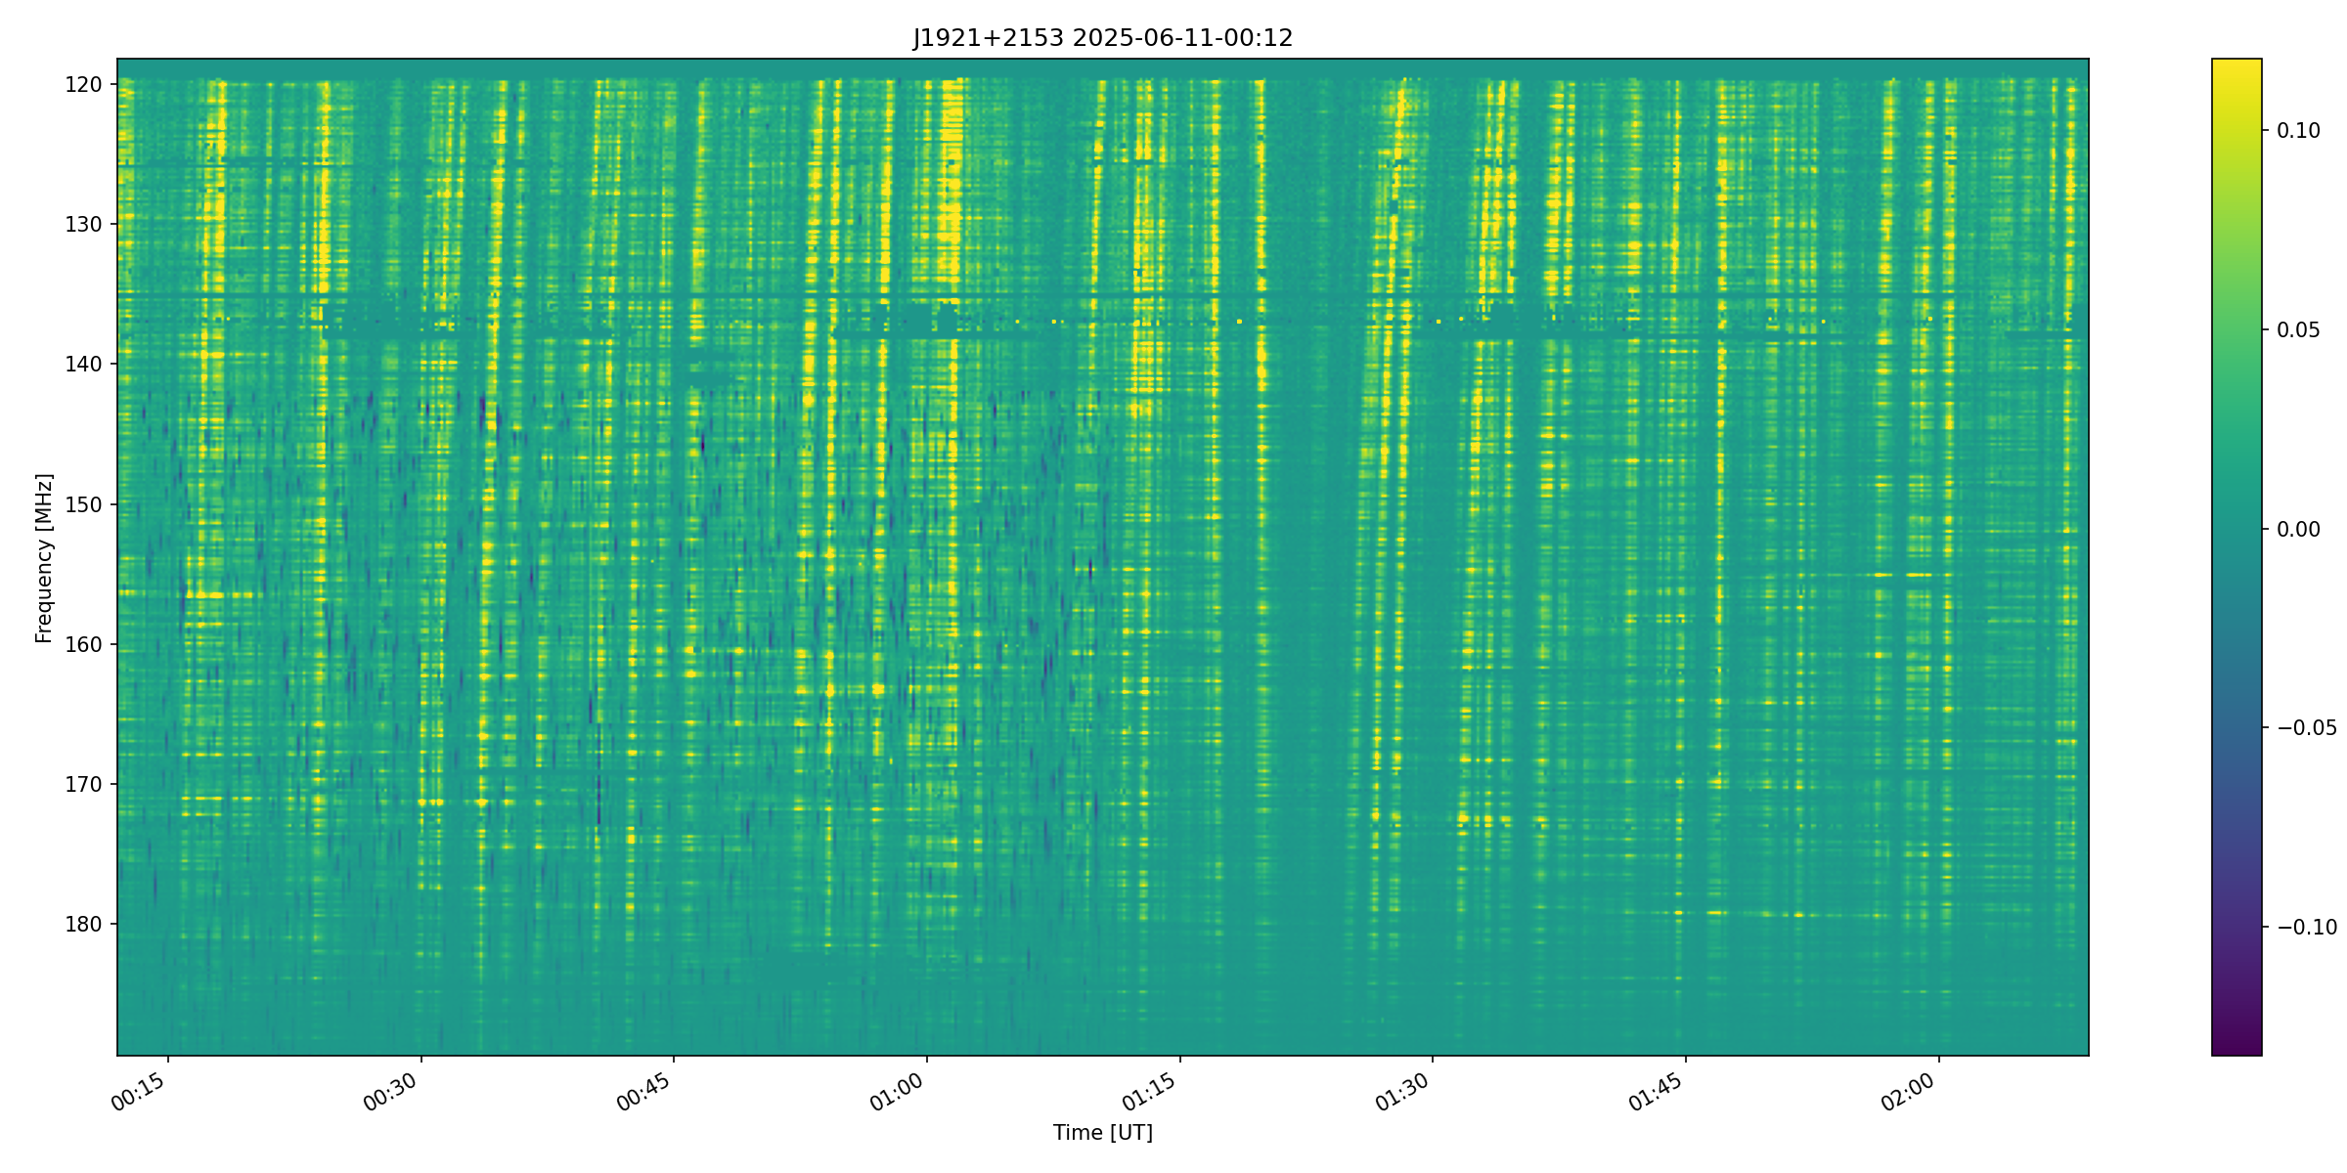
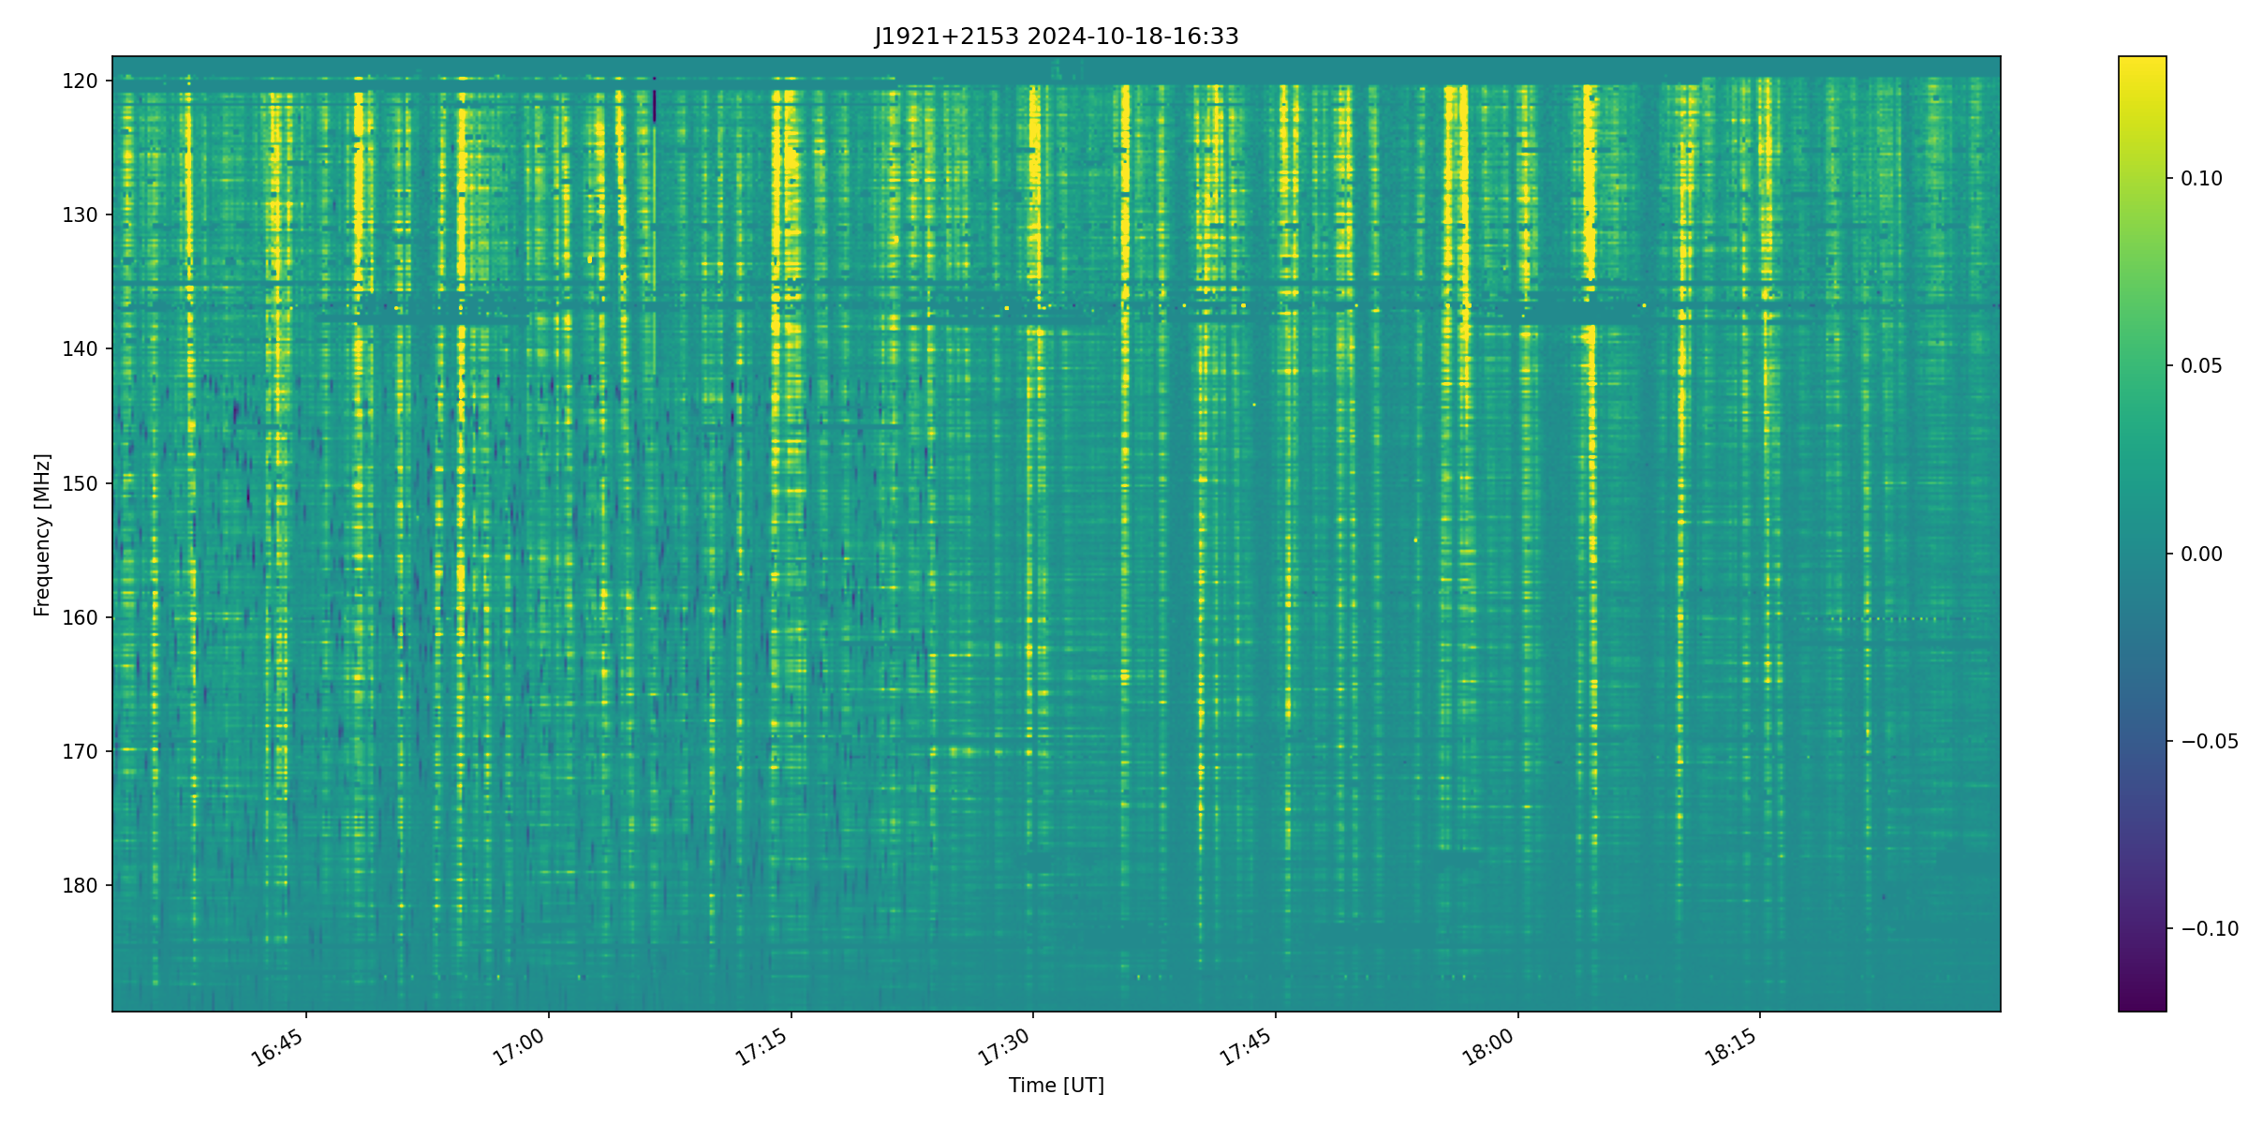
Dynamic spectra of J1921+2153
The spectrum on the left was recorded during opposition, when the pulsar signal was propagated through the Earth plasma tail.

Slide 13
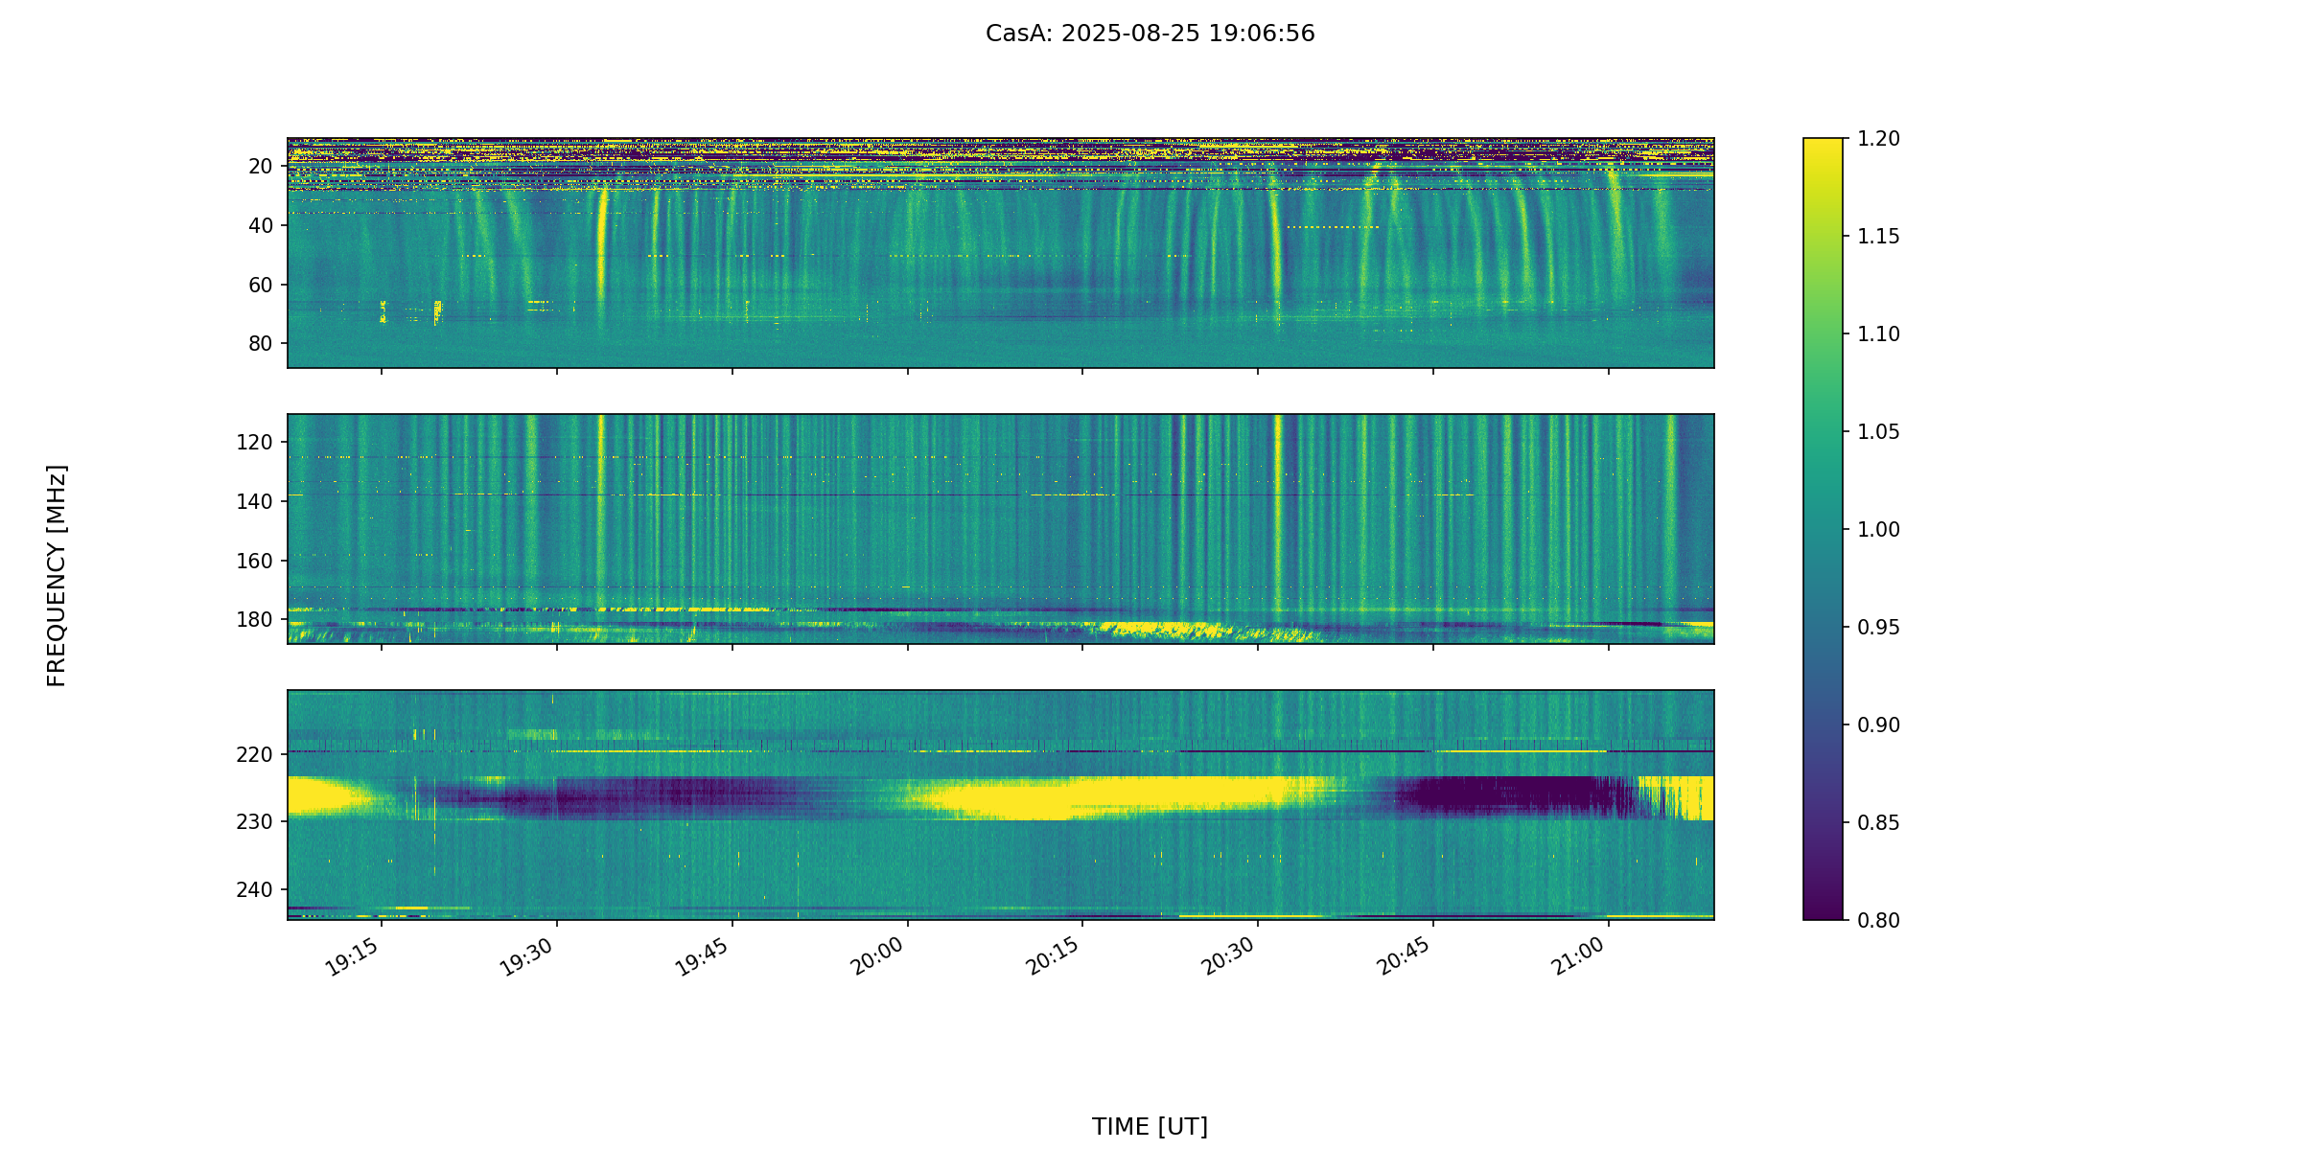
Dynamic spectra of J1921+2153

Slide 14
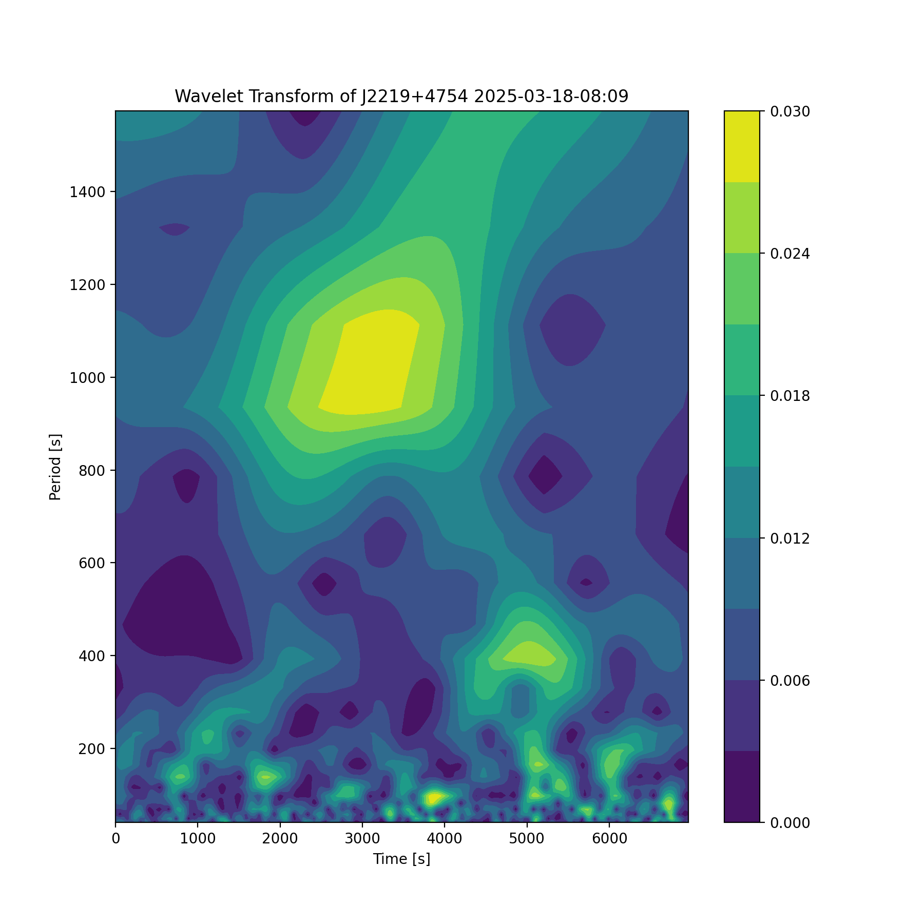
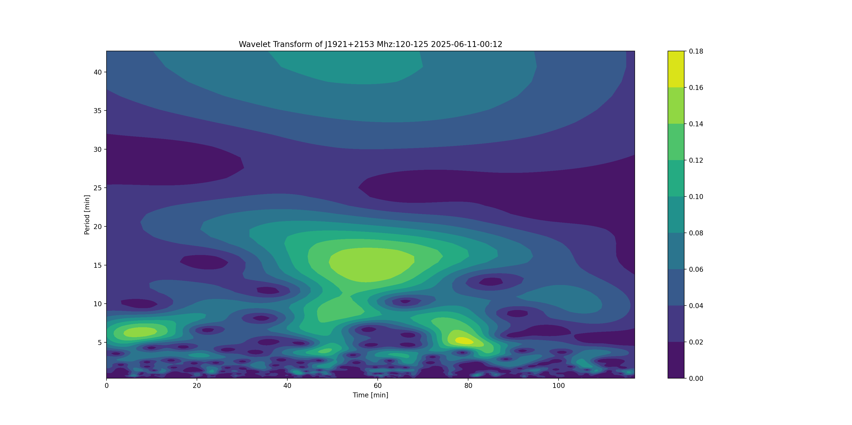
Variability in Pulsar Dynamic Spectra
We noted the existence of 3 groups of periods in DS:
3-6 minutes
10-15 minutes
16+ minutes

Slide 15
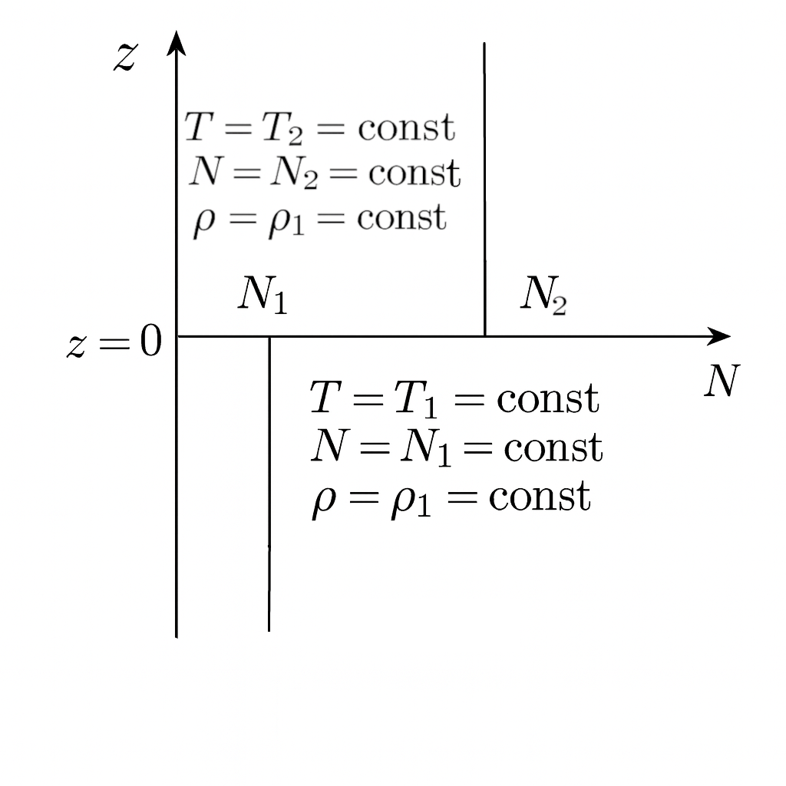
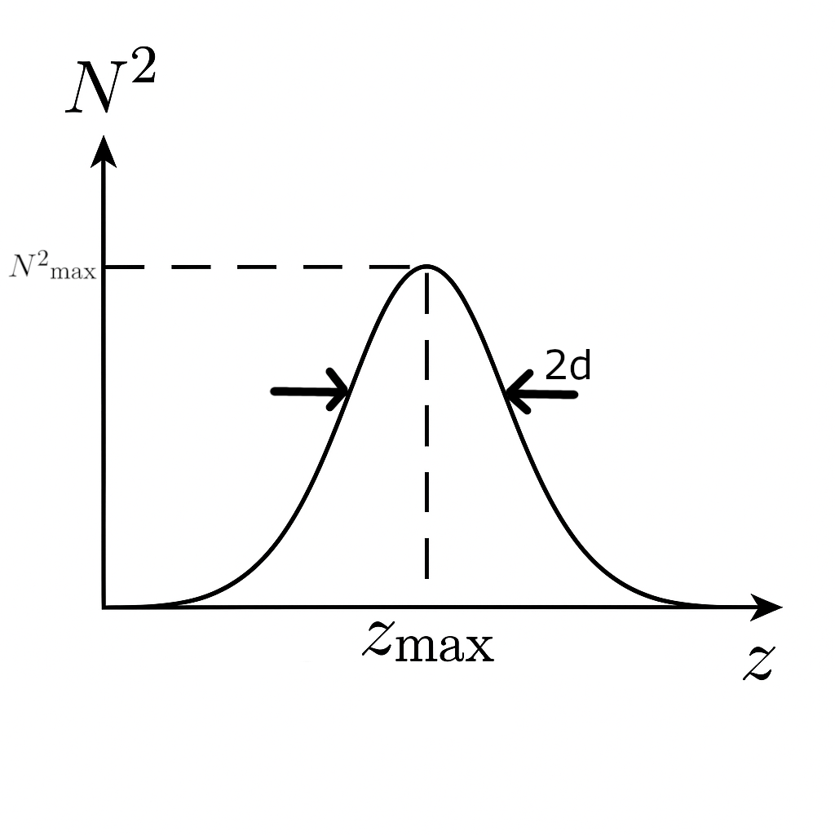
Resonant AGW-TID excitations in the Atmosphere-Ionosphere
Surface mode on the boundary “Atmosphere-Thermosphere” (Fig A)
Excitation of the AGW modes in the AGW waveguide in E region of the ionosphere (Fig B)
Excitation of AGW in the thermosphere /F region of the ionosphere in the presence of inhomogeneous wind, in particular sheared wind. AGW generation in active and nonlinear atmosphere-ionosphere
Nonlinear excitations in the atmosphere-ionosphere with resonant nonlinear losses
Waveguide/resonant excitations of AGW-TIDs in the atmosphere-ionosphere, including the situations with the presence of wind gradient; in particular, this is possible in the presence of the wind with horizontal velocity gradient in the direction of wave propagation capable to cause amplification or damping AGW with proper sign of the gradient.
this mechanism leads to a period of approximately several minutes
Fig A) Atmosphere as two semi-Infinite isothermal layers
with parameters N1, T1, ρ1; N2, T2, ρ2
N- Brunt-Visala Frequency (BVF), T – Temperature, ρ - density
Fig B) Atmospheric waveguide at the altitudes of ionospheric E region.
Z=Z max is the altitude where the N² of BVF reaches value N² max

Slide 16

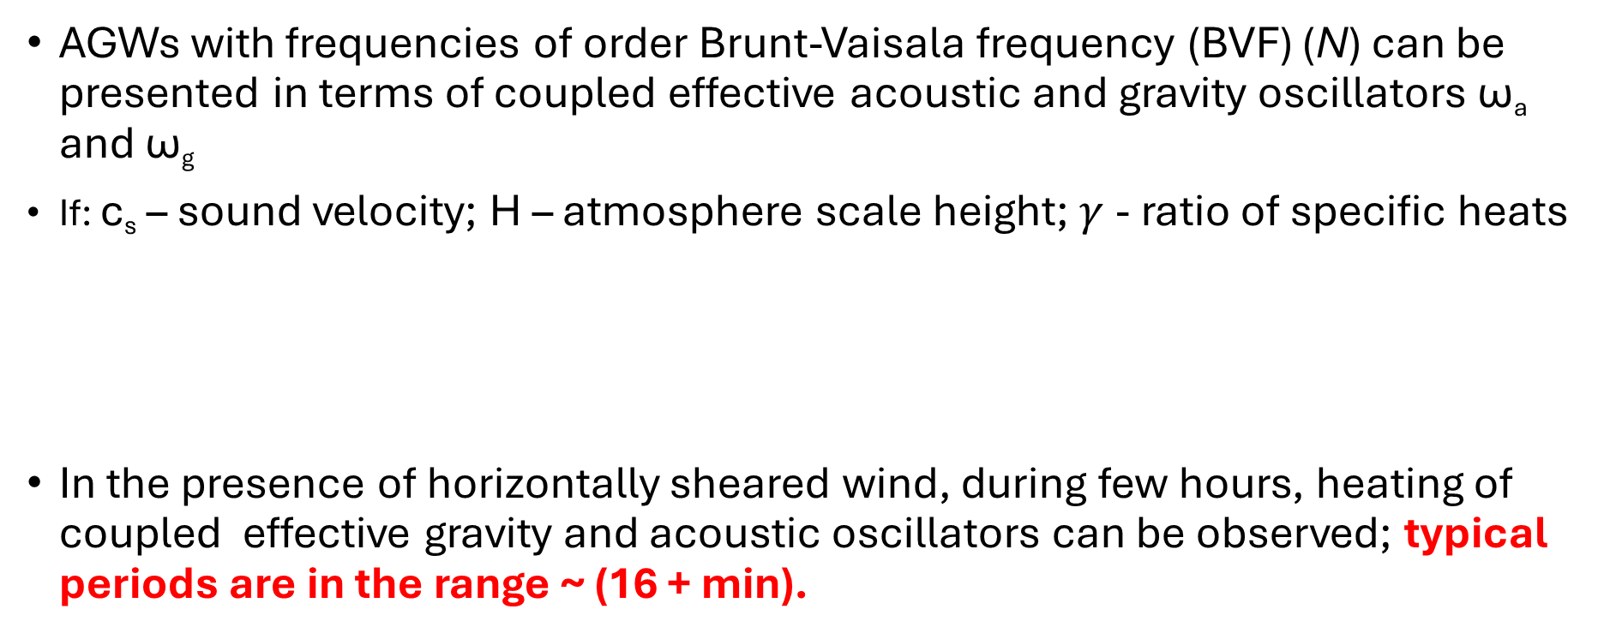
Acoustic Gravity Wave (AGW) in the thermosphere /F region of the ionosphere in the presence of inhomogeneous wind
AGWs with frequencies of order Brunt-Vaisala frequency (BVF) (N) can be presented in terms of coupled effective acoustic and gravity oscillators ω_{a} and ω_{g}
If: c_{s} – sound velocity; H – atmosphere scale height; $γ$- ratio of specific heats
In the presence of horizontally sheared wind, during few hours, heating of coupled effective gravity and acoustic oscillators can be observed; typical periods are in the range ~ (16 + min).

Slide 17
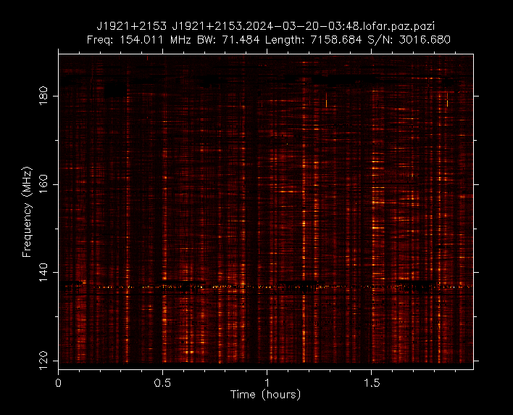
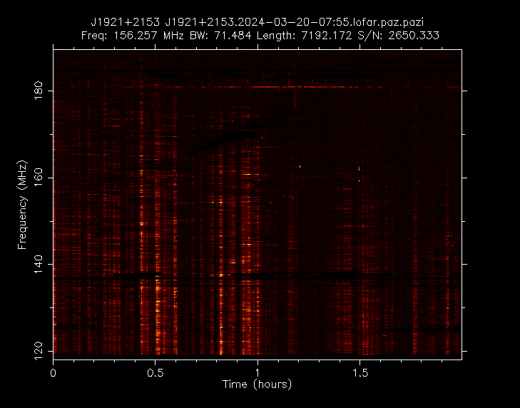
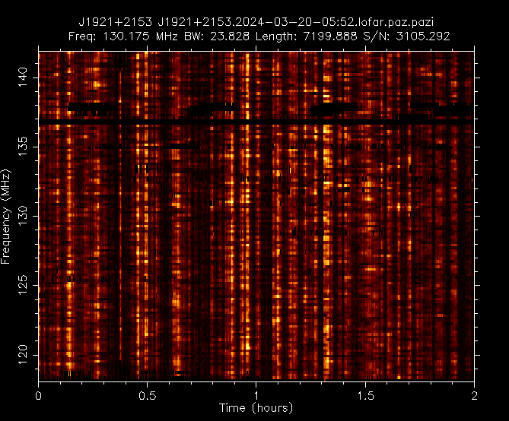
J1921+2153 Bałdy

Slide 18

J1921+2153 Łazy

Slide 19


Bałdy
~2:13
Łazy
~2:08

Slide 20


Bałdy
8:19
Łazy
8:08

Slide 21
Conclusions
We realize that the observed with LOFAR shape and changes in dynamic spectra may be partly caused by unknown pulsation modes. This diagnosis requires multi-instrumental observations at multiple frequencies.
We also believe that the structures recorded in dynamic spectra are likely to be caused, at least in part, by the effects of signal propagation through the ionosphere.
The observed frequency of changes can be explained by ionospheric disturbances caused by two possible mechanisms:
Resonant AGW-TID excitations in the Atmosphere-Ionosphere;
Acoustic Gravity Wave (AGW) in the thermosphere /F region of the ionosphere in the presence of inhomogeneous wind
We are currently analyzing data from an experiment of simultaneous observations of pulsars by various instruments in Europe, but…
We need more simultaneous obs. from different LOFAR stations to be certain about the appearance of similar structures in dynamic spectra and their relationships.

