Slide 1



Solar and Space Weather Observations with LOFAR
Kamen Kozarev¹, Pietro Zucca², Vergil Yotov¹, and the Solar KSP Team
LOFAR Family Meeting, 22-26 September, 2025
Paris, France

Slide 2
Outline
Introduction - Solar cycle phase, space missions, and coordinated observations
Recent solar/heliospheric results from LOFAR
Plans for the LOFAR2.0 era - new observing modes, improved pipelines, technical developments, coordinated observing
Instead of a conclusion - LOFAR-BG slide

Slide 3
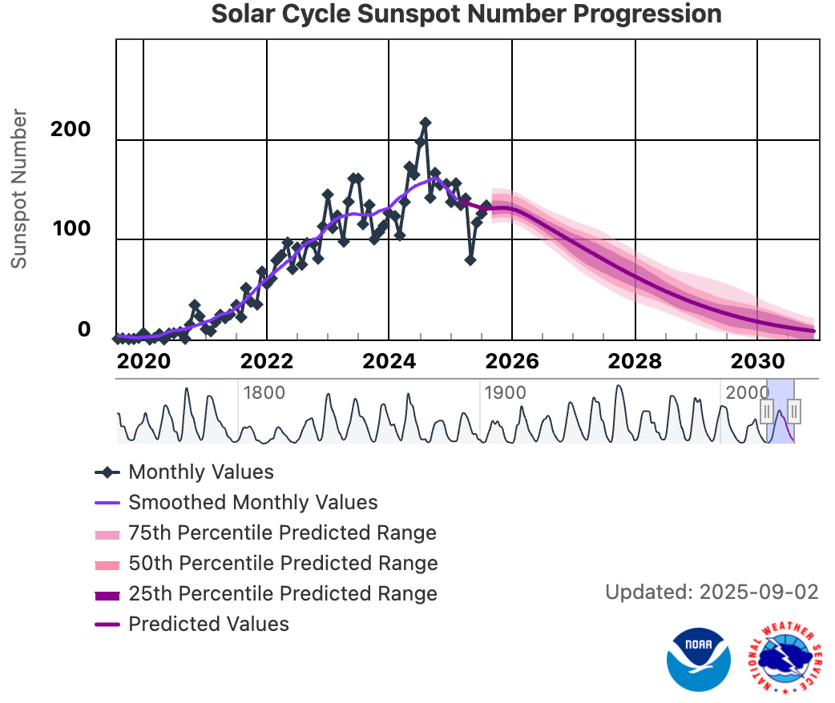
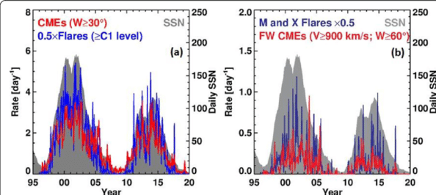
Introduction - Solar cycle phase, space missions, and coordinated observations
Zhang+2021
NOAA/SWPC

Slide 4
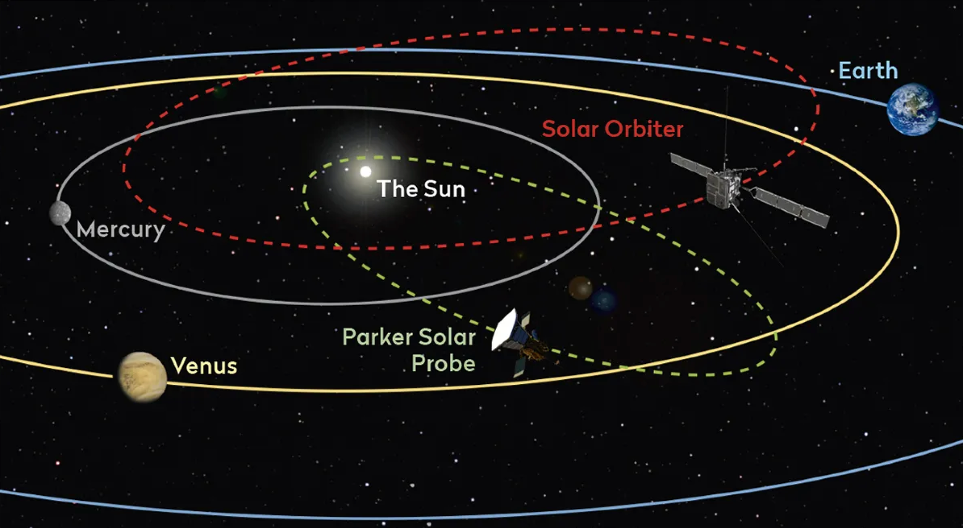
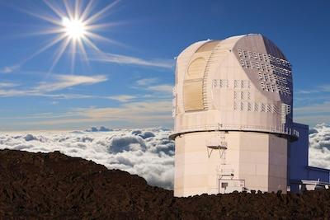
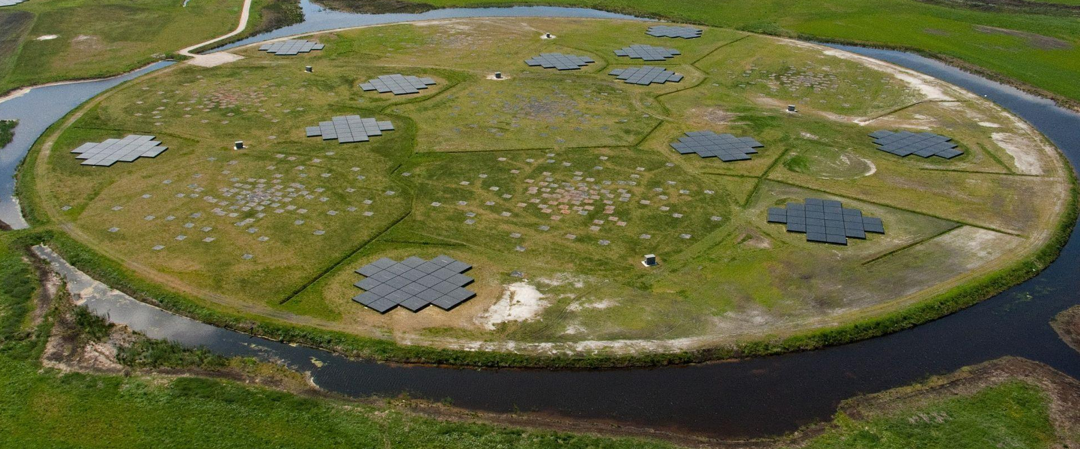
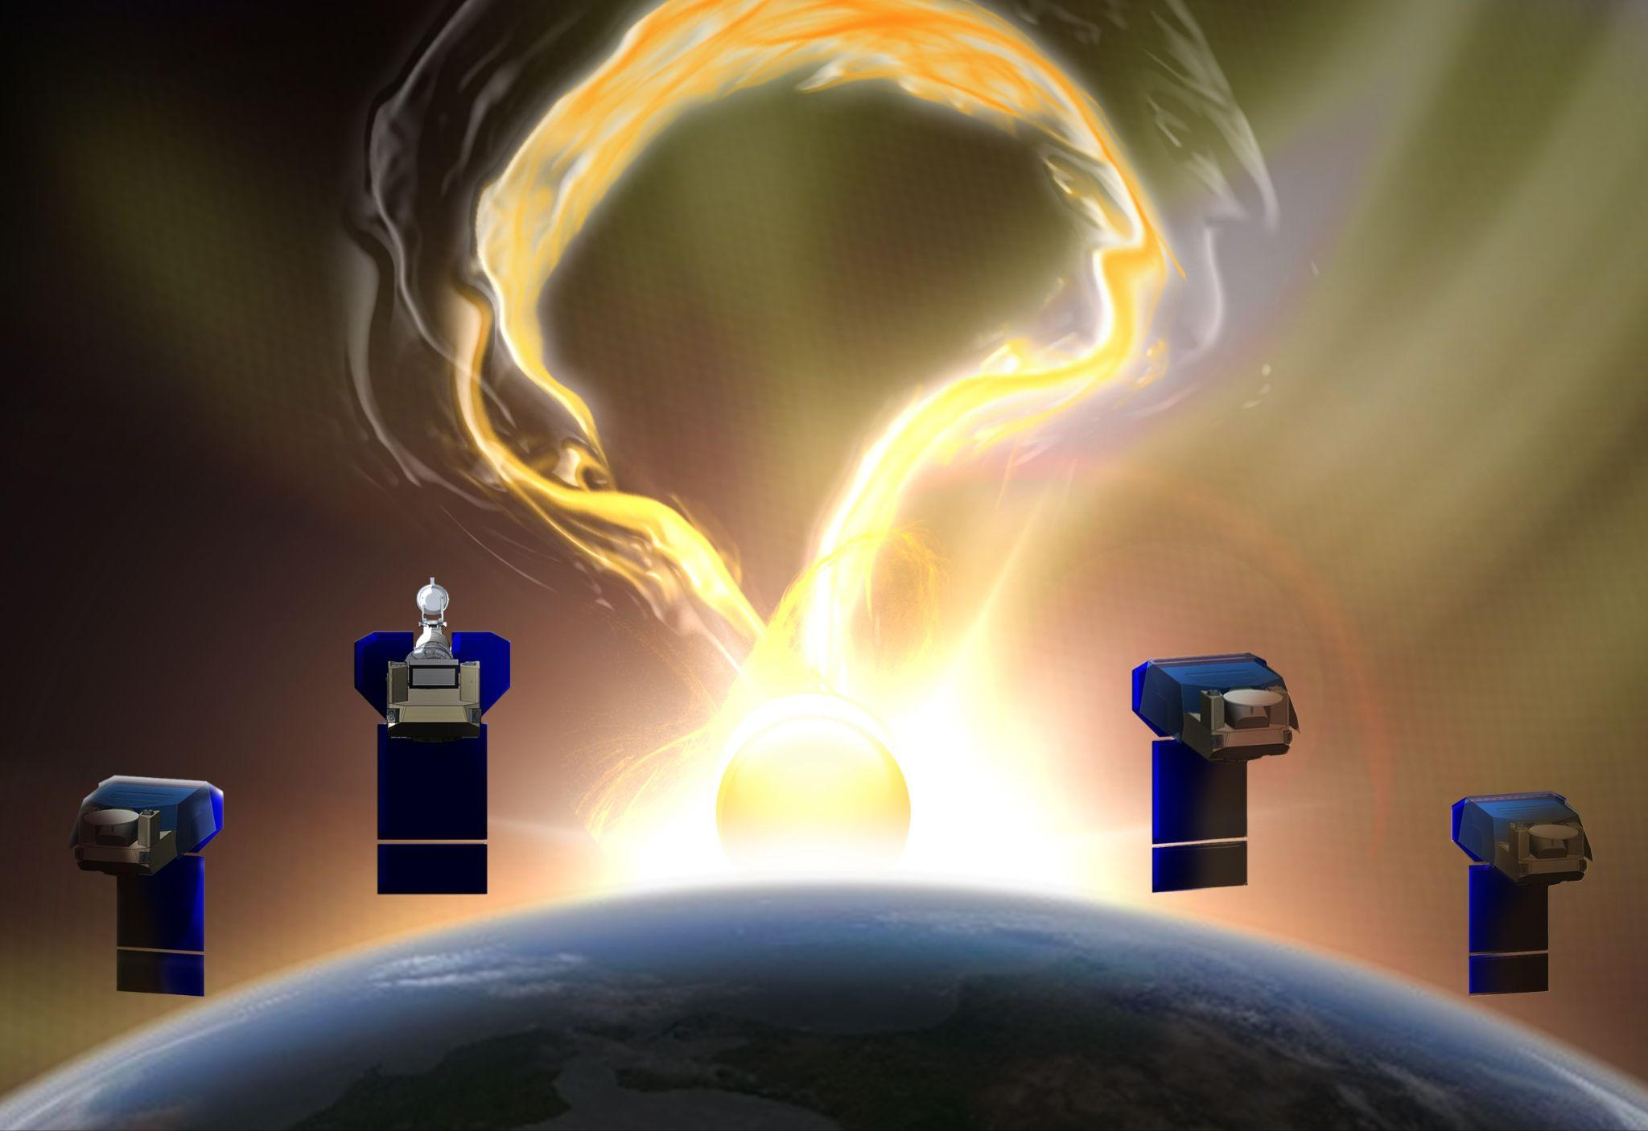
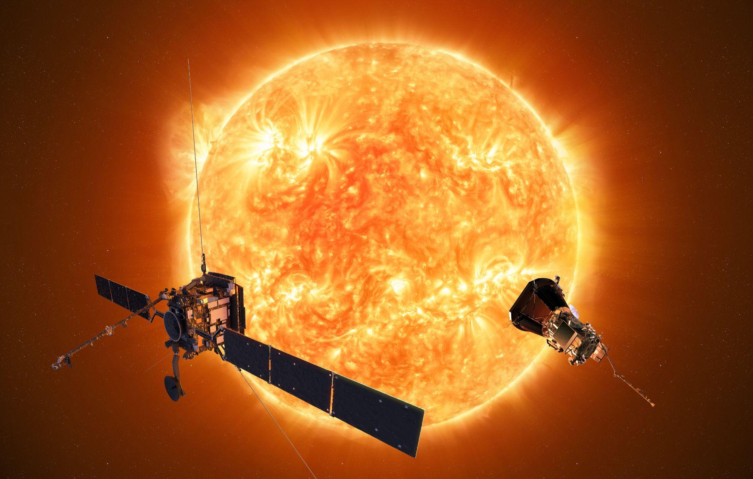
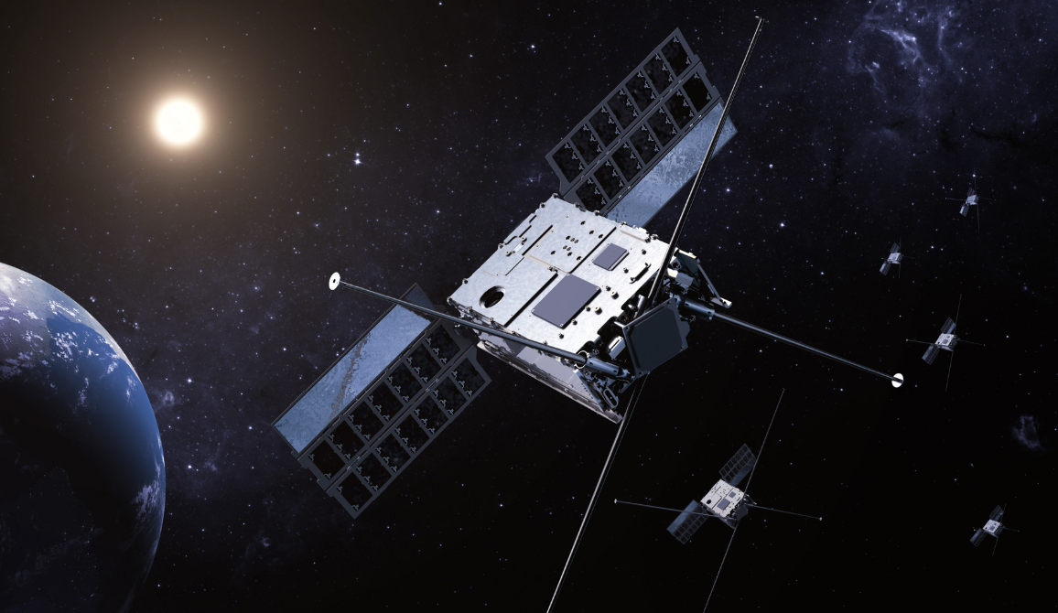
Introduction - Solar cycle phase, space missions and coordinated observations
DKIST
PUNCH
Also: STEREO-A, SDO, SOHO, BepiColombo, Vigil…
SUNRISE

Slide 5
Recent solar/heliospheric results from LOFAR

Slide 6

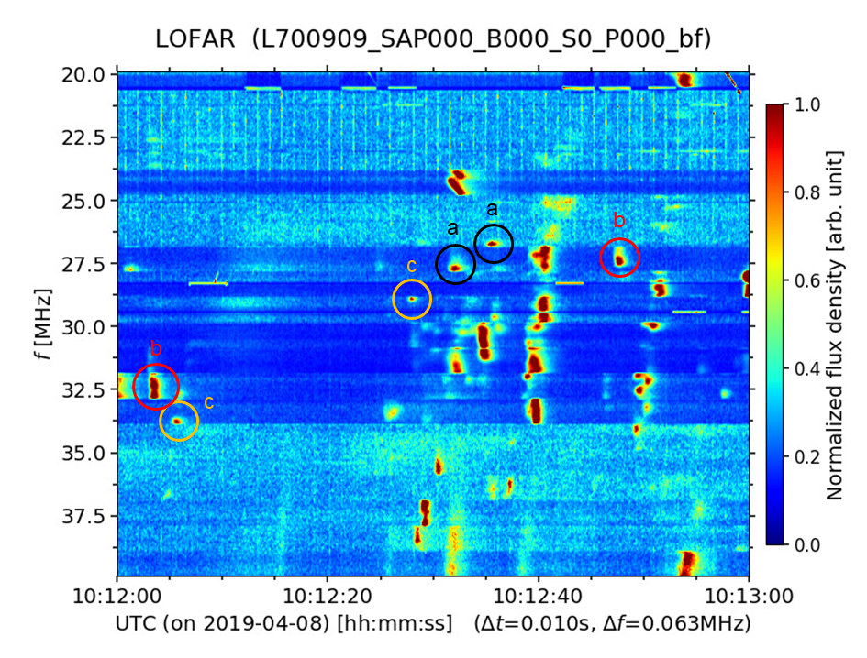
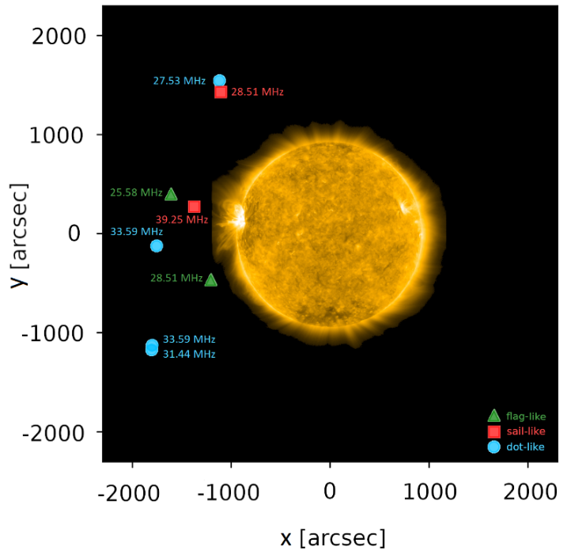
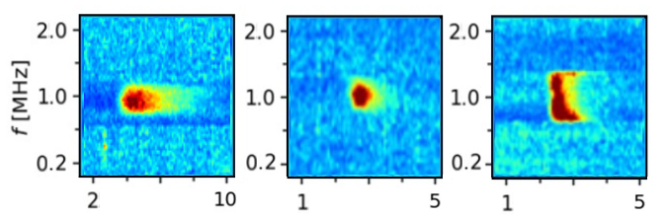

FINE STRUCTURES OF A SOLAR TYPE III RADIO BURSTS OBSERVED WITH LOFAR
B. Dąbrowski*, A. Wołowska*, C. Vocks, J. Magdalenić, P. Zhang, P. Flisek*, M Bröse, D. Morosan, A. Krankowski*, A. Froń*, G. Mann, P. Zucca, M. Bisi, R. Fallows, P. Gallagher, C. Marqué, B. Matyjasiak, and H. Rothkaehl, 2025, Acta Geophysica, 73, 987–993
*Space Radio-Diagnostics Research Centre, University of Warmia and Mazury, Poland
Part of the solar dynamic spectrum with examples of fine structures in the 20–40 MHz band: flag-like, sail-like, and dot-like structures.
Image of the Sun received in the AIA 171 Å channel by SDO with superimposed centroids of the fine structures.
(a) FLAG-LIKE
(c) DOT-LIKE
(b) SAIL-LIKE

Slide 7
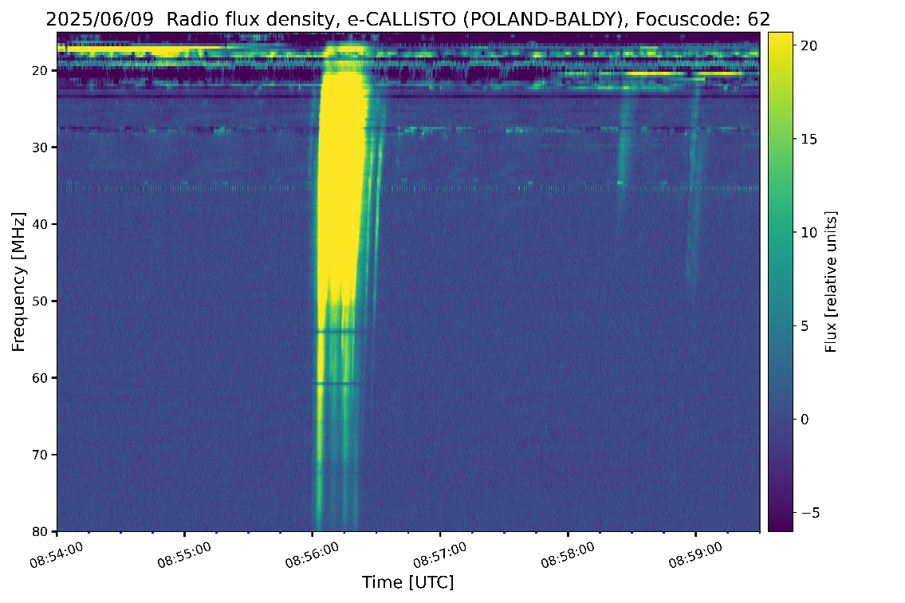
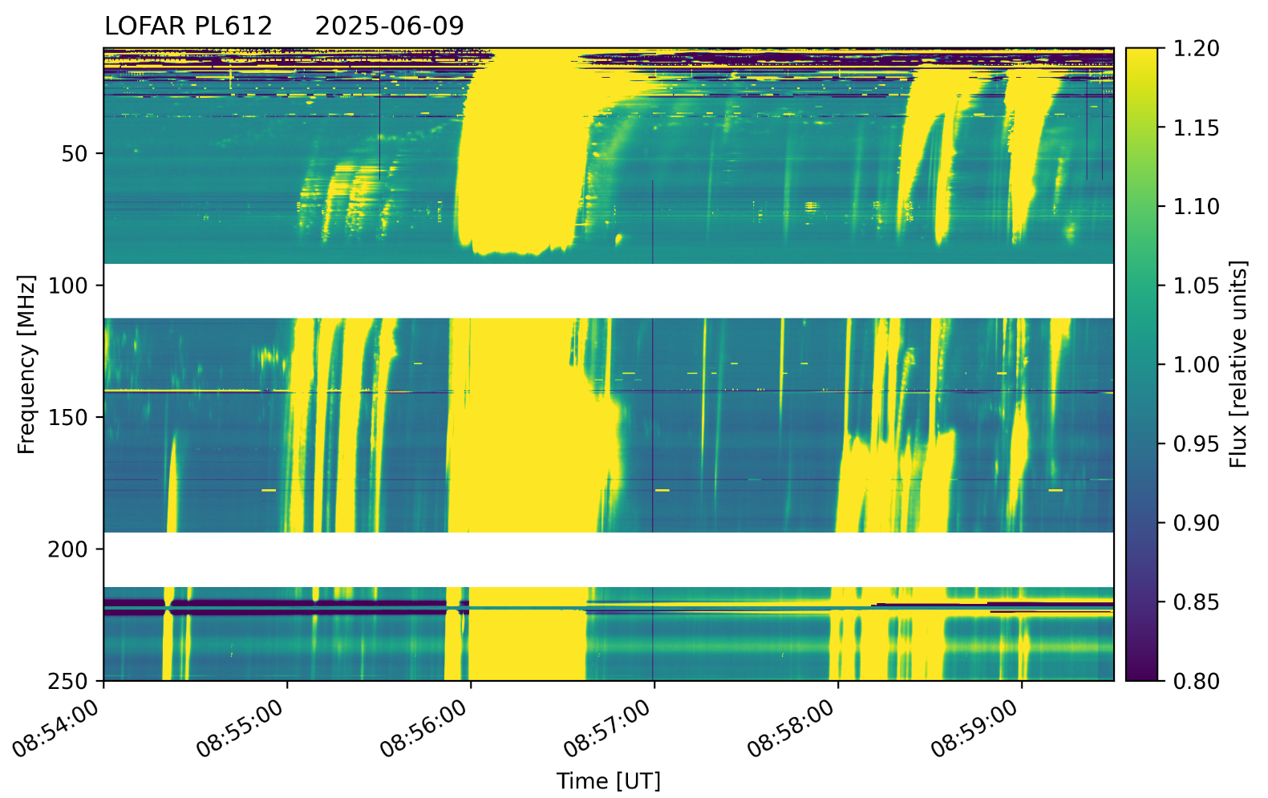
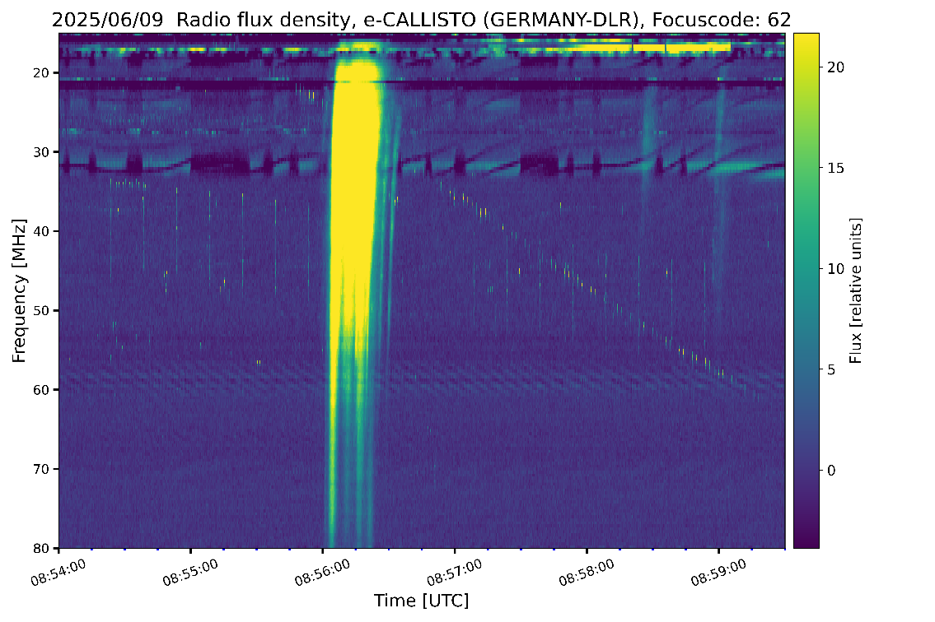
THE SOLAR RADIO BURSTS OBSERVATIONS WITH LOFAR BALDY STATION AND TWO CALLISTO SPECTROMETERS (B. Dabrowski et al.)
Simultaneous observations of the different types of the solar radio bursts made with LOFAR Baldy station and CALLISTO spectrometers located in Baldy (Poland) and Neustrelitz (Germany).
The CALLISTO spectrometer is a receiver operating in the 10–80 MHz frequency range and capable of recording two polarizations.
POLAND
GERMANY

Slide 8


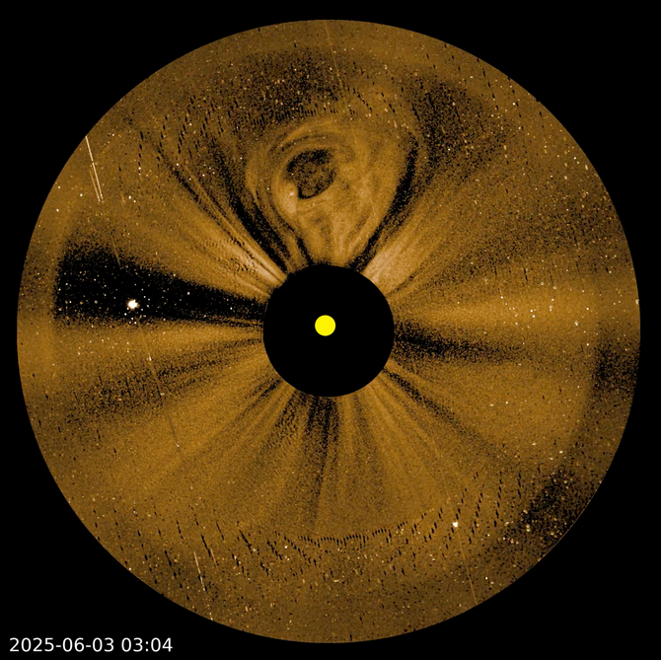
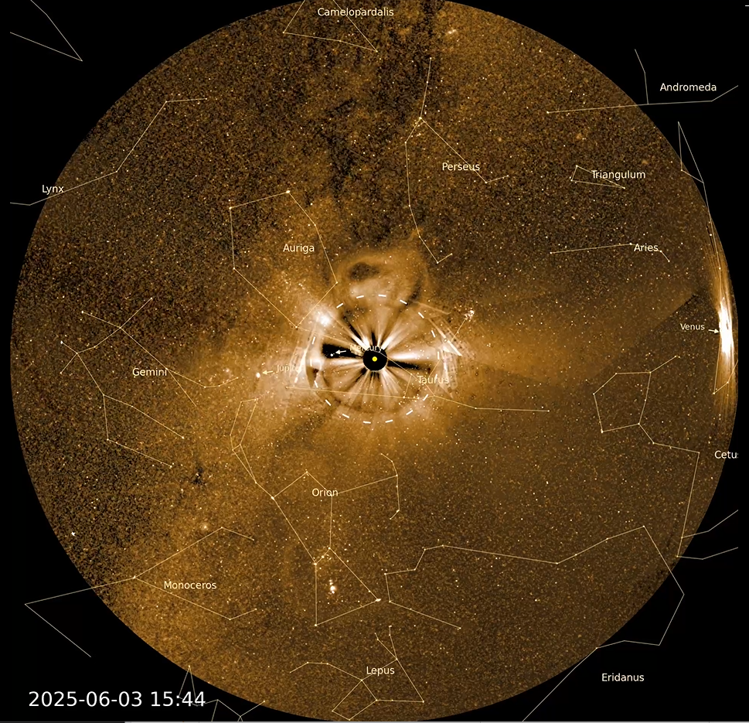
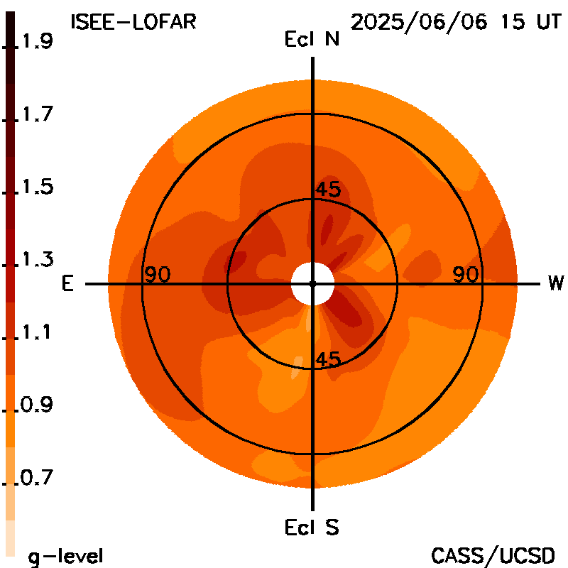
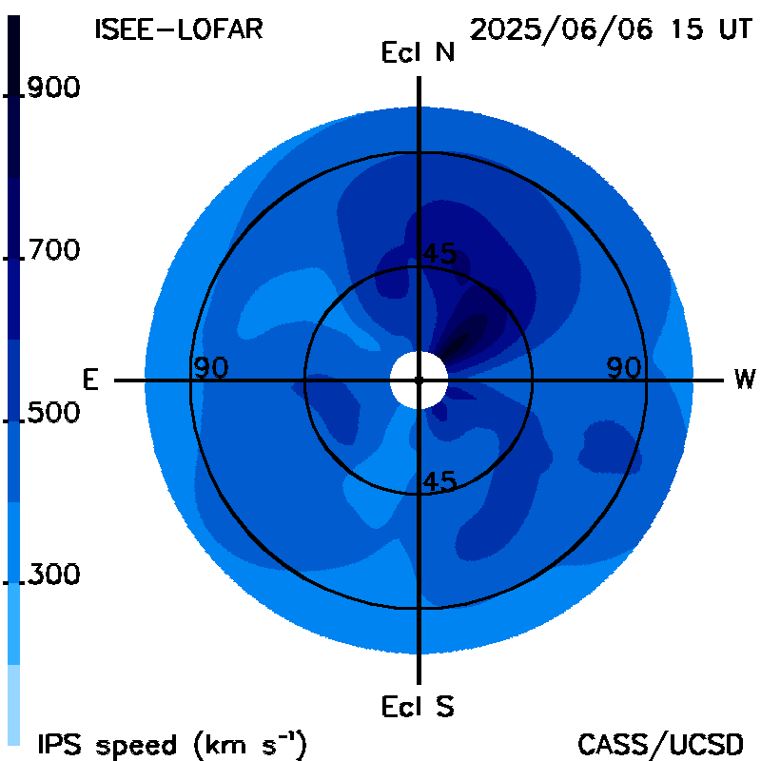
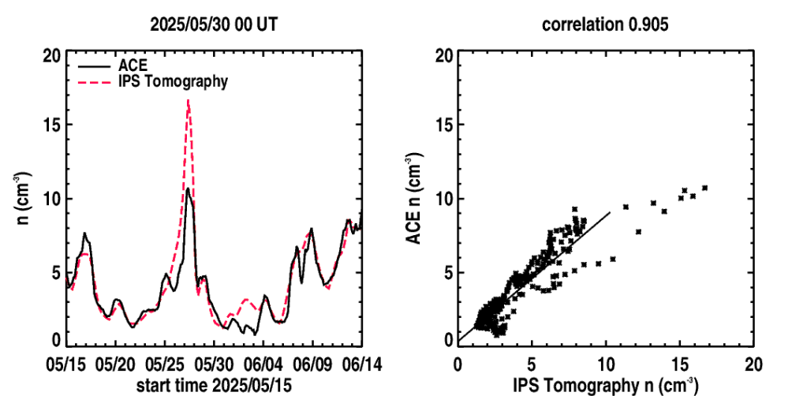
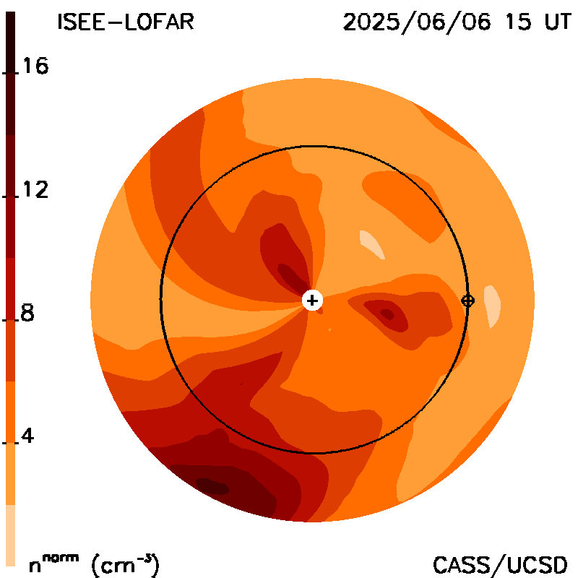
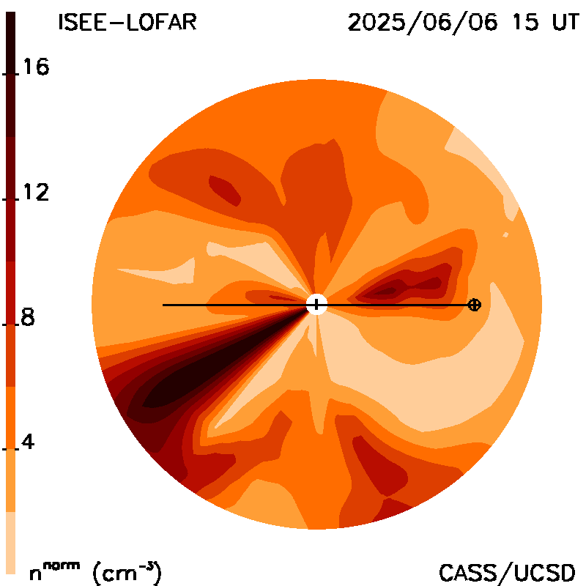
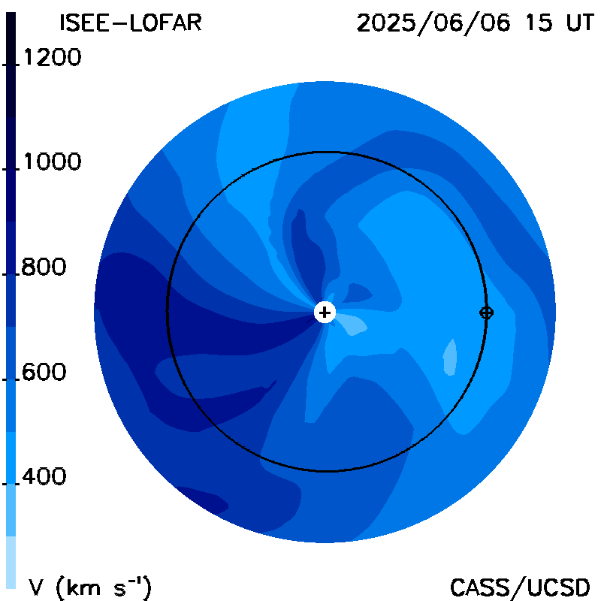
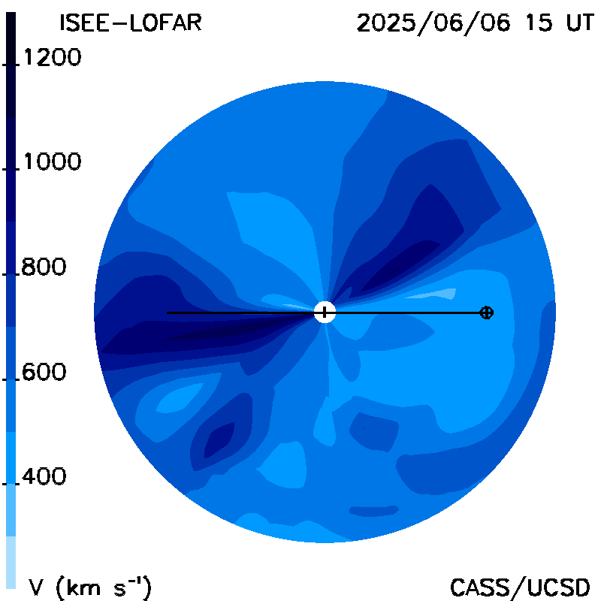
A World-Wide Interplanetary Scintillation Stations (WIPSS) Analysis
for use with Thomson Scattering Brightness
Bernard V. Jackson^{1#*}, Kazumasa Iwai², Ken’ichi Fujiki², Mario M. Bisi³, Richard Fallows³,
Jackie Davies³, David Barnes³, and Oyuki Chang³
¹Department of Astronomy and Astrophysics, University of California, San Diego 9500 Gilman Drive #0424, La Jolla, CA 92093
²Institute for Space-Earth Environmental Research, Nagoya University, Furo-cho, Chikusa-ku, Nagoya 464-8601, Japan
³United Kingdom Research and Innovation – Science & Technology Facilities Council - Rutherford Appleton Laboratory, RAL Space, Harwell Campus, Oxfordshire, OX11 0QX, United Kingdom
PUNCH NFI 2025 06 03 03:04 PUNCH WFI 2025 06 03 15:44 ISEE-LOFAR G-level Skymap ISEE-LOFAR Velocity Skymap
June 3 CME
Earth Arrival
2025/06/06 15 UT
ISEE-LOFAR time series with CME WIPSS Np ecliptic & meridional cuts WIPSS V ecliptic & meridional cuts
PUNCH NFI and WFI both see a CME as does the WIPSS IPS analysis from ISEE and LOFAR
Notes:
The above synopsis from left to right top slides:
The Polarimeter to Unify the Corona and Heliosphere (PUNCH) Near Field Imager (NFI) near first light coronagraph images of a halo CMEat the time indicated. PUNCH Wide Field Imager (WFI) image of the CME ~12 hours later. The view of the same CME in skymaps of g-level and velocity 3 days later as it reached 1 AU as observed in the combined ISEE-UK Chilbolton LOFAR array systems.
Left to Right bottom slides:
A 27-day long timeseries of density from combined IPS data set at Earth compared with ACE data with an arrow showing the time of the CME Earth arrival. Cuts through the same volume that made the skymap images as a Density Ecliptic Cut. A Density Cut through Earth’s meridian. Velocity ecliptic and meridional cuts. The CME density traveled mostly north of Earth for this event, and perhaps high velocity from an earlier event proceeded this later CME.

Slide 9
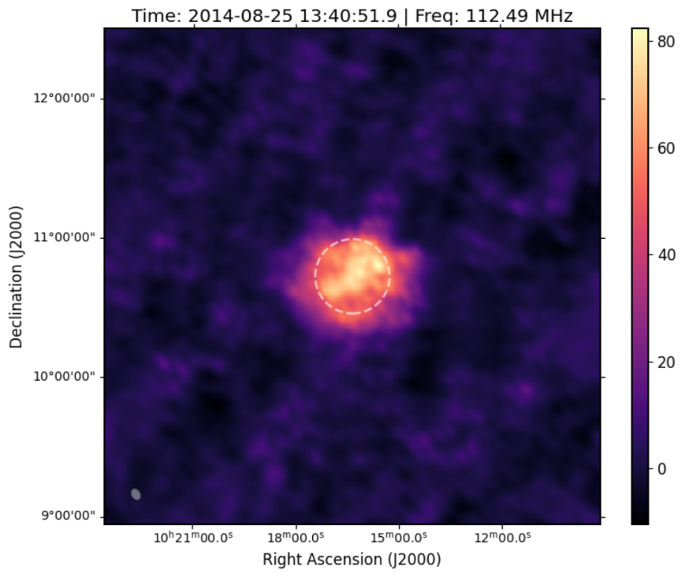
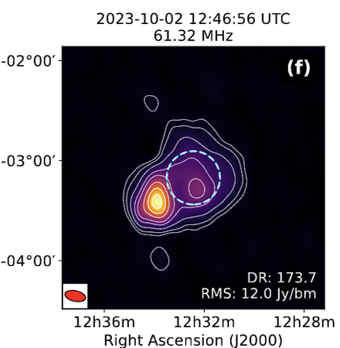
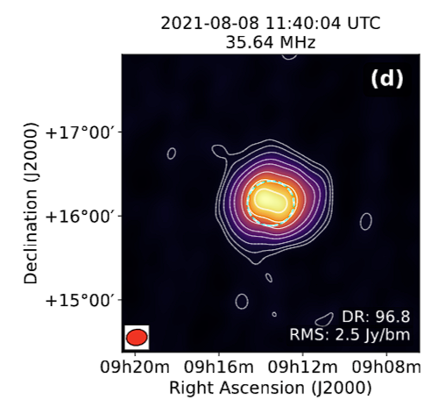
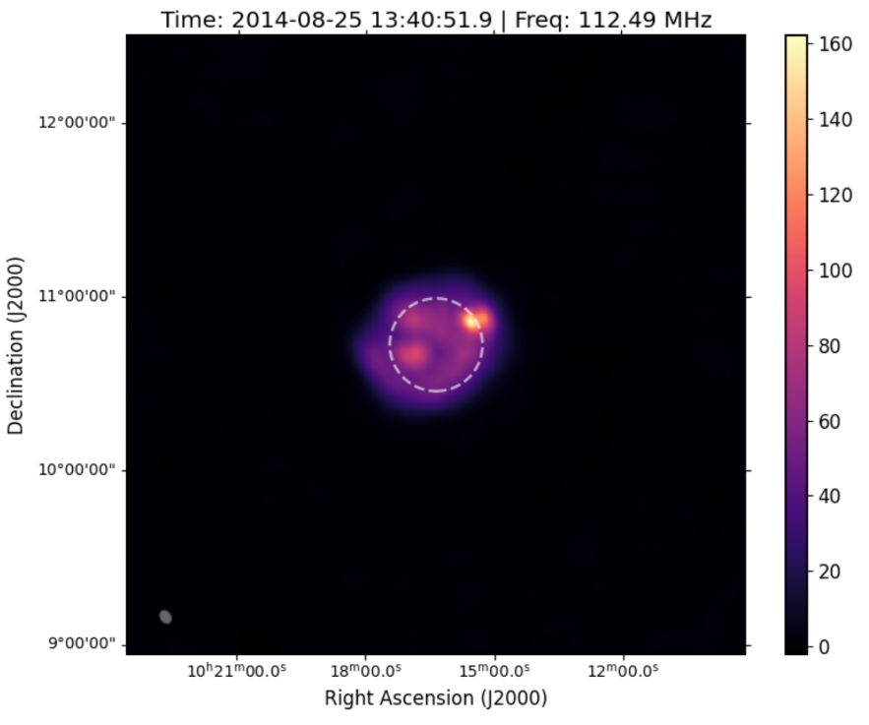
SIMPL pipeline for complex calibration – Dey+ (accepted in A&A)
SIMPL – Solar IMaging Pipeline for LOFAR
Careful calibration solution estimation
Self-calibration based
Flagger for solar data
Works for both HBA and LBA data
Significant improvement to Dynamic Range and image fidelity
Calibrator soln. DR: 26
SIMPL output. DR: ~500

Slide 10
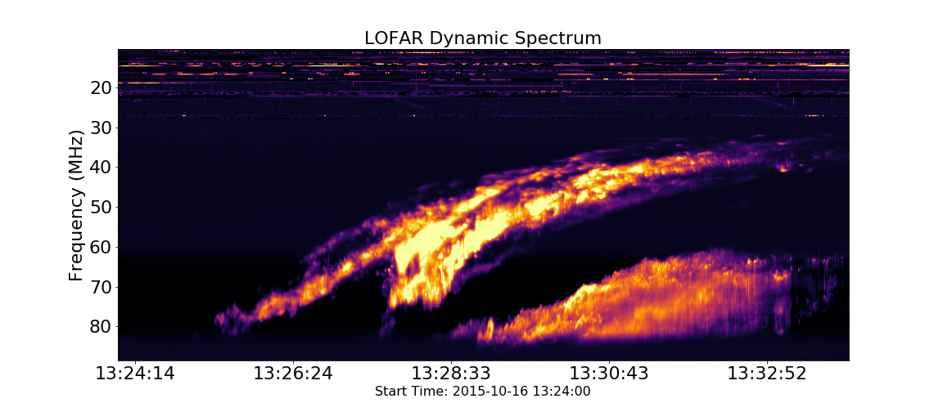
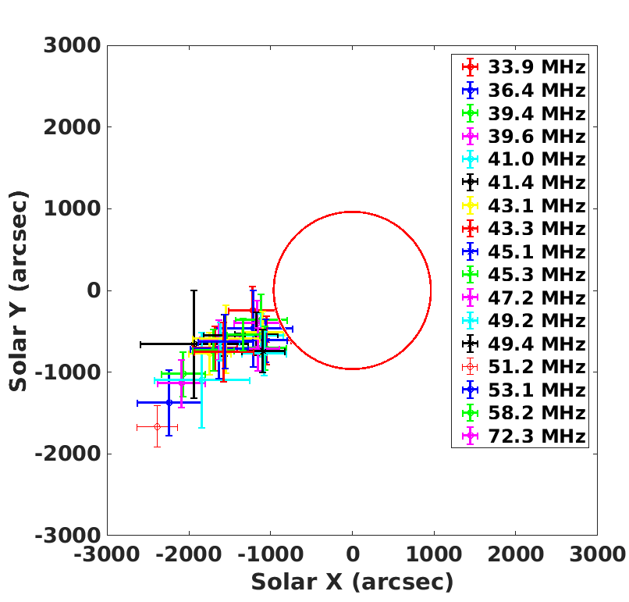
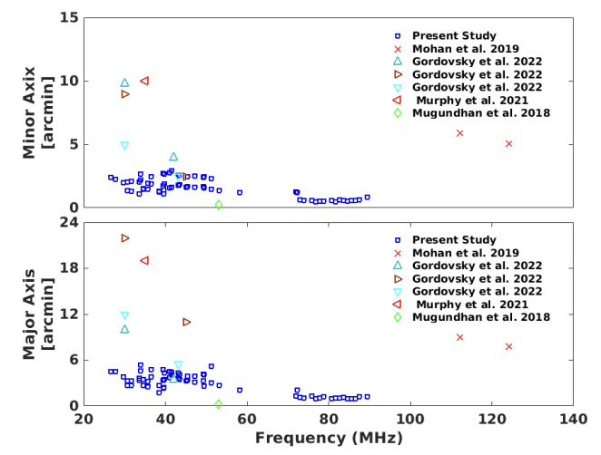
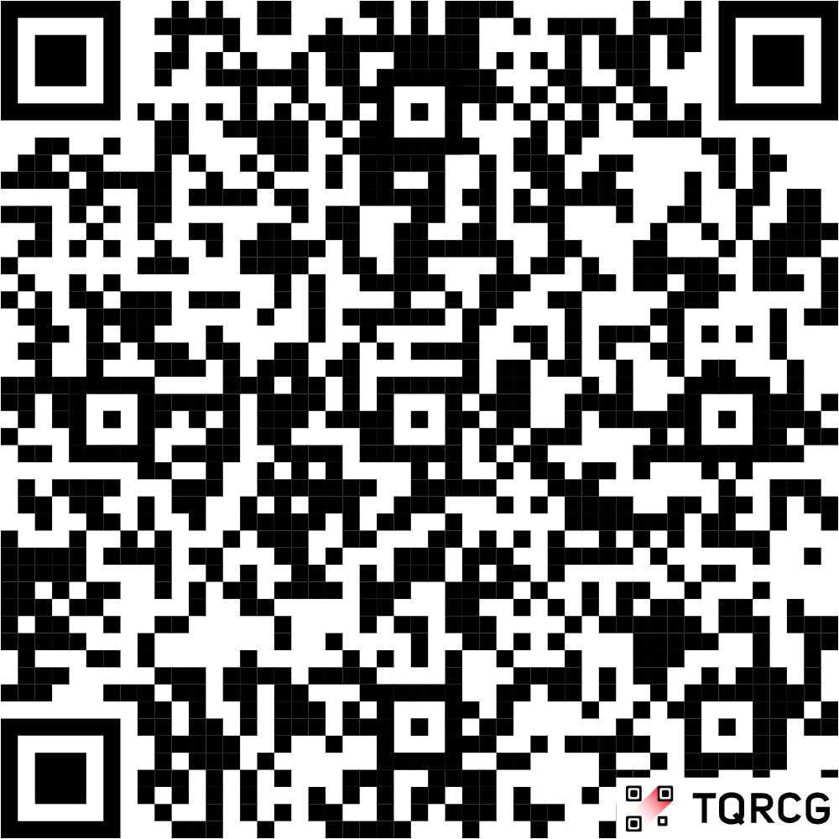
Source Sizes of Type II Radio Bursts – Kumari et al. 2025 (A&A)
LOFAR’s combined core (24 stations) and remote (14 stations) baselines
3 Events (type IIs), with FH and SB pairs:
16 Oct 2015 (A)
16 Oct 2015 (B)
25 Aug 2014
The authors’ findings indicate notably smaller radio source sizes than previously reported.
1. Scattering effects are generally smaller than previously expected.
2. The level of the scattering experienced by the radio emission is depending not only on the density inhomogeneities of the ambient corona but also on the orientation of the underlying magnetic field.

Slide 11
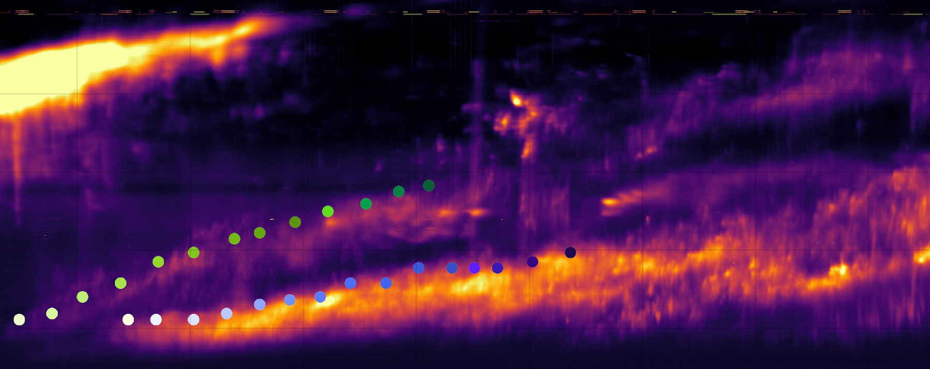
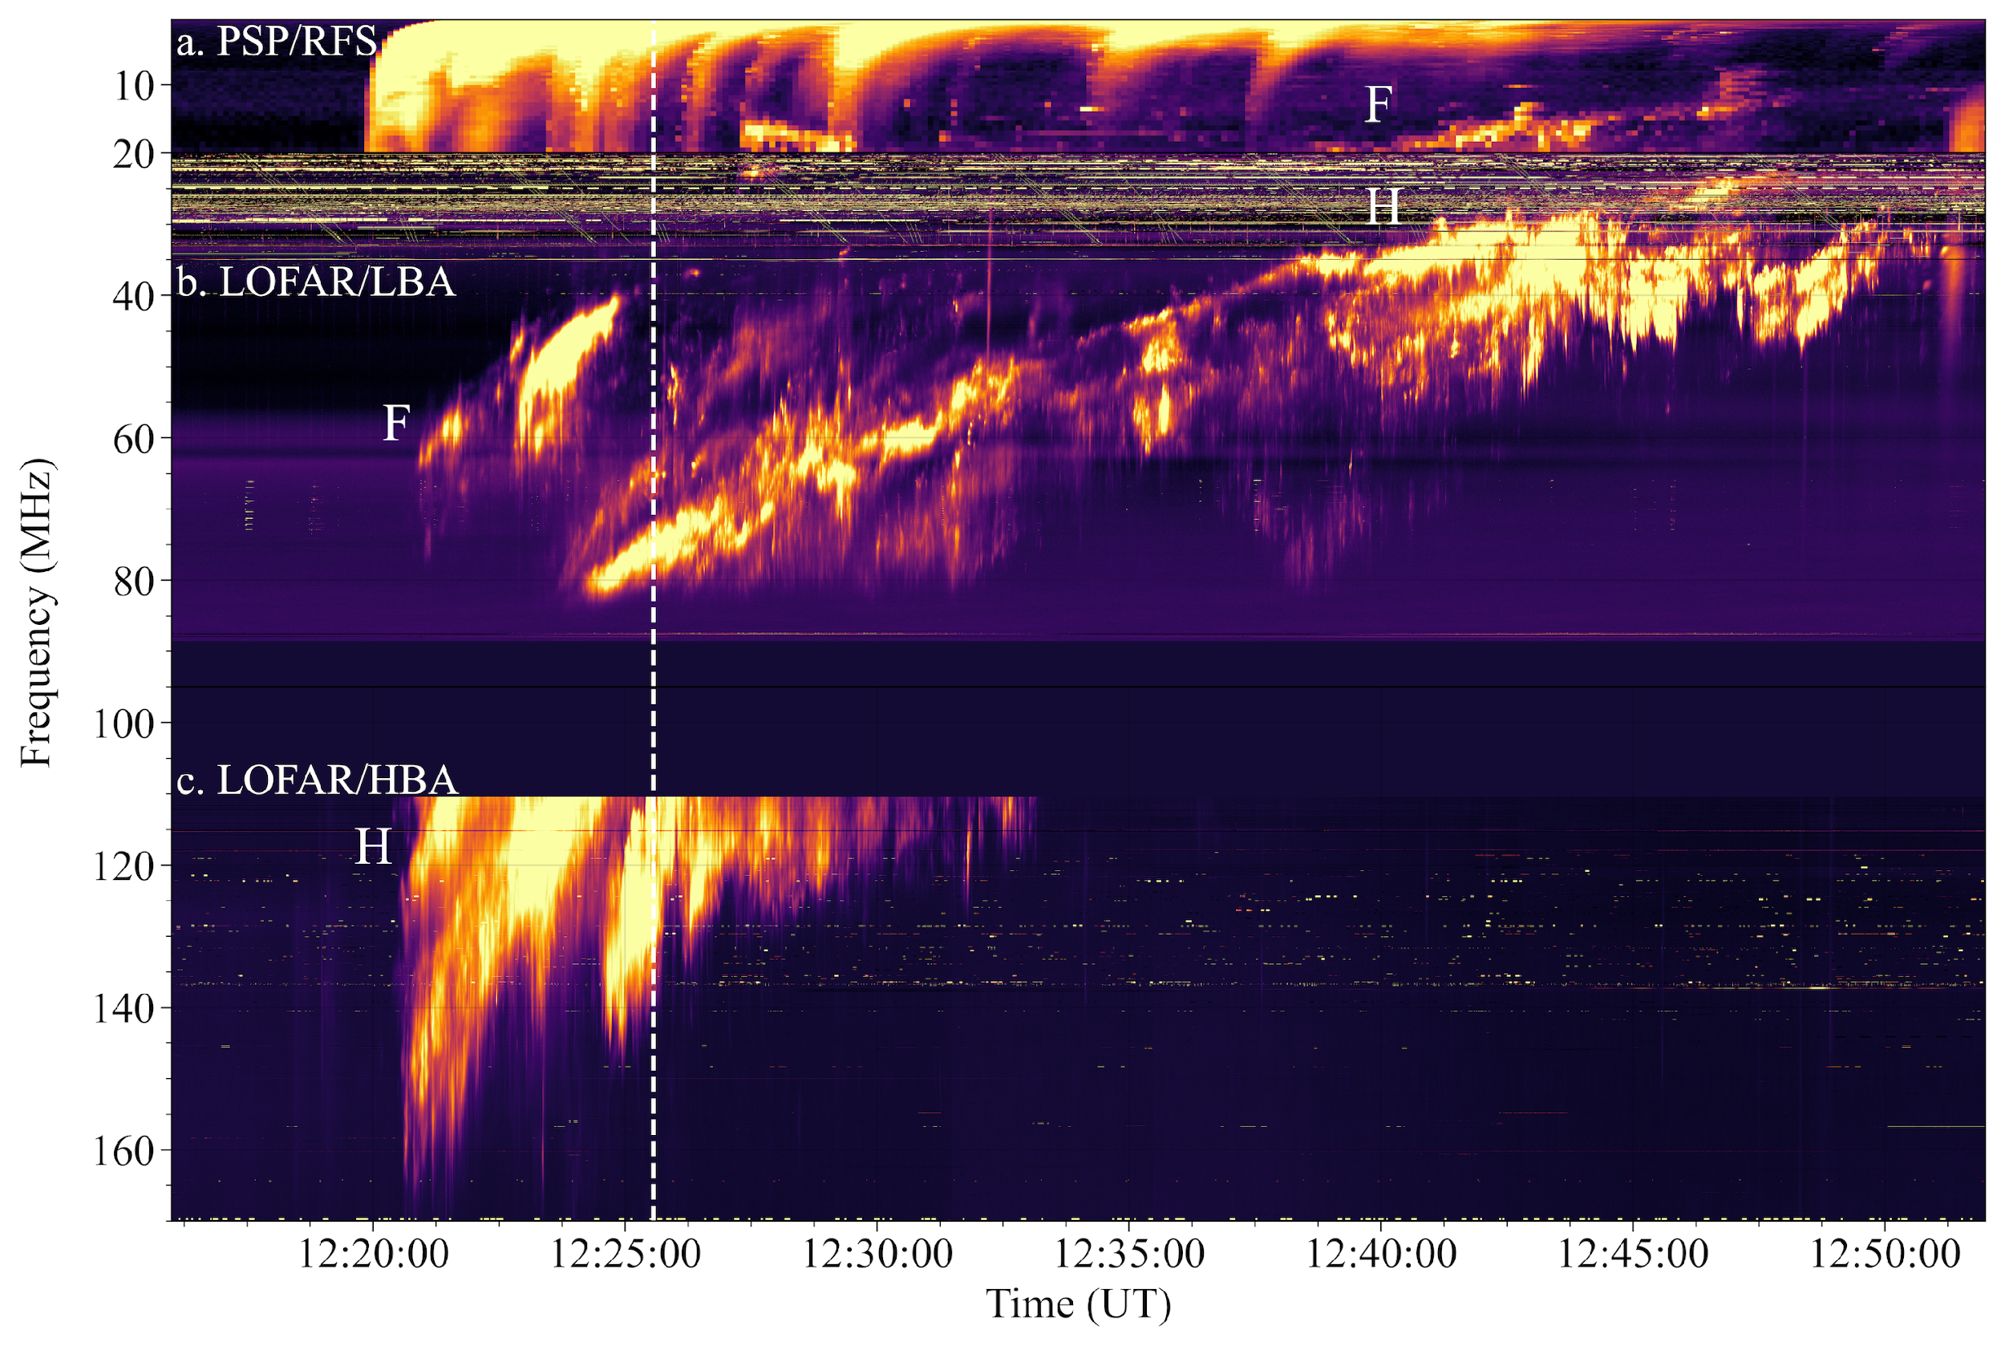
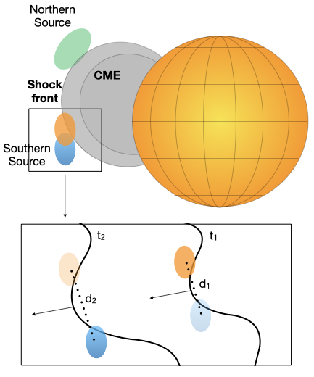
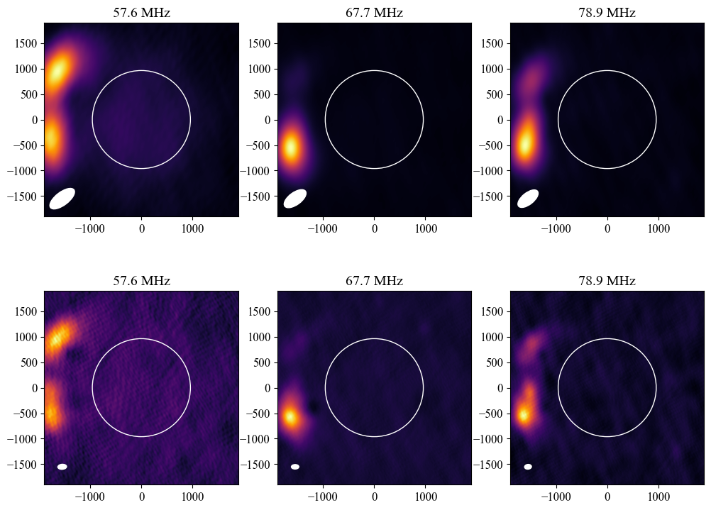
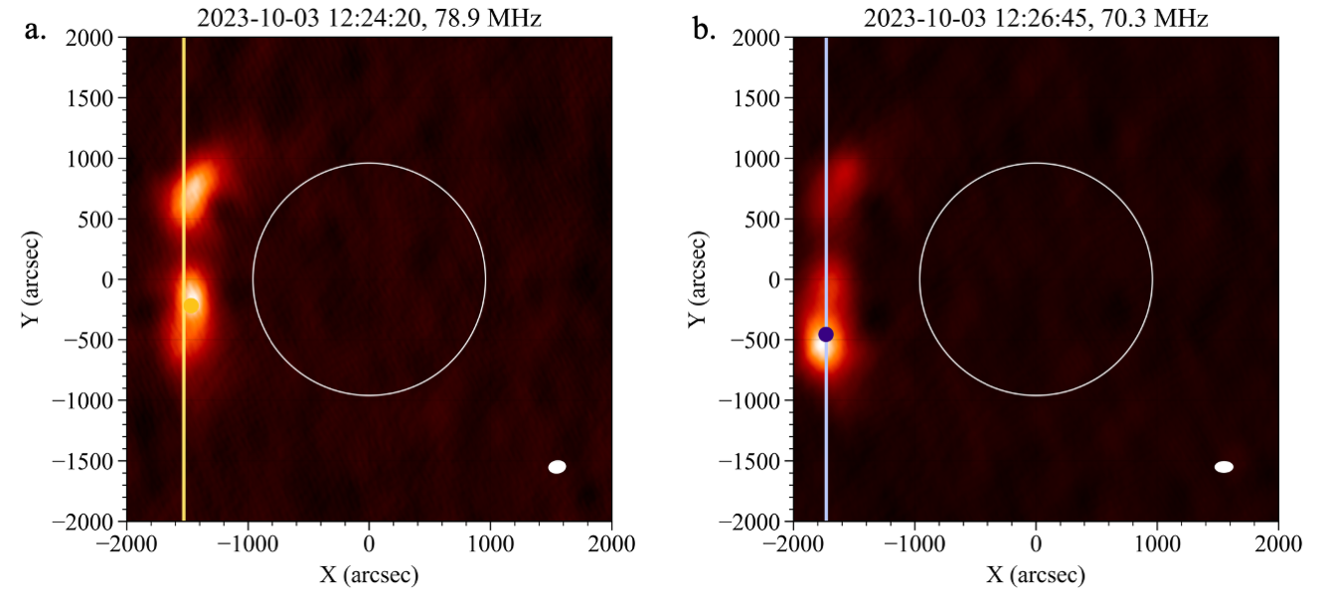
Type II burst of 3 October 2023 – Morosan et al., A&A, 2025
- Imaging with remote stations
- Double source separates at a rate of ~3000 km/s.
- Separation increases from 0.3 to 0.5 solar radii in ~1 minute
Shock corrugation or ambient medium inhomogeneity ~10⁵ km

Slide 12
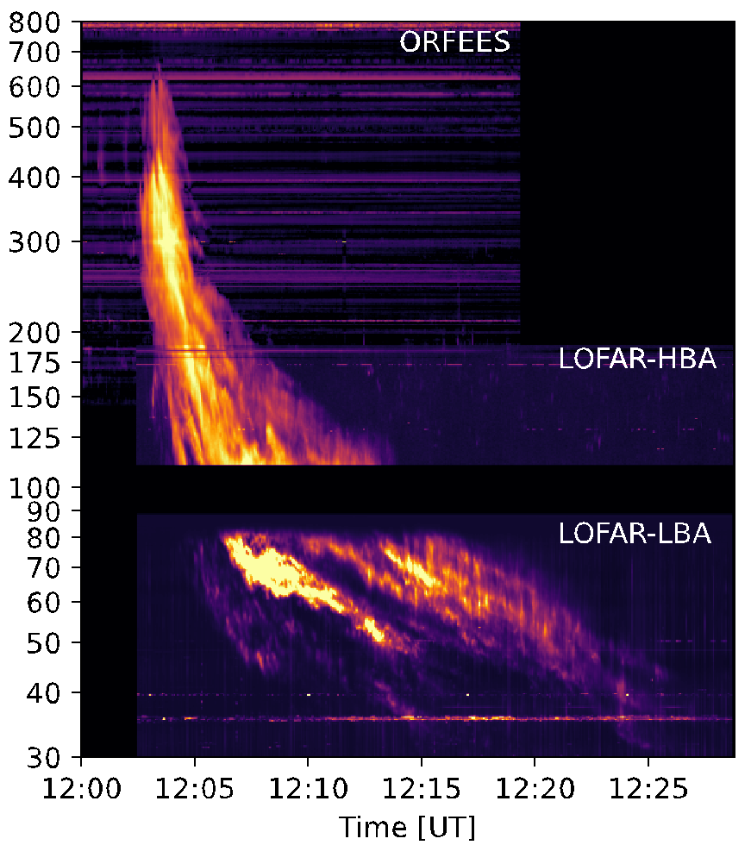
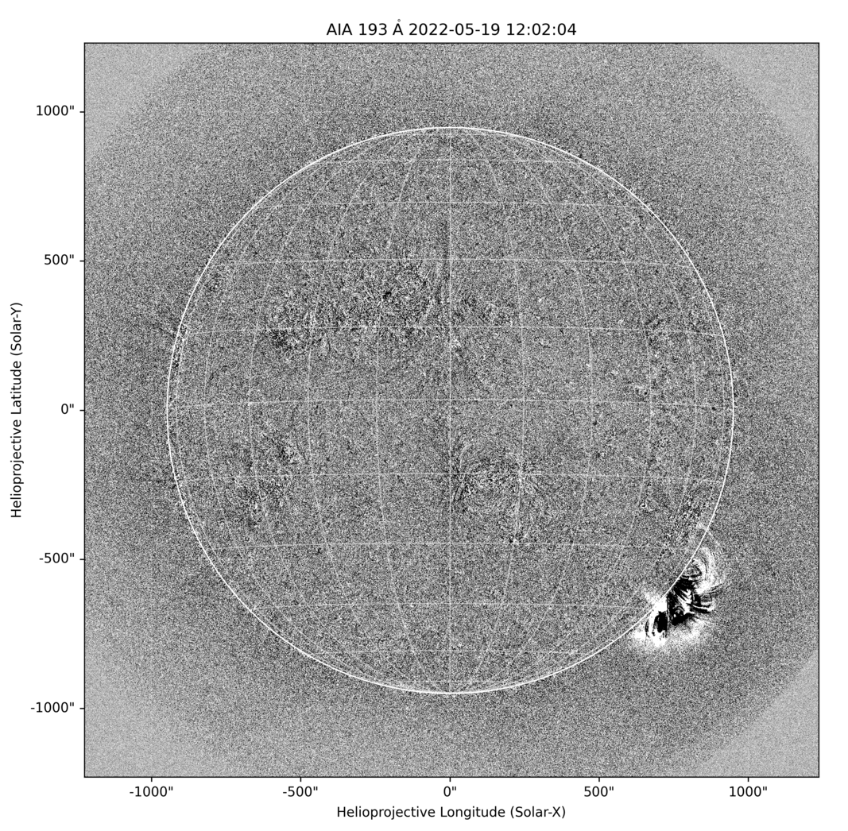
Multi-Lane Type II Burst Imaged with LOFAR LBA – Zucca+ 2025

Slide 13
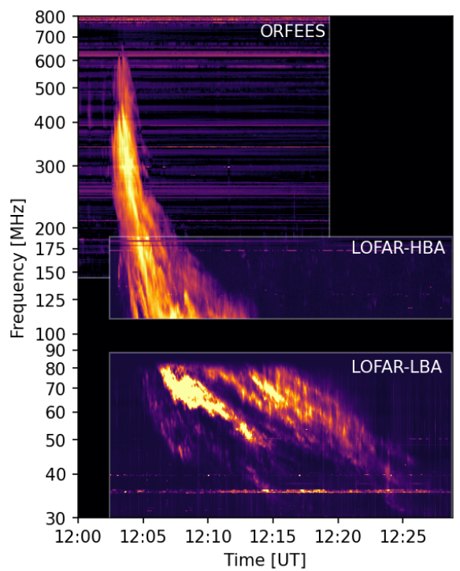
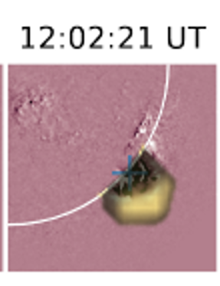
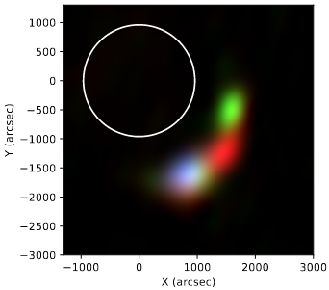
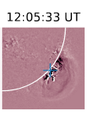
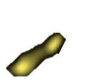
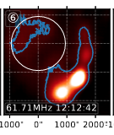
Zucca et al. 2025

Slide 14
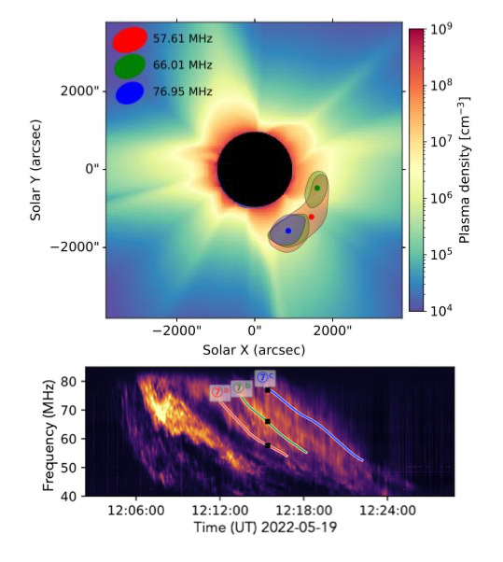
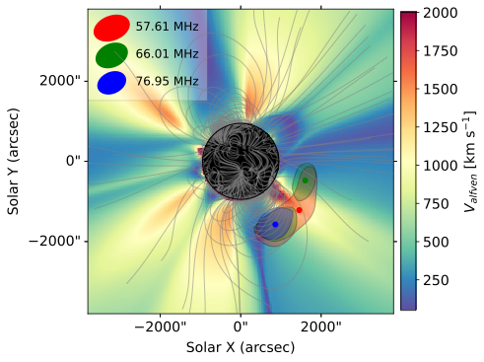
Comparison with coronal MHD model
Separate emission sources originate from different coronal environments on front along the shock propagation direction
Zucca et al. 2025

Slide 15
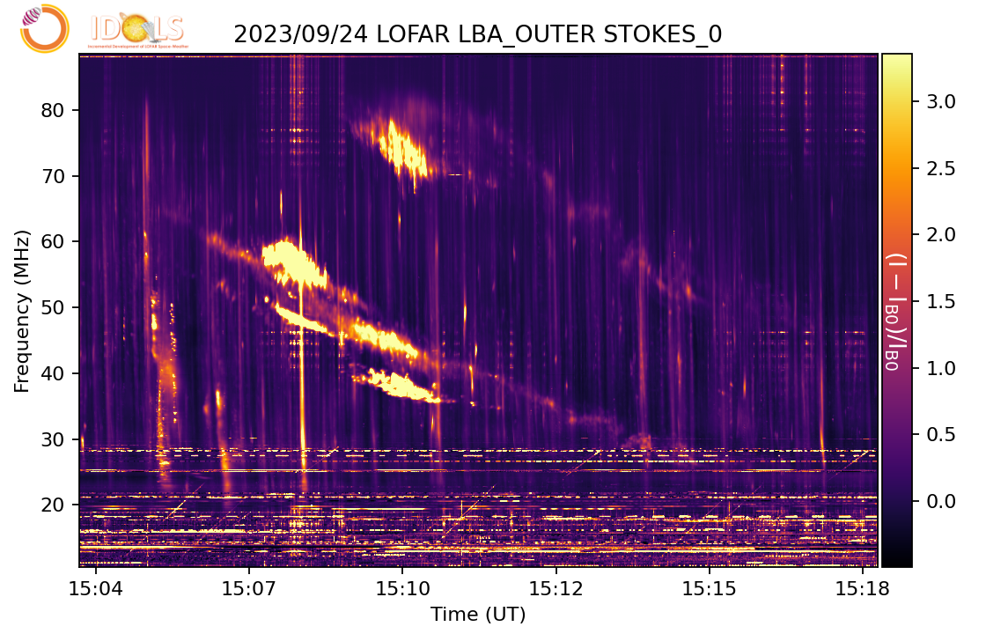
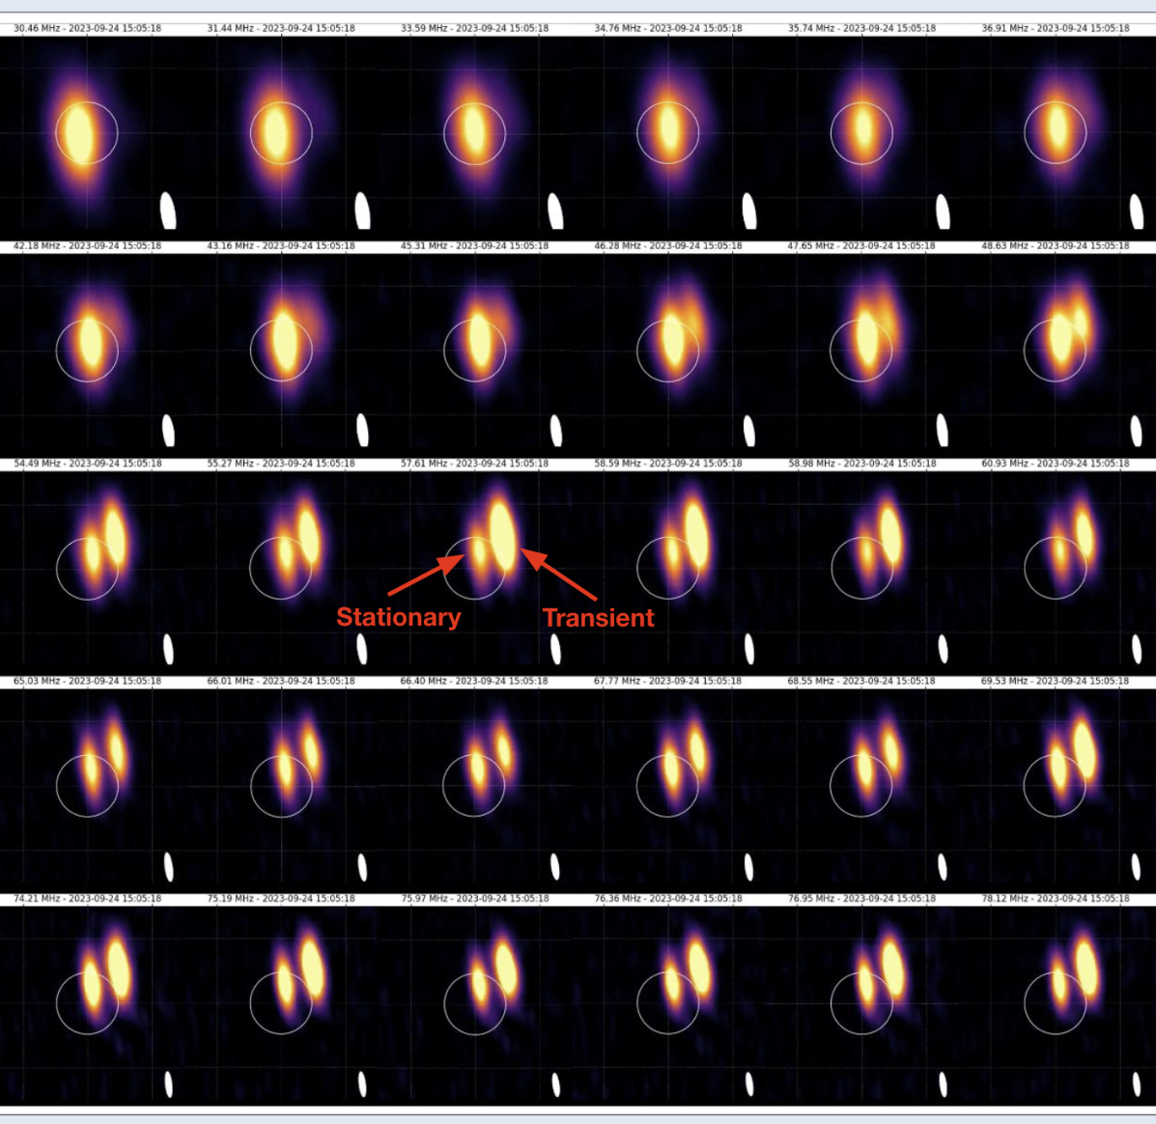
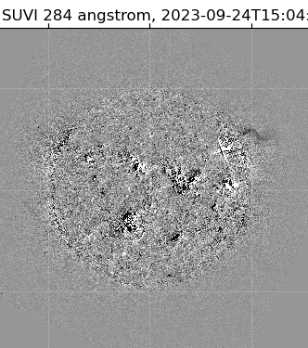
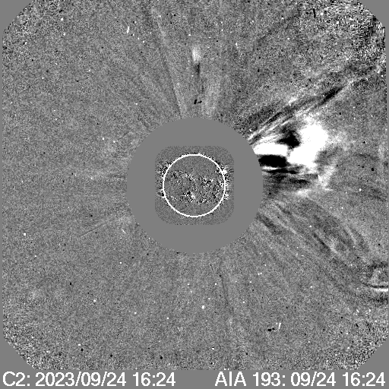
Tracking of a type II burst with LOFAR/LBA – Yotov, Kozarev+ (in prep), presentation tomorrow
– Separate and track stationary and transient sources
– Imaging gives important information in

Slide 16


Tracking of a type II burst with LOFAR/LBA – Yotov, Kozarev+ (in prep), presentation tomorrow

Slide 17





In situ and remote detection of flare electrons with LOFAR and PSP - Kozarev, Yotov et al. (in prep.)
Flare (AIA)
LASCO/C2
V_{Alfven} + B-conn.
– M1.0 flare on 24 September, 2023
– Type III burst storm 5 minutes after flare start
– LBA imaging reveals source above northwest limb
Type III emission above northwest limb

Slide 18





In situ and remote detection of flare electrons with LOFAR and PSP - Kozarev, Yotov+ (in prep.)
– PSP very well positioned, electron beams observed in situ
– VDA relates them to pre-flare bursts with circular polarization

Slide 19



First spectro-polarimetric imaging of the Sun with LOFAR – Dey+ (in prep.)
– Spectro-polarimetric snapshot imaging with LOFAR of type I noise storm
– Residual I->V leakage < 0.5 %

Slide 20






High angular resolution imaging with LOFAR – Dey+ in prep.
30” resolution observations of noise storm above AR at HBA (27 June, 2015)
Different regions dominate noise storm/bursts with time
30 arcsec resolution

Slide 21




Incremental Development of LOFAR Space-Weather
Led by P. Zucca and the Solar KSP team since 2022
Near-real time single-station solar, heliospheric and ionospheric observations
Online catalog of archival solar dynamic spectra

Slide 22




Incremental Development of LOFAR Space-Weather
Pipelines
Status
IDOLS observations currently not possible
Working on possibilities on LOFAR2.0 station
Exploiting archival data and creating synergies with SDCO/TO – improving metadata, adding archival snapshot imaging previews
Special Thank you to Mattia Mancini
Images

Slide 23
Plans for the LOFAR2.0 era
Imaging and dynamic spectra pipelines nearing completion of development for the SHI Lofar2.0 Large Programme campaigns
Testing pipelines on different environments, discussions on compute and archiving
Planning restarting IDOLS observations in the next couple of months
Looking into hardware/software to split the signals via GPU backends - allowing for continuous SW observations by individual stations
Standardization of signal processing in international stations

Slide 24


LOFAR as a space weather instrument - DANTE
DANTE project
HBA Dual Beam project DANTE since 2022
Will enable cotemporal dual beam capability, allowing for full-time SW observations from Sun to Earth (radio bursts, IPS CMEs)
Based on the LOFAR4SW concept
Phase 1 (HBA-FrontEnd board development) completed, production ongoing
Phase 2 under discussion (beamformer board development), potentially to start soon!

Slide 25






L-FIRE: Low-Frequency Interferometric Radio Explorer
Jasmina Lazendic-Galloway (TUe) & Pietro Zucca (ASTRON/TUe)
Proposal submitted in May 2025

Slide 26
Mission Goals
To conduct pioneering astrophysical investigations in the largely unexplored radio frequency range of 0.1 to 40 MHz, unlocking new scientific discoveries and serving as a technology and science pathfinder for future space-based low-frequency radio observatories.
Satellite orbits | Value | Units
Altitude | 800 | km
Orbital period (cricular orbit) | 1.68 | h
Satellite constellation
No. of satellite nodes | 16 | -
Satellite configuration | 3D cloud | -
Max. baseline length | 30 | km
Narrow band condition | 1.59 | MHz
Baseline a-posteriori accuracy | 0.375 | m
Maximum baseline drift rate | 31.2 | m/s
Payload nodes: antennas
No. of dipole antennas per satellite | 2 | -
Antenna length (tip-tip) | 3 | m
Payload nodes: frequency related
Lowest sky frequency | 0.1 | MHz
Maximum sky frequency, primary science | 20 | MHz
Maximum sky frequency for overlap with "Earth" | 40 | MHz
Instantaneous bandwidth | 2 | MHz
Spectral resolution | 10 | kHz
Number of frequency bins | 200 | -
Solar physics
Star-planet interaction and planetary magnetic fields
Space weather
Galactic synchrotron emission
Low-frequency sky surveys
Structure of the ISM
Transient Radio sources: X-ray Binaries, Cataclysmic Variables and Pulsars
Extragalactic surveys: High-redshift galaxies and quasars, galaxy clusters, etc
The global 21-cm line
Auroral kilometric radiation

Slide 27




Instead of a conclusion - LOFAR-BG Developments
- LOFAR-BG station to be completed in Q3 2026
- With HBA Dual Beam - Design & prep underway

Slide 28
THANK YOU!

