Slide 1
Navigating the spectrum
Regulatory realities and RFI challenges for LOFAR
Emma van der Wateren

Slide 2
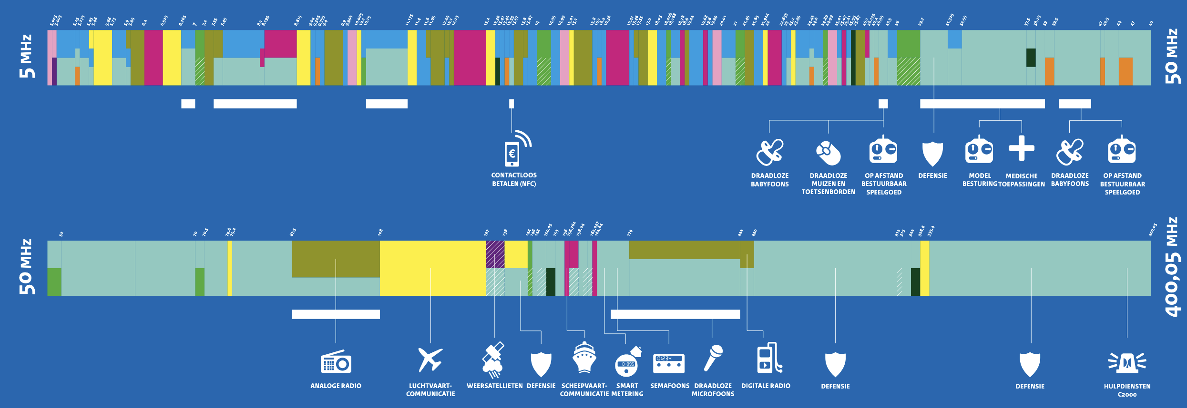
Frequency allocations

Slide 3



Regulatory landscape
International Telecommunication Union (ITU) -> Radio Regulations, World Radiocommunication Conference (WRC)
European Conference of Postal and Telecommunications Administrations (CEPT)
National regulators

Slide 4

Committee on Radio Astronomy Frequencies (CRAF)
Represents European observatories
Technical and scientific studies
Discussions with industry
Diplomacy at all levels

Slide 5

Windturbines

Slide 6
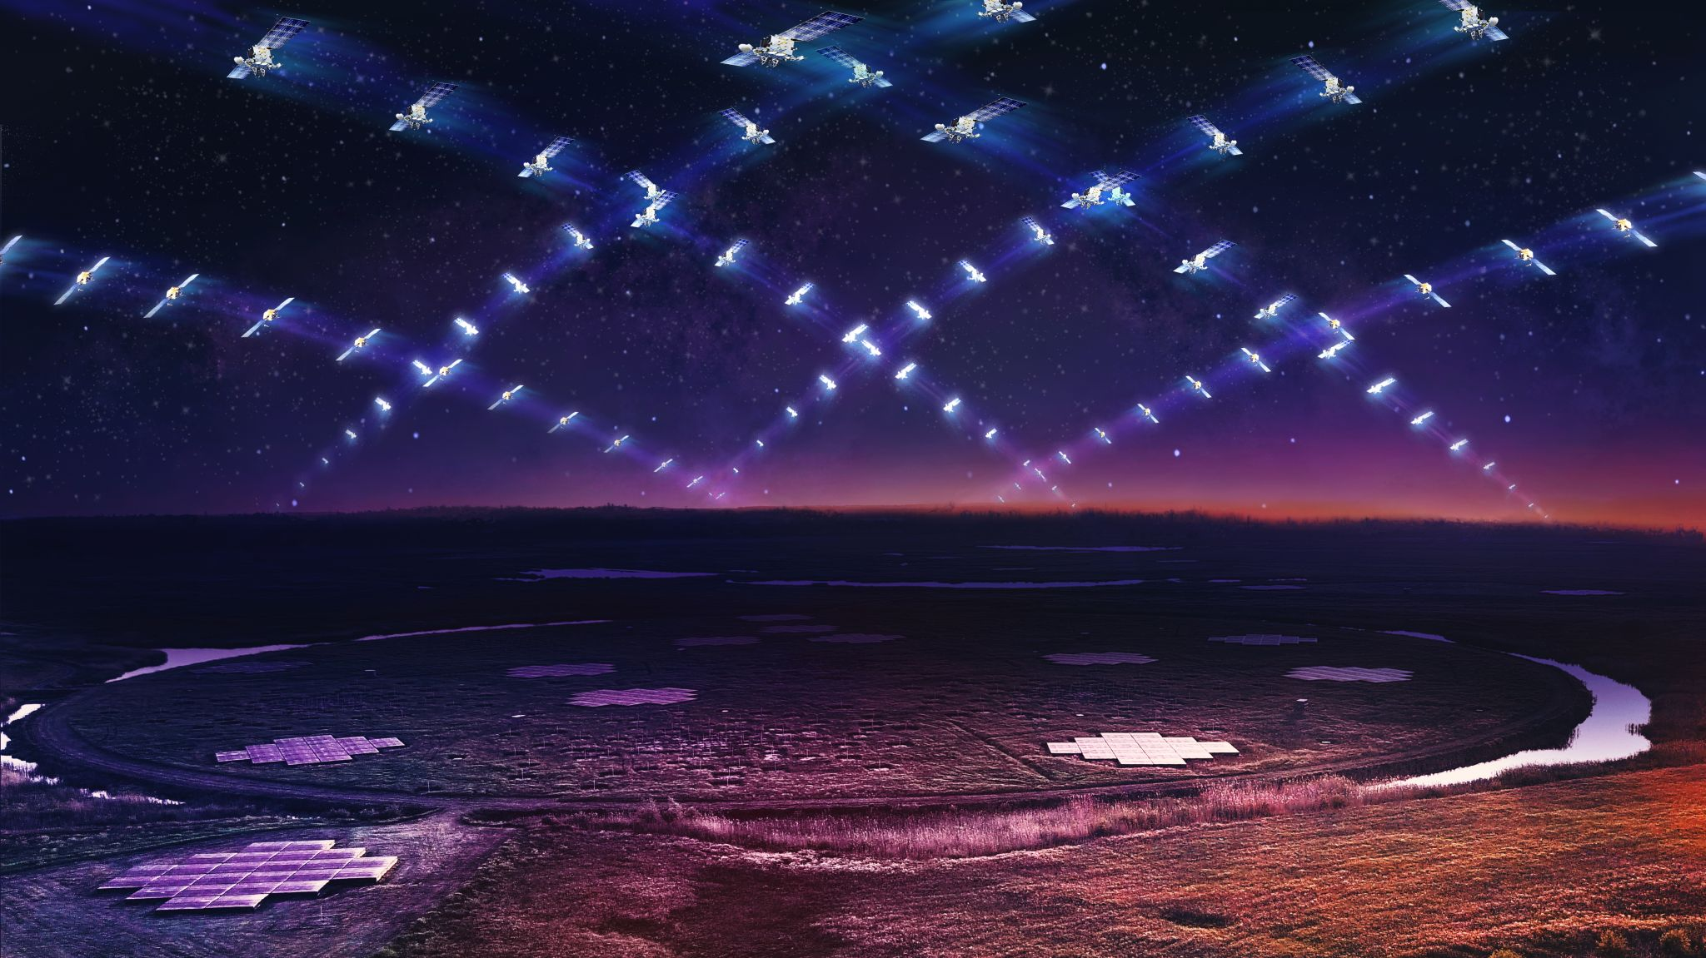
Unintended Electromagnetic Radiation (UEMR) from satellites

Slide 7
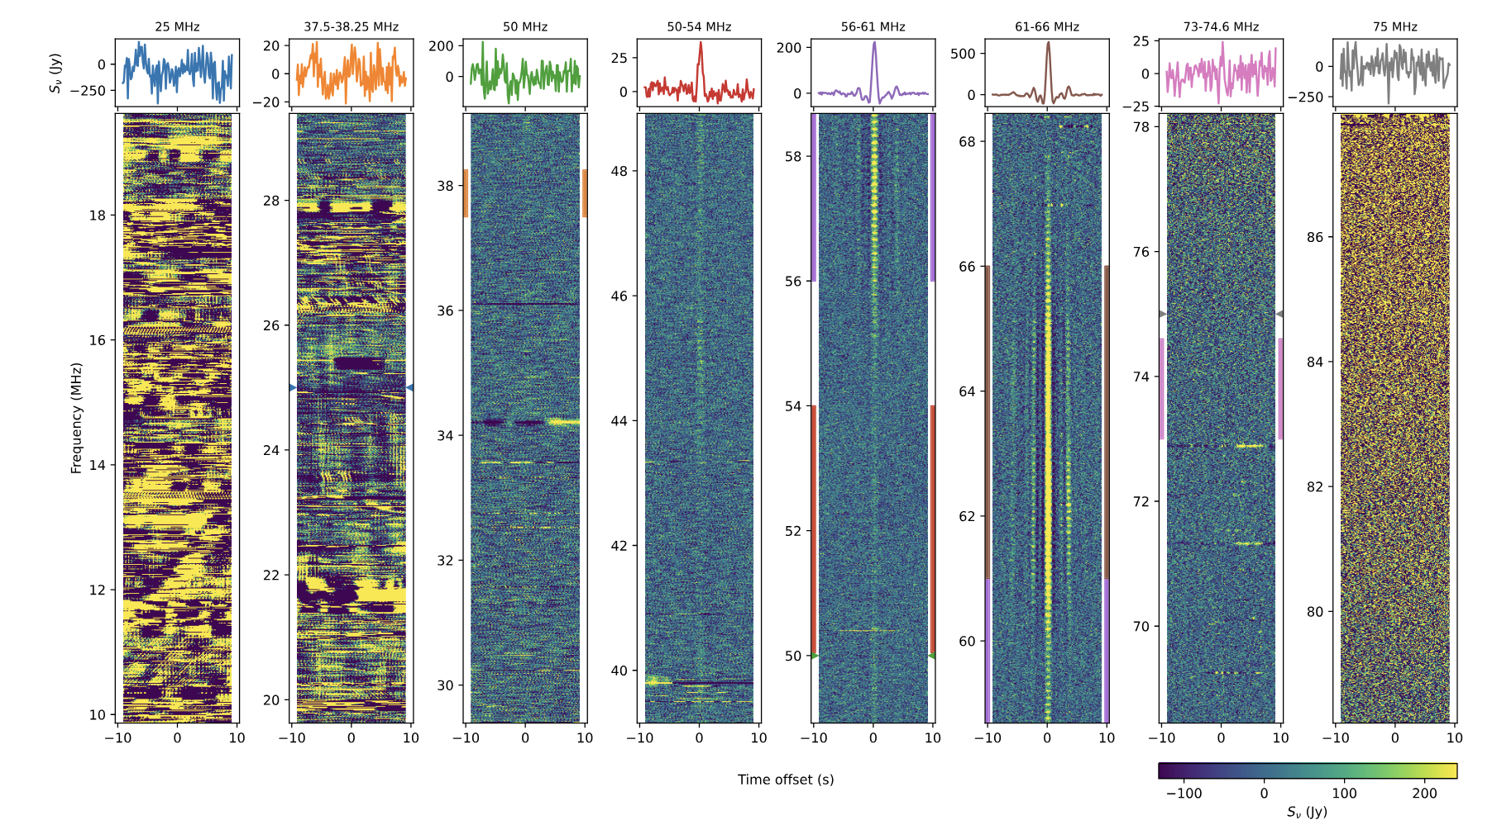
UEMR LOFAR measurements
Bassa et al (2024)

Slide 8
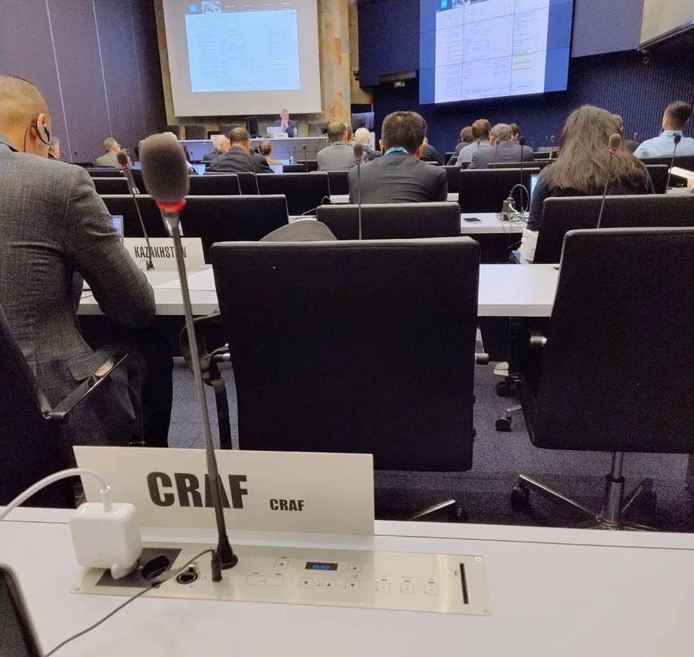

Slide 9
