Slide 1
RISER – High-Resolution Visualisation of the Inner Heliosphere Using LOFAR
Richard Fallows, RAL Space – UKRI STFC
Mario Bisi (RAL), Oyuki Chang (RAL), David Barnes (RAL), Bernie Jackson (UCSD), Edmund Henley (UKMO), Siegfried Gonzi (UKMO), David Jackson (UKMO)

Slide 2
RISER – Radio Investigations for Space Environment Research
RISER is a £3.7M FEC NERC-funded (NE/X019004/1) Large Environment 5-Year Project (commenced 01 September 2023 – Kick-Off Meeting 06-08 September 2023) to address the chain of events through which the Sun creates adverse space-weather conditions at Earth and within the Earth’s space environment.
Investigates how LOFAR can be utilised for continuous and accurate tracking of inner-heliospheric and ionospheric plasma structures, combined with magnetospheric modelling, leading to more-precise and advanced forecasts of space-weather conditions and their impacts at Earth.
Provides a comprehensive understanding of the Earth’s space-environment through the use of novel radio observations and modelling techniques to investigate coupling between solar-driven inner-heliospheric structures and the Earth.

Slide 3
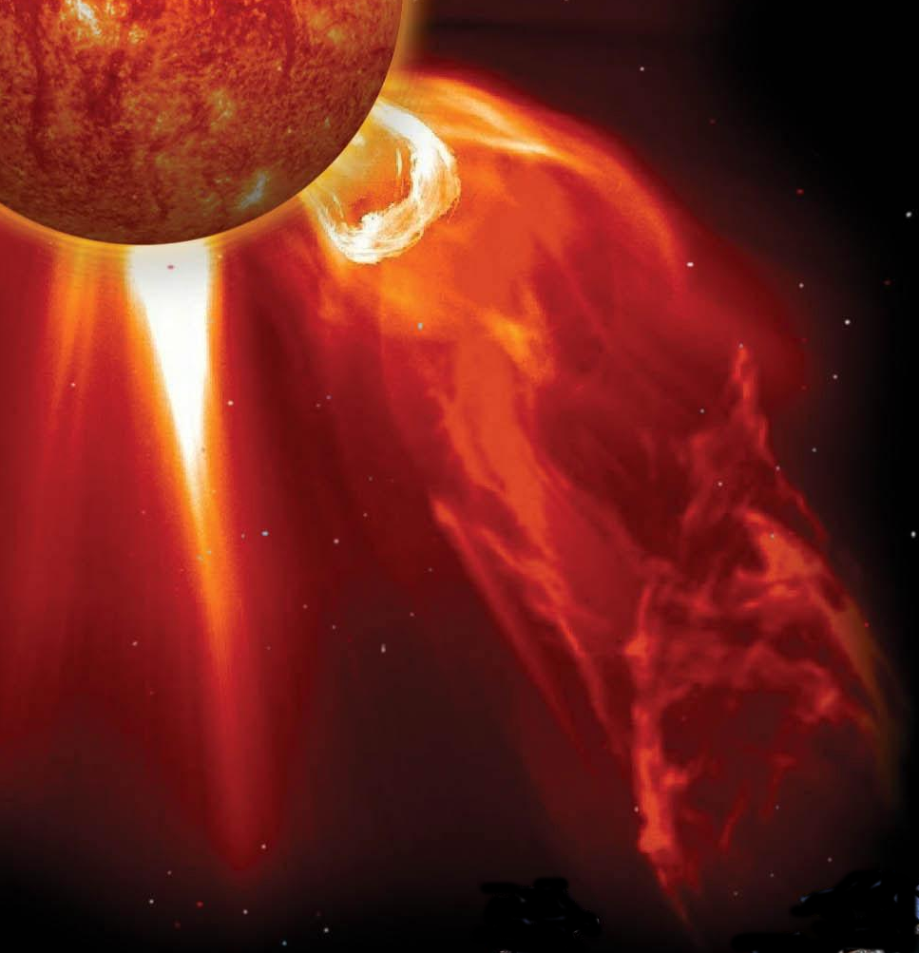
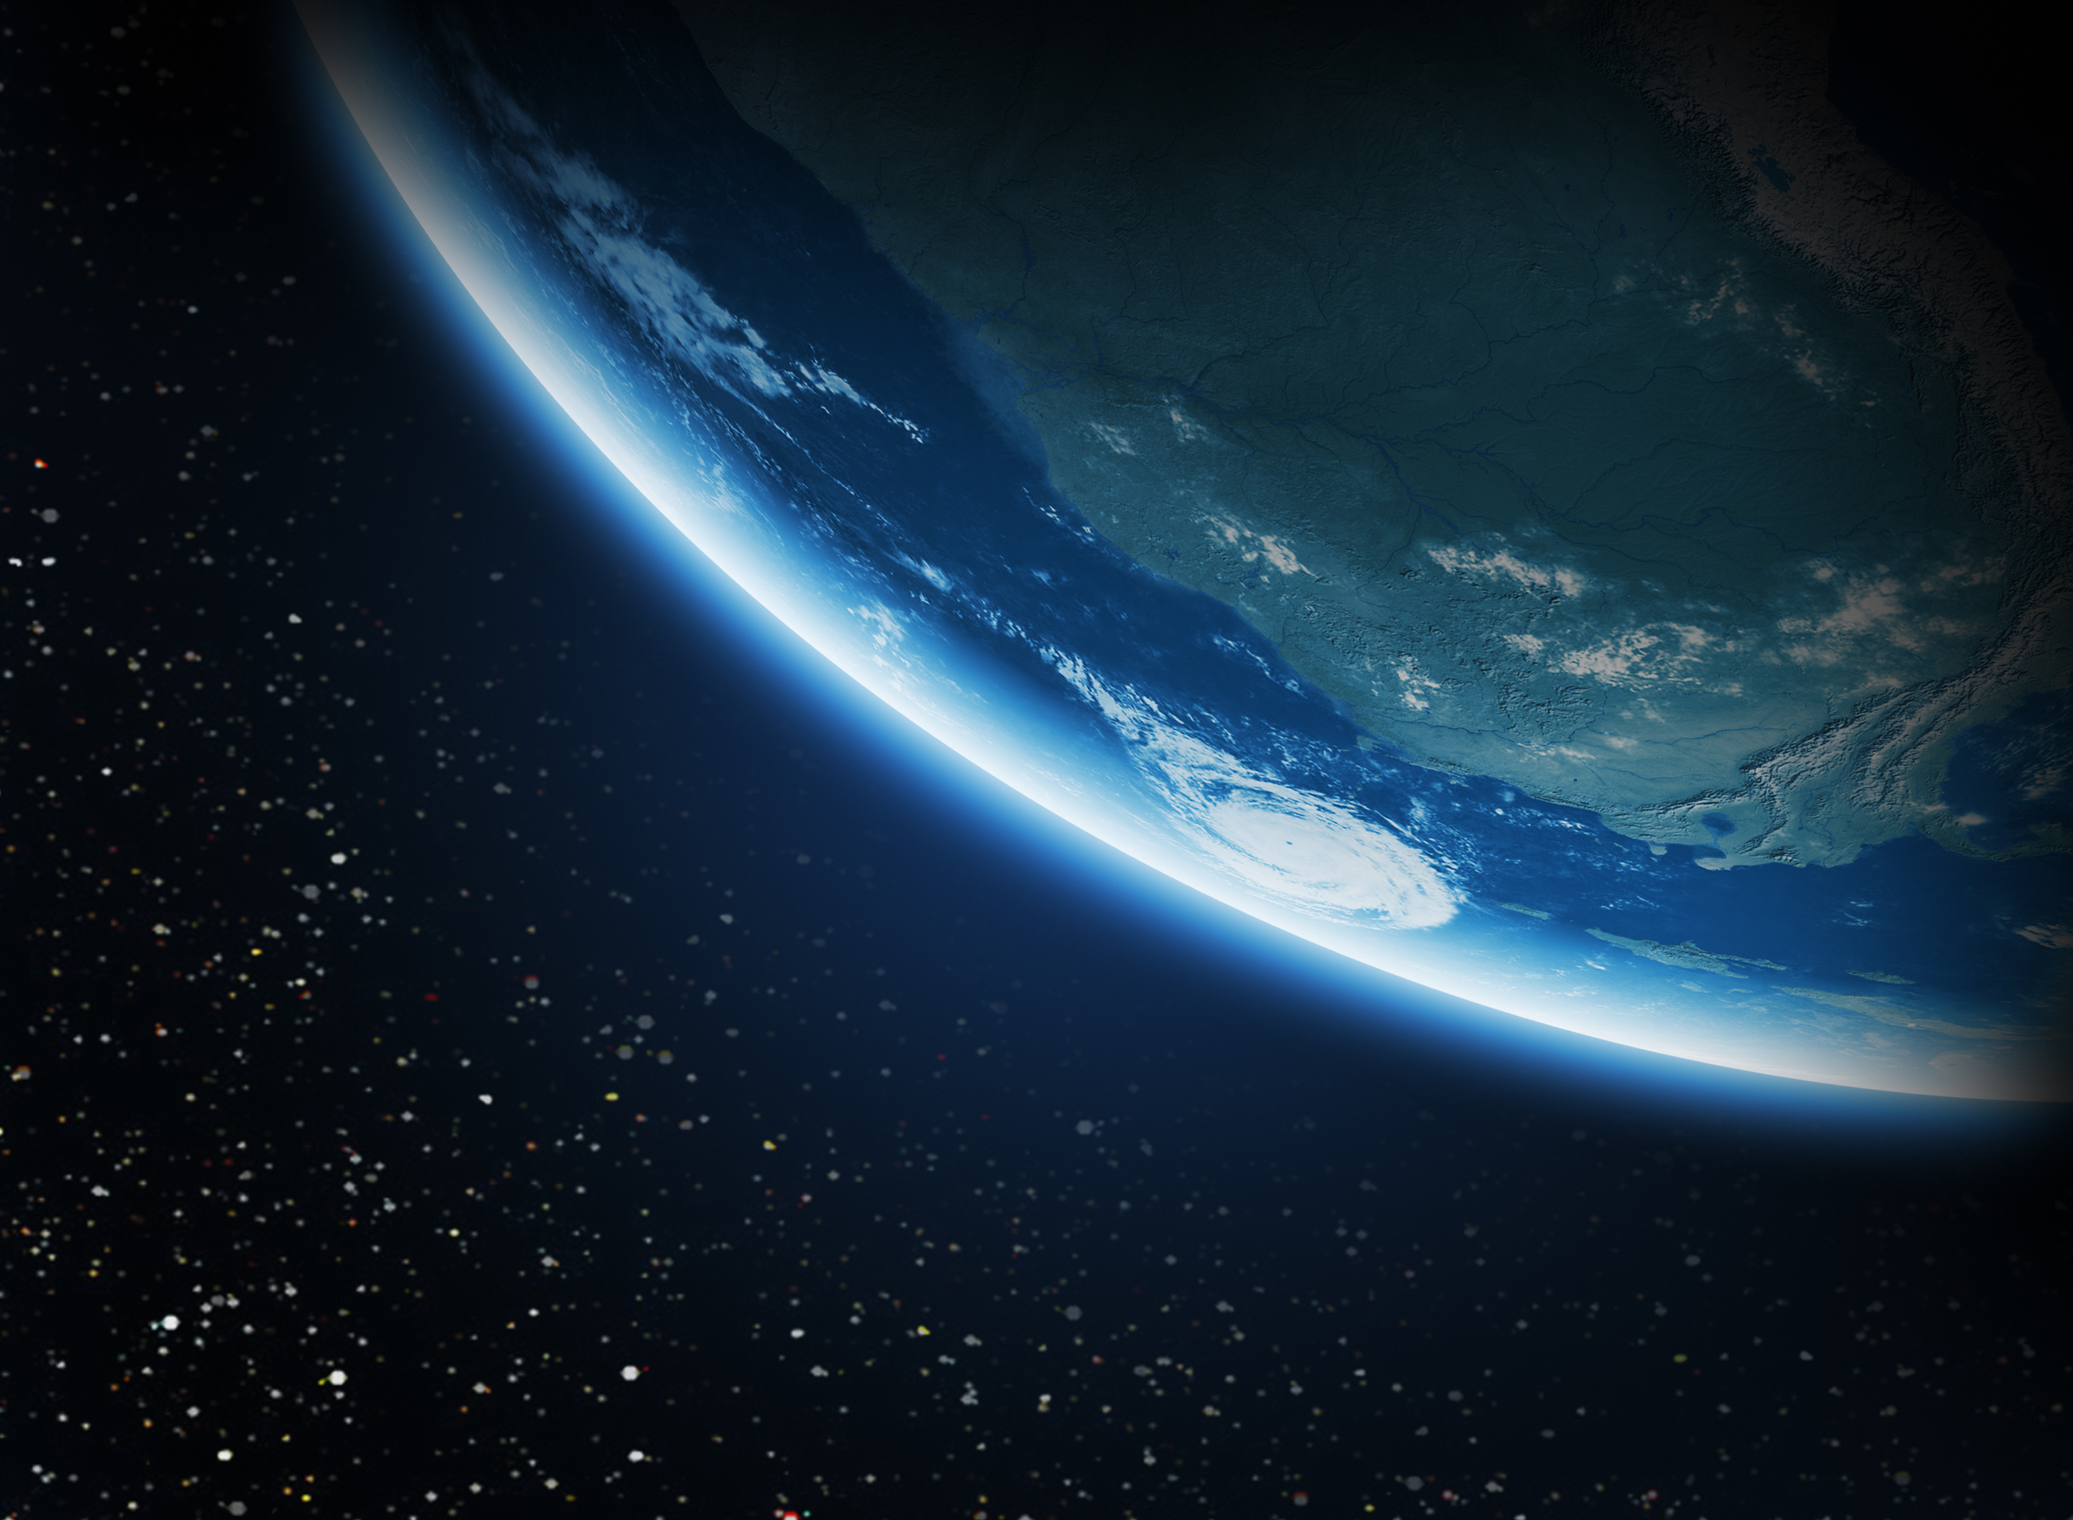

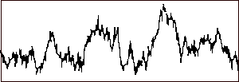
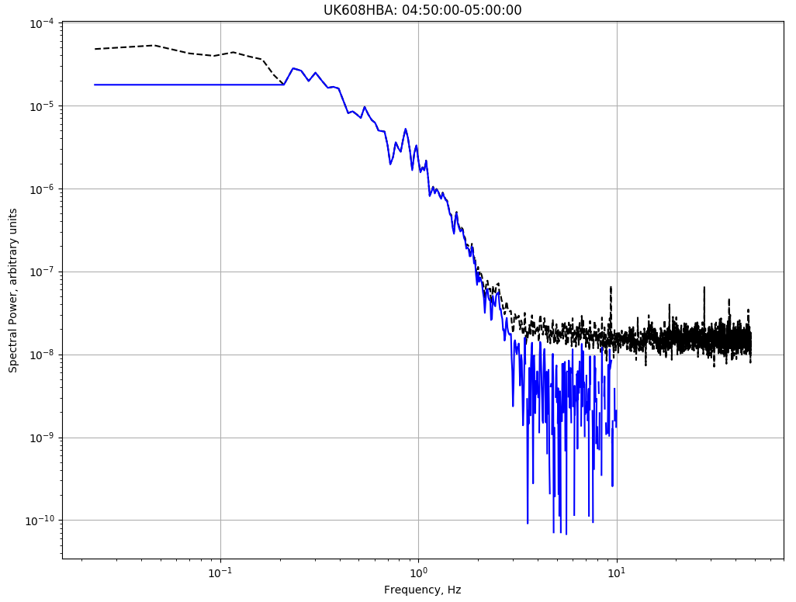
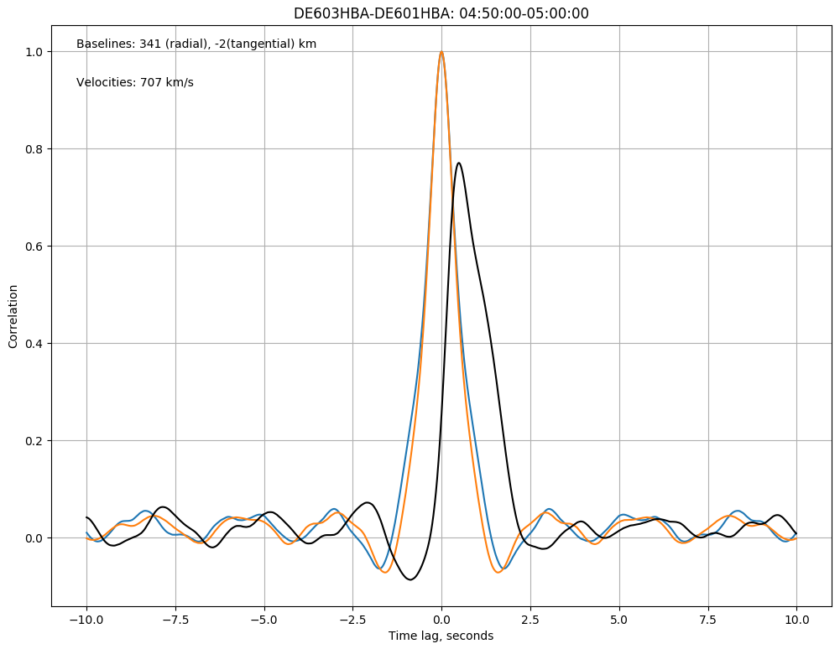
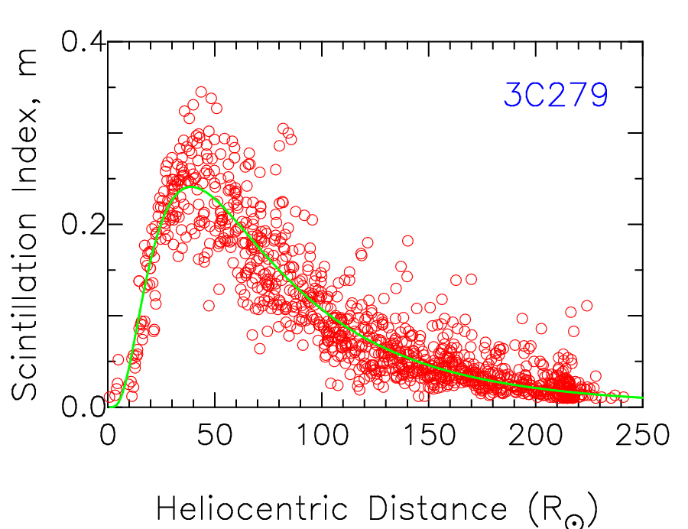
Interplanetary Scintillation - IPS
Time series
Baseline
Interplanetary Scintillation
from compact source
measured velocity component
solar wind velocity
Received IPS dominated by scintillation from material around the point of closest approach of the line of sight to the Sun, but denser material further away (e.g., slow solar wind, CME) can still contribute.
Power spectrum – model to find velocity and scintillation index
Cross-correlation of
intensity time series →
velocity
Variation in amount
of scintillation about a mean level (green line) ->
density

Slide 4
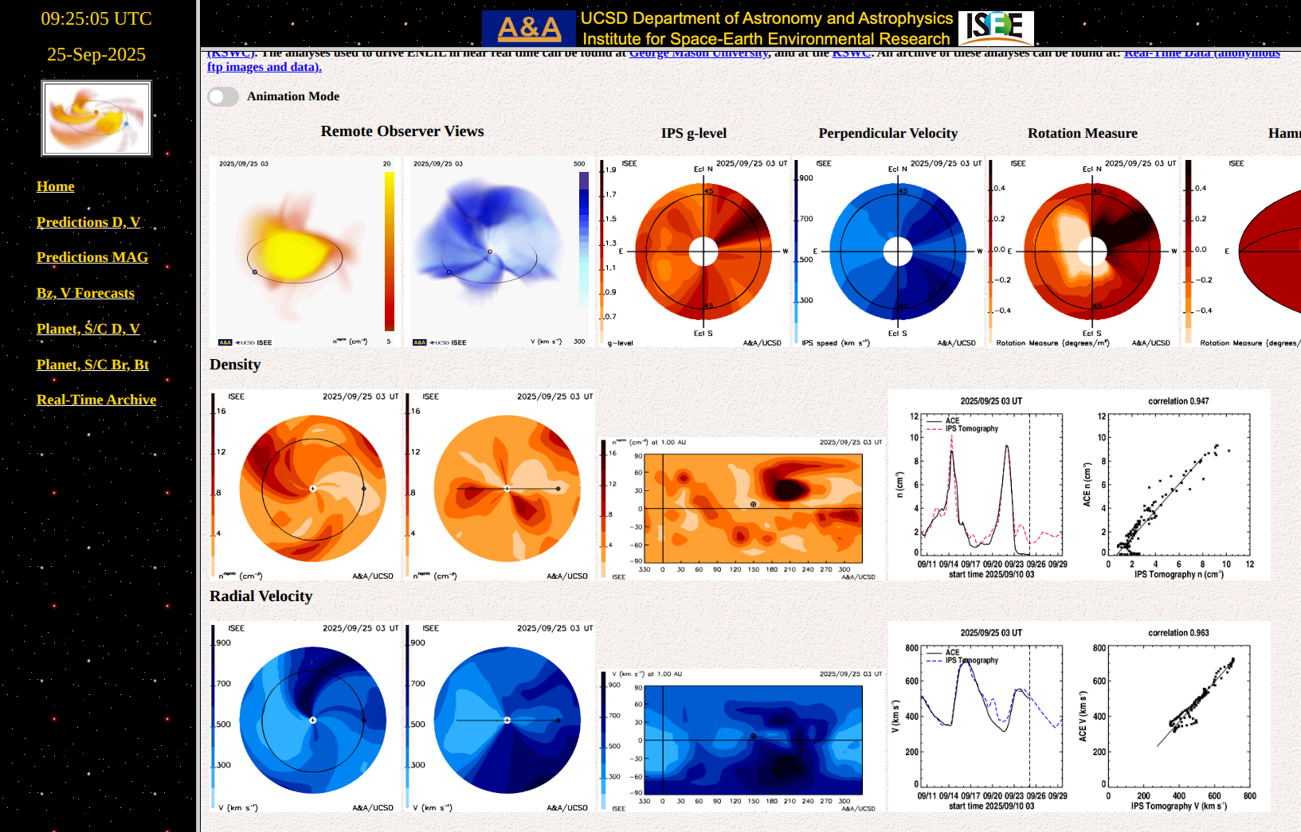
Heliospheric Tomography
IPS data are fed into a tomographic model to generate 3-D views of density and velocity throughout the inner heliosphere.
These are compared with spacecraft measurements at L1 and predictions made.
Near real-time system operates at UCSD using data from the ISEE IPS instrument in Japan.
https://ips.ucsd.edu/high_resolution_predictions

Slide 5
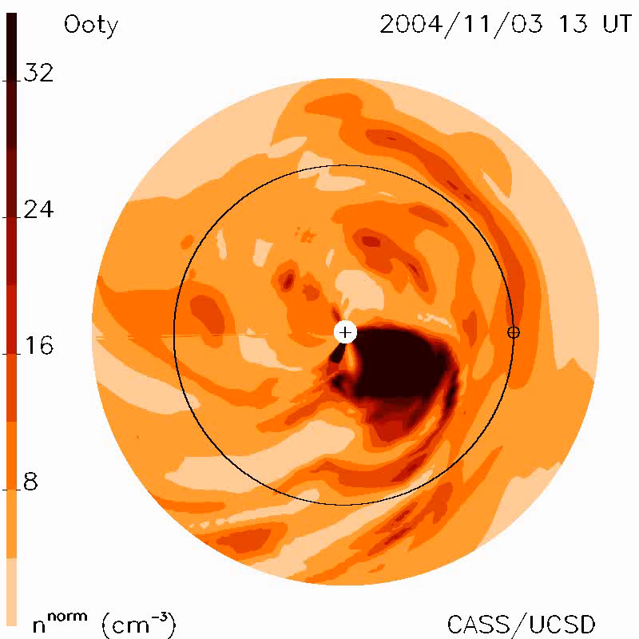
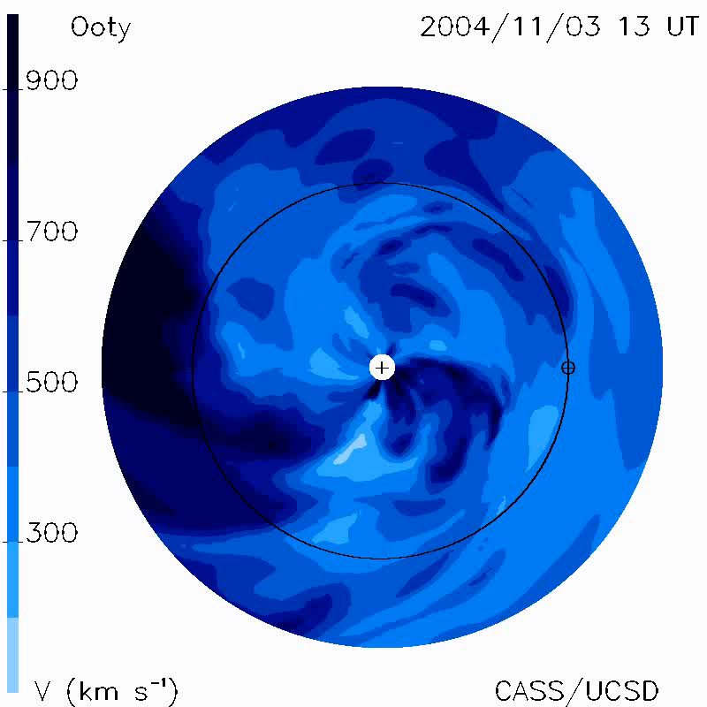
Aiming for more detail
This is the level of detail which could be achieved with many more observations, from observatories world-wide, Bisi+ 2009
RISER aims to demonstrate how the addition of LOFAR IPS data can help to improve tomographic modelling.

Slide 6
RISER First Steps
A few case studies identified, based on events with a high Kp (>=5), at times corresponding with previous LOFAR space weather campaigns.
IPS data were already processed using an initial pipeline developed for LOFAR4SW.
LOFAR IPS data combined with ISEE IPS data for tomography model runs.

Slide 7
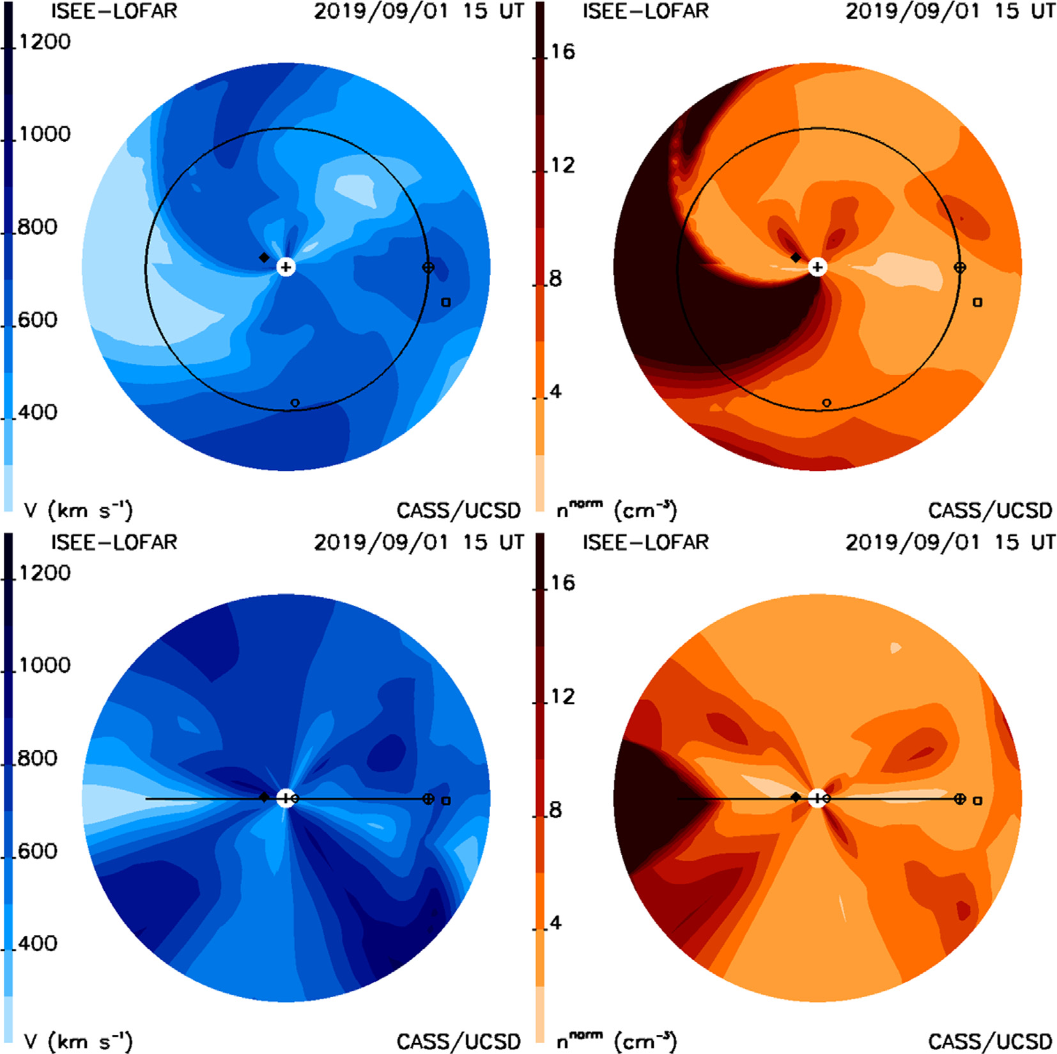
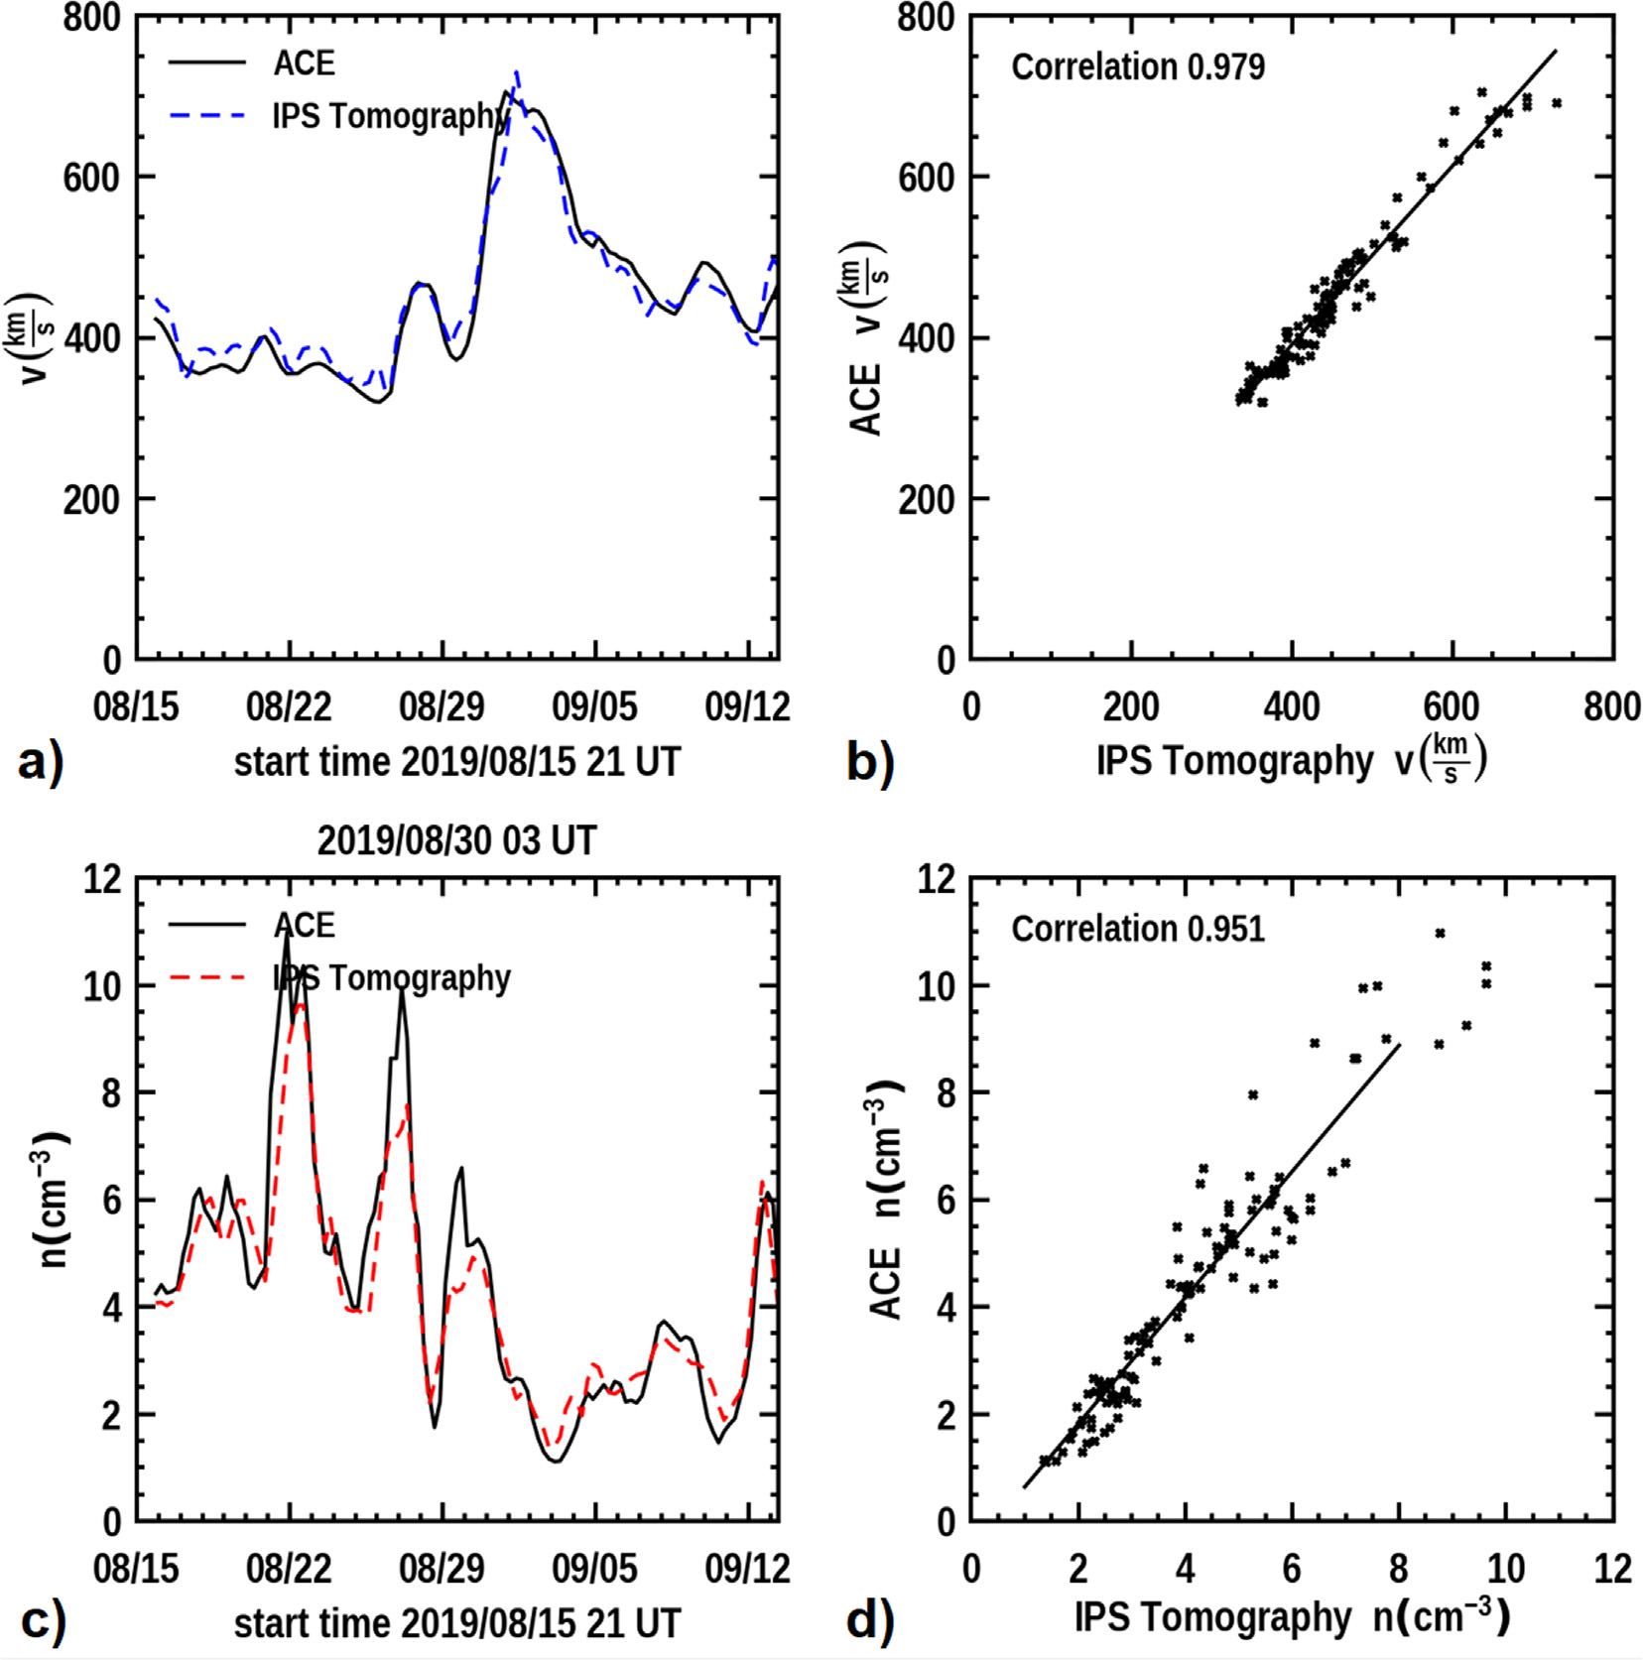
Early Test Study – Jackson+ 2022

Slide 8
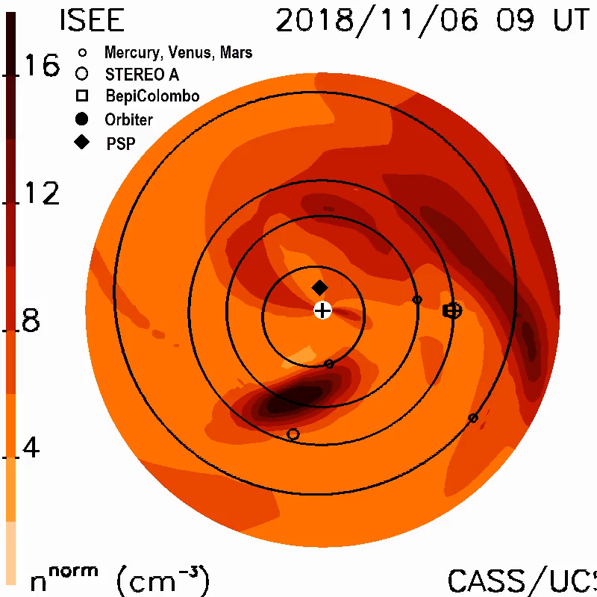
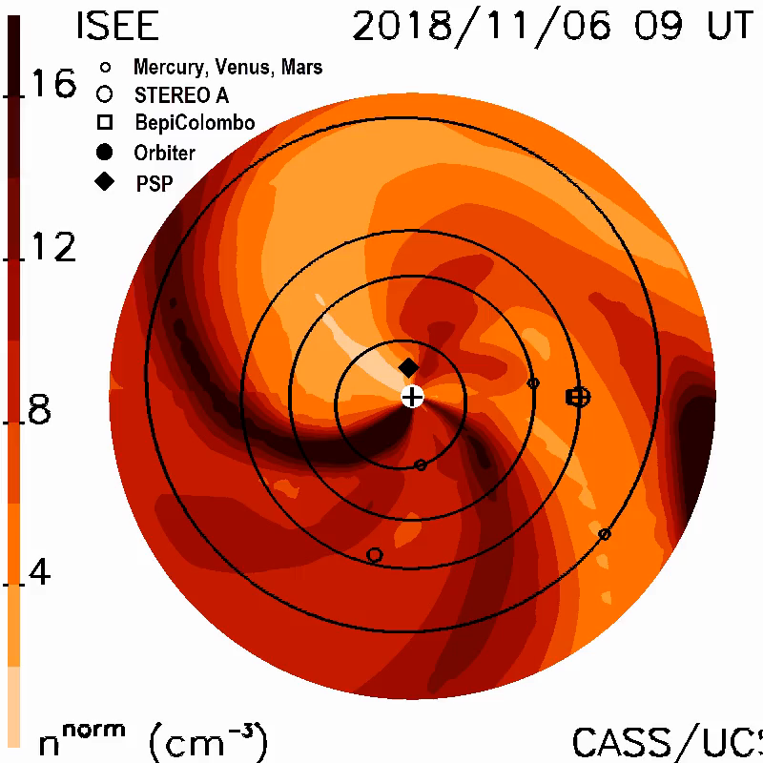
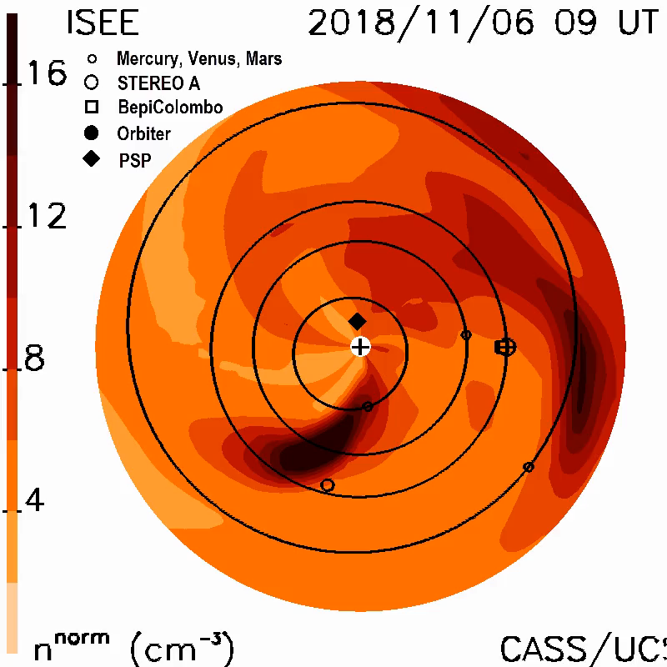
RISER Case Study
ISEE
LOFAR
LOFAR+ISEE
Event 5: 2018/11/04 – Kp 5

Slide 9
Making the most of Standalone Time
Observing 24/7 with UK608 since March, IPS observations during daytime and Cas A observations for ionospheric scintillation at night.
Series of scripts developed as steps towards automation:
Comprehensive script to generate a schedule of observations using LOFAR and MWA calibrator source lists (John Morgan, CSIRO) - >100 observations per day!
Running of observations automated through adapted version of iLiSA (Tobia Carozzi,Onsala);
Post-processing script deals with data conversion to h5 (dynspec), transfer to RAL systems, and raw data removal;
Checking script to go through all observations run on a given day to ensure data processing and transfer has been done correctly and allow for removal of remaining raw data from Chilbolton systems.
IPS processing pipeline updated to run automatically with the arrival of new data.
Tomography currently run automatically once each day.

Slide 10
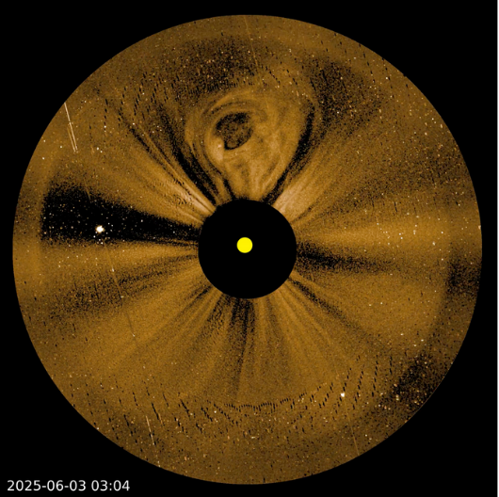
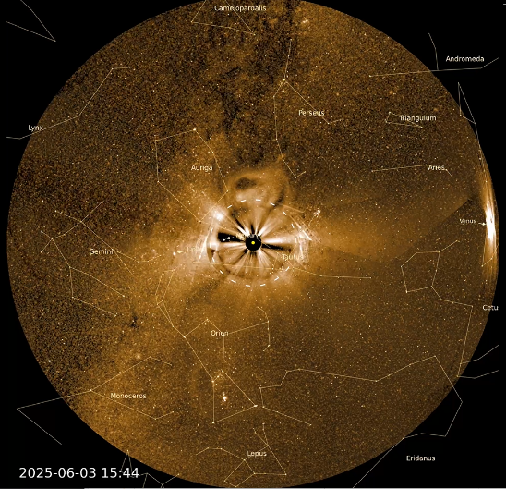
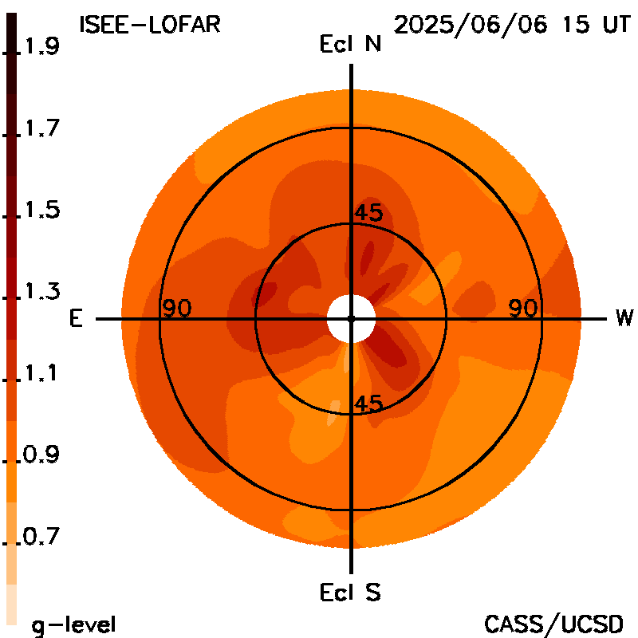
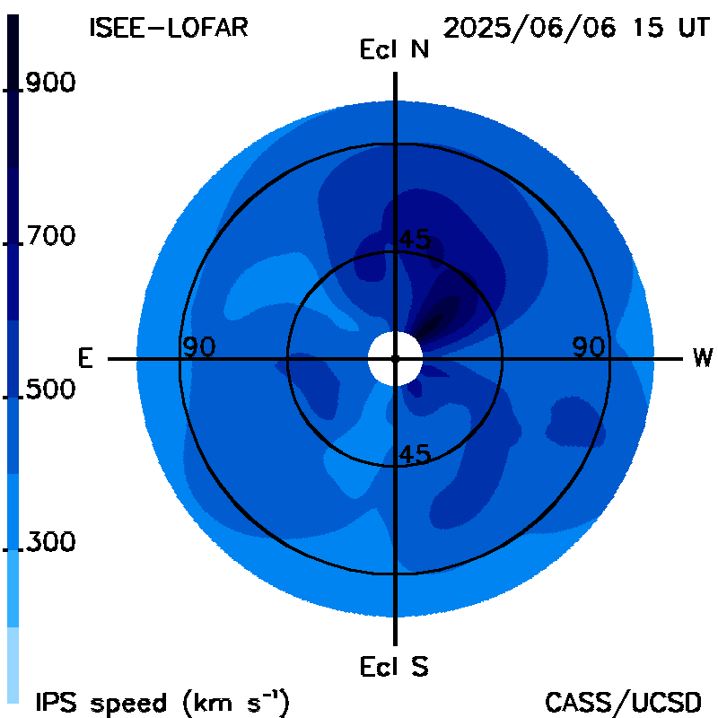
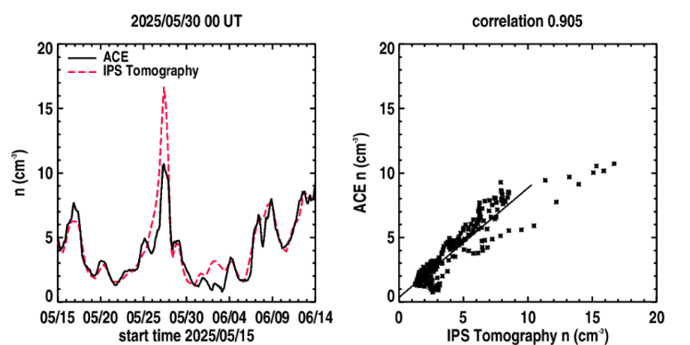
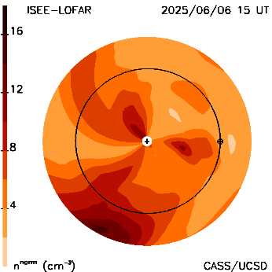
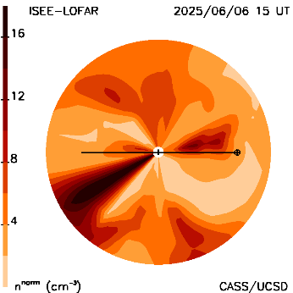
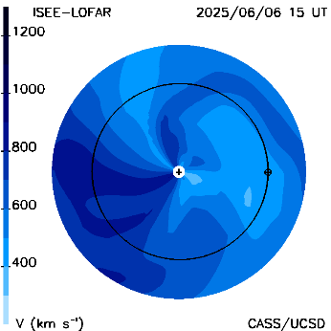
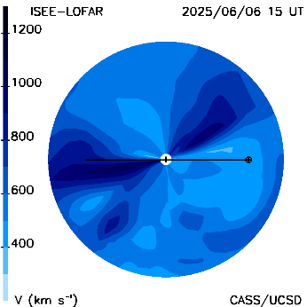
CME June 2025 – Jackson+, in prep.
PUNCH NFI 2025 06 03 03:04 PUNCH WFI 2025 06 03 15:44 ISEE-LOFAR G-level Skymap ISEE-LOFAR Velocity Skymap
June 3 CME
Earth Arrival
2025/06/06 15 UT
ISEE-LOFAR time series with CME - WIPSS Np ecliptic & meridional cuts - WIPSS V ecliptic & meridional cuts
PUNCH NFI and WFI both see a CME as does the WIPSS IPS analysis from
ISEE and LOFAR (UK Chilbolton) IPS analysis

Slide 11
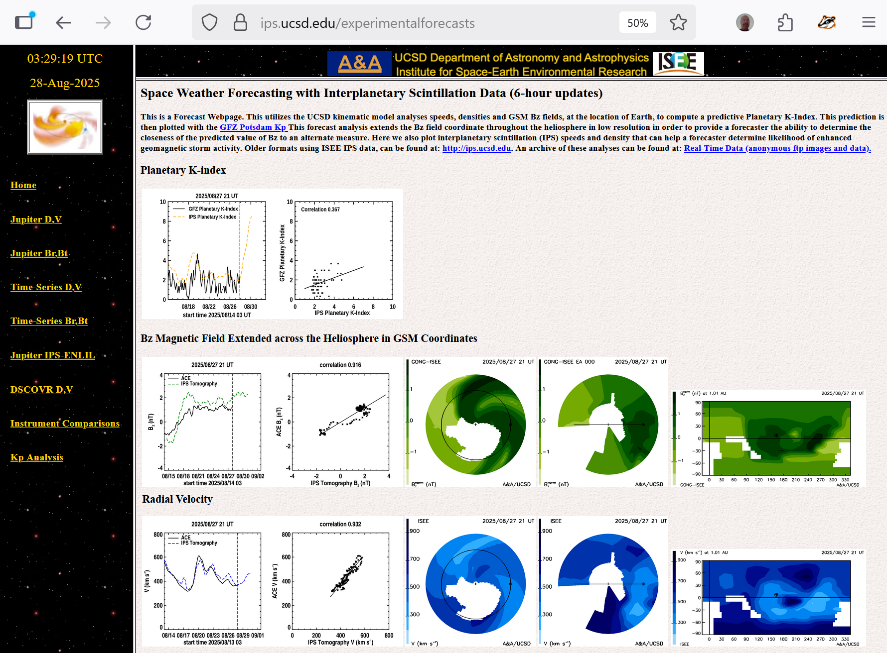
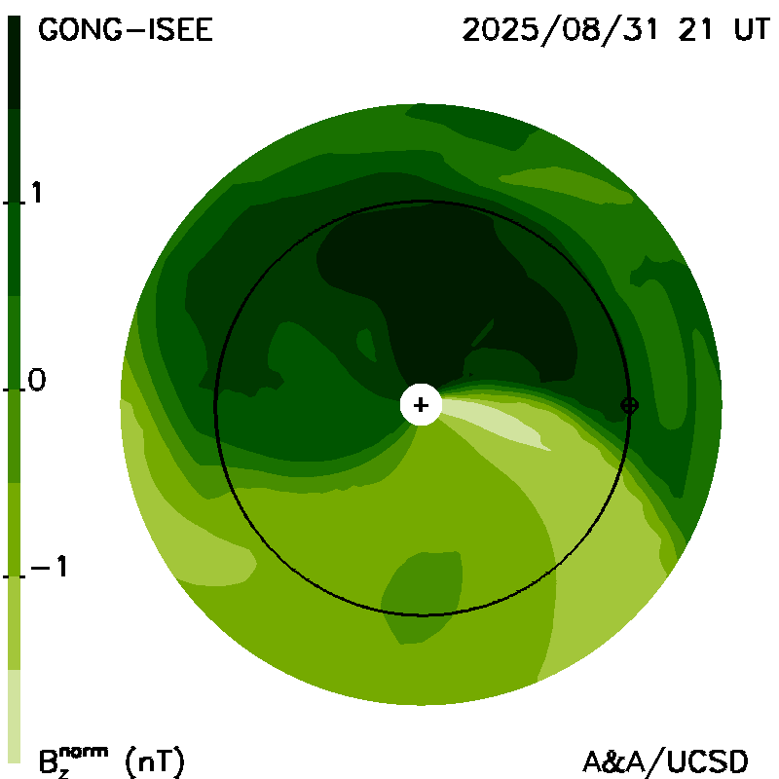
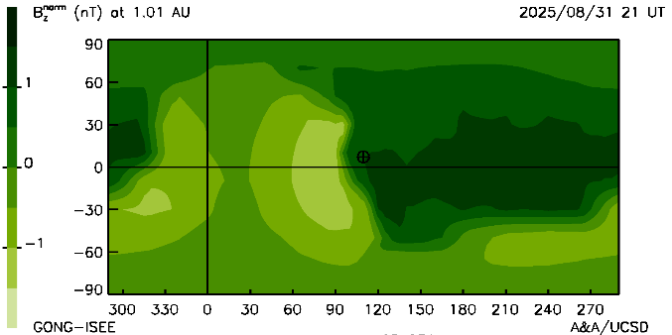
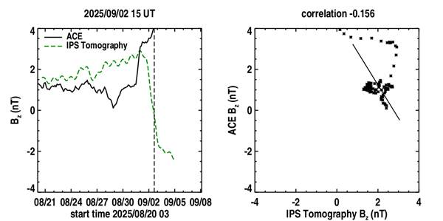
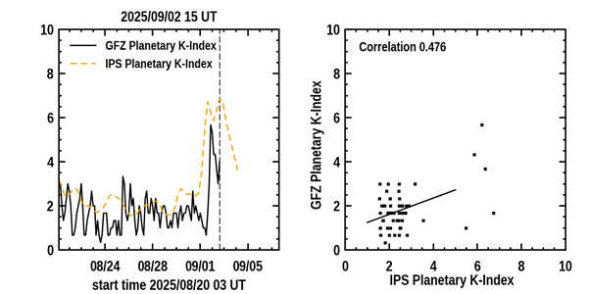
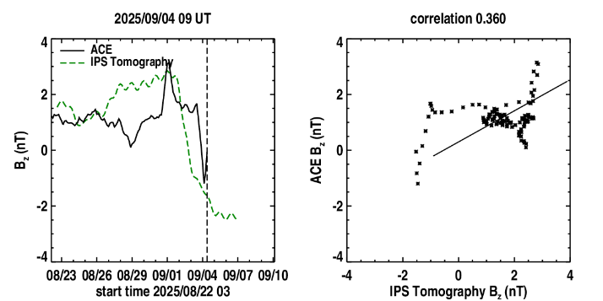
Combining IPS Density/Velocity with GONG for Bz
(2025/08/31 21 UT)
(2025/08/27 21 UT)
(2025/09/02 15 UT)
(2025/09/04 09 UT)
ACE -Bz finally
caught up!

Slide 12
Next Steps
We have been scheduling long-baseline observations with PL610 and PL612 over the summer:
Data transfer now being established, analysis will follow.
Long observations (1 hour) to follow single points on the sky for an extended time.
Anybody else is welcome to join this effort!
Running IPS-ENLIL in parallel with tomography.
Further automation of observing and processing in collaboration with the UK Met Office to demonstrate near-real time forecasting capabilities.
Extract density/velocity/B-field values at L1 (or a more convenient location nearer Earth) from tomography to feed into magnetospheric model.
Ultimately – can we increase the resolution?!?

