Slide 1

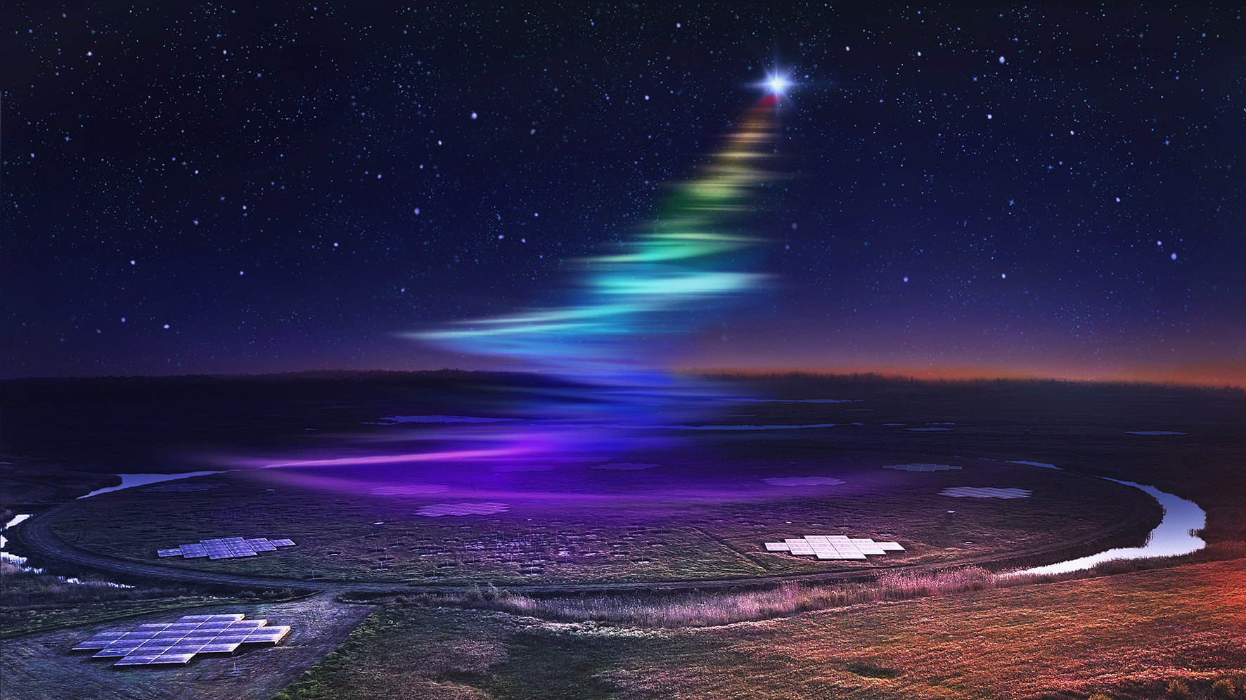
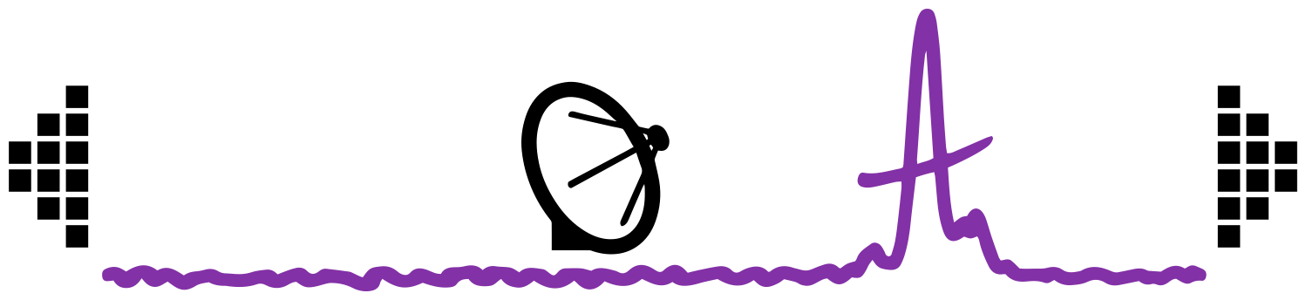
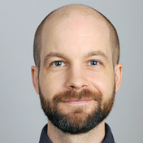

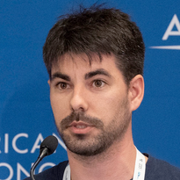


DETECTING
RADIO TRANSIENTS WITH LoTSS
Image credit: Daniëlle Futselaar
ASTR
FL
SH
Sylvain RANGUIN
in collaboration with Tim Shimwell, Reshma Anna-Thomas, Inés Pastor-Marazuela
Advised by: Jason Hessels, Ziggy Pleunis, Benito Marcote, Antonia Rowlinson

Slide 2


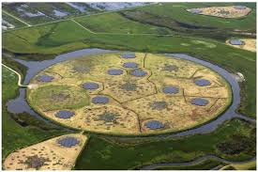
Radio transients' detection with LOFAR
Large collecting area
Image: ASTRON
Wide field of view
Fast imaging correlation
Handle Ionospheric variability
Notes:
Why actually LOFAR is important to detect radio transients ! In fact with this wide field of view and unprecedent sensitivity, we can actually probe this part of the radio sky !

Slide 3
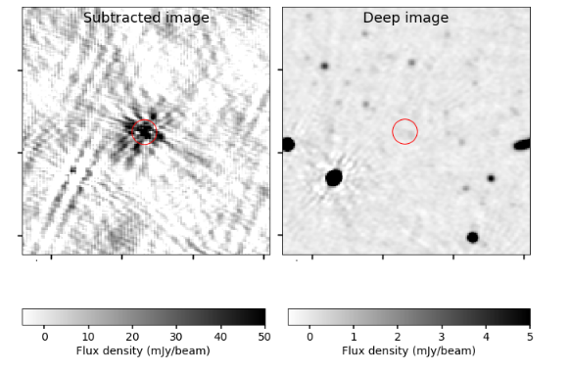
Radio transients' detection with LOFAR
Large collecting area
Characterize the emission
Image: ASTRON
Wide field of view
Fast imaging correlation
Handle Ionospheric variability
Bright and bursty signals
Timescales (sec →mins)

Slide 4
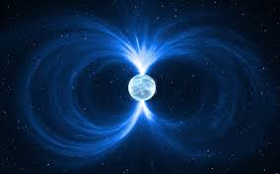
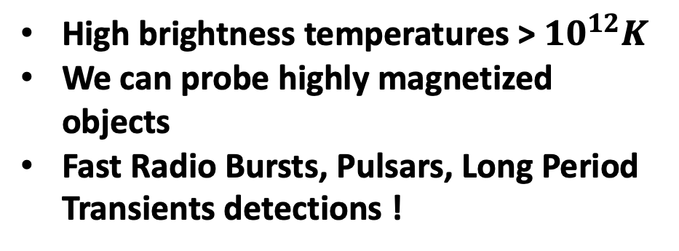
Radio transients' detection with LOFAR
Low frequency band very sensitive to coherent emission
Large collecting area
Characterize the emission
Image: ASTRON
Image Credit: Jurik Peter
Wide field of view
Fast imaging correlation
Handle Ionospheric variability
High brightness temperatures > ${10}^{12}K$
We can probe highly magnetized objects
Fast Radio Bursts, Pulsars, Long Period Transients detections !
Bright and bursty signals
Timescales (sec →mins)

Slide 5
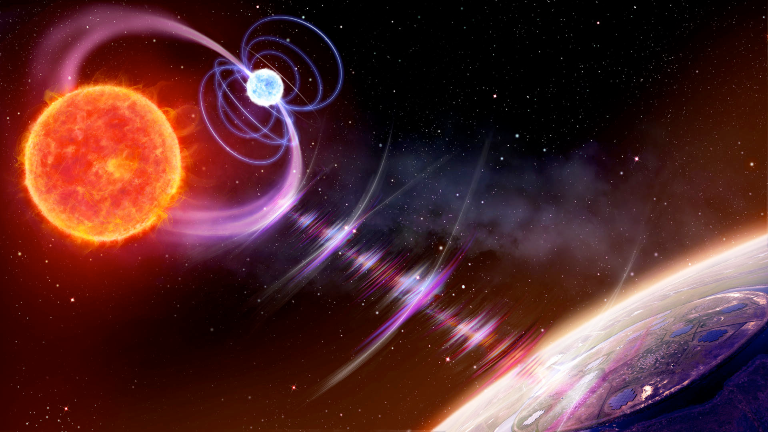

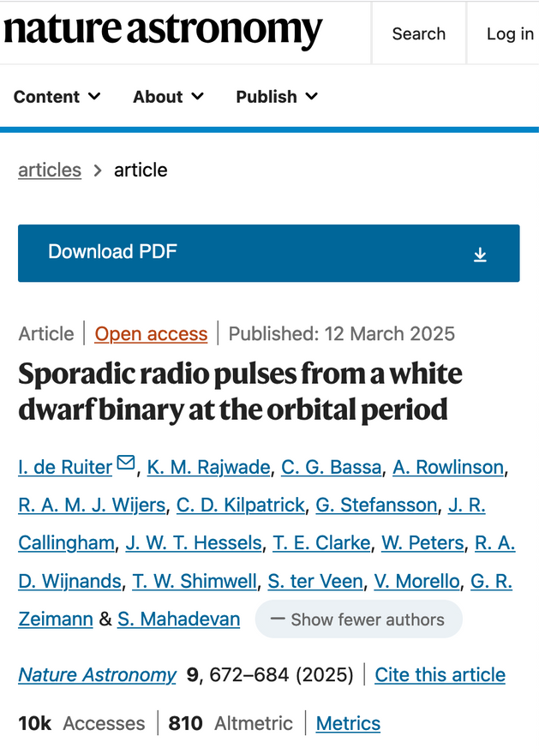

Image credit: Daniëlle Futselaar
First Long Period Transient’s counterpart found with LOFAR !
A white dwarf binary showing sporadic radio pulses at the orbital period (De Ruiter et al., 2024)
9

Slide 6
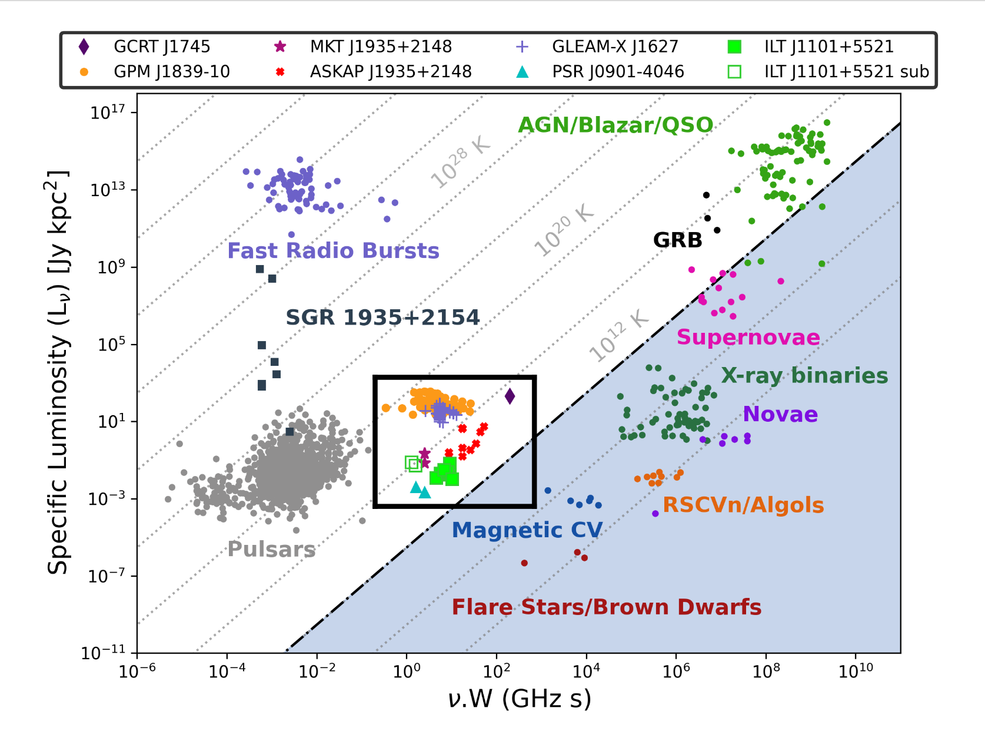




Coherent emission
Incoherent emission
Credit: De Ruiter et al. 2024
Notes:
I wanted to start this talk by the very common transient phase-space diagram, where we have here a big picture of the emission and objects detected in the radio sky. As we know in the plot, we have 2 type of emission, (coherent and in-coherent) differentiate by the brightness temp of this objects. Exceeding this temperature by 10^12K we will mainly detect coherent emission. That’s where I will mainly focus during this talk.
As we know most of the coherent emission processes have been detected using beamformed data (high time resolution). BUT We recently open a new window in the transient phase space diagram. Where we detected for the first time radio coherent emission from a new population of objects called LPTs. This emissions where detected in very short timescales from sec to minutes, mainly in the image plane. Each of this LPTs detected have actually different origins from WD-MD binaries, pulsars (RRAT) or magnetars. This is actually a very exited topic at the moment where a lot of radio observatories are now looking for this emission using fast imaging that was poorly explored historically.

Slide 7
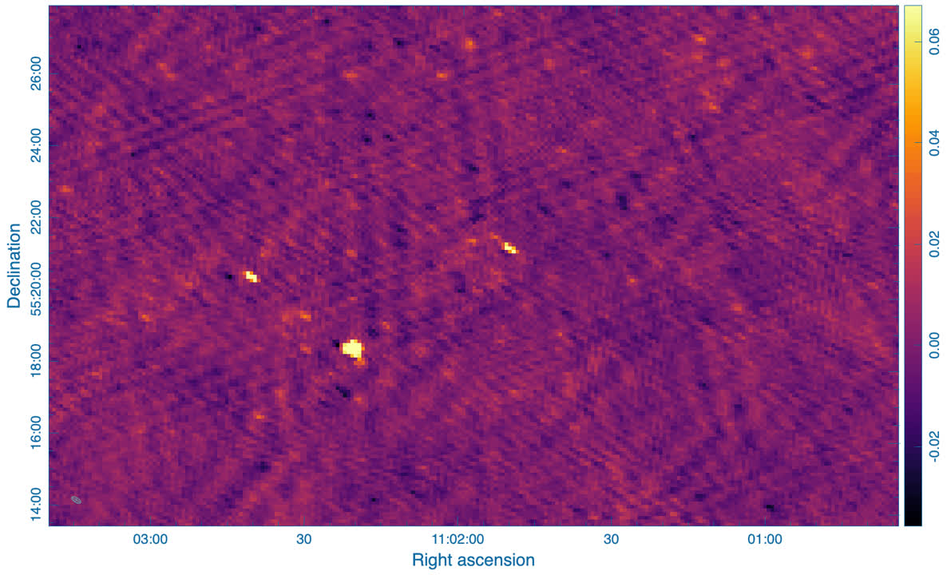
8-sec snapshot images of the first detection
Credit: Iris de Ruiter

Slide 8
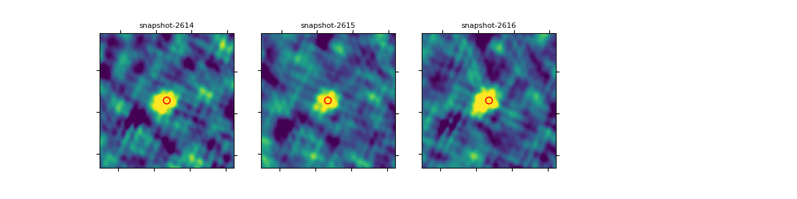
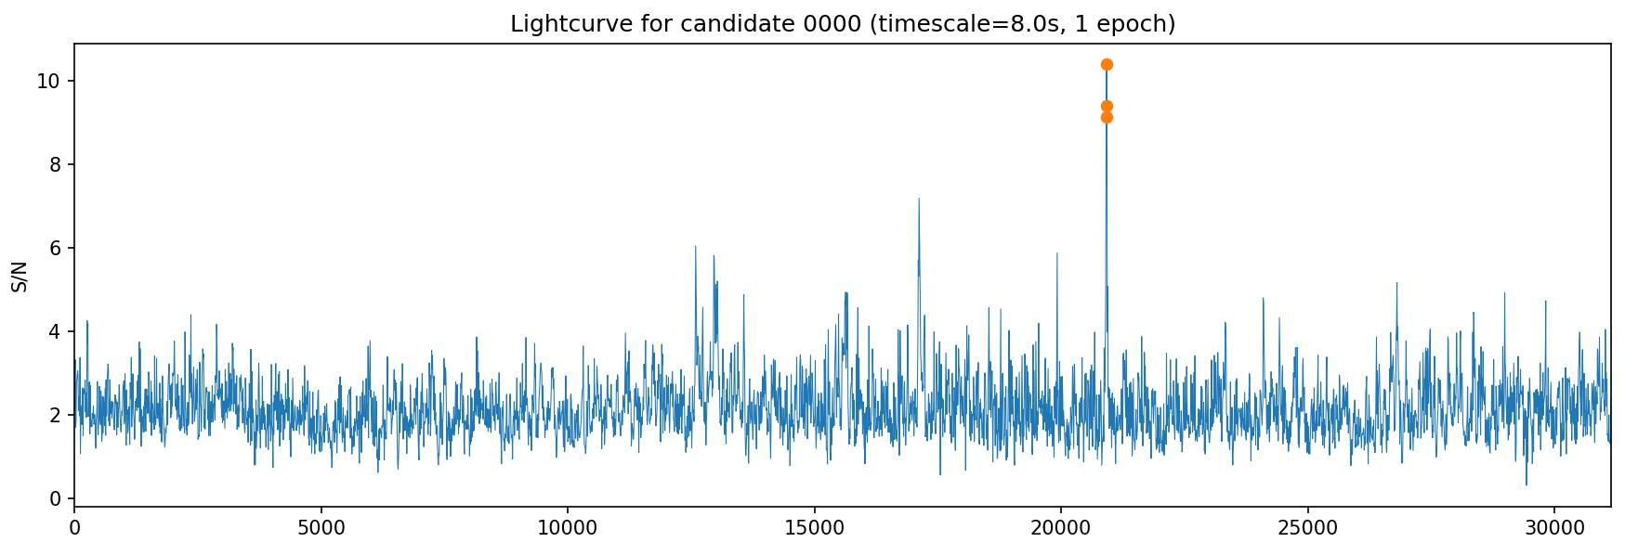
Re-detection of ILT J1101 +5521 in the initial observation using our pipeline

Slide 9
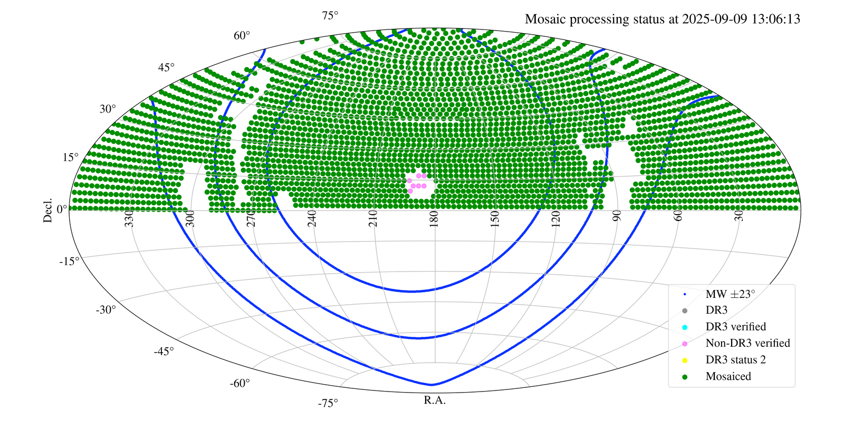
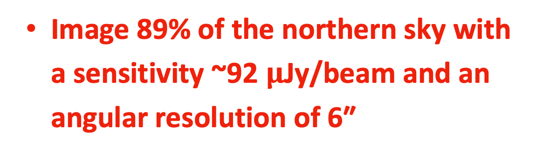
The LOFAR Two meter Sky Survey (LoTSS)
The LOFAR HBA of 120-168MHz wide-area survey.
2000+ pointings to search for !
Image 89% of the northern sky with a sensitivity ~92 $μ$Jy/beam and an angular resolution of 6″
Credit DR3 internal data release,
Shimwell et al. in prep. (2025)

Slide 10
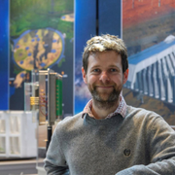
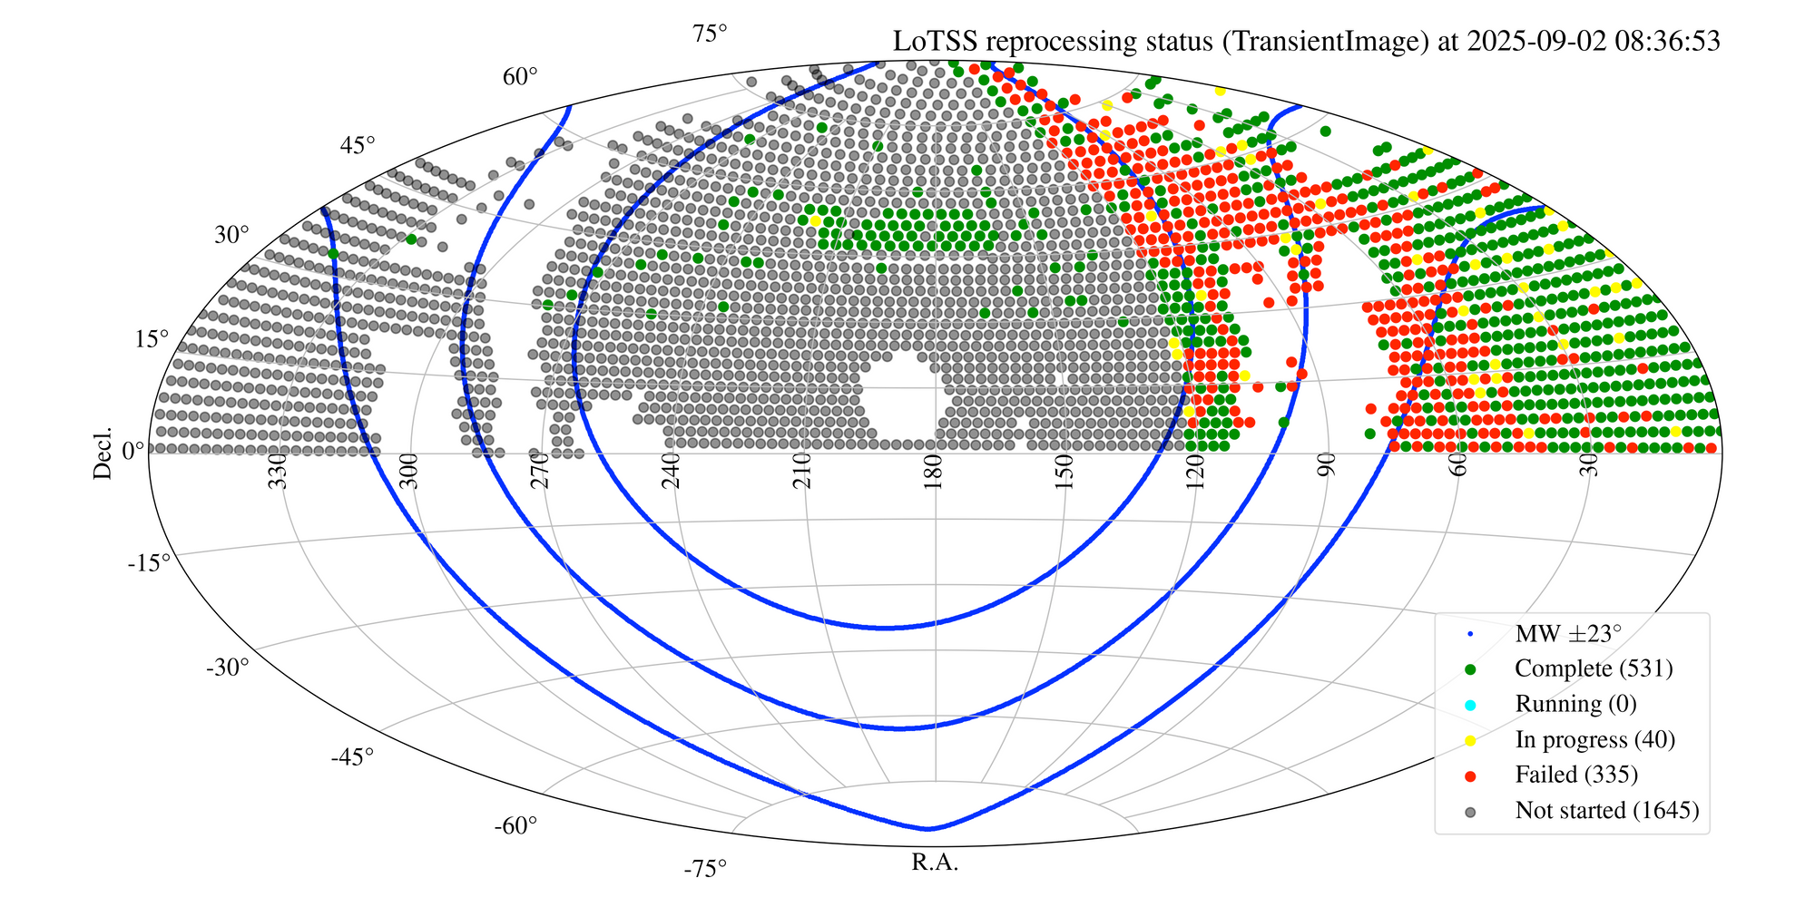
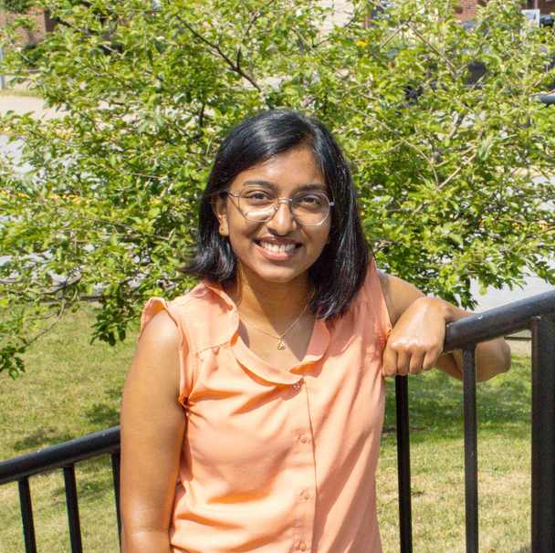

The LOFAR Two meter Sky Survey (LoTSS)
Current status
Tim Shimwell
Reshma Anna-Thomas
Credit: LOFAR surveys’ website, Tim Shimwell
Inés Pastor-Marazuela

Slide 11
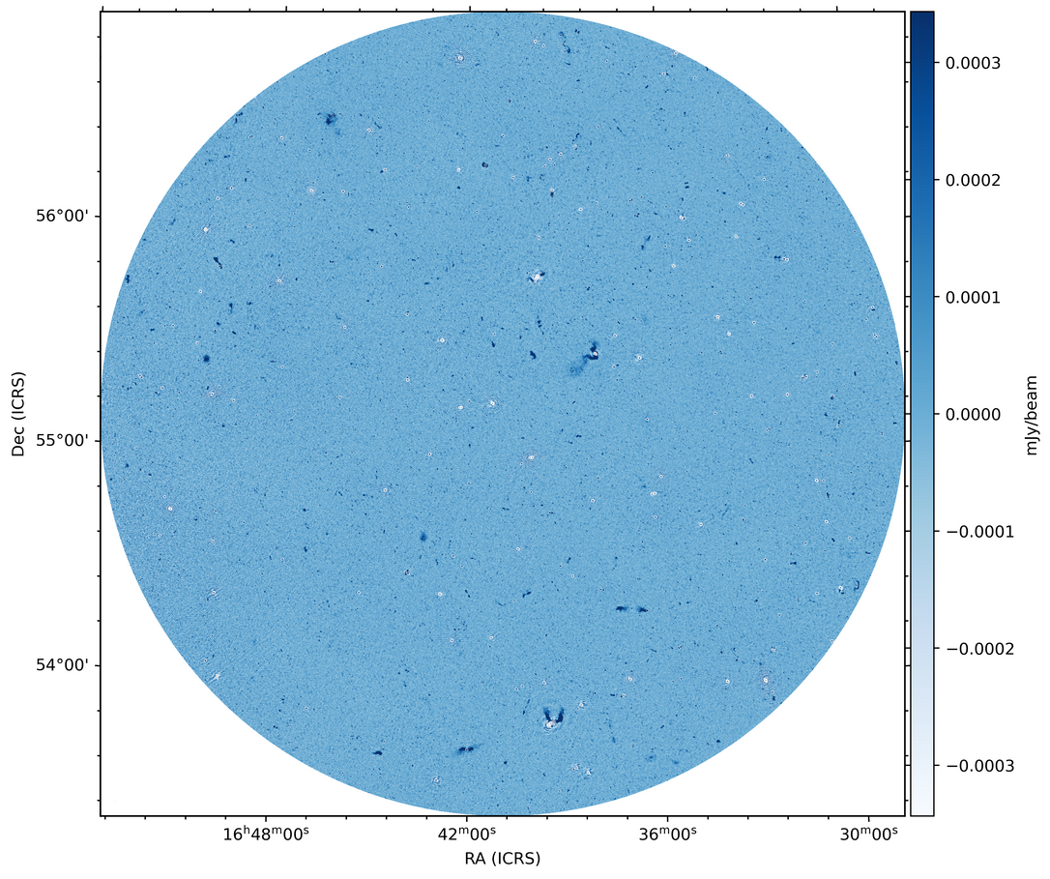
The LOFAR Two meter Sky Survey (LoTSS)
Current status
Credit: LOFAR surveys’ website, Tim Shimwell

Slide 12

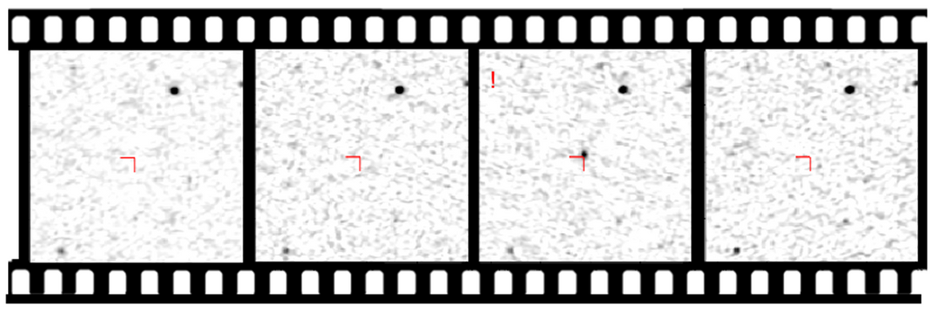

LoTSS pointing vs Subtraction image
Our inputs
8 seconds snapshots
Film example of a LoTSS 8-hour observation
Subtraction imaging
Snapshot images
~3600 images to process
About 100 000 detections per field !
Credit: Iris de Ruiter

Slide 13
LoTSS pointing vs Subtraction image
Our inputs
8 seconds snapshots
Film example of a LoTSS 8-hour observation
?
Subtraction imaging
Snapshot images
~3600 images to process
About 100 000 detections per field !
Credit: Iris de Ruiter

Slide 14
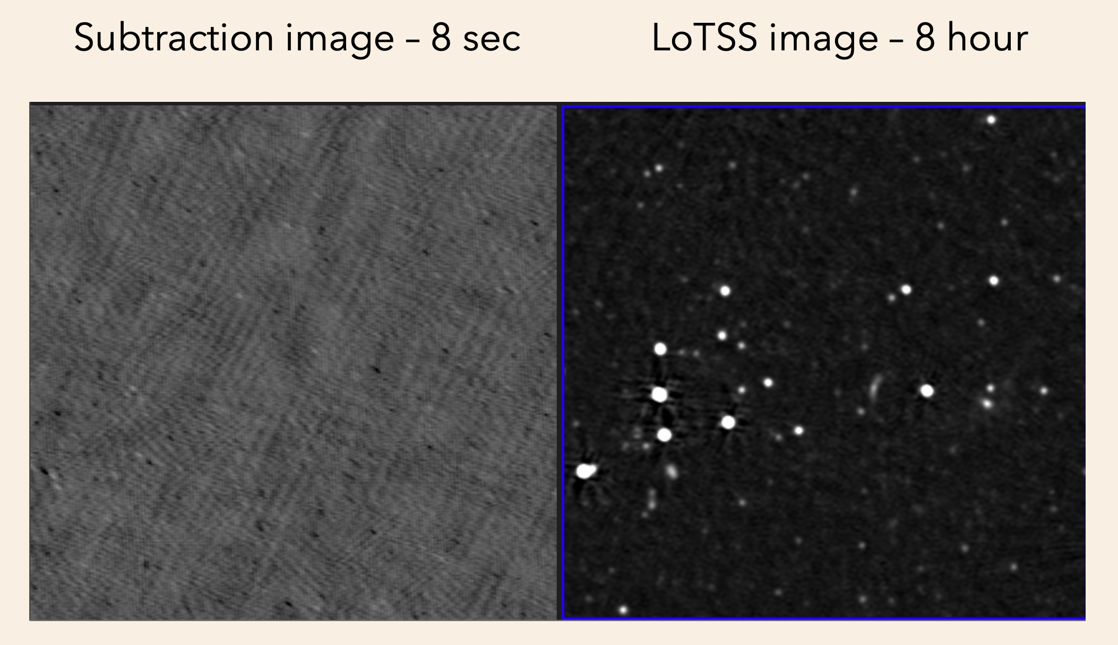
Credit: Iris de Ruiter

Slide 15
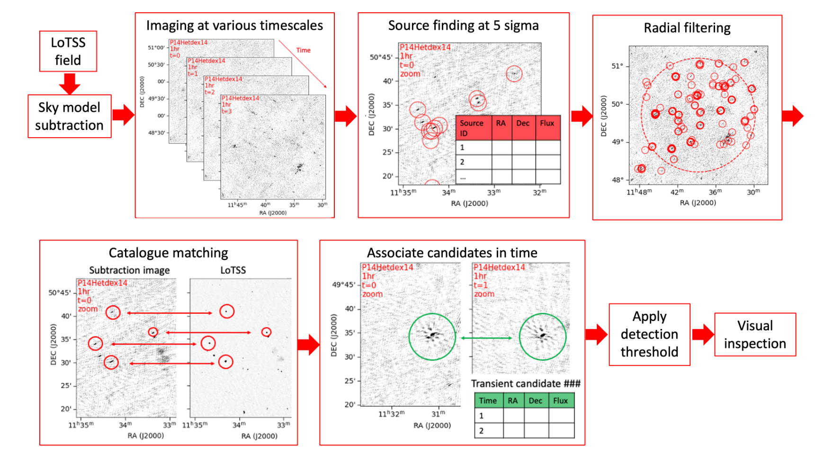
Image processing
Pipeline process
RMS clipping
De Ruiter et al.(2023)

Slide 16
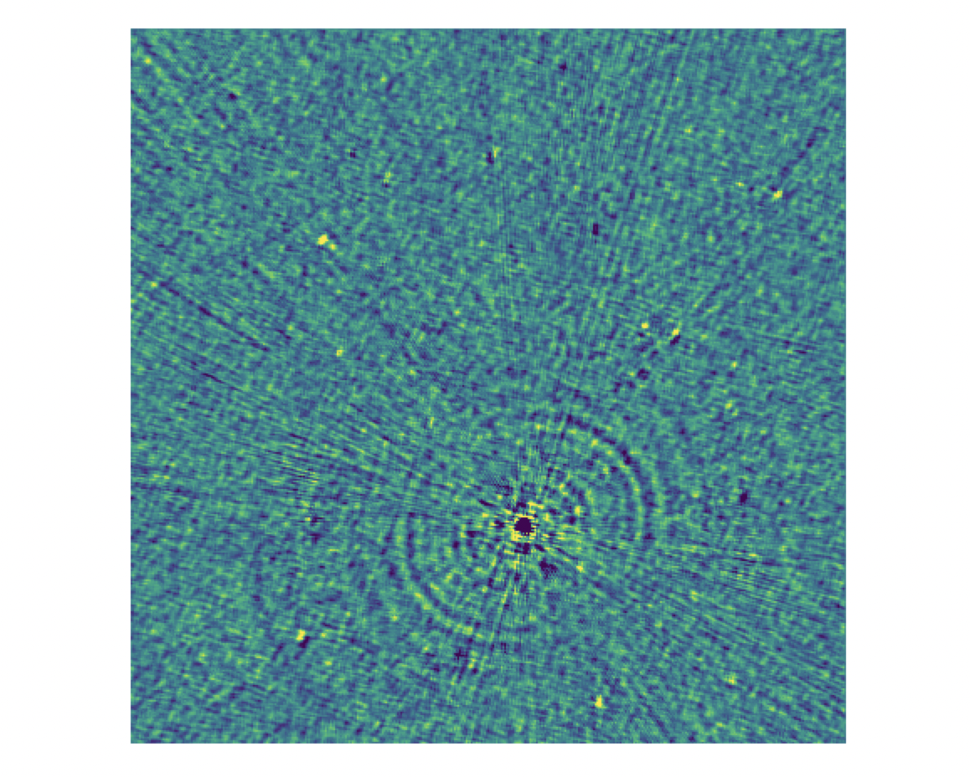
RMS clipping for noisy images
Example of a bad image with an artifact from a known source
We remove this bad images from further analysis by using an RMS threshold computed beforehand

Slide 17

Image processing
Pipeline process
Up to 8 $σ$ now!

Slide 18
Image processing
Pipeline process
Up to 8 $σ$ now!

Slide 19
Image processing
Pipeline process
Up to 8 $σ$ now!
De Ruiter et al.(2023)
De Ruiter et al.(2023)

Slide 20
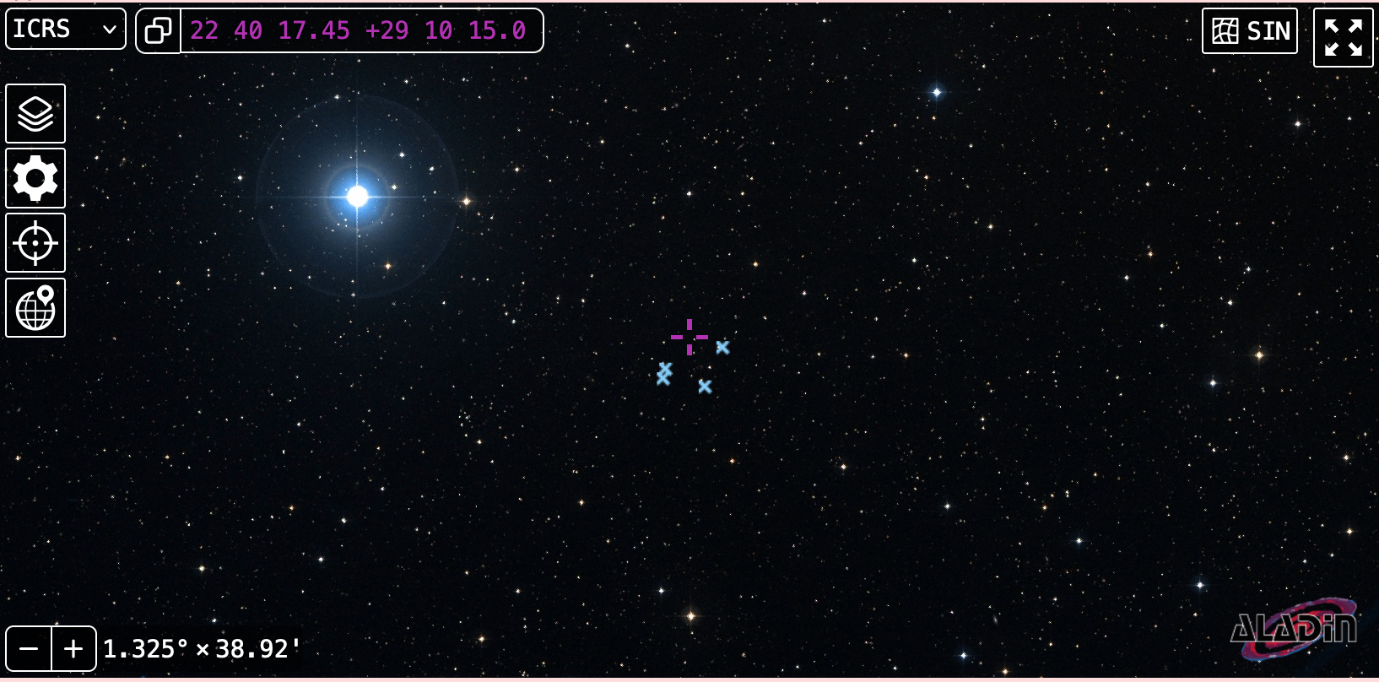



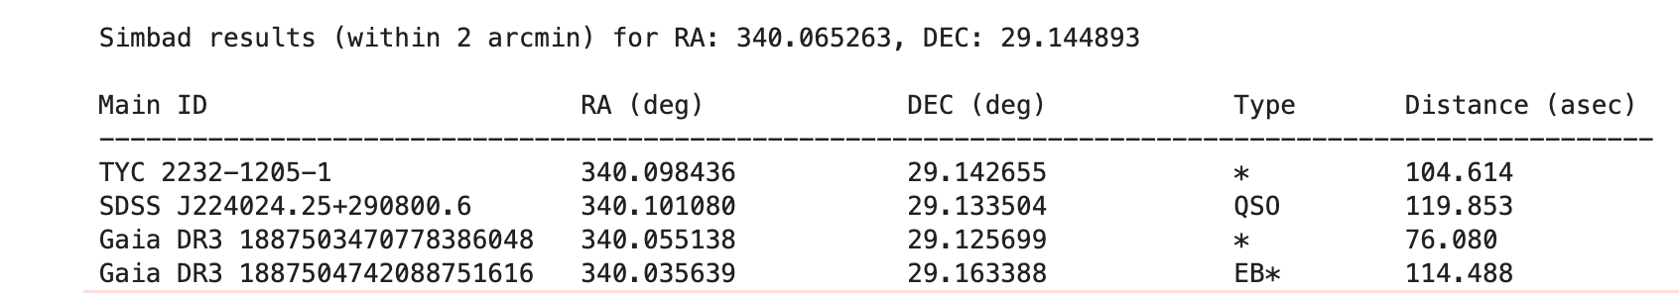
New implementation to find counterparts

Slide 21
Image processing
Pipeline process
Up to 8 $σ$ now!
De Ruiter et al.(2023)
De Ruiter et al.(2023)

Slide 22
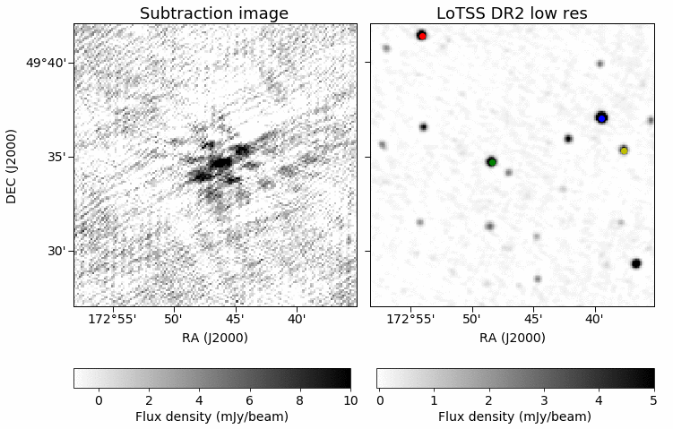
Example of a false positive in our images
Aliased source
Source location is moving quite a bit over the observation.
Gather within 1 arcmin to avoid this artifacts!

Slide 23
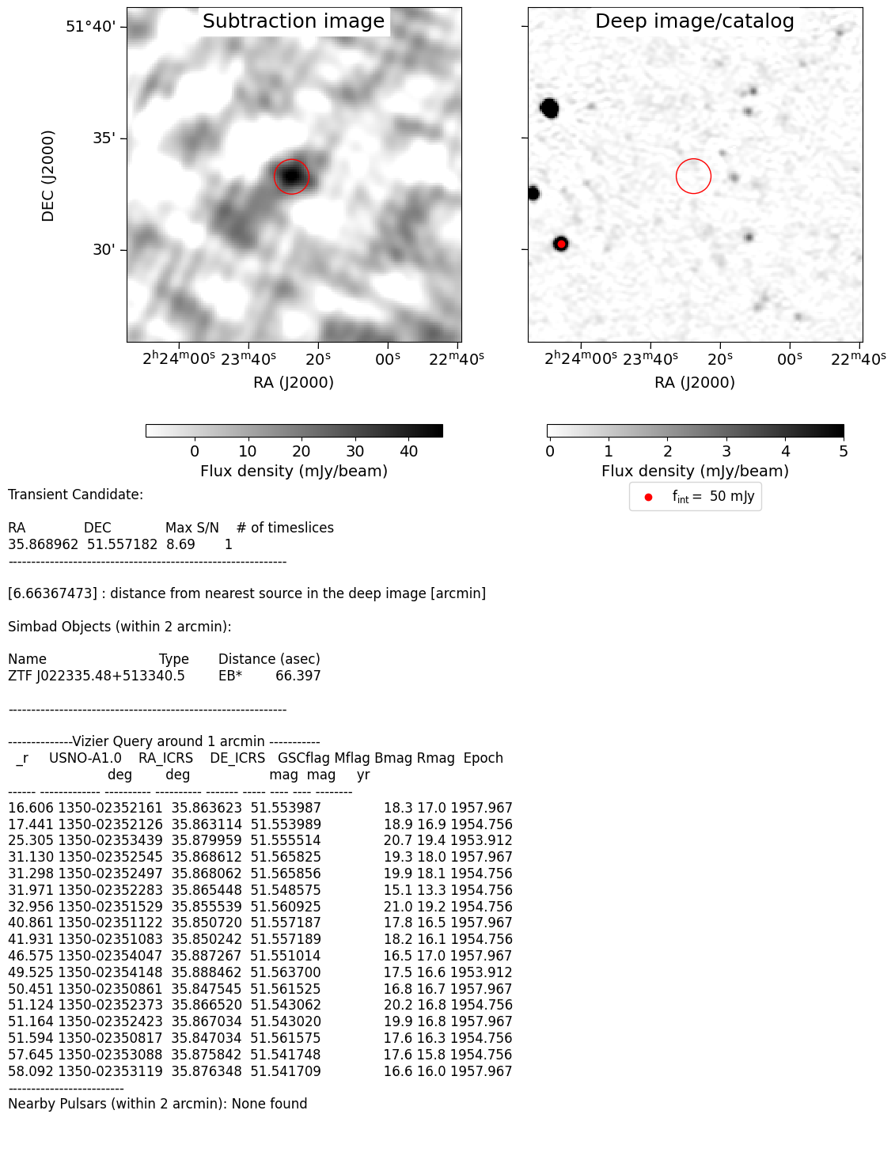
Transients' candidate
More candidates to discover in the next talk with Reshma!

Slide 24

Pipeline’s overview
RMS clipping
Pipeline processing
Field report summary

Slide 25
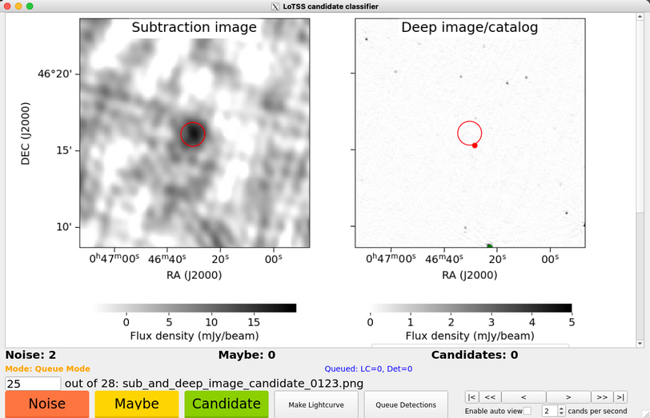

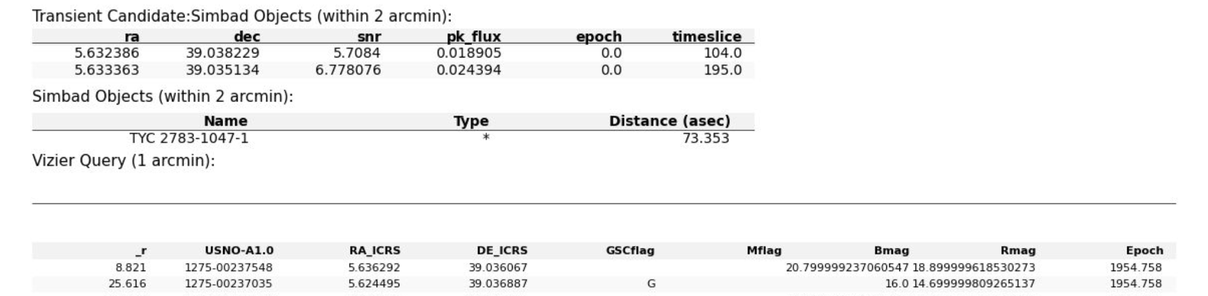
Pipeline’s overview
LoTSS classifier
RMS clipping
Pipeline processing
Field report summary
Credit: Inés Pastor-Marazuela
Based on jester (MeerTRAP)
Classification of candidates as Noise, Maybe, or Candidate.

Slide 26
Pipeline’s overview
RMS clipping
LoTSS classifier
Full processing for an 8-hour observation, with 8-s snapshot images, done in ~7 minutes using 3000 cores at once ! (without classification)
Pipeline processing
Credit: Inés Pastor-Marazuela
Field report summary
Thanks to SURF !

Slide 27


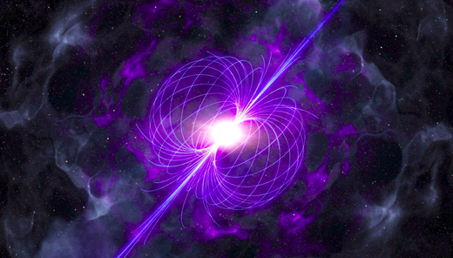
CONCLUSION AND OUTLOOK
New optimization of our existing pipeline to investigate more on the transient candidates !
Apply a new de-dispersion method on the images to look for highly dispersed signals
LoTSS DR3
Image the whole Northern sky, including the Galactic Plane with more than 2000 pointings
?
?
LoTSS observations, Credit: T. W. Shimwell (2025)

Slide 28
BACKUP SLIDES

Slide 29
Coherent emission
Incoherent emission
Credit: De Ruiter et al. 2024
3
Notes:
I wanted to start this talk by the very common transient phase-space diagram, where we have here a big picture of the emission and objects detected in the radio sky. As we know in the plot, we have 2 type of emission, (coherent and in-coherent) differentiate by the brightness temp of this objects. Exceeding this temperature by 10^12K we will mainly detect coherent emission. That’s where I will mainly focus during this talk.
As we know most of the coherent emission processes have been detected using beamformed data (high time resolution). BUT We recently open a new window in the transient phase space diagram. Where we detected for the first time radio coherent emission from a new population of objects called LPTs. This emissions where detected in very short timescales from sec to minutes, mainly in the image plane. Each of this LPTs detected have actually different origins from WD-MD binaries, pulsars (RRAT) or magnetars. This is actually a very exited topic at the moment where a lot of radio observatories are now looking for this emission using fast imaging that was poorly explored historically.

Slide 30
Time’s window that we probe with LOFAR
Coherent emission
Incoherent emission
Credit: De Ruiter et al. 2024
4
Notes:
I wanted to start this talk by the very common transient phase-space diagram, where we have here a big picture of the emission and objects detected in the radio sky. As we know in the plot, we have 2 type of emission, (coherent and in-coherent) differentiate by the brightness temp of this objects. Exceeding this temperature by 10^12K we will mainly detect coherent emission. That’s where I will mainly focus during this talk.
As we know most of the coherent emission processes have been detected using beamformed data (high time resolution). BUT We recently open a new window in the transient phase space diagram. Where we detected for the first time radio coherent emission from a new population of objects called LPTs. This emissions where detected in very short timescales from sec to minutes, mainly in the image plane. Each of this LPTs detected have actually different origins from WD-MD binaries, pulsars (RRAT) or magnetars. This is actually a very exited topic at the moment where a lot of radio observatories are now looking for this emission using fast imaging that was poorly explored historically.

Slide 31
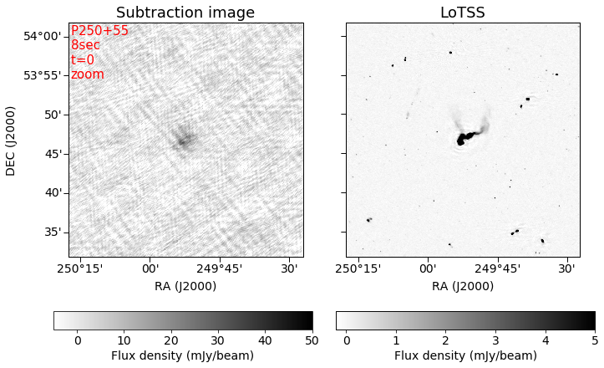
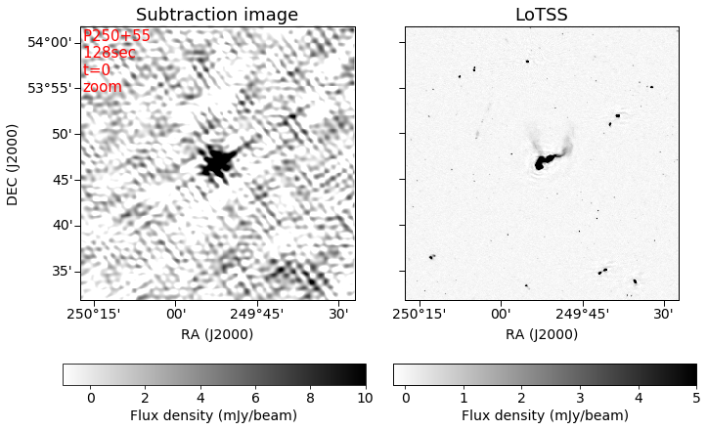
Snapshot images for different time-scales
8 sec snapshot
2 min snapshot

Slide 32
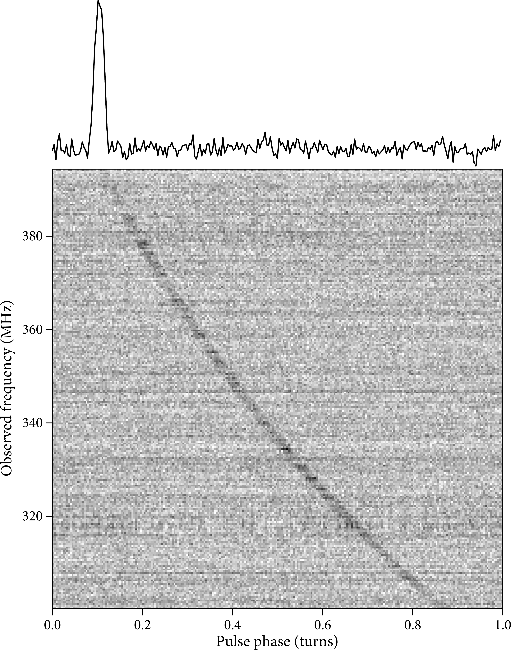
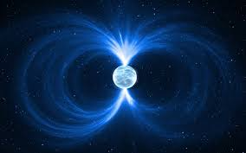
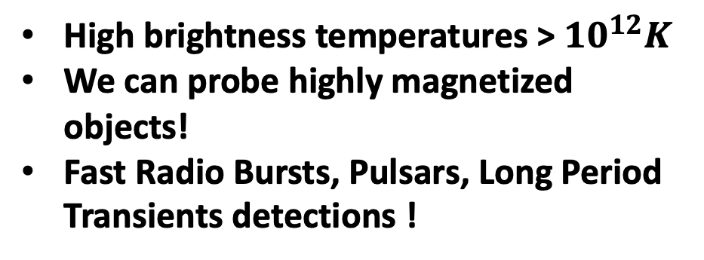
Probing coherent radio emission with LOFAR
Low frequency band very sensitive to coherent emission
Characterize the emission
Large collecting area
Image Credit: Jurik Peter
Image: ASTRON
High brightness temperatures > ${10}^{12}K$
We can probe highly magnetized objects!
Fast Radio Bursts, Pulsars, Long Period Transients detections !
Wide field of view
Fast imaging correlation
Handle Ionospheric variability
James J. Condon et al.(2018)
Bright and bursty signals
Timescales (sec →mins)

Slide 33

IMAGING BOTTLENECK
Cleaning
Iterative process
Per snapshot
Imaging
Solution:
Sky model subtraction
See Wang et al. (2023), Fijma et al. (2023), Hurley-Walker et al. (2022)

Slide 34
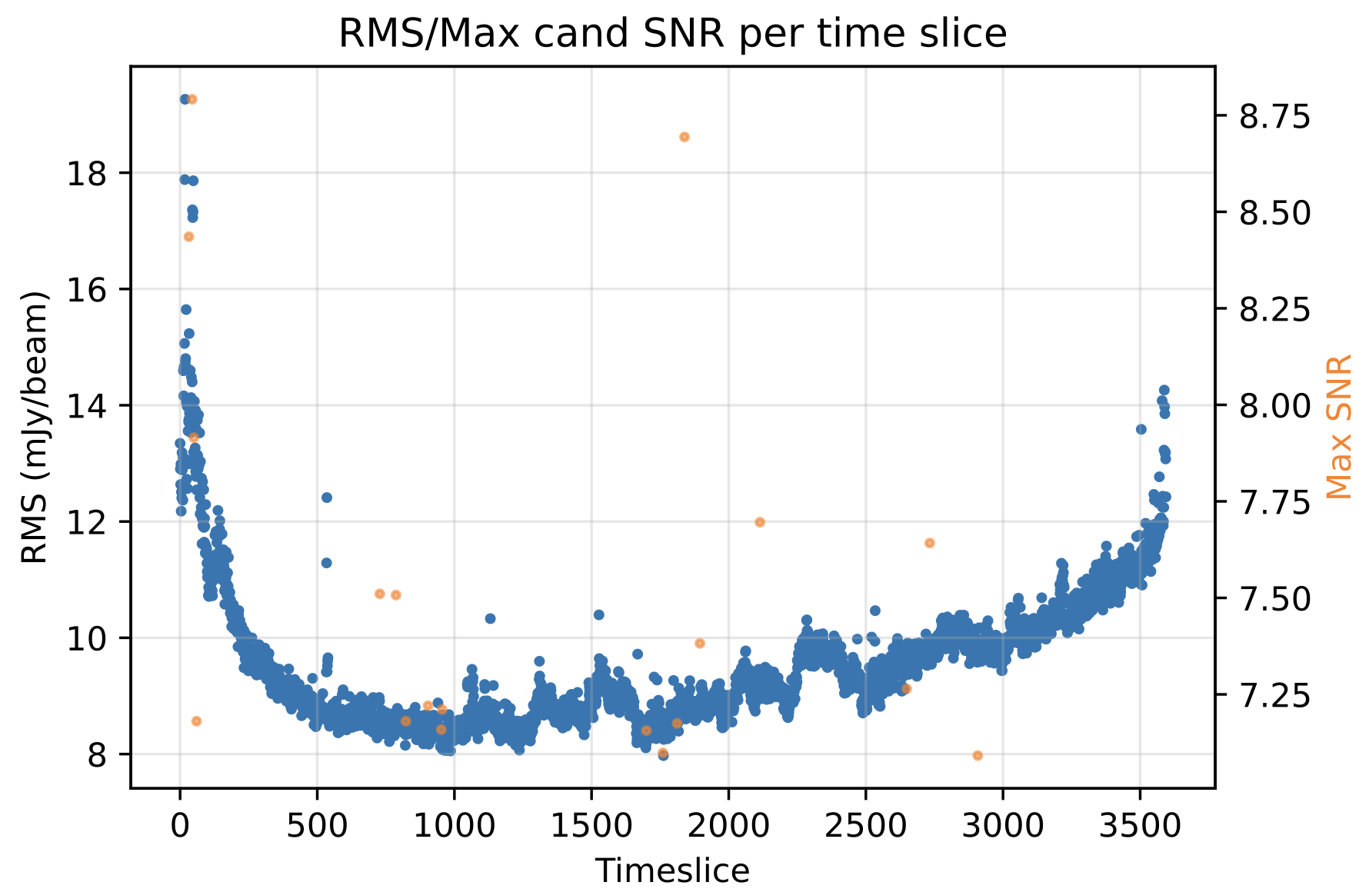
RMS clipping for noisy images
We remove bad images from further analysis by using an RMS threshold computed beforehand
Example of a bad image with an artifact from a known source

Slide 35

DETECTING
RADIO TRANSIENTS WITH LoTSS
ASTR
FL
SH
Image credit: Daniëlle Futselaar
Sylvain RANGUIN
Email: s.l.ranguin@uva.nl
24-09-2025
Supervised by: Jason Hessels, Ziggy Pleunis, Benito Marcote, Antonia Rowlinson

Slide 36
DETECTING
RADIO TRANSIENTS WITH LoTSS
Image credit: Daniëlle Futselaar
ASTR
FL
SH
Sylvain RANGUIN
E-mail: s.l.ranguin@uva.nl
24-09-2025
Advised by: Jason Hessels, Ziggy Pleunis, Benito Marcote, Antonia Rowlinson

Slide 37


Image processing
Subtraction imaging
-
We take the calibrated data
We take a source sky model
Subtracted datasets calibrated
WSClean imager
Subtracted images

Slide 38
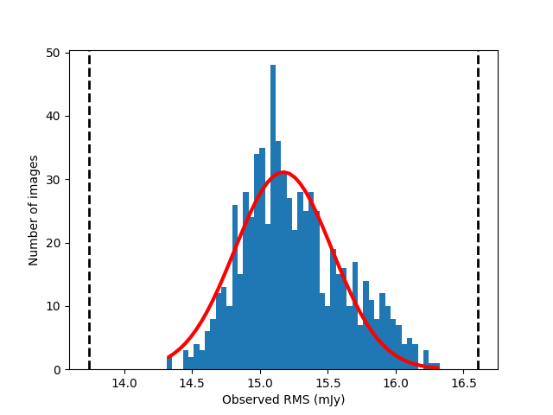
RMS clipping for noisy images
RMS computation done in parallel for efficiency
Allow us to remove bad images from further analysis

Slide 39
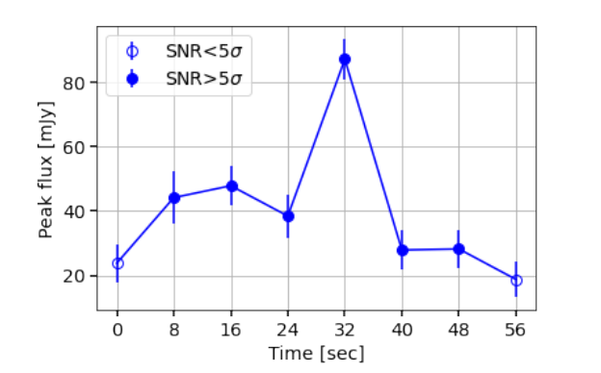

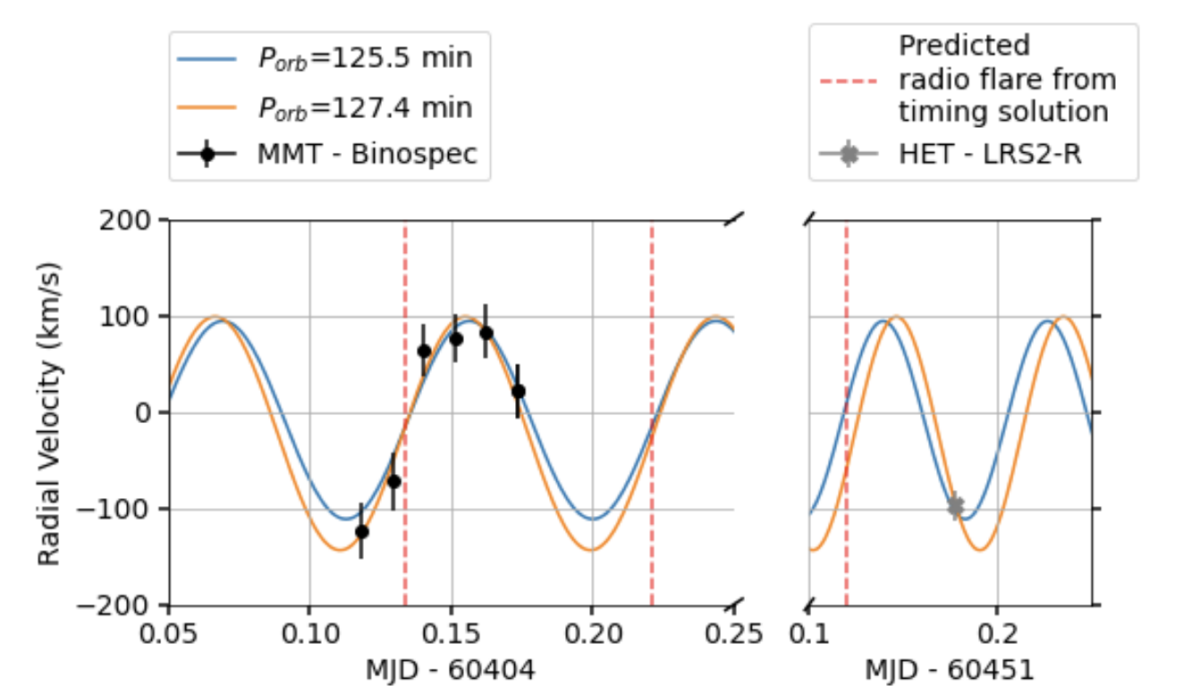
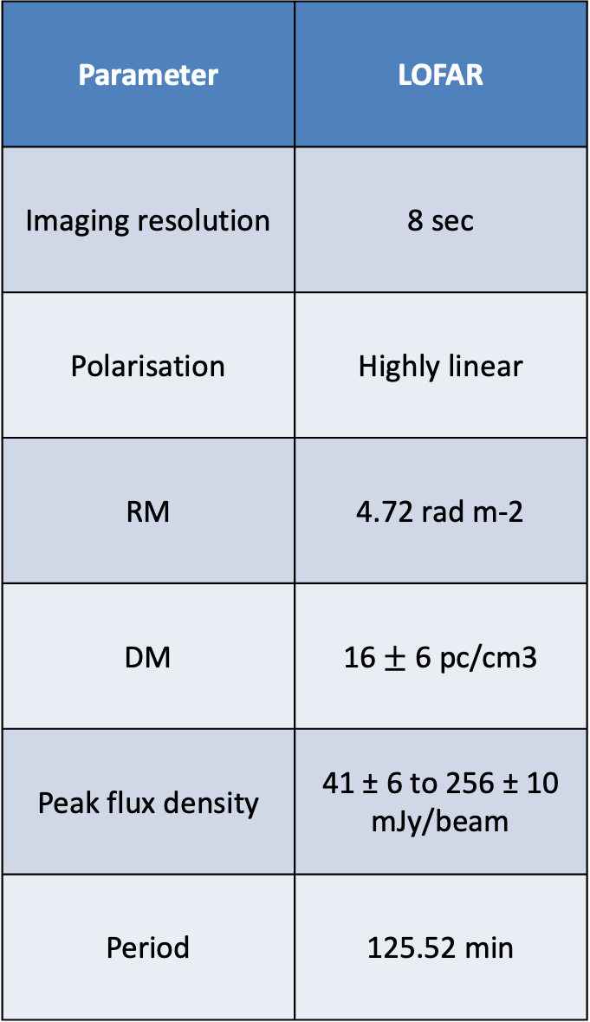
White Dwarf binary : ILT J1101 + 5521
The first LPT found with LOFAR with a counterpart!
Parameter | LOFAR
Imaging resolution | 8 sec
Polarisation | Highly linear
RM | 4.72 rad m-2
DM | 16 $±$ 6 pc/cm3
Peak flux density | 41 ± 6 to 256 ± 10 mJy/beam
Period | 125.52 min
Credit: de Ruiter et al.(2025)

Slide 40
Snapshot image and deep image of the first detection
GIF of the 8-sec snapshot images
Credit: Iris de Ruiter
Credit: de Ruiter et al.(2024)

Slide 41
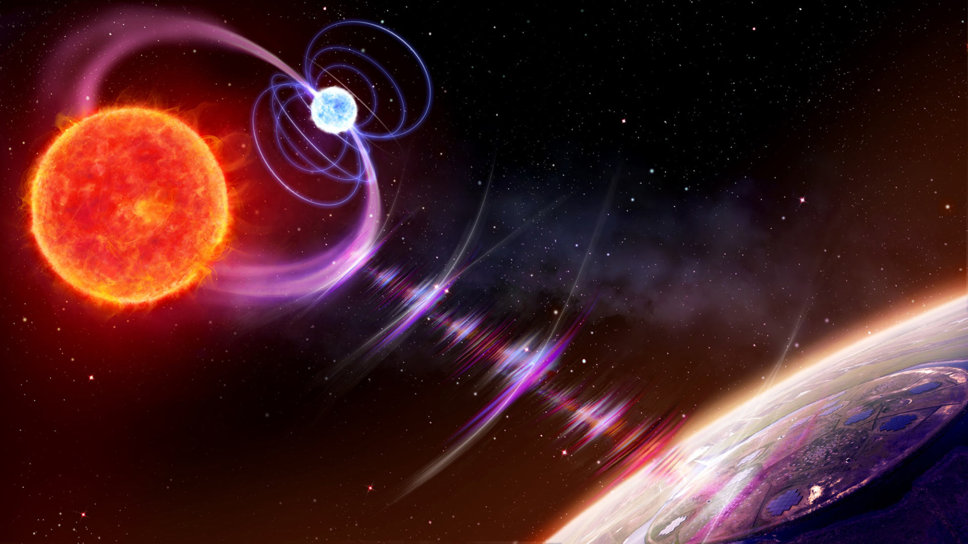
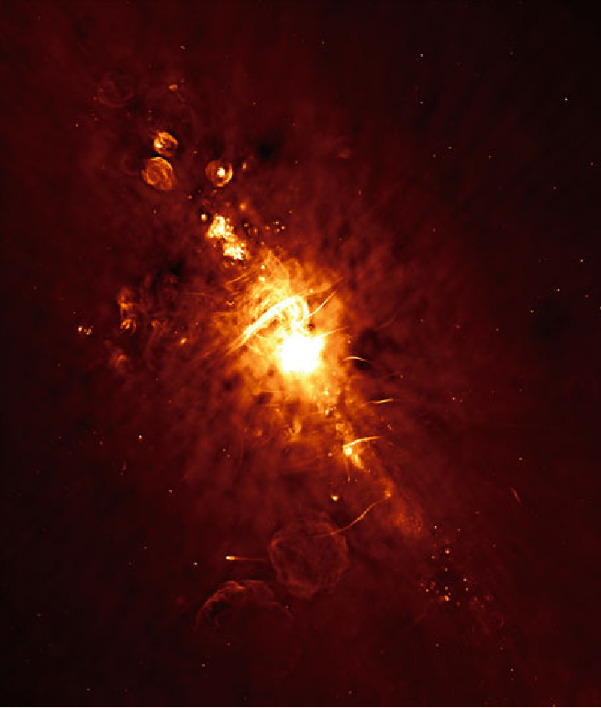
Long Period transients
Progenitor
2 confirm WD+MD and a new one possible ? 2 possible WD pulsars also detected !
1 Galactic transient found by (Hyman et al. (2005)
2 confirm NS and 3 possible magnetars origins ??
Unknown or unidentified | ??
Image credit: Daniëlle Futselaar
Image credit: NRAO
Image Credit: Jurik Peter
You can visit this very nice website created by Sam McSweeney for LPTs: https://lpt.mwa-image-plane.cloud.edu.au/published/galactic_view

Slide 42
Long Period transients
Progenitor
2 confirm WD+MD and a new one possible ? 2 possible WD pulsars also detected !
1 Galactic transient found by (Hyman et al. (2005)
2 confirm NS and 3 possible magnetars origins ??
Unknown or unidentified | ??
First LPT’s progenitor found with LOFAR !
Image credit: Daniëlle Futselaar
Image credit: NRAO
Image Credit: Jurik Peter
You can visit this very nice website created by Sam McSweeney for LPTs: https://lpt.mwa-image-plane.cloud.edu.au/published/galactic_view

Slide 43
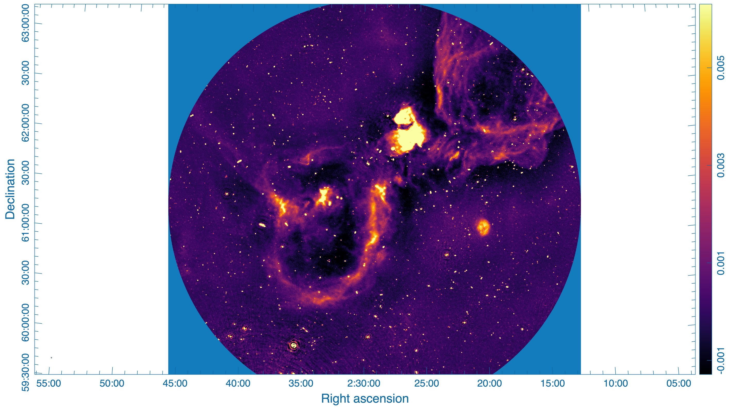
GALACTIC PLANE SEARCH

Slide 44
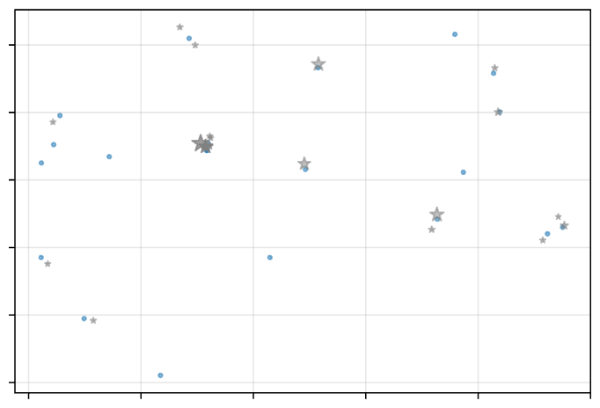
Field information
Transients' candidate
No: of sources without match
No:of unique sources
Distance to sun
Distance to CasA, CygA,
Vir A, Tau A
= 21
= 19
= 73.5731 deg
= [25.5238, 61.842] deg
= [112.2208, 47.8584] deg
Sky distribution of sources
52.5
52.0 51.5
transients
Dec (deg)
51.0 50.5 50.0
32
33
34
35
36
37
RA (deg)
More candidates to discover in the next talk with Reshma!

Slide 45
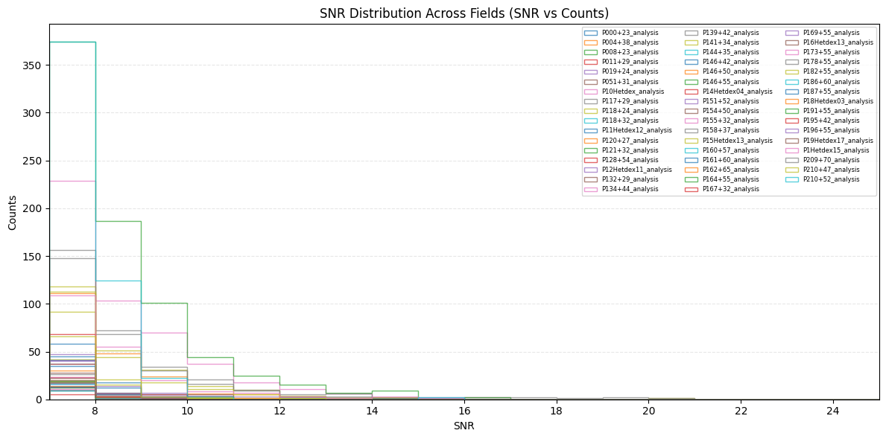
First batch of 100 fields

Slide 46
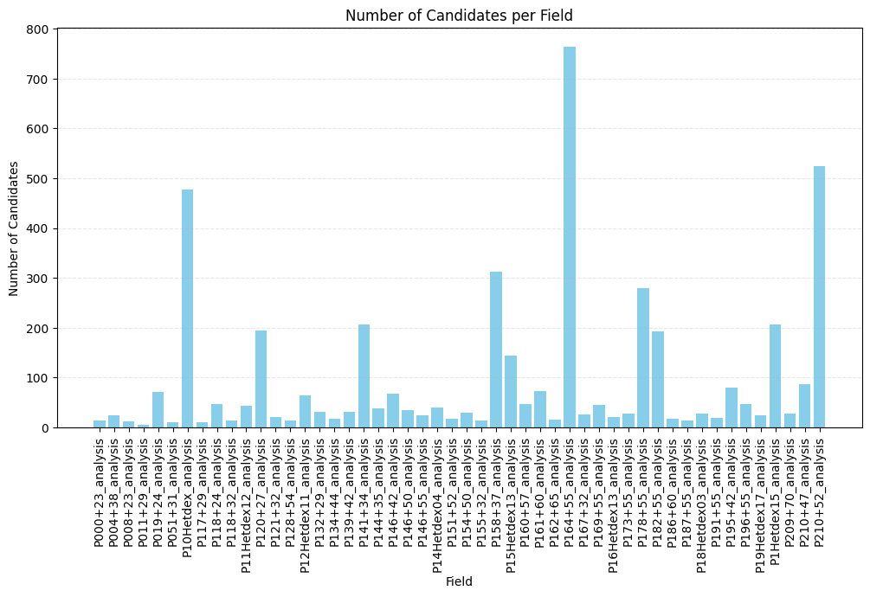
First batch of 100 fields

Slide 47
Long Period transients
Galactic transient
White Dwarf- M Dwarf Binaries
Neutron stars or Magnetars ??
Unknown or unidentified
Image credit: Daniëlle Futselaar
Image Credit: Jurik Peter
ASKAP J175534.9-252749.1, Dobie et al.(2024)
ASKAP J144834-685644, Anumarlapudi et al. (2025)
…
ILT J1101 +5521, de Ruiter et al. (2025)
GLEAM-X J0704-37, Hurley-Walker et al. (2024)
…
GLEAM-X J162759.5−523504.3, Hurley-Walker et al. (2022)
ASKAP J193505.1+214841.0, Caleb et al.(2024)
…
Image credit: NRAO
GCRT J1745-3009 (Hyman et al. (2005)
…
You can visit this very nice website created by Sam McSweeney for LPTs: https://lpt.mwa-image-plane.cloud.edu.au/published/galactic_view

Slide 48
LoTSS pointing vs Subtraction image
Film example of a LoTSS 8-hour observation
LoTSS 8-hour integration image
Credit: LoTSS DR2 catalog
Credit: Iris de Ruiter

Slide 49
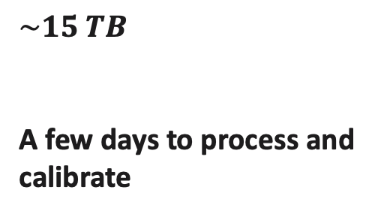
Image processing
Subtraction imaging
-
We take the calibrated data
We take a source sky model
$$\sim 15 TB$$
A few days to process and calibrate
Subtracted datasets calibrated
WSClean imager
From 15 TB to ~ 50 GB
A few hours to process and image
Subtracted images
> ${10}^{6}$ order , from petabytes to gigabytes → Data reduction factor is enormous !!

Slide 50
Image processing
PySE - LOFAR Transients Pipeline
Up to 8 sigma now!
Source extraction for radio-synthesis images
Fitting of identified sources with elliptical Gaussians
Force fit axis lengths to beam size
Created by Spreeuw (2010)

Slide 51
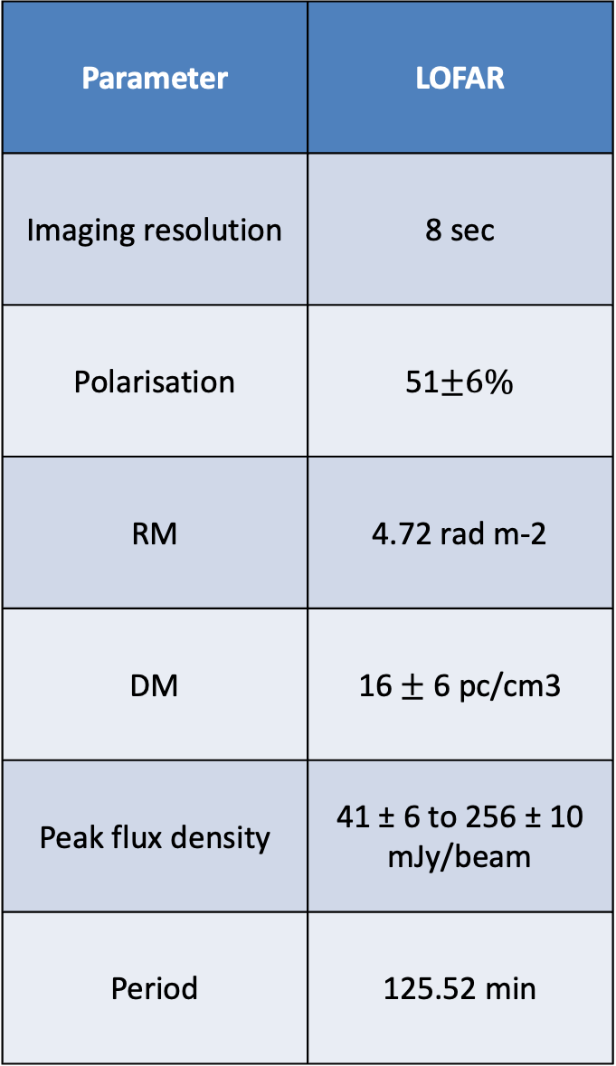
White Dwarf binary : ILT J1101 + 5521
The first LPT found with LOFAR with a counterpart !
Parameter | LOFAR
Imaging resolution | 8 sec
Polarisation | 51$±6\%$
RM | 4.72 rad m-2
DM | 16 $±$ 6 pc/cm3
Peak flux density | 41 ± 6 to 256 ± 10 mJy/beam
Period | 125.52 min
Credit: de Ruiter et al.(2024 & 2025)
9

Slide 52
White Dwarf binary : ILT J1101 + 5521
The first LPT found with LOFAR !
Low-frequency band sensitive to coherent radio-emission processes
Periodicity of ~125.5 minutes
Credit: de Ruiter et al.(2024)
)
9

Slide 53

LoTSS pointing vs Subtraction image
Film example of a LoTSS 8-hour observation
8hr observation data
For each Field
4.8 millions of pixels per image (size)
~100 000 sources in total
Credit: Iris de Ruiter
11

Slide 54
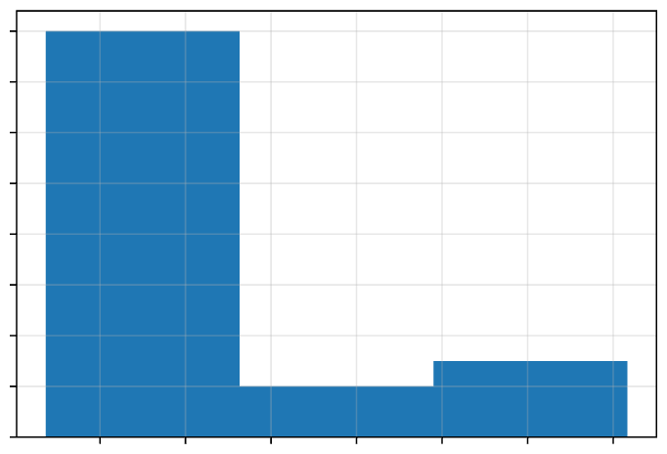



RA
DEC
Elevation
Center freq
Obs Time
Field information
= 34.3895 deg
= 51.2995 deg
= 58.7188 deg
= 143.65 MHz
= 2023-07-24T02:17:04.0
Sky distribution of sources
52.5
52.0 51.5
transients
No:of unique sources
Distance to sun
Distance to CasA, CygA,
Vir A, Tau A
No: of sources without match = 21
= 19
= 73.5731 deg
= [25.5238, 61.842] deg
= [112.2208, 47.8584] deg
Dec (deg)
51.0 50.5 50.0
32
33
34
RA (deg)
35
36
37
SNR distribution
No:of candidates per time slice
16 14 12 10
1.04
1.02
8 6 4 2 0
1.00
Counts
No:of candidates
0.98
0.96
7.25
7.50
7.75
8.00
8.25
8.50
8.75
0
500
1000
1500
2000
2500
3000
SNR
Timeslice
RMS distribution
RMS/Max cand SNR per time slice
8.75 8.50 8.25 8.00
500
400
18
16 14
Counts
300 200 100 0
RMS (mJy/beam)
Max SNR
12 10 8
7.75 7.50 7.25
8
10
12
14
16
18
0
500
1000
1500
2000
2500
3000
3500
RMS (mJy/beam)
Timeslice

Slide 55


Slide 56



Previous background and studies
Bachelor degree in Physics at the Universite des Antilles
Internship abroad on Radio Transients at API in Amsterdam
PhD on
Fast Radio Burst in Amsterdam
2019-2022
2022-2024
01/2024-03/2024
03/2024-08/2024
10/2024-Now
Master in Astrophysics at the Cote d’Azur University
Master thesis on Be stars at the Observatoire de Paris
2

Slide 57

Transients candidates for 8-s snapshot images
20

Slide 58


Transients candidates
20

Slide 59



Transients candidates
Lightcurve for all detections
20

Slide 60


Gaussian distribution of all the flux density measurements
12 outliers (above 3 sigma detections) !
20

Slide 61

LOFAR : Low Frequency Array
Low-frequency radio telescope: LoTSS --> the ongoing LOFAR HBA of 120-168MHz wide-area survey.
Stations are distributed all over the Netherlands and Europe
Image the whole northern sky between 10 and 240 MHz.
Credit: astron.nl
10

Slide 62


Radio window
LOFAR range observations
Credit: NASA/IPAC
3

Slide 63

Particular settings
No clean iterations
Find an emission not substracted out
Only shows sources with significantly different flux density
Uniform noise background
2

Slide 64

Particular settings : No iterations
=
Iteration proces
Deconvolution of the dirty images
No clean iterations
Thousands iterations
Credit : Iris de Ruiter
Computation time reduce by 81 % !
Only shows sources with significantly different flux density
Uniform background noise
2

