Slide 1



When Satellites Speak Loudly:
Polarized Starlink Emission Below 100 MHz Seen by NenuFAR
X. Zhang + the NenuFAR team
LIRA-CNRS, Observatoire de Paris
LOFAR family meeting
Paris | 2025-09-25

Slide 2
Satellites are known sources of RFI
GNSS satellites cause RFI bursts in ASKAP observations

Slide 3
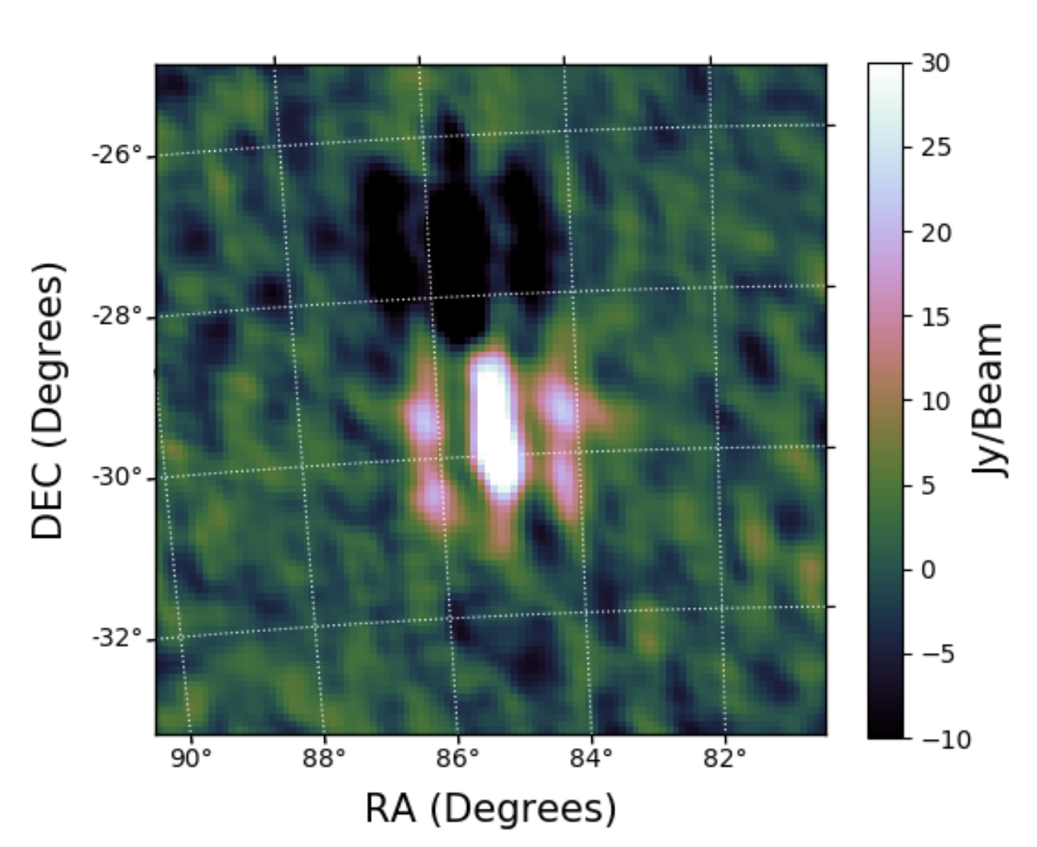
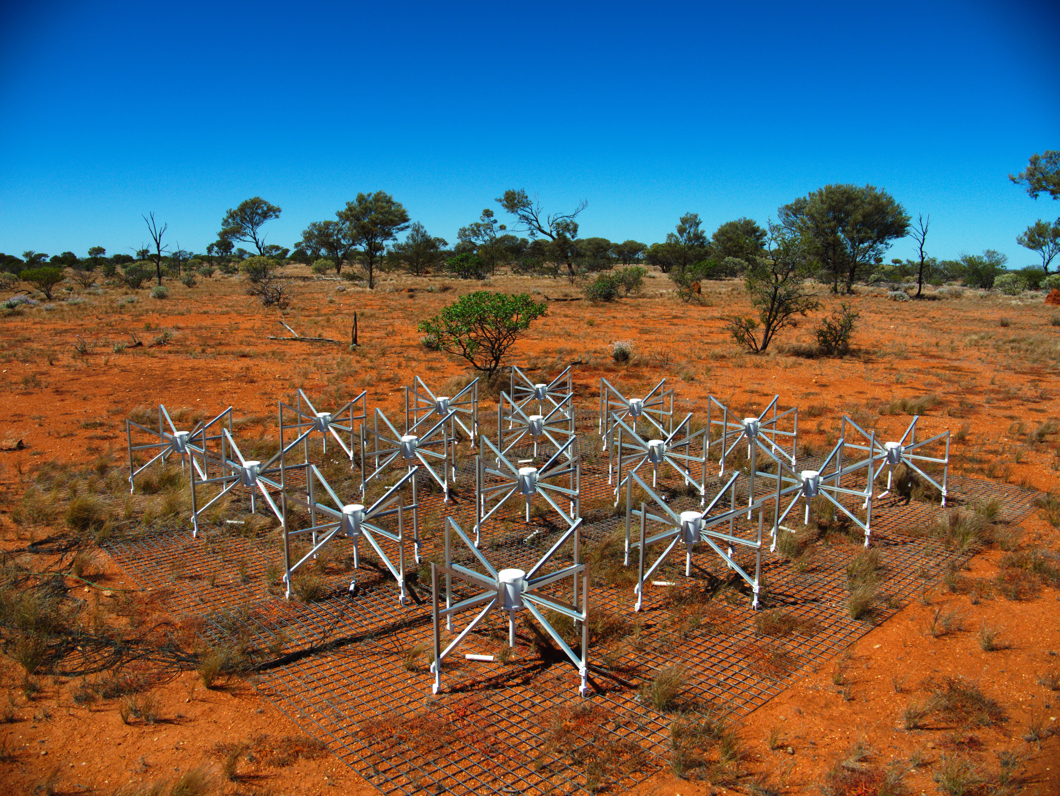
LEO satellites: reflecting ground-based RFI
LEO satellites reflecting FM radio signals, seen by the MWA at SKA-Low site.
Image credit: N. Hurley-Walker
Prabu, Steve, P. Hancock, X. Zhang, and Steven J. Tingay. "A low-frequency blind survey of the low Earth orbit environment using non-coherent passive radar with the Murchison widefield array." Publications of the Astronomical Society of Australia 37 (2020): e052.

Slide 4
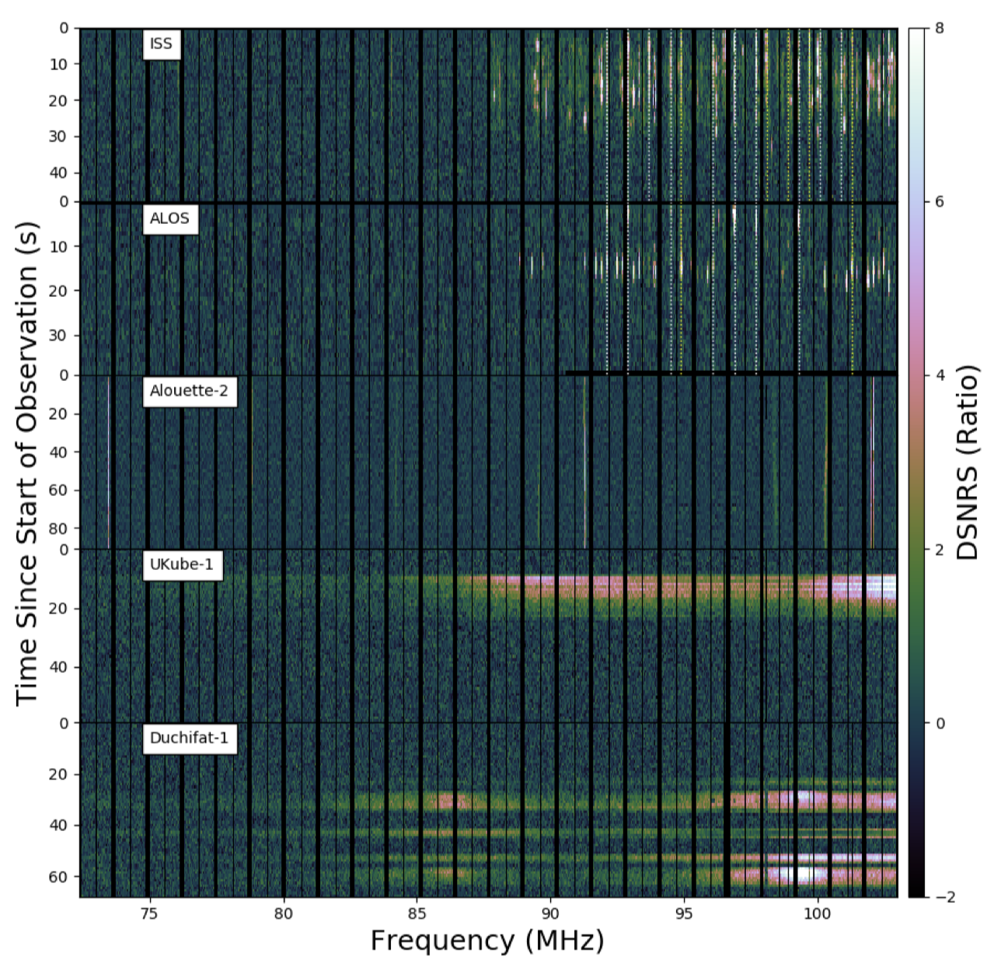
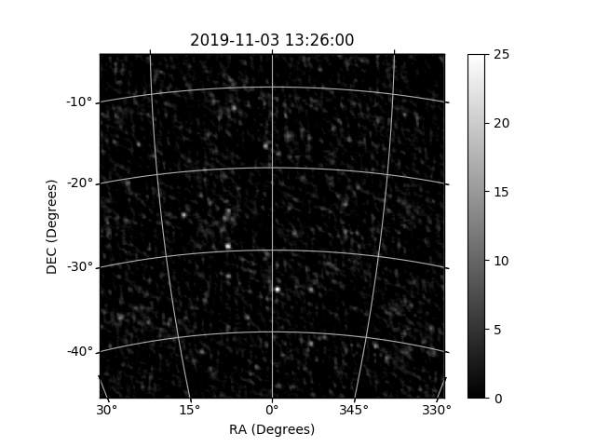
Cubesats can have out-of-band emission
Satellite RFI as seen by the MWA
Prabu, Steve, Paul J. Hancock, Xiang Zhang, and Steven J. Tingay. "The development of non-coherent passive radar techniques for space situational awareness with the Murchison Widefield Array." Publications of the Astronomical Society of Australia 37 (2020): e010.

Slide 5
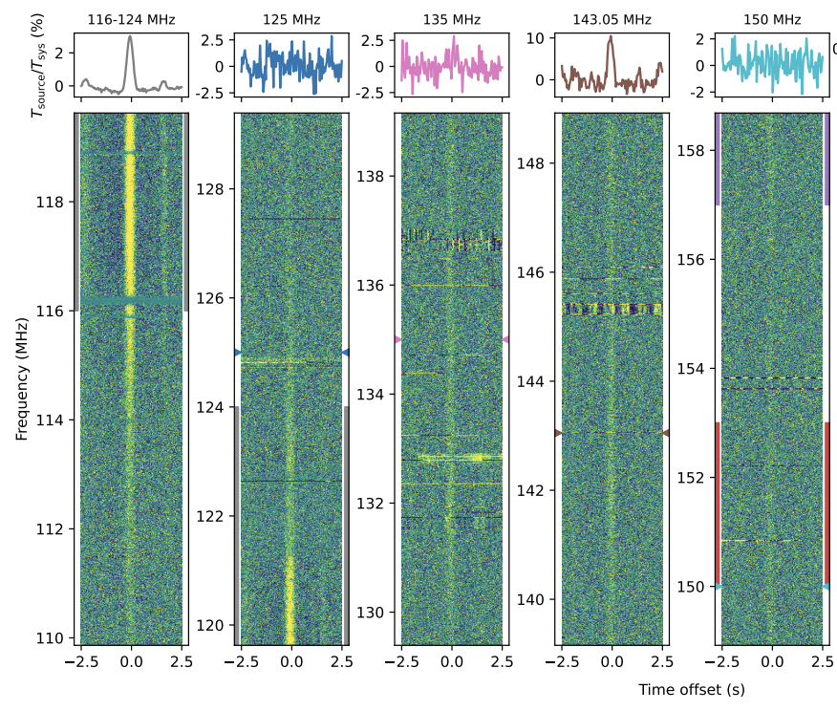
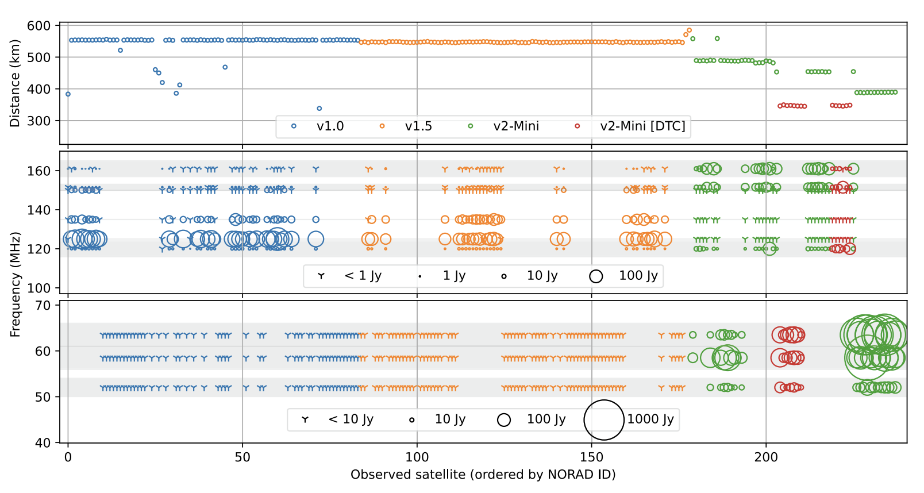
And then, the mega-constellations
LOFAR work: broadband emission from Starlink; mini-v2 satellites brighter than original ones
Di Vruno, F., Winkel, B., Bassa, C. G., Józsa, G. I. G., Brentjens, M. A., Jessner, A., & Garrington, S. (2023). Unintended electromagnetic radiation from Starlink satellites detected with LOFAR between 110 and 188 MHz. Astronomy & Astrophysics, 676, A75.
Bassa, C. G., F. Di Vruno, B. Winkel, G. I. G. Józsa, M. A. Brentjens, and X. Zhang. "Bright unintended electromagnetic radiation from second-generation Starlink satellites." Astronomy & Astrophysics 689 (2024): L10.

Slide 6
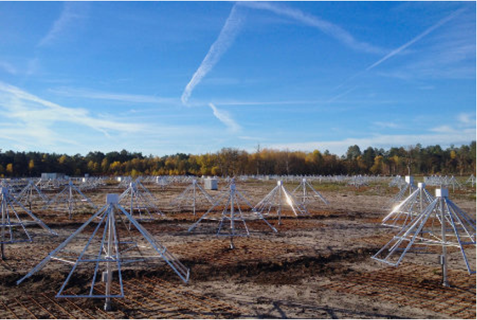
NenuFAR
Dense core (400 m) + remote antennas (~3 km)
Low-frequency (10 - 88 MHz)
High sensitivity @ 20-30 MHz
Low spatial resolution (1 deg @ 20 MHz)

Slide 7
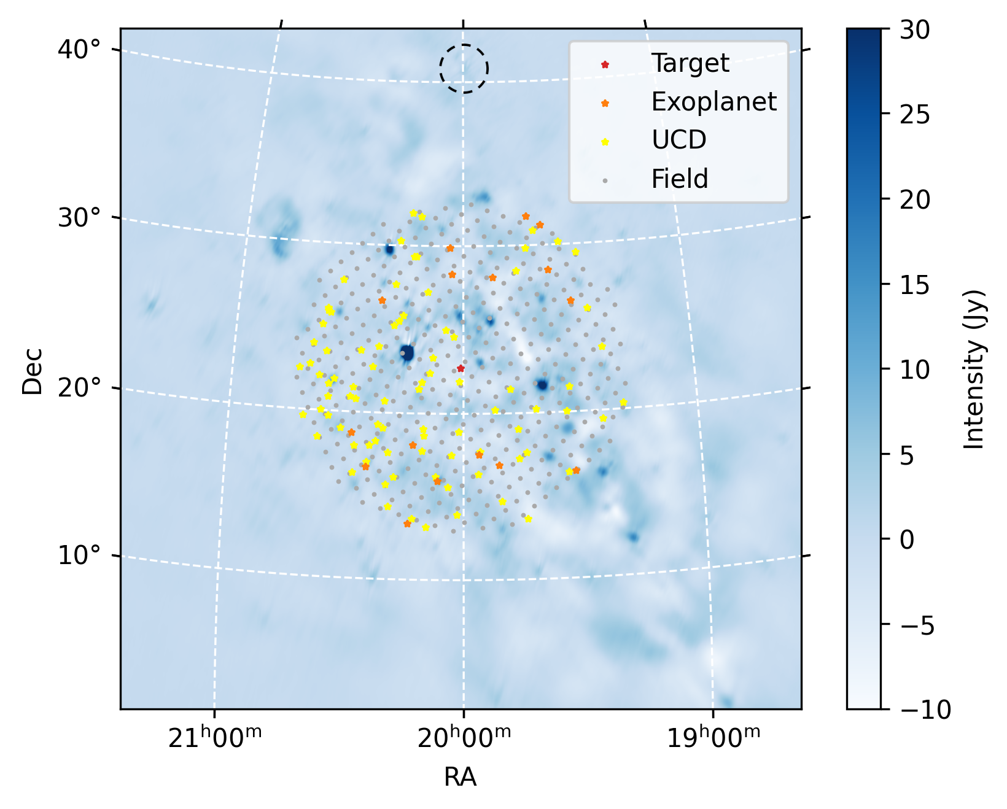
Dynamic spectra, multiple directions
500 “beams” within the FoV!
Primary target
Exoplanets (~20)
Brown Dwarfs (~80)
Field grids (~400, 1 deg separation)

Slide 8
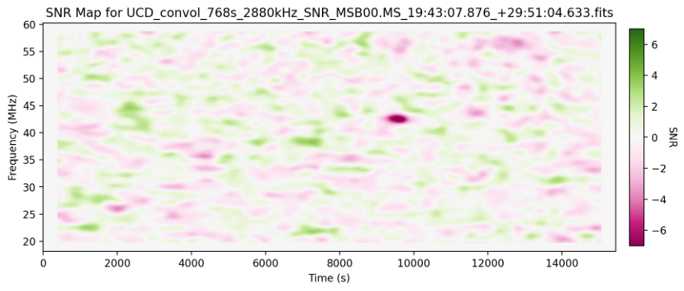

Finding transients in dynamic spectra
Convolution: multiple resolution to search for transients
Time: 16, 32, … 4096 seconds Freq: 0.24, 0.48, … 15.36 MHz
Verification: Re-image the bursting time/freq range.

Slide 9
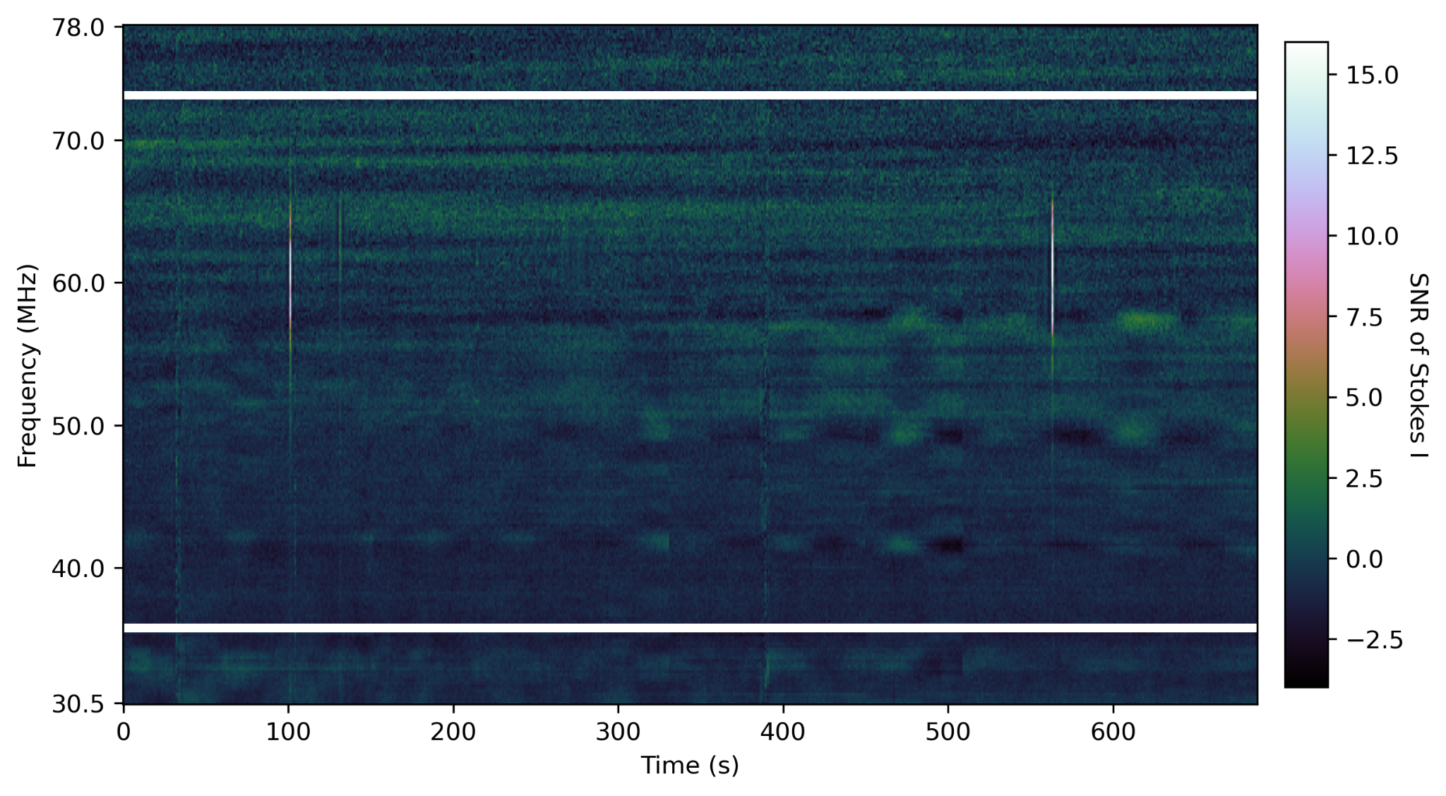
Weird bursts popping up…
3 bursts in 8 minutes; maybe not aircrafts?

Slide 10
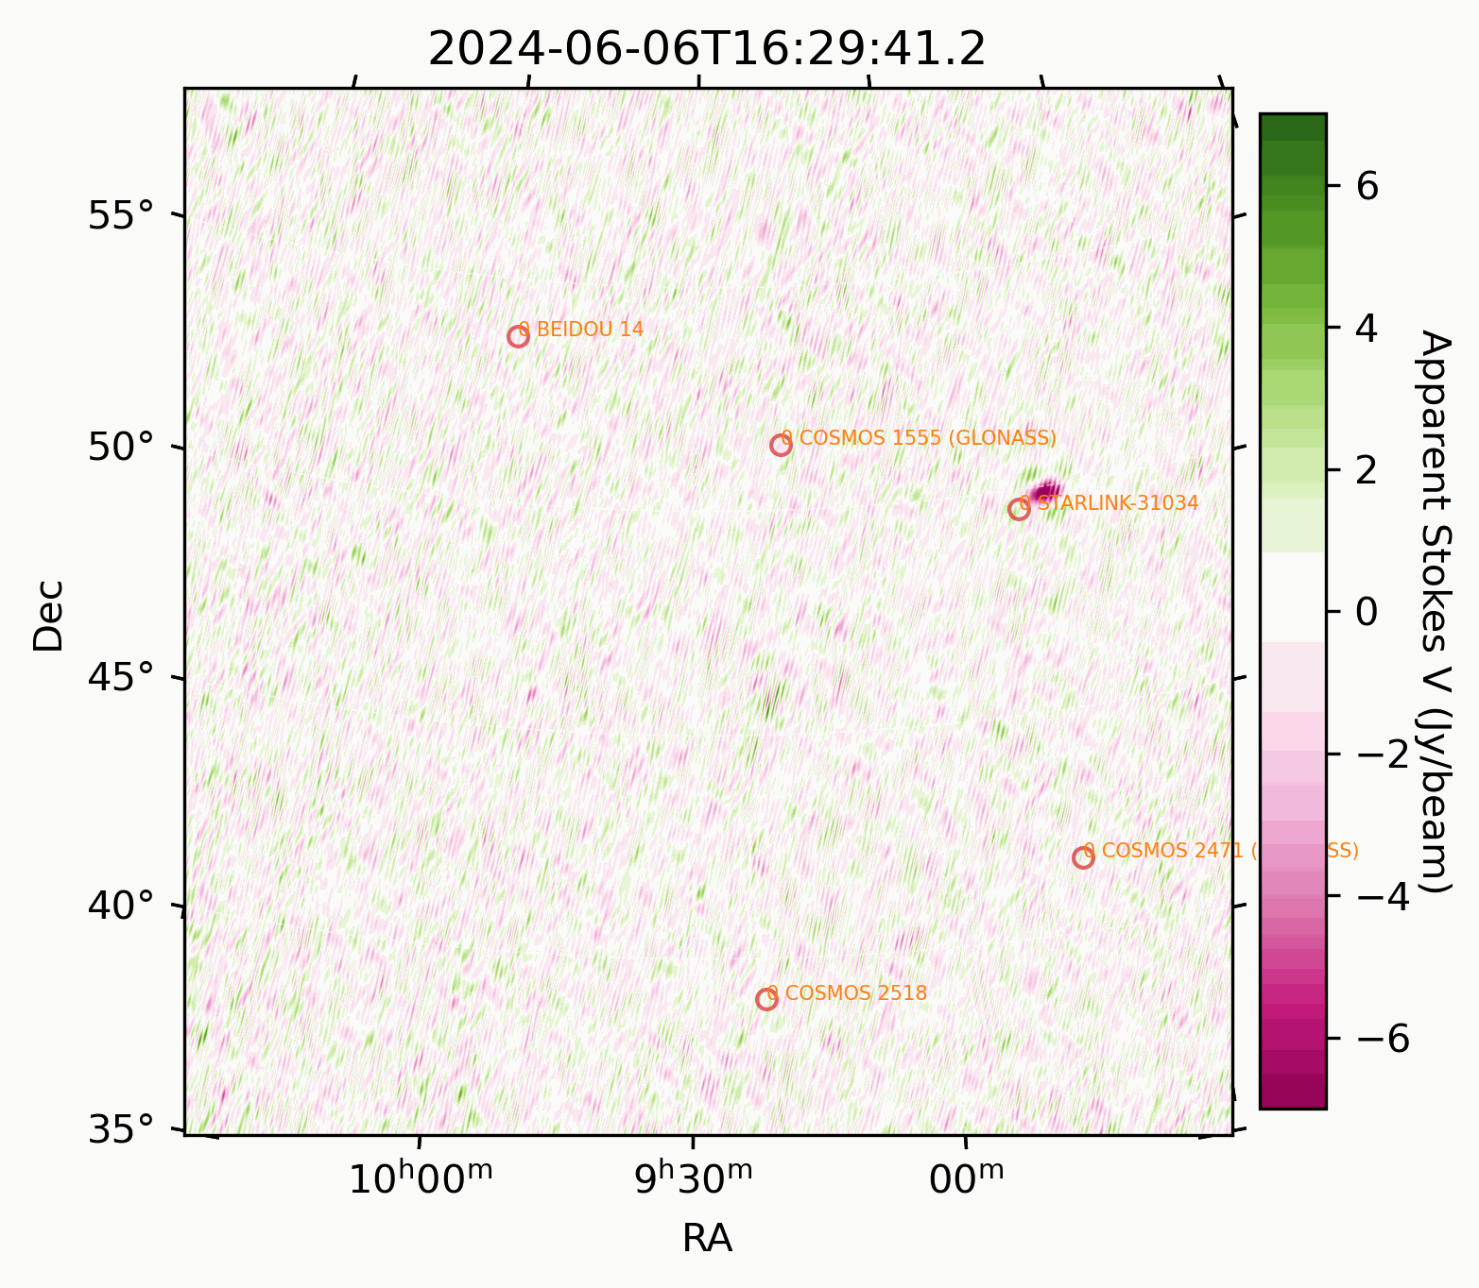
What are these bursts?
Making 1 sec Stokes V images
Using TLE to predict satellite locations
Finding the baddies

Slide 11
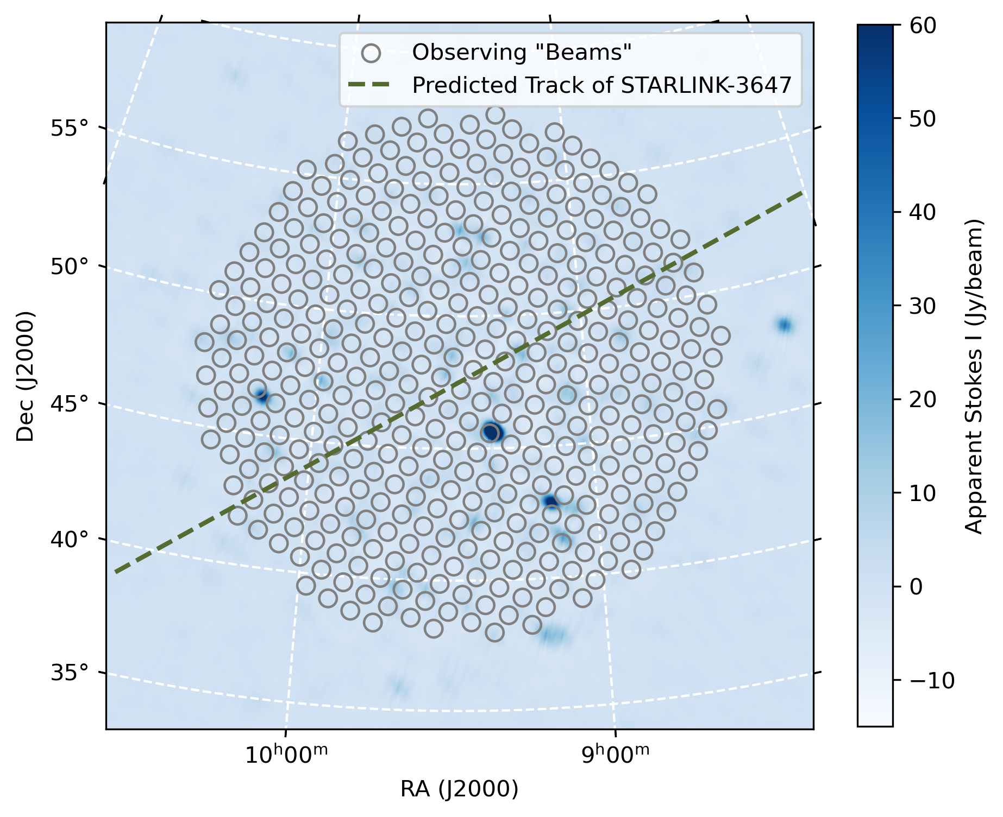
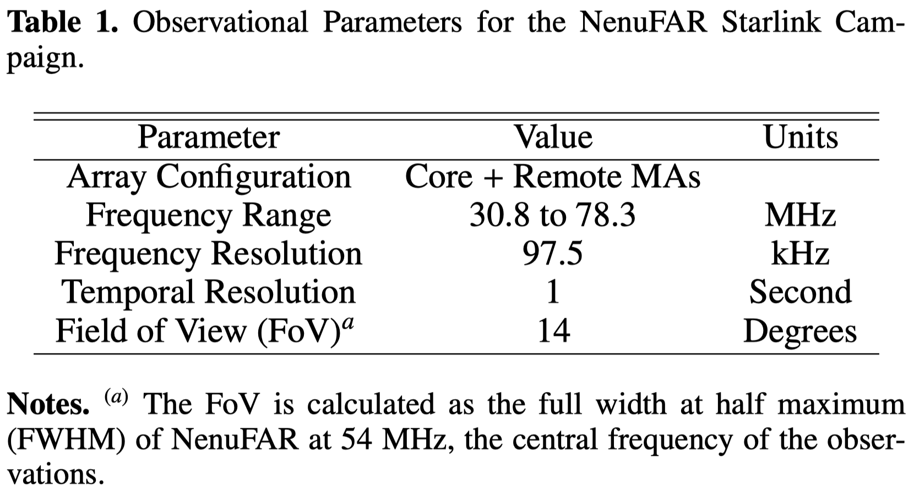
Starlink campaign with NenuFAR
40-hour observation during June-July 2024

Slide 12
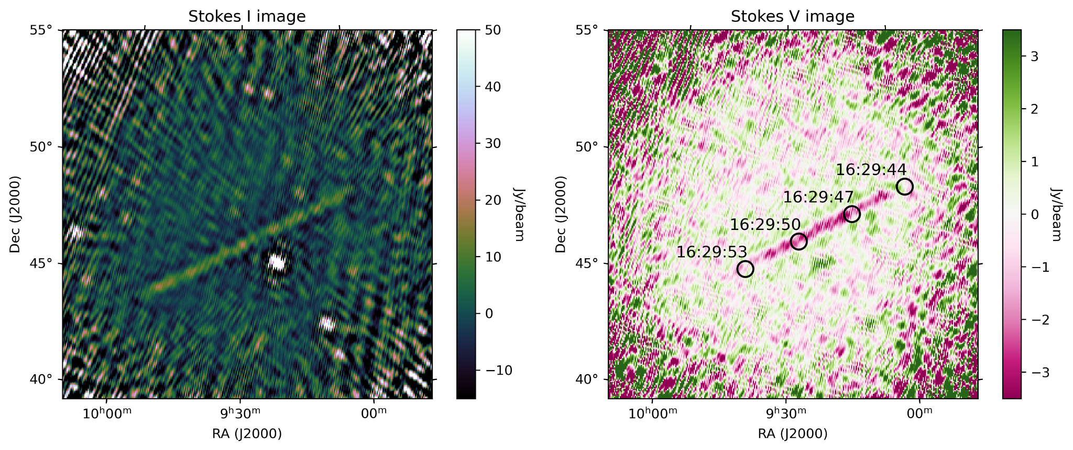
Starlink leaving trails in Stokes I and V
55-65 MHz, 15 sec integration, single satellite

Slide 13
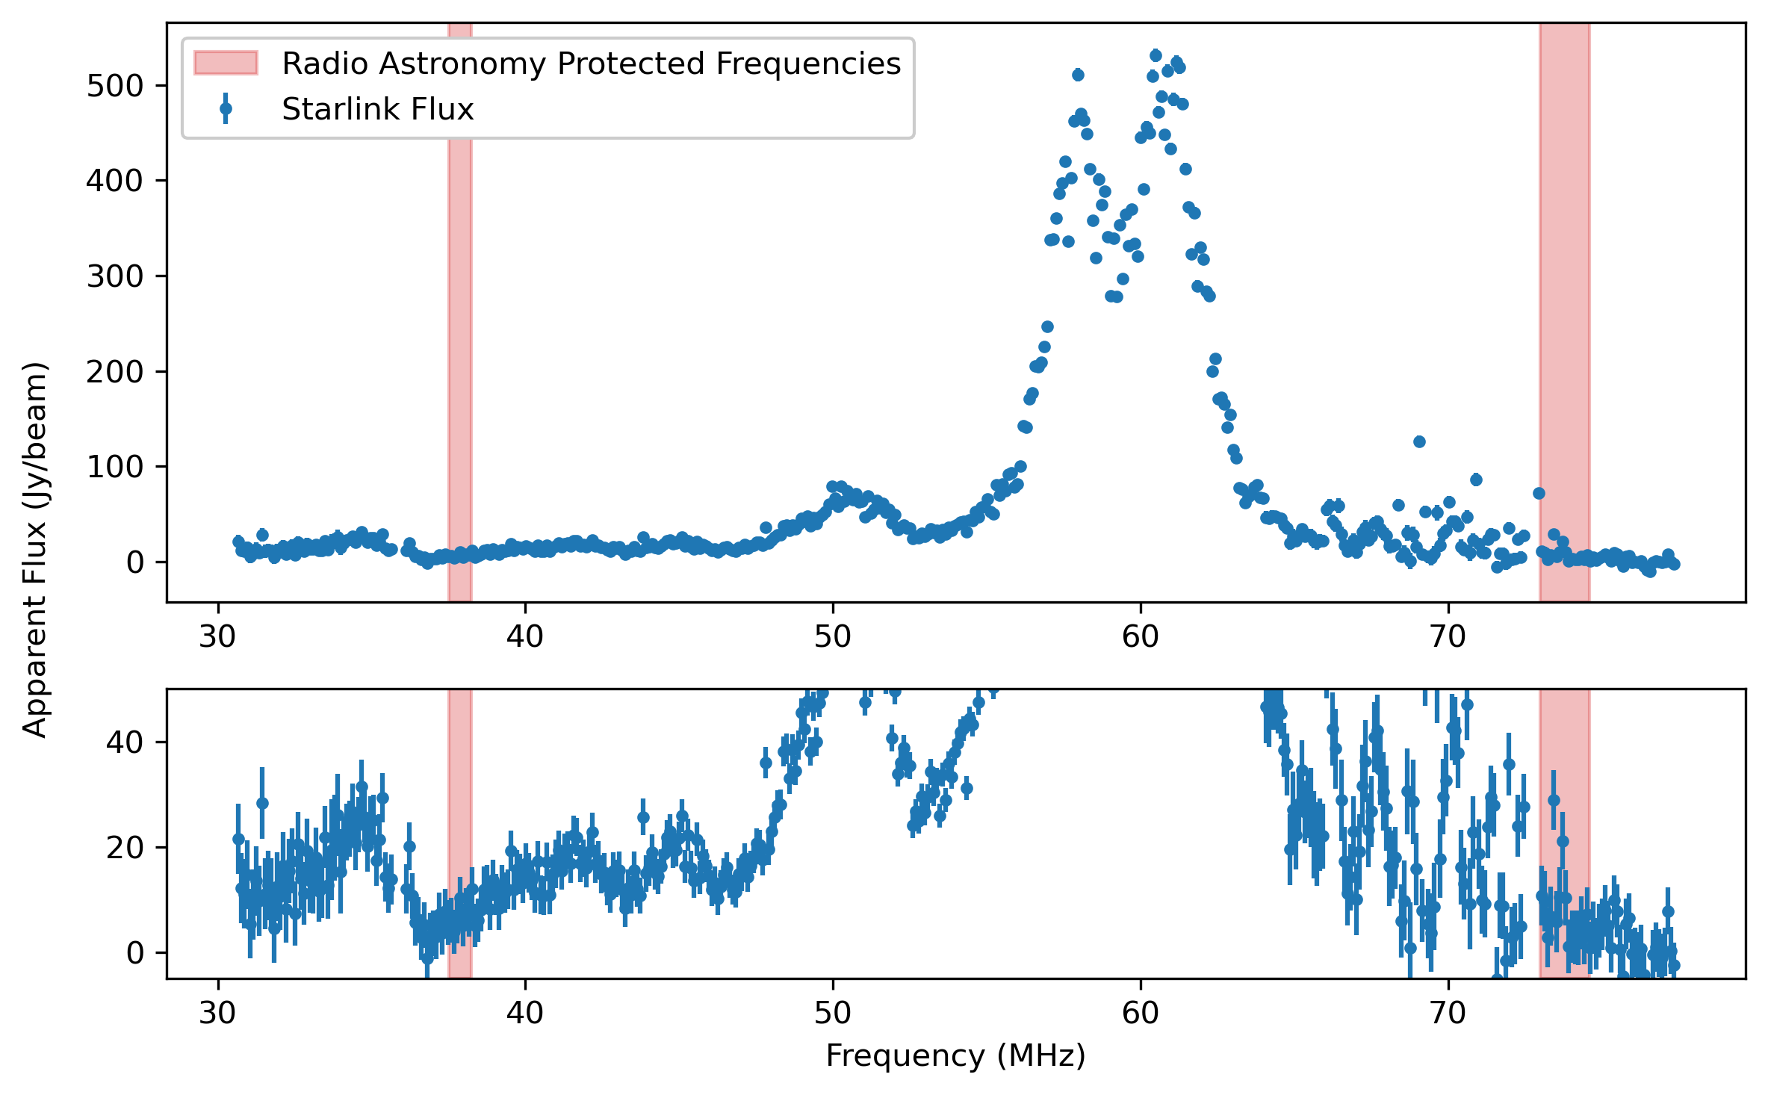
A potential threat to radio astronomy protected frequencies?
Peaking between 55-65 MHz
Radio astronomy protected frequencies
37.5 - 38.25 MHz
73.0 - 74.6 MHz

Slide 14
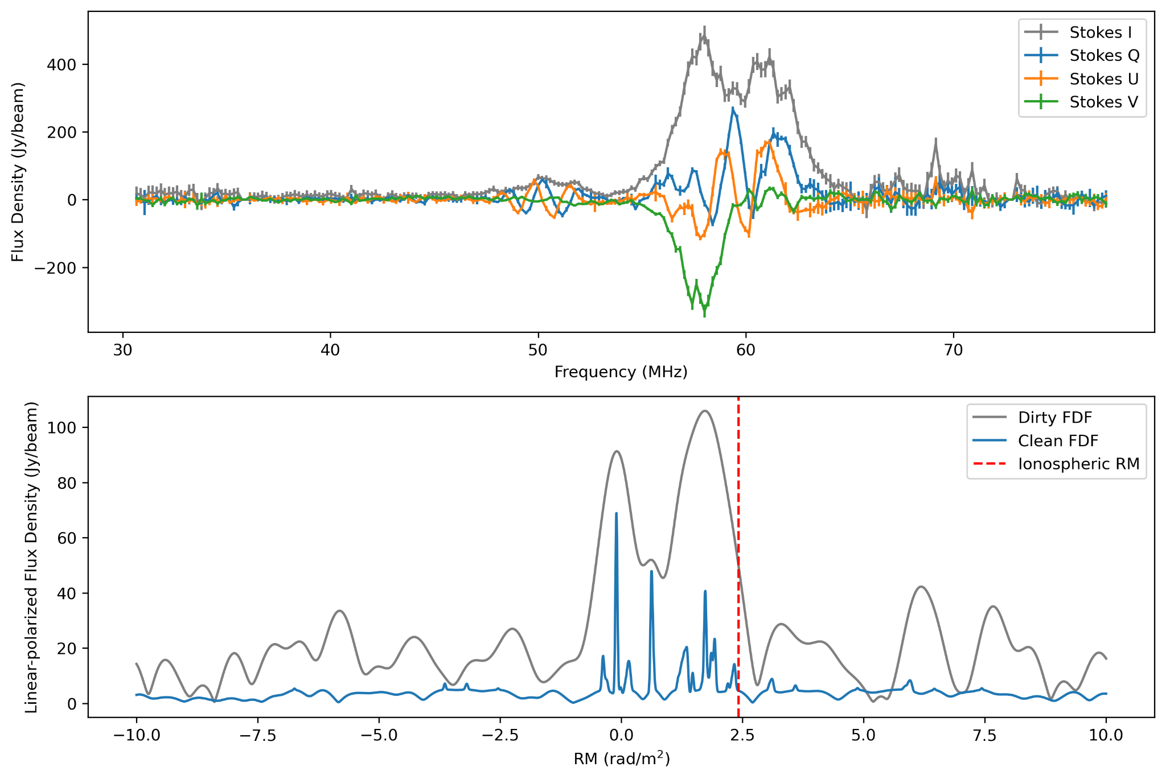
A quick polarisation analysis
68% circularly polarised
22% linearly polarised
Polarimetry properties change with geometry

Slide 15
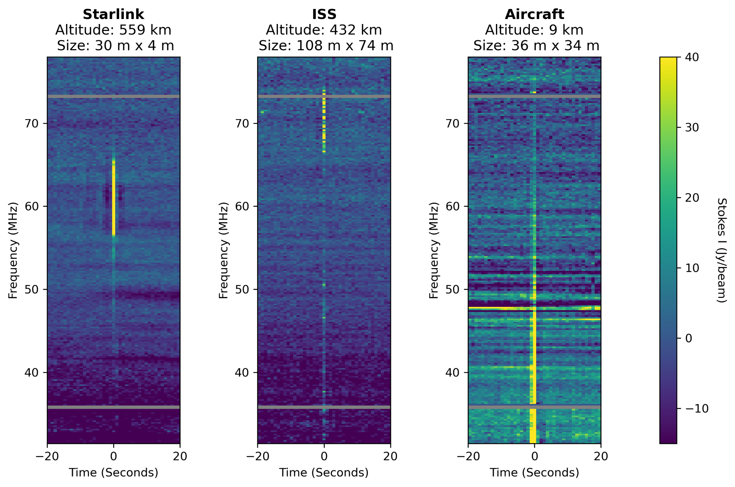
Origin of the radiation: reflection?
Astrophysical?
Sun, Galactic plane, A-team sources
Ground-based RFI?
if radiation == “reflection”:
bigger = brighter
lower = brighter

Slide 16
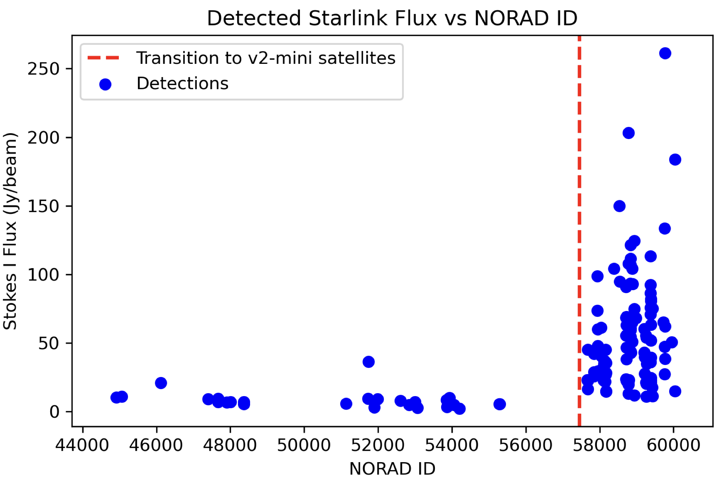
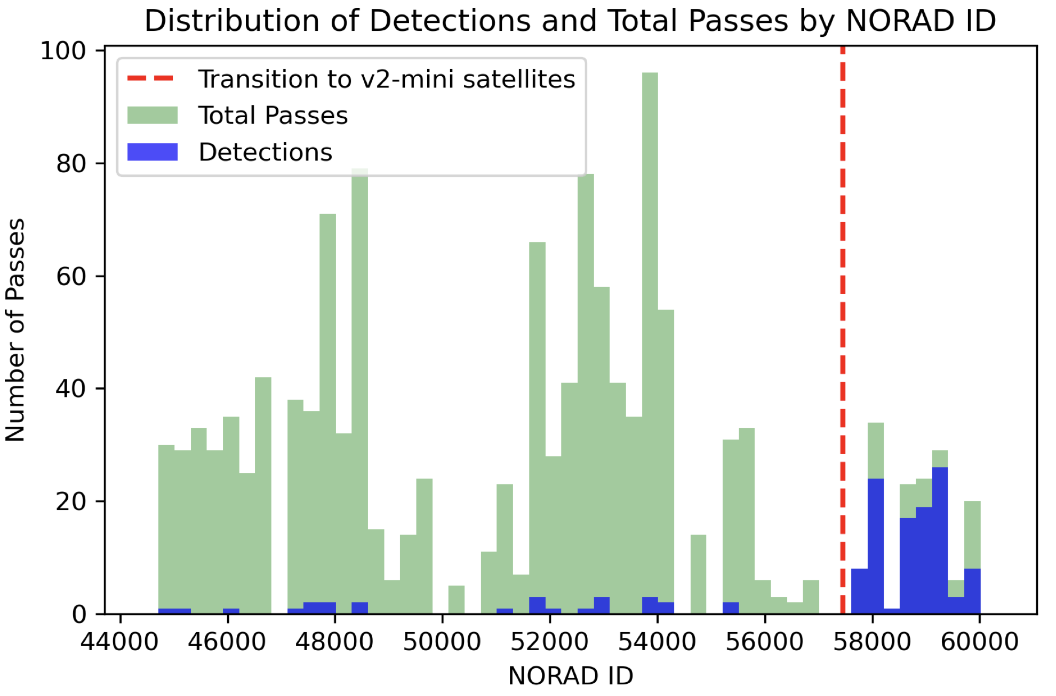
Origin of the radiation: intrinsic emission?
New satellites much brighter than old ones!

Slide 17
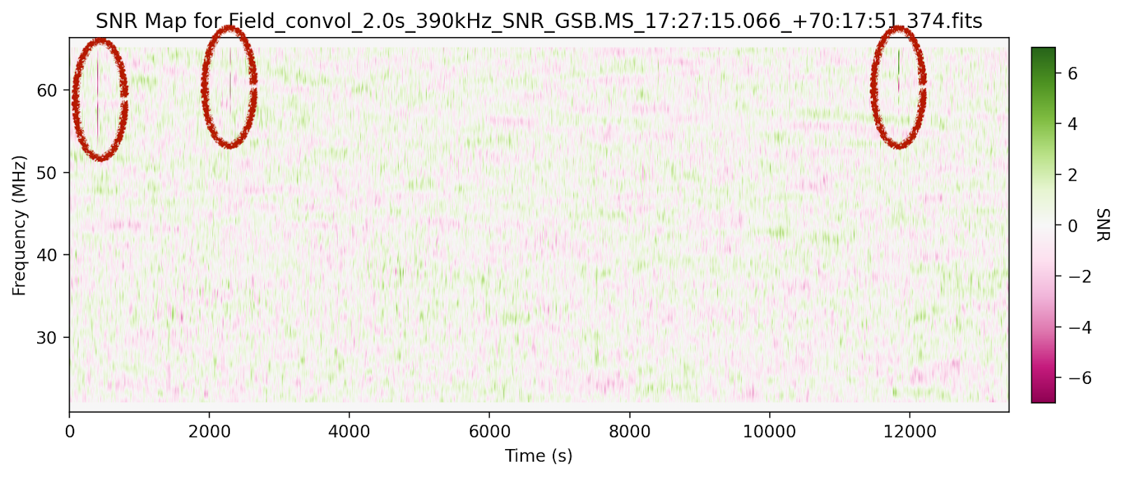
Recent updates – The Sun is playing a role
Summer night – Satellites lit by the Sun – 95% transients caused by Starlink
Winter night – Satellites in Earth’s shadow – No Starlink radiation detected

Slide 18
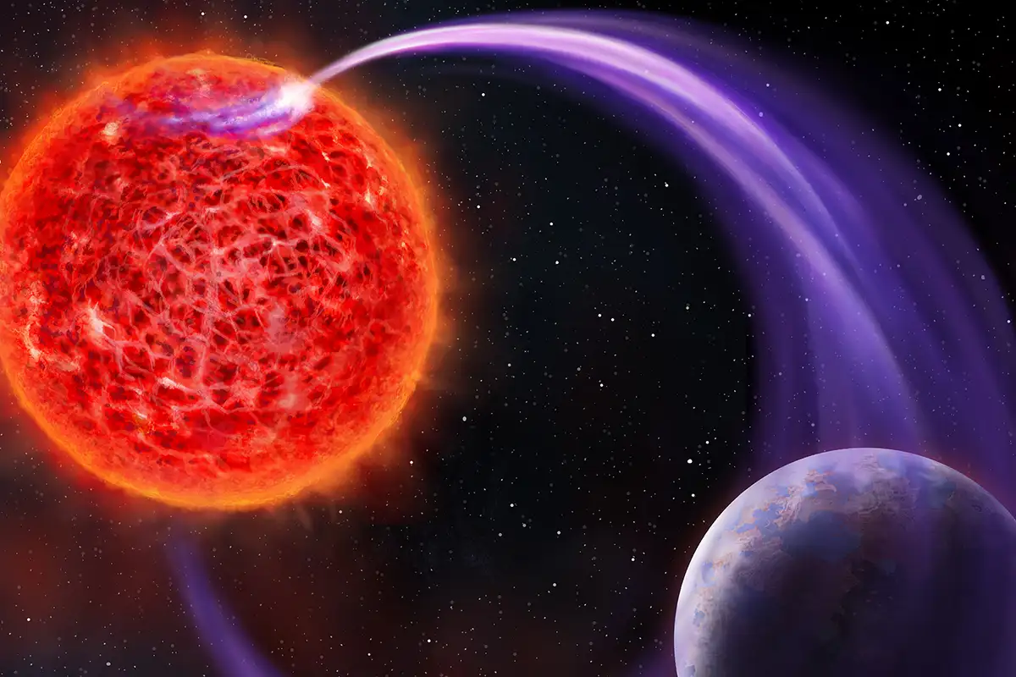
How does it affect low-frequency astronomy?
Transients (exoplanet, star, pulsar etc.)
Need to verify detected bursts
Continuum (survey, deep field etc.)
“Satellite Metrewave Foreground”
Polarimetry, Direction-dependent calibration
Artefacts after calibration
Image credit: Danielle Futselaar

Slide 19
Potential mitigation strategy
If we remove 1.5% of data with ~1000 satellites, how much data we need to remove with ~36000 more satellites?
Temporary solution:
Removing affected data
1 detection per 15 min for 14 deg FoV
Removing 1.5% of data
Long-term solution: Collaboration with industry?
SKAO is in collaboration with SpaceX
Regulations?
See Emma’s talk

Slide 20

Take-away messages
Broadband emission from Starlink satellites detected below 100 MHz
Emission peaking between 55-65 MHz, potentially contaminating radio astronomy protected frequencies
Emission is both linearly and circularly polarised
New satellites much brighter than old ones
Temporary mitigating strategy: removing affected data. Long-term strategy: collaborating with industry + regulations

