Slide 1


b.barkus@herts.ac.uk
From Radio to Optical: Streamlining Source Identification in LoTSS DR3
LOFAR Family Meeting Paris 2025
Bonny Barkus
Lara Alegre
Martin Hardcastle

Slide 2
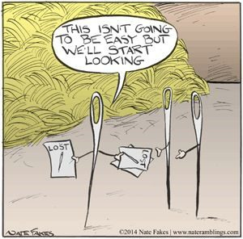
Background
Largest problem for radio continuum surveys
Matching radio sources to optical or IR counterparts
Important:
Properties - redshift, size, luminosity
Comprehensive catalogues
LoTSS DR2 cross-matching was a combination of (Williams+ 2019, Hardcastle+ 2023):
Statistical methods - likelihood ratio
Visual inspection – LGZ
Automated– reduce time, manual input, chance of errors
Page 2
Notes:
One of the largest problems for radio continuum surveys is matching radio sources to their optical or IR counterparts.
Why is this so important? Why do we need it? Because it gives us different properties of the sources such as redshift, size, and luminosity. This creates comprehensive catalogues, 3D maps of the Universe.
In LotSS DR2 the Xmatching was done using a combination of statistical methods (through the likelihood ratio) and visual inspection (through LGZ). All of this took about 5 years in total to come together, and when compared to the size of LoTSS DR3 we don't have 10 to 15 years to wait for these methods to work again.
We need more efficient automated procedures to reduce time, the amount of manual input, and the chance of human error.

Slide 3
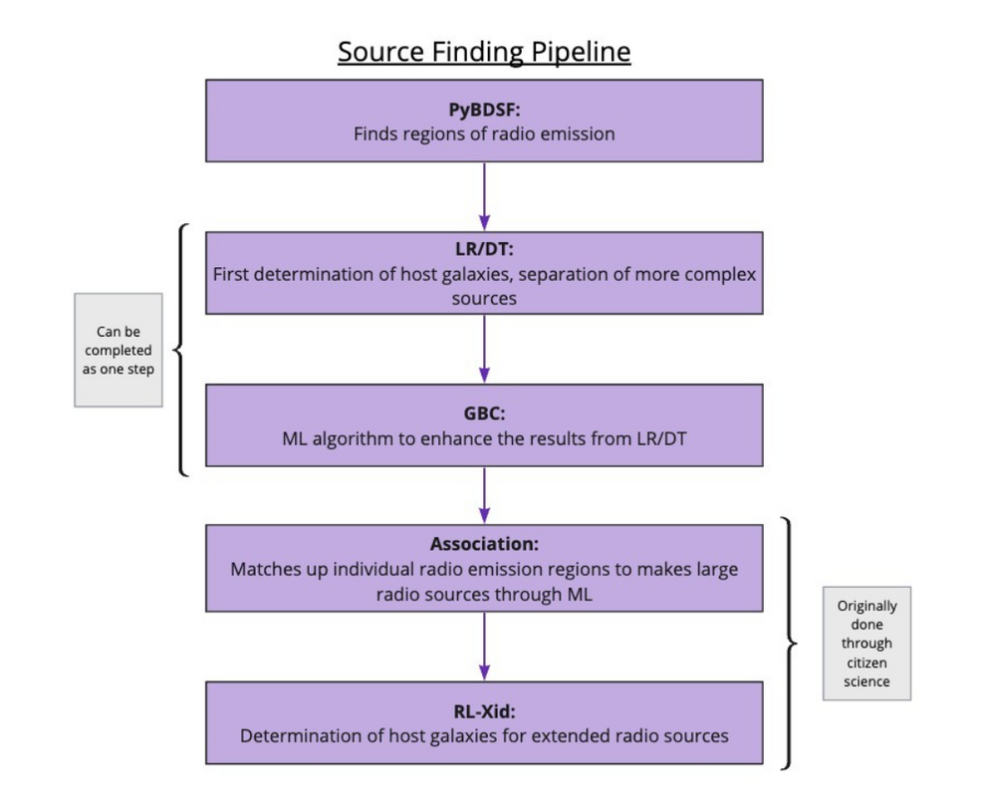
To source identification
Five (ish) steps to source identification
Statistical and machine learning
Radio source finding
Point source cross matching
Gradient boosting classifier
Filtering
Partially automated
Visual inspection
Further filtering
Association
Source identification
Page 3
Notes:
Going to talk through the pipeline used and adapted from LoTSS DR2.
There are five main steps to this process: radio source finding, point source crossmatching, and a gradient booster refining and filtering process - all of which are statistical or machine learning processes and are already partially automated. Then there are those steps which were main done by visual inspection which were further filtering, and association of sources, and source identification of more complex and extended sources.
Each of these steps are going to be discussed in detail.

Slide 4
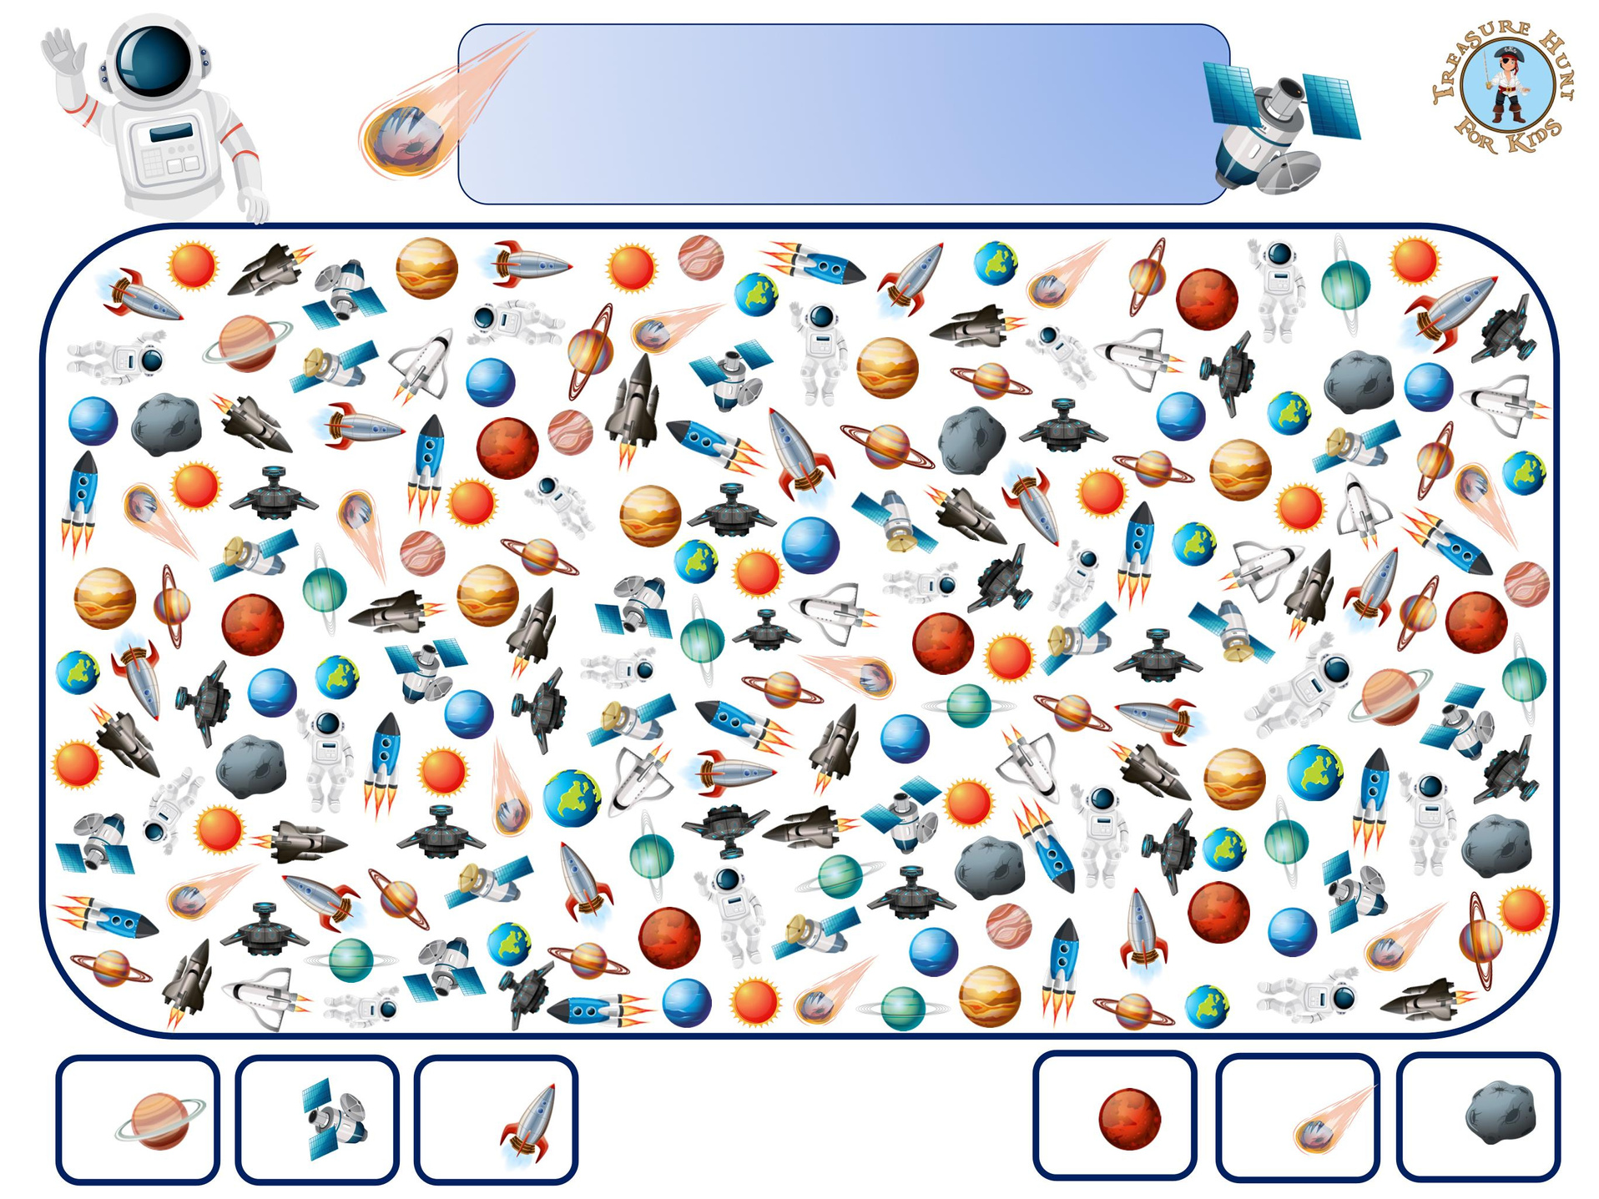
Source Finding
Search& find
Space 7
2
9
14
7
10
6
Page 4
2
9
14
10
6
Notes:
First we need to find the radio sources, other wise we cannot match them to any other multi wavelength data. This has been done with PyBDSF and for LoTSS DR2 we have about ~4million sources. Work has been done to improve PyBDSF by Catherine Hale and Tim Shimwell (Shimwell+ 2023), and we have re-run it with the updated version, which detects fainter sources better and we now get ~7million sources over the LoTSS DR2 area.
Combine this greater detection rate with the larger area for DR3 and hopefully you get an idea of the size of the problem.

Slide 5
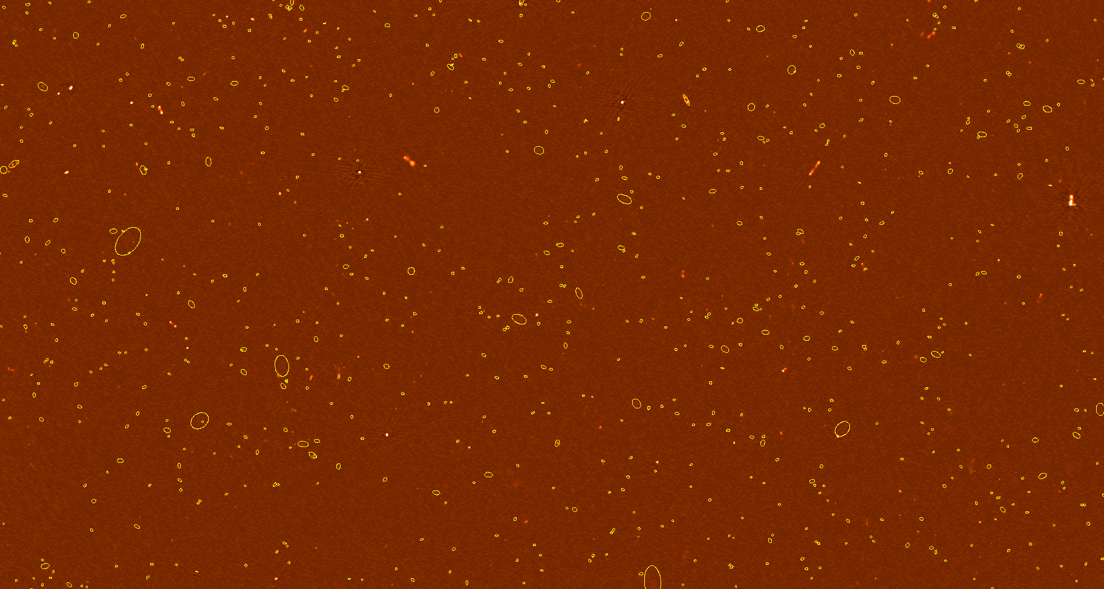
Source Finding
PyBDSF for radio sources
LoTSS DR2 ~4 million sources
Hale, C. and Shimwell, T. adjusted for fainter sources (Shimwell+ 2023)
Re-run LoTSS DR2 ~7 million sources
Batch run
Whole survey
Collates final catalogue
Page 5
Notes:
The image here highlights just the newer regions found in a small patch of area.
We have also set this up to batch run, which means that with a single command you can do the entirety of a survey, and collate the final outputs catalogue.

Slide 6
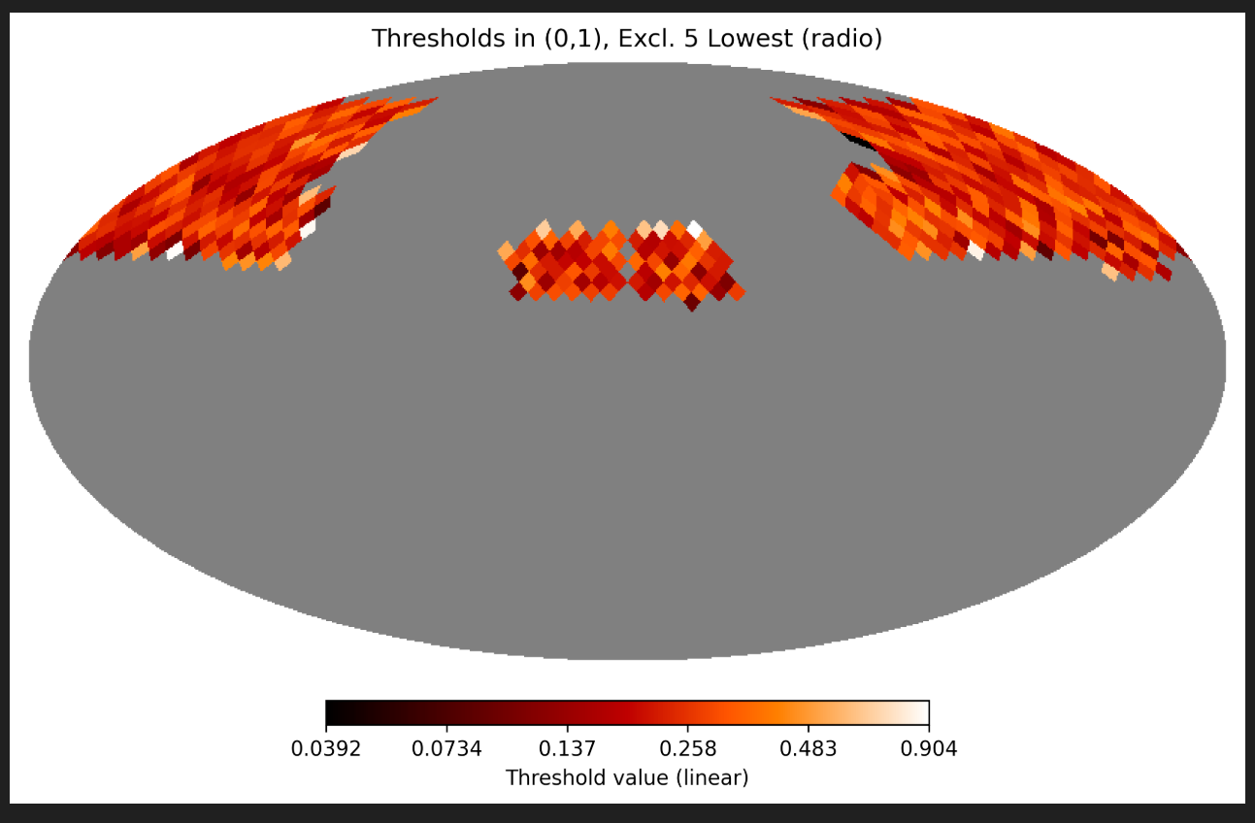
Healpix
Dividing the sky into healpix regions
Reproducibility
Manageable resources
Computing
Time
Systematic/regular determination of outcomes
Easier to repeat whole survey
Images of LoTSS DR2 sky area
Page 6
Notes:
Started by healpix
break the sky into smaller chunks
makes it more manageable resource wise, and systematic/regular determination for reproducibility - in case you want to repeat doing the whole sky!
One of the main steps we took was to divide the sky into healpix areas. This makes the whole process more manageable resource wise (computing and time), and systematic (or for regular) determination of outcomes for reproducibility - in case you want to repeat doing the whole survey a few times (which I have done).
The two images on the right will get explained in more detail in a couple of slides. They show the break down of areas of LoTSS DR2 into healpix regions.

Slide 7


Likelihood Ratio (LR)
Statistical method - probability that an optical/IR source is a likely counterpart to a radio source
Parameters:
Distance
Magnitude
Colour
Works very well for point sources
Williams+ 2019
Required input of sky area
Healpix areas inputted instead
smaller sky areas
automated
no manual input
Williams+ 2019
Page 7
Notes:
Next step is the Likelihood ratio, this is a statistical method which determine a probability that an optical/IR source is a counterpart to a radio source.
It takes distance, magnitude, and colour as parameters. It works very well for point sources, less so for larger or more complex sources.
Previously it required inputs of the sky area to be calculated. We have automated and batched it up so that it will run on healpix areas areas instead. This makes for smaller sky areas, so better uses computing resources, and doesn't need manual inputs any longer.

Slide 8
Thresholds
Healpix shaded by threshold, above which an optical/IR source is a possible counterpart
No gradient
No north/south divide
Average threshold over all healpix areas
Missing areas
RA = 0
Page 8
Notes:
We have looked at the outputs from the healpix areas. For example the image shows the healpix areas shaded by the threshold used in each area, above which an optical/IR source is selected as a potential counterpart.
It is clear that there are no gradients, either across the sky or as a north/south divide. Therefore we have set the code up to use a single average threshold for all healpixs.
This therefore gives us parameters for for missing HP areas, and those at the RA = 0 line where there is a wrap around issue.
We can now re-run the whole of the radio and gaussian catalogues in an afternoon.

Slide 9
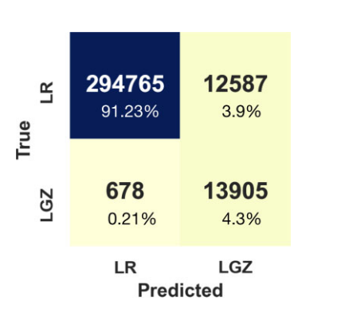
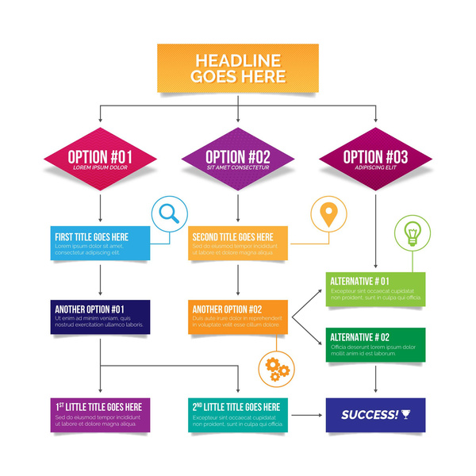
Gradient boosting classifier
Machine learning model (Alegre+ 2022)
Features from radio sources and nearby neighbours
sizes, fluxes, and LR values
Probability automatically cross-matched
Decision Tree
Alegre+ 2022
Flags sources for host identification or further investigation
complex, blends, artefact
Initial catalogue of simple sources
Page 9
Notes:
To support the LR we use a ML model consisting of a gradient boosting classifier that uses various radio parameters of the radio sources and the nearby neighbour information as features. More specifically, it takes information from the PyBDSF sources and Gaussians, including sizes, fluxes, and LR values from the cross-matching process. At the end, the model outputs the probability that a PyBDSF source can be automatically cross-matched with LR or otherwise requires other methods for cross-matching.
Both of these feed into the decision tree, which is a flowchart of choices leading to sources being flagged as to whether they can have their hosts identified now or need further investigation. For example, it is a more complex source, or a blend or artefact.
The thing to note is that this works really well on simple point sources, and we can have at this stage a catalogue of simple sources.
This removes a large portion of sources, but it is the ones where this doesn't work that the fun comes in.

Slide 10
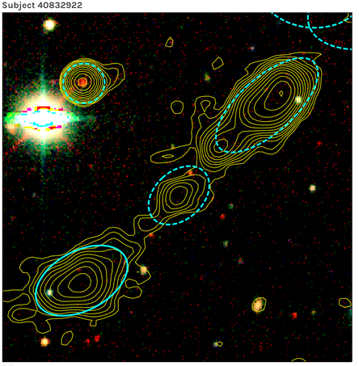
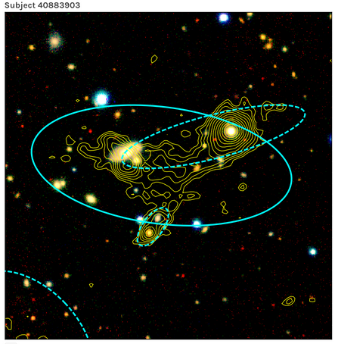
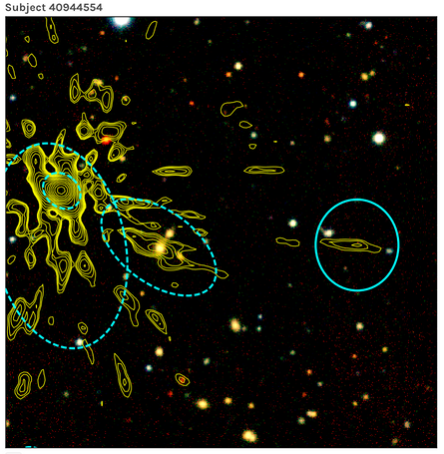
Complex sources
Regions with higher complexity
Associations
Blends
Artefacts
Visual inspection takes time!
Association
Blend
Artefact
Page 10
LOFAR Galaxy Zoo
Notes:
At this point the decision tree has flagged out regions with a higher complexity. Such as those that need multiple gaussians to be associated into a single radio source. Bottom left is a single source and those three ellipses need to be associated to that one source rather than considered individual regions.
We also need to identify blends; these are multiple radio sources which have been detected as a single source like the centre image. Or even artefacts, which are just small blobs of radio emission from a nearby bright source, such as the image in the bottom right.
All of these and the identification of the optical hosts was determined through citizen science, LGZ for LoTSS, and that took about 5 years for DR2. That does not scale: You do not want to be waiting 10 to 15 years for your catalogues to be ready.
This is part of the work we need to be looking at automating

Slide 11
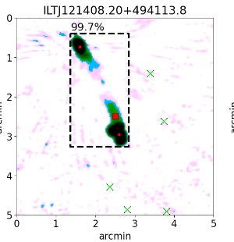
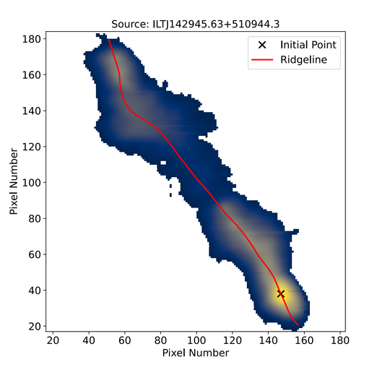
Automated techniques
Automated methods for complex sources
Machine learning techniques for association (Mostert+ 2022)
Ideas and expertise welcome 🙂
Mostert+ 2022
RL-Xid - ridgelines to identify optical/IR counterparts for extended sources (Barkus+ 2022)
Reduce the need for visual inspection and identification
Page 11
Barkus+ 2022
Notes:
As it took a while to work through LGZ, automated methods to deal with association and host identification for extended sources in LoTSS were developed.
There is a ML technique that uses bounding boxes to help associate separate regions into a single source. This is one of the areas that we are looking to work into so ideas and expertise are welcome if you want to chat )
And there is RL-Xid which use ridgelines to build on the likelihood ratio method for host identification of extended sources. This was used in DR2 to compliment the citizen science work.
Methods like these help to reduce the the need for visual inspection.

Slide 12
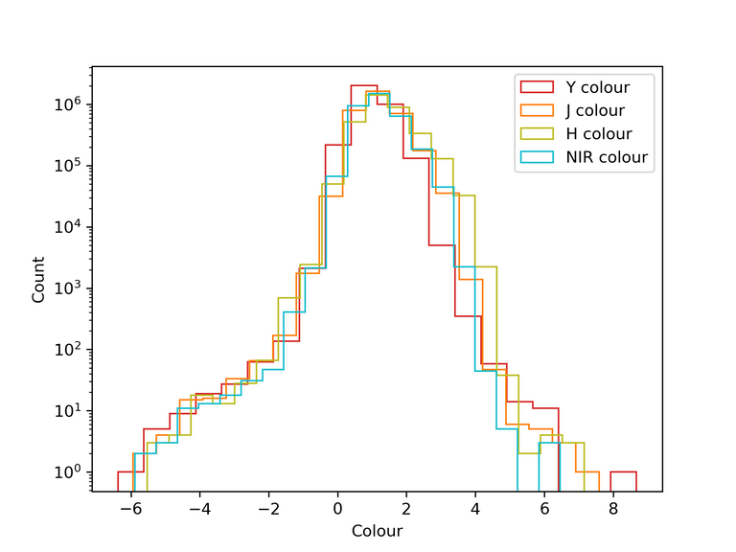
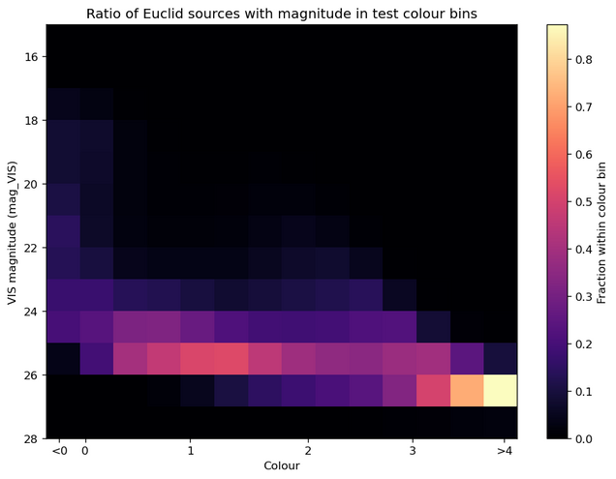
Let’s talk colour
Euclid Wide Survey
Visible i-band
NIR Y, J, H, and stacked bands
Distributions are quite similar regardless of bands used (top image)
Colour = VIS - H
n(m, c) density of the sources of magnitude (m) in colour bin (c) (bottom image)
Page 12
Notes:
Well repeating it on DR2 is not very useful but actually applying it! Yes.
Run PyBDSF on LoTSS DR3!
What you really want is to know if we have optical ID for any of LoTSS DR3.
To tell you that we need to talk a little about a survey called Euclid.
Now to run the LR you need colour and magnitude. TO create colour, you need a visible magnitude and an IR magnitude. Luckily the Euclid Wide survey is taking observations, in both the visible (Band i) and the NIR (Bands Y, J and H, and a stacked band). The top image show the distribution of colours using each of these bands with the i-band.
We have gone with H band for the largest separation from i band. The bottom image shows the ratio of sources in each colour bin which have a particular magnitude. This is how the likelihood ratio determines one of the probability parameters, and shows the distribution of high/low magnitude sources, by colour.

Slide 13
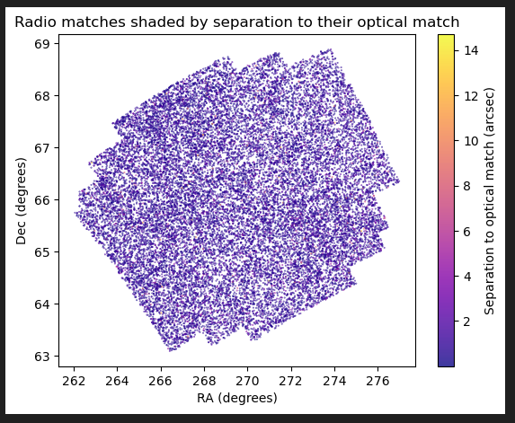
DR3 x Euclid
INTIAL RESULTS
No GBC and flowchart
LR on Euclid Q1 and LoTSS DR3
~28,500 radio sources
~24,100 matches
~85%
Right hand image shows:
Radio sources with matches
Shaded according to distance to the optical match
Mainly < 2 arcsecs
Page 13
Notes:
These are the INITIAL results. Only a few days old. This is the LR only, no ML from the GBC or the flowchart to add extra filters, and confirmations.
There are ~28,500 LoTSS DR3 radio sources that cross over with the Euclid WS Q1 area, and the LR matches ~24,500 approximately 86% of these.
I am showing on the right with all the matched radio sources shaded according to their separation from the optical source they have been matched with. Mainly purple, means mainly, less than 2 arcsecs.
This an excellent start for a point source catalogue!

Slide 14
Conclusion
b.barkus@herts.ac.uk
Dealing with one of the biggest challenges for large sky surveys like LoTSS
Introduced the stages of the pipeline
Difference the updates to PyBDSF has made
Adapting for healpix regions
LR + GBC+ Flowchart giving a point source catalogue
Complex sources needing association, filtering, host identification
Started applying these updates to LoTSS DR3 and Euclid
~86% radio sources matched to Euclid
Page 14
Notes:
We are dealing with one of the biggest challenges for large sky surveys like LoTSS.
I have introduced the different stages of the pipeline: I have shown you the difference updating PyBDSF has made with a before and after with LoTSS DR2; we have added the healpix regions for easier computation and reproducibility, and we have adapted the LR and GBC and Flowchart for this. We also have the the automation of complex sources which need association filtering and identification. And we have a group of people which you are welcome to join if you are interested in helping out with this.
To demonstrate that all this works we have applied it to LoTSS DR3 and Euclid's Q1 area, giving an initial match of ~86% of the radio sources in this area.

Slide 15
b.barkus@herts.ac.uk
THANK YOU!
Questions
Notes:
Will either be a summary page as the last one won't have been or I will come off the summary page for this :P

