Slide 1



SPECTRAL FEATURES AND SCINTILLATION STUDIES OF CAS A FROM LOW-FREQUENCY OBSERVATIONS WITH NENUFAR
L.A. Stanislavsky¹, I.M. Bubnov¹, A.A. Konovalenko¹,
P. Zarka², A. Loh², A.A. Stanislavsky¹, C. Viou², R.V. Vaschishyn³, A.V. Frantsuzenko³, and
V.I. Myrhorod⁴
¹Institute of Radio Astronomy, NASU, Kharkiv, Ukraine
²Laboratoire d’Etudes Spatiales et d’Instrumentation en Astrophysique (LESIA), CNRS/Observatoire de Paris, Meudon F-92195, France
³Poltava Gravimetrical Observatory, S. Subotin Institute of Geophysics, NASU, Poltava 36029, Ukraine
⁴National Technical University “Kharkiv Polytechnic Institute”, Kharkiv, Ukraine
22-26 September 2025, Paris, France
LOFAR Family Meeting 2025

Slide 2



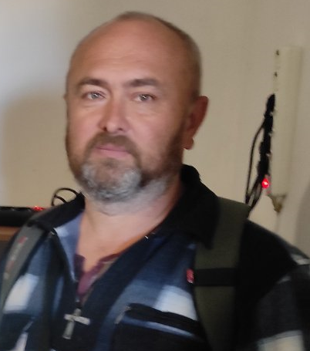
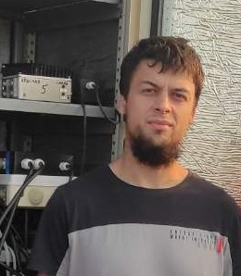

INTERNATIONAL TEAM
Philippe Zarka
Aleksander Stanislavsky
Alan Loh
Igor Bubnov
Cedric Viou
Lev
2

Slide 3
MOTIVATION
Supernova remnants play an important role in the evolution of galaxies.
Ones of them (Cas A, Crab Nebula) are the brightest extrasolar radio sources on the sky.
Radio spectrum evolution of Cassiopeia A is one of the mysteries in astrophysics.
Low-frequency observations can give many useful information about SNRs.

Slide 4
OUTLINE
Observations of Cassiopeia A and Cygnus A from May to October in 2019.
Details of data processing.
Radio spectrum of Cassiopeia A in 2019 epoch.
NenuFAR and URAN-2 together in SNR observations.
Free-free absorption parameters obtaining from this radio spectrum.
Detection of temporal changes in free-free absorption parameters.
Attempt to detect interplanetary scintillations (IPS) in the radio emission of this supernova remnant (SNR).
Perspectives for further research.

Slide 5
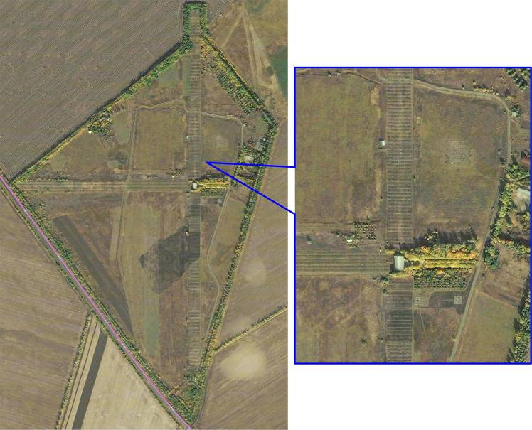
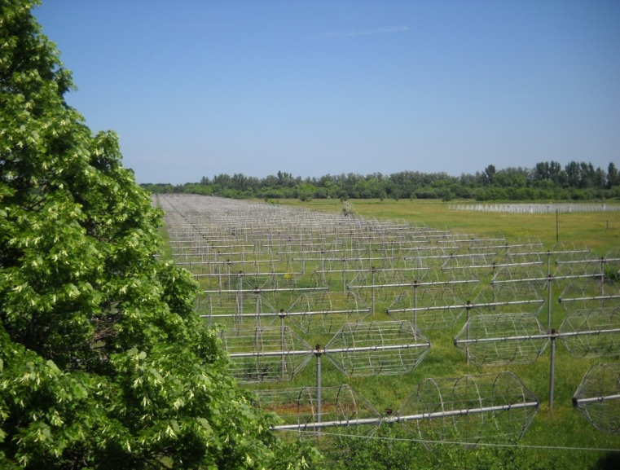
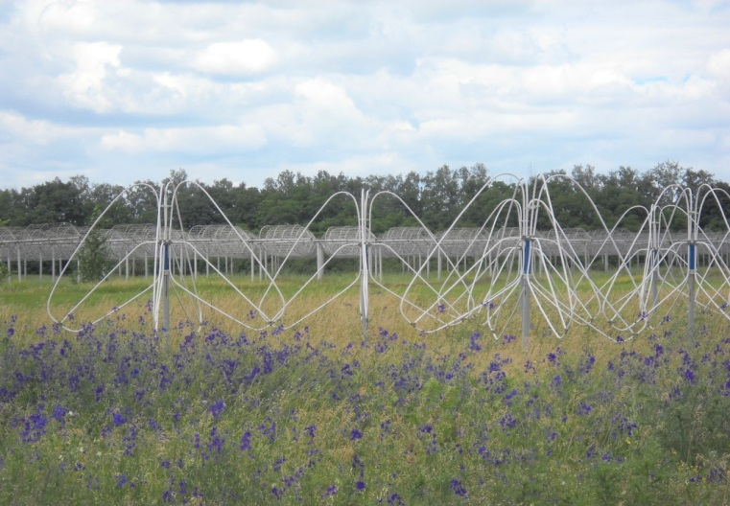
UTR-2 AND GURT FROM ABOVE
5

Slide 6
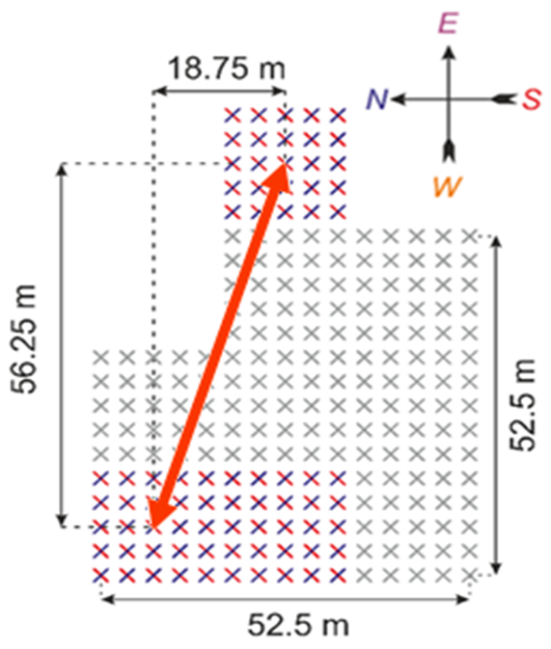
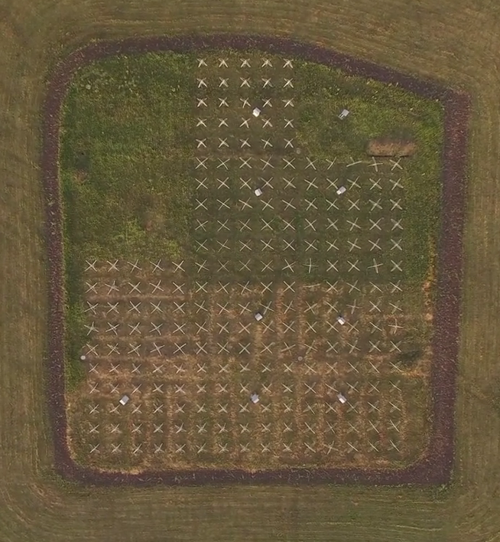
GURT CORRELATION INTERFEROMETER
Used sections of the GURT radio telescope.
6

Slide 7
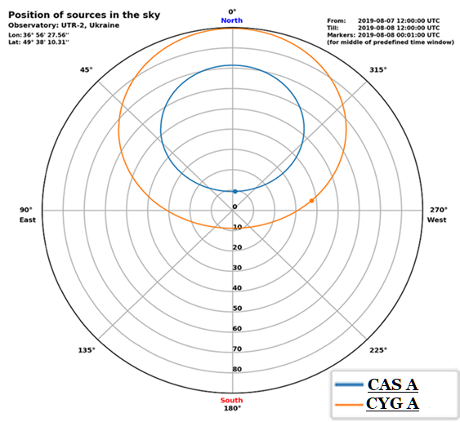
THE POSITION OF CASSIOPEIA A AND CYGNUS A ON THE SKY
7

Slide 8
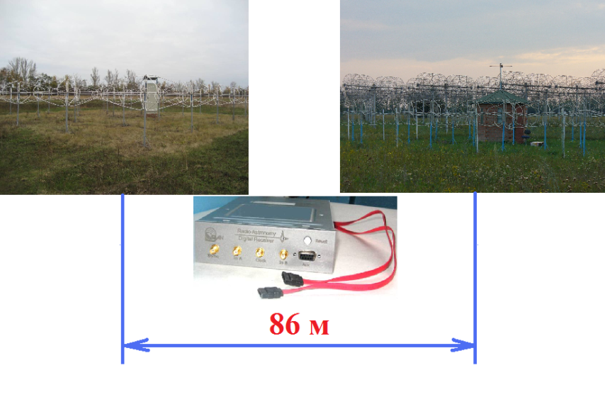
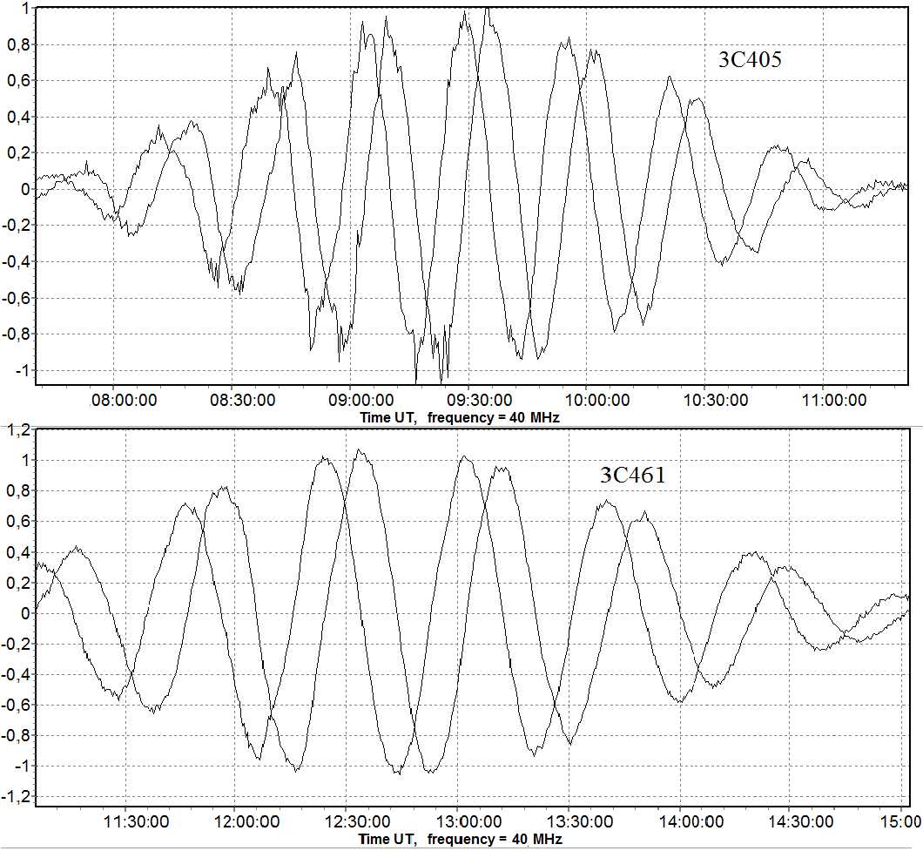
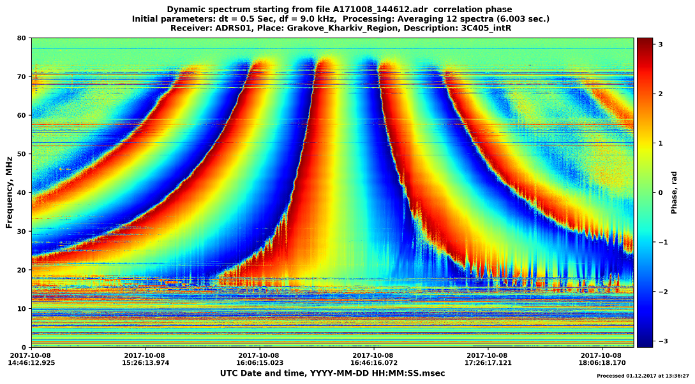
MODERN OBSERVATIONS WITH GURT
2014 - 2022
8
8
Notes:
8

Slide 9
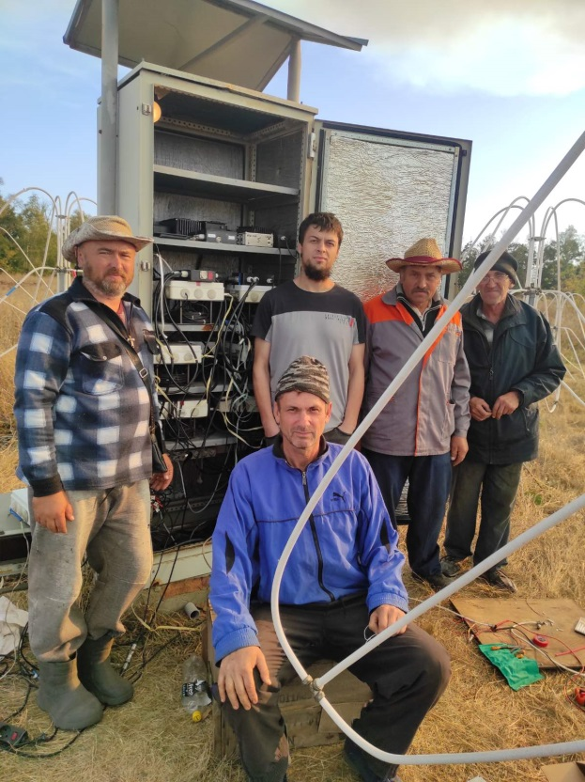
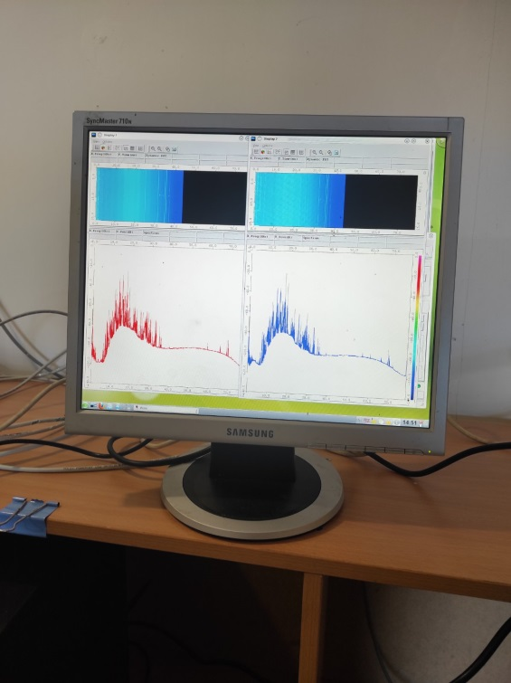
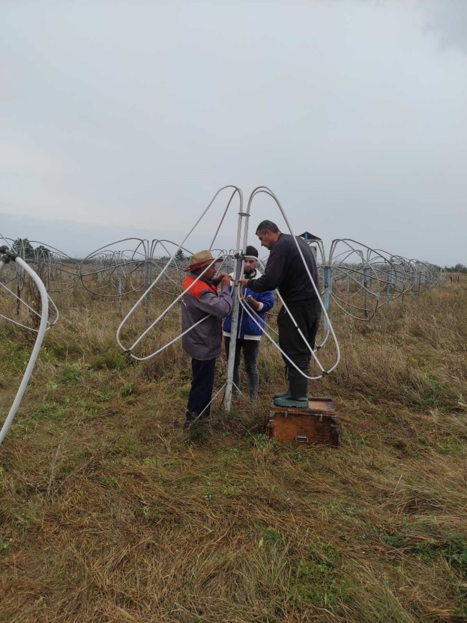
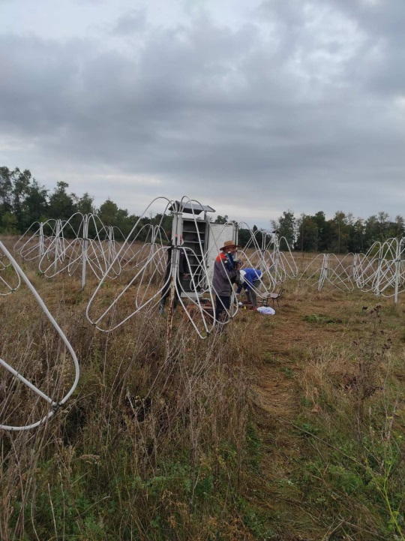
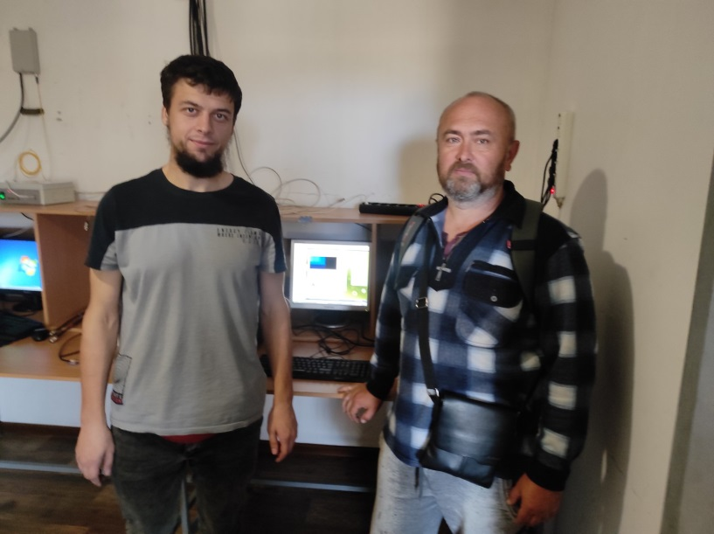
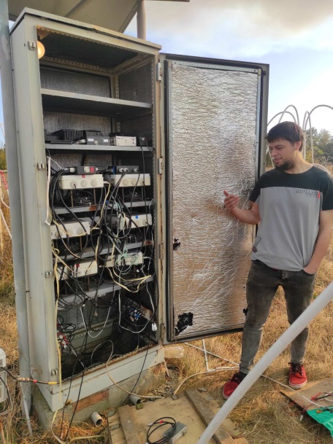
RESTORATION OF THE GURT

Slide 10
DYNAMIC CROSS-SPECTRA OF THE INTERFEROMETRIC RESPONSE
Cyg A
Cas A

Slide 11
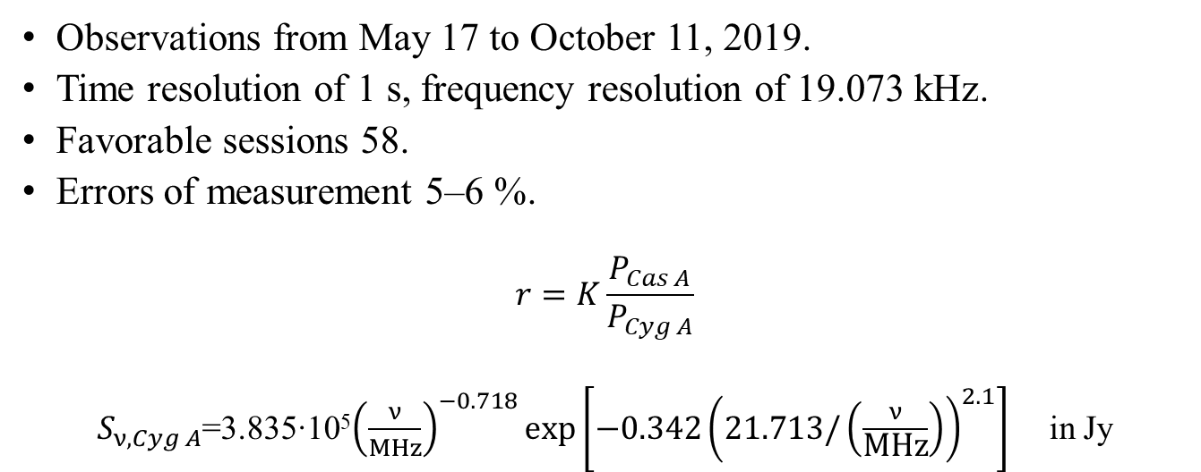
MEASUREMENTS
Observations from May 17 to October 11, 2019.
Time resolution of 1 s, frequency resolution of 19.073 kHz.
Favorable sessions 58.
Errors of measurement 5‒6 %.
$$r=K\frac{P_{Cas A}}{P_{Cyg A}}$$
$S_{ν, Cyg A}$=3.835‧10⁵${\left(\frac{ν}{MHz}\right)}^{−0.718}\text{exp}\left[−0.342{\left(21.713/\left(\frac{ν}{\text{MHz}}\right)\right)}^{2.1}\right]$ in Jy
flux-density ratio of Cas A to Cyg A from 12 MHz to 73 MHz in 1 MHz steps.
11

Slide 12
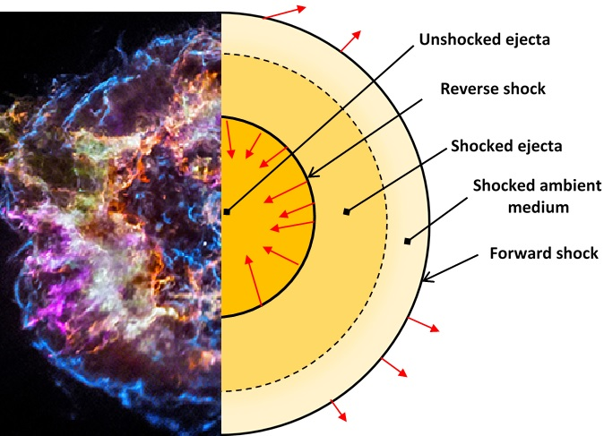
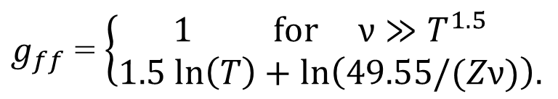
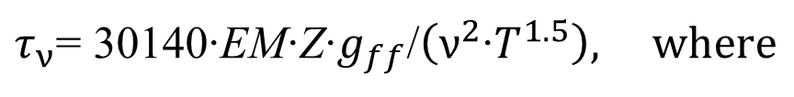
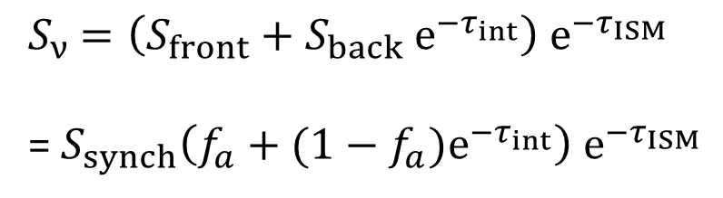
RADIO SPECTRUM OF SNR
Structure of SNR
$S_{ν}$ $=\left(S_{front}+S_{back}{ e}^{−τ_{int}}\right){ e}^{−τ_{ISM}}$
=${ S}_{synch}\left(f_{a}+(1−f_{a})e^{−τ_{int}}\right){ e}^{−τ_{ISM}}$
Rayleigh–Jeans approximation (Wilson et al. 2009):
$τ_{ν}$= 30140‧EM‧Z‧$g_{ff}$/$\left(ν^{2}{‧T}^{1.5}\right), where$
$g_{ff}$ = $\left\{\begin{aligned}1 for ν≫T^{1.5} \\ 1.5 ln\left(T\right)+ln\left(49.55/(Zν)\right).\end{aligned}\right.$
12

Slide 13
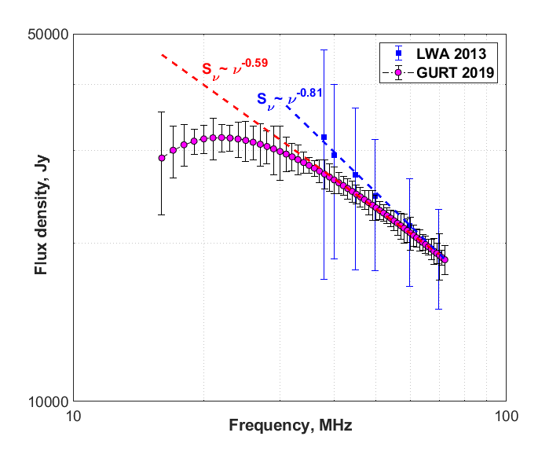
SPECTRUM OF CASSIOPEIA A AT 16-72 MHZ

Slide 14

COMPARISON OF EXPERIMENTAL RESULTS WITH MODELS
$S_{ν}$ =${ S}_{synch}\left(f_{a}+(1−f_{a})e^{−τ_{int}}\right){ e}^{−τ_{ISM}}$
14

Slide 15
RESULTS OF MEASUREMENTS FOR THE RATIO OF THE FLUX DENSITY OF CAS A AND CYG A
At the frequency of 38 MHz
Data from the references:
Baars et al., 1977;
Helmboldt & Kassim, 2009;
Rees, 1990;
Vinyaikin, 2006.
15

Slide 16

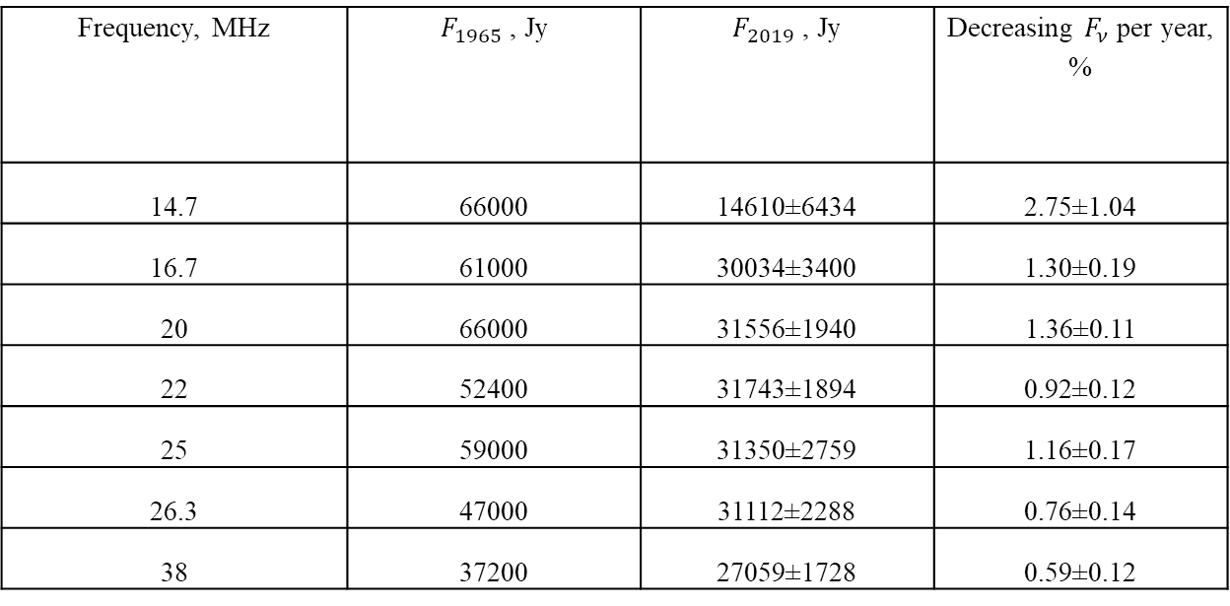
DEPENDENCE OF THE RATE OF DECREASE IN THE FLUX DENSITY OF CASSIOPEIA A
Frequency, MHz | $F_{1965}$, Jy | $F_{2019}$, Jy | Decreasing $F_{ν}$ per year, %
14.7 | 66000 | 14610±6434 | 2.75±1.04
16.7 | 61000 | 30034±3400 | 1.30±0.19
20 | 66000 | 31556±1940 | 1.36±0.11
22 | 52400 | 31743±1894 | 0.92±0.12
25 | 59000 | 31350±2759 | 1.16±0.17
26.3 | 47000 | 31112±2288 | 0.76±0.14
38 | 37200 | 27059±1728 | 0.59±0.12
Bridle (1967), Braude (1969), Roger (1969), Viner (1975), Parker (1968)
$$F_{2019}=F_{1965}{\left(1−\frac{p}{100}\right)}^{n}$$
16

Slide 17
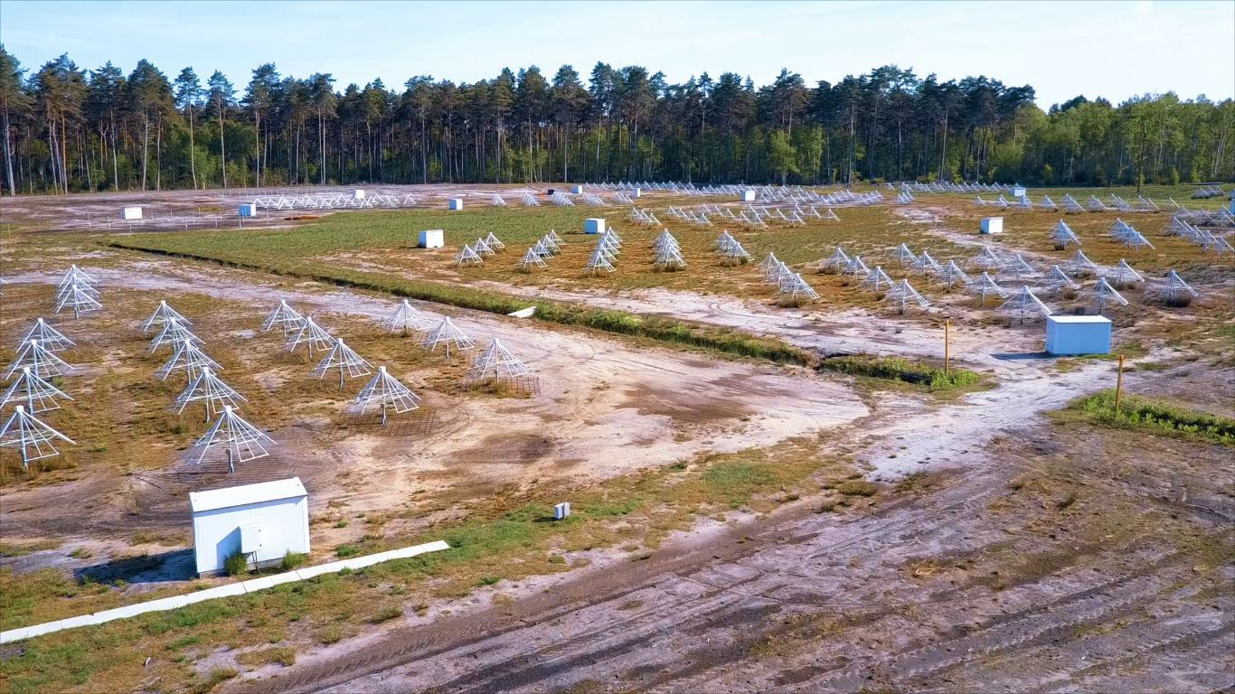
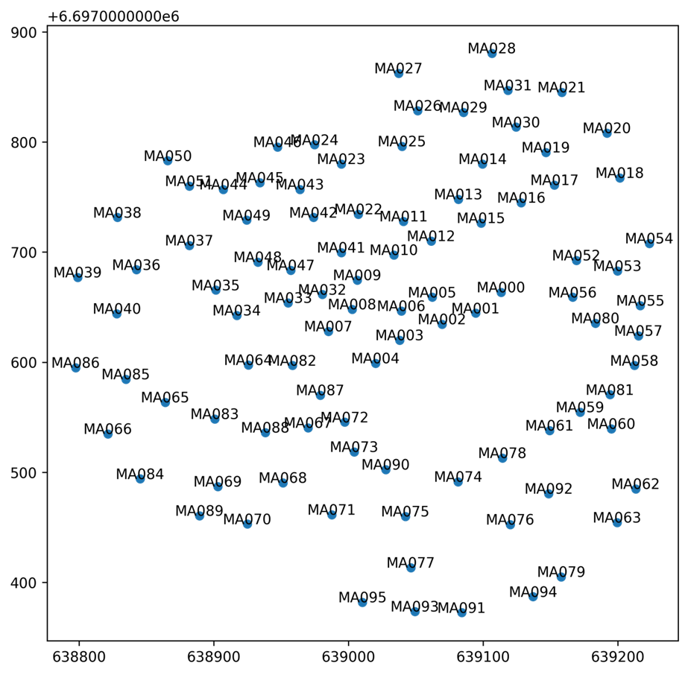
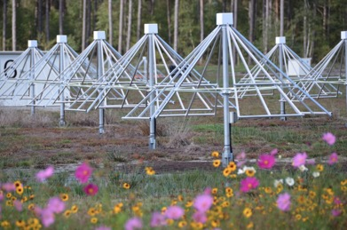
NENUFAR RADIO TELESCOPE

Slide 18

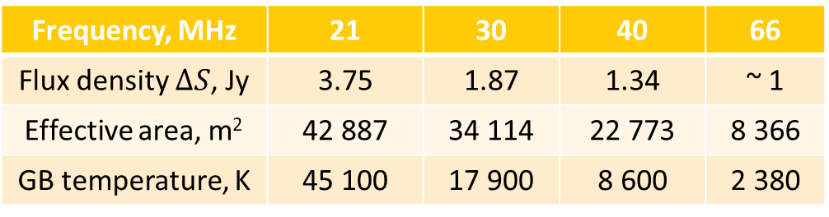
SENSITIVITY OF RADIO OBSERVATIONS
NenuFAR core
Frequency, MHz | 21 | 30 | 40 | 66
Flux density $∆S$, Jy | 3.75 | 1.87 | 1.34 | ~ 1
Effective area, m² | 42 887 | 34 114 | 22 773 | 8 366
GB temperature, K | 45 100 | 17 900 | 8 600 | 2 380
$∆S=$ $\frac{2kT_{B}}{A_{eff}\sqrt{∆τ ∆f}}$
GURT and NenuFAR mini-array
Frequency, MHz | 21 | 30 | 40 | 66
Flux density ∆𝑆, Jy | 329 | 160 | 87.5 | 28.6
Effective area, m² | 489 | 398 | 350 | 297
Δ τ = 1 s
Δ f = 600 kHz
One half of the URAN-2 array
Frequency, MHz | 10 | 20 | 30 | 40
Flux density ∆𝑆, Jy | 68.3 | 12.5 | 4.6 | 2.3
Effective area, m² | 16 256 | 14 400 | 13 806 | 13 514
GB temperature, K | 311 700 | 50 320 | 17 900 | 8 600
18

Slide 19
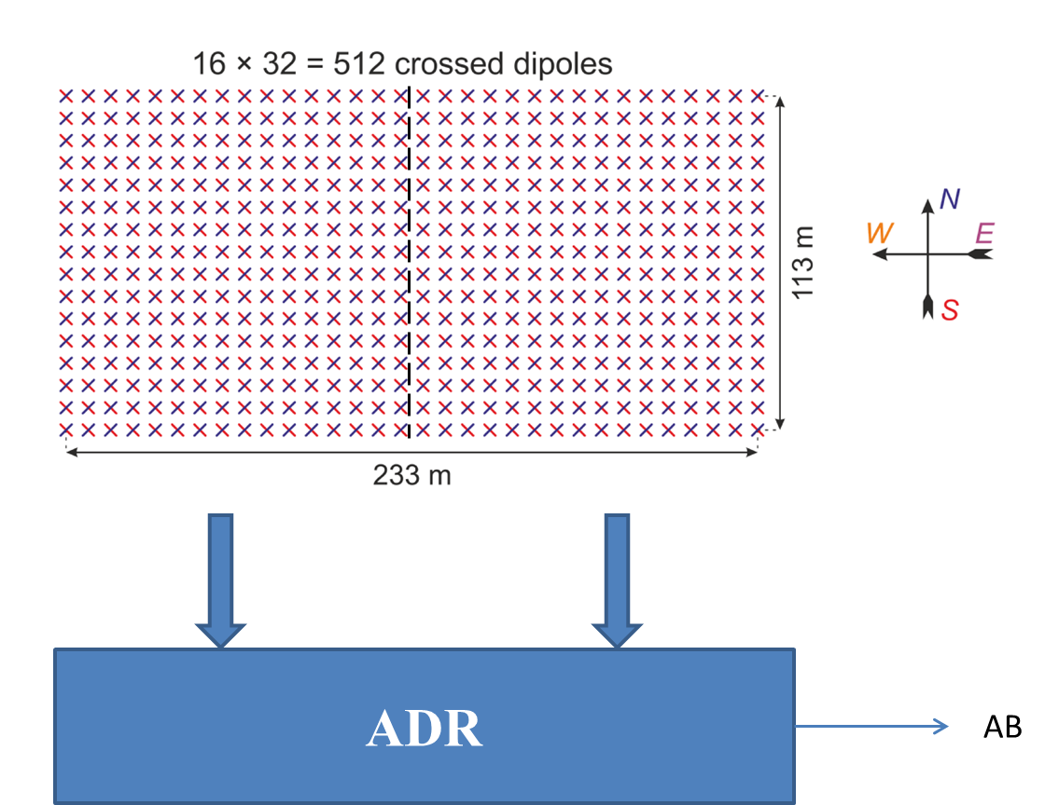
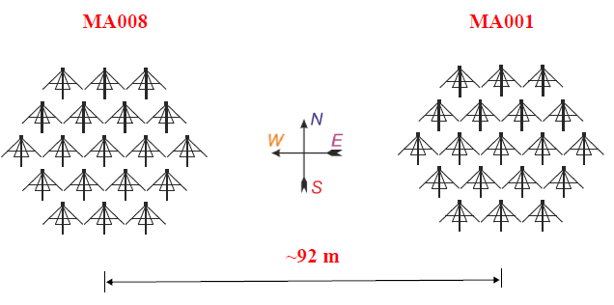
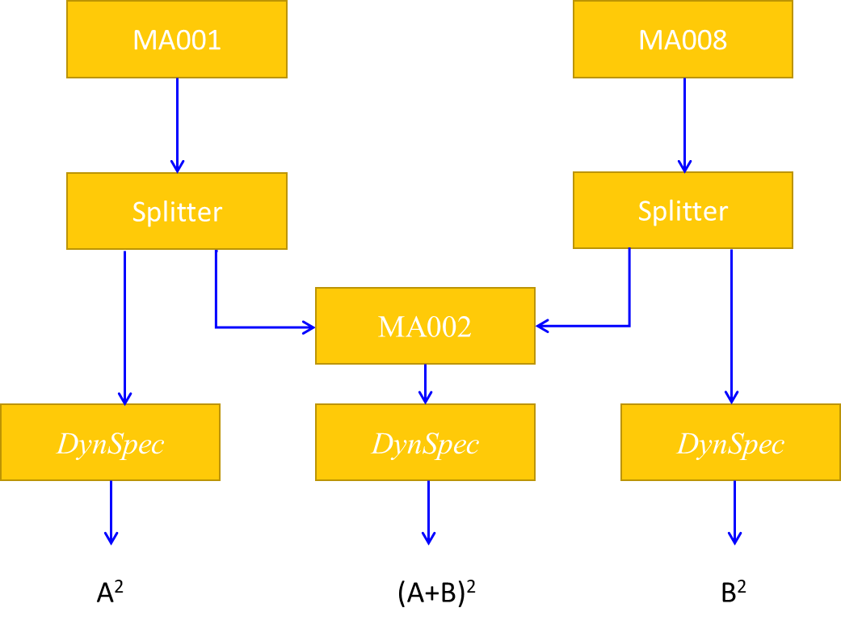
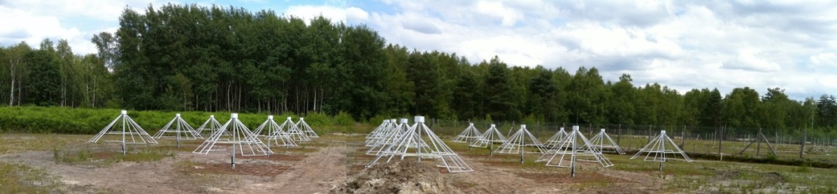
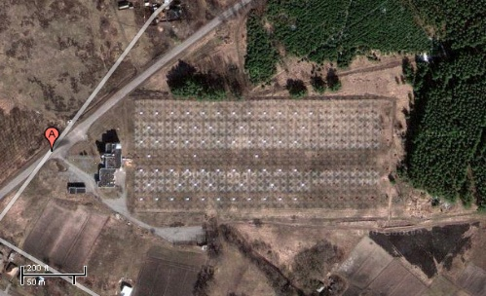
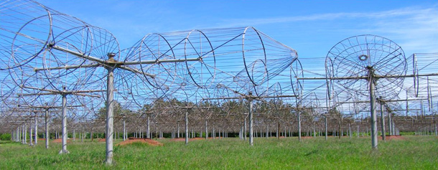
EXPERIMENTAL FEATURES
URAN-2
NenuFAR
19

Slide 20
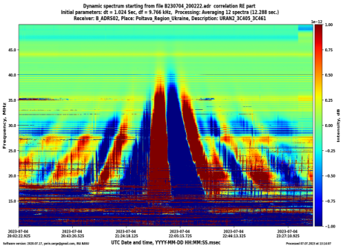
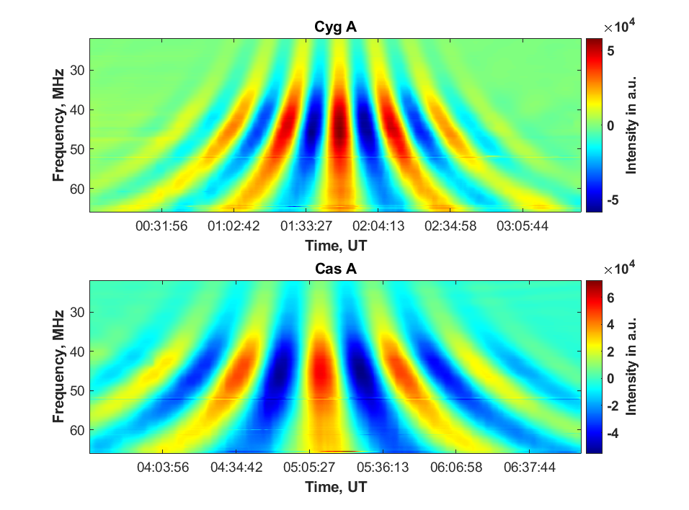
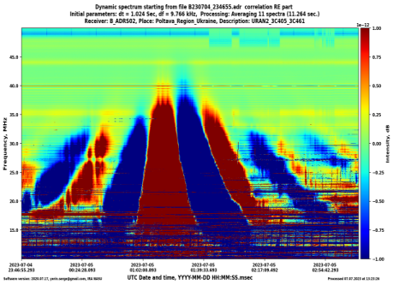
INTERFEROMETRIC RESPONSES
NenuFAR
URAN-2

Slide 21
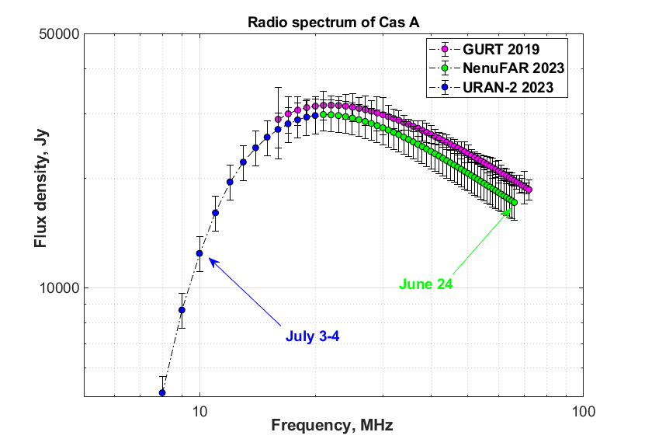
SPECTRUM OF CAS A WITH NENUFAR+URAN-2

Slide 22
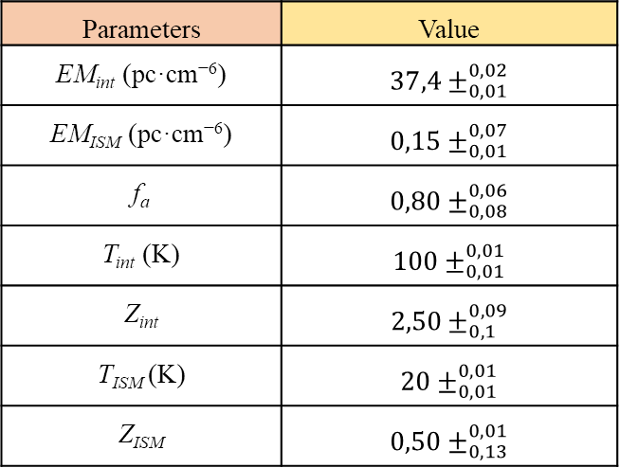
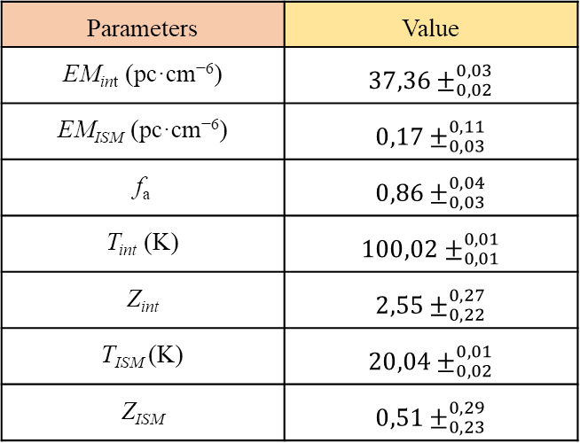
PARAMETERS OF ABSORPTION REGIONS IN CASSIOPEIA A
GURT observations(2019)
NenuFAR+URAN-2 observations (2023)
Parameters | Value
EM_{int} (pc·cm⁻⁶) | $${37,36±}_{0,02}^{0,03}$$
EM_{ISM} (pc·cm⁻⁶) | $${0,17±}_{0,03}^{0,11}$$
f_{a} | $${0,86±}_{0,03}^{0,04}$$
T_{int} (K) | $${100,02±}_{0,01}^{0,01}$$
Z_{int} | $${2,55±}_{0,22}^{0,27}$$
T_{ISM} (K) | $${20,04±}_{0,02}^{0,01}$$
Z_{ISM} | $${0,51±}_{0,23}^{0,29}$$
Parameters | Value
EM_{int} (pc·cm⁻⁶) | $${37,4±}_{0,01}^{0,02}$$
EM_{ISM} (pc·cm⁻⁶) | $${0,15±}_{0,01}^{0,07}$$
f_{a} | $${0,80±}_{0,08}^{0,06}$$
T_{int} (K) | $${100±}_{0,01}^{0,01}$$
Z_{int} | $${2,50±}_{0,1}^{0,09}$$
T_{ISM} (K) | $${20±}_{0,01}^{0,01}$$
Z_{ISM} | $${0,50±}_{0,13}^{0,01}$$

Slide 23
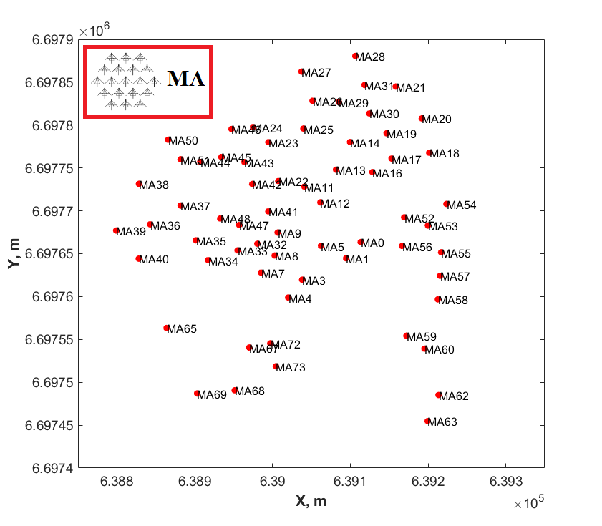
MULTI-BASELINE INTERFEROMETER
23

Slide 24
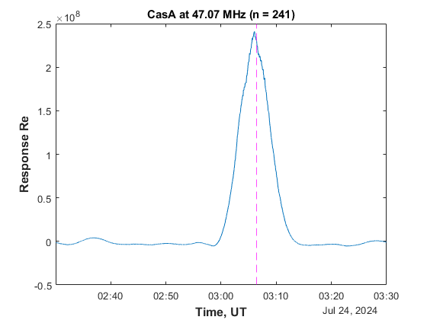
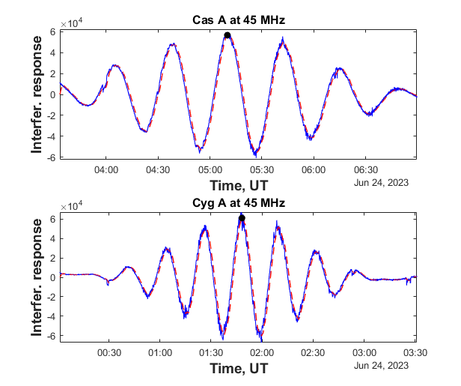
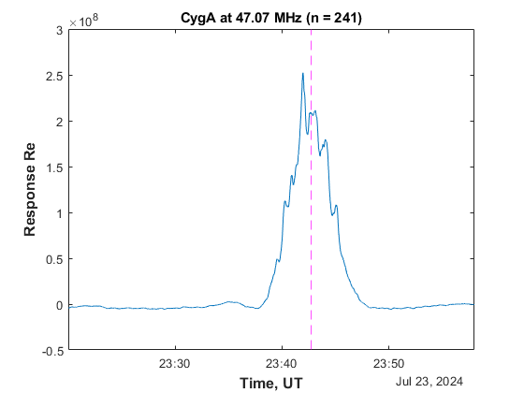
MULTI-BASELINE RESPONSES
One baseline
Sum of many baselines
N(N-1)/2
24

Slide 25
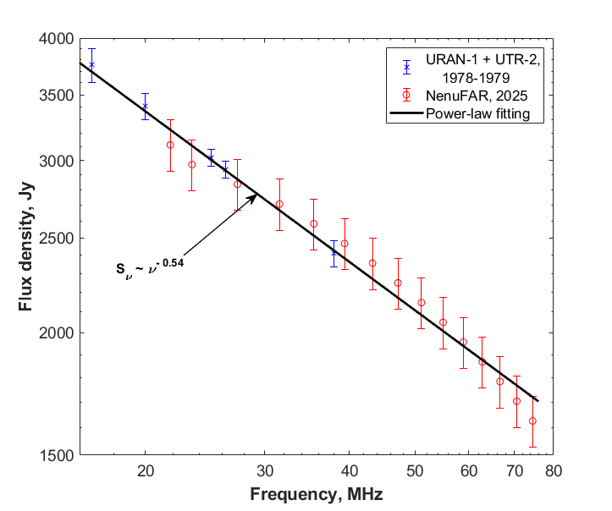
CRAB FLUX-DENSITY SPECTRUM WITH NENUFAR
25

Slide 26
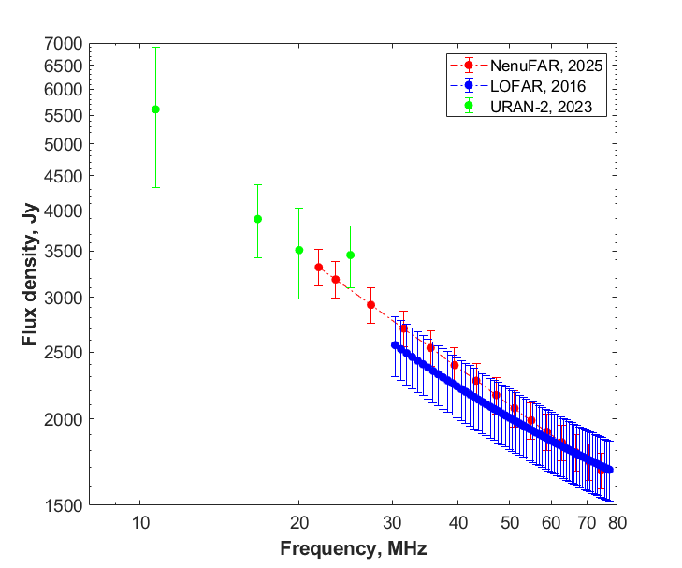
COMPARISON OF MEASUREMENTS FROM NENUFAR, LOFAR AND URAN-2
Crab
26

Slide 27
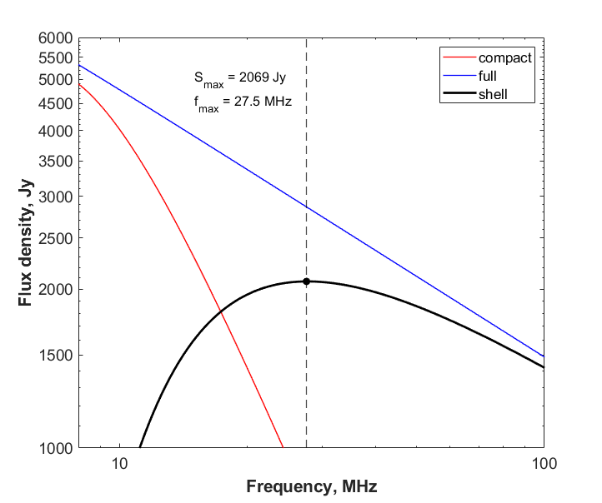
BREAKDOWN OF RADIO EMISSION COMPONENTS FROM THE CRAB
27

Slide 28
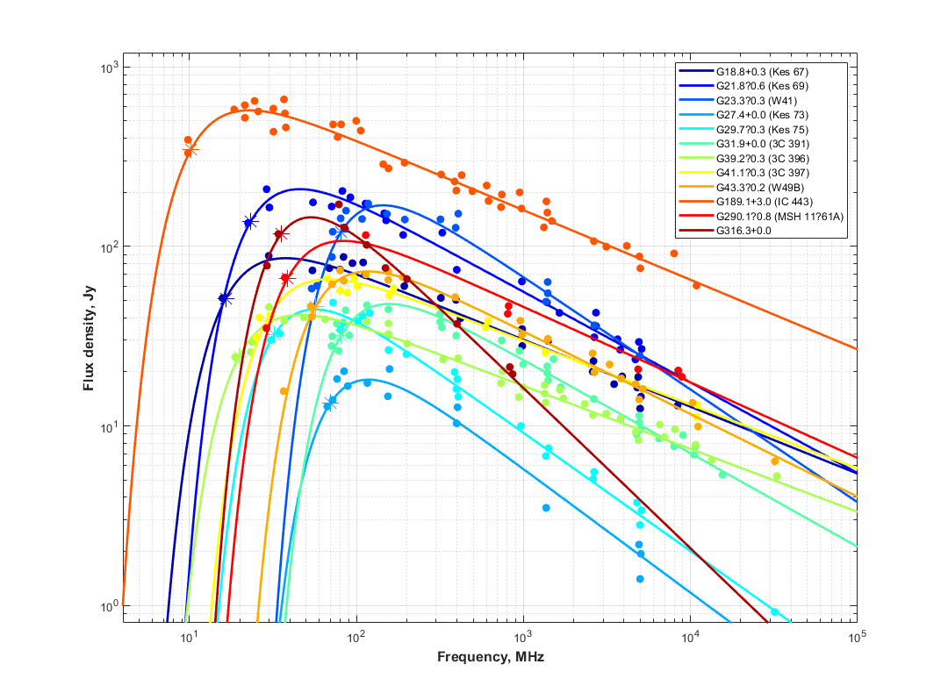
PERSPECTIVES
Abadi et al.
(2024)
28

Slide 29
CAS A IPS: KEY PROVISIONS
The radio spectrum from Cas A has been well measured at low frequencies.
It is governed by the thermal absorption of radio emission in unshocked ejecta within the shell of Cas A.
Using the NenuFAR radio telescope, we analyzed the scintillation of radio observations from Cas A.
The aim was to detect interplanetary scintillation (IPS) in the radio emission from this supernova remnant (SNR).
Subsequently, the compact component was associated with a non-pulsating neutron star.
The observed IPS variability may indicate neutron star activity.
29

Slide 30
OBSERVATIONS
Telescope | Observation details
NENUFAR | Observations in May-September of 2024 (10 sessions). Time resolution of 1 s, frequency resolution of 195 kHz. 64 mini-arrays (MAs) and 2016 different baselines. Frequency range from 23.4 to 67 MHz. 15 equally spaced groups of beamlets, each had 4 consecutive beamlets. Interferometer with multiple baselines in transit mode.
30

Slide 31
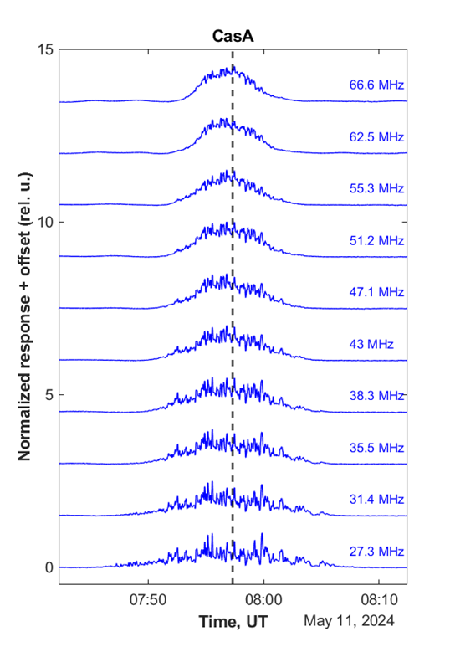
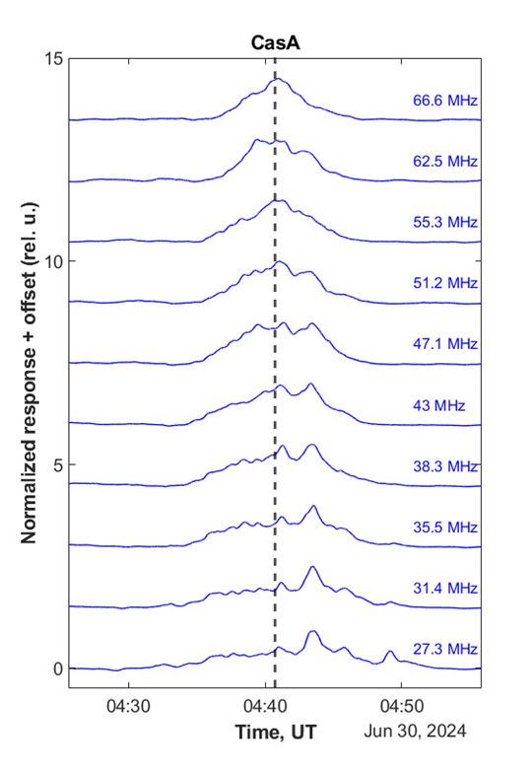
INTERFEROMETRIC RESPONSE OF CAS A AT DIFFERENT FREQUENCIES
31

Slide 32

DATA PROCESSING
32

Slide 33



SPECTRAL ANALYSIS OF SCINTILLATION FROM CAS A
33

Slide 34
CONCLUSIONS (1)
The NenuFAR interferometer method can be used to probe stellar relics of SNRs through ionospheric scintillation and IPS.
While the impact of ionospheric effects cannot be entirely ruled out, IPS appears to be the more plausible explanation.
Further observations of Cassiopeia A will help refine these results.
34

Slide 35
CONCLUSIONS (2)
Multi-baseline interferometer, based on the NenuFAR radio telescope, opens new capabilities in the spectral measurements of low-frequency radio emission from weak supernova remnants (SNRs).
This method allows us to find values of the free-free absorption parameters inside and outside SNRs from their flux-density spectrum. As SNR evolve, their free-free absorption parameters also change. The effect clearly show Cassiopeia A.
The sensitivity and accuracy of new radio astronomical instruments is now such that the flux decrease in SNRs’ radio emission can be detected in a shorter time rather than before.
Further observations of different SNRs with the GURT, URAN-2 and NenuFAR radio telescopes will refine these results.

Slide 36

Thank you for your attention
We would like to thank ACME (The Astrophysics Centre for Multi-messenger studies in Europe) for their grant support and assistance in organizing my participation in this conference.

Slide 37

THE POSSIBLE EPISODIC IPS FROM CAS A
37

