Slide 1
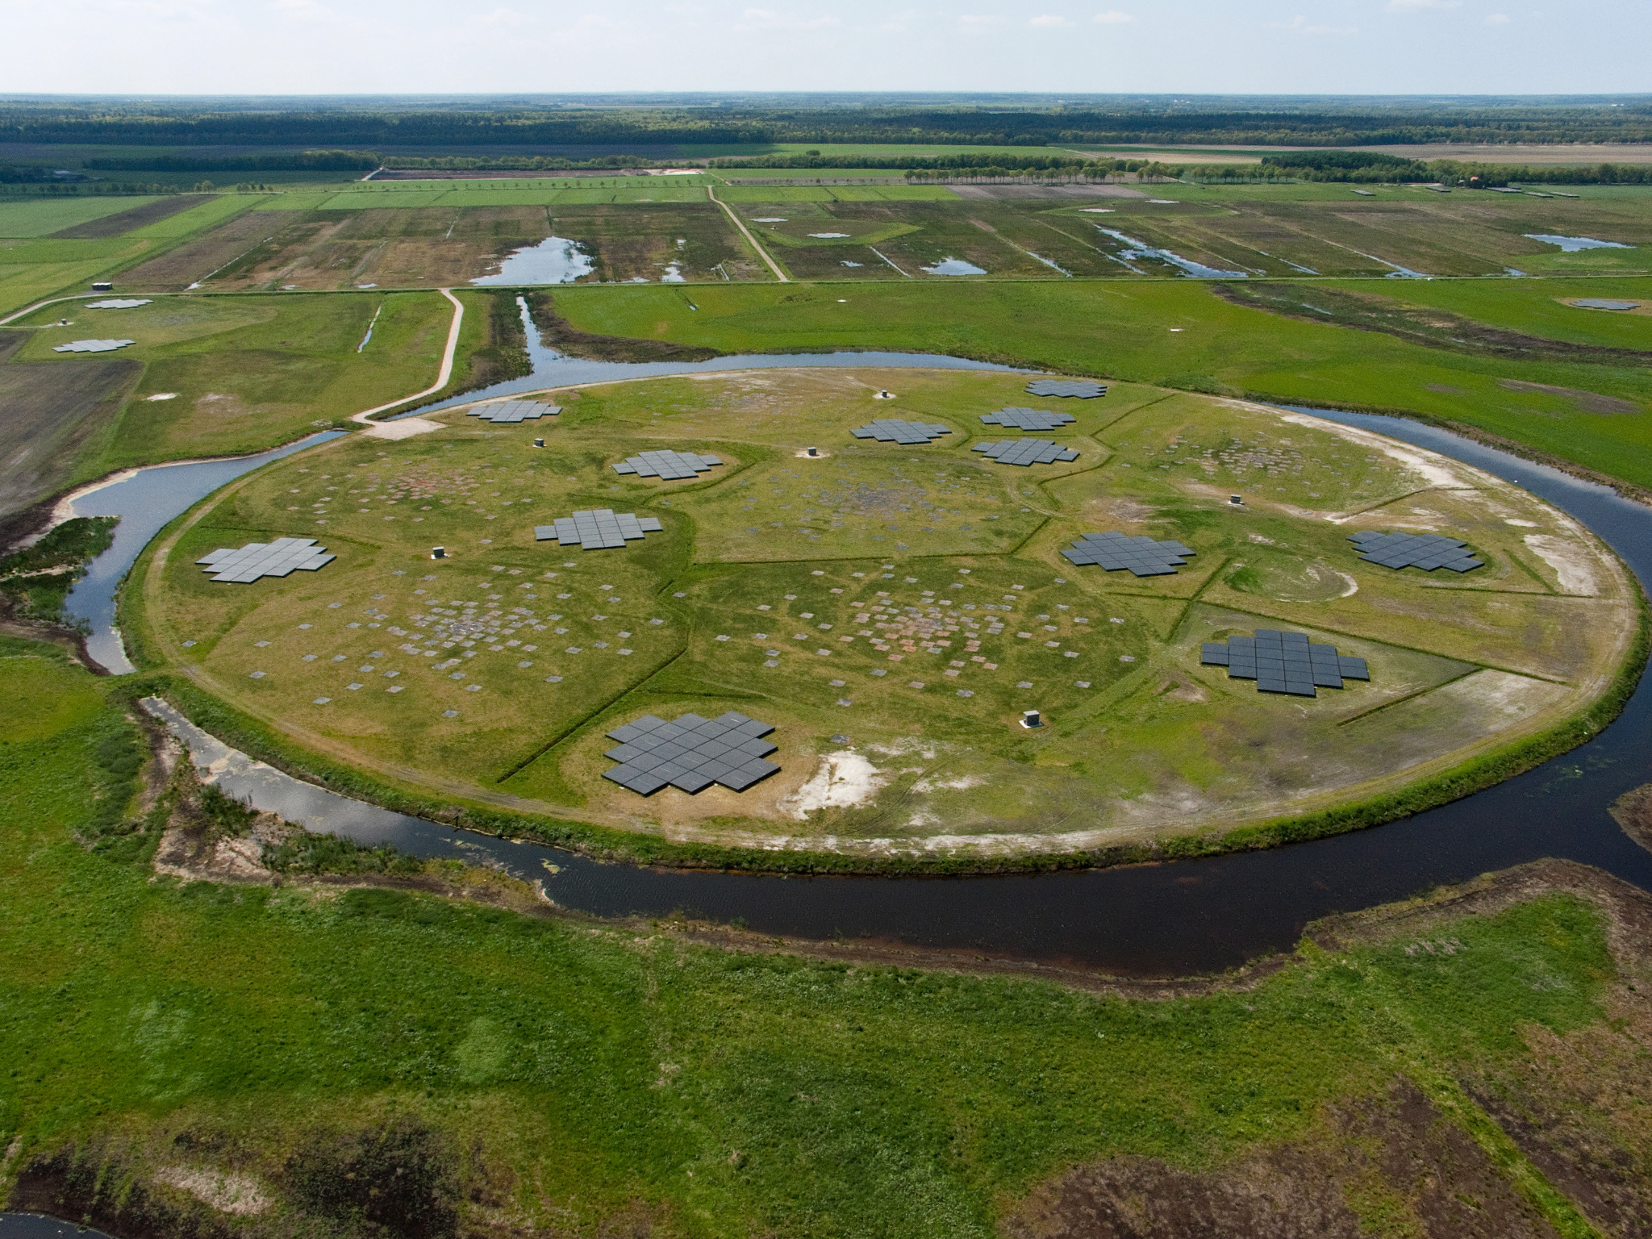



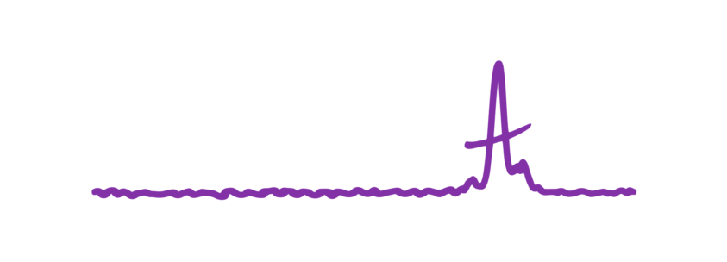
Reprocessing the Full LOTAAS Survey with Improved Methods: Paving the Way for Commensal LOFAR 2.0 Transient Searches
LFM 2025 - Paris
Dirk Kuiper
University of Amsterdam
Jason Hessels, Ziggy Pleunis, Cees Bassa
This project has received funding from the European Research Council (ERC) under the European Union’s Horizon 2020 research and innovation programme (`EuroFlash’; Grant agreement No. 101098079)
Image credit: LOFAR/ASTRON

Slide 2




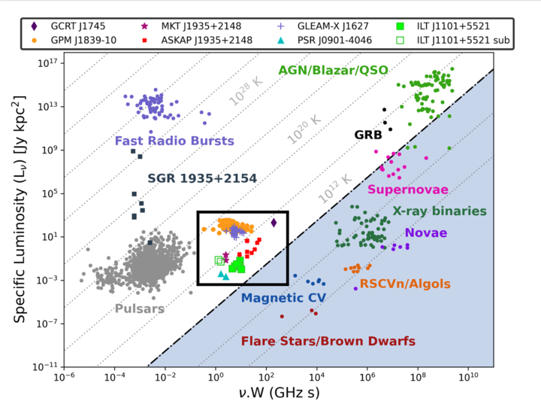
The objects of interest
Intro Methods Results Outlook
FRBs → ms bursts, extreme luminosities
Pulsars → broad population, from ms to tens of seconds
Long-period transients → newly emerging population
LOFAR: uniquely sensitive to dispersion, scattering, absorption
De Ruiter et al. 2024

Slide 3
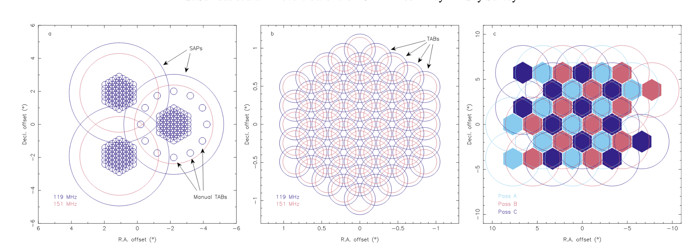
Original LOTAAS Setup
Intro Methods Results Outlook
Sanidas et al. 2019

Slide 4
Original LOTAAS Setup
Intro Methods Results Outlook
Sanidas et al. 2019

Slide 5
Original LOTAAS Setup
Intro Methods Results Outlook
Sanidas et al. 2019

Slide 6
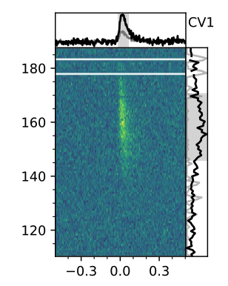
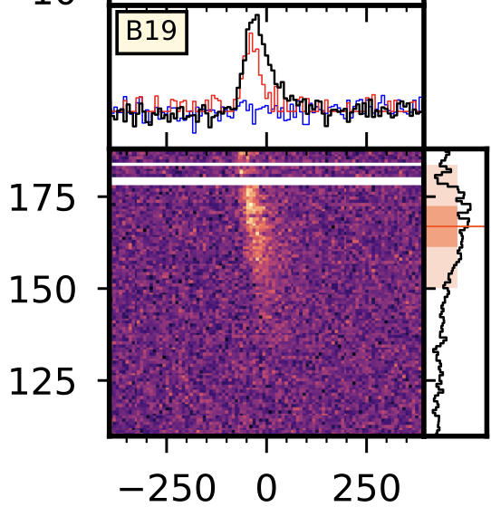
Why reprocess?
Intro Methods Results Outlook
Original single-pulse search had limitations
Transient landscape has changed since LOTAAS
⇒ Signals may still be hiding in there
Gopinath et al. 2024
Pleunis et al. 2020

Slide 7


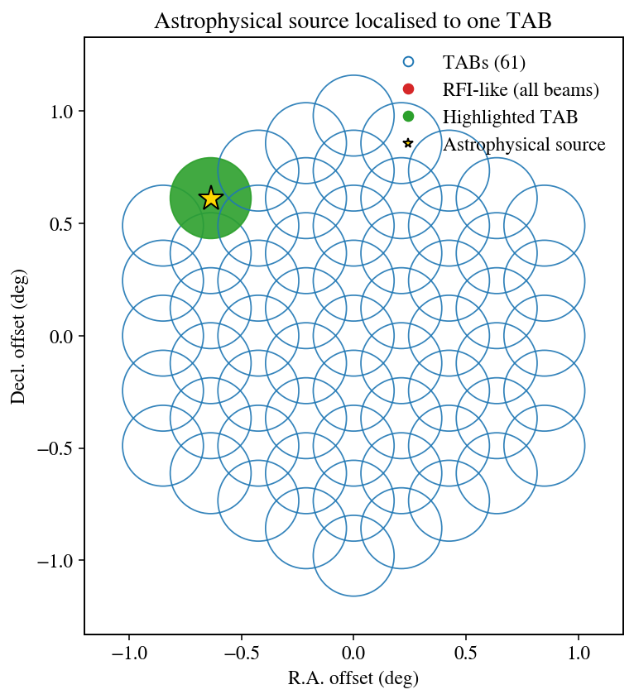
Flatfielding as a concept
Intro Methods Results Outlook
Bassa + Kuiper (in prep.)

Slide 8
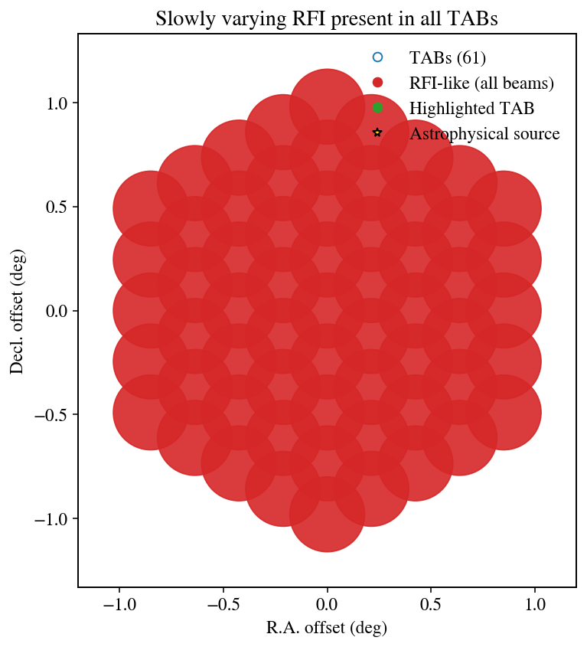
Flatfielding as a concept
Intro Methods Results Outlook
Bassa + Kuiper (in prep.)

Slide 9
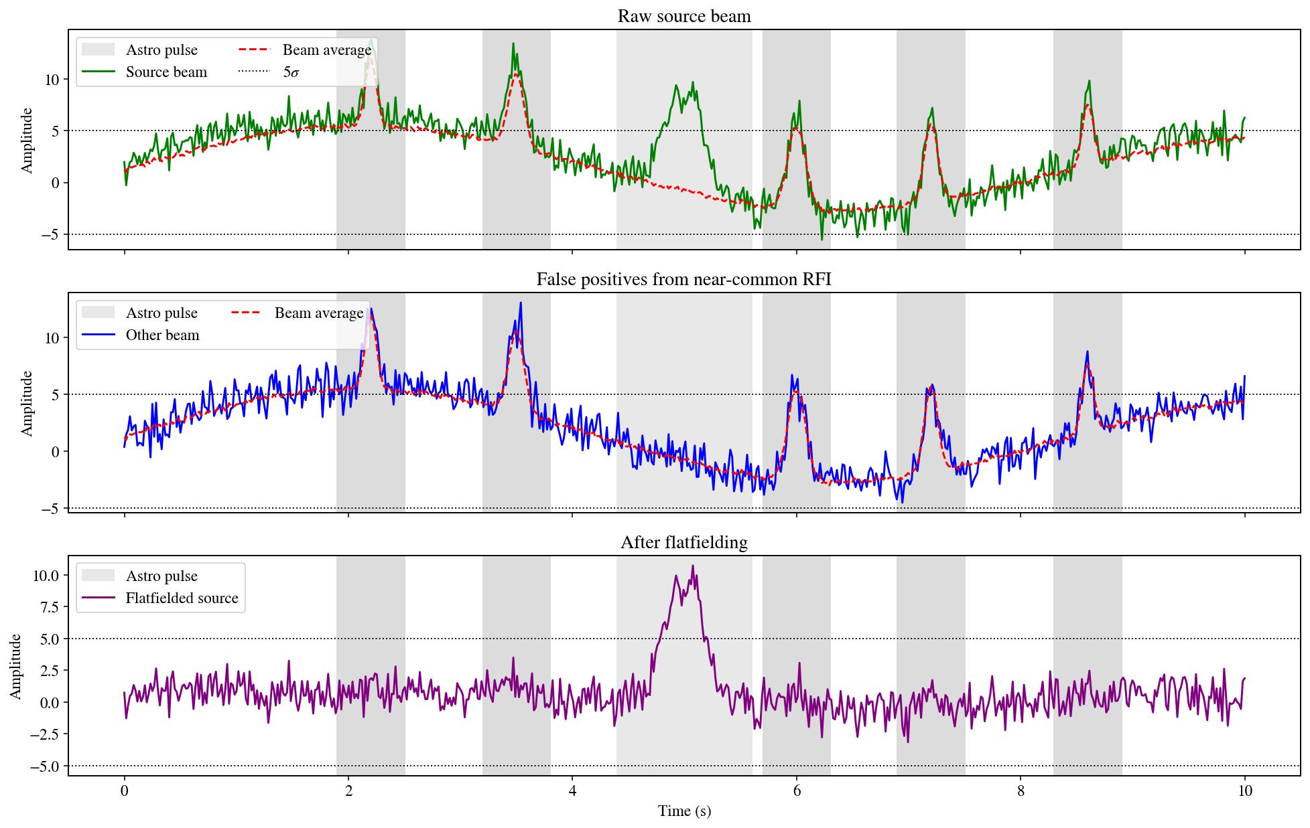
Intro Methods Results Outlook

Slide 10
Intro Methods Results Outlook

Slide 11
Intro Methods Results Outlook

Slide 12
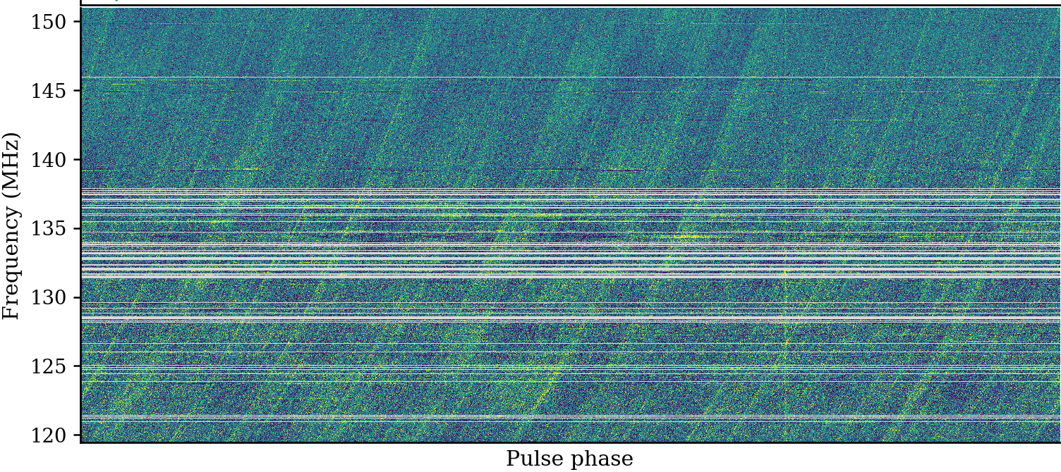
Now with real data
Intro Methods Results Outlook
Good channels post-fold: 586 / 648

Slide 13
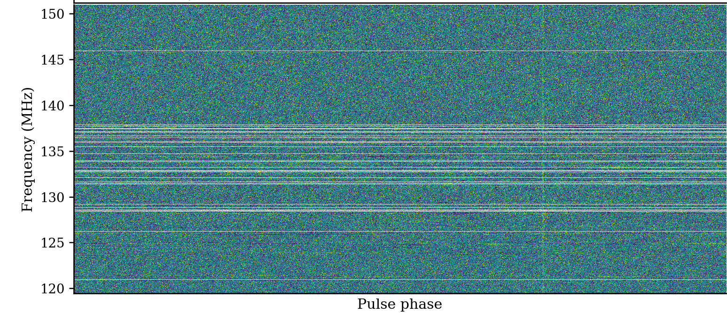
Now with real data
Intro Methods Results Outlook
Good channels post-fold: 618 / 648

Slide 14
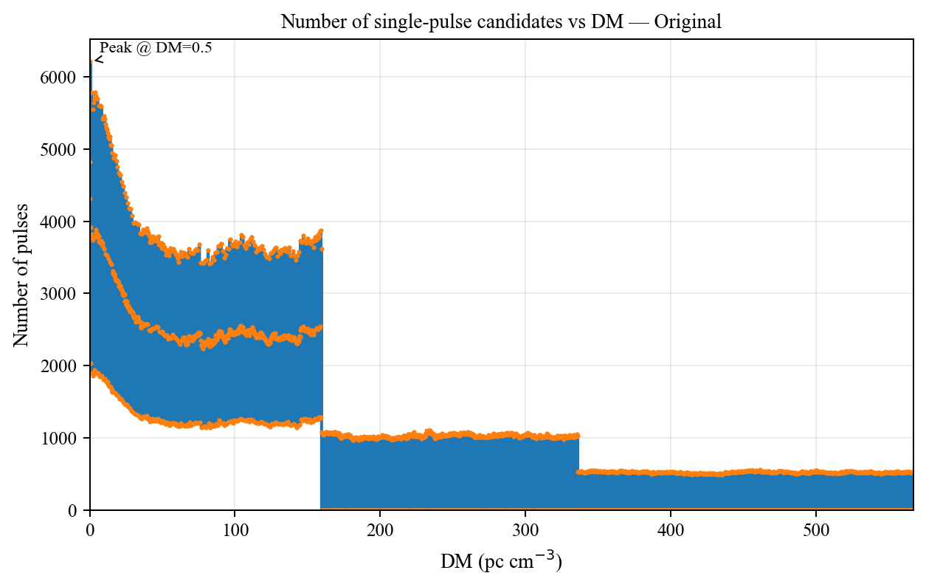
From millions to thousands
Intro Methods Results Outlook

Slide 15
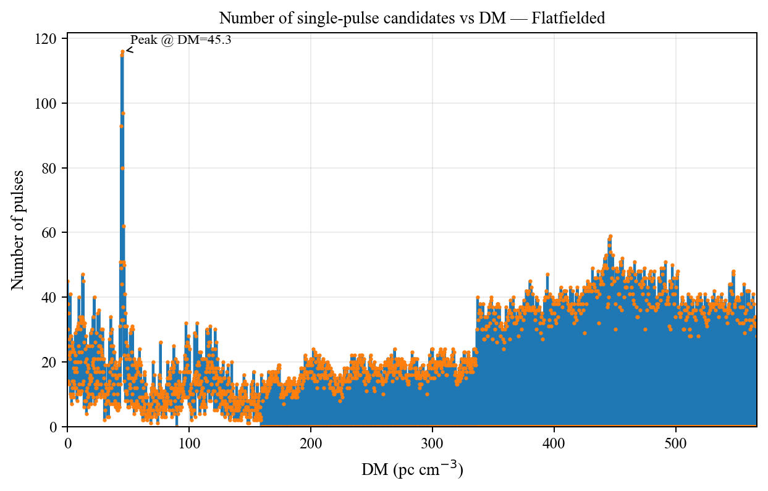
From millions to thousands
Intro Methods Results Outlook

Slide 16

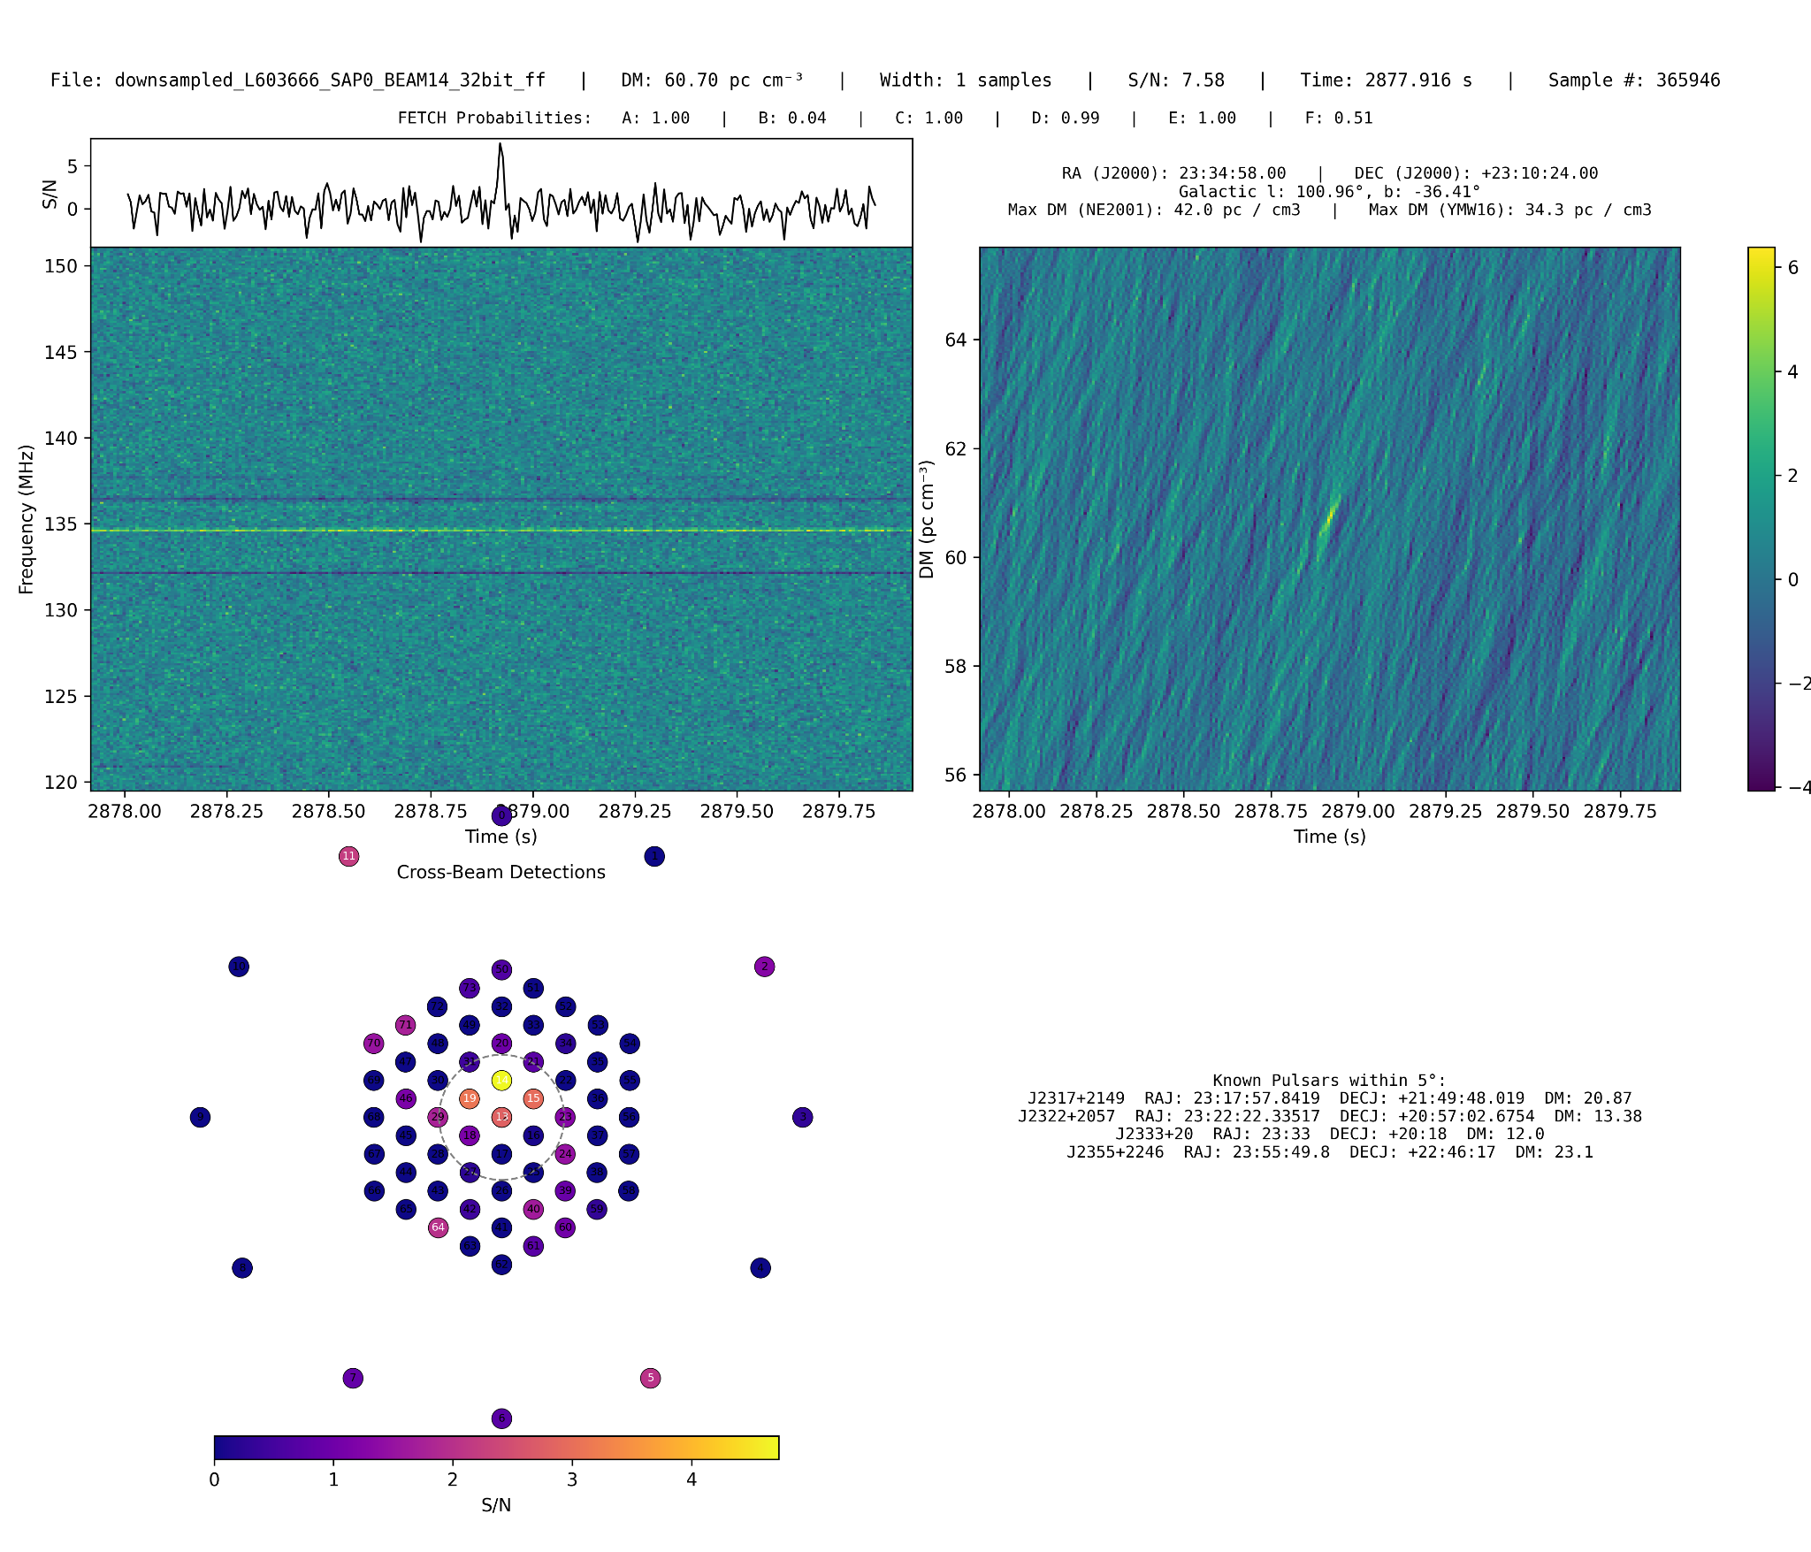
A (tentative) detection
Intro Methods Results Outlook

Slide 17
A (tentative) detection
Intro Methods Results Outlook

Slide 18
A (tentative) detection
Intro Methods Results Outlook

Slide 19
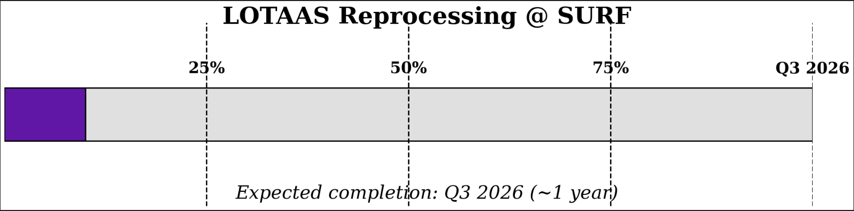
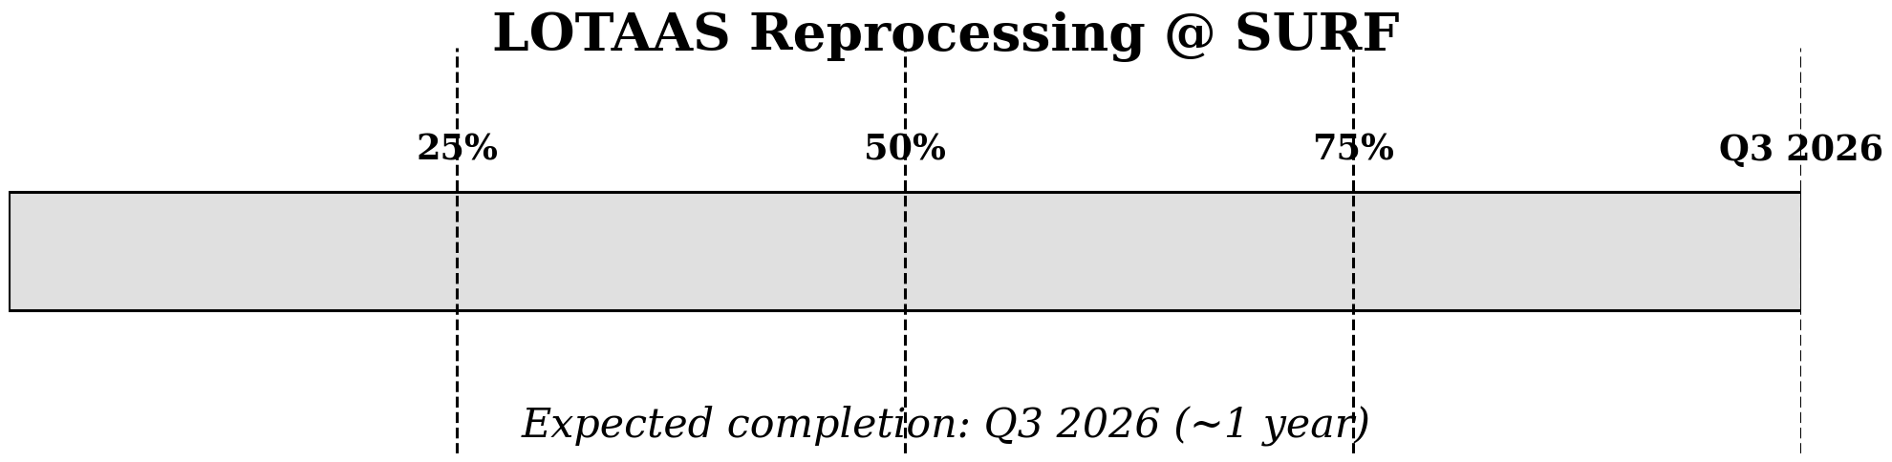

Processing progress
Intro Methods Results Outlook
Pipeline running on SPIDER
Full reprocessing: ~20000 GPU hours + 1000000 CPU hours

Slide 20


What lies ahead?
Intro Methods Results Outlook
LOFAR 2.0: EuroFlash backend - clone of COBALT3
Wide-field searches: up to ~1000 tied-array beams
Single-pulse searches up to extragalactic DMs (>1000)
Running in parallel with LOFAR 2.0 observations
Can we use flatfielding in real time?
More efficiently use computing resources

Slide 21
Takeaways
Intro Methods Results Outlook
Flatfielding slashes false positives (~10³×)
Recovers known pulsars & reveals new signals
Pipeline @ SURF → full LOTAAS in ~1 yr
LOFAR 2.0 + EuroFlash → scalable commensal searches
This project has received funding from the European Research Council (ERC) under the European Union’s Horizon 2020 research and innovation programme (`EuroFlash’; Grant agreement No. 101098079)

Slide 22
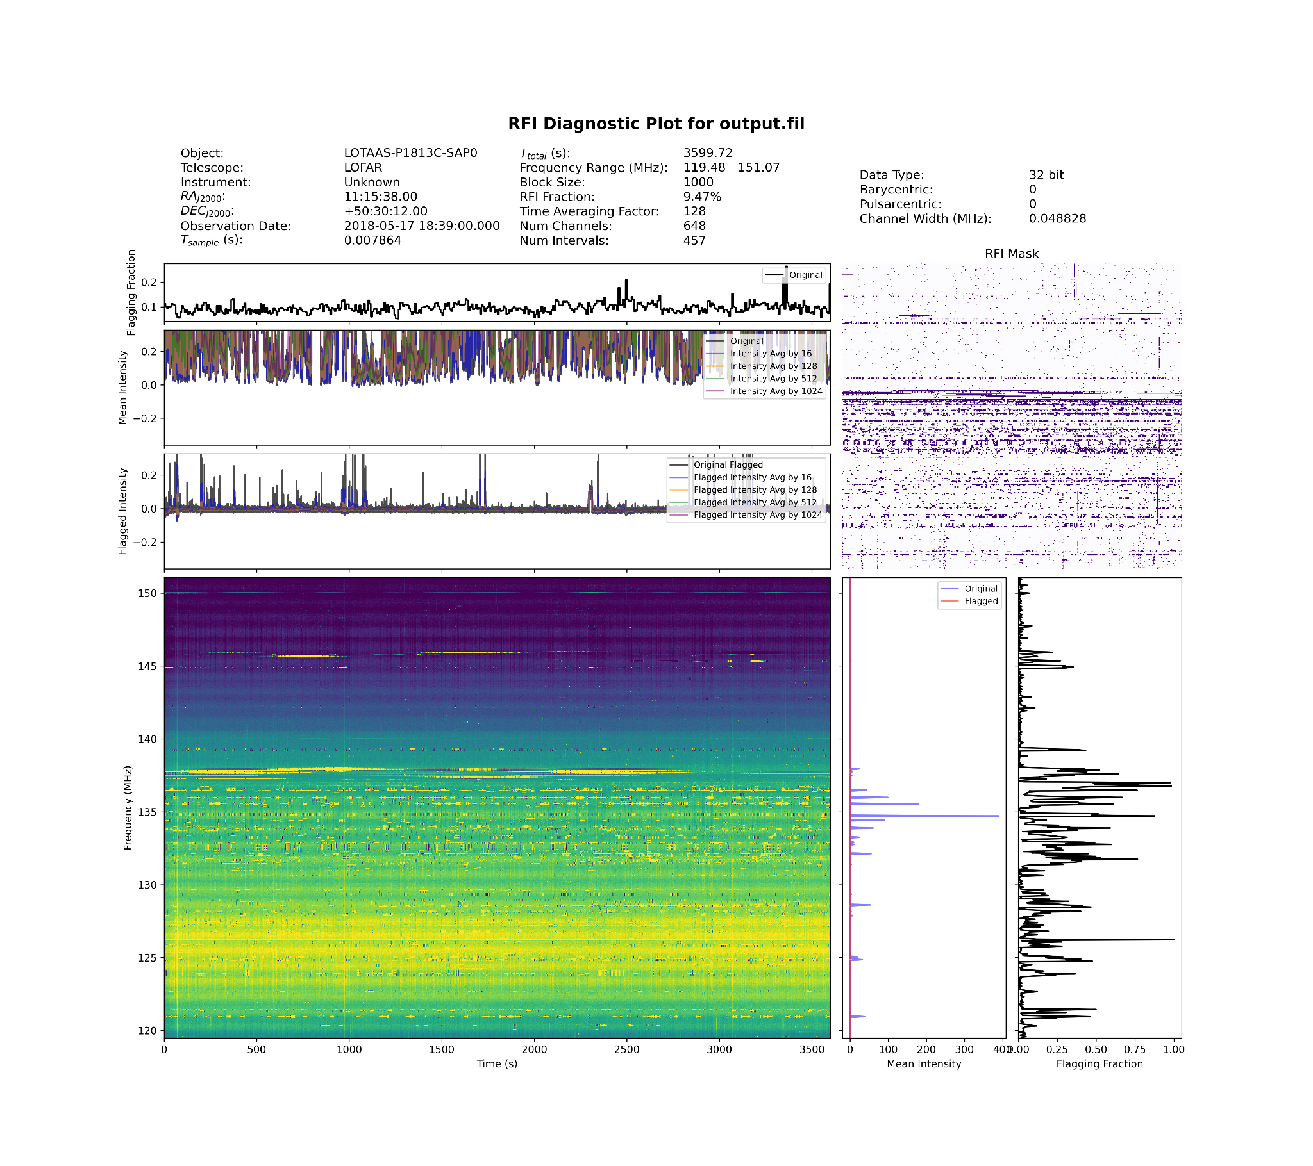
How does the real data look?
Intro Methods Results Outlook

Slide 23
How does the real data look?
Intro Methods Results Outlook

Slide 24
How does the real data look?
Intro Methods Results Outlook

Slide 25
How does the real data look?
Intro Methods Results Outlook

Slide 26
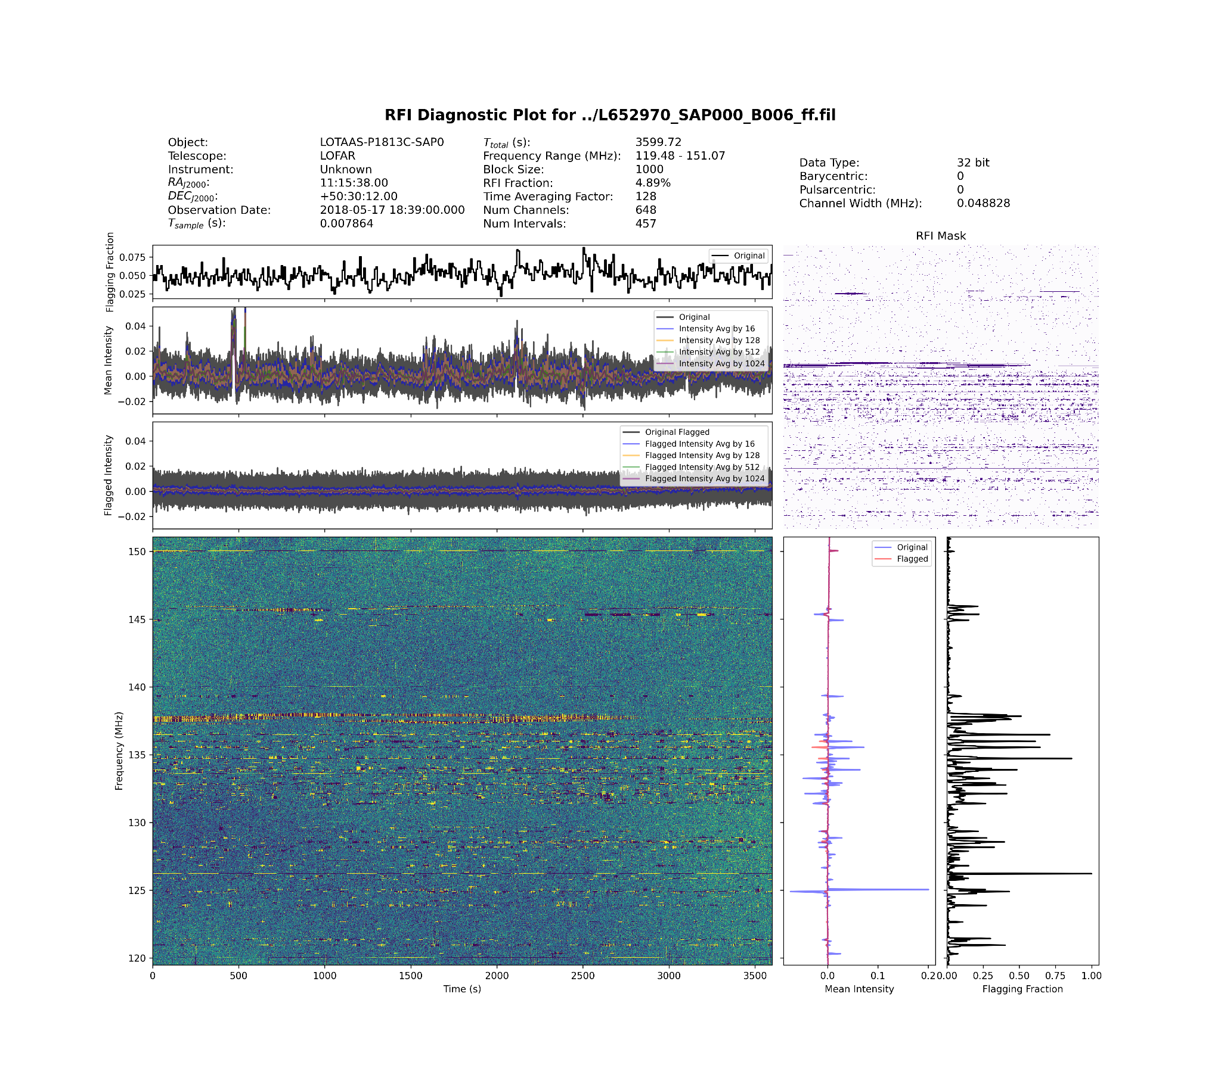
Intro Methods Results Outlook

Slide 27
Intro Methods Results Outlook

Slide 28
Intro Methods Results Outlook
Text HERE

Slide 29
Intro Methods Results Outlook
Text HERE

