Slide 1
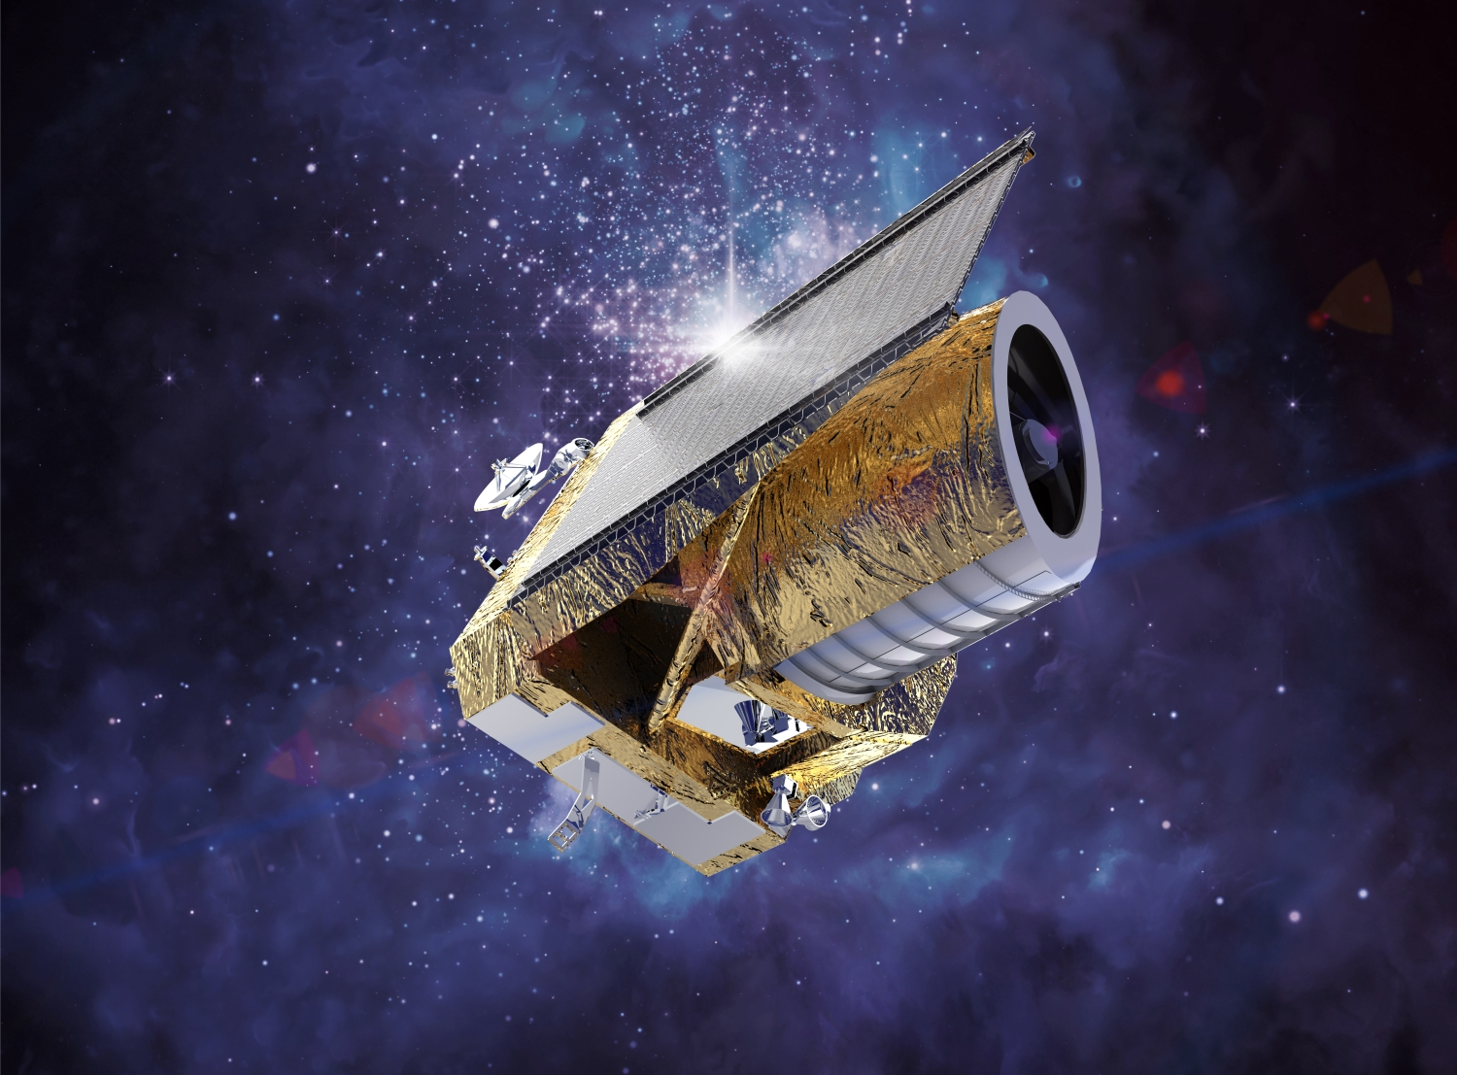
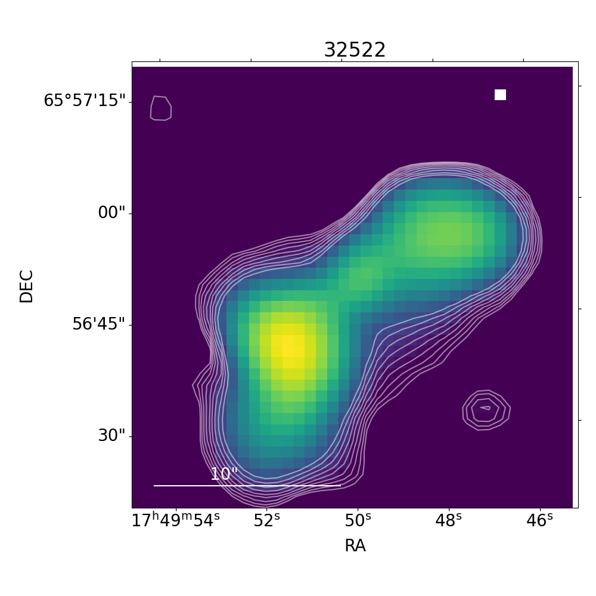
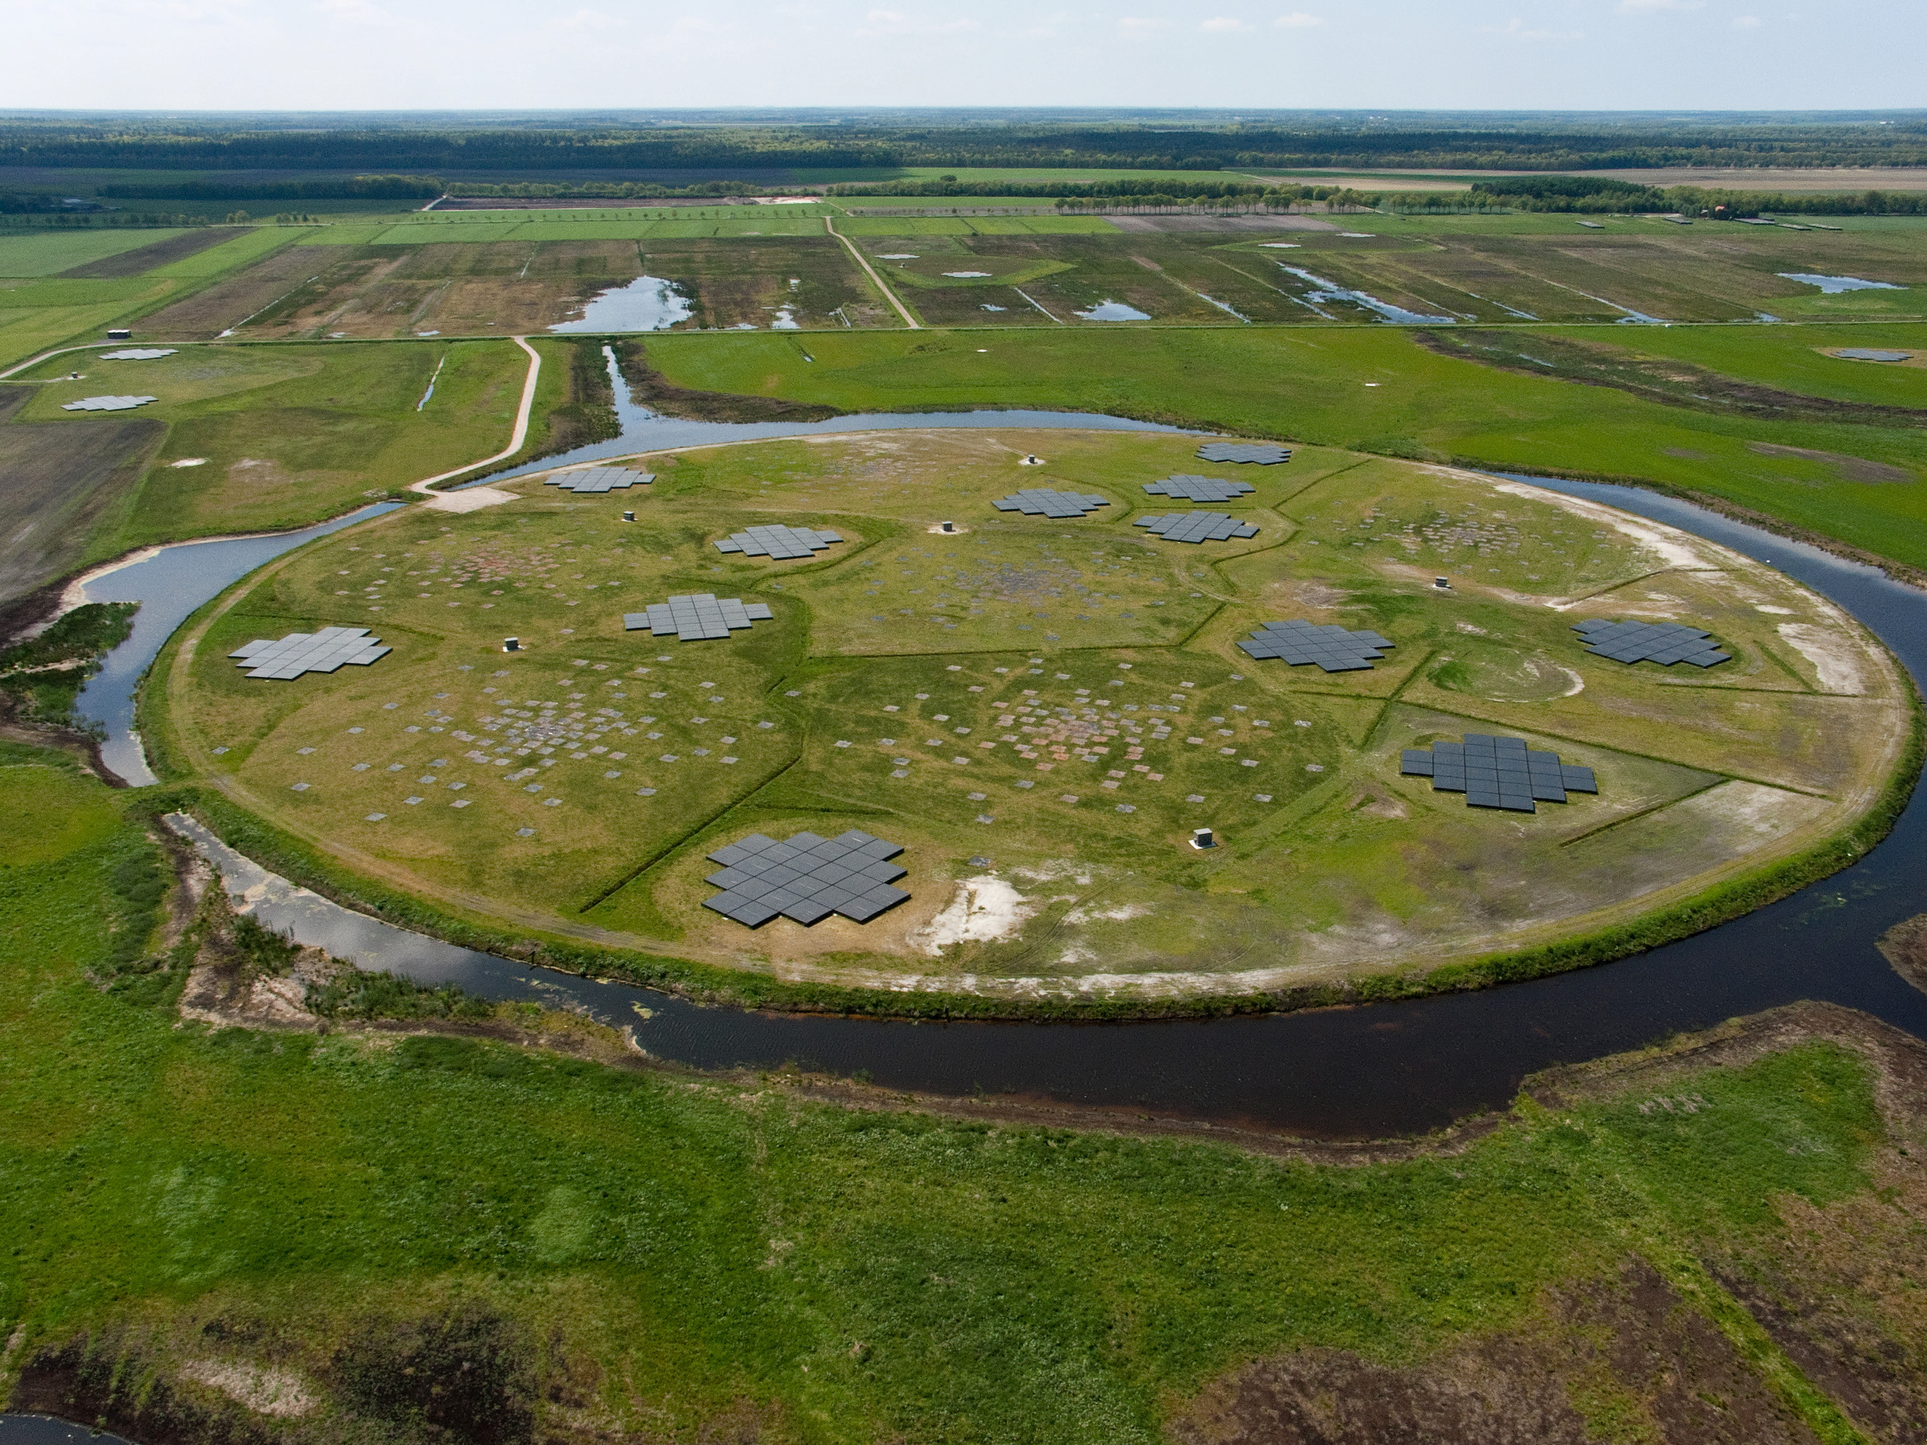
The connection between galaxy close encounters and their radio activity (a joint Euclid/LOFAR venture)
+
Manuela Magliocchetti – INAF/IAPS
Collaborators: A. La Marca, L. Bisigello, M. Bondi, F. Ricci, S.Fotopoulou,
L.Wang, R.Scaramella, L.Pentericci, I.Prandoni…

Slide 2
Aim: Incidence of
merging vs isolated systems in radio AGN and radio SF galaxies and dependence on radio morphology (i.e. whether unresolved or extended emission)

Slide 3
The method
23,333 LOFAR sources in the EDFN observed at 144 MHz
with 6” resolution down to central rms 32μJy/beam. Radio
morphological info available. About 7% extended (Bondi+24)
19,401 with multiwavelength info and redshift determination (Bisigello+25)
Radio sources divided into AGN and SFGs with criterion on
(evolving) radio luminosity (Magliocchetti+2014+…)
Radio-AGN and SFGs associated with their Euclid/VIS hosts
and in particular with catalogue of mergers by La Marca+2025
within 0.5<z<2
(Radio) Morphological properties of both AGN and SFGs
investigated wrt optical morphology of their host galaxies

Slide 4
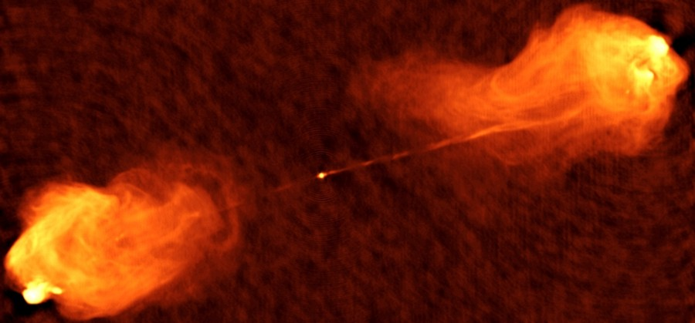
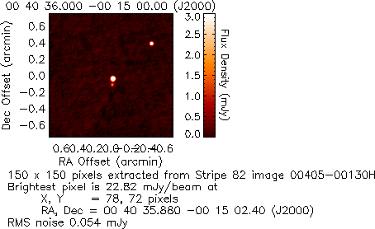
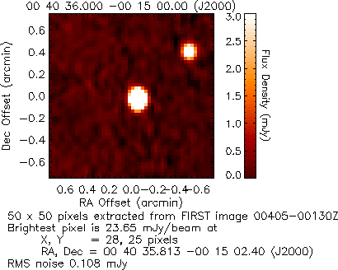
RADIO-EMITTING AGN OR STAR-FORMING GALAXY?
AGN!!
AGN?/SFG?
AGN?/SFG?
AGN?
Radio AGN
AGN???
Radio AGN
It also depends on resolution

Slide 5
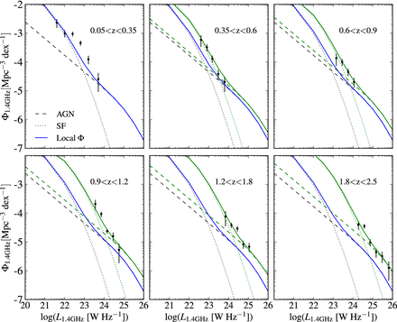
CRITERIA FOR AGN/SF DIVISION IN RADIO SURVEYS
(Magliocchetti+2014;2016,2017,2018a,2018b)
From McAlpine+13 RLF
z evolution of cross-point
from SF-dominated to
AGN-dominated sources:
Log₁₀P_{cross}(z)=Log₁₀P₀,_{cross}+z
@ z<1.8
Log₁₀P_{cross}=23.5 [W/Hz/sr]
@ z>1.8
P₀,_{cross} break of local SF RLF
(Magliocchetti+2002;
Mauch& Sadler 2007)
Rescale from 1.4 GHz to
144 MHz with α=0.7
AGN
AGN
AGN
X-ray AGN
RADIO LUMINOSITY FUNCTION
AGN
AGN
AGN
Radio AGN
McAlpine+2013
RADIO LUMINOSITY
AGN all sources with P(z)>P_{cross}(z)
SF all sources with P(z)<P_{cross}(z) [N.B. also includes
radio-quiet AGNs where radio emission is from SF]

Slide 6
The master catalogue
3456 R-AGN (647 with spectro-z from DESI)
438 extended (13%)
14900 R-SF (3340 with spectro-z from DESI)
26 extended (0.17%)
Matched to the La Marca+25 catalogue which provides morphological information for Euclid galaxies with I_{E}<23.5
in 0.5<z<2
819 R-AGN (47%) and 3679 R-SF (40%) in combined sample
Note: 6” resolution within 0.5<z<2 corresponds to 36-50 pKpc
→ resolved radio emission from outside typical galaxy outskirts

Slide 7
Frequency of association with merging vs isolated systems for R-AGN and R-SF
R-AGN
R-SF
R-AGN preferentially in
merging systems more so
for extended/complex
(45% vs 15%)
R-SF preferentially in
isolated systems (40% vs 25%)
No radio-complex sources

Slide 8
Frequency of association with merging vs isolated systems for R-SF with various P and z
Low P
Low z
Low P
High z
High P
Low z
High P
High z
R-SF preferentially isolated systems in all P/z cases. More marked for low P<10²³ luminosities (caveat: less contamination from RQ-AGN)

Slide 9
Frequency of association with mergers vs isolated systems for R-AGN with various P and z
Low P-Low z
Low P-High z
High P-High z
High P-Low z
z<1 most high luminosity P>10^{24.2} AGN associated with merging
systems (60% vs 10%) regardless of radio morphology. Lower P trend mainly driven by extended AGN. Same for 1<z<2 (caveat: for z>1 only observing bright optical tip of R-AGN iceberg plus low-P incomplete)

Slide 10
Radio vs optical images for FRI in
merging systems
8”x8”
8”x8”

Slide 11
Radio vs optical images for FRII in
merging systems
8”x8”
8”x8”

Slide 12
Extended R-AGN clearly prefer merging
systems: connection with accretion
mechanism (LERGs vs HERGs)?
LERGs → inefficient accretion → weak lines in optical spectra
HERGs → efficient accretion → strong lines in optical spectra
No (Euclid) spectra available yet. Rely on radio morphology and luminosity
Almost all FRI’s are LERGs.
FRII’s mixture of LERGs and HERGs with strong dependence on P
P<~10^25 W/Hz/sr almost all LERGs (e.g. Chiaberge+00; Mingo+19;22…)
LOFAR sample of extended R-AGN even mixture of FRI and FRII + very few P>10^25 W/Hz/sr
LOFAR sample of R-AGN (extended but also with unresolved emission) is made of LERGs
No appreciable dependence on accretion mode
only on radio luminosity and on radio morphology

Slide 13
Examples of FRI associated with
mergers

Slide 14
Examples of FRII associated with
mergers

Slide 15
Extended R-AGN within isolated
systems (even mixture FRI and FRII)

Slide 16
Conclusions
Radio-selected star-forming galaxies are preferentially isolated
systems (~40% vs ~20% in mergers) the more so for low - P<10²³ W/Hz/sr - luminosities at all z<2. Same result also for radio-brighter galaxies at z<1
internal gas reservoirs suffice to trigger star formation in the
majority of galaxies, especially for moderately-to-low SF activity.
Radio-selected AGN do prefer merging systems. Trend primarily driven by a) z<1 high-luminosity – P>~10^24 W/Hz/sr – AGN (~60% in mergers vs ~10% isolated)
b) extended radio emission at all probed redshifts and luminosities
need to fetch outer gas from local encounters in order to trigger
(radio) activity, especially in the case of extended radio emission such
as hot-spots and lobes. This is mostly observed at z < 1, since in the
local Universe galaxies are more gas deprived than their higher-
redshift counterpart. Result independent of accretion properties.
Waiting for high-resolution LOFAR images to see what happens within galaxy range and in the BH outskirts

Slide 17
Backup slide: luminosity vs redshift

Slide 18
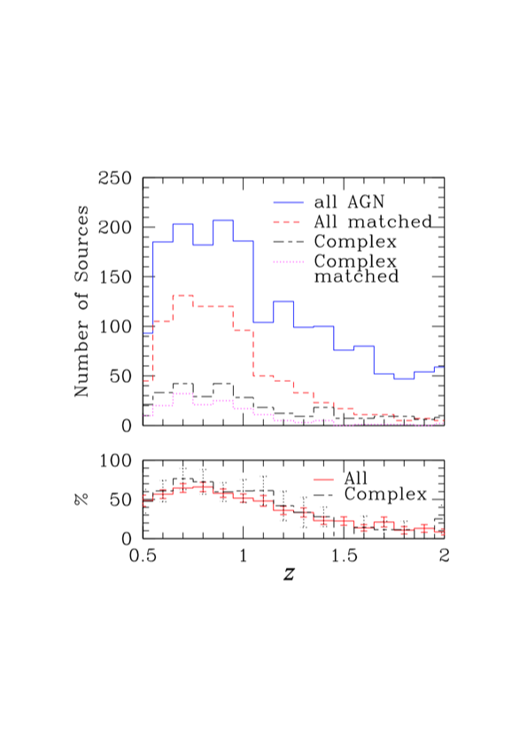
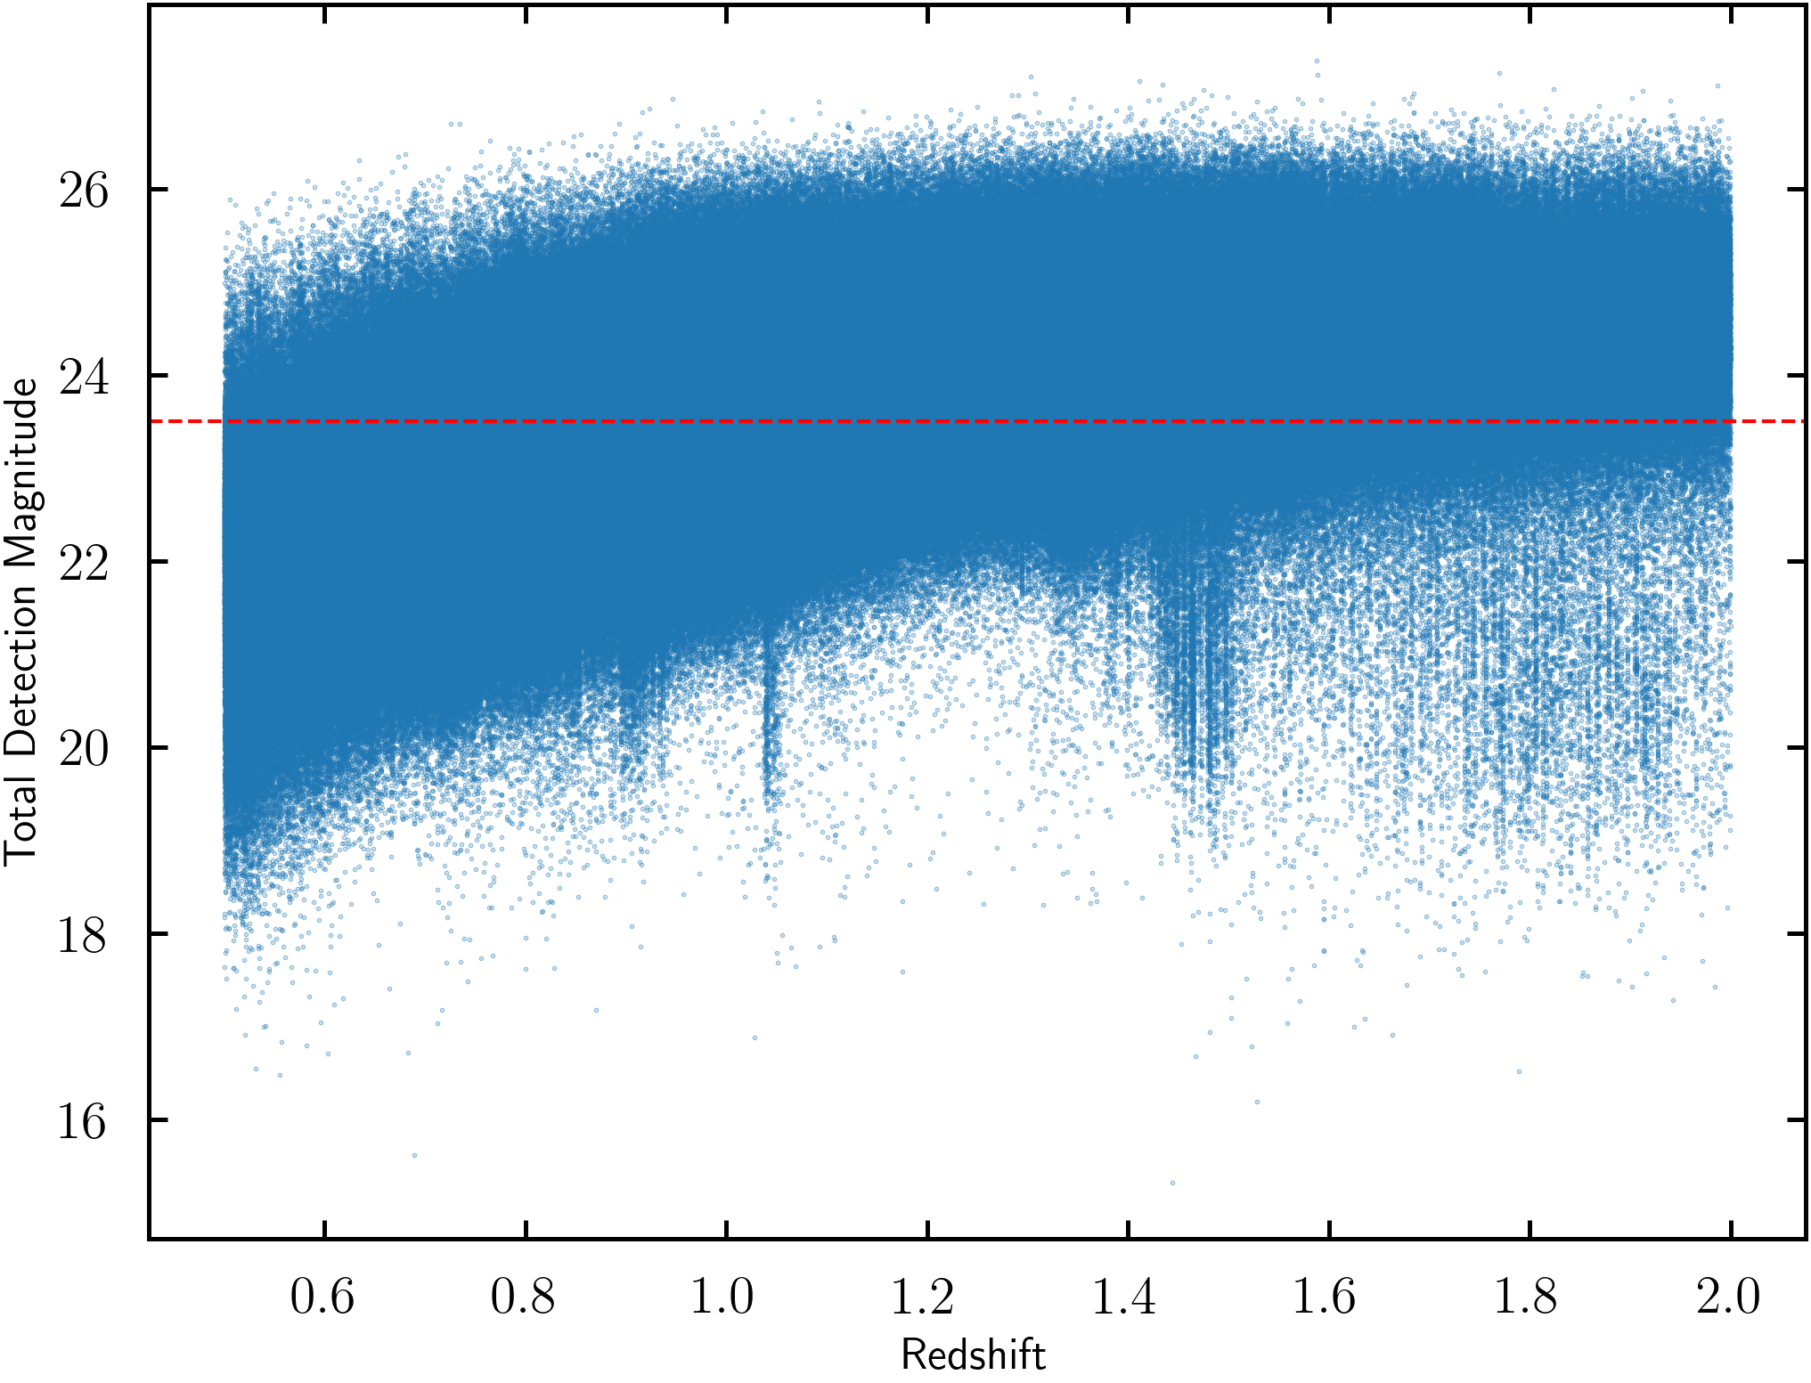
The redshift distributions
R-AGN+extended
R-SF
redshift
redshift
Ratio parent vs matched sample
60% in 0.5<z<1 then decreases
to 15% at z=2 in all cases
Same as all Euclid
galaxies due to
I_{E} cut
I_{E}=23.5
NO REDSHIFT BIASES
Redshift

Slide 19
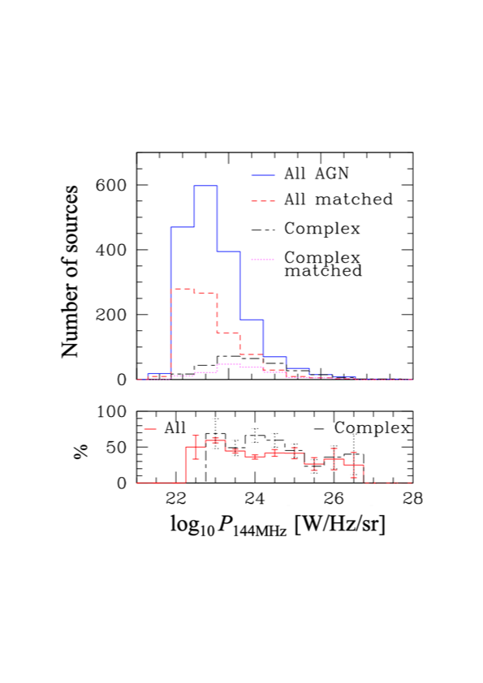
The luminosity distributions
R-AGN+extended
R-SF
Radio Luminosity W/Hz/sr
Radio Luminosity W/Hz/sr
No luminosity bias in
both R-AGN samples
Peak at ~10^{21.5-22.5} W/Hz/sr
then steep decline

