Slide 1
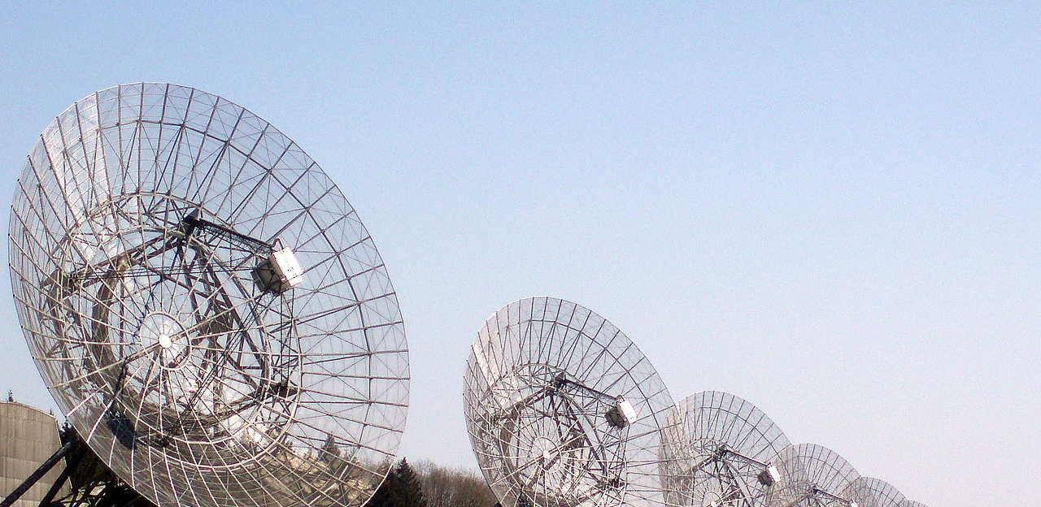
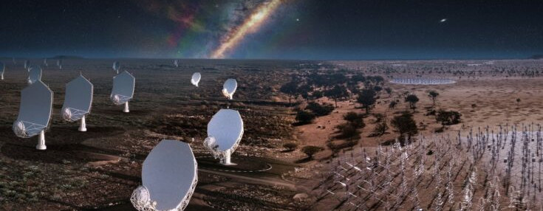

ApPolLo - Apertif counterparts of polarised LOFAR sources
Anna Berger

Slide 2
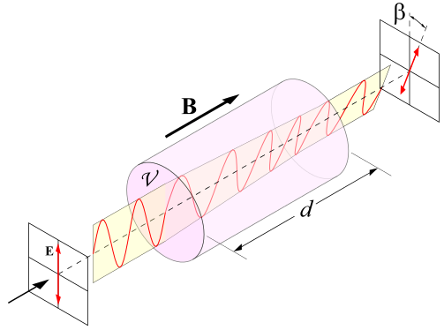
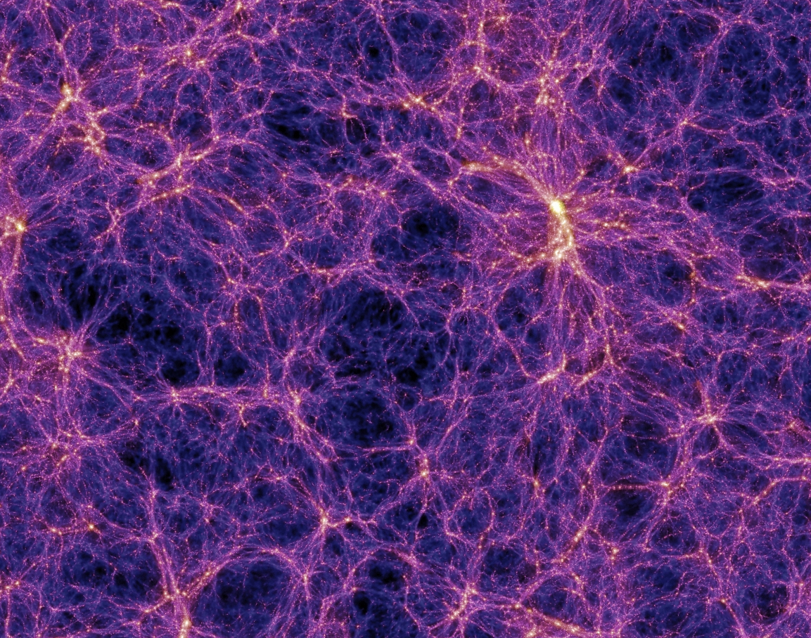
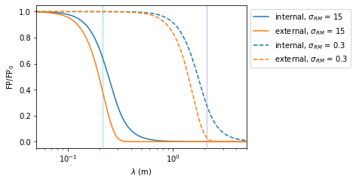
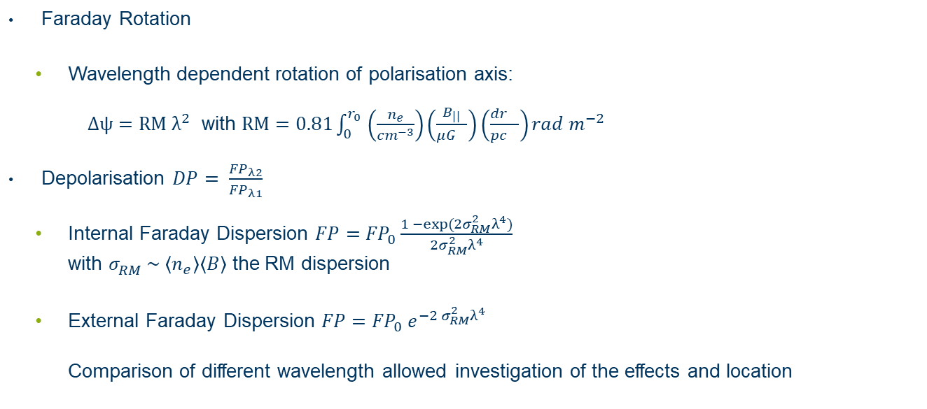
Motivation
Magnetic field evolution
Faraday Rotation
Wavelength dependent rotation of polarisation axis: $Δψ=RM λ^{2}$ with $RM=0.81\int_{0_{}}^{r_{0}}{\left(\frac{n_{e}}{{cm}^{−3}}\right)\left(\frac{B_{||}}{{μG}^{}}\right)\left(\frac{{dr}_{}}{{pc}^{}}\right)rad m^{−2}}$
Depolarisation $DP= \frac{{FP}_{λ2}}{{FP}_{λ1}}$
Internal Faraday Dispersion $FP={FP}_{0}\frac{1 −exp⁡(2σ_{RM}^{2}λ^{4})}{2σ_{RM}^{2}λ^{4}}$ with $σ_{RM}^{} \sim \left\langle n_{e}\right\rangle \left\langle B\right\rangle$ the RM dispersion
External Faraday Dispersion $FP={{FP}_{0} e}^{−2 σ_{RM}^{2}λ^{4}}$ Comparison of different wavelength allowed investigation of the effects and location

Slide 3
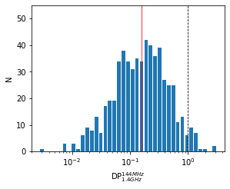
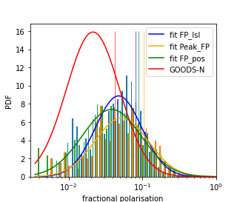
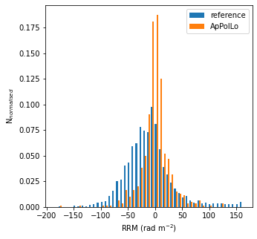
Overview and Comparison
LoTSS DR2 RM grid catalog (O‘Sullivan et al. 2023)
→ 598 ApPolLo sources
Compare to GOODS-N and SVC Apertif data → higher fractional polarisation → lower median RRM → low density environment

Slide 4
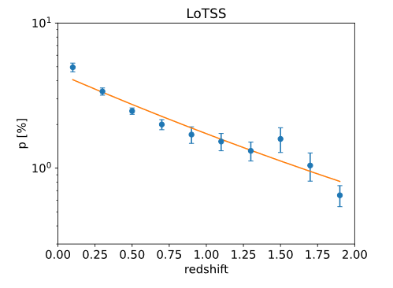
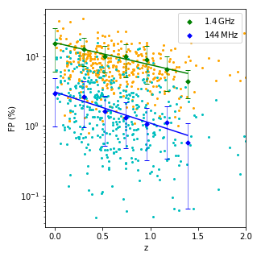
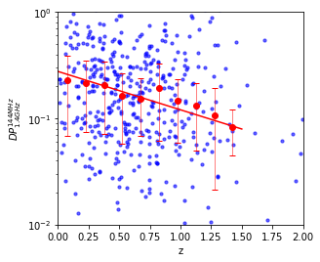
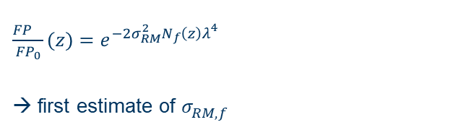

Depolarisation - redshift
Redshift information for 429 ApPolLo sources
${DP}_{1.4GHz}^{144MHz}= \frac{{FP}_{144MHz}}{{FP}_{1.4GHz}}$
$\frac{\begin{aligned} \\ {FP}_{}\end{aligned}}{{FP}_{0}}(z)=e^{−2σ_{RM}^{2}N_{f}\left(z\right)λ_{}^{4}}$
→ first estimate of $σ_{RM,f}^{}$
Carretti et. al. 2022
Berger et. al. in prep.
Berger et. al. in prep.
Include possible redshift depencency

Slide 5
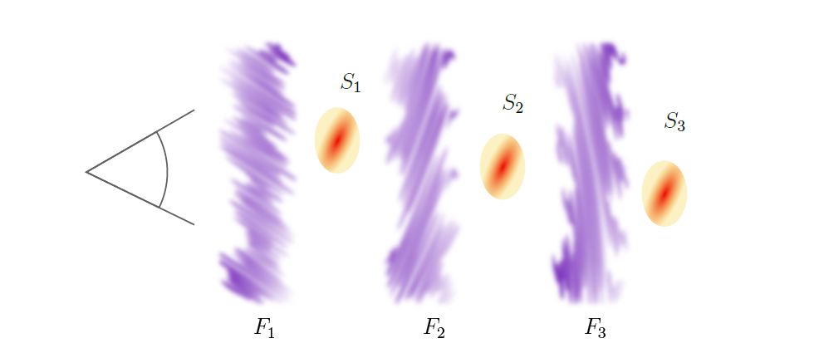
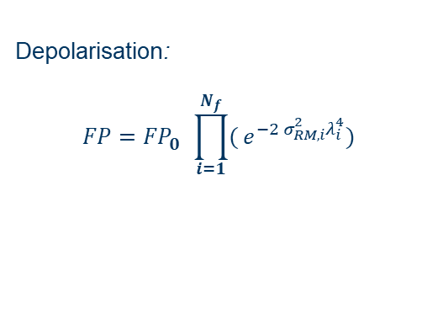
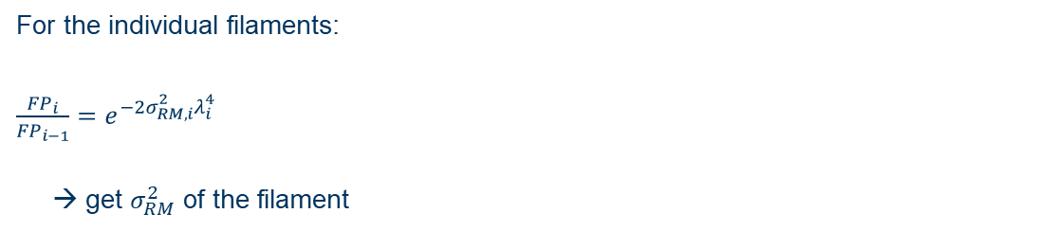
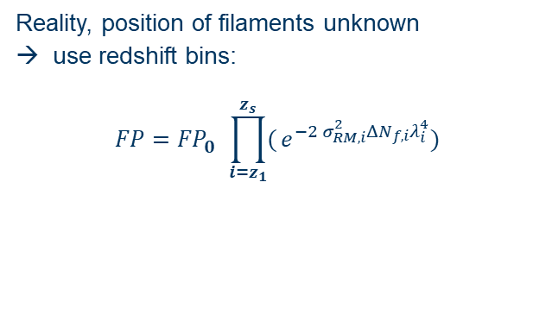
Cosmic Web Filaments
Depolarisation: $$FP={{FP}_{0}^{}\prod_{i=1}^{N_{f}}{(}e}^{−2 σ_{RM,i}^{2}λ_{i}^{4}})$$
For the individual filaments: $\frac{\begin{aligned} \\ {FP}_{i}\end{aligned}}{{FP}_{i−1}}=e^{−2σ_{RM,i}^{2}λ_{i}^{4}}$
→ get $σ_{RM}^{2}$ of the filament
Reality, position of filaments unknown → use redshift bins: $$FP={{FP}_{0}^{}\prod_{i=z_{1}}^{z_{s}}{(}e}^{−2 σ_{RM,i}^{2}{ΔN}_{f,i}λ_{i}^{4}})$$

Slide 6
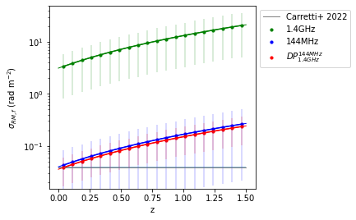
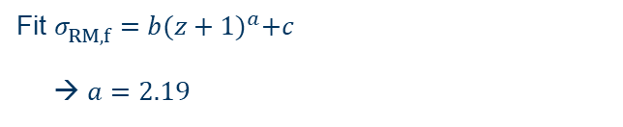
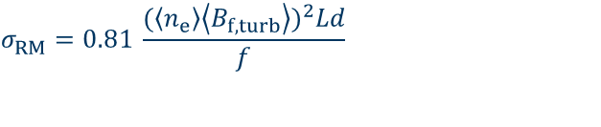

Cosmic Web Filaments
Fit $σ_{RM,f}^{}=b{(z+1)}^{a}+c$
→ $a=2.19$
$$σ_{RM}^{}=0.81 \frac{{(\left\langle n_{e}\right\rangle \left\langle B_{f,turb}\right\rangle )}^{2}Ld}{f}$$
with $n_{e}∝{(z+1)}^{3}$ and $L∝{(z+1)}^{−1.4}$ → $B_{f,turb}∝{(z+1)}^{0.11}$
→ no evolution of $B_{f,turb}$

Slide 7
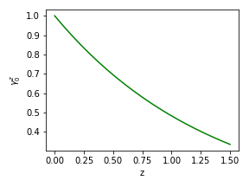
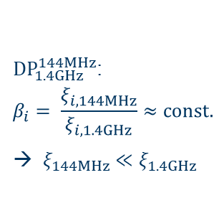

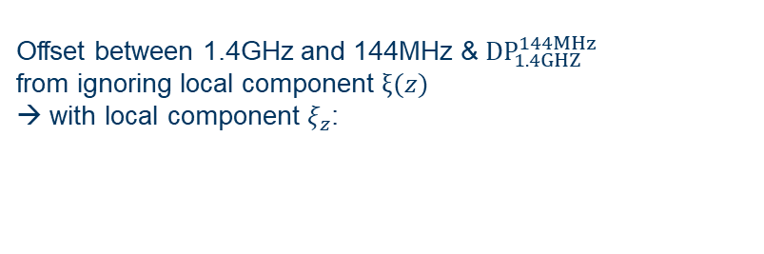


Cosmic Web Filaments
Offset between 1.4GHz and 144MHz & ${DP}_{1.4GHZ}^{144MHz}$ from ignoring local component $ξ(z)$ → with local component $ξ_{z}$:
$$FP={{FP}_{0}^{}ξ_{z_{s}}\prod_{i=z_{1}}^{z_{s}}{(}e}^{−2 σ_{RM,i}^{2}{ΔN}_{f,i}λ_{i}^{4}})$$
Berger et. al. in prep.
Correct 1.4GHz data for $σ_{RM,f}^{}$ from 144MHz:
${DP}_{1.4GHz}^{144MHz}$:
$$β_{i}= \frac{ξ_{i,144MHz}}{ξ_{i,1.4GHz}}≈const.$$
→ $ξ_{144MHz}≪ξ_{1.4GHz}$
1.4GHz and 144MHz: $$γ_{0}^{z}=\frac{ξ_{z}}{ξ_{0}}≈const.$$
Assumptions:
Berger et. al. in prep.

Slide 8
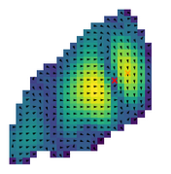
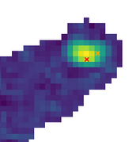
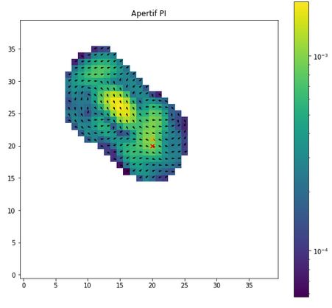
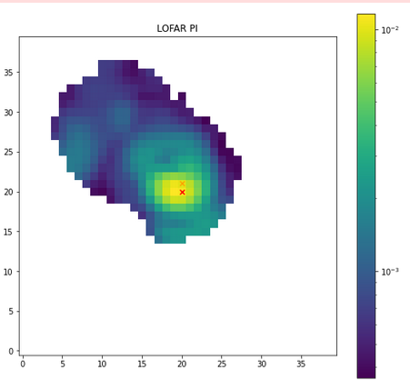
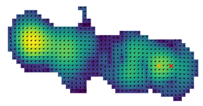
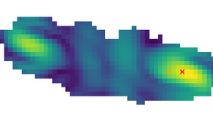
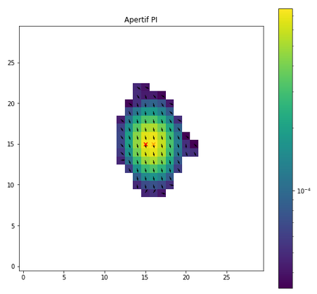
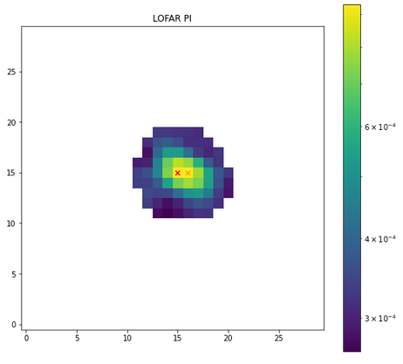
Repolarised Sources
21 sources with DP_peak>1 36 sources with DP_pos > 1
Total 39 sources with any DP > 1
4 IDs not repolarised
4 insignificant /non-detections
2 unclear classification
3 beamdepolarisation
5 extended sources
15 Quasars +2 Seyfert
4 double-doubles

Slide 9
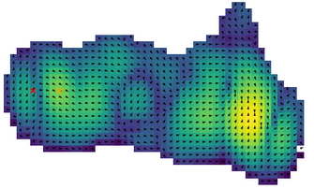
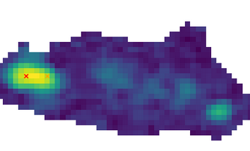
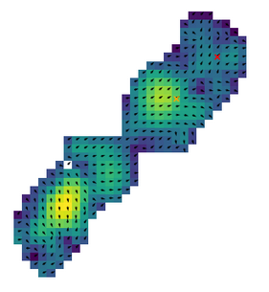
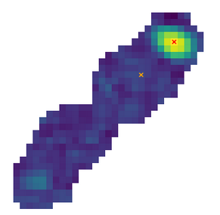
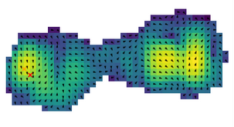
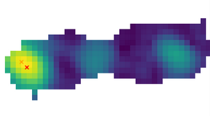
Repolarised Sources
2936
7280
1785
1186

Slide 10

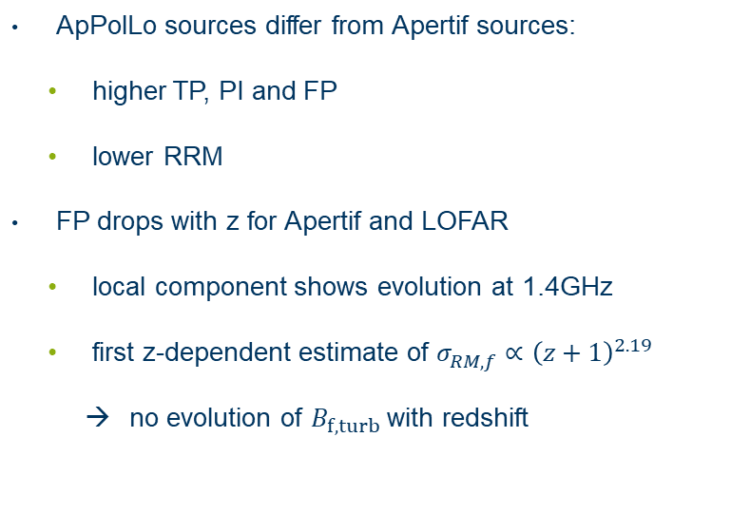
Summary
ApPolLo sources differ from Apertif sources:
higher TP, PI and FP
lower RRM
FP drops with z for Apertif and LOFAR
local component shows evolution at 1.4GHz
first z-dependent estimate of $σ_{RM,f}^{}∝{\left(z+1\right)}^{2.19}$
no evolution of $B_{f,turb}$ with redshift
31 sources with ${DP}_{1.4GHZ}^{144MHz}>1$
15 Quasars (+2 Seyfert)
5 extended sources
4 double double
3 beamdepolarisation
2 unclear

