Slide 1
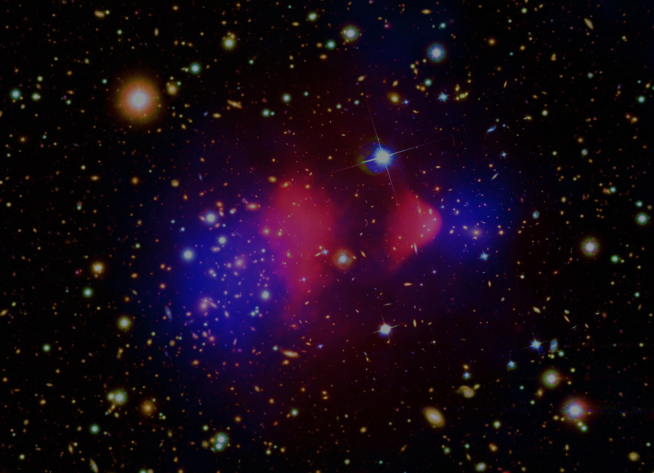


Unveiling the spectral properties of radio halos in the galaxy clusters of the LOFAR sky survey
LOFAR FAMILY MEETING
Sept 22, 2025
Supervisors
Rossella Cassano, Andrea Botteon, Gianfranco Brunetti (IRA-INAF BOLOGNA)
Annalisa Bonafede (University of Bologna)
Koushika Srikanth
PhD cycle 39 (A.Y 2023-2026)
IRA-INAF BOLOGNA

Slide 2
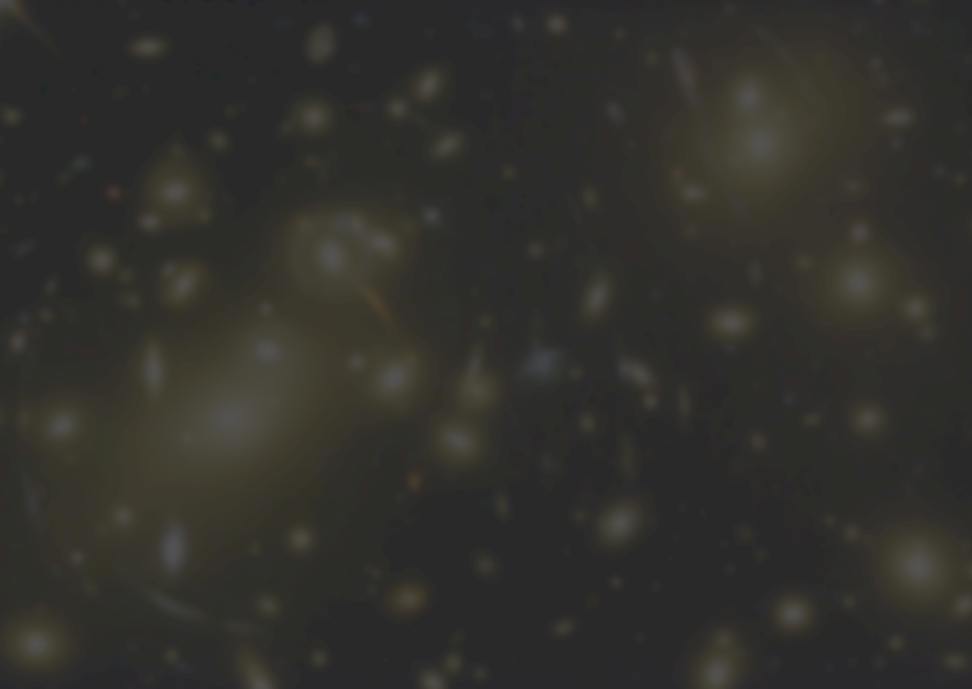
RADIO HALOS IN GALAXY CLUSTERS

Slide 3
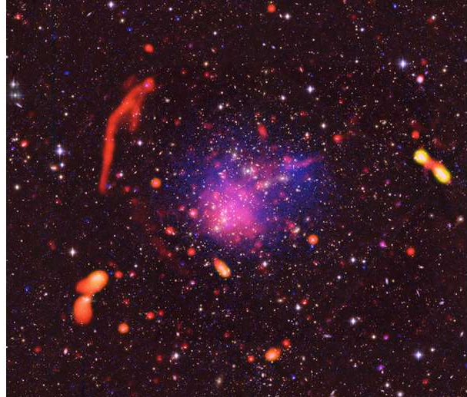
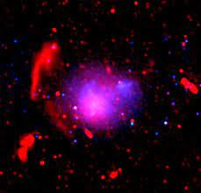
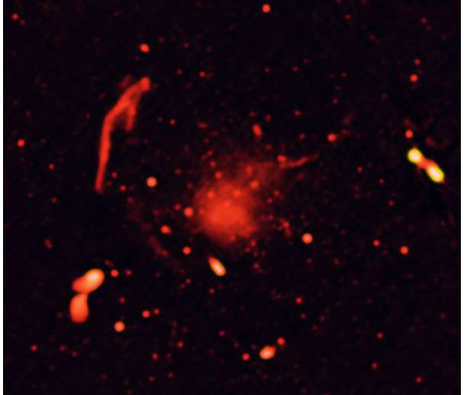
COMPONENTS IN GALAXY CLUSTERS
Galaxy clusters are massive gravitationally bound structure with a mass range of : 10¹⁴ - 10¹⁵ M⊙ .
They are composed of galaxies, baryonic matter, hot gas, dark matter (70%-80%).
Relics
ICM –Plasma between the galaxies in Clusters
THERMAL (Bremsstrahlung X-ray emission)
NON-THERMAL – relativistic electrons and magnetic field (diffuse radio emission like relics, halos, bridges)
Halo
X-ray emisison
A2744 Optical + Xray + Radio

Slide 4
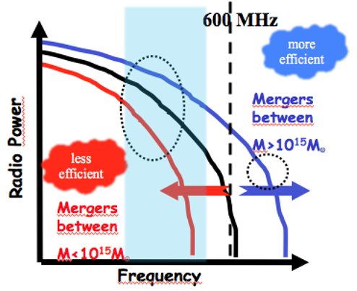
RADIO HALOS​
Diffuse, ~ Mpc Unpolarised synchrotron radio sources
Origin – Turbulence by merging of clusters of galaxies (Fermi II)
Mass of the merging clusters
Turbulent energy
Proof ?
Very low steepening frequency
Bright at lower frequency
Analyzing a large sample of galaxy clusters in LOFAR and uGMRT
First systematic study of 45 radio halos observed in LoTSS-DR2 in uGMRT. (My PhD work)

Slide 5
THE PLANCK CLUSTERS IN THE LOFAR SKY SURVEY

Slide 6

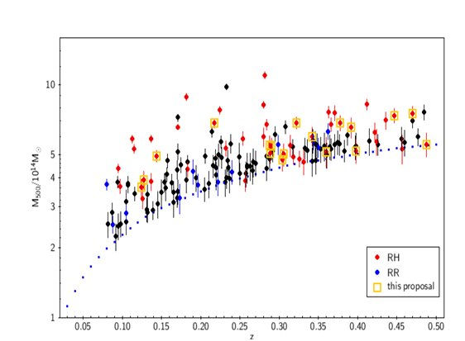
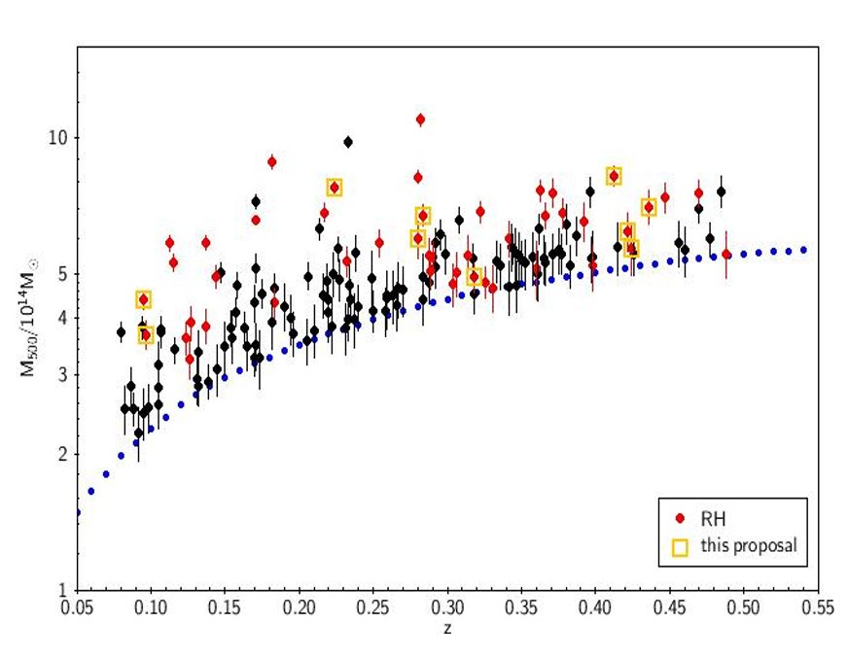
UNVEILING THE SPECTRAL PROPERTIES BY LOFAR-uGMRT
MOTIVE – CONSTRAINING THE SPECTRUM OF RADIO HALOS
45 RH clusters in LOFAR
Proposal uGMRT: 28 clusters
Archive: 17 clusters
309 clusters
164 clusters
LoTSS-DR2 PSZ2 sample
Botteon et al +22
0.07 < z < 0.5
0.08< z < 0.5
Phase 1
Phase 2
Phase 1 : 18 clusters
Phase 2 : 10 clusters

Slide 7
UNVEILING THE SPECTRAL PROPERTIES BY LOFAR-uGMRT
MOTIVE – CONSTRAINING THE SPECTRUM OF RADIO HALOS
45 RH clusters in LOFAR
Proposal uGMRT: 28 clusters
Archive: 17 clusters
309 clusters
164 clusters
LoTSS-DR2 PSZ2 sample
Botteon et al +22
0.07 < z < 0.5
0.08< z < 0.5
Phase 1
Phase 2
Proposal – 28 clusters
Archive – 17 clusters
Why Band 4?
To match Lofar resolution at 5" + recover extended sources
Flatter spectra better imaged at uGMRT
Expecting LOFAR-uGMRT B4 to have similar sensitivities for RHs with α = 1.5
Maximum leverage for spectral studies

Slide 8
PROGRESS

Slide 9
PROGRESS
Processed the uGMRT data with SPAM pipeline (22 clusters).
Produced images at different resolutions.
Discrete source subtraction to study the radio halos.
Found the flux density and spectral index.
1. 2 sigma contours (regions based on LOFAR and uGMRT)
2. LOFAR model injection (injection of a real LOFAR model instead of an exponential model)
Statistical analysis with cluster dynamics.

Slide 10
Diffuse radio emission in the massive clusters Abell 773 and Abell 1351(Srikanth et al in prep)

Slide 11
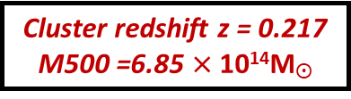
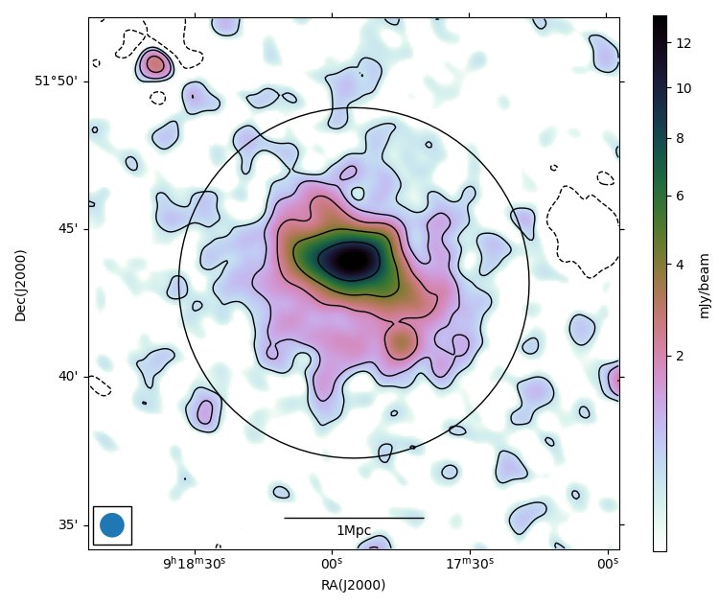
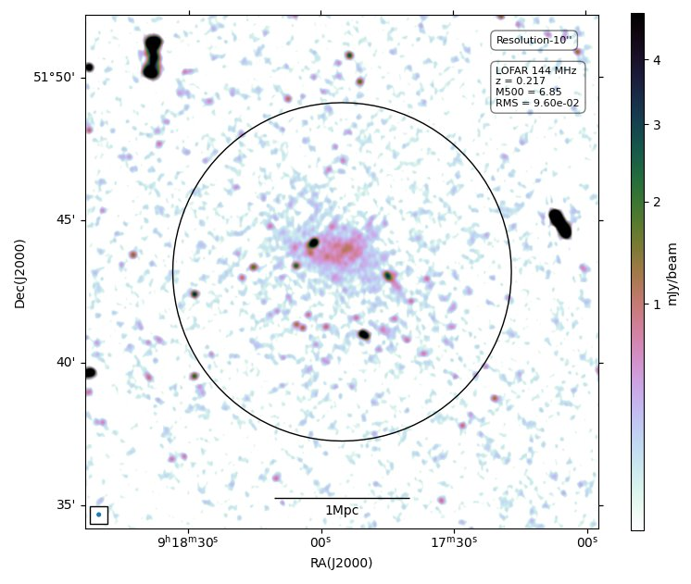
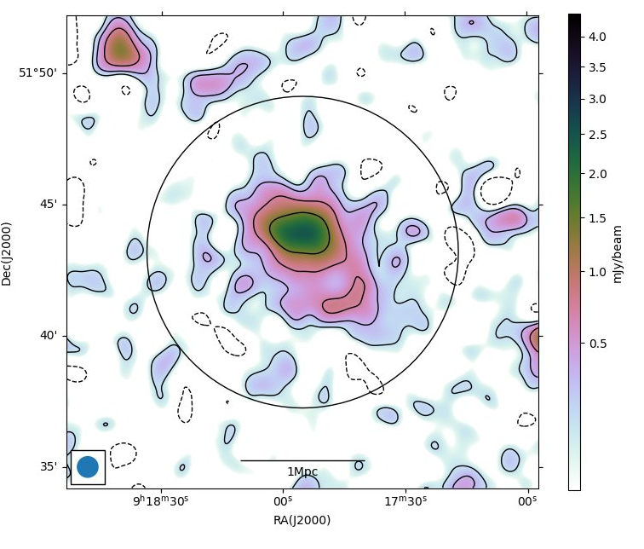
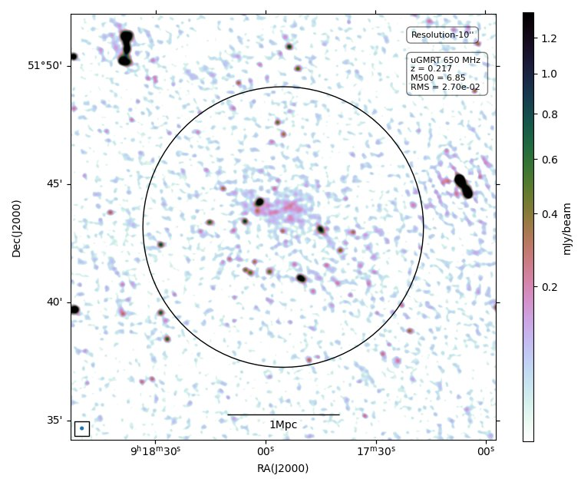
A773
High resolution – 10'' × 10''
Low resolution – 50 '' × 50''
LOFAR
uGMRT
11
(Srikanth et al in prep)

Slide 12
A773
LOFAR
•Active merging cluster.
• Halo is very bright and at the center of the cluster.
•Size of the halo ~1Mpc from LOFAR and uGMRT analysis. ~1.6 Mpc at VLA (F. Govoni et al 2001).
•Halo is extended along NE-SW direction.
Merger axis
Method | LOFAR | uGMRT | Slope
LOFAR 2 sigma | 143.4 ± 14.5 | 27.1 ± 1.5 | -1.1 ± 0.08
uGMRT 2 sigma | 141.1 ± 14.3 | 26.5 ± 1.5 | -1.1 ± 0.08
LOFAR injection | 149.2 ± 15.1 | 28.9 | -1.1 ± 0.07
Flux loss in uGMRT : ~7%
12
(Srikanth et al in prep)

Slide 13
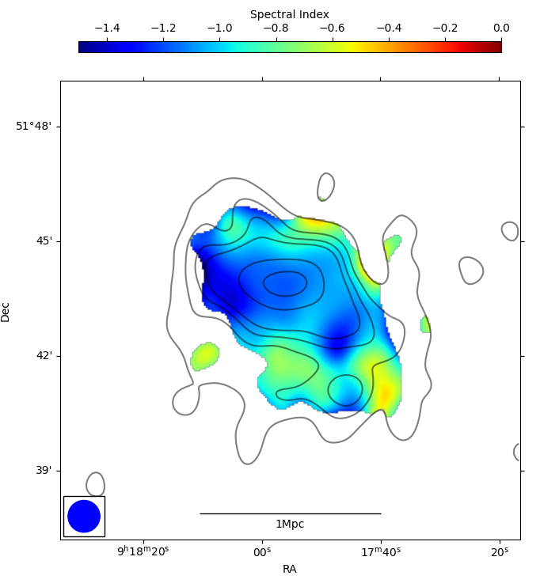
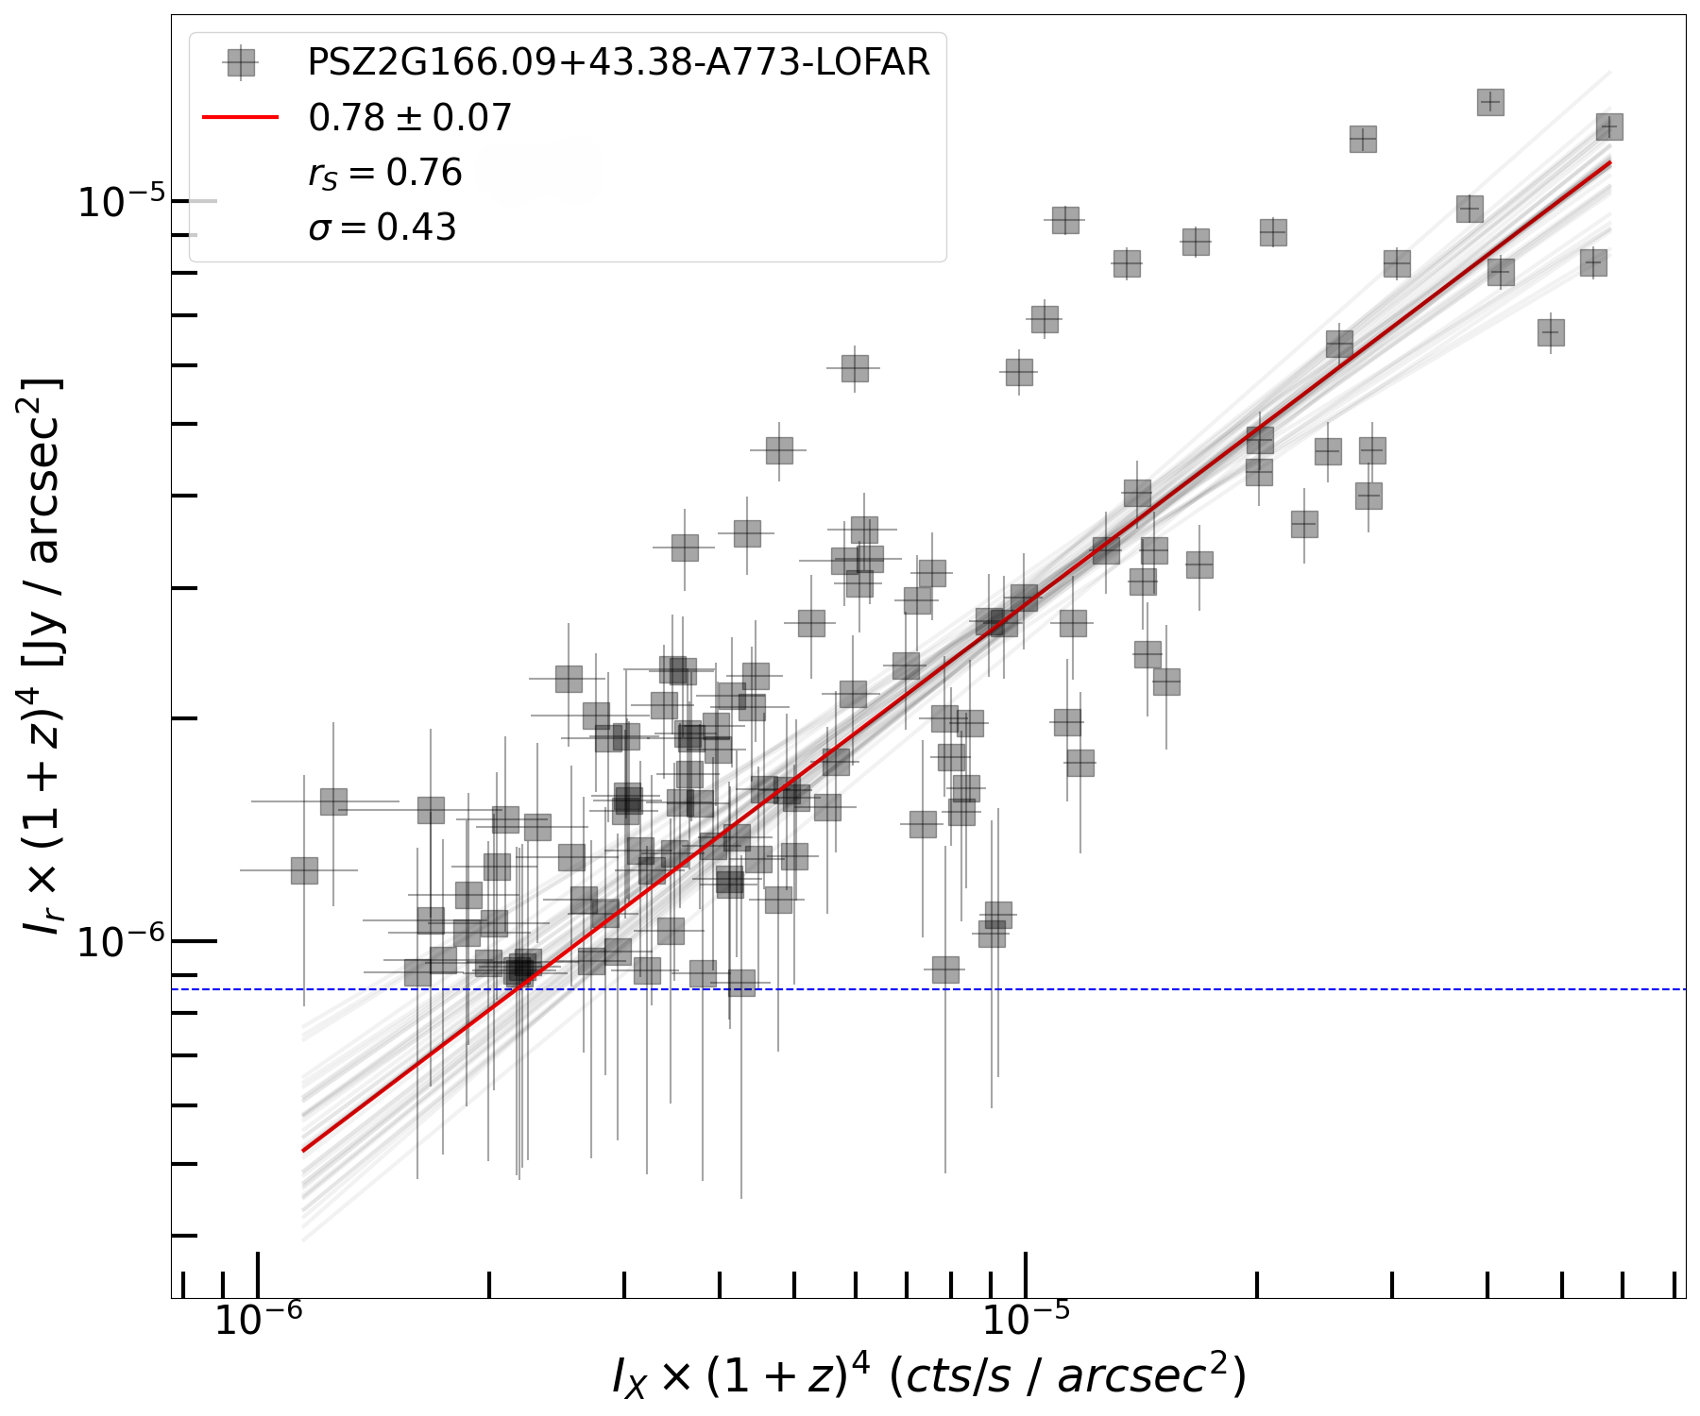
A773 SPECTRAL INDEX MAP AND POINT TO POINT ANALYSIS
Spectral index –1.1 in the center region of the halo.
Sublinear relation – turbulent reacceleration model.
13
Notes:
a slower decline of the non-thermal (CRe +B) component with respect to the thermal one. The majority of the results point towards a weaker radial decline of the non-thermal component with respect to the thermal one.

Slide 14
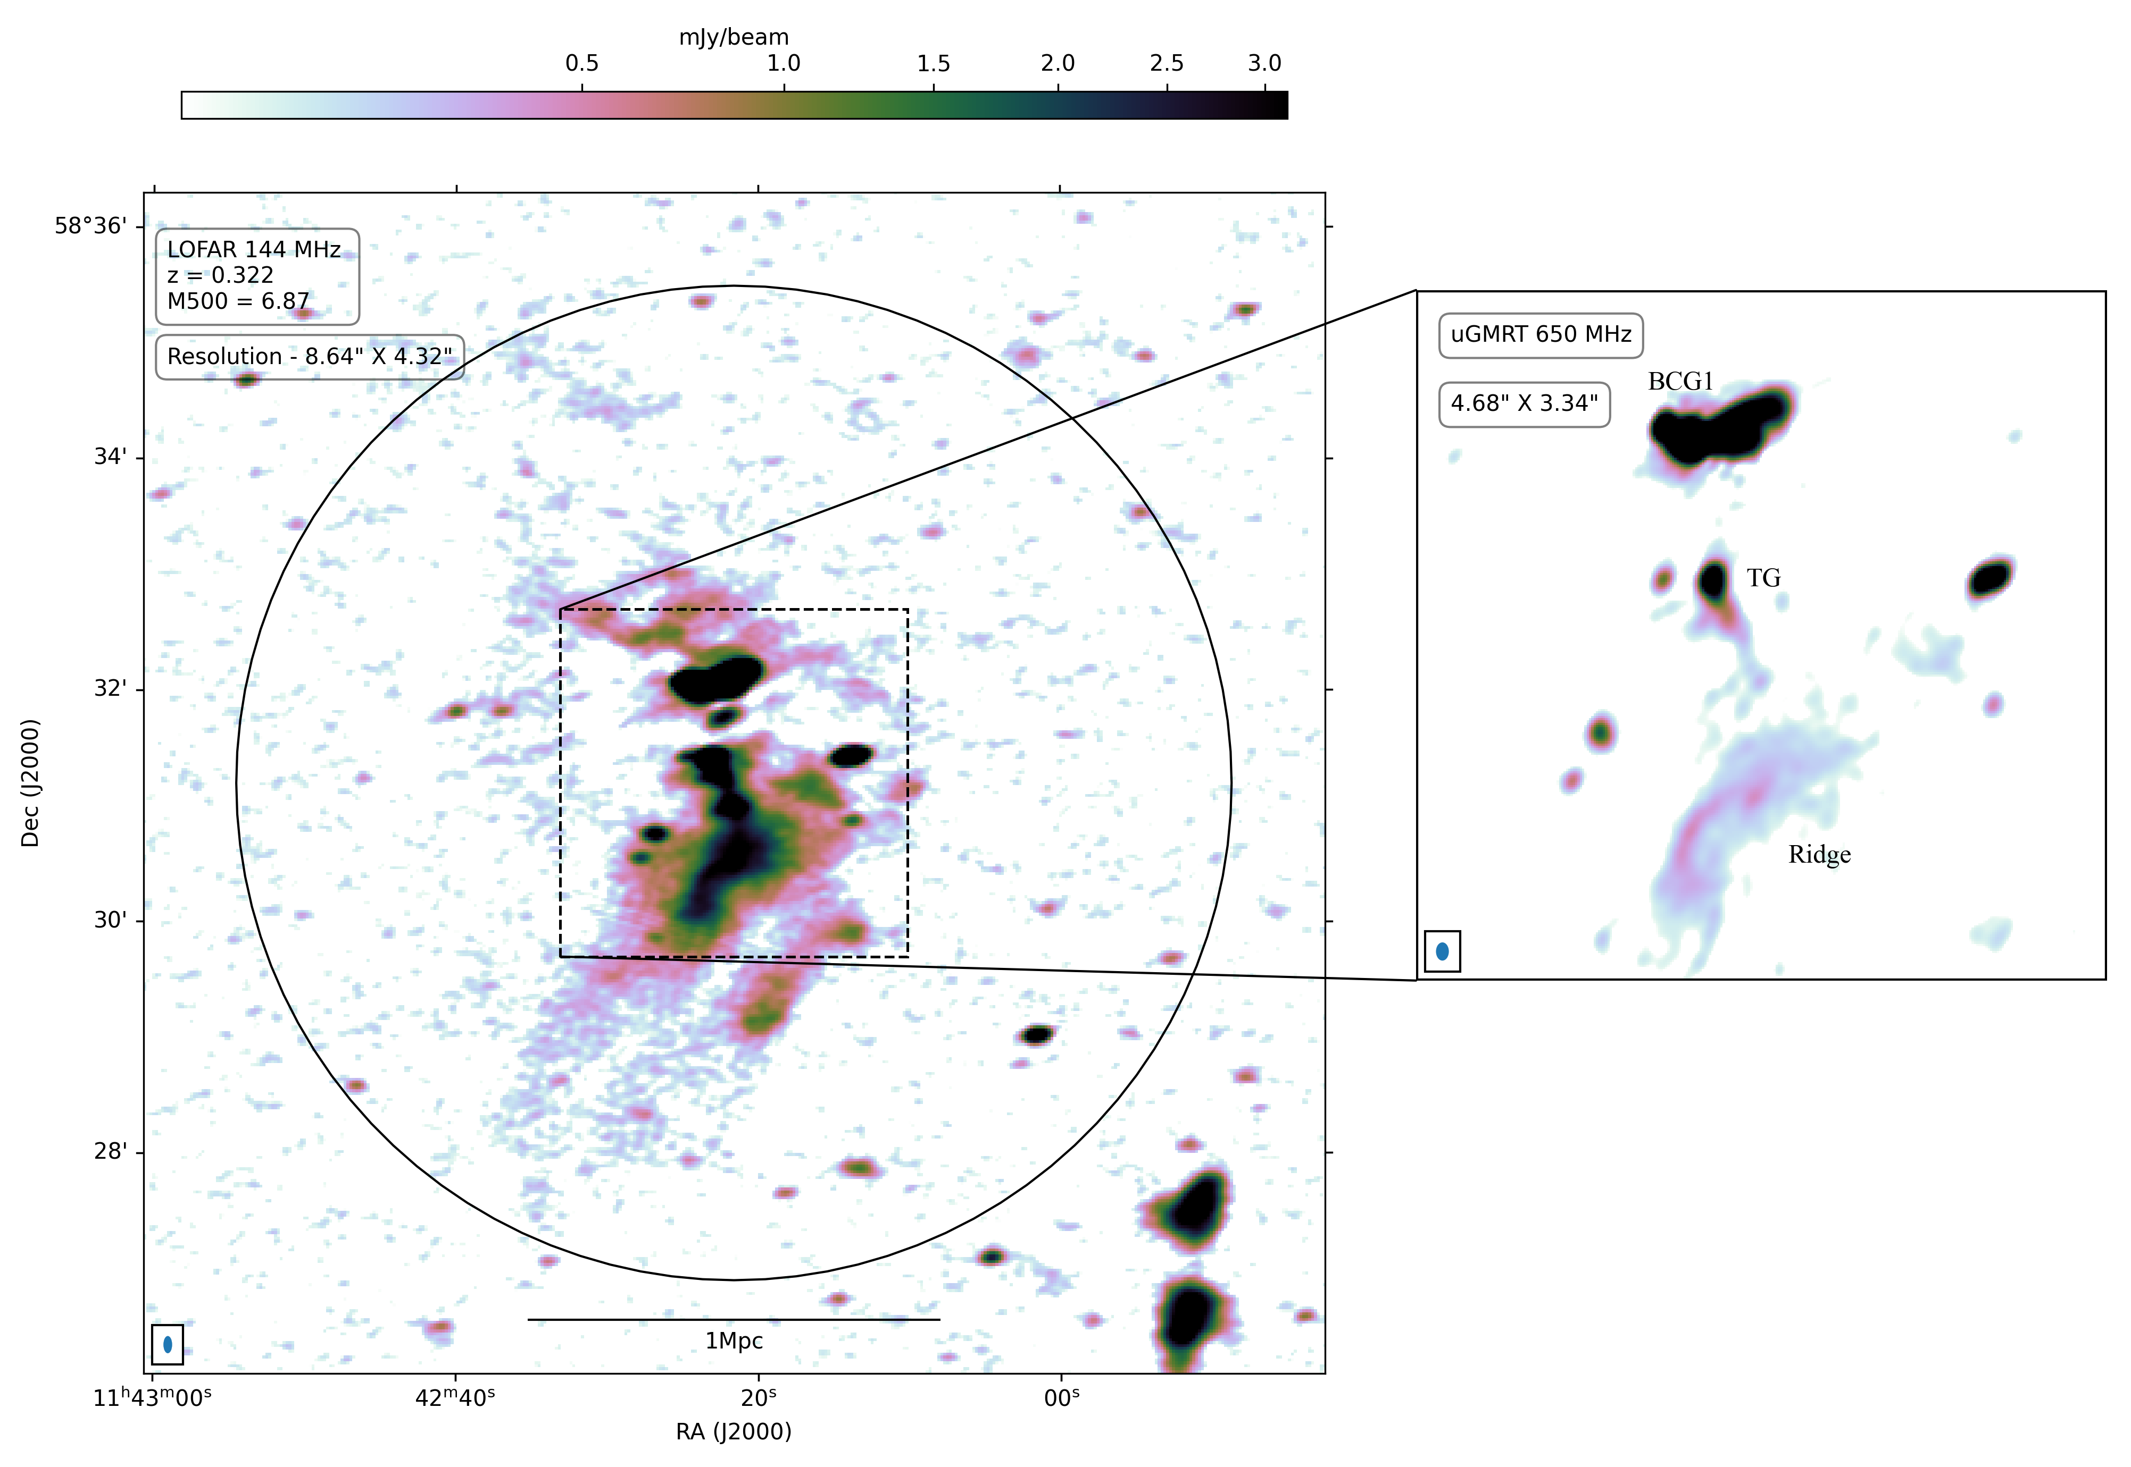
A1351
The source subtraction is difficult and can still leave some residuals in the final subtracted image
Claimed as a relic in the literature (Chatterji 2022, Giacintucci 2009, Barrena 2014)
(Srikanth et al in prep)

Slide 15
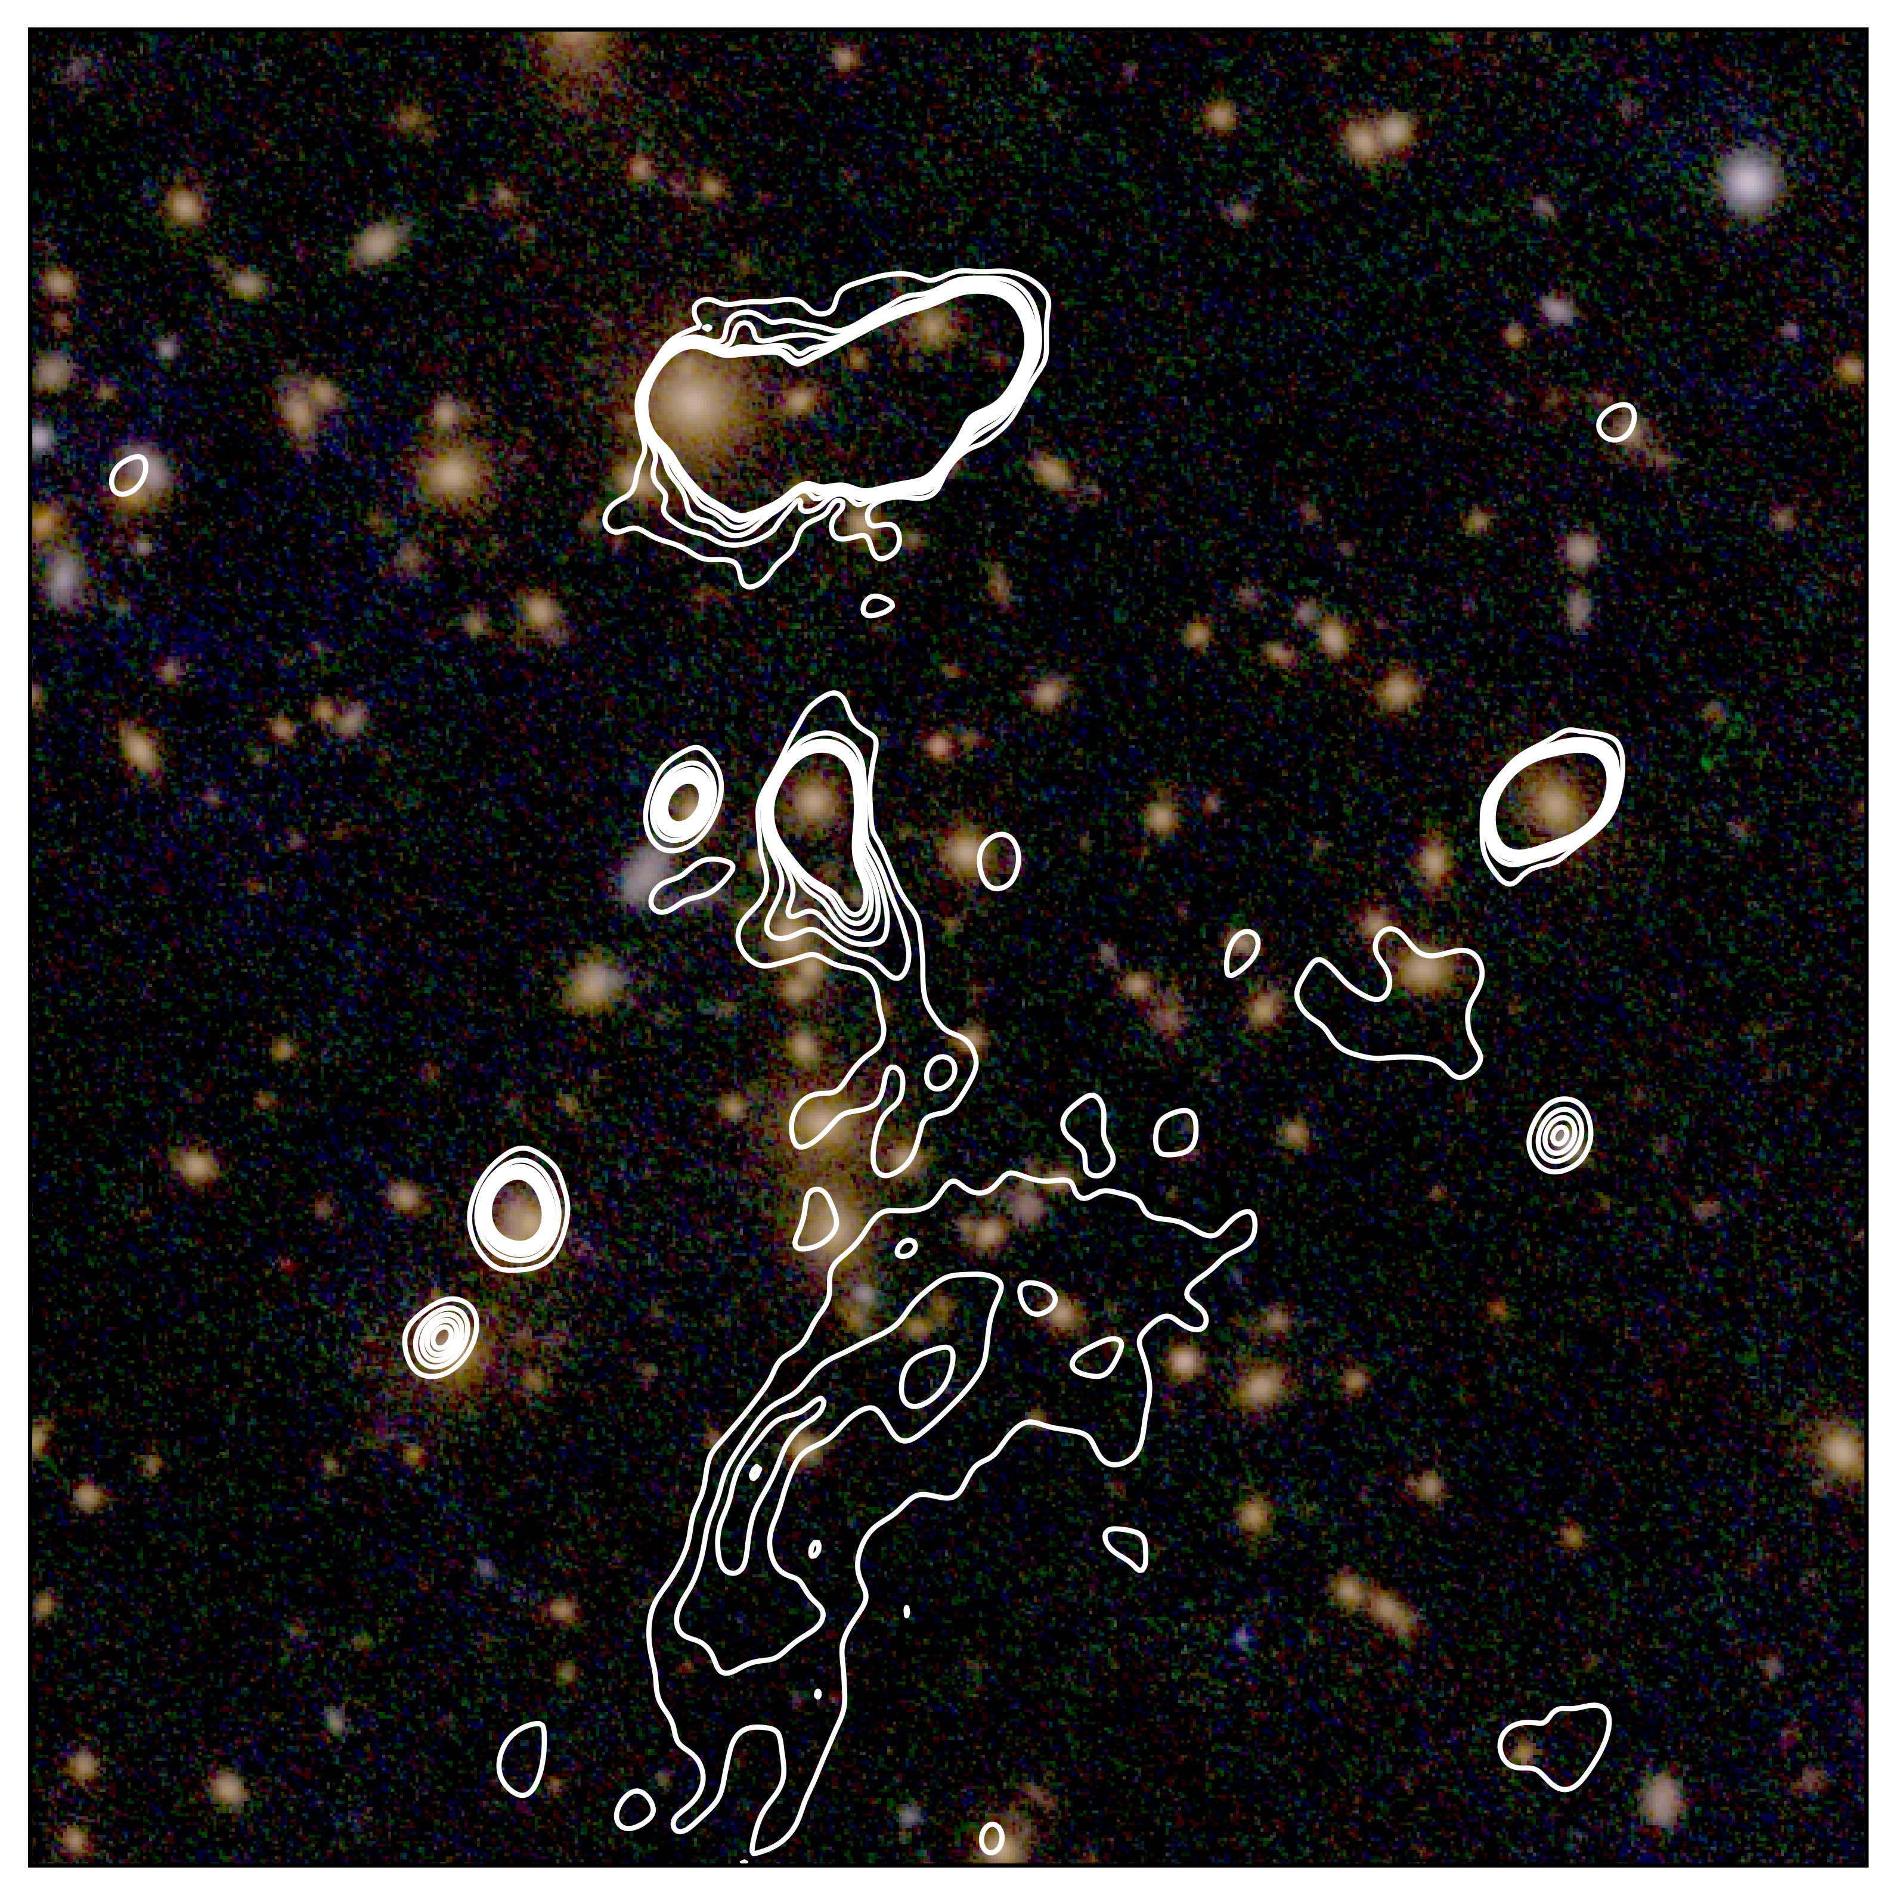
A1351
presence of a galaxy on the center of the ridge with optical overlay.​
(Srikanth et al in prep)

Slide 16
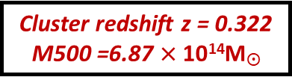
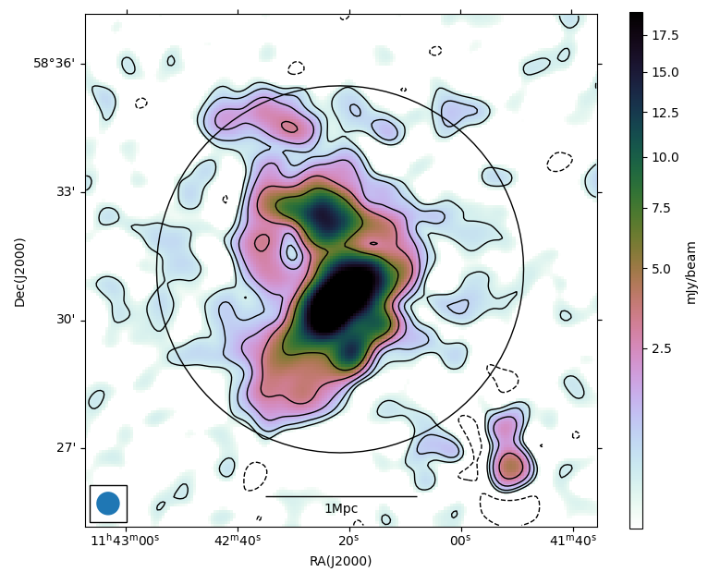
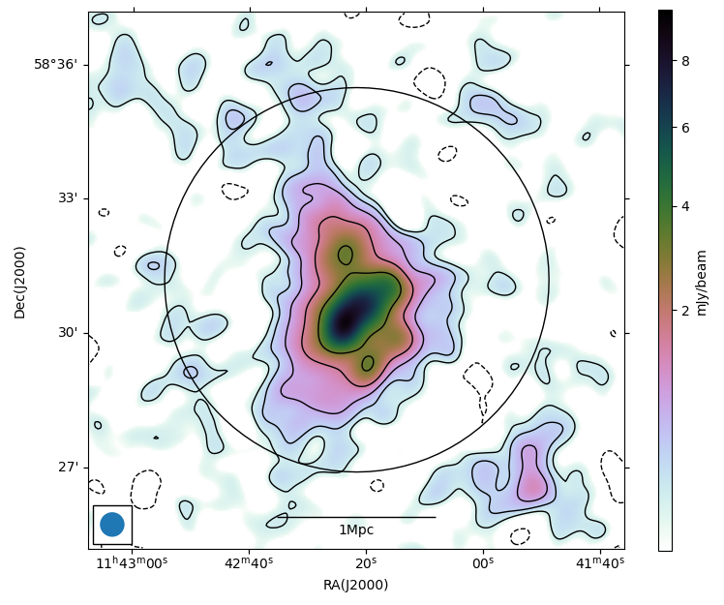
A1351
Resolution – 33'' × 33''
LOFAR
uGMRT
contaminants
16
(Srikanth et al in prep)

Slide 17
A1351
LOFAR
Merging cluster.
Size of the halo ~1 Mpc.
Merger axis NE-SW.
Method | LOFAR | uGMRT | Slope
LOFAR 2 sigma | 392.6 ± 39.3 | 93.4 ± 4.7 | -0.95 ± 0.07
uGMRT 2 sigma | 385.2 ± 38.56 | 91.5 ± 4.6 | -0.95 ± 0.07
LOFAR injection | 408.6 ± 40.9 | 97.6 | -0.95 ± 0.07
Flux loss in uGMRT : ~4-7%
17
(Srikanth et al in prep)

Slide 18
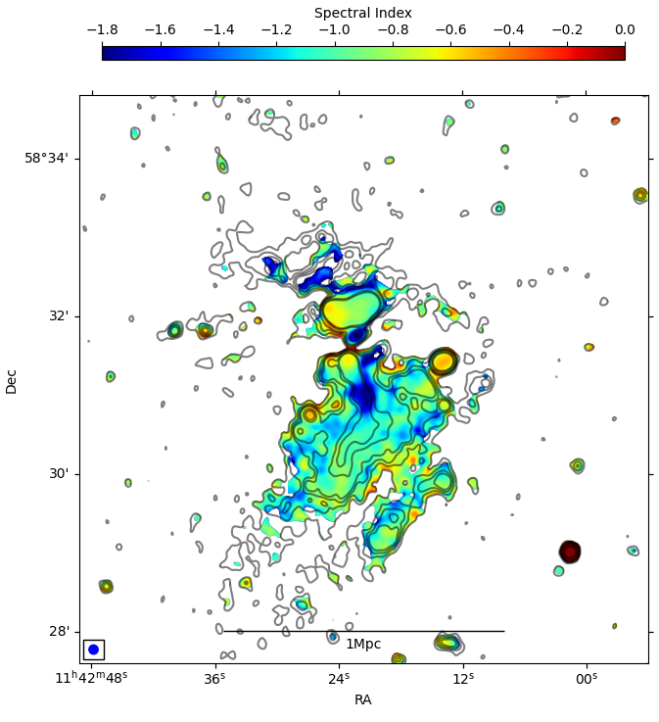
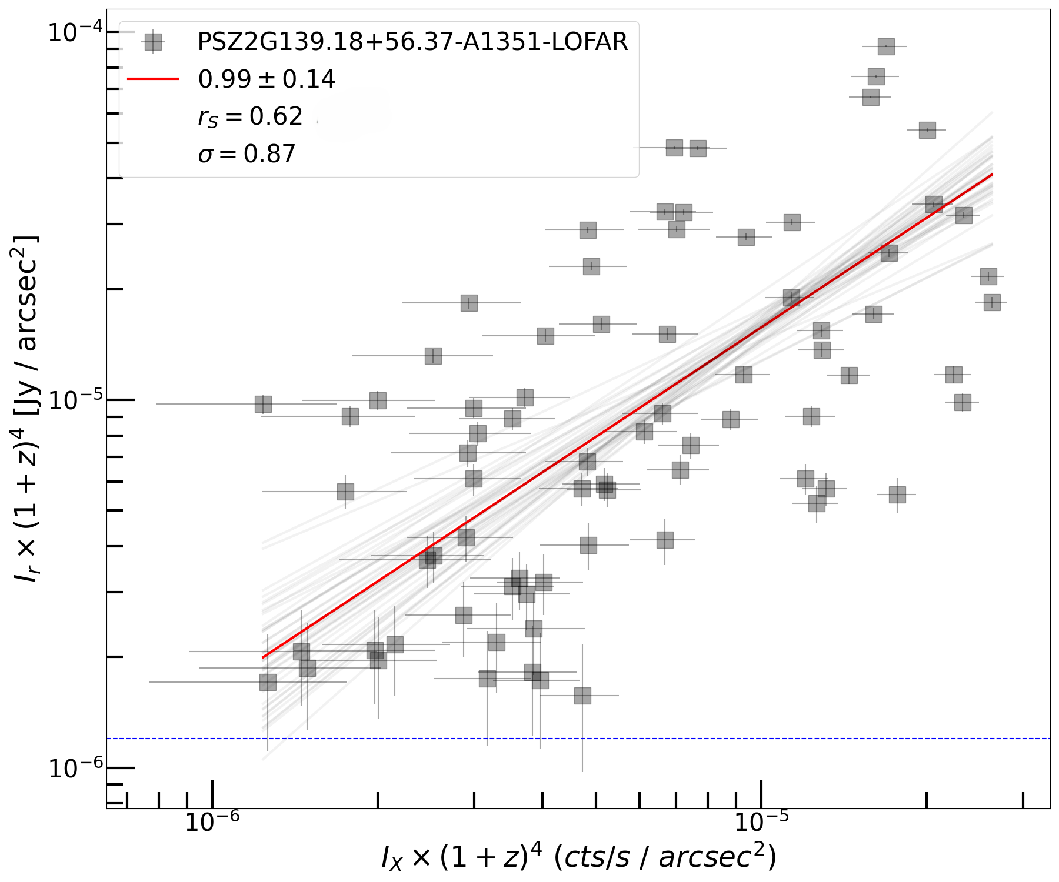
A1351
Resolution - 7 '' × 7 ''
BCG
Steepening of the tail
RG
Ridge-flat
AGN
No spectral steepening along the ridge – from our analysis hints of a radio galaxy-presence of a galaxy on the center of the ridge with optical overlay.
No relation – high amount of scatter due to contaminants.
18
Notes:
the expected correlation between IX and IR in (re-)acceleration and hadronic models is different. In particular, the sublinear scaling often observed in radio halos is hardly reproduced by the hadronic scenarios, as they would require an unphysical amount of CRp in the cluster peripheries to justify such IR−IX relation (e.g. Brunetti & Jones 2014). We provide a consistent comparison among five radio halos whose results confirm the general view that radio halos show sub-linear IR−IX relations. It implies a flatter profile of the radio components with respect to the X-ray one, suggesting the distribution of CRe and/or the magnetic field to be rather flat compared to the thermal ICM. This potentially indicates a larger size of the radio emission than the X-ray one when not limited by sensitivity, as already observed in a few cases (Shweta et al. 2020; Botteon et al. 2020b, 2022b; Rajpurohit et al. 2021a; Bruno et al. 2023).

Slide 19
STATISTICAL ANALYSIS OF THE SAMPLE

Slide 20
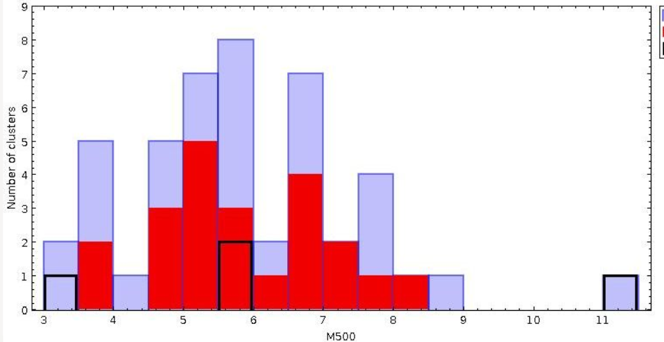
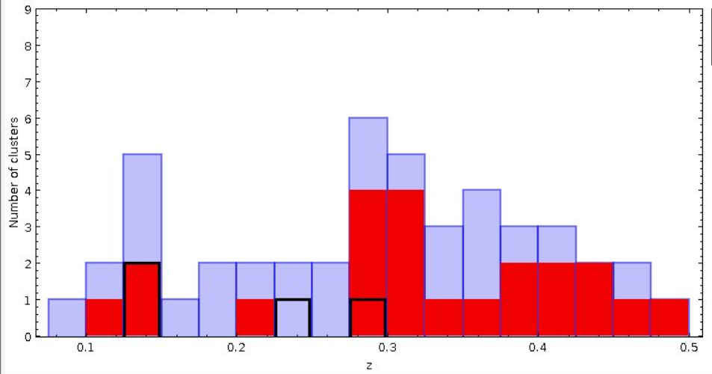

DISTRIBUTION OF MASS AND REDSHIFT
20

Slide 21
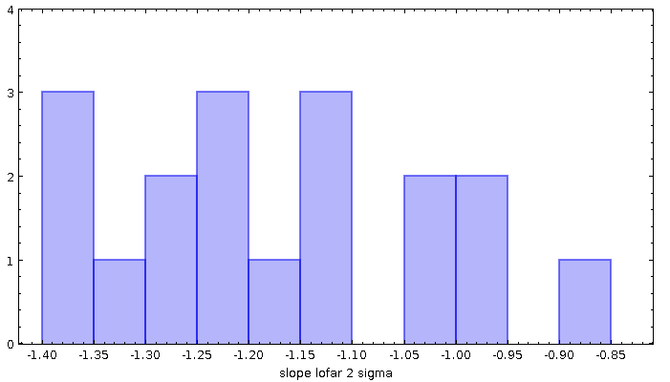
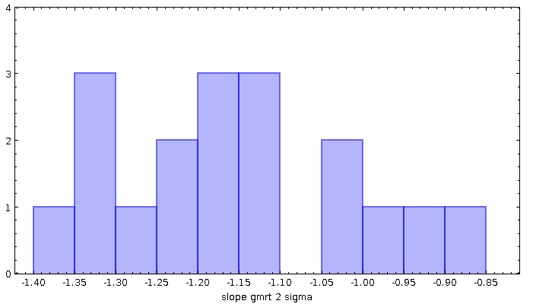
DISTRIBUTION OF SLOPE FOR THE SUBSAMPLE (22)
2σ regions based on LOFAR
Almost the distribution of the slopes are same for both the methods.
It includes only 18 clusters as for 4 clusters I did not detect the halo in uGMRT.
In a couple of clusters, Lofar 2σ might cover larger regions giving a steeper slope !
The literature spectral index extend the low end of the spectral index estimated in my sample
Archive spectral values available for clusters from the sample:
A697 (𝛼=1.7-1.8; Macario et al. 2010)
A1033 (𝛼=1.65; Edler et al. 2022)
A1132 (𝛼=1.75; Wilber et al. 2017)
A1550 (𝛼=1.6; Pasini et al. 2022, LOFAR HBA+LBA+GMRT+JVLA)
2σ regions based on uGMRT
21

Slide 22
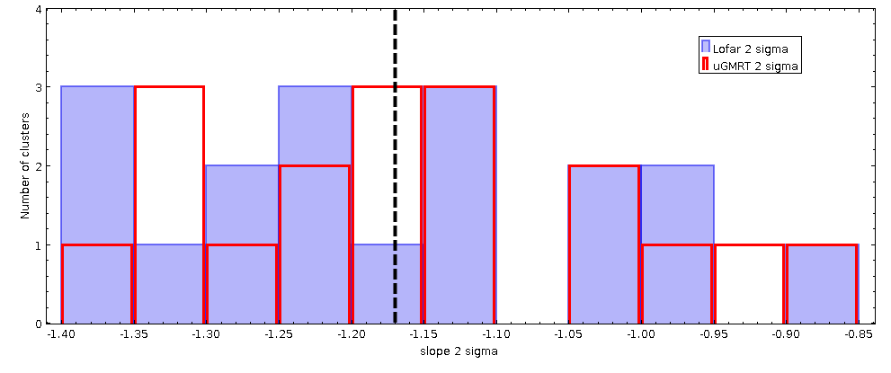
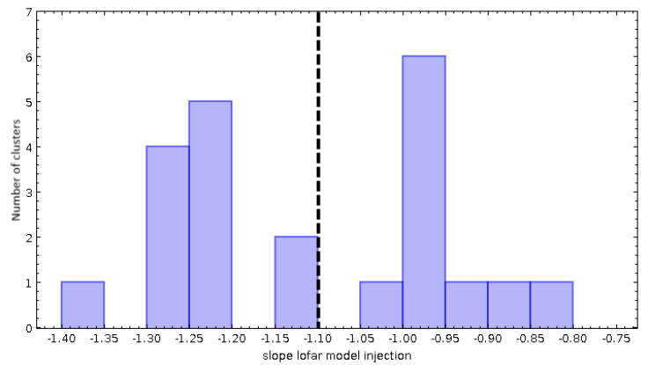
DISTRIBUTION OF SLOPE FOR THE SUBSAMPLE (22)
2σ regions
uGMRT radio halo fluxes found by injection of LOFAR model is higher than what is measured from observation.
Slopes from the lofar model injection method is more promising as it is calculated between lofar flux and gmrt flux without any losses.
LOFAR MODEL INJECTION
Most of the halos detected in uGMRT suffers from a flux loss of ~10-15%.
Flux loss increases for faint halos.
22

Slide 23
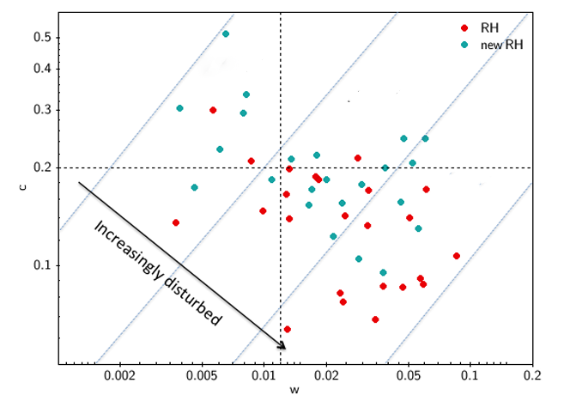
CORRELATION WITH CLUSTER DYNAMICS
c – concentration parameter (if a cluster is cool core or non-cool core cluster) Santos et al 2008.
w – centroid shift (presence of substructures) Maughan et al 2008.
Cassano et al 2023

Slide 24
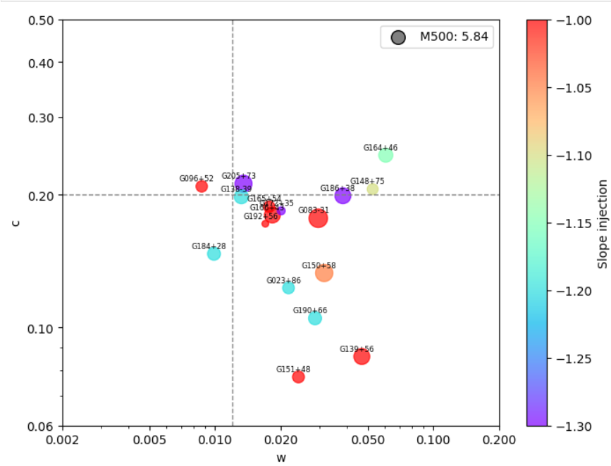
CORRELATION WITH CLUSTER DYNAMICS (22)
c – concentration parameter (if a cluster is cool core or non-cool core cluster) Santos et al 2008.
w – centroid shift (presence of substructures) Maughan et al 2008.
Slope – slope from injection Jmeasurements
17 out of 22 clusters in the sample have info about dynamical status as derived from the X-ray images
Increasingly disturbed
Most of the radio halos are in disturbed/merging clusters

Slide 25
CORRELATION WITH CLUSTER DYNAMICS (22)
c – concentration parameter (if a cluster is cool core or non-cool core cluster) Santos et al 2008.
w – centroid shift (presence of substructures) Maughan et al 2008.
17 out of 22 clusters in the sample have info about dynamical status as derived from the X-ray images
Increasingly disturbed
These halos reside in more relaxed clusters and exhibit a steep spectral index.

Slide 26
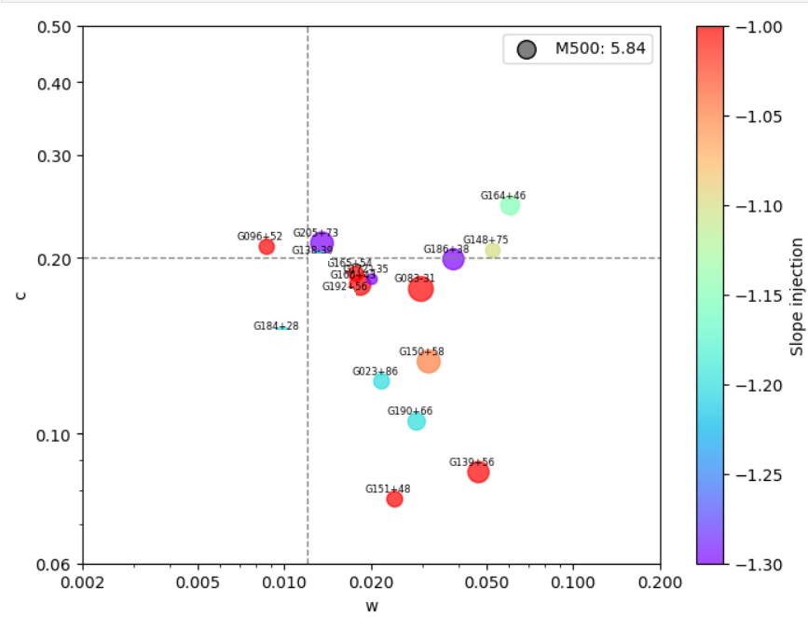
CORRELATION WITH CLUSTER DYNAMICS (22)
FOR CLUSTERS WITHOUT RADIO HALO IN uGMRT
Among the 4 clusters without radio halo in uGMRT, 3 clusters have X-ray data.
The slope values in the plot represents the upper limit found during Lofar model injection .
Increasingly disturbed
G184+28 ( Mini halo, relaxed cluster) - α = -1.2
G192+56 ( lowest mass cluster in my subsample) - α = -1 (uGMRT was not sensitive)
G138-39 (The halo was also not detected in EGRHS)- α = -1.2
G183+34 - α = -1.3 (cRH, same upper limits even with exponential models)

Slide 27
SUMMARY
With the preliminary results on the sample dynamically disturbed clusters host most radio halos.
Completing the entire sample will help constrain the origin of radio halos effectively.
First study on a complete sample about the spectral properties of radio halos.
It is important to constrain the models.
Additional study on A773 and A1351 with spectral index map and point to point analysis.

Slide 28
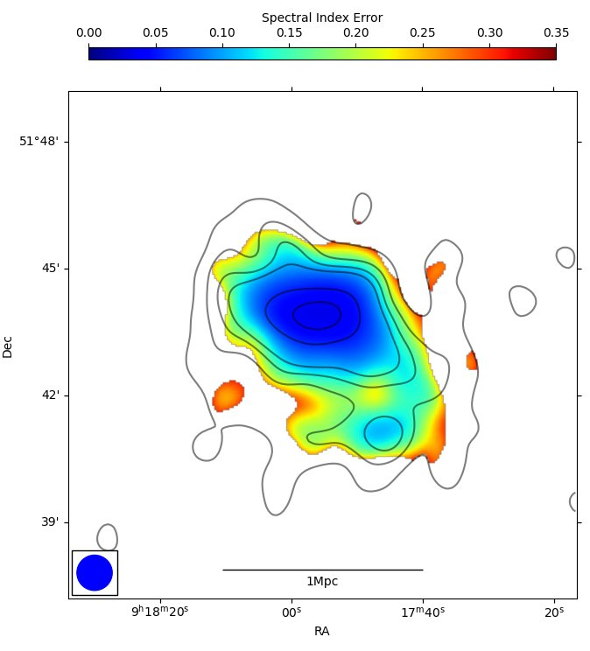
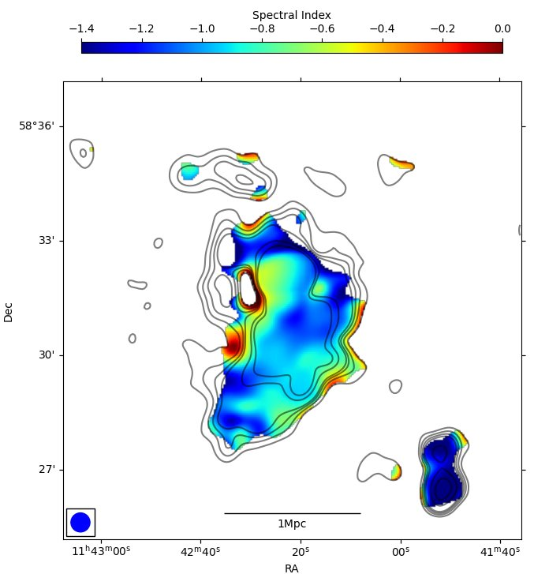
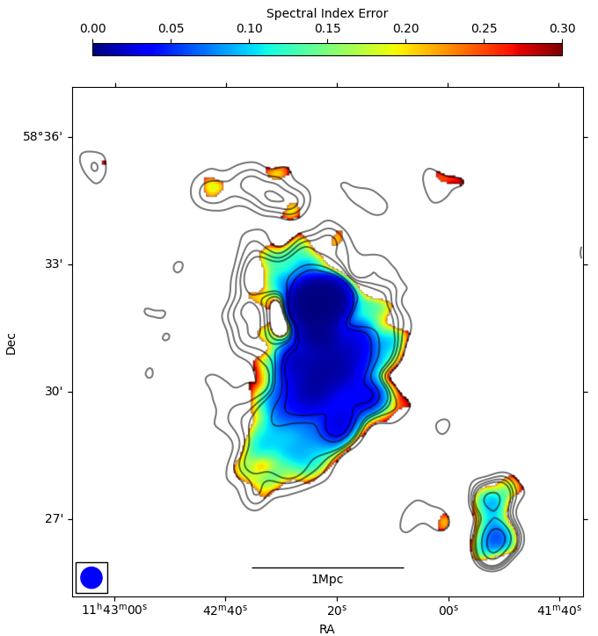
28

Slide 29
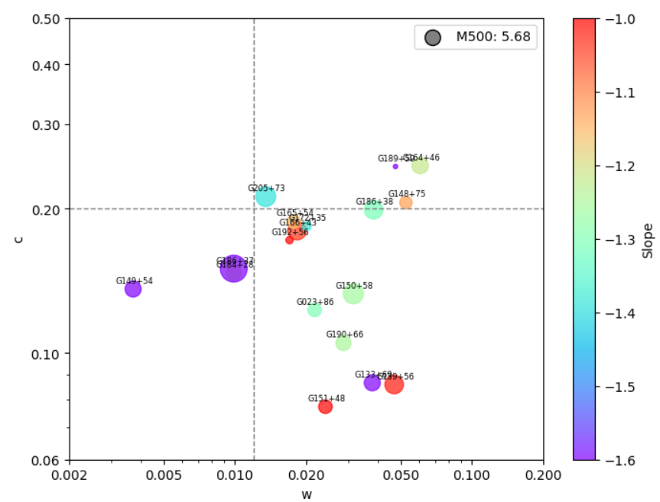
CORRELATION WITH CLUSTER DYNAMICS
FOR CLUSTERS WITH ARCHIVAL SPECTRAL INFORMATION
G186+37 (A697) - α = -1.7 (GMRT + VLA)
G189+59 ( A1033) - α = -1.65 (LOFAR + GMRT)
G149+54 (A1132) - α = -1.75 (LOFAR + GMRT)
G133+69 (A1550) - α = -1.6 (LBA+HBA+GMRT+JVLA)
Increasingly disturbed
detailed analysis needs to be carried out !!

Slide 30
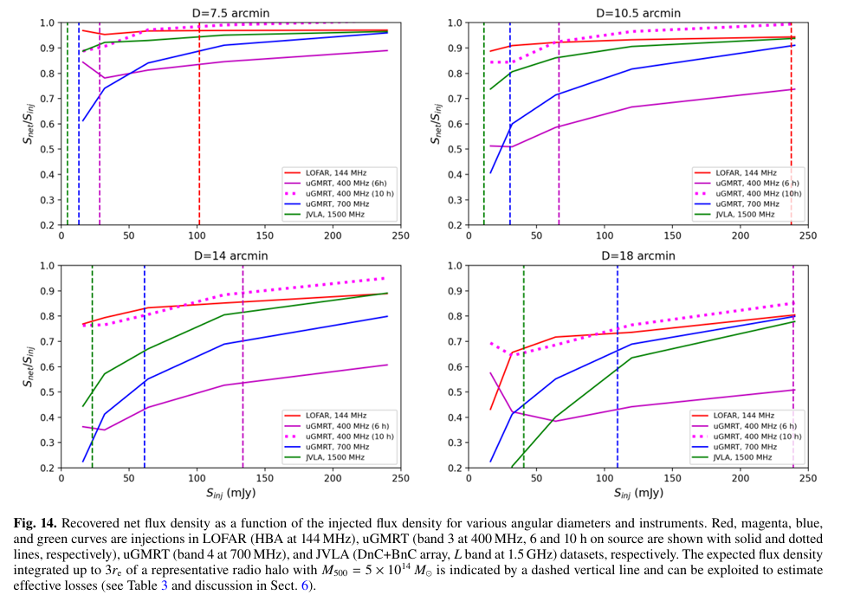

Slide 31
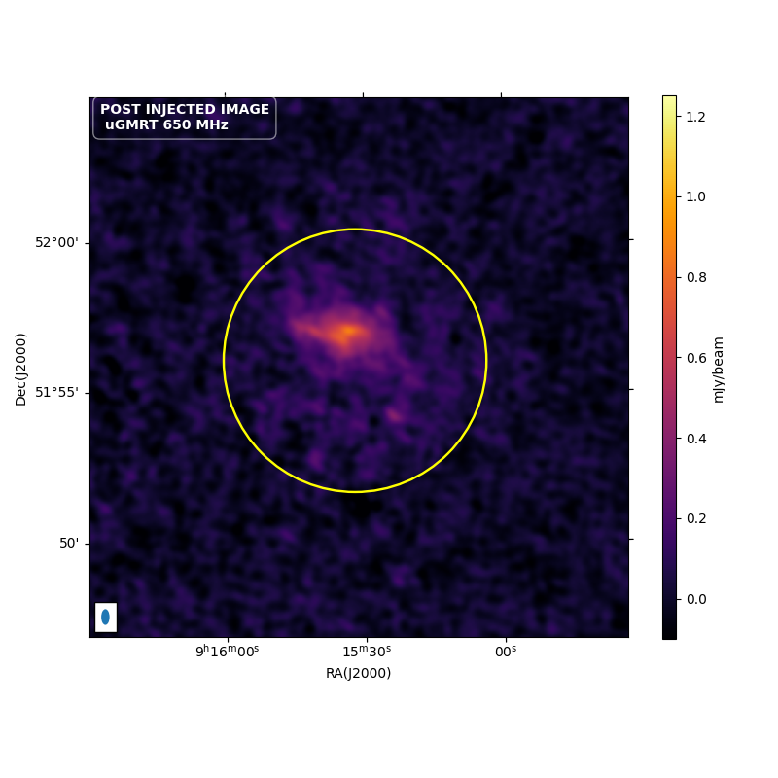
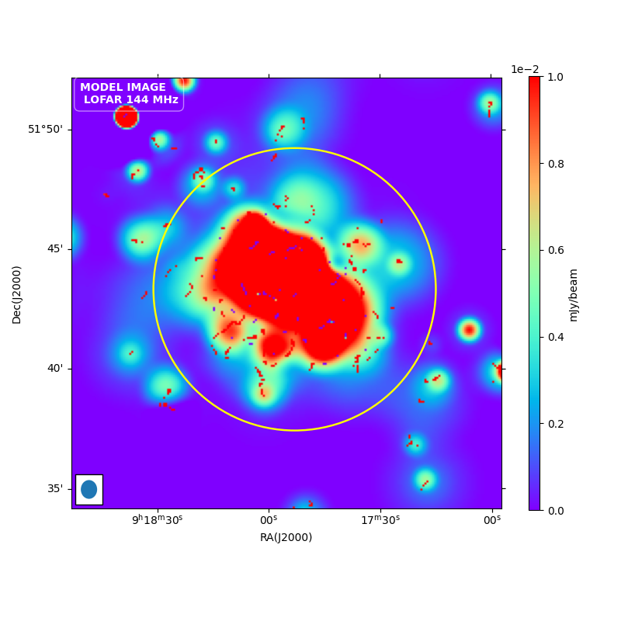
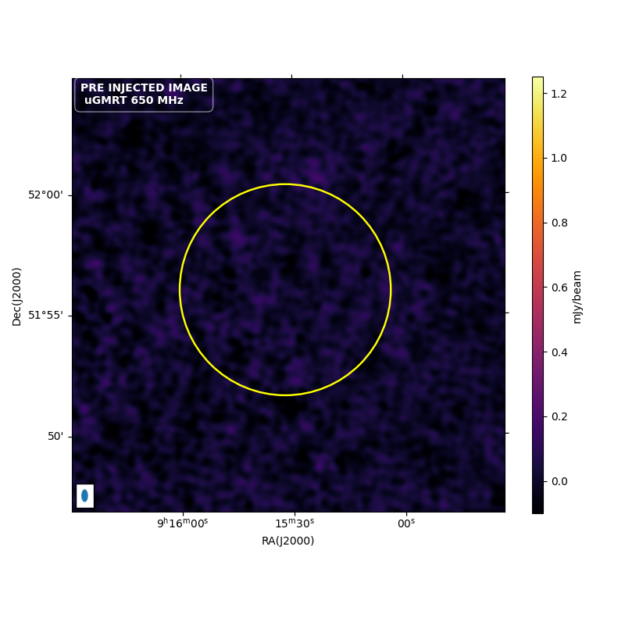

Slide 32
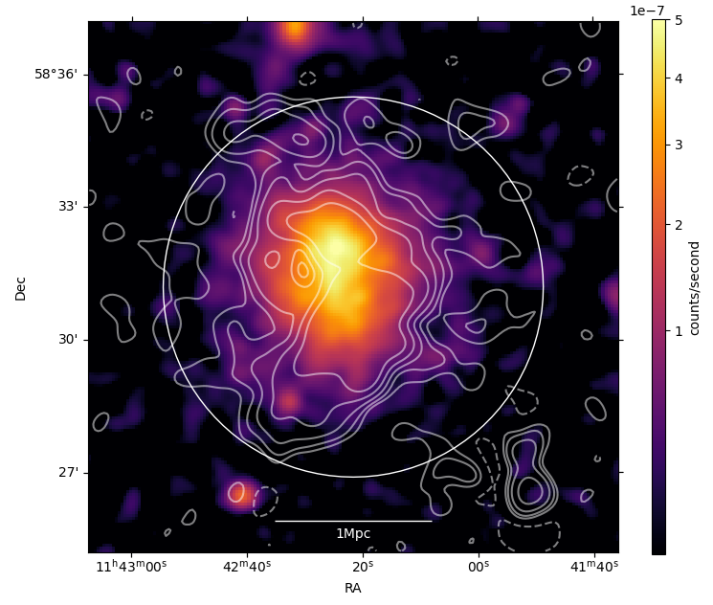
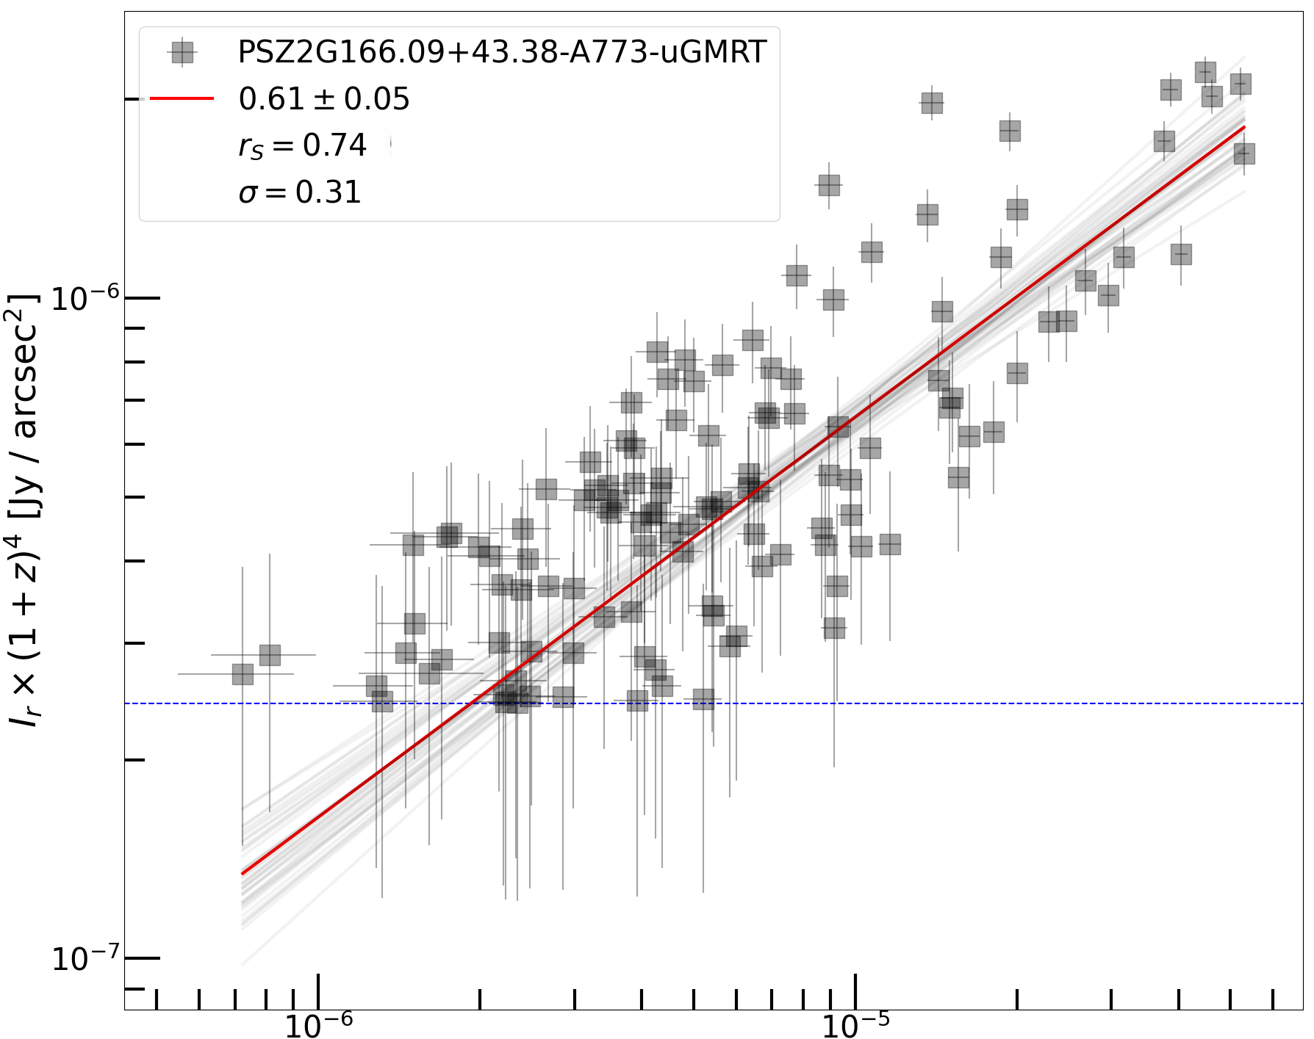
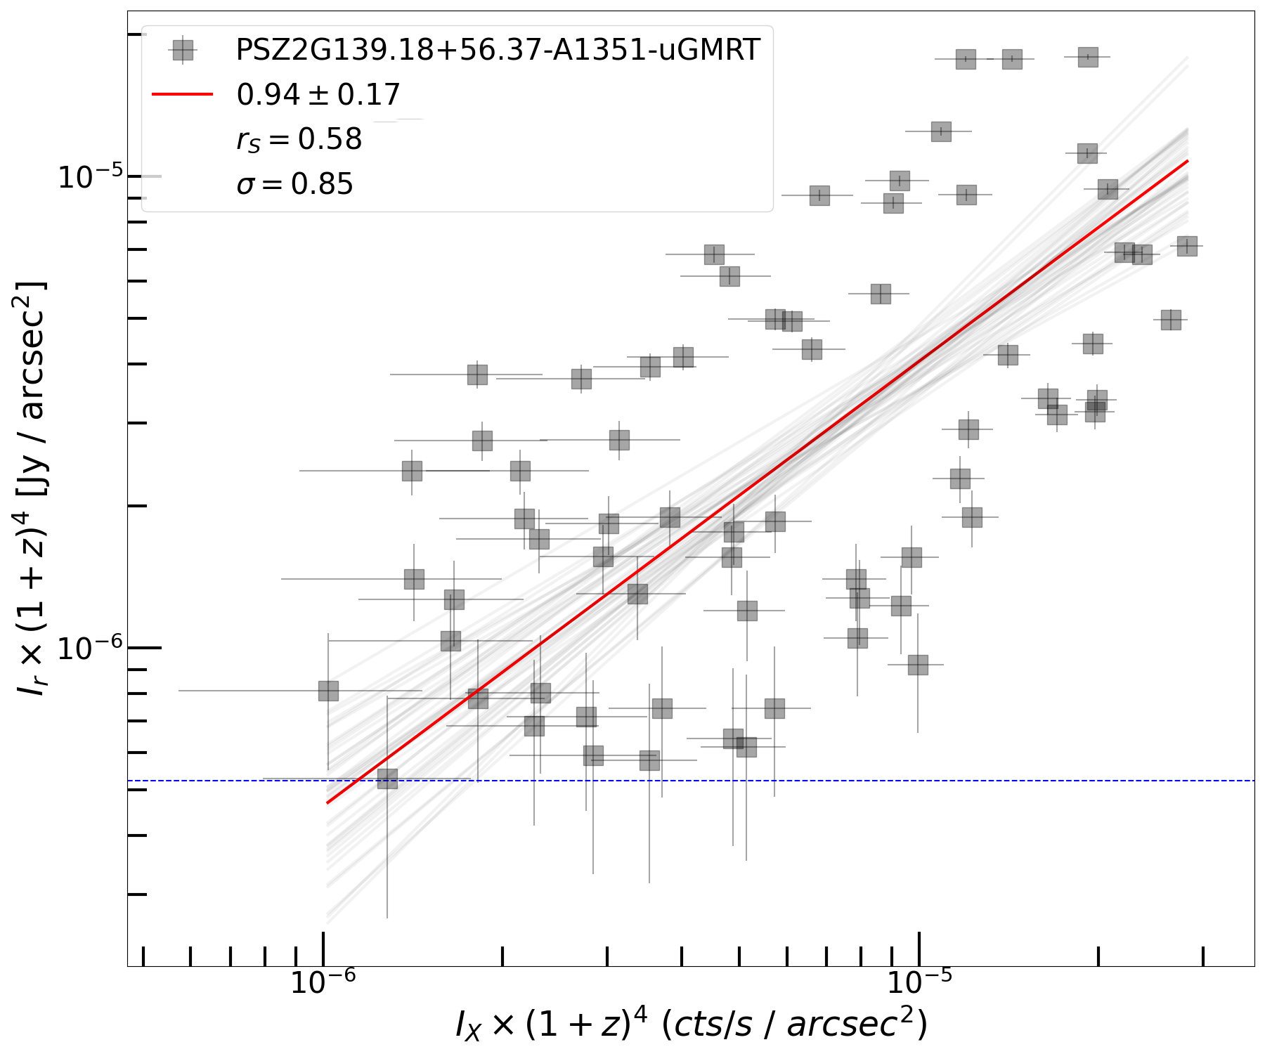
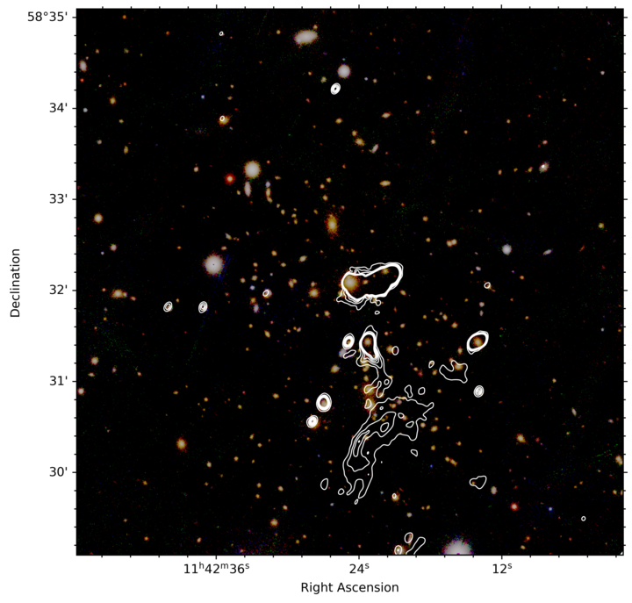
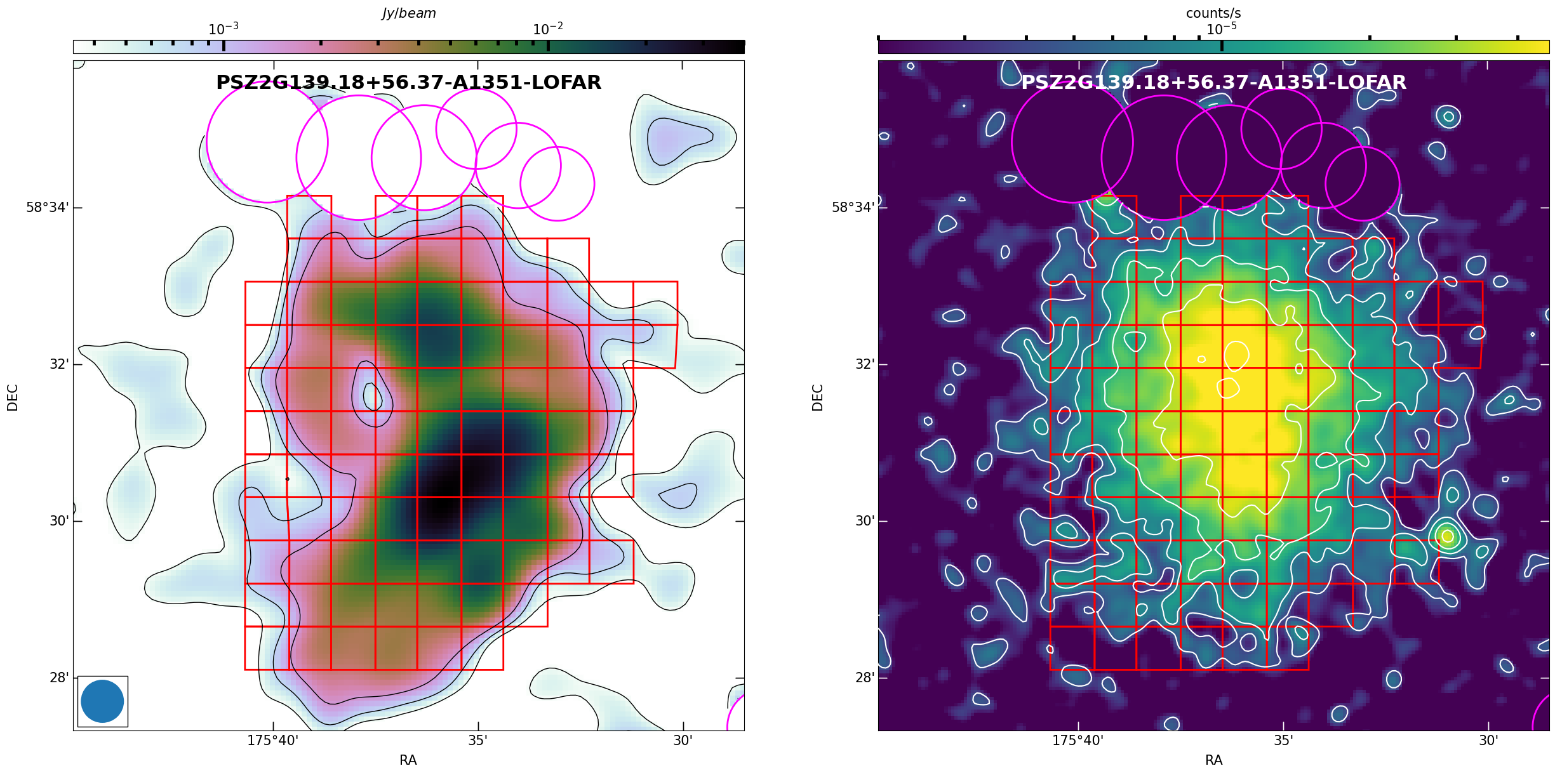
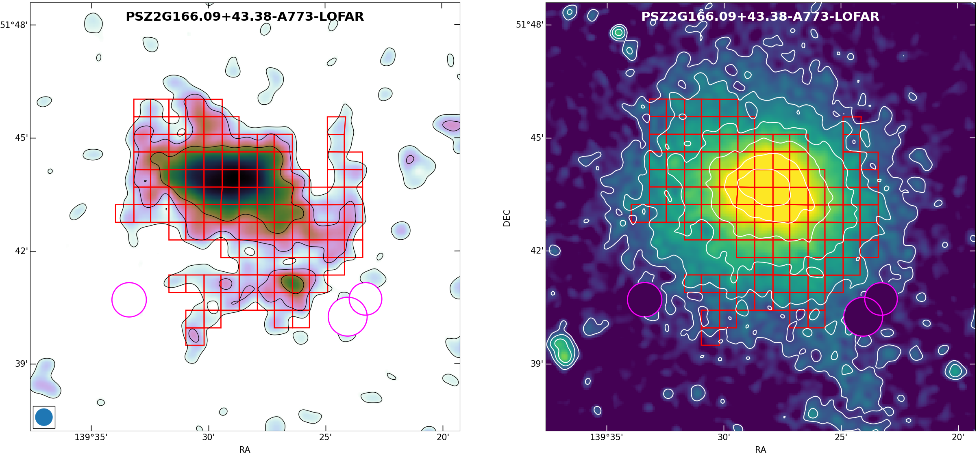

Slide 33
