Slide 1
Radio-Detected Lyα Emitters at 1.88 < z < 3.52: AGN Fraction and
Lyα Visibility
Sai Zhai, 4th year PhD candidate, Leiden Observatory
Collaborators: Huub Röttgering, Anniek Gloudemans, Erin Mentuch Cooper, and Maya H. Debski.
Notes:
Good morning/afternoon everyone. My name is Sai Zhai, a 4th-year PhD student at Leiden Observatory. Today I will present my work on Radio-detected Lyman-alpha emitters at redshifts 1.88 to 3.52, focusing on their AGN fraction and Lyα visibility.

Slide 2
Outline
Background (LAE)
Motivation (the AGN fraction + Lya visibility)
Data (HDR4 + LOFAR)
Result
Discussion
Summary
Notes:
Here is the outline of my talk. I will start with a short introduction to Lyα emitters,
then explain the scientific motivation for studying the ***
After that I will describe the data and sample selection,
followed by the results on fractions and correlations. Finally, I will summarize the main conclusions.

Slide 3
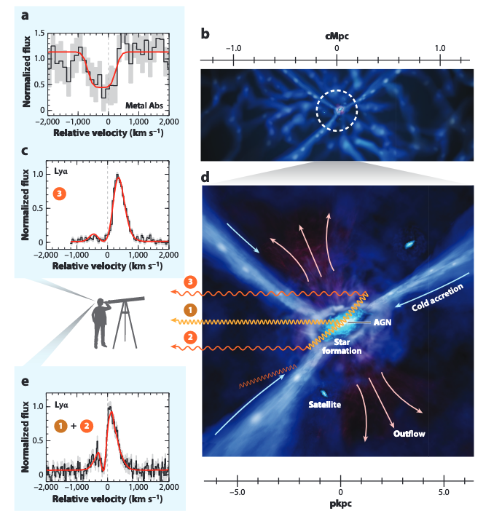
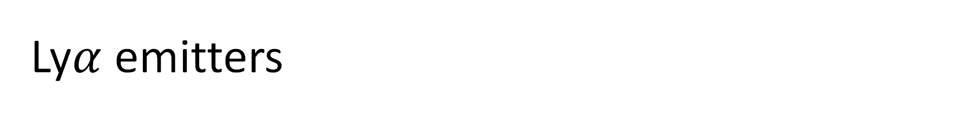
Ly$α$ emitters
λ = 1216 Å (rest-frame emission line)
Two types:
Star-forming galaxies
AGN
Origins of Lyα emission
O/B star formation
AGN activity
Cooling radiation
Major mergers
Fluorescence
Gawiser et al. 2007; Pentericci et al. 2009; Ouchi et al. 2020;
Hui & Gnedin 1997; Dijkstra 2014; Cantalupo et al. 2014; Borisova et al. 2016;
Costa et al. 2022; Rosdahl & Blaizot 2012;
Notes:
The Lyman-alpha line is at 1216 Å in the rest-frame, and it is one of the most widely used tracers of galaxies at high redshift.
The Lyα emission itself can arise from several processes: massive O and B star formation, AGN activity, cooling radiation from gas accretion, major mergers, or even fluorescence due to external ionizing sources.

Slide 4
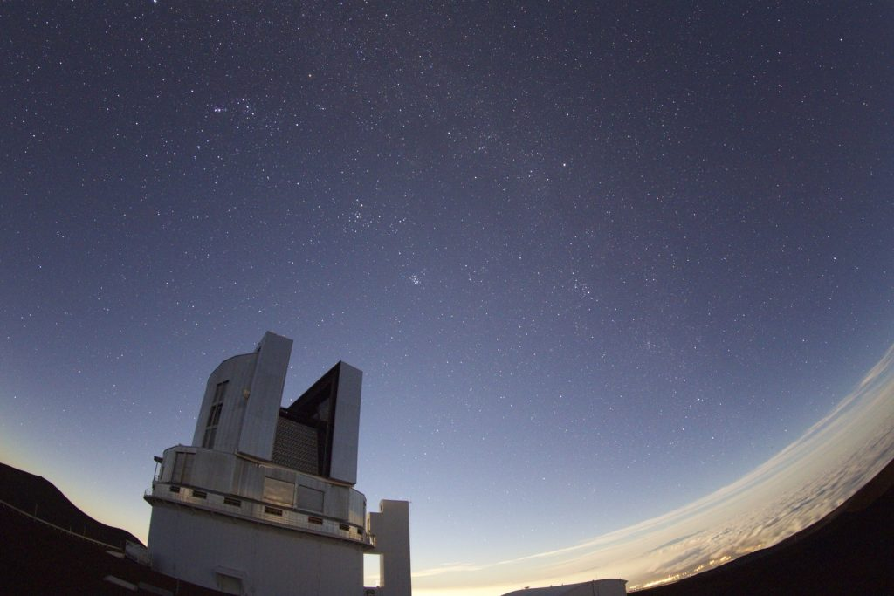
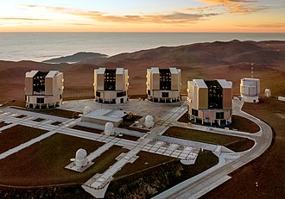
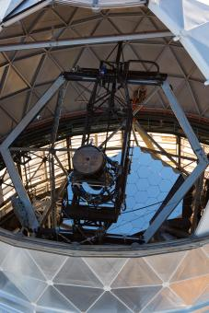
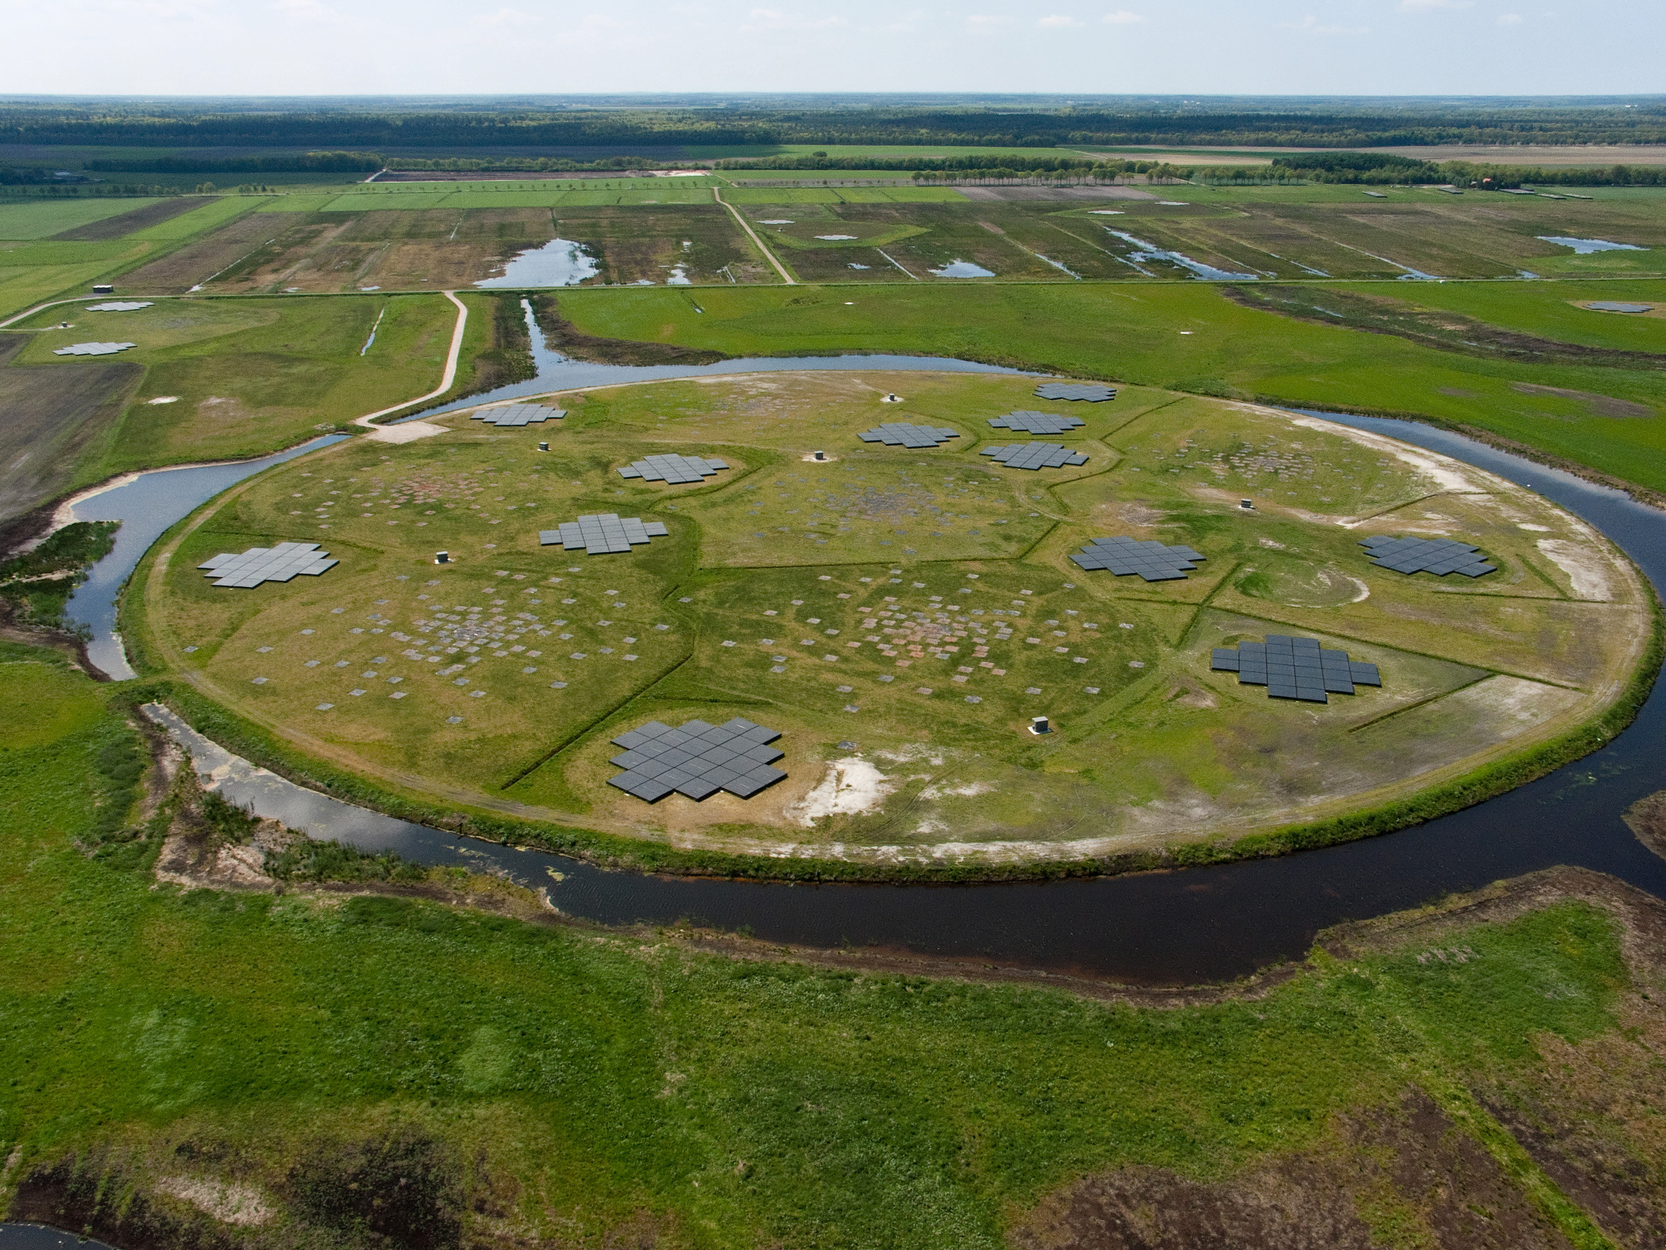
Multi-wavelength observations
Optical/UV:
NB imaging (HSC)
Blind spectroscopic survey (MUSE,HETDEX)
Radio:
Dust-unbiased view;
Trace hidden SF and AGN activity;
Radio power & morphology-> Lya transfer model
Notes:
To disentangle these contributions, we need multi-wavelength observations:
Optical/UV data from narrowband imaging or blind spectroscopic surveys such as MUSE and HETDEX,
And radio data, which is dust-unbiased and can trace hidden star formation and AGN activity. Radio power and morphology also help constrain Lyα transfer models.”

Slide 5
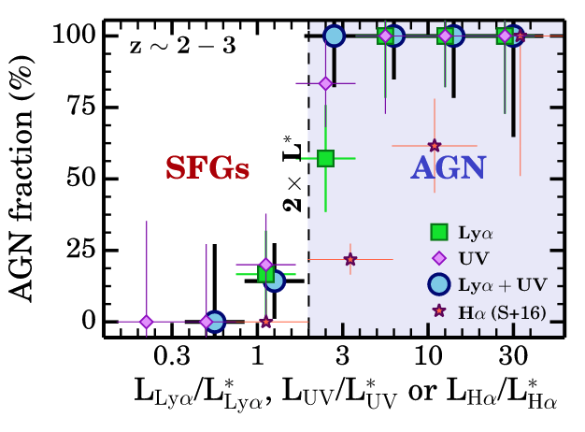
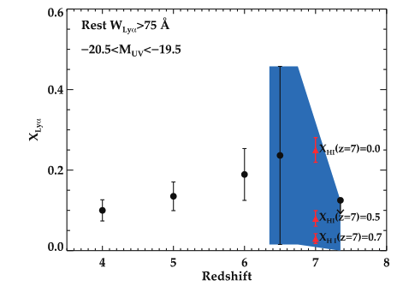
Important topics about fractions
Sobral et al. 2018; Stark et al. 2011
​
Lyα visibility studied in LBGs;
AGN fraction in LAEs increase with Lya luminosities;
Need radio-detected LAEs → probe energy source
Notes:
Previous studies have shown that the AGN fraction in LAEs increases with Lyα luminosity (for example Sobral et al. 2018 and Stark et al. 2011). However, these studies often rely on optical diagnostics or X-ray, which may miss dust-obscured AGN. This motivates us to look at radio-detected LAEs, which can provide a more complete picture of the underlying energy sources.”

Slide 6
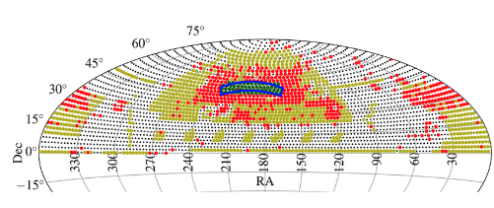
Data:
Shimwell et al. 2019
🔹 HETDEX DR4 (HDR4)
920k LAE candidates (SNR > 4.8)
1.88 < z < 3.52
67.5 deg²
🔹 LOFAR DR1
Over 325k radio sources
400 deg²
🔹 HETDEX-LOFAR spectroscopic catalog (Debski et al. 2024)
28,705 radio sources in the HDR4 field
1,075 LAEs (without optical AGN) + 804 AGNs

Slide 7
Result: the completeness corrected fraction
Require Lyα SNR > 6.5 and confident level > 0.9:
Lyα-emitting sources in the HDR4 field: 79,022
Radio sources: 28705
Radio sources with Lyα emission: 400
LAEs with radio AGN
Optical AGN with Lyα emission
Radio AGN fraction of Lyα-emitting sources = 400/79,022 = 0.51± 0.03 %
Corrected Radio AGN fraction of Lyα-emitting sources = 1.67 ± 0.33 %
Completeness correction factors:
HETDEX LAE completeness
LOFAR radio source completeness
LOFAR redshift fraction
Lyα emission fraction of radio sources = 400/28,705 =
1.4 ± 0.1 %
Corrected Lyα emission fraction of radio sources =
23.8 ± 4.8 %
Notes:
To ensure robust measurements, we require Lyα SNR > 6.5 and a confidence level greater than 0.9. With this cut, we have about 79,000 Lyα-emitting sources in the HETDEX field, and about 28,700 radio sources. Among them, around 400 sources show both Lyα emission and radio detection.
From these numbers, we can calculate two basic fractions:
The radio AGN fraction of Lyα emitters is 400 out of 79,000, which is 0.51% ± 0.03%.
The Lyα emission fraction of radio sources is 400 out of 28,700, which is 1.4% ± 0.1%.
both surveys are incomplete, so we correct for three factors:
HETDEX LAE completeness,
LOFAR radio source completeness,
And the LOFAR redshift fraction.
After these corrections, the fractions increase.
Specifically, the radio AGN fraction of LAEs rises to 1.67% ± 0.33%, and the Lyα fraction of radio sources increases strongly to 23.8% ± 4.8%.

Slide 8
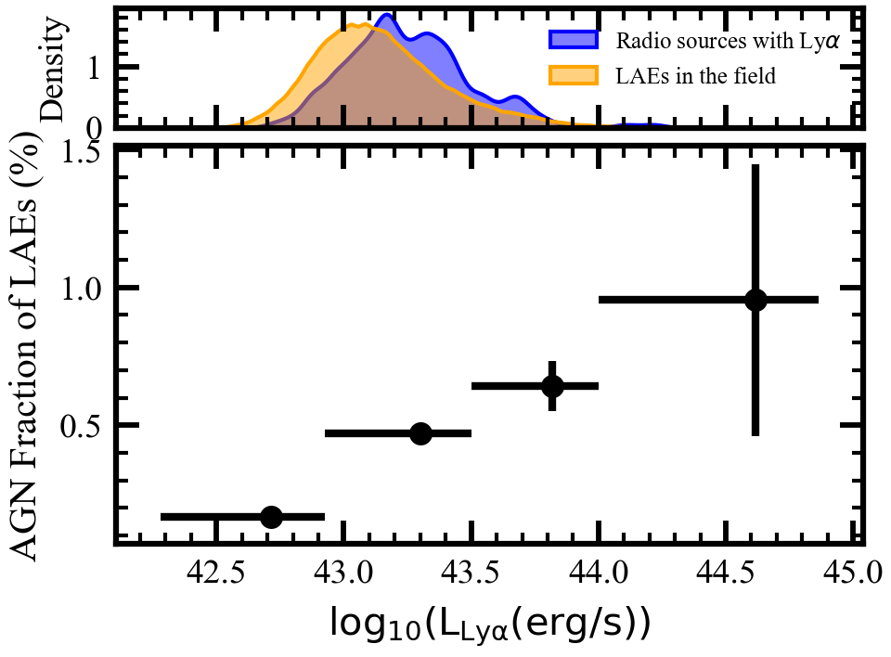

Results: the radio AGN fraction of LAEs
A increasing trend between the radio AGN fraction and Ly$α$ luminiosites;
However, the maximum fraction is around 1.0% -> AGN contributes a small fraction of Ly$α$ emission

Slide 9
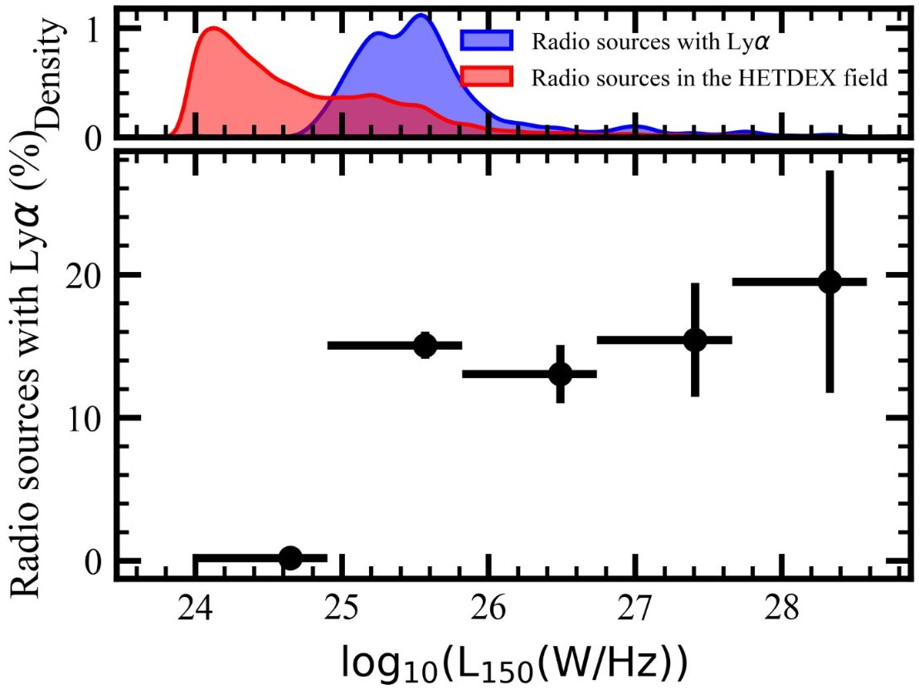
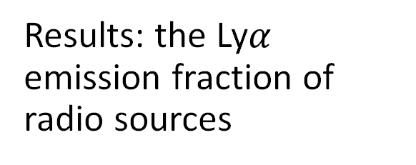
Results: the Ly$α$ emission fraction of radio sources
Ly𝛼 fraction rises at the lowest radio luminosity bin, then flattens.
Likely due to both evolution and selection effects.

Slide 10
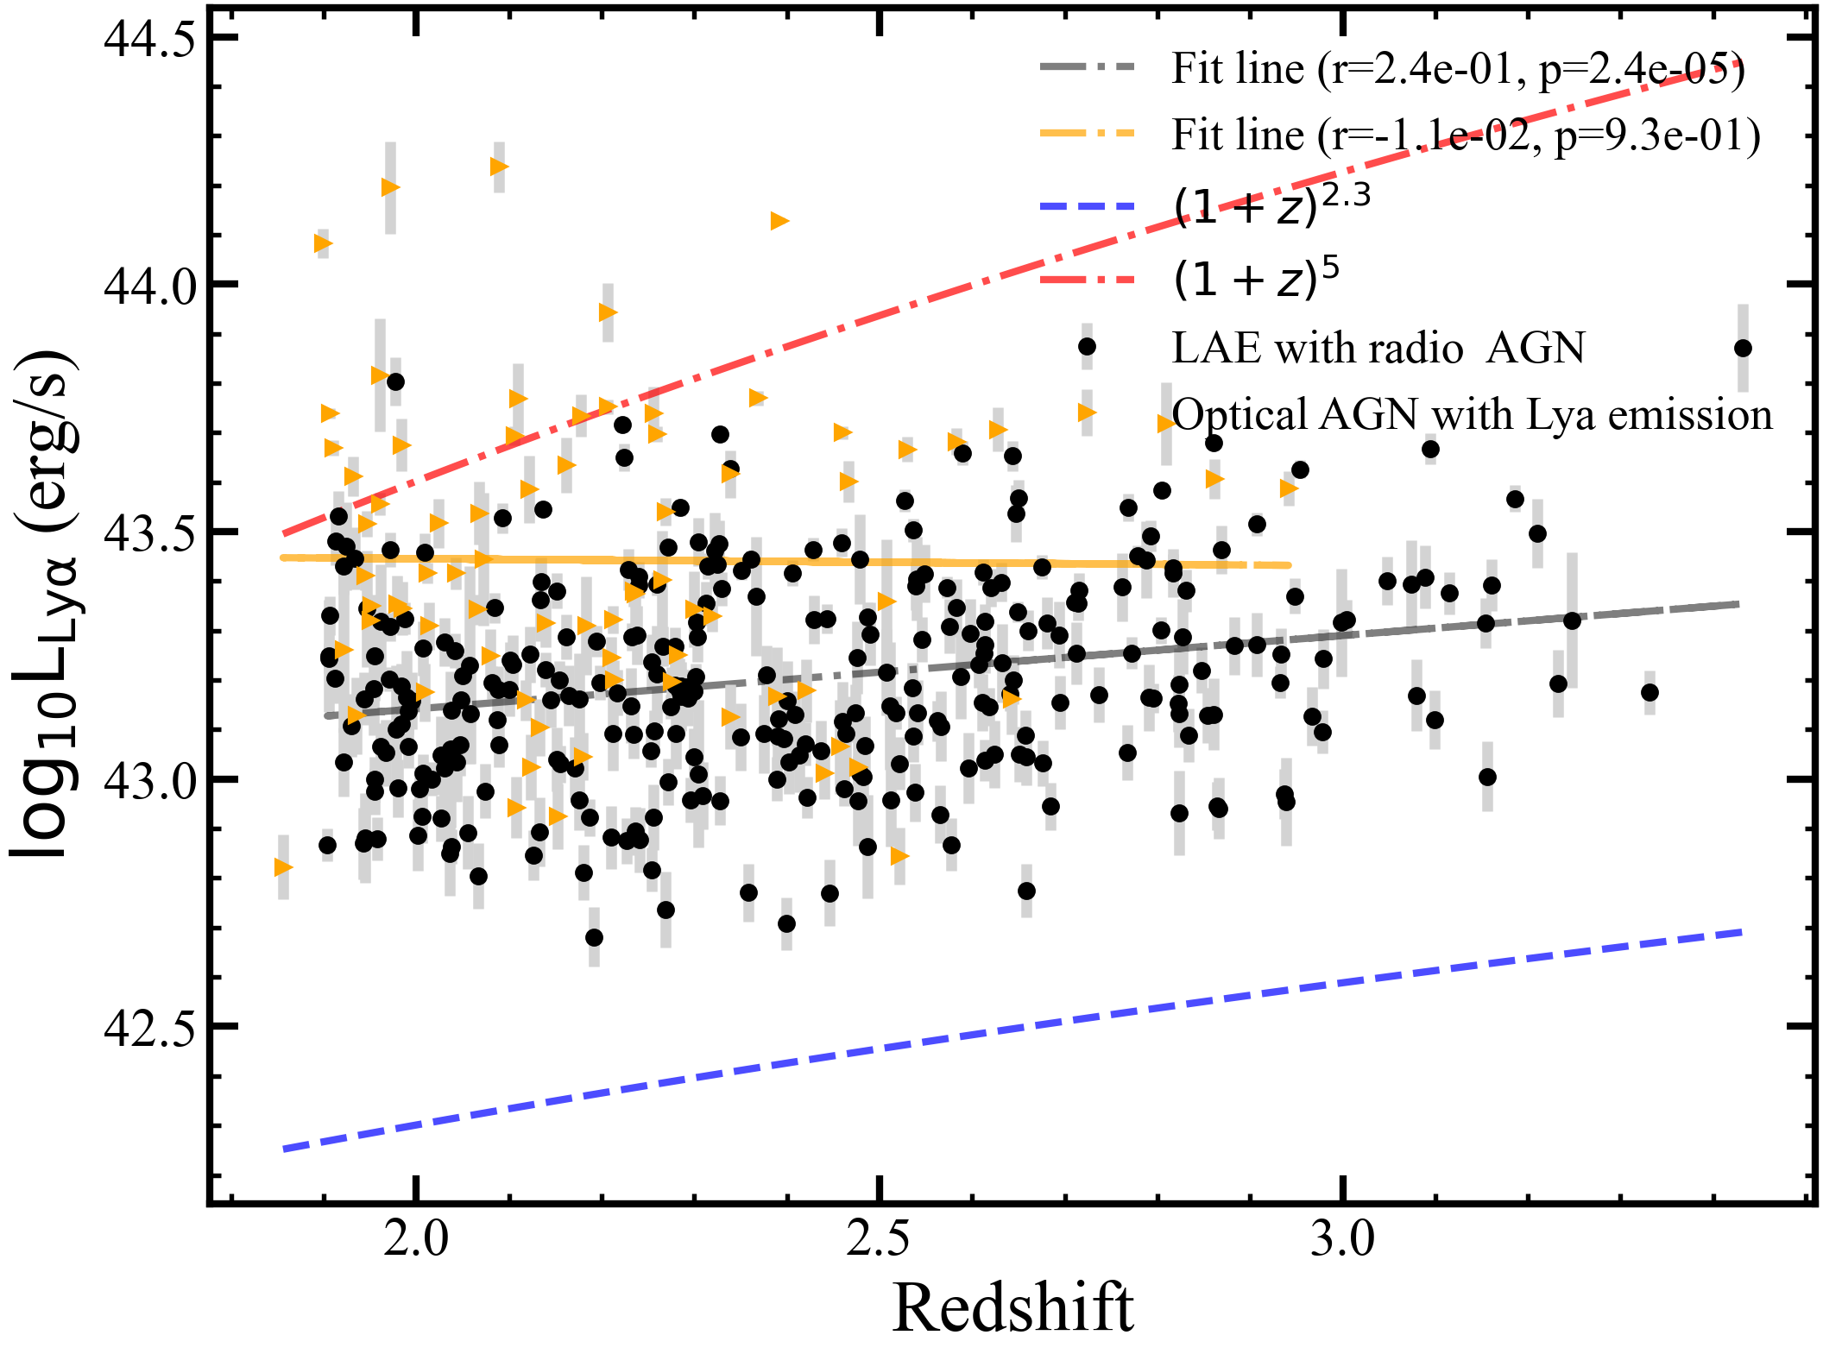
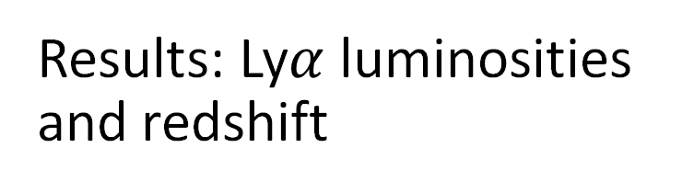
Results: Ly$α$ luminosities and redshift
LAEs with radio AGN
Weak positive, statistically significant correlation
Likely powered by surrounding gas (low-excitation/obscured AGN)
Optical AGN with Lyα
Weak negative, statistically insignificant correlation
Show strong nuclear activity

Slide 11
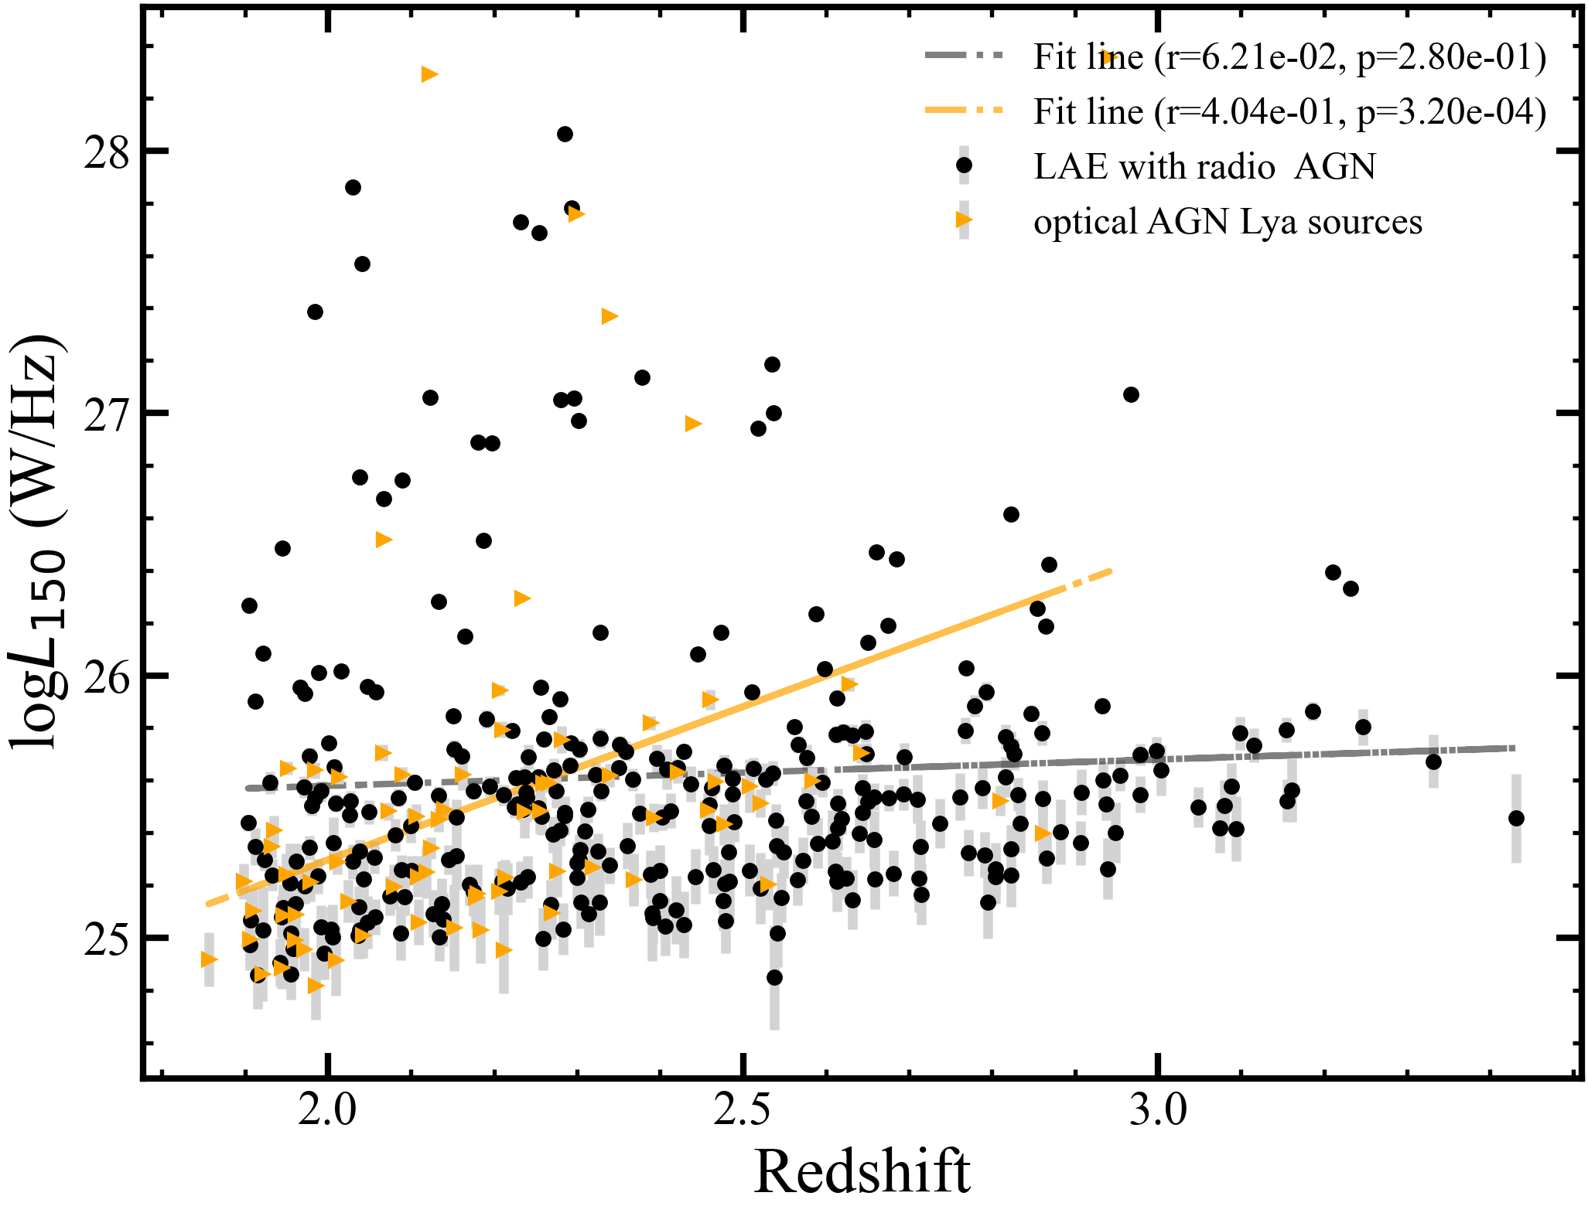
Results: 150 MHz radio luminosities and redshift
LAEs with radio AGN
Weak positive, not statistically significant
Optical AGN with Lyα
Weak positive, statistically significant
Mild cosmic evolution of radio power

Slide 12
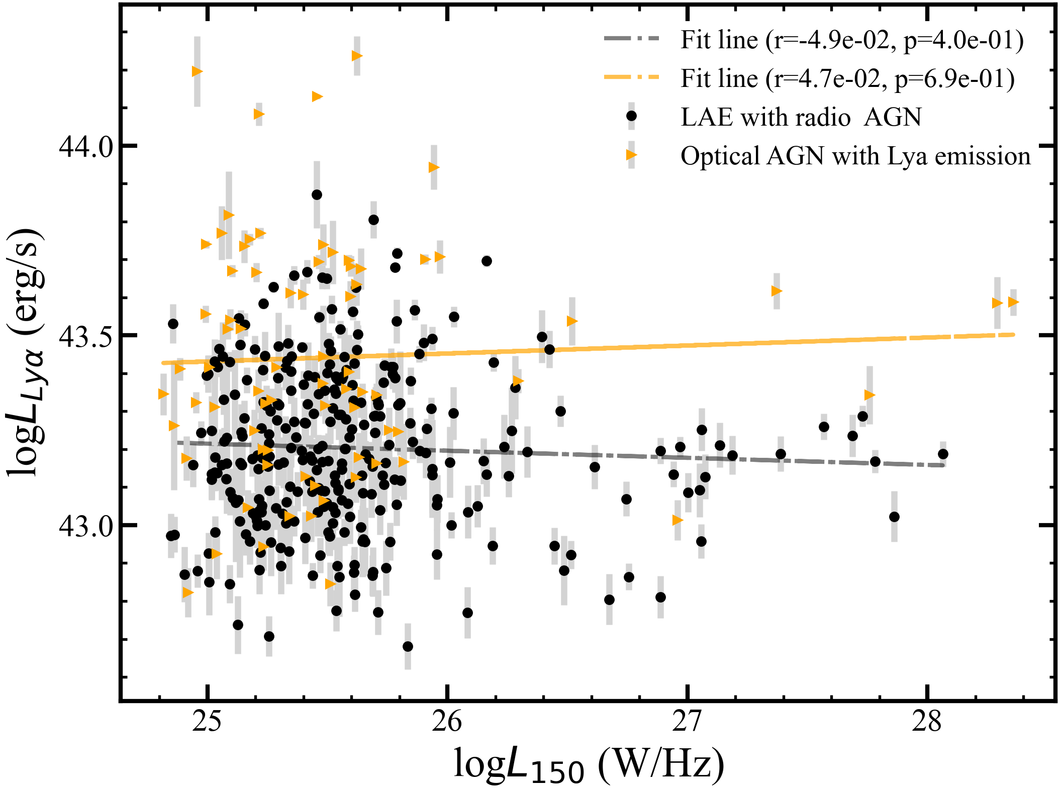
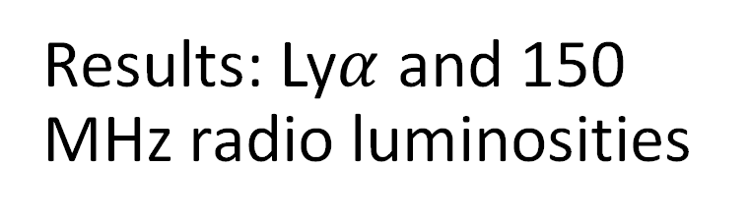
Results: Ly$α$ and 150 MHz radio luminosities
LAEs with radio AGN
Weak negative, not significant
Lyα likely powered by SF/cooling
Optical AGN with Lyα
Weak positive, not significant
Jet vs radiative activity may evolve independently
Conclusion
Radio jet power and Lyα output are not directly coupled

Slide 13
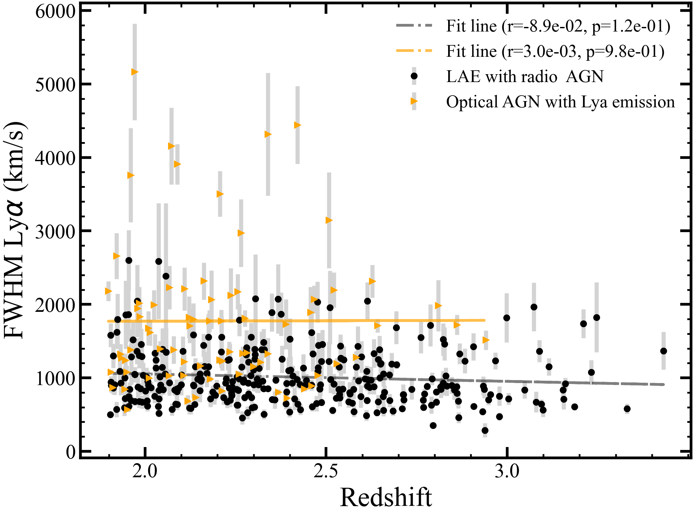
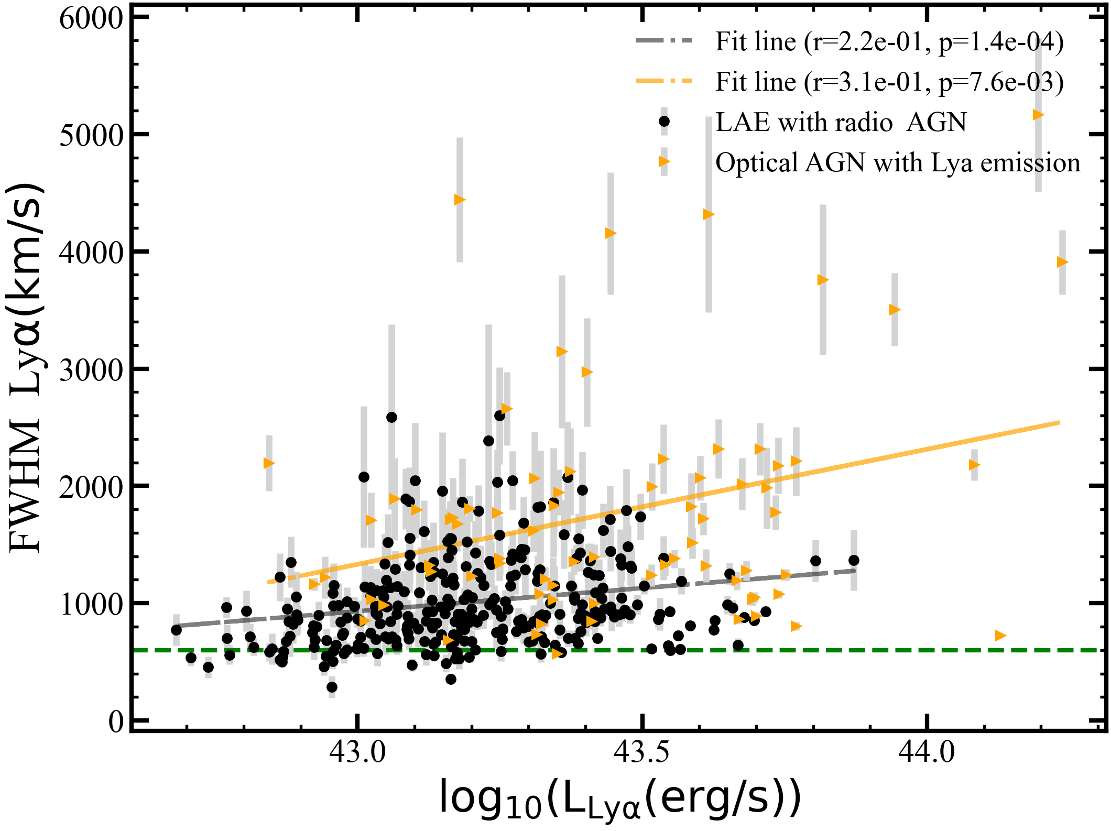
Results: FWHM trends
FWHM vs redshift → weak correlation
High-z galaxies not necessarily broader lines
FWHM vs Lyα luminosity → positive correlation
Brighter systems → higher velocity dispersion

Slide 14
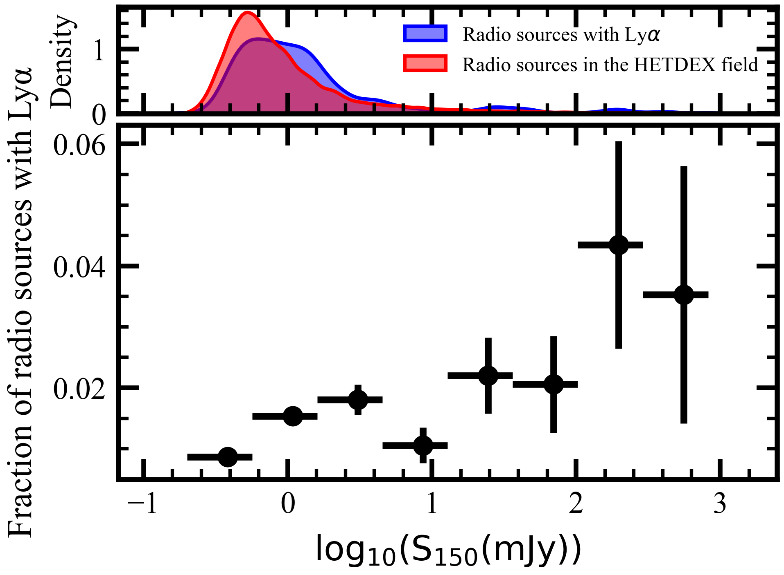
Discussion
Increasing trend: 150 MHz flux vs Lyα fraction
Likely influenced by selection effect

Slide 15
Summary
Radio AGN fraction in LAEs
≲2%, but increases with Lyα luminosity → brighter LAEs more likely host AGNs & most LAEs are powered by SF;
Lyα fraction in radio sources
≲2%, but rises strongly (≈24%) after correction → brighter AGN more likely with Lyα emission;
Lyα vs radio
weakly coupled, regulated by gas/geometry/transfer
LAEs with radio AGN-Optical AGN with Lyα
distinct evolutionary tracks, diverse growth histories
Thanks for listening! Questions and comments are welcome!

