Slide 1
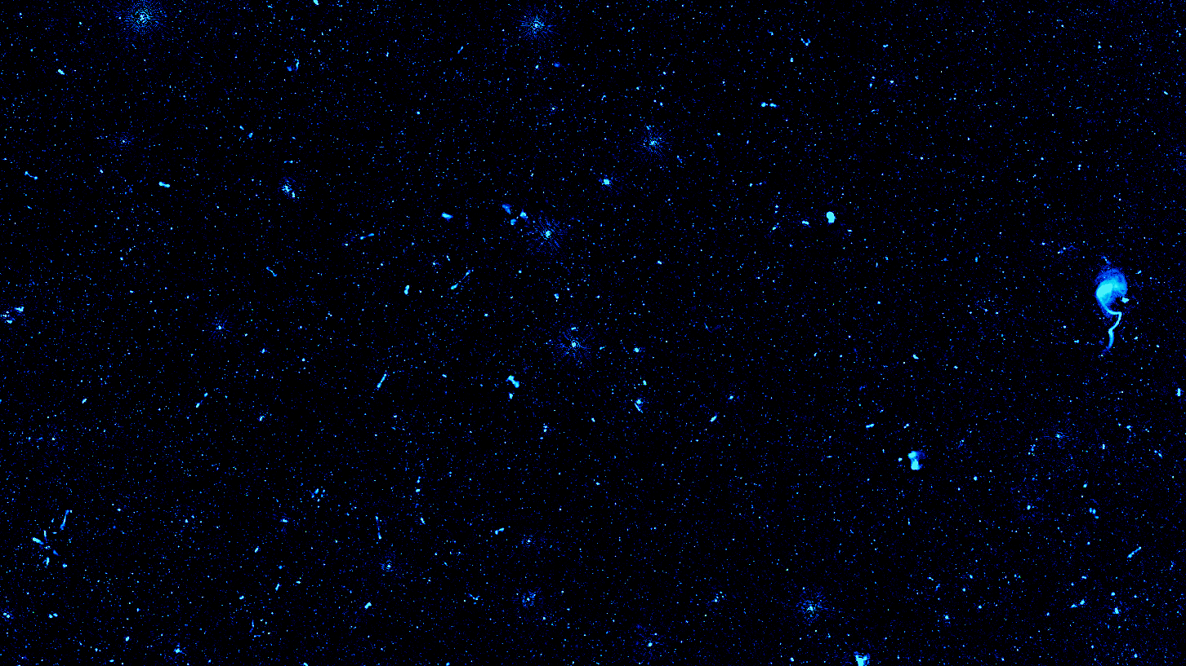





WEAVE-LOFAR: Harnessing the Power of Radio Observations Using Optical Spectroscopy
Marina I. Arnaudova
Postdoctoral Research Associate Royal Observatory, University of Edinburgh, UK
Collaborators: P. N. Best, K. J. Duncan, D. J. B. Smith, M. J. Hardcastle, L. R. Holden, S. Das, S. Shenoy
The WEAVE consortium, ORCHIDSS and the LOFAR Key Science Team

Slide 2
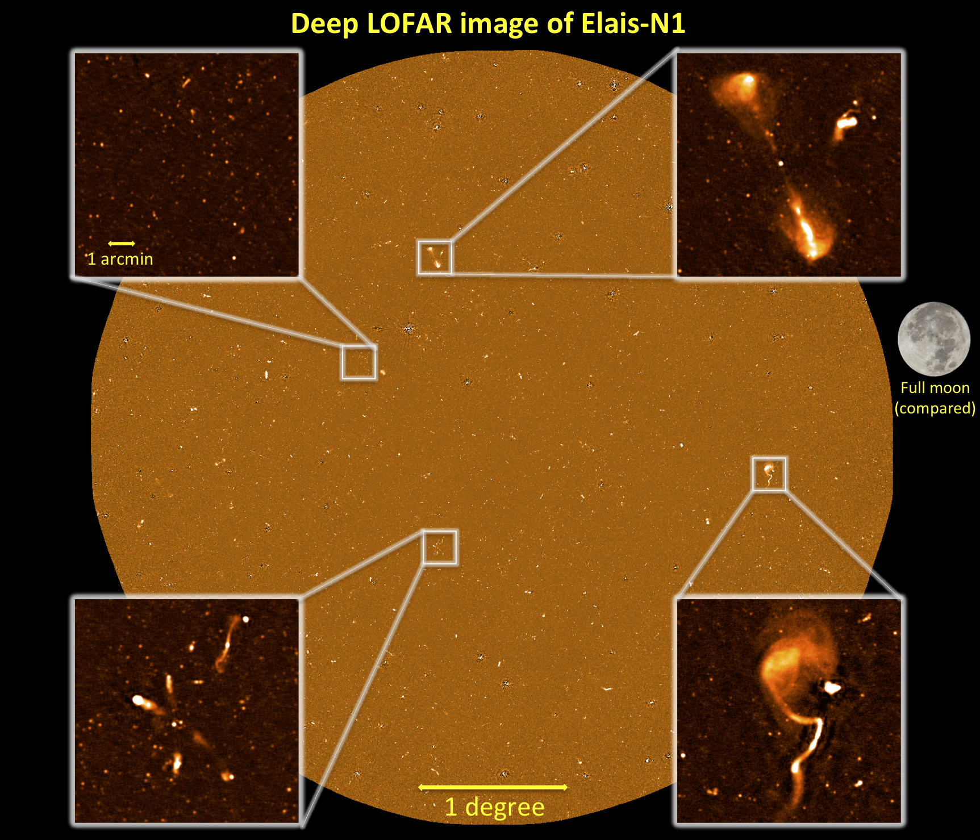
Radio Observations + Optical Spectroscopy
Radio Observations + Optical Spectroscopy
Radio observations:
Impervious to dust
Trace the activity in the Universe (e.g. SF and AGN feedback)
Identify radiatively-inefficient AGN
But radio information alone is insufficient for determining distances.
Optical spectroscopy alongside radio observations:
Redshift information
Galaxy properties such as SFR, metallicities, BH mass
The “gold standard” of distinguishing between SFG and AGN, and between accretion modes
LOFAR image of the ELAIS-N1 field, showcasing the diverse types of radio sources. Credits: Philip Best, Jose Sabater, and the LOFAR surveys team.

Slide 3
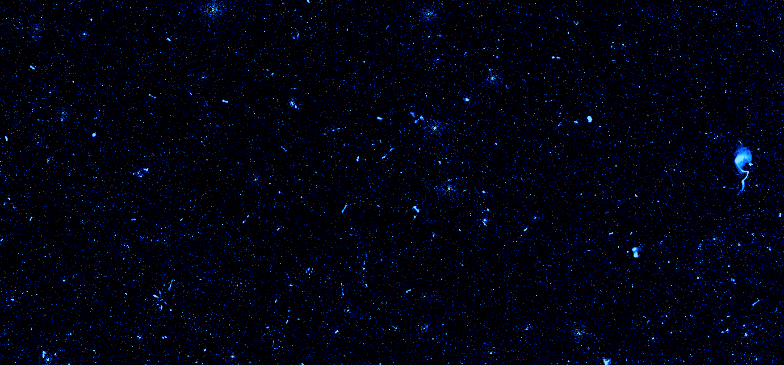
The Radio Source Population
Low-excitation radio galaxies:
radio emission in excess and weak low-ionisation lines
Radio Excess
High-excitation radio galaxies:
radio emission in excess and strong high-ionisation lines
LERGs
HERGs
Presence of
Radiatively-efficient AGN
Star-forming galaxies:
radio emission dominated by star forming (SF) processes
SFGs
RQ AGN
Radio-quiet AGN:
radio emission consistent with SF and strong high-ionisation lines

Slide 4
The Radio Source Population
Low-excitation radio galaxies:
radio emission in excess and weak low-ionisation lines
Radio Excess
High-excitation radio galaxies:
radio emission in excess and strong high-ionisation lines
LERGs
HERGs
Presence of
Radiatively-efficient AGN
Star-forming galaxies:
radio emission dominated by star forming (SF) processes
SFGs
RQ AGN
Radio-quiet AGN:
radio emission consistent with SF and strong high-ionisation lines

Slide 5
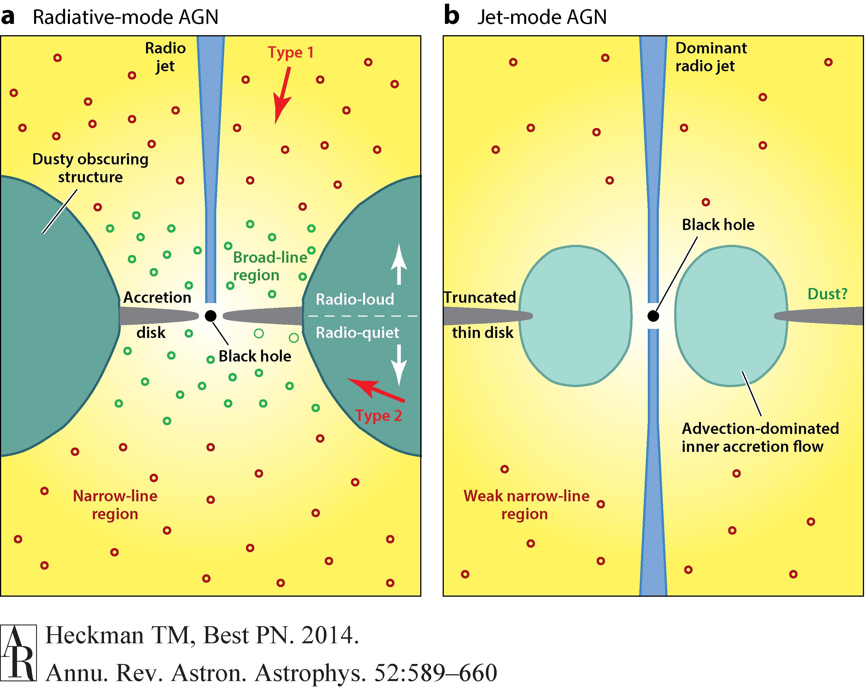
The Radio Source Population
Radiatively-efficient AGN
Low-excitation radio galaxies:
radio emission in excess and weak low-ionisation lines
Radio Excess
High-excitation radio galaxies:
radio emission in excess and strong high-ionisation lines
LERGs
HERGs
Presence of
Radiatively-efficient AGN
Star-forming galaxies:
radio emission dominated by star forming (SF) processes
SFGs
RQ AGN
Radio-quiet AGN:
radio emission consistent with SF and strong high-ionisation lines

Slide 6
The Radio Source Population
Radiatively-inefficient AGN
Low-excitation radio galaxies:
radio emission in excess and weak low-ionisation lines
Radio Excess
High-excitation radio galaxies:
radio emission in excess and strong high-ionisation lines
LERGs
HERGs
Presence of
Radiatively-efficient AGN
Star-forming galaxies:
radio emission dominated by star forming (SF) processes
SFGs
RQ AGN
Radio-quiet AGN:
radio emission consistent with SF and strong high-ionisation lines

Slide 7
The Radio Source Population
Low-excitation radio galaxies:
radio emission in excess and weak low-ionisation lines
Radio Excess
High-excitation radio galaxies:
radio emission in excess and strong high-ionisation lines
LERGs
HERGs
Presence of
Radiatively-efficient AGN
Star-forming galaxies:
radio emission dominated by star forming (SF) processes
SFGs
RQ AGN
Radio-quiet AGN:
radio emission consistent with SF and strong high-ionisation lines

Slide 8
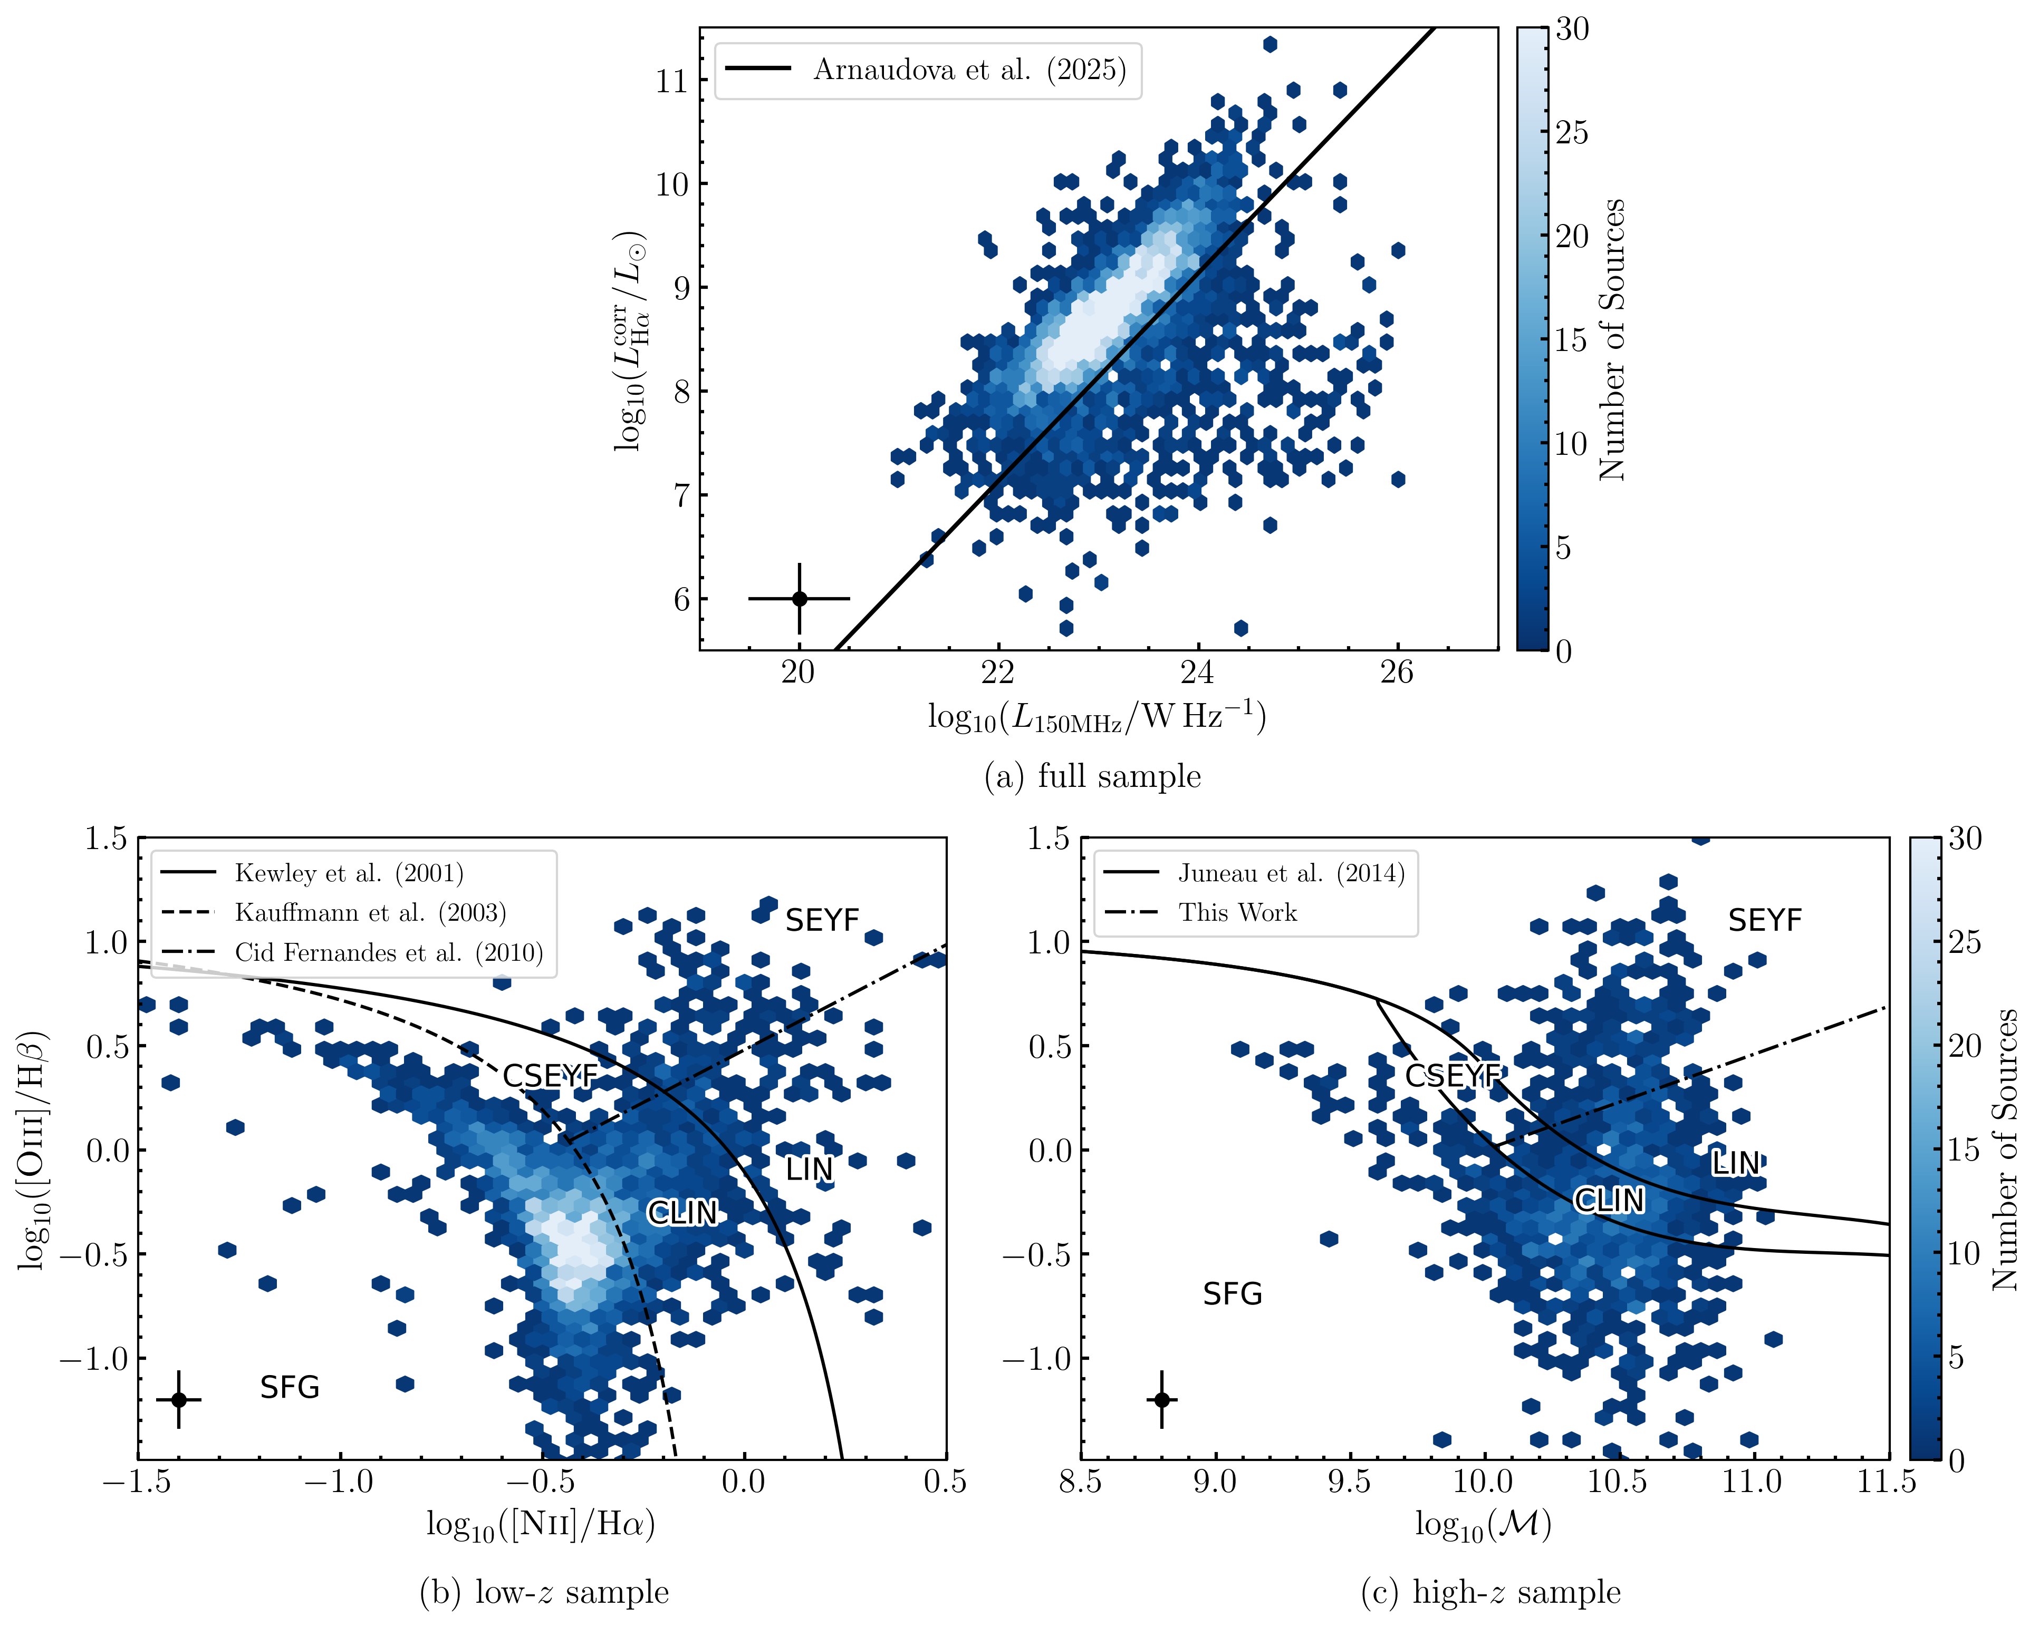
Radio Source Classifications
Classification Method:
Use the L_{150MHz} vs L_{Hα} to identify radio-excess AGN, and the BPT and MEx for radiatively-efficient AGN
Perform Monte Carlo realisations to obtain the probability of each source belonging to a given class.
Novelty:
Probabilistic approach – e.g. prioritise purity or completeness depending on goals.
Extends previous efforts to higher redshift.
Current Use:
Using DESI DR1 spectra in ELAIS-N1 to compare results with photometric classification.
Expanding the approach to the LoTSS wide area to study ~350,000 radio sources
Arnaudova et al. (2025)

Slide 9
Radio Source Classifications
Classification Method:
Use the L_{150MHz} vs L_{Hα} to identify radio-excess AGN, and the BPT and MEx for radiatively-efficient AGN
Perform Monte Carlo realisations to obtain the probability of each source belonging to a given class.
Novelty:
Probabilistic approach – e.g. prioritise purity or completeness depending on goals.
Extends previous efforts to higher redshift.
Current Use:
Using DESI DR1 spectra in ELAIS-N1 to compare results with photometric classification.
Expanding the approach to the LoTSS wide area to study ~350,000 radio sources
Radio Excess Sources
Arnaudova et al. (2025)

Slide 10
Radio Source Classifications
Classification Method:
Use the L_{150MHz} vs L_{Hα} to identify radio-excess AGN, and the BPT and MEx for radiatively-efficient AGN
Perform Monte Carlo realisations to obtain the probability of each source belonging to a given class.
Novelty:
Probabilistic approach – e.g. prioritise purity or completeness depending on goals.
Extends previous efforts to higher redshift.
Current Use:
Using DESI DR1 spectra in ELAIS-N1 to compare results with photometric classification.
Expanding the approach to the LoTSS wide area to study ~350,000 radio sources
High ionization
AGN
SFG
Low ionization
Arnaudova et al. (2025)

Slide 11
Radio Source Classifications
Classification Method:
Use the L_{150MHz} vs L_{Hα} to identify radio-excess AGN, and the BPT and MEx for radiatively-efficient AGN
Perform Monte Carlo realisations to obtain the probability of each source belonging to a given class.
Novelty:
Probabilistic approach – e.g. prioritise purity or completeness depending on goals.
Extends previous efforts to higher redshift.
Current Use:
Using DESI DR1 spectra in ELAIS-N1 to compare results with photometric classification.
Expanding the approach to the LoTSS wide area to study ~350,000 radio sources
Arnaudova et al. (2025)

Slide 12
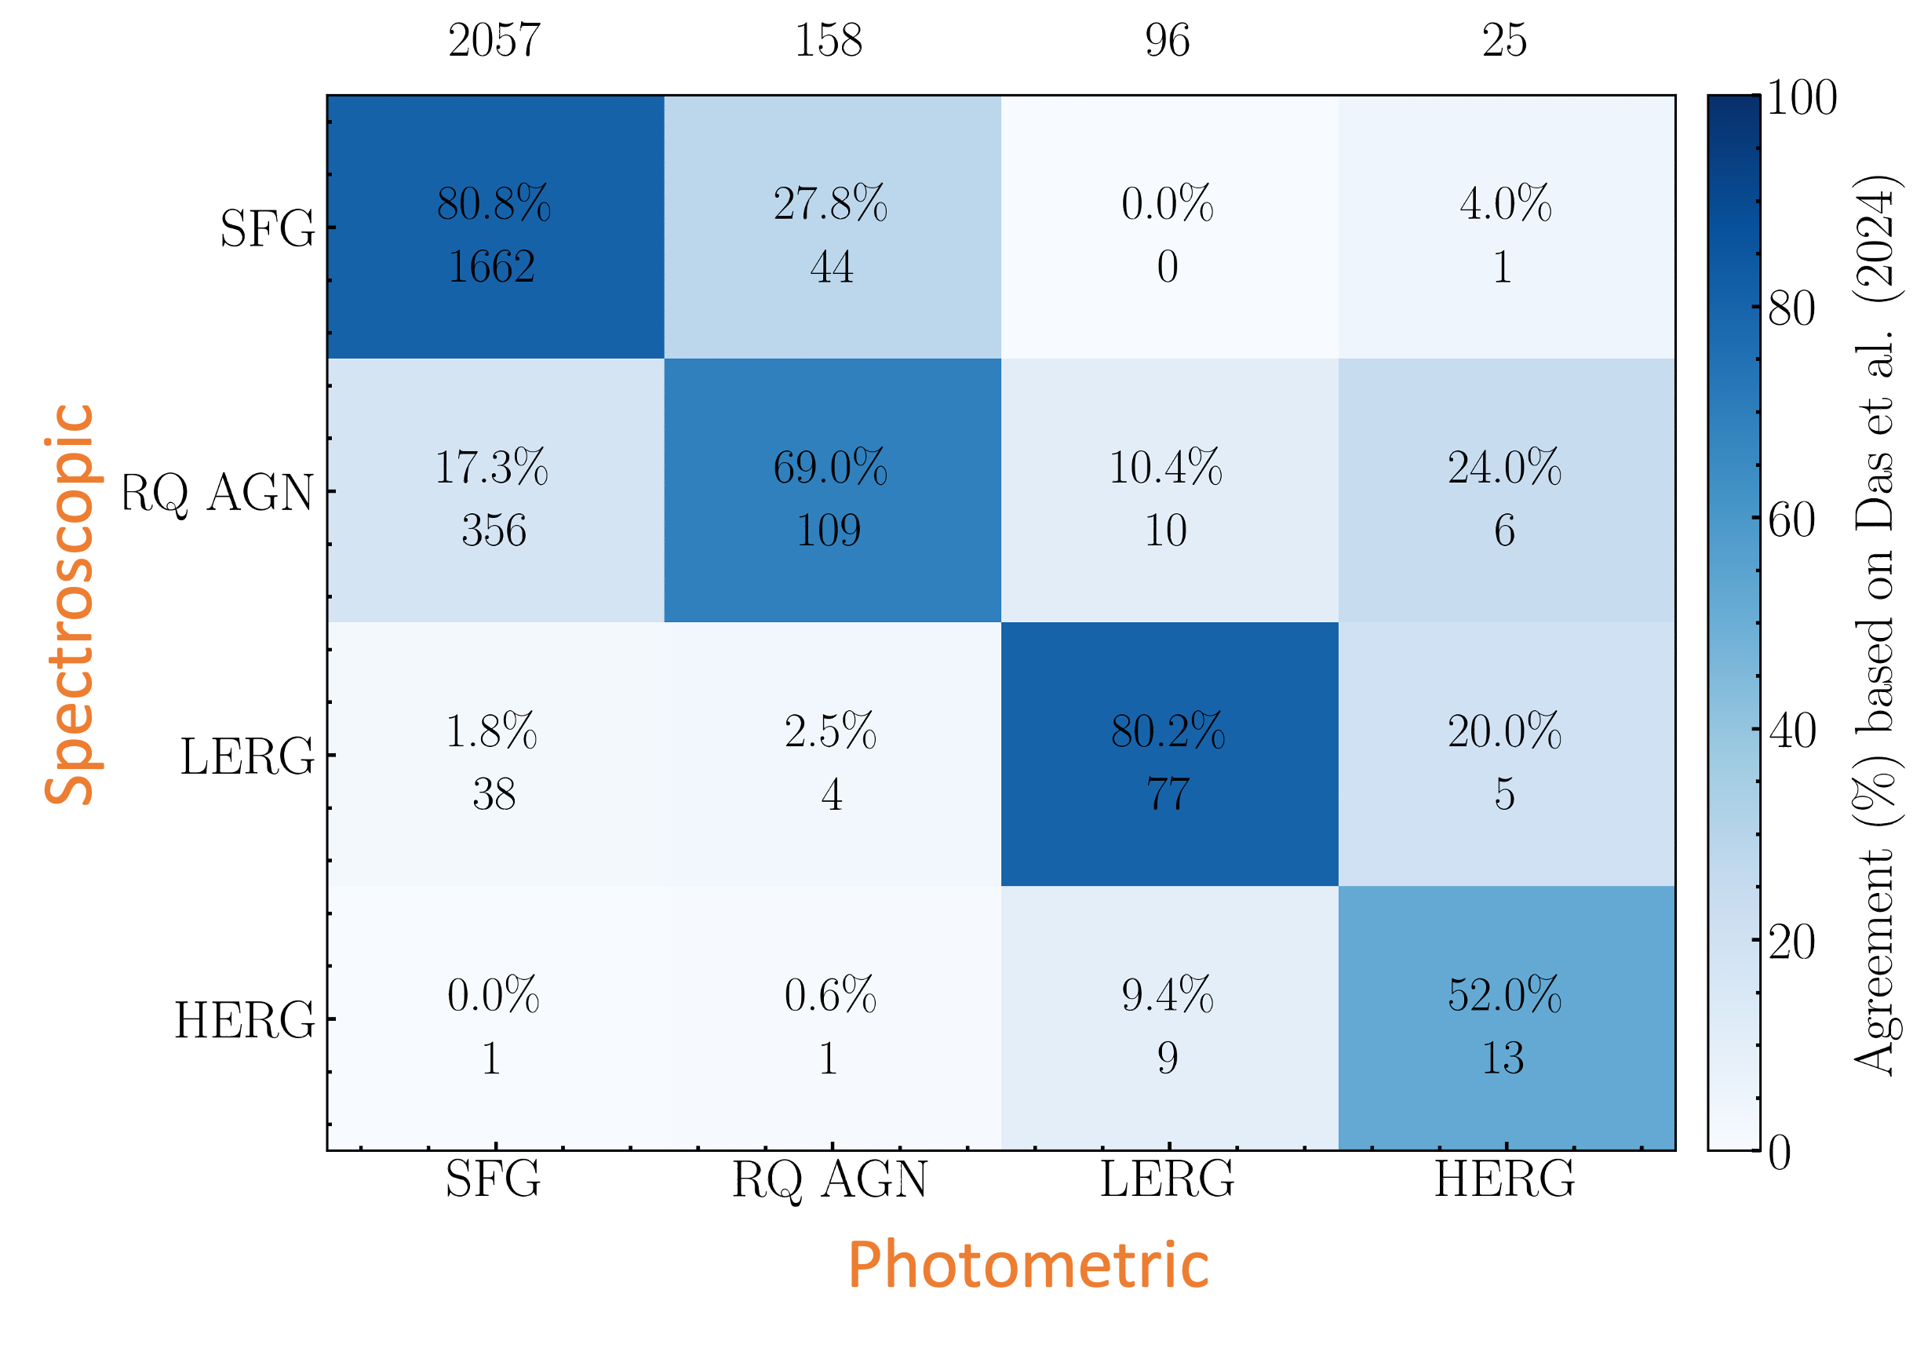
Classifications in ELAIS-N1
Spectroscopic Classifications
~8,000 sources from DESI DR1
Independent spectral fitting using multi-component emission line modelling
Physical properties derived with Prospector
Comparison with Photometric Classifications
Overall agreement: ~77%
Photometry misclassifies:
RQ AGN → SFGs
LERGs / HERGs
Spectroscopy might miss:
Obscured AGN (recovered via SED fitting)
Compact AGN (identified with Tb methods)
SFGs: 1757 RQ AGN: 488 LERGs: 129 HERGs: 24
Arnaudova et al. (2025)

Slide 13
Classifications in ELAIS-N1
Arnaudova et al. (2025)

Slide 14
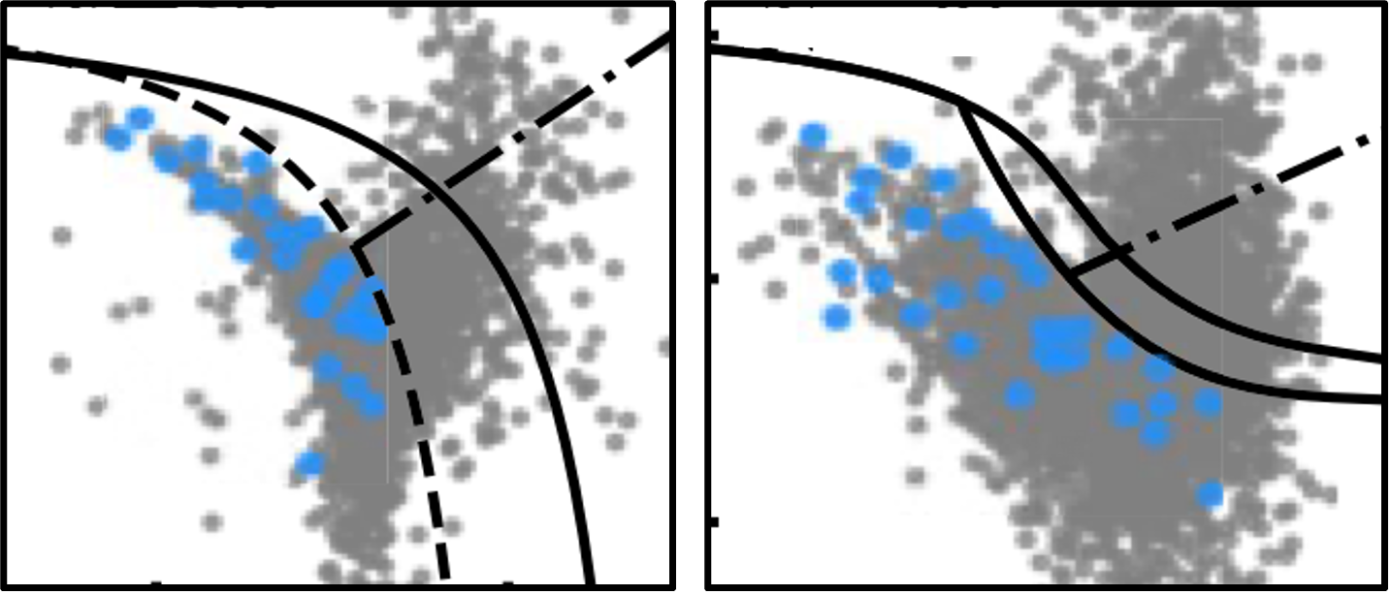
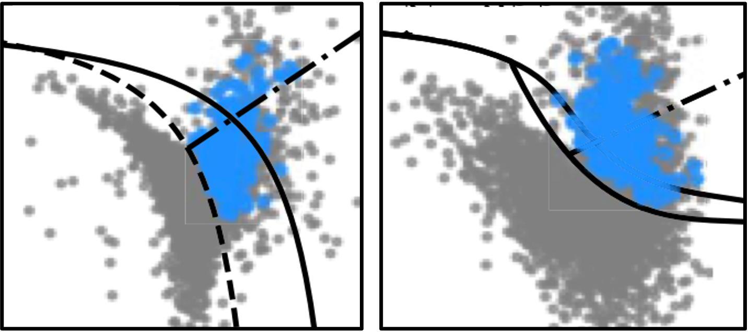
Classifications in ELAIS-N1
RQAGN SFG
SFG RQAGN
Arnaudova et al. (2025)

Slide 15
Classifications in ELAIS-N1
HERG LERG RQAGN
Arnaudova et al. (2025)

Slide 16
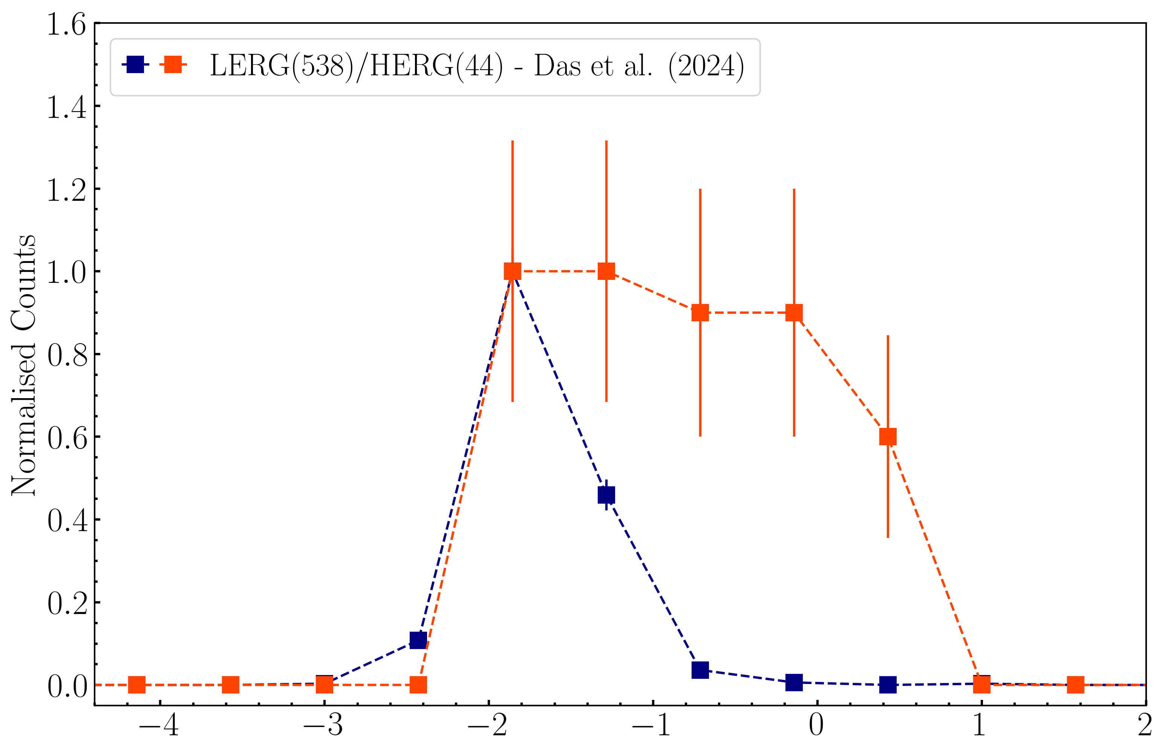
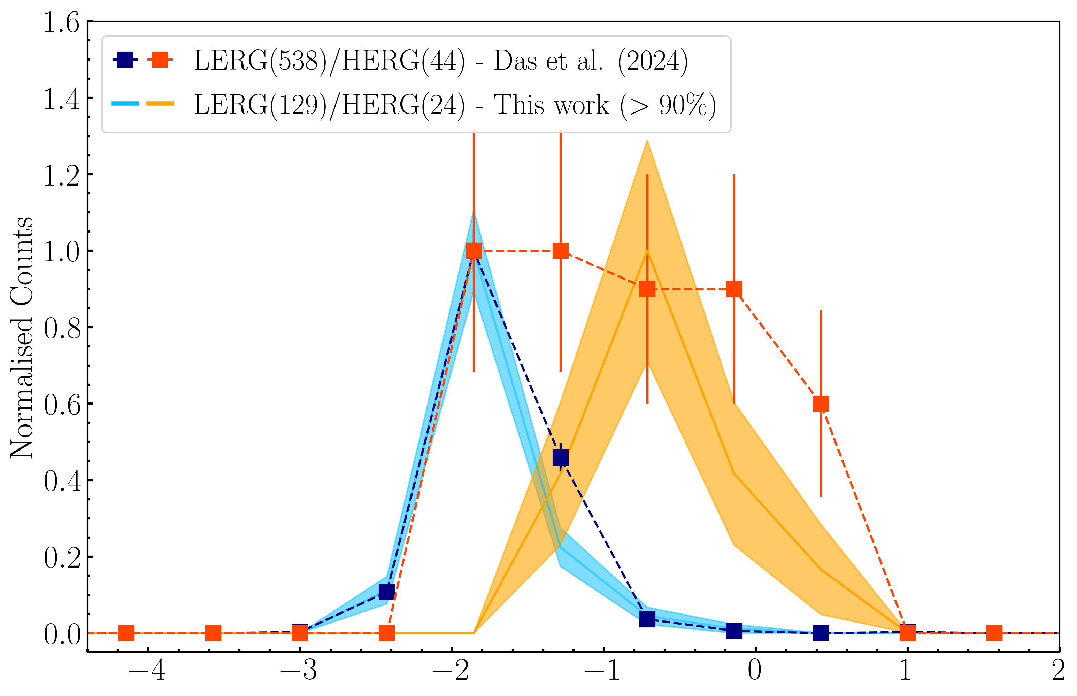
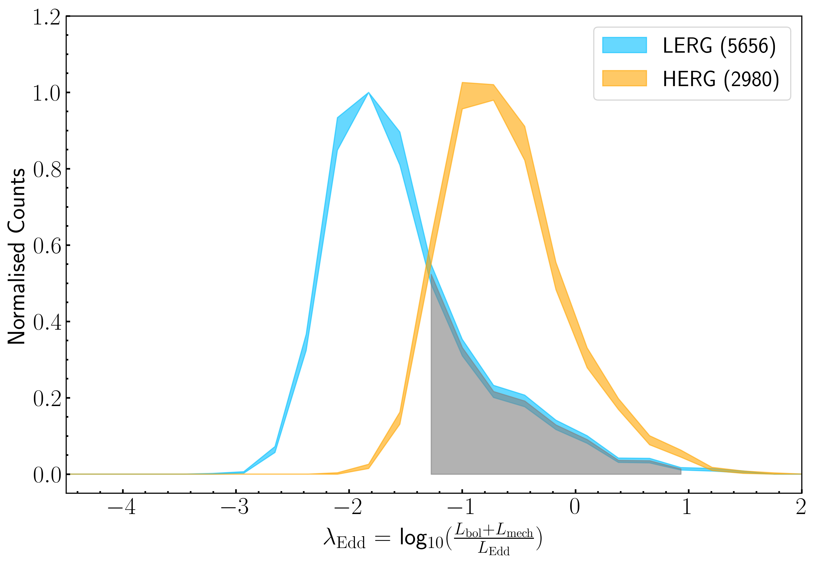
Classifications in ELAIS-N1
Spectroscopic Classifications
~8,000 sources from DESI DR1
Independent spectral fitting using multi-component emission line modelling
Physical properties derived with Prospector
Comparison with Photometric Classifications
Overall agreement: ~77%
Photometry misclassifies:
RQ AGN → SFGs
LERGs / HERGs
Spectroscopy might miss:
Obscured AGN (recovered via SED fitting)
Compact AGN (identified with Tb methods)
SFGs: 1757 RQ AGN: 488 LERGs: 129 HERGs: 24
A complete view of the radio source population requires combining spectroscopy with other multi-wavelength methods.

Slide 17
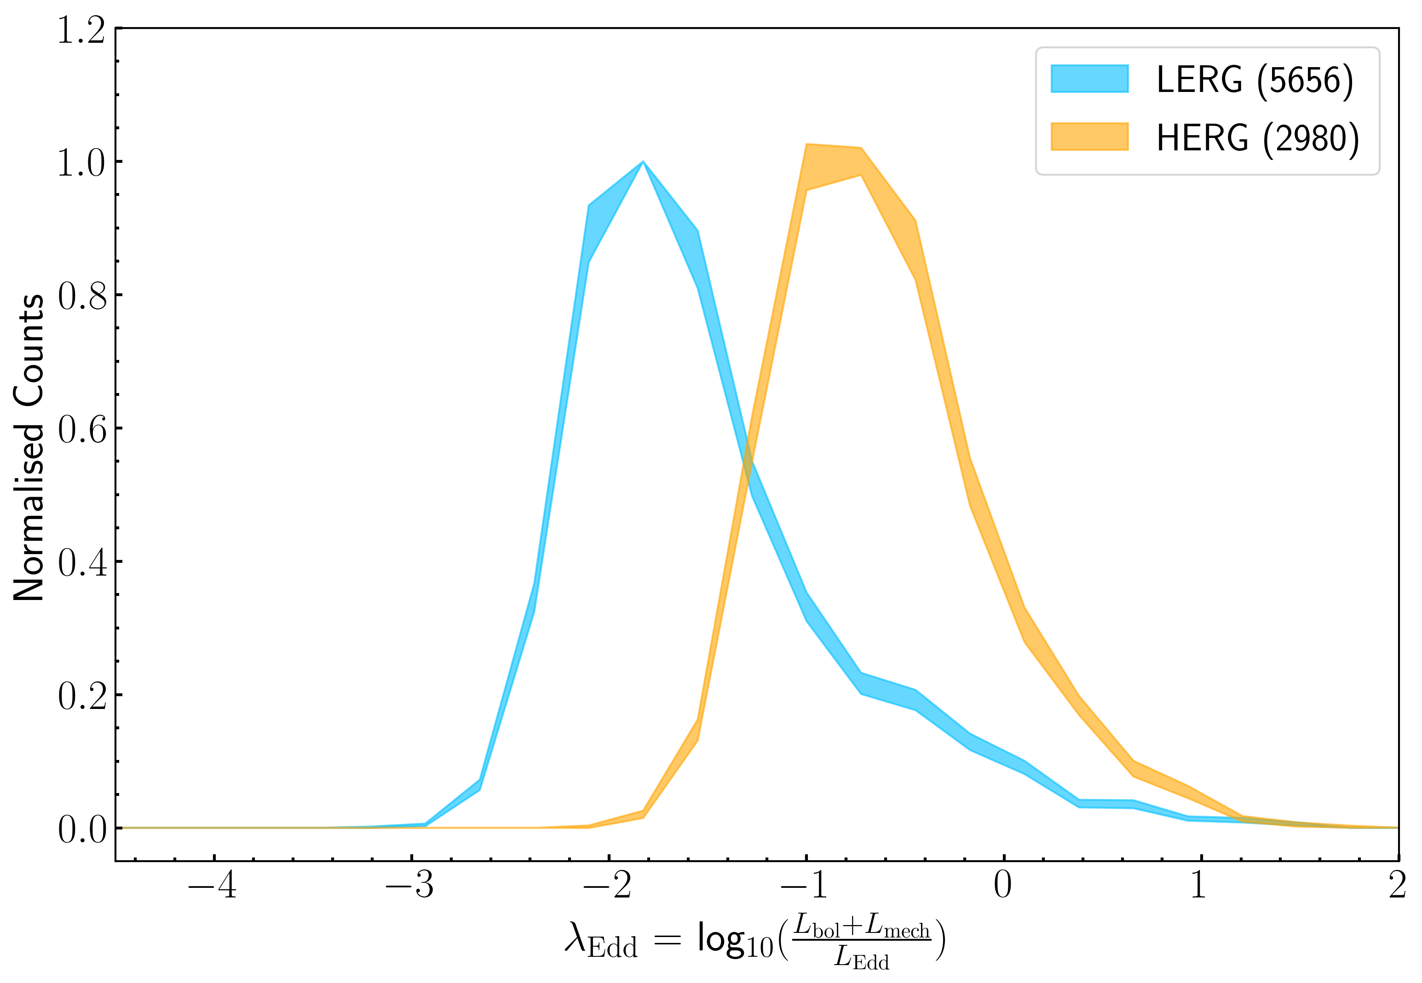
LoTSS-wide Classifications
Expanding this method to the LoTSS-wide gives us a large statistical sample of high purity classifications:
SFGs: 1757 → 55 152 RQ AGN: 488 → 26 752 LERGs: 129 → 5656 HERGs: 24 → 2980
Star-forming LERGs (Kondapally et al. 2025)?
Different accretion properties?
Issues with classifications?
Issues with the scaling relations (L_{bol}, L_{mech}, L_{Edd})?
Arnaudova et al. (in prep)

Slide 18
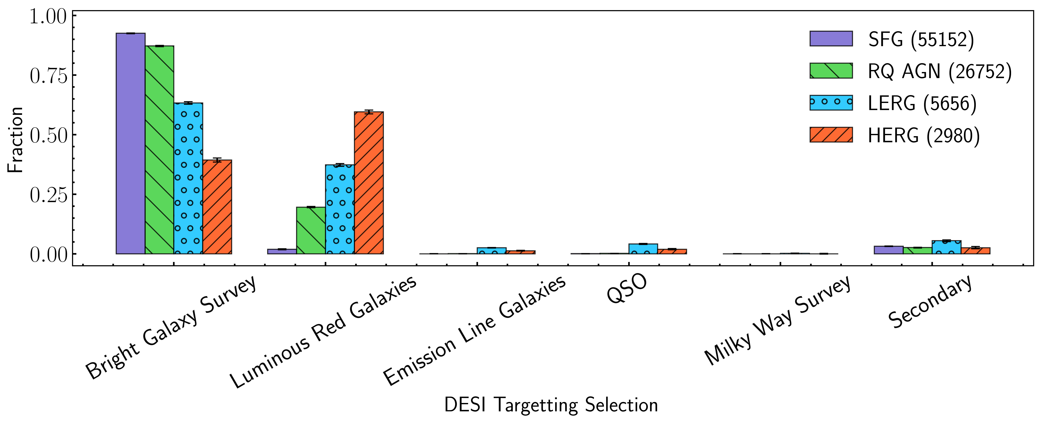
DESI Selection Effects
DESI is great but introduces a lot of additional selection effects!
Arnaudova et al. (in prep)

Slide 19
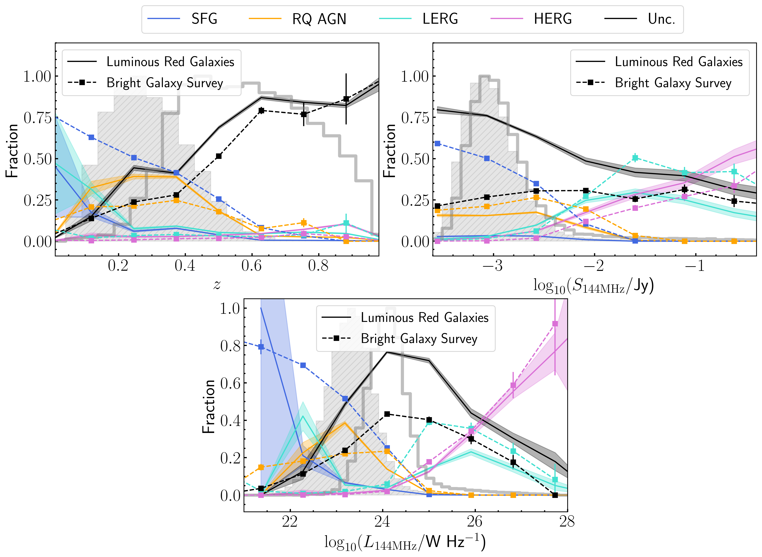
DESI Selection Effects
We need a radio-selected spectroscopic survey!
Arnaudova et al. (in prep)

Slide 20
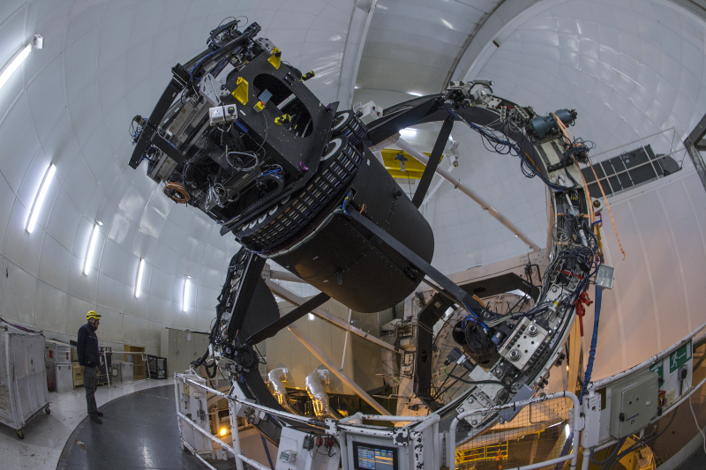
WEAVE: The WHT Enhanced Area Velocity Explorer
A next generation spectroscopic facility on the William Herschel Telescope, La Palma.
One of its primary goals is to provide over a million spectra of LoTSS targets – the WEAVE-LOFAR survey.
Current Status
MOS: Almost commissioned, SV data within a few weeks, survey data by the end of the year!!!
LIFU: Fully commissioned and its first observation was Stephan’s Quintet.
Want to get involved? Contact Dan Smith – d.j.b.smith@herts.ac.uk
Mode Fibres/FoV Resolution (Low/High) Coverage (Low/High)
MOS ~1000/2deg² 5 000/20 000 3660–9590Å/4040–6850Å
mIFU 20×37/11×22″ 5 000/20 000 same as MOS
LIFU 527/90×78″ 2 500/10 000 same as MOS
WEAVE on the William Herchel Telescope. Credits: the ING.

Slide 21
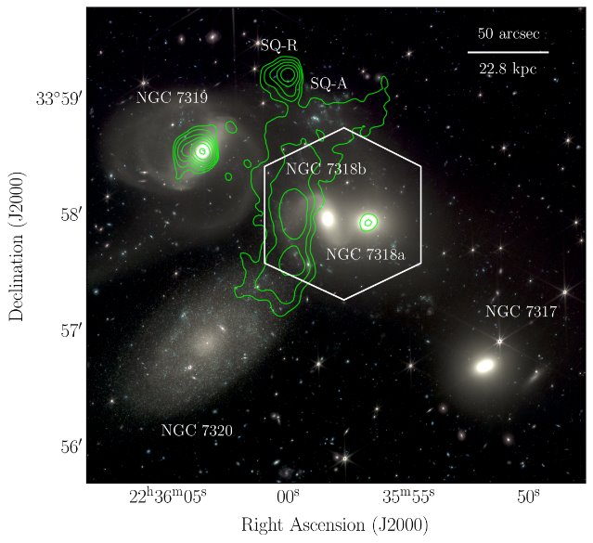
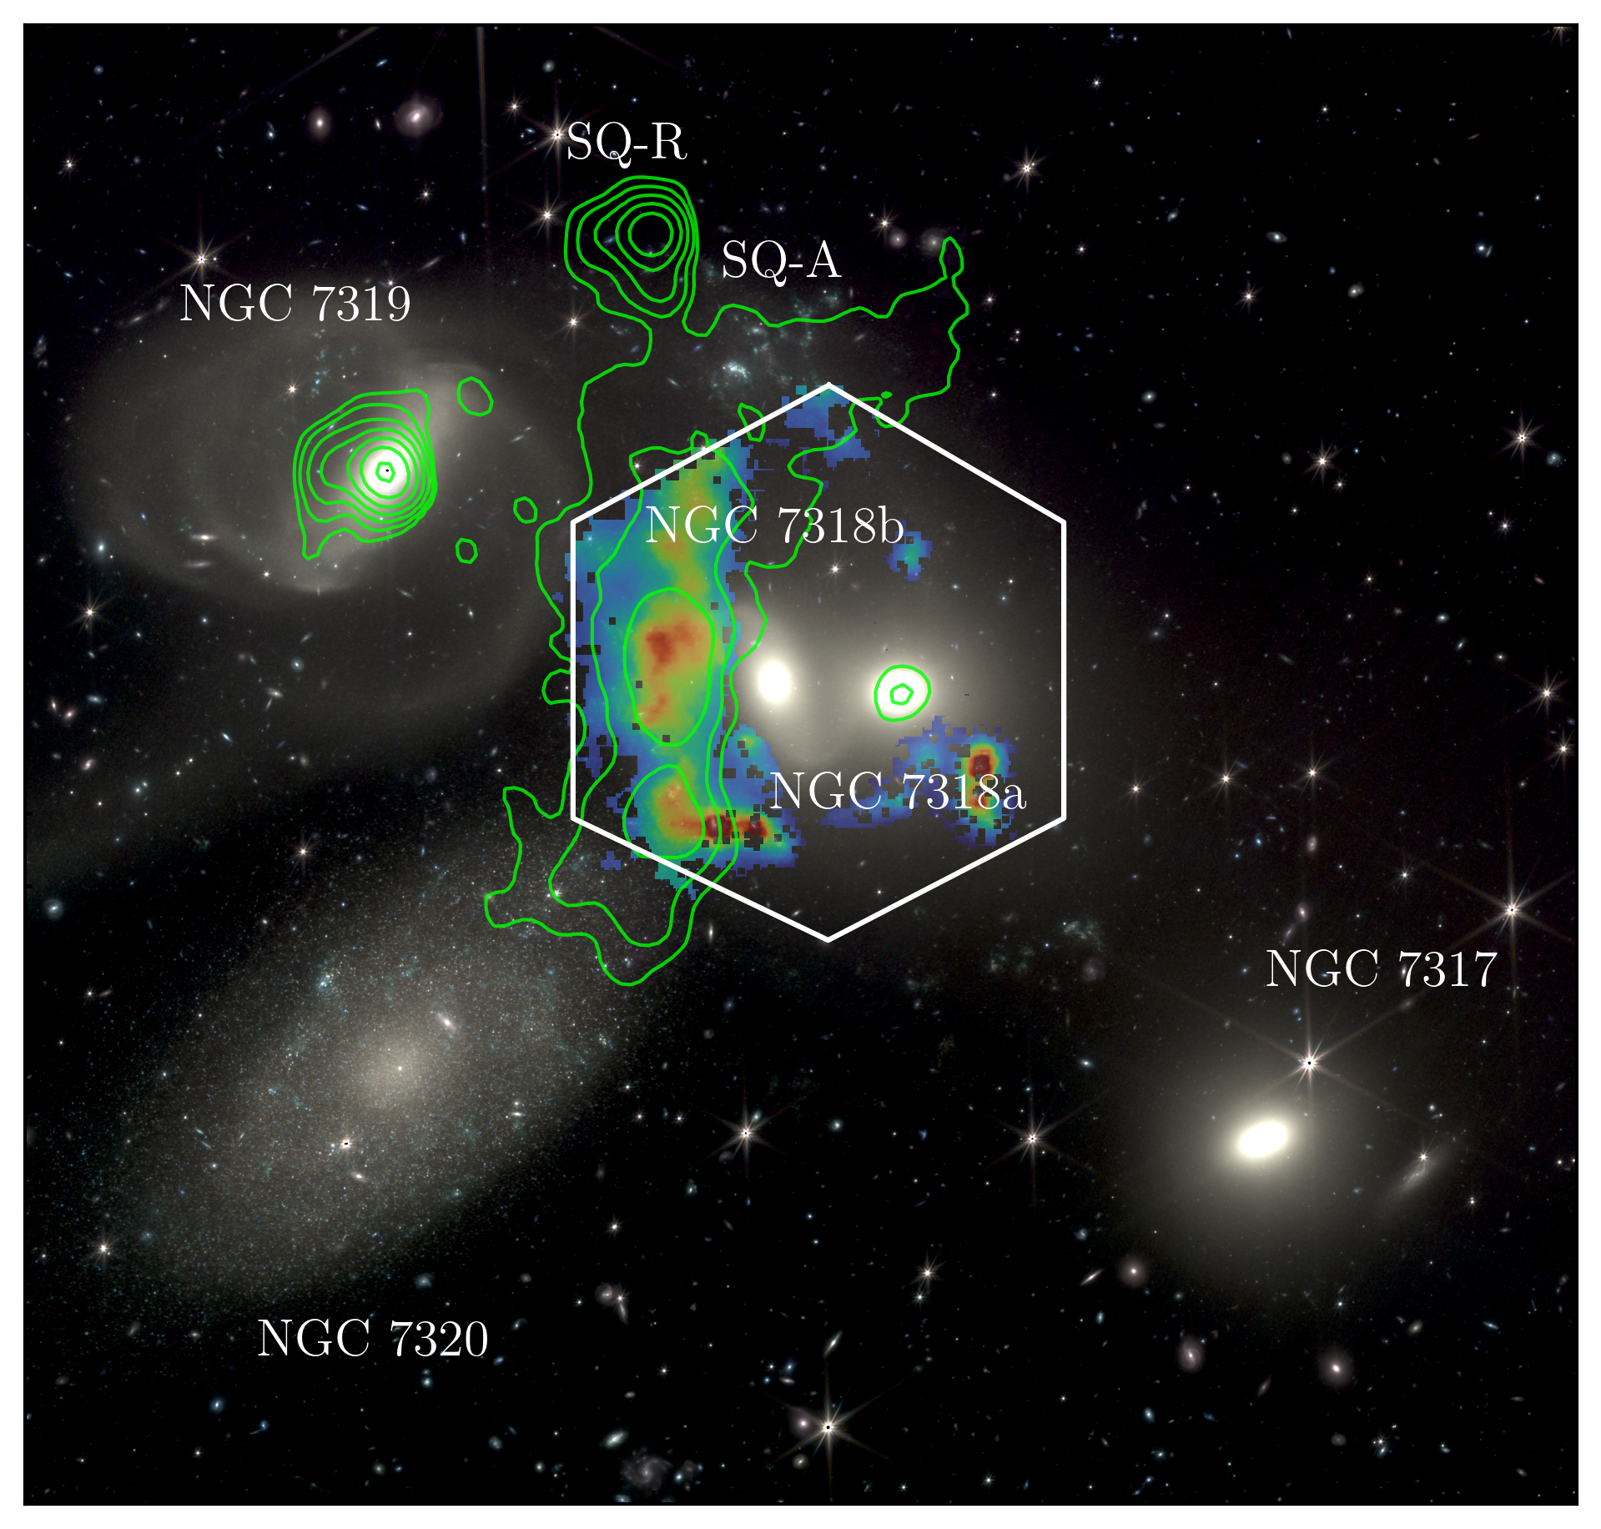
WEAVE + LOFAR Observations of Stephan’s Quintet
Stephan’s Quintet – nearby, compact galaxy group (z=0.025).
Ideal laboratory for studying galaxy interactions
Contains a large-scale shock region, believed to arise from past and ongoing interactions.
LoTSS
The WEAVE data allowed us to dynamically locate the shock and place the multi-wavelength information into context.
WEAVE
This allowed us to show that the collision event led to:
Hypersonic shock in the cold phase that can
Excite pre-existing HI gas into the ionised gas traced by WEAVE.
Destroy dust grains in low-density regions but allow those in denser clouds to survive.
Weak shock in the hot phase that adiabatically compressed the medium, resulting in ~10-fold boost in the radio emission
See Arnaudova et al. (2024b)

Slide 22
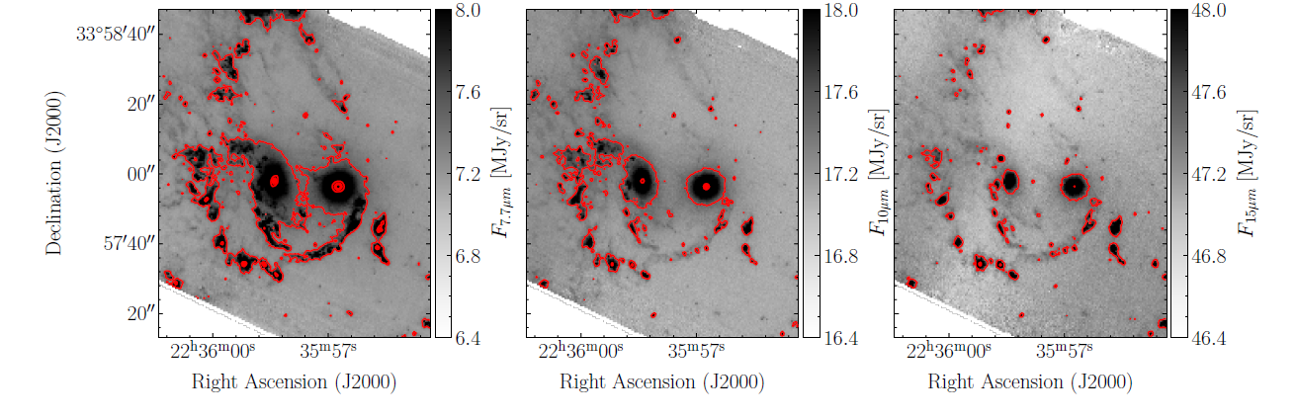
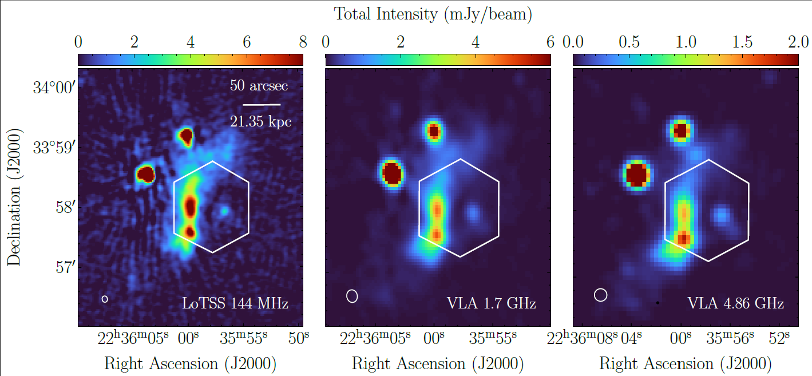
WEAVE + LOFAR Observations of Stephan’s Quintet
Stephan’s Quintet – nearby, compact galaxy group (z=0.025).
Ideal laboratory for studying galaxy interactions
Contains a large-scale shock region, believed to arise from past and ongoing interactions.
JWST MIRI
LoTSS
The WEAVE data allowed us to dynamically locate the shock and place the multi-wavelength information into context.
WEAVE
WEAVE-LIFU
This allowed us to show that the collision event led to:
Hypersonic shock in the cold phase that can
Excite pre-existing HI gas into the ionised gas traced by WEAVE.
Destroy dust grains in low-density regions but allow those in denser clouds to survive.
Weak shock in the hot phase that adiabatically compressed the medium, resulting in ~10-fold boost in the radio emission
LoTSS+VLA
See Arnaudova et al. (2024b)

Slide 23
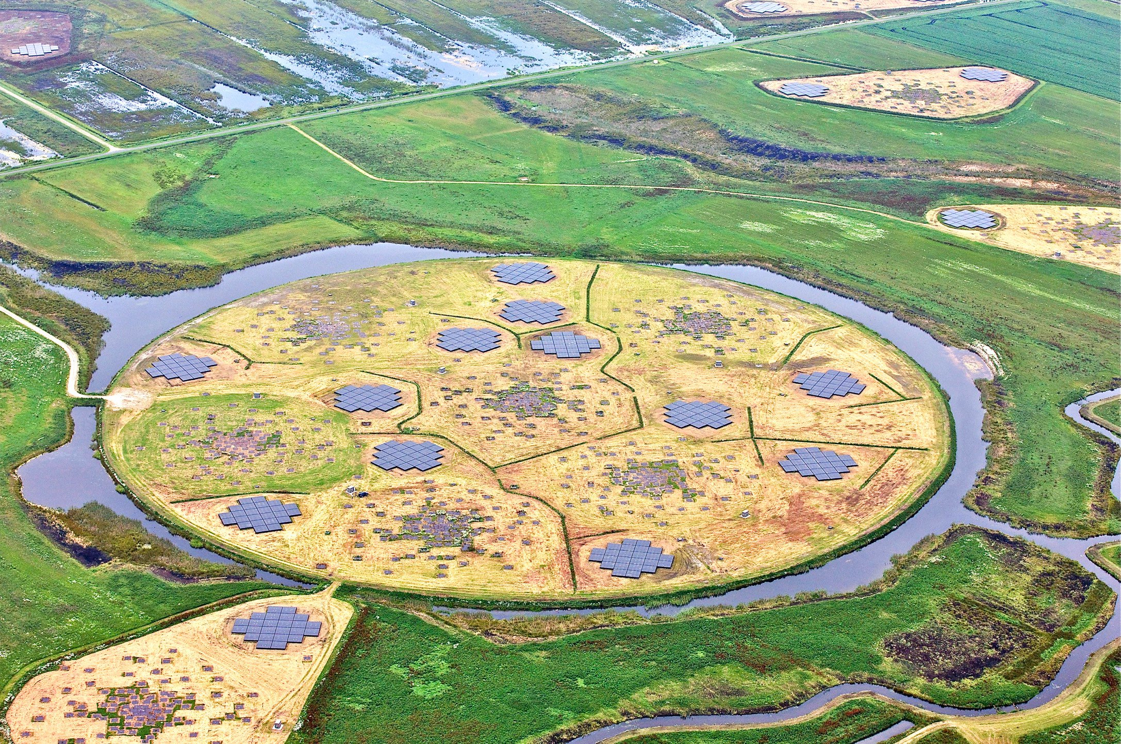
Summary
Why combine spectroscopy with radio?
Radio gives a dust-unobscured view of SFGs and AGN
Spectroscopy provides physical properties and the means to robustly classify them into SFG, RQ AGN, LERG and HERG
Our spectroscopic classification:
Identifies more RQ AGN than with SED-based photometric classifications
Provides a cleaner LERG/HERG separation
Delivers a more complete view of the radio source population
If you have any questions or want to know more, contact me via m.i.arnaudova@gmail.com
Get ready for LoTSS of WEAVE-LOFAR science in 2026!

